Slide 1
Planning of Research in Third World Countries:
Lecture 3 –Date. 02.10.13

Slide 2
Introduction
This lecture is intended provide bases for a researchers who are supposed to start research in an area, region or culture in a developing country other than the one in which they grew up, or with which they are not familiar

Slide 3

Good Book to read

Slide 4
Technical Aspects
The research proposal contains all the technical details, in conformity to that researcher has to implement the research. However, in implementation of the research, the logistics also play a significant role.

Slide 5
Logistic Aspects
1. Selecting a field location
Reading about the area
Having a local co-researcher
Google map
Other maps available (after going to the country)

Slide 6
2. Development contacts with partners
Village or community can be approached systematically by developing partnership with important people and institutions. In order to use them some mechanism has to be developed before the field research.
Relevant ministry or ministries:
Universities
NGOs:
CBOs

Slide 7
3. Finding a RA/interpreter
Interpretation is a rather free lance job in developing countries when it comes to research. Most occasions university undergraduate, postgraduate student who have language capabilities happen to work as interpreters to foreign researchers. Language knowledge is not sufficient, but several other characteristics have to be considered. Nancy Schweda Nicholson’s article on personality characteristics of interpreter trainees give a good insight on interpretation (http://www.openstarts.units.it/dspace/bitstream/10077/2476/1/08.pdf

Slide 8
What then is the ‘typical’ interpreter like?
A self-reliant,
Articulate
Extrovert,
Quick and intelligent,
(a jack of all trades)
Henderson (1980)

Slide 9
4. Being aware of regulations and local customs
As foreign researcher develops contacts with local bodies he or she gradually becomes familiar to regulations. However, becoming familiar to local customs is still challenging. Unless getting used to local customs people might get offend and it may obstruct to build a good rapport between researcher and researched. This may be obstruct in collecting accurate data. RA’s help and good reading about local culture is very important in this regard. This is very important for the persons who carry out lengthy research, such as ethnographic research.

Slide 10
5. Safety concerns
Social concerns
Violence, robberies, cheating, animal attacks, deceases, accidents
Natural concerns
Weather extremes
Diseases

Slide 11
6. Timing
Holidays: National holidays and major social cultural and political events which hinder into research activities, e.g., charismas time, new year, election time period,
India-Durga puja October 10-14, 2013. Whole festival goes around 15 days
Nepal –holi Feb/March- Aug-Sep, Festival fever period
Regional events: Kandy pageant,
Harvesting periods
Weather pattern: Some geographical locations can have serious problems related to rainy period having floods. Weather forecast could be a guidance for planning.

Slide 12
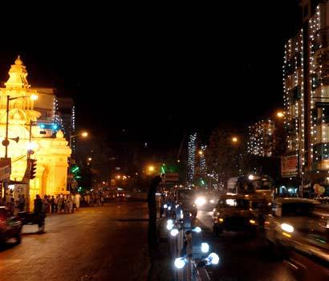
India- Durga puja

Slide 13
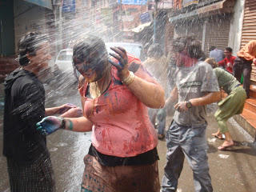
Nepal Holi Festival

Slide 14
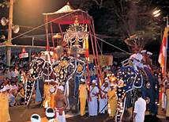
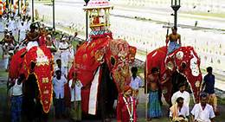
Kandy pageant- Sri Lanka

