Slide 1








Zoologické dny 2015
Brno

Slide 2
Počet účastníků ZD 2002-2015
Praha
Ostrava
České Budějovice
Olomouc
482 registrovaných účastníků (z toho 257 studentů)

Slide 3
Počty prezentací ZD 2002-2015
164 posterů, 162 přednášek

Slide 4
Studentská soutěž – 57 přednášek a 83 posterů
3 nejlepší přednášky a 3 nejlepší postery
předplatné časopisu Živa
poukázka na knihy z nakladatelství Academia (v brněnském knihkupectví)
finanční odměna

Slide 5
ZOOLOGICKÉ DNY 2016 ...

Slide 6
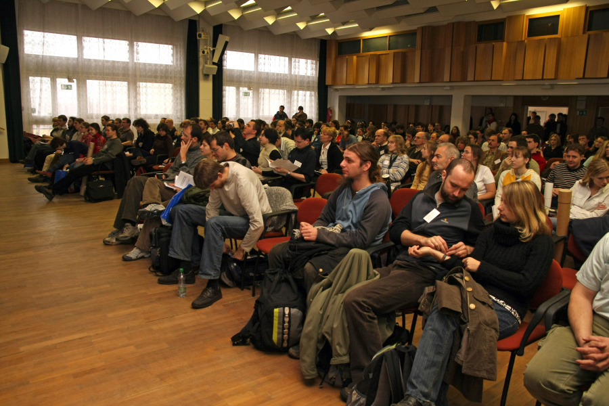
2008

Slide 7
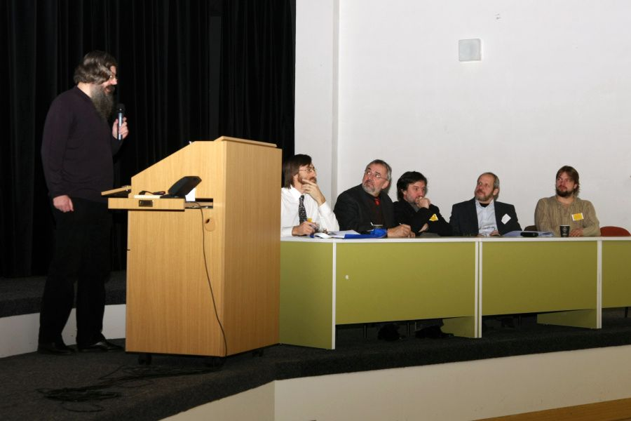
2008

Slide 8
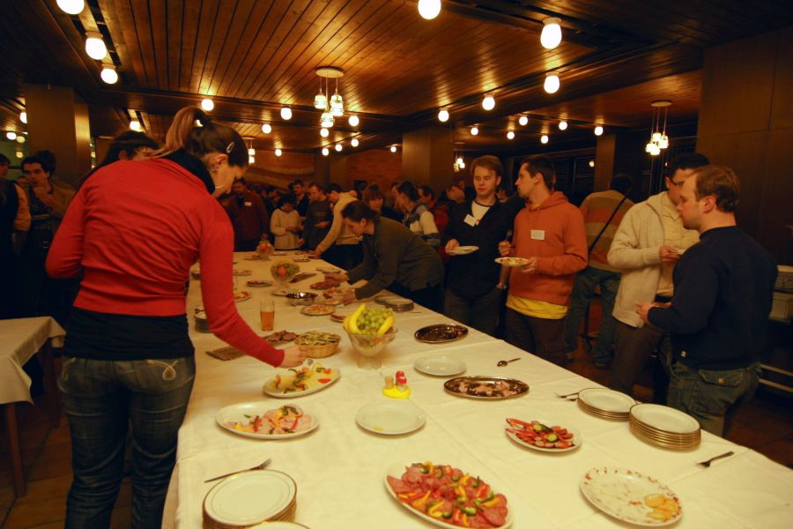
2008

Slide 9
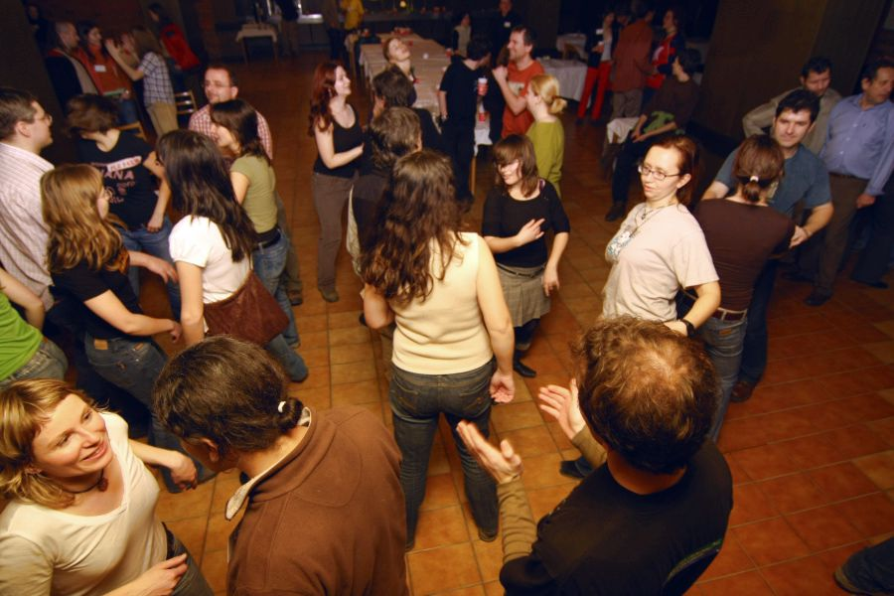
2008

Slide 10
ZOOLOGICKÉ DNY 2016 ...
ČESKÉ BUDĚJOVICE!
Únor 2016

Slide 11


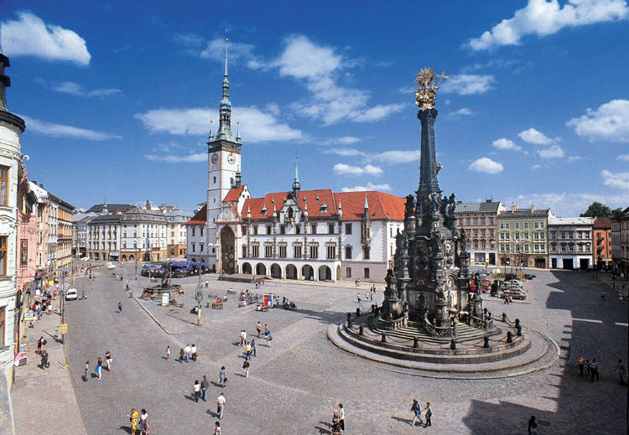
Plenary speakers:
prof. Ottar Bjornstad (Penn State University, U.S.A.): population ecology and population dynamics with particular emphasis on mathematical and computational
aspects
Dr. Gerald Heckel (University of Bern, Switzerland): evolutionary biology from speciation and reproductive isolation, over colonisation and invasion processes, host-pathogen co-evolution, the molecular ecology of mating systems to the evolution of behaviorally-active genes
prof. Nancy Solomon (Miami University, U.S.A.):
ecology, reproduction and behaviour of small mammals
Dr. Stuart J. E. Baird (IVB ASCR, Czech Republic): evolutionary biology, spatial genetics, population genetics, bioinformatics,
hybrid zones

Slide 12
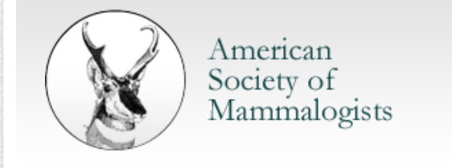
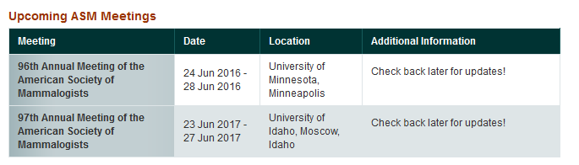

Slide 13
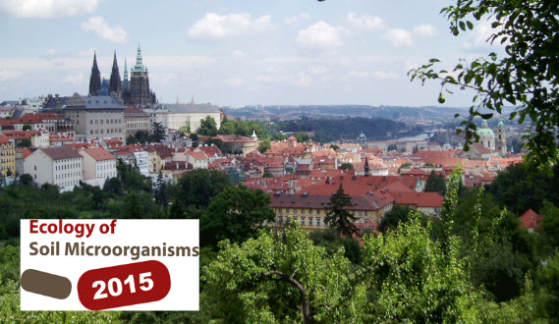
Ecology of soil Microorganisms 2015
Microbes as Important Drivers of Soil Processes
29.11. - 3.12. 2015, Prague, Czech Republic
Decomposition and Carbon Cycling
Soil Biogeochemistry and Nutrient Cycling
Biodiversity and Functioning of Agricultural Soils
Biodiversity and Functioning of Forest Soils
Interactions among Micro- and Macroorganisms
Microbes in the Changing Environment
Microbial Life in Contaminated and Anthropogenic Soils
Archaeomicrobiology, Paleomicrobiology and Microbial Forensics
http://www.biologicals.cz/conferences/index.php?template=conferences&page=conference_login&conference_id=22#bm186

Slide 14
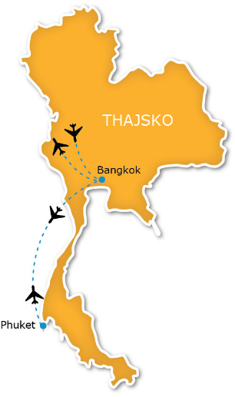
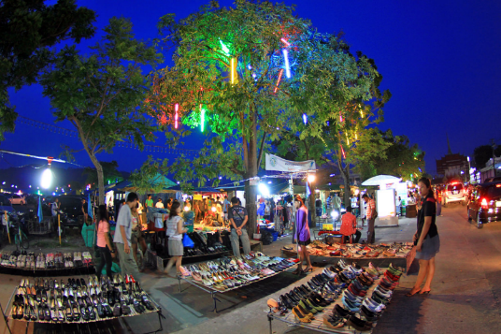
International Conference on Agriculture, Biological & Environmental Sciences(ICABE- 2015)
December 12-13, 2015, Phuket, Thailand
Paper Submission Deadline: 20 November 2015
Registration Deadline: 30 November 2015
http://www.icabe2015.org/

Slide 15

The sessions are organized in a theme-based manner, with related topics discussed from the perspective of diverse viruses, ranging from bacteriophage, plant, and insect viruses to animal viruses.
Abstract Submission Deadline: 31 October, 2015
http://sciforum.net/conference/viruses-2016

Slide 16

The aim objective of ICBCB 2016 is to present the latest research and results of scientists (preferred students, PhD Students, and post-doc scientist) related to Bioinformatics and Computational Biology topics.
Paper Submission (Full Paper) Deadline: October 10, 2015
http://www.icbcb.org/

Slide 17
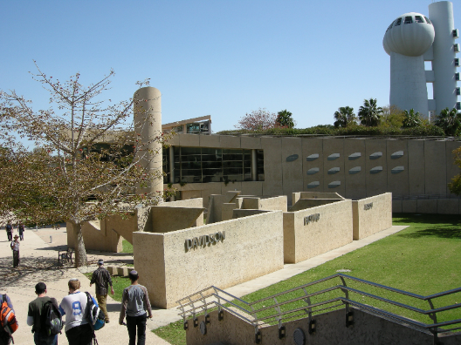

EMBO conference Next gen immunology, From Host Genome to the Microbiome: Immunity in the Genomic Era
February 14-16, 2016, Weizmann Institute of Science, Rehovot, Israel
Scholarships for outstanding PhD students and Postdocs, based on competitive track record in the fields of systems biology, microbiome, immunology, genomics, computer science, and physics. Interdisciplinary research integrating these fields is a plus.
Deadline for submission of scholarships: October 15, 2015
Deadline for submission of abstracts: December 1, 2015
http://www.weizmann.ac.il/conferences/NGI2016/welcome

Slide 18
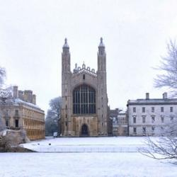
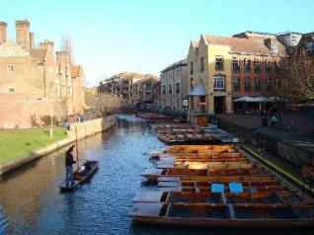
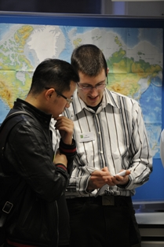
Student Conference on Conservation Science 2016
22-24 March 2016, Cambridge, UK
Most delegates are Masters or PhD students, or are working at a similar level in a conservation organisation.
The conference is extremely international with over 60 countries represented each year.
Deadline for applications: 23 October, 2015
http://www.sccs-cam.org/overview.htm

Slide 19

ICCB 2016 : 18th International Conference on Conservation Biology
April 22 - 23, 2016, London, UK
…interdisciplinary forum for researchers, practitioners and educators to present and discuss the most recent innovations, trends, and concerns, practical challenges encountered and the solutions adopted in the field of Conservation Biology.
Paper submission deadline: October 22, 2015
https://www.waset.org/conference/2016/04/london/ICCB

Slide 20

EMBO/EMBL SYMPOSIUM New Model Systems for Linking Evolution and Ecology
8 May - 11 May 2016, EMBL Heidelberg, Germany
…focuses on the interface of ecology and evolutionary genetics, with special emphasis placed on the interaction between organisms as a basis for understanding ecological adaptation. New sequencing-based methods are bridging the gap between modern genetics and systems-level ecological studies…
Genotype-phenotype map
Interorganismal interactions
Ecological genomics
Evolutionary genetics
Landscape genomics
http://www.embo-embl-symposia.org/symposia/2016/EES16-03/index.html

Slide 21


25-27 May 2016, Dublin, Ireland
An interdisciplinary event for scientists and practitioners concerned with the study of human or animal behavior.
This unique conference focuses on methods, techniques and tools in behavioral research in the widest sense…
Deadline submission abstracts of oral papers and posters: 27 January 2016
Deadline early bird and presenters’ registration: 23 March 2016
http://www.measuringbehavior.org/mb2016/home

Slide 22


June 12-16, 2016, San Marcos, Texas USA
http://www.txstate.edu/continuinged/Events/ICBF.html

Slide 23

4th International Conference on Integrative Biology (Integrative Biology-2016)
June 13-15, 2016, Berlin, Germany
…will be organized around the theme “Insight, Innovation and Integration of Future Science”
Genomics and Bioinformatics
Drug Discovery and Integrative Biology
Cell and Molecular Biology
Tissue Biology
Developmental Biology
Bio-Engineering
Systems Toxicology
Ecology, Evolution and Behaviour
Systems Biology
Bioimaging
http://integrativebiology.conferenceseries.com/call-for-abstracts.php

Slide 24
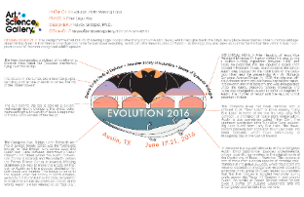
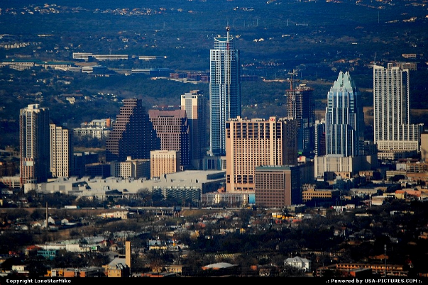
Evolution 2016
June 17-21 2016, Austin, TX, USA
…a joint conference of the American Society of Naturalists, the Society for the Study of Evolution, and the Society of Systematic Biologists
Registration will open in early 2016
http://www.evolutionmeetings.org/evolution-2016---austin-texas.html

Slide 25

GGBN Second International Conference on Biodiversity Biobanking
June 21-24 2016, Berlin, Germany
http://ggbn.org/ggbnConference16.html

Slide 26
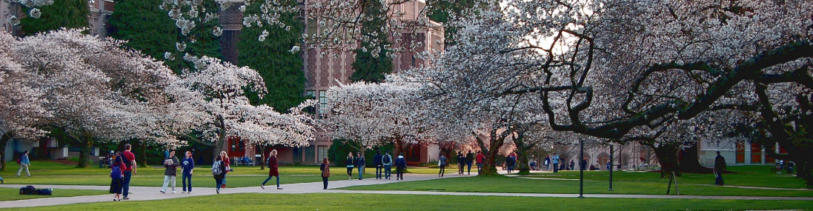
2016 International Statistical Ecology Conference
28 June – 1 July 2016, Seattle, Washington, USA
Pre-Conference Workshops 26-27 June
Abstracts accepted starting: 9 October 2015
Conference Registration Opens: 8 December 2015
Abstract submission deadline: 10 January 2016
http://depts.washington.edu/uwconf/wordpress/isec2016/

Slide 27

The conference will have a similar format to former ECBB conferences which will include plenary talks, participant proposed symposia as well as oral and poster presentations.
http://www.ecbb2016-vienna.com/home/

Slide 28

Abstract Submission/Registration Open: January 2016
Abstract Submission Deadline: March 2016
http://www.genetics2016.org/mouse/

Slide 29

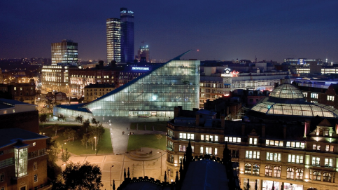
EuroScience Open Forum
22-27 July 2016, Manchester, UK
EUROPE’S LARGEST interdisciplinary science meeting. It brings together over 4,500 leading thinkers, innovators, policy makers, journalists and educators from more than 90 countries…
The overarching theme of the 2016 Forum is ‘Science as Revolution’, encouraging debate and exploration of how science and technology transform our lives…
http://www.esof.eu/

Slide 30

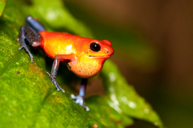
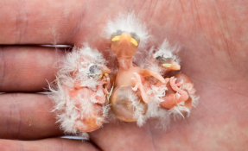
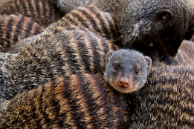
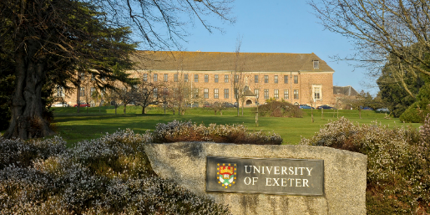
The 16th Congress of the International Society for Behavioral Ecology
28 July – 3 August 2016, University of Exeter, UK
…on the 30th anniversary of its founding. We look forward to five days of presentations spanning the full spectrum of current research effort in behavioural ecology, and a chance to forge new relationships and catch up with friends…
http://www.isbe2016.com/

Slide 31

http://www.eurobats.org/bat_news/17th_international_bat_research_conference_2016

Slide 32


Paper Submission Deadline: 15 May 2016
Early Registration: 1 March 2015 - 31 March 2016
http://www.wch2016hangzhou.com/

Slide 33

http://www.izw-berlin.de/ewda-conference-2016-european-wildlife-disease-association-kopie.html

Slide 34

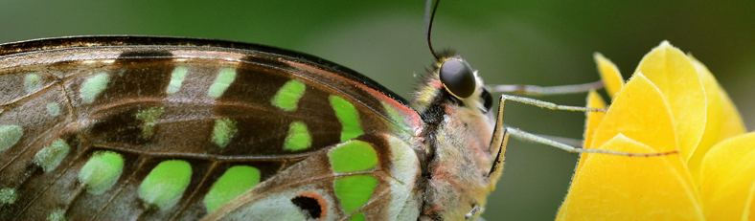
2016 XXV International Congress of Entomology
September 25-30 2016, Orlando, Florida, USA
International Graduate Student Showcase
The IGSS will showcase cutting-edge research conducted by talented graduate students of entomology from around the world, by providing a high-profile forum for select students to present completed or nearly completed thesis projects to future employers, graduate degree/post-doc supervisors and the entomological community at large. Outstanding applicants may be given the opportunity to present their project in an extended (30 minute) format.
IGSS Showcase Submission Deadline: October 31, 2015
Paper and Poster Submission Deadline: February 1, 2016
Early-bird Registration Deadline: March 25, 2016
http://ice2016orlando.org/submit-to-ice-2016/

Slide 35


22nd International Congress of Zoology (ICZ)
15 - 19 November 2016, Okinawa, Japan
The registration will start in early 2016
http://www.zoology.or.jp/2016-jointmeeting/

Slide 36
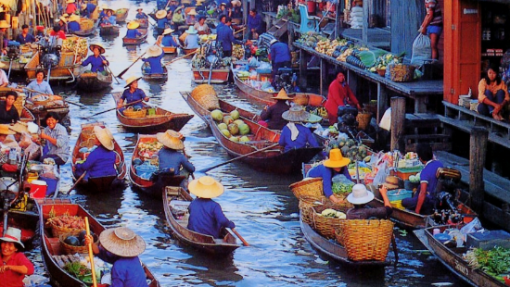
ICMEEGID 2016 : 18th International Conference on Molecular Epidemiology and Evolutionary Genetics of Infectious Diseases
December 12 – 13 2016, Bangkok, Thailand
Molecular Epidemiology and Evolutionary Genetics of Infectious Diseases
Genetics, genomics, proteomics, population biology, mathematical modeling and bioinformatics (..can deal with the host, the pathogen, or the vector in case of vector-borne diseases)
Host + pathogen or pathogen + vector (co-evolution)
All infectious models, including those of veterinary or agronomical relevance
Cancer and infectious diseases
Paper submission deadline: June 12, 2016
https://www.waset.org/conference/2016/12/bangkok/ICMEEGID

Slide 37

AKTUÁLNÍ INFO A DALŠÍ KONFERENCE:
http://www.provaz.ivb.cz/

