Slide 1
BIOMARKERS AND TOXICITY MECHANISMS
11 – BIOMARKERS
of EXPOSURE and SUSCEPTIBILITY
Luděk Bláha, PřF MU, RECETOX
www.recetox.cz

Slide 2
Biomarkers of Exposure
Biomarkers of internal and effective dose
depends on toxicokinetics
Biomarkers of internal dose (short / long term)
– examples: Cd in urine, DDE in fat tissues
  - should be easy to sample (urine, breath)
  - instrumental analytical methods (analyses of toxicant)
Biomarkers of effective dose
- the chemical interacted with the biological target
→ analyses of ADDUCTS
Two types of adducts: selective and non-selective

Slide 3
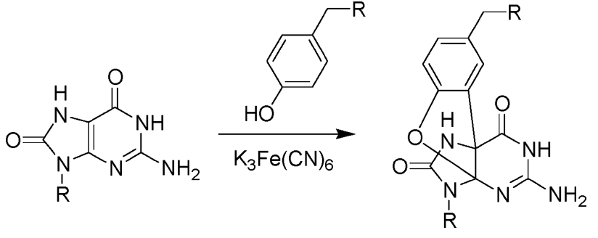
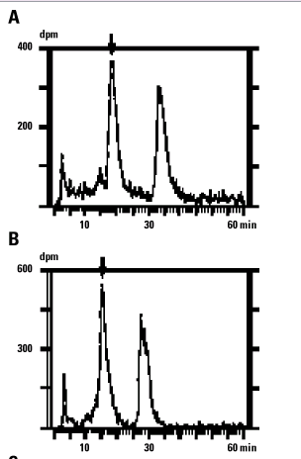
SELECTIVE ADDUCTS OF TOXICANTS with BIOMOLECULES
SELECTIVE = CHEMICAL-SPECIFIC
Adducts with DNA
styrene-oxide-O6-guanine
N7-guanyl-aflatoxin B1
Hemoglobin-pesticides adduct
Methods of analyses:
- analytical chemistry
- extraction from biological sample
- chemical determination by HPLC or GC

Slide 4
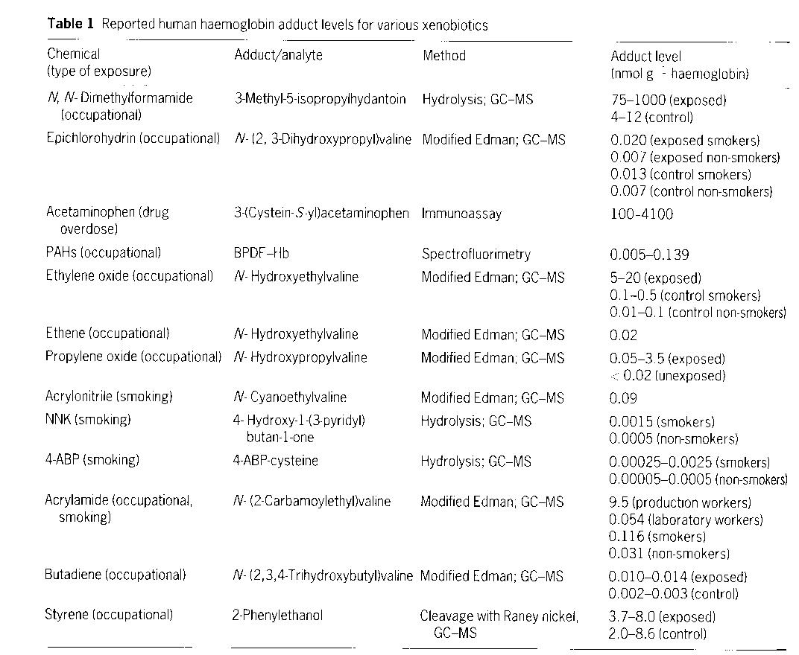

Slide 5
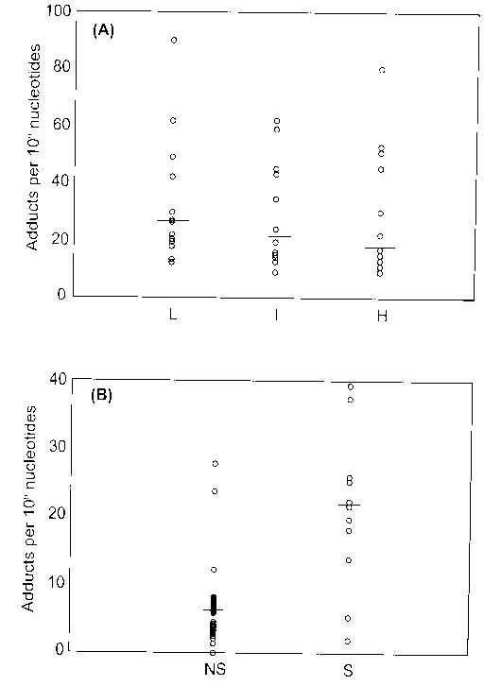
PAH-DNA adducts
PAH (polycyclic aromatic hydrocarbons)
* often high variability
* may have difficult interpretation
Occup. exposure
(Low / Intermed. / High)
Occupational
Non-exposed (NS)
vs.
Exposed (S)

Slide 6
Non-selective adducts
– binding with macromolecules (DNA, proteins) with no further information on the structure of actual adduct
(i.e. causative agent not clear)
Typical nonselective biomarker methods
- ³²P-postlabelling assay
- oxidized DNA: 8-hydroxy-2´-deoxyguanosine

Slide 7
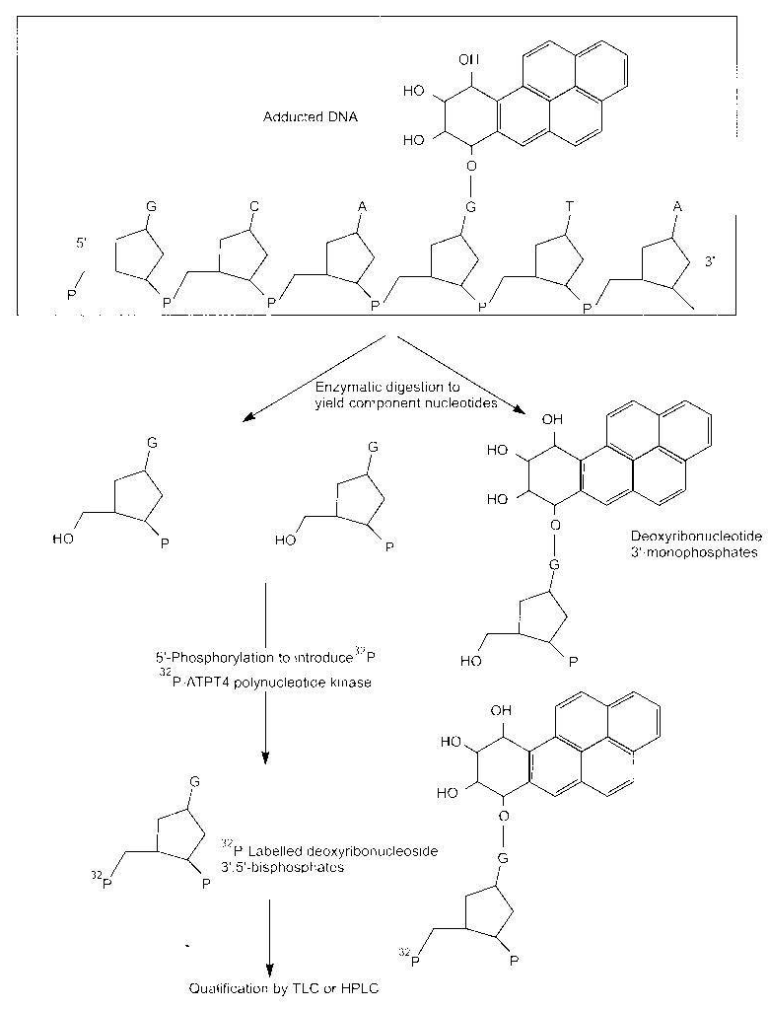
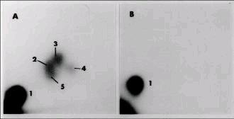
³²P-postlabelling assay
principle
Digestion of NA
Enzymatic labelling with 32P (kinase)
TLC or HPLC analyses of products
TLC result
(thin layer chromatography)
A - 2-5 = various adducts
B - controls

Slide 8
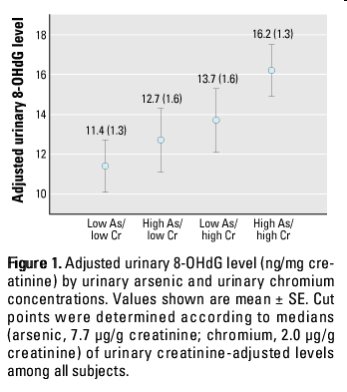
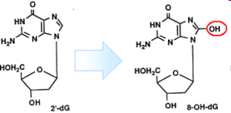
8-hydroxy-2´-deoxyguanosine analysis
Oxidative damage to DNA
- many causes → 8-OH-dG is the most common marker of DNA oxidation
Analysis: analytical chemistry methods
- HPLC
- immunochemistry (ELISA)

Slide 9
Biomarkers of susceptibility

Slide 10
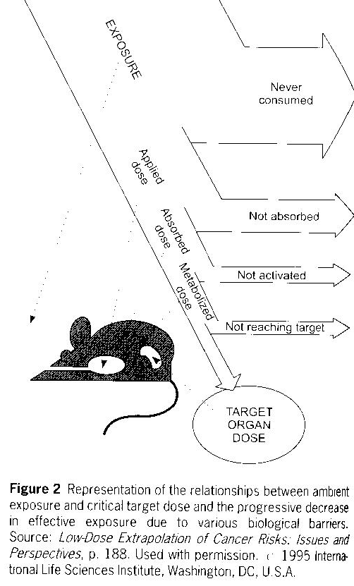
Toxicokinetics determines susceptibility of an individual at various levels
→ Biomarkers of susceptibility
Will the individual be sensitive?
Will patient respond to a drug?

Slide 11
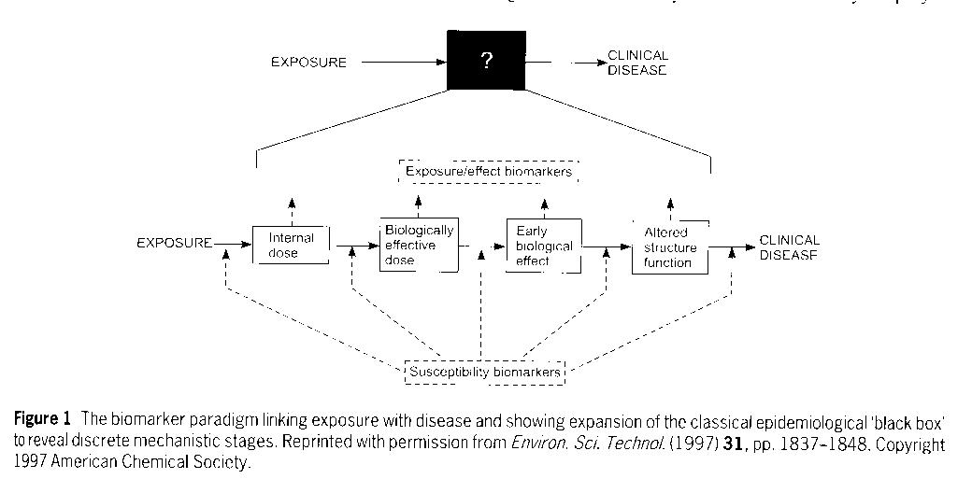
Importance of susceptibility biomarkers

Slide 12
Biomarkers of susceptibility
Susceptibility depends on genotype and metabolism
- genetic polymorphism in detoxification enzymes
- variability in specific isoenzymes
susceptibility to „activate“ toxicants:
example: N-acetylation of arylamines – NAT2
  susceptibility to genotoxins
family cancers
susceptibility to drugs (including anticancer drugs)

Slide 13
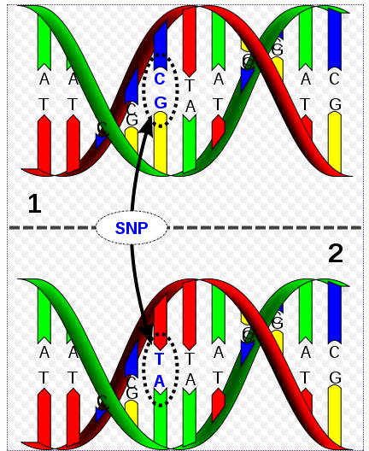
Example: genetic polymorphism
SNPs - single nucleotide polymorphism
SNPs
→ affects protein functions
→ in specific cases (see example) some SNPs identified
→ PERSONALIZED MEDICINE
To identify SNP as a biomarker
Many genotypes (from many individuals) must be sequenced and compared with phenotype (e.g. responsiveness to certain drug)

Slide 14
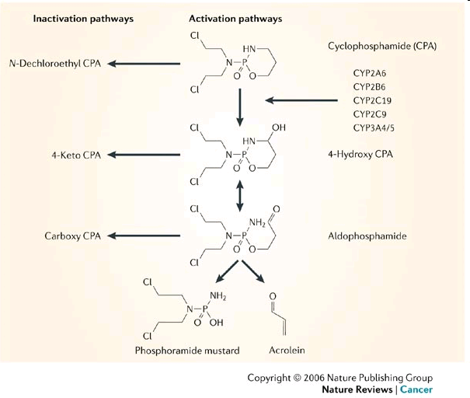
Cyclophosphamide (anticancer drug) and its toxicity
Genetic
polymorphism

Slide 15
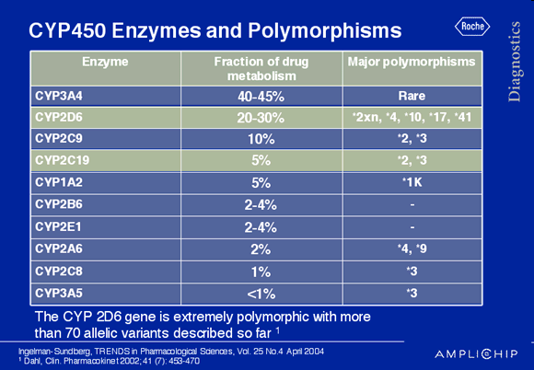
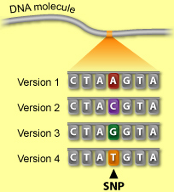
Example: genetic polymorphism
Alleles known
to be involved
in polymorphism

Slide 16
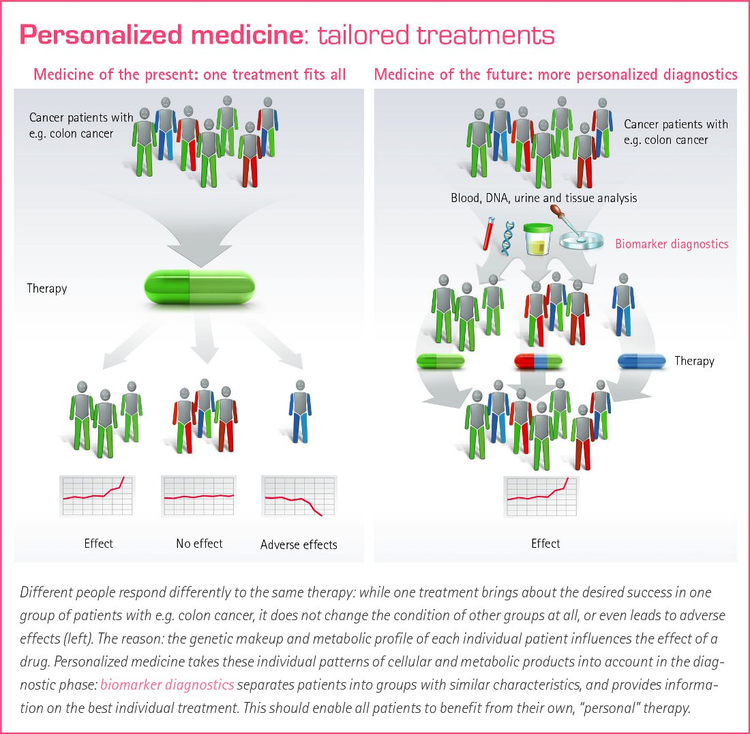
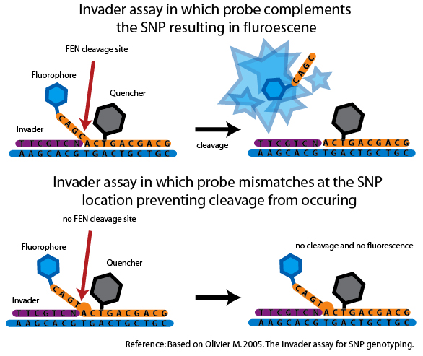
Personalized medicine
SNP diagnostics:
1) DNA isolation
2) Multiplication of specific gene eg. CYP
3) SNP identification
... Molecular biology methods such as
* NA sequencing
* Probe pairing ... number of variants

