Slide 1
Bi9393 Analytická cytometrie
Lekce 5
Karel Souček, Ph.D.
Oddělení cytokinetiky
Biofyzikální ústav AVČR, v.v.i.
Královopolská 135
612 65 Brno
e-mail: ksoucek@ibp.cz
tel.: 541 517 166
K. Souček Bi9393 Analytická cytometrie

Slide 2

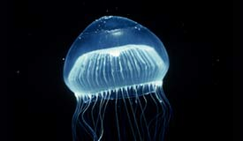
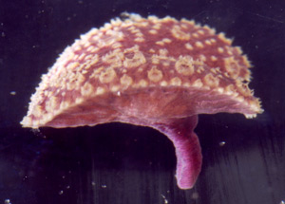
Fluorescenční proteiny
bioluminescence resonance energy transfer (BRET)
  Aequorea victoria - medúza žijící ve vodách na pobřeží Severní Ameriky.
  je schopna modře světélkovat (bioluminescence). Ca²⁺ interaguje s fotoproteinem aequorinem.
  modré světlo excituje green fluorescent protein.
  Renilla reniformis – korál žijící ve vodách na severním pobřeží Floridy.
  luminescence vzniká degradací coelenterazinu za katalytického působení luciferázy.
  modré světlo excituje green fluorescent protein.
Aequorea victoria “Crystal jelly “
Renilla reniformis "Sea Pansy"
http://www.mbayaq.org/efc/living_species/default.asp?hOri=1&inhab=440
http://www.whitney.ufl.edu/species/seapansy.htm

Slide 3
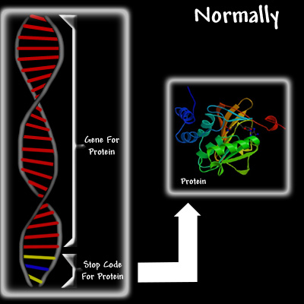
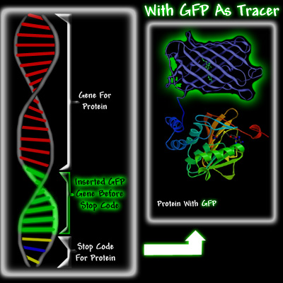
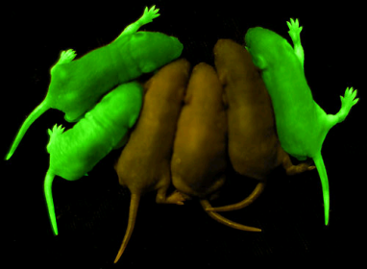
Fluorescenční proteiny
http://www.conncoll.edu/ccacad/zimmer/GFP-ww/GFP2.htm

Slide 4
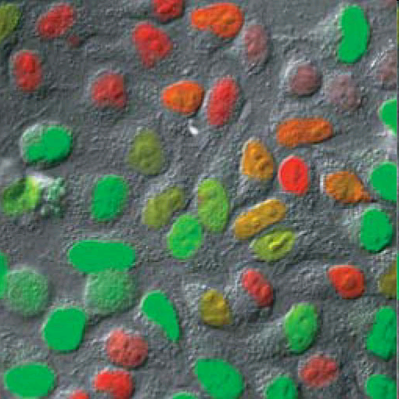
Fucci
(fluorescent ubiquitination-based cell cycle indicator) cells
Ubiquitin E3 ligase complexes
G1 - APC^{Cdh1}
S, G2, M- SCF^{Skp2}
Nature Methods - 5, 283 (2008)

Slide 5
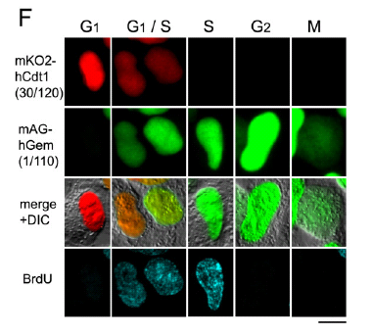
Fucci

Slide 6
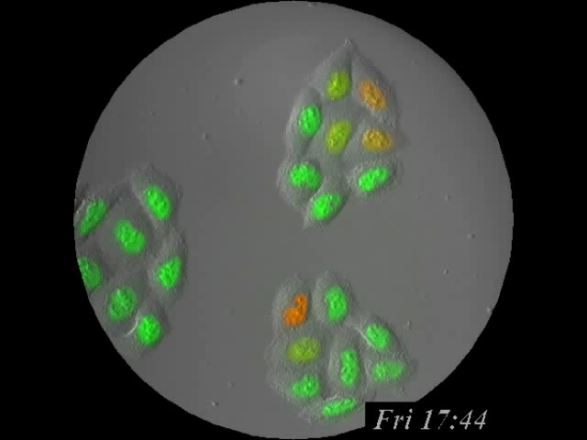

Slide 7
Detekce reaktivních kyslíkových skupin
Reaktivní kyslíkové skupiny hrají klíčovou roli v celé řadě biologických procesů
  posttranslační modifikace proteinů
  regulace transkripce
  regulace struktury chromatinu
  přenos signálu
  funkce imunitního systému
  fyzický a metabolický stres
  neurodegenerace, stárnutí

Slide 8
4 e– reduction to water
O₂
e–
O₂• –
e–
H₂O₂
e–
• OH
e–
H₂O
Unreactive at STP, but a great electron acceptor
Biological activation via radicals, transition metals
Generally, radical intermediates are enzyme-bound
Reacts with virtually any molecule at diffusion-limited rates
The molecule that makes ionizing radiation toxic
Actually a chemical reductant
Not so terribly reactive with most biomolecules
Mitochondrial superoxide the major source of active oxygen
Maintained at very low concentration
Superoxide dismutases
Not so terribly reactive with most biomolecules
Maintained at very low concentration
Catalases, peroxidases, GSH, etc…
© Simon Melov

Slide 9
Potential sites of intervention
Neurodegeneration
Energy
Crisis
Vascular Tone
Mitochondrial
Damage
Cardiac Output
Sensory Acuity
Oxidative
Stress
Cell Death
Skin Thickness
DNA
Damage
Bone Density
Endocrine Function
Oncogenesis
Immune Function
Cancer
© Simon Melov

Slide 10
Hydroethidine
HE EB
O₂⁻
H₂N
NH₂
H₂N
NH₂
H
N
N
+
Br⁻
CH₂CH₃
CH₂CH₃
Phagocytic Vacuole
NADPH Oxidase
NADPH
O₂
HE
NADP
O₂⁻
SOD
H₂O₂
DCF
O₂⁻
DCF
H₂O₂
OH⁻
Example: Neutrophil Oxidative Burst
© J. P. Robinson, Purdue University

Slide 11
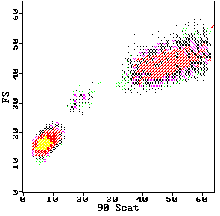
DCFH-DA DCFH DCF
2’,7’-dichlorofluorescin diacetate
O
O
CH3-C-O
O
O-C-CH3
Cl
Cl
2’,7’-dichlorofluorescin
H
COOH
HO
O
OH
Fluorescent
Cellular Esterases
Cl
Cl
H
COOH
2’,7’-dichlorofluorescein
Hydrolysis
HO
O
O
H₂O₂
Cl
Cl
Oxidation
H
COOH
DCFH-DA
Neutrophils
DCFH-DA
Monocytes
80
Control
PMA-stimulated PMN
DCFH
H O
60
2 2
Lymphocytes
counts
40
DCF
20
0
.1
1
10
100
1000
log FITC Fluorescence
© J. P. Robinson, Purdue University

Slide 12
Oxidative Burst
- DCFH-DA
- DHR-123
- HE
K. Souček Bi9393 Analytická cytometrie

Slide 13
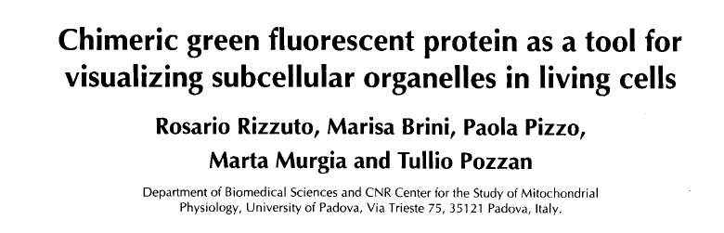
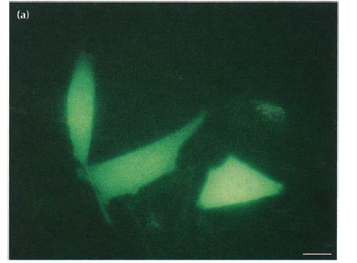
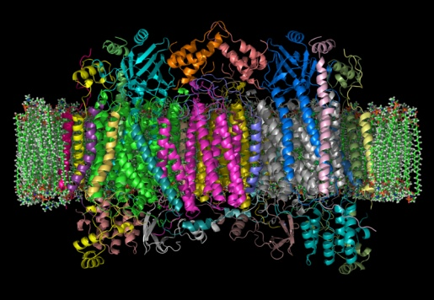
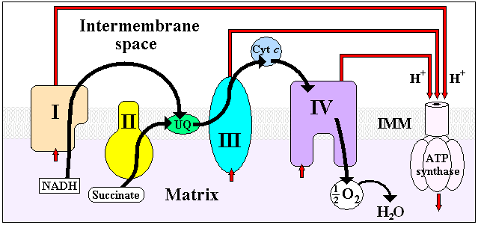
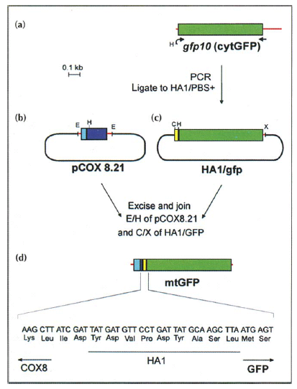
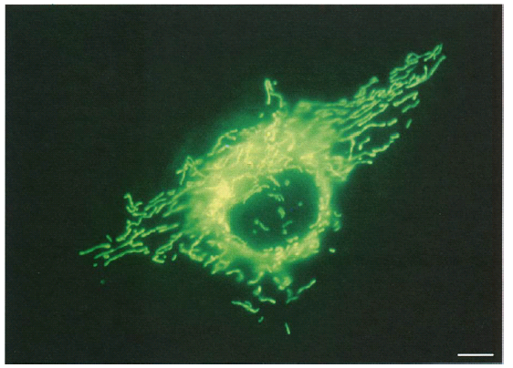

Slide 14
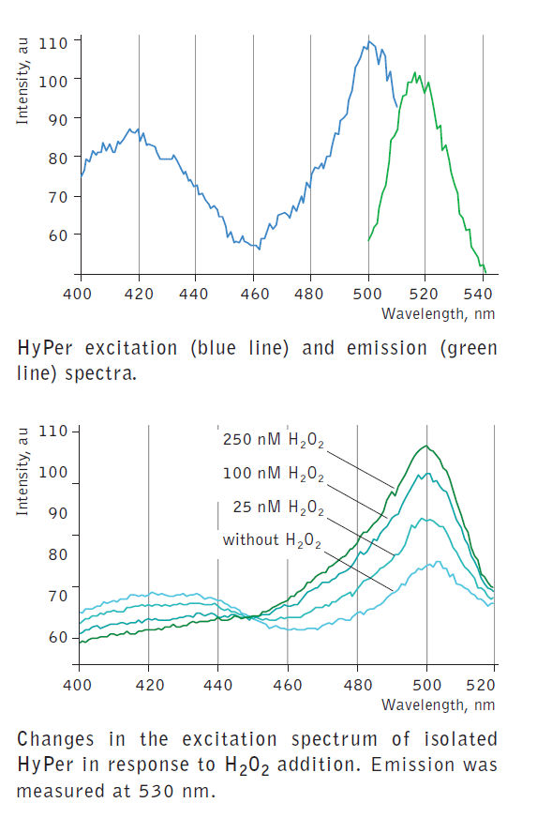
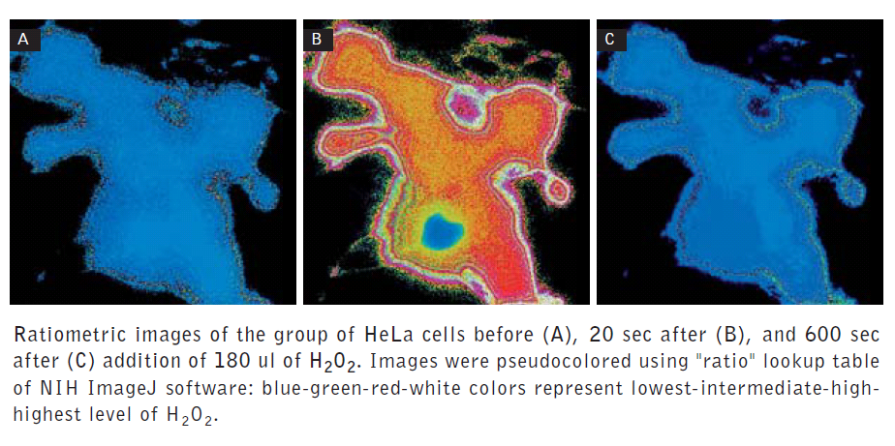

Fluorescent sensors for detection of H₂O₂

Slide 15
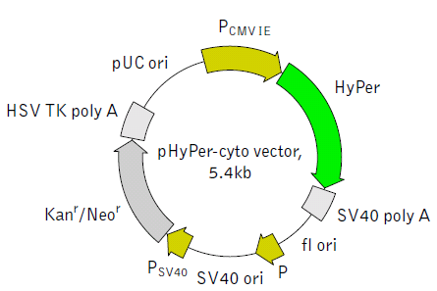
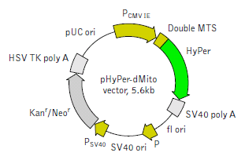
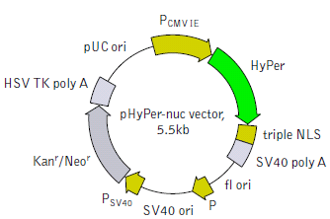
Variants & fusions
pHyPer-cyto vector
pHyPer-dMito vector
  Duplicated mitochondrial targeting sequence (MTS) is fused to the HyPer N-terminus. MTS was derived from the subunit VIII of human cytochrome C oxidase [Rizzuto et al., 1989; Rizzuto et al., 1995].
pHyPer-nuc vector
  Three copies of the nuclear localization signal (NLS) fused to the HyPer C-terminus provide for efficient translocation of HyPer to the nuclei of mammalian cells [Fischer-Fantuzzi and Vesco, 1988]

Slide 16
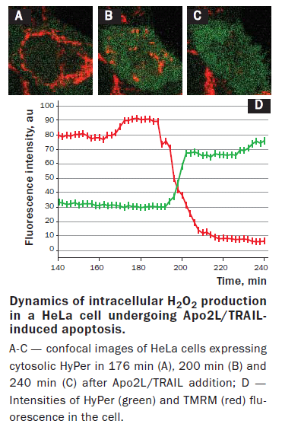
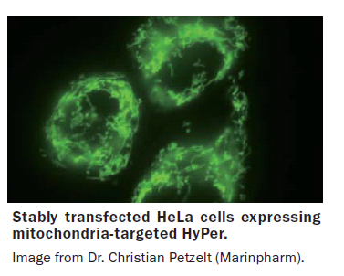


Slide 17
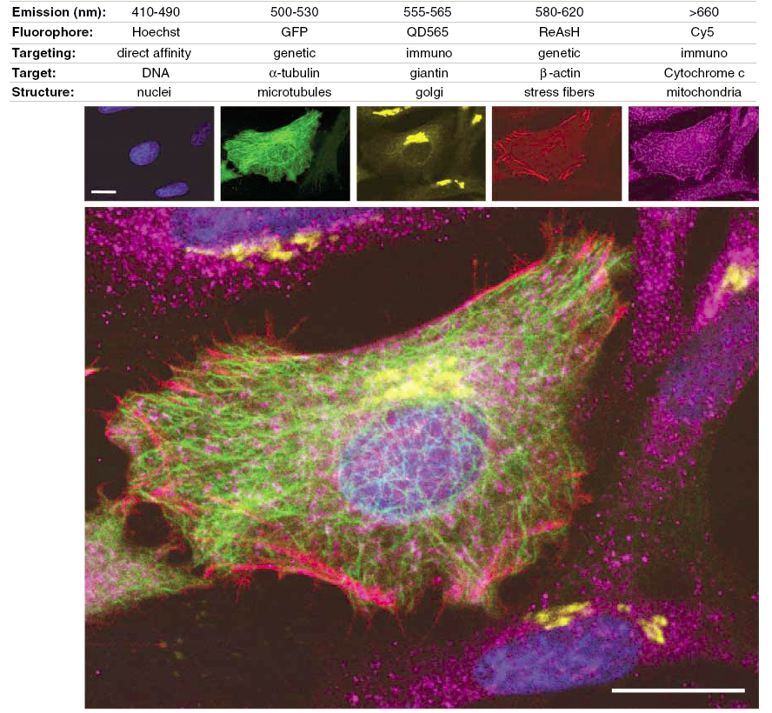

Slide 18
biarsenical–tetracysteine system
Nefluorescenční, membránově permeabilní biarsénová značka vytváří kovalentní fluorescenční komplex s jakýmkoliv intracelulárním proteinem obsahujícím krátký tetracysteinový motiv (CCPGCC)

Slide 19
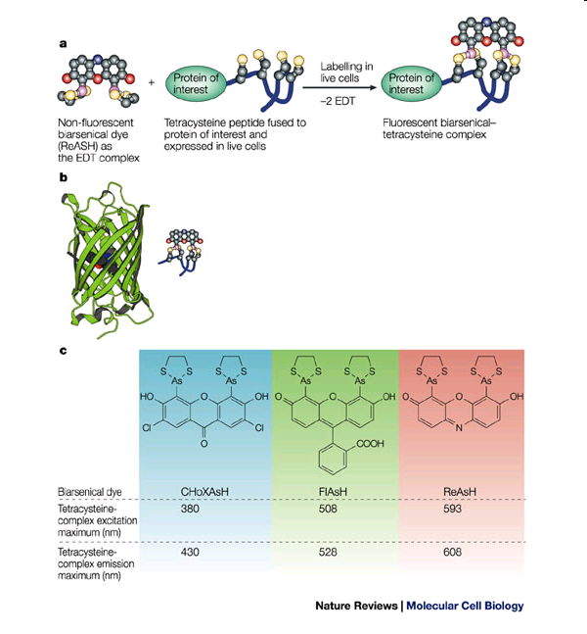
biarsenical–tetracysteine system

Slide 20

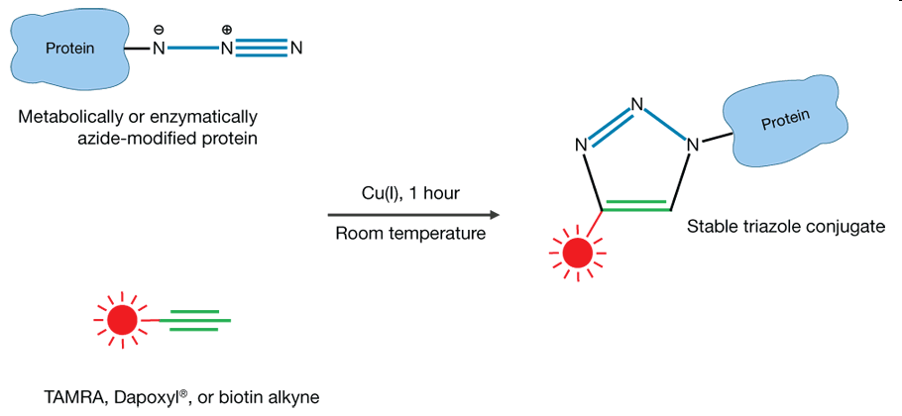
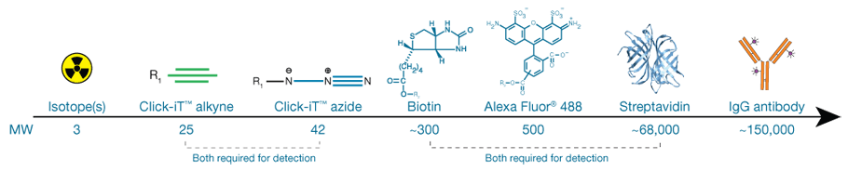
Click azide/alkyne reaction

Slide 21
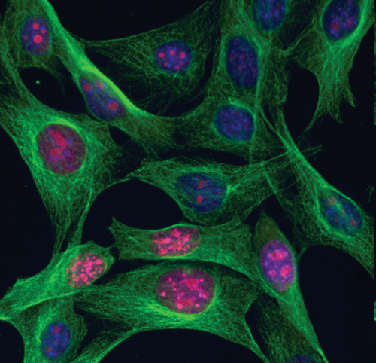
Aplikace Click-IT (Invitrogen)
Multiplex imaging with Click-iT® RNA assays.
NIH3T3 cells were incubated with 1 mM EU, formaldehyde-fixed, and permeabilized with Triton® X-100. EU incorporated into newly synthesized RNA (red) in some cells was detectied using the Click-iT® RNA Alexa Fluor® 594 Imaging Kit. Tubulin (green) was detected with anti-tubulin mouse IgG9 and visualized with Alexa Fluor® 488 goat anti-mouse IgG. Nuclei (blue) were stained with Hoechst 33342.

Slide 22
Aplikace Click-IT (Invitrogen) analýza syntézy DNA (proliferace)

Slide 23

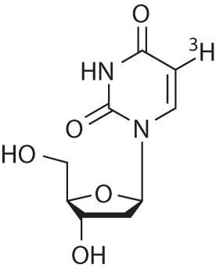
³H-thymidine
Tritiated (3H) thymidine

Slide 24
³H-thymidine
Original method for measuring cell proliferation
Radioactive
Not compatible for multiplexed analyses

Slide 25
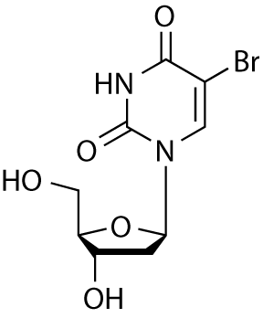
BrdU
Br
Br
Br
BrdU (5-bromo-2'-deoxyuridine)
Br

Slide 26
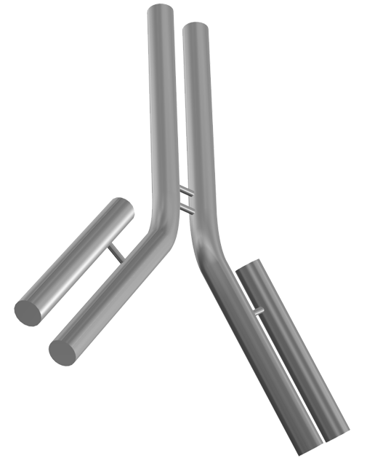

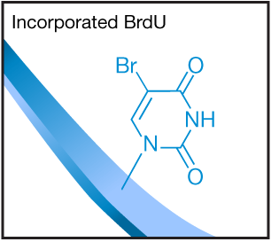
BrdU
Br
Br
Br
Br

Slide 27
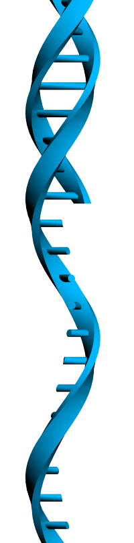
BrdU
Br
Br
Acid or DNase
Br
Br

Slide 28
BrdU
Br
Br
Br
Br

Slide 29
BrdU
Br
Br
Non-radioactive
Multiplex compatible but, strand separation requirement for anti-BrdU access, can affect:
  Ability for other antibodies to bind
  Morphology
  Ability for dyes that require dsDNA to bind efficiently, i.e., cell cycle dyes
Br
Br

Slide 30
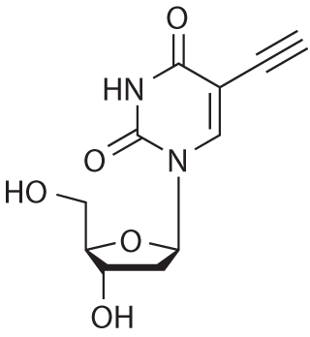
Click-iT™ EdU
EdU (5-ethynyl-2'-deoxyuridine)

Slide 31

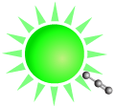


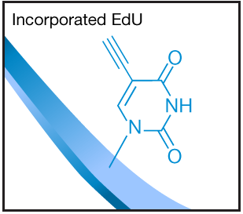
Click-iT™ EdU

Slide 32
Click-iT™ Edu
Non-radioactive
No DNA denaturation required
Simplified protocol
Small molecule detection
Multiplex compatible, including
  Other antibodies
  Dyes for cell cycle analysis

Slide 33
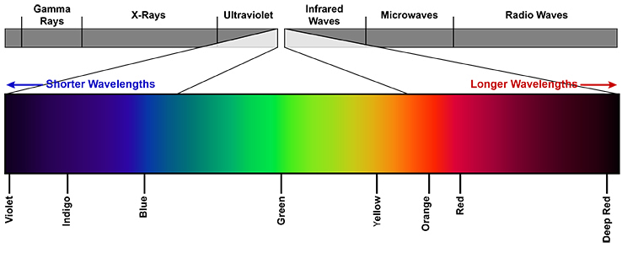
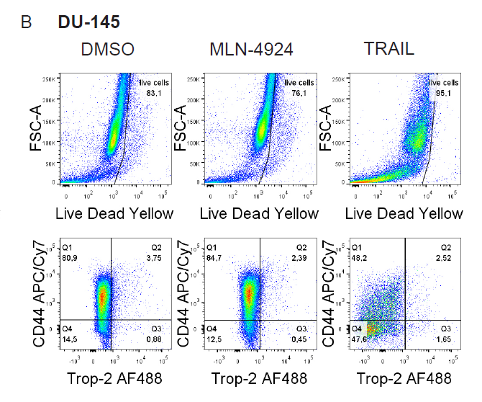
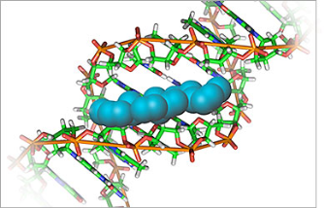
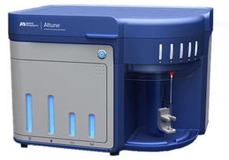
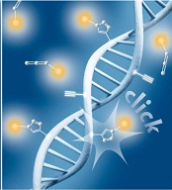
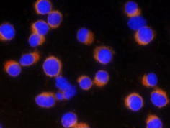
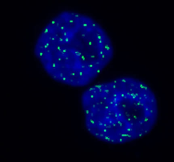
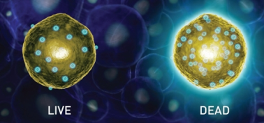
Flow cytometry most common application
Immunophenotype characterisation of the cells
(CSCs markers, differentiation, …)
Cell Cylcle (DNA content, Cell cycle modulation after treatment)
Cell Death analysis (AnnexinV, Cleaved Caspase3, …)
Proliferation (BrdU, EdU, mitosis - pH3)
DNA damage ( yH2AX,…)
Viability assays (propidium iodid, CalceinAM, …)

Slide 34
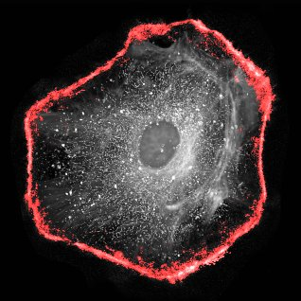
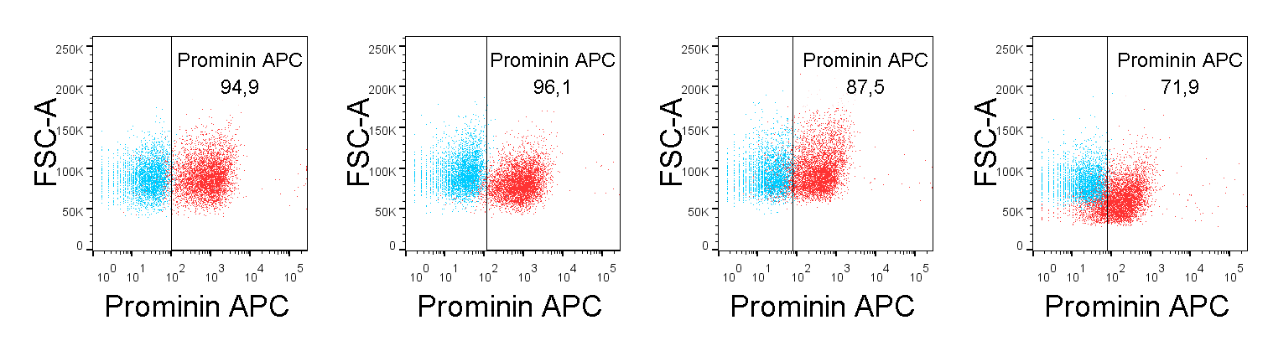
Incompatibility of Fluorochrome with Click-iT reaction
Not possible to use fluorochromes prior to click-iT reaction, e.g. PE, Qdots,…
Several antibodies are not compatible with the procedure
Permeabilized cells
Live cells
Fixed cells
Click-iT
procedure

Slide 35
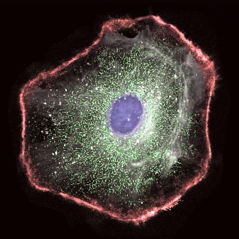
Example of final set-up
Parametr | Marker | Fluorochrome
Cell Surface Marker | CD44 | APC/Cy7
Cell Surface Marker | Trop-2 | AF488
Viability | LIVE/DEAD kit | Yellow
DNA synthesis | Click-iT EdU | AF647
Cell Cycle | DNA content | PO-PRO-1
DNA damage | yH2AX | PE
Apoptosis | Cleaved Caspase 3 | AF494

Slide 36
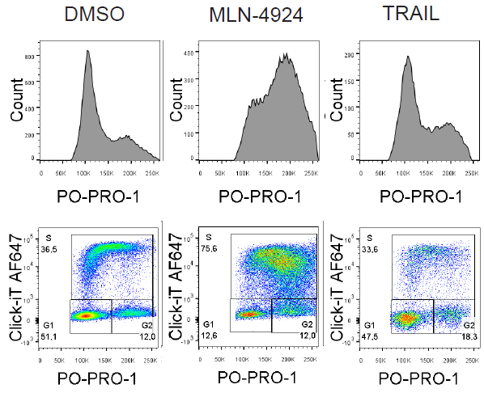
Example of final results (DU-145)
Viability and Immunophenotype
Cell cycle and Proliferation

Slide 37
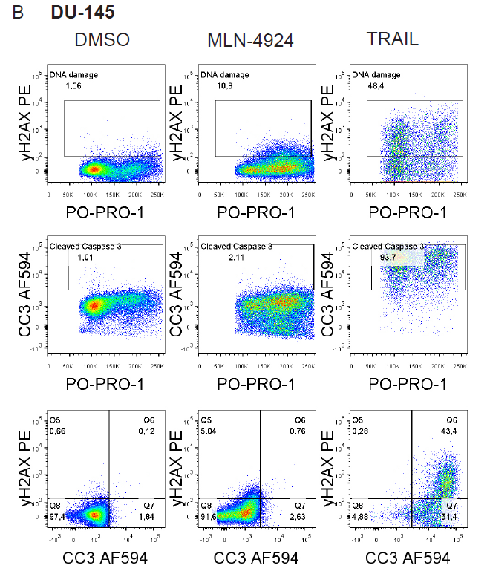
Example of final results
DNA damage and Apoptosis

Slide 38
„High Throughput Flow Cytometry“
automatizace + robotizace = urychlení a efektivita sběru dat (měření desítky vzorků za hodinu s minimálním zásahem operátora )
využití principu vícebarevné analýzy
K. Souček Bi9393 Analytická cytometrie

Slide 39
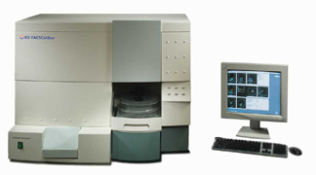

Automatizované systémy měření vzorků
Automatický karusel (autosampler)
Adaptér pro nasávání vzorků z
mikrotitrační desky

Slide 40
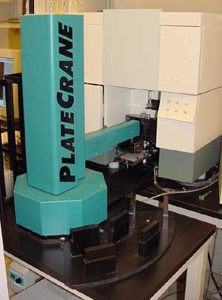





Automatizovaný „microsampler“ systém
K. Souček Bi9393 Analytická cytometrie

Slide 41


Slide 43

The steps in a high-throughput fluorescence-microscopy experiment.

Slide 44

Analysis

Slide 45


Slide 46


Slide 47


Slide 48



Garry Nolan
Peter Krutzik
„Fluorescent cell barcoding“
http://www.stanford.edu/group/nolan/

Slide 49

Krutzik PO, Nolan Fluorescent cell barcoding in flow cytometry allows high-throughput drug screening and signaling profiling.
Nat Methods. 2006 May;3(5):361-8.
K. Souček Bi9393 Analytická cytometrie

Slide 50

Krutzik PO, Nolan Fluorescent cell barcoding in flow cytometry allows high-throughput drug screening and signaling profiling.
Nat Methods. 2006 May;3(5):361-8.
K. Souček Bi9393 Analytická cytometrie

Slide 51

Aim: To identify new surface molecules associated with epithelial-to-mesenchymal transition
many intracellular markers known, but no reliable surface antigen enabling tracking of EMT available

Slide 52
Aim: To identify new surface molecules associated with epithelial-to-mesenchymal transition
many intracellular markers known, but no reliable surface antigen enabling tracking of EMT available
WHY TO HAVE SUCH SURFACE ANTIGEN?
vital cell characterisation and further compatibility with downstream applications (e.g. cell sorting, cultivation, in vivo studies…)
this approach is applicable to any field in cell biology

Slide 53
Model cell lines
HUMAN PANEL
HMLE | HMLE-EMT
MCF10A | MCF10A KRasV12
BPH-1 | CAFTD03
MOUSE PANEL
MMC Her2 | ANV2 Her2
cE2 Pten -/- | E2 Pten -/-
RM1 Myc/Ras
UGSM Ink4-/-

Slide 54

Get the best out of your model
FACS-based surface screen:
validated antibodies in 96w plates
several comercially available possibilities, we have gone for…
- LEGENDScreen HUMAN
332 PE conjugated antibodies + ISOs
- LEGENDScreen MOUSE
252 PE conjugated antibodies + ISOs
there are XY vials in LN
price of kit ≈ 1000 € (27k Kc)
How to get the best of it all?

Slide 55

Fluorescent barcode
possibility 1 – fluorescent proteins
- which, how many, isn’t it too laborous w/out lentiviral TXF?
possibility 2 – amino-reactive probes, lipophilic dyes…
- how to choose the right one?

Slide 56

Final workflow

Slide 57

The optimal concentation issue
HOW TO TEST IT:
10x serial dilution
REQUIREMENTS:
optimal resolution
compatibility w/ PE

Slide 58


Sample results I
EpCAM
- marker of epithelial cells
- commonly lost during EMT

Slide 59

Sample result II

Slide 60

Cytometric bead array (CBA)
Multiplexed Bead-Based Immunoassays
flow cytometry application that allows users to quantify multiple proteins simultaneously

Slide 61

Multiplex microsphere‐based flow cytometric platforms for protein analysis and their application in clinical proteomics – from assays to results
ELECTROPHORESIS
Volume 30, Issue 23, pages 4008-4019, 3 DEC 2009 DOI: 10.1002/elps.200900211
http://onlinelibrary.wiley.com/doi/10.1002/elps.200900211/full#fig1
Notes:
Microspheres can be immobilized with capture molecules and immunoassays can be performed. (A) Coupling reactions for microspheres: Microspheres with functional groups (carboxyl‐, thiol‐) can be used for immobilizing peptides, proteins, or amino group‐functionalized molecules; alternatively, streptavidin‐functionalized microspheres can be applied for biotin‐labeled capture molecules. (B) Standard capture sandwich assay: An individual assay involving an optically encoded microsphere immobilized with a specific capture molecule (antibody) is being carried out on the particle. After sample incubation, another analyte‐specific antibody (a so‐called detection antibody, which is biotinylated and usually recognizes epitopes that are different from that of the capture antibodies) is then applied to the reaction. The presence and quantity of the reporter tag (e.g. strepavidin‐phycoerythrin) allows the precise quantification of the reactions that occur.
© This slide is made available for non-commercial use only. Please note that permission may be required for re-use of images in which the copyright is owned by a third party.

Slide 62

CBA

Slide 63
CBA
multiplexing capabilities
speed
incorporation of multiple assay formats
rapid assay development and reasonable cost
automation

Slide 64
Biologické aplikace průtokové cytometrie
Cytogenetika
  analýza chromozómů
    karyotyp
    sortrování
      chromozómové DNA knihovny
      FISH značení (chromosome painting)
K. Souček Bi9393 Analytická cytometrie

Slide 65
Analýza a sortrování chromozómů

Slide 66




Analýza a sortrování chromozómů
synchronizace buněk – zisk metafázních chromozómů (colcemid, hydroxyurea)
izolace chromozómů
značení DAPI nebo Hoechst vs. chromomycin A3 (CA3) nebo mithramycin
= celková DNA vs. G/C-bohaté oblasti
http://www.scienceclarified.com/Ca-Ch/Chromosome.html
http://www.nccr-oncology.ch/scripts/page9243.html

Slide 67

Analýza a sortrování chromozómů

Slide 68



Slide 69


„Flow karyotype“
♀
♂
Karcinom močového měchýře
http://www.sanger.ac.uk/HGP/Cytogenetics/

Slide 70


Sortrování chromozómů
Pisum sativum

Slide 71

Sortrování chromozómů
Vicia faba

Slide 72
Aplikace průtokové cytometrie v mikrobiologii
ekologie
potravinářství
http://www.cyto.purdue.edu/flowcyt/research/micrflow/

Slide 73
Aplikace průtokové cytometrie v mikrobiologii

Slide 74
Aplikace průtokové cytometrie v mikrobiologii
viabilita
metabolické funkce
sortrování
analýza aerosolů (Fluorescence Aerodynamic Particle Sizer (Flaps))

Slide 75



Aplikace průtokové cytometrie v mikrobiologii
Sortrování
  EPICS + Autoclone® modul

Slide 76




Fluorescence Aerodynamic Particle Sizer (Flaps)
http://www.dres.dnd.ca/ResearchTech/Products/CB_PRODUCTS/RD98001/index_e.html

Slide 77


Průtoková cytometrie kvasinek
buněčné dělení
viabilita
membránový potenciál
respirace
produkce H₂O₂
citlivost k antibiotikům
separace
http://www.sbs.utexas.edu/mycology/sza_images_SEM.htm
Saccharomyces cerevisiae
http://en.wikipedia.org/wiki/Image:Budding_yeast_Lifecycle.png

Slide 78


Průtoková cytometrie kvasinek

Slide 79

Průtoková cytometrie v hydrobiologii
studium pico- a nano-fytoplanktonu (< 20 μM)
analýza metabolických funkcí planktonu
studium pigmentace (analýza chlorofylu a fykoeritrinu)

Slide 80
Průtoková cytometrie v hydrobiologii

Slide 81



Průtoková cytometrie v hydrobiologii
analýza DNA
http://www.soes.soton.ac.uk/staff/tt/
http://planktonnet.awi.de/portal.php?pagetitle=assetfactsheet&asset_id=15127

Slide 82





Průtoková cytometrie v hydrobiologii
http://omlc.ogi.edu/spectra/PhotochemCAD/html/chlorophyll-a(MeOH).html
http://www.cyto.purdue.edu/flowcyt/research/micrflow/sieracki/sierack2.htm

Slide 83



Slide 84




Průtoková cytometrie bezobratlých
lze aplikovat běžné metodické přístupy a fluorescenční značky
Příklady aplikací:
  buněčný cyklus
  cytotoxicita
  apoptóza

Slide 85
Invertebrate Survival Journal
http://www.icms.qmul.ac.uk/flowcytometry/uses/insects/index.html

Slide 86


Figure 5. Representative flow-cytometry scatter plot of hemocytes from 25 oysters.
Rebelo MdF, Figueiredo EdS, Mariante RM, Nóbrega A, et al. (2013) New Insights from the Oyster Crassostrea rhizophorae on Bivalve Circulating Hemocytes. PLoS ONE 8(2): e57384. doi:10.1371/journal.pone.0057384
http://www.plosone.org/article/info:doi/10.1371/journal.pone.0057384

Slide 87

Figure 6. Proposed model for hemocyte maturation, as seen by flow cytometry.
Rebelo MdF, Figueiredo EdS, Mariante RM, Nóbrega A, et al. (2013) New Insights from the Oyster Crassostrea rhizophorae on Bivalve Circulating Hemocytes. PLoS ONE 8(2): e57384. doi:10.1371/journal.pone.0057384
http://www.plosone.org/article/info:doi/10.1371/journal.pone.0057384

Slide 88
Shrnutí přednášky
„High-throughput“ průtoková cytometrie …
… a uplatnění vícebarevné detekce a beads array
sortrování chromozómů
aplikace v mikrobiologii, hydrobiologii a studiu bezobratlých
Na konci dnešní přednášky byste měli:
vědět co je to „high-throughput„ průtoká cytometrie
  …a jak se v ní může uplatnit princip vícebarevného značení.
znát základní principy měření a sortrování chromozómů pomocí průtokového cytometru;
mít představu o možných aplikacích průtokové cytometrie v mikrobiologii, hydrobiologii a studiu bezobratlých
K. Souček Bi9393 Analytická cytometrie

