Slide 1
REMOTE SENSING APPLICATIONS
RS, GIS, SDI, Big Data
For Mitigation
How to Deal with it on the ground?
Sanyo, Hainan, December 1st, 2015

Slide 2
Early Warning and Crises Management in Big Data Era: Geoinformatics Challenges
Sanya, RADI, December 1, 2015
Milan KONECNY
Former President of ICA and ISDE
Chairman of ICA Commission for Cartography on EW&CM
Masaryk University, Brno,
Czech Republic

Slide 3
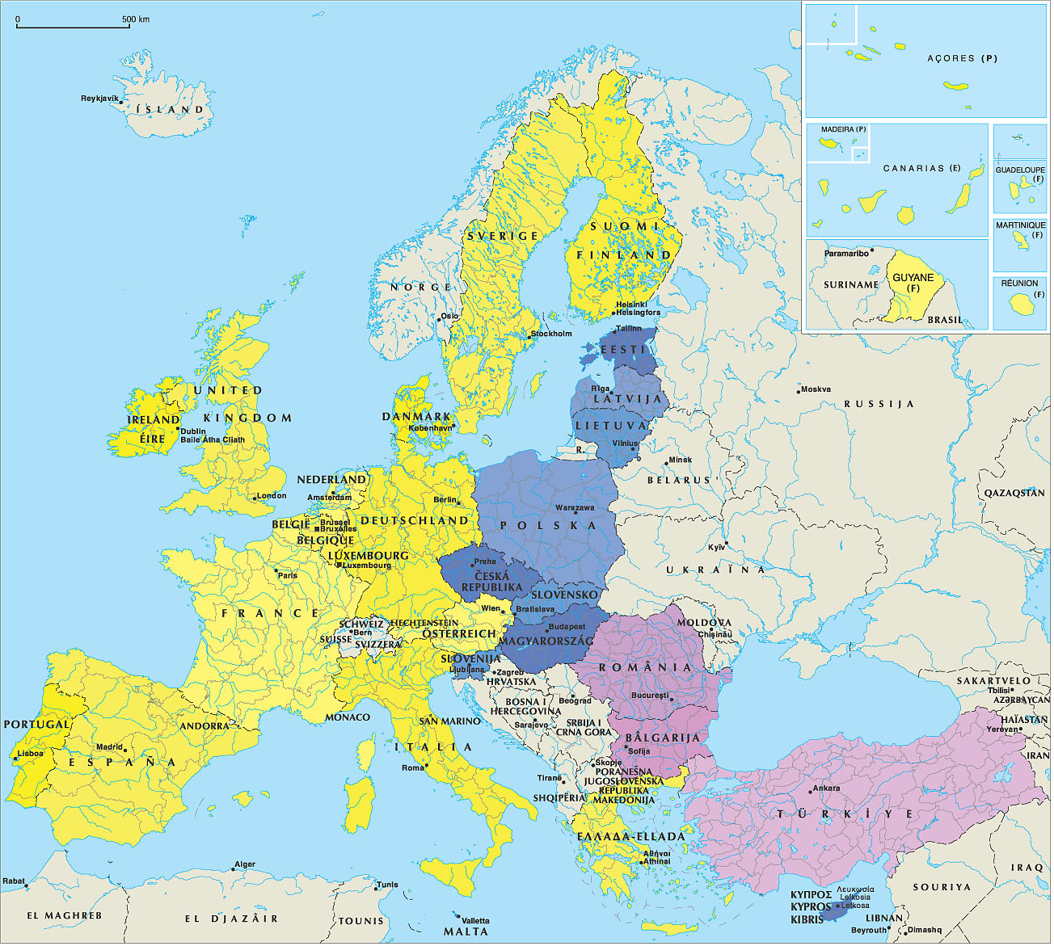

Slide 4
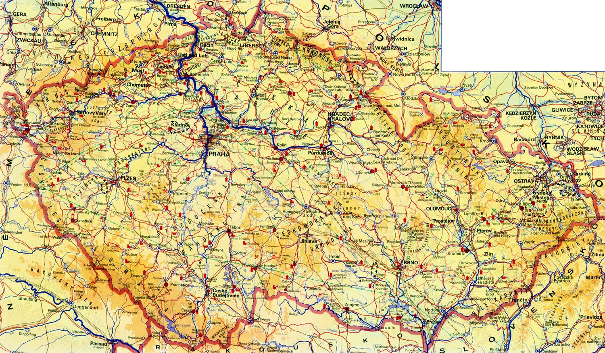
Main catchment areas of the Czech Republic:
Labe (Elbe) - Vltava (Moldau) - Morava - Odra (Oder)
Czech Rep.

Slide 5
What is Mitigation?
Mitigation is the effort to reduce loss of life and property by lessening the impact of disasters.
In order for mitigation to be effective we need to take action now—before the next disaster—to reduce human and financial consequences later (analyzing risk, reducing risk, and insuring against risk). It is important to know that disasters can happen at anytime and anyplace and if we are not prepared, consequences can be fatal.

Slide 6
Effective mitigation requires that we all understand local risks, address the hard choices, and invest in long-term community well-being. Without mitigation actions, we jeopardize our safety, financial security and self-reliance.
Disasters can happen at anytime and anyplace; their human and financial consequences are hard to predict.

Slide 7
CONTENT
Introduction, incl. Mitigation definition
GIS and GSDI concepts
DRM to DRR: from Hyogo to Sendai
4. Big Data Concepts and Policies: USA and EU
5. Where we are now?
- SDI Concepts (INSPIRE, COPERNICUS)
- Digital Earth
- Spatially-Enabled Society
6. Geo Info Strategies
7. Selected Potentials of Cartography and Geoinformatics
8. Integrated Research on Disaster Risk (IRDR)
9. Conclusions

Slide 8
GSDI Cookbook:
“The term “Spatial Data Infrastructure” (SDI) is often used to denote the relevant base
collection of technologies, policies and institutional arrangements that facilitate the availability of and access to spatial data.
The SDI provides a basis for spatial data discovery, evaluation, and application for users and providers within all levels of government, the commercial sector, the non-profit sector, academia and by citizens in general….

Slide 9
Introduction
Scope
Metadata
Framework
Future
Spatial Data Infrastructures
sources
requirements
added value
databases
metadata
network
institutional
agreements
policy &
standards
technology
users

Slide 10
The word infrastructure is used to promote the concept of a reliable, supporting environment,
analogous to a road or telecommunications network, that, in this case, facilitates the
access to geographically-related information using a minimum set of standard practices,
protocols, and specifications….

Slide 11
An SDI must be more than a single data set or database;
an SDI hosts geographic data and attributes, sufficient documentation (metadata), a means to discover, visualize, and
evaluate the data (catalogues and Web mapping), and some methods to provide access to
the geographic data.

Slide 12
Beyond this are additional services or software to support applications
of the data. To make an SDI functional, it must also include the organisational agreements
needed to coordinate and administer it on a local, regional, national, and or transnational
scale…

Slide 13
Although the core SDI concept includes within its scope neither base data collection activities or myriad applications built upon it,
the infrastructure provides the ideal environment to connect applications to data – influencing both data collection and applications construction through minimal appropriate standards and policies….

Slide 14
The creation of specific organisations or programs for developing or overseeing the development
of SDI, particularly by government at various scales can be seen as the logical
extension of the long practice of co-ordinating the building of other infrastructures necessary
for ongoing development, such as transportation or telecommunication networks.”

Slide 15
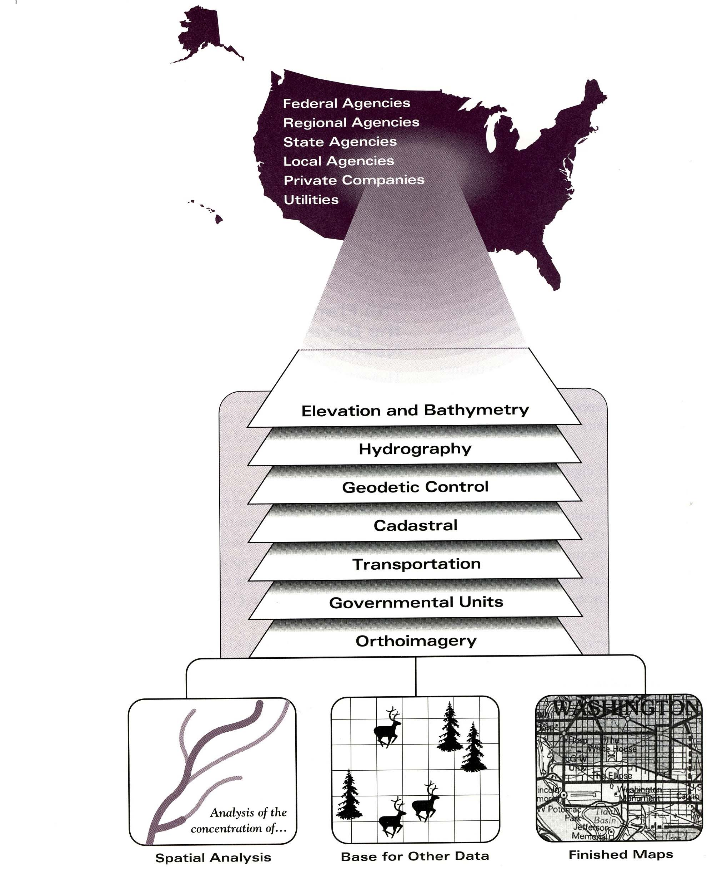

Slide 16
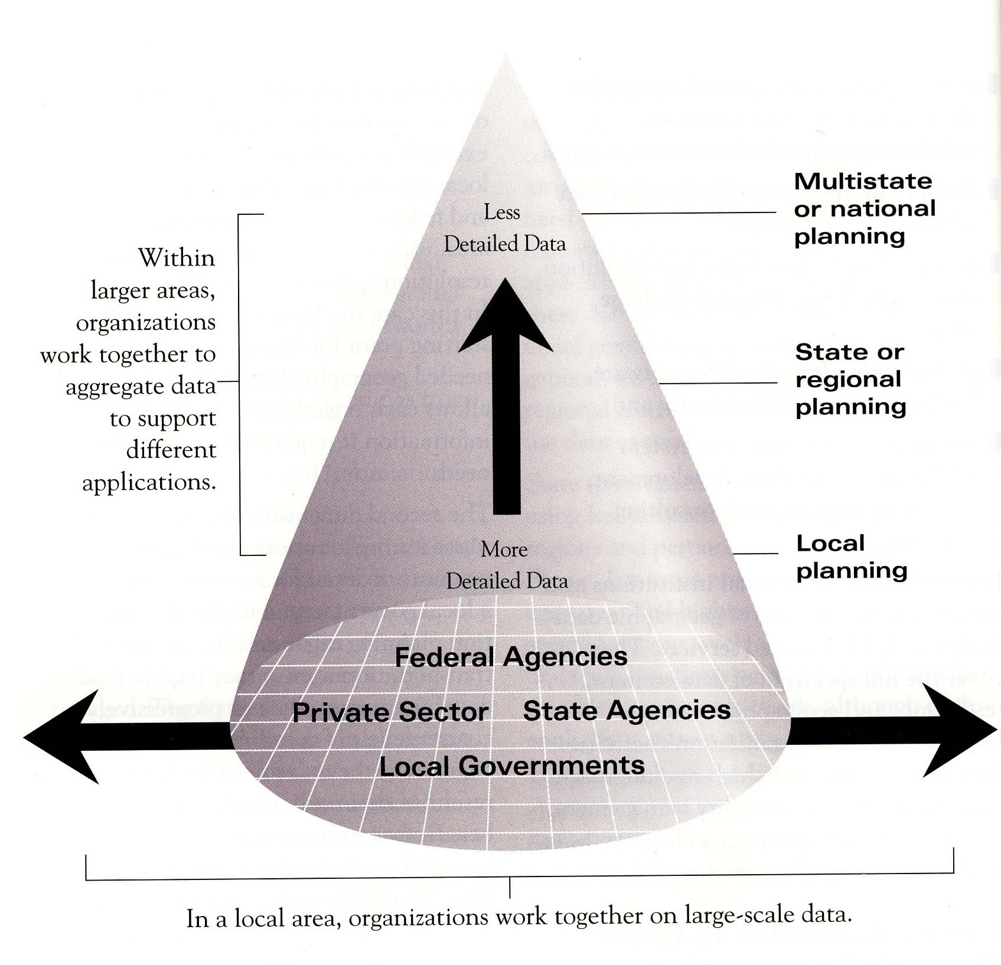

Slide 17
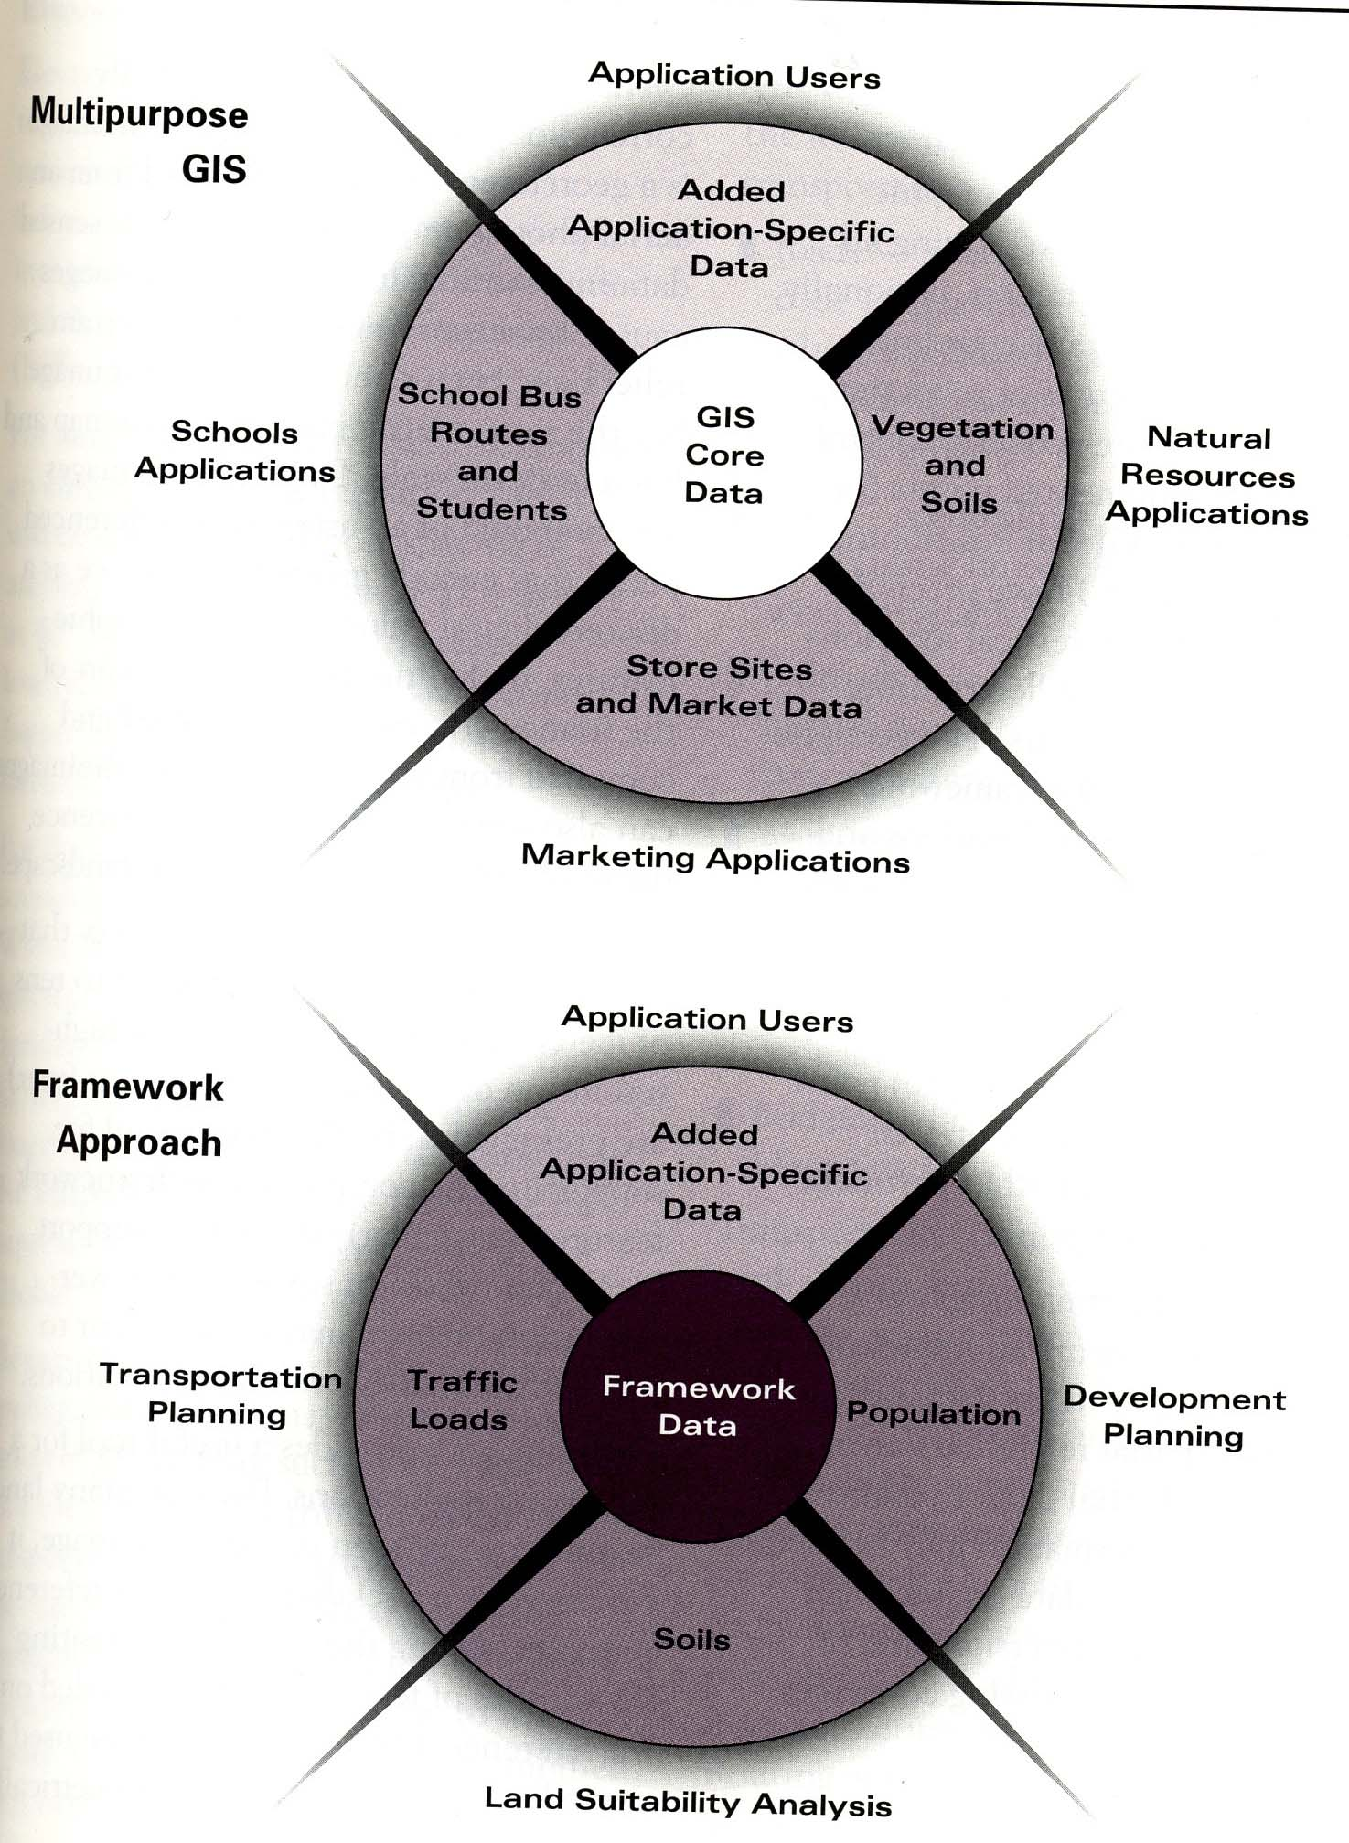

Slide 18
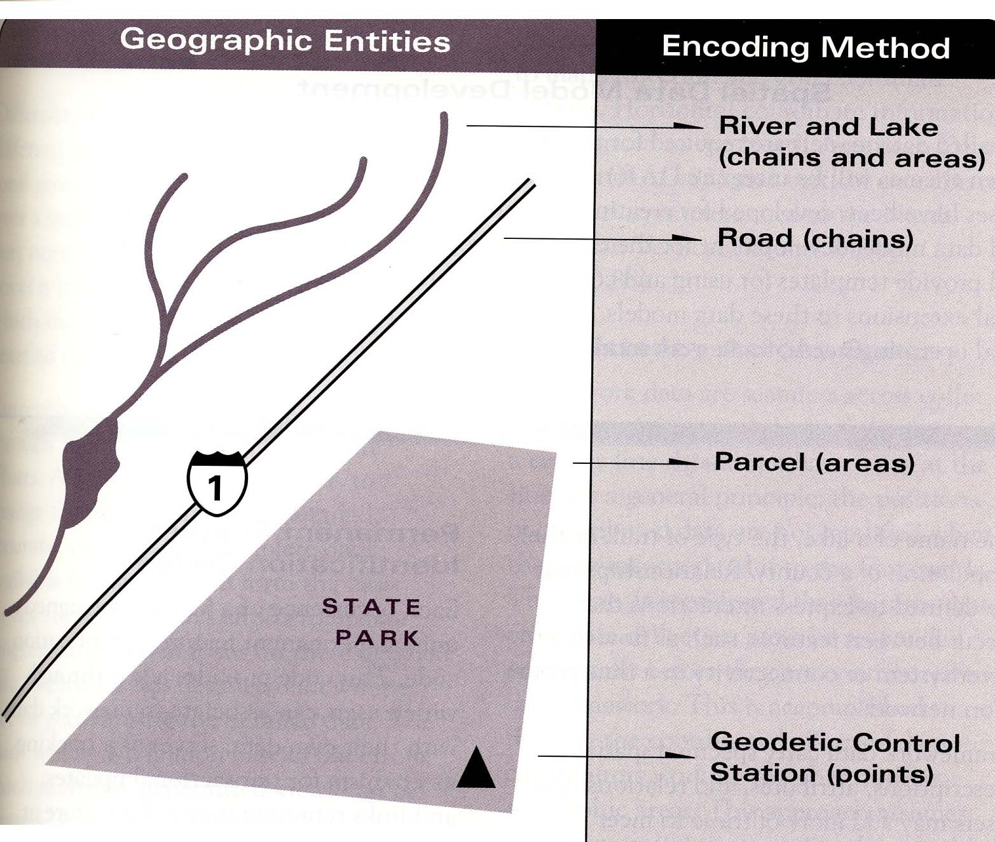

Slide 19
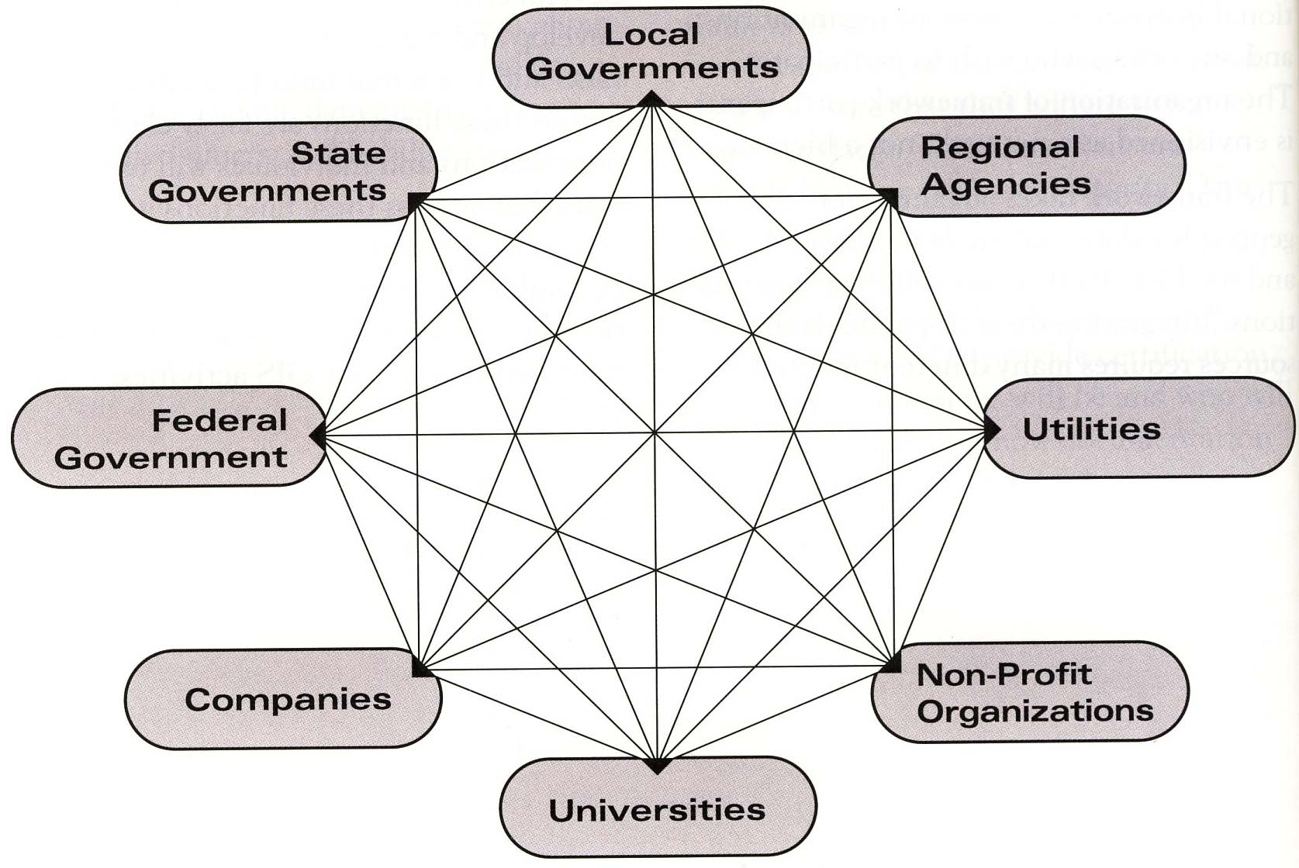

Slide 20
DISASTER RISK MANAGEMENT
And
DISASTER RISK REDUCTION
From Hyogo to Sendai

Slide 21
The impacts of natural hazards continue to increase around the world;
the frequency of recorded disasters affecting communities significantly rose from about 100 per decade in the period 1900-1940, to 650 per decade in the 1960s and 2000 per decade in the 1980s, and reached almost 2800 per decade in the 1990s.
Hundreds of thousands of people are killed and millions injured, affected or displaced each year because of disasters, and the amount of property damage has been doubling about every seven years over the past 40 years.

Slide 22
2005-2015: the well-being and safety of persons, communities and countries as a whole have been affected by disasters.
Over 700 thousand people have lost their lives, over 1.4 million have been injured
and approximately 23 million have been made homeless as a result of disasters.

Slide 23
Overall, more than 1.5 billion people have been affected by disasters in various ways, with women, children and people in vulnerable situations disproportionately affected.
The total economic loss was more than $1.3 trillion. In addition, between 2008 and 2012, 144 million people were displaced by disasters.

Slide 24
Video
Tsunami Asia Indian Ocean

Slide 25
Lessons from disaster management situations
The World Conference on Disaster Reduction, Kobe from 18-22 January 2005

Slide 26
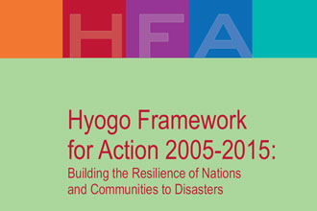

Slide 27
Priority Action 1: Ensure that disaster risk reduction is a national and a local priority with a strong institutional basis for implementation.
Priority Action 2: Identify, assess and monitor disaster risks and enhance early warning.
Priority Action 3: Use knowledge, innovation and education to build a culture of safety and resilience at all levels.
Priority Action 4: Reduce the underlying risk factors.
Priority Action 5: Strengthen disaster preparedness for effective response at all levels.

Slide 28
Hyogo Declaration:
it was recognized that a culture of disaster prevention and resilience,
and associated pre-disaster strategies, must be fostered at all levels, ranging from the individual to the international levels. Human societies have to live with the risk of hazards posed by nature.

Slide 29
Jan Egeland, Under-secretary of UN, used at the time of his opening speech in The World Conference on Disaster Reduction, which took place in Kobe from 18-22 January 2005 a famous Japanese proverb that reminds us that:
“Vision without action is but a daydream; action without vision is a nightmare.”

Slide 30
Egeland enhanced:
- that as the tsunami tragedy has shown us, local disasters can have global impact.
that global risks require truly global solutions.
it is necessary to adopt as soon as possible clear indicators for building disaster-resilience at the local and at the global level.
He also requested to radically revise our development models so that reducing and managing risk becomes central to sustainable development policy.

Slide 31
that Disaster reduction is not simply a matter of sophisticated technology and hardware; at root, it is also a matter of communication and education., we need a global early warning system.
- technology is not a cure-all. Experience shows us that people, not hardware, must be at the centre of any successful disaster warning and preparedness measures.

Slide 32
Key activities for realization of the topic in the field of National and local risk assessments were formulated:
Develop, update periodically and widely disseminate risk maps and related information to decision-makers, the general public and communities at risk in an appropriate format.

Slide 33
J.Egeland about Early Warning (Hyogo):
- We need to go to the people at risk; to help them understand what is at stake, and to get them actively involved in the development of their early warning systems;
We need the political weight and commitment by governments, to protect their people with early warning systems;
And we need international support and funds to help countries develop their systems and be part of the global system.

Slide 34
In the United Nations report the Global Survey of Early Warning Systems is summarizing that:
„to be effective, early warning systems must be people-centered and must integrate four elements:
Knowledge of the risks faced;
Technical monitoring and warning service;
Dissemination of meaningful warnings to those at risk; and
Public awareness and preparedness to act.
Failure in anyone of these elements can mean failure of the whole early warning system.“

Slide 35
Early warning is more processing oriented activity.
Information and data coming from various sources are permanently handled, identified, interpreted, visualized and responsible persons or institutions can recognized which kind of dangerous situation can happen.
These methods have been successfully used in EU, Czech Republic etc. for operational steps towards BSA, bird flu or flu epidemic.

Slide 36
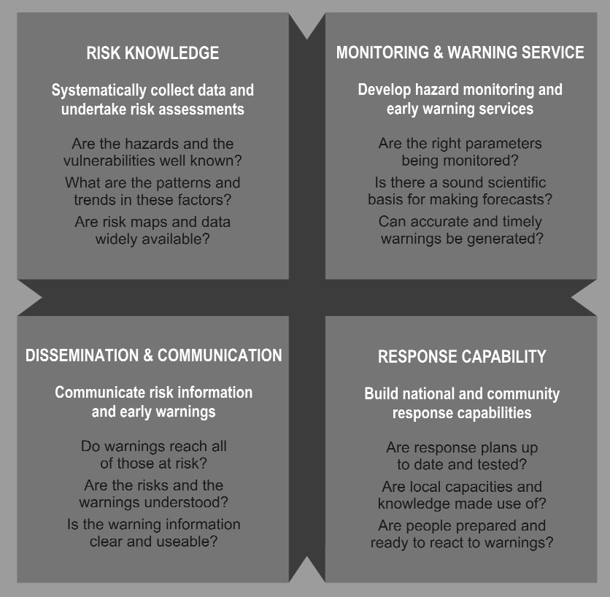

Slide 37
Video
New Tsunami Japan

Slide 38
Kamaishi City, Iwate Prefecture constructed huge breakwaters 2km long, 20m thick, 8m above sea level and 65m deep, which have been registered as the deepest breakwaters in the Guinness World Records (see Fig.4a and 4b).

Slide 39
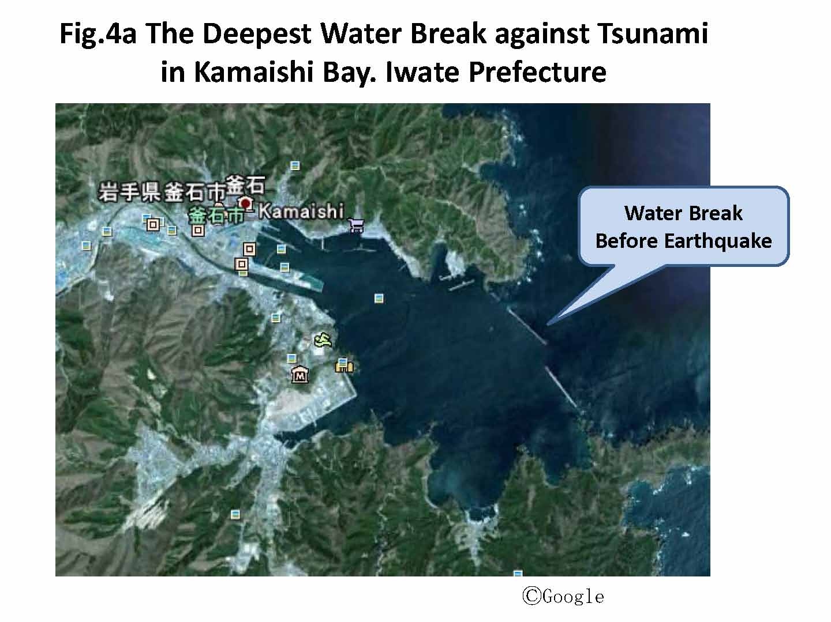
Sunji Murai, 2011

Slide 40
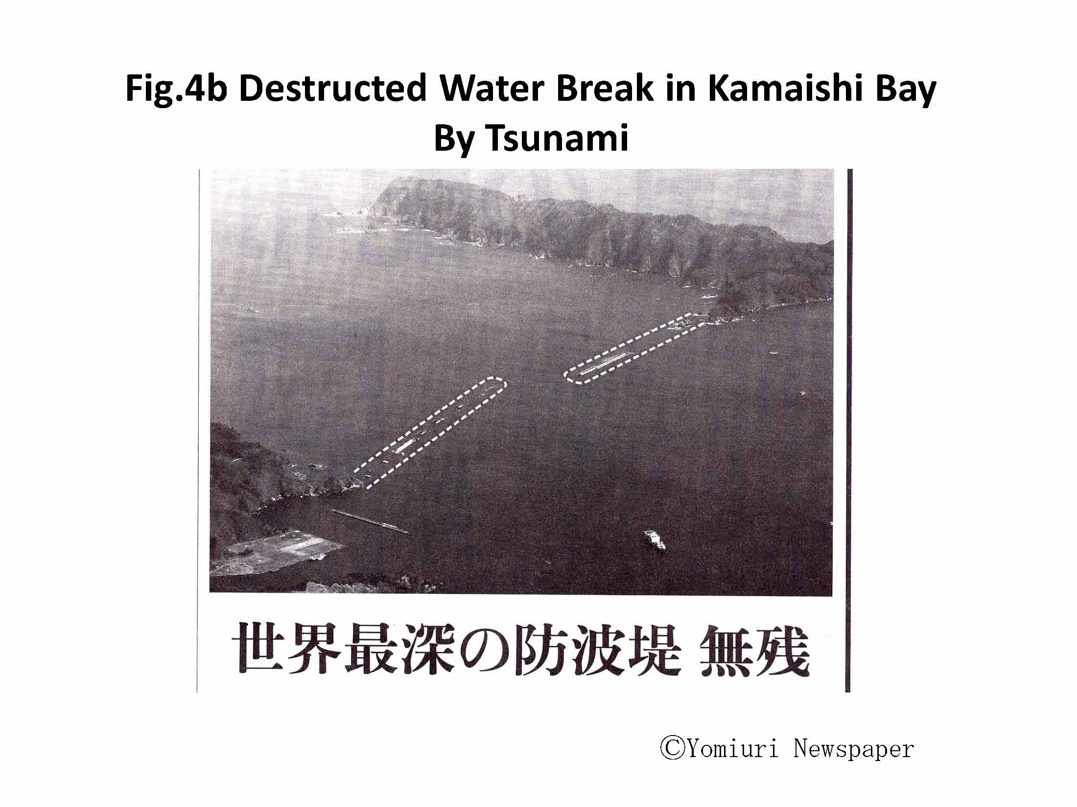
Sunji Murai, 2011

Slide 41
We should have learnt the lessons that ‘hardware’ including very high breakwaters, cannot save people
but
we need to use ‘software’ including procedures for providing early warning and evacuation systems.

Slide 42
I. Actual impulses from U.N. CDRR in Sendai
The Sendai Framework for Disaster Risk Reduction 2015-2030
was adopted at the
Third UN World Conference in Sendai, Japan, on March 18, 2015

Slide 43
Main stream:
To keep importance of Disaster Risk Management
But contemporary create wider approach under
Disaster Risk Reduction

Slide 44
Priorities for action
Priority 1:
Understanding disaster risk.
Priority 2:
Strengthening disaster risk governance to manage disaster risk.
Priority 3:
Investing in disaster risk reduction for resilience.
Priority 4:
Enhancing disaster preparedness for effective response and to “Build Back Better”
in recovery, rehabilitation and reconstruction.

Slide 45
Priority 1:
Understanding disaster risk. National and local level
(c) To develop, periodically update and disseminate, as appropriate, location-based disaster risk
information,
including risk maps,
to decision makers, the general public and communities
at risk of exposure to disaster in an appropriate format by using, as applicable, geospatial
information technology;

Slide 46
(f) To promote real time access to reliable data, make use of space and in situ information,
including geographic information systems (GIS), and use information and communications technology innovations
to enhance measurement tools and the collection, analysis and dissemination of data;

Slide 47
Global and regional levels
To achieve this, it is important:
To enhance the development and dissemination of science-based methodologies and tools to record and share disaster losses and relevant disaggregated data and statistics, as well
as to strengthen disaster risk modelling, assessment, mapping, monitoring and multi-hazard early warning systems;

Slide 48
(b) To promote the conduct of comprehensive surveys on multi-hazard disaster risks and
the development of regional disaster risk assessments and maps, including climate change scenarios;

Slide 49
(c) To promote and enhance, through international cooperation, including technology transfer,
access to and the sharing and use of non-sensitive data and information, as appropriate, communications and geospatial and space-based technologies and related services; maintain and strengthen in situ and remotely-sensed earth and climate observations;
and strengthen the utilization of media, including social media, traditional media, big data
and mobile phone networks, to support national measures for successful disaster risk
communication, as appropriate and in accordance with national laws;

Slide 50
Sendai
International, regional, subregional and transboundary cooperation remains pivotal in
supporting the efforts of States, their national and local authorities, as well as communities
and businesses, to reduce disaster risk. Existing mechanisms may require strengthening in
order to provide effective support and achieve better implementation.

Slide 51
Third World Conference on Disaster Reduction (DRR), Sendai, Japan
Mr. Liguo LI, minister of Civil Affairs, P.R. China, March 14, Sendai, Japan:
Hyogo protocol 2005- 2015
„China has adopted the concept of comprehensive disaster reduction by linking the disasters with socio-economic development, adapting to climate change and building disaster reduction into rural and urban development, placing people at the central consideration.“

Slide 52
National comprehensive disaster planning, there are realized targets such keeping the share of direct disaster looses under 1.5% of total GDP annualy and disaster relief accessible for affected people within 12 hours after disaster as well as others.
There is established disaster prevention and reductionn system and legislation network, disaster reduction committee – central and provincial levels – 30 laws and rules – working reduction mechanism established.
Nature Disaster Monitoring, early warning system further improved (meteo-hydro-, earthquake, geological, ocean, forest fire, and pest and disease issues)

Slide 53
5) Disaster education and advocacy system has been established (6723 communities granted the special accreditation)
6) International cooperation (UN, regional activities and cooperation)

Slide 54
Chinese contribution to World Disaster Reduction after 2015:
Continue to implement comprehensive disaster reduction strategy and include the disaster risk reduction and adaptation of climatic change into national and local sustainable development process.
Formulate and implement „thirteen-five-year-planning for comprehensive disaster prevention and reduction based on chinese’s national conditions and disaster risks.

Slide 55
3. Give full play of experts and schollars to strenghten the scientific approaches in disaster prevention and reduction.
4. Enhance the structural construction against nature disasters to further uplift of prevention level and increase people’s awareness about disaster prevention and reduction.

Slide 56
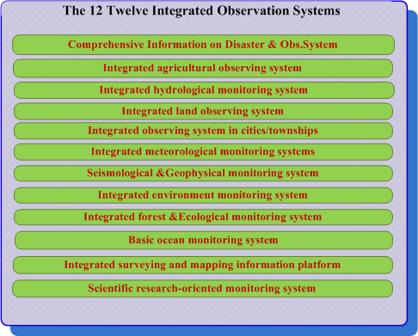

1.3 The Current Situation of Chinese Disaster Reduction - The available operational systems

Slide 57
1.3 The Current Situation of Chinese Disaster Reduction - The Existing problems
Sensors, data and information cannot be shared and integrated sufficiently
“Rich of data, barren of information, lack of knowledge”
Collaboration among different ministries/institutions is insufficient.
Stable and efficient channel for disaster information transmission among stricken areas, related ministries and headquarters cannot be guaranteed.
We need to integrate multiple disaster related systems among different ministries/institutions by federated databases and interoperability and to use the sensor web to integrate airborne, space borne and in-situ observations through a web service.

Slide 58
1.4 Integration of Multiple Systems is the Resolution - The Task of CNDRSS
To share multi-source data and information
Sensor web available for real-time or near real-time use.
Full and open exchange of data, service and other resources;
Effective mechanism and platform for the collaboration of various ministries;
Timely and rapid delivery of disaster data and information;
Notes:
e.g. To conduct comprehensive evaluation from multi-perspective by different ministries
To coordinates emergency preparedness and response work with other ministries

Slide 59
4. Big Data Concepts and Policies : USA and EU

Slide 60
Obama Administration Releases Historic Open Data Rules to Enhance Government Efficiency and Fuel Economic Growth
- groundbreaking new steps to make information generated and stored by the Federal Government more open and accessible to innovators and the public, to fuel entrepreneurship and economic growth while increasing government transparency and efficiency.

Slide 61
President Obama said:
“One of the things we’re doing to fuel more private sector innovation and discovery is to make vast amounts of America’s data open and easy to access for the first time in history. And talented entrepreneurs are doing some pretty amazing things with it.”
“Starting today, we’re making even more government data available online, which will help launch even more new startups. And we’re making it easier for people to find the data and use it, so that entrepreneurs can build products and services we haven’t even imagined yet.”

Slide 62
European Union
Big Data is an emerging field where innovative technology offers alternatives to resolve the inherent problems that appear when working with huge amounts of data, providing new ways to reuse and extract value from information.
Three main dimensions characterize Big Data: huge variety of data format, often time-sensitive and large.
Big Data offers tremendous untapped potential value for many sectors but no specific intelligent-large-data-handling/brokering industrial sector exists.

Slide 63
Big Data: buzz word or reality?
Information superhighway,
SDI´s,
System of Systems concepts (GEO, GEOSS,..)

Slide 64
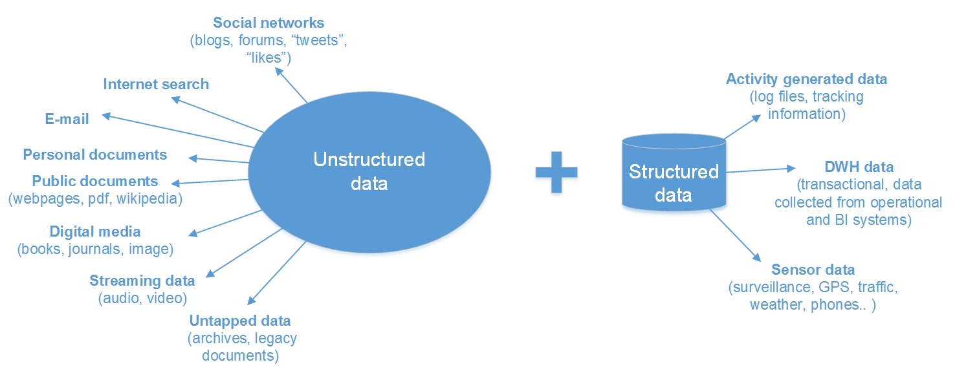
(Bandrova, Konecny, Yotova, 2014)

Slide 65
BD: Definitions

Slide 66
Zucker, S., (2014) :
“a popular term used to describe the exponential growth and availability of data, both structured and unstructured” .
”There is no rigorous definition of big data. Initially the idea was that the volume of information had grown so large that the quantity being examined no longer fit into the memory that computers use for processing, so engineers needed to revamp the tools they used for analyzing it all” (Mayer-Schönberger V., Cukier K., 2013).

Slide 67


Slide 68
Today era of terabytes or petabytes and this trend leads to new challenges in geoinformatics and cartography for gathering, storing, analyzing and visualizing the spatial information and data.
It will not happen first time in the history of cartography that it is one of few visualizing disciplines to use BD for correct analyzing of huge amount of data and their presentation and visualization on different levels of preciseness according to wishes of potential users.

Slide 69
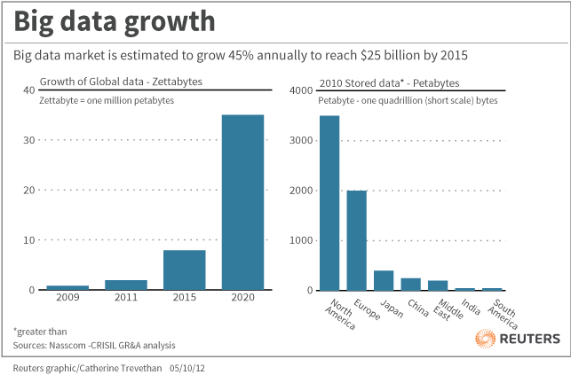
Introduction
- The increasing amount of data encourages the creation of new methodologies for data processing and the development of digital technologies
New potentials and possibilities to the evolution of cartographic visualization and its applications
In 2010, the volume of digital content on the planet exceeded 1 ZB

Slide 70
“Big Data” BD:
It is the ability of society to harness information in novel ways to produce useful insights or goods and services of significant value .
The bridge between BD and the society cannot be done only by the existing technologies and computers.
The presence of professionals should be more active in the process of transforming BD in useable variant to users and society.

Slide 71
BD needs to establish teams with people coming from branches which did not work together to now.
Design new complex approaches.
Geographers (physical and human and economical ones), cartographers and geoinformatics + RS want to add their knowledge to enhance such linkages and develop paradigma for and supportive approaches of higher level usage of BD in everyday decision making, solving problems and improvement of life of inhabitants.

Slide 72
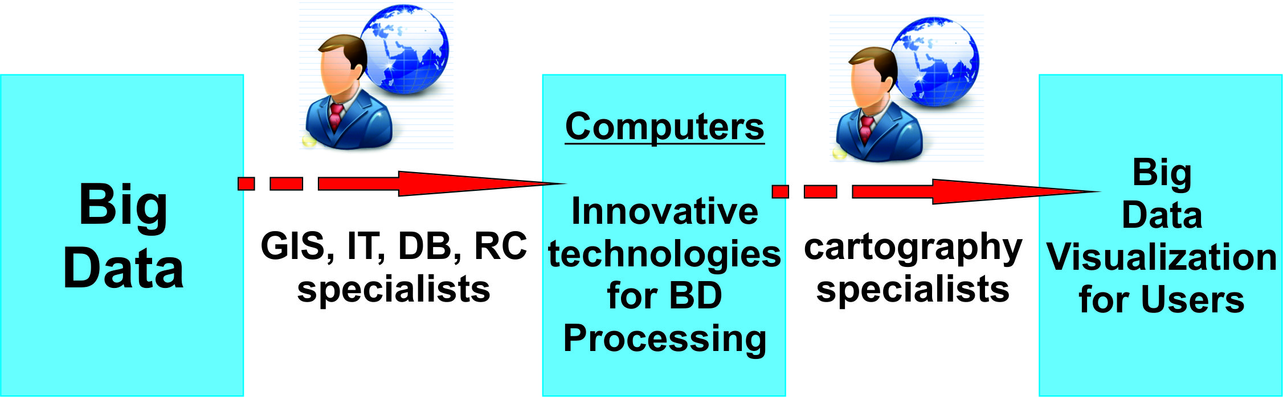
The Professional Places in BD Era (Bandrova, Konecny, Yotova, 2014)

Slide 73
Characteristics of Big Data
(by IT industry)
Volume of BD means the quantity of data; as well size of data which is more than this one defined a structured data base.
Velocity of BD means the speed of generation of data.
or frequency of data delivery.
(thermometers, microphones, video cameras, sensor and Web data gathering in real time and data volumes get big in a hurry).

Slide 74
Variety of BD means different category of data in different formats and purpose of analyzing and using.
Here we can include all data coming from sensors, digitalization, mobile applications, Web, data bases, photos, videos, audios, sms, automations and others. This characteristics show us the next step of processing: storage, standardizing, classification and analyzing of this structured or unstructured data.
Variability of BD means the time of generating the data.

Slide 75
Complexity of BD means multiple resources generating data
From cartographic point of view, we can add also Accuracy, Dimensionality, Quality and Interactivity of BD.
Accuracy means the degree of correct information and data which can be projected or referred to a coordinate system;
Dimensionality means a measure of spatial, time and characteristics extents of the information represented to the map. We will achieve 2D, 3D, 4D to multi-dimensional map;

Slide 76
Quality means a high level of value of the gathered information and data;
Interactivity means the level of allowance of user activity.

Slide 77
2. Where we are now?

Slide 78
Global Mapping
UN-GGIM
GMES and INSPIRE: step ahead than GOOGLE, offering data (not only showing)
GEO, GEOSS
Digital Earth (Annoni and JRC)
Concepts and strategies (Spatial-Enabled Society,
e-Government, ….)
VGI, VGE…..

Slide 79
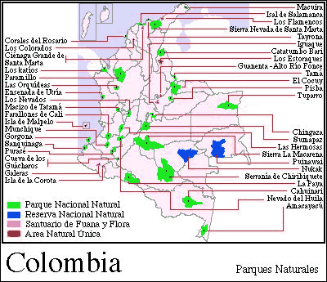
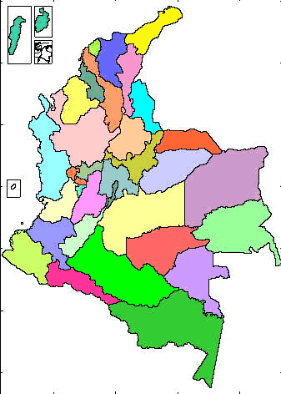
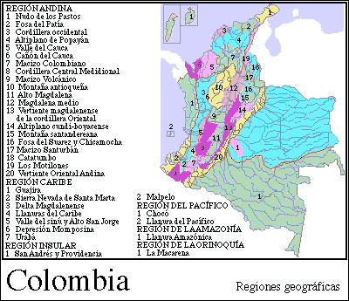
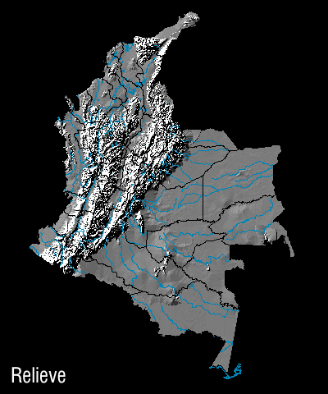
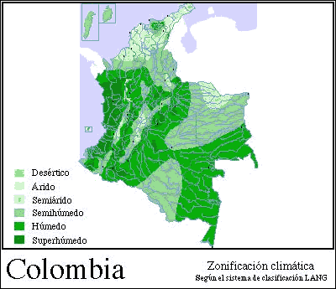

Slide 80
3. Spatial Data Infrastructure Concepts

Slide 81
UN-GGIM
AIMS AND OBJECTIVES
The United Nations initiative on Global Geospatial Information Management (UN-GGIM) aims at playing a leading role in setting the agenda for the development of global geospatial information and to promote its use to address key global challenges. It provides a forum to liaise and coordinate among Member States, and between Member States and international organizations.

Slide 82
UN GGIM
Doha, Qatar, in 2013:
"... National geospatial information infrastructure
in each country should be based on internationally recognized standards, which will integrate, manage and deliver geospatial information for timely, legitimate and authoritative decision-making and policy should be based on location, including disasters and humanitarian needs;

Slide 83

Former GMES – Global Monitoring of Environment and Security)

Slide 84
COPERNICUS
Global Monitoring for Environment and Security
(INSPIRE/ESDI)

Slide 85
The Copernicus Emergency Management Service supports actors dealing with natural disasters, man-made emergency situations, and humanitarian crises as well as those involved in preparedness and recovery activities.
The service improves people’s safety and helps to prevent loss of lives and/ or property by improving the effectiveness of preparedness, prevention, disaster risk reduction and resilience activities, in particular through the provision of early warning services for floods and fires.

Slide 86

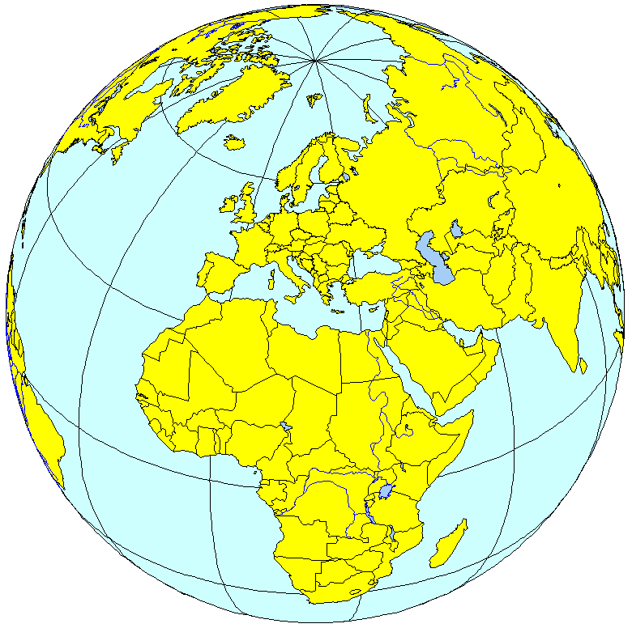
Overall GMES objectives
to provide information services to policy-makers and other users
Information
EARTH OBSERVING
SYSTEMS
(space, airborne, in-situ)
PUBLIC
POLICIES
(Environment & Security)
Needs
(policy driven)
Space Agencies
In-situ Observing systems
Scientific Community
EO Value Adding Industry
National Governments and Agencies
European Union Institutions
Inter-Governmental Organisations (IGOs)
Non Governmental Organisations (NGOs)
Virginia PUZZOLO, EC DG Enterprise-GMES Burreau, Prague Symposium, 2009
Notes:
86

Slide 87
The Copernicus programme supports the protection of the environment and the efforts of Civil Protection and civil security, and contributes to European participation in global initiatives.
Copernicus offers six different service lines:
Emergency Management, Atmosphere Monitoring, Marine Environment Monitoring, Land Monitoring, Climate Change, and services for Security applications.

Slide 88
The Copernicus Emergency Management Service (EMS) provides actors
with timely and accurate geo-spatial information derived from satellite-based remote sensing complemented by available in situ (non-space) or open source data.
As an EU service, the EMS’s first priority is responding to national or cross-border disasters in Europe and large-scale disasters outside of the EU.

Slide 89
The Copernicus Emergency Management Service (EMS) has two main components:
- Early Warning, EW component strengthens the preparedness of national and local authorities for floods and forest fires, and
- Mapping, as well as a dedicated component for the validation of the mapping products.

Slide 90
The EMS Mapping Service
is provided in two modules:
Rapid Mapping, for rapid service delivery during the response phase of crises, and
Risk & Recovery Mapping, which is designed for pre- or post-crisis situations in support of recovery, disaster risk reduction, prevention, and preparedness activities.

Slide 91
Overall architecture
Space Infrastructure
In Situ
Infrastructure
Security
Emergency
Atmosphere
Users
CORE
SERVICES
Marine
Land
Added Value Chain
Farming
ICZM
Air quality
DOWNSTREAM SERVICES
Notes:
91

Slide 92
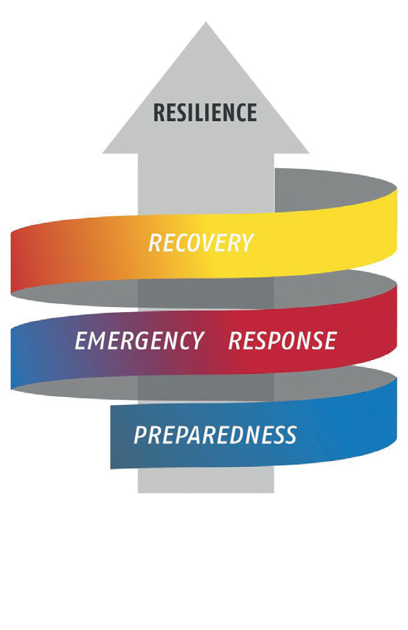
● On demand
● Standardised
● Hours-days
REFERENCE MAPS
DELINEATION MAPS
GRADING MAPS
VALIDATION
RISK AND RECOVERY MAPPING
● On demand
● Tailored to user needs
● Weeks-months
REFERENCE MAPS
PRE-DISASTER SITUATION MAPS
REFERENCE MAPS
POST-DISASTER SITUATION MAPS
VALIDATION
EARLY WARNING
● Floods: EFAS
● Forest Fires: EFFIS
CONTINOUS ALERTS

Slide 93
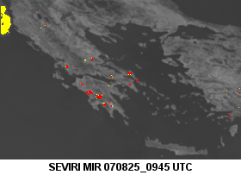
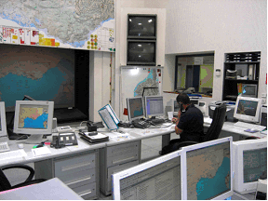
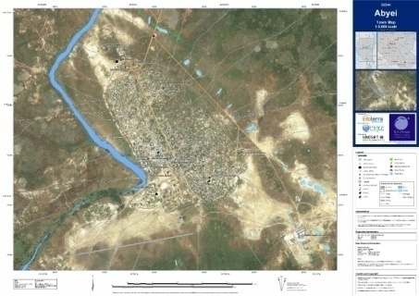
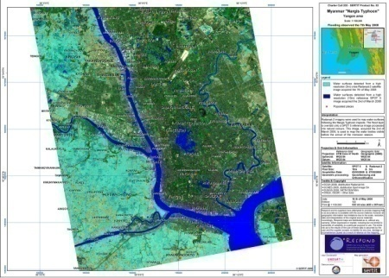
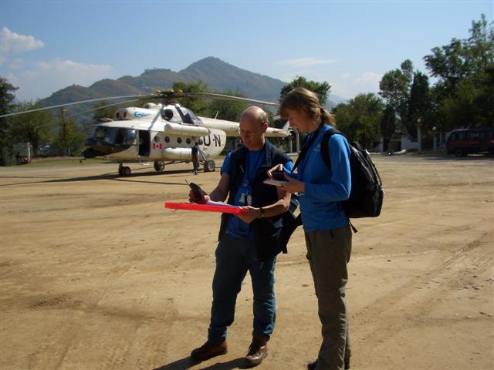
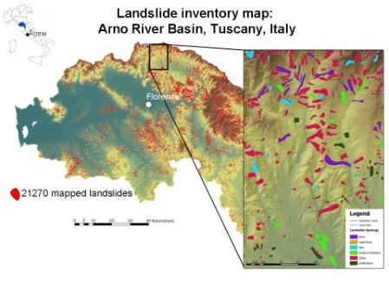
Four main types of products:
Early warning
Reference maps
For headquarters,
decision-makers
and in-field operatives
In Europe and worldwide
Assessment maps
Thematic maps
Notes:
93
93

Slide 94
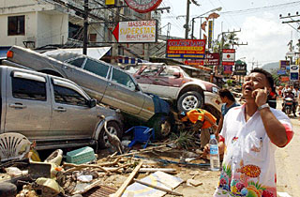
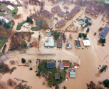
ERCS 1st priority
Rapid mapping on demand in case of humanitarian crises, natural disasters, and man-made emergency situations within & outside Europe
  Reference maps available within 6 hours over crisis area
  Damage assessment maps available within 24 hours & daily updated
  Situation maps and forecasts of evolution of situations within the few days-weeks after crisis
Notes:
94

Slide 95

INSPIRE
Infrastructure for Spatial Information in Europe

Slide 96
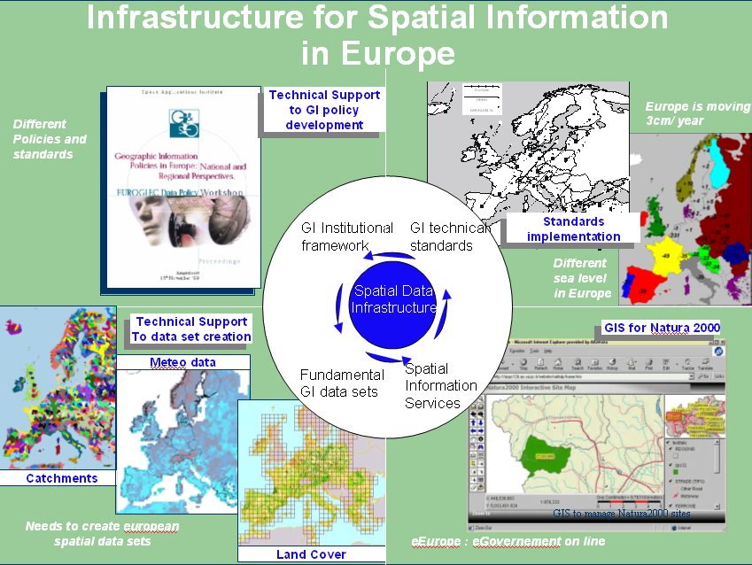

Slide 97
The INSPIRE concept:
Availability
Accessibility
Legislation rules.

Slide 98
Towards an Infrastructure for Spatial Information
From discovery
to Full Interoperability
Standardisation
Harmonisation
Integration
Metadata
Discovery Service
Data Policies
Licensing Framework
Coordinating structures
…
Geodetic Framework
Seamless data
Quality insurance
Certification
Updating
Data model
…
Catalog Services
View Service
Query Service
Object Access Service
Generalisation Services
Geo-Processing services
…

Slide 99
Current status
Architecture model
User applications
Clients
Access to transformed
data, pictures, maps, reports,
multi-media content
Service chaining:
search, display, access, e-commerce,
….
Metadata search and retrieval for
data and services
Middleware
Geo-processing
and catalog Services
Direct
data
access
Catalogs
Metadata update
Other data
e.g., administrative,
statistical, env. reporting
Content
Repositories
Servers
Coverages
Features
Distributed Geographic reference data
After the Digital Earth Reference Model

Slide 100
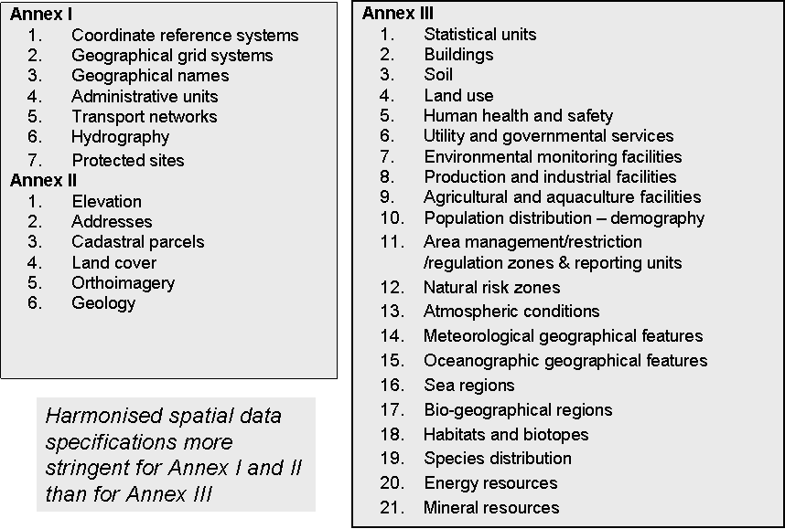

Slide 101
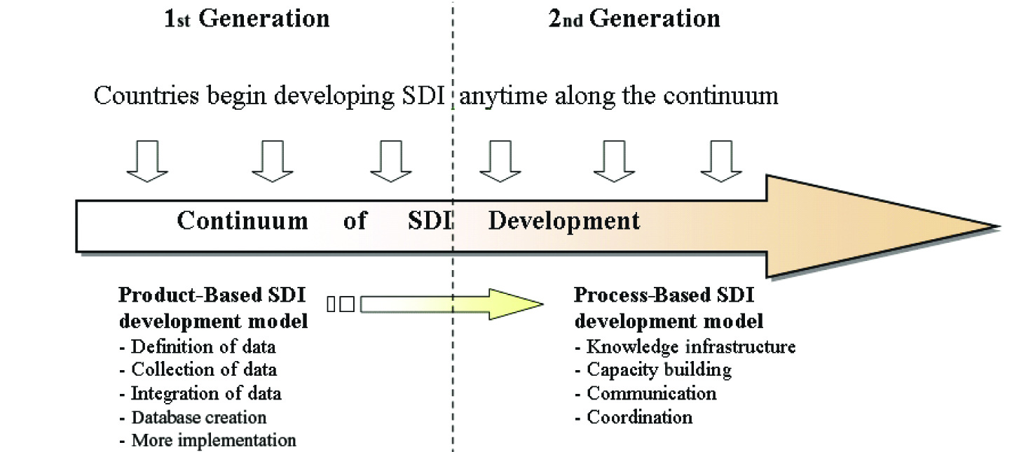
Relationship between the first and second generations of SDIs.
(by Williamson Rajabifard, Binns, 2007, reprinted from Rajabifard at al.2006 with permission of the International Journal of GIS)

Slide 102
DIGITAL EARTH

Slide 103








Understanding Digital Earth
  Cloud
  El Nino
Sea water temperature
Vegetation
Earth Surface
  Earthquake
Volcano
Plate Boundary
(http://www.nasm.si.edu/EarthToday)

Slide 104

Understanding Digital Earth
Enabling Citizens
Tools &
Applications
Enabling Citizens
Tools &
and Communities
Technology
and Communities
Technology
Private
Public
Interoperability
Interoperability
EARTH
EARTH
Digital Resources
Digital Resources
Collecting Data
Collecting Data
(White paper by NASA Digital Earth office, 2000)

Slide 105
Spatially-Enabled Society
Rajabifard, Williamson, …..

Slide 106
Australian Government, Ministerial Online and Communications Council
8 September, 2006
“…spatially-enabled government is an exciting area for government. Spatially-enabled government uses place or location to manage and integrate government services and enhance business opportunities.”
The Hon Gary Nairn MP, Special Minister for State, Australian Government

Slide 107
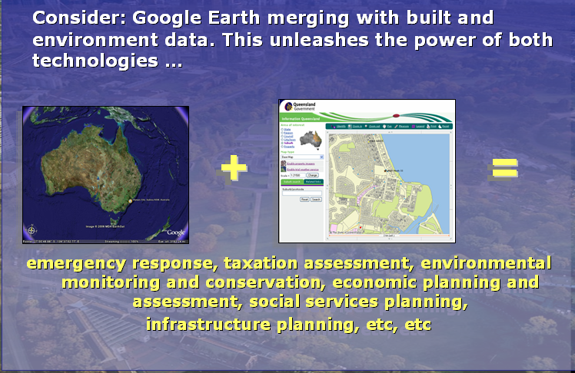
The answer: Provide the systems and people use them!!!

Slide 108
Three visions to support spatially enabled government as part of e-government
A land management vision: incorporating spatially enabled land administration
A spatial data infrastructure (SDI) vision: SDI as an enabling platform
A vision for a spatially enabled society

Slide 109
Governments are spatially enabled when -
Location is used to organise their information
and
Location and spatial information are common goods available to citizens and businesses to encourage creativity and product development.

Slide 110
Challenges and Issues for spatially enabled society
SDI to facilitate spatially enabled government as part of an e-government strategy
SDI to facilitate integration of natural and built environment datasets
Development of SDI vision, mission and road map – where are we heading?
Role of government, private and academic sectors
Capacity building

Slide 111
Conclusion
SDI is a new and evolving concept
SDI development is multi-disciplinary with policy, legal, institutional and technical dimensions
SDI will be a virtual environment supported by an enabling platform - spatially enabling society and government within an e-government environment
Innovations in use of information will involve private and government sectors.
Research is central to SDI development

Slide 112
5. What is it Geo Info Strategy and
why we need it?

Slide 113

Czech eGovernment
PA Basic Registers
smart public administration
  better laws
  functional authorities
  professional public servants
  effective information technologies
„the document has to circulate instead of the citizen“
four measures
  Czech Point
  Public Administration Communication Infrastructure
  eGovernment Act (2008)
  Public Administration Basic Registers (2012)
eGov Act
CzechPoint
PA Communication Infrastructure

Slide 114

PA Basic Registers System
Act No. 111/2009 Coll., on basic registers
4 basic registers of public administration
  Register of Inhabitants (MoI)
  Register of Corporations (Czech Statistical Office)
  Register of Rights and Obligations (MoI)
  Register of Territorial Identification, Addresses
  and Real Estates (Czech Office for Surveying, Mapping
  and Cadastre)
Basic Registers Information System (MoI)
ORG (The Office for Personal Data Protection)
fully operational in July 2012

Slide 115
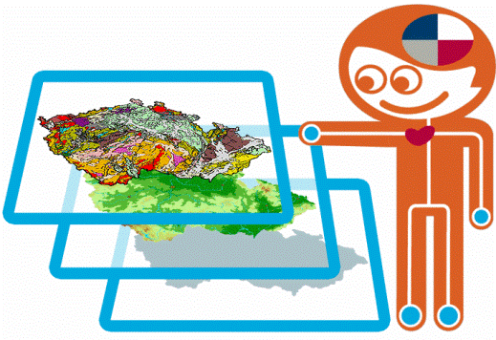
RUIAN
Basic Register of Territorial Identification, Addresses and Real Estates (RUIAN)
content of RUIAN
  administration units (country, regions, …cadastral units, parcels, buildings)
  entities of land administration (municipality districts, streets, …)
  addresses
  location data (centroids of parcels, buildings, …)
  other data (building features, …)
no personal data
the crucial pillar of the Czech NSDI
administrated by Czech Office for Surveying, Mapping
and Cadaster (COSMC)
edited by Municipal and Building Authorities, Czech Statistical Office (CSO) and Local Cadastral Authorities

Slide 116
GeoInfoStrategy
Czech Government
  approved the proposal of working out of the „Strategy of spatial information infrastructure development in the Czech Republic up to 2020“ (GeoInfoStrategy) by Resolution No. 837 on the 14th November 2012
  ordered to submit the GeoInfoStrategy draft for approval to the end of February 2014
  ordered to cooperate to all central state administration bodies
  recommend to cooperate to regions and cities

Slide 117
GeoInfoStrategy Main Goals
to set up effective coordination and integration of public bodies and commercial sector activities in the field of spatial data
to help to set up conditions for
  major improvement of eGovernment services regarding spatial data
  reduction of costs of public administration
  enhancing of the overall competitiveness of the Czech economy

Slide 118
6. Selected Potentials of Cartography and Geoinformatics

Slide 119
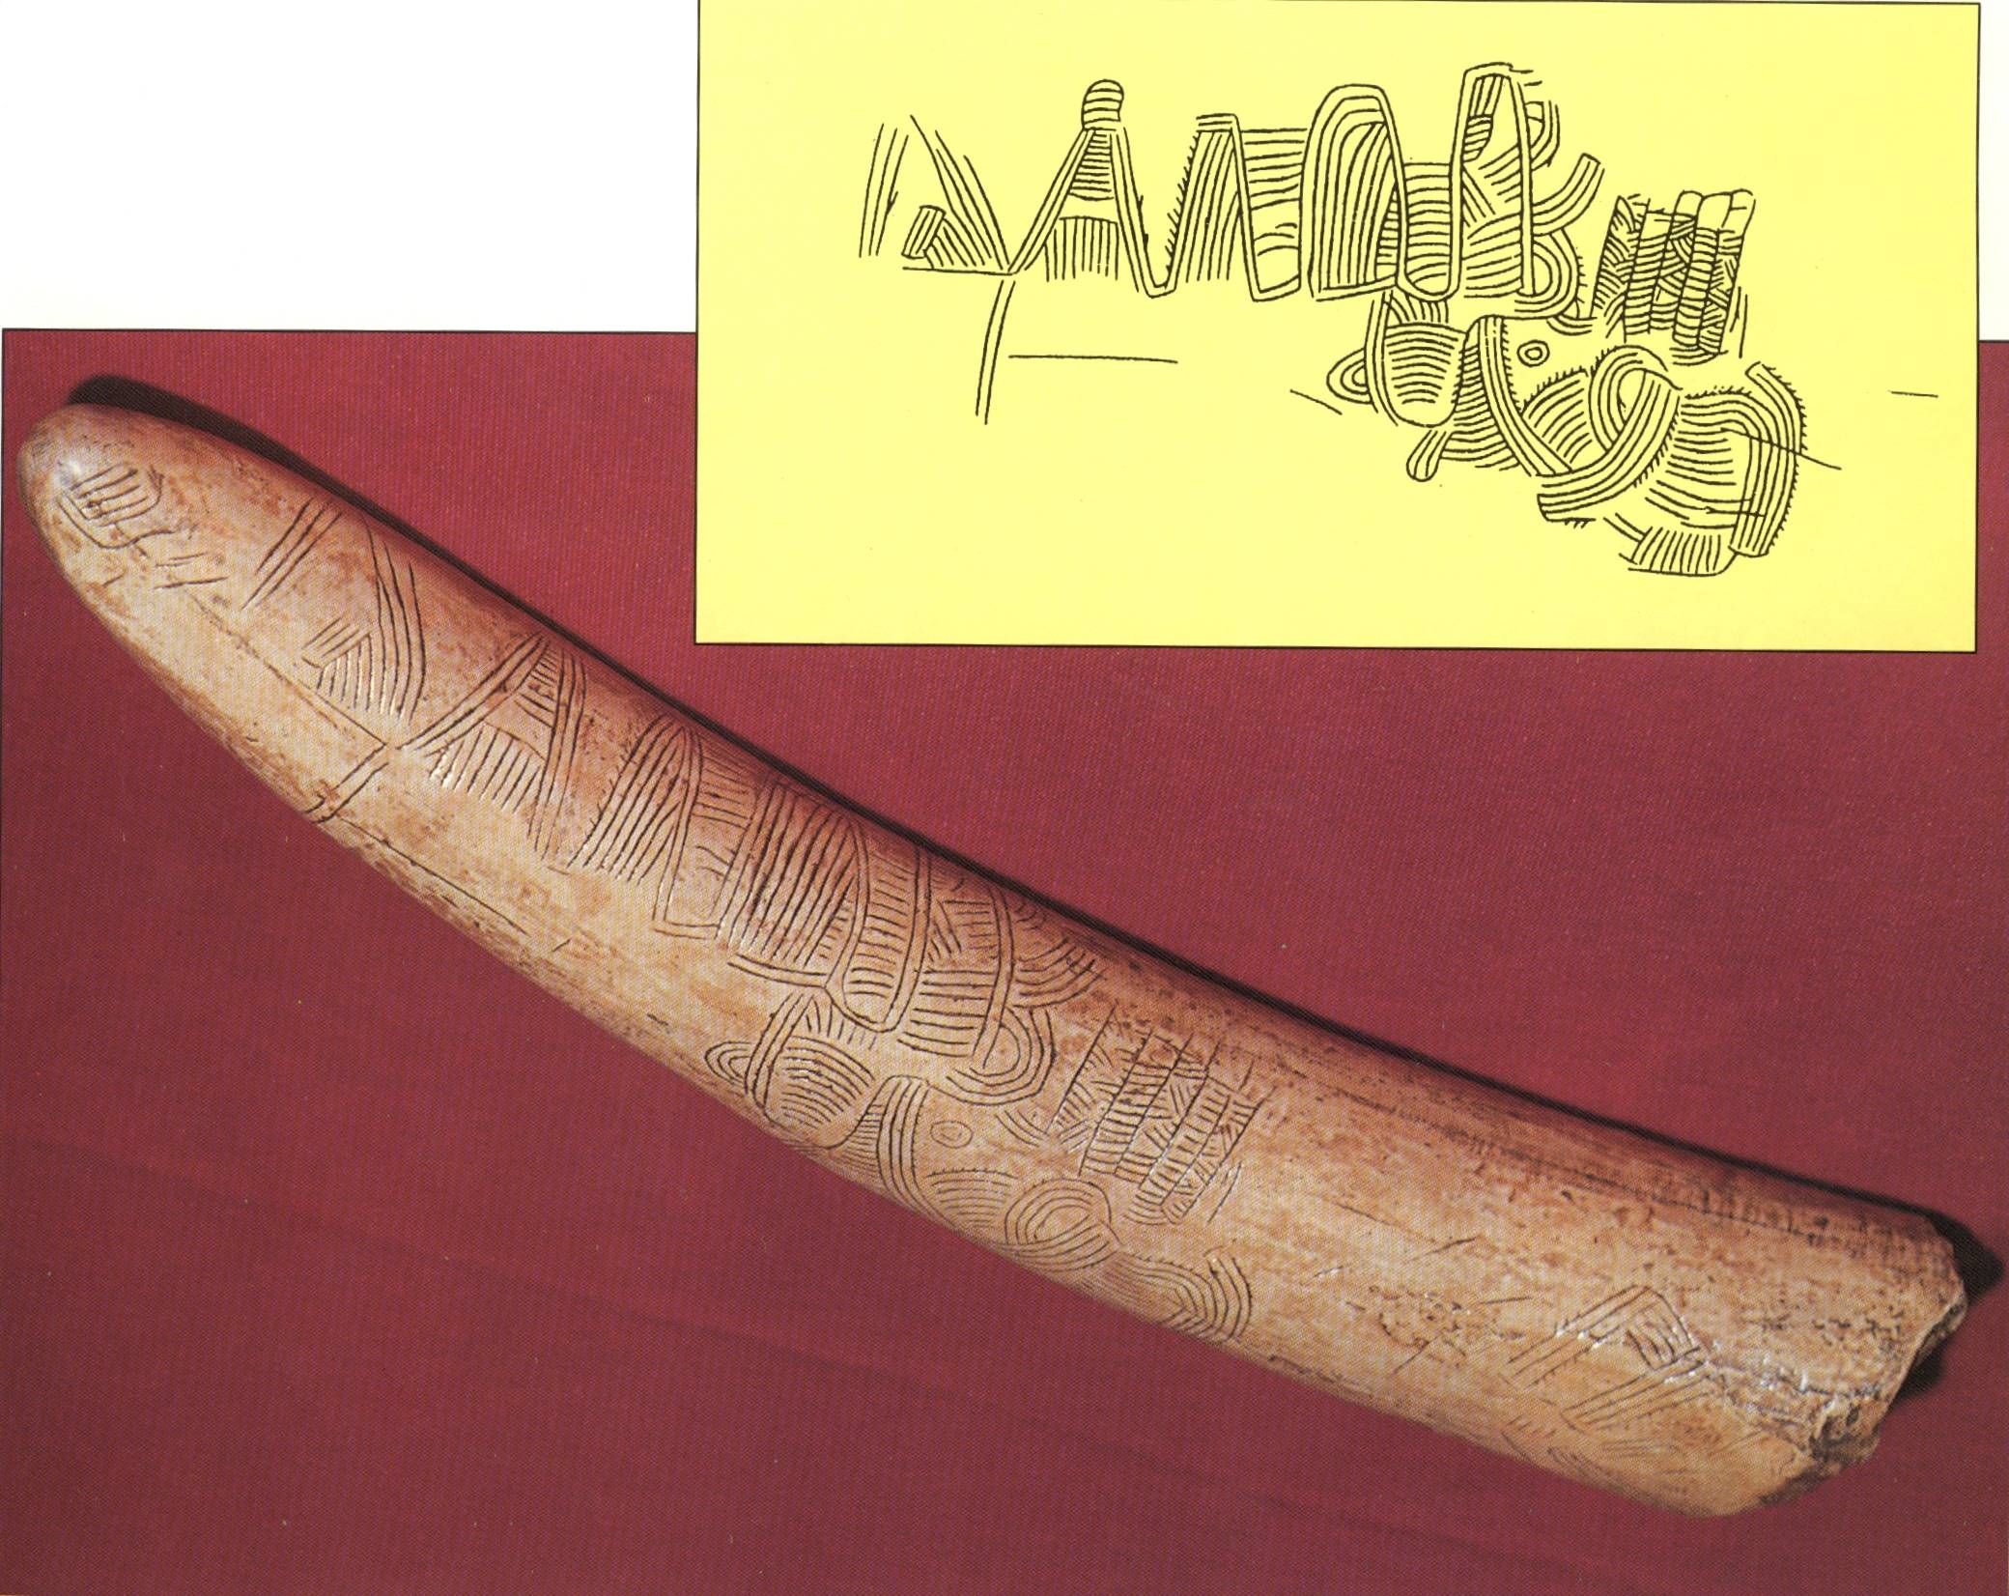
Prehistoric Map, Pavlov Hills, South Moravia, 24 000 B.C.

Slide 120
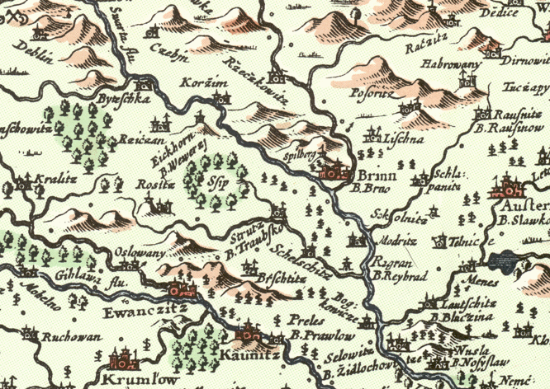

Slide 121
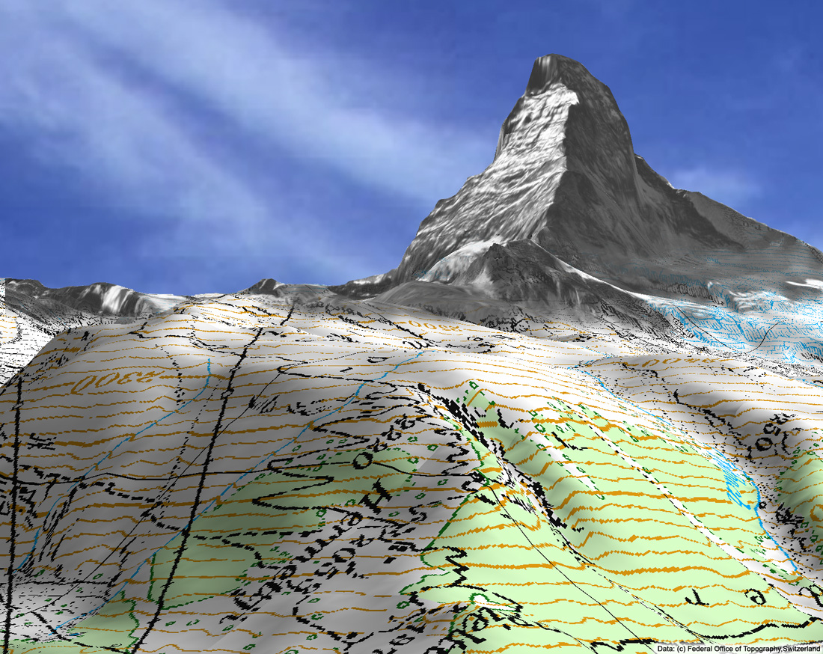

Slide 122
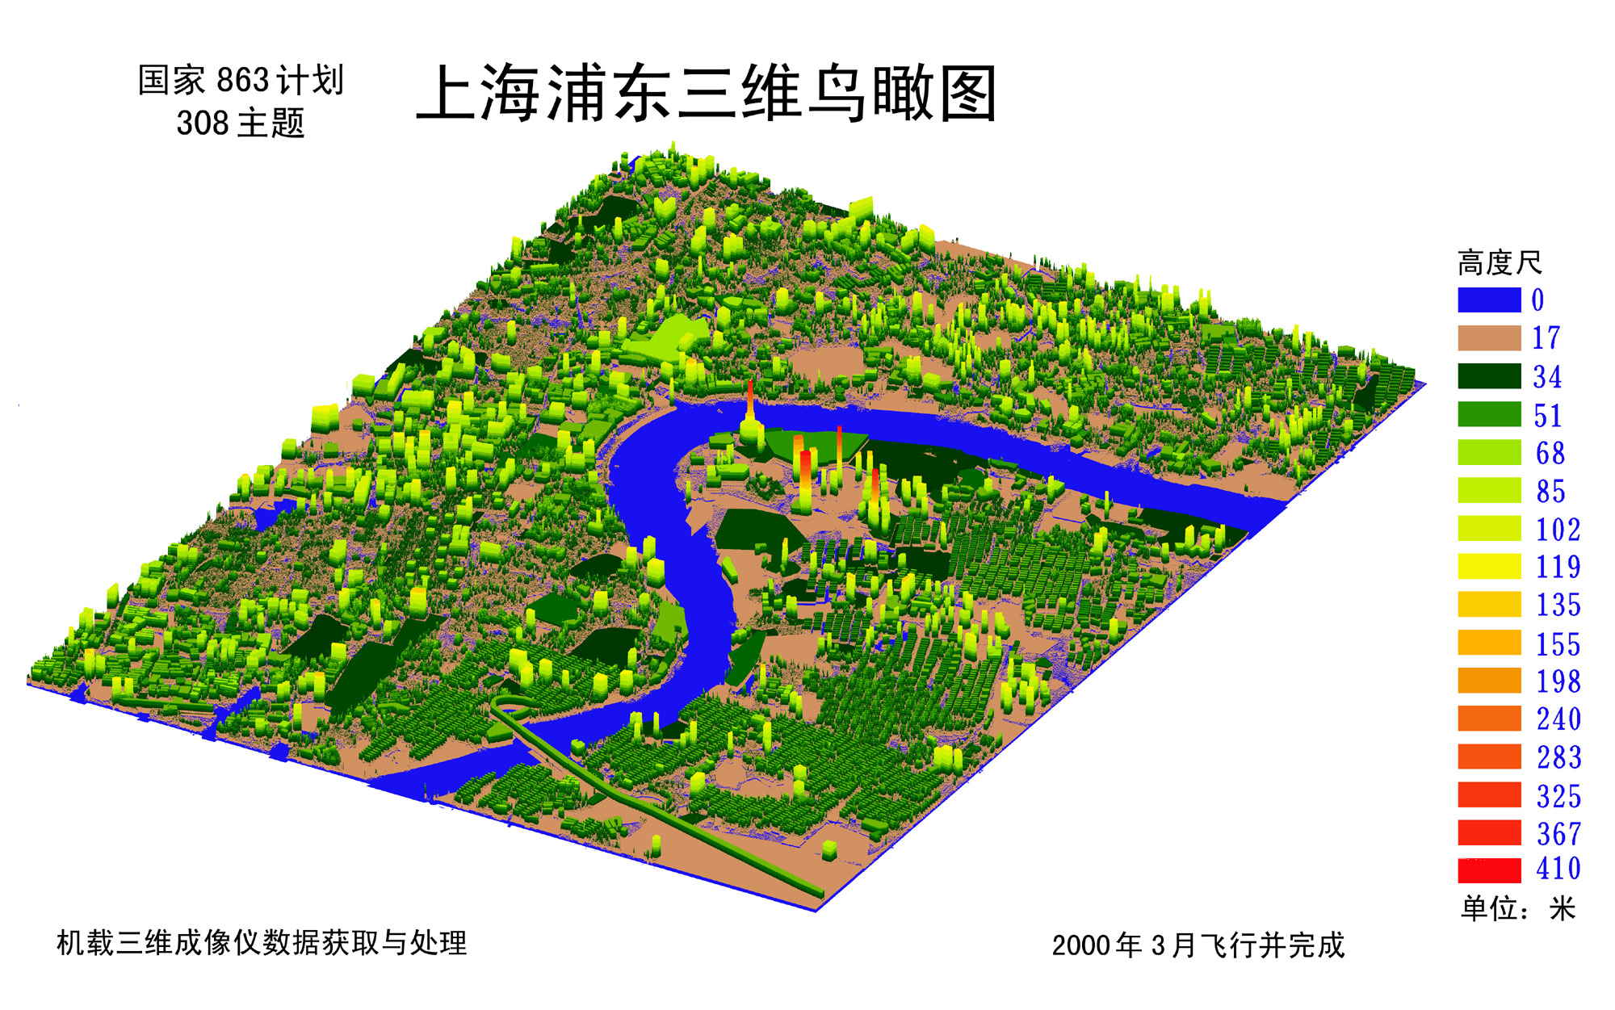
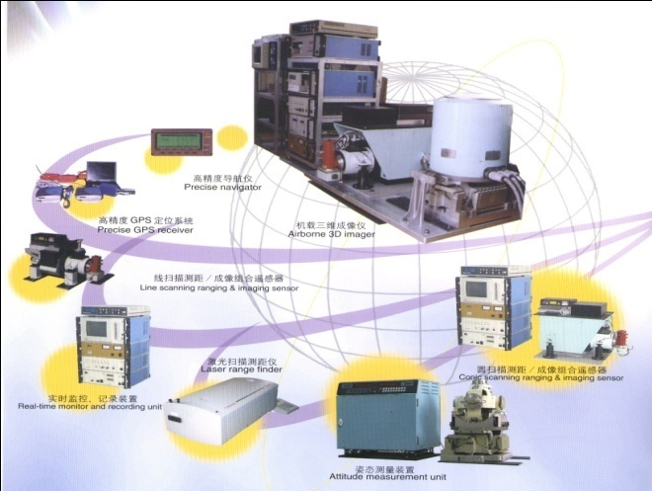
3-D Image of Pudong Area, Shanghai
Height
Unit: m
Elevation Map of Buildings Produced from 3-D Imager

Slide 123
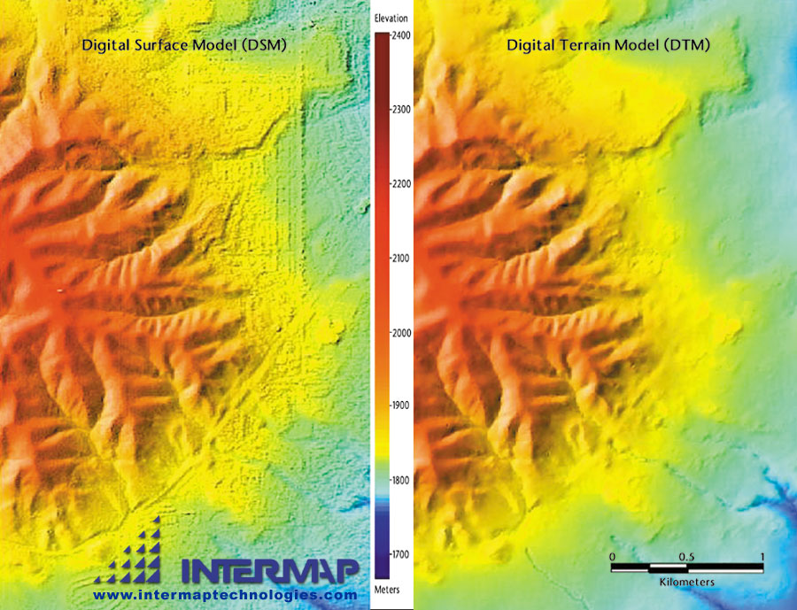

Slide 124
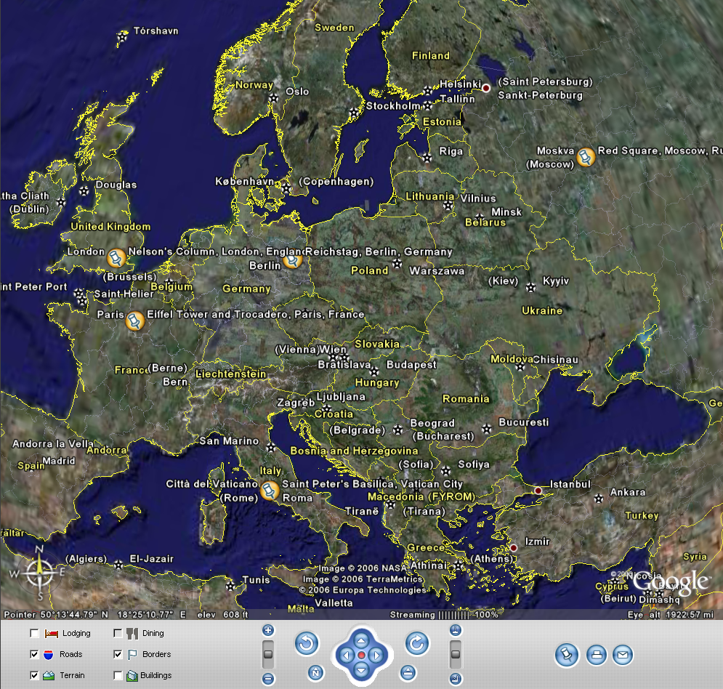
Easy navigation

Slide 125
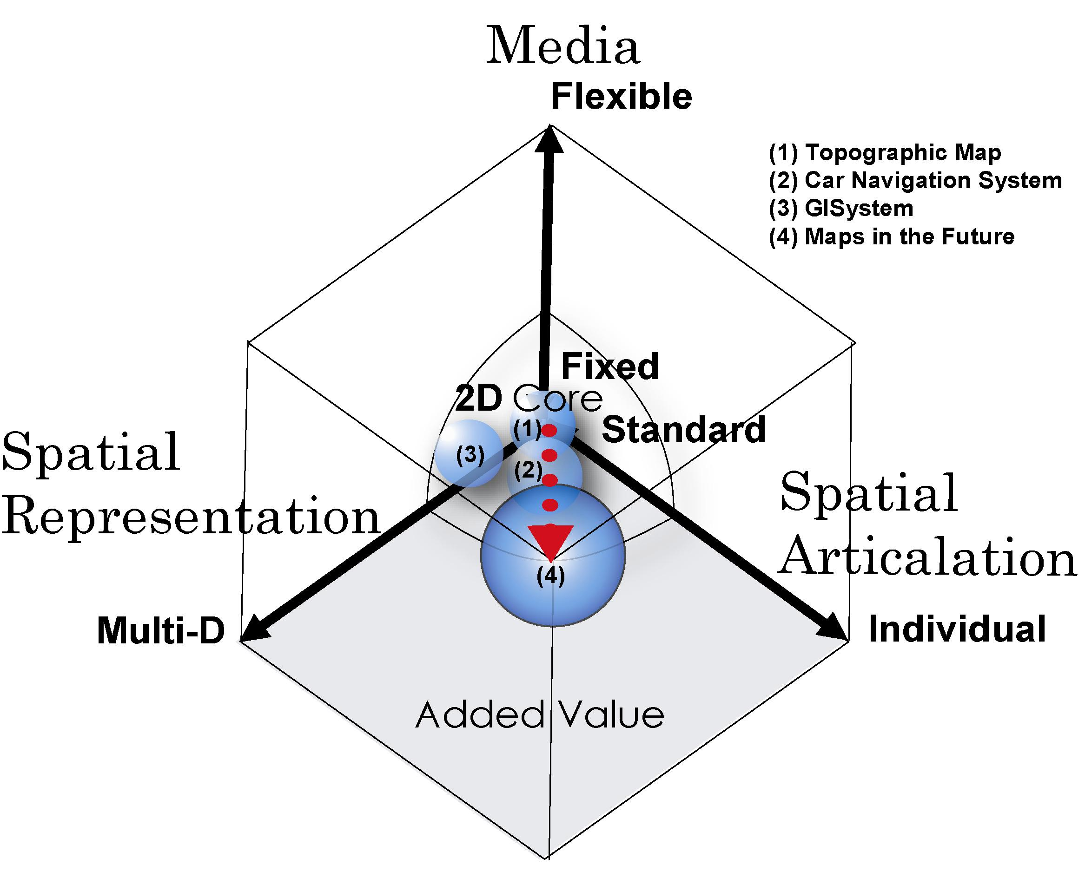

Slide 126
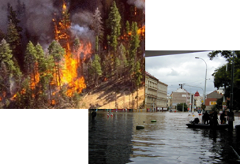
Disaster Management Cycle
Preparedness
Scenarios development
Emergency Planning
Training
Disasters
Prevention and Mitigation
Hazard prediction and modeling
Risk assessment and mapping
Spatial Planning
Structural & non structural measures
Public Awareness & Education..
Alert
Real time monitoring
& forecasting
Early warning
Secure &dependable telecom
Scenario identification
all media alarm
Post Disaster
Lessons learnt
Scenario update
Socio-economic and environmental impact assessment
Spatial (re)planning
Response
Dispatching of resources
Emergency telecom
Situational awareness
Command control coordination
Information dissemination
Emergency healthcare
Recovery
Early damage assessment
Re-establishing life-lines transport &communication infrastructure

Slide 127
Disaster risk reduction projects
MONITORING SYSTEMS
INFORMATION SYSTEMS
SANY
In-situ monitoring
Stream
Humanitarian
ORCHESTRA
Architecture ontologies
EU-FIRE
Acoustic sensor
INTAMAP
Automated mapping
WINSOC
advanced sensors
Warmer
Water monitoring
InterRisk
Marine risks
WIN
Information services
Dyvine
Visual sensors
SCIER
Sensor fusion
OSIRIS
crisis monitoring
OASIS
Operations, C3
STARRS
Search& rescue
Command Control
Coordination
DEWS
Tsunami
ERMA
Alert
MITRA
transport
Euritrack
Illicit trafficking
U2010
PSC& IPv6
CHORIST
emergency communications
WISECOM
satcom
PUBLIC SAFETY TELECOM
EUROPCOM
UWB

Slide 128
Video Katrina tayfoon

Slide 129
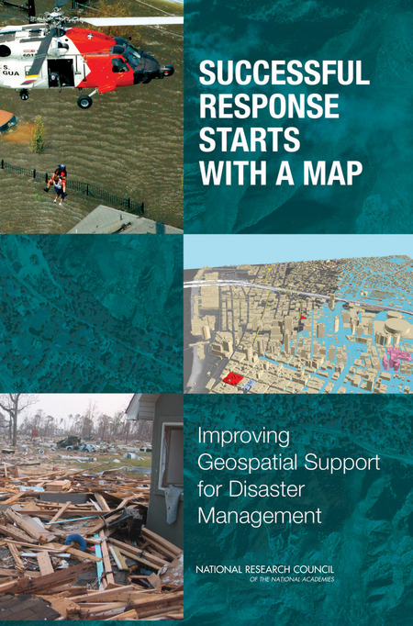
Successful Response Starts with a Map: Improving Geospatial Support for Disaster Management, NRC (2007)

Slide 130
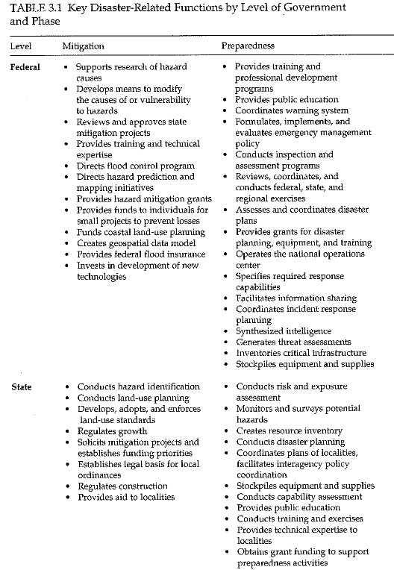
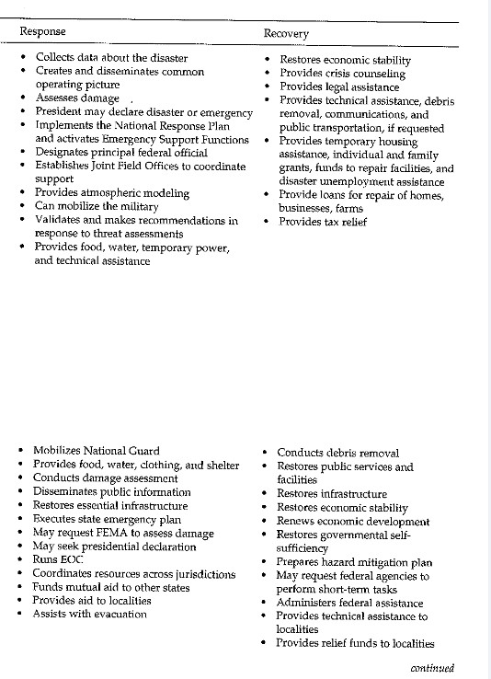
Fig.3.1 Key Disaster-Related Functions by Level of Government and Phase-A

Slide 131
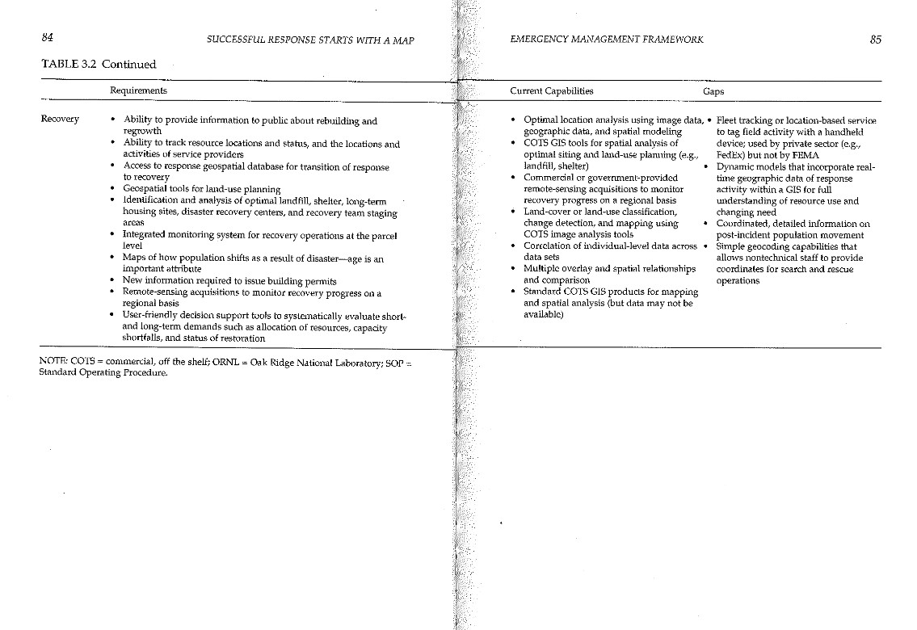

Slide 132
7. Potentials of cartography: context and adaptive cartography

Slide 133
The subject-matter of adaptive cartography is automatic creation of correct geodata visualization with regard to situation, purpose and the user.
Adaptive maps are still maps in the conventional sense – they are correct and well-readable medium for transfer of spatial information. The user controls map modifications indirectly via modification of context.

Slide 134
Traditional vs. adaptive map
Traditional map
  Static
  Universal
  As much information as possible (level of legibility)
  Demand on high level of user knowledge
Adaptive map
  As little information as needed for interpretation
  No redundancy of information
  Individual

Slide 135
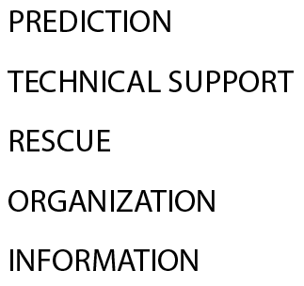
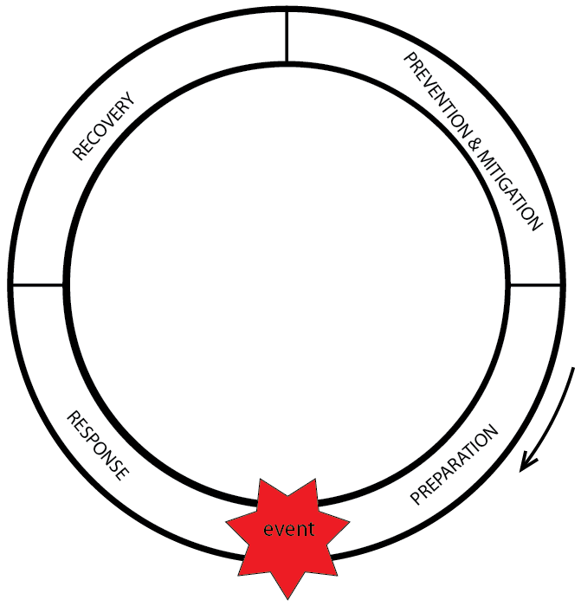



EMERGENCY CONTEXT
EVENT
TASK
STAGE
FLOOD
CAR ACCIDENT
FOREST FIRE
WHAT
WHEN
OPERATION RANGE
REGION-DISTRICT-MUNICIPALITY-LOCAL
WHERE

Slide 136

Adaptabile Geovizualization
Figure: Examples of changes in visualization according to change of context (Friedmanová, Konečný and Staněk 2006)

Slide 137
Cartography and Geoinformatcs tasks:
Big Data and Map Scale: 3D cyber models; 1:1 scales?
Big Data and Map Dimensionality: 2D, 3D, 4D,….?
Guerley, 2013: „the map is a multi-dimensional rendering of any type of information, representing the relationships of objects (by statistical methods for “small” data. Now Big Data, but statistics are still missing.

Slide 138

BD and
Map Scale
(Bandrova, Konecny, Yotova, 2014)

Slide 139
BD Generalization: The modern GIS - automatic generalization in special cartographic cases.
In the case of Big Data it will be big challenge for all GI specialists.
We cannot leave generalizations principles we just have to create new ones in new environment and new situations.

Slide 140
Cartography cannot deal with all kinds of data of the BD environment and cannot provide all the solutions of BD processing and management.
Cartography can handle only a part of the data and extract valuable information from it.
- Data must be spatially distributed: The power of cartography is in its capacity of describing quality and quantity characteristics of objects, their positioning and relations.

Slide 141
- Data must be classified. The majority of BD is semi- or non-classified. To map the data, we need clear classification first.
- Data must have quality and / or quantity characteristics. Cartography visualizes objects’ and phenomena’s characteristics and provides to readers their distribution. Modern cartography capabilities like multidimensional representation and animation allow us to represent much more data characteristics than before.
- Data of interest must be generalized. Many data in semi- or non- classified format can represent an interest for cartography.

Slide 142
PERSPECTIVES
To look from the BD perspective we see that cartography will continue its development in some kind of equilibrium between sciences, technology and art.
This equilibrium is more valid than before, because combination of new scientific approaches based on ICT in cartography provides many possibilities for map creation and inclusion of art not only make maps attractive but also enables new and imaginative forms in which maps could be shown and naturally understood.

Slide 143
In the era of BD, it is very important for cartography to take advantage of the development of the ICT.
The distance between cartographers and the world's leading information providers like Google, Open Streat Maps, Facebook and Twitter have to be reduced through clear involvement of cartography roles and rules in solution delivery.
As experts, we are happy of the new possibilities presented by ICT, but still we cannot hide the fact that much chaotically transmitted information is not correct and can lead to misinterpretation by the users.

Slide 144
Video
Prezentace Red Cross and Red Crescent
Nepal

Slide 145
7. Integrated Research on Disaster Risk (IRDR) is a decade-long research programme
Guided by ICSU’s Science Plan for Integrated Research on Disaster Risk, IRDR
“envisages an integrated approach to natural and human-induced environmental hazards through a combination of natural, socio-economic, health and engineering sciences, including
socio-economic analysis, understanding the role of communications, and public and political
responses to reduce the risk.”

Slide 146
SCIENTISTS AND DECISION MAKERS
Our knowledge and understanding of natural hazards has grown dramatically.
Scientists can more accurately characterise the possible magnitude of hazard events and better estimate the probability of their occurrence at specific magnitudes. Forecasting capacity has also dramatically improved, especially for weather-related events.
Far more is now known about the social dimensions of disasters, for instance human exposure and vulnerability (and lack of resistance and resilience) to natural hazards and places where poverty and multiple stresses shape the character and distribution of losses.

Slide 147
IRDR SCIENCE PLAN
…has observed that there is a shortfall in current research on how science is used to shape social and political decision-making in the context of hazards and disasters. It noted
that addressing this problem would require an approach that would integrate expertise in research and policy-making
across all hazards, disciplines, geographic regions and political institutional frameworks.

Slide 148
ICSU, ISSC, UNISDR and Co-Sponsors
IRDR Programme
… a global, trans-disciplinary research programme to address the major challenges of natural and human-induced environmental hazards.
The complexity of the task is such that it requires the full integration of research expertise from the natural, socio-economic, health and engineering sciences,
encompassing also areas of inquiry and practice such as policy-making, the role of communications, and public and political perceptions of and responses to risk.

Slide 149
The IRDR program is guided by three research objectives:
1. Characterising hazards, vulnerability and risk.
2. Understanding decision-making in complex and changing risk contexts.
3. Reducing risk and curbing losses through knowledge-based actions.

Slide 150
Three cross-cutting themes support IRDR’s work towards these objectives:
1. Capacity building, including mapping capacity for disaster reduction and building self-sustaining
capacity at various levels and for different hazards.
2. Development and compilation of case studies and demonstration projects.
3. Assessment, data management, and monitoring of hazards, risks and disasters.

Slide 151
The IRDR Strategic Goals,
2013-2017
The Strategic Plan has expressed the ambitions of the programmes in six strategic goals.
Goal 1: Promoting integrated research.
Goal 2: Characterizing hazards, vulnerability and risk.
Goal 3: Understanding decision-making.
Goal 4: Reducing risk and curbing losses.
Goal 5: Networking and partnership-building.
Goal 6: Supporting the science and policy dialogue.

Slide 152
GOAL 2
….. Address the gaps in knowledge, methodologies and types of information that prevent the effective application of science to avert disasters and reduce risk.
Disaster Loss Data (DATA)
DATA aims to establish an overall framework for disaster loss data for all providers, to establish
nodes and networks for databases, and to conduct sensitivity testing among databases to ensure
some level of comparability.

Slide 153
GOAL 2
Extension 1
Example-1:
Hazards and Vulnerability Research Institute (HVRI), University of South Carolina, USA, meeting:
to modified IRDR peril classification schema to serve multiple types of databases—global, national and sub-national—in order to make loss information more comparable despite different goals and objectives of individual databases. The working group will test the classification system on each of
its members’ databases.

Slide 154
GOAL 2
Extension2
Example – 2:
the Asian Disaster Reduction Center (ADRC) in Japan to
continue work on the GLobal IDEntifier Number (GLIDE) system, an identification system that enables linking events that have multiple impact areas;
and concurred with the new definitions proposed in a joint Centre for Research on the Epidemiology of Disasters (CRED) and United Nations Development Programme (UNDP) draft Human Impact Indicators document.

Slide 155
GOAL 3
Understanding decision-making
…. in the context of risk management – what it is and how it can be improved; identify relevant decision-making systems and their interactions; understand decision-making in the context of environmental hazards and help improve the quality of decision-making practices.
Risk Interpretation and Action (RIA): main objective is to build a community of practice on risk perception, communication and decision-making that focuses on the question of how people make decisions in the face of risk.

Slide 156
GOAL 4
Reducing risk and curbing losses
Develop a methodology for implementing comprehensive, long-term
vulnerability assessments and effective approaches to risk reduction, by also bringing together insights gained under Goals 2 and 3.
Forensic Investigations of Disasters (FORIN):
has produced a template that aims to guide the discovery of root
causes of disasters through in-depth investigations that go beyond the typical reports and case studies conducted after disaster events.

Slide 157
Connecting Science, Policy and Practice – Goal 5 and Goal 6
GOAL 5:
Networking and partnership-building
Develop, strengthen and collaborate within the IRDR network at global, regional and national levels
GOAL 6:
Supporting the science and policy dialogue
Enhance the utilisation of research findings.

Slide 158
And BIG DATA?
Loss of data versus BIG DATA
Need of understandable data versus non-understandable
Structured DB versus Non-Structured DB:
Volunteer Geographic Information, inclusion of inhabitants
New kinds of Data Presentations and Visualisations
New promising applications in other fields: Mr. Steve Jobs, Apple,
Crime Mapping, USA

Slide 159
How to manage volunteer geographic information? Chaos or help?

Slide 160
Volunteer geographic information VGI:
“The terms, “crowdsourcing” and “collective intelligence” draw attention to the notion that the collective contribution of a number of individuals may be more reliable than those of any one individual.
The term VGI refers specifically to geographic information and to the contrast between the actions of amateurs and those of authoritative agencies.” Goodchild (2009, p. 18)

Slide 161
The term asserted that geographic information draws attention to the fact that such information is not subject to the normal checks and quality control mechanisms of those agencies,
while neo-geography emphasizes the contrast between the grass-roots phenomenon and the current state of the academic discipline of geography.

Slide 162


Publications
Editing of specialized double issues for EW and CM in International Journal on Digital Earth
Result:
Growth of IF from 0.853 to 1.222

Slide 163

Geoinformation Support for Flood Management in China and the Czech Republic
Result of Research Bilateral Project Czech republic – China.
Targeted for selected aspects of geoinformation support of floods management.

Slide 164

Geographic Information and Cartography for Risk and Crisis Management
From publishing on March 25 2010, Geographic Information and Cartography for Risk and Crisis Management have been 3161 requests for chapter uploading. Statistics of last two years:
Yea Amount of uploadings
2011 1261
2010 1900

Slide 165


Publications
The best papers will be proposed for publication in a Book titled:
Thematic Cartography for Society
Publisher: Springer
Book topics:
User-friendly Internet Cartography
User-oriented Map Design and Production
Context-oriented Cartographic Visualization
Map interfaces for Volunteered Geographic Information
Sensing Technologies and their integration with Maps
Cartography in Education
On-line publication
CD Publication, ISSN
Abstract/ paper submission Deadline:
10. January 2014

Slide 166


Slide 167


Slide 168
Xie, Xie!!!!!
Bardzo Dziekuje
Chvala
THANK YOU
Muchas Gracias
Terima KasimO Brigada
Kammsa Hamida
Aligator
SHUKRAN
BLAGODARJA
DĚKUJI ( in Czech)

Slide 169


6th International Conference on
Cartography and GIS
17-21 June 2016, Albena, Black Sea, BULGARIA
SEMINAR WITH EU COOPERATION
ON EARLY WARNING AND DISASTER / CRISES MANAGEMENT
Under the auspices of the Czech ambassador to Bulgaria
www.cartography-gis.com

Slide 170
2016 Digital Earth Workshop, April 20-22, Novosibirsk, Russian Federation,
International Society Digital Earth
and
Workshop EW and CM in Big data Era

Slide 171
Joint conference of
ICA Commission Cartography on Early Warning and Crises Manmagement
and
ICA Commission on Maps and the Internet
October 2016, NANJING, China

