Slide 1
BIOMARKERS AND TOXICITY MECHANISMS
05 – Mechanisms - DNA
Luděk Bláha, PřF MU, RECETOX
www.recetox.cz

Slide 2
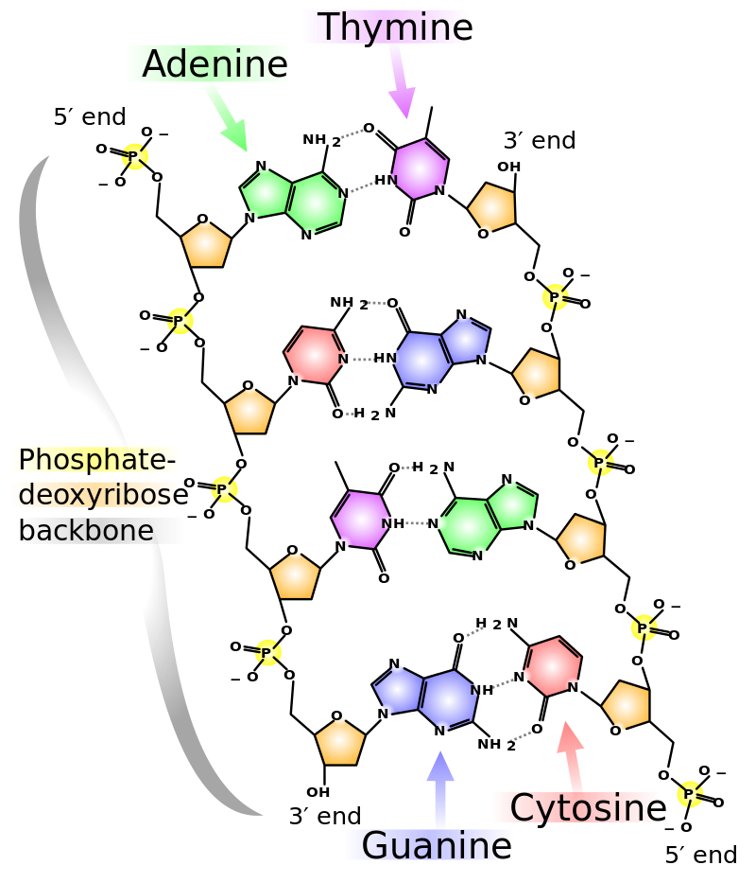
DNA
principal molecule for life
structure and function carefully checked
changes rapidly repaired
irreversible changes → cell death
(physiologically by apoptosis)
Mutagenesis → MUTATIONS
→ variability and evolution
or → damage to DNA
(structure or coding)
… naturally
billions of nucleotides/day
→ most are repaired
… stress-induced → toxicity

Slide 3
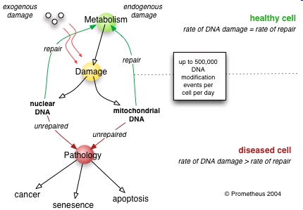
DNA damage and its effects
Cellular changes → Health and evolutionary consequences

Slide 4
DNA repair
Damage of DNA is carefully controlled
constitutively expressed repair systems
Sudden changes in DNA
→ induction of additional repair enzymes
(e.g."SOS-repair“ in bacteria - biomarker of DNA damage)

Slide 5
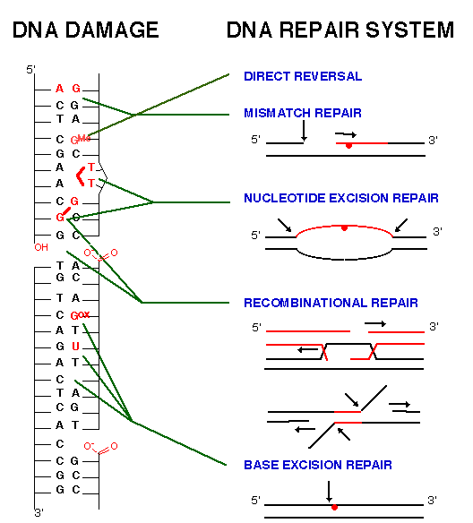
Various types of
molecular changes
in DNA ...
and corresponding
repair systems
Note!
Not all nucleotides
are affected in the
same rate
(mutations occur only at
specific sites due
to physicochemical properties)
Most common patterns:
G - the most frequent target
(highly nucleophilic character)
T=T at the same strand
G=G crosslinks

Slide 6
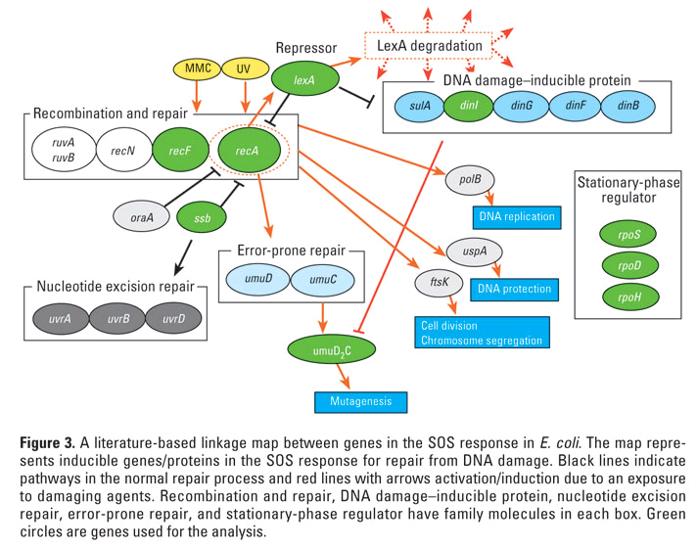
Complex system of SOS repair proteins induced in E. coli
by DNA damage

Slide 7
TYPES of mutations
POINT mutationts
Base exchanges
Deletions / Insertions
→ Impacts of point mutations
(a) silent, (b) missense, (c) nonsense, (d) frameshift
CHROMOSOMAL mutations
→ large scale impact

Slide 8
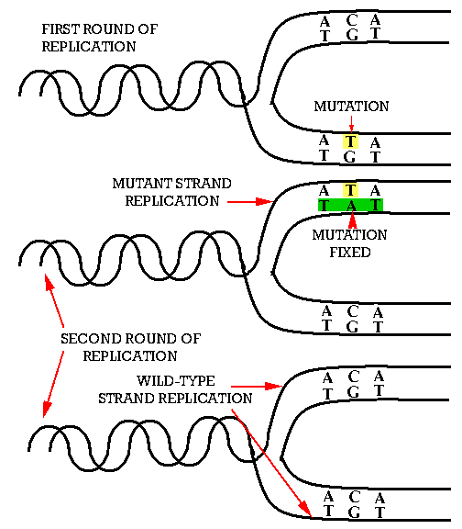
BASE – EXCHANGE
→ Mutation
fixed in
50% of cells
after the first
replication

Slide 9
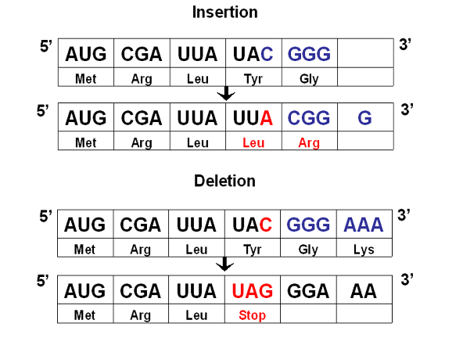
INSERTION
DELETION → reading frame shifts

Slide 10
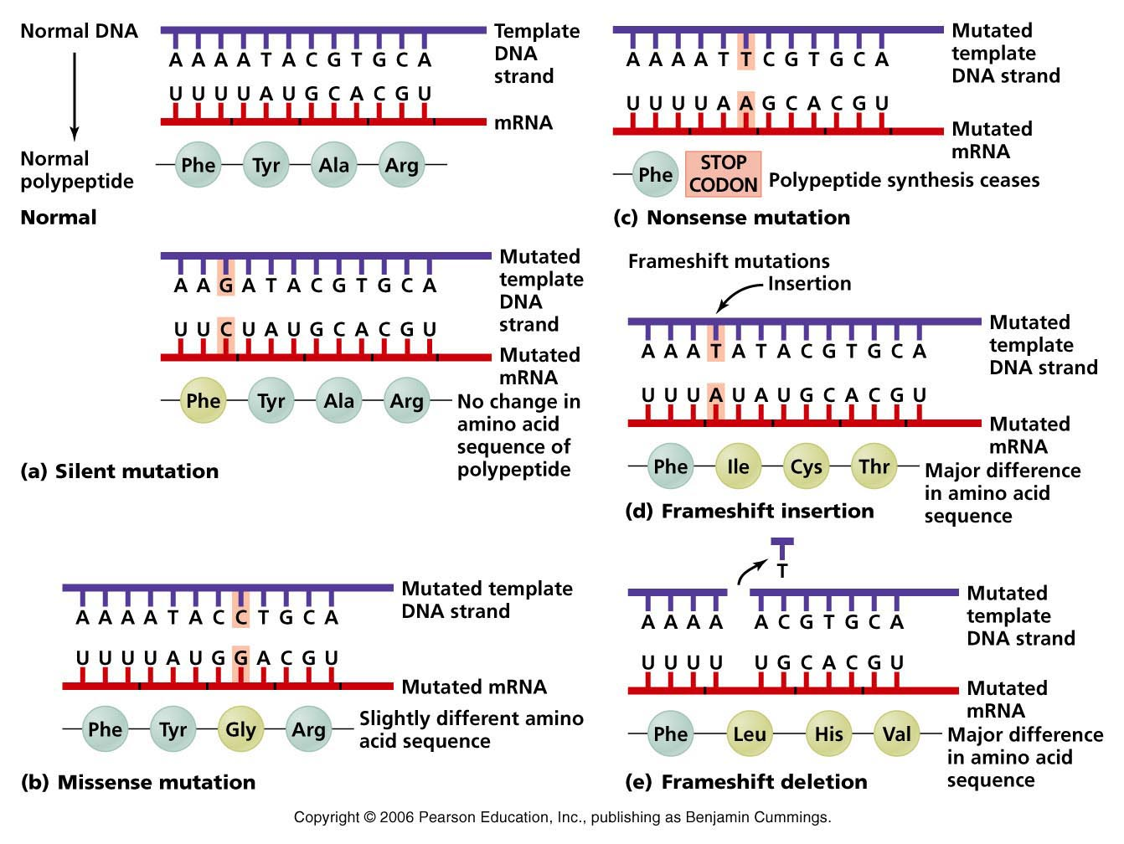
Impacts of point mutations
→ (a) silent, (b) missense, (c) nonsense, (d) frameshift

Slide 11
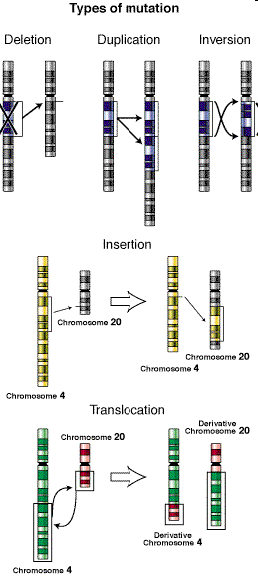
Large – chromosomal mutations

Slide 12
What are the agents inducing mutations? MUTAGENS
PHYSICAL FACTORS
Ionizating radiation
- direct interactions with NA
- interactions with water
→ formation of OH*
(and other oxygen radical species – ROS)
→ Various impacts on bases and strands
UV radiation
- interaction with aromatic cycles (bases)
→ base dimerization (T=T)

Slide 13
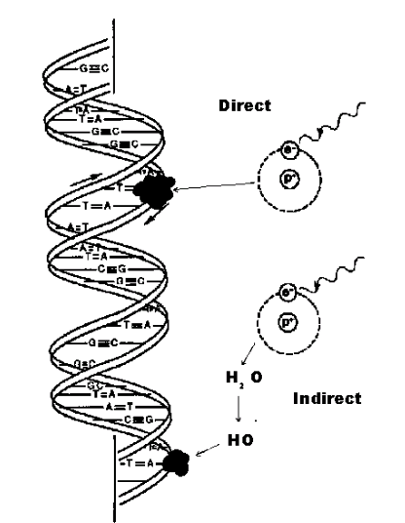
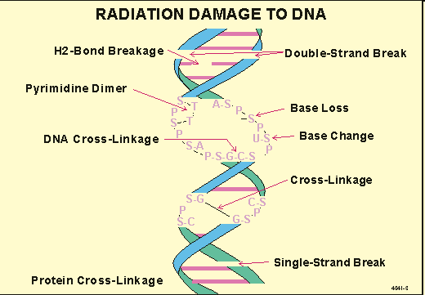
Ionizing radiation effects on DNA

Slide 14
What are the agents inducing mutations? MUTAGENS
CHEMICALS
1) Small electrophilic molecules
(attracted by nucleophilic/basic sites … e.g. in DNA)
2) Other reactive molecules
* alkylating and arylating agents – covalent adducts
* specifically intercalating agents
3) Base analogs
inserted during replication instead of nucleotides
Some compounds may require “activation” by metabolism
pro-mutagen (pro-carcinogen) → mutagen (carcinogen)

Slide 15
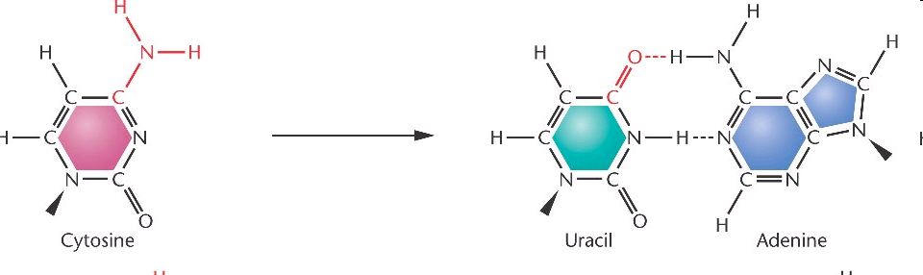
Small molecules → deamination of bases
HNO₂, HSO₃⁻ Hydroxylamine (HO-NH2), Methoxyamine (CH3-O-NH2)
Example: oxidation (deamination)
→ CG to → TA shift

Slide 16
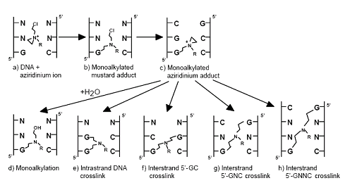

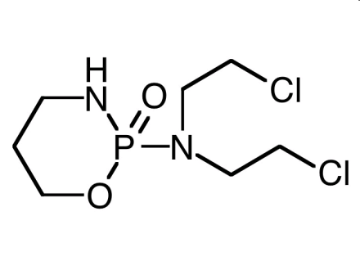
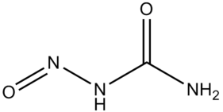
ALKYLating compounds
Covalent binding to NA (alkylation of bases, crosslinks in dsDNA)
Alkylsulphates, Nitro-urea, N-nitroso-alkyles, cis-platinum
cisplatin
cyclophosphamide
Nitrourea

Slide 17
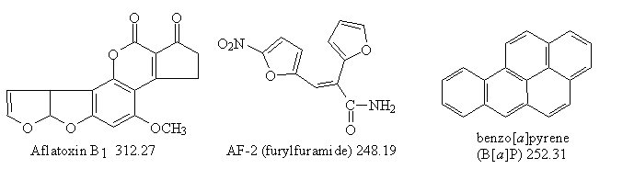
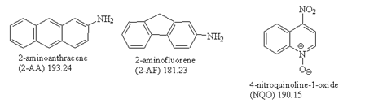
ARYLating compounds
Covalent binding, aromatic „adducts“ with bases
(see also discussion at biomarkers)
Mycotoxins (Aflatoxins) – requires activation
PAHs (benzo[a]pyrene) – requires activation
PAH derivatives
- 2-AA, 2-AF (grill products)
- NQO – model mutagen
in experiments
... many others

Slide 18
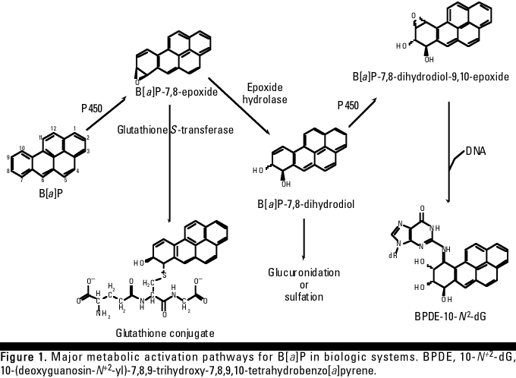
Bioactivation of benzo[a]pyrene → genotoxicity
BaP is oxidized to epoxides and OH-derivatives during detoxification (CYP450)
→ increased reactivity (including binding to bases ... primarily G or A)
(Similar bioactivation e.g. at aflatoxin)

Slide 19
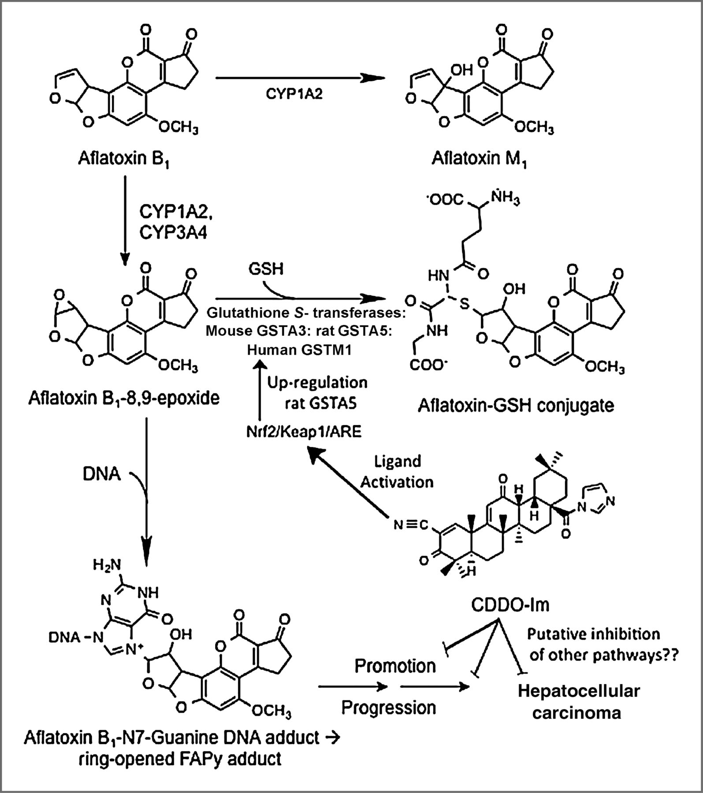
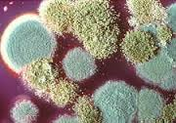
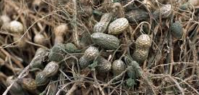
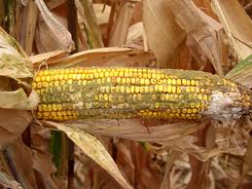
Bioactivation of aflatoxin → genotoxicity
AFLATOXIN sources

Slide 20
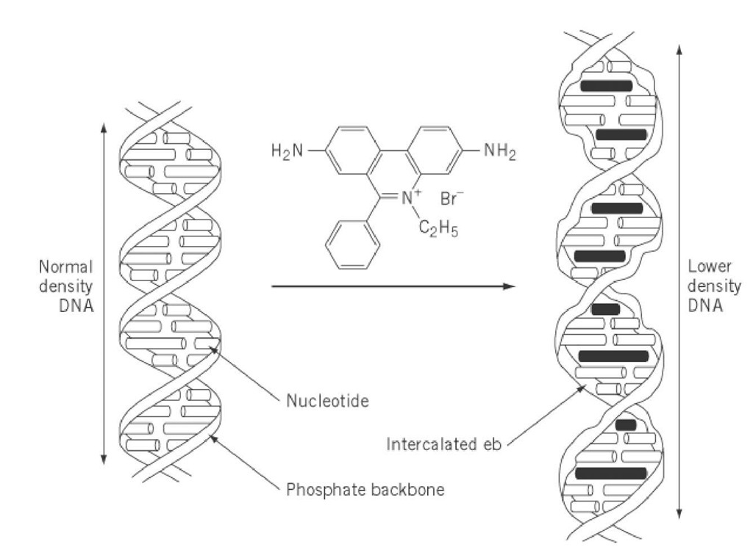
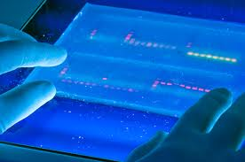
Intercalating agents
INTERCALATORS
Compounds with characteristic structures “fitting” into DNA
→ both noncovalent and covalent intercalation
Example 1 – ETHIDIUMBROMIDE
- experimental dye – visualization of DNA
- intercalation → sharing of electrones with bases → high fluorescence

Slide 21
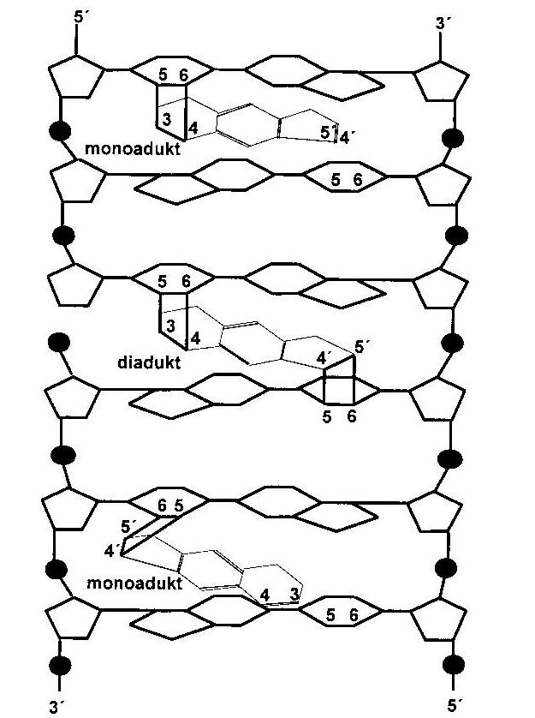
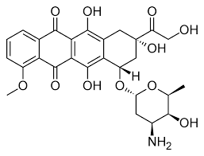

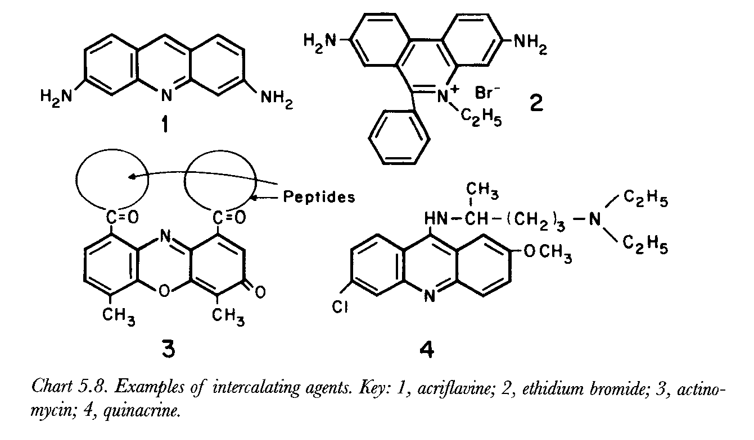
Intercalating agents
Other intercalator examples
Anticancer drug - doxorubicin
Psoriasis treatment – psoralen →
Experimental research compnds (e.g. acriflavine) →

Slide 22
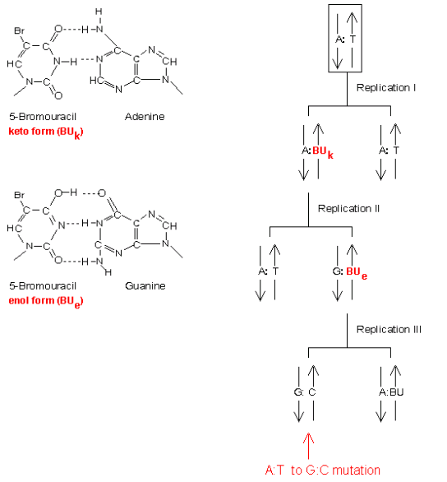
Base analogs
Structure similarity with natural bases
→ Incorporation into DNA during replication
→ Base exchange mutations
Example
5-Br-Uracil (anticancer drug)
  AT → GC shift

Slide 23
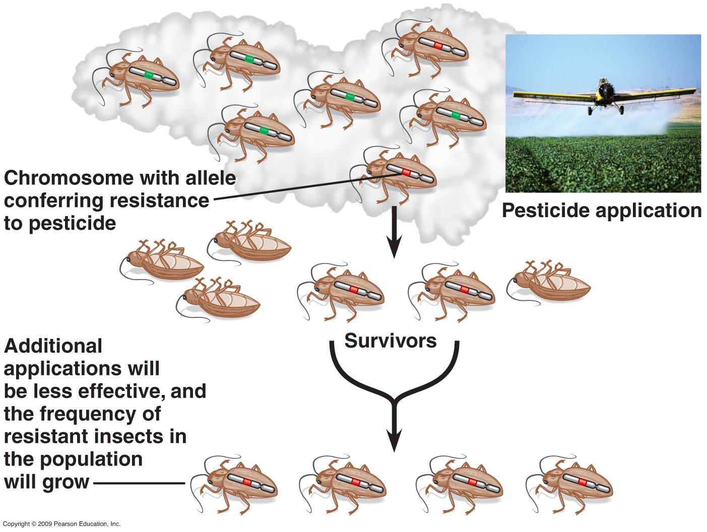
Mutations (alleles) and evolution

