Slide 1
BIOMARKERS AND TOXICITY MECHANISMS
08 –Toxicity mechanisms at cell level
Luděk Bláha, PřF MU, RECETOX
www.recetox.cz

Slide 2
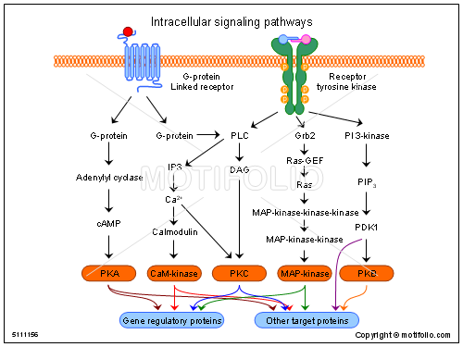
INTRACELLULAR signals as target to toxicants

Slide 3
Intracellular signal transduction: target of toxicants
- Regulation controlled by complex signalling
- "network" of general pathways
- similar in all cells / different cell-specific effects
- Consequences of signalling disruption
- unwanted changes in „homeostatic“ rates among
proliferation / differentiation / apoptosis
  → cell transformation (carcinogenicity)
  → embryotoxicity
  → immunotoxicity
  → reproduction toxicity
  .... and other chronic types of toxicity

Slide 4
Signal transduction - principles
Two major intracellular signalling processes
– protein-(de)phosphorylation
ProteinKinases - PKs, ProteinPhosphatases - PPases
- secondary messengers
cAMP / IP3, PIP2, DAG, Ca2+, AA
Three major types of signalling
  1: Membrane receptors - G-proteins / kinases
  → activation of protein kinase A (PKA):
  major messenger: cAMP
  2: Membrane receptors
  → activation of membrane lipases → and later proteinkinase C
  IP3, PIP2, DAG, Ca2+, AA
  3: Cytoplasmic (nuclear) receptors (discussed in detail in other sections)

Slide 5
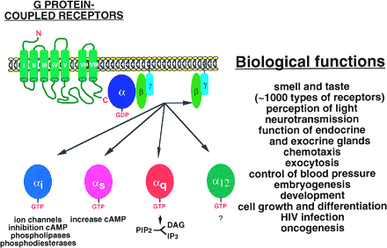
Membrane receptors acting as ProteinKinases
G-proteins & G-protein coupled receptors - GPCRs

Slide 6
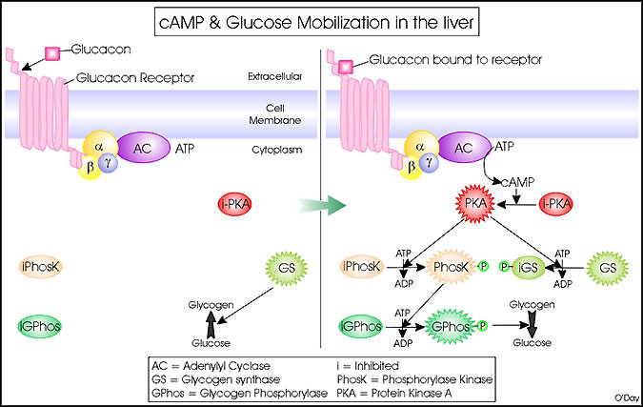
Signalling mechanism 1
→ Activation of adenylate cyclase → cAMP → PKA

Slide 7
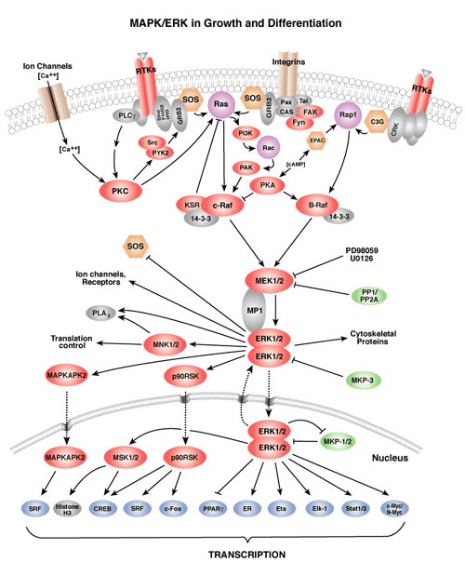
←PKA is central to
a number of signalling
events and following
effects
←Including modulation
of “MAPKs”

Slide 8
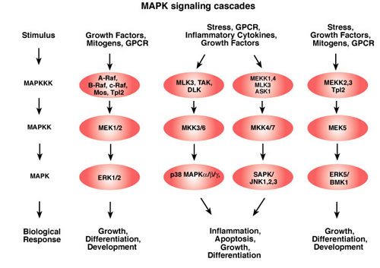
Mitogen Activated Protein Kinases (MAPKs)
& dependent effects

Slide 9
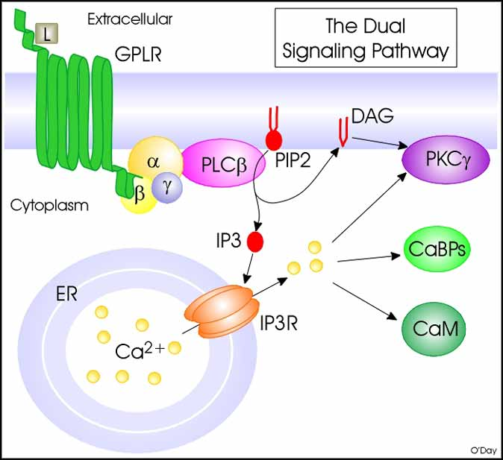
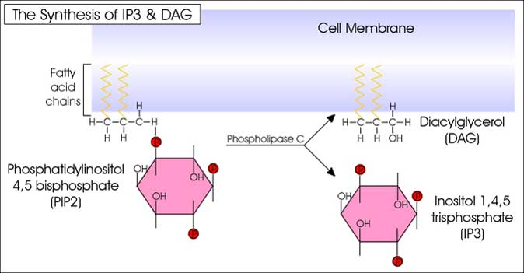
Signalling mechanism 2
Activation of Phospholipase C
→ release of PIPs → DAG → PKC / arachidonic acid
+ IP3 → activation of Ca²⁺ signalling

Slide 10
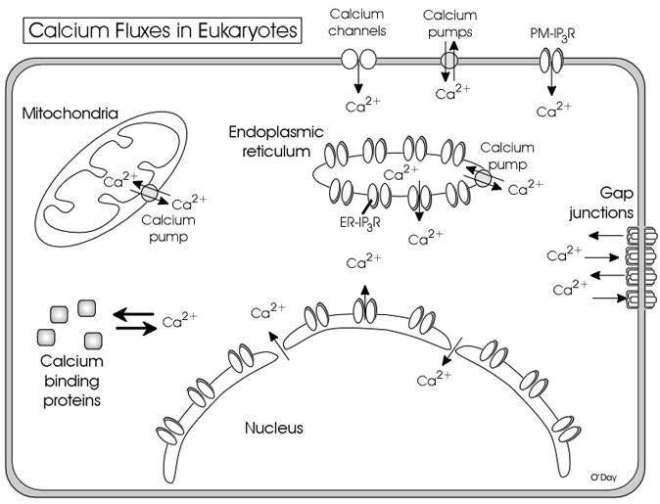

Slide 11
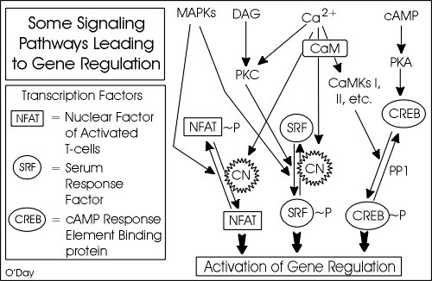
Different “types” of signalling crosstalk → networks

Slide 12
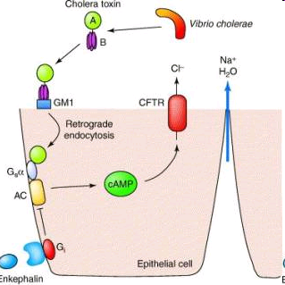
Disruption of intracellular signaling - EXAMPLES
Cholera toxin
CT acts as adenylate cyclase enzyme
increasing cAMP levels
TOXICITY

Slide 13
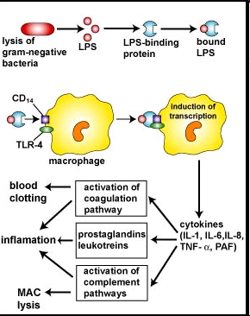
Example: Lipopolysaccharides (LPS) from cell walls
→ hyperactivation of intracellular signals → immunotoxicity

Slide 14
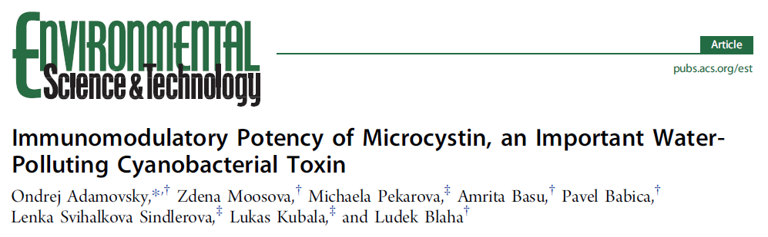
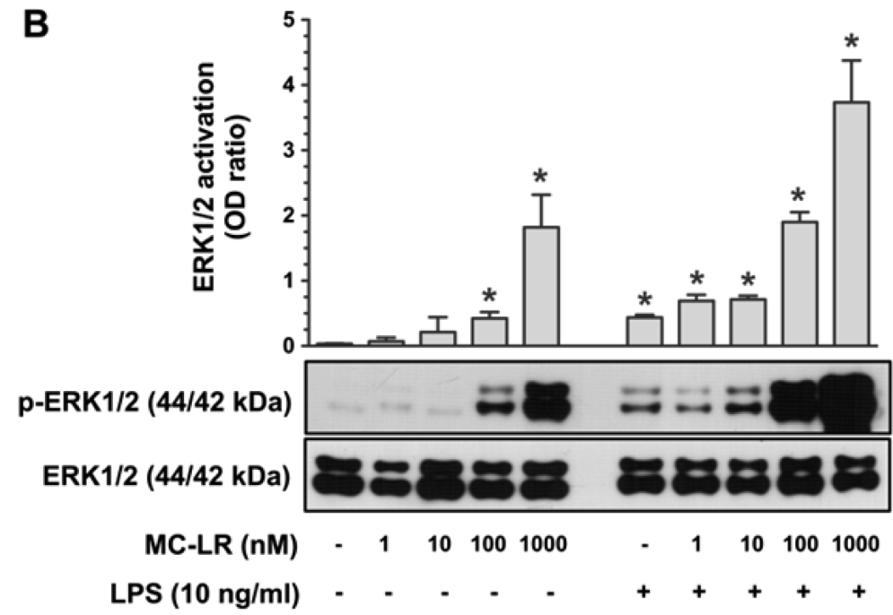
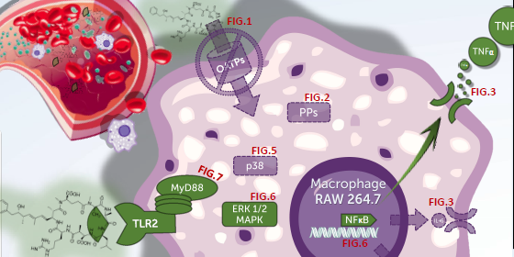
DOI: 10.1021/acs.est.5b02049
Environ. Sci. Technol. 2015, 49, 12457−12464

Slide 15
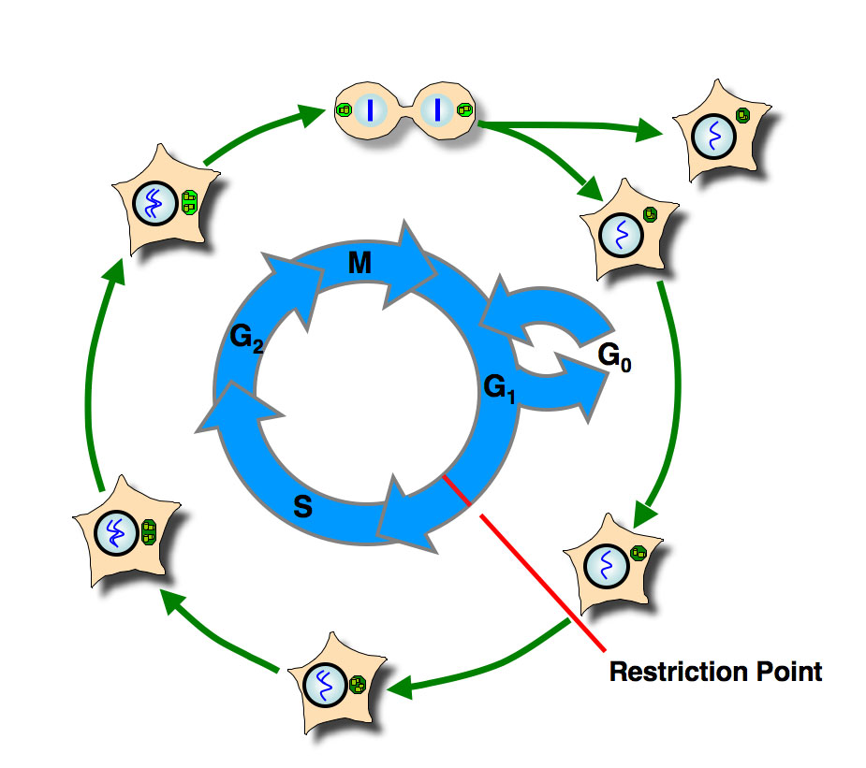
Cell and its basic functions and life trajectories
Metabolism
Proliferation (cell division) – cell cycle
Diferentiation
Senescence
Cell death
  Apoptosis
  Necroptosis
  Necrosis

Slide 16
Influence of toxicity mechanisms on cellular life trajectories
Various toxicity mechanisms / modes of action
  i.e. those discussed previously
    PROTEINS – enzyme inhibitions, protein damage/oxidation
    DNA damage
    MEMBRANE disruption
  as well as others
    including mainly INTRACELLULAR signalling disruptions
… affect the cell fate, and propagate to systemic effects: …examples…
  Disruption of metabolism
    Acute → (cell) death (CO, CN- → effects on mitochondria/haeme)
    Chronic → various diseases (e.g. diabetes)
  Effects on proliferation (cell division) – cell cycle
    Tumor growth, carcinogenesis, effects on immune system / haemopoiesis
  Diferentiation
    Developmental toxicity, embryotoxicity, teratogenicity, immune system effects
  Senescence (Usually not adverse or toxic)
  Cell death
    NECROSES (e.g. after irradiation)
    APOPTOSES (bone marrow – haemopoetic effects; effects on tumors)

Slide 17
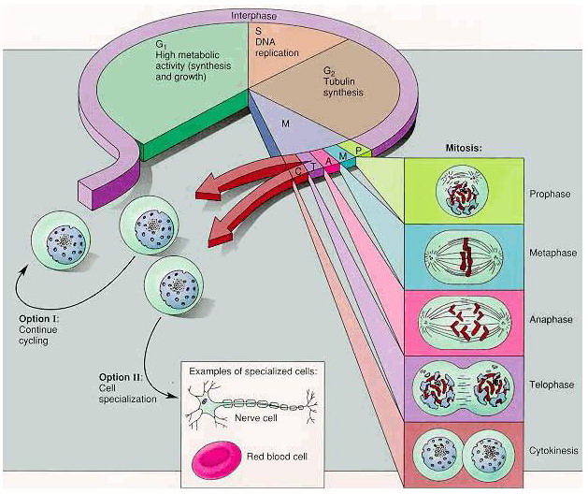
CELL CYCLE and its careful CONTROL - importance
GENERAL
  Control of genetic material and information (including reparation)
  Proper distribution of genetic material into daughter cells
EARLY DEVELOPMENT
  Regulation of development, embryo- and organogenesis
ADULTHOOD
  Reconstruction and renewal of adult tissues
  Control of proliferation / tumor growth

Slide 18
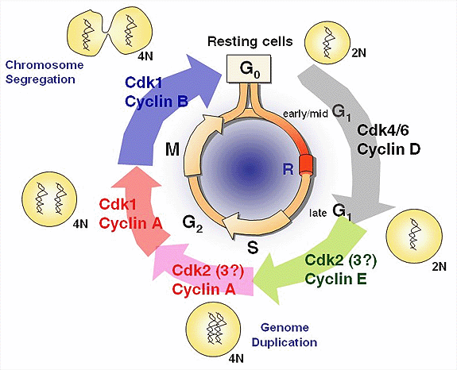
Cell cycle regulation and control
Factors controlling proper cell cycle
  Extracellular signals (hormones, neurotrasmitters…)
  Intracellular „stress sensors“ and signals
    p53 protein among others
  Correct sequence of individual events (phases)
  Error-free events
Controlling principles
  General:
    Phosphorylation (kinases) / dephosphorylation (phosphatases) of proteins → discussed further
  Such as … for cell cycle:
    cyclines and CDK (cycline-dependent kinases)

Slide 19
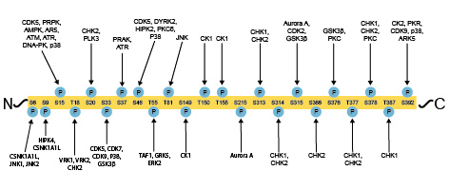
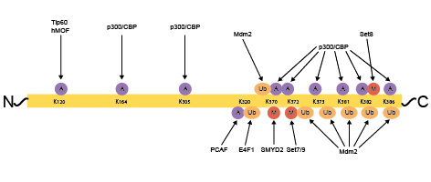
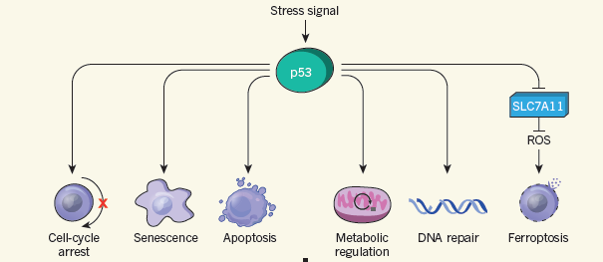
Role and functions of p53
* Phosphorylation of p53 * acetylation (A), methylation (M)
* and ubiquitylation (Ub) of p53
* as well as „mutations“ (SNPs) of p53
→ Control and affect key cellular processes →

Slide 20
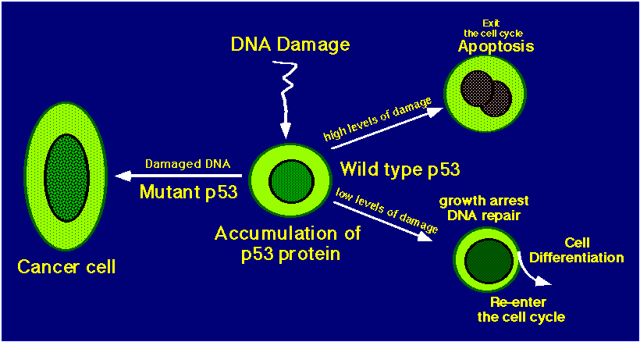
Example - p53 in control of intracellular stress / such as DNA damage

Slide 21
Cell deaths
Necrosis
Pathology
Membrane damage
Cell „explosion“/ lysis
Chromatin disintegration
→ immune reaction (inflammation)
„scars“ formation
Apoptosis
Physiological
Suicidal process (internal
Carefully controlled
DNA fragmentation
Membrane „blebbing“
Apoptotic bodies → fagocytosis
Further cell death variants also recognized
(different cell fate and control)
Necroptosis
Ferroptosis

Slide 22
