Slide 1
BIOMARKERS AND TOXICITY MECHANISMS
10 – BIOMARKERS
Introduction
Luděk Bláha, PřF MU, RECETOX
www.recetox.cz

Slide 2
Definition and applications
- markers in biological systems with a sufficently long half-life which allow location where in the biological system change occur and to quantify the change.
Various definitions and applications of „biomarkers“
  – Ecology / Geology
  Human health and diseases
  Toxicology (special focus in this class)

Slide 3
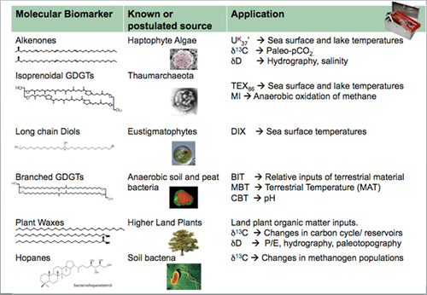
Biomarkers in ECOLOGY / GEOLOGY

Slide 4
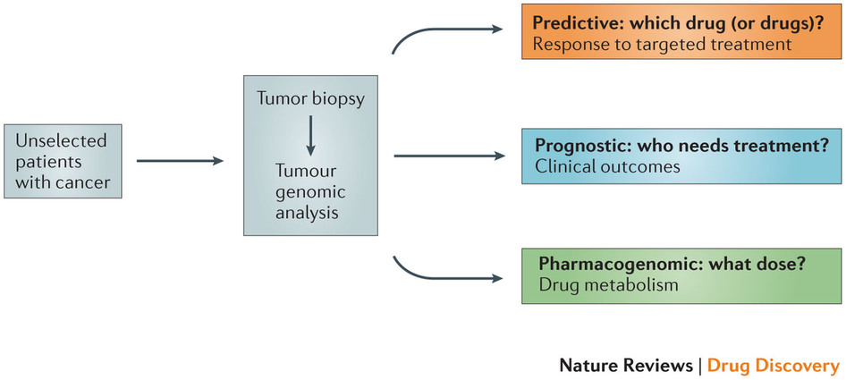
Biomarkers in HUMAN HEALTH
Potential applications
of biomarkers:

Slide 5
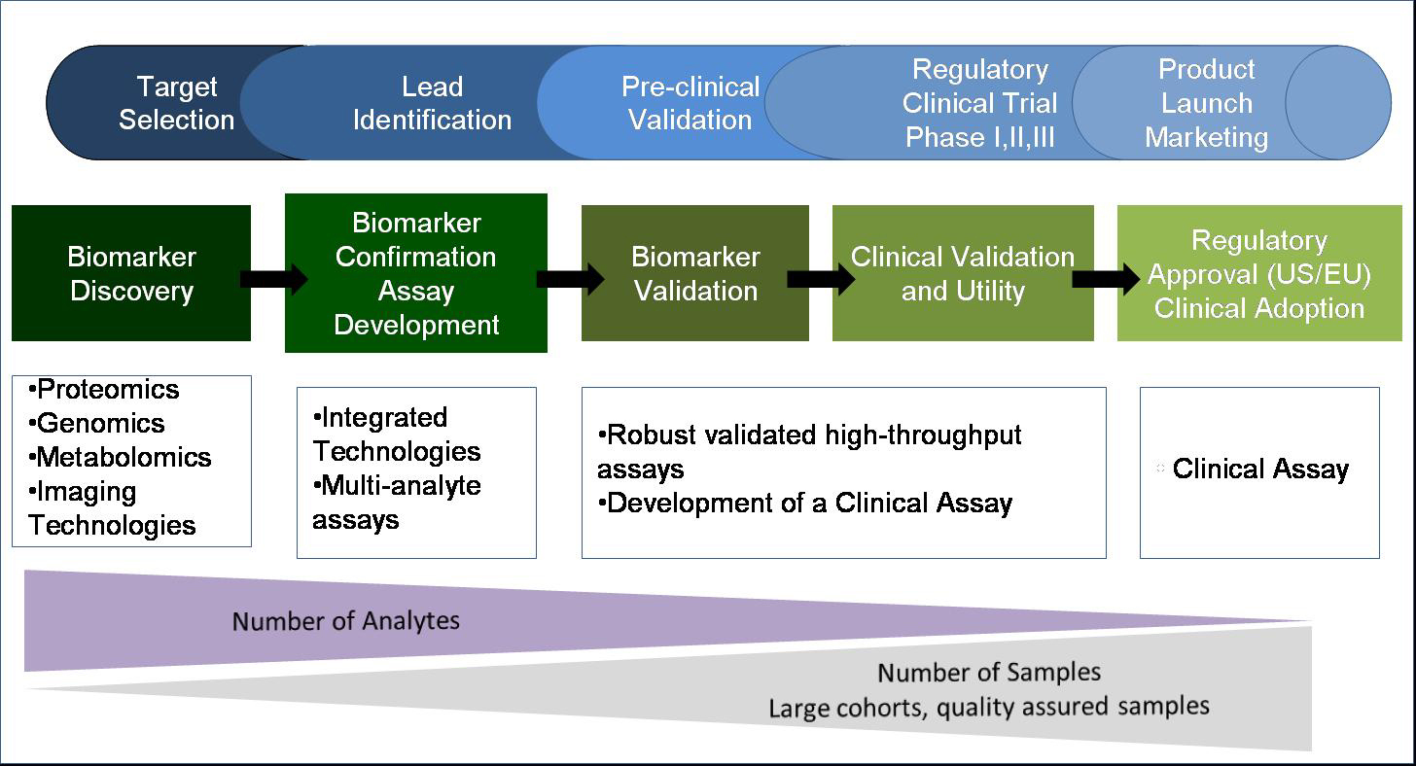
Biomarkers in HUMAN HEALTH … a lot of work

Slide 6
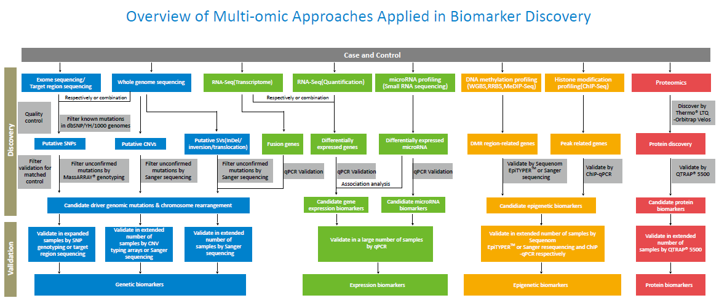
Biomarkers in HUMAN HEALTH … a lot of work

Slide 7
Biomarkers in TOXICOLOGY
Identification of markers of long-term risks
  Human: health, toxicology and carcinogenesis
  Ecotoxicology: early markers of toxic effects
BIOMARKER
  Change which occurs as response to "stressors“ (xenobiotics, disease, temperature...) extending the adaptive response beyond the normal range
In vivo biomarkers:
  changes measured in stressed organisms ("classical biomarkers")
In vitro biomarkers
  in vitro testing characterizing potencies of xenobiotic to induce specific biological activity (or toxicity mechanism)
    = biological potencies (markers of potential hazards)

Slide 8
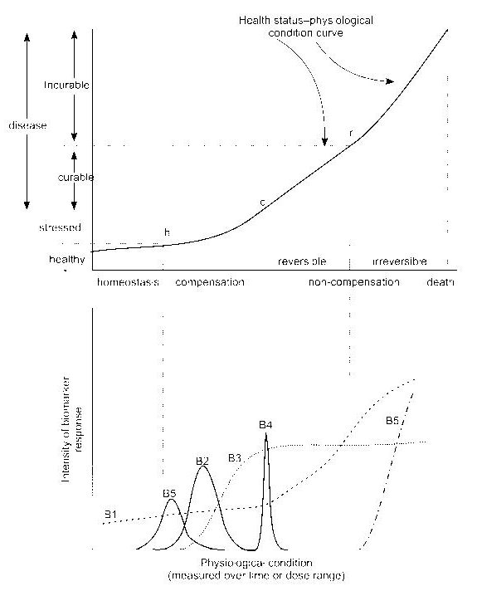
Biomarkers
& Exposure
Health effect intensity
h: homeostatic conditions
c: reversible stage
r: irreversible effects of pollutants
Various biomarker profiles
- temporal changes–B2; B4
- repeated occurrence (B5)
- continuous increase (B1)
- increase with maximum (B3)
: B1 + B3 are candidate biomarkers !
Stressor / time
Biomarker intensity
Stressor / time

Slide 9
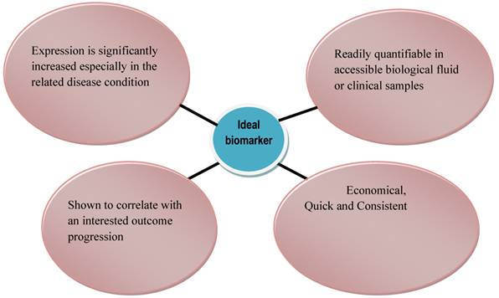
Ideal biomarker

Slide 10
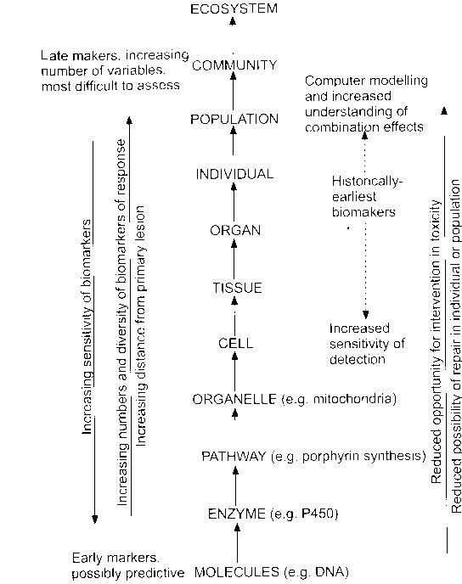
Biomarkers at different levels of biological organisation

Slide 11
Biomarkers - classification
Categorization by US National Academy of Sciences
- Biomarkers of exposure
- Biomarkers of response or effect
- Biomarkers of susceptibility
Continuum exists among biomarkers
example: adducts of toxicant to DNA
? biomarker of exposure / ? response

Slide 12
Various biomarker types
Specific (selective) in vivo biomarkers
  Biomarkers selectively reflecting specific types (mechanisms) of toxicity
    E.g. inhibition of AcCholE :
    exposure = organophosphates; effect = neurotoxicity
+ provides specific information
- multiple biomarkers must be measured in parallel
Non-specific (non-selective) in vivo biomarkers
  Biomarkers of general stress
    E.g. induction of Heat Shock Proteins (hsp)
+ general information about stress
- sensitive to many "stressors" (temperature, salinity ...)

Slide 13
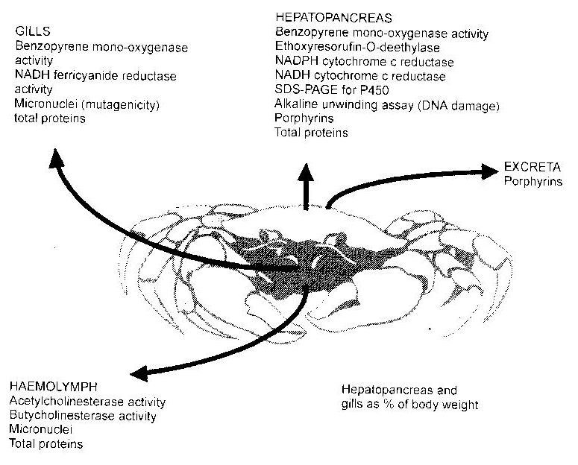
Sampling biological materials for biomarker analyses
Non-destructive (non-invasive)
  blood / haemolymph collection & analyses
  skin, feather, hair …
  (life of the organism not affected)
Destructive (invasive)
  whole animal
  → 3R principles: maximum use of the material
  multiple biomarker evaluation

Slide 14
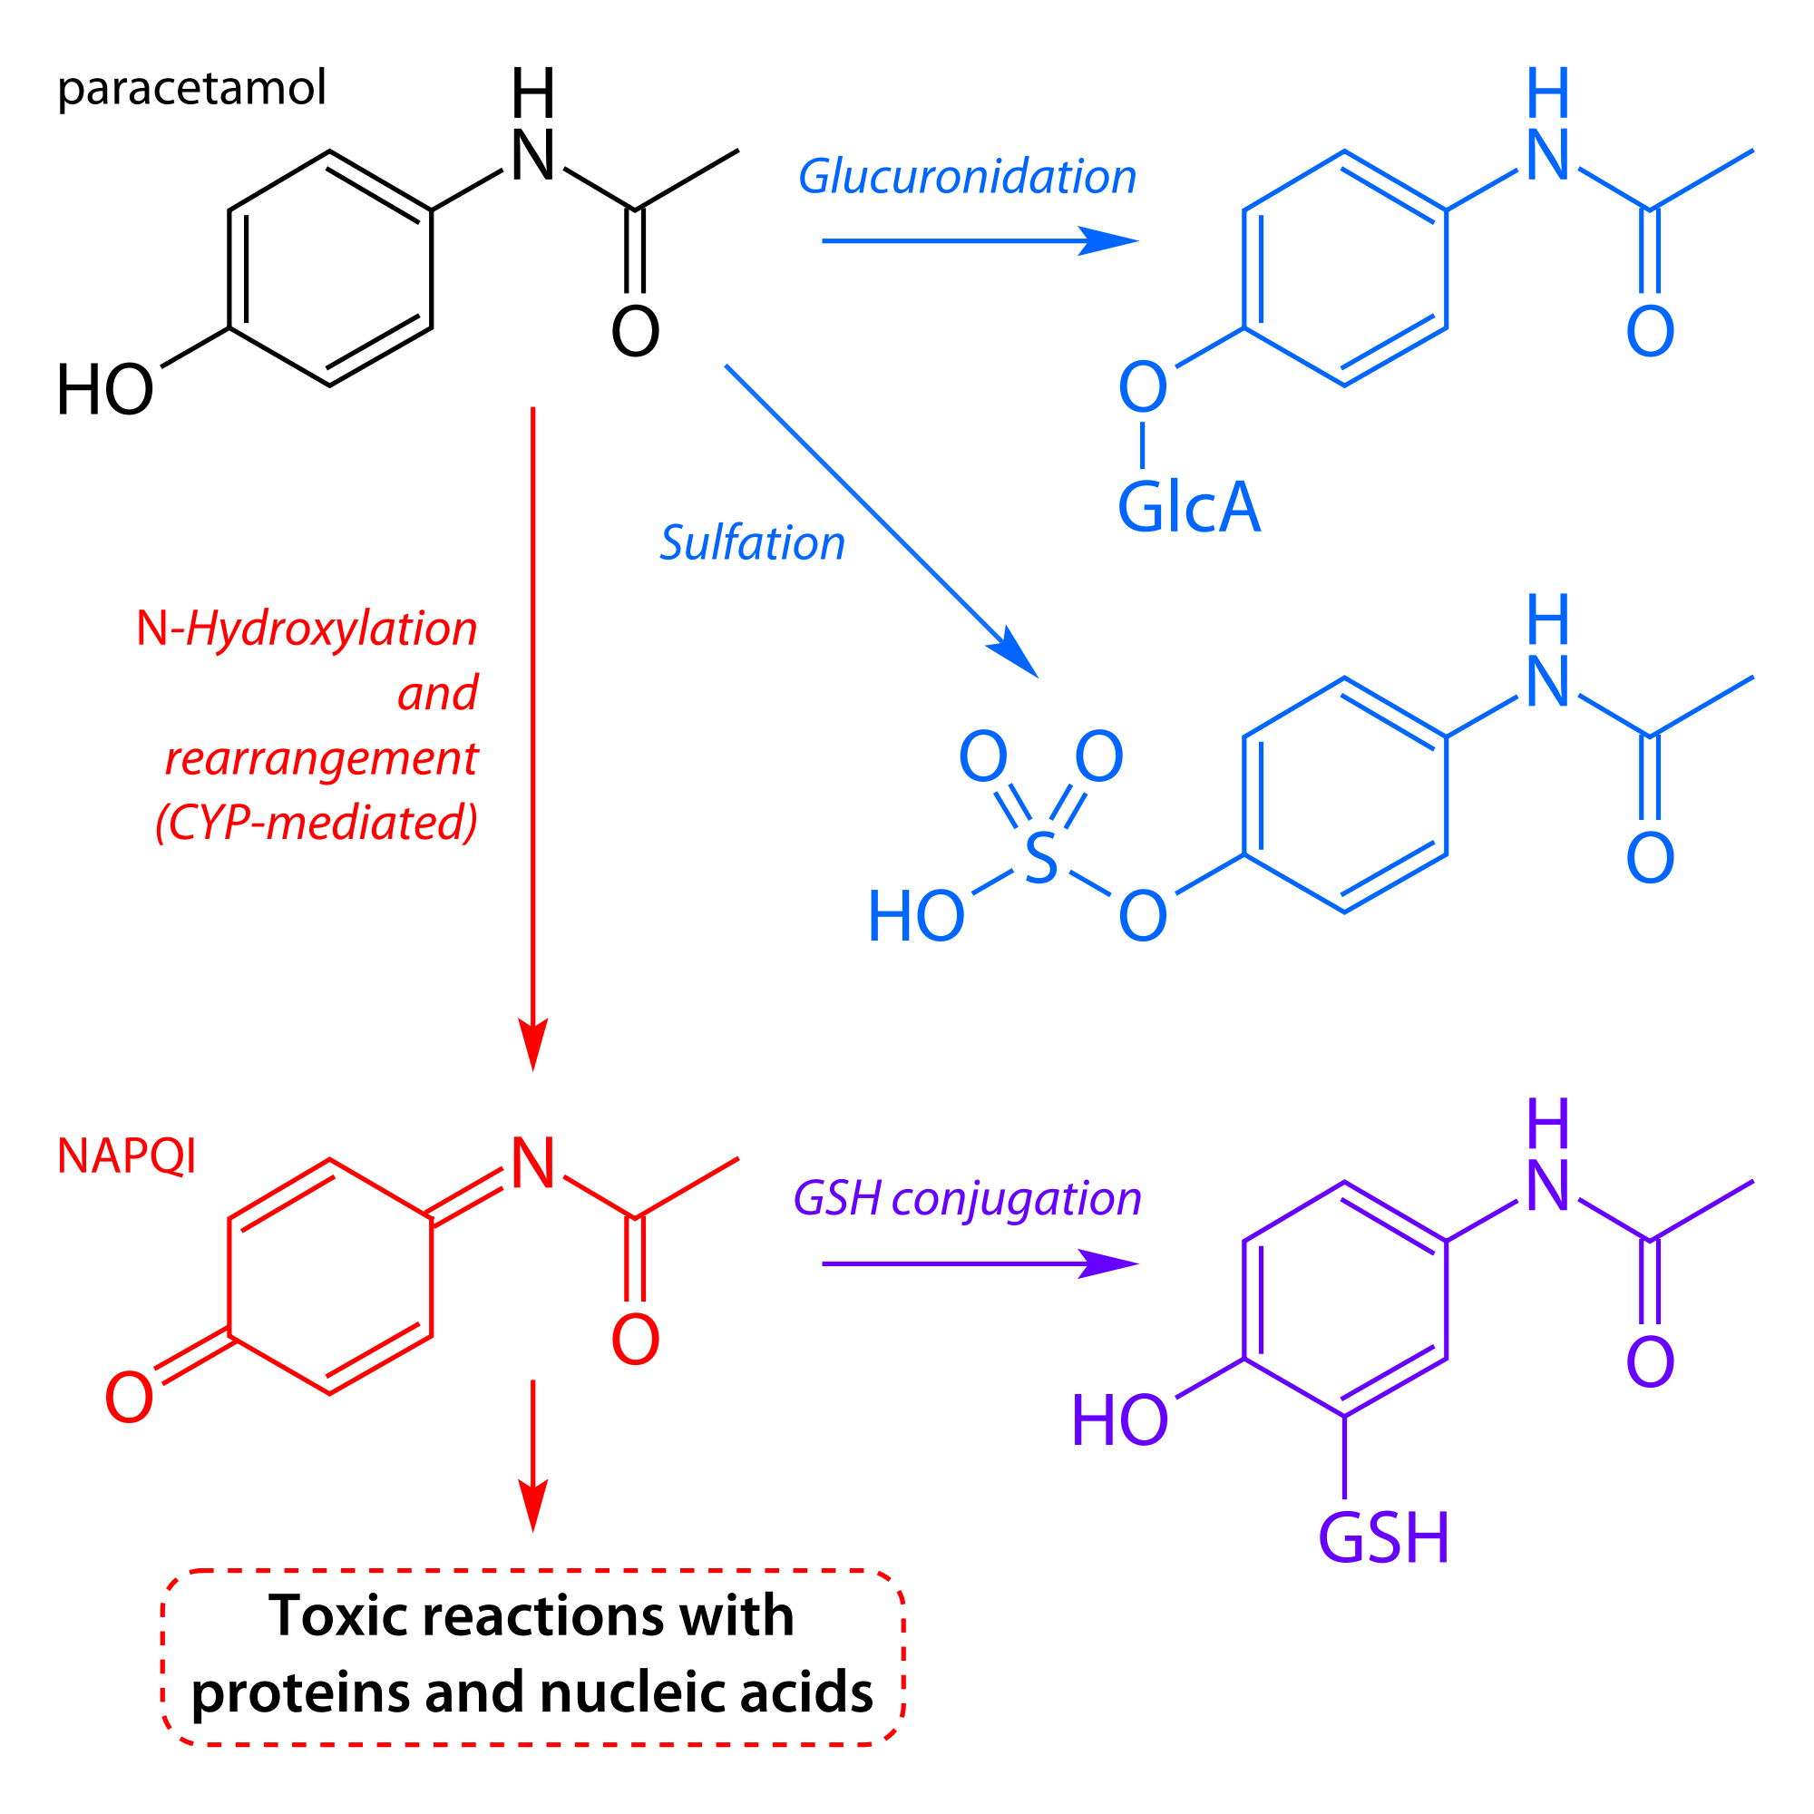
EXAMPLE
- Paracetamol

Slide 15
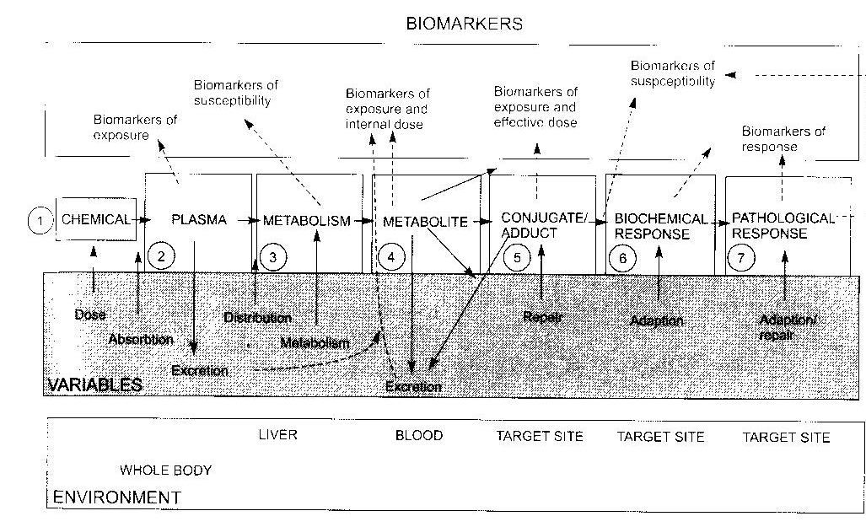
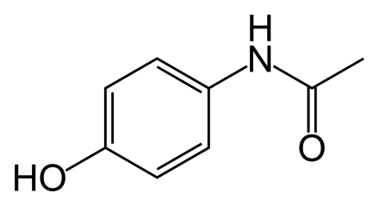
EXAMPLE
- Paracetamol
paracetamol
parent compound measurement - biomarker of exposure
activation to reactive metabolite (N-ac-p-benzoquinone, NAPQI) by CYP
→ reaction with GSH / measurement – levels of CYPs; levels of GSH – susceptibility
GSH-NAPQI conjugate – exposure, susceptibility
NAPQI-protein adducts → toxicity: exposure, effective dose
adaptations: GSH depletion, inhibition of protein synthesis – biomarkers of response
protein alkylation → degeneration of hepatocytes: necrosis
→ increase concentrations of bilirubin in plasma + inflammation - response / effect

Slide 16
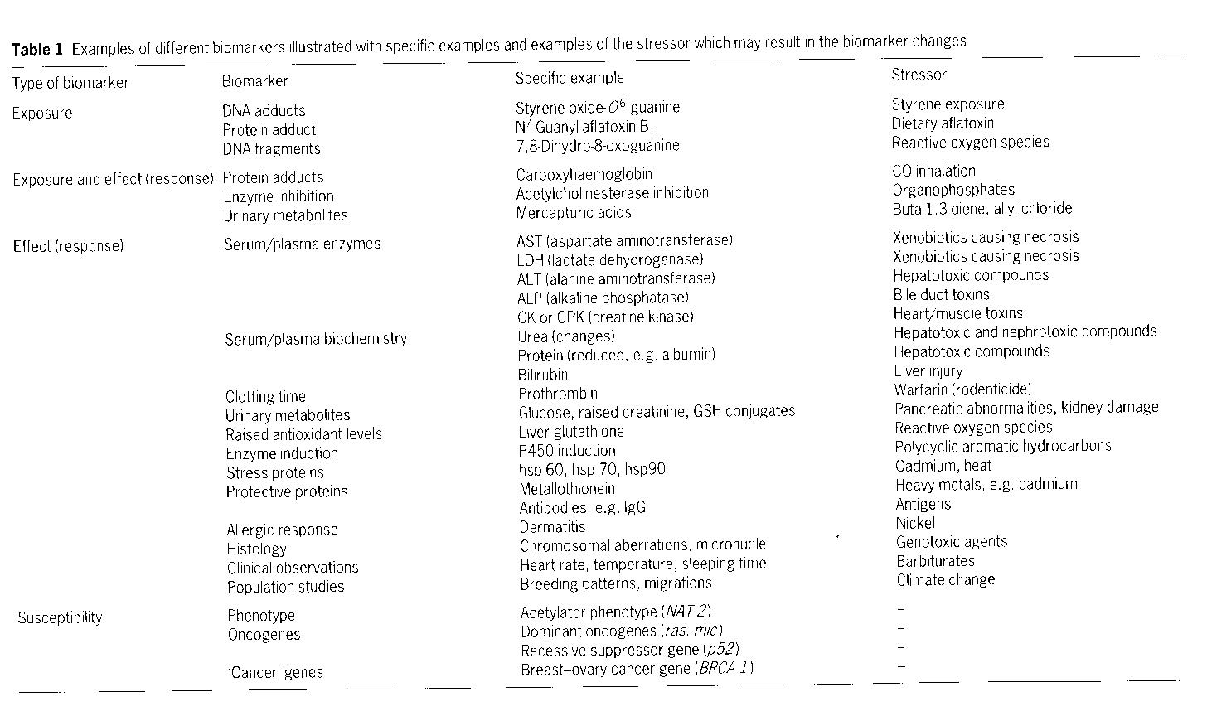
Toxicity biomarkers – examples

Slide 17
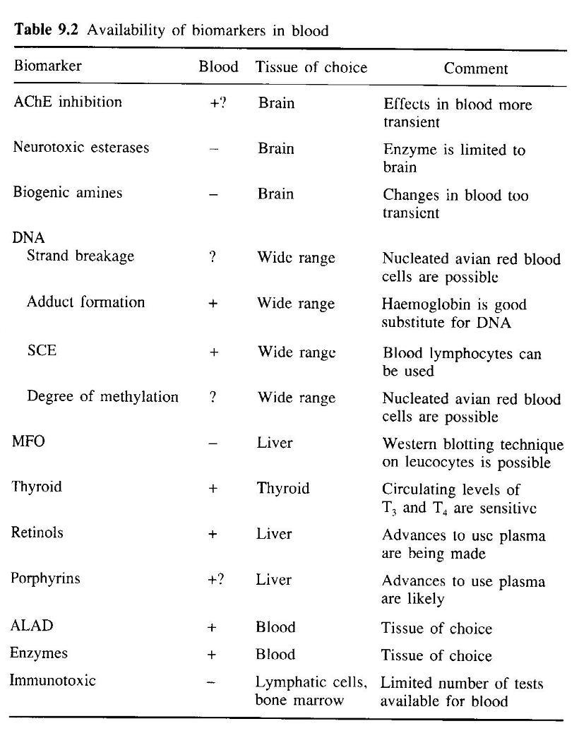
Other
examples
Toxicity
biomarkers

