Slide 1
BIOMARKERS AND TOXICITY MECHANISMS
13 – BIOMARKERS
Omics + final notes
Luděk Bláha, PřF MU, RECETOX
www.recetox.cz

Slide 2
Topics covered in the final presentation
Biomarkers at different levels
  Omics
  ... and beyond
Biomarkers in human medicine and drug development
  Strategy and steps in development
  Application examples

Slide 3
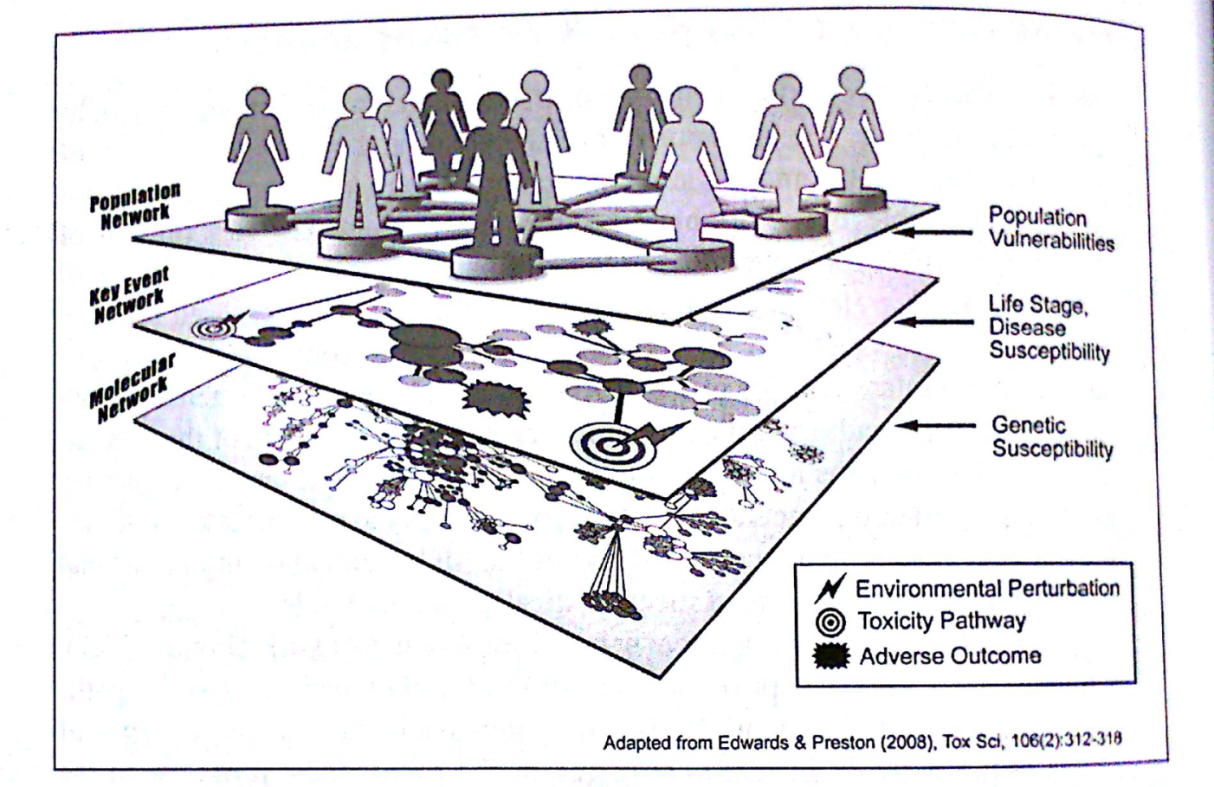
Systems biology/toxicology/medicine = “omics”
The overall hypothesis or idea (for future)
Linking genetics / environment / health
Early and improved diagnostics
Personalized prevention (elimination of risk factors)
➔ Personalized treatment/medicine

Slide 4
„OMICs“
“Omics” techniques (Systems biology)
  Result of rapid technological advances (microarrays, next generation sequencing, HPLC-mass spectrometry techniques etc.)
  Simultaneous and „instant“ assessment of thousands of parameters (biological / toxicological responses) at different levels
  „Big data“generated ➔ bottleneck is data analysis (bioinformatics, self-learning machines, artifical intelligence? )
Genomics
  Genes (DNA) - relatively stable
    not responding to immediate environmental changes (e.g. Toxicants)
    „slow“ changes possible
      Epigenetics (e.g. DNA methylation)
      Mutations (evolution) → Single Nucleotide Polymorphisms (SNPs)
  Used as “biomarkers of susceptibility” (SNPs / personalized medicine)
Other omics
    mRNA levels (transcriptomics)
    proteins (proteomics)
    metabolites (metabolomics), etc....
  Resposive to stress (including toxicants, therapy etc.)

Slide 5
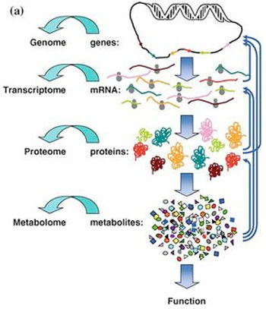
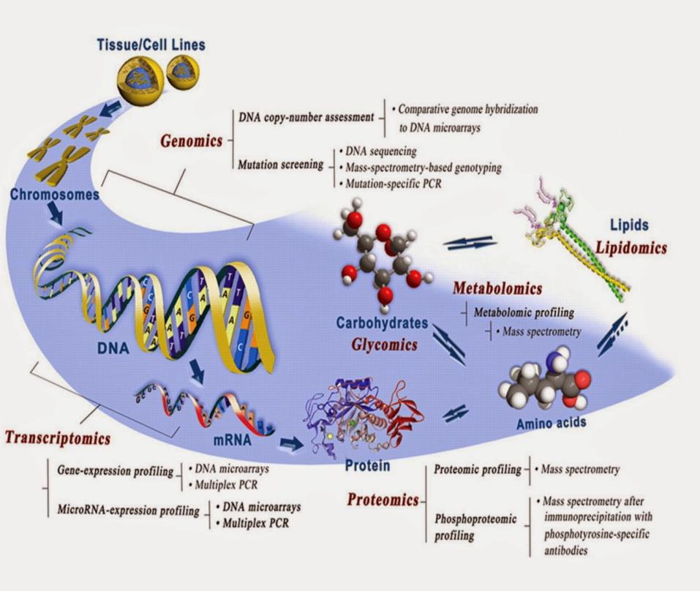
Biomarkers at different biological levels – „omics“ approach
OMICs (1) – from genes …. to … functions

Slide 6
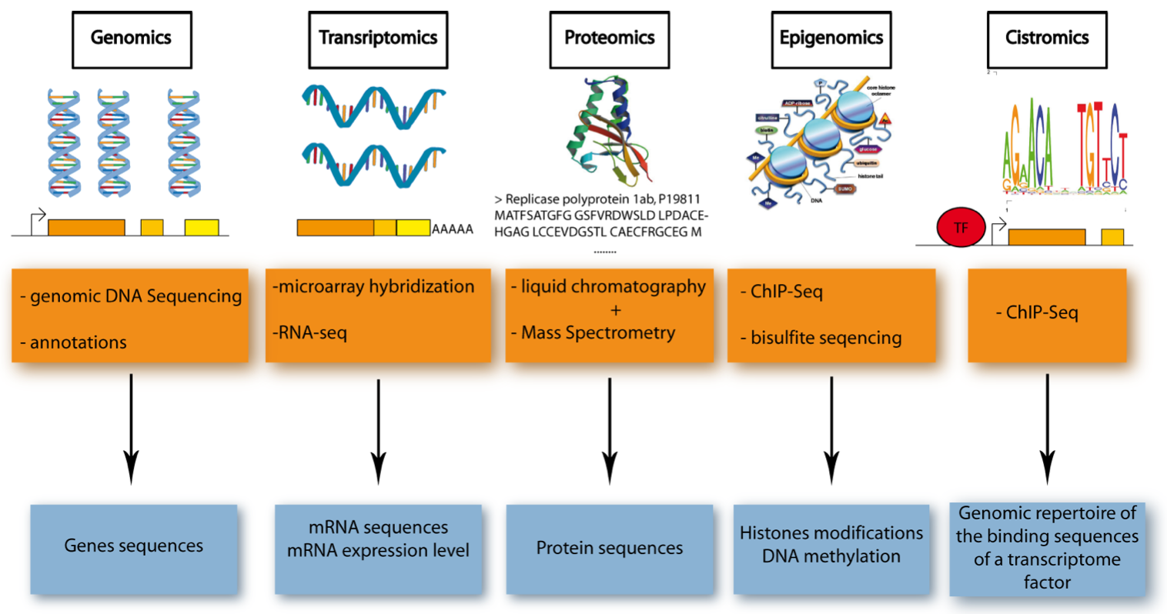
Biomarkers at different biological levels – „omics“ approach
Current advanced „omics“ technologies

Slide 7
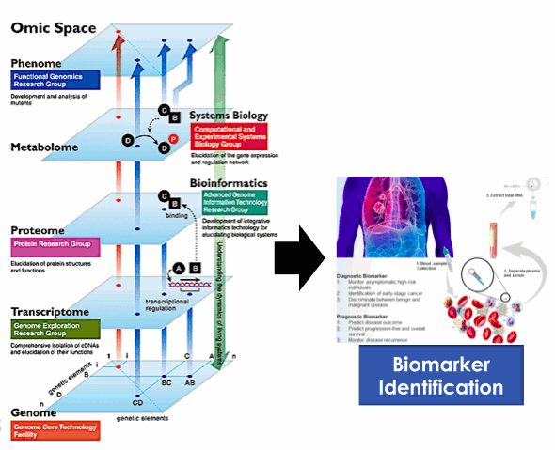
Biomarkers at different biological levels – „omics“ approach
OMICs (2) – … including PHENOTYPE (phenomics)
Linking „outcome“
(health, intoxication, phenotype)
with mechanistic changes
(i.e. „biomarkers“)

Slide 8
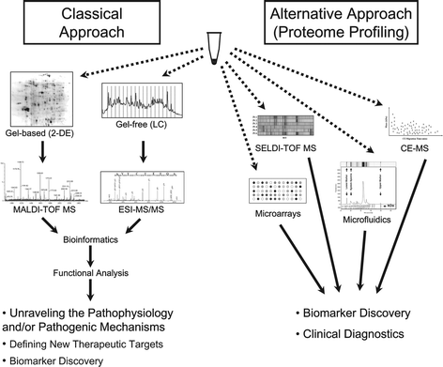
Biomarkers develoment using „omics“ approaches
Different approaches towards new biomarkers
  Hypothesis driven
  Data driven - omics
  = screening followed by correlations (example figure – „proteome“)

Slide 9
Biomarkers develoment using „omics“ approaches
Steps towards biomarkers
    „Big omics data“ generated (easy and fast)
    Correlations (bioinformatics) with health outcomes (bottleneck)
    →eventual identification of suspected biomarkers
      e.g. Toxicant activates genes → higher level(s) of specific mRNAs (or higher protein levels)
      E.g. Complex effects at several levels → modulation of profile(s) of certain metabolites
    Characterization and validation of biomarkers (bottlenec: time and cost demanding)
      Experimental - stability of biomarker responses throughout different stress levels (exposure doses, exposure duration, various conditions, males x females …. Etc)
    Qualification and approval (clinical and epidemiological studies)
  → Despite of decades of omics era, there are only rare (if any) examples of biomarkers derived by omics currently applied in practice

Slide 10
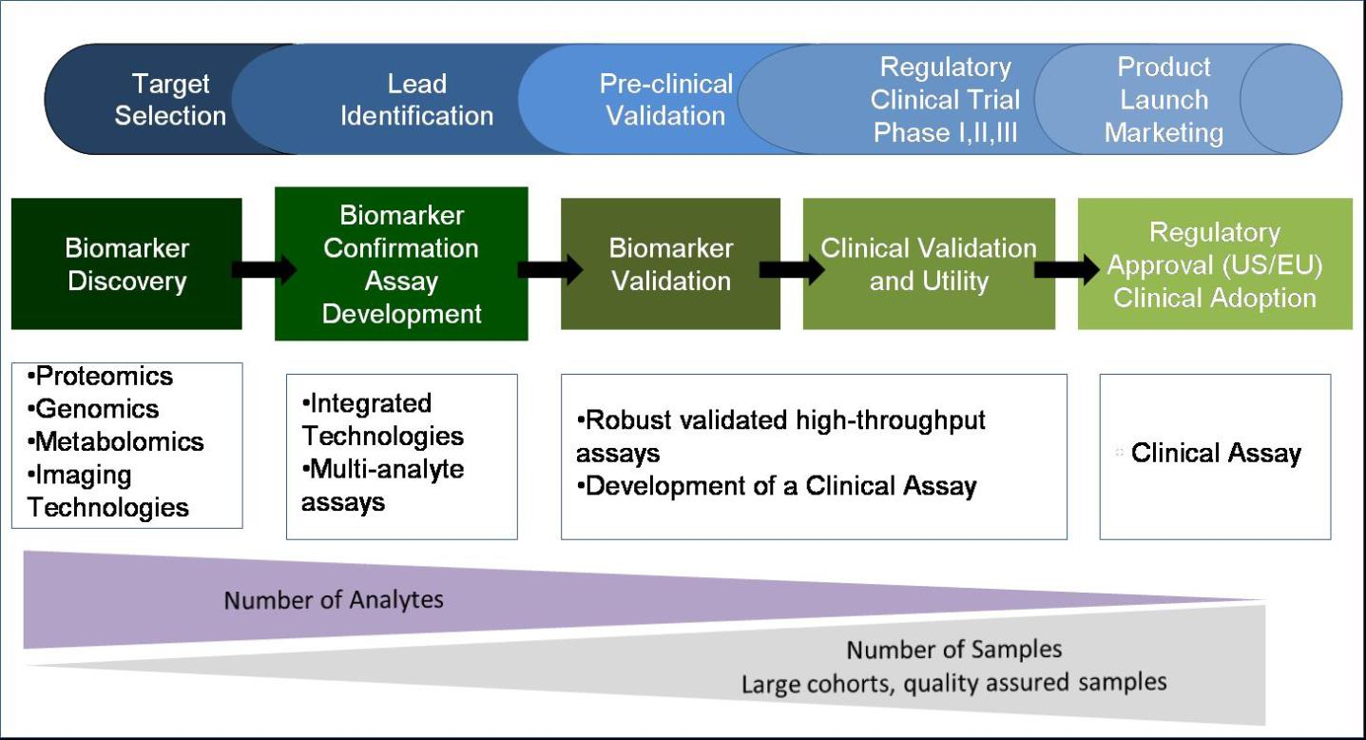
More detailed view: 5 steps leading to biomarker use in practice
DISCOVERY → VALIDATION STEPS → APPROVAL

Slide 11
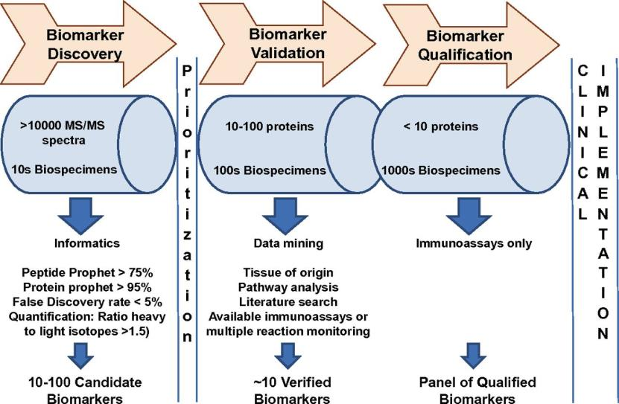
Detailed zoom = example: proteomics
Biomarker development
  High numbers of endpoints (e.g. proteins)
  Low numbers of samples compared (e.g. 10 controls vs 10 “treatments”)
Biomarker characterization and validation
  Decreasing number of markers
  Increasing numbers of specimens (biological samples)
Biomarker qualification and approval
  Individual markers
  Analytical methods validated and well established

Slide 12
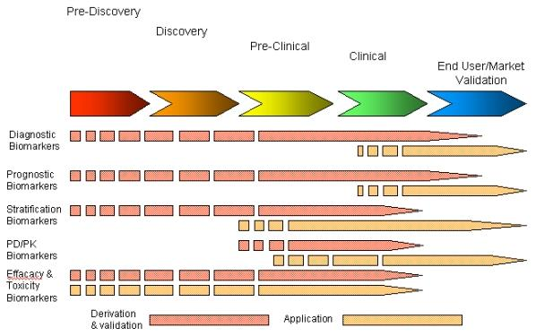
Biomarkers have potential for different applications ... such as:

Slide 13
Biomarkers have potential for different applications ... such as:
Biomarkers in research
  Search of “potential” therapies/drugs
    Changes in biochemical responses provide information on efficiency and mechanism of action
  Identification of “early markers” of chronic diseases
    Early diagnosis (e.g. identification of developing cancer, coronary disease...)
Biomarkers in medicine
  Identification of status of an individual
    Healthy vs Disease
  Assessment of therapy/treatment
    Efficiency – Did treatment improved situation? (improvements in biomarker responses)
    Adverse or side effects of therapy
Biomarkers in toxicology
  Identification of status
    Intoxicated (exposed) vs Controls
    Forensic toxicology (e.g. consumption of drugs of abuse, alcohol etc)
  Early warnings of future health consequences
    Biochemical changes are detectable before the actual health problems

Slide 14
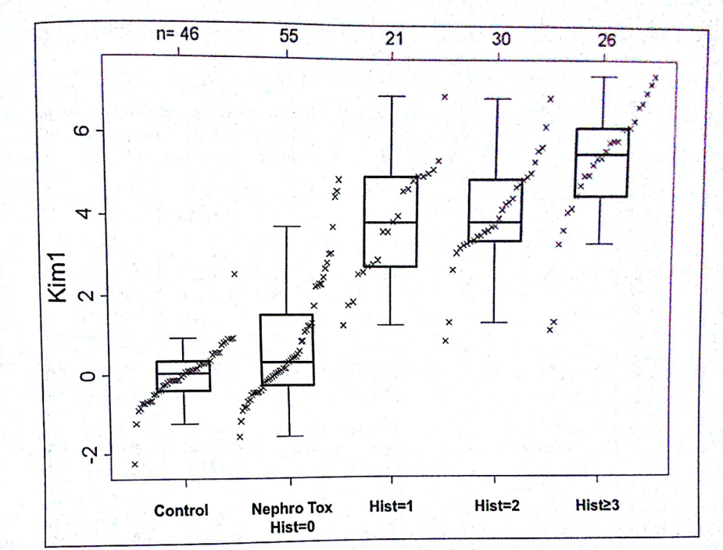
Biomarker „validation“– example
Good characterization and critical assessment needed during validation.
Example: Kim-1 protein related to kidney injury by toxicants
Kim-1 levels significantly elevated only at manifested clinical signs = histopathology grades 1-3 („diagnostic“ biomarker = status)
Poor „prognostic“ potential (overlap of Controls and initial toxicity condition (histo-grade 0)

Slide 15
Summary and overview
Class on toxicity mechanisms (MoA) and biomarkers

Slide 16
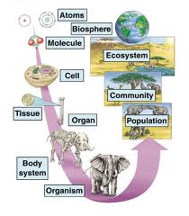
Class summary and take home message
* Molecular effects of toxicants = MoAs (1)
* Propagate to higher levels (2),
* … where they induce measurable “responses” - biomarkers (3)
1
3
Biomarkers
- types
- examples
- methods
MoAs
* Molecular interactions
* Key targets ...:
- DNA, RNAs
- proteins (and their functions)
- membranes
* Complex mechanisms
- Oxidative stress
- Signalling and hormones
- Detoxification
1
2
Biological
organization

Slide 17
Summary on toxicity mechanisms (MoA) and biomarkers
For excellent performance and successful exam student should:
have an overview of different types of MoAs (see also point 2 below) and be able to link MoAs to higher level effects (toxicity)
  Example: inhibition of AcCholE enzymes (mechanism) → propagates as neurotoxicity (effect)
know some details for selected example MoAs for different toxicant targets
= based on your own interest select one example from each of the following categories, learn details, be able to discuss (i.e. know details for 7 example modes of toxic action)
  nucleic acids
  proteins
  membranes (lipids)
  cellular
  Complex 1 – detoxification/metabolization
  Complex 2 – intra- and inter-cellular signalling, hormones
  Complex 3 – oxidative stress
have understanding of biomarker issues
  What is a biomarker and what properties it should have (or not to have)?
  Why we search for them = how can they be used?
  What different types and groups of biomarkers can be recognized?
  What are suitable matrices for sampling and further analyses?
  What approaches are applied in biomarker discovery („hypothesis“ vs omics)?
and know example biomarkers
same approach as for point 2 above = based on your own interest select one example biomarker for each of seven categories and know some details)

