Slide 1
Chemické vlastnosti, struktura a interakce nukleových kyselin
Bi7015

Slide 2
Struktura DNA
Báze, nukleosidy, nukleotidy
Párování bazí
Dvoušroubovice DNA
Víceřetězcové struktury

Slide 3
Chemická reaktivita NK.
Hydrolýza NK, redukce, oxidace, nukleofily, elektrofily, alkylační činidla.
Mutageny, karcinogeny, protinádorově účinné látky.
Interakce DNA s UV a ionizujícím zářením.
Maxamovo a Gilbertovo sekvencování, chemické strukturní sondy.
Poškození DNA a jeho detekce.
Základní mechanismy opravných procesů

Slide 4
Nekovalentní interakce DNA s malými molekulami.
Iontové interakce, vazba do žlábku, interkalace.
Bisinterkalátory, „provlékající se“ (threading) interkalátory, metalointerkalátory.
Přenos náboje/elektronů zprostředkovaný dvoušroubovicí DNA.
Analytické využití interkalátorů a látek vázajících se do žlábku; chemické nukleázy.

Slide 5
Interakce DNA s proteiny.
Principy, funkční skupiny DNA a proteinů zprostředkující vzájemné interakce.
Nespecifické a sekvenčně specifické interakce.
Příklady sekvenčně specifických interakcí (např. helix-otáčka-helix, zinkové domény). HMG proteiny.
Příklady: Mechanismus interakce restrikčních endonukleáz s DNA. Interakce proteinu p53 s DNA.
Základní metody studia interakcí bílkovin s DNA; EMSA, imuno-techniky, footprinting DNA.

Slide 6
Enzymy účastnící se metabolismu NK.
DNázy, RNázy, polynukleotidfosforyláza.
Endonukleázy rozpoznávající jednořetězcové NK
Enzymy účastnící se opravných procesů.
Topoizomerázy, helikázy.
Ligázy, polynukleotid kináza.
Restrikční endonukleázy, metyltransferázy; metylované baze, metylace DNA u prokaryot a eukaryot.
Využití enzymů při studiu struktury a interakcí DNA.

Slide 7
Struktura a funkce ribonukleových kyselin a regulace genové exprese.
Ribozomální, transferové a informační RNA.
Sestřih prekurzorových RNA.
Katalytické funkce RNA, samosestřih.
RNA interference. Regulace genové exprese, úloha RNA; vztah k metylaci DNA. Metodické přístupy.

Slide 8
Elektrochemie nukleových kyselin a DNA biosenzory.
Vztah mezi strukturou DNA a jejím chováním na rtuťových a uhlíkových elektrodách.
Elektrochemické biosenzory pro hybridizaci DNA. Značení DNA elektroaktivními skupinami.
Elektrochemické biosenzory pro poškození DNA.

Slide 9
You and chemistry? ☺

Slide 10
Some basic terms
hydrogen bond
ionic interactions
hydrophobic interactions, stacking
ester bond
N-glycosidic bonds
condensation, hydrolysis
oxidation, reduction
electrophile, nucleophile
tautomers, enol-keto, amino-imino

Slide 11
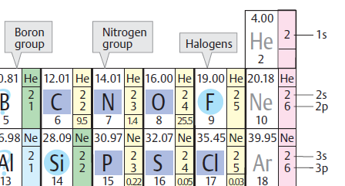
Hydrogen bond
δ−
δ+
δ−
electronegative atom (O, N)
electronegative atom with lone electron pair (O, N)

Slide 12
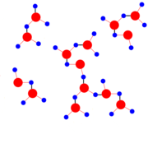
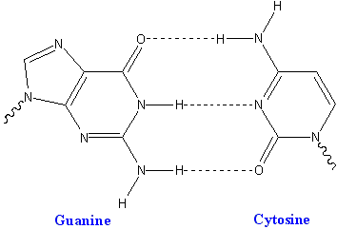
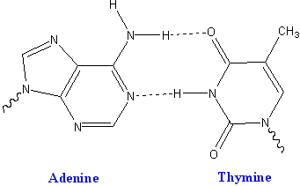
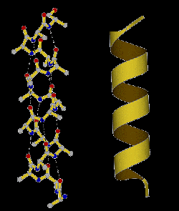
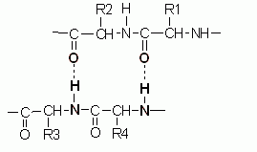
Hydrogen bond
crucial importance for biology
properties of water
nucleobase pairing
protein structures
protein-DNA interactions
many others

Slide 13
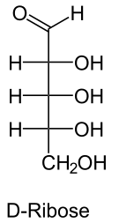
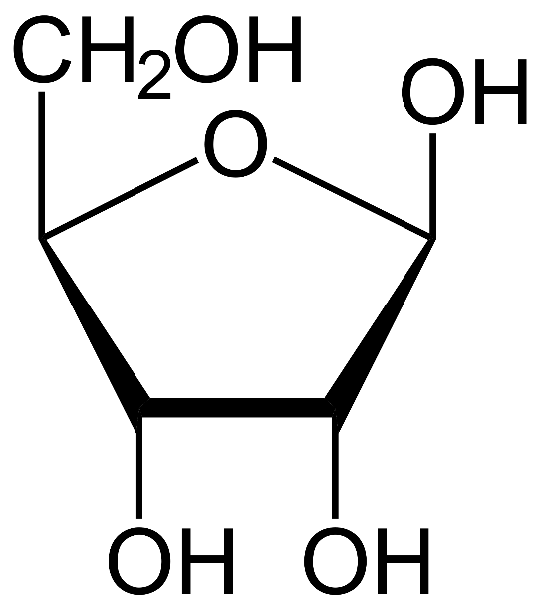
N-glycosidic bond
anomers:
α (hemiacetal hydroxyl „down“) β („up“ as here)
hemiacetal
(more exactly: in β anomer the hemiacetal hydroxyl is on the same side of the furanose ring as the -CH₂OH group)
β-D-ribofuranose

Slide 14
N-glycosidic bond
HO-R
O-glycosides
substitution of hemiacetal OH
(condensation reaction)
N-glycosides
- H₂O
β-D-ribofuranose

Slide 15
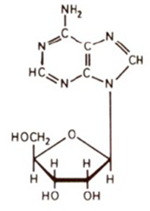
N-glycosidic bond
nucleoside formation
- H₂O
β-D-ribofuranose
nucleoside

Slide 16

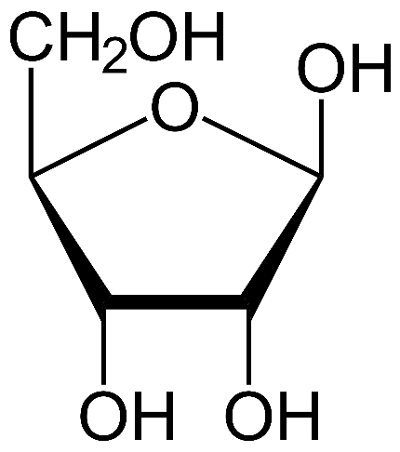
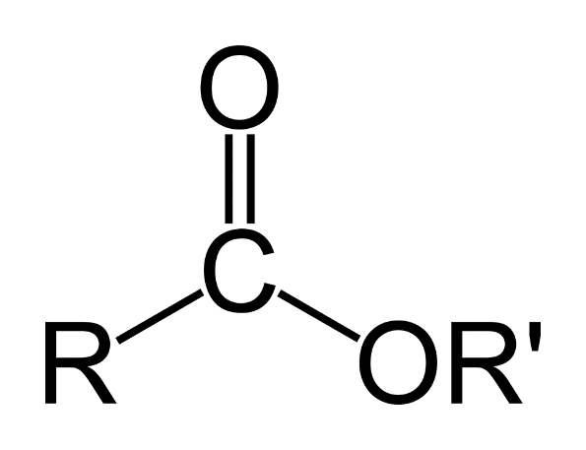
Ester bonds
H
H
esters: products of condensation of acids with alcohols
substitution of –OH of the acid with –OR
phosphoric acid (dihydrogen phosphate)
- H₂O
phosphodiester
carboxy ester
- H₂O
-OH
H-

Slide 17
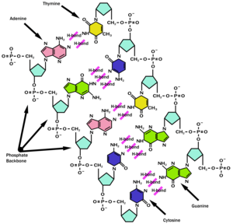

Slide 18
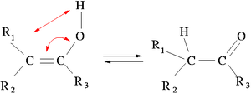
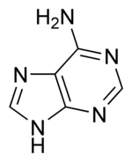
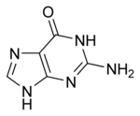
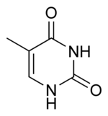
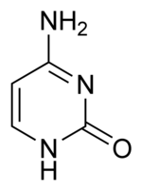
Tautomers
isomers enol-keto, amino-imino
double bond switch plus hydrogen/proton migration
in nucleobases: critical effect on pairing properties
6-substituents in purines + 4-substituents in pyrimidines: oxygenous=keto, nitrogenous=amino
hydrogen yes or not on the neighboring ring nitrogen
relation to chemical mutagenesis
6
4

Slide 19

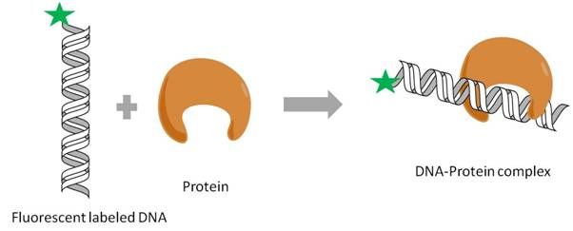
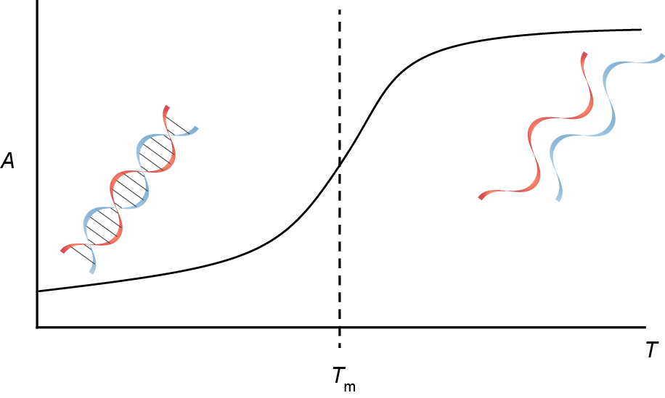
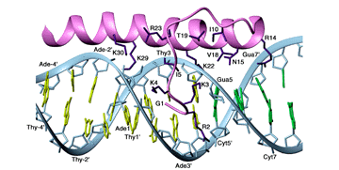
Energetics of interactions (including structure)
absolute temperature
<0
less ordered
ordered
Gibbs energy
enthalpy
(reaction heat)
entropy
(disorder)
hydrogen bonds
stacking
(heat released)
bonds broken (consumes heat)
ordered
disordered
network of „weak“ bonds– released heat
(H-bonds, electrostatic...)

Slide 20
DNA structure

Slide 21
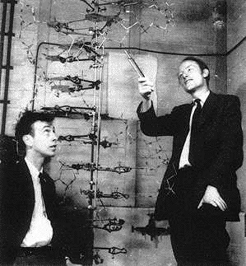
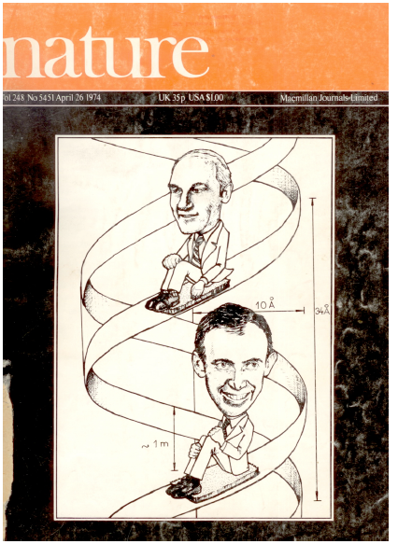
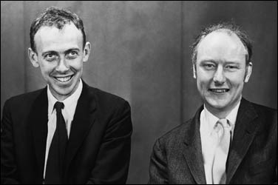
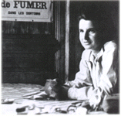
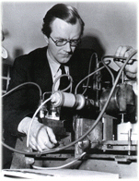
1953: James Watson, Francis Crick, Rosalind Franklin, Maurice Wilkins: the DNA double helix
1962: Nobel Prize (JW, FC, MW)
basic principle of the preservation, transfer and expression of genetic information explained

Slide 22
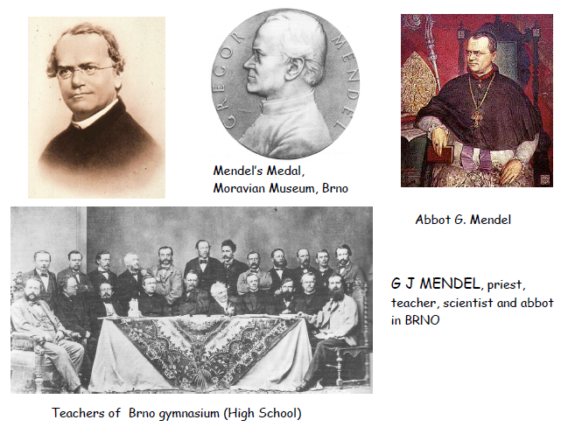
Mendel 1864: „elements of heredity“, Mendel laws

Slide 23
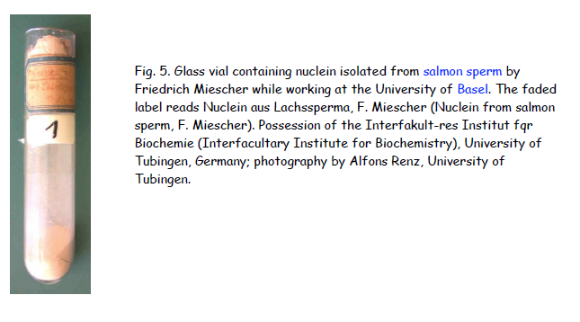
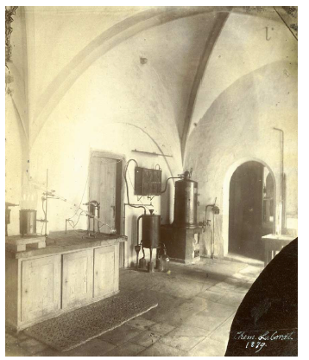
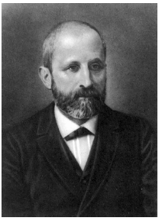
Miescher 1871: discovered „nuclein“, a substance occuring in cell nuclei

Slide 24
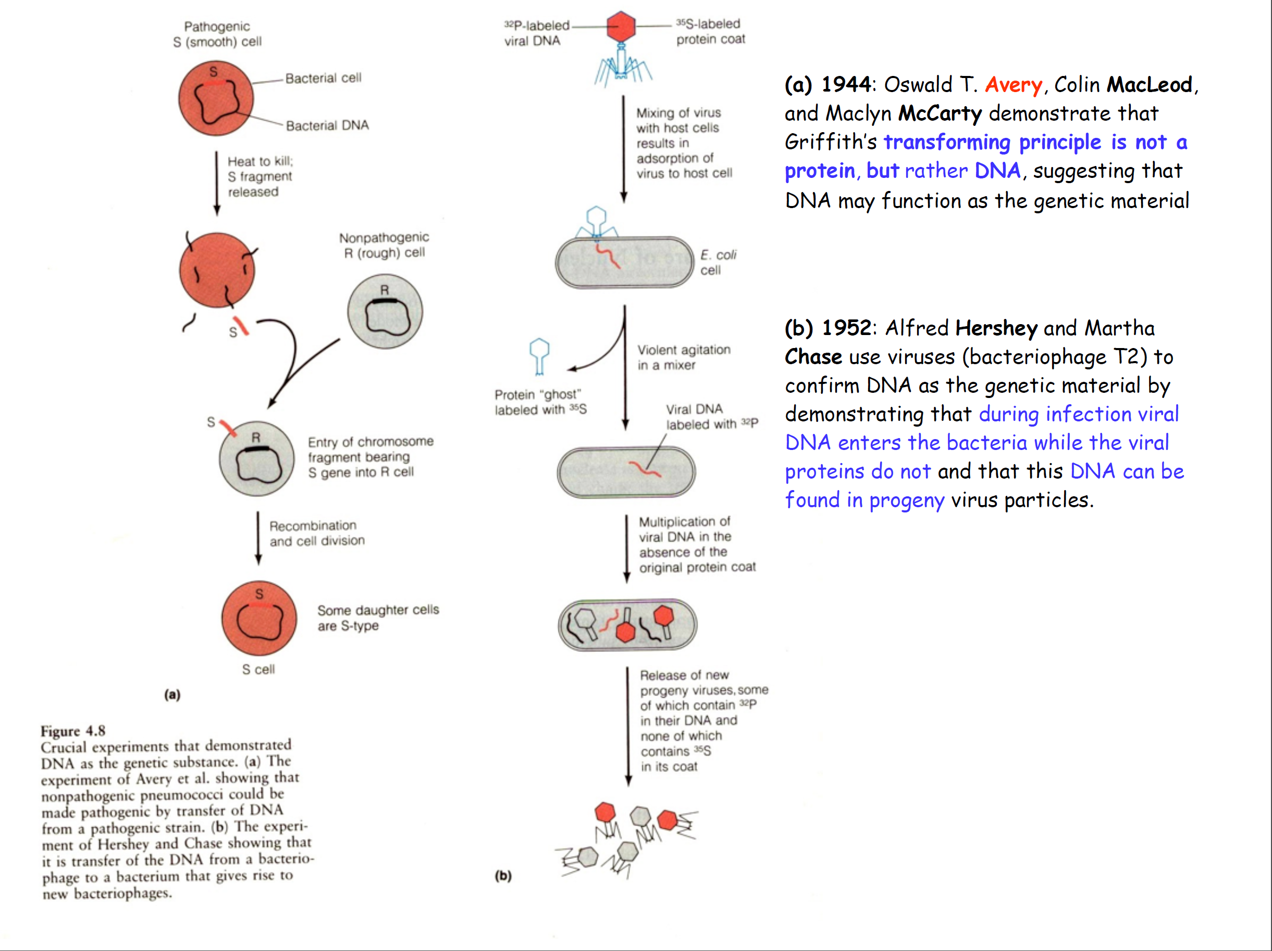
DNA is the genetic material (1944 Avery, 1952 Hershey)

Slide 25
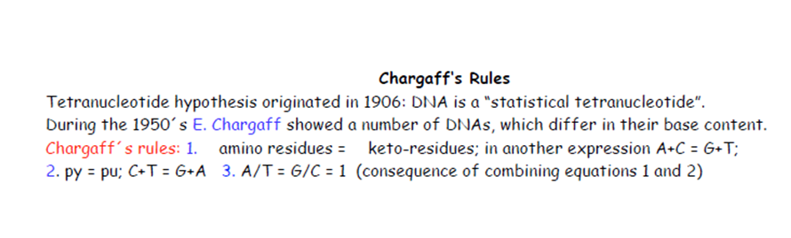
amino pairs with keto
purine pairs with pyrimidine
consequently, A pairs with T and G with C
nitrogen in the ring: donor or acceptor of H bond

Slide 26
Tautomers
isomers enol-keto, amino-imino
double bond switch plus hydrogen/proton migration
in nucleobases: critical effect on pairing properties
6-substituents in purines + 4-substituents in pyrimidines: oxygenous=keto, nitrogenous=amino
hydrogen yes or not on the neighboring ring nitrogen
6
4

Slide 28
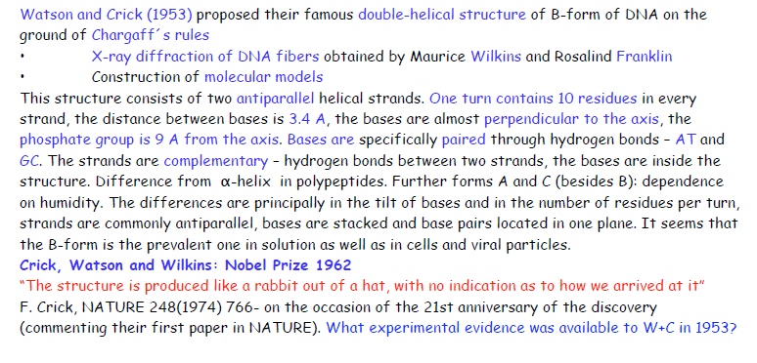

Slide 29
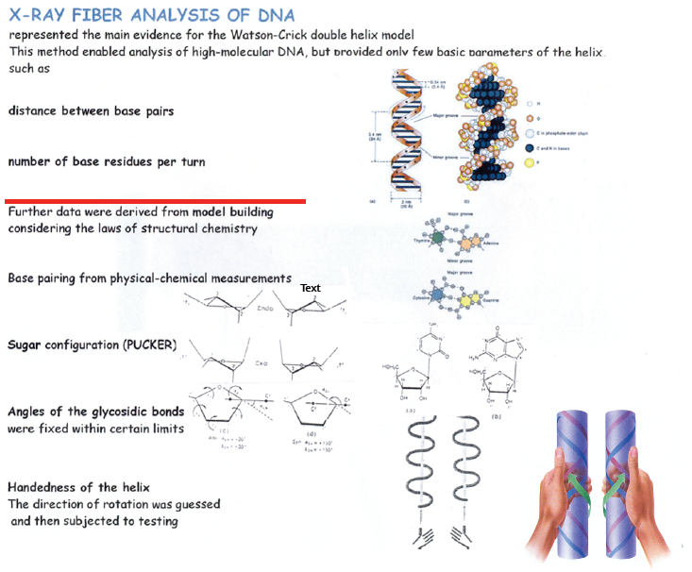
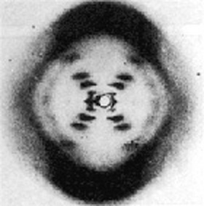

Slide 30
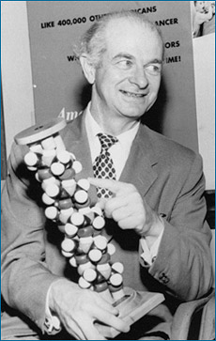
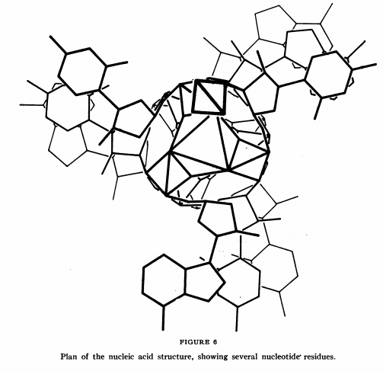
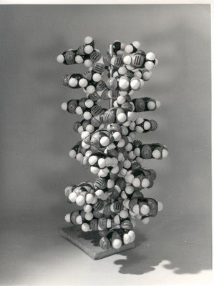
Linus Pauling – suggested triple helix structure with bases outside - INCORRECT
Other concepts: ladder (not interwound) structure (to overcome topological problems with unwinding the double helix)

Slide 31
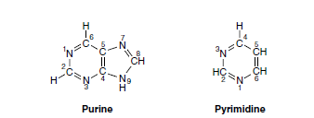
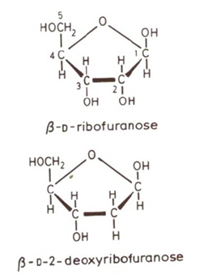
Building blocks of nucleic acids: bases and pentoses
RNA
Sugar numbering in nucleosides: 1‘, 2‘....5‘
DNA

Slide 32
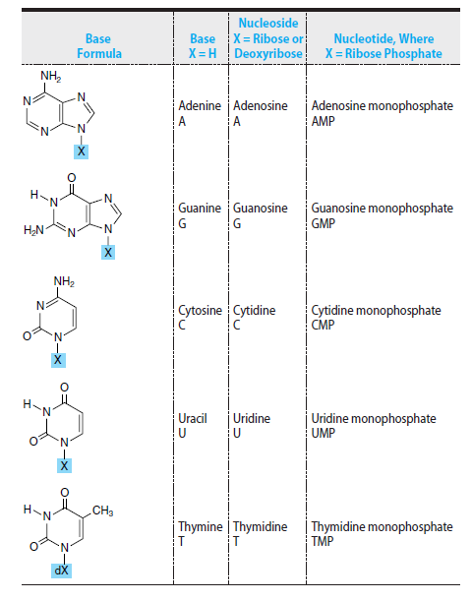
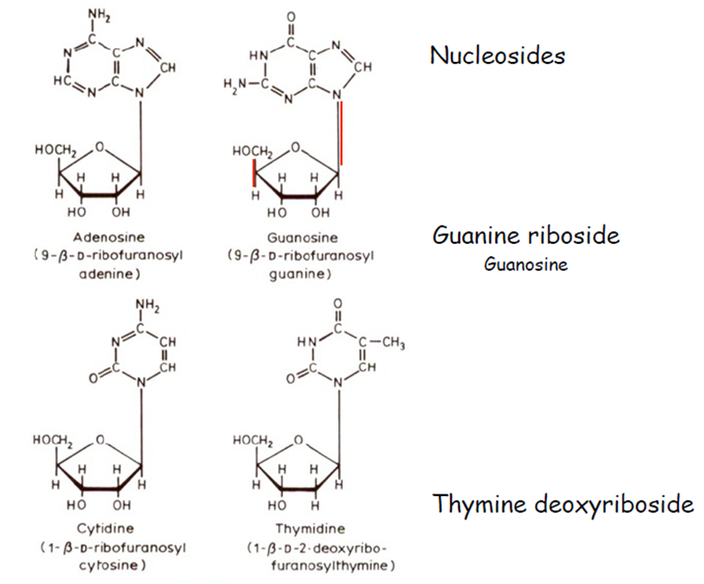
always β anomer

Slide 33
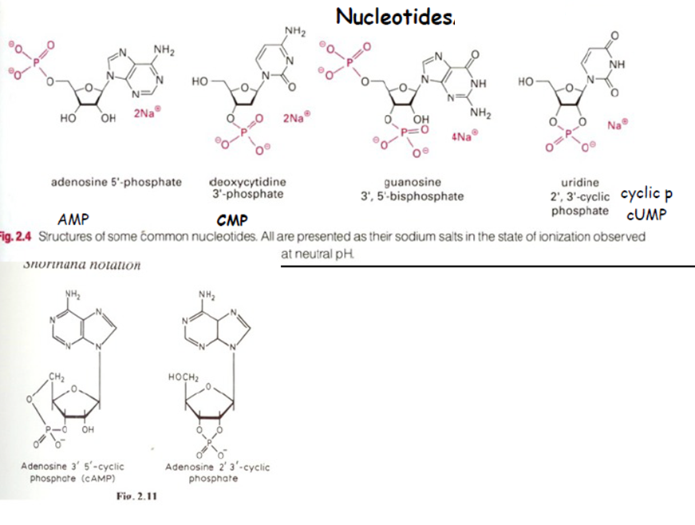




Slide 34
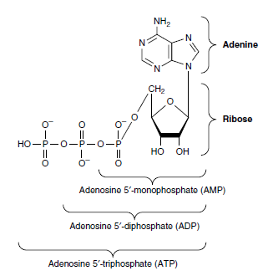
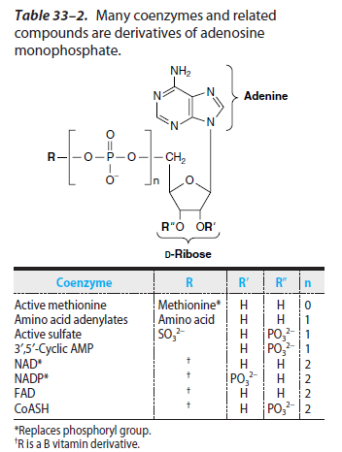
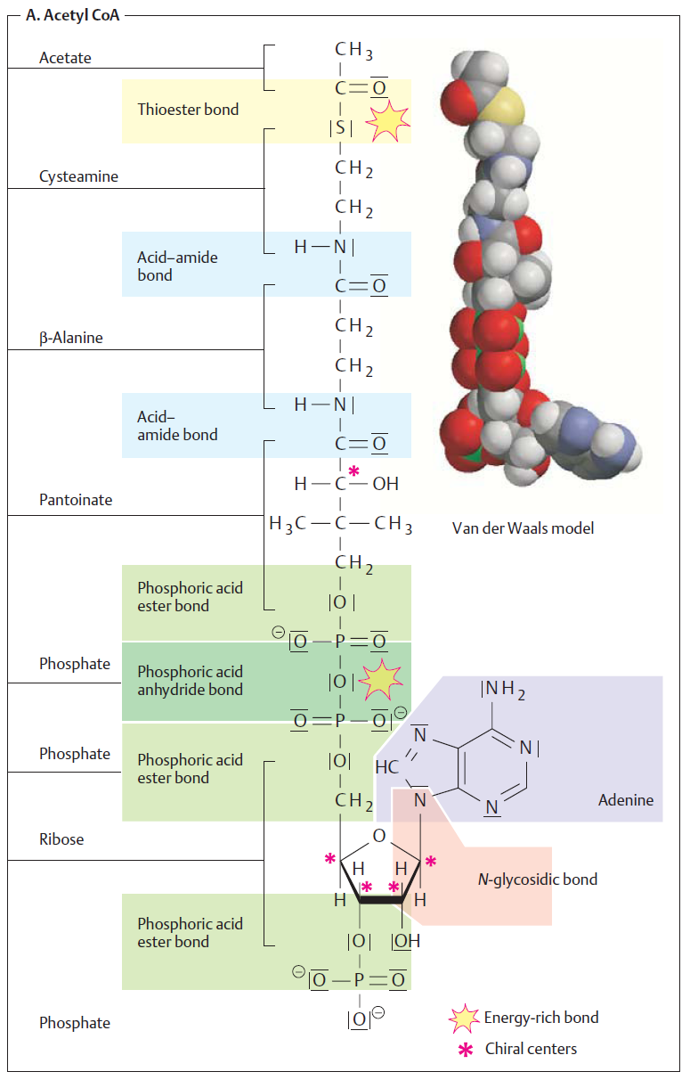
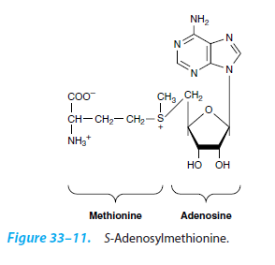
ATP
methyl donor
for methylation reactions

Slide 35
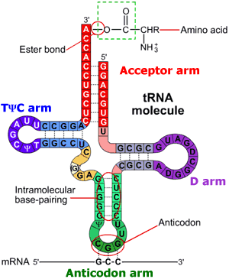

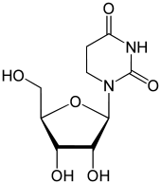
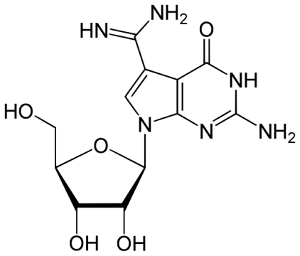
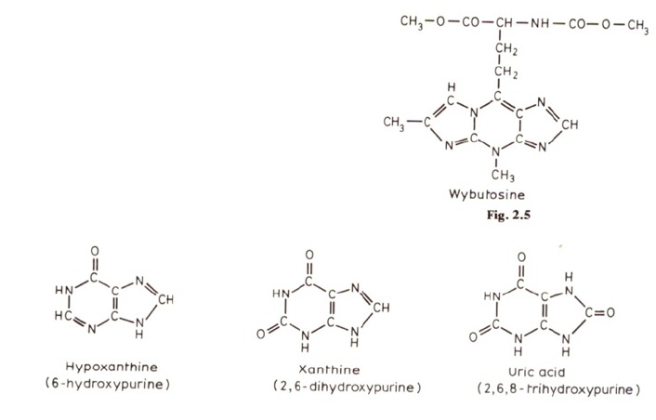
Unusual bases and nucleosides
5
in archeae
dihydrodouridine
archaeosine
pseudouridine
in tRNA
tRNA^{Phe}
adenine deamination
guanine deamination
catabolism of purines
nucleoside=inosine (I)

Slide 36



Watson-Crick base pairs
(„canonical“)
wobble pairs (examples)
(in fact canonical)

Slide 37



Slide 38

Stacking
-interakce mezi paralelně orientovanými páry bazí
-překryv π-orbitalů aromatických kruhů
-interakce s jinými molekulami (interkalátory, zbytky aromatických aminokyselin při interakcích DNA-protein)

Slide 39


Slide 40


Slide 41




Slide 42


Slide 43
Multistranded DNA structures
triplexes
tetraplexes (quadruplexes)

Slide 44

Hoogsteen base pairs (triads)
cytosine protonation

Slide 45


Triplex DNA
(homopurine·homopyrimidine stretch of suitable sequence)
e.g. TTTTTTTTTTTTTTTTTTTTTTTTTTTTTTTTTTTTTTTT
AAAAAAAAAAAAAAAAAAAAAAAAAAAAAAAAAAAAAAAA
TTTTTTTTTTTTTTTTTTTTTTTTTTTTTTTTTTTTTTTT
(intermolecular triplex)

Slide 46





Guanine tetrad
Guanine tetraplex
tetramolecular
parallel
bimolecular
antiparallel
intramolecular
parallel
intramolecular
antiparallel

Slide 47


cytosine tetraplex (i-motif)
metal ion-mediated pairing
(non-physiological)
hemiprotonated C⁺•C pair

Slide 48
Chemical reactivity of DNA

Slide 49
Chemical reactivity of DNA
DNA chemistry is derived from chemistry of its costituents
phosphodiester bonds
N-glycosidic bonds
deoxyribose
nitrogenous bases
2-deoxyribose
phosphate

Slide 50
Chemical modification of DNA:
damage to the genetic material
analytical use

Slide 51

DNA hydrolysis
both phosphodiester and N-glycosidic bonds susceptible to acid hydrolysis
N-glycosidic bond more stable toward hydrolysis in pyrimidine than in purine nucleosides (and more in ribo- than in deoxynucleosides)
stable in alkali (unlike RNA)
alkali-labile sites: upon DNA damage
enzymatic hydrolysis (N-glycosylases, nucleases, phosphodiesterases)

Slide 52



Oxidation
two main sites susceptible to oxidation attacks:
  C8 of purines (ROS)
  C5-C6 of pyrimidines
+

Slide 53

reactions with nucleophiles
C4 and C6 are centres of electron deficit in pyrimidine moieties (electrophile centres)
reaction with hydrazine: pyrazole derivative and urea residue bound to the sugar
with T the reaction is disfavored in high salt: Maxam-Gilbert sequencing technique

Slide 54


reactions with nucleophiles
hydroxylamine: cytosine modification
the products‘ preferred tautomer pairs with adenine →mutagenic
bisulphite: cytosine modification inducing its deamination to uracil →mutagenic
5-methyl cytosine does not give this reaction: genomic sequencing
of 5^{m}C

Slide 55


reactions with electrophiles
attacking N and/or O atoms
nitrous acid (HNO₂) causes base deamination (C→U, A→I) – affecting base pairing, mutagenic
aldehydes: reactions with primary amino groups
formaldehyde: two step reaction

Slide 56


DNA alkylation
hard or soft alkylating agents
hard ones attack both N and O atoms, soft only N
dimethyl sulfate: typical soft alkylating agent
N-alkyl-N-nitroso urea: typical hard alkylating agent
modifies all N + O in bases as well as phosphate groups (forming phosphotriesters)
analytical use (sequencing, foorprinting)

Slide 57

Biological consequences of base alkylation
N-alkylation: the primary site = N7 of guanine (accessible in both ss and dsDNA)
  does not change base pairing; easily repairable
N3 of adenine or guanine: located in minor groove
  cytotoxic modification (DNA/RNA polymerization blocked)
N1 of guanine: interferes with base pairing
O-alkylation (G-O6, T-O6) the bases „locked“ in enol forms → improper base pairing → mutagenic

Slide 58



Tautomerization, base pairing and chemical mutagenesis
similarly uracil is deamination product of cytosine

Slide 59





chloro- (bromo-) acetaldehyde: two reactive centres (aldehyde and alkylhalogenide)
reaction with C or A
chemical probes (react only with unpaired bases)
diethyl pyrocarbonate: acylation of purines (primarily A) or C
modification leads to opening of the imidazole ring
chemical DNA probing

Slide 60
Metabolically activated carcinogens
some substances became toxic after their metabolic conversion
detoxifying machinery of the organism acts here as a bad fellow
microsomal hydroxylase complex, cytochrome P450
the role of this system is to introduce suitable reactive groups into xenobiotics enabling their conjugation with other molecules followed by removal from the organism
but….

Slide 61

Metabolically activated carcinogens
aromatic nitrogenous compounds (amines, nitro- or azo- compounds):
aromatic amines are converted into either (safe) phenols, or (dangerous) hydroxylamine derivatives
azo- compounds: „cleaved“ into amines
nitro- compounds: reduced into hydroxylamines

Slide 62


Metabolically activated carcinogens
polycyclic aromatic hydrocarbons like benzo[α]pyrene: three-step activation
  P450 introduces epoxy group
  epoxide hydrolase opens the epoxide circle
  P450 introduces second epoxy group
DNA adduct formation (primarily -NH₂ of guanine, then G-N7, G-O6 and A-N6)
similar pathway of
aflatoxin activation
bay region

Slide 63




anticancer drugs
some types of antineoplastic agents act via formation of DNA adducts
metallodrugs: mainly platinum complexes
(ineffective)

Slide 64
cisplatin: reaction with DNA in certain sequence motifs
some adduct types preferred (and/or more stable than others)
1,2-GG and 1,2-AG IACs = the main cytotoxic lesions

Slide 65


other platinum complexes tested as cytostatics

Slide 66


Photochemical DNA modifications
mainly pyrimidines
excitation at 240-280 nm: reactive singlet state
water addition at C5-C6
excitation at 260-280 nm: photodimerization of pyrimidines
photoproducts of C can deaminate to U (mutagenic effects)

Slide 67

effects of ionizing radiation
mostly indirect – through water radiolysis
each 1,000 eV produces ~27 •OH radicals that attack DNA
sugar damage:abstraction of hydrogen atoms from C-H bonds
a series of steps resulting
in strand breakage

Slide 68


effects of ionizing radiation
base damage: hydroxylation and/or (under aerobic conditions) peroxylation
pyrimidine products
purine products (mainly C8 hydroxylation or opening of the imidazole ring)

Slide 69

chemical nucleases
species containing redox active metal ions mediating production of hydroxyl radicals (or othe reactive oxygen species) via Fenton and/or Haber-Weiss processes
Me^{n} + H₂O₂ → Me^{n+1} + •OH + OH⁻
iron/EDTA complex
Cu(phen)₂ complex
Fe or Cu
bleomycine

Slide 70
Chemical approaches in DNA studies
(several examples)

Slide 71
Maxam and Gilbert method of DNA sequencing

Slide 72
G
DMS
(preferential methylation of G at N7; spontaneous depurination)
HCOOH
(acid depurination)
A
T
hydrazine (modification
&breakdown of the pyrimidine ring)
C
hydrazine+NaCl
(selective modification of cytosine)
at sites of base modification (removal) the sugar-phosphate backobone is labile towards alkali
treatment with hot piperidine → cleavage at such sites

Slide 73
DNA fragment is end-labeled (radionuclide, fluorophore)
the sample is divided into four reactions (HCOOH, DMS, hydrazine, hydrazine + NaCl)
the conditions are chosen to reach only one modification event per DNA molecule

Slide 74
G
G
G
G
A
A
A
A
T
T
T
T
T
C
HCOOH
C
C
C
C
or
or
or
G
G
G
G
A
A
A
A
T
T
T
T
T
C
C
C
C
C

Slide 75
G
G
A
A
T
T
C
C
piperidine
A
T
A
C
T
C
only the „subfragment“ bearing the label is „visible“ in the following detection step

Slide 76
G
A
A
autoradiography
T
piperidine
T
T
HCOOH
PAGE
C
C
C
G
G
or
G
or
or
A
A
A
A
T
T
T
T
T
C
C
C
C
C

Slide 77
Hydrazine
+NaCl
hydrazine
HCOOH
DMS
G
A
T
C
G
A
T
C

Slide 78


Slide 79
DNA „footprinting“: determination of binding sites of other molecules (e.g. proteins)
at the DNA sequence level

Slide 80
complex
free DNA
DMS (guanine) piperidine
DNaseI
UO₂ UV
Cu(phen)₂
OH radicals

Slide 81
single strand-selective chemical probes

Slide 82


Open local structures in negatively supercoiled DNA
relaxed circular DNA
negatively supercoiled DNA (linking deficit)
stress related to the negative superhelicity (the linking deficit) can be absorbed in local open structures

Slide 83



Open local structures in negatively supercoiled DNA
DNA segments of specific sequence can adopt „alternative“ local structures
cruciform DNA (inverted repeat)
unpaired bases

Slide 84
Open local structures in negatively supercoiled DNA
Triplex DNA
(homopurine·homopyrimidine stretch with mirror symmetry)
e.g. TTTTTTTTTTTTTTTTTTTTTTTTTTTTTTTTTTTTTTTT
AAAAAAAAAAAAAAAAAAAAAAAAAAAAAAAAAAAAAAAA
TTTTTTTTTTTTTTTTTTTTTTTTTTTTTTTTTTTTTTTT
(intermolecular triplex)

Slide 85


Otevřené lokální struktury v negativně nadšroubovicové (sc) DNA
Intramolecular triplex
(homoPu•homoPy segment within negatively supercoiled DNA)
T
T
A
T
A
A
A
A
A
A
T
T
T

Slide 86
Chemicals selectively reacting with unpaired bases:
osmium tetroxide complexes
(Os,L)
(T, more slowly C)
chloroacetaldehyde
(CAA)
(A, C)
diethyl pyrocarbonate
(DEPC)
(A, G)

Slide 87

carbodiimide
steric clash
steric clash
footprinting of CGC+ triplex by DMS
carbodiimide

Slide 88

Using the Maxam-Gilbert technique, it is possible to determine with a high preciseness which nucleotides are forming the local structure
modification of supercoiled DNA
restriction cleavage, radiactive labeling
hot piperidine
sequencing PAGE
the structure can be deduced from the modification pattern
TTTTTTTTTTTTTTTTTTTTTTTTTTTTTTTTTTTTTTTT
AAAAAAAAAAAAAAAAAAAAAAAAAAAAAAAAAAAAAAAA

