Slide 1
Nonsense mediated mRNA decay
NGS, Repeat primed-PCR

Slide 2
Neuromuskulární nemoci (NMD)
NMD narušují funkci svalu a to buď přímo v důsledku patologie svalu nebo nepřímo v důsledku patologie nervů a neuromuskulárních spojení.
780 typů NMD
16 skupin NMD
417 genů
http://www.musclegenetable.fr
1. Muscular dystrophies | 5. Other myopathies | 9. Metabolic myopathies | 13. Hereditary ataxias
2. Congenital muscular dystrophies | 6. Myotonic syndromes | 10. Hereditary cardiomyopathies | 14. Hereditary motor and sensory neuropathies
3. Congenital myopathies | 7. Ion channel muscle diseases | 11. Congenital myasthenic syndromes | 15. Hereditary paraplegias
4. Distal myopathies | 8. Malignant hyperthermia | 12. Motor neuron diseases | 16. Other neuromuscular disorders

Slide 3
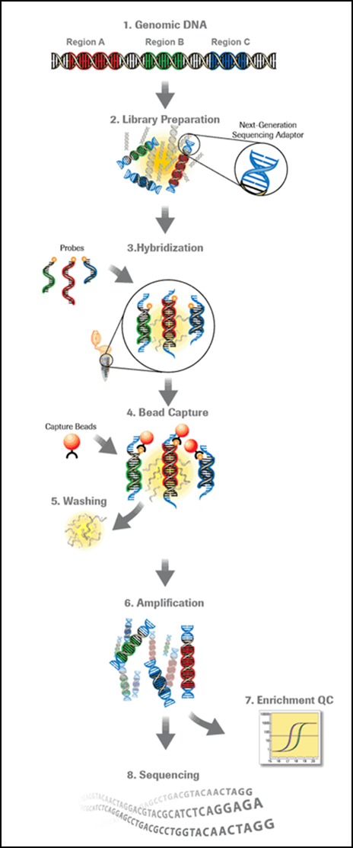
NGS v diagnostice NMD
NMD – klinická a genetická heterogenita → většinou obtížné vytypovat určitý gen pro analýzu → vyžití technik sekvenování nové generace
  Sekvenace genů spojených s následujícími skupinami NMD
  Svalové dystrofie
  Kongenitální svalové dystrofie
  Kongenitální myopatie
  Distální myopatie
  Další myopatie
  Myotonické syndromy
  Svalové nemoci spojené s iontovými kanály
  Maligní hypertermie
  Hereditární kardiomyopatie
  Kongenitální myastenické syndromy
  Nemoci motorického neuronu
  Další neuromuskulární nemoci
Celkem 250 genů

Slide 4
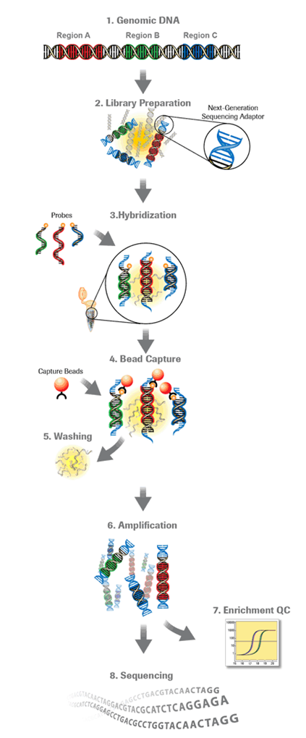
„Sequence Capture“ (SeqCap EZ Choice Library, NimbleGen) a
cílená sekvenace (MiSeq, NextSeq, Illumina)
Postup:
Zadání cílových úseků, design sond
Příprava knihovny – fragmentace DNA pacienta, …..
Hybridizace DNA pacienta se sondami s navázaným biotinem
Vychytání komplexu sonda-fragment DNA pacienta pomocí magnetických kuliček s navázaným streptavidinem
Amplifikace „vychytané“ DNA pacienta
Sekvenace

Slide 5
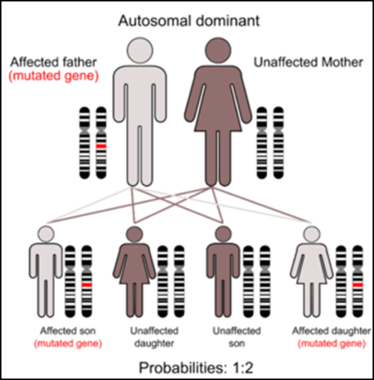
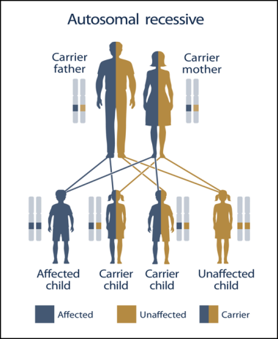
„Sequence capture“ a cílená sekvenace, nevýhody
RYANODINE RECEPTOR 1; RYR1
Nelze detekovat rozsáhlejší delece/duplikace a velké přestavby v genech
Není vhodnou metodou pro nemoci spojené s expanzí/delecí repetitivních sekvencí
Sekvenujeme cca 95% vybraných oblastí
Location | Phenotype | Phenotype MIM number | Inheritance
19q13.2 | Central core disease | 117000 | AD, AR
 | King-Denborough syndrome | 145600 | AD
 | Minicore myopathy with external ophthalmoplegia | 255320 | AR
 | Neuromuscular disease, congenital, with uniform type 1 fiber | 117000 | AD, AR
 | {Malignant hyperthermia susceptibility 1} | 145600 | AD
Identifikace nových sekvenčních variant s neznámou kauzalitou

Slide 6
„Sequence capture“ a cílená sekvenace, kazuistika
Syn (NMD)
SeqCap-TR
LAMA2 (AR, kongenitální svalová dystrofie): p.(Asp267Asn)/p.(Glu1231*)
Otec (NMD):
LAMA2: p.(Asp267Asn)
SeqCap-TR
p.(Asp267Asn)/c.9095dupA
Matka (zdravá):
LAMA2:
p.(Glu1231*)
Autosomálně recesivní NMD u syna i otce

Slide 7
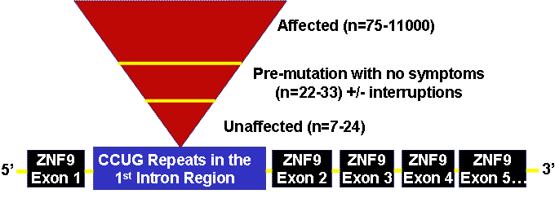
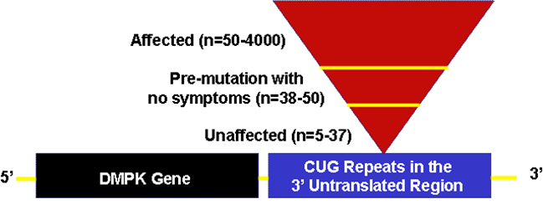
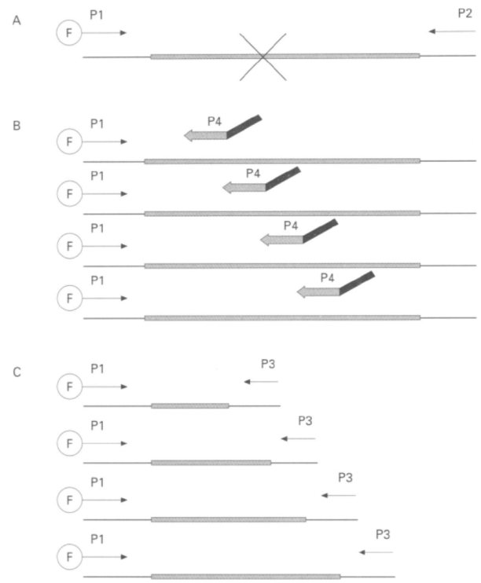
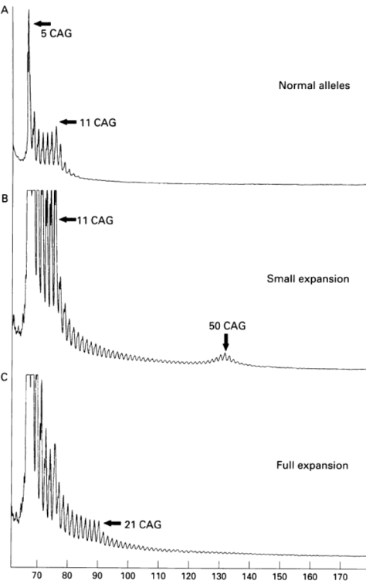
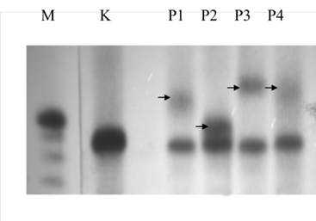
Myotonická dystrofie
MD1
Expanze CTG repetice v 3’UTR genu DMPK (19q13, dystrophia myotonica protein kinase)
AD dědičnost
MD2
Expanze CCTG repetice v 1. intronu genu ZNF9 (3q21, zinc finger 9 protein)
AD dědičnost
DNA diagnostika, metody:
Repeat-primed PCR
Souther blot a hybridizace
Warner JP, J Med Genet 1996

Slide 8
Repeat primed PCR (RP-PCR)
Stippled box represents
(CAG)n repeat. F shows 5' fluoresceinated primer.
(A) For large alleles exceeding 100 CAG the PCR using flanking primers P1 and P2 fails to give a product.
(B) RP-PCR: primers P1, P4, P3: in early amplification cycles primer P4 (the repeat specific 3' terminus) binds at multiple sites within CAG alleles giving rise to a mixture of products. Specificity is dictated by P1.
(C) The primer P3 amplifies from the end of products from previous amplification rounds. A long extension time is used to allow complete extension of the larger sized products within the PCR product mixture.
A 10:1 molar ratio of P3 to P4 ensures that primer P4 is exhausted in the early amplification cycles.
Warner JP, J Med Genet 1996

Slide 9

Electrophoreogram of PCR (primers P1 + P2)
The axis shows migration time in minutes. CAG allele sizes shown with the arrows.
(A) Trace obtained from a heterozygous normal subject. (B) Trace obtained from a heterozygous
subject with a small expansion. (C) Trace obtained from a patient with myotonic dystrophy and an expanded allele size of >4 kb as determined by Southern blot analysis. The larger allele fails to amplify.
Warner JP, J Med Genet 1996

Slide 10

Electrophoreogram of repeat-primed PCR (primers P1+P3+P4)
The axis shows migration time in minutes. CAG allele sizes shown with the arrows. Note the characteristic ladder with a 3 bp periodicity.
(A) Both alleles give peaks and all the intermediate priming sites give peaks.
(B) Both alleles give peaks as in (A).
(C) The ladder shows the presence of a large CAG allele undetectable using flanking primers.
Warner JP, J Med Genet 1996

Slide 11
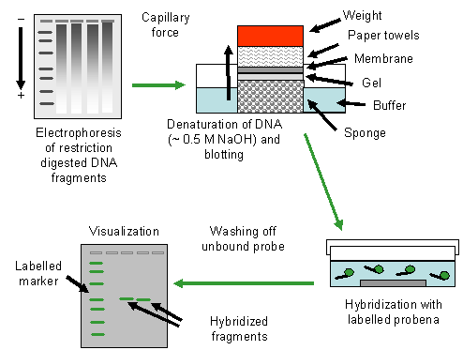

Restrikční štěpení DNA.
Elektroforetické rozdělení naštěpené DNA v agarózovém gelu
Southern blot:
0,25 M HCl - depurinace DNA
0,5M NaOH - denaturace DNA, rozštěpení cukr-fosfátové vazby v místě depurinace (účinnější přenos DNA z gelu na membránu).
Alkalický přenos DNA na membránu v 0.5 M NaOH (vazba negativně nabité DNA k pozitivně nabité membráně), různé možnosti.
Hybridizace s radioaktivně značenou sondou

Slide 12
Nonsense mediated mRNA decay
Detekce mutací v genu CAPN3 (LGMD2A)
PACIENT
MUTACE DETEKOVANÁ NA ALELE 1
MUTACE DETEKOVANÁ NA ALELE 2
1
245C>T, P82L
550delA, T184RfsX36
2
245C>T, P82L
2314-2317del,
D772delK773NfsX3
3
550delA, T184RfsX36
598-612del, F200_L204del
4
550delA, T184RfsX36
1468C>T, R490W
mRNA: homozygotní výskyt missense mutace nebo in-frame delece
DNA: heterozygotní výskyt missense mutace nebo in-frame delece + detekce mutace vytvářející předčasný terminační kodon (PTC)
→mRNA nesoucí PTC byla degradována mechanismem nonsense mediated mRNA decay

Slide 13
Nonsense mediated mRNA decay
Stanovení relativního množství mRNA genu CAPN3
Relativní množství mRNA v závislosti na typu mutace:
Pacient 1-4: non-PTC/non-PTC
Pacient 5-9: non-PTC/PTC
Pacient 10-12: PTC/PTC
non-PTC/non-PTC: 0,97
non-PTC/PTC: 0,37
PTC/PTC: 0,02

Slide 14
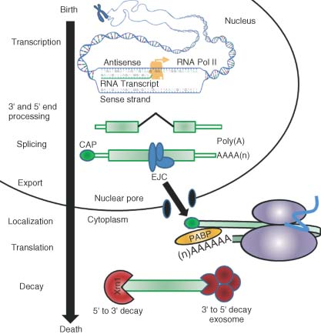
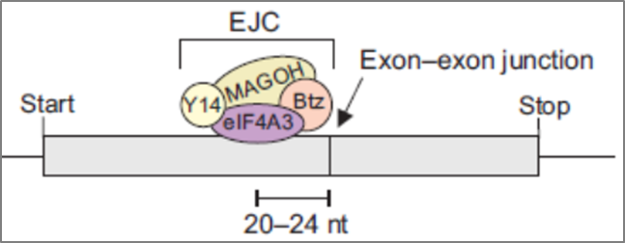
Nonsense mediated mRNA decay (NMD)
The process of eukaryotic gene expression involves a number of interlinked steps - transcription, splicing, polyadenylation, capping, translation, and mRNA degradation.
Intron splicing of pre-mRNA results in the deposition of the exon-junction complex (EJC) onto mRNA 20–24 nucleotides upstream of exon–exon junctions during splicing.
In cytoplasm, mRNA undergoes a pioneer round of translation which removes many of the proteins bound to the mRNA in the nucleus.
In the event that a ribosome terminates translation prematurely due to the presence of a PTC, EJCs downstream of the PTC will remain and recruit NMD effectors, forming functional NMD complexes.
Wiley Interdisciplinary Reviews – RNA, Vol. 1, Is. 1, 2010

Slide 16
In mammals, newly synthesized CPB80–CBP20-bound mRNA is targeted for NMD once mRNA has been generated by pre-mRNA processing and exported from the nucleus to the cytoplasm. During pre-mRNA processing, splicing results in the deposition of an EJC of proteins upstream of mRNA exon–exon junctions. EJC components include eIF4AIII, Y14, MAGOH, BTZ and many other proteins. The UPF3 (UPF3a) or UPF3X (UPF3b) join EJCs in the nucleus so as to be exported with mRNA to the cytoplasm. In the cytoplasm, UPF3 or UPF3X recruits UPF2. The translation of CBP80–CBP20-bound mRNA constitutes the pioneer round. Translation termination during the pioneer round at a PTC that is situated 50–55 nt upstream of an exon–exon junction (i.e. 25–30 nt upstream of an EJC) involves the SURF complex, which consists of the PI3K-related protein kinase that phosphorylates UPF1, SMG1, together with UPF1, eRF1 and eRF3. As a consequence, NMD generally occurs. During the process, UPF1 together with SMG1 is thought to bind EJC-associated UPF2
in a way that is promoted by CBP80. UPF1 binding to the EJC results in UPF1 phosphorylation. Phospho-UPF1 triggers NMD by promoting translational repression of the NMD target. Translational repression involves the binding of phospho-UPF1 to eIF3 within the 43S pre-initiation complex that is poised at the AUG translation initiation codon so as to prevent 60S ribosomal subunit joining. Phospho-UPF1 also promotes NMD by recruiting mRNA degradative activities. Not shown are SMG5, SMG6 and SMG7, which activate UPF1 dephosphorylation and thus recycling. SMG6 appears to additionally function as an endonuclease. Very recently, roles for SMG8 and SMG9 as SMG1-interacting proteins have been defined. Nucleolytic activities are indicated by the red irregular hexagons. PABP, poly(A)-binding protein, where darker shapes specify the largely nuclear PABPN1 and lighter shapes denote the largely cytoplasmic PABPC1; AUG, translation initiation codon; STOP, normal termination codon; 1, eRF1; 3, eRF3.
Maquat LE, 2010

Slide 17
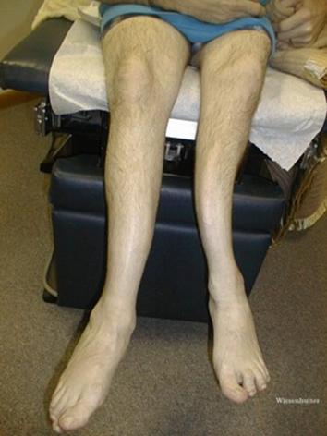
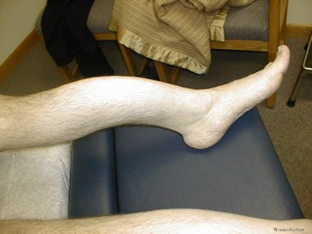
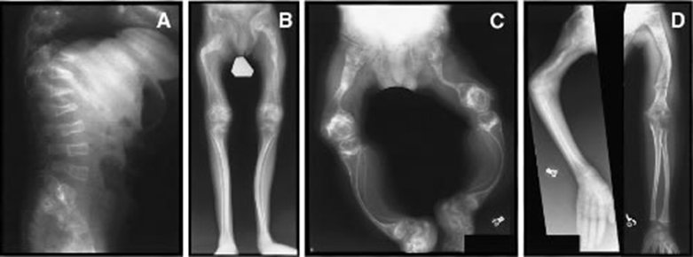
Nonsense mediated mRNA decay
NMD zhoršuje klinické projevy nemocí – Duchennova svalová dystrofie
NMD zmírňuje klinické projevy nemocí – Osteogenesis imperfecta
Osteogenesis imperfecta:
Mutace kolagenu typu I (geny COL1A1 a COL1A2); kolagen typu I - hlavní strukturní protein kostí, mutace mají za následek náchylnost k lomivosti kostí a deformitám skeletu.

Slide 18
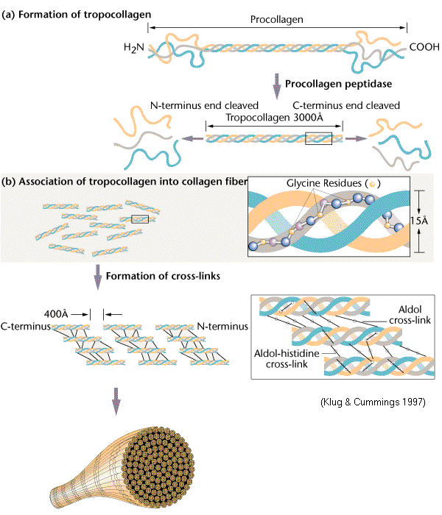
Osteogenesis imperfecta
Kolagen typu I – tvořen ze dvou řetězců prokolagenu α1 (COL1A1) a jednoho prokolagenu α2 (COL1A2).
Missense mutace asociované s genem COL1A jsou příklady dominantně-negativních alel ......... ruší konformaci kolagenových podjednotek a jsou spojeny s těžkými klinickými fenotypy osteogenesis imperfecta typu II–IV.
PTC mutace vyvolávající NMD (nevzniká mutantní protein účastnící se struktury) a jsou spojeny s mírnějšími klinickými fenotypy osteogenesis imperfecta typu I.

Slide 19
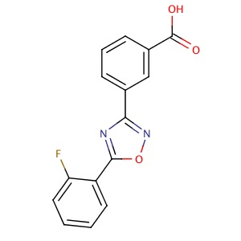
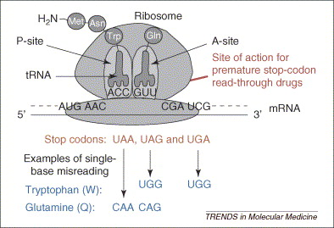
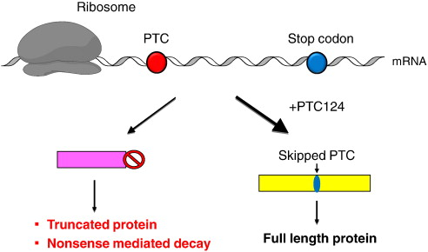
Nonsense mediated mRNA decay
Therapies based on translational read-through
PTC124 - a new drug in development for mutation-specific treatment of inherited diseases such as DMD, CF, ….
PTC124 is able to bind the decoding centre of the ribosome and decrease the accuracy of codon–anticodon pairing. The recognition of PTC is suppressed and, instead of chain termination, an amino acid is incorporated into the polypeptide chain.
PTC124 promotes read-through of PTCs without affecting normal stop codons. PTC124 is being investigated in clinical studies.

