Slide 1
Fast repetition reate Fluorometry
FRRF nebo také FRRf
Miloš Barták

Slide 2
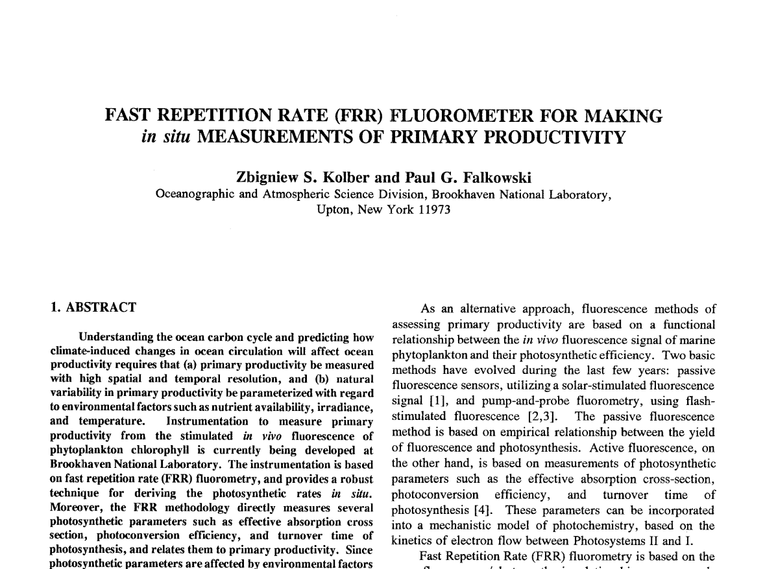
1992

Slide 3
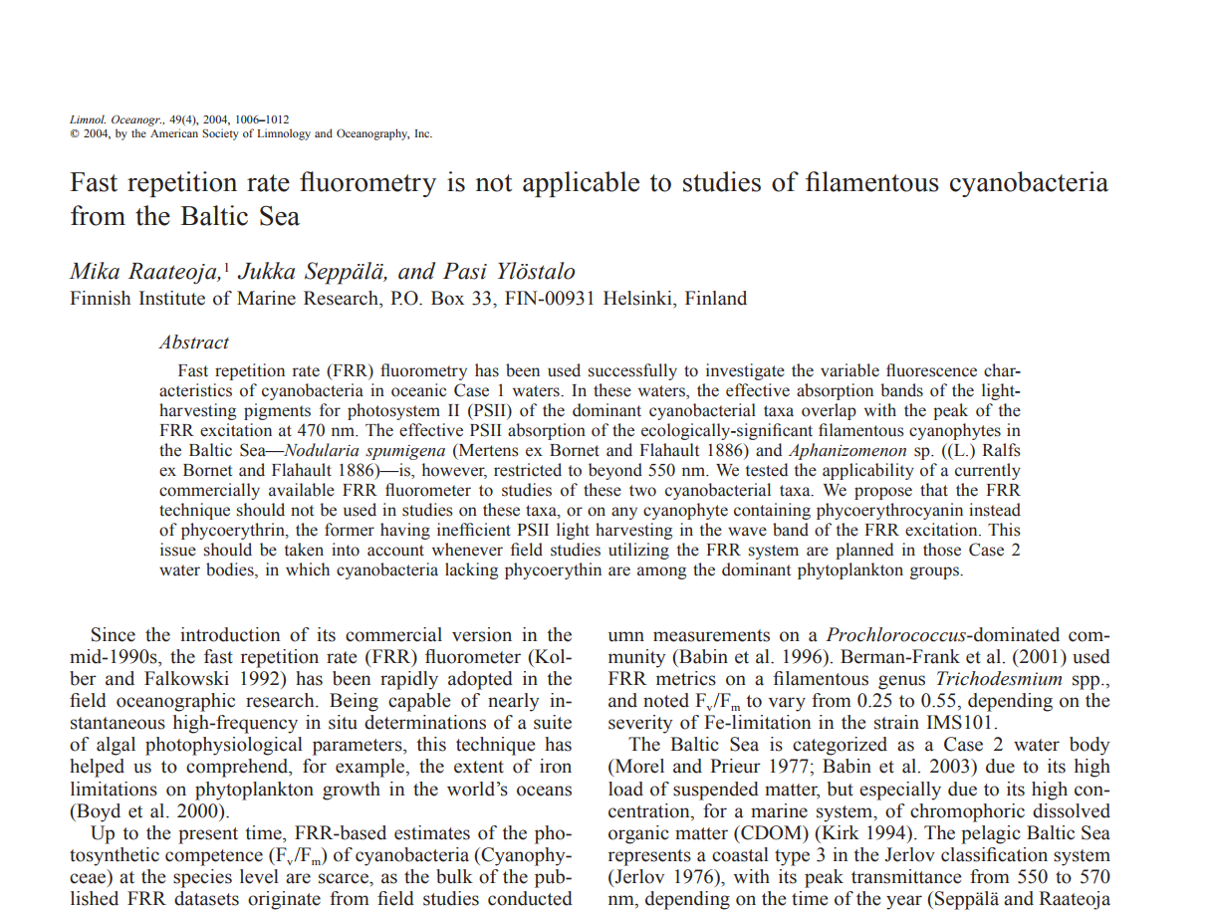

Slide 4
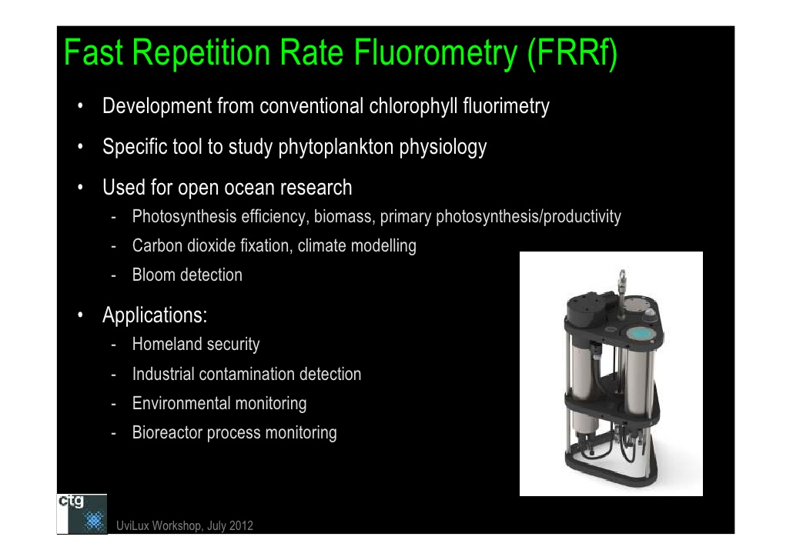

Slide 5
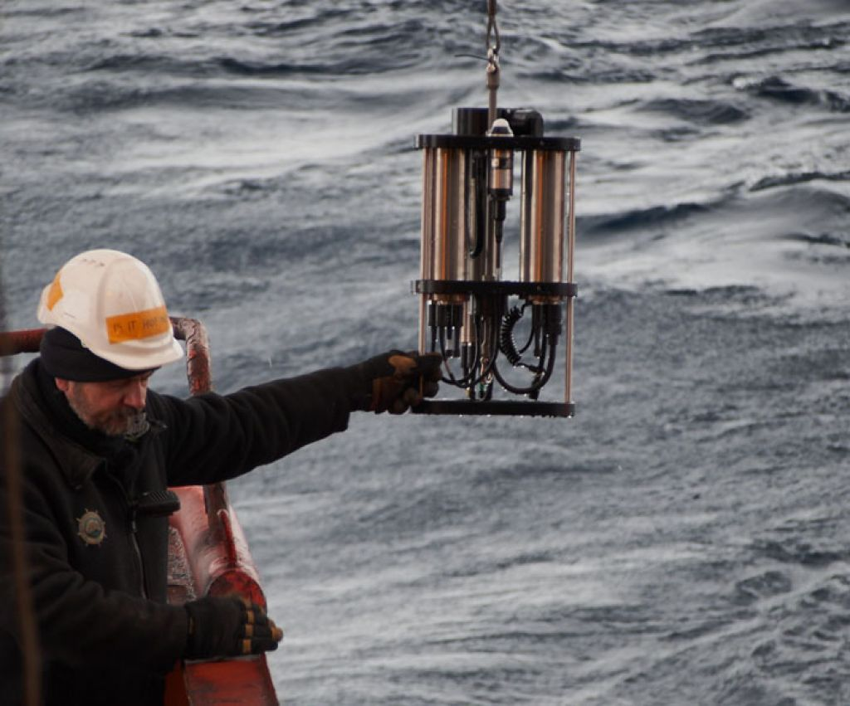

Slide 6
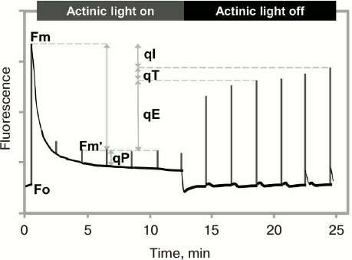

Slide 7
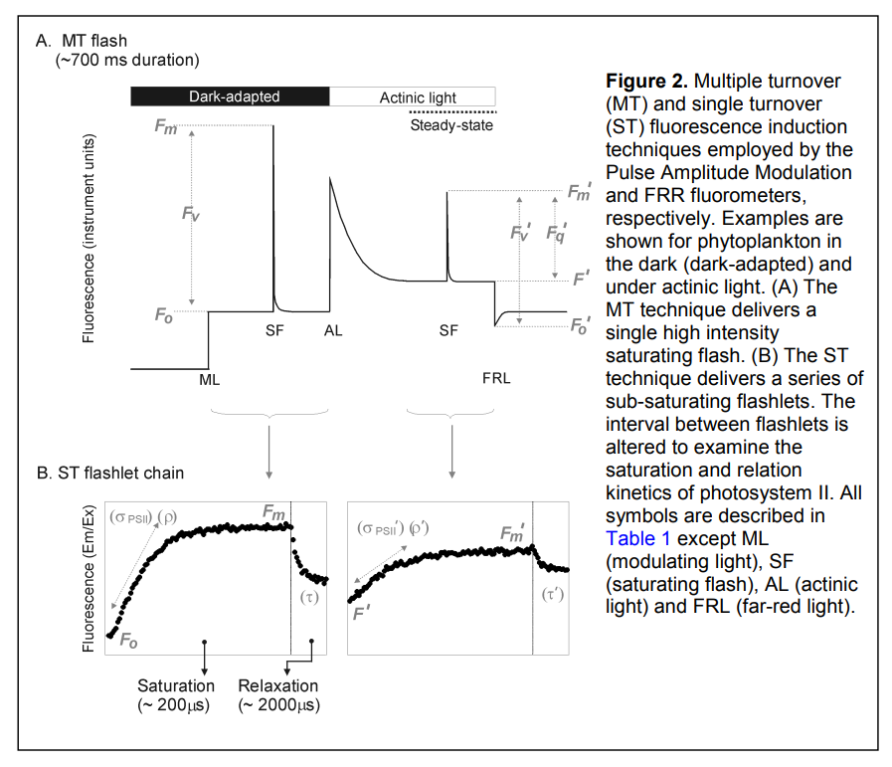

Slide 8
Úplně základní definice nezbytné pro pochopení
Metody FRRF
Právě jednou jsou všechna RC PSII zahlcena (zavřená)
a velmi rychle se ´překlopí´zpět do otevřeného stavu
Single turnover flash
The QA primary acceptor can be reduced with a minimal perturbation of the photosynthetic
electron transport chain by using a saturating flash of light that is short enough to ensure
a single turnover of Photosystem II reaction centers. The duration of the flash should be
shorter than few tens of microseconds. Such flashes have been experimentally realized by
pulsed lasers, xenon flashlamps

Slide 9
Úplně základní definice nezbytné pro pochopení
Metody FRRF
Multiple turnover flash
RC PSII jsou postupně zahlcena (zavřená) a primární akceptor přechází
Z oxidovaného (ready to transfer) do plně redukovaného stavu (not ready)
The QA primary acceptor is reduced with a further transfer of entery to the photosynthetic
electron transport causing gradual reduction of plastoquinone pool. The duration multiple turnover
flash should is about hundreds of miliseconds.

Slide 10
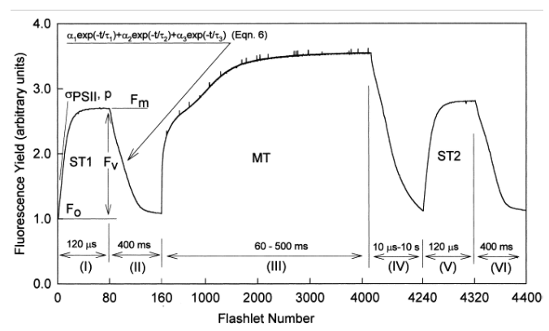

Slide 11
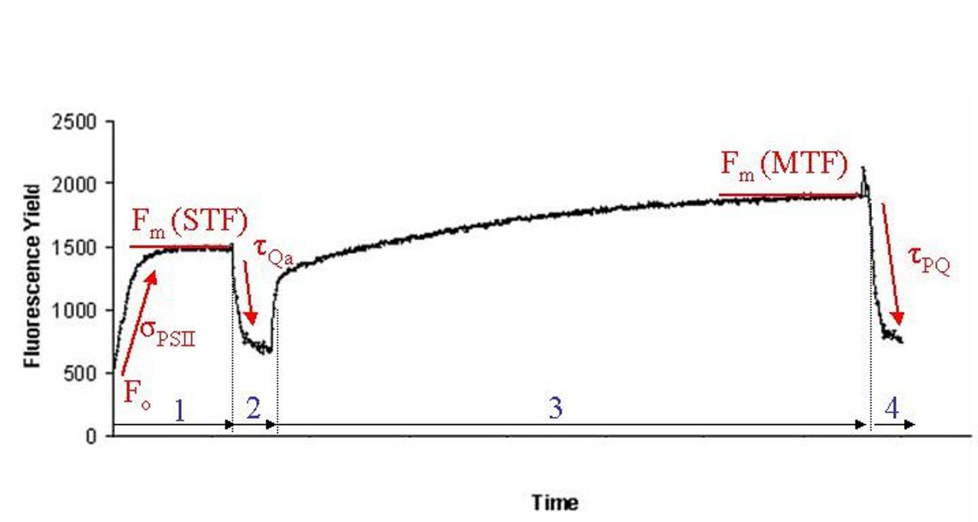

Slide 12
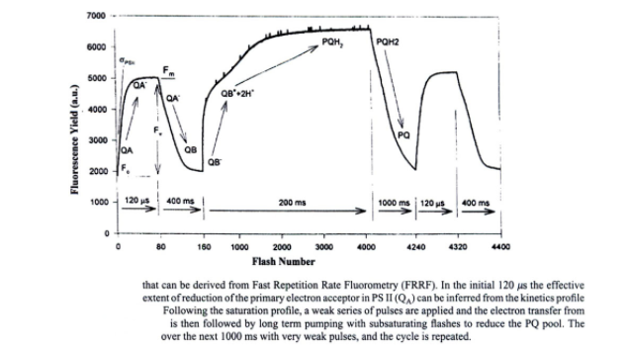

Slide 13
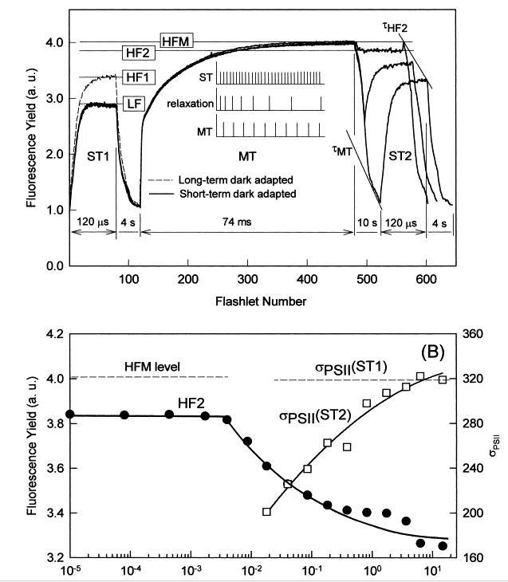

Slide 14
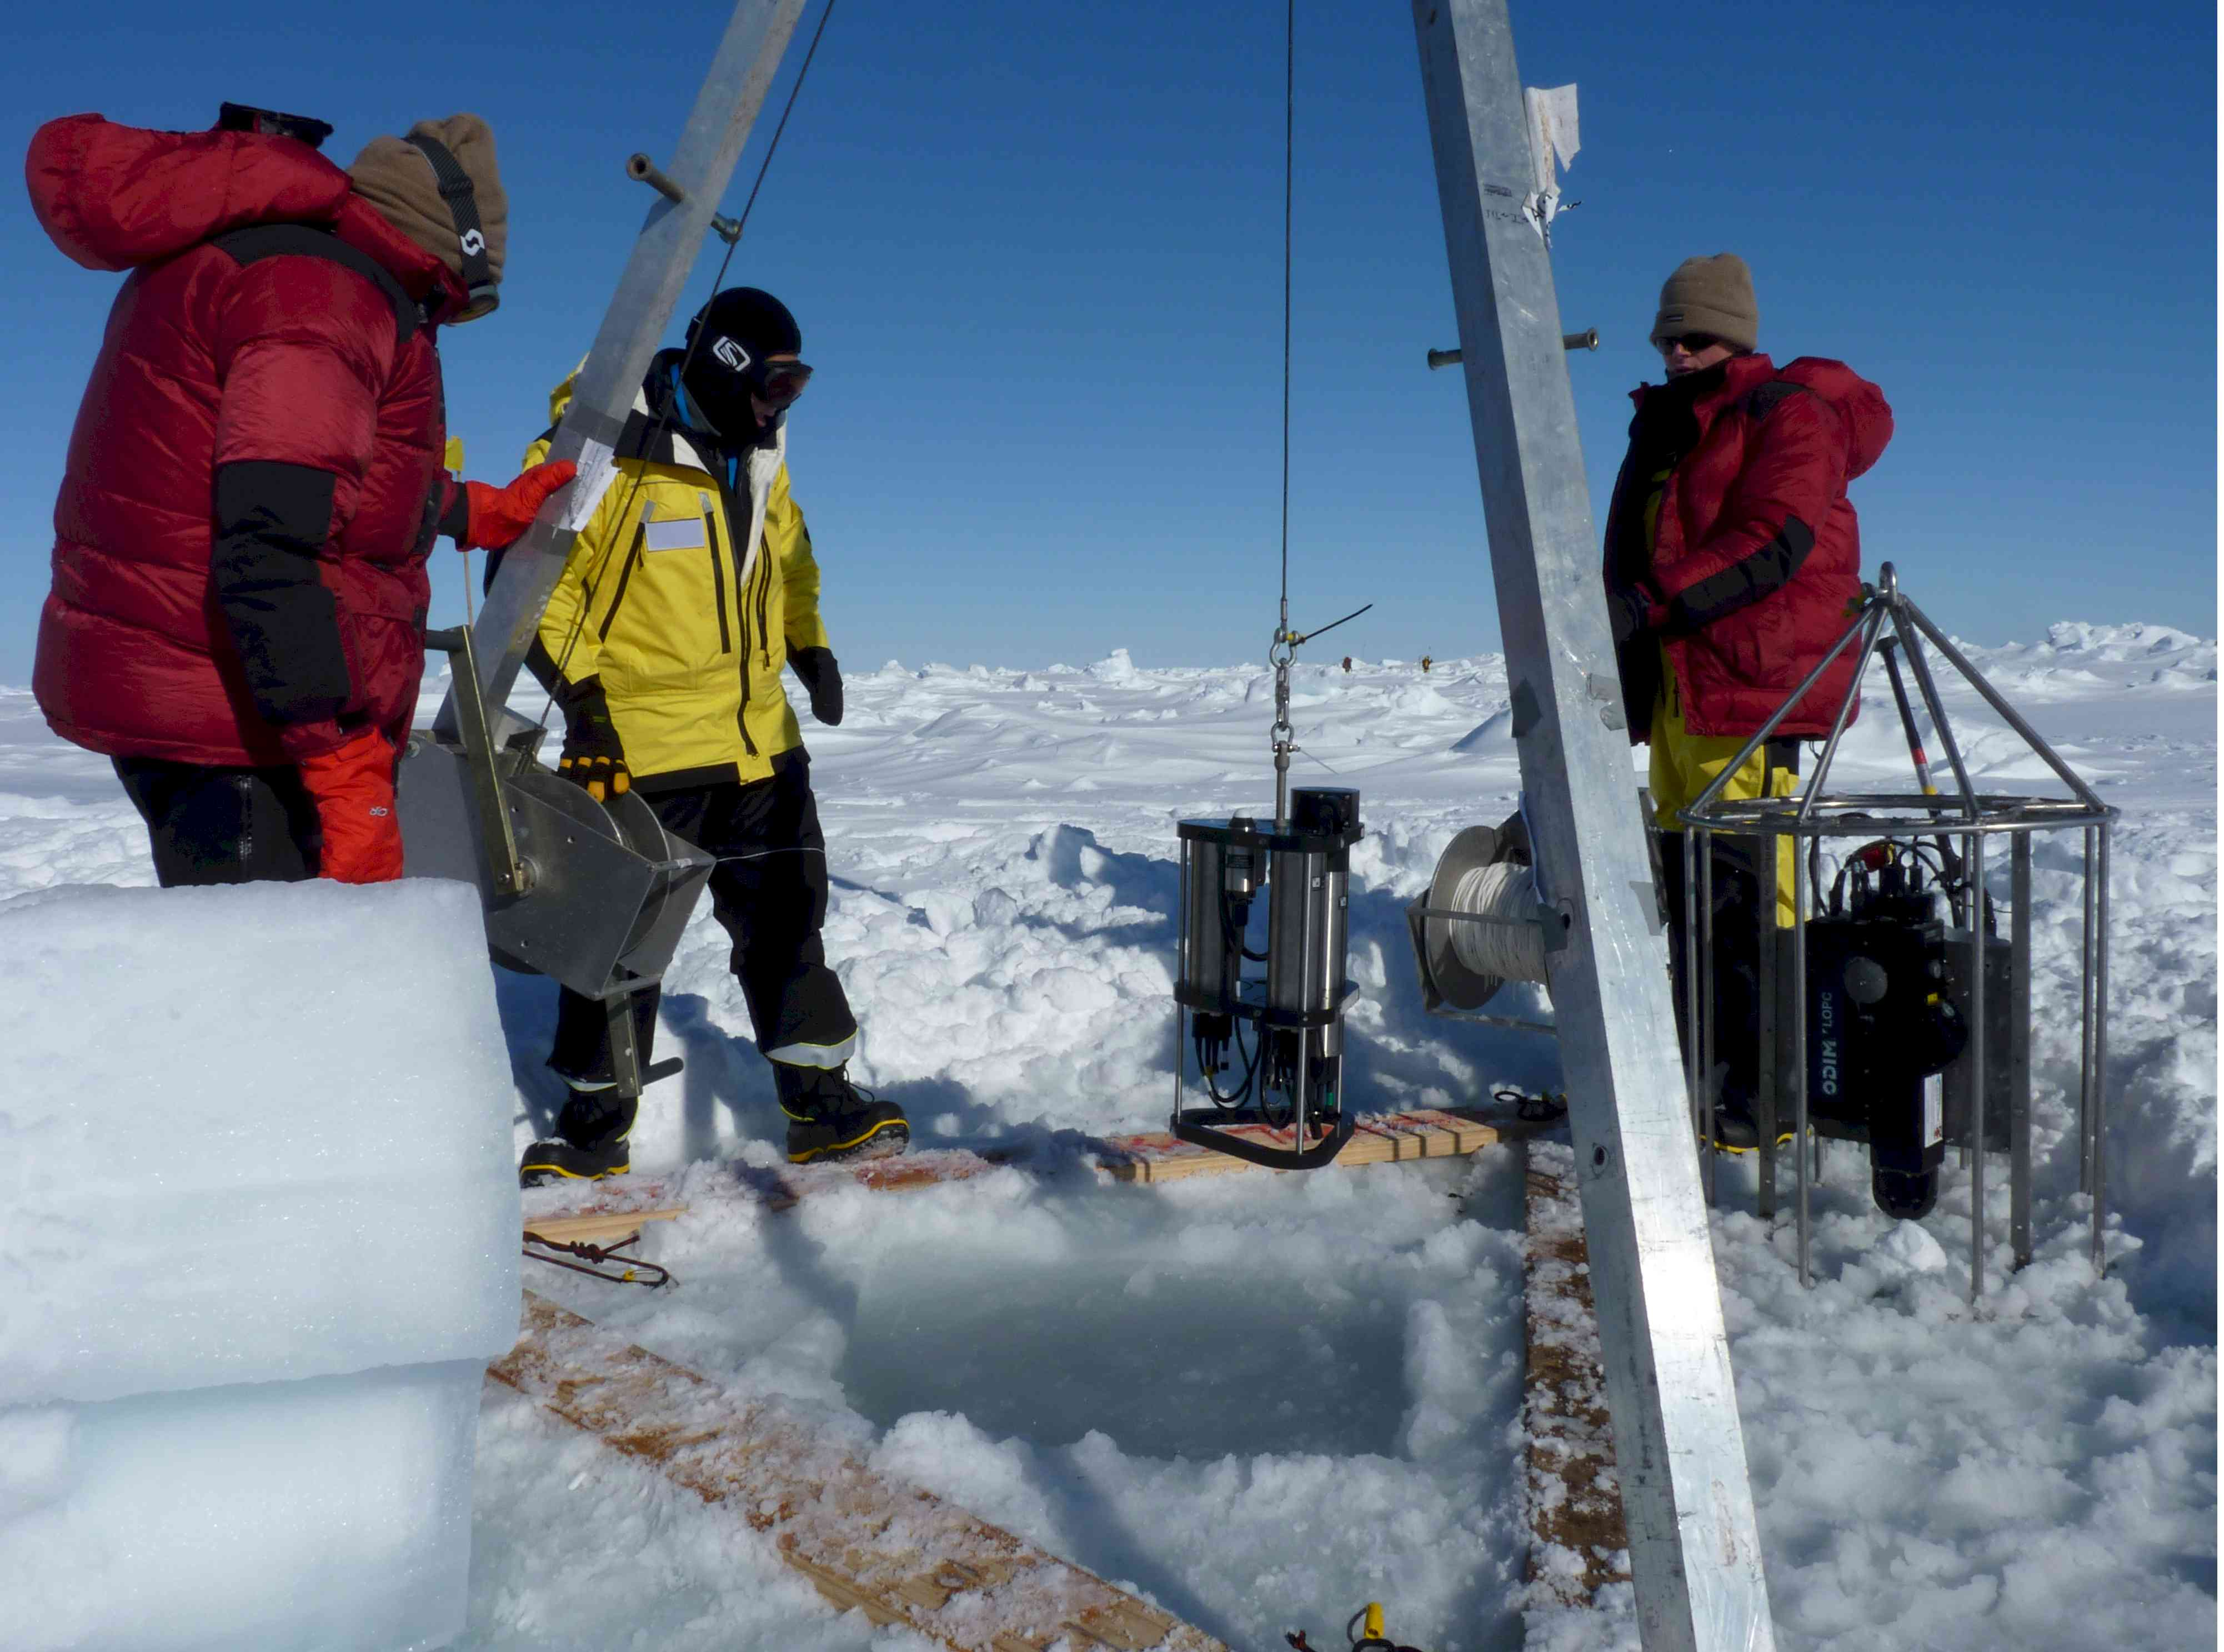

Slide 15
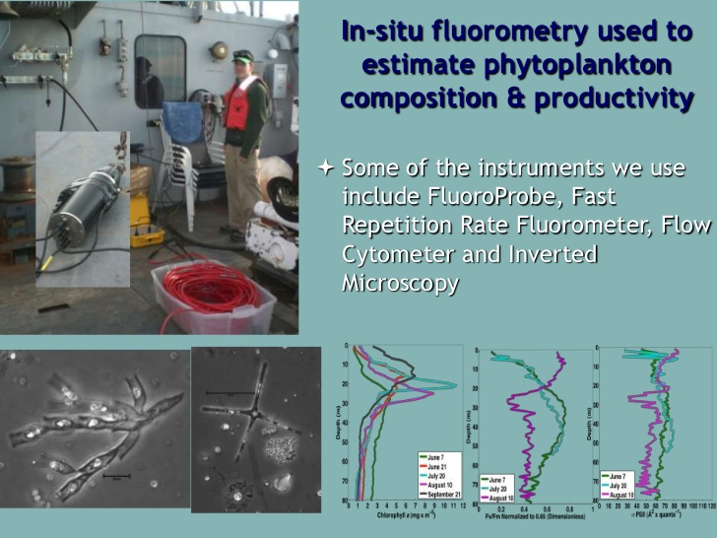

Slide 16
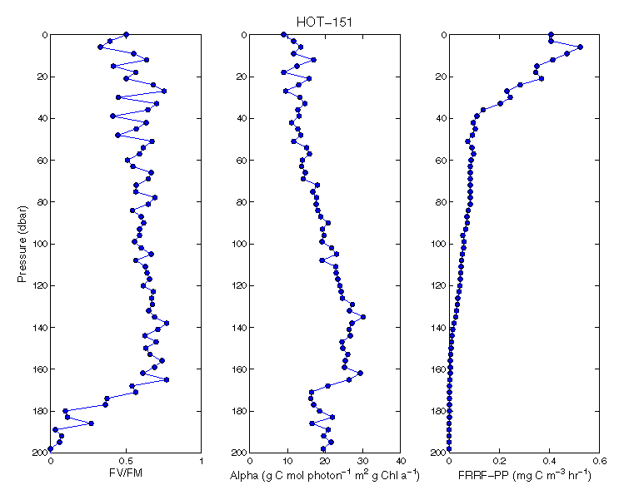

Slide 17
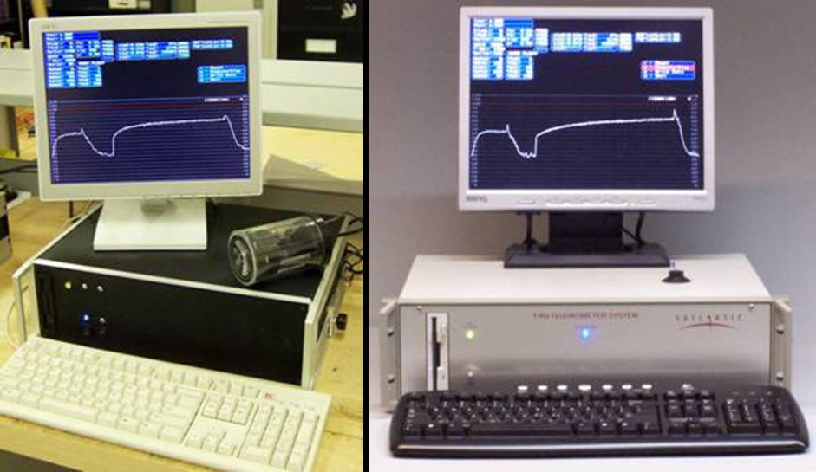
Ritgers School of Biological Sciences

Slide 18
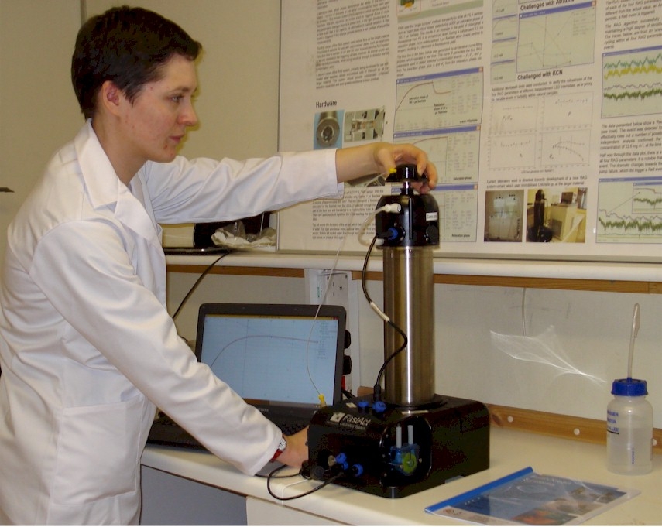

Slide 19
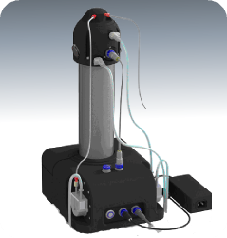
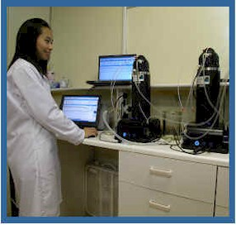
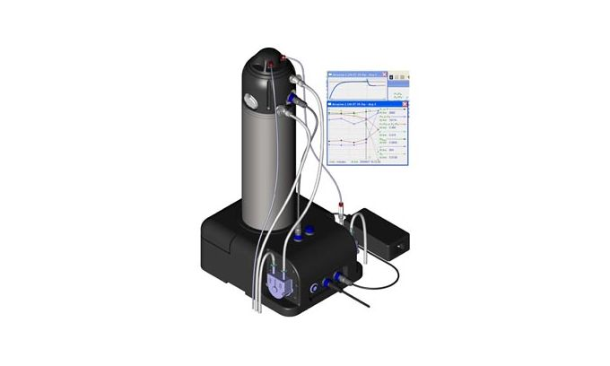
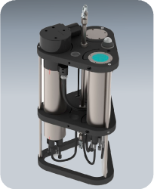

Slide 21
Variable | Definition
PC_{FRR} | Rate of gross photosynthesis (mg C (mg Chl-a)⁻ ¹ h⁻ ¹)
E | Photosynthetically active radiation (400–700 nm) (μmol photons m⁻ ² s⁻ ¹) of light (wavelength dependent)
σ_{PSII} | Functional absorption cross section nm² quanta⁻ ¹
σPSII′ | Functional absorption cross section nm² quanta⁻ ¹ in actinic light
1 − C | Fraction of open reaction centres (C = 1 − qJ)
PSU | Photosynthetic unit size is the concentration of functional PSII reaction centres (mol Chl-a m⁻ ³/mol RCII m⁻ ³)
[RCII] | Number of functional reaction centres (mol RCII m⁻ ³) = KRELED×ChlFRRfσPSII
[Chl]^{FRRf} | Gain normalised minimum fluorescence signal parameter calculated by Fast^{PRO}
K_{R} | Instrument specific constant (mol photons m⁻ ³ s⁻ ¹)
Φ_{E : C} | Electron requirement for carbon uptake (molecule CO₂ (mol electrons)⁻ ¹)

Slide 22
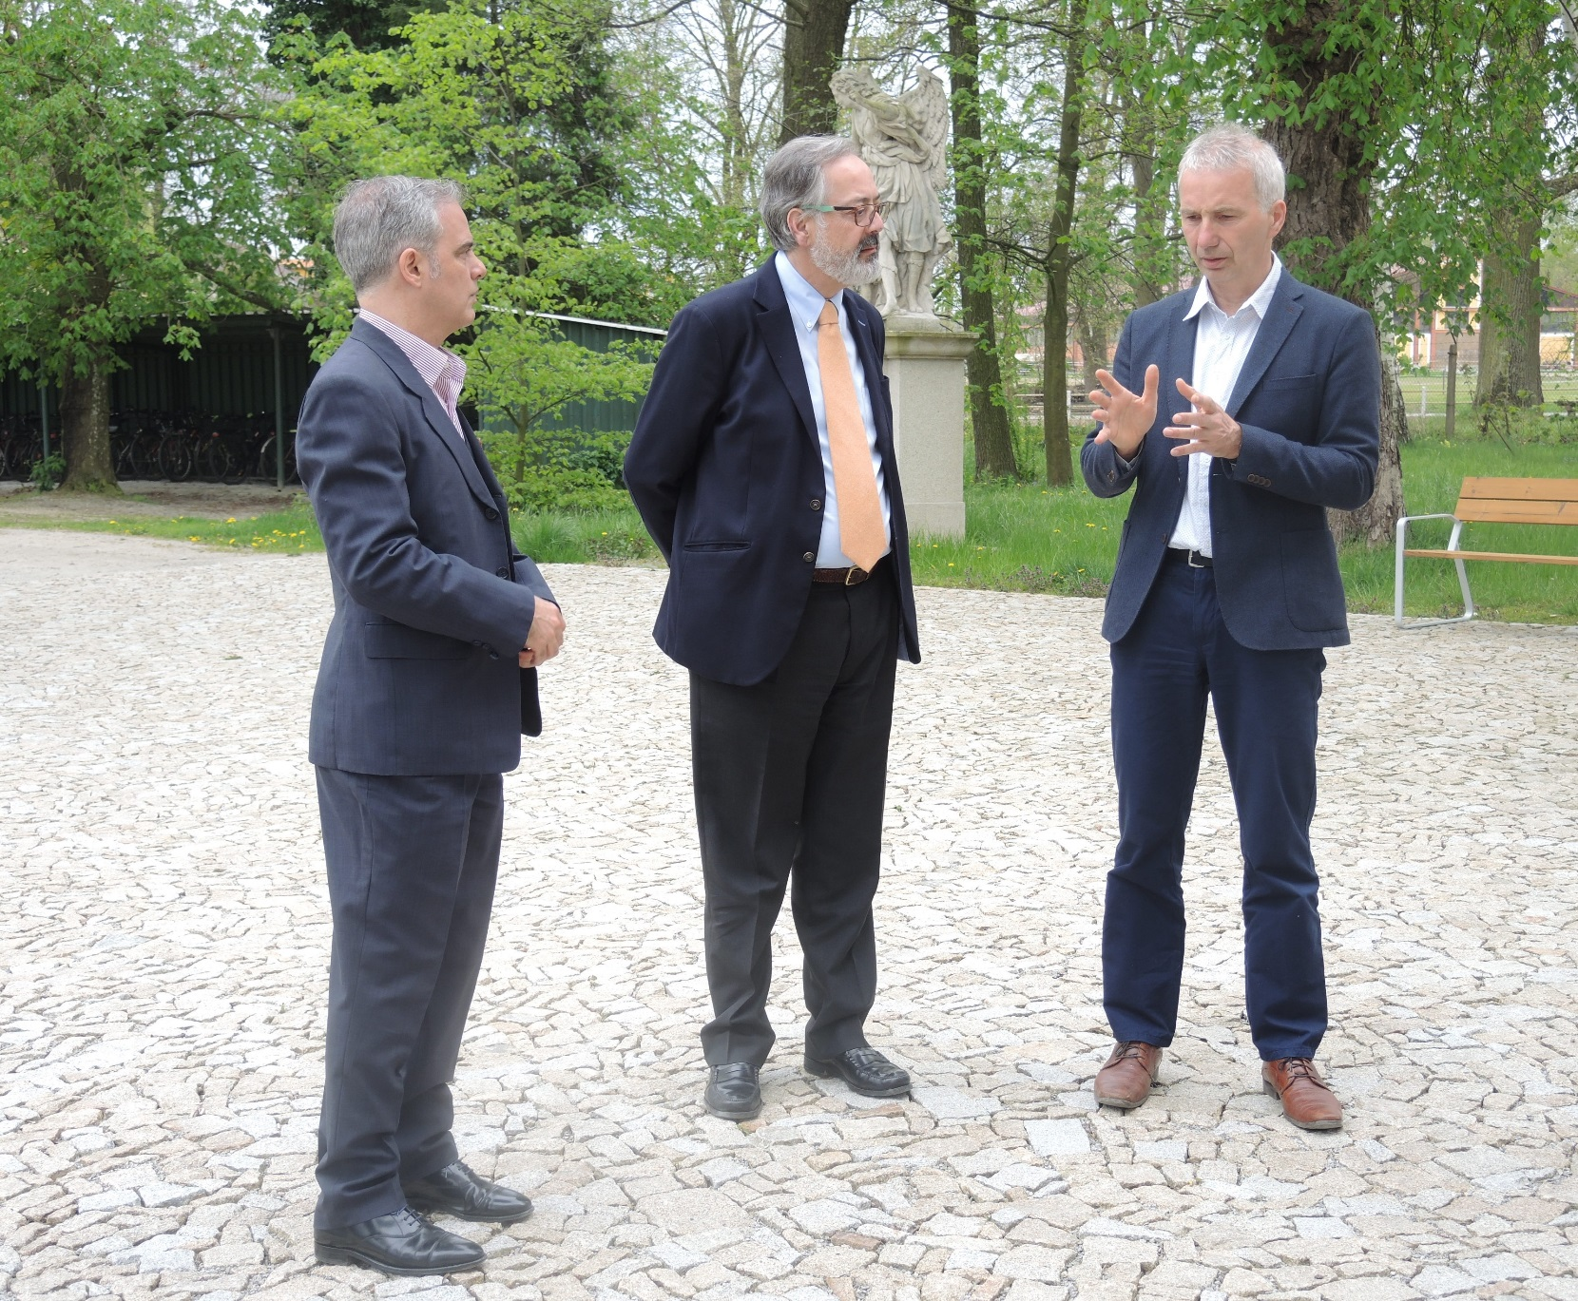

Further reading

Slide 23
Ladies and gentleman,
Thank you for your attention

