Slide 1
BIOMARKERS AND TOXICITY MECHANISMS
09 –Intercellular communication
& regulation
Luděk Bláha, PřF MU, RECETOX
www.recetox.cz

Slide 2
Cell communication & regulation: a target for toxicants
… especially sensitively regulated processes are highly susceptible to toxicants
→ toxicity to REGULATIONS & SIGNALLING
Hierarchy in signalling
- systems: neuronal ←→ endocrine
- cell-to-cell
hormonal & neuronal signal transmission
contact channels
- intracellular signal transduction

Slide 3
INTER-cellular signals
Overview

Slide 4
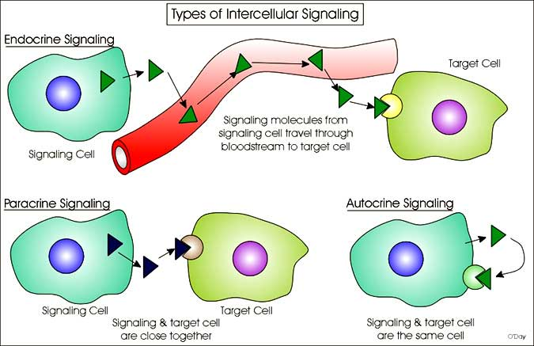
Cell to cell communication & regulation: a target for toxicants

Slide 5
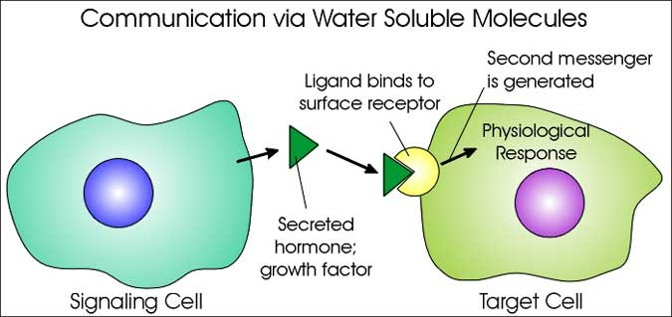
Cell to cell communication (1)

Slide 6
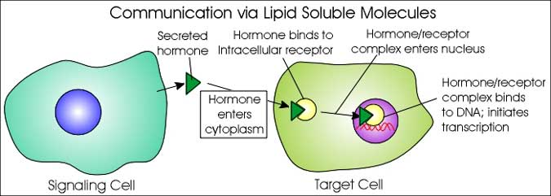
Cell to cell communication (2)

Slide 7
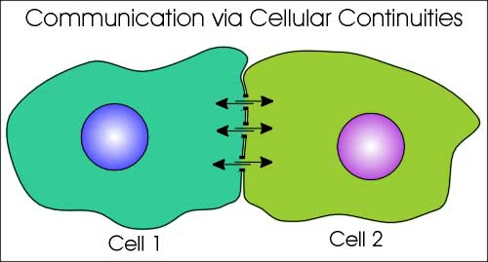
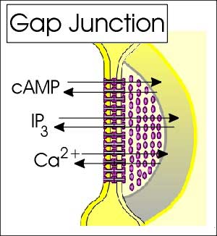
Cell to cell communication (3)

Slide 8
INTER-cellular signals
Hormones

Slide 9
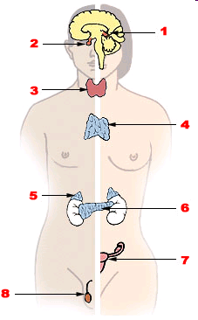
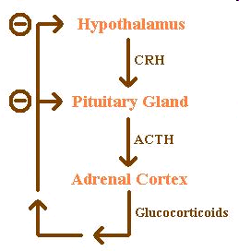
Endocrine system:
1. Pineal gland, 2. Pituitary gland, 3. Thyroid gland, 4. Thymus, 5. Adrenal gland, 6. Pancreas, 7. Ovary, 8.Testis
Example: feedback loop

Slide 10
FUNCTIONS OF HORMONES
* stimulation or inhibition of growth
* mood swings
* induction or suppression of apoptosis
(programmed cell death)
* activation or inhibition of the immune system
* regulation of metabolism
* preparation for fighting, fleeing, mating …
* preparation for a new phase of life
  (puberty, caring for offspring, and menopause)
* control of the reproductive cycle
…. etc.
Chemicals interfering with
various hormonal functions
→ diverse impacts (effects)

Slide 11
System regulation = HORMONES & ENDOCRINE SYSTEM
FATE OF HORMONES: target for toxicants
Toxic compounds can affect “hormone signalling” at various levels (highligted):
1. Biosynthesis of a particular hormone in a particular tissue
2. Storage and secretion of the hormone
3. Transport of the hormone to the target cell(s)
4. Recognition of the hormone by an associated cell membrane or intracellular receptor protein.
5. Relay and amplification of the received hormonal signal via a signal transduction process -> cellular response.
6. The reaction of the target cells is recognized by the original hormone-producing cells (negative feedback loop)
7. Degradation and metabolism of the hormone
More details will be discussed
in the lectures dedicated to
nuclear receptors

Slide 12
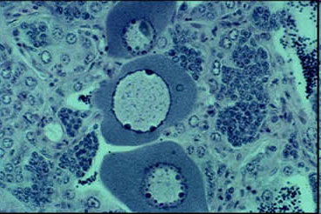
Toxicity to hormone regulation = ENDOCRINE DISRUPTION
ED & EDCs (endocrine disrupting compounds)
= major problem in environmental toxicology
Effects at all levels of hormonal action have been demonstrated
→ synthesis, transport, site of action ….
- Multiple effects due to ED (! Not only „xenoestrogenicity“ & feminization)
→ immunotoxicity, developmental toxicity
(ED - WILL ALSO BE DISCUSSED FURTHER)
Example of ED - Intersex roach testis
containing both oocytes and spermatozoa,
caused by exposure to environmental oestrogens

Slide 13
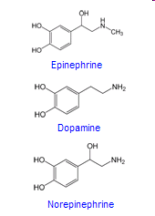
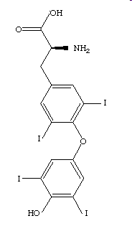
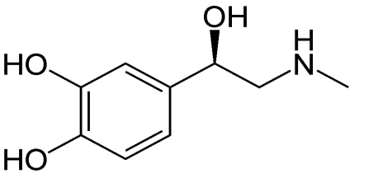
Types of hormones in vertebrates
Amine-derived hormones
structure: derivatives of the amino acids tyrosine and tryptophan.
Examples - catecholamines and thyroxine.
(small molecules - similar to organic toxicants → TOXIC EFFECTS)
Adrenalin
Thyroxin

Slide 14
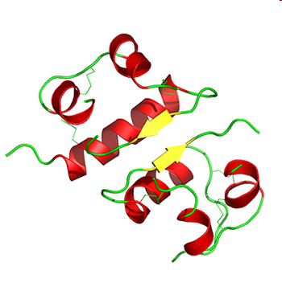
Types of hormones in vertebrates
Peptide hormones
structure: chains of amino acids.
- small peptides: TRH and vasopressin;
- large proteins: insulin, growth hormone, luteinizing hormone, follicle-stimulating hormone and thyroid-stimulating hormone etc.
Large molecules;
receptors on surfaces of the cells
(Interactions with toxic chemicals less likely)
Example - insulin

Slide 15
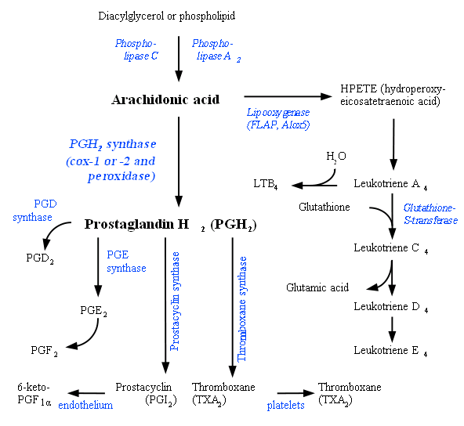
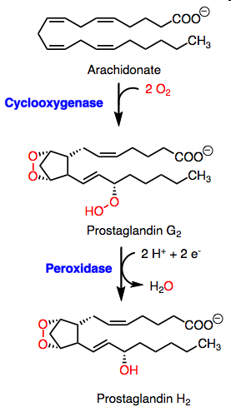
Types of hormones (signal molecules) in vertebrates
Lipid derived “hormones” (1) - from linoleic acid, arachidonic acid
- prostaglandins

Slide 16
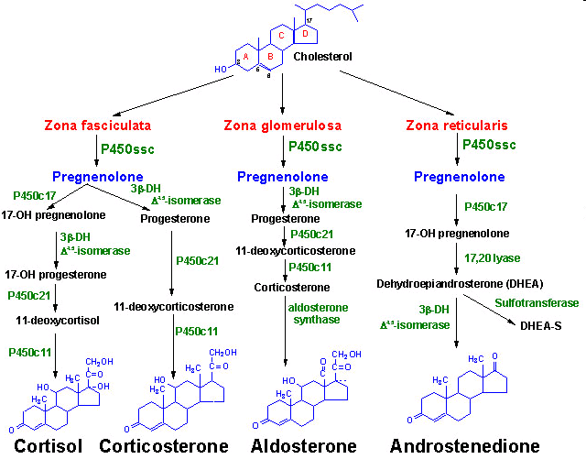
Types of hormones in vertebrates
Lipid derived hormones 2 - steroid hormones
* Small molecules - similar to organic toxicants:
→ several compounds interfere with steroid hormones → toxicity !!!
Derived
from cholesterol
Examples:
testosterone,
cortisol,
estradiol …

