Slide 1
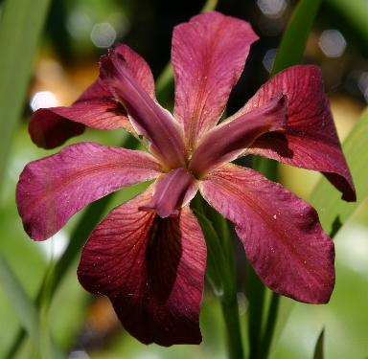
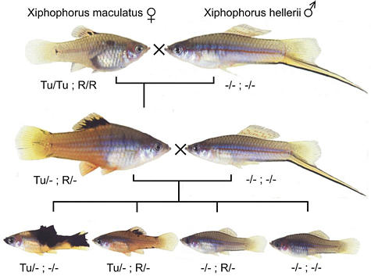
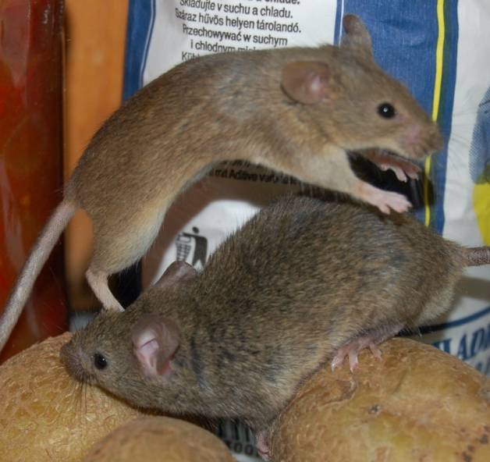
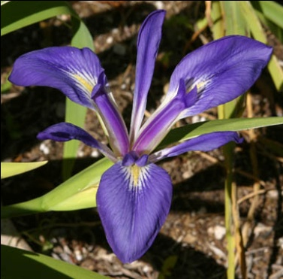
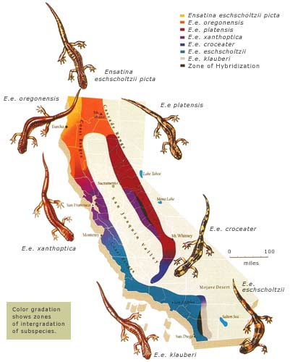
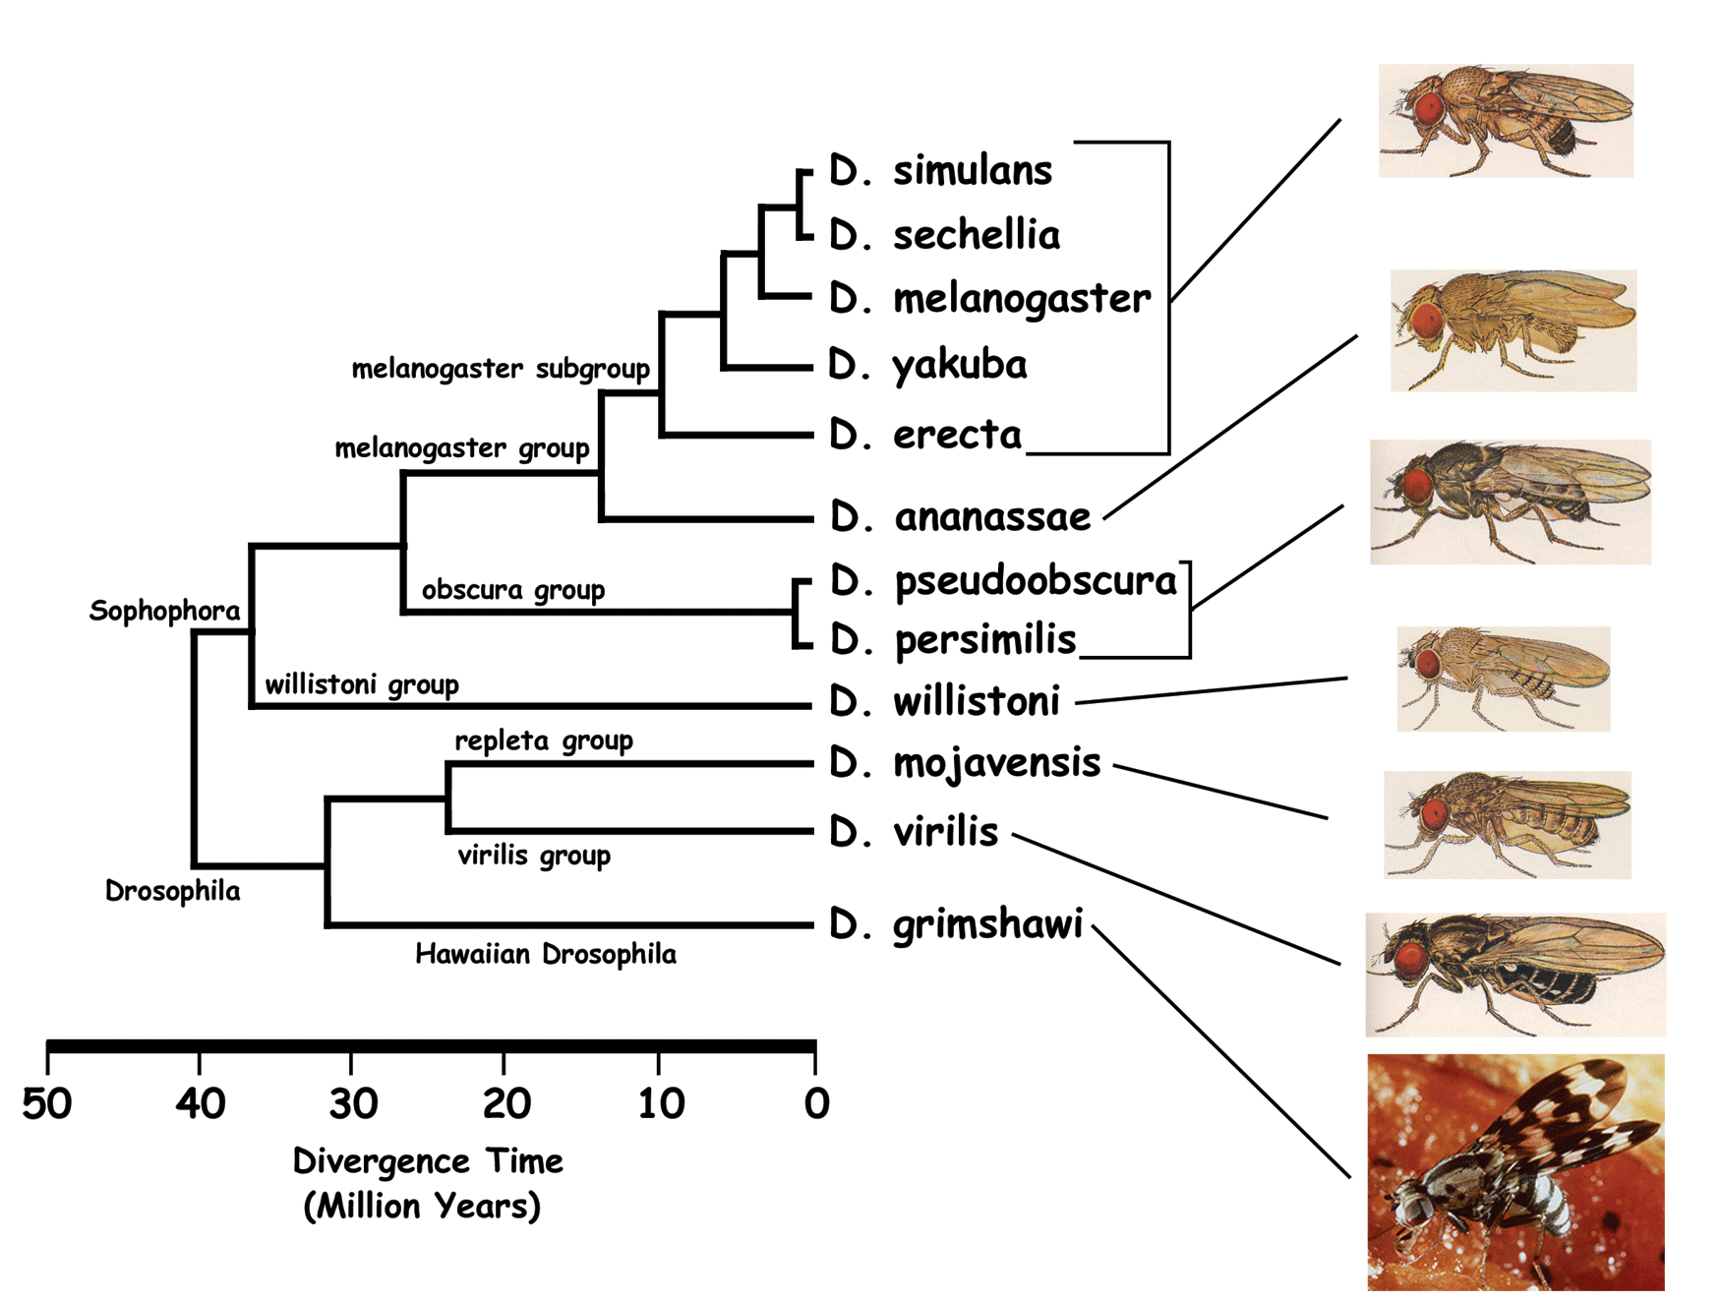
SPECIATION

Slide 2
What is species?
How do species arise?

Slide 3
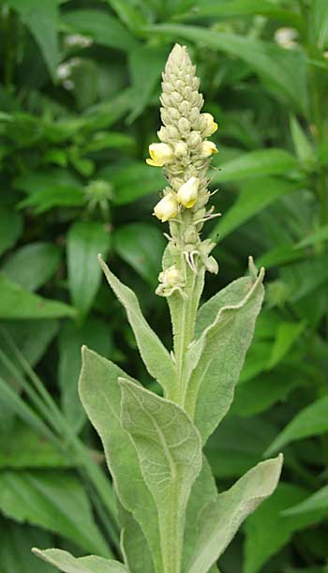
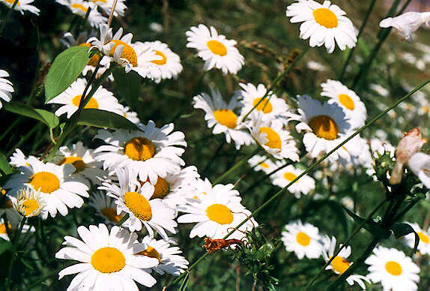
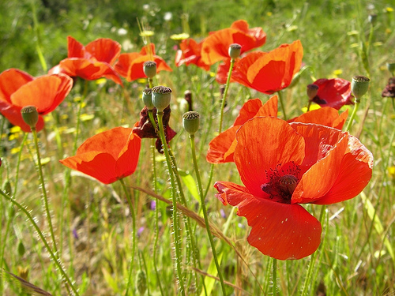

Slide 4
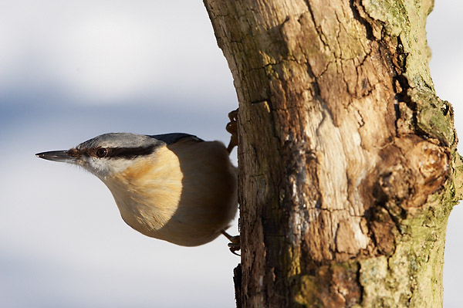
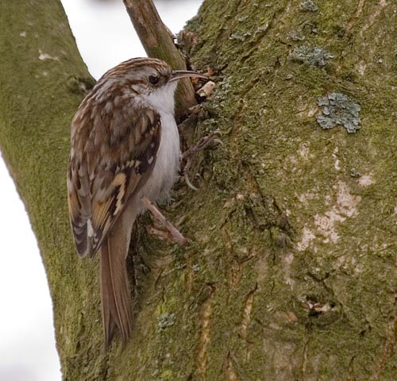
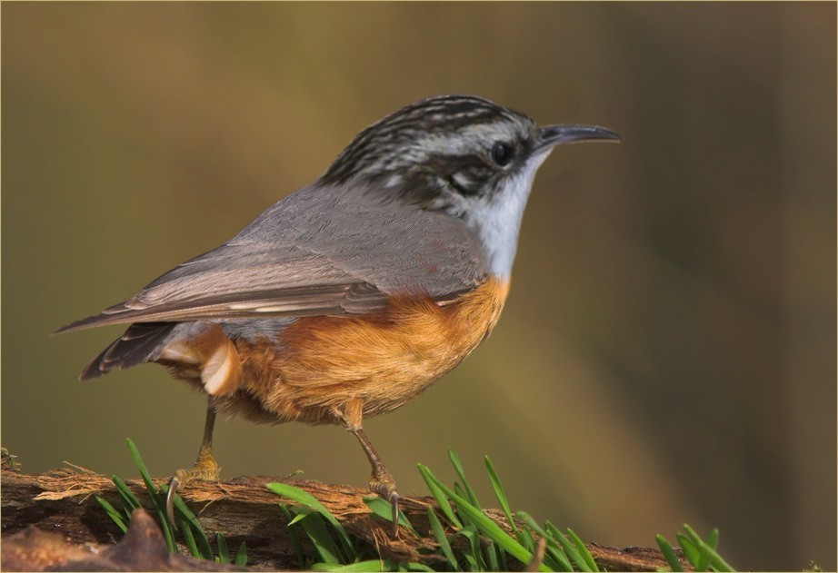
x
x
Eurasian nuthatch (Sitta europea)
common treecreeper
(Certhia familiaris)
Mechanisms maintaining species integrity

Slide 5
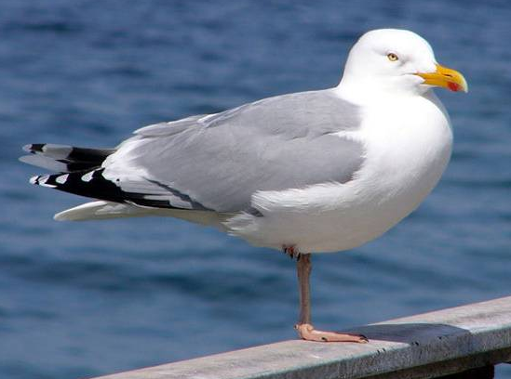
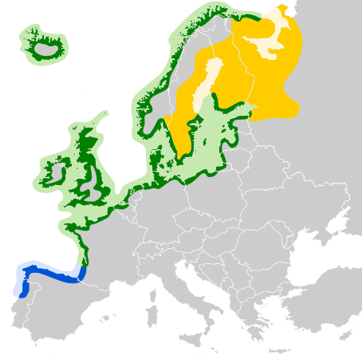
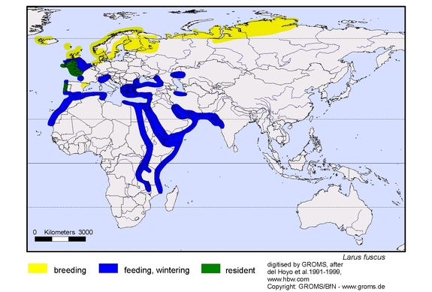
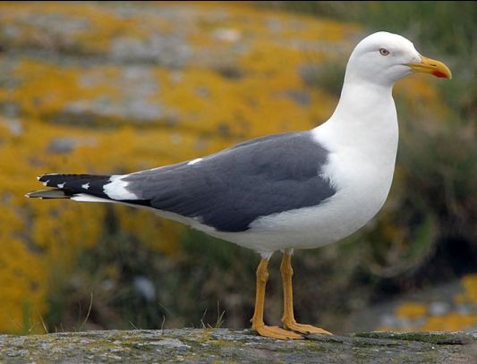
European herring gull
(Larus argentatus)
lesser black-backed gull
(L. fuscus)

Slide 6
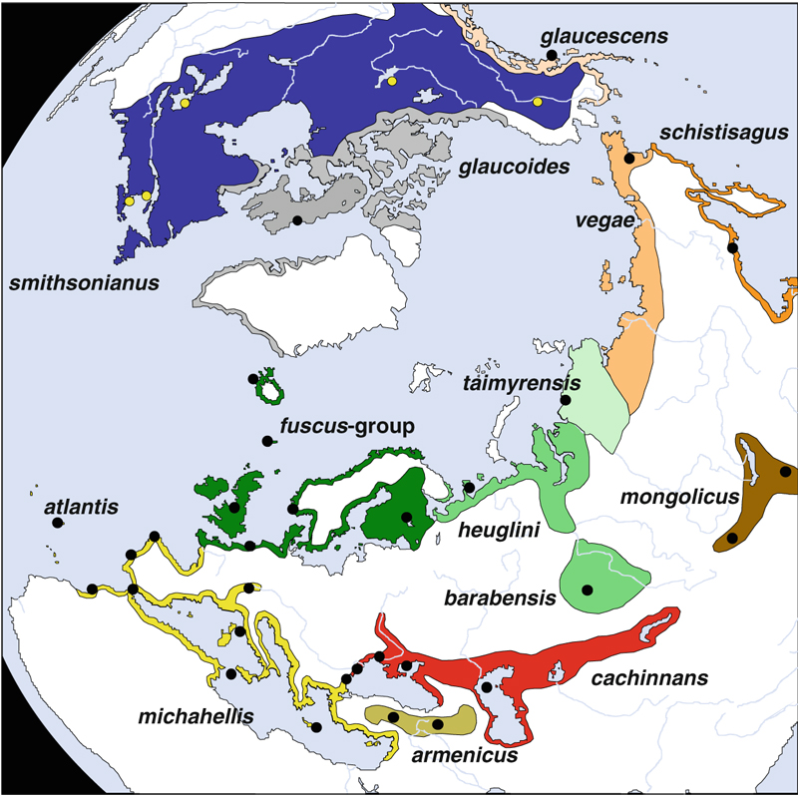

Slide 7
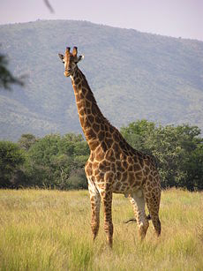
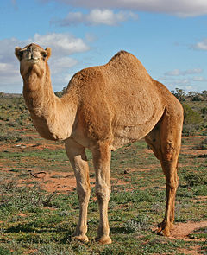
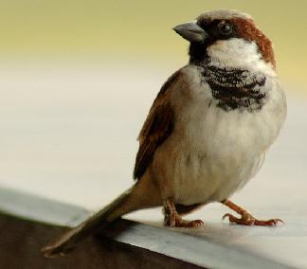
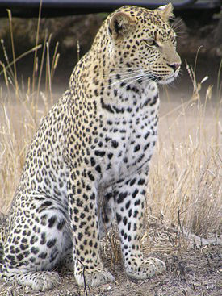
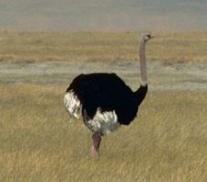
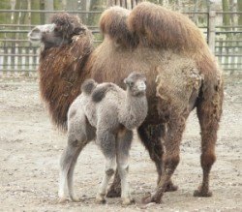
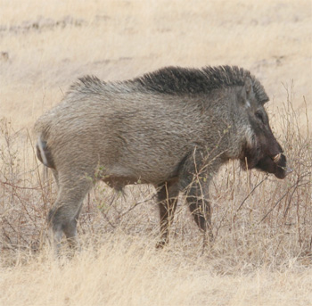
Antics:
species unstable and highly variable
×
×
×

Slide 8
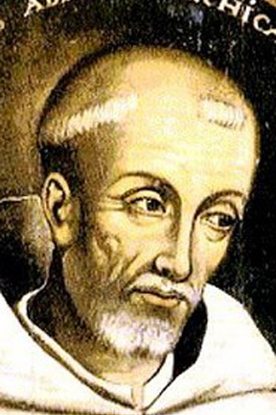
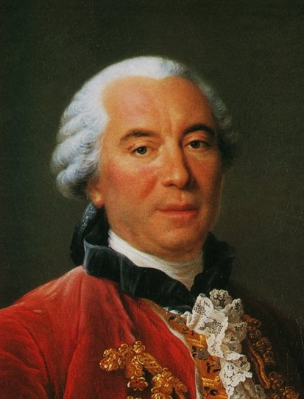
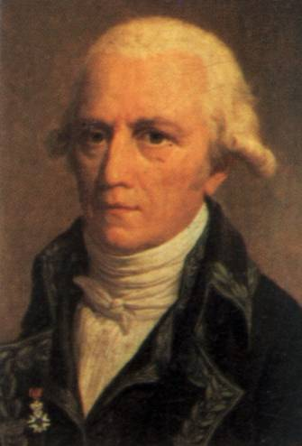
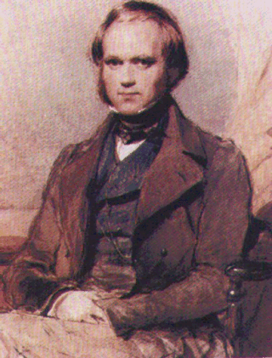
Are species real entities?
nominalists:
no universals and abstract objects (= only words), only particulars exist
eg. William of Ockham, popular in France in the 1700s (young Buffon
and Lamarck), Darwin
species are human abstractions, artificially dividin natural
continuum

Slide 9
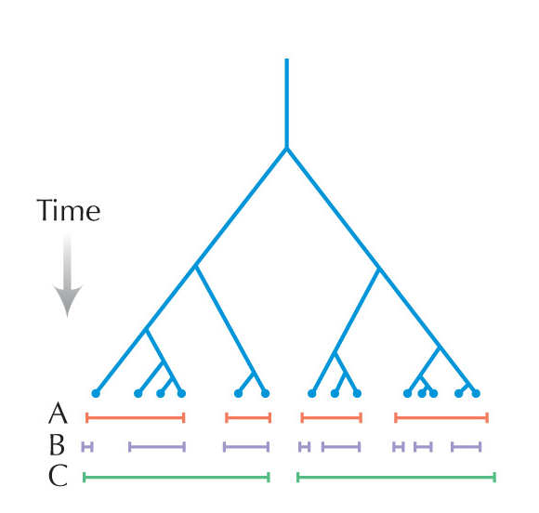
according to Darwin classification of organisms to a large extent arbitrary:

Slide 10
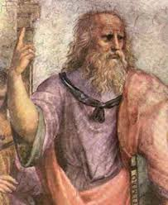
realists:
only universals are real, particulars are derived, random, variable, and
ephemeral
eg. Plato
species really exist in nature

Slide 11
New Guinea tribes:
Karam people → almost identical discrimination of bird species with
western taxonomists (but bats considered as birds)
Rofaifo people → only two names for mammals (small = Hunembe,
big = Hefa); cassowary considered as a mammal
× human brain same in aborigines and professional taxonomists
free hybridization within species × rare between species
Problem: definition should be both universal and operational

Slide 12
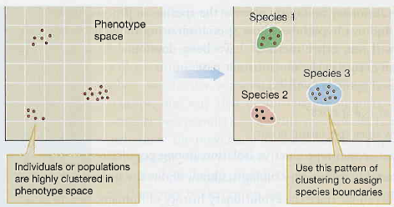
Typological (essentialist) concept
Plato´s world of ideas: assumption of existence of limited number of types (universals)
species composed of idividuals having the same essence
variability strongly limited, results from imperfekt expression of the idea
each species separated from others by sharp boundary
constant in time

Slide 13
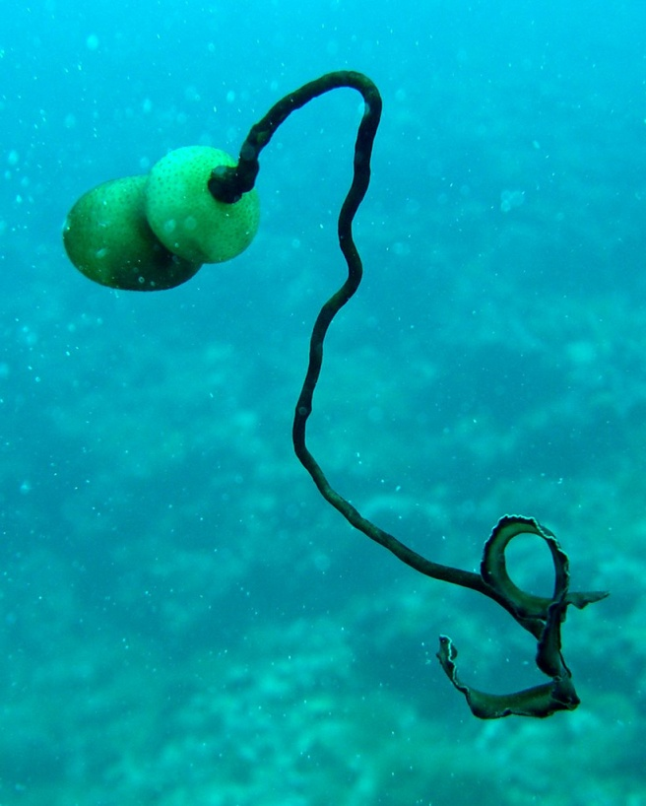
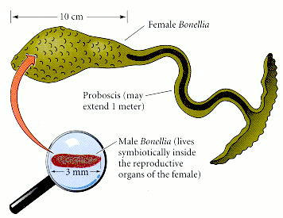
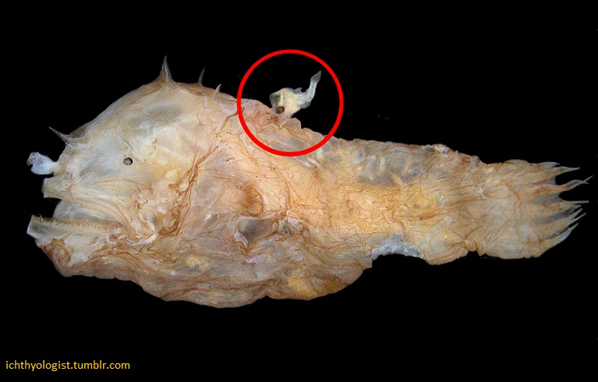
× sexual dimorphism
male
Bonellia viridis
angler
(Lophius piscatorius)

Slide 14
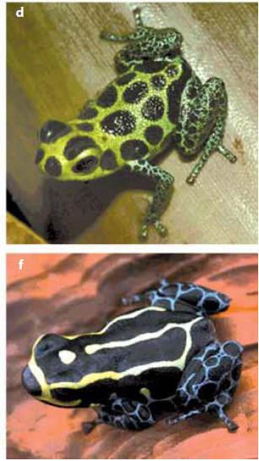
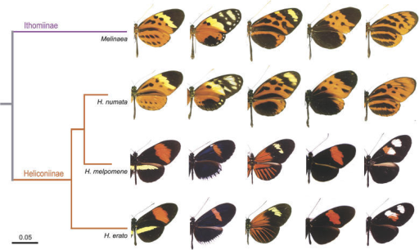
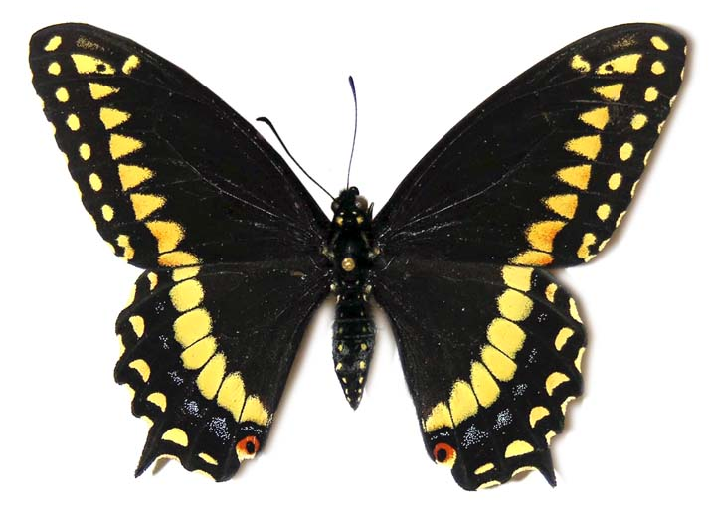
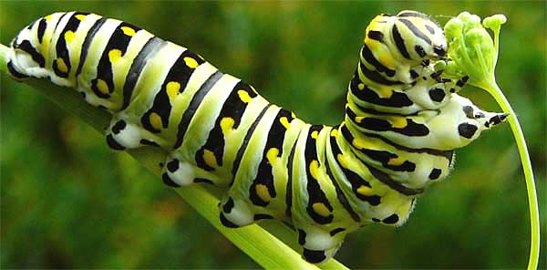
× polymorphism, different ontogenetic stages
Heliconius spp.
Papilio polyxenes
Ranitomeya imitator

Slide 15
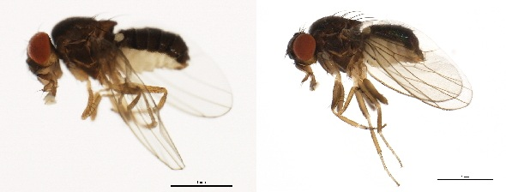
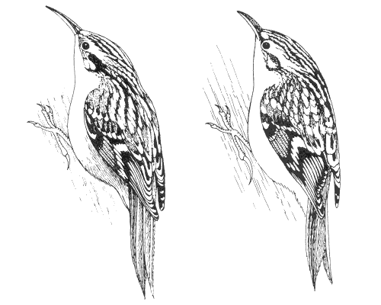
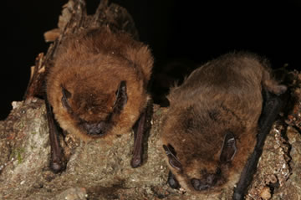
× sibling species, cryptic species
Drosophila persimilis/
D. pseudoobscura
Pipistrellus pipistrellus/P. pygmaeus
Certhia brachydactyla/C. familiaris

Slide 16
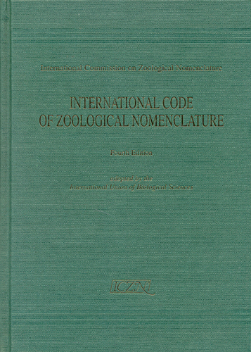
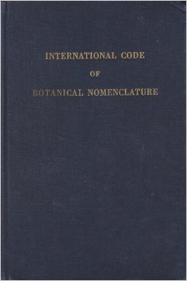
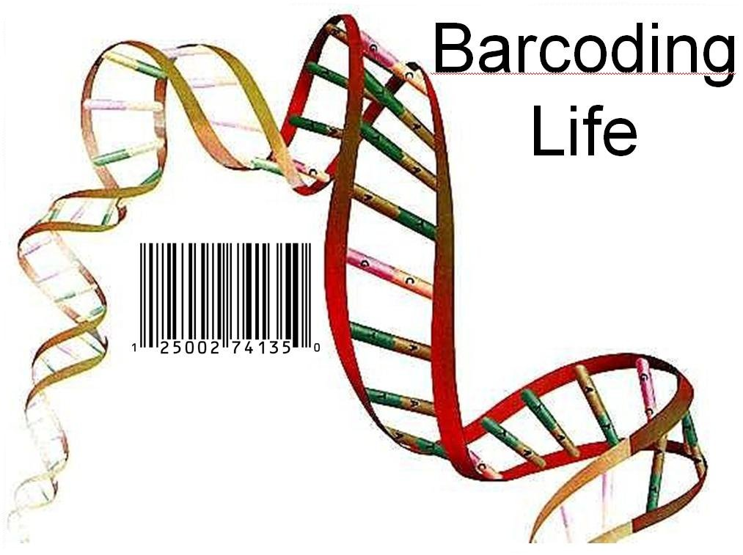
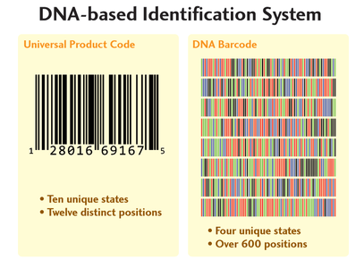
Typological species still in nomenclatorial practice:
type specimen = holotype, type series, type locality
barcoding

Slide 17
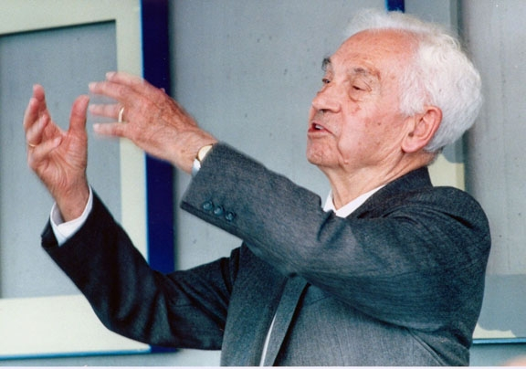
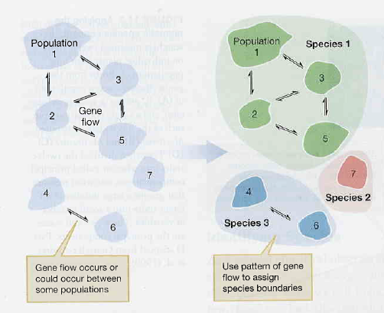
Biological species concept (BSC)
T. Dobzhansky, H. Muller, J. Huxley, E. Mayr
species as gene pools, reproductive communities
reproductively isolated from others
no constant, „essential“ characters
E. Mayr

Slide 18
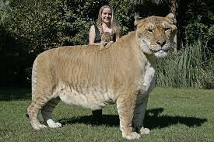
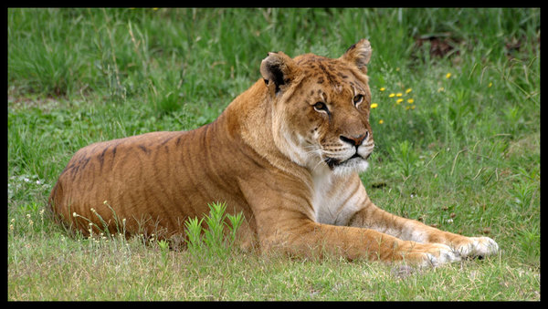
Ernst Mayr (1942):
Species are groups of interbreeding natural populations that are reproductively isolated from others such groups.
liger
free mating
reproductive barrier
free mating
X
tigon

Slide 19
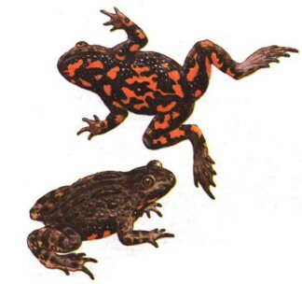

Limitations and problems of biological species:
only sexual organisms
problems in allopatry („potential“ hybridization) ⇒ auxiliary morphological
and genetic criteria (degree of divergence ∼ degree of reproductive
isolation)
problems in palaeontology – populations are not contemporary
hybridization between „good“ species
(Bombina bombina × B. variegata)
auxiliary criteria (DNA sequences)

Slide 20



Q. grisea
Quercus gambelii
grisea + gambelii = syngameon

Slide 21

Reproductive barriers
formerly reproductively isolating mechanisms = RIM ... today we prefer the term reproductive barriers (RIM imply „in order to“)!
1. Prezygotic
A) pre-copulatory:
partners do not meet:
seasonal (temporal)
eg. fireflies, crickets Gryllus pennsylvanicus (autumn) × G. veletis (spring)

Slide 22


Reproductive barriers
ecological (habitat):
Viola arvensis (chalk soils) × V. tricolor (acidic soils),
hybrids limited to neutral or weakly acidic soils

Slide 23









Reproductive barriers
1. Prezygotic
A) pre-copulatory:
partners meet but do not mate:
ethological, behavioral, sexual
signals:
- acoustic
mediterranea
lucasina
johnsoni
lacewing (Chrysoperla)
carnea
zastrowi arabica

Slide 24


Reproductive barriers
1. Prezygotic
A) pre-copulatory:
partners meet but do not mate:
ethological, behavioral, sexual
signals:
- acoustic
- chemical
- light
firefly´s track

Slide 25
Reproductive barriers
1. Prezygotic
A) pre-copulatory:
partners meet but do not mate:
ethological, behavioral, sexual
signals:
- acoustic
- chemical
- light
- behavioral (eg. wedding dances)

Slide 26






grey-crowned crane (Balearica regulorum)
great bustard (Otis tarda)
black-necked stilt (Himantopus mexicanus)
western grebe
(Aechmophorus occidentalis)
red-crowned crane (Grus japonensis)

Slide 27





Reproductive barriers
signals:
- acoustic
- chemical
- light
- behavioral (eg. wedding dances)
- different pollinators in plants

Slide 28






Reproductive barriers
1. Prezygotic
B) post-copulatory:
partners mate but without transfer of gametes:
mechanical:
- especially plants; in animals shape of genitalia
cat
fox
os penis
walrus (fossil: 1,2 m and recent: 56 cm)
mink
racoon

Slide 29
Reproductive barriers
1. Prezygotic
B) post-copulatory:
transfer of gametes occur but without fertilization:
gametic incompatibility
external fertilization: esp. marine invertebrates (mollusks, echinoderms)
internal fertilization: eg. Drosophila – sperm cannot survive in spermatheca
of females of other species
plants: pollen tube grows through style

Slide 30

2. Postzygotic
inviability of F1 hybrids
sterility of F1 hybrids
reduced viability or fertility of F2 or backcrosses
= hybrid dysgenesis
Haldane´s rule:
When in the F1 offspring of two different animal races one sex is absent, rare, or sterile, that sex is the heterozygous (heterogametic) sex.^{*)}
*) Drosophila – males (XY); Abraxas – females (WZ)

Slide 31

Haldane´s rule explains Large X effect: genes having large impact on postzygotic reproductive isolation are usually located on X chromosome
dominance theory
(Muller 1940, 1942; Orr 1997):
males – both dominant and recessive
alleles of X-linked genes
females – only dominant alleles
Drosophila pseudoobscura × D. persimilis

Slide 32

Rate of prezygotic isolation between allopatric species is similar
to rate of postzygotic isolation ...
both sympatric and allopatric
sympatric
allopatric
... prezygotic isolation between sympatric/parapatric species arises more
rapidly

Slide 33

Concepts related to biological species:
Recognition species concept
Hugh E.H. Paterson (1985)
empasizes shared fertilization system rather than isolation:
specific mate recognition system (SMRS)
courtship, timing of mating, choice of condition, coloration, endocrine
system, shape of copulatory organs, gametic compatibility, …
reproductive isolation as a byproduct

Slide 34

Concepts related to biological species:
Cohesion species concept
Alan R. Templeton (1989)
empasizes mechanisms maintaining morphological stability of populations
cohesion mechanisms: gene flow, stabilizing selection, ontogenetic
constraints, reproductive isolation
aplication also to asexual organisms, possibility of interspecific hybridization

Slide 35



Evolutionary species concept
attempts for vertical species concepts
George Gaylord Simpson (1961):
phyletic speciation, chronospecies
asexual organisms
temporal perspective
biological species is a part of it
Edward O. Wiley (1978):
„A species is a lineage of ancestral descendant populations which maintains
its identity from other such lineages and which has its own evolutionary
tendencies and historical fate.“
contrary to Simpson´s concept Wiley admits only cladogenesis,
ie. splitting speciation

Slide 36

Phylogenetic species concept
emphasis on diagnostic criteria → but which ones?
⇒ primary inference of phylogeny (synapomorfies)
Phylogenetic species = smallest monophyletic group distinguished by
a shared derived trait

Slide 37
Relation of biological and phylogenetic species:
biological species B
biological species A
B1
B2
C
RI
origin of reproductive barrier
X
A

Slide 38
Relation of biological and phylogenetic species:
phylogenetic species C
phylogenetic species B
B1
B2
C
RI
X
origin of synapomorfy
A

Slide 39
SPECIATION
geography: allopatric allopatric
(isolation) peripatric
allo-parapatric (reinforcement)
sympatric parapatric
(no isolation) sympatric
mechanism: drift
selection
sexual selection
hybridisation
polyploidisation
genetic elements: genes vs. chromosomes (stasipatric speciation)

Slide 40
Allopatric speciation
geographic isolation
advancing divergence: mutation, drift, selection, sexual selection
reproductive barriers as a byproduct

Slide 41



original population
geographic
barrier
mutation
drift
selection
⇒ divergence
incompatibility

Slide 42



Dobzhansky-Muller model:
W. Bateson
T. Dobzhansky
H. Muller
2 genes:
aAbb
AAbb
A-b compatible
aabb
AABB
a-B compatible
aaBb
aaBB
A-B incompatible

Slide 43
large population
allopatric speciation usually slow (exceptions: sexual selection,
genetic conflict)
genetic conflict:
subpop. 1
incompatible!
arms race in
ancestral
population
ongoing
arms race
secondary contact
subpop. 2

Slide 44



co-speciation (parasite-host):
hybrids
J. Goüy de Bellocq
Wasimuddin

Slide 45
Peripatric speciation
(founder-effect speciation)
Mayr: founder effect
island organisms, peripheral isolates (extinction-recolonisation)

Slide 46
genetic revolution ⇒ rapid speciation

Slide 48




founder-flush model: Drosophila
colonisation of a novel environment – no selection ⇒ rapid divergence
Notes:
Interlaced fingers, braid, fingerloop braiding, twist together

Slide 49

Allo-parapatric speciation
(reinforcement speciation)
A. R. Wallace, R. A. Fisher, T. Dobzhansky
secondary hybrid zone
initial geographic isolation
reproductive isolation incomplete → secondary hybrid zone

Slide 50
selection against hybrids
selection against hybrids ⇒ formation of prezygotic barrier
→ strenghtening of isolation (reinforcement) = Wallace´s effect
faster isolation in contact
both sym/parapatric and allopatric pairs
allopatric pairs

Slide 51


Vošlajerová Bímová et al. (2011)
Both female and male preference show reinforcement in the zone centre ⇒
prezygotic barrier probably contributes to reproductive isolation

Slide 52
Parapatric speciation
A
a
a
A
a
A
a
A
a
A
a
ecotone
environmental gradient ⇒ genetic gradient
⇒ primary hybrid zone
different selection in the two parts ⇒ genetic divergence even with gene flow

Slide 53
Sometimes difficult to distinguish allopatric and parapatric speciation:
ring species

Slide 54

ring species:
Larus
Ensatina
Phylloscopus

Slide 55

ring species:
European herring gull (Larus argentatus) and
lesser black-backed gull (L. fuscus)

Slide 56





ring species:
greenish warbler (Phylloscopus trochiloides)

Slide 57


ring species:
Ensatina eschscholtzii
Ensatina e. xanthoptica
Ensatina e. klauberi

Slide 58

Sympatric speciation
Polyploidisation
2N → 4N
2N × 4N = 3N
2N
4N
aneuploid hybrids
R. pomonella
Host shift
apple magot (Rhagoletis pomonella):
hawthorn → 1866 apple → ca. 1960 cherry
peer, rose, plum etc.
assortative mating, genetic differences, different incubation period
(seasonal isolation)
absence of postzygotic mechanisms

Slide 59

Final overview:
allopatric
peripatric

Slide 60

Rate of speciation:
allopatric speciation usually slow
rapid speciation and adaptive radiation:
Darwin´s finches
fruit flies in Hawaii
cichlids in African lakes

Slide 61

Great Rift Valley – Viktoria, Malawi, Tanganyika;
Viktoria: 400 000 years, 17 300 – drying, 14 700 re-creation;
molecular clock: ancestor of cichlids – 100 000 years

Slide 62



Cameroon: Barombi Mbo (4,2 km²) – 11 species, Bermin (0,6 km²) –
9 cichlid species, monophyletic origin, absolute isolation, ancestor –
10 000 years
Barombi Mbo
Bermin

Slide 63

Paralel speciation
habitat shift
role of natural selection
role of sexual selection (cichlids)

