Slide 1
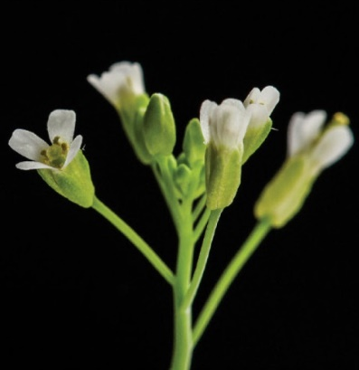
Reproduction and Senescence
Katerina Dadakova, Department of Biochemistry
1
Figures adopted from Buchanan et al., Biochemistry & molecular biology of plants

Slide 2
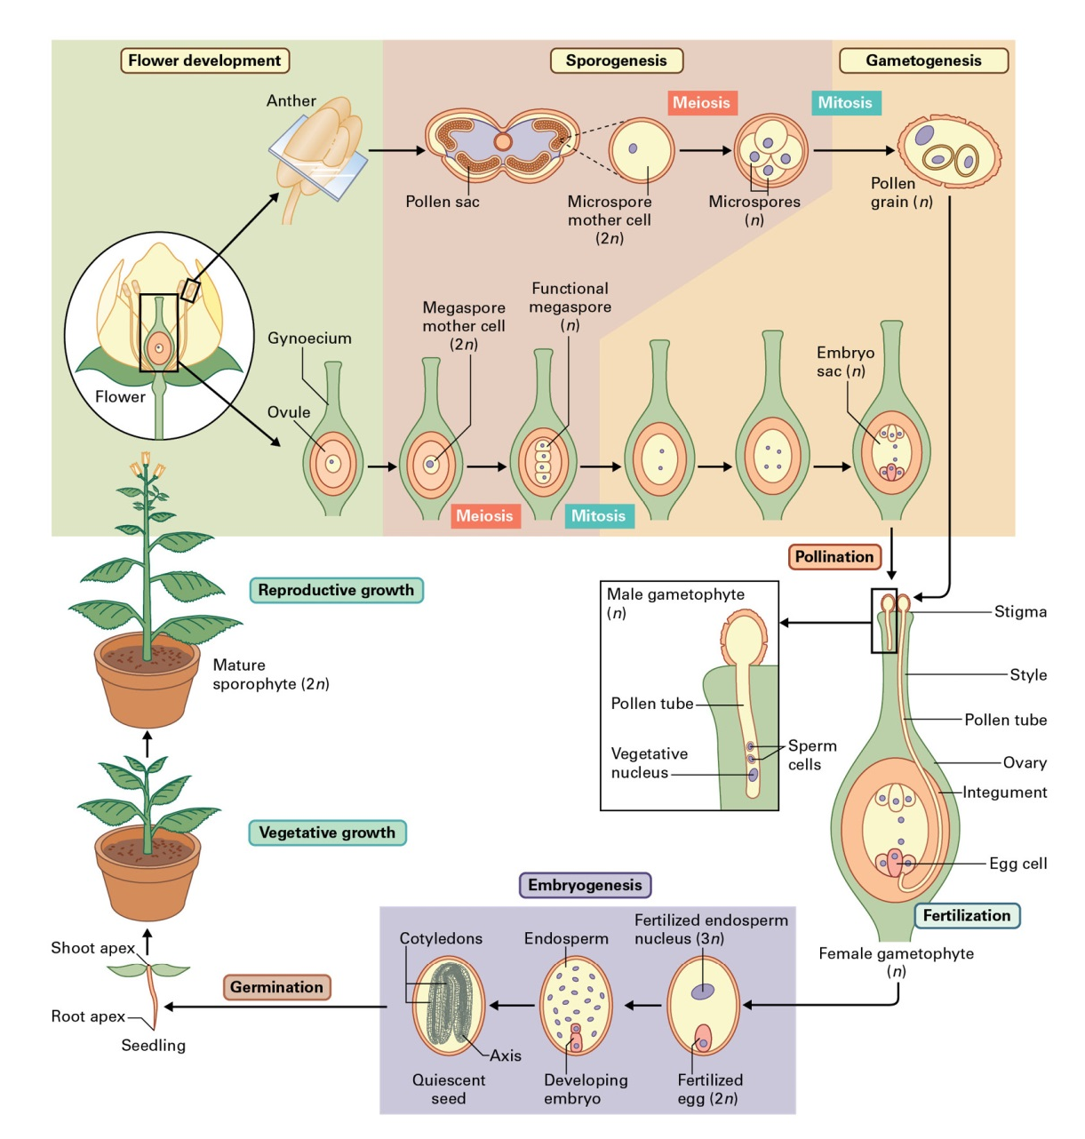
Reproduction and Senescence
The life cycle of flowering plants

Slide 3
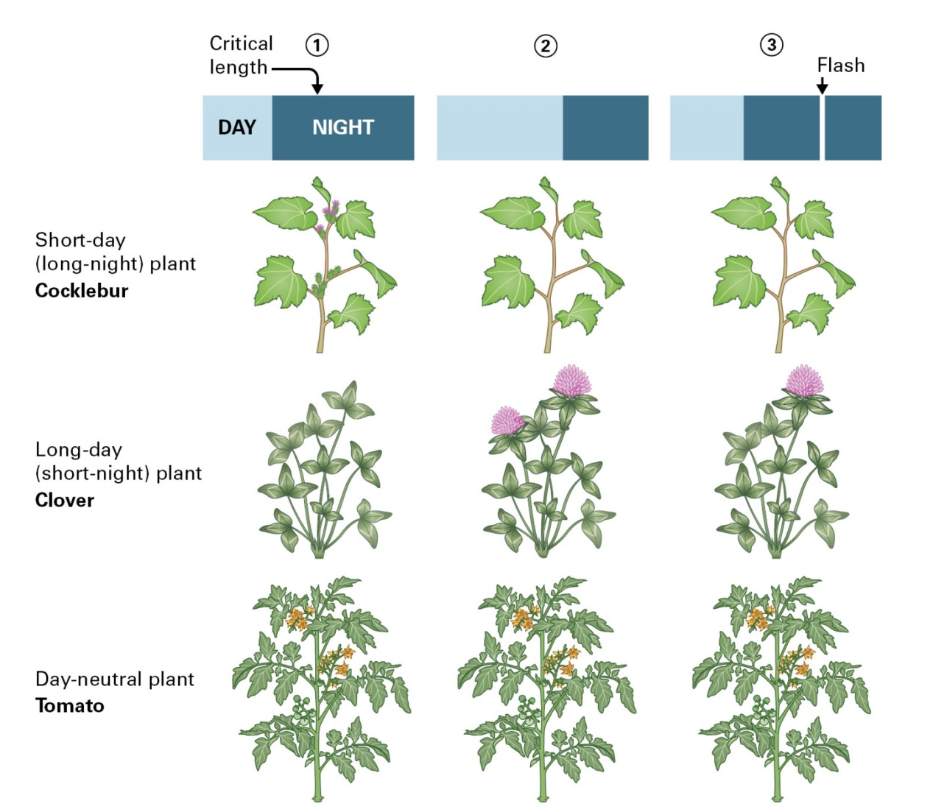
Reproduction and Senescence
The transition to reproductive development

Slide 4
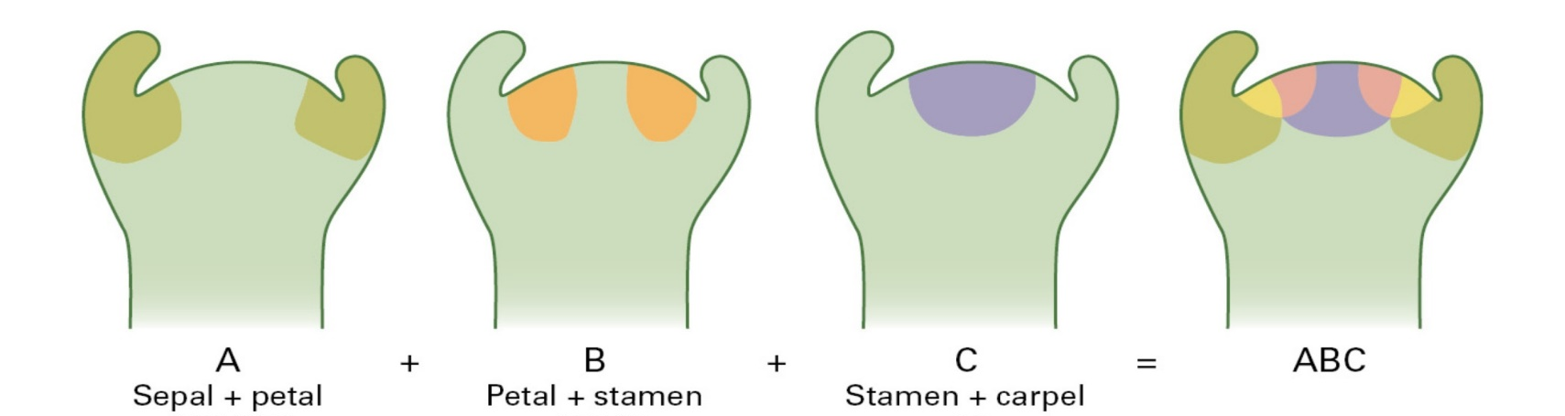
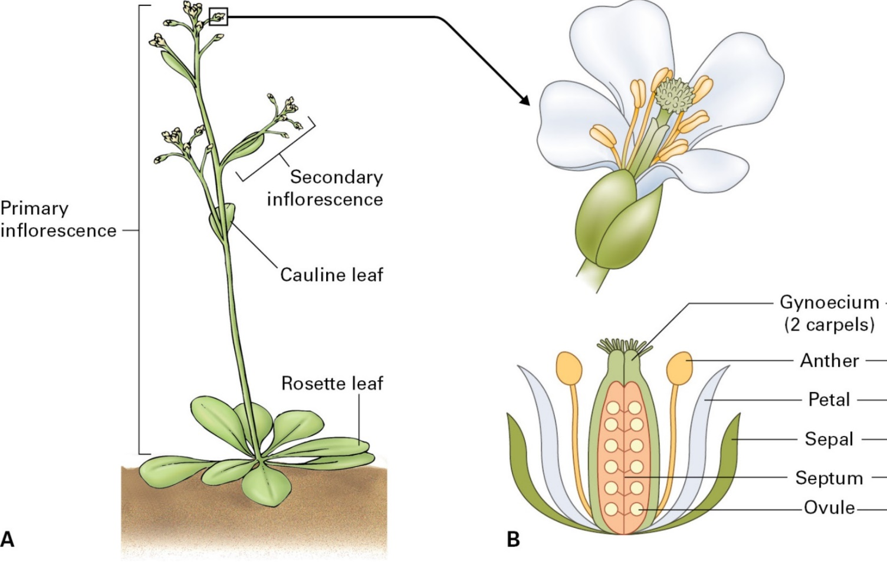
Reproduction and Senescence
Flower development

Slide 5
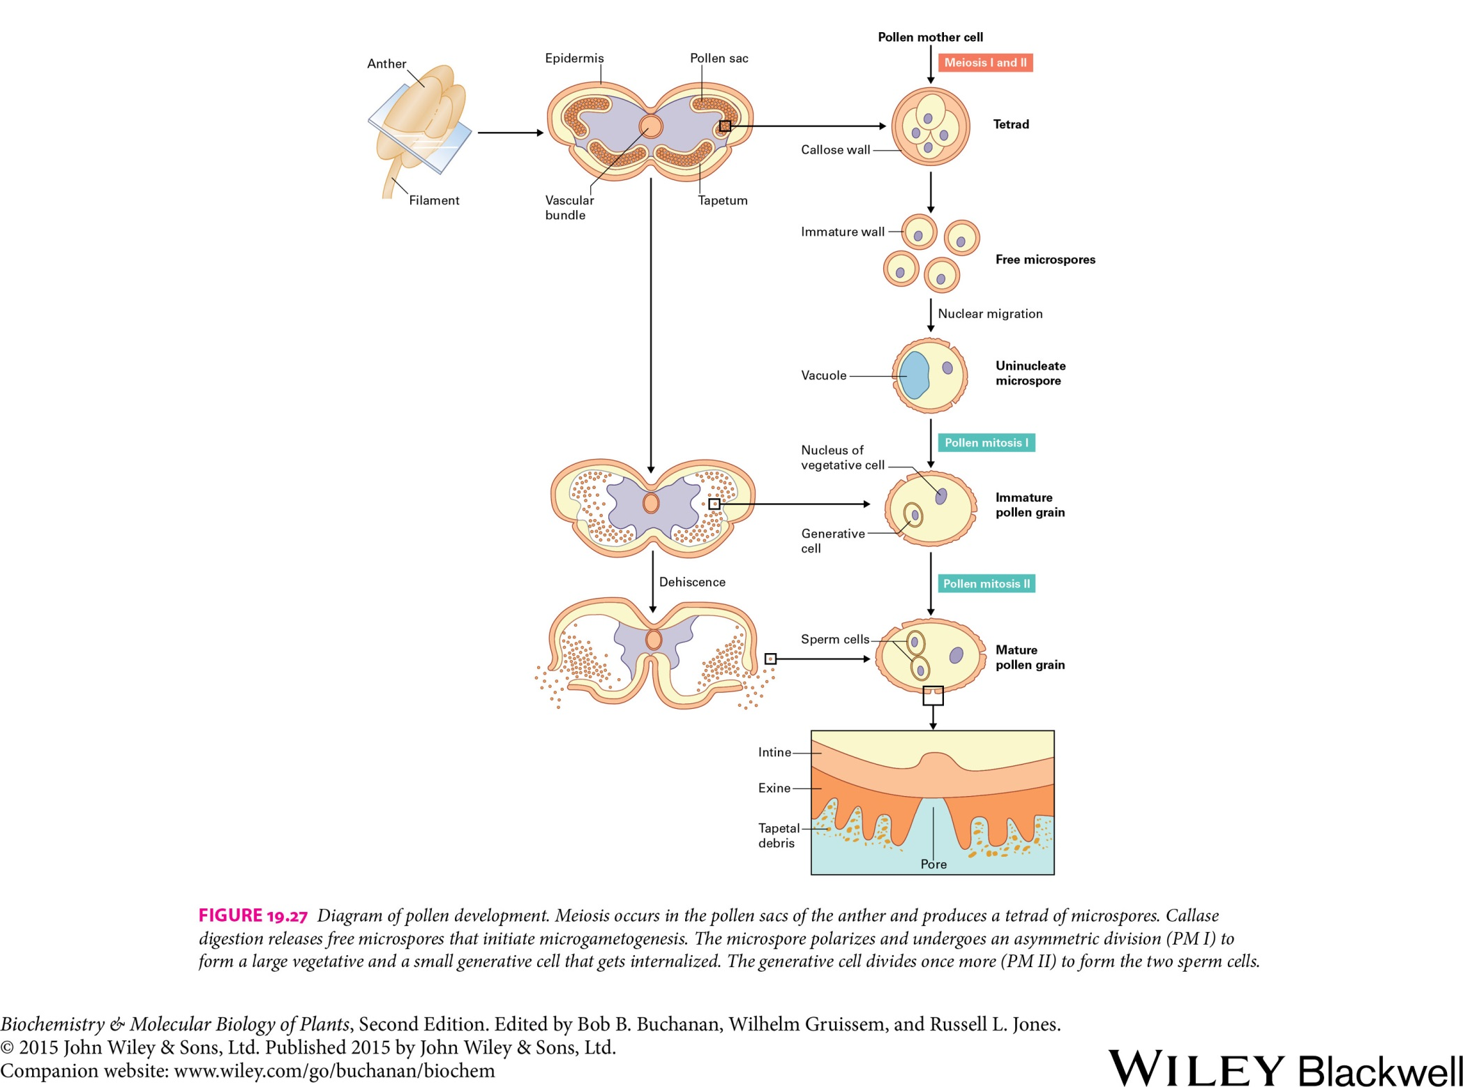
Reproduction and Senescence
Male gametes

Slide 6
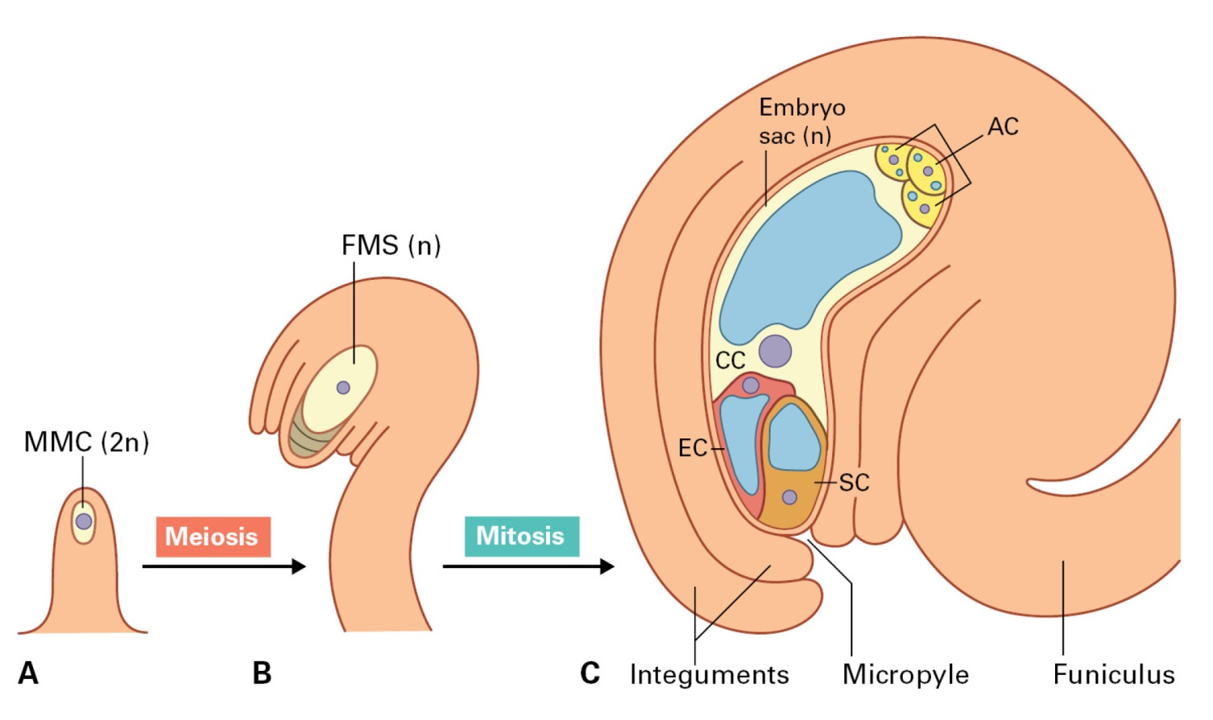
Reproduction and Senescence
Female gametes
(A) Megaspore mother cell at the tip of a young ovule primordium
(B) Functional megaspore initiates embryo sac development
(C) Mature ovule containing synergid cells, egg cell, central cell, and antipodal cells

Slide 7
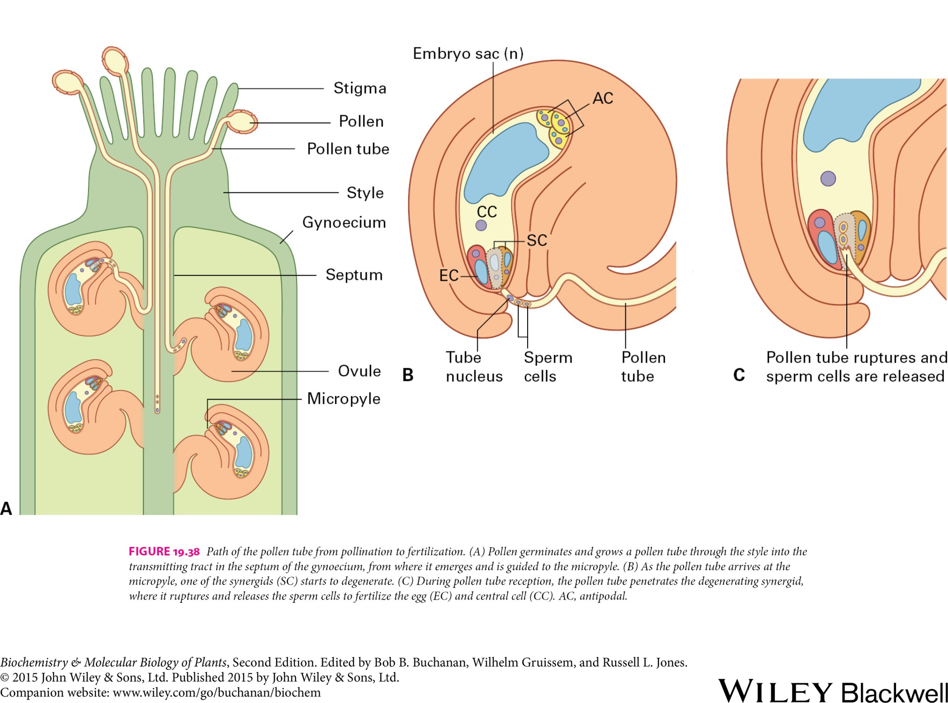
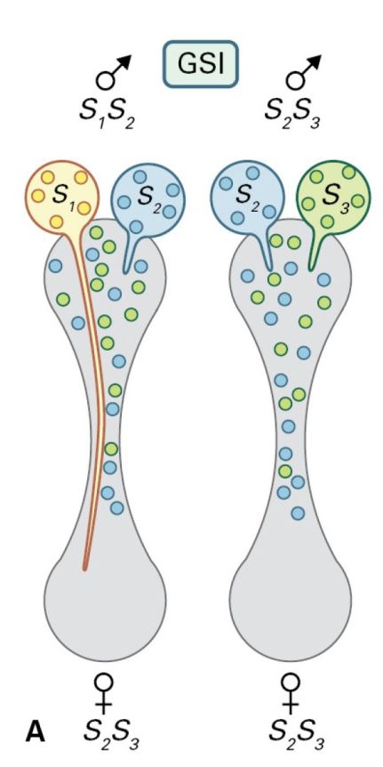
Reproduction and Senescence
Pollination and fertilization
Genetic basis of self-incompatibility

Slide 8
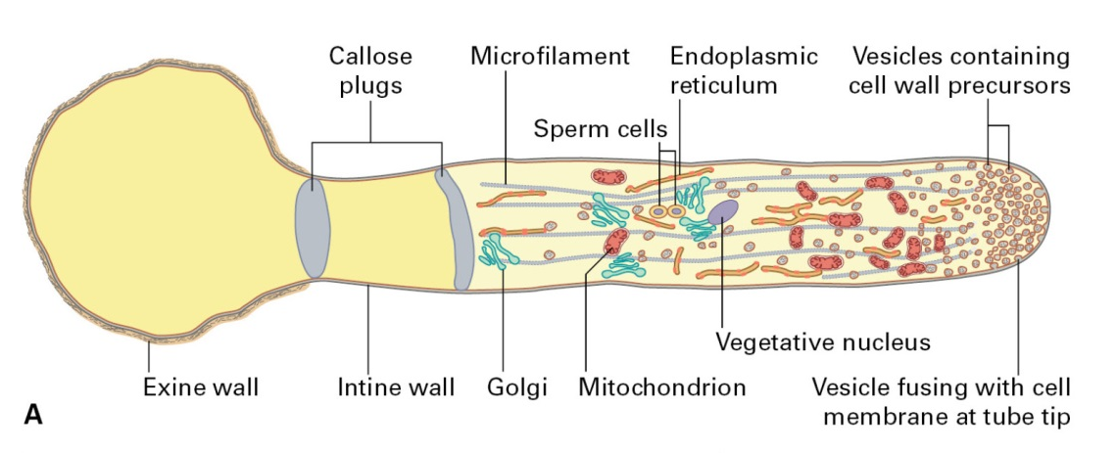
Reproduction and Senescence
Pollination and fertilization
Growing pollen tube

Slide 9
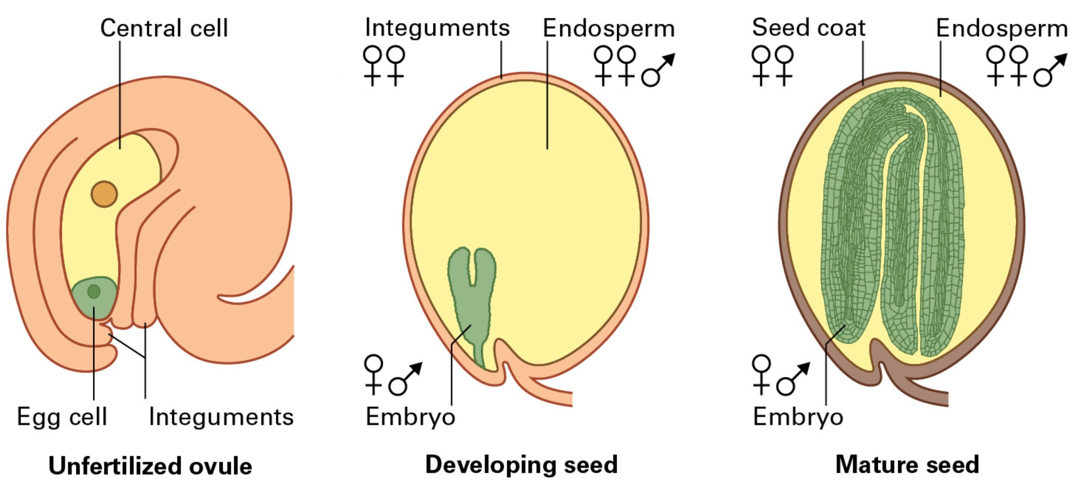
Reproduction and Senescence
Seed development

Slide 10
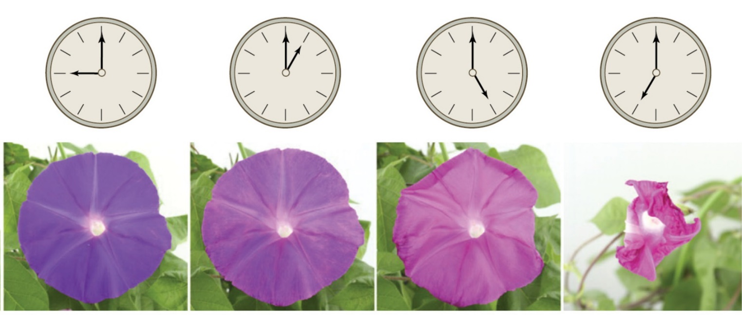
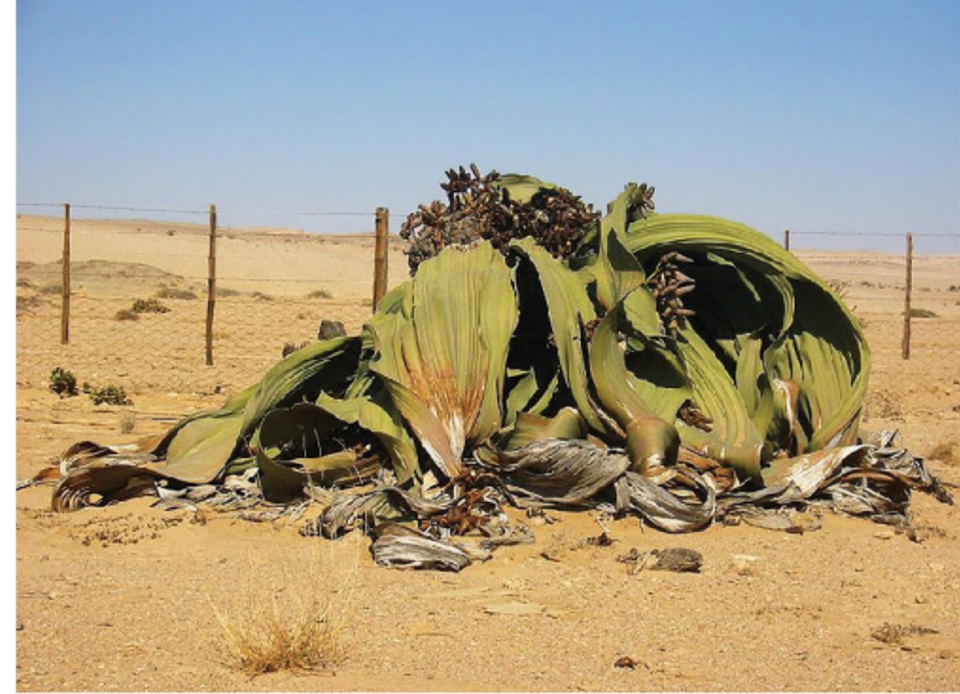
Reproduction and Senescence
Senescence
Ipomoea tricolor
Welwitschia mirabilis

Slide 11
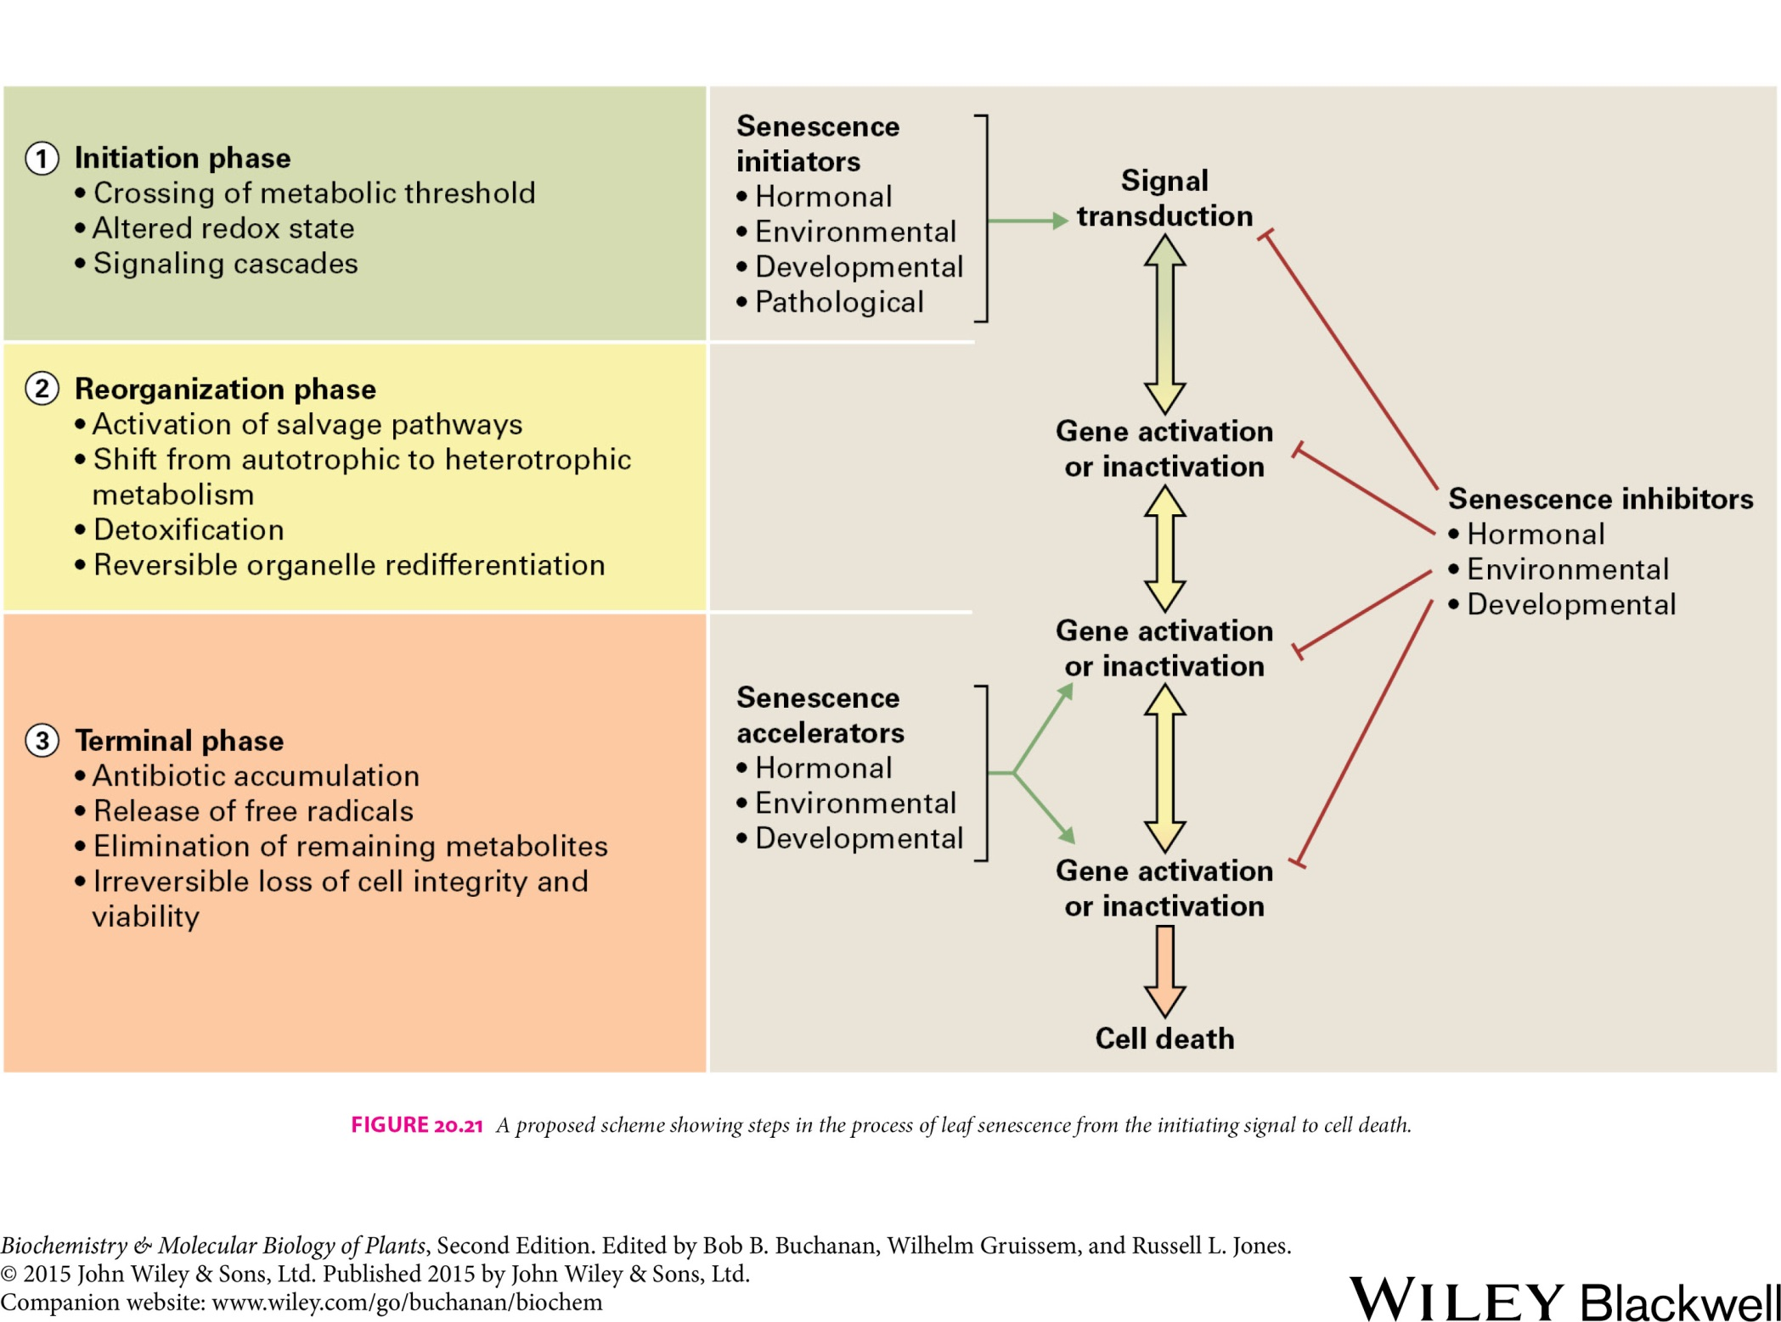
Reproduction and Senescence
Senescence

Slide 12
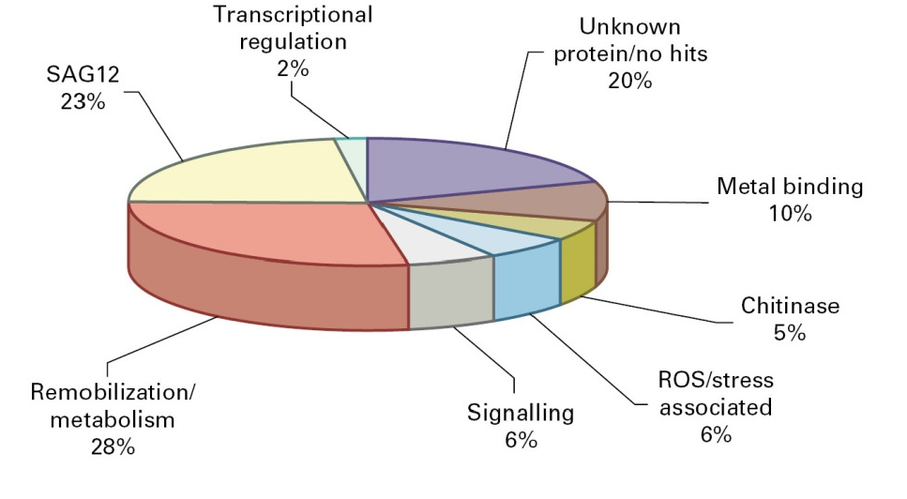
Reproduction and Senescence
Gene expression during senescence
Groups of genes upregulated in senescing leaves and petals

Slide 13
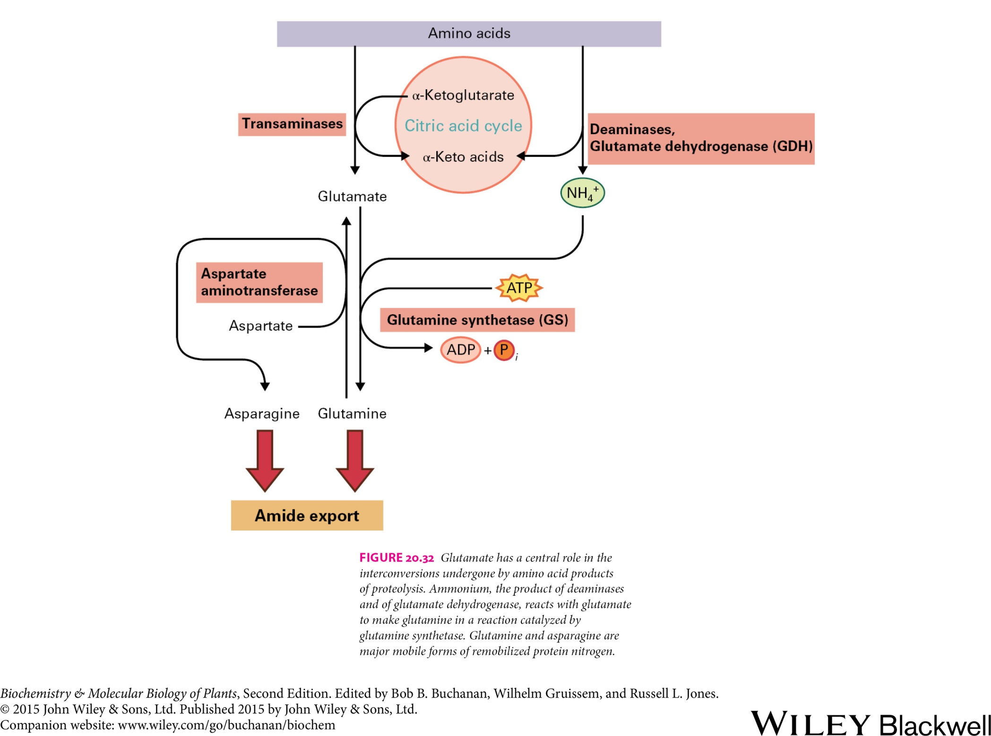
Reproduction and Senescence
Salvage of nutrients
Nucleic acids
Phosphate export

Slide 14
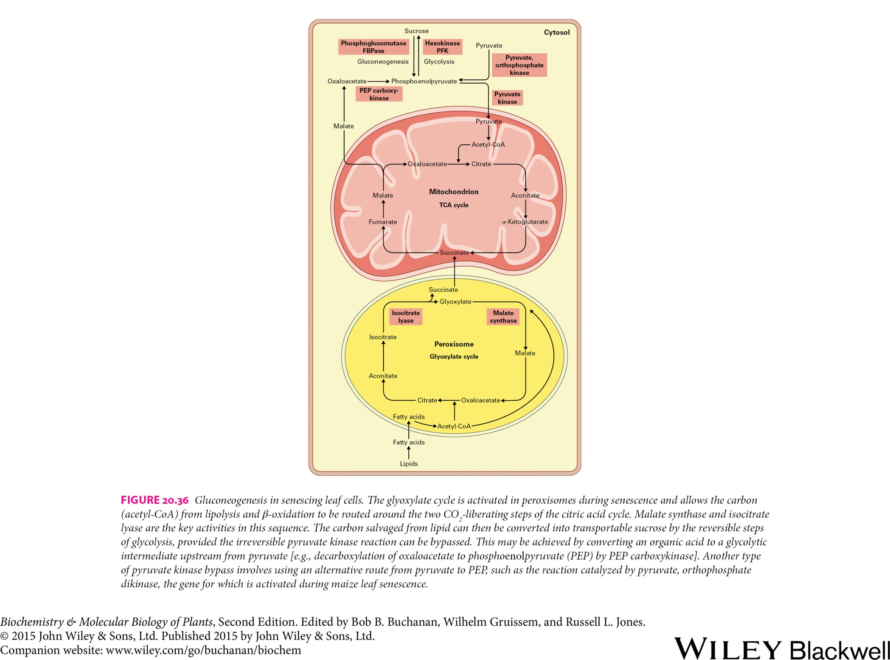
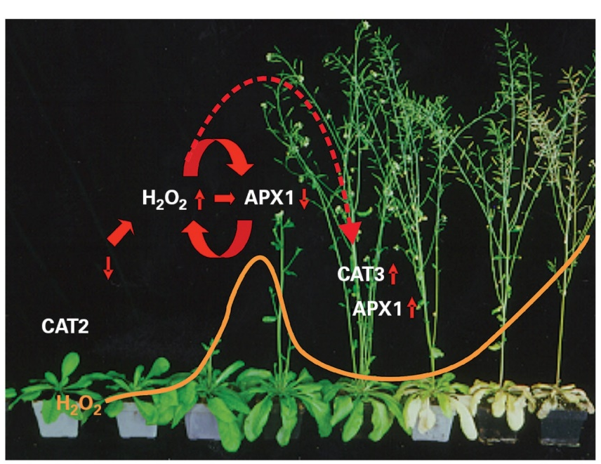
Reproduction and Senescence
Energy and metabolism
Mitochondrion
TCA cycle

Slide 15
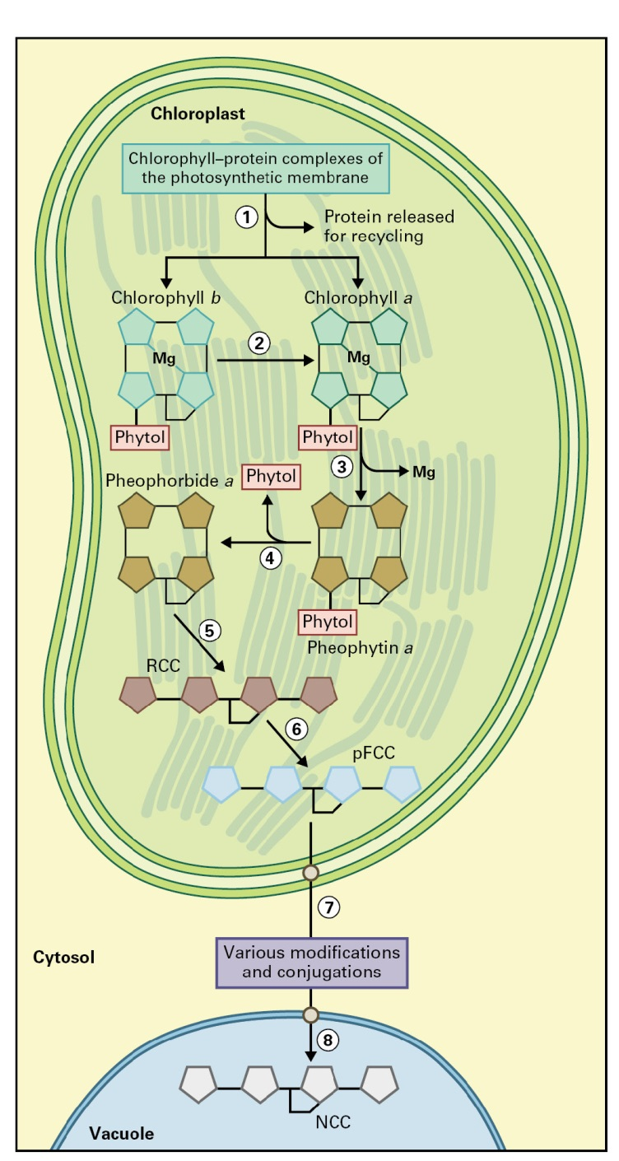
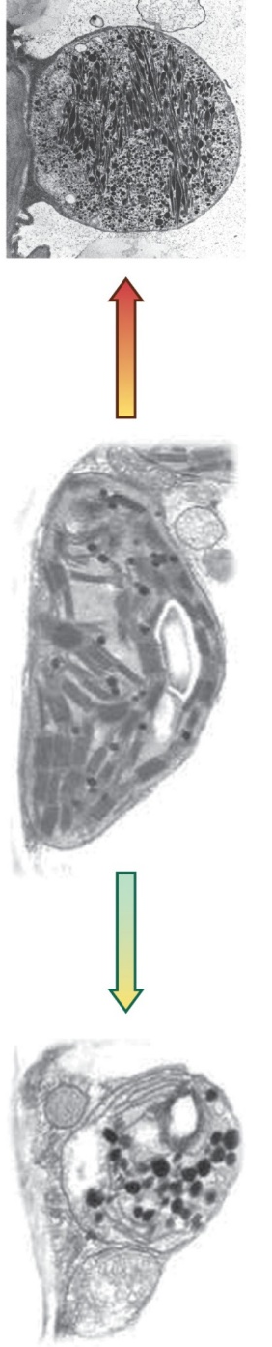
Reproduction and Senescence
Pigment metabolism in senescence
Chromoplast
Chloroplast
Gerontoplast

Slide 16
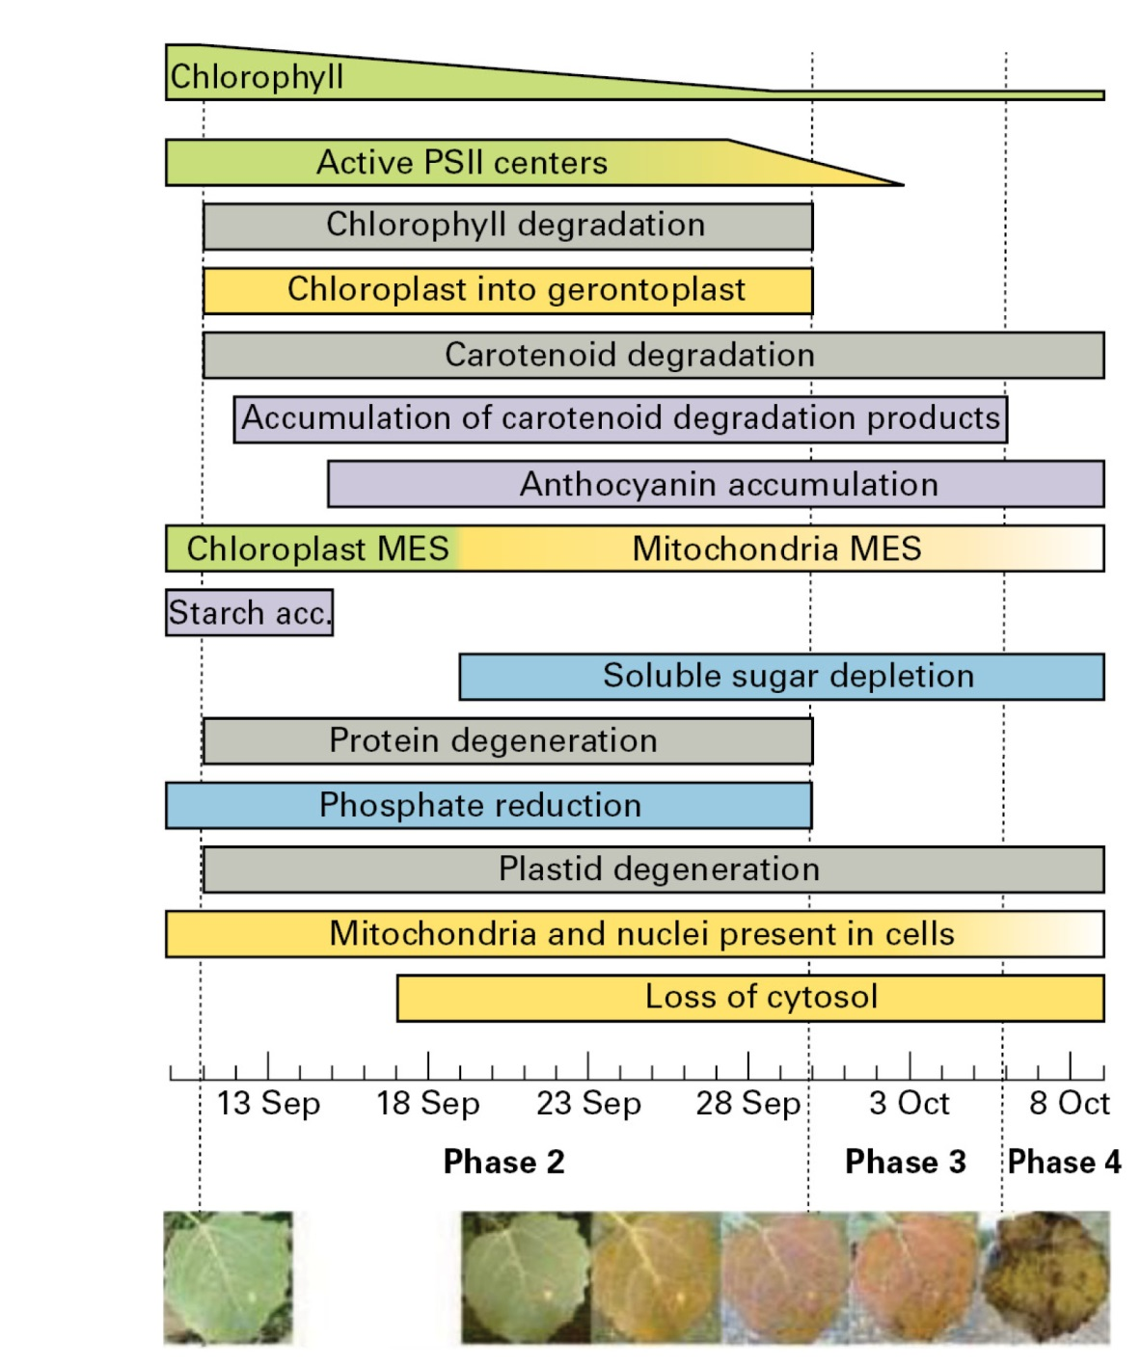
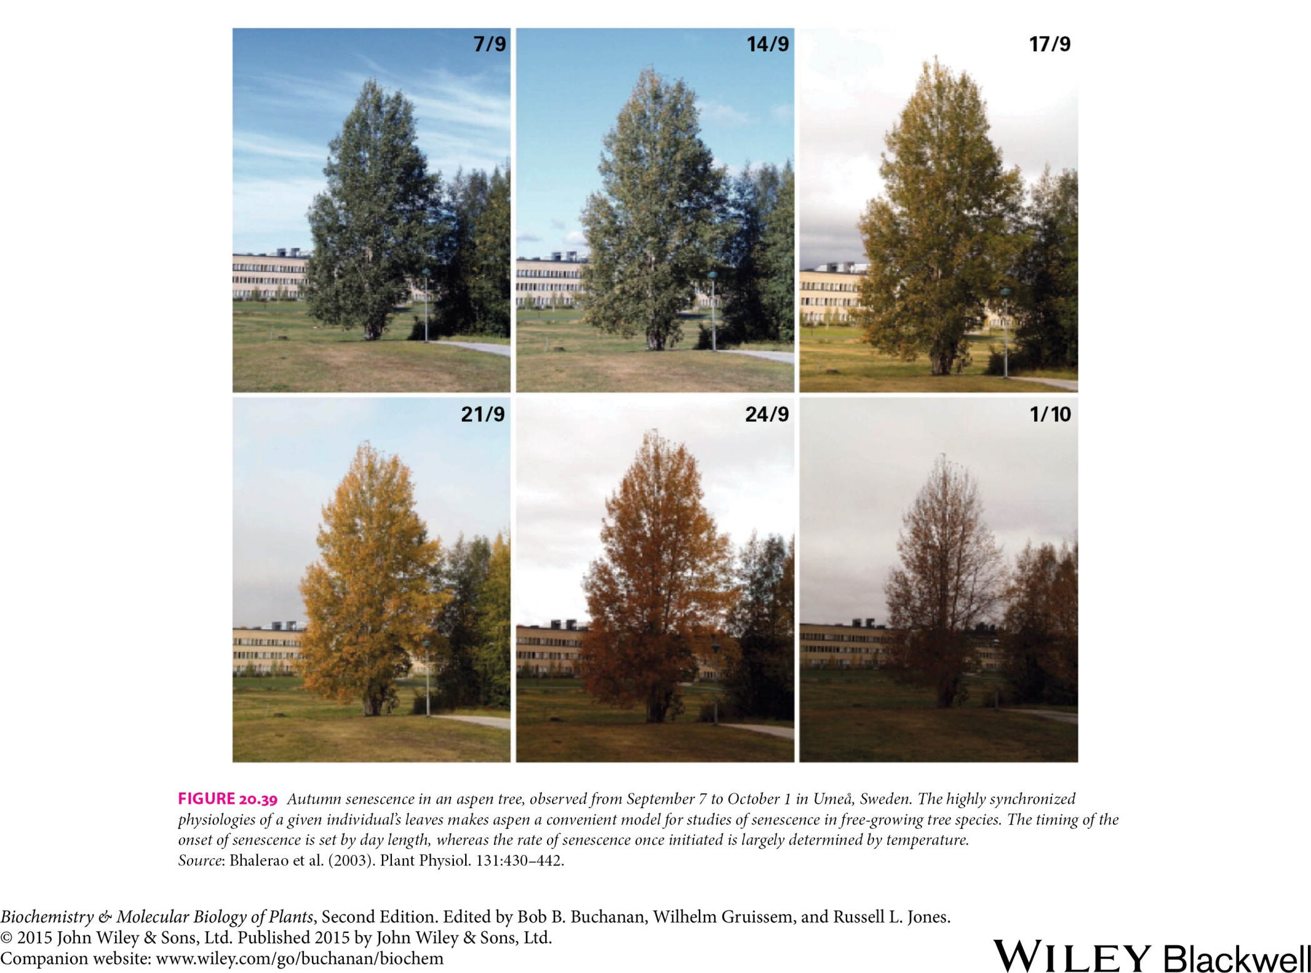
Reproduction and Senescence
Environmental influences of senescence
Cellular events during autumnal senescence in aspen

Slide 17
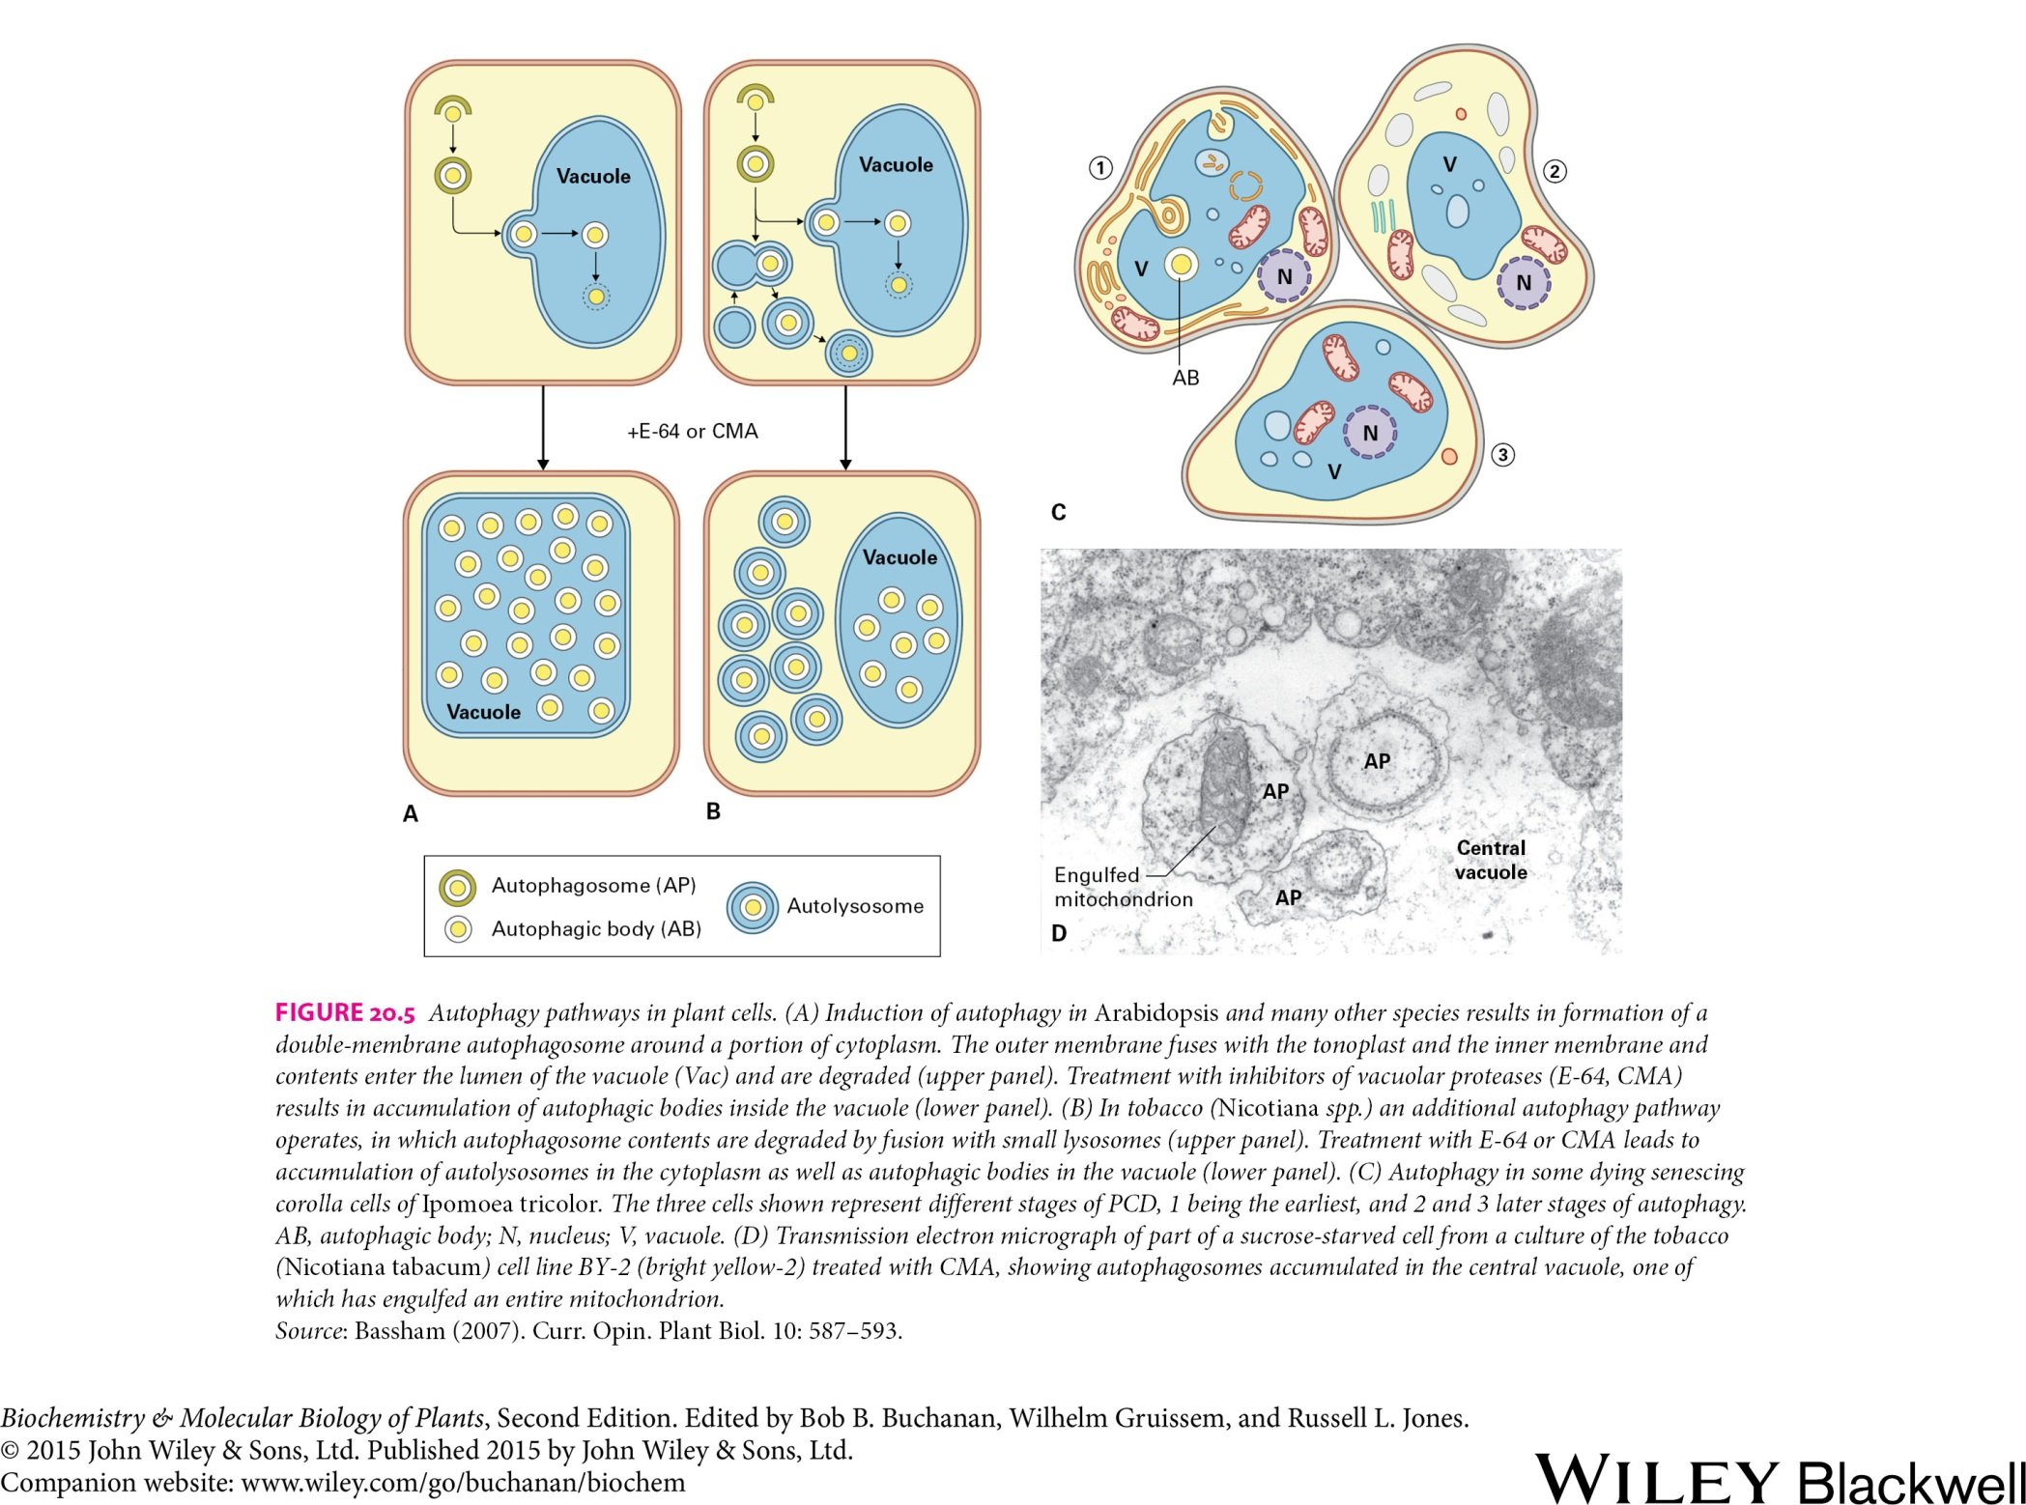
Reproduction and Senescence
Programmed cell death
AB, autophagic body
AP, autophagosome

Slide 18
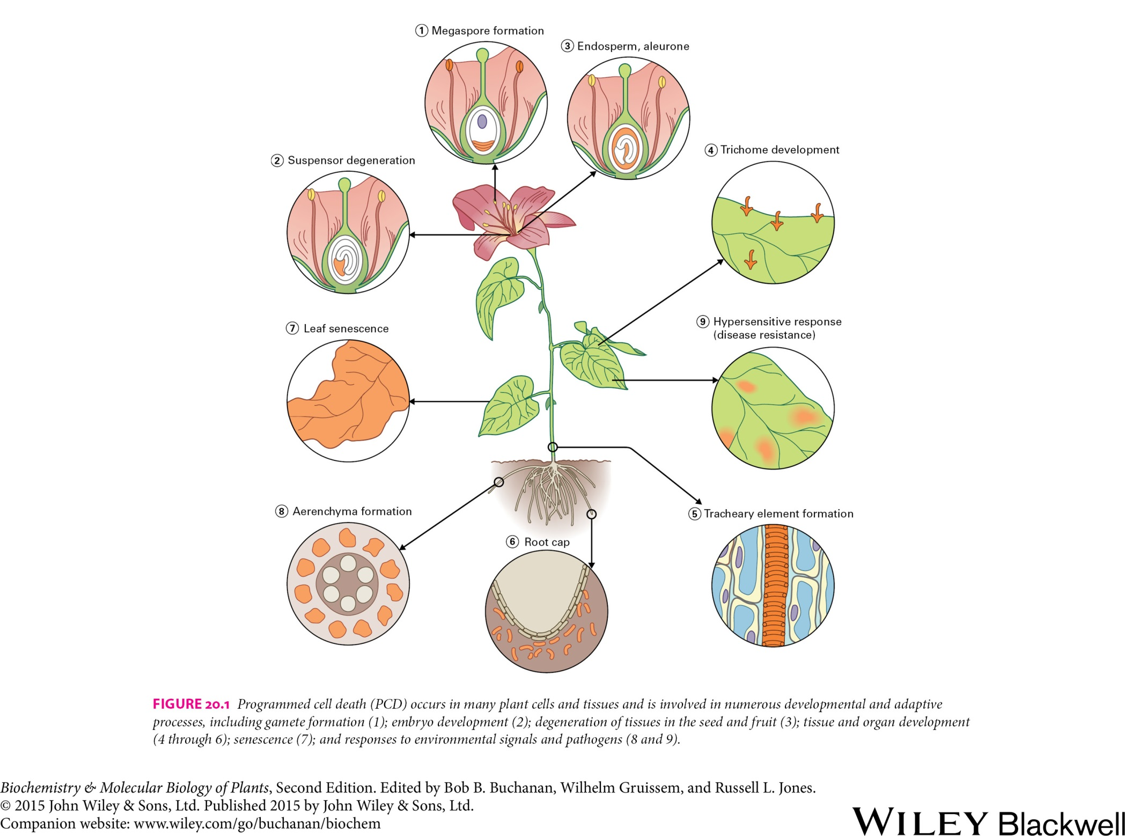
Reproduction and Senescence
Programmed cell death

Slide 19
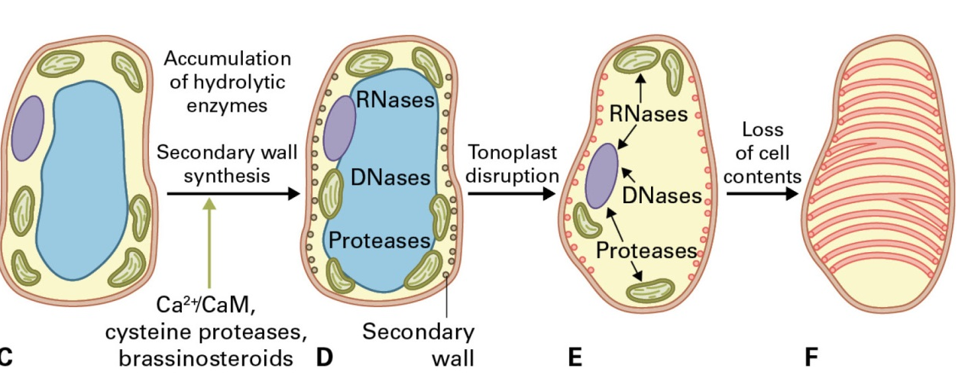
Reproduction and Senescence
Programmed cell death
The differentiation of tracheary elements

Slide 20
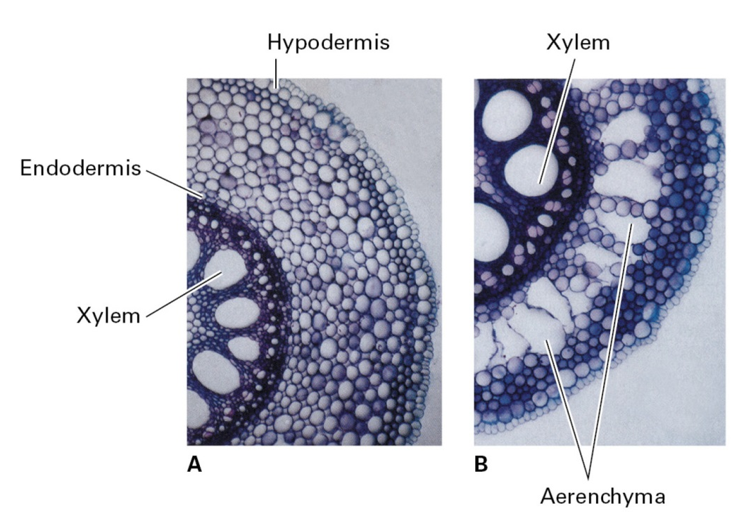
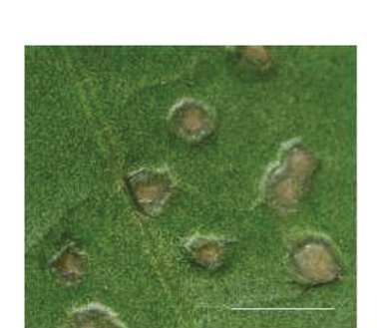
Reproduction and Senescence
Environmental influences of PCD
Cell death during the HR

