Slide 1
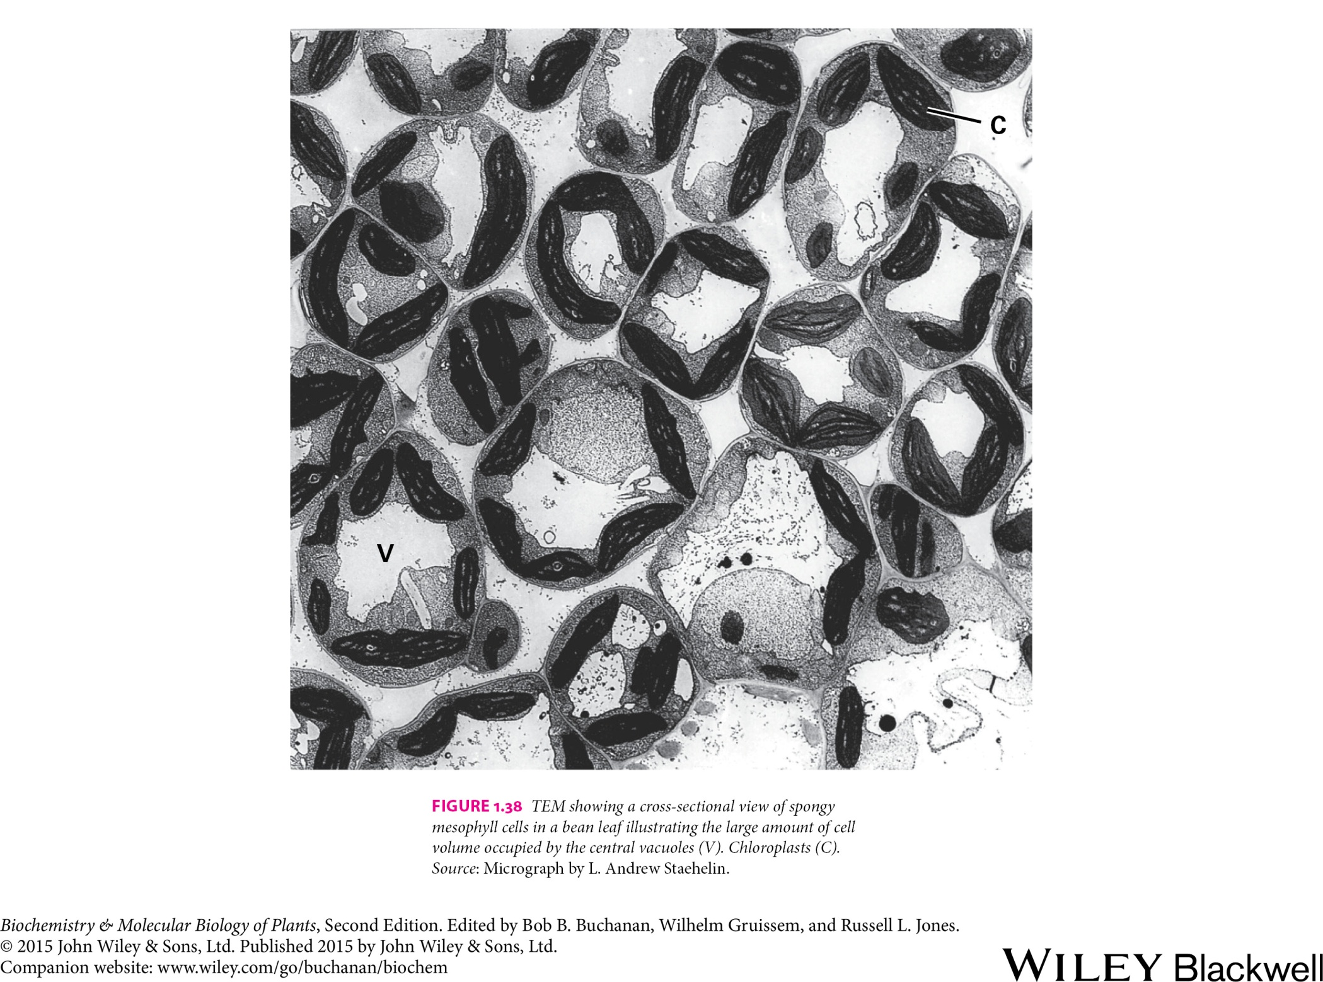
Plant cell
1
Figures adopted from Buchanan et al., Biochemistry & molecular biology of plants

Slide 2
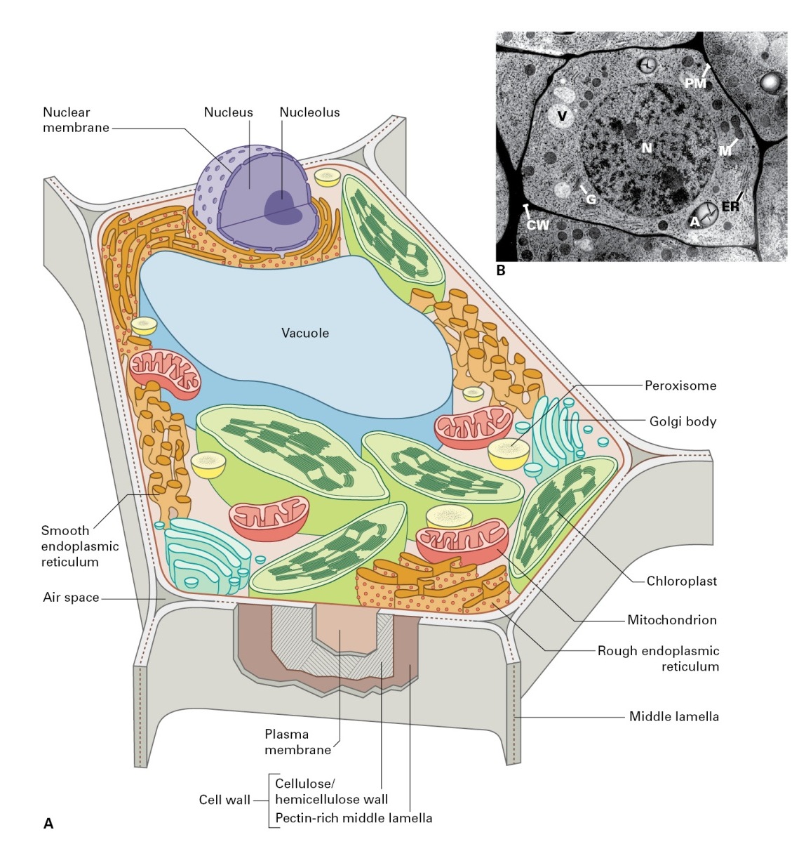
Plant cell

Slide 3
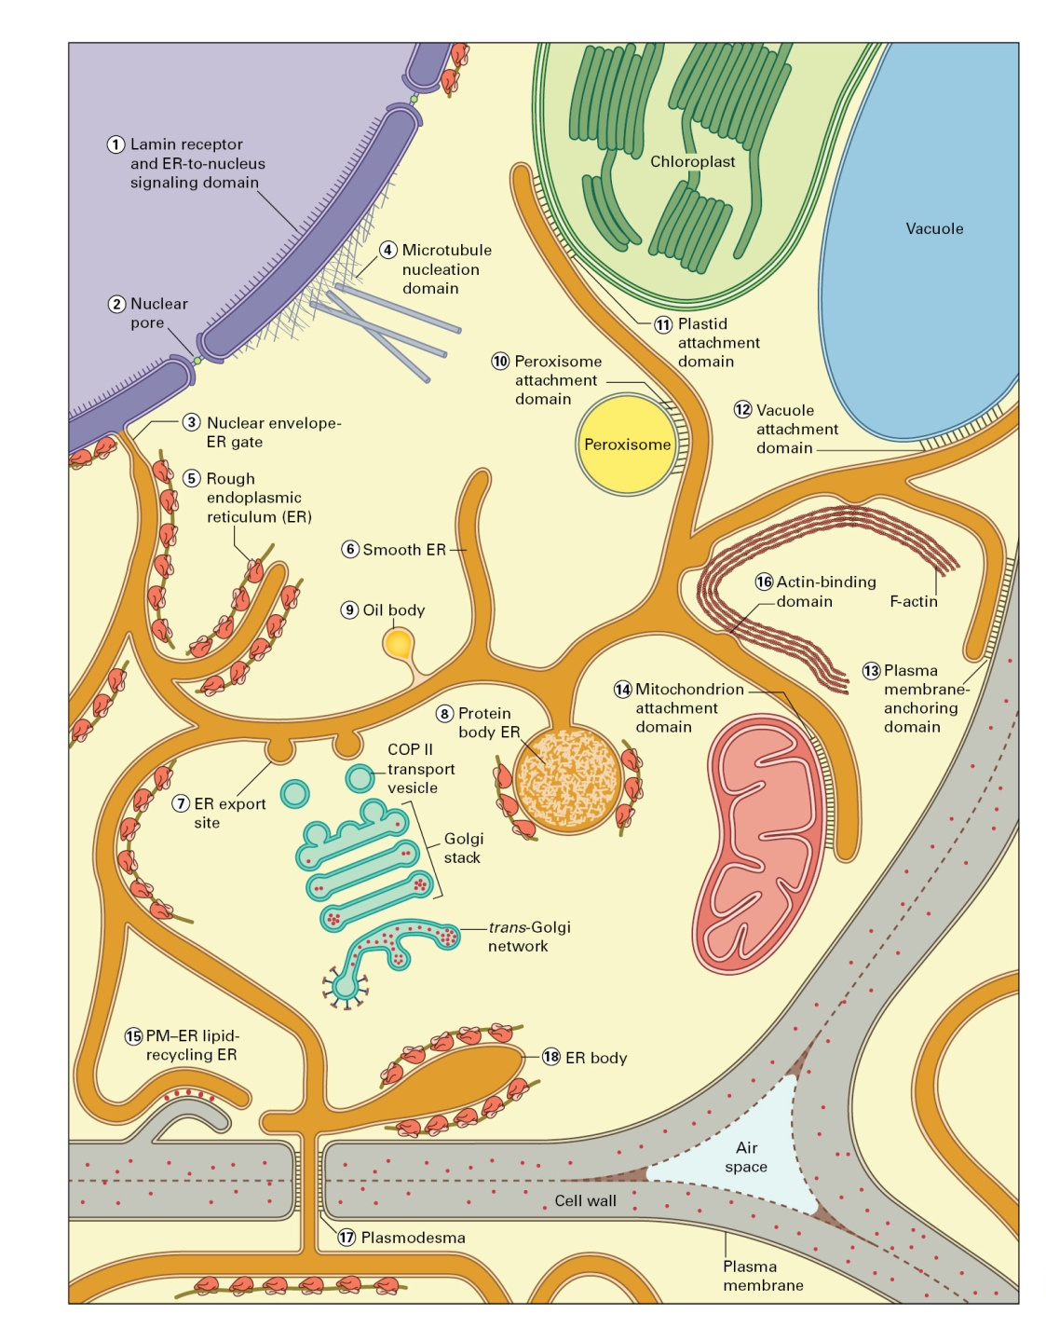
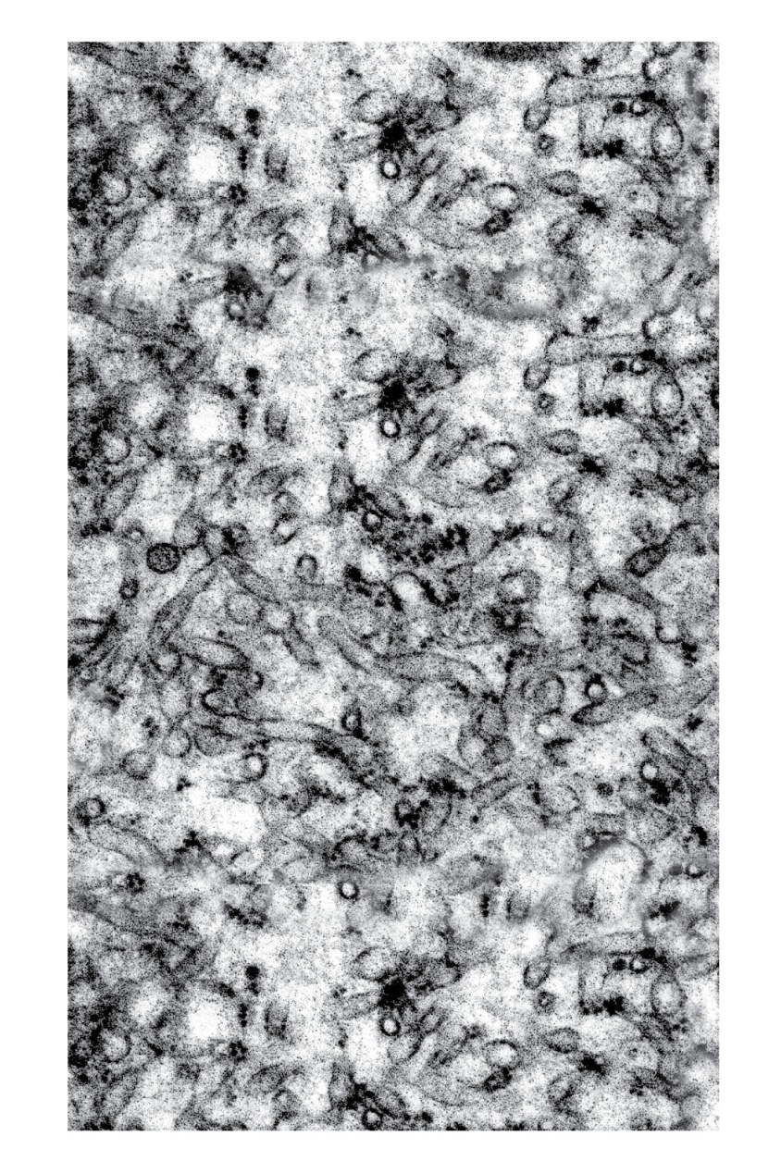
Plant cell
Endoplasmic reticulum
ER tubules

Slide 4
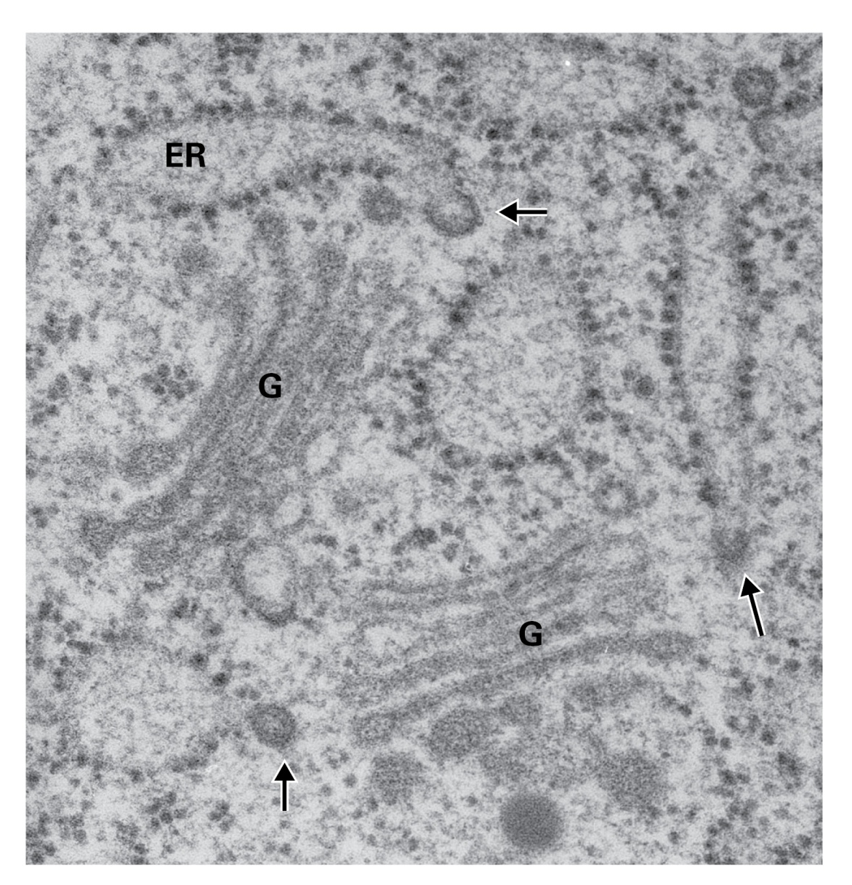
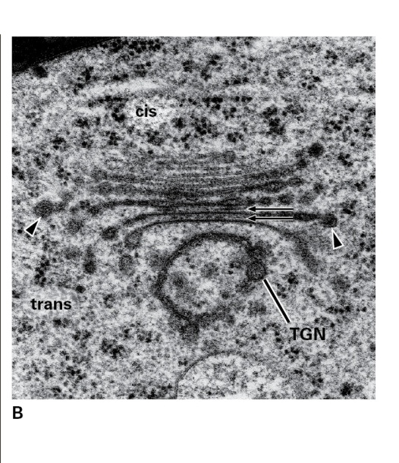
Plant cell
Golgi apparatus

Slide 5
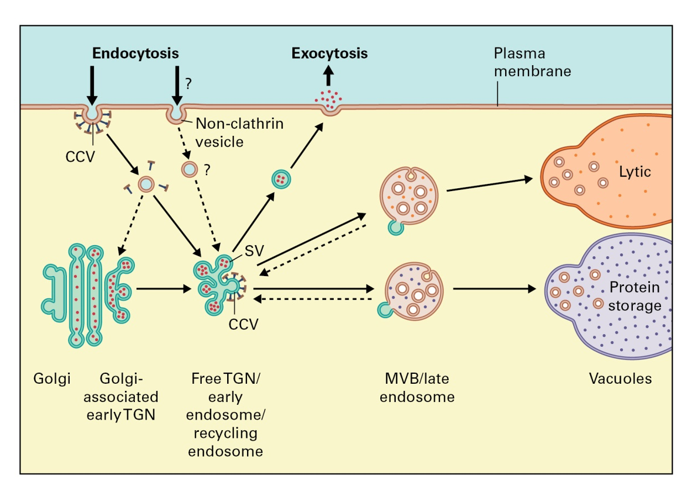
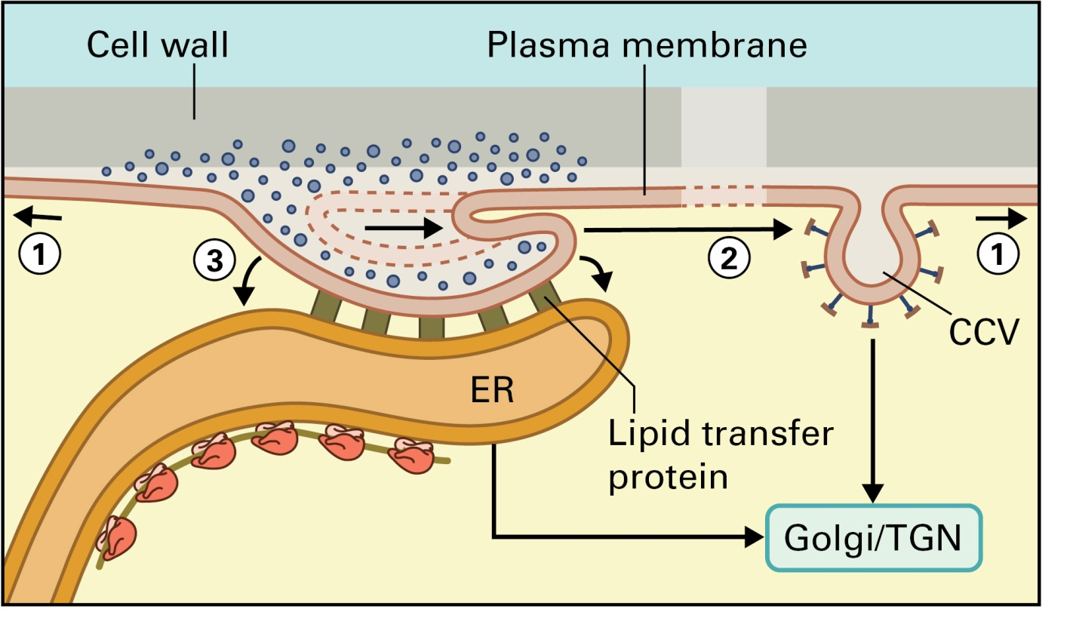
Plant cell
Exocytosis and endocytosis
The mechanisms for removing the excess membrane from the plasma membrane

Slide 6
Plant cell
Vacuoles
Metabolic roles of vacuoles:
Growth
Storage
Digestion
pH and ionic homeostasis
Defense against microbial pathogens and herbivores
Sequestration of toxic compounds
Pigmentation

Slide 7
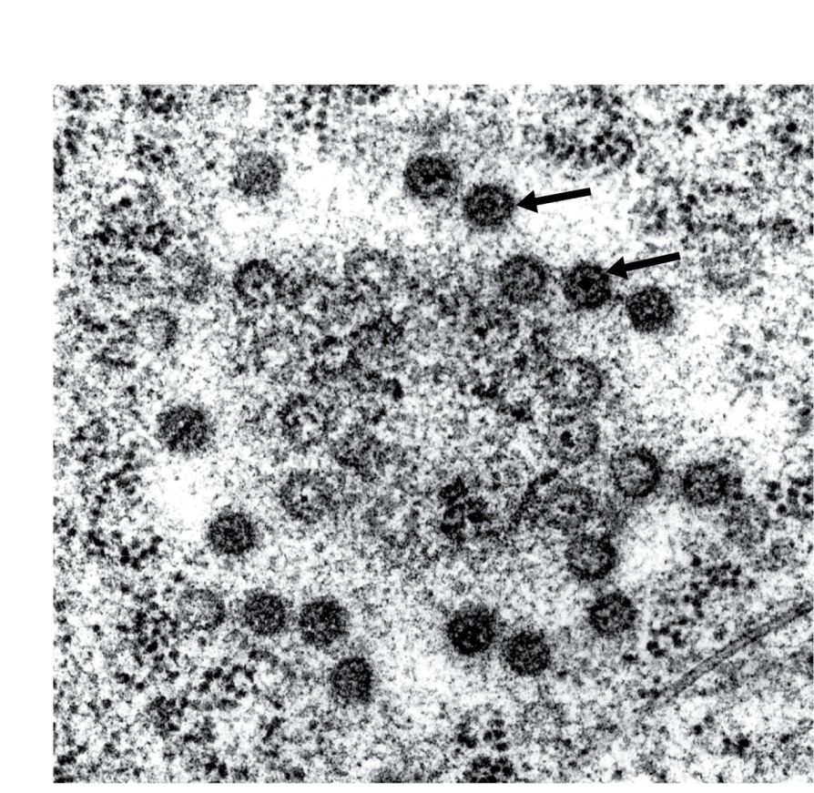
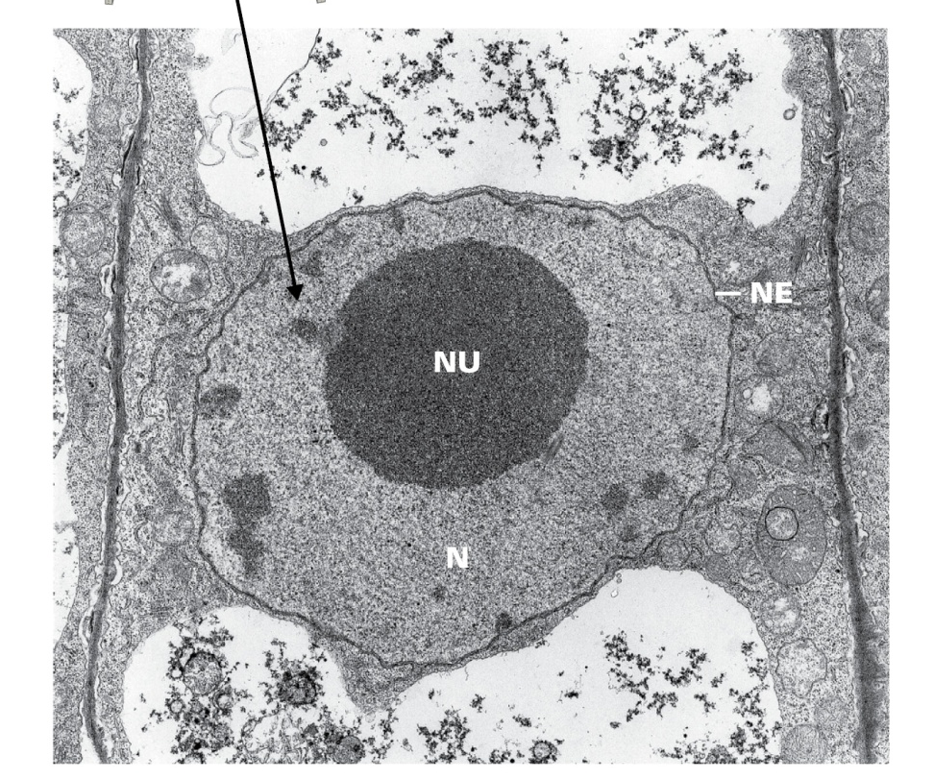
Plant cell
The nucleus
N, nucleus
NE, nuclear envelope
NU, nucleolus
Nuclear pores

Slide 8
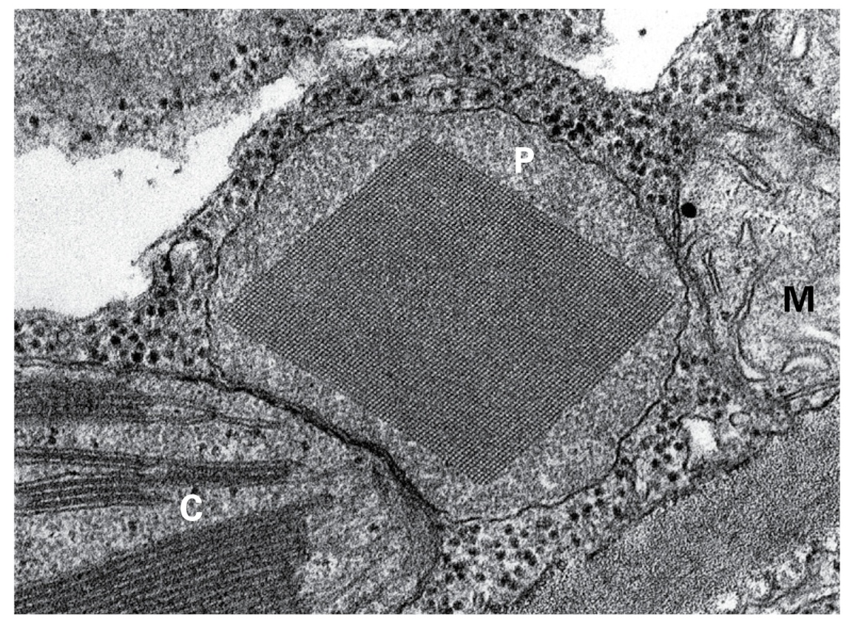
Plant cell
Peroxisomes
C, chloroplast
P, peroxisome
M, mitochondrion

Slide 9
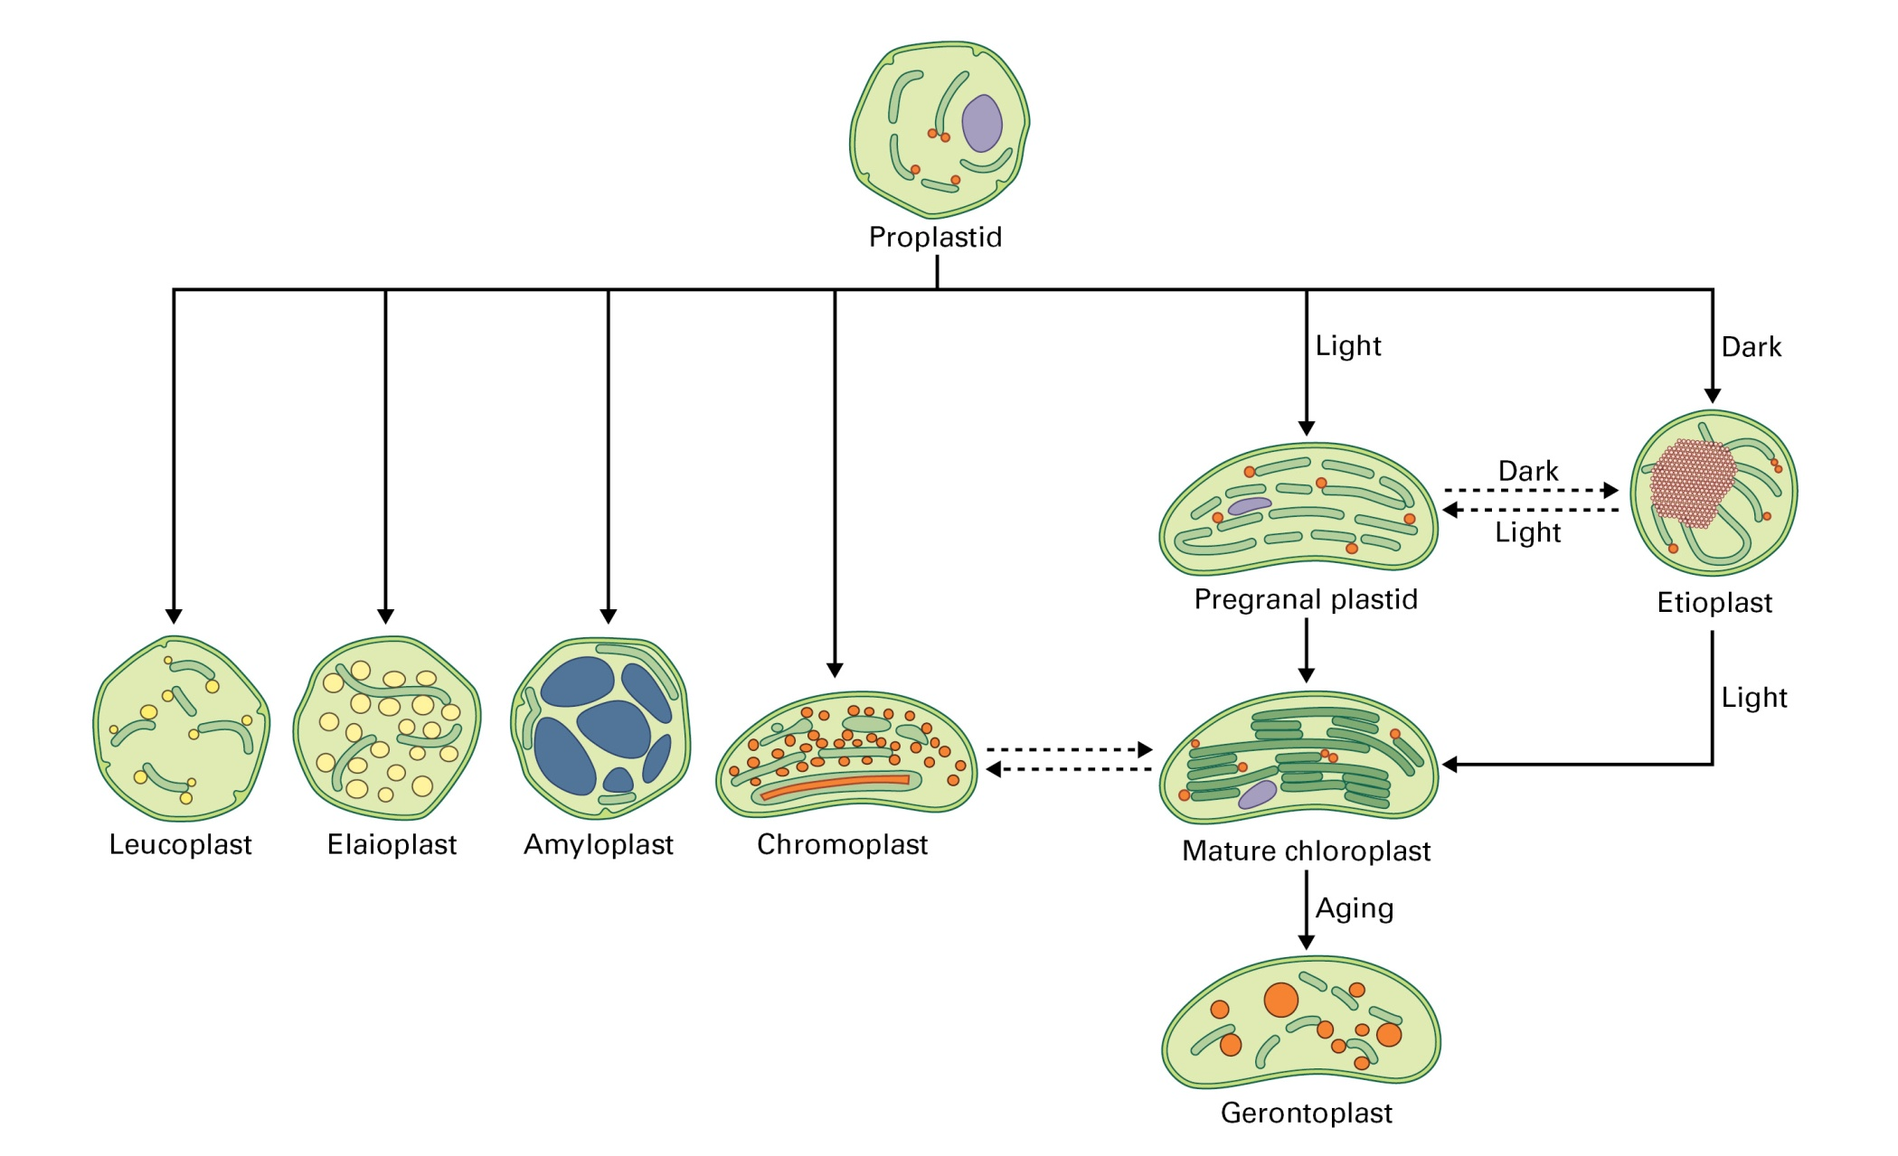
Plant cell
Plastids

Slide 10
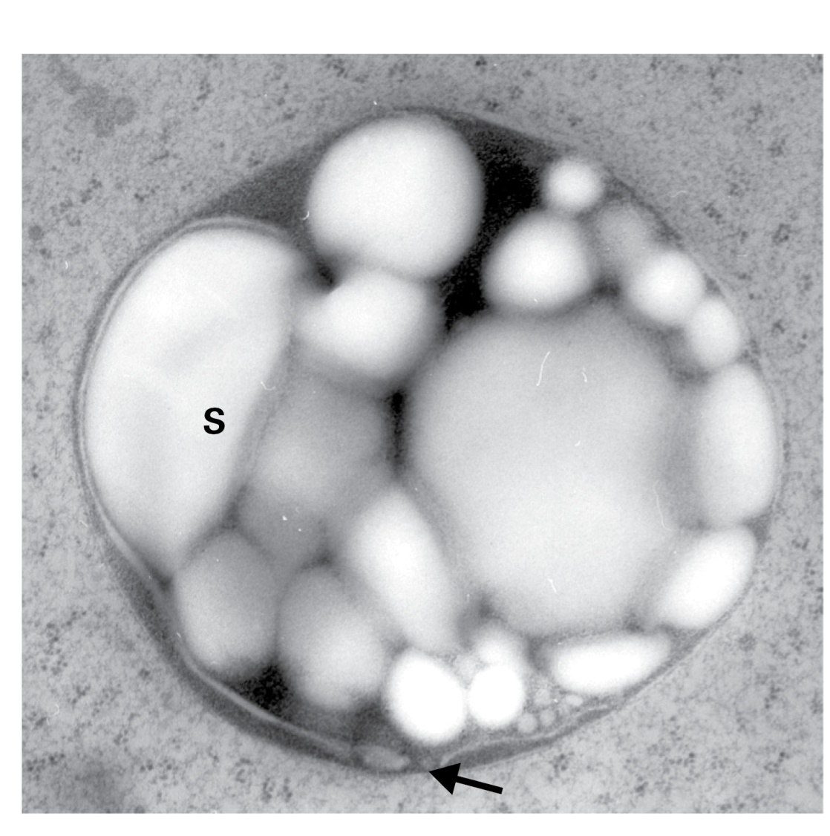
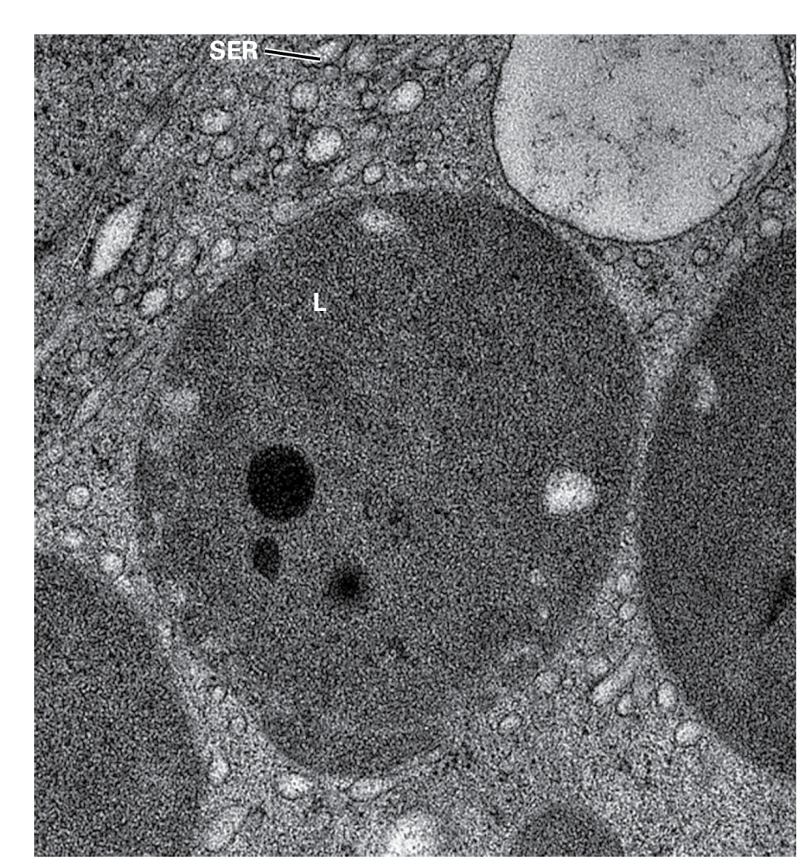
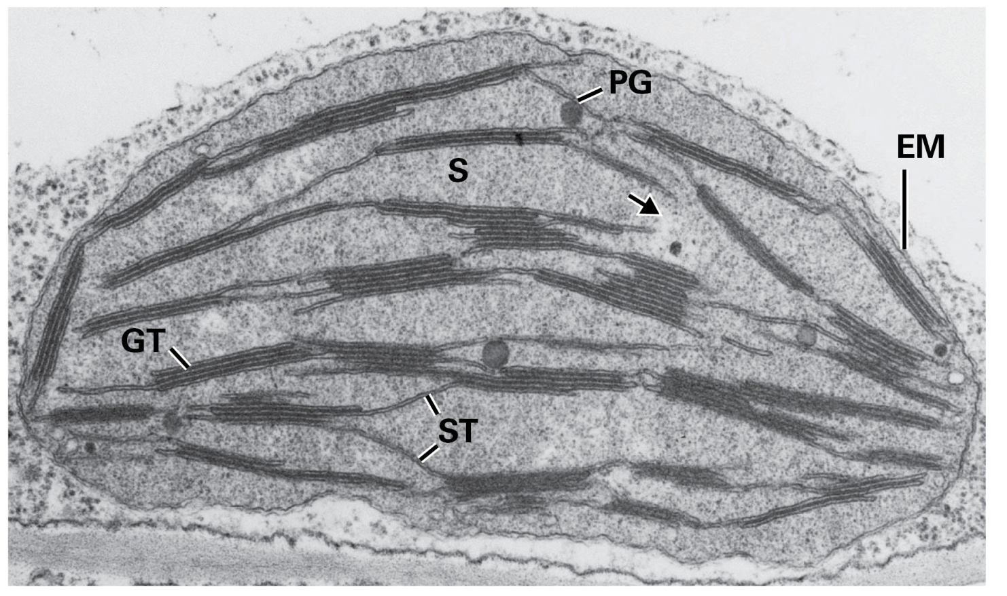
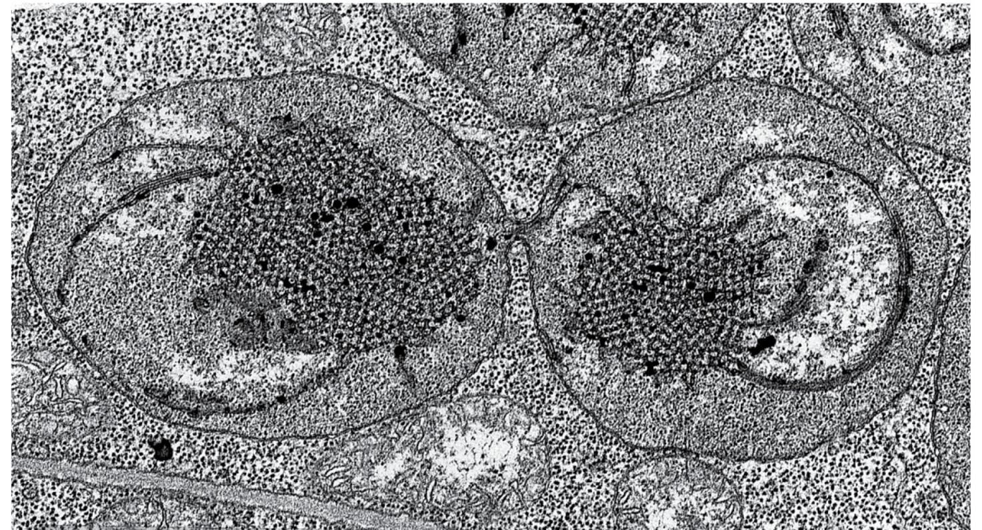
Plant cell
Plastids
Chloroplast
Amyloplast
Leucoplast
Etioplasts

Slide 11
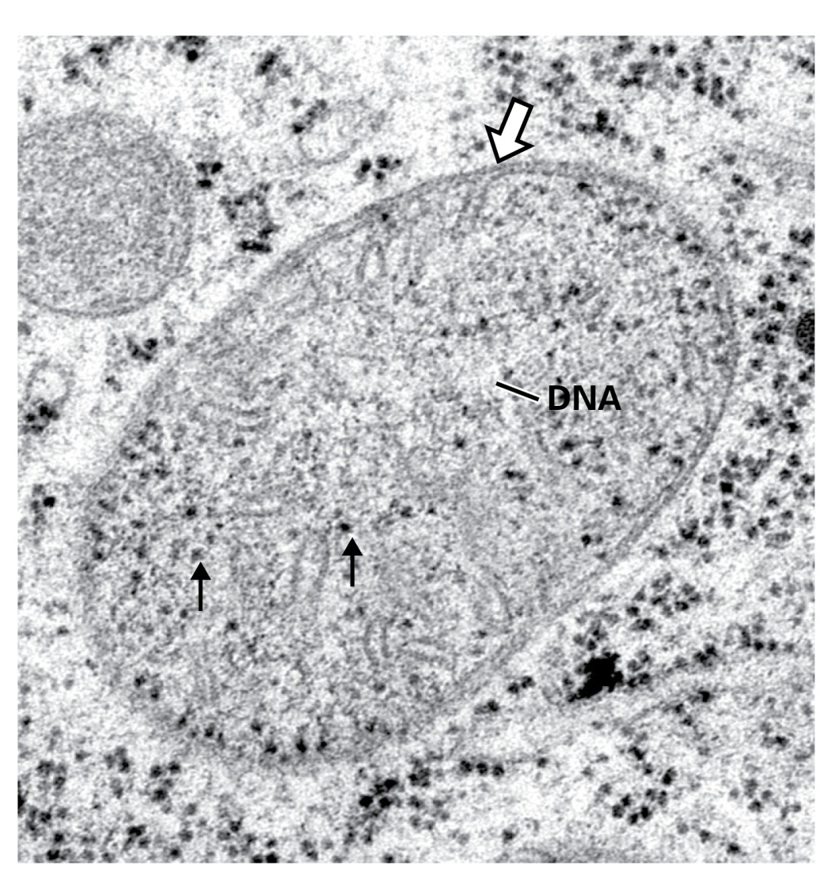
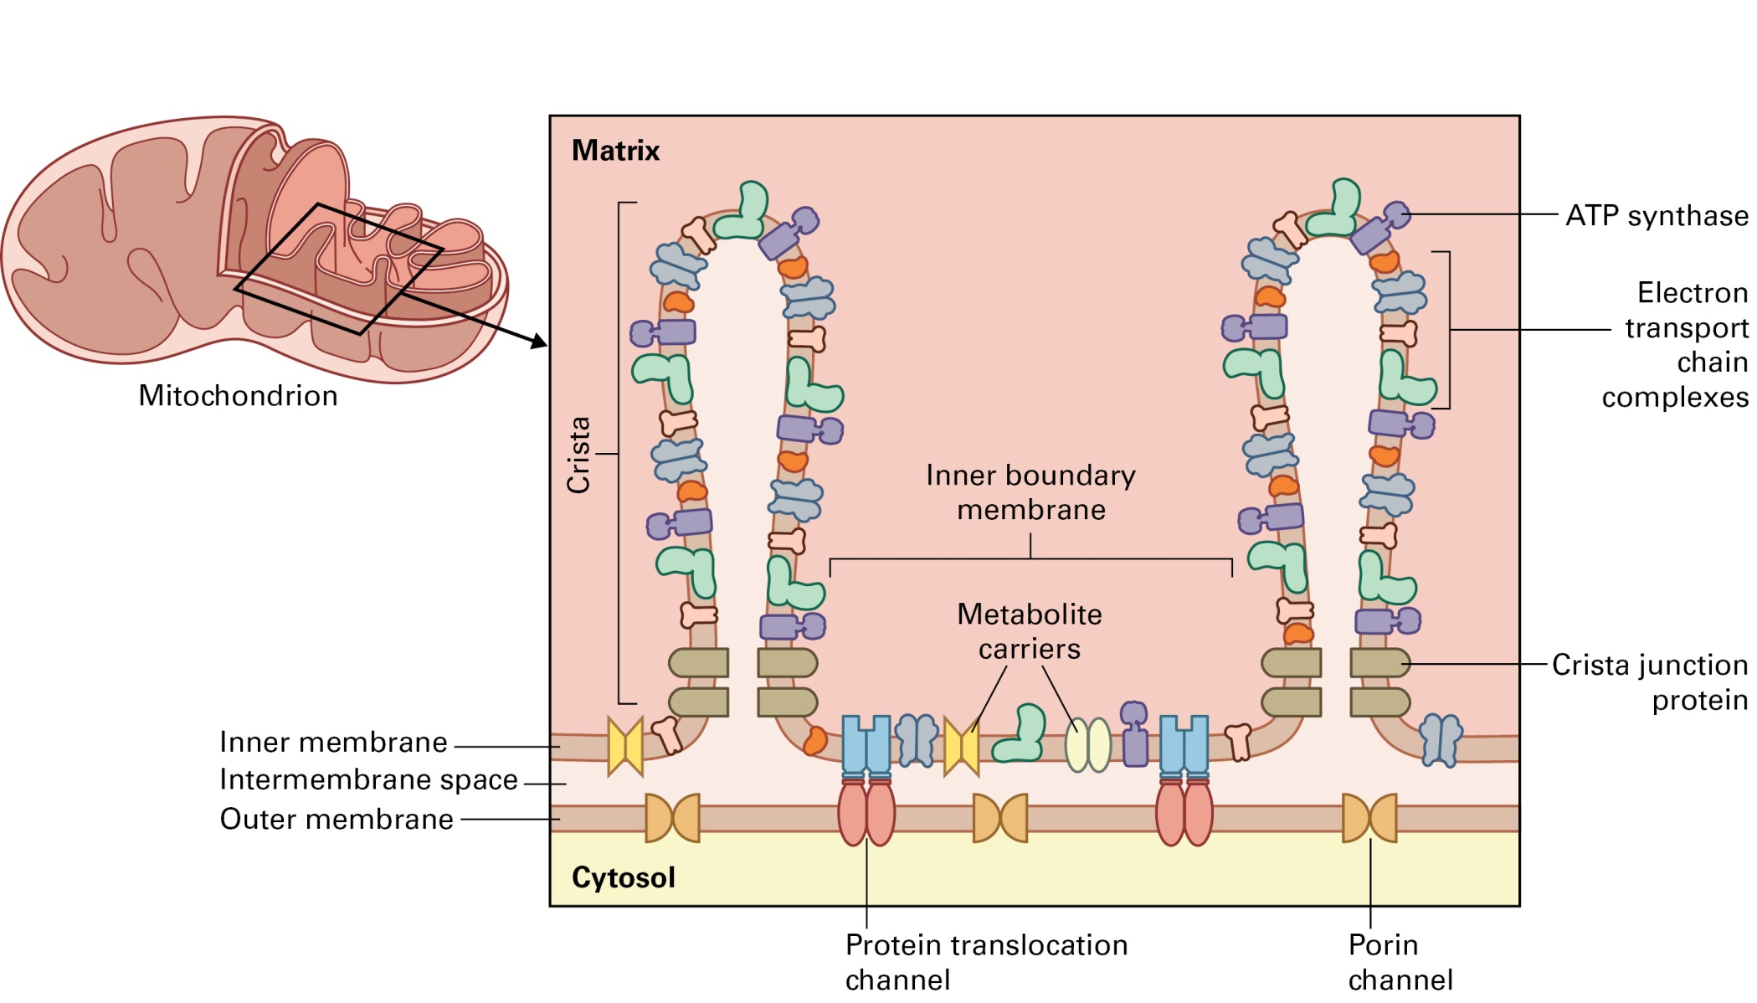
Plant cell
Mitochondria

Slide 12
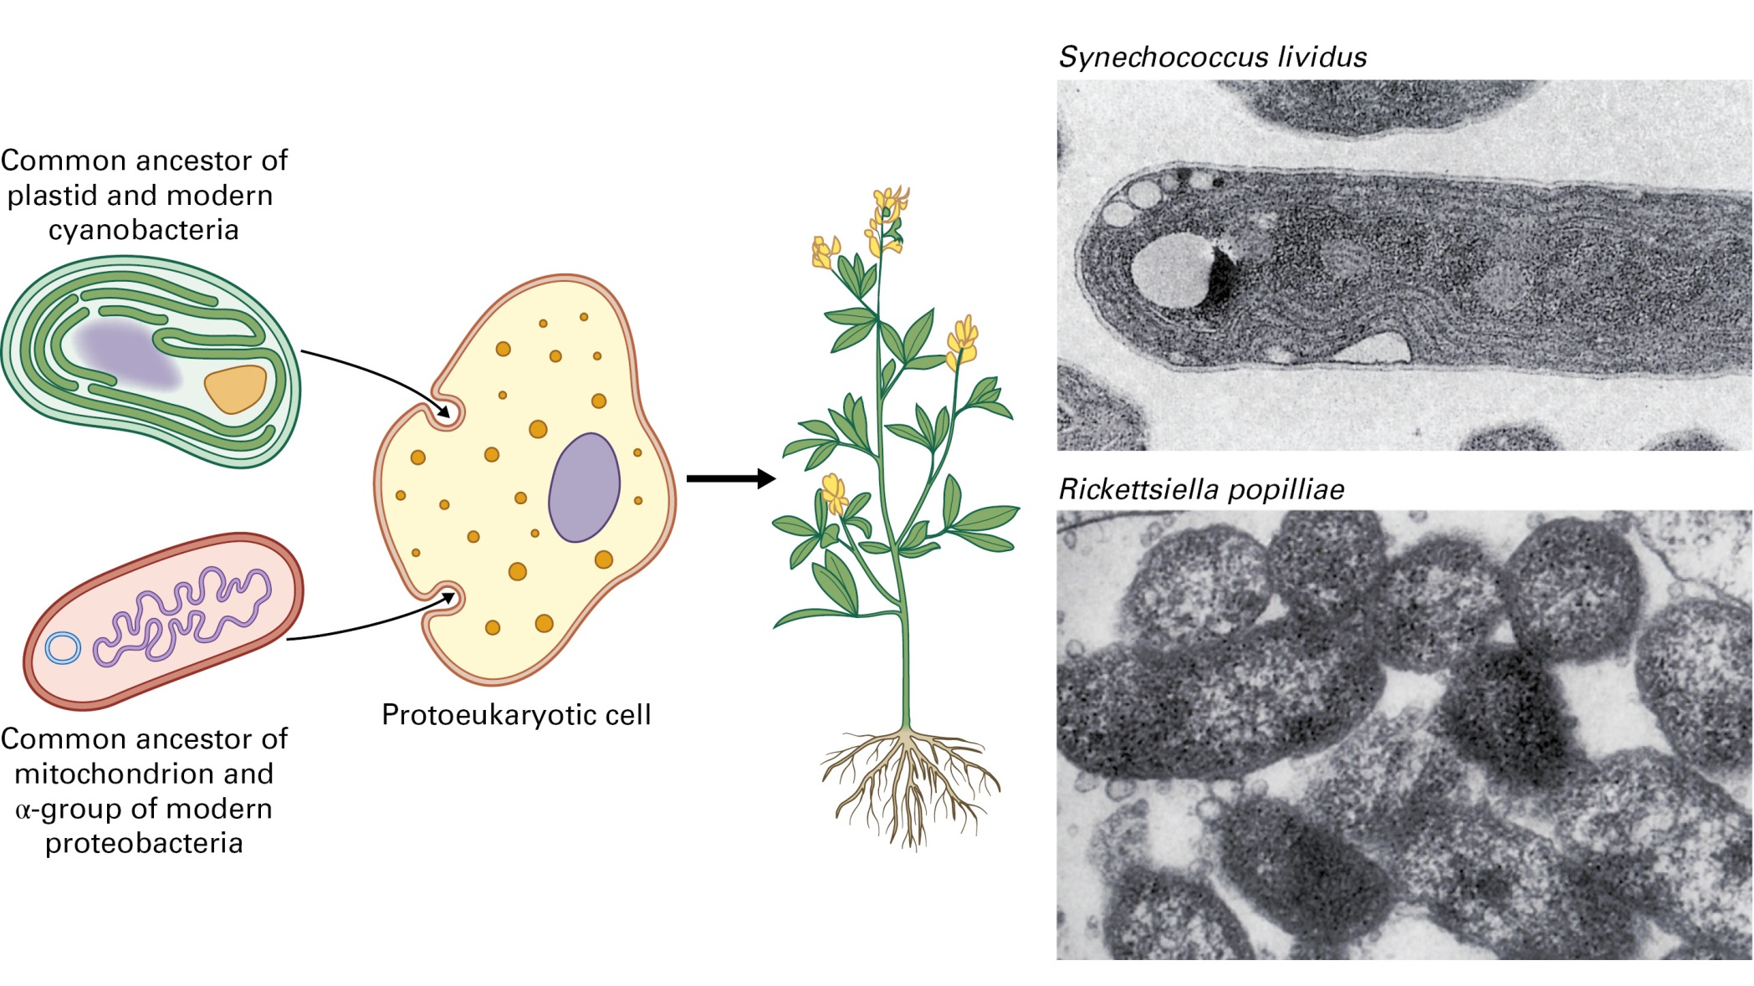
Plant cell

Slide 13
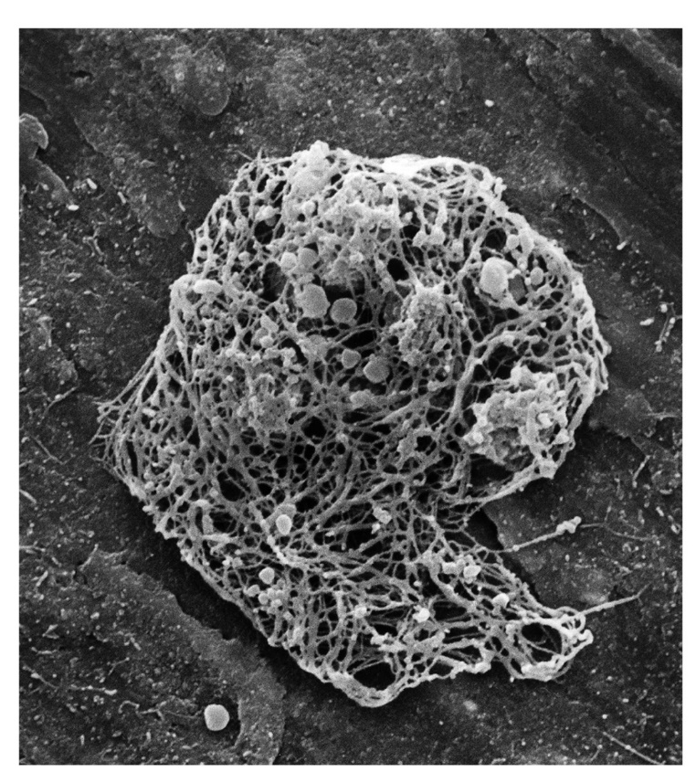
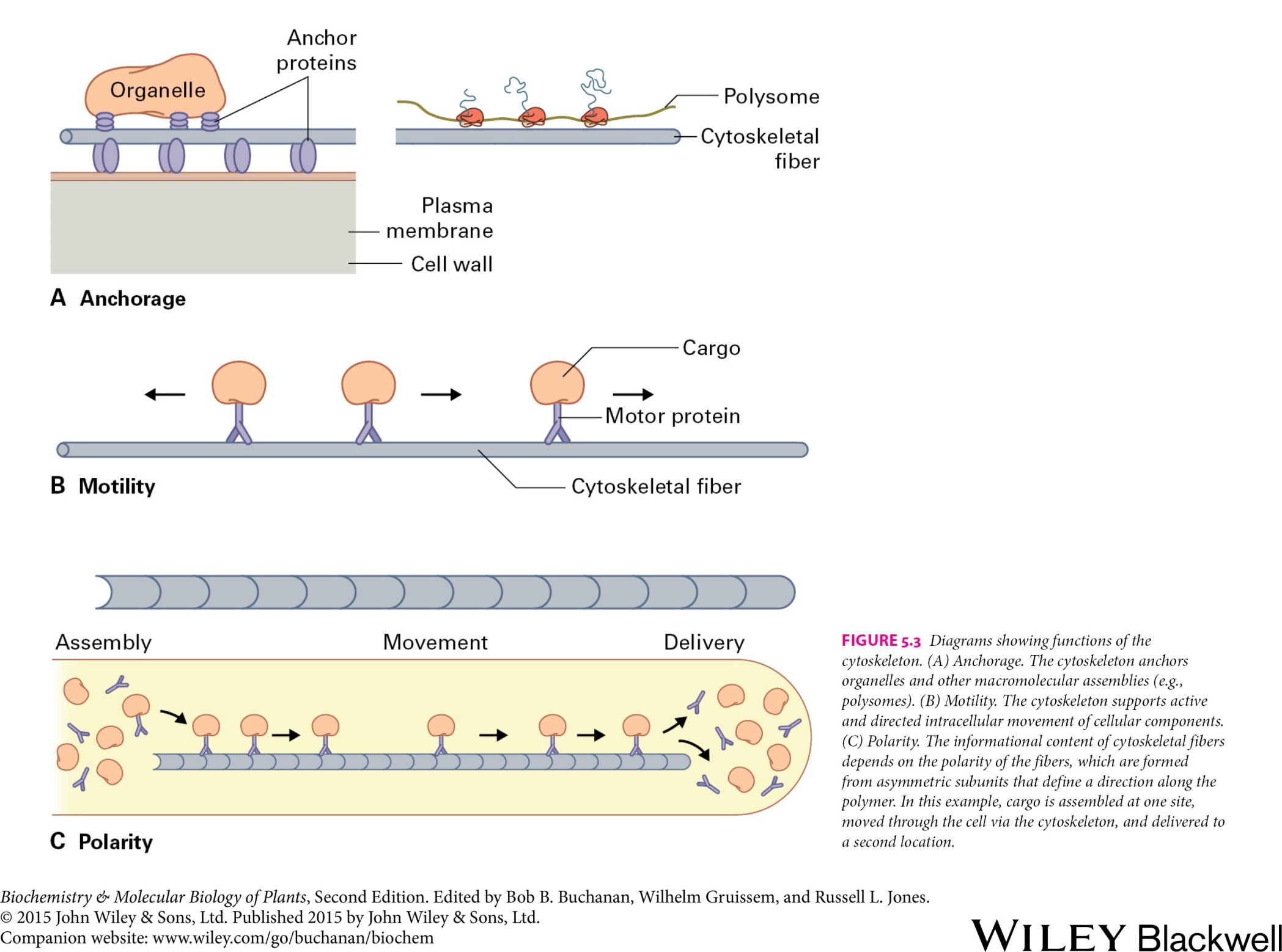
Plant cell
The cytoskeleton
Electron micrograph of a cytoskeletal meshwork from a carrot cell

Slide 14
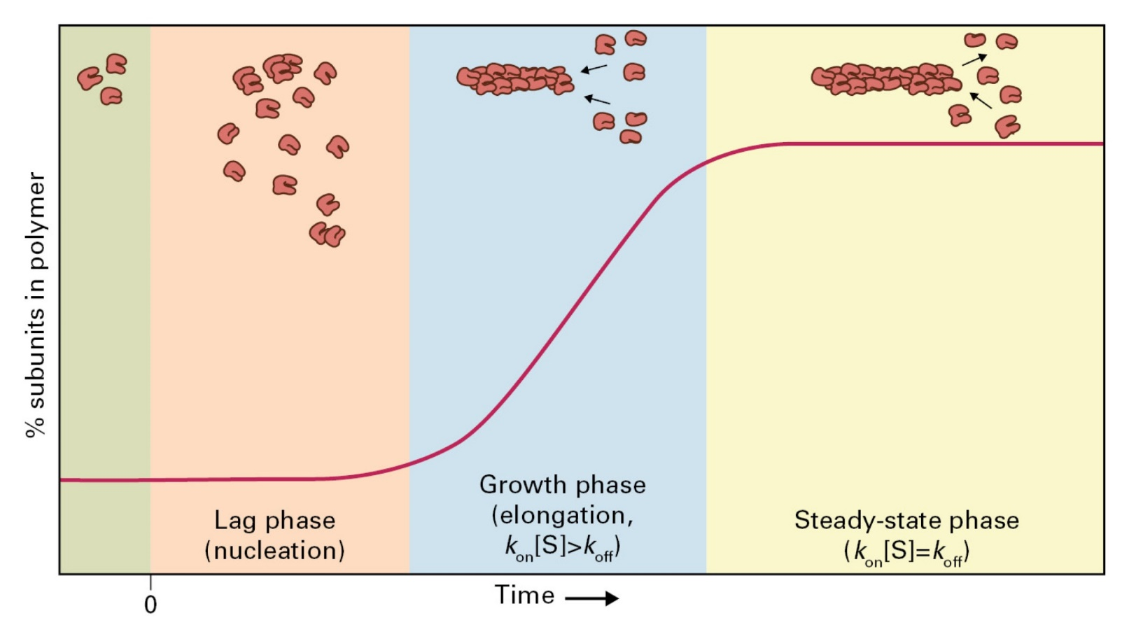
Plant cell
The cytoskeleton

Slide 15
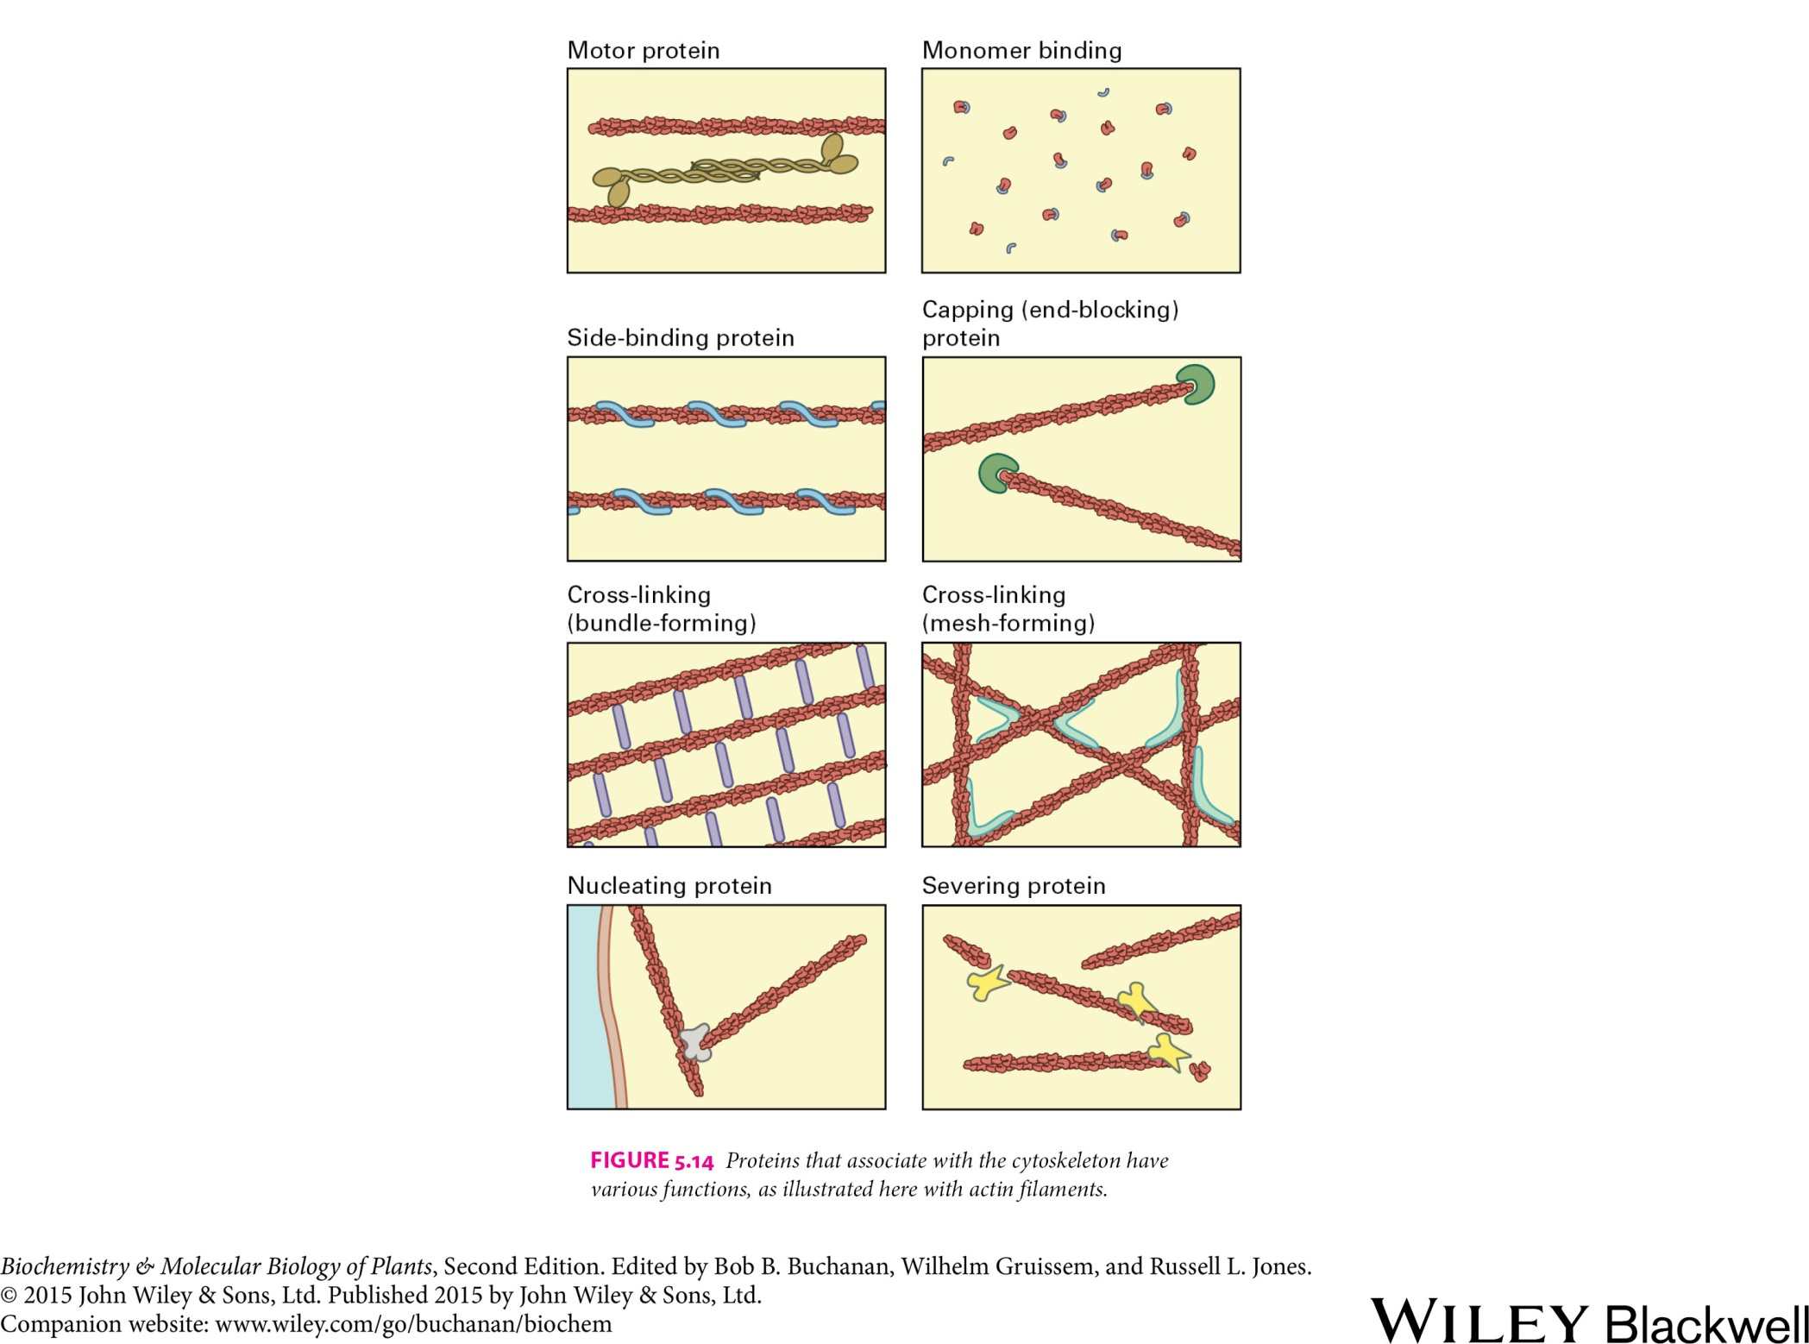
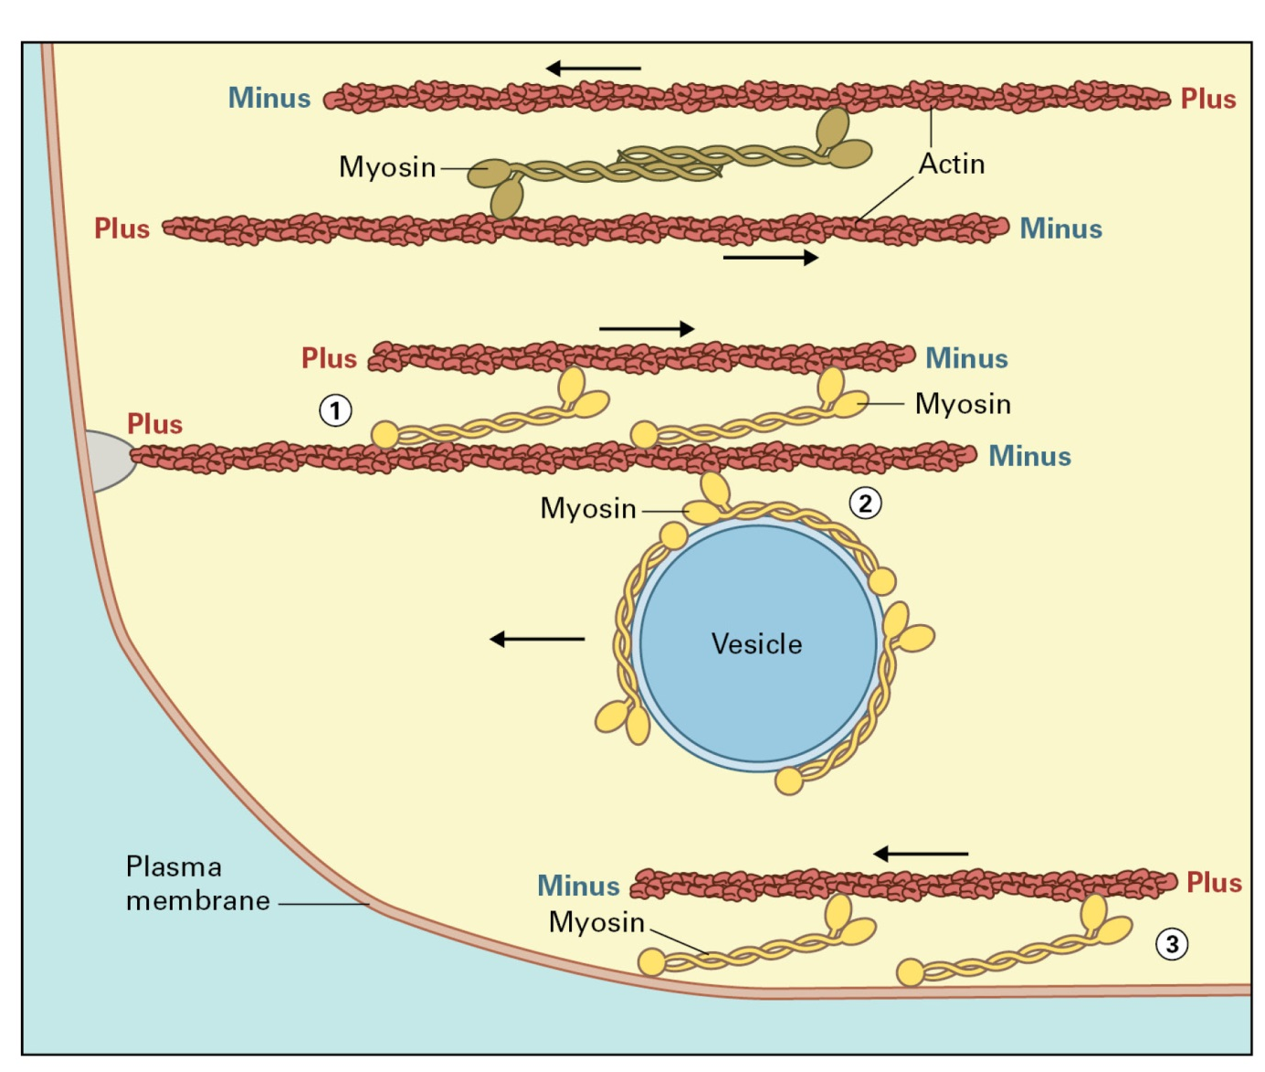
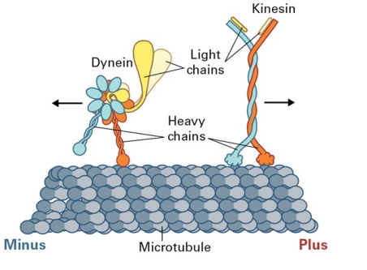
Plant cell
The cytoskeleton

Slide 16
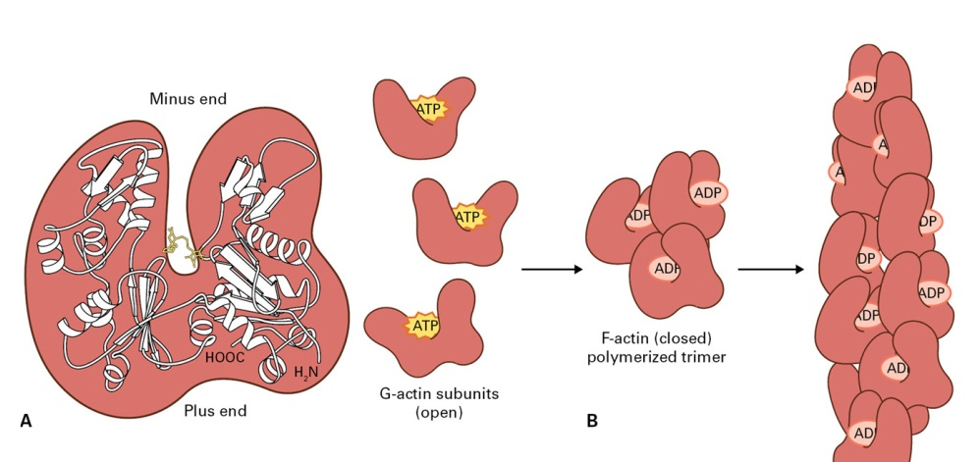
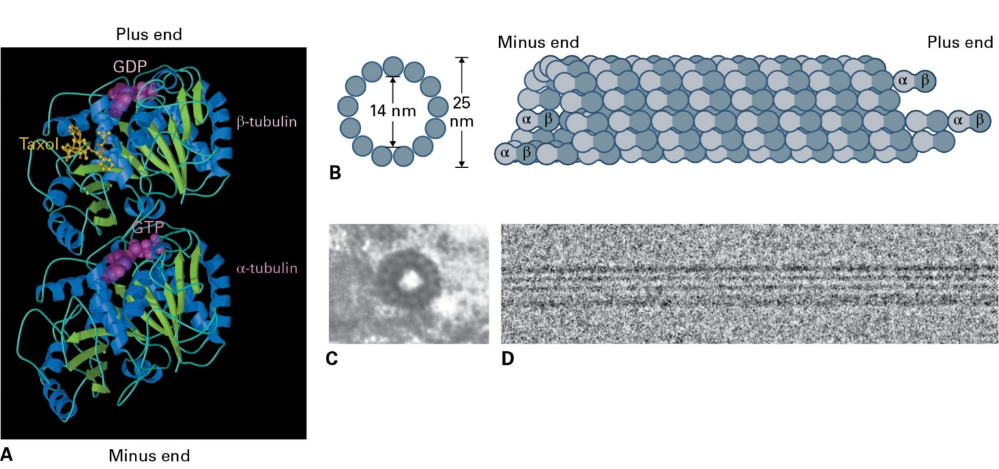
Plant cell
The cytoskeleton
The structure of actin and actin filaments
The structure of tubulin and microtubules

Slide 17
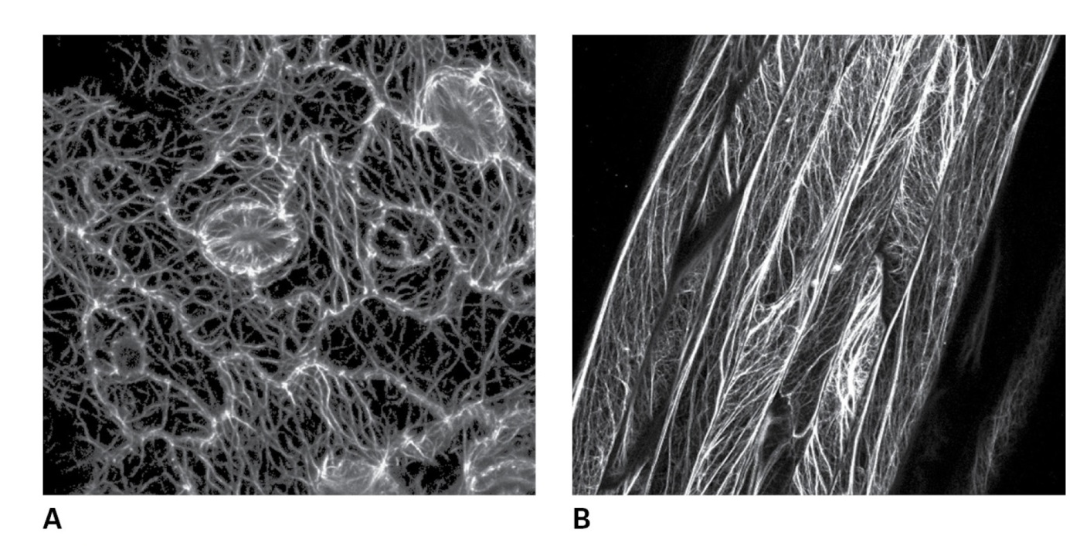
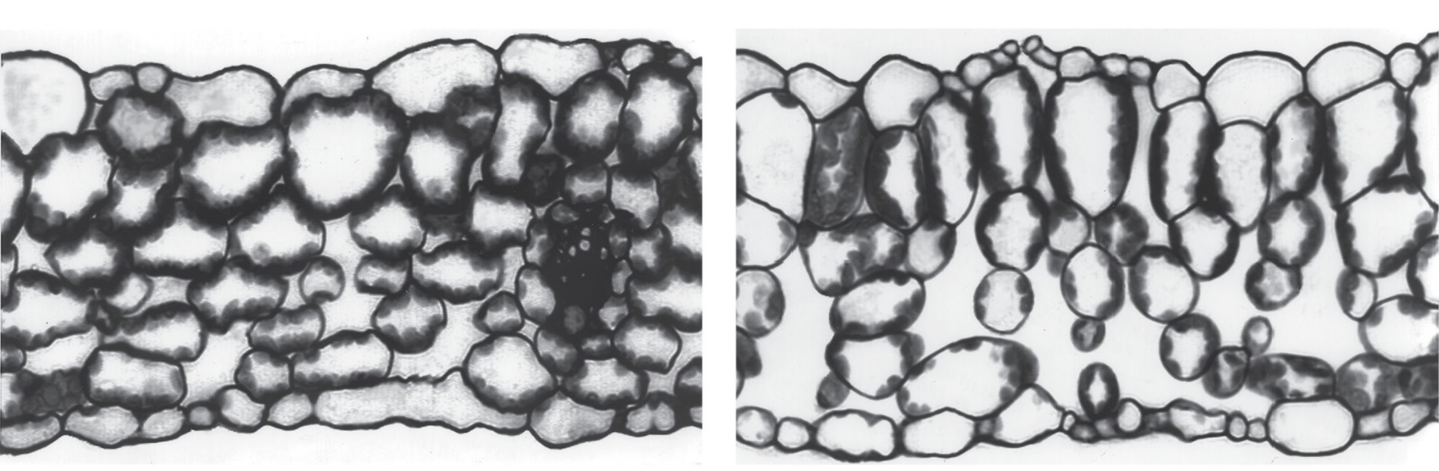
Plant cell
The cytoskeleton
Actin filaments in plant epidermis (A) and leaf veins (B).
Dim light
Bright light

Slide 18
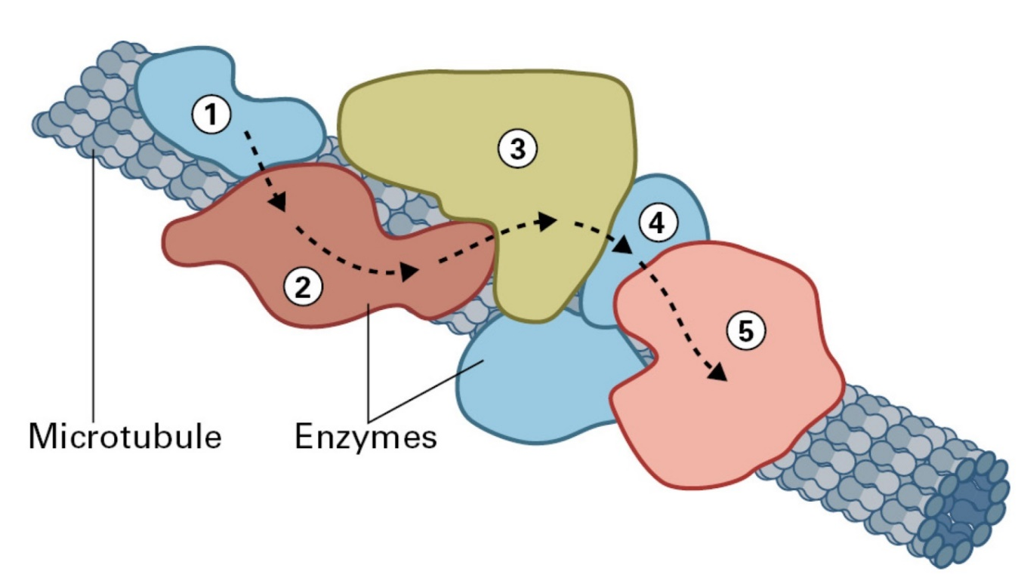
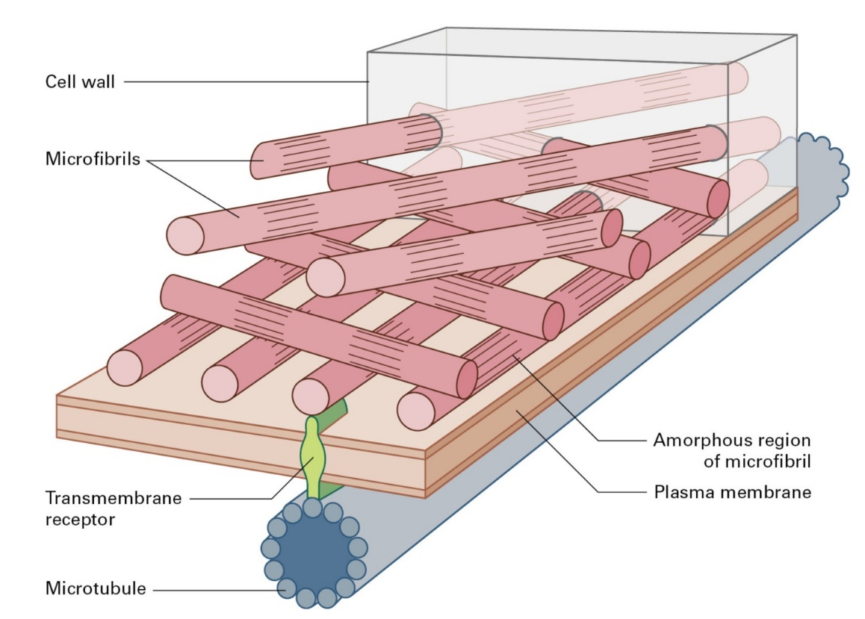
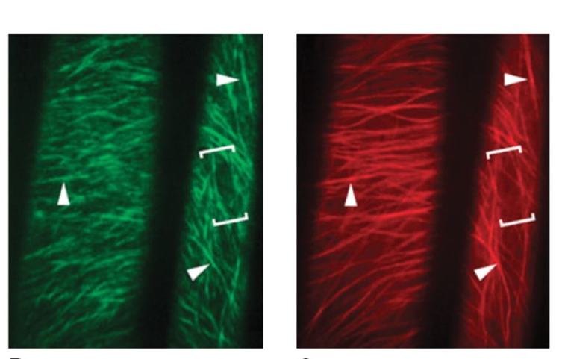
Plant cell
The cytoskeleton
Trajectories of motion of cellulose synthase
Cortical microtubules

Slide 19
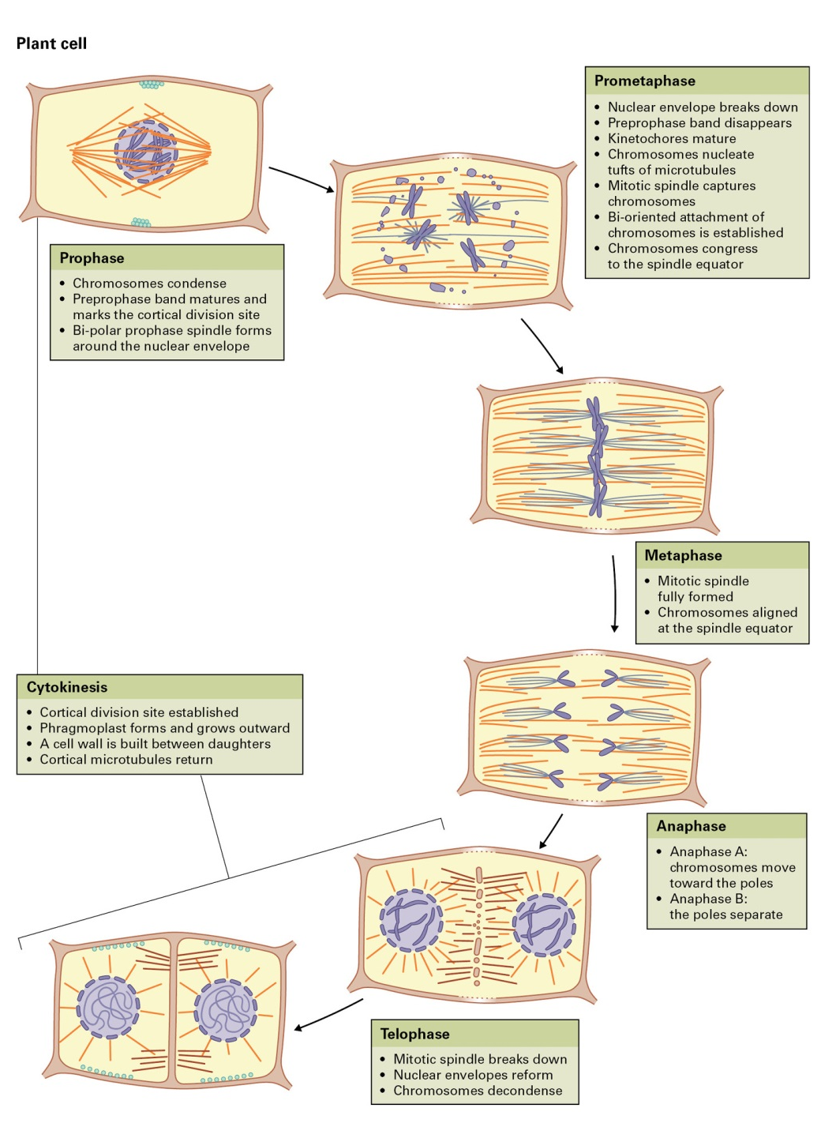
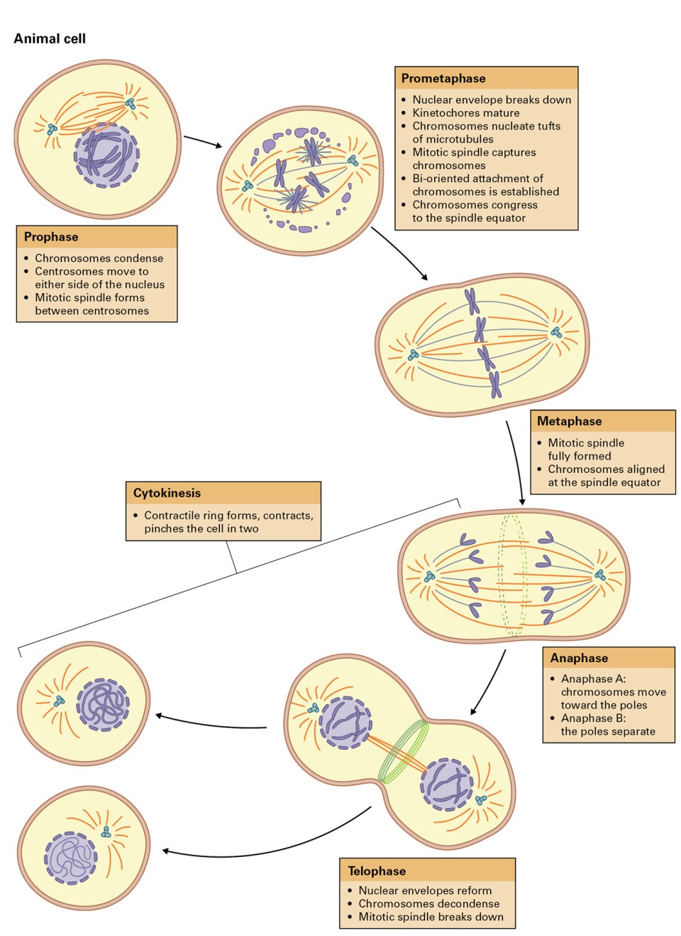
Plant cell
Plant cell division
Mitosis in plant
and animal cells

