Slide 1
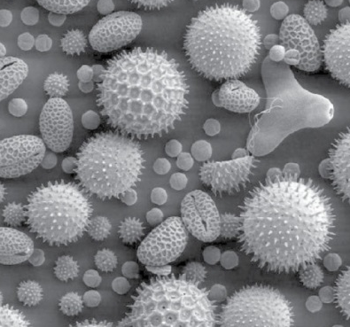
Membrane and Cell Wall
Katerina Dadakova, Department of Biochemistry
1
Figures adopted from Buchanan et al., Biochemistry & molecular biology of plants

Slide 2
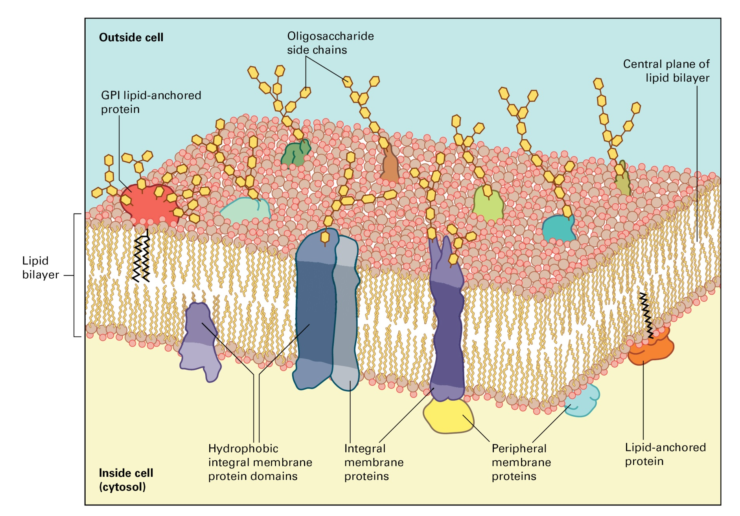
Membrane and Cell Wall
Plant membrane

Slide 3
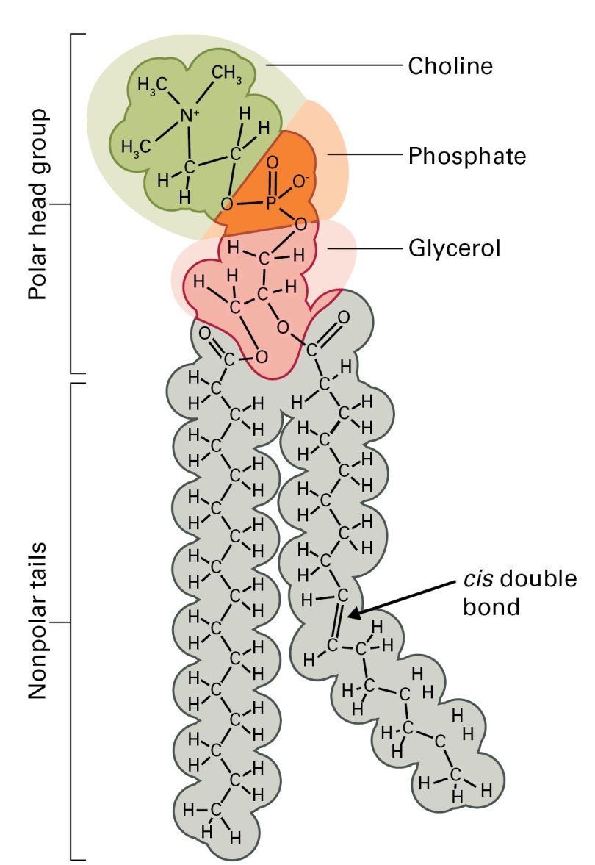
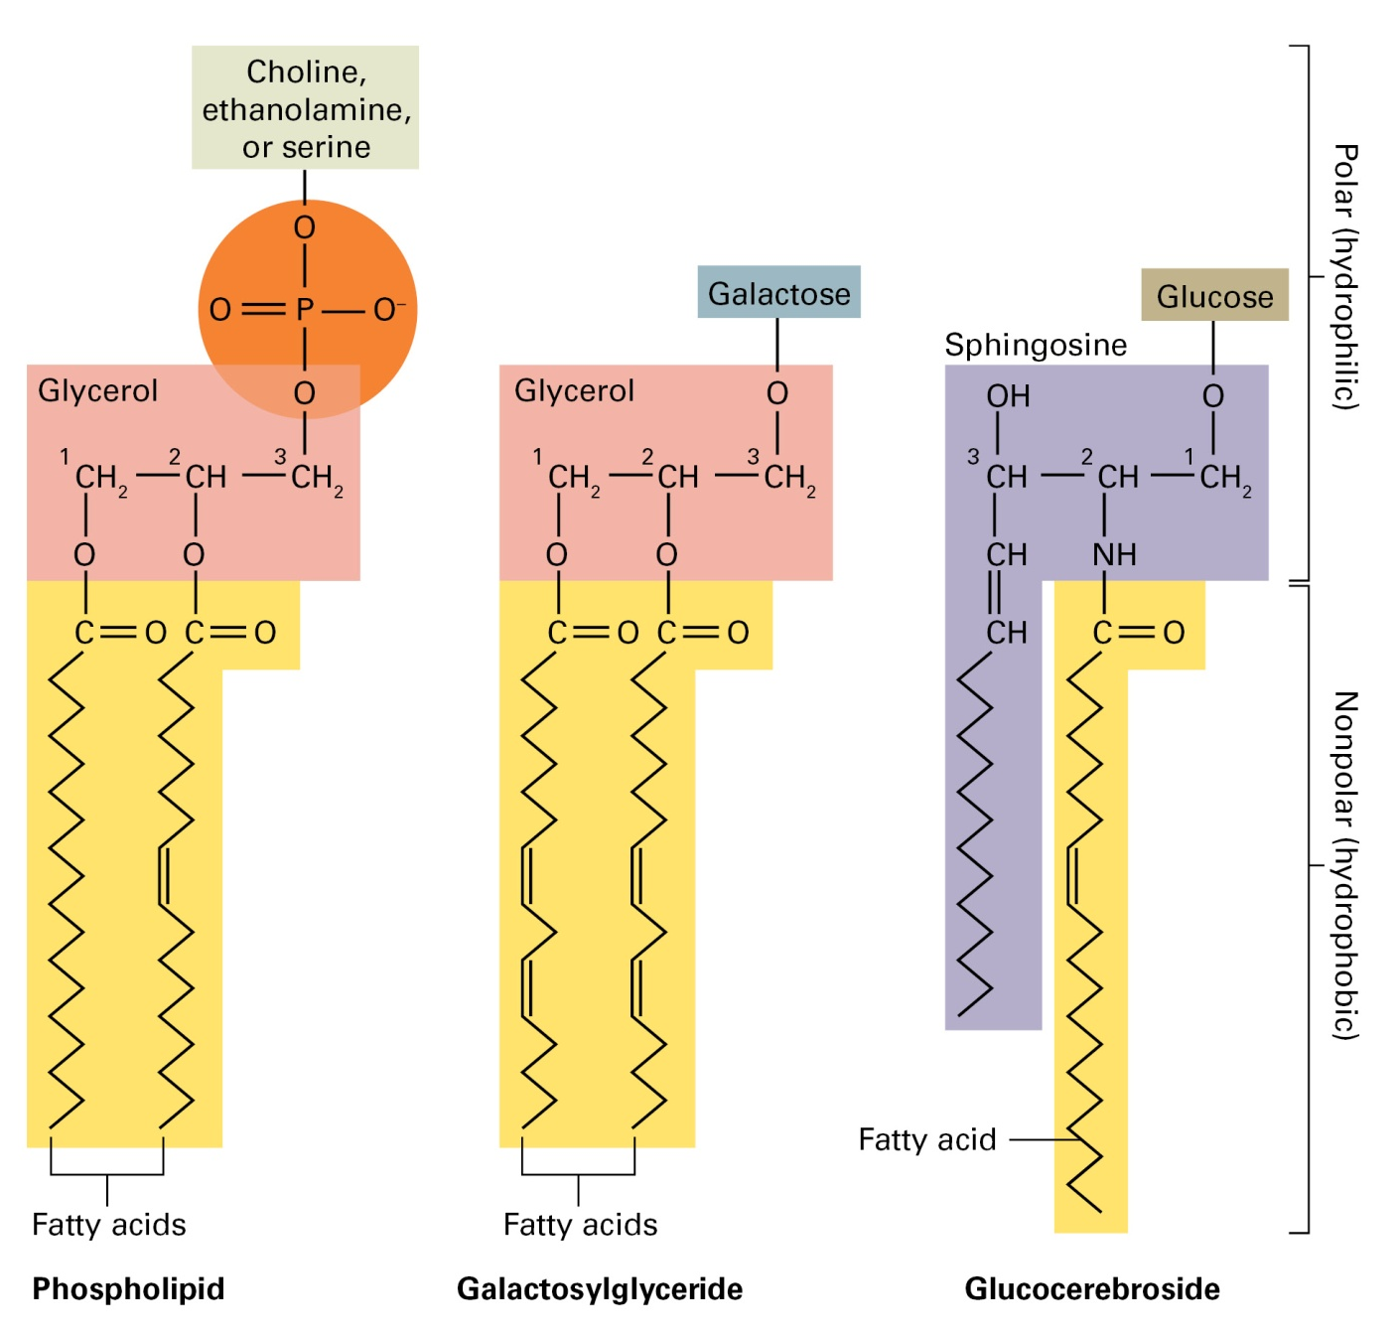
Membrane and Cell Wall
Plant membrane lipids

Slide 4
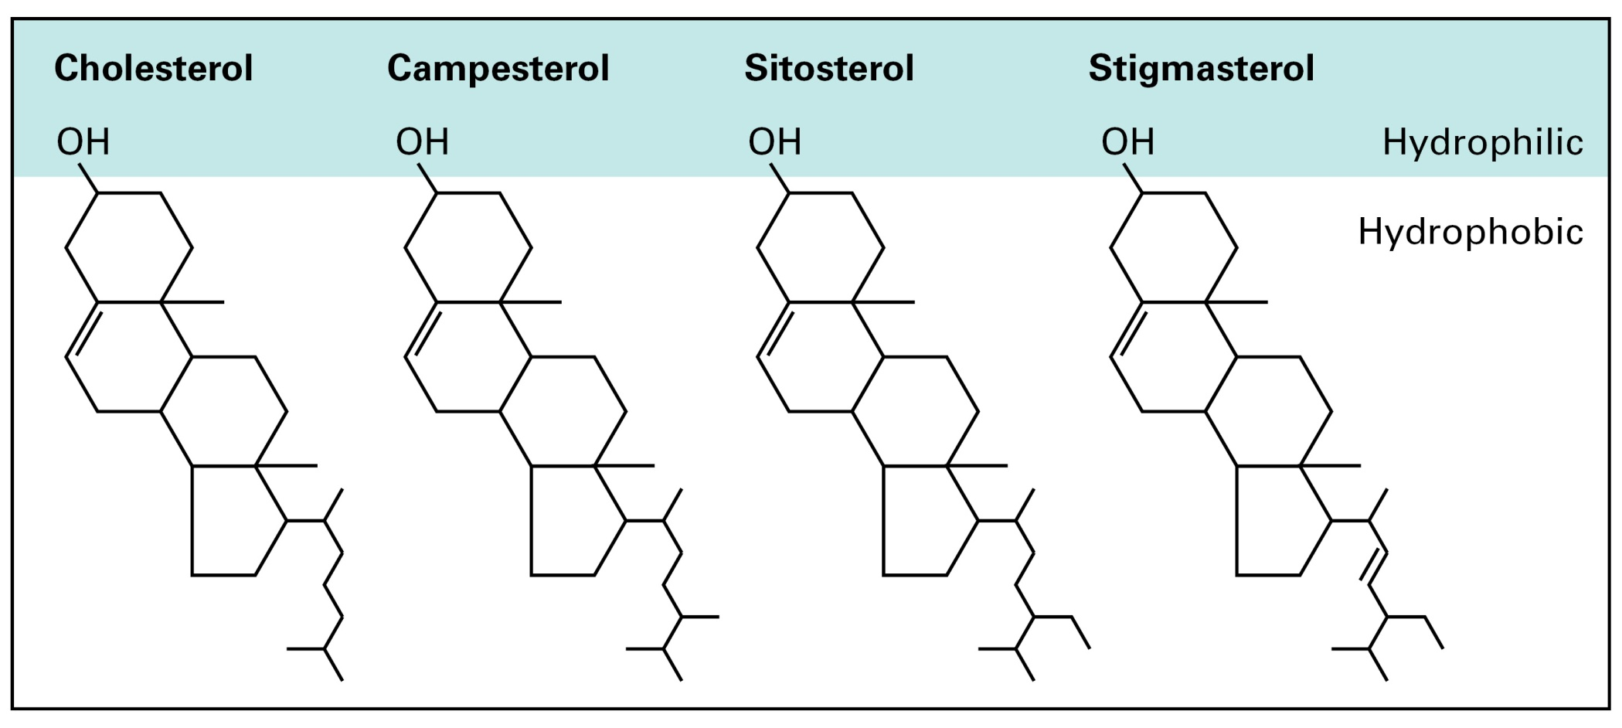
Membrane and Cell Wall
Plant membrane lipids

Slide 5
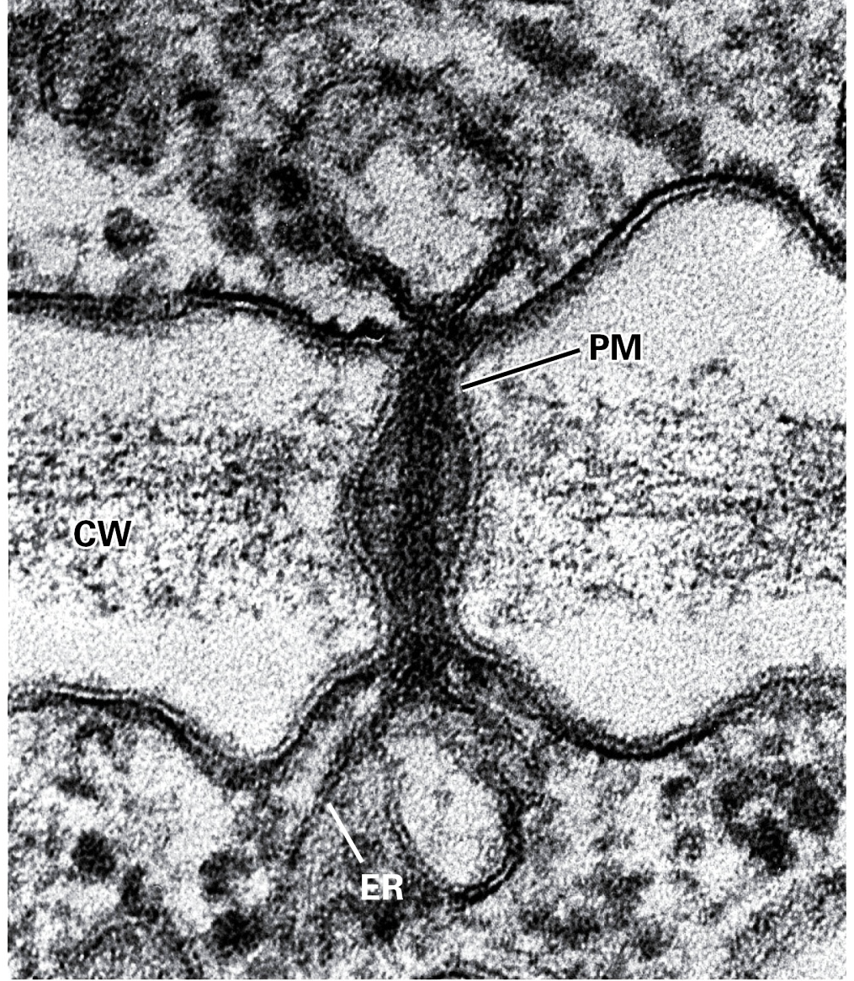
Membrane and Cell Wall
Plasma membrane
Transport of molecules
H⁺-ATPase, aquaporins,...
Signal transduction
receptors
Cell wall synthesis
cellulose synthase, callose synthase
Plasmodesma
PM, plasma membrane
ER, endoplasmic reticulum
CW, cell wall

Slide 6
Membrane and Cell Wall
Membrane transport
Membrane transport systems:
Pumps
Channels
Cotransporters
Nutrient acquisition
Metabolite distribution
Compartmentalization of metabolites
Energy transduction
Turgor generation
Waste product excretion
Signal transduction
ATP
ADP+P
H⁺
K⁺
H⁺
Sucrose

Slide 7
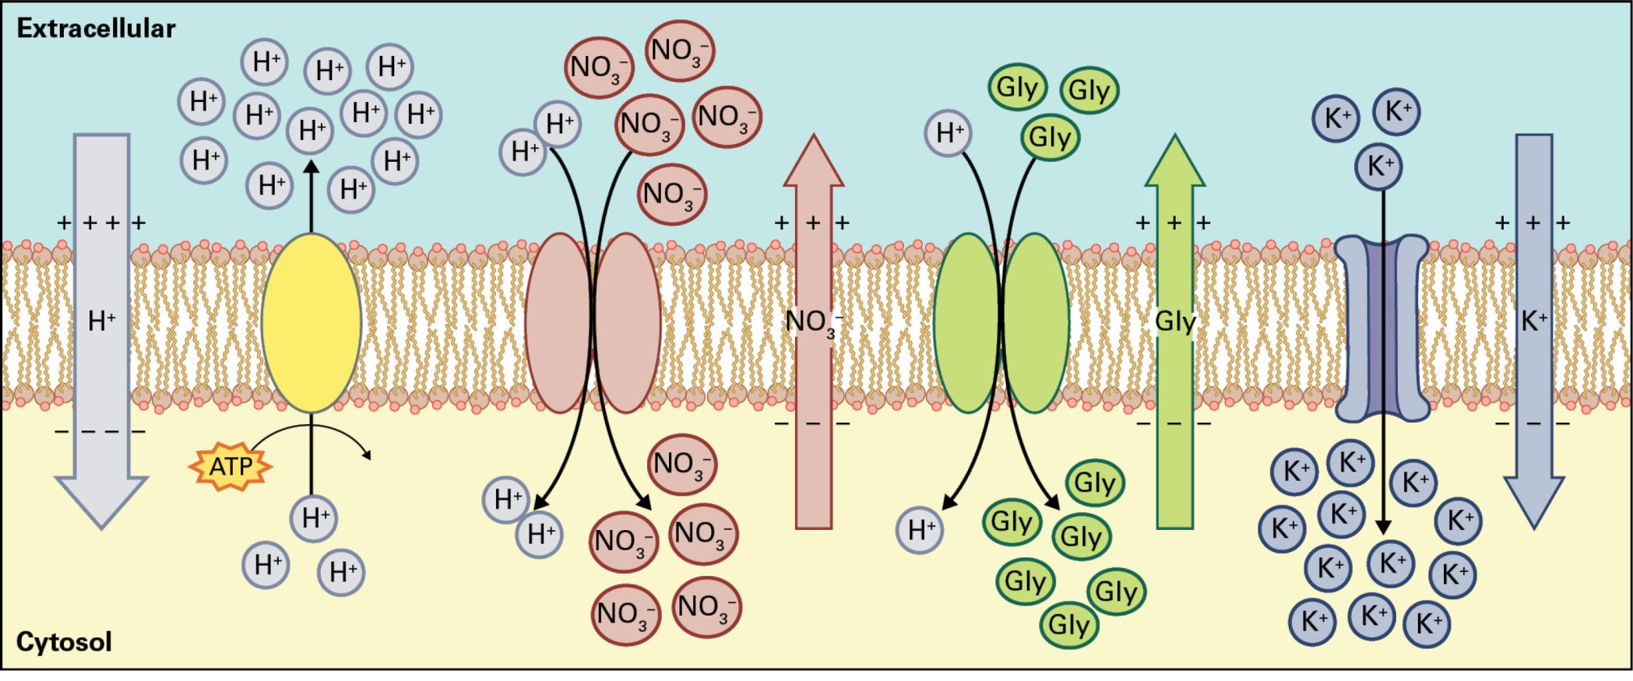
Membrane and Cell Wall
Transmembrane electrochemical potential
Electrochemical potential:
concentration
charge
membrane voltage

Slide 8
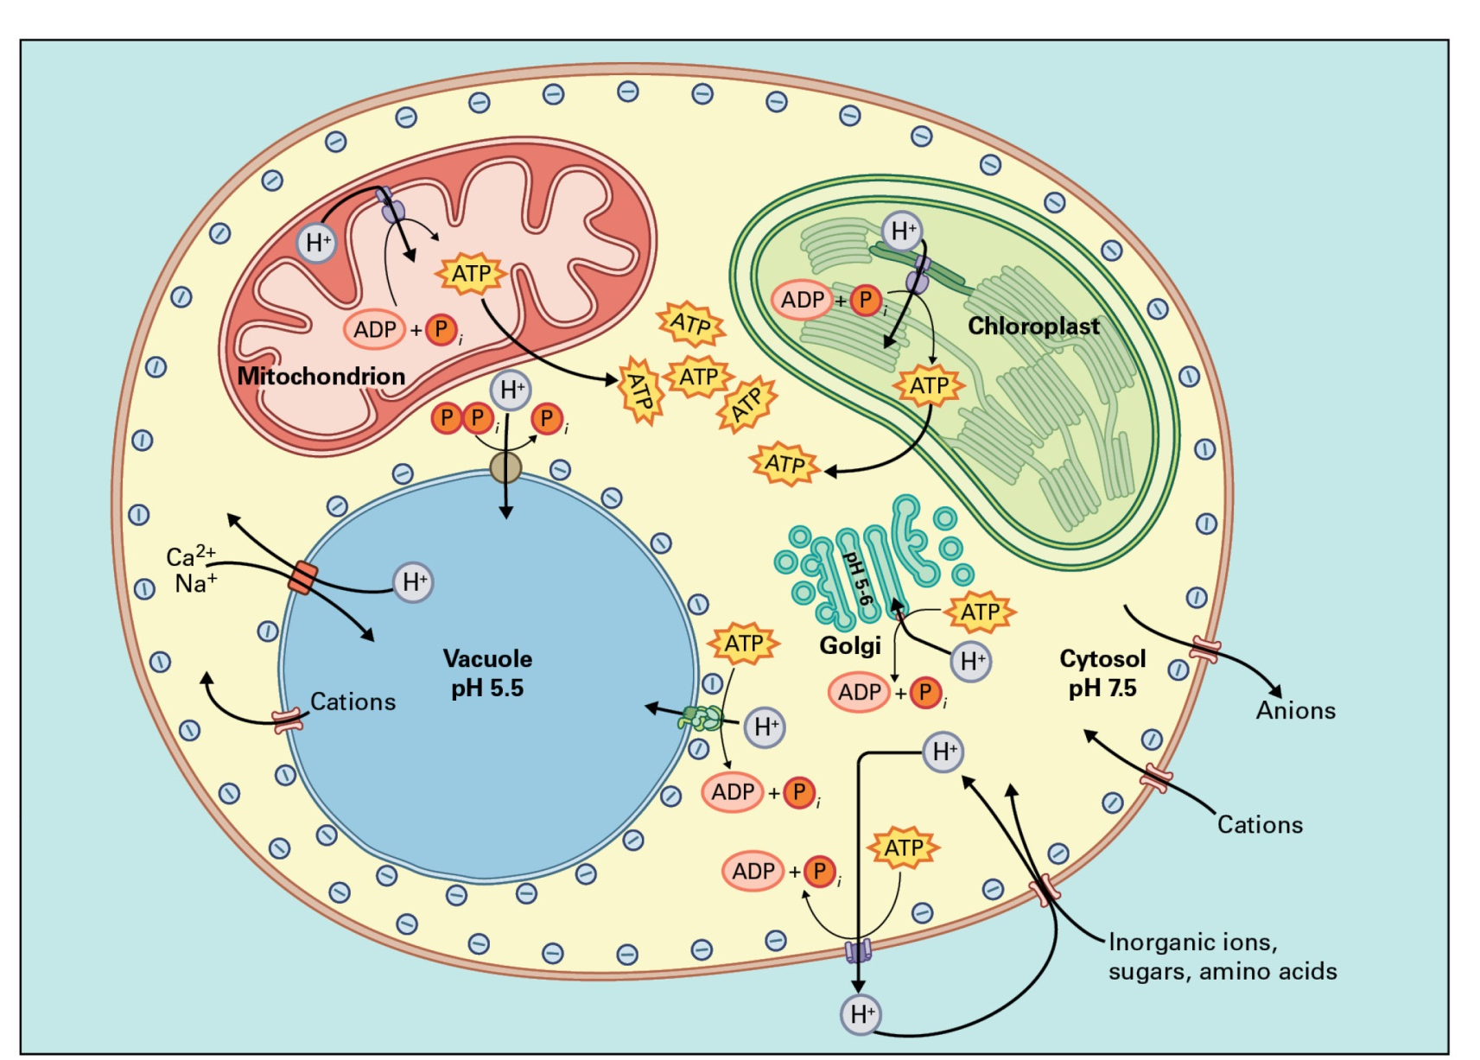
Membrane and Cell Wall
H⁺ pumps

Slide 9
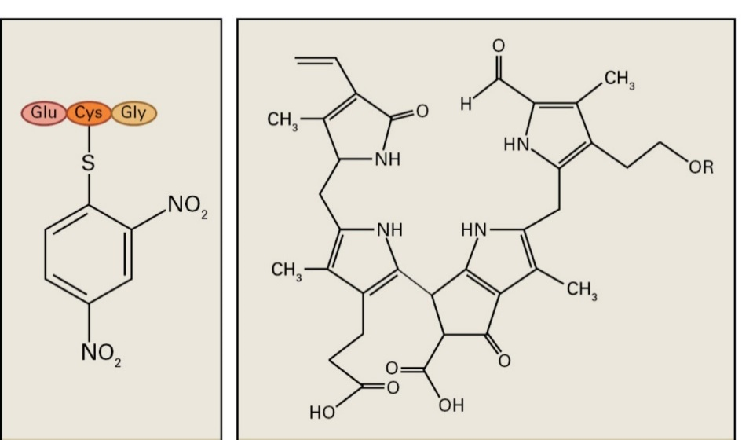
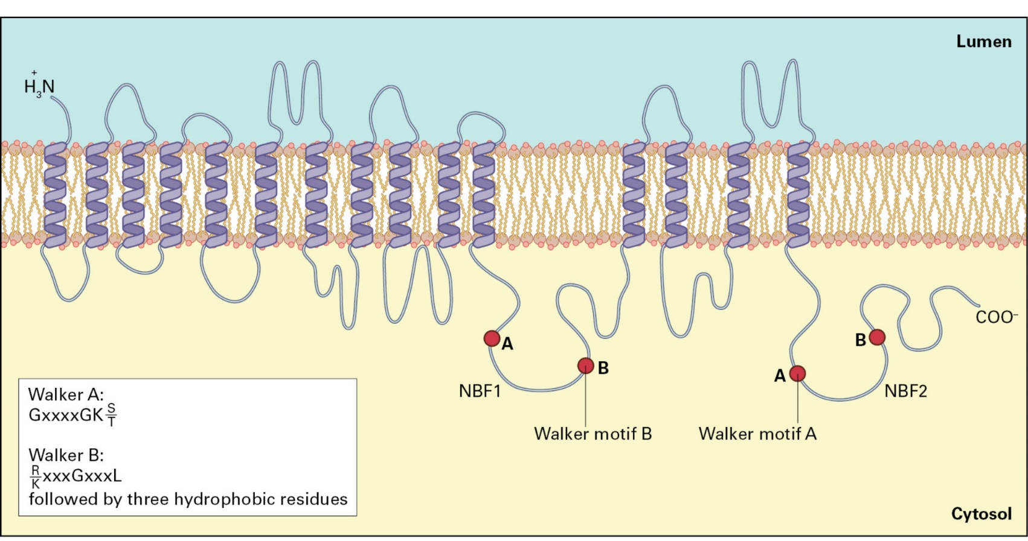
Membrane and Cell Wall
ABC-type pumps
A glutathione-conjugated xenobiotic and a chlorophyll catabolite
ATP-binding cassette transporter

Slide 10
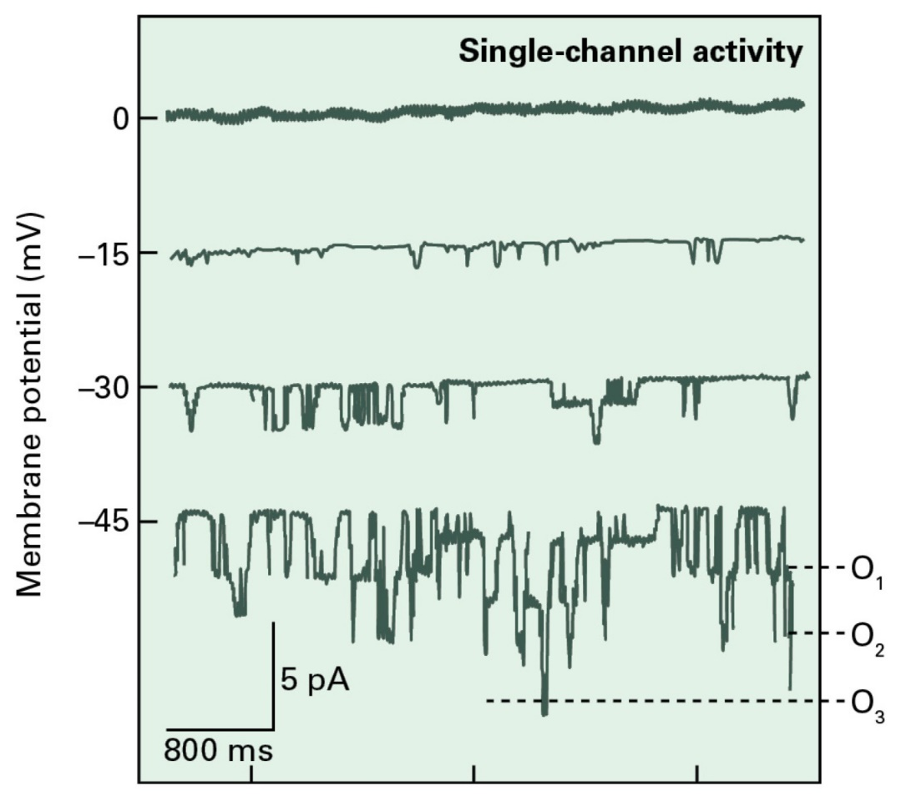
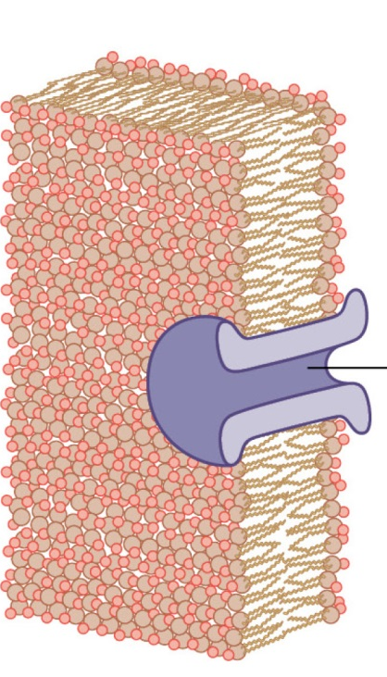
Membrane and Cell Wall
Ion channels
Ion channels are:
passive
selective (to some degree)
regulated
Activity of channels in tonoplast. The prevalence of open state is influenced by membrane voltage.
O₁,₂, or ₃ is the number of channels open.

Slide 11
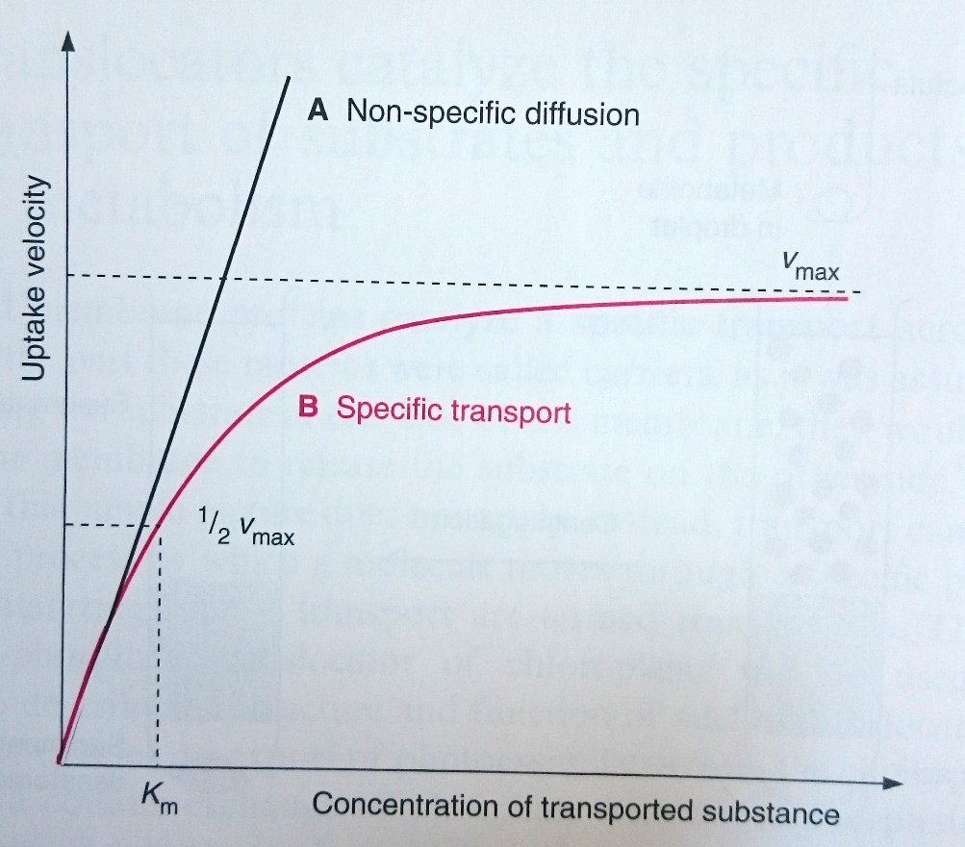
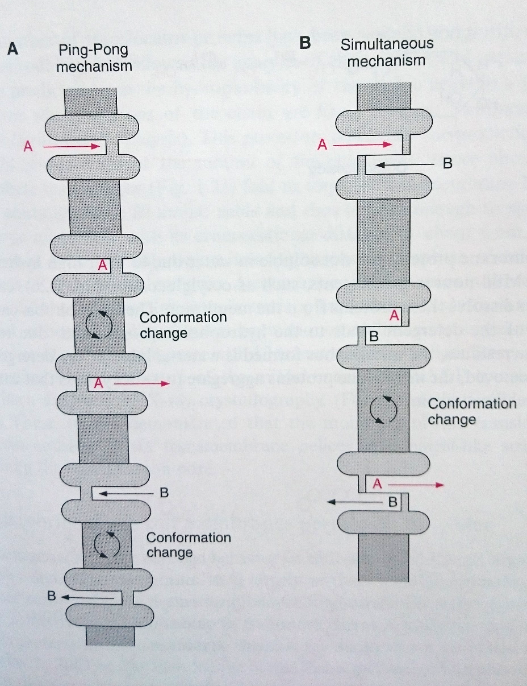
Membrane and Cell Wall
Cotransporters
Transport process mechanisms

Slide 12
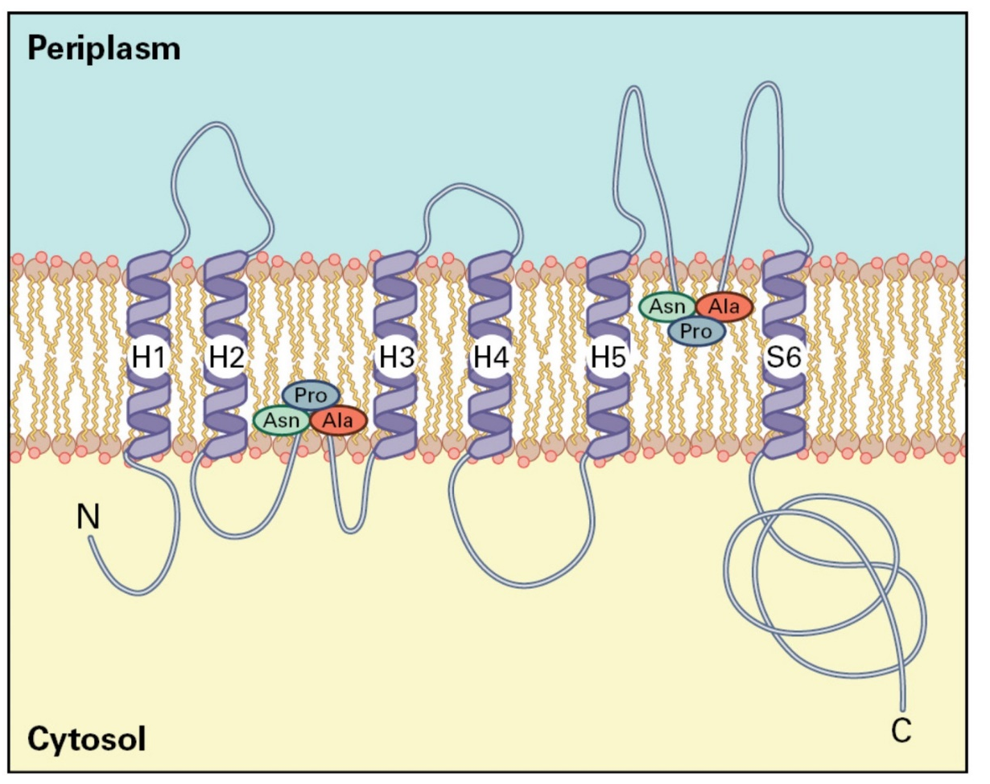
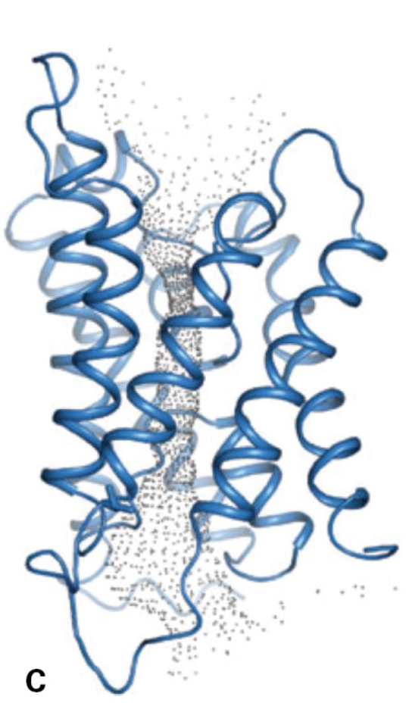
Membrane and Cell Wall
Aquaporins
Plant membranes are highly permeable for water
The direction of water transport across membranes is determined by hydrostatic and osmotic pressures.

Slide 13
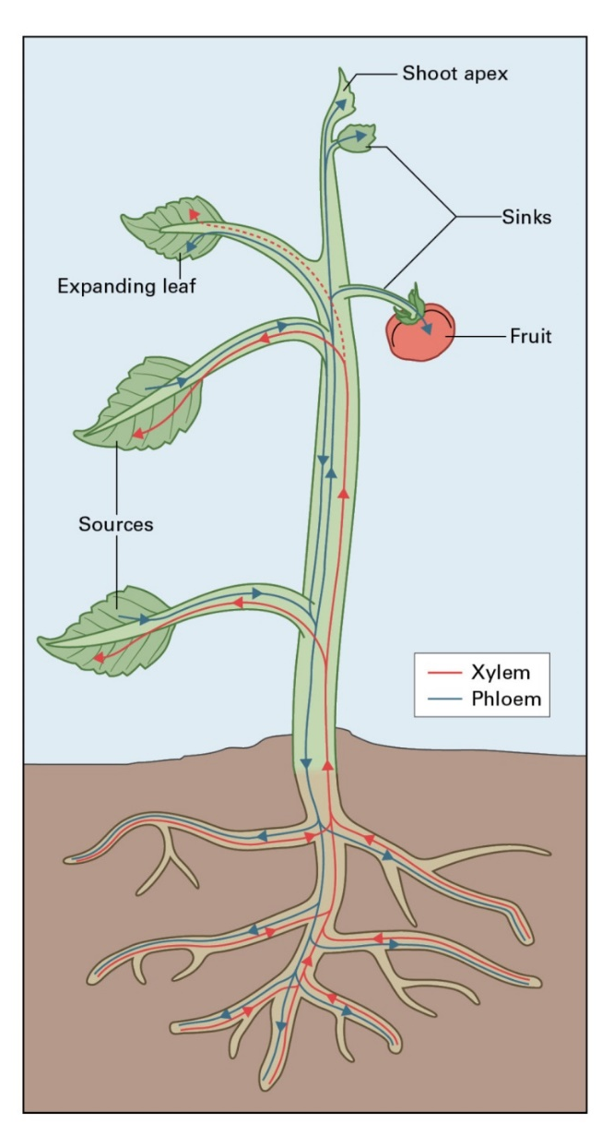
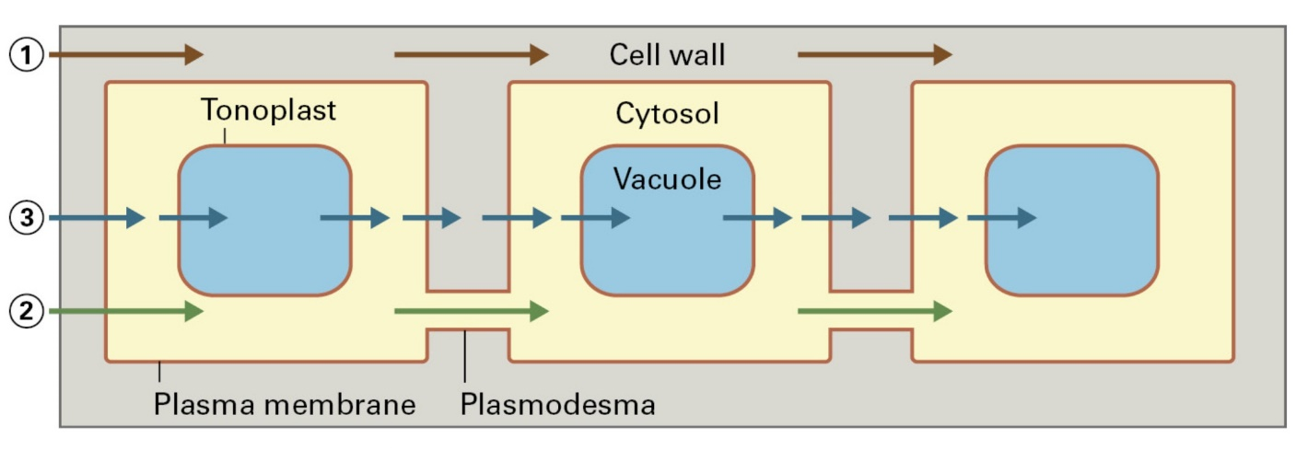
Membrane and Cell Wall
Cell-to-cell transport
Intercellular transport can occur along apoplastic, symplastic, and transcellular routes
Long-distance transport follows two pathways: xylem and phloem

Slide 14
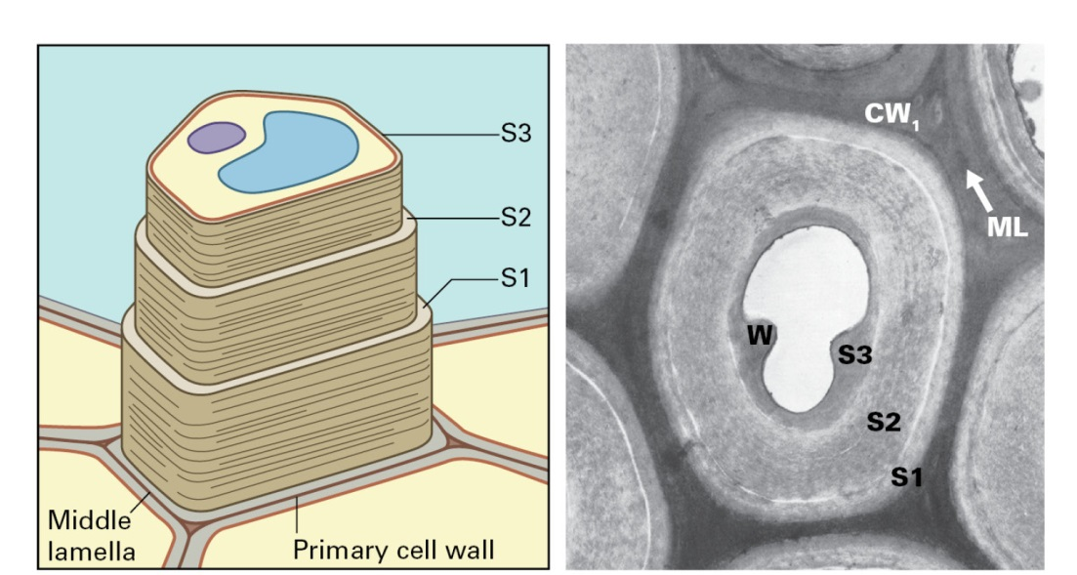
Membrane and Cell Wall
Cell wall

Slide 15
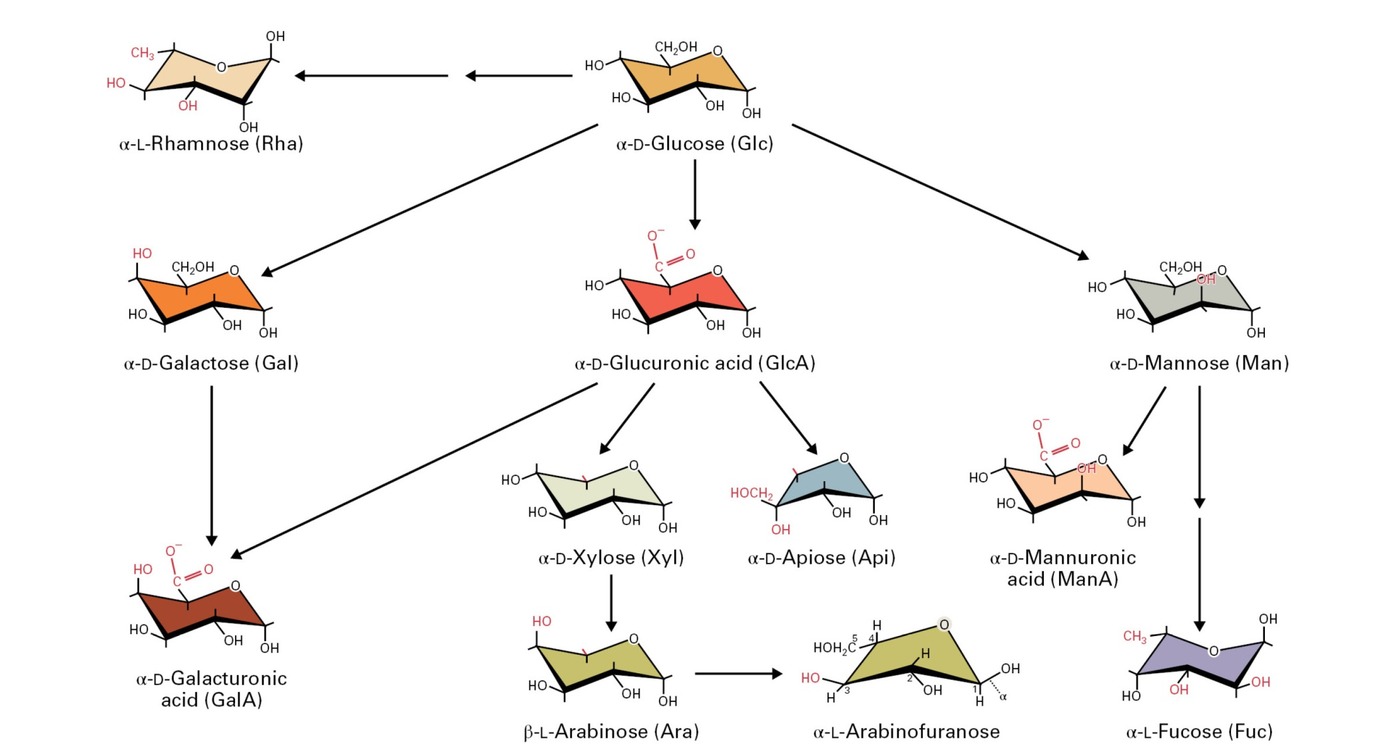
Membrane and Cell Wall
Cell wall sugars

Slide 16
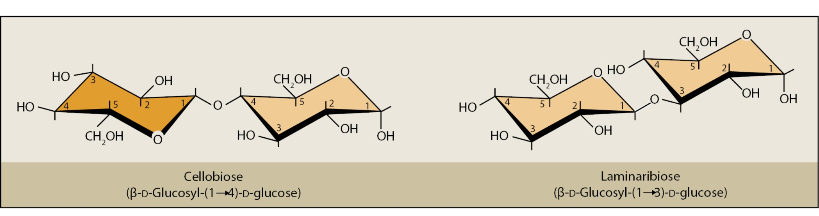
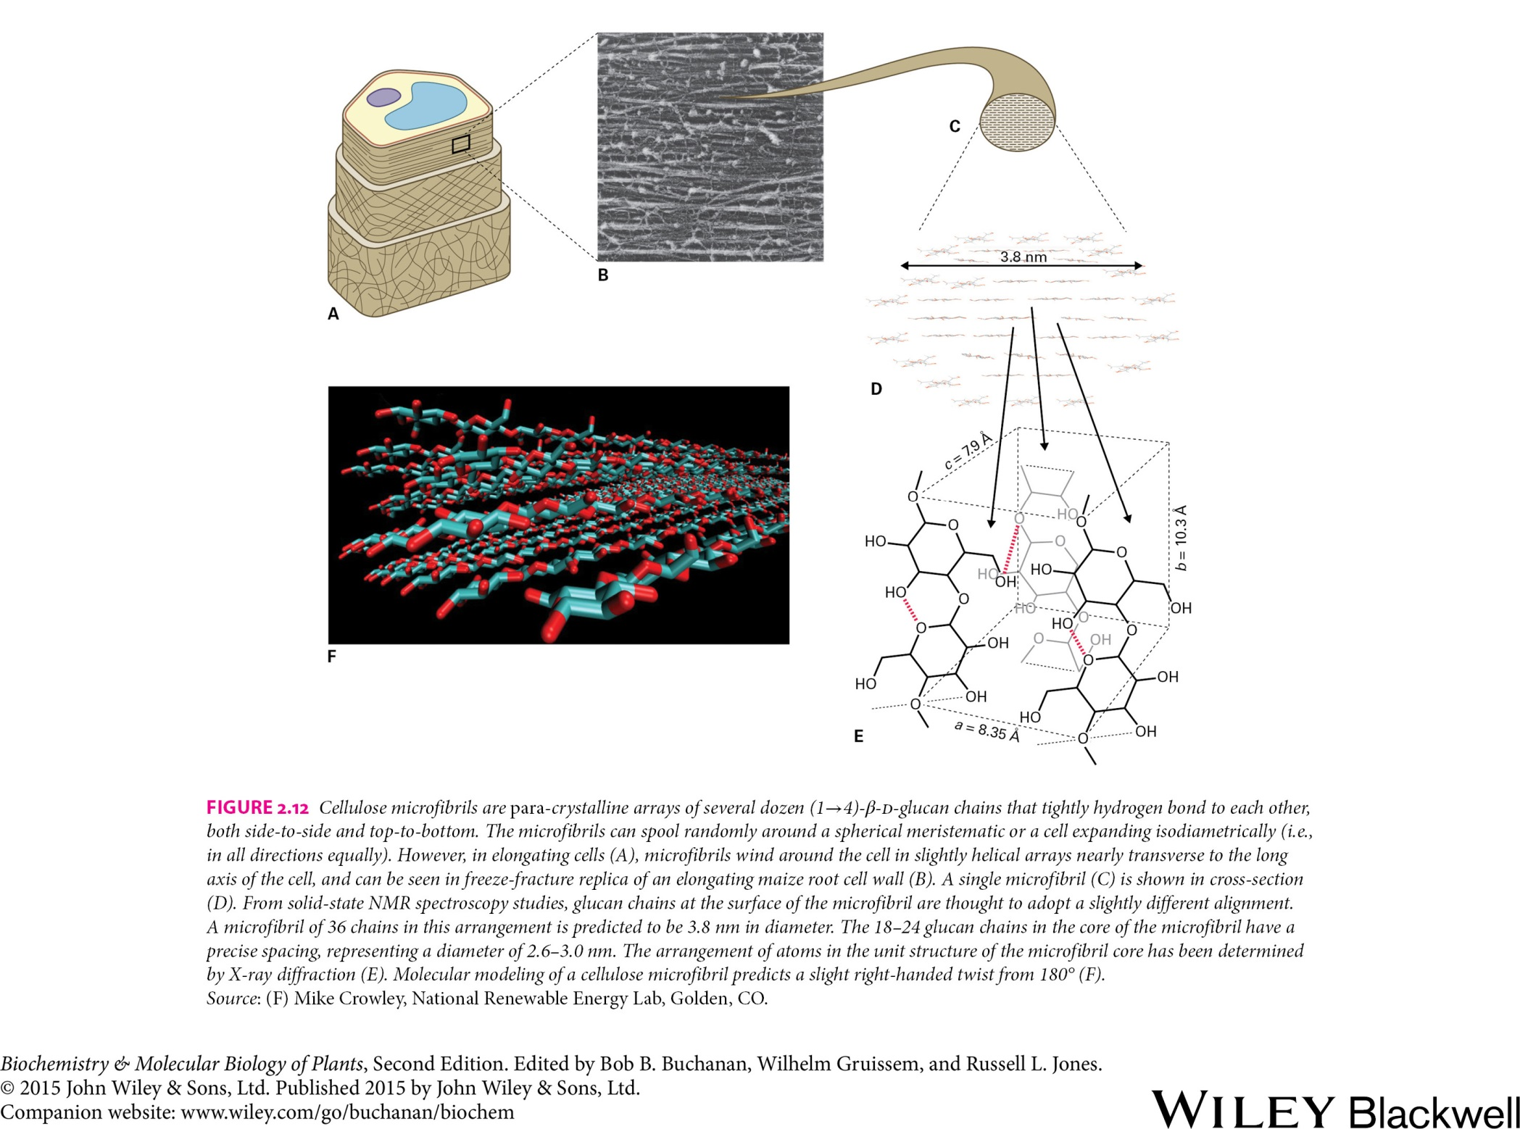
Membrane and Cell Wall
Cell wall polysaccharides
Cellulose
Extracellular space
Cellulose synthase
UDP UDP-Glucose
Sucrose synthase
Plasma memrane
Cytosol
Sucrose Fructose

Slide 17
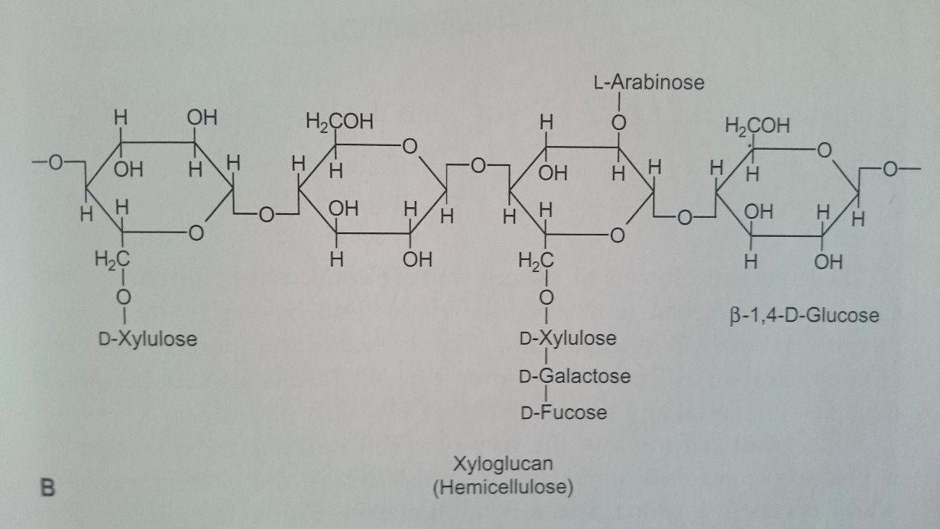
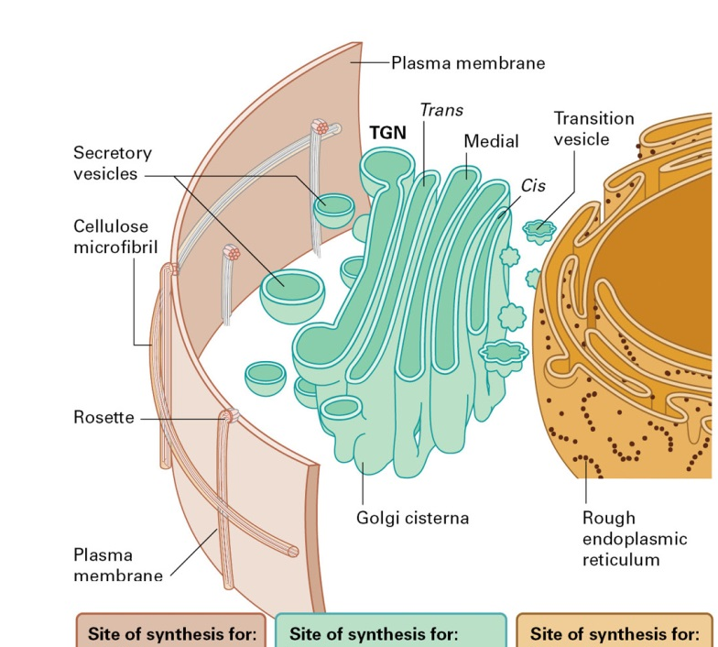
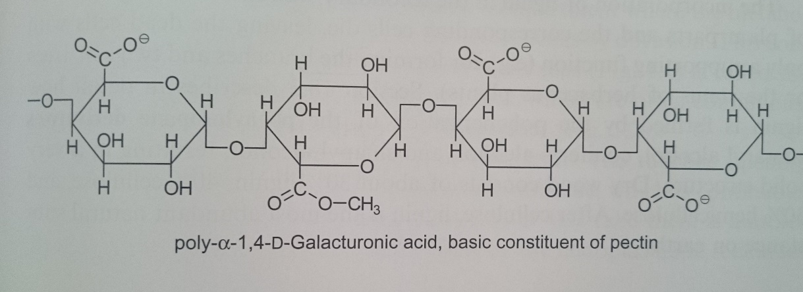
Membrane and Cell Wall
Crosslinking glycans and pectin polymers
Cellulose Pectins Cell wall proteins
Callose Crosslinking glycans

Slide 18
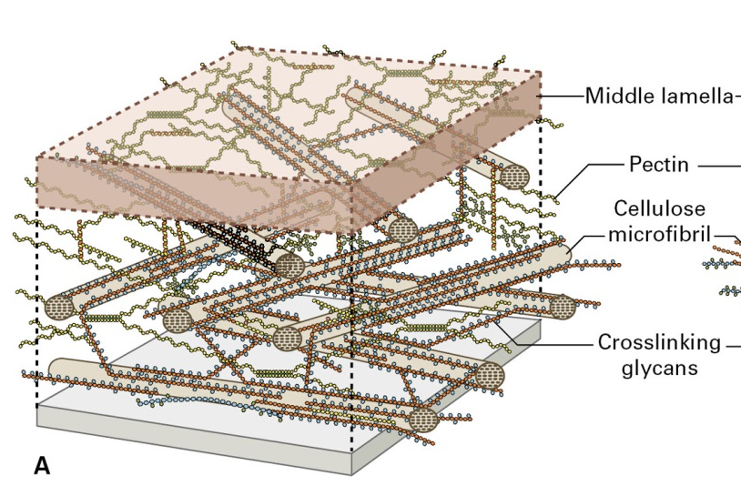
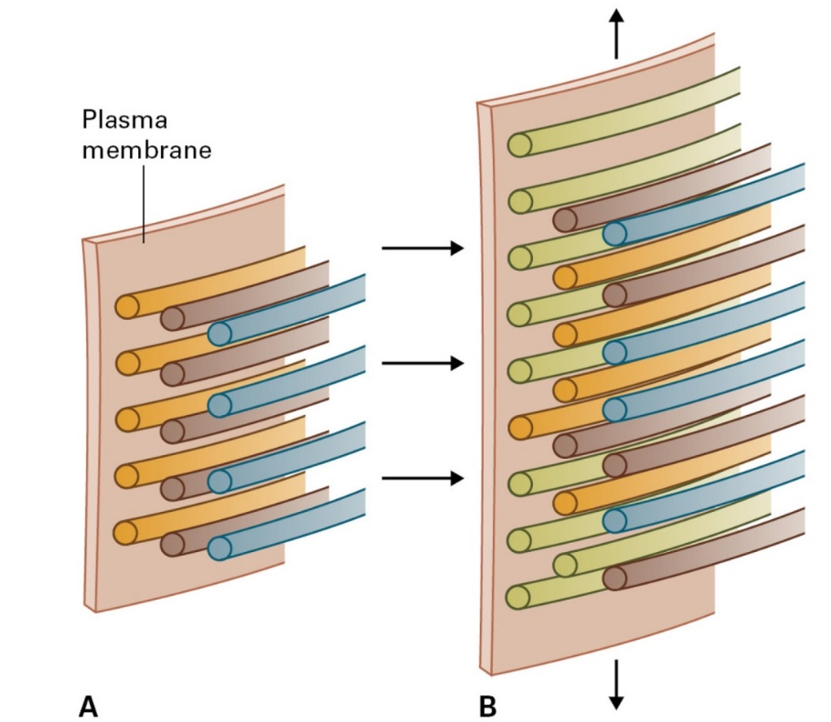
Membrane and Cell Wall
Cell wall architecture
Middle lamela
Pectin
Cellulose microfibril
Crosslinking glycans
Cell growth

Slide 19
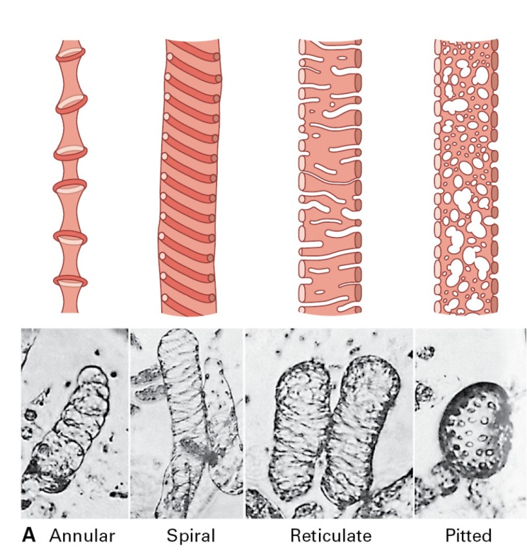
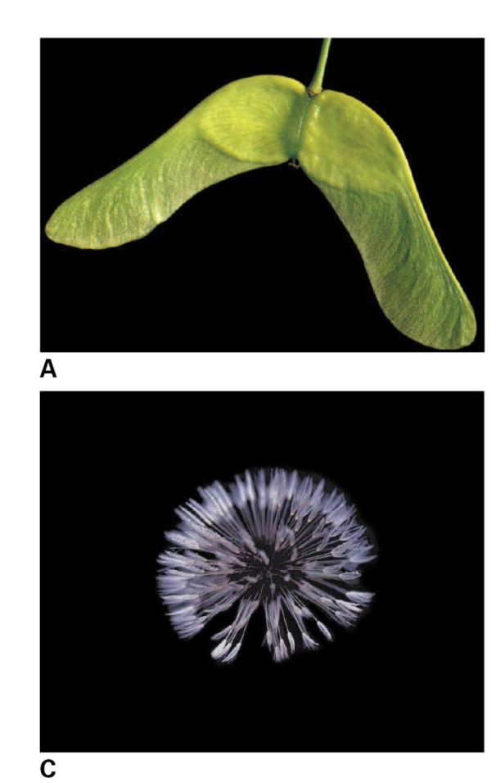
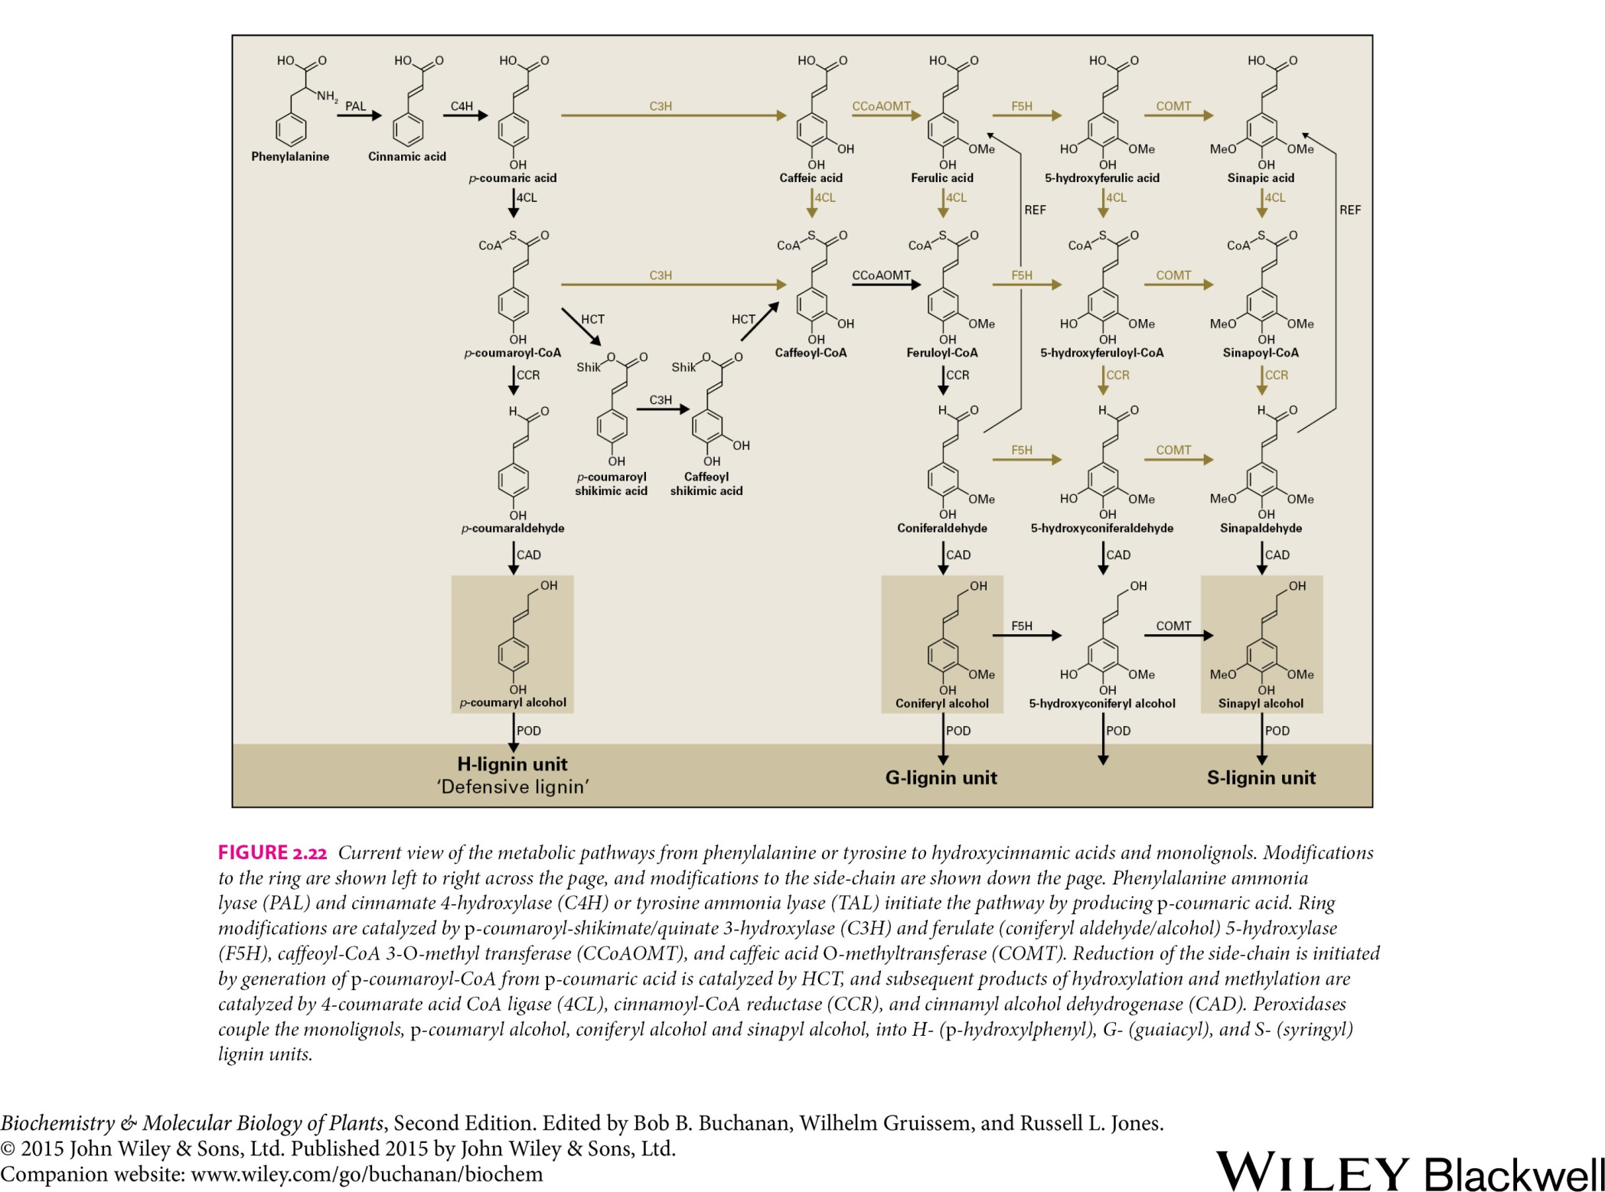
Membrane and Cell Wall
Secondary wall
Vessel elements
Monolignols

