Slide 1
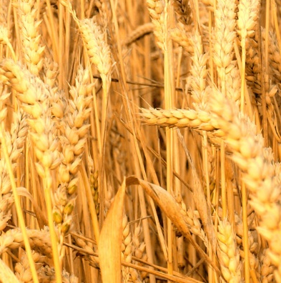
Carbohydrate and
lipid metabolism
Katerina Dadakova, Department of Biochemistry
1
Figures adopted from Buchanan et al., Biochemistry & molecular biology of plants

Slide 2
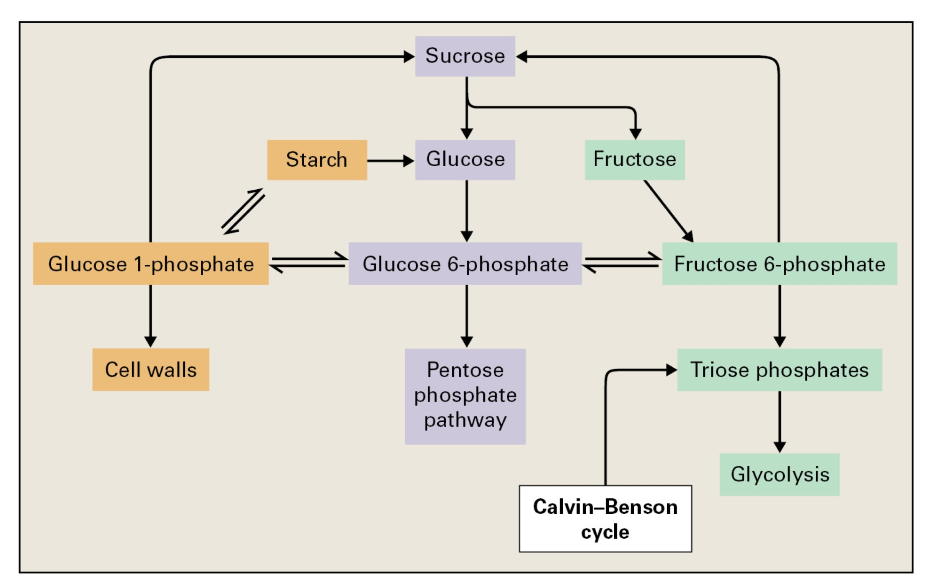
Carbohydrate and lipid metabolism

Slide 3
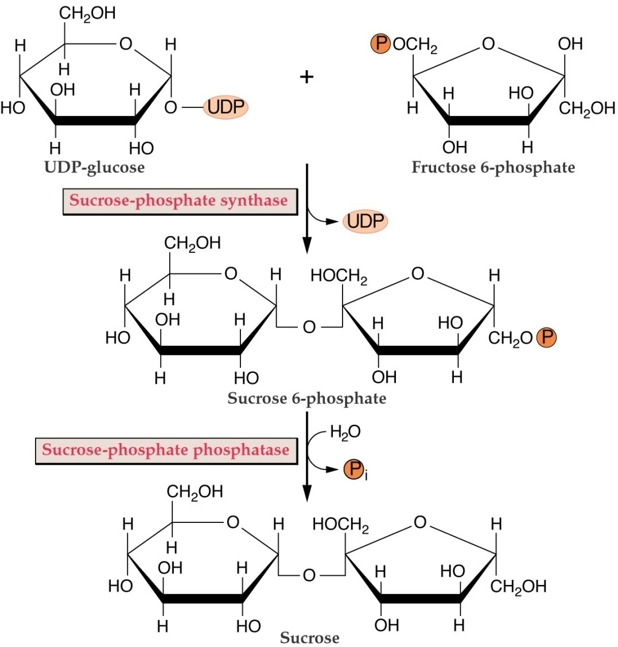
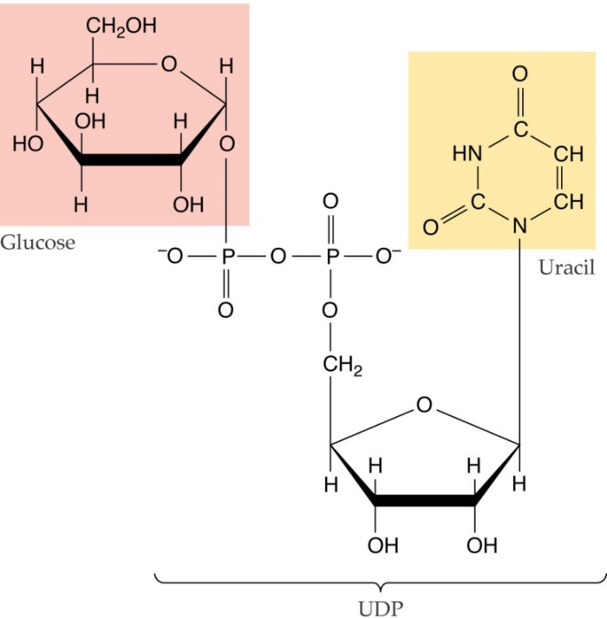
Carbohydrate and lipid metabolism
Sucrose synthesis
UDP-glucose

Slide 4
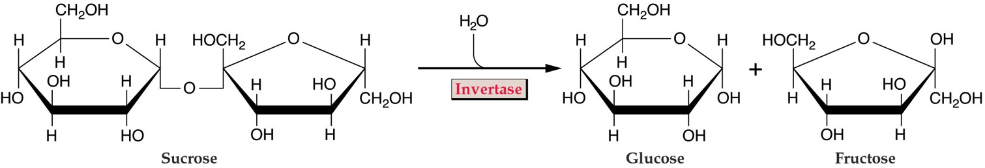
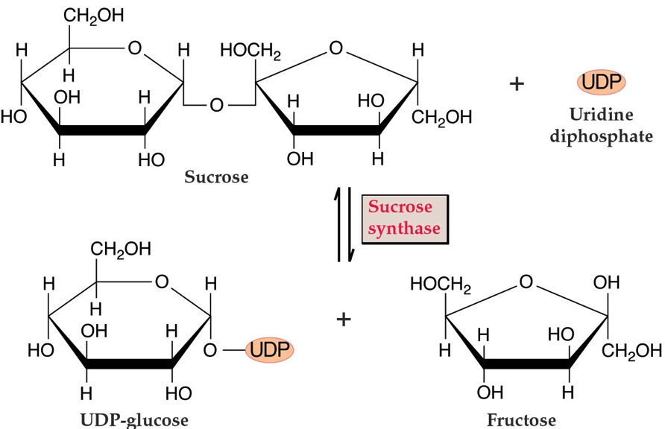
Carbohydrate and lipid metabolism
Sucrose degradation

Slide 5
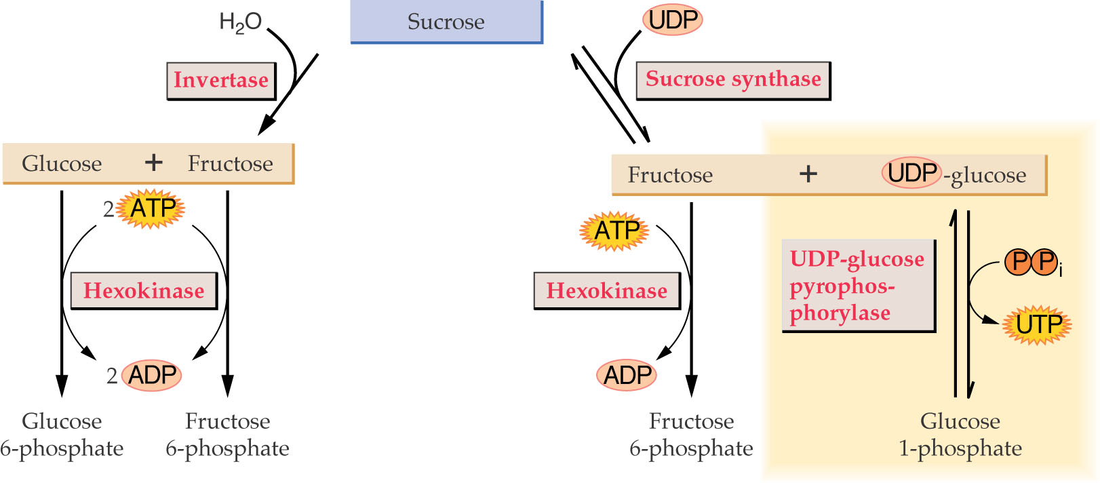
Carbohydrate and lipid metabolism
Sucrose degradation

Slide 6
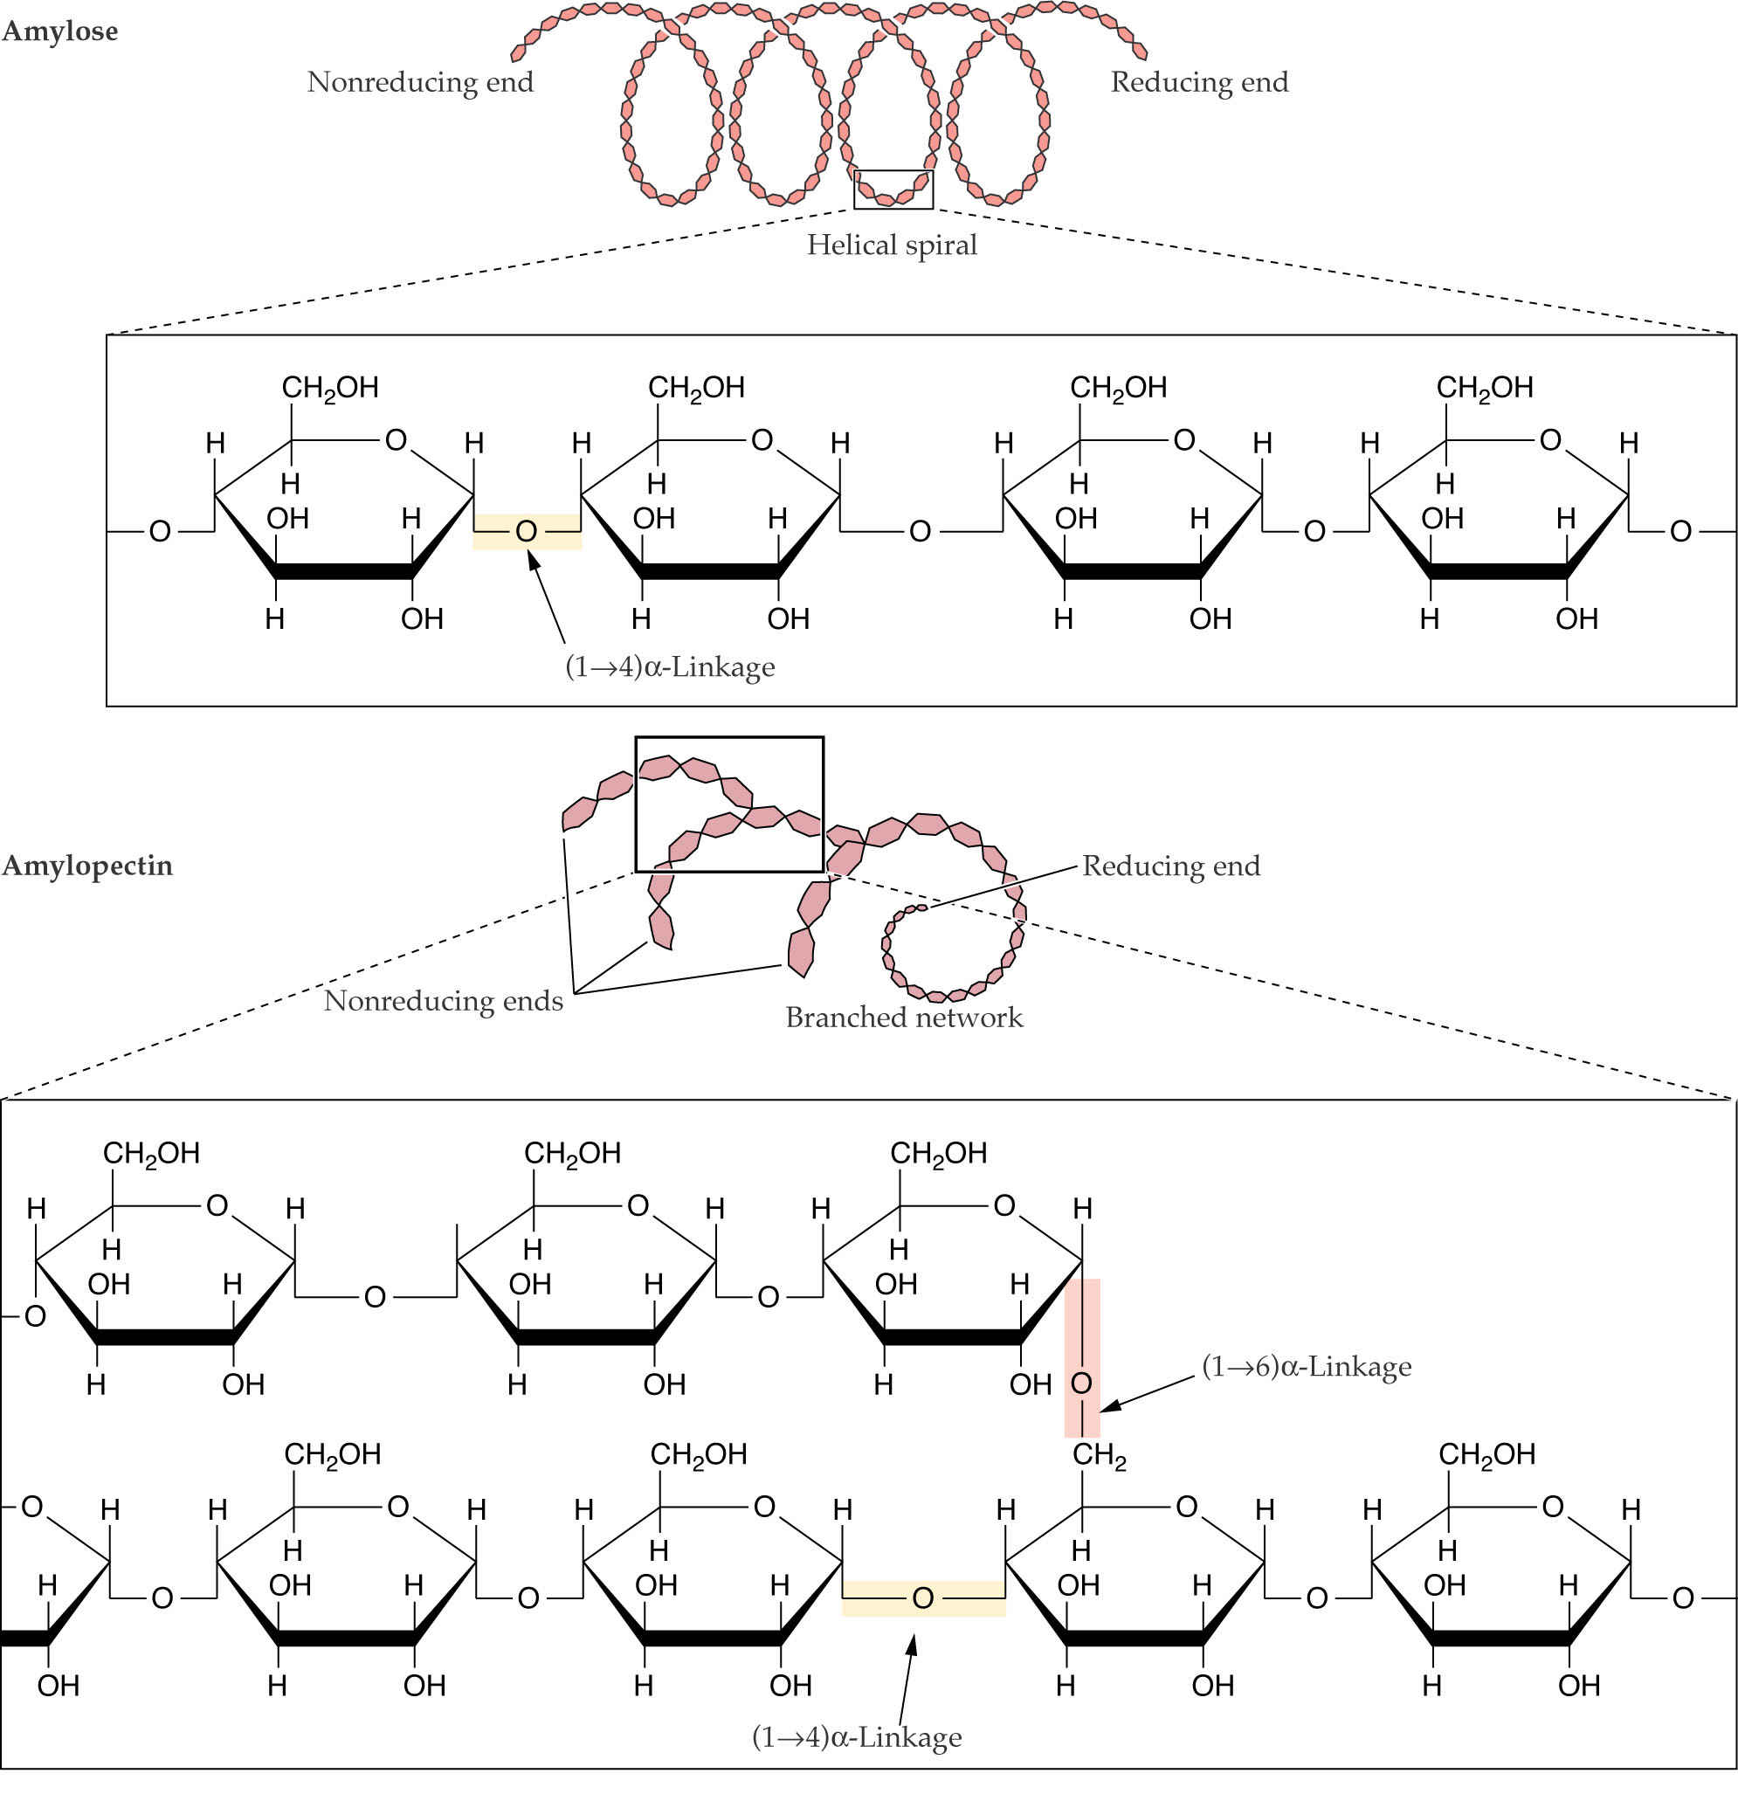
Carbohydrate and lipid metabolism
Starch
Starch, a polymer of glucose, is synthesized and stored in plastids.
Starch synthesis protects plastids from osmotic disruption.
Starch is organized into grains that grow by adding layers.

Slide 7
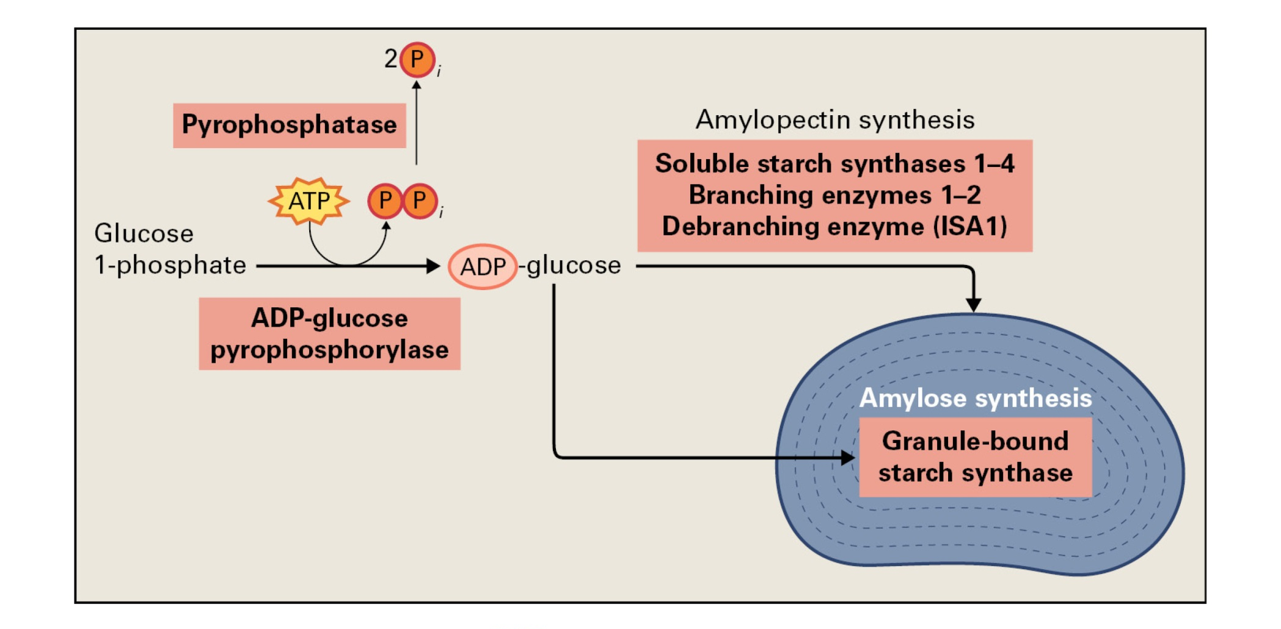
Carbohydrate and lipid metabolism
Starch synthesis

Slide 8
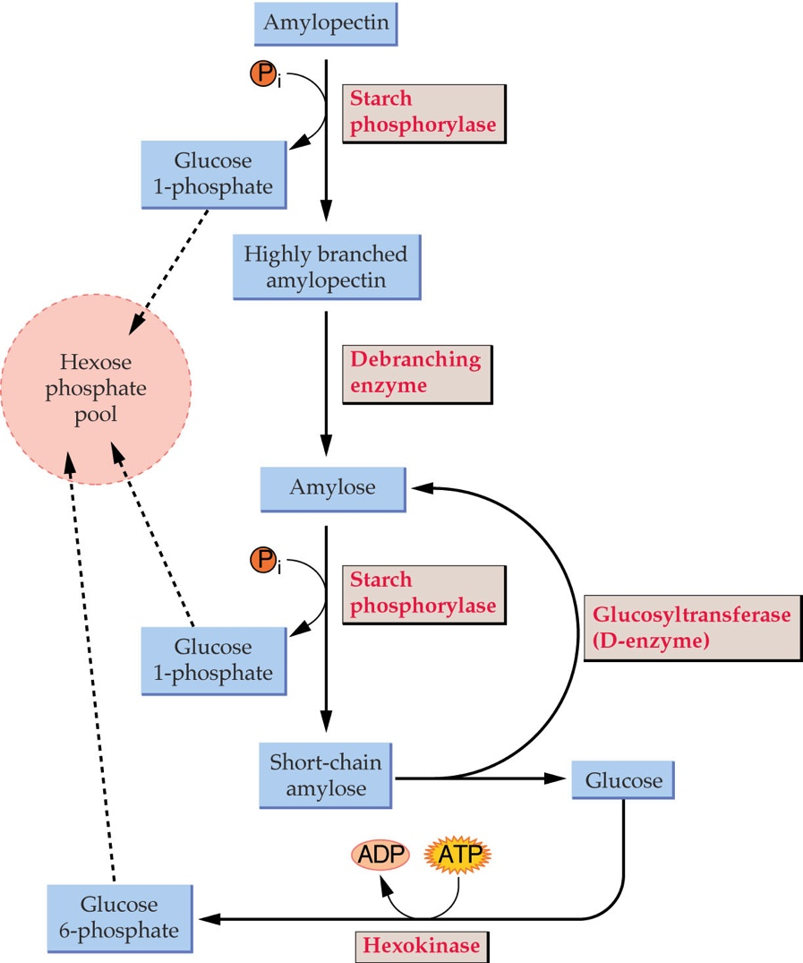
Carbohydrate and lipid metabolism
Starch degradation

Slide 9
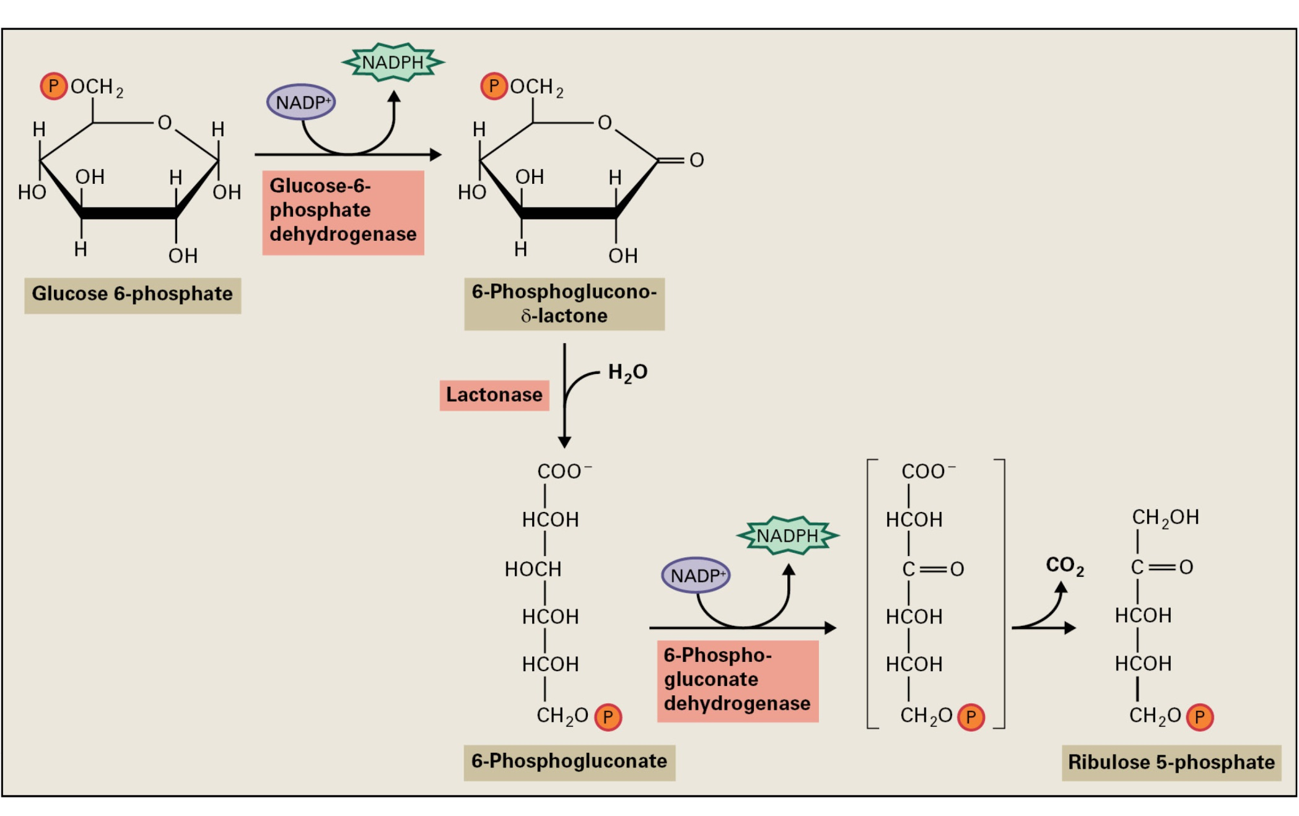
Carbohydrate and lipid metabolism
Pentose phosphate pathway – oxidative reactions

Slide 10
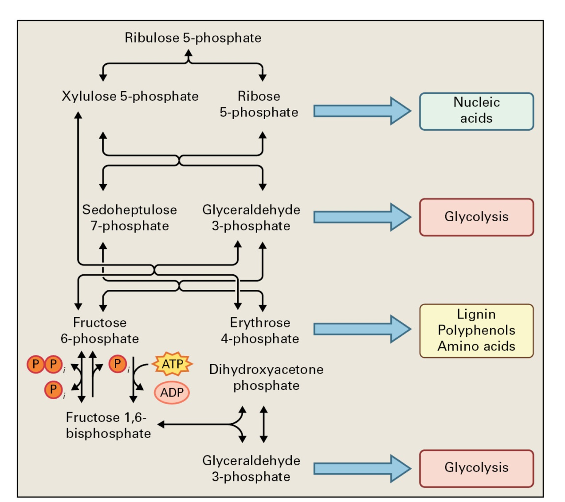
Carbohydrate and lipid metabolism
Pentose phosphate pathway – reversible reactions
Glycolysis, the pentose phosphate pathway, and various biosynthetic pathways are interconnected in plants

Slide 11
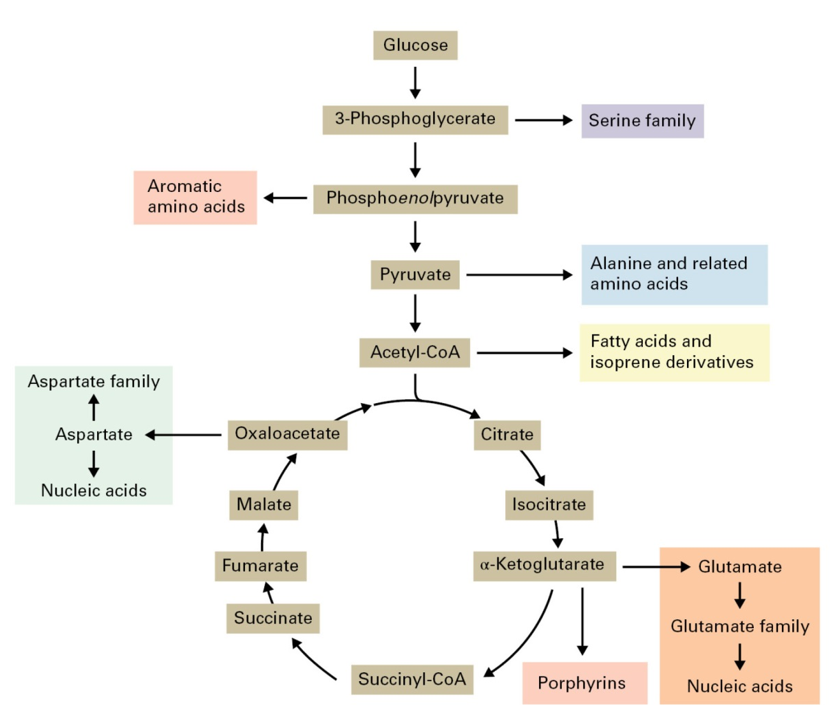
Carbohydrate and lipid metabolism

Slide 12
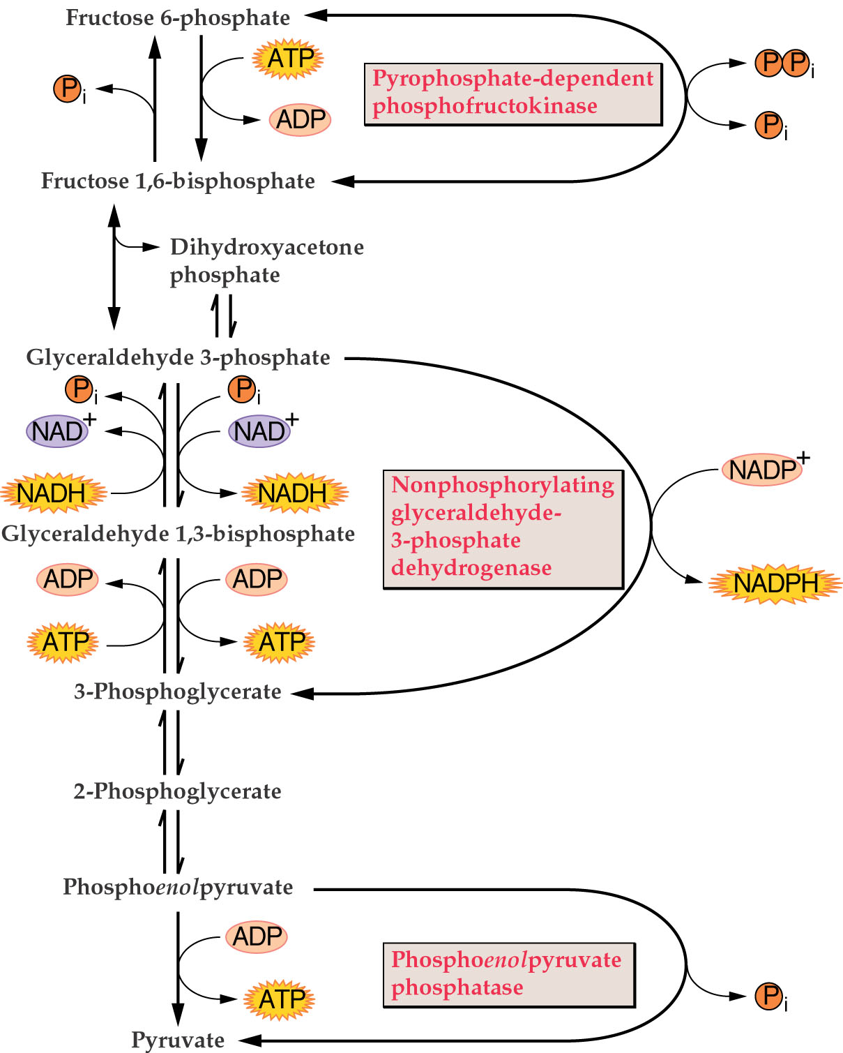
Carbohydrate and lipid metabolism
Glycolysis
Functions:
ATP production
Supply of reducing power
Funneling carbon for oxidative phosphorylation
Production of biosynthetic precursors
Bypass reactions give plants metabolic flexibility

Slide 13
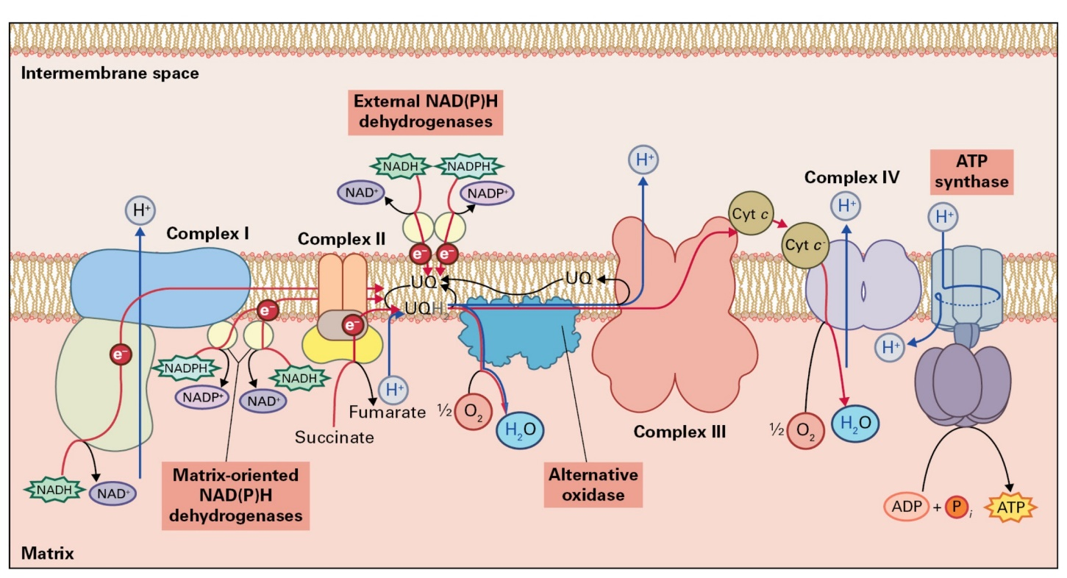
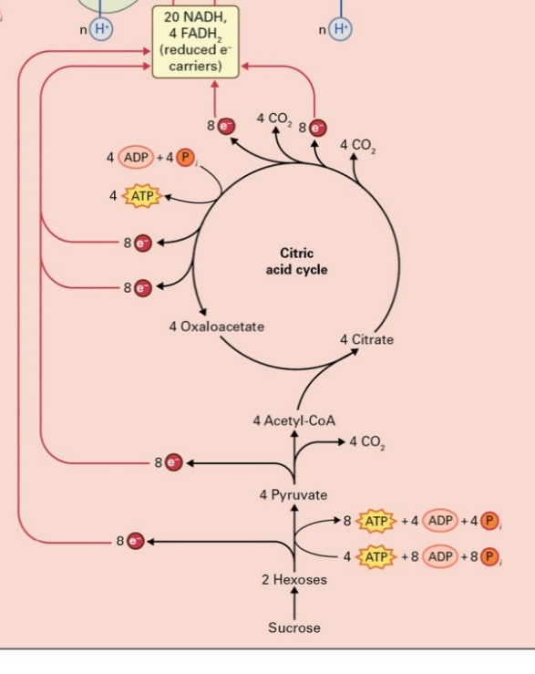
Carbohydrate and lipid metabolism
Respiration

Slide 14
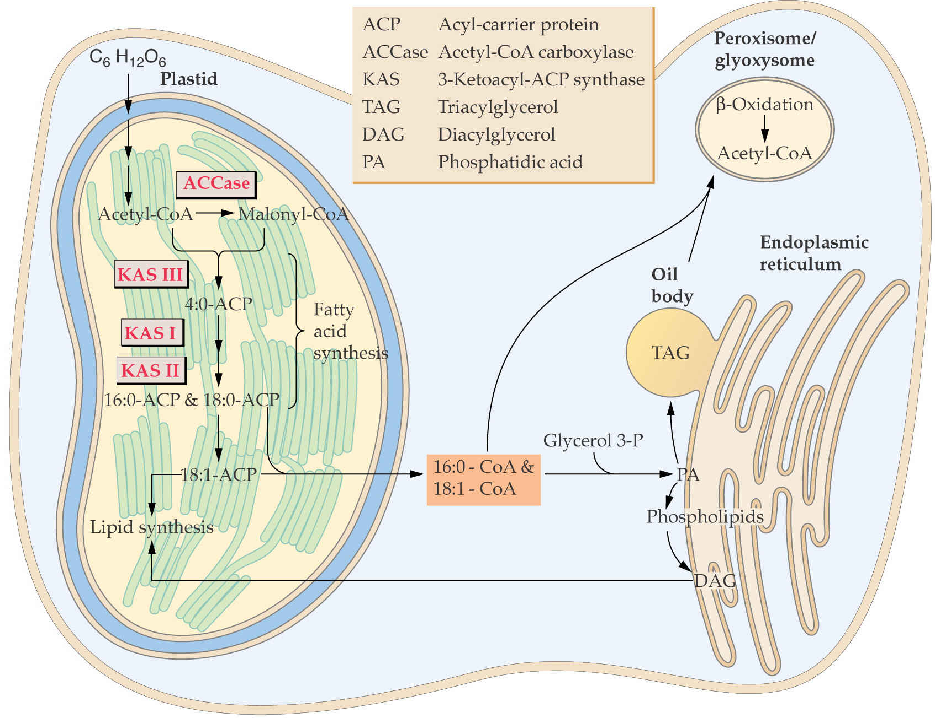
Carbohydrate and lipid metabolism
Lipids

Slide 15
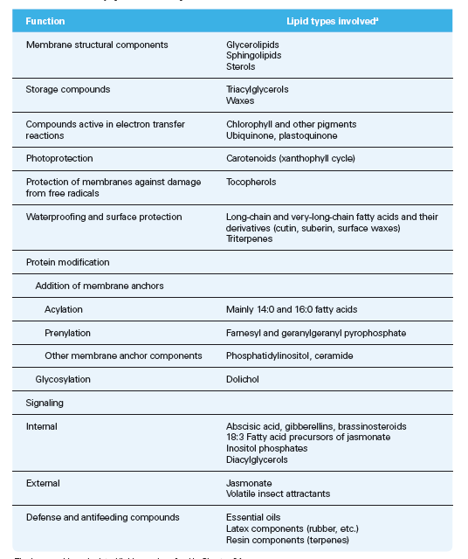
Carbohydrate and lipid metabolism
Lipid functions

Slide 16
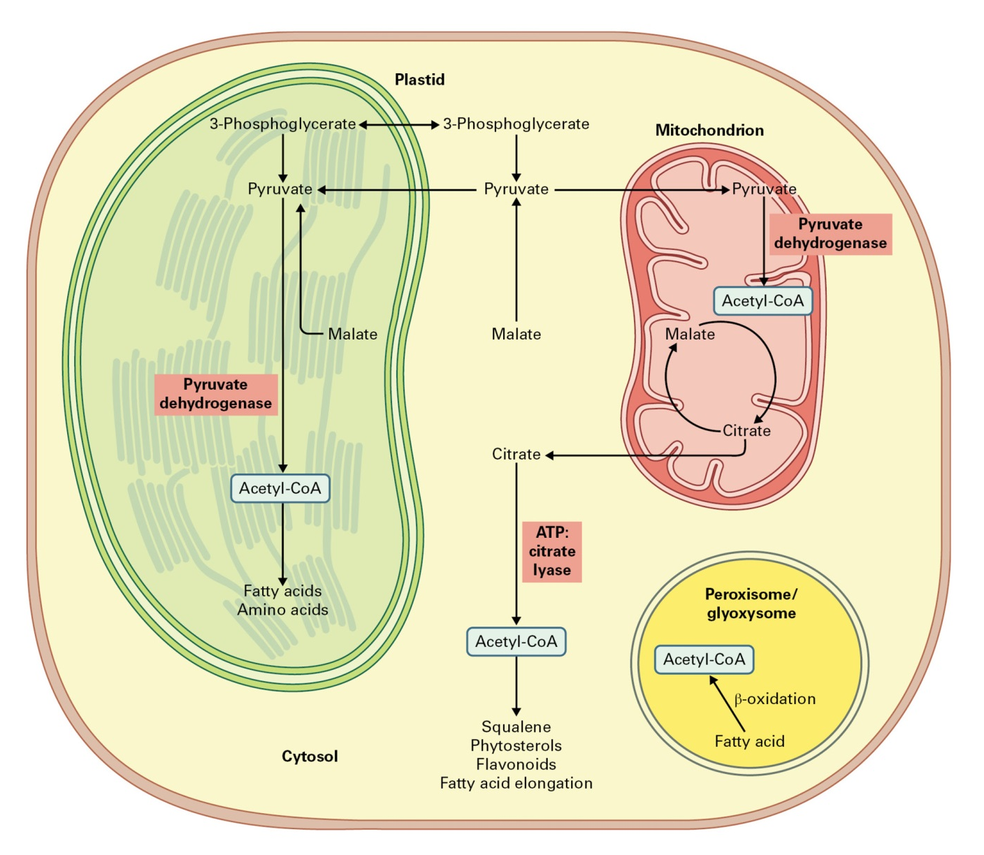
Carbohydrate and lipid metabolism
The central role of acetyl-CoA in metabolism

Slide 17
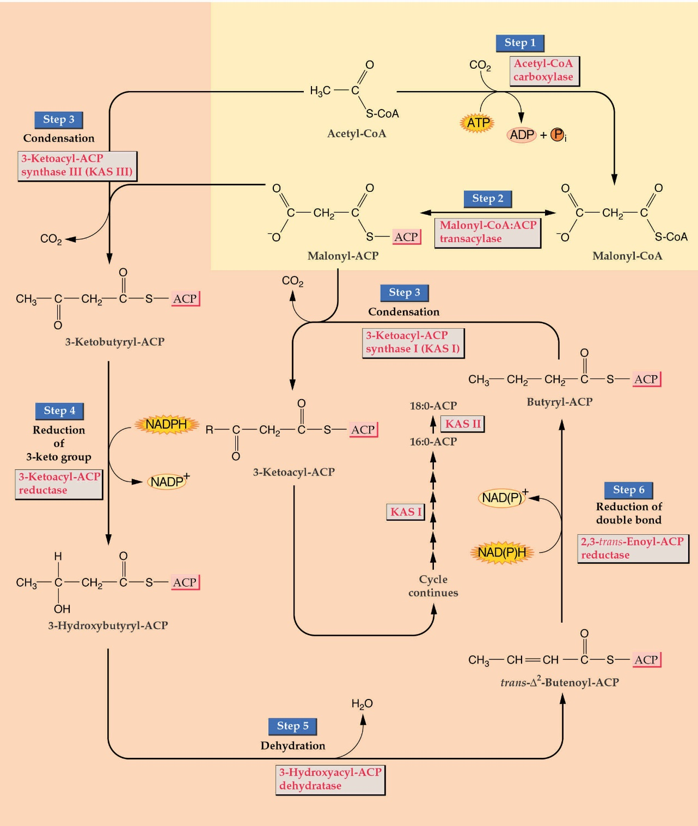
Carbohydrate and lipid metabolism
Fatty acid synthesis

Slide 18
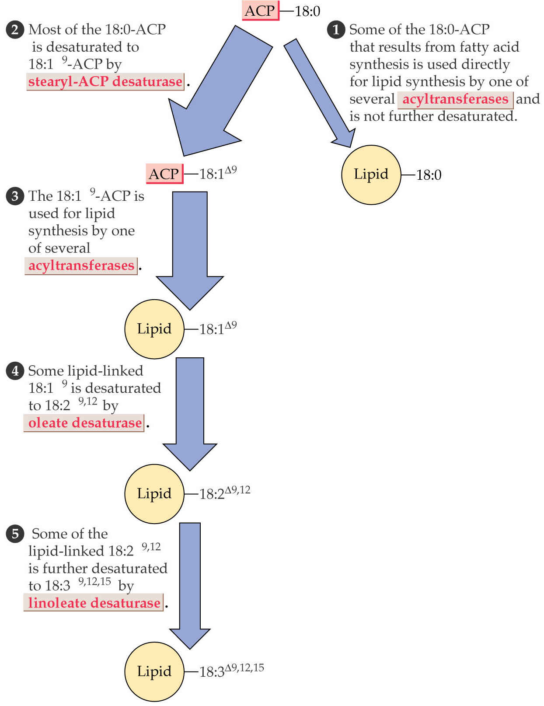
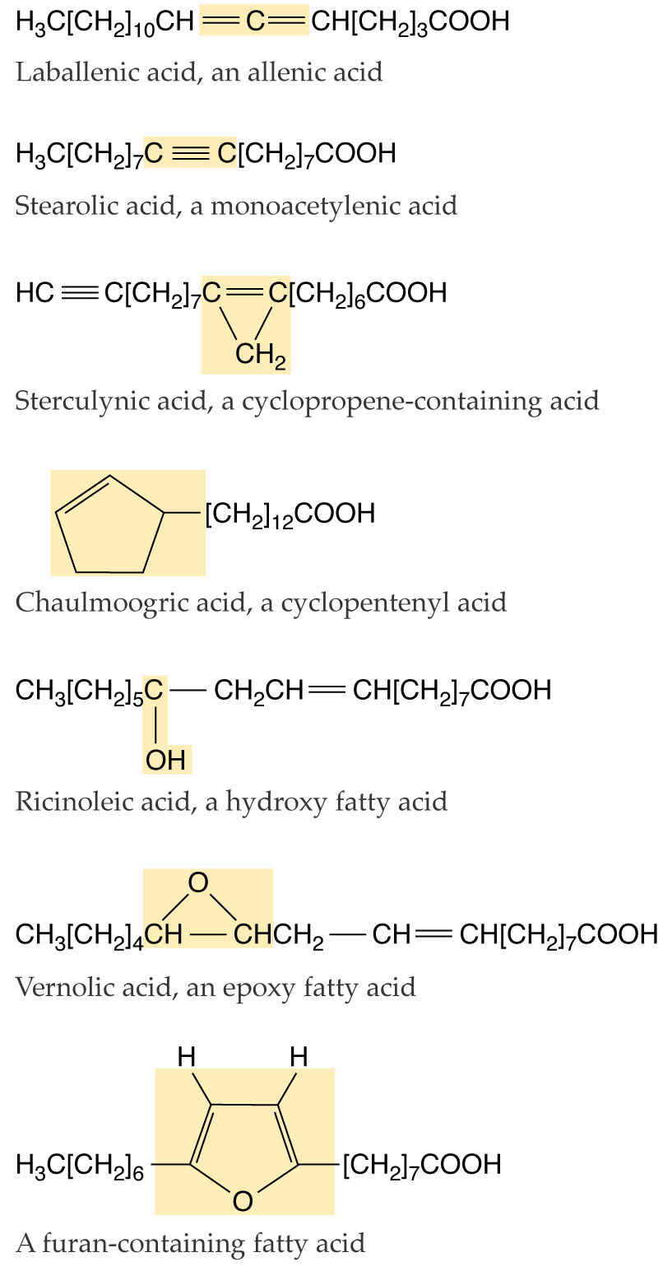
Carbohydrate and lipid metabolism
Fatty acid synthesis

Slide 19
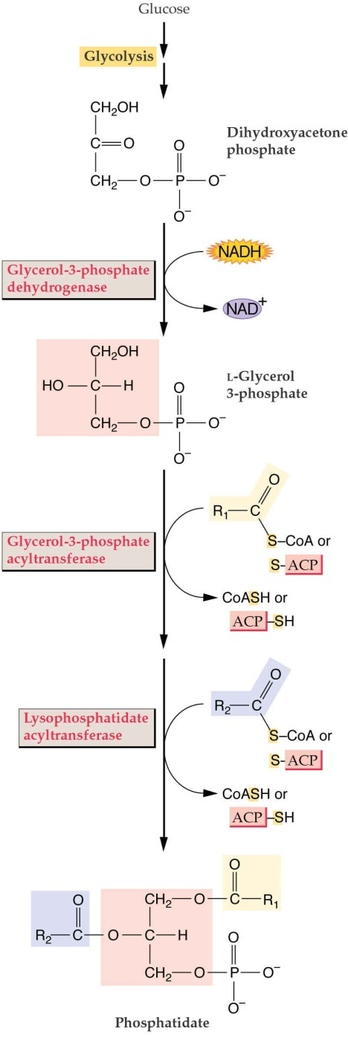
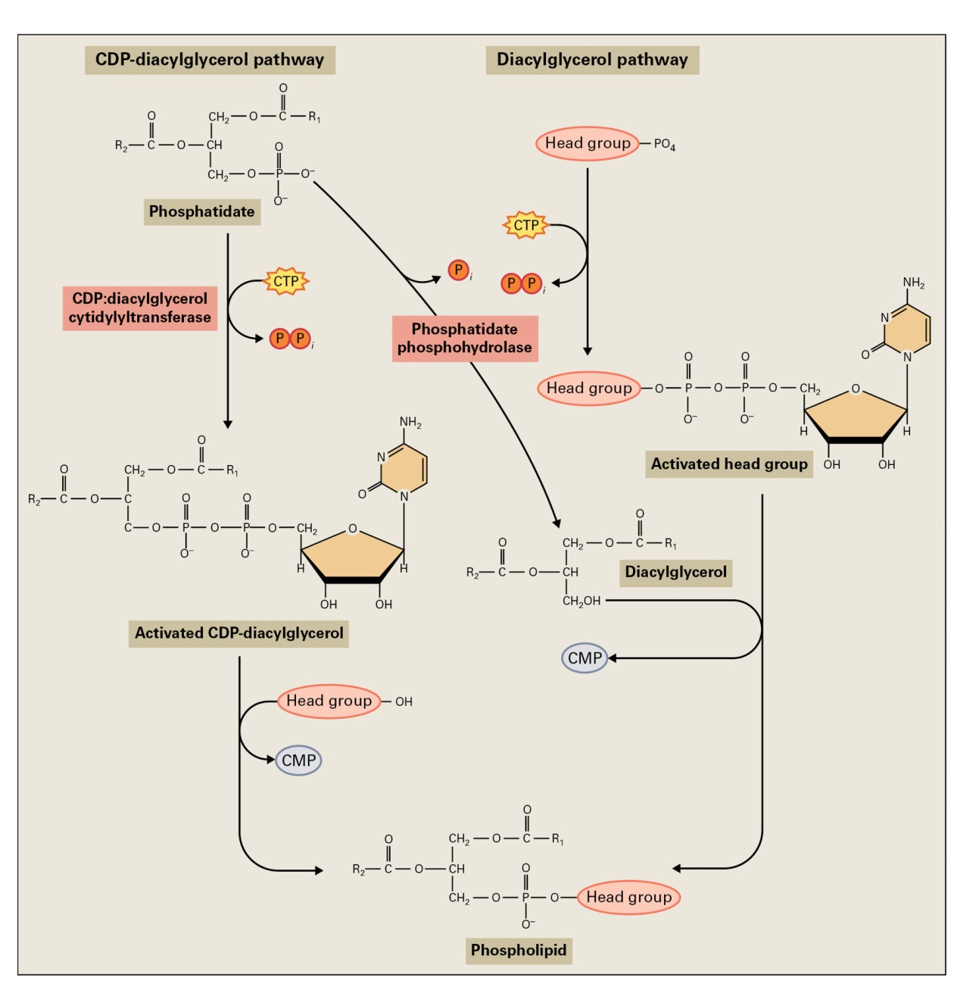
Carbohydrate and lipid metabolism
Membrane lipids

Slide 20
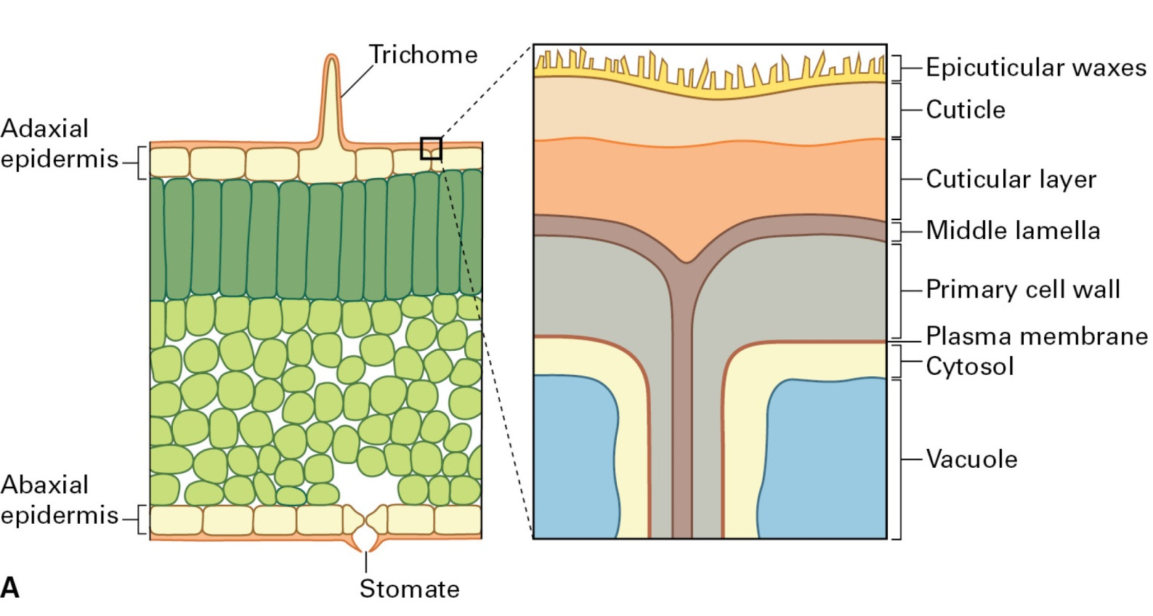
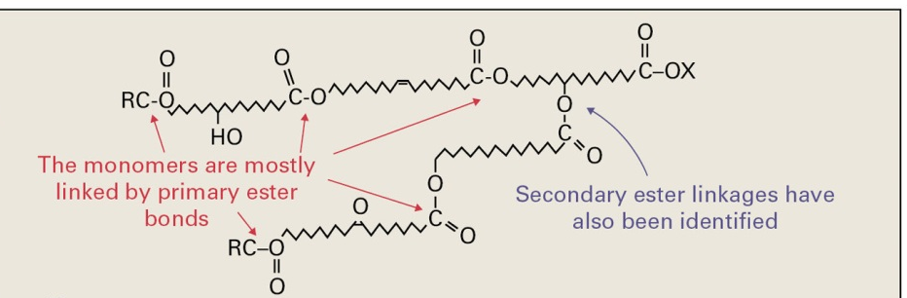
Carbohydrate and lipid metabolism
Structural lipids
Cutin structure

Slide 21
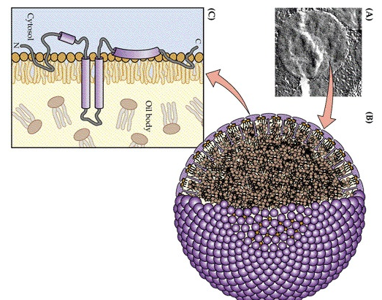
Carbohydrate and lipid metabolism
Storage lipids

Slide 22
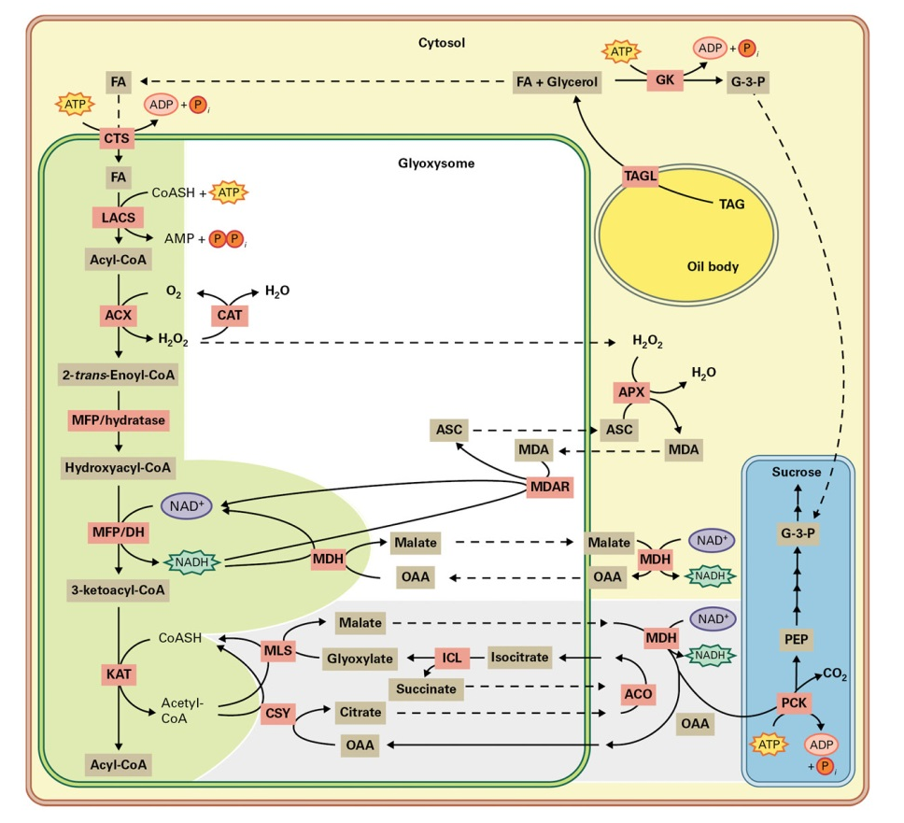
Carbohydrate and lipid metabolism
Storage lipid mobilization

Slide 23
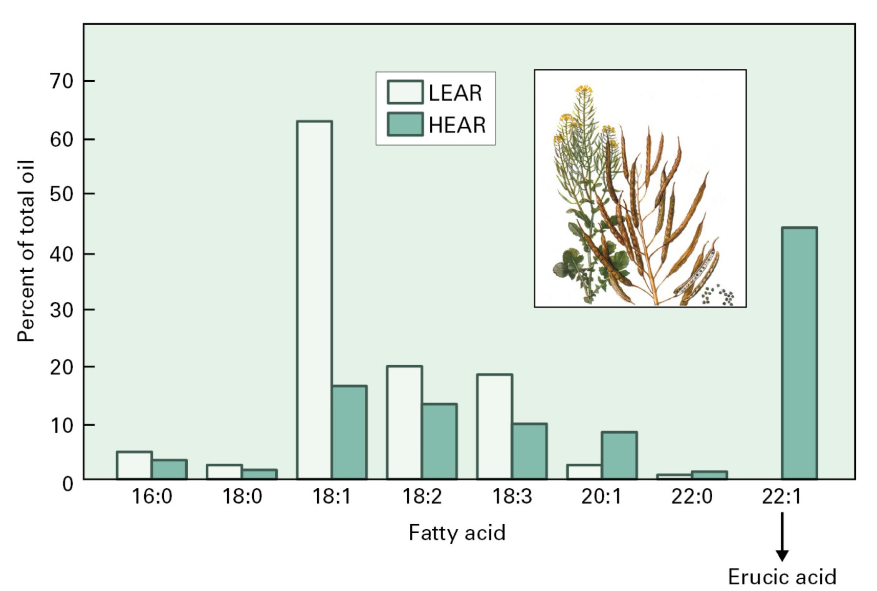
Carbohydrate and lipid metabolism
Genetic engineering of lipids

