Slide 1
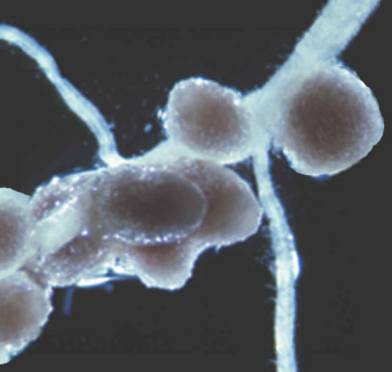
Nutrients
Katerina Dadakova, Department of Biochemistry
Figures adopted from Buchanan et al., Biochemistry & molecular biology of plants

Slide 2
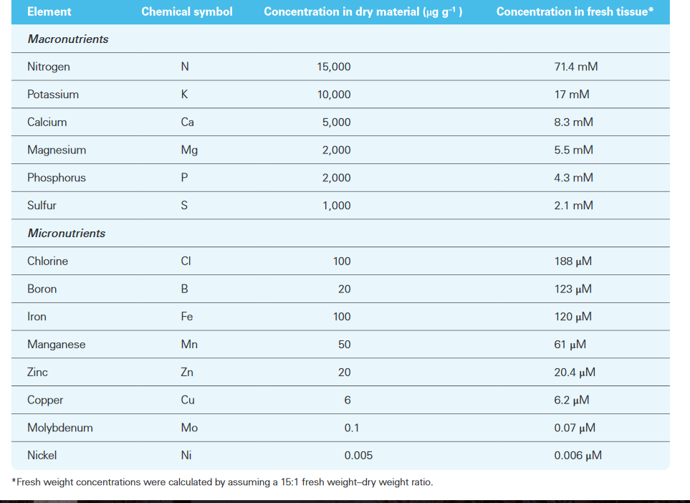
Nutrients
Essential mineral nutrients

Slide 3
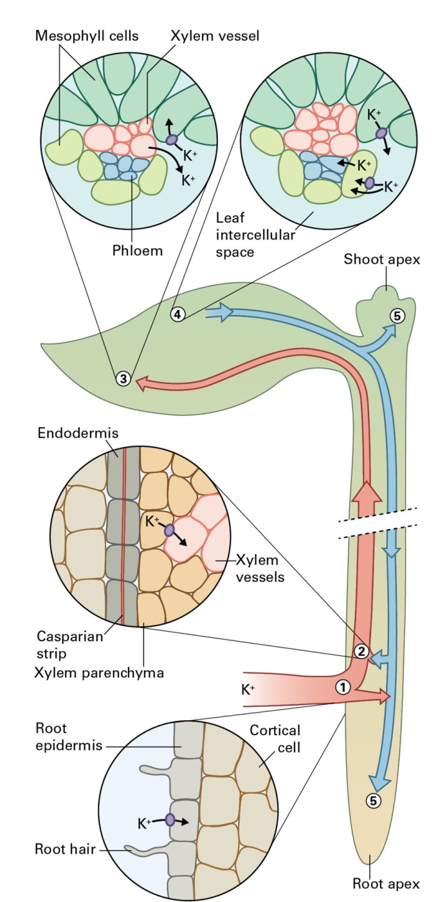
Nutrients
Potassium
K⁺ is the most abundant cellular cation
K⁺ functions:
osmoticum
charge balance
enzyme activation

Slide 4
Nutrients
Nitrogen
Compound | Oxidation state of N | Name
N₂ | 0 | Dinitrogen (nitrogen gas)
HN₃ | -3 | Ammonia
NH₄⁺ | -3 | Ammonium ion
N₂O | +1 | Nitrous oxide
NO | +2 | Nitric oxide
NO₂⁻ | +3 | Nitrite
NO₂ | +4 | Nitrogen dioxide
NO₃⁻ | +5 | Nitrate
nitrogen fixation glutamine synthetase
N₂ NH₄⁺ Glutamine Organic nitrogen compounds
Glutamate

Slide 5
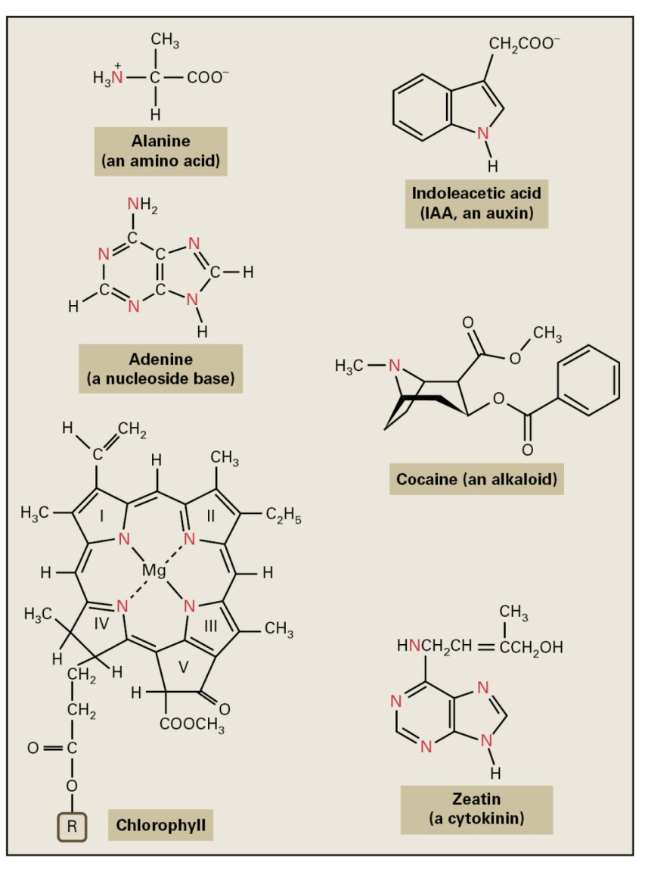
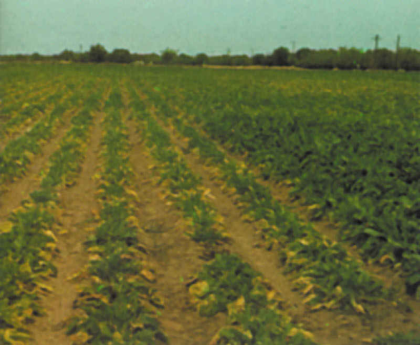
Nutrients
Nitrogen deficiency phenotype
Selected organic nitrogen compounds

Slide 6
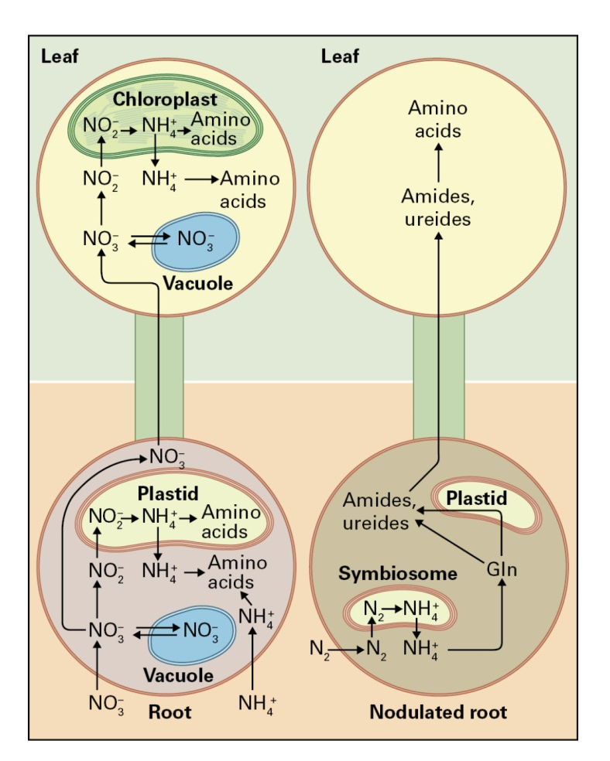
Nutrients
Plants may acquire N as:
ammonium ion
nitrate
dinitrogen, only in the case of plant species capable of endosymbiosis with nitrogen-fixing bacteria
Obtaining nitrogen through symbiosis consumes 12 to 17 g of carbohydrate per gram of N fixed

Slide 7
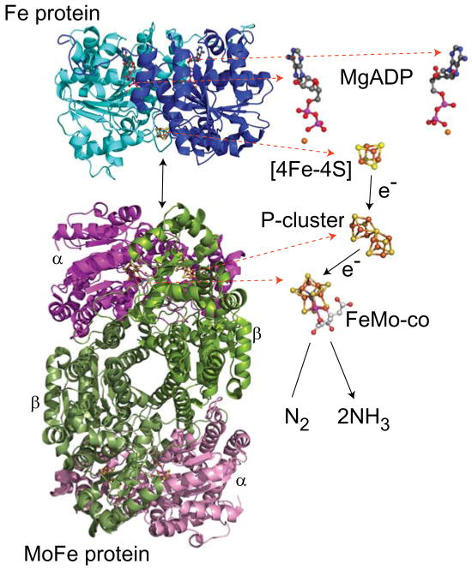
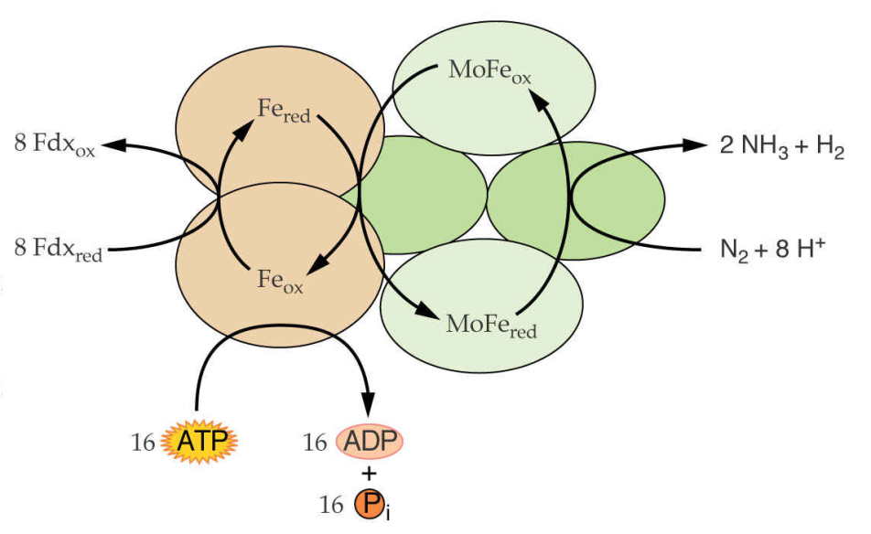
Nutrients
Nitrogen fixation
Nitrogenase complex
Dinitrogenase reductase
Fe protein
Dinitrogenase
MoFe protein
N₂ + 16ATP + 8e⁻ + 8H⁺
2NH₃ + H₂ + 16ADP + 16P_{i}

Slide 8
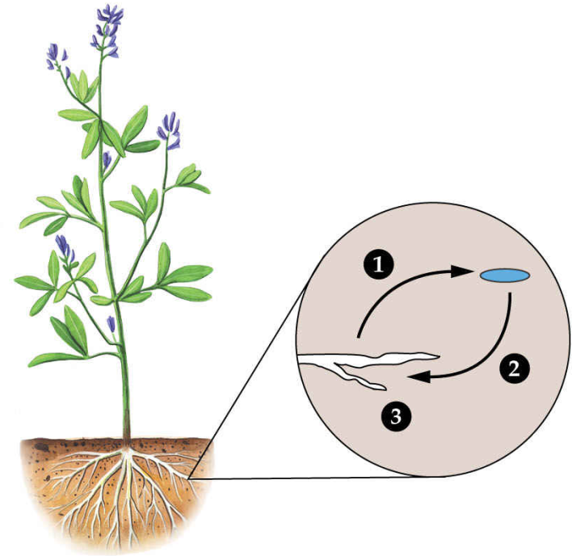
Nutrients
Legume-rhizobial symbiosis
The plant creates root nodules to ensure:
microaerobic environment
organic acids to feed the bacteria
carbon skeletons to transport fixed nitrogen
Bacterial symbionts fix nitrogen and release the resulting ammonia
Plant signals
Nod factors
Nodulin proteins

Slide 9
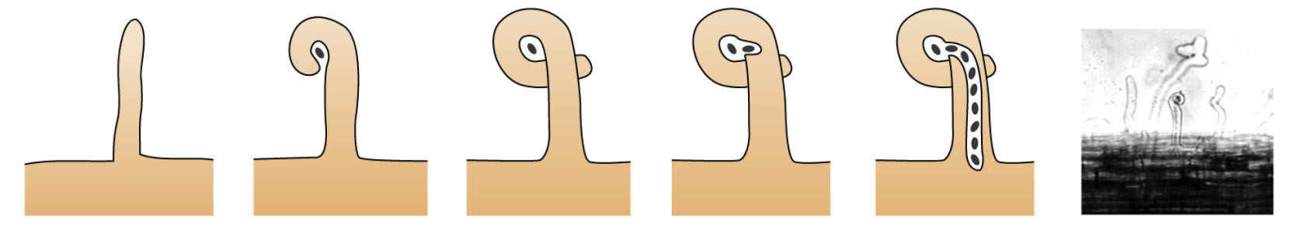
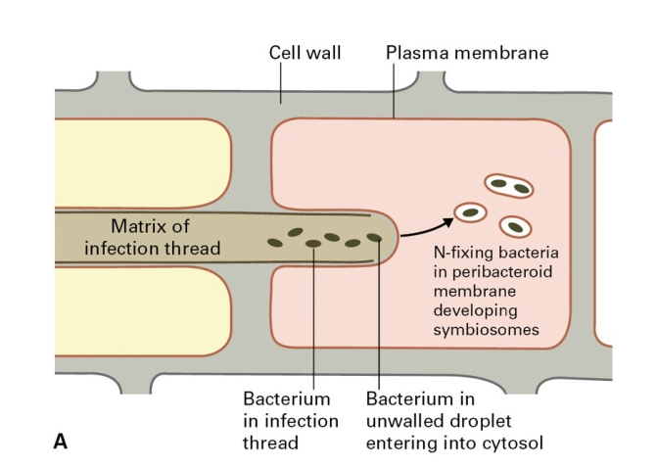
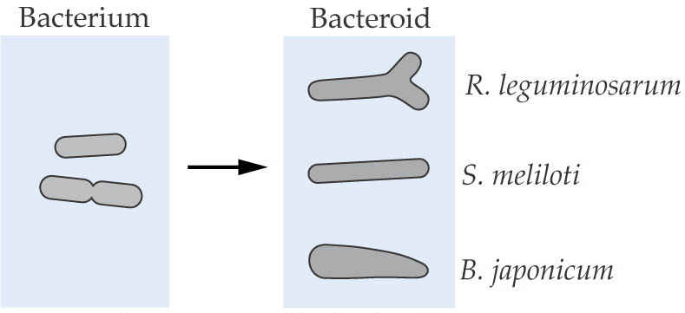
Nutrients
Nodule morphogenensis
In symbiosomes, bacteria differentiate into bacteroids

Slide 10
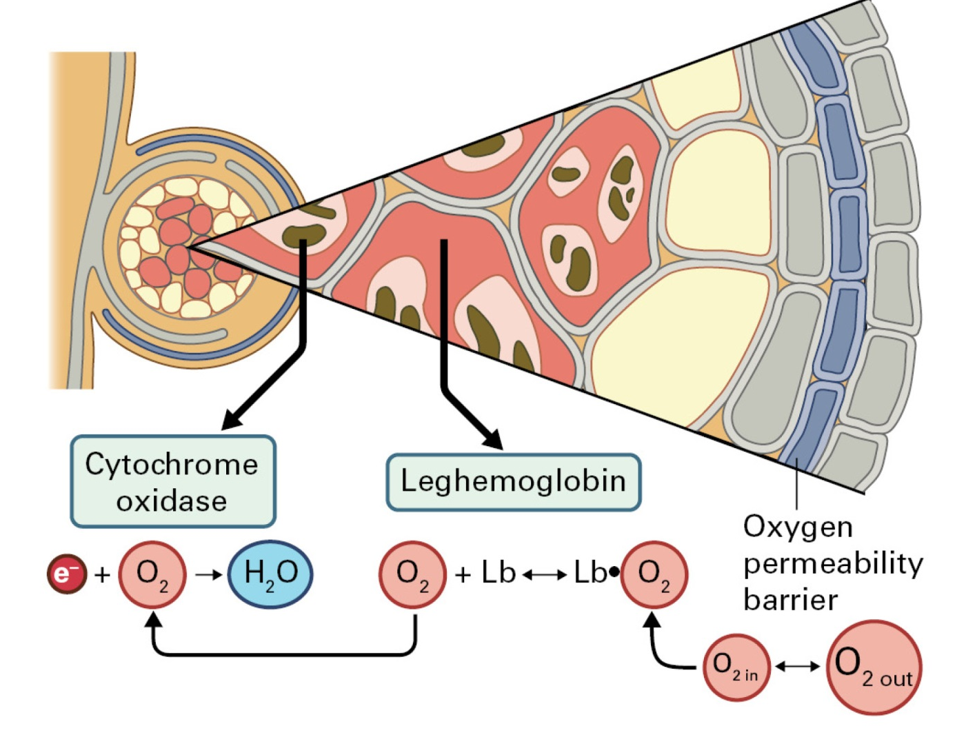
Nutrients
Microaerobic nodule environment is created
Carbon is provided to the bacteroids as dicarboxylic acids
oxidation of DCA provides ATP
DCA carbon backbones are used for nitrogen transport

Slide 11
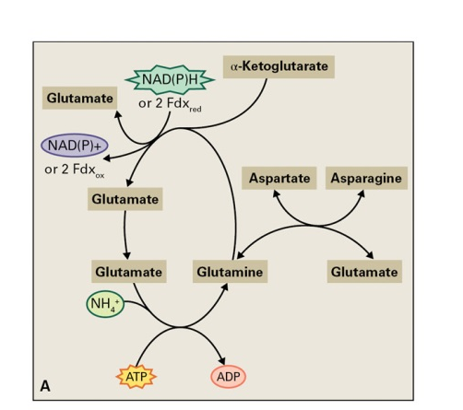
Nutrients
Ammonia assimilation
GS-GOGAT cycle

Slide 12
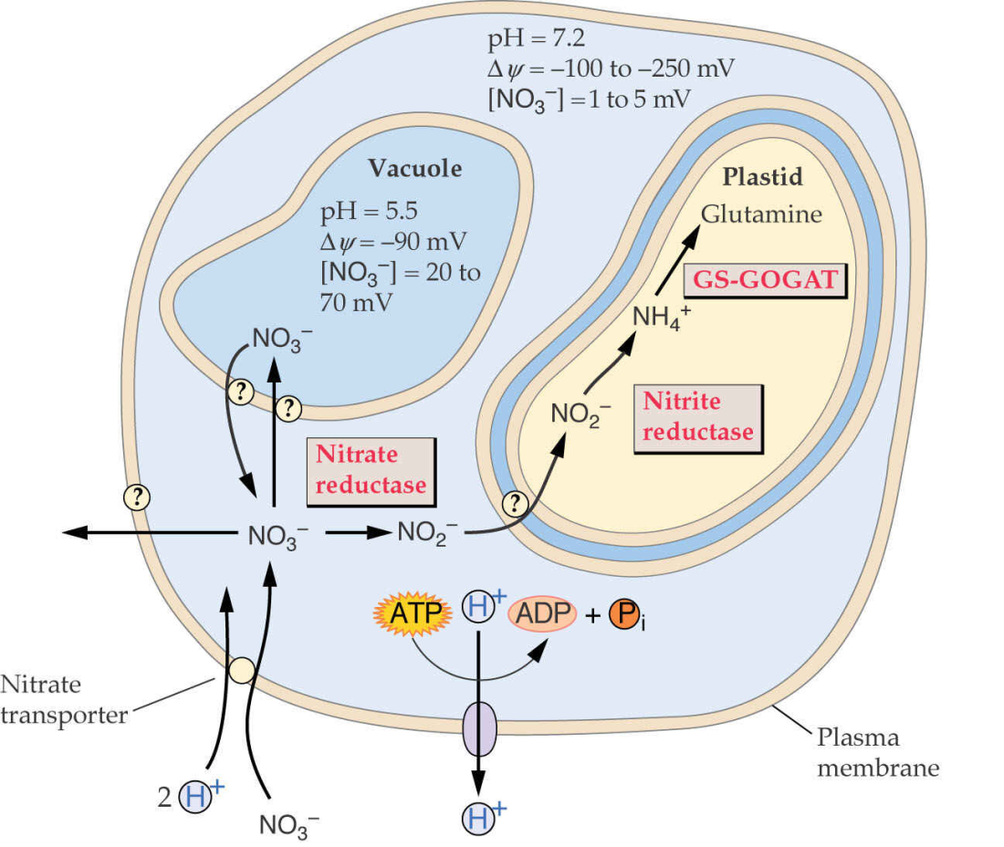
Nutrients
Nitrate assimilation

Slide 13
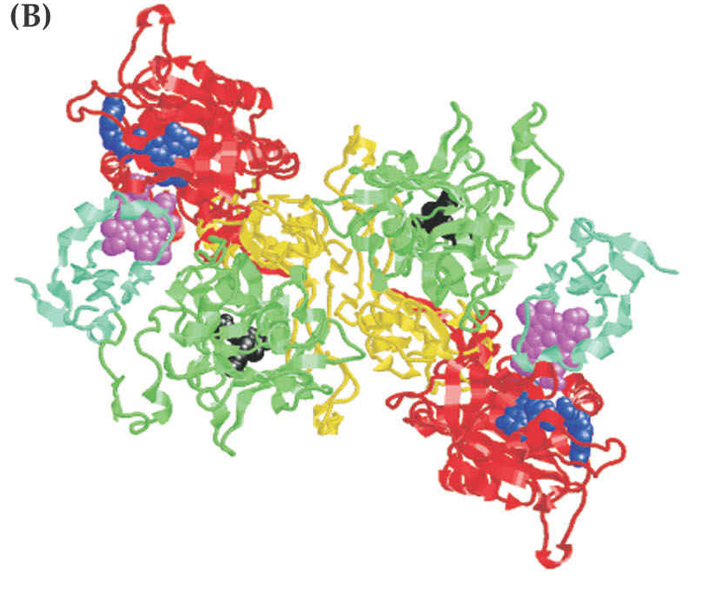
Nutrients
Nitrate reductase
NR reaction
NR homodimer
NO₃⁻ + NAD(P)H + H⁺
NO₂⁻ + NAD(P)⁺ + H₂O
NAD(P)H NAD(P)⁺ NO₃⁻ NO₂⁻
FAD
Heme
-Fe
MoCo
Hinge II Hinge I

Slide 14
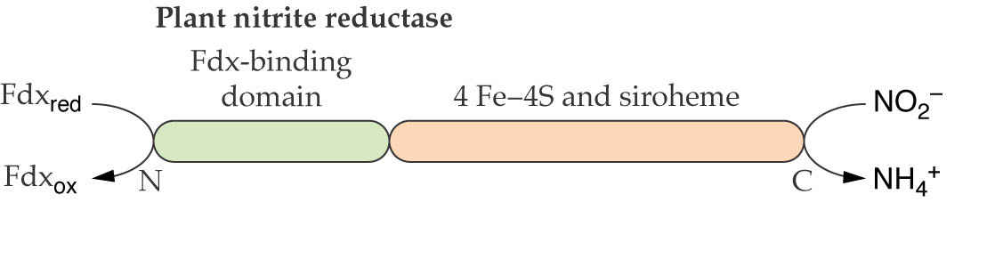
Nutrients
Nitrite reductase
NiR reaction
NO₂⁻ + 6 Fdx_{red} + 8 H⁺ NH₄⁺ + 6 Fdx_{ox} + 2 H₂O

Slide 15
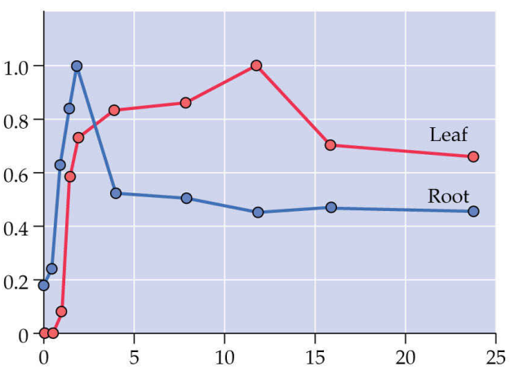
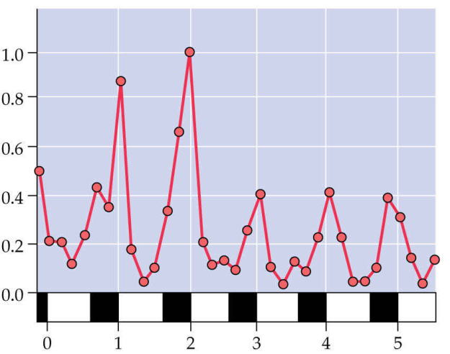
Nutrients
Regulation of nitrate assimilation
Relative NR mRNA abundance
Relative NR mRNA abundance
hours of nitrate exposure
days
nitrogen assimilation into amino acids
nitrate
light
CO₂

Slide 16
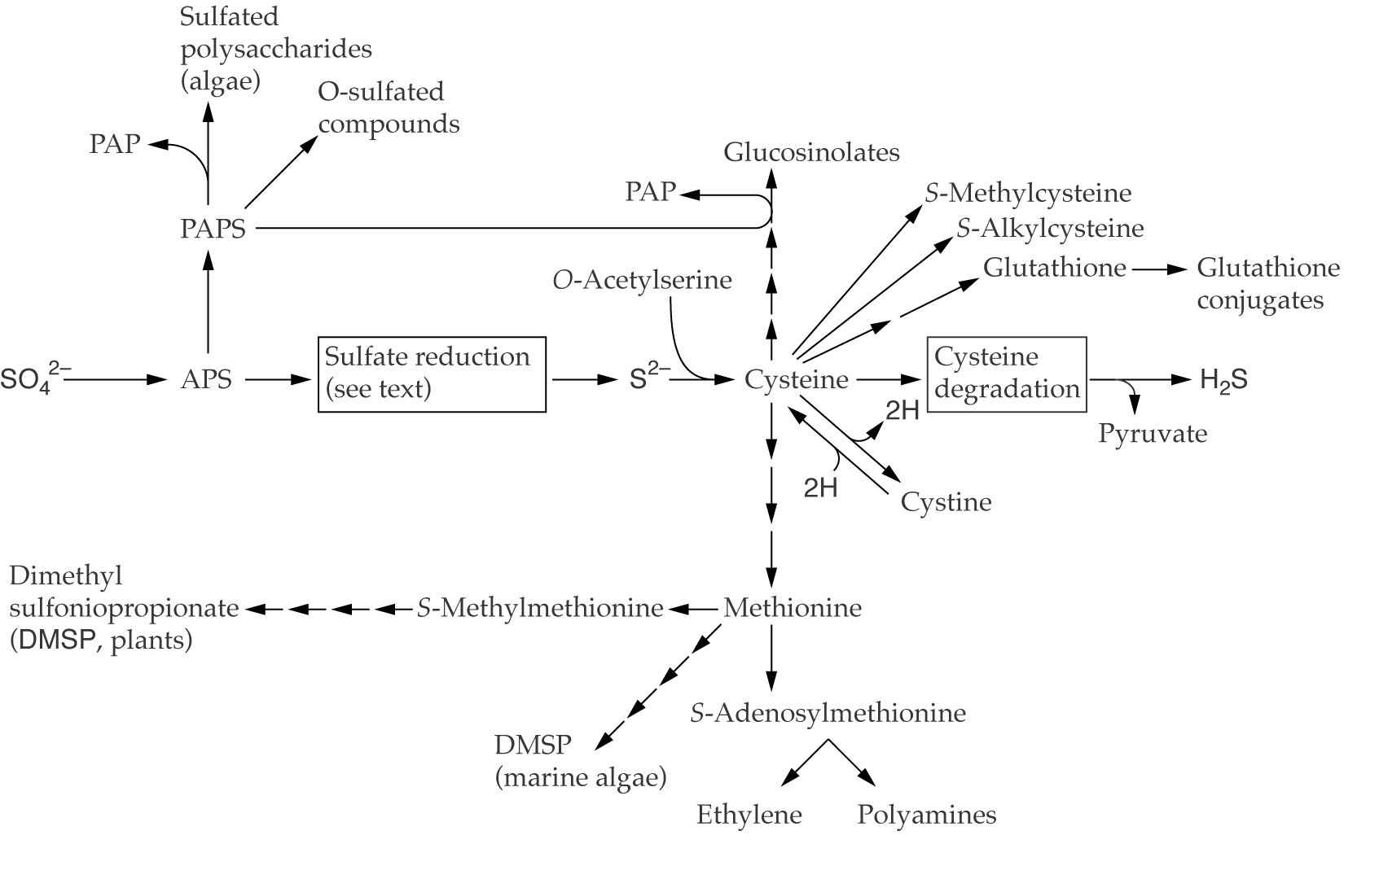
Nutrients
Sulfur
APS – 5-adenylylsulfate
PAPS – 3´phosphoadenosine-5´-phosphosulfate,

Slide 17
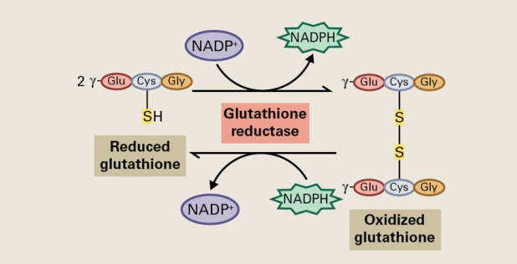
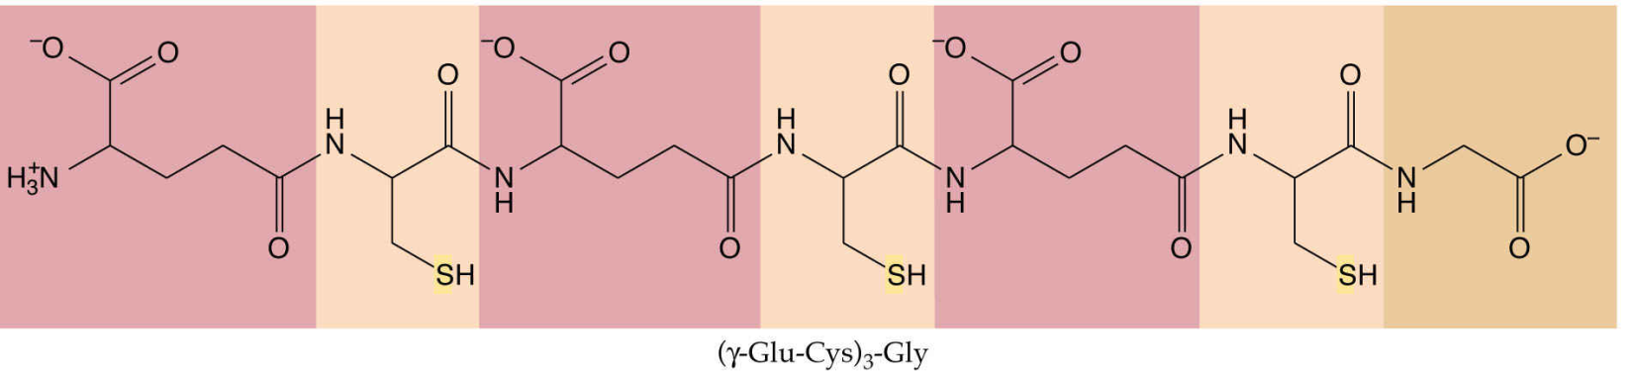
Nutrients
Phytochelatin molecule

Slide 18
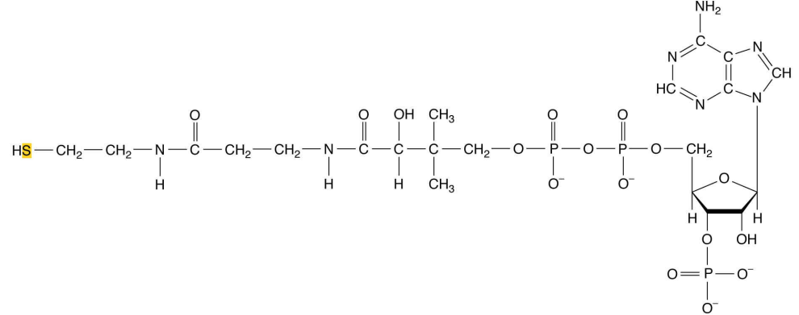
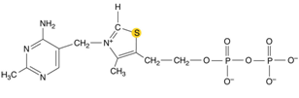
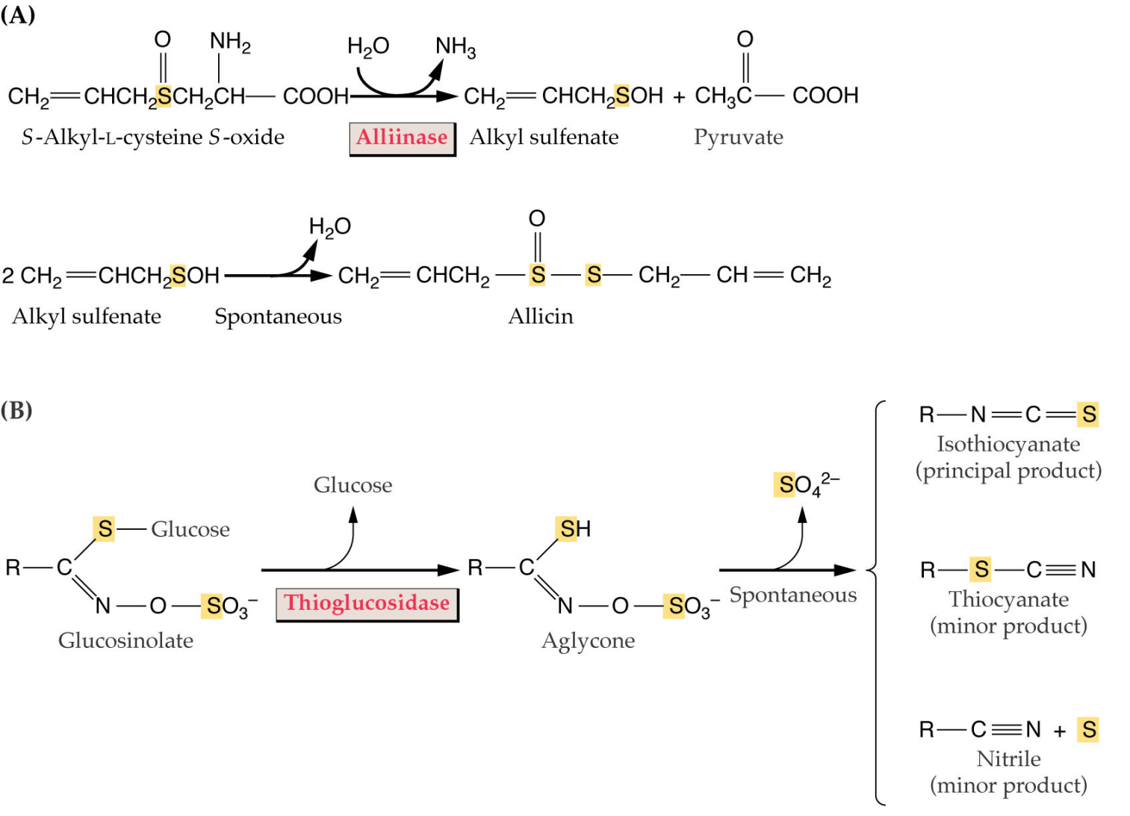
Nutrients
Thiamine pyrophosphate
Coenzyme A

Slide 19
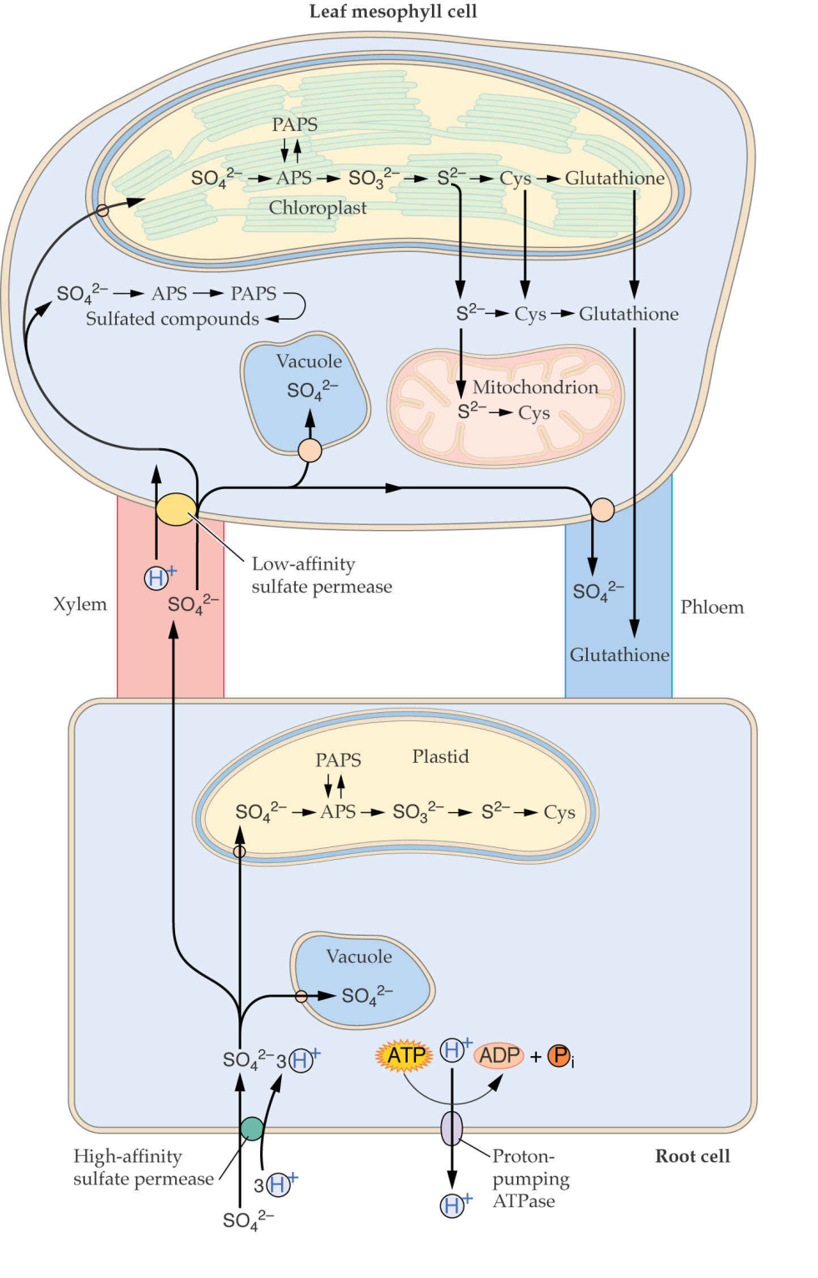
Nutrients

Slide 20
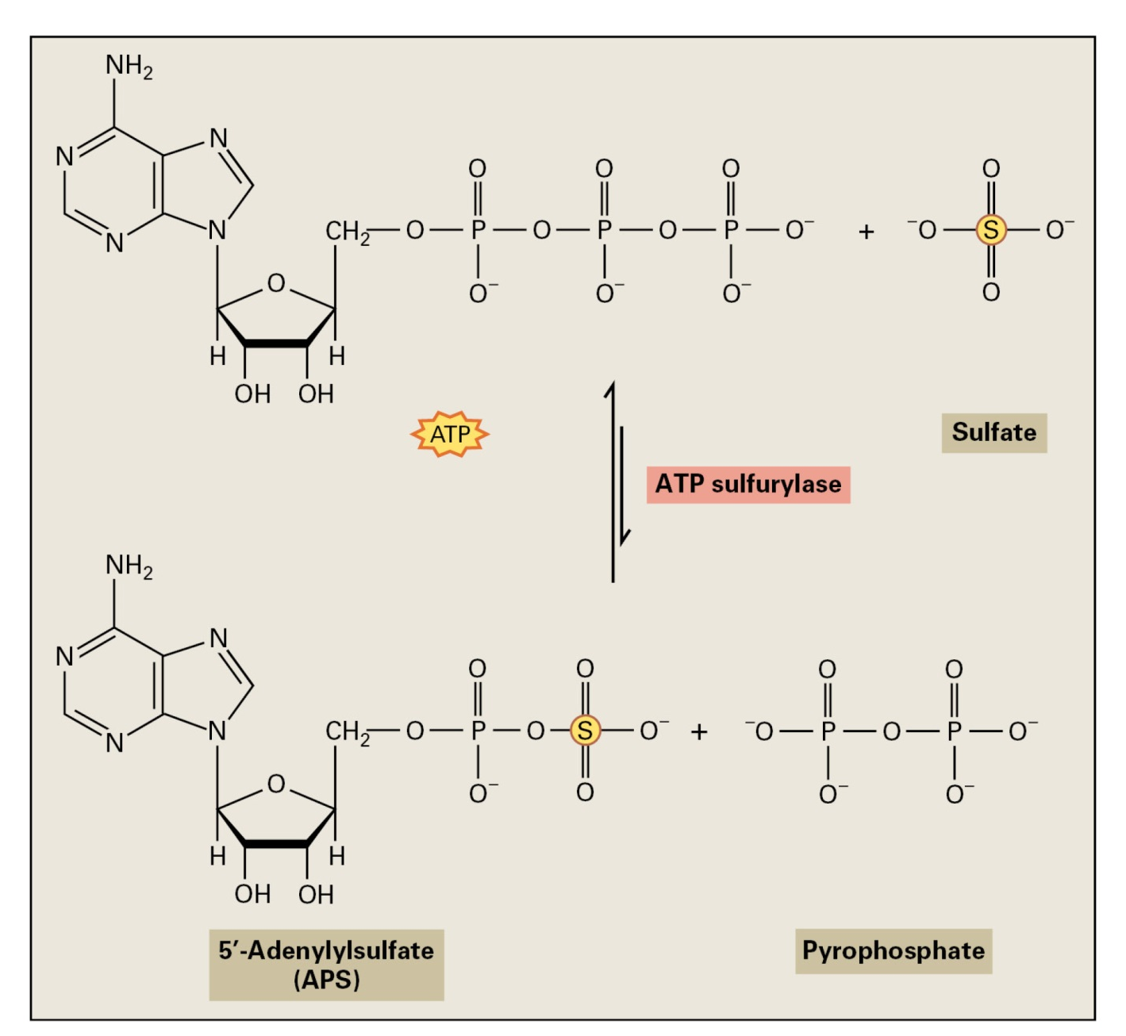
Nutrients
Sulfate activation

Slide 21
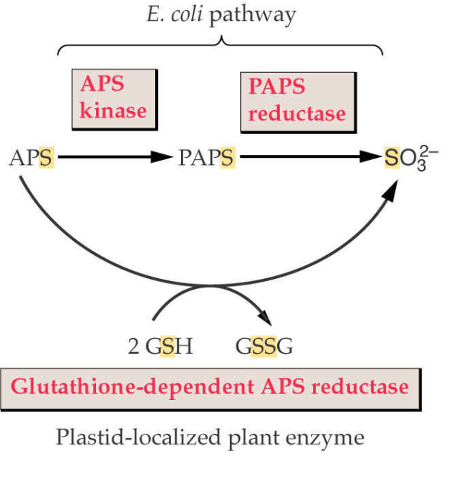
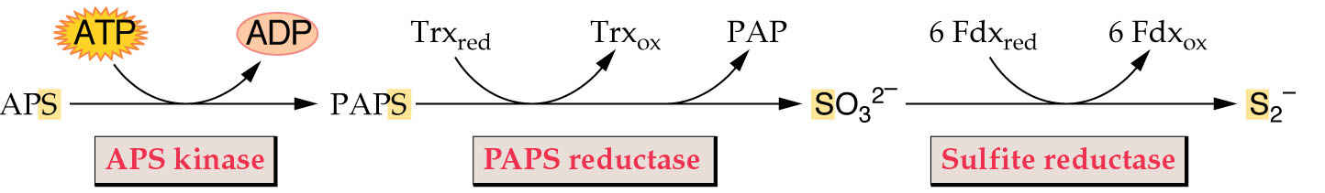
Nutrients
Sulfate reduction to sulfide
Notes:
The sulfate reduction in plants is still a matter of intensive research.
A family of cDNA isolated from Arabidopsis has been shown to encode plastid-localized enzymes with thiol-dependent APS reductase activity
The cDNAs are able to complement APS kinase and PAPS reductase mutants of E. coli, indicating that the enzyme uses APS as a substrate and that free sulfite is produced
The complementation depends on the ability of the E. coli strain to synthesize glutathione, supporting the idea that glutathione is the in vivo reductant in plants
The free sulfite reduction is catalyzed by sulfite reductase found in the plastids
Plant sulfite reductase is a homooligomeric protein, where each subunit contains one siroheme and one iron-sulfur cluster, just like the C-terminal half of nitrite reductase.
And also the sequence of the enzyme is homologous to the C-terminal region of NiR

Slide 22
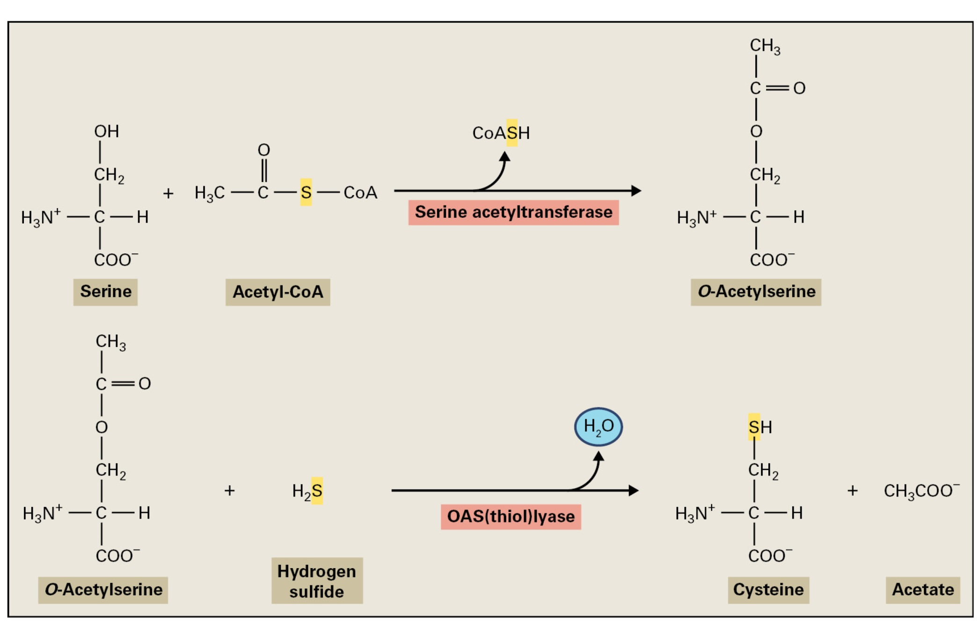
Nutrients
Cysteine synthesis
Notes:
Cysteine is synthesized from serine by the combined activities of serine acetyltransferase and O-acetylserine(thiol)lyase
First, O-acetylserine is formed from serine and acetyl-CoA
There are several sources of acetyl-CoA in plants, e.g. by the action of pyruvate dehydrogenase that generates acetyl-CoA and CO2
OAS and the sufide ion then react to form cysteine
O-acetylserine(thiol)lyase contains pyridoxal phosphate as a prosthetic group

Slide 23
Nutrients
Regulation of sulfate assimilation
Sulfur assimilation is not strongly regulated by light
the enzymes are also active in etiolated plants and do not demonstrate diurnal oscillations
Sulfur assimilation is regulated by developmental stage
all the enzymes are highly active in young leaves and root tips
Sulfur assimilation is regulated in response to the availability of sulfur
sulfur starvation results in the up-regulation of sulfate transport and APS reductase
The content of reduced sulfur and nitrogen is strictly coordinated
Sulfite and sulfide are not allowed to accumulate
Notes:
The regulation is very different from regulation of nitrate or carbon assimilation
First, sulfur assimilation is not strongly regulated by light: although the activities of the sulfur assimilation enzymes increase severalfold when dark-grown plants are illuminated, these enzymes are also active in etiolated plants and do not demonstrate diurnal oscillations in activity (in contrast, nitrate reductase and Rubisco are not expressed in etiolated plants)
Sulfur assimilation is regulated by developmental stage: all the sulfur assimilation enzymes are highly active in young leaves and root tips and decline markedly in older tissues (in young actively growing tissues is actually a high demand for cysteine and methionine for protein synthesis)
Just as N-assimilating enzymes are regulated by nitrogen availability, sulfur assimilation is regulated in response to the availability of sulfur, but differently: sulfur starvation results in the up-regulation of sulfate transport and APS reductase.
What is the product of APS reductase-catalysed reaction?
Keeping the activity of APS reductase low, except of the case of sulfur starvation, makes sense, because the intermediates of this pathway, i.e. sulfite and sulfide, are toxic and must not be allowed to accumulate.
Sulfur assimilation is coordinated with the rate of nitrogen assimilation and with the growth rate so that the content of reduced sulfur and nitrogen in plants is strictly maintained at a ratio of 1:20

Slide 24
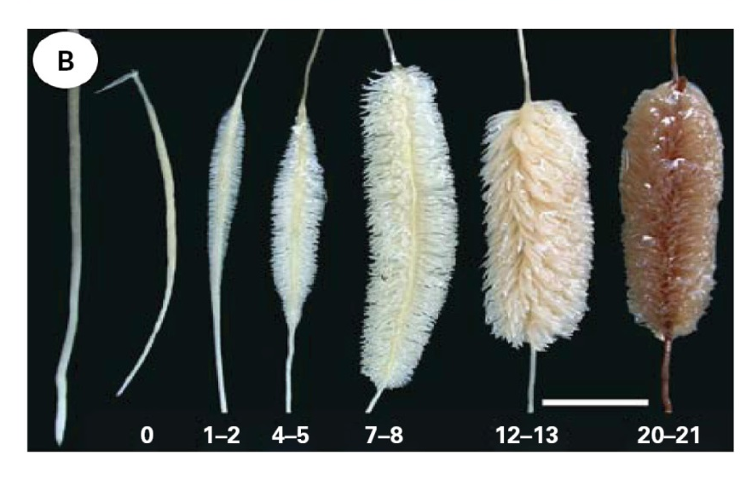
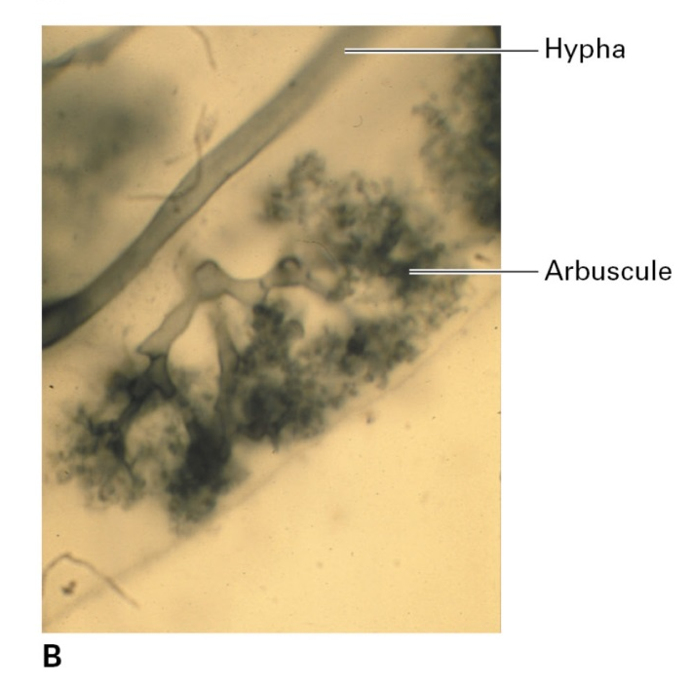
Nutrients
Phosphorus
Root modifications in low Pi concentration
Phosphate functions:
component of nucleic acids and phospholipids
energy conversion (ATP)
regulation
Endomycorrhizae
Notes:
P can exist in plants as both inorganic phosphate anions and organophosphate compounds. Unlike nitrate and sulfate, phosphate is not reduced in plants during assimilation, but instead remains in its oxidized state, forming phosphate esters. Phosphate constitutes an important structural component of nucleic acids and phospholipids, plays a critical role in energy conversion, and is an important factor in regulation and signal transduction by way of protein phosphorylation.
Because of its low solubility, phosphate is relatively unavailable to plant roots. Hence, P supply is one of the major constraints of plant growth. Therefore, roots exhibit an impressive plasticity and can modify their structure to obtain soil P that would be otherwise unavailable.
A wide range of plant species create mycorrhizal associations to enhance the P absorption, the so-called endomycorrhizae. These soil fungi form extensive hyphal networks in the soil to acquire Pi. Within root cortical tissues, they form branched haustoria called arbuscules that exchange the solutes with the host plant. Arbuscules are in intimate associations with the plasma membrane but do not penetrate the cell.
Further, roots can release phosphatases to release organically bound P from the soil.

