Slide 1
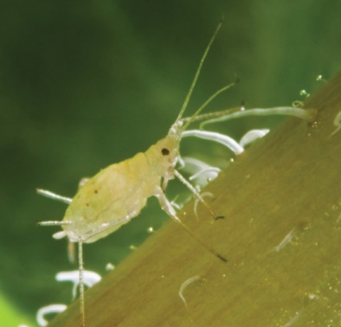
Responses to stress
Katerina Dadakova, Department of Biochemistry
1
Figures adopted from Buchanan et al., Biochemistry & molecular biology of plants

Slide 2
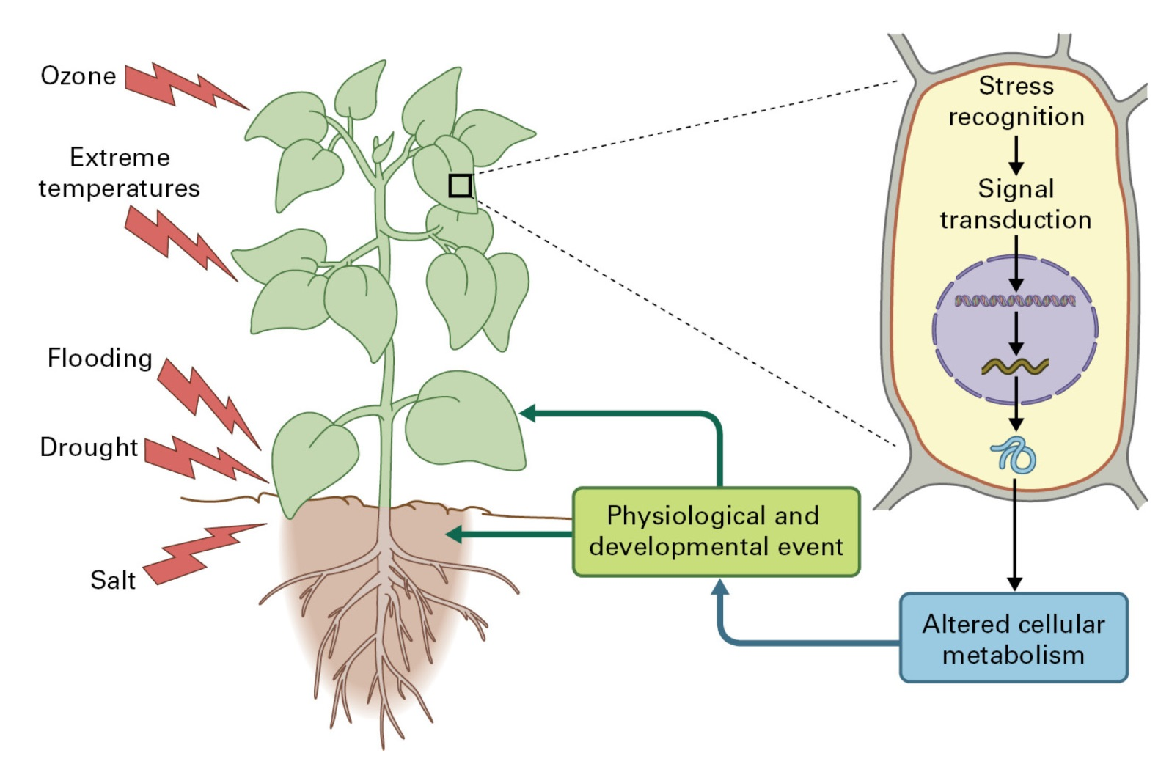
Responses to stress
Pathogens and pests

Slide 3
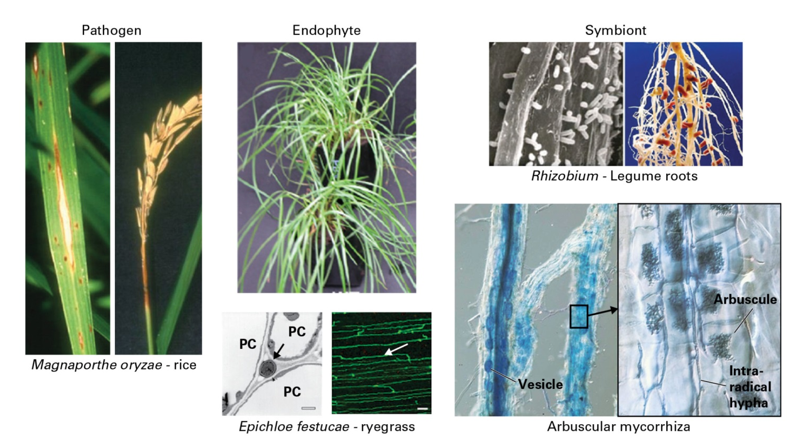
Responses to stress
Plant-microbe interactions

Slide 4
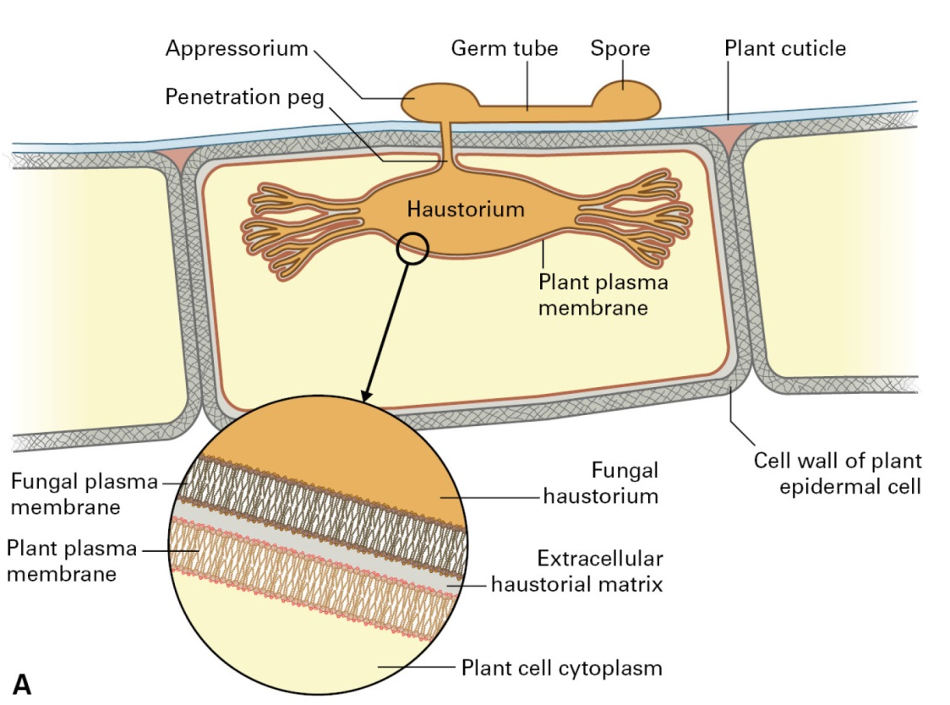
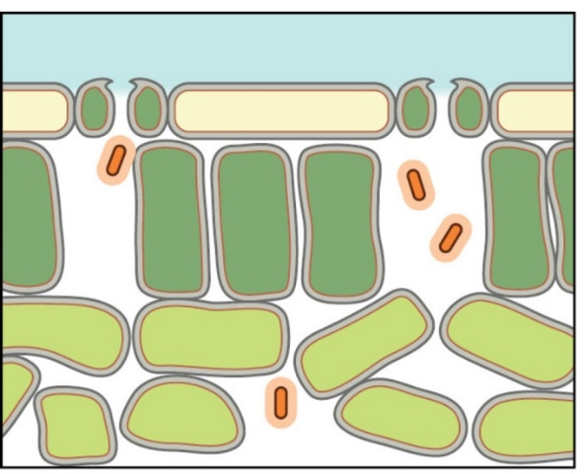
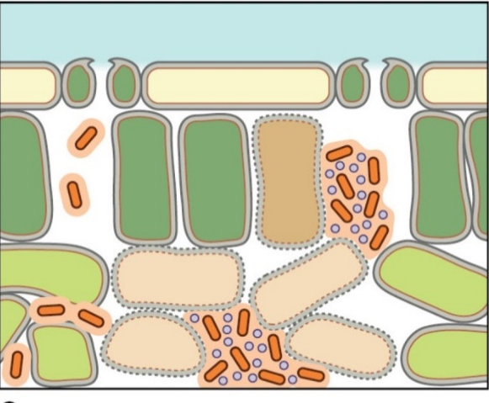
Responses to stress
Pathogens
Necrotrophy
Biotrophy
Hemibiotrophy
Pathogenic bacteria often enter the leaves through stomata, and produce effector molecules only at higher density of bacterial population, leading to the death of plant cells.
Biotrophic fungi usually form haustoria

Slide 5
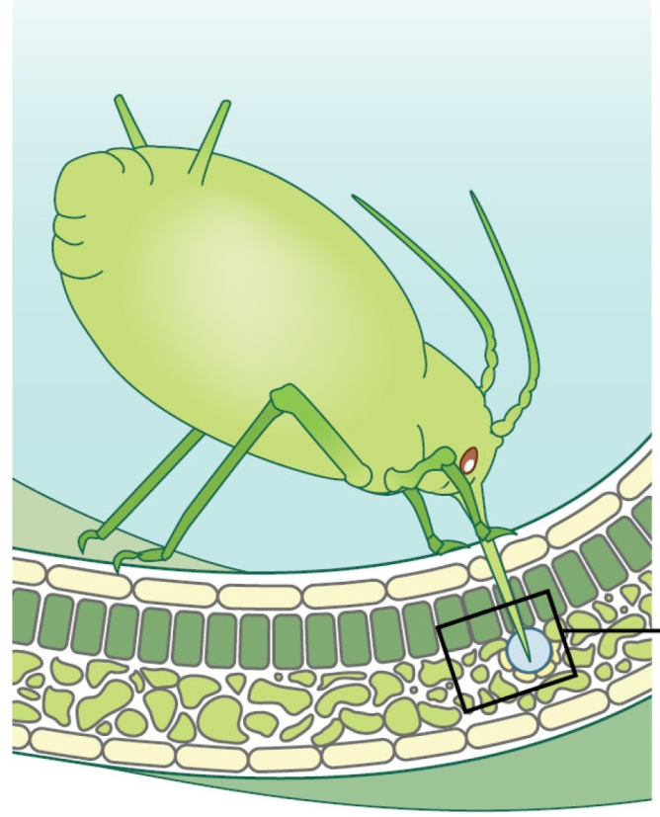
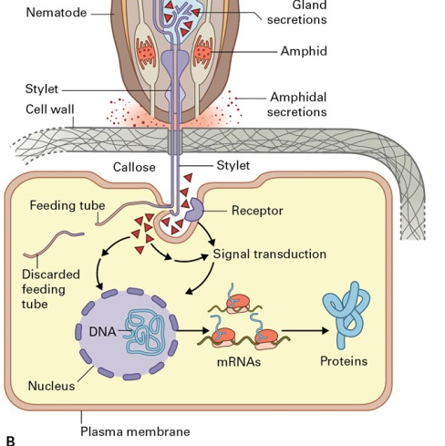
Responses to stress
Pests
Aphids locate and penetrate the phloem sieve elements, and remove the sap
Plant-nematode interaction

Slide 6
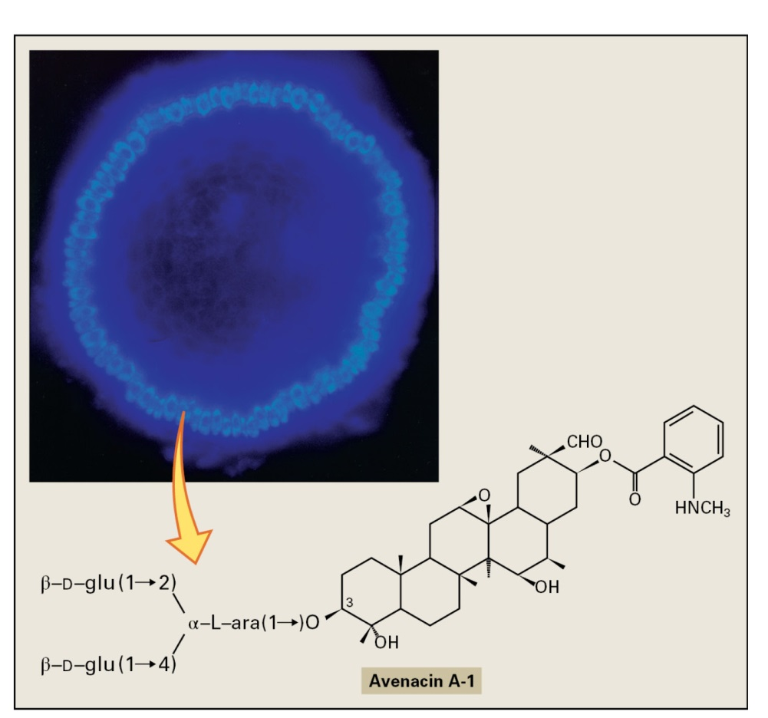
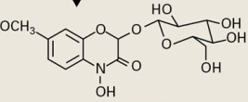
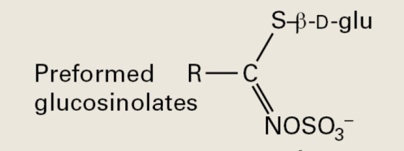
Responses to stress
Preformed defenses
Benzoxazinoid metabolite
Saponin
Glucosinolate

Slide 7
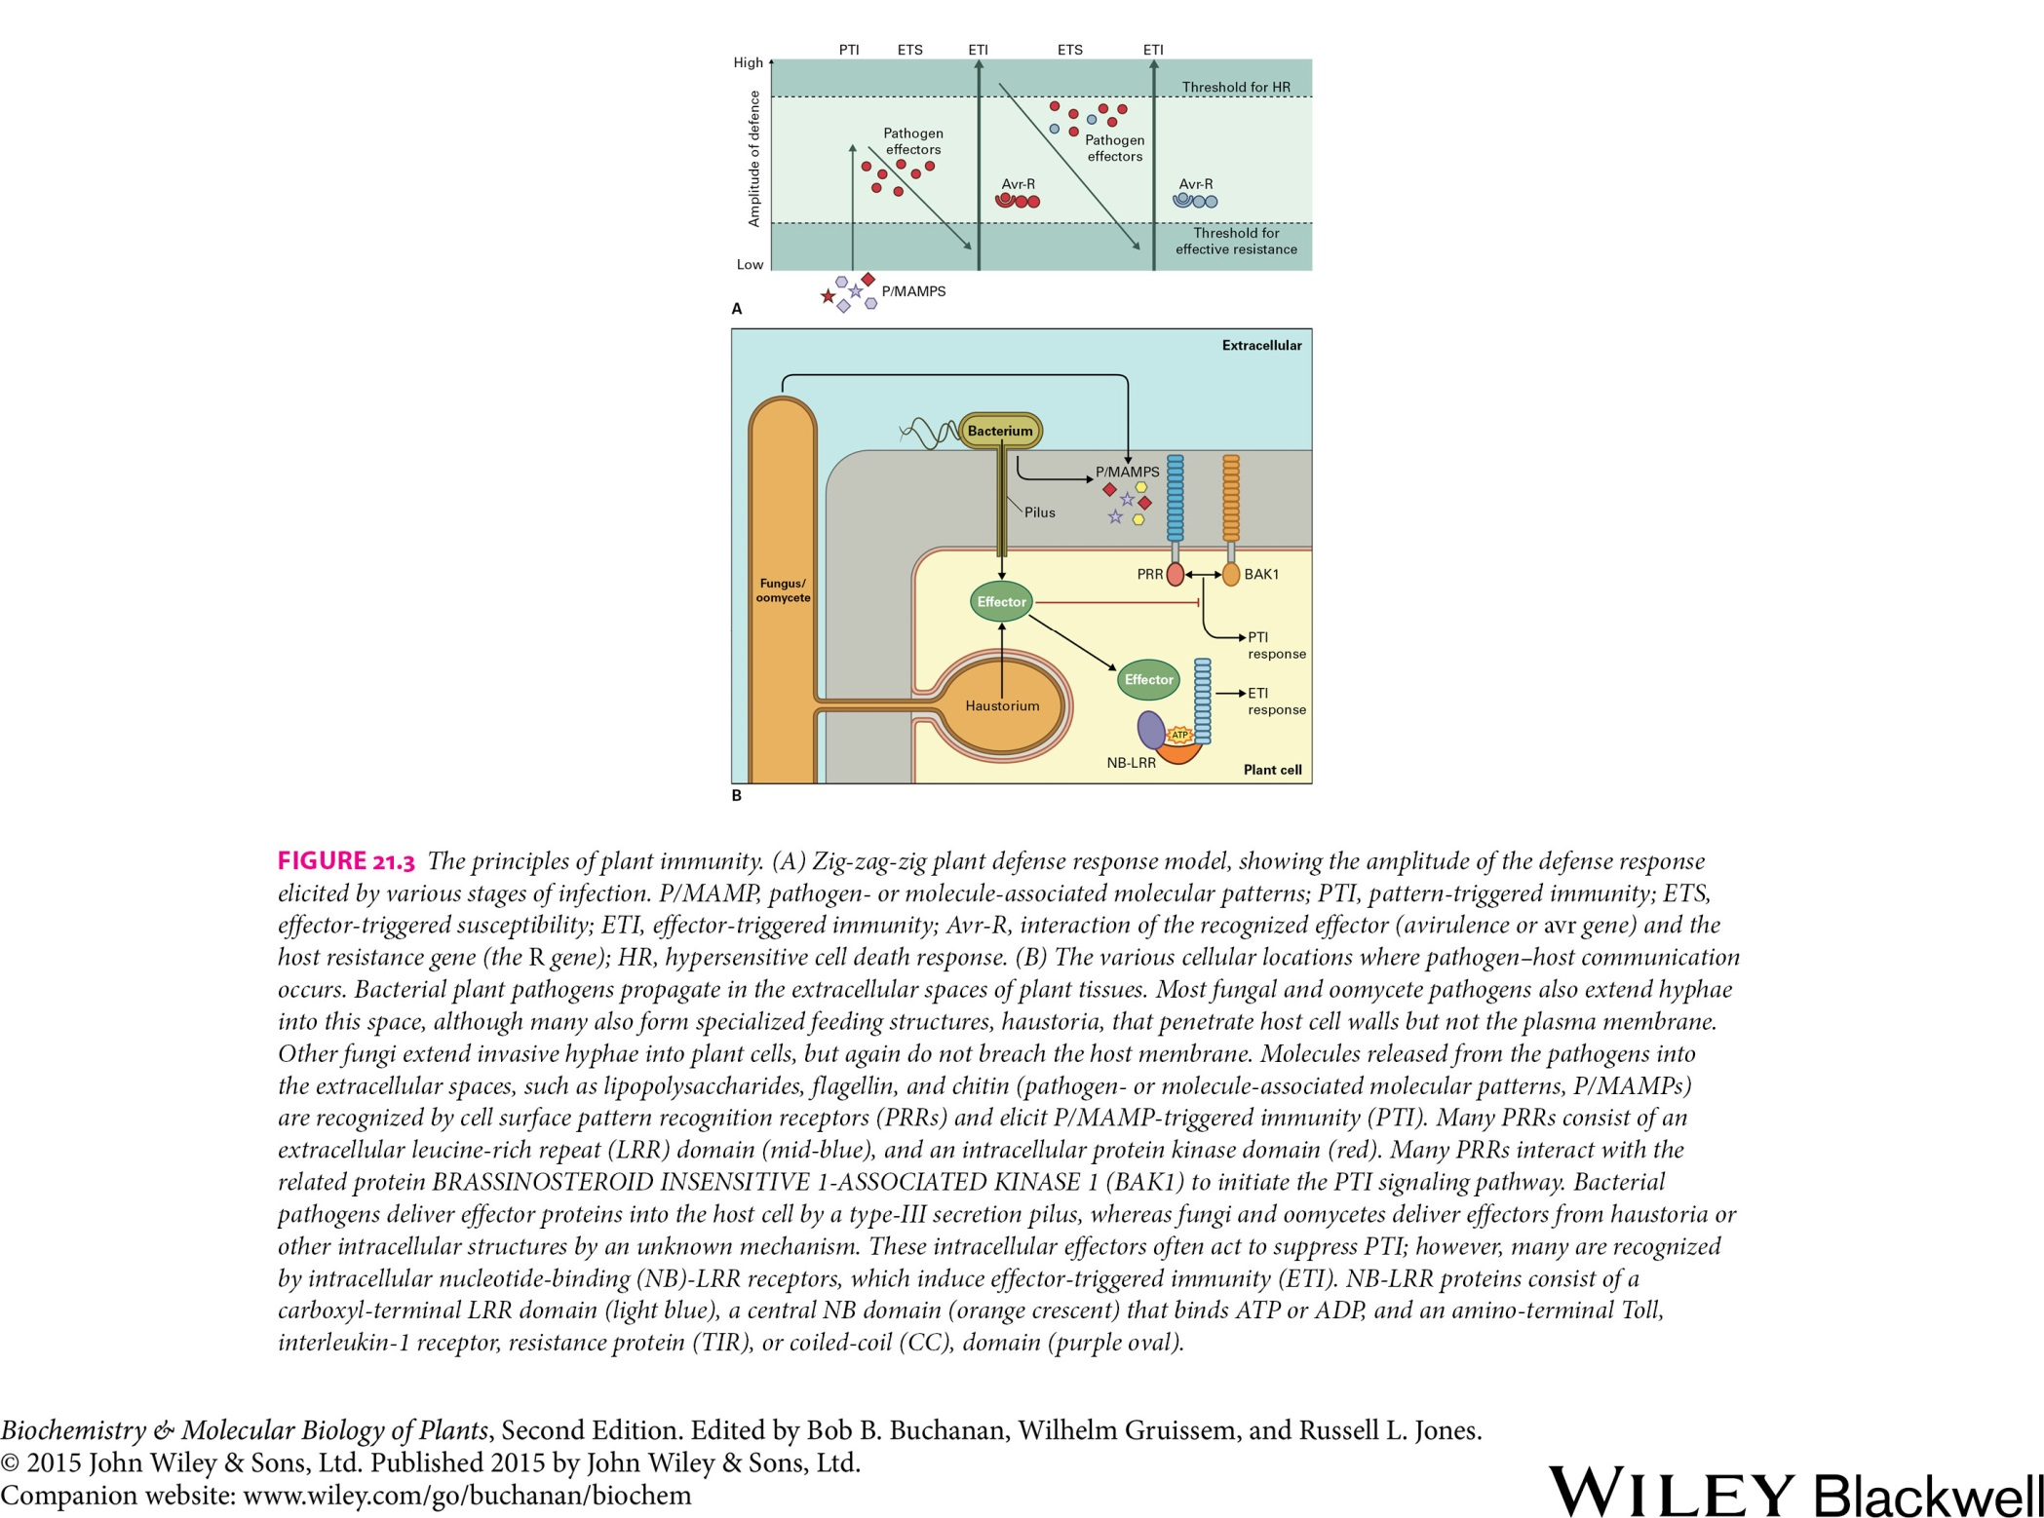
Responses to stress
Plant immunity

Slide 8
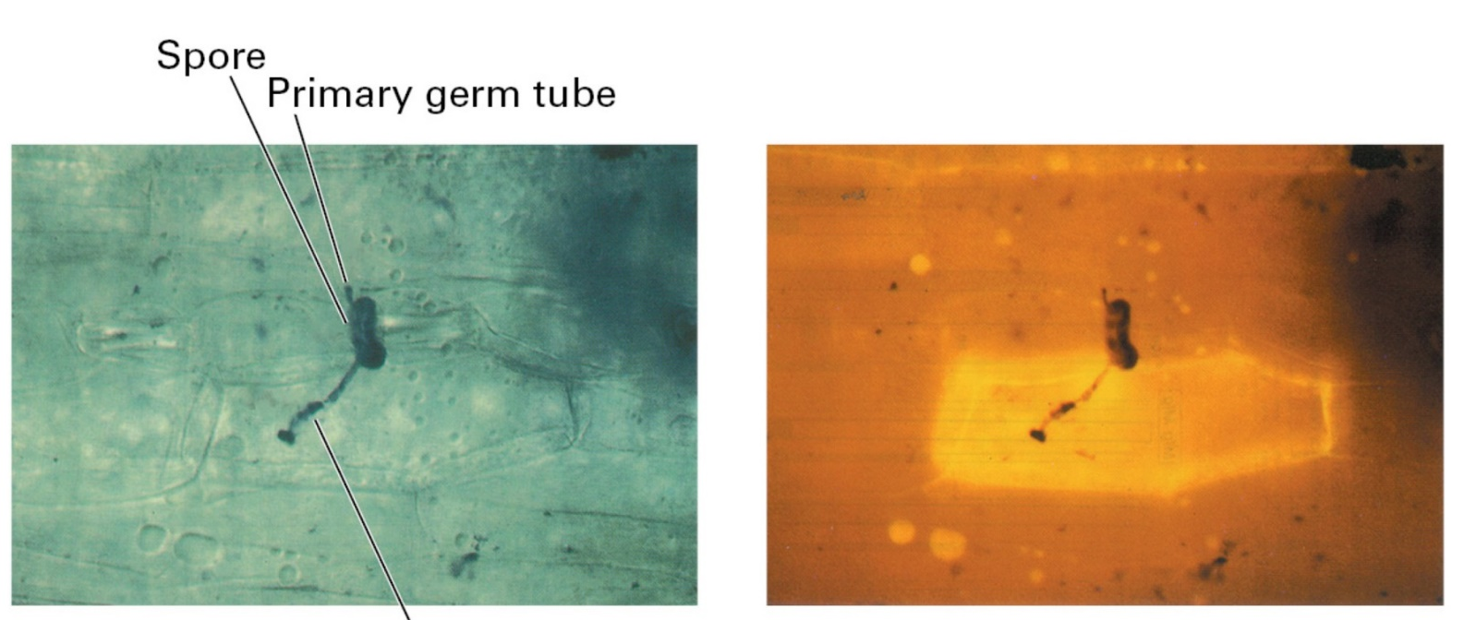
Responses to stress
Plant immunity
Zig-zag model of the plant defense response
The hypersensitive cell death response

Slide 9
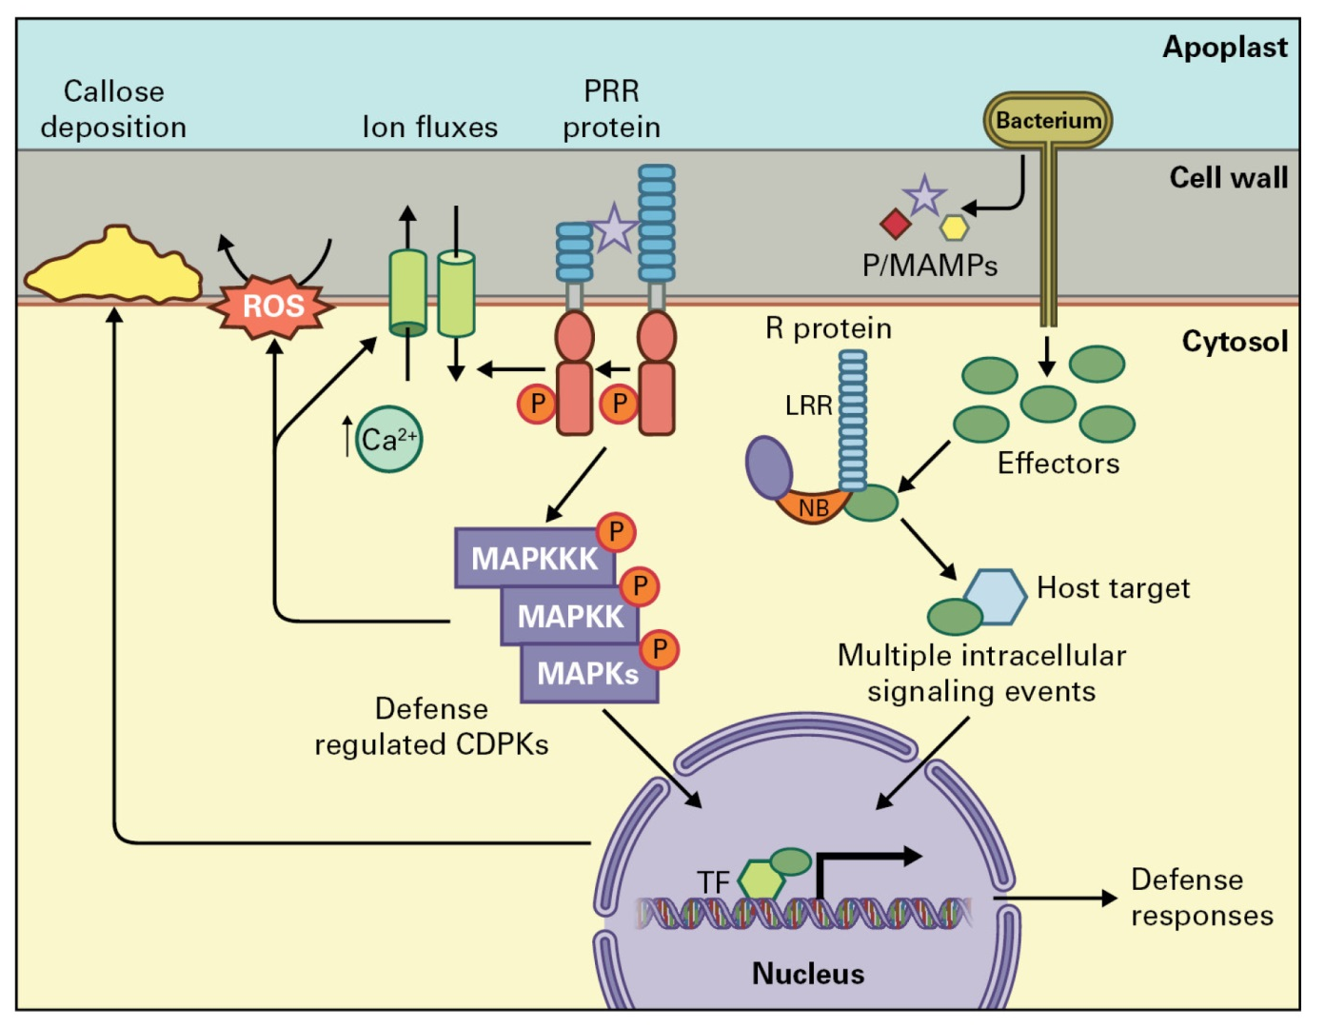
Responses to stress
Induced defenses

Slide 10
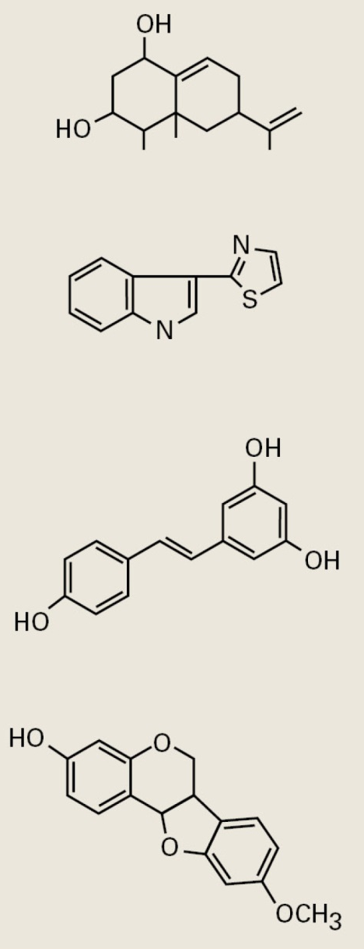
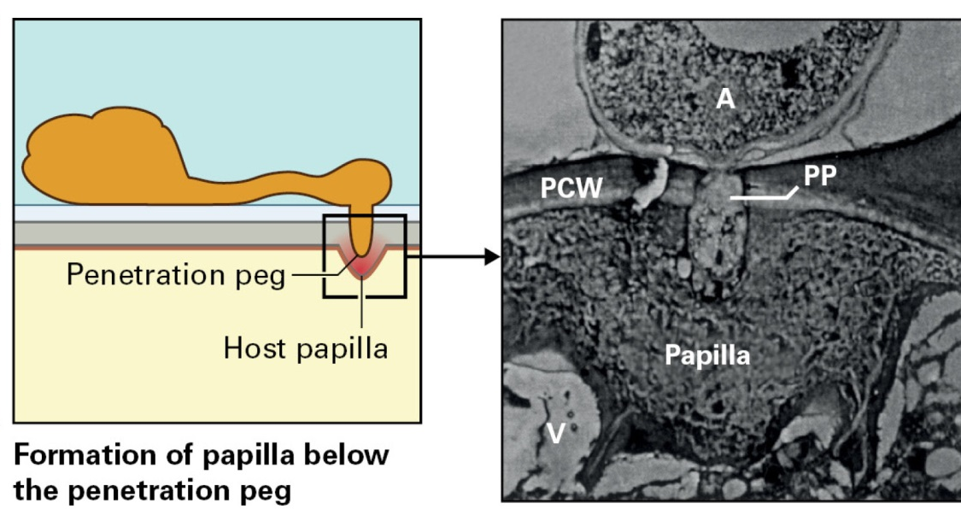
Responses to stress
Induced defenses
Capsidiol
Camalexin
Resveratrol
Medicarpin

Slide 11
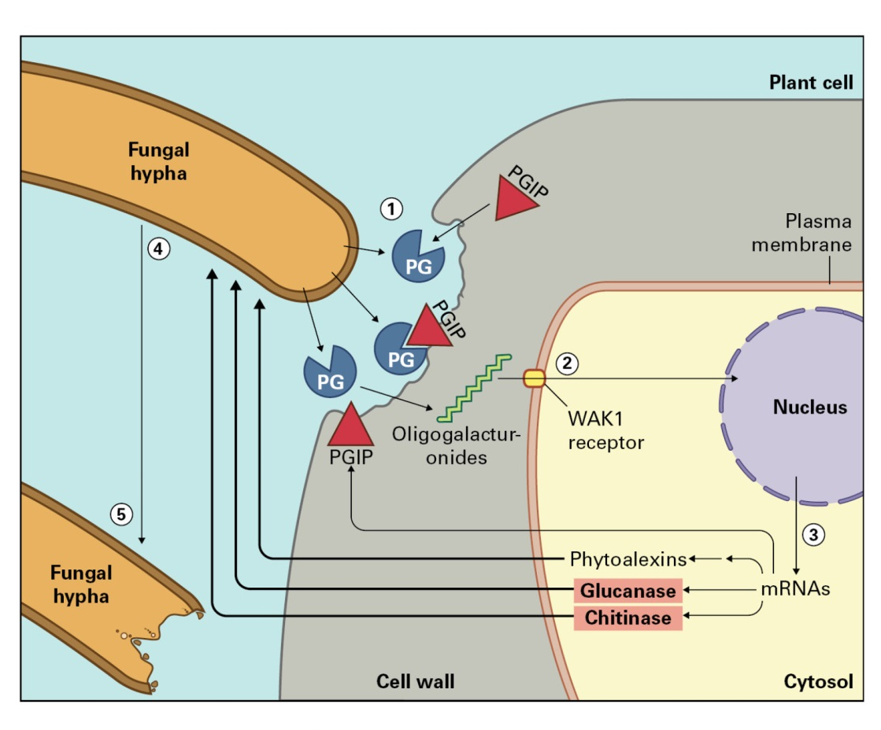
Responses to stress
Induced defenses

Slide 12
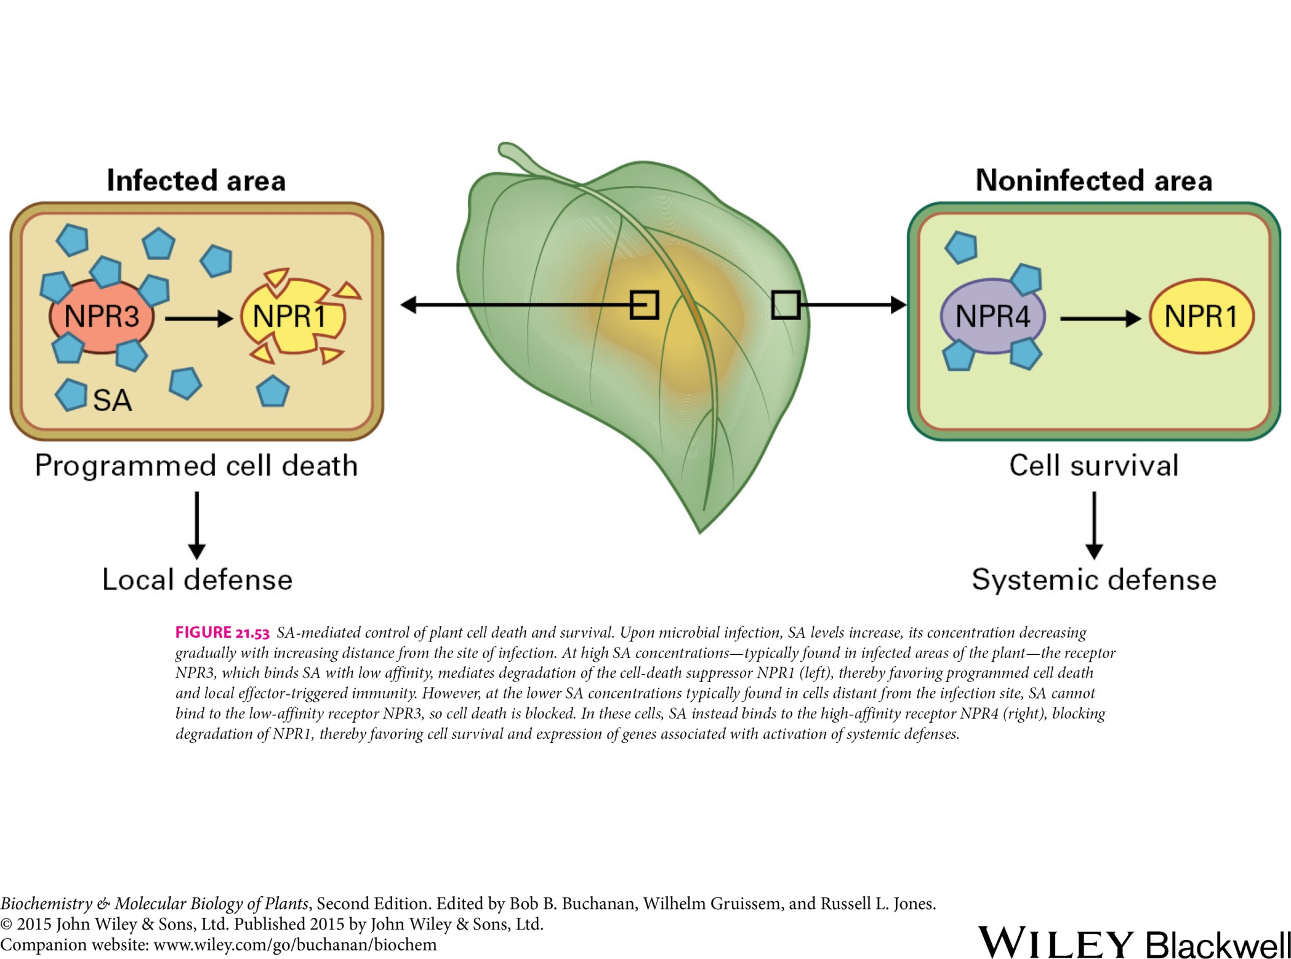
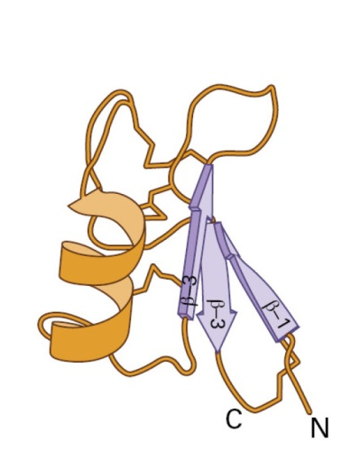
Responses to stress
Systemic defenses
Defensin accumulation is controlled by a combination of JA and ethylene.

Slide 13
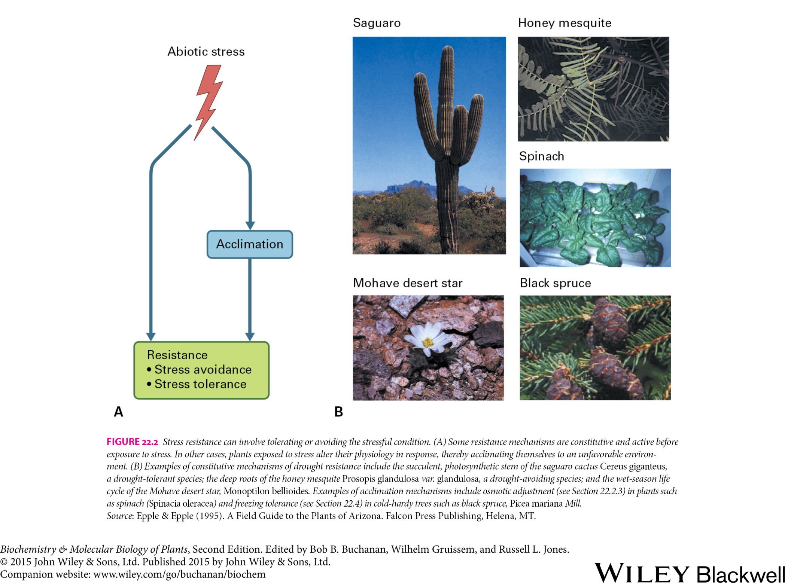
Responses to stress
Abiotic stress

Slide 14
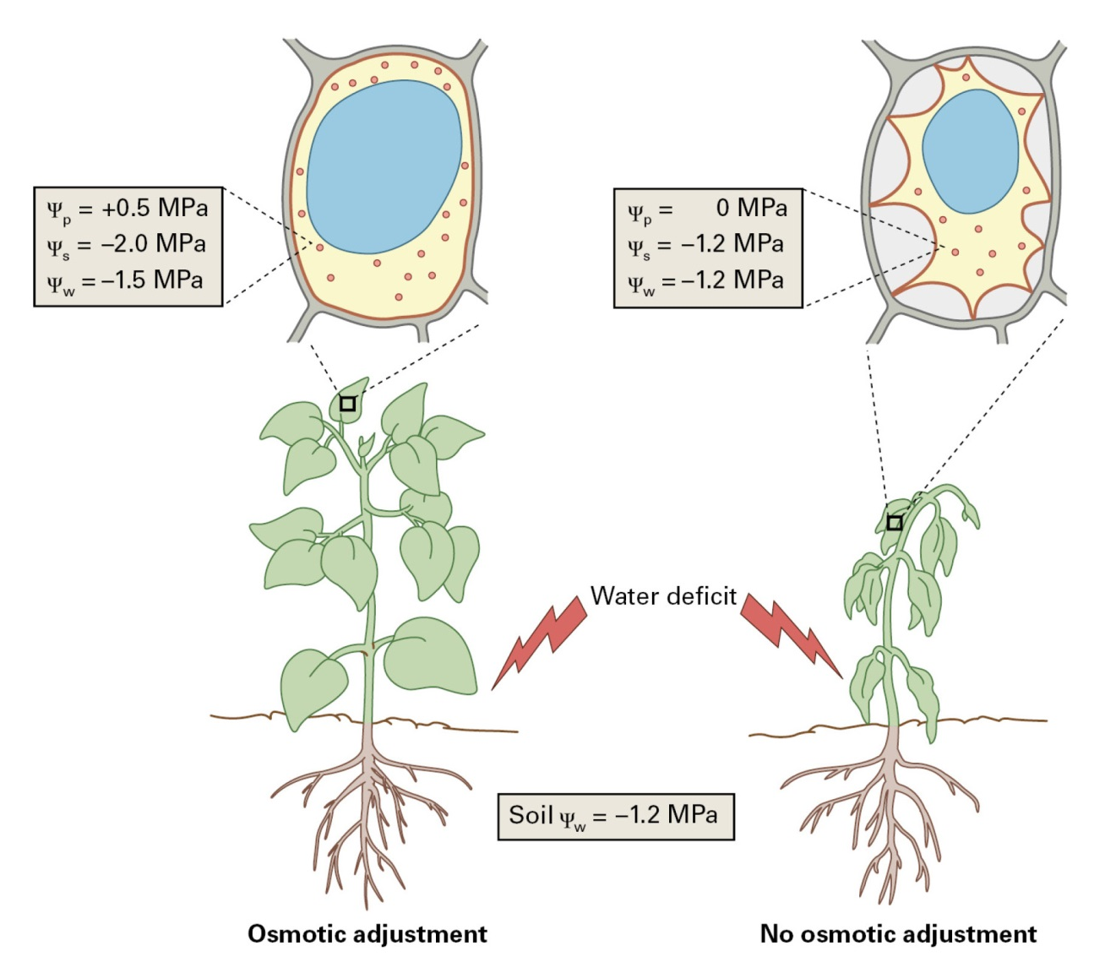
Responses to stress
Water deficit

Slide 15
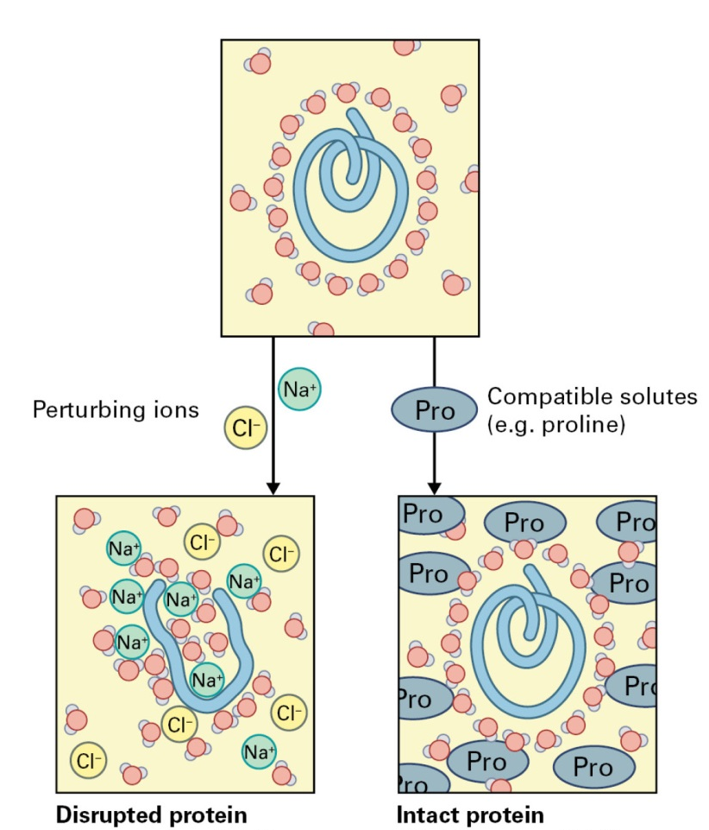
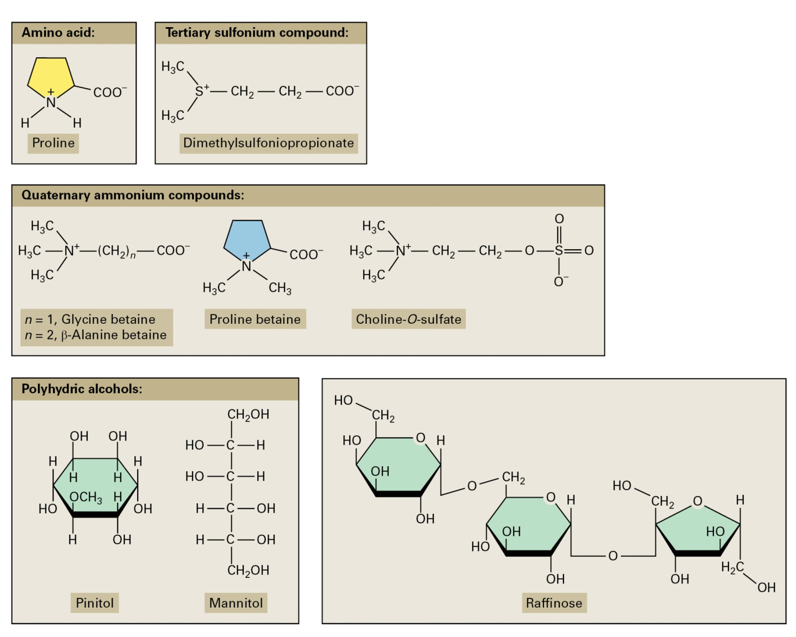
Responses to stress
Compatible solutes

Slide 16
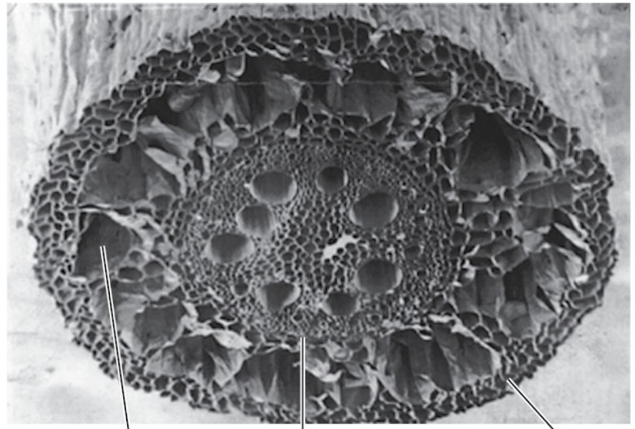
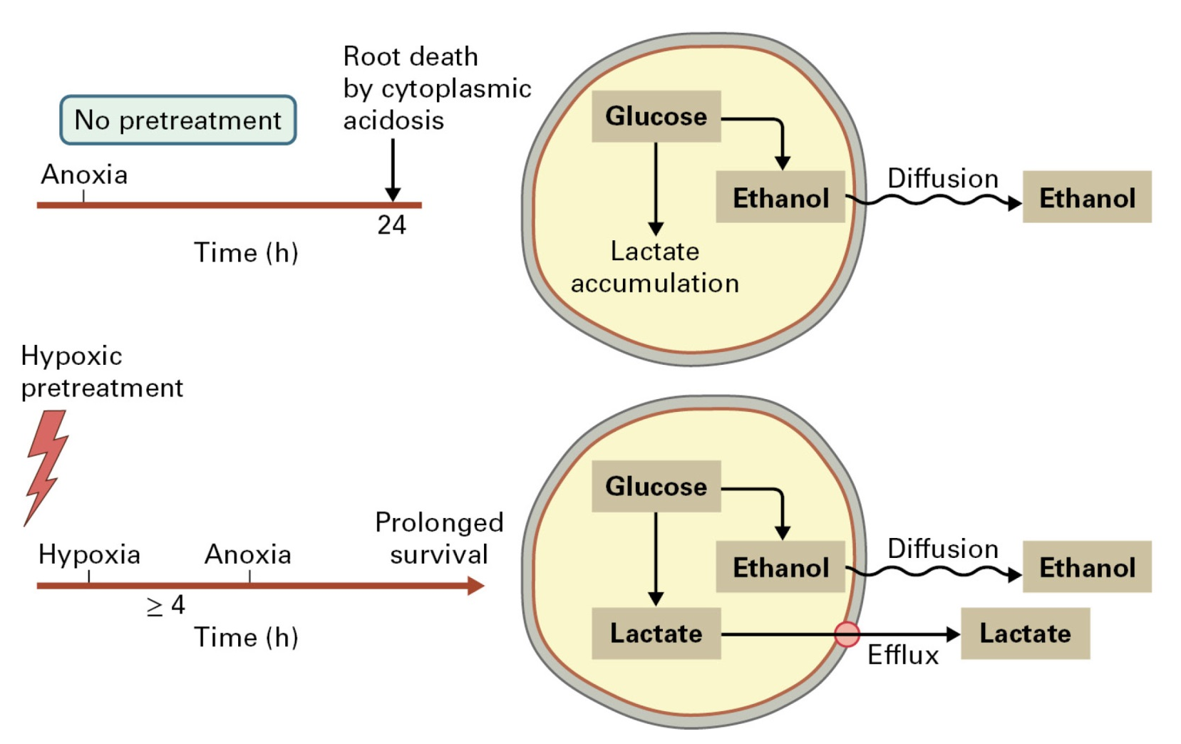
Responses to stress
Flooding and oxygen deficit
Aerenchyma

Slide 17
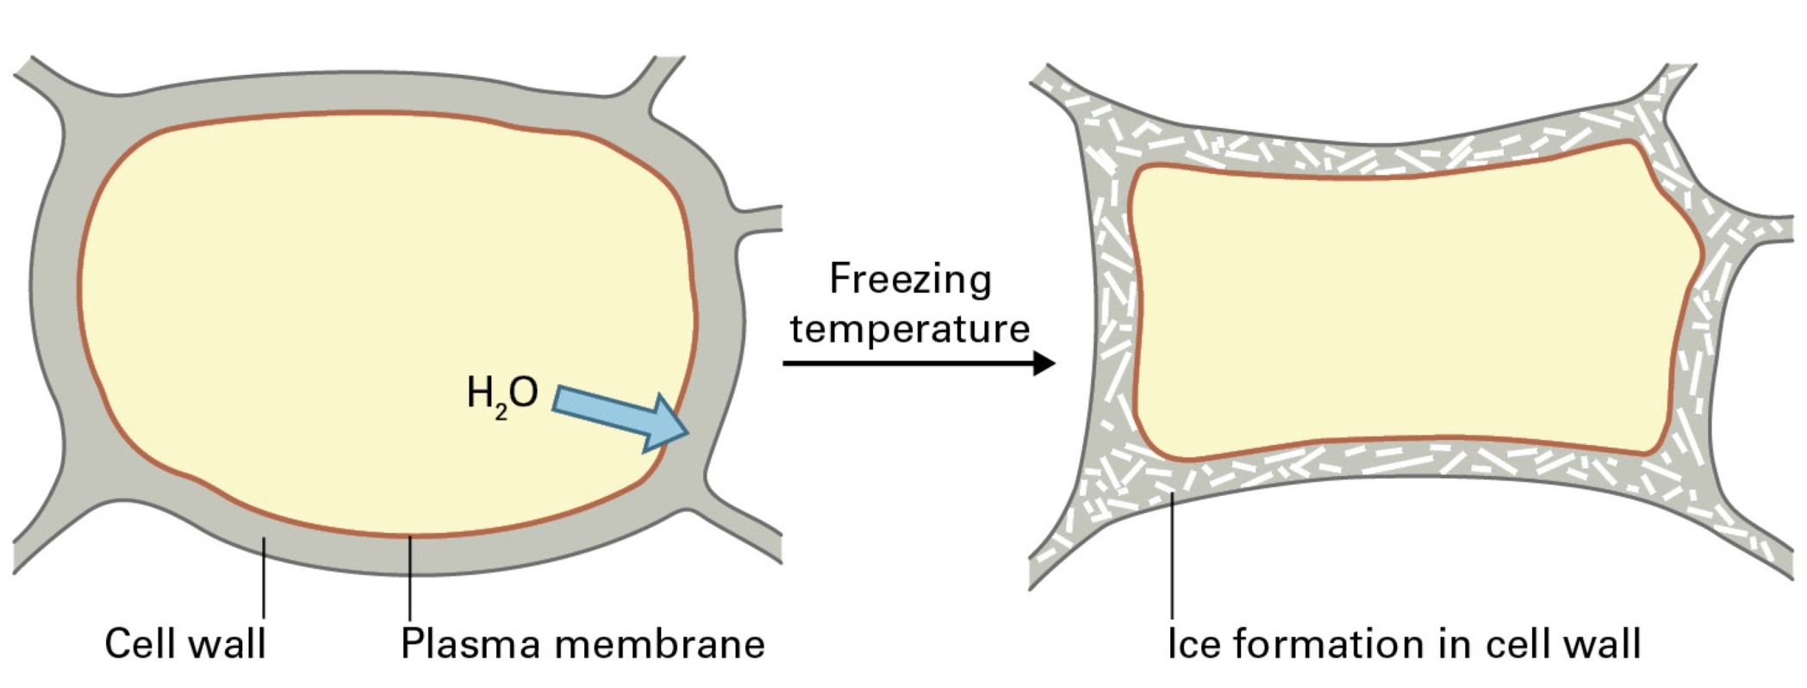
Responses to stress
Low temperatures
Detrimental effects
membrane solidification
reductions in enzymatic reaction rates
dehydration (freezing)
mechanical stress (freezing)
Acclimation
membrane stabilization
compatible solutes

Slide 18
Responses to stress
High temperatures
Protein classes | Size (kDa) | Major functions
HSP 100 | 100-114 | Protein disaggregation, unfolding, degradation
HSP90 | 80-94 | Maturation of signaling molecules
HSP70 | 69-71 | Prevention of aggregation, assisting refolding, protein import and translocation, signal transduction, transcriptional activation
HSP60 | 60 | Folding, assisting refolding
Small HSP | 15-30 | Prevention of aggregation, stabilization of nonnative proteins

Slide 19
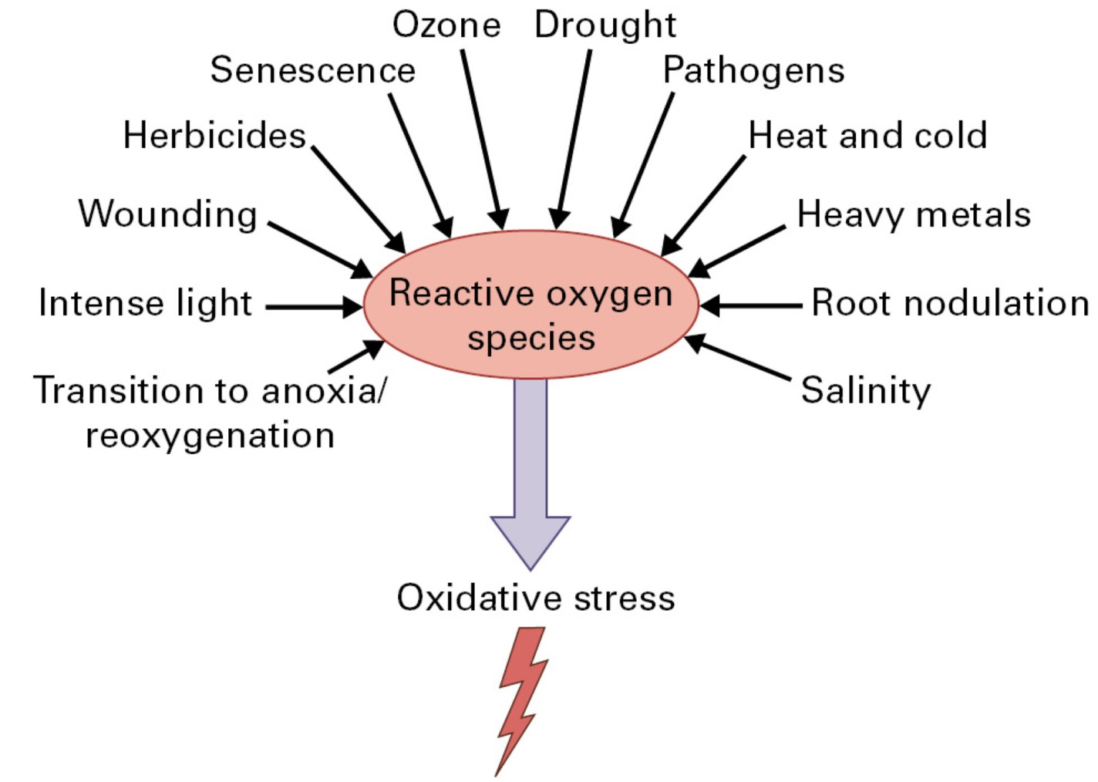
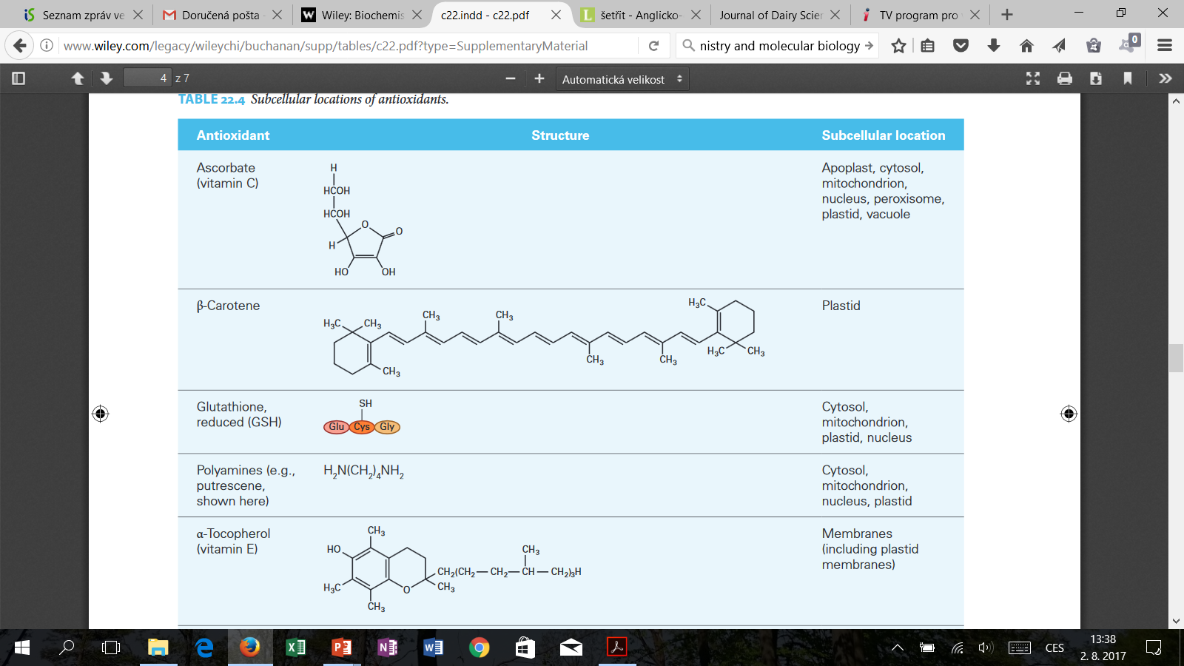
Responses to stress
Oxidative stress
H₂O₂, O₂^{.-}, HO^{.-}

Slide 20
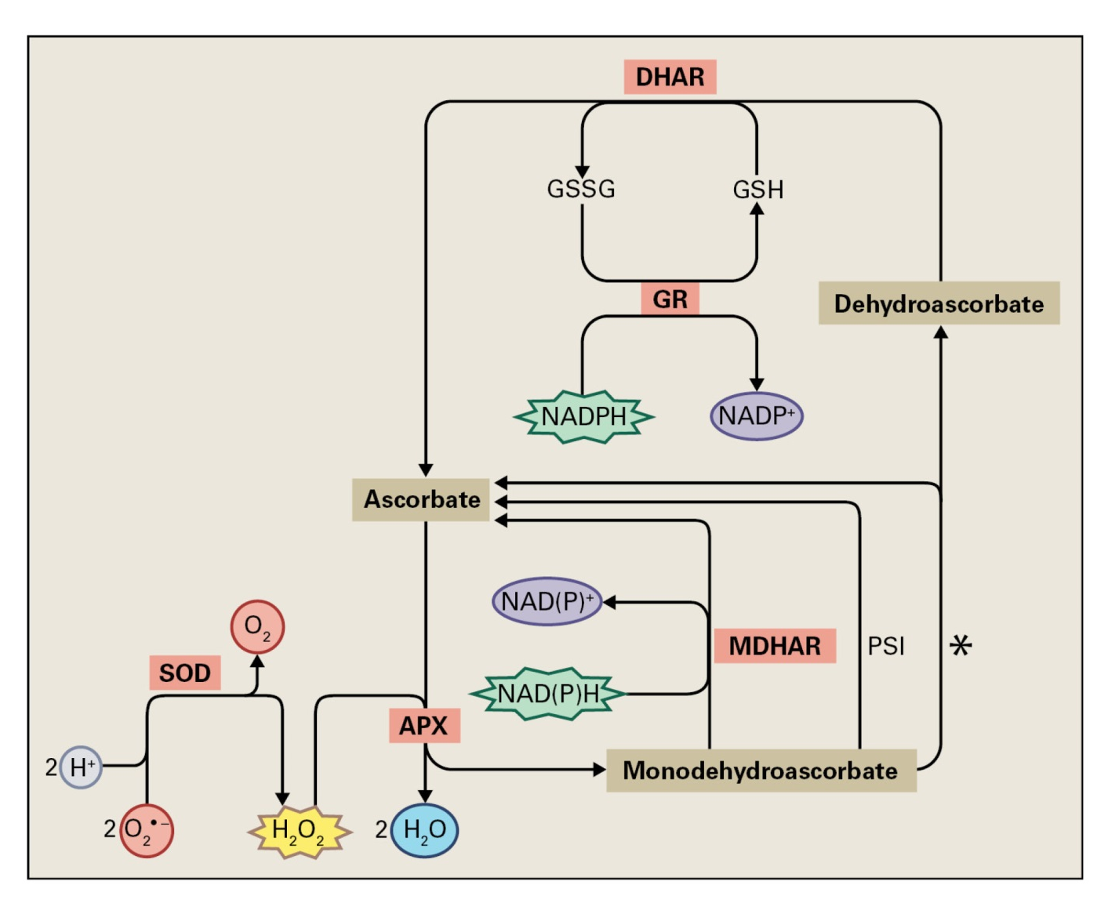
Responses to stress
Ascorbate-glutathione cycle

