Slide 1
Tracing the origin of cave sands:
State of the art in the Moravian Karst
Jiří Otava

Slide 2
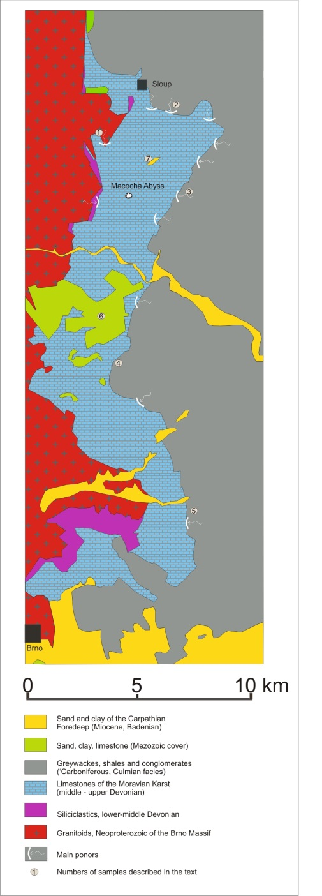
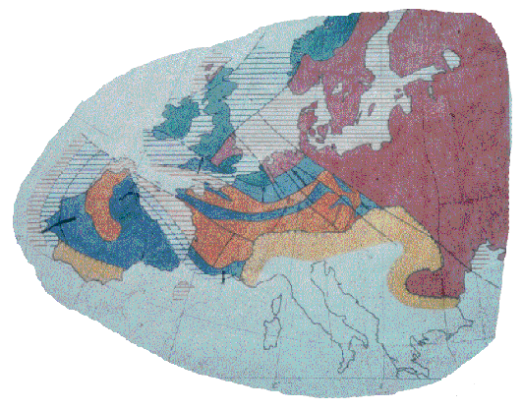
Variscan Europe and Moravian Karst, Czech Republic

Slide 3
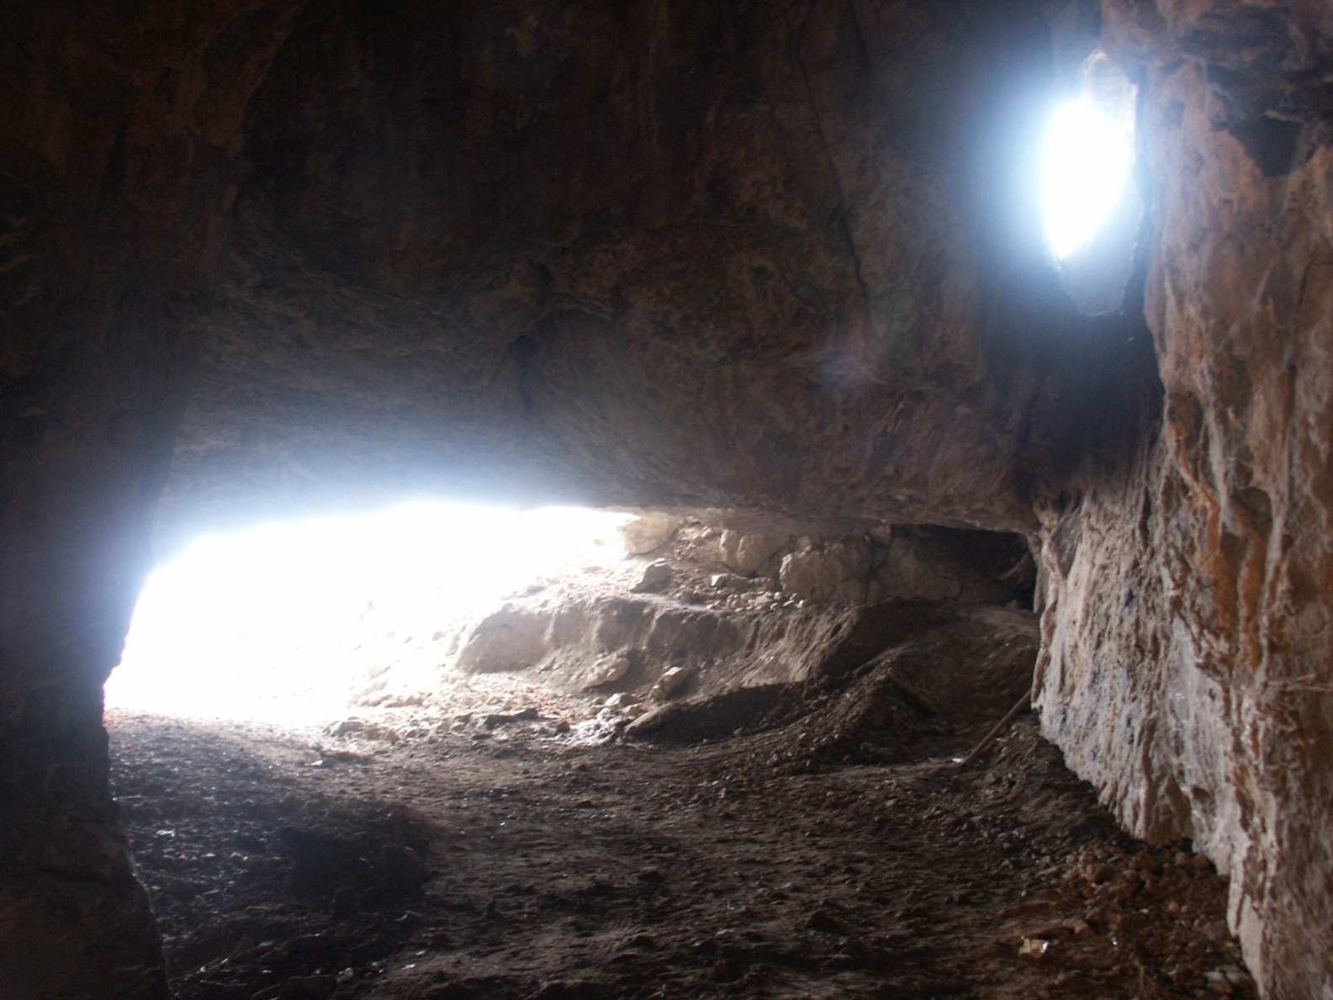
…it is very easy to know the provenance of cave sands near the ponor…

Slide 4
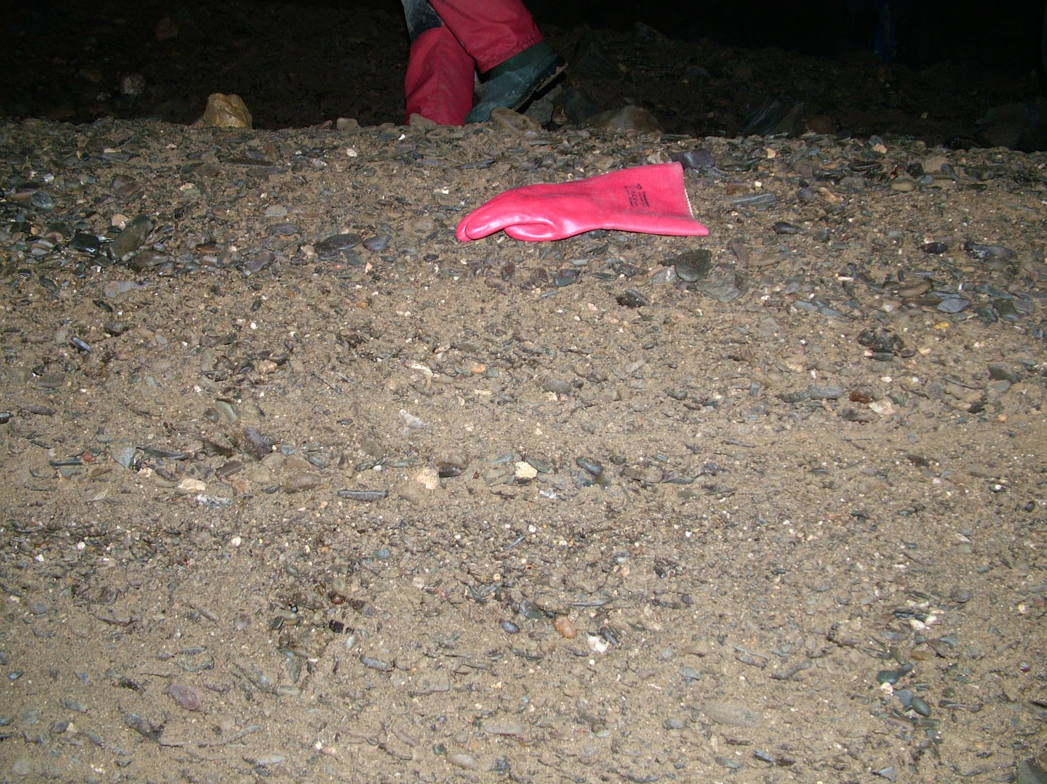
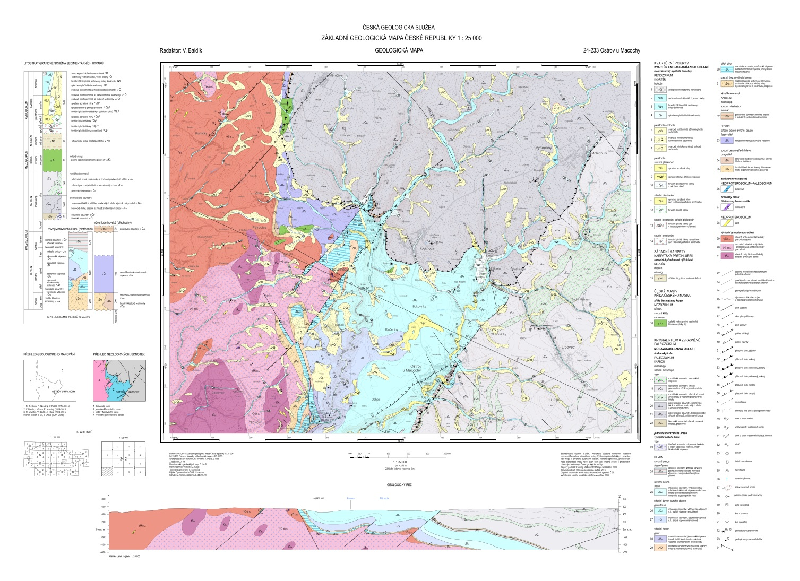
…but it is sometimes very difficult to recognize the sources of cave sediments
when you are deep inside the limestone massif:

Slide 5
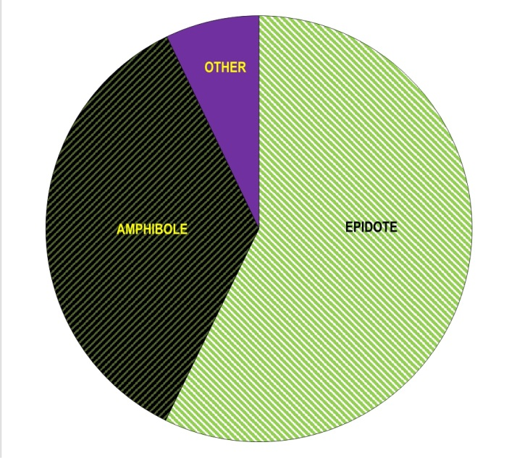
Assemblages coming from the western sources
(Neoproterozoic granitoids and Devonian clastics):
Translucent heavy mineral assemblage derived directly from Devonian clastics and granitoids of the Brno Massif, locality 1 on fig. 1, Suchdolský ponor, Dóm Juniorů.

Slide 6
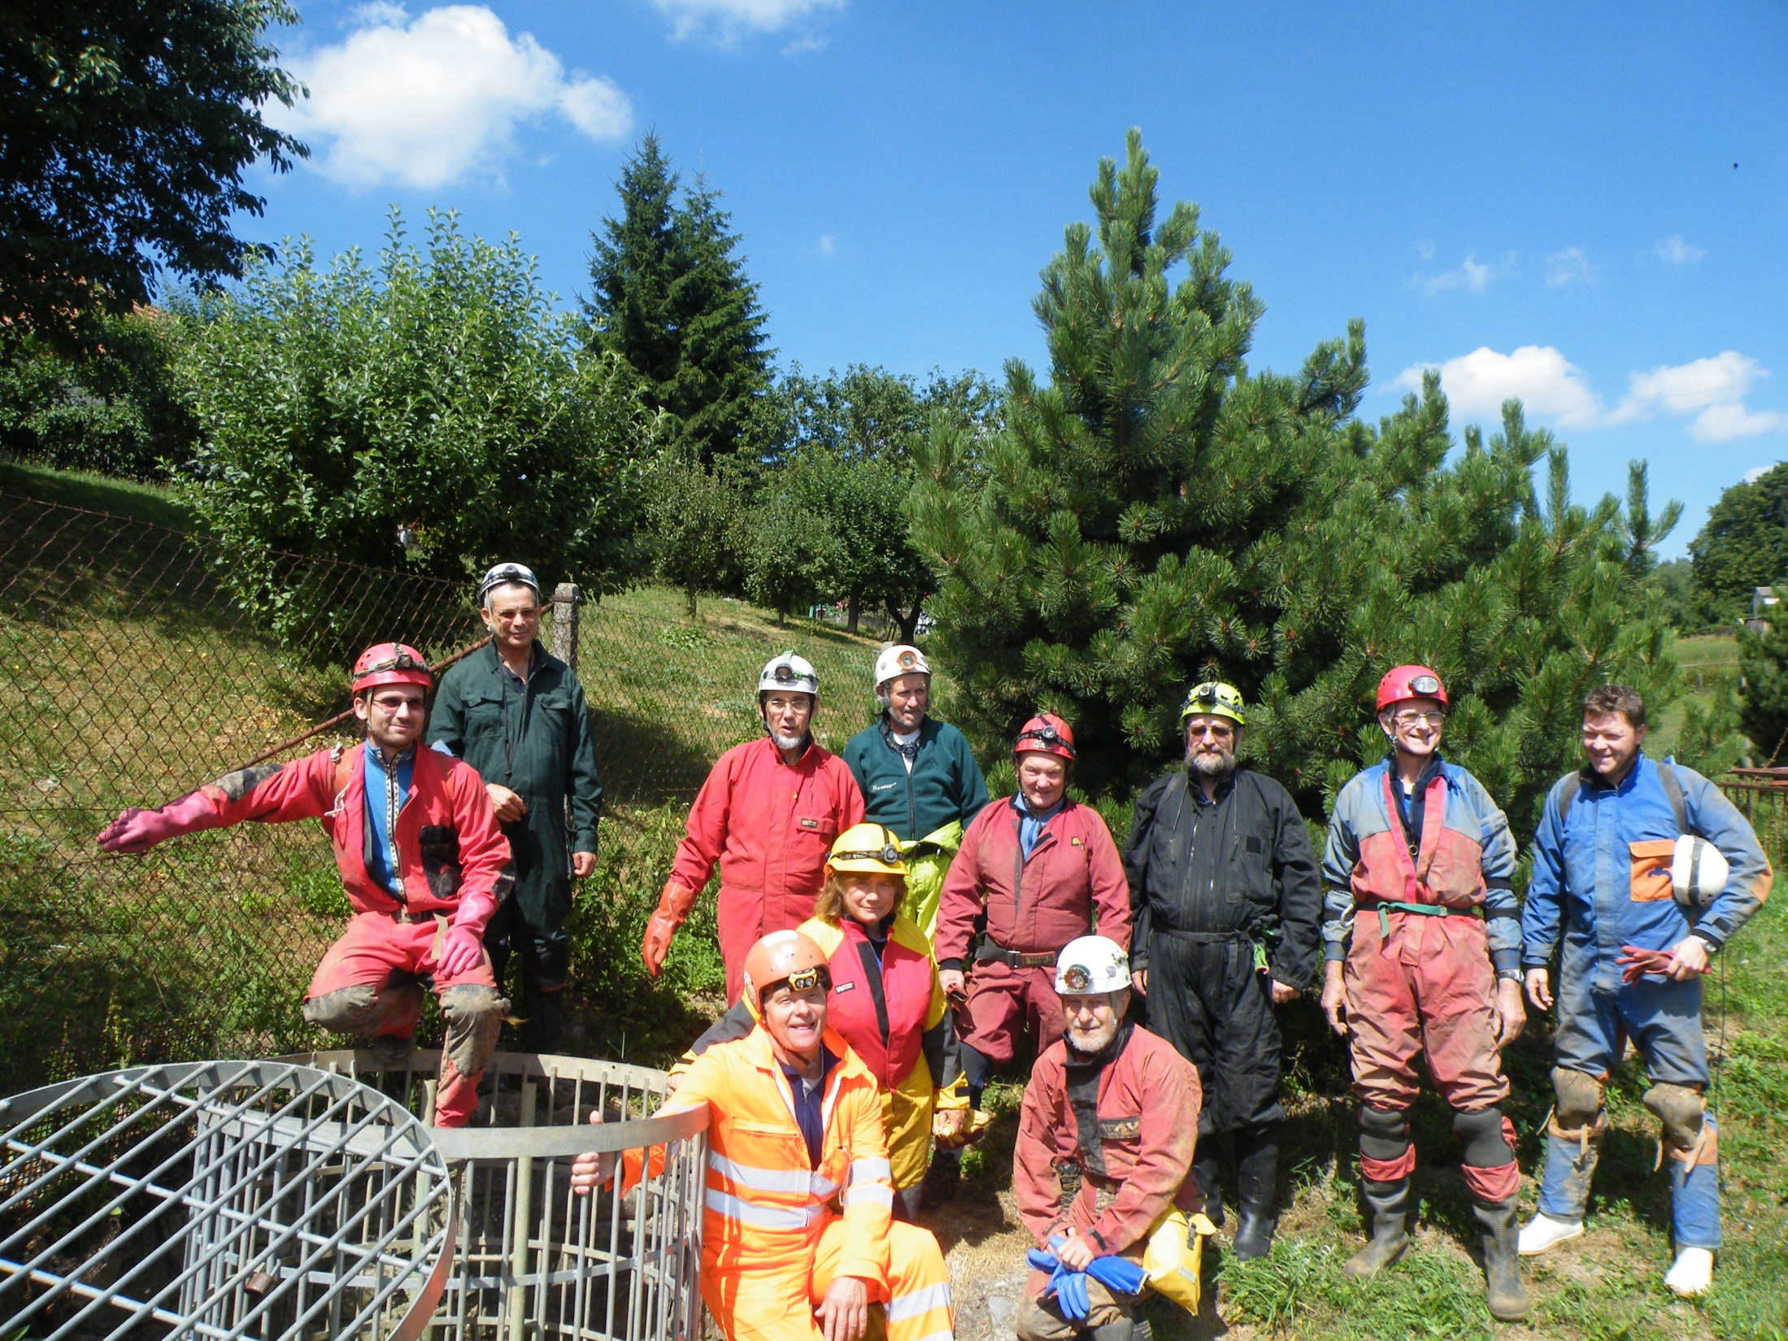

Slide 7
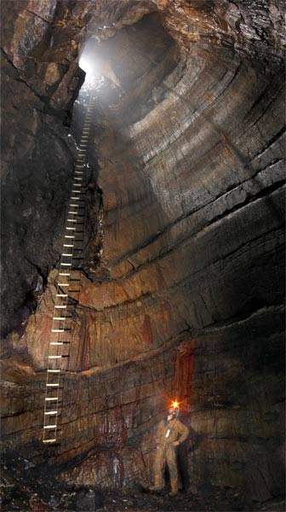
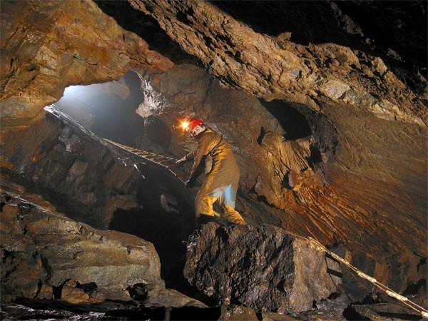

Slide 8
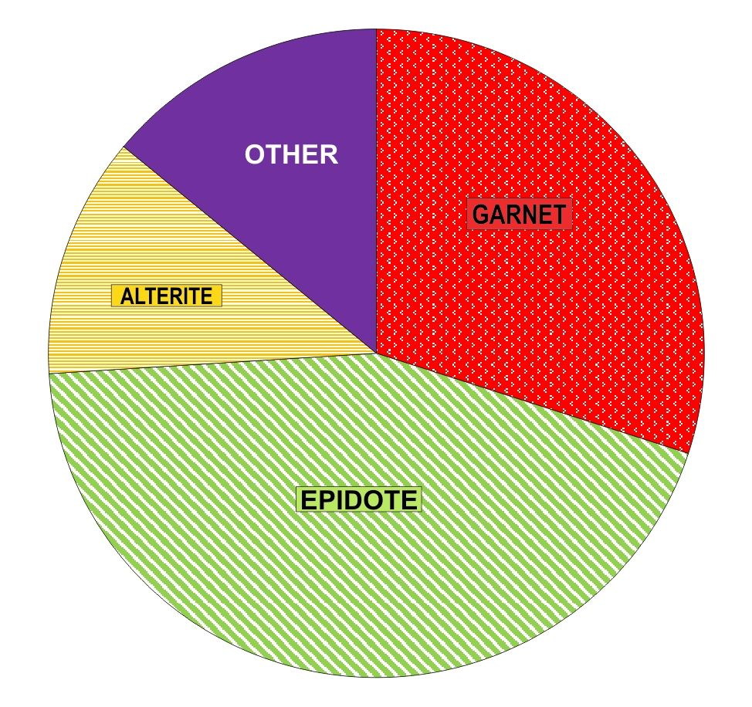
Translucent heavy mineral assemblage of the northern Culmian greywacke, locality 2 on fig. 1, Helišova skála.
Assemblages coming from the northern sources:
Lower Carboniferous, Mississippian
(greywackes of the Protivanov F.):

Slide 9
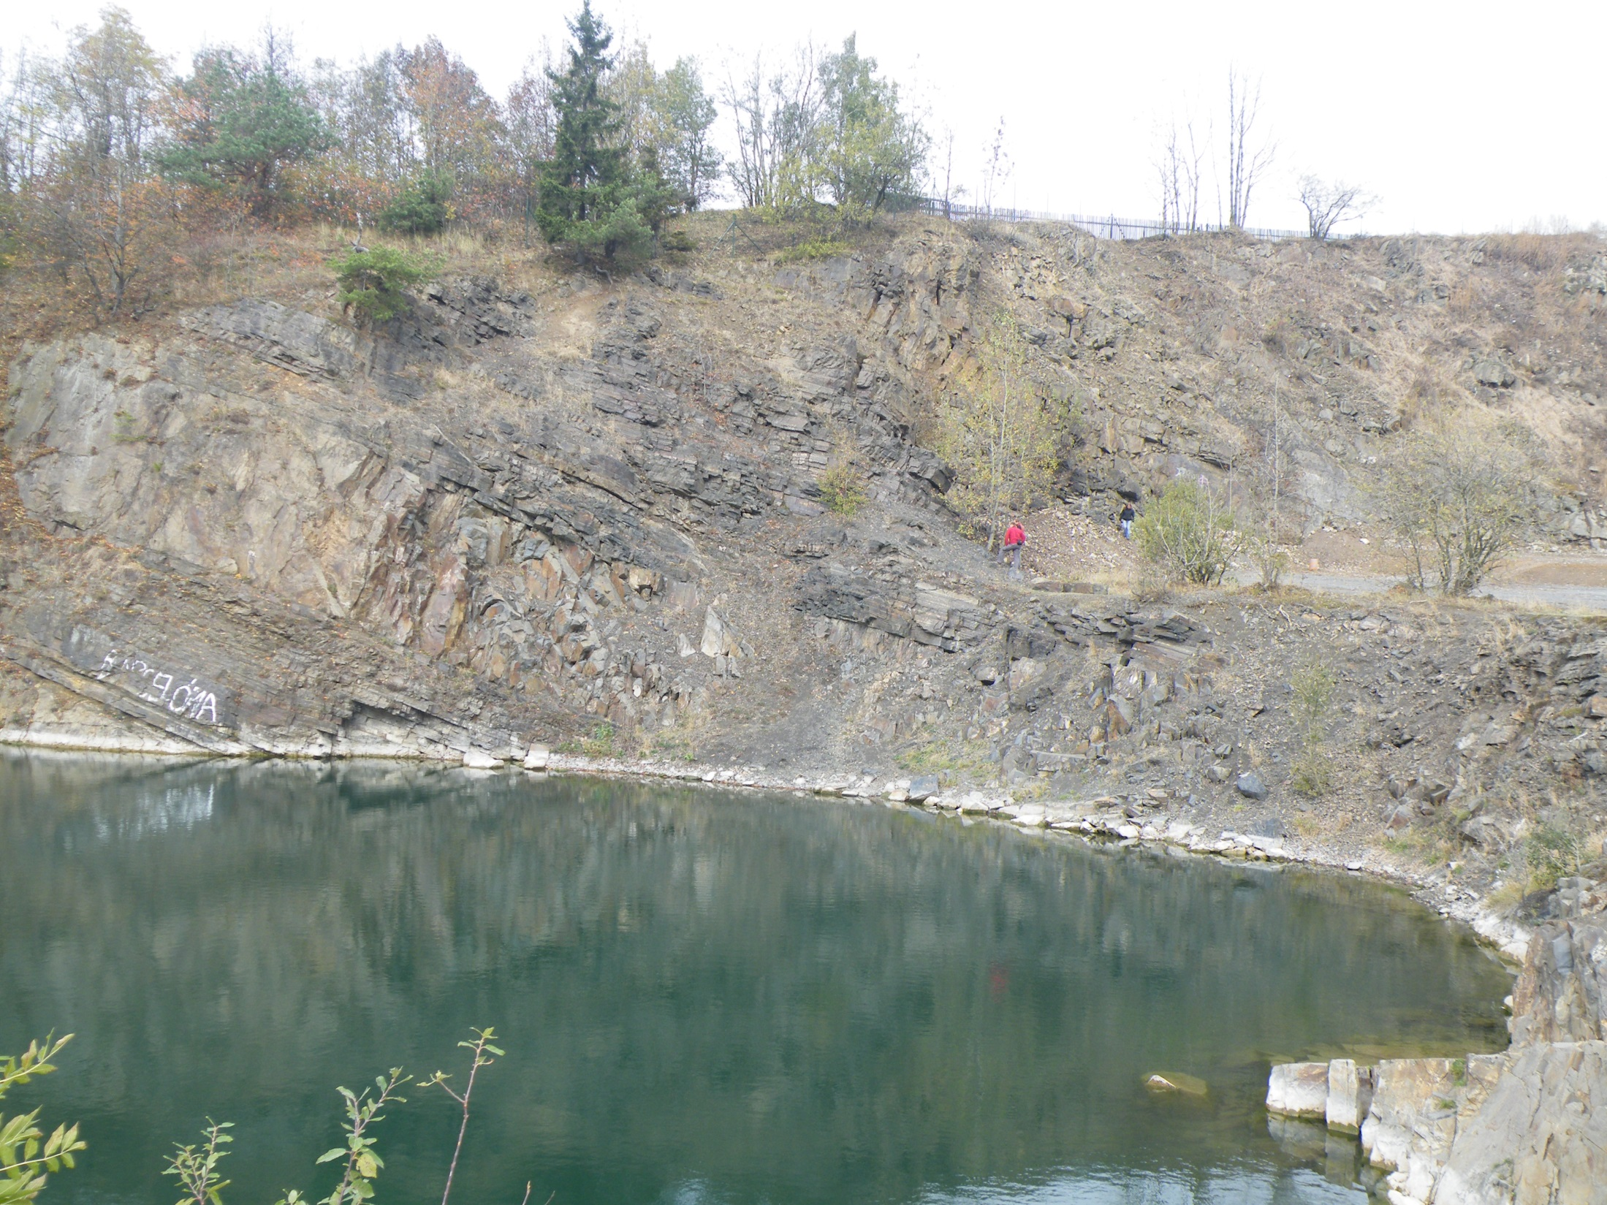

Slide 10
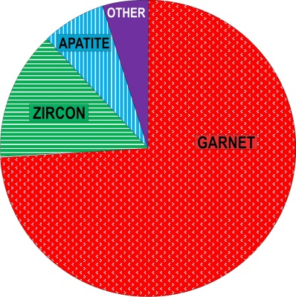
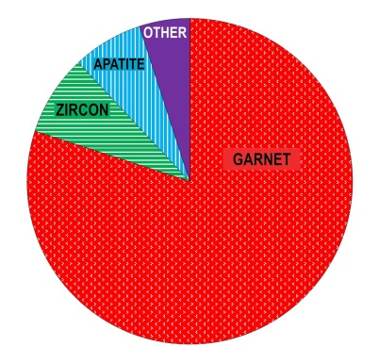
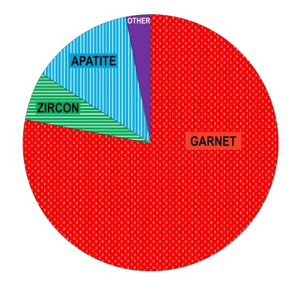
Translucent heavy mineral assemblage of the Culmian
greywacke at NE, locality 3 on fig. 1, Krasovský potok Valley.
Translucent heavy mineral assemblage of the Culmian
greywacke easterly from the Moravian Karst, locality 4 on fig. 1, Habrůvka Village.
Translucent heavy mineral assemblage of the Culmian
greywacke SE from the Moravian Karst, locality 5 on fig. 1, Hádek near Ochoz.
Assemblages coming from the eastern sources
Lower Carboniferous, Mississippian
(greywackes of the Rozstání and Myslejovice Fms.):

Slide 11
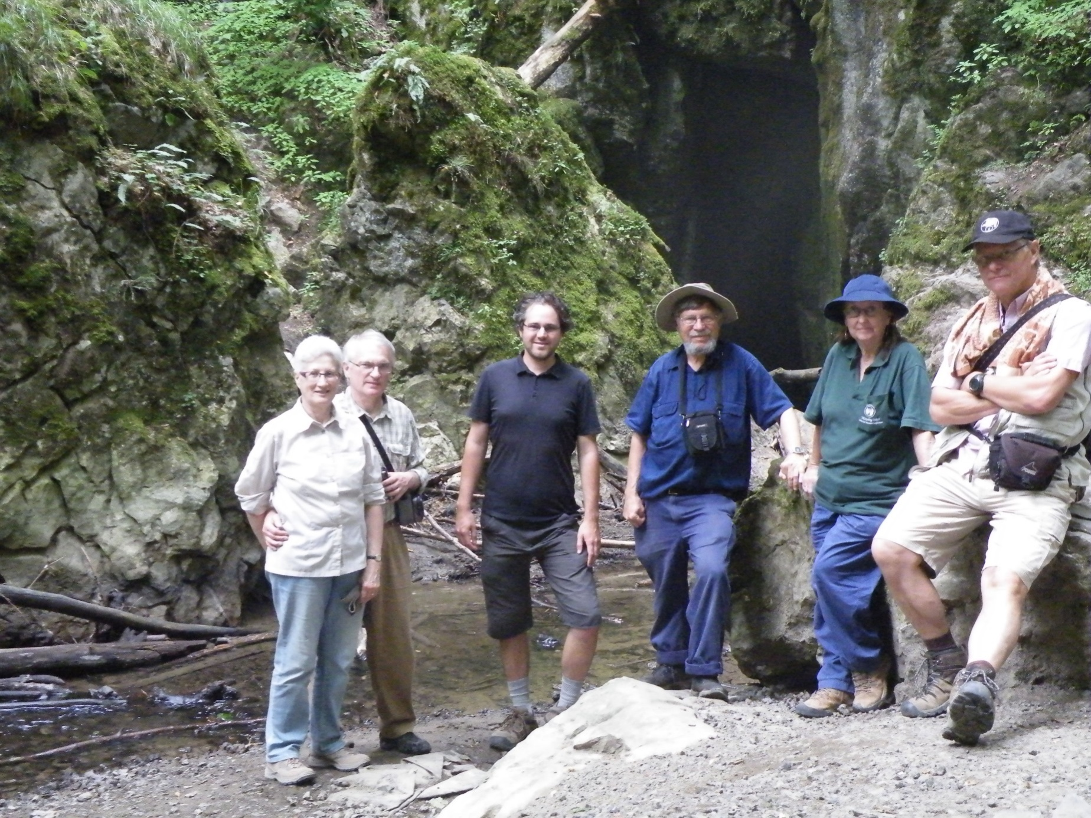
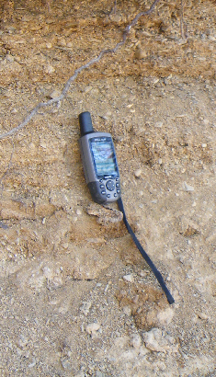

Slide 12
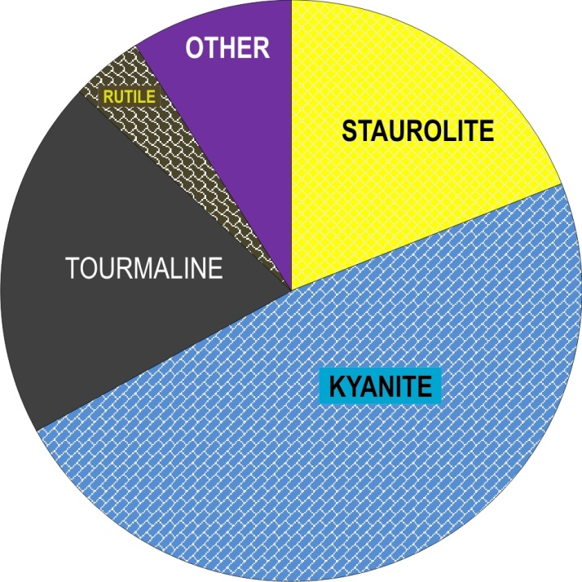
Assemblages coming from the paleokarst fill,
Cretaceous, Cenomanian
(sands of the Rudice Formation):
Translucent heavy mineral assemblage
of the Cretaceous sands, locality 6 on fig. 1, Rudice-Seč.

Slide 13
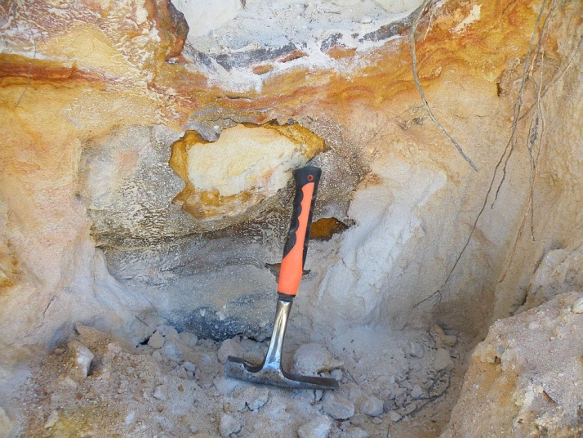
Cretaceous (Cenomanian) kaolinic quartz sands in a palokarst depression, locality 6 on fig. 1, Rudice-Seč

Slide 14
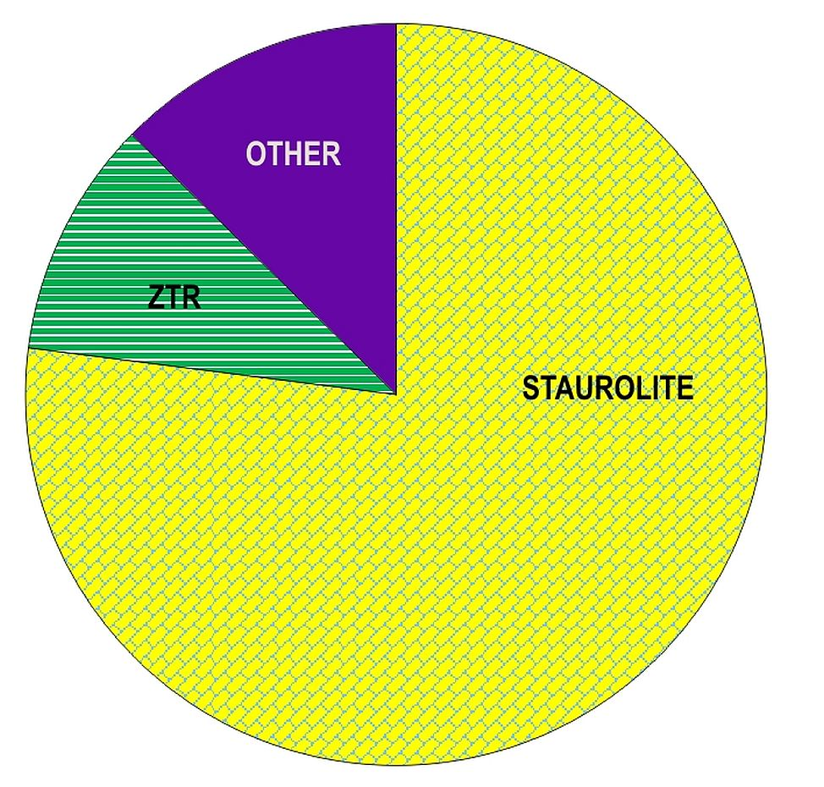
Assemblages coming from the lower Miocene sands:
Translucent heavy mineral assemblage of the terrestric Miocene, locality 7 on fig. 1, Ostrov, borehole OM3. ZTR means ultrastable minerals zircon + tourmaline + rutile.

Slide 15
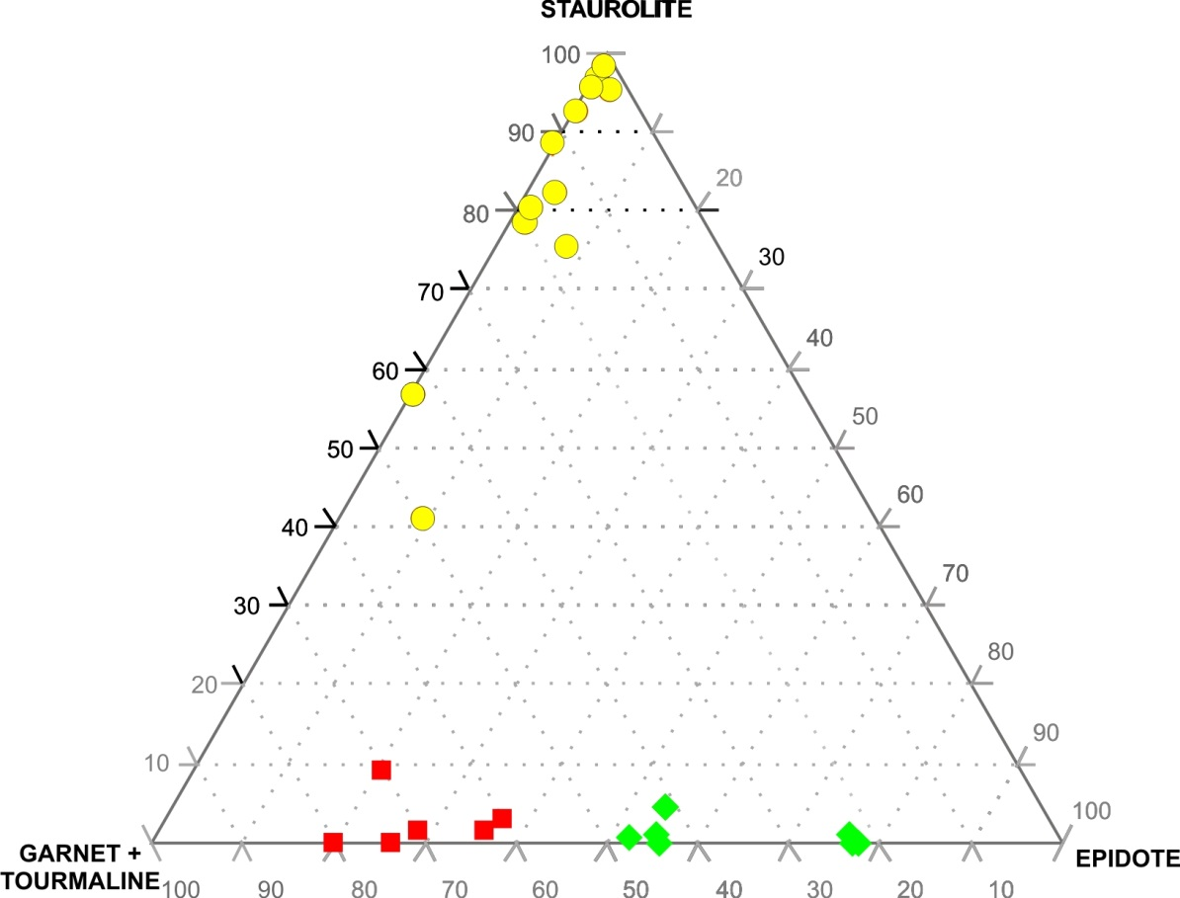
Distiguishing of source of cave sands in the northern part of the Moravian Karst:
terrestric Miocene source;
eastern Culmian source;
western and northern sources.

Slide 16
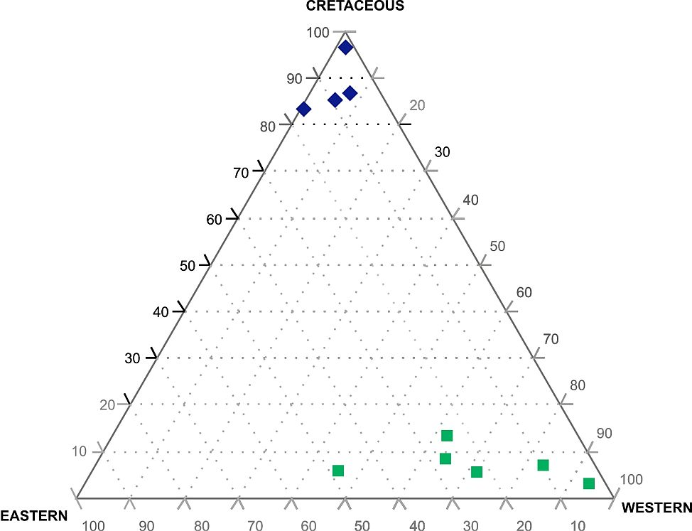
Cave sands of the Macocha Abyss and its closest vicinity are divided in two groups with different provenance:
The first one ( ) comes from Cretaceous paleokarst fill (staurolite, kyanite, tourmaline, rutile), while the other one ( )
comes mainly from the western vicinity of the Moravian karst ((epidote, amphibole) with various admixture
of the eastern source (garnets).

Slide 17
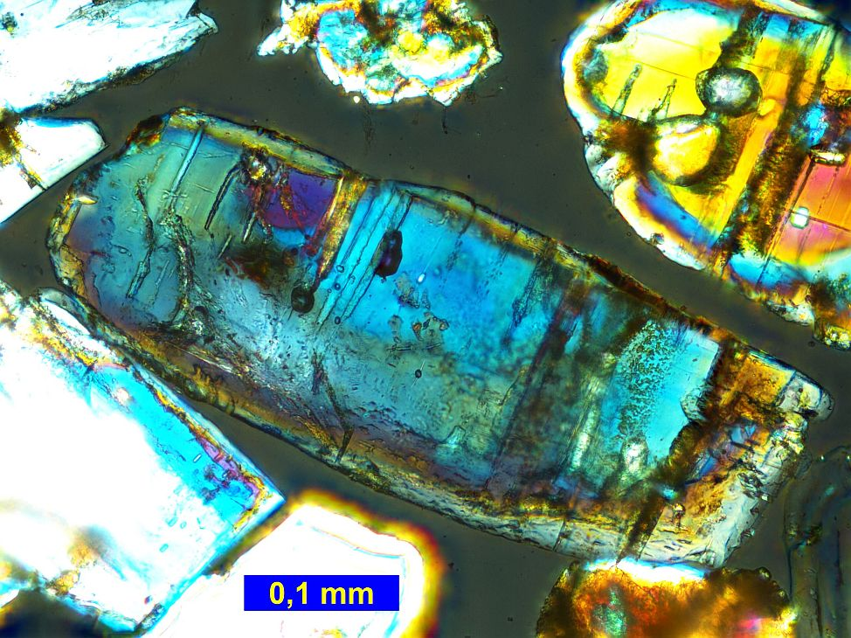
Kyanite – one of the most characteristic heavy mineral of the Cretaceous paleokarst fill. Photo in crossed polars.

Slide 18
Conclusions
The metod of translucent heavy mineral analyses has been used to trace the provenance af cave sands in the Moravian Karst.
Several examples of distiguishing the source of sands in enigmatic positions are presented.
The first one shows differences between cave sands coming from W and N, i.e. from granitoids and old Culmian rocks, from E (younger Culmian rocks) and from terrestric miocene
The other example was taken from cave sands in the close vicinity of the Macocha Abyss.
The result shows mixing of prevailing western source with minor share of easten source and another clearly different source – the products of Cretaceous paleokarst fill.
One of main goals of the analyses is to establish the paleohydrography of Moravian Karst (or any other karst)
and off course to show possibilities of new discoveries

Slide 19
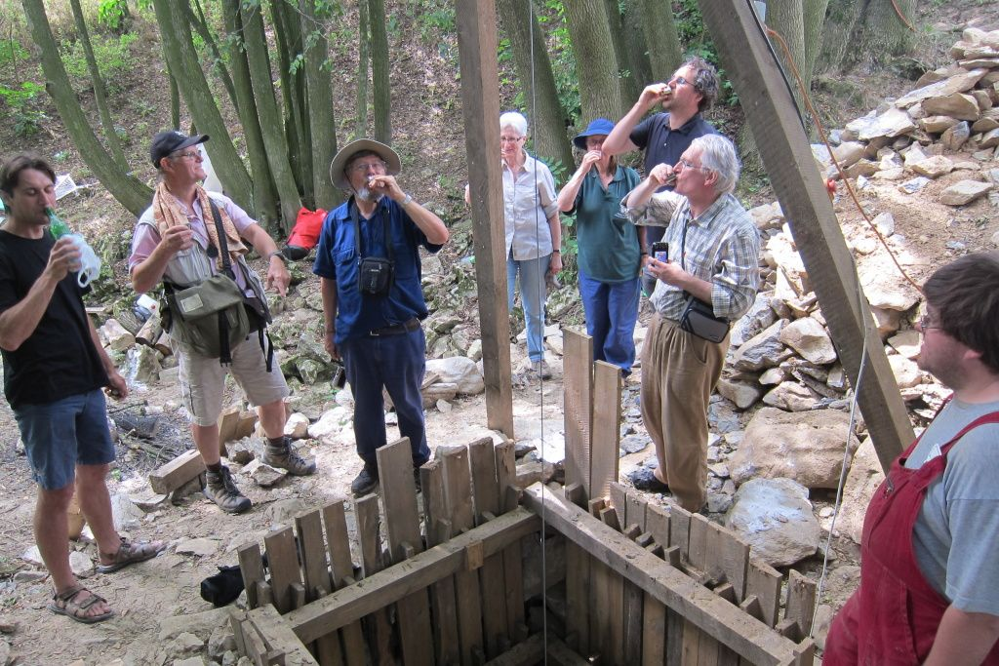
Thank you for your kind attention

