Slide 1
Optical spectroscopic methods
Daniel Renčiuk
IBP AS CR
S1001 / 2016 - CEITEC

Slide 2
Contents
Brief background
Absorption spectroscopy (AS)
  Electronic (UV/Vis)
  Vibrational (IR)
Raman scattering
Emission spectroscopy
  Fluorescence
  FRET
  Fluorescence polarisation / anisotropy
Chirooptical methods
  Linear dichroism
  Circular dichroism

Slide 3
Interaction of mass with EM radiation
Theory
Experiment
QUANTUM MECHANICS
SPECTROSCOPY
Wavefunction describes states of the molecule.
Position of absorption and emission peaks correspond to differences in E between states.

Slide 4
Phenomena X EM spectral regions
Phenomenon | Spectral region | Wavelength
Nuclear | Gamma | 0.1 nm
Inner electrons | X-rays | 0.1 - 1.0 nm
Ionisation | UV | 0 - 200 nm
Valency electrons | near UV / VIS | 200 - 800 nm
Molecular vibrations | near IR / IR | 0.8 - 25 μm
Rotation and electron spin orientation in mag. fields | Microwaves | 400 μm – 30 cm
Nuclear spin orientation in mag. fields | Radiowaves | > 100 cm
OPTICAL SPECTROSCOPY

Slide 5
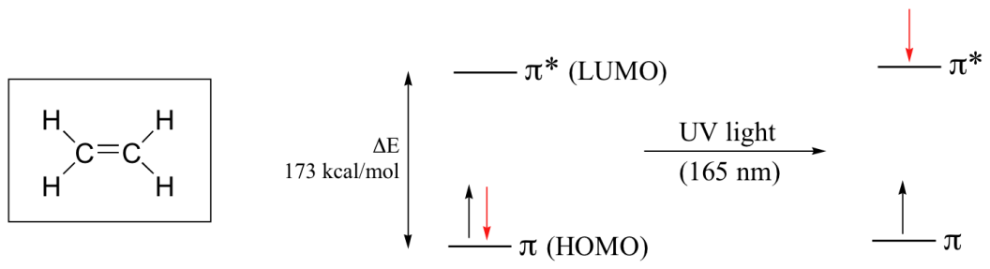
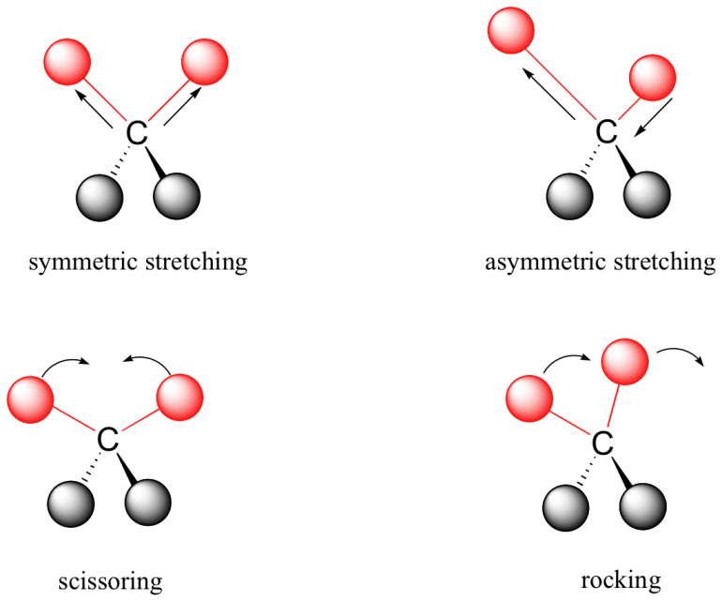
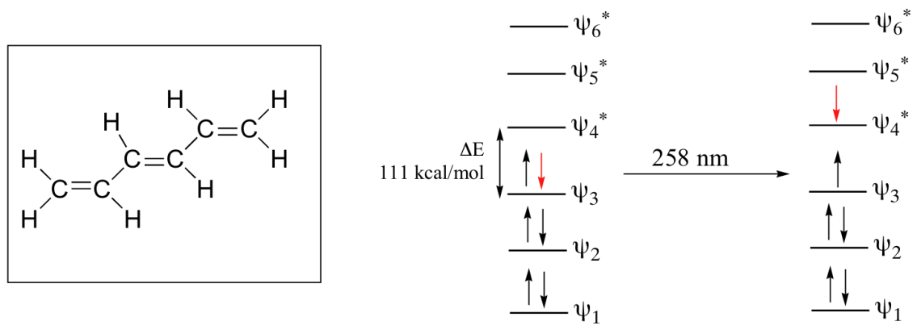
Electron energy levels
Molecular vibrations

Slide 6
Transitions
SPECTROSCOPIES MEASURES TRANSITION BETWEEN ENERGY STATES OF THE MOLECULE
NONRADIATIVE
INTERCONVERSION
6’
5’
4’
3’
2’
E = h·v = h·c/λ
1’
0’
Total E
ABSORPTION
EMISSION
Morse potential – E vs r_{AB}
6
5
40,000 cm⁻¹ Electronic spectra measured in UV and VIS
4
3
2
1
2000 cm⁻¹ Vibrational spectra measured in infrared region
0
100 cm⁻¹ Additional structure to the vibrational and electronic spectra - rotations
0
r_{AB}

Slide 7
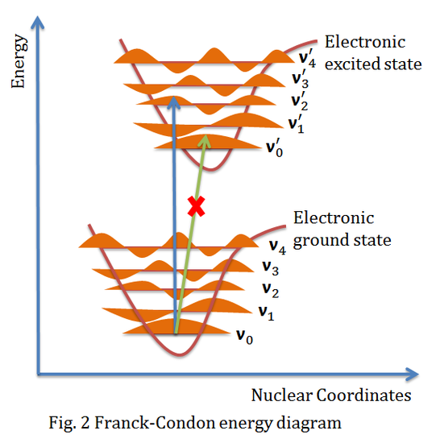
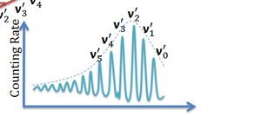
Background – Franck-Condon principle
Transition to an excited electronic state can be to any of the vibrational level
Vibrational transitions are very slow, compared to electronic transitions
Certain vertical transitions corresponding to no nuclear displacement during an electronic transition have the highest probability (Franck-Condon principle)
Absorption band has the vibronic structure - one E0-E1 transition is a superposition of several transitions v0-vn’ characterized by different energy and probability (intensity of the peak)
UCDavis / Physical Chemistry course

Slide 8
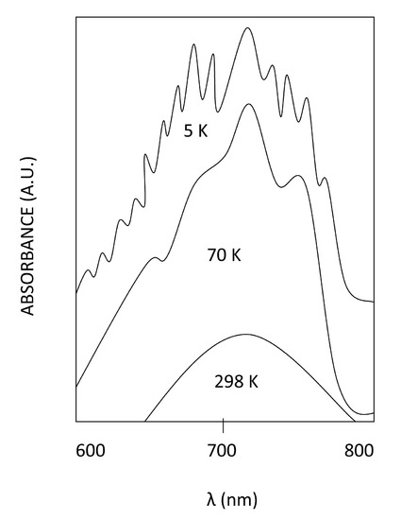
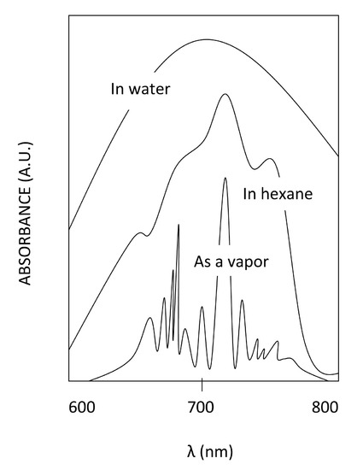
Vibronic structure of absorption spectra

Slide 9
Transition times
2nd
singlet
Internal
conversion
~ 10⁻¹² sec
1st
singlet
Intersystem
crossing
~ 10⁻⁸ sec
In E1v0’ before fluorescence
1st
triplet
~ 10⁻⁸ sec
Total E
~ 10² - 10⁻⁴ sec
before fosforescence
Absorption ~ 10⁻¹⁵ sec
Emission ~ 10⁻¹⁵ sec
Nonradiative ~ 10⁻⁸ sec
Nonradiative
~ 10² - 10⁻⁴ sec
Emission ~ 10⁻¹⁵ sec
ground
state
Jablonski diagram
Van Holde et al., Principles of Physical Biochemistry, 2nd ed., 2006

Slide 10
Background – Kasha’s rule
Kasha’s rule: photon emission occurs only from the lowest excited level
As a consequence, the emission wavelength is independent of the excitation wavelength
Few exceptions from Kasha’s rule
Kasha’s rule + Franck-Condon principle stands behind the symmetry of absorption and fluorescence spectra (E₀v₀ to E₁v_{n} = E₁v_{0’} to E₀v_{n’})

Slide 11
Background - Stokes and antistokes shift
KASHA’S RULE
antistokes
Stokes’s shift
Intensity
absorbance
fluorescence
λ [nm]
SYMETRY
E_{ex} > E_{em} => v_{ex} > v_{em} => λ_{ex} < λ_{em}
11

Slide 12
Optical spectroscopy
PROPERTY
LIGHT POLARIZATION
EMISSION
CIRCULAR
Electronic circular dichroism
LINEAR
ABSORPTION
“NONE”
UV
VIS
IR
WAVELENGTH

Slide 13
Type of spectroscopy
These types require different instrumentation and are used for different purposes.
Steady-state
continuous excitation
weak intensities of excitation light
highly populated ground state
Time-resolved experiment
short excitation pulse (fs,ps)
higher intensities of excitation light (laser)
significantly populated excited states
“pump” – light for excitation
“probe” – light for measurement
Either the same source or different.

Slide 14
UV absorption spectroscopy
All molecules absorb in UV – all atoms have electrons + UV has enough E to excite outer-shell electrons to higher energy orbitals
bottom λ limit – buffer absorption x O₂ (<160 nm) absorption – vacuum UV – synchrotron up to 100 nm
Absorption bands are broad – vibronic structure + solution effects
Chromophore – part of the molecule that strongly absorbs in the desired region (UV/Vis)

Slide 15
UV absorption spectroscopy
Determination of concentration of nucleic acids – Beer-Lambert law
Determination of conformation of DNA – Thermal (TDS) and Isothermal (IDS) Differential Spectra
Measurement of renaturation and denaturation processes – determining of thermodynamic parameters using van’t Hoff equation
Following interactions of nucleic acids with ligands
Protonation of bases

Slide 16
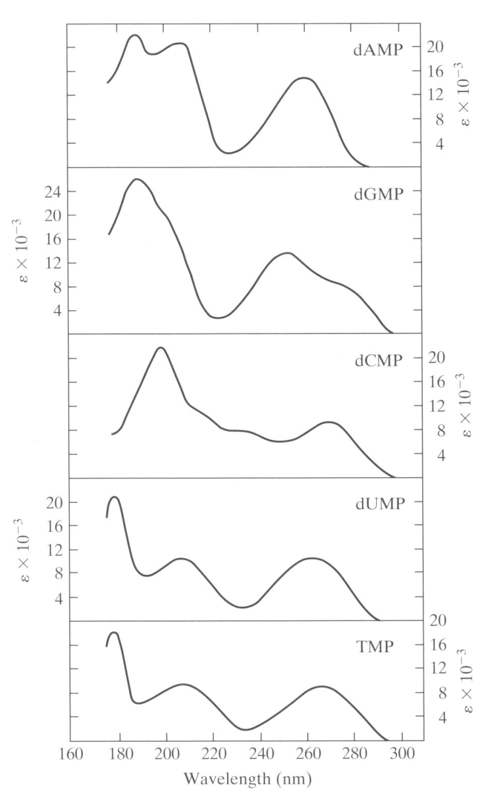
DNA absorption spectrum
Spectra of particular nucleotides depend on transition dipole moments of the bases.
Peak around 260 nm due to a conjugated π-bonding system (bases).
Final spectrum of unstructured DNA depends on primary sequence.

Slide 17
Effect of structure
final NA spectrum is based on contributions of individual monomers in primary sequence + contributions of their interactions
spectrum different for structured and non-structured NA (hypochromism around 260 nm after folding)
d[G₃(TTAG₃)₃] at 23°C in 1cm cell
Hypochromic effect
Hyperchromic effect
Sprecher et al., Biopolymers, 1977

Slide 18
UV absorption – NA concentration
Beer-Lambert law
A = c·ε·l = log₁₀ I₀/I
I = I₀·10^{-c·ε·l}
I₀ – incident light
I – output light
Light intensity decreases exponentially when passing through sample thus absorbance (as log) increases linearly – 2x sample concentration or pathlength = 2x absorbance but 10x less light
Optimal absorbance 0.6-0.8

Slide 19
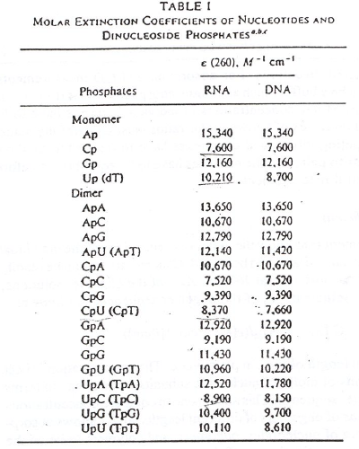
Molar absorption coefficient - ε
A = c·ε·l
ε – molar absorption coefficient [M⁻¹.cm⁻¹]
specific for each NA primary sequence
can be either:
  calculated – 2*sum of ε of dimers minus sum of ε of monomers except the two terminal ones (Gray et al., 1995, Methods Enzymol)
  analytically determined – amount of phosphorus vs absorbance
  usually calculated by DNA provider
  http://eu.idtdna.com/calc/analyzer

Slide 20
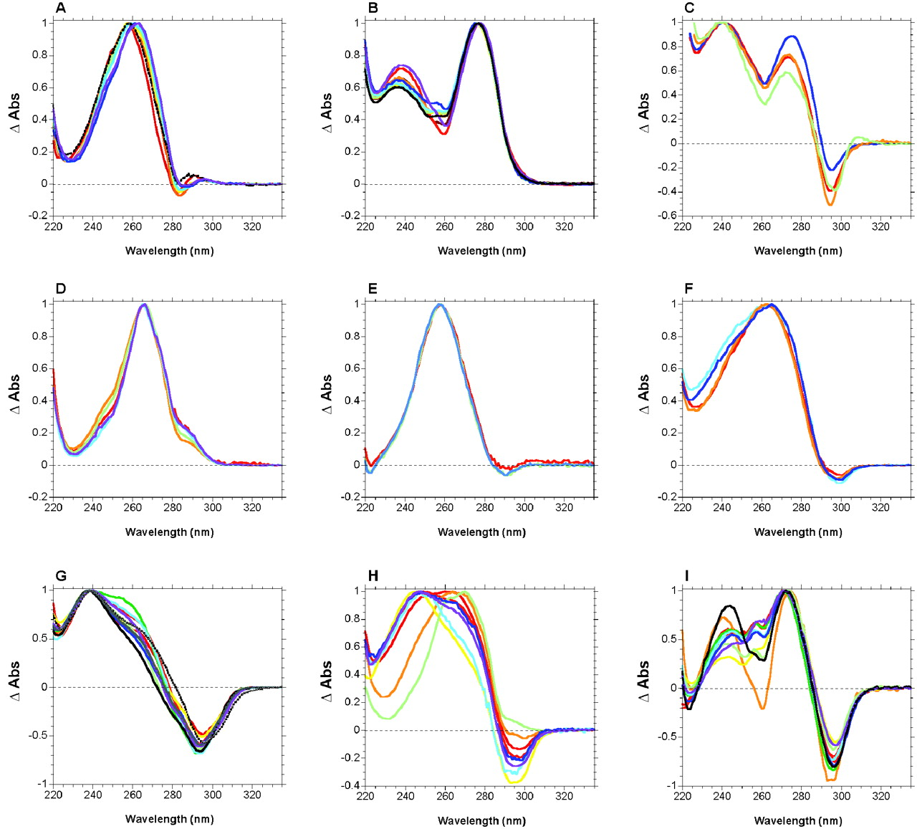
UV Absorbance – TDS (or IDS)
Normalized differential absorbance signatures: (A) DNA self-complementary duplexes, 100% AT; (B) DNA self-complementary duplexes 100% GC; (C) Z-DNA; (D) Parallel-stranded DNA; (E) GA DNA duplexes; (F) Hoogsteen DNA duplexes; (G) i-DNA; (H) Pyrimidine triplexes; (I) DNA G-quadruplexes in Na+.
Mergny et al. Nucl. Acids Res. 2005

Slide 21
UV Absorbance – NA melting
Guanine quadruplex G₃(TTAG₃)₃ in 150 mM Na
Increasing
temperature

Slide 22

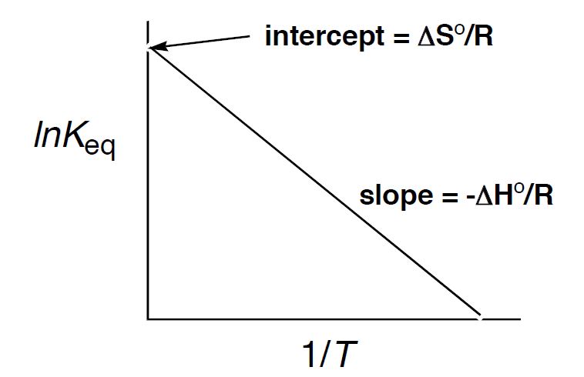
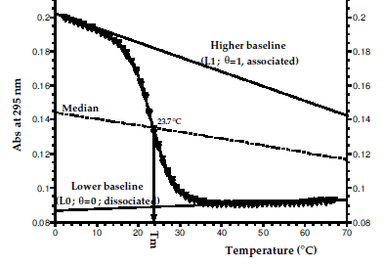
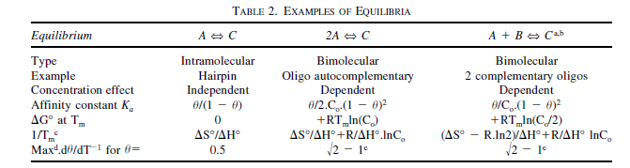
Thermodynamic parameters - Van’t Hoff
Mergny and Lacroix, Oligonucleotides, 2003

Slide 23
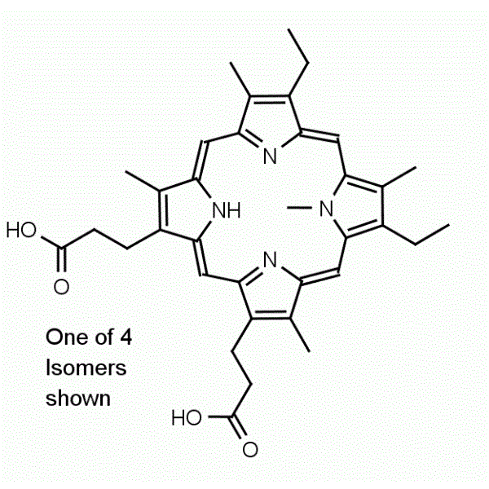
UV Absorbance – ligand interaction
NMM ligand titrated by guanine quadruplex
c DNA

Slide 24
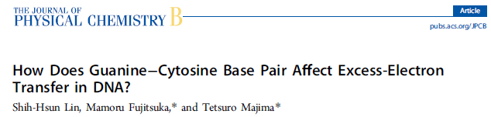
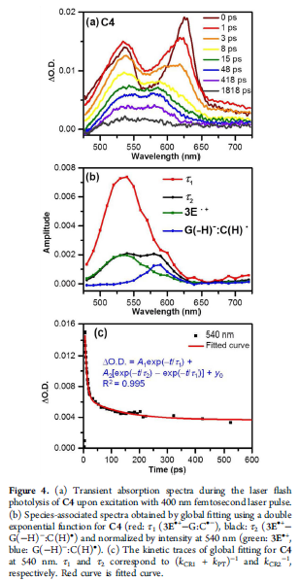
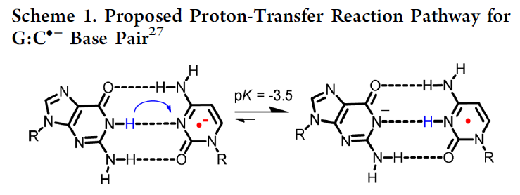
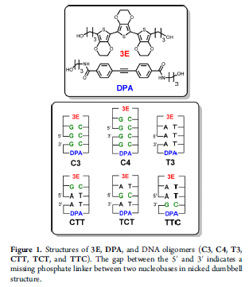
Time-resolved absorption

Slide 25
IR absorption
Measures the energies of vibration of atomic nuclei in the molecule
Each molecule has 3n-6 internal degrees of freedom (n=number of atoms in molecule)
specific absorption bands for various chemical groups
modern IR spectrofotometers are Fourier transform instruments – Michelson interferometer + FT transformation of intensity to frequency – all frequencies taken simultaneously
water absorption in interesting IR regions – D₂O (peak in other regions, films
stretching
In-plane bending

Slide 26
IR absorption – group vibrations
v (cm⁻¹)
non H-bonded
v (cm⁻¹)
H-bonded
λ (nm)
2500
4000
4000
OH
NH
H₂O absorption
3333
3000
CH
3000
SH
5000
2000
C=O
2000
C=N
H₂O absorption
PO₃⁻
10000
1000
1000
∞
0
0

Slide 27
IR absorption – Miles experiment
IR spectra in the 1750 to 1550 cm⁻¹ region for two nontautomerizing methyl derivatives (c) and (d), and cytidine, now known to be in the first tautomeric form shown (a).
Miles, 1961, PNAS

Slide 28
Raman spectroscopy
Band position: v₀₁ = (E_{in}-E_{sc})/hc
Excited electronic stationary state
when used light with E < E0-E1 – scattering
in most cases E_{in} = E_{sc} – Rayleigh scattering
sometimes E_{in} <> E_{sc} – Raman scattering
  E_{in} > E_{sc} – Stokes
  E_{in} < E_{sc} – antistokes
Raman photon incidence around 10⁻⁸
Raman band position: v₀₁ = (E_{in}-E_{sc})/hc
complementary to vibrational absorption – the same transition (0-1)
  Raman – visible photon
  vibrational – IR photon
  some vib. transitions detected differently
nonstationary states are not quantized => any UV/Vis source may be used
practically lasers – intense monochromatic light
scattered light split by monochromator
3’
2’
1’
0’
Nonstationary
state
E_{in}
E_{sc}
Ground electronic stationary state
3
2
1
0
vibrational
absorption
Rayleigh
scattering
Raman
scattering
resonance Raman
scattering

Slide 29
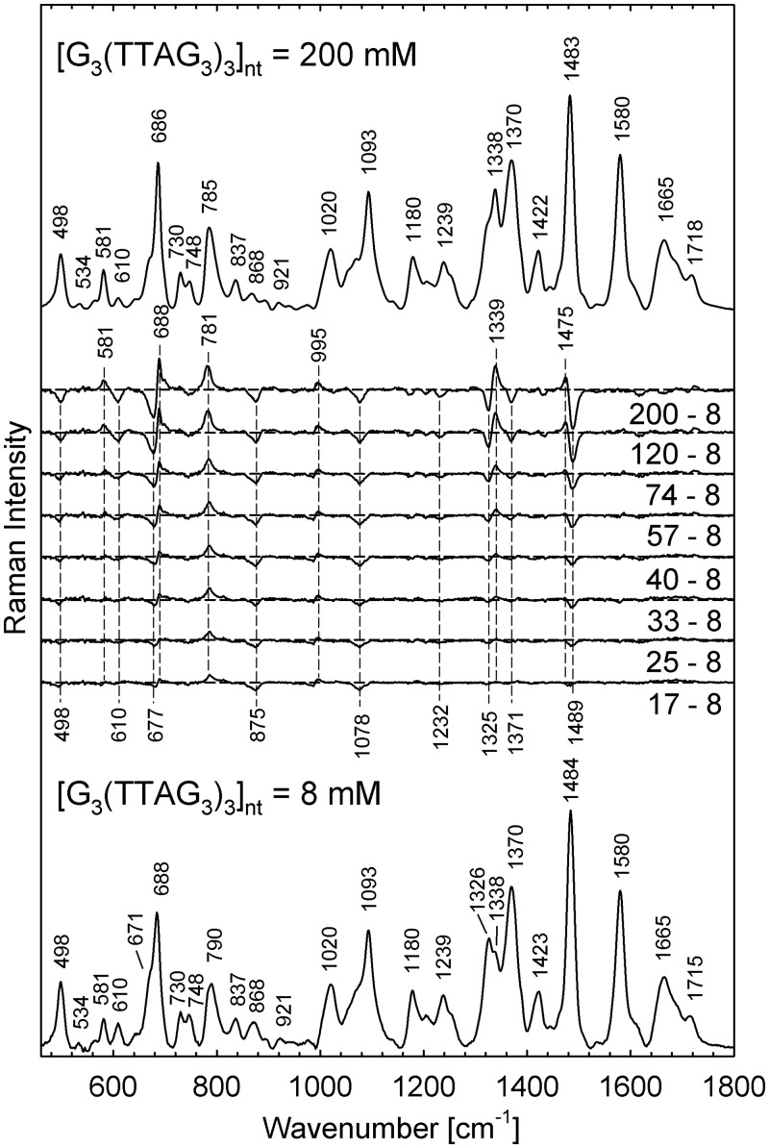
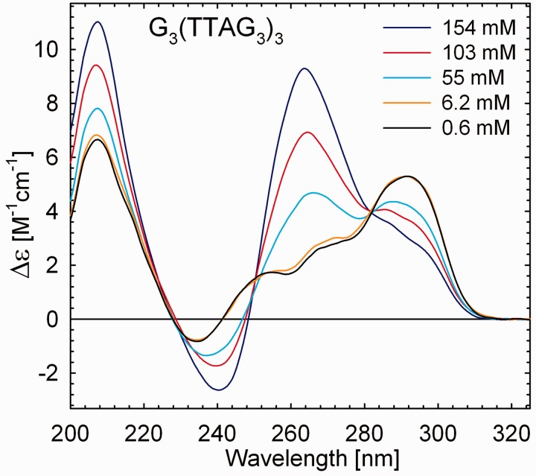
Raman spectroscopy
CD
Raman spectra of G₃(TTAG₃)₃ in 200 mM K⁺ (30 mM of PBS, pH 6.8, t = 5°C) at the nucleoside concentrations of 8 mM (bottom trace) and 200 mM (top trace). Intermediate traces show the differences between the spectra at indicated concentration and that of the lowest one
Deng et al., 1999, Biopolymers
Palacky et al., 2013, NAR

Slide 30
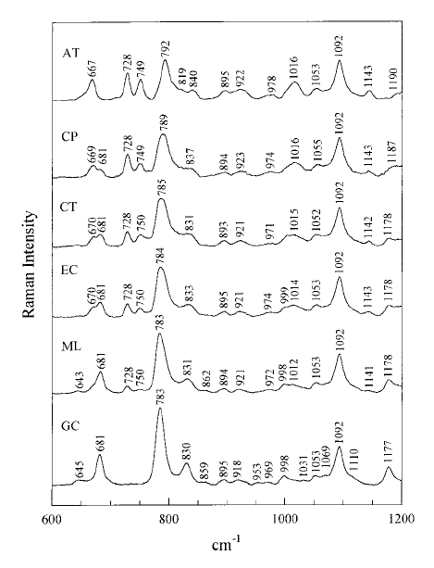
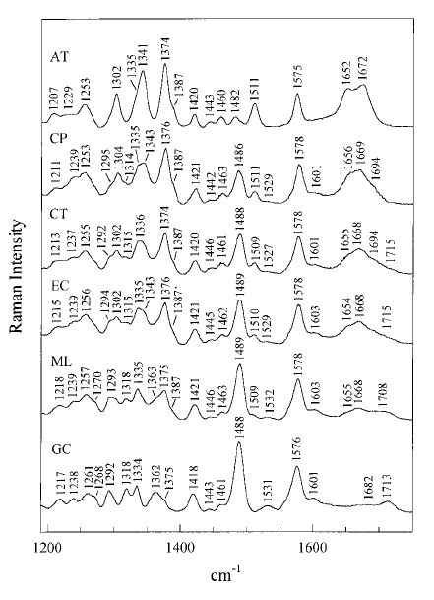
Raman spectroscopy
poly(dA-dT) · poly(dA-dT) (0% G+C), C. perfringens DNA (27% G+C), calf thymus DNA (42% G+C), E. coli DNA (50% G+C), M. luteus DNA (72% G+C), and poly(dG-dC) · poly(dG-dC) (100% G+C).
Deng et al., 1999, Biopolymers

Slide 31
Fluorescence in nucleic acids
Spontaneous emission of the photon followed by transition to electronic ground state (any vibrational state – Franck-Condon)
Emission always from the vibrational ground state of the electronic excited state (Kasha’s rule)
fluorescence itself very fast (10⁻¹⁵ s), but some time takes nonradiative conversion to v0’
Fluorophores – molecules/parts of the molecule that exhibit fluorescence
Fluorescence lifetime – τ – average time from excitation of the molecule to emission of light [ns]
Quantum yield – ratio between emitted and absorbed photons – “efficiency” of the fluorescence - max = 1, but usually lower (non-radiative transitions)
3’
2’
1’
0’
absorption
fluorescence
3
2
1
0

Slide 32
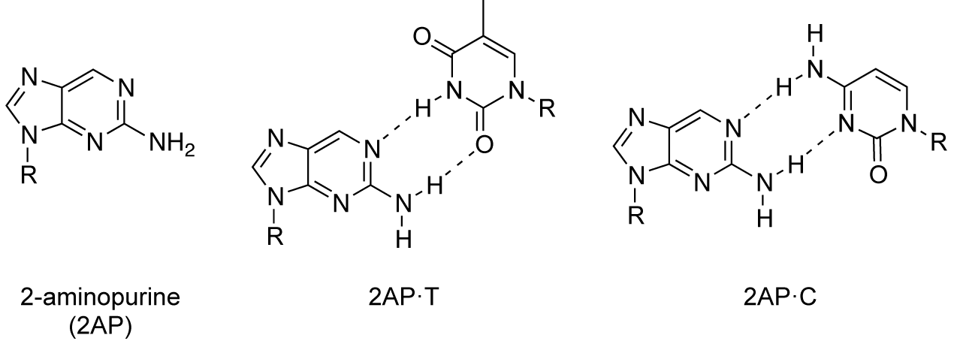
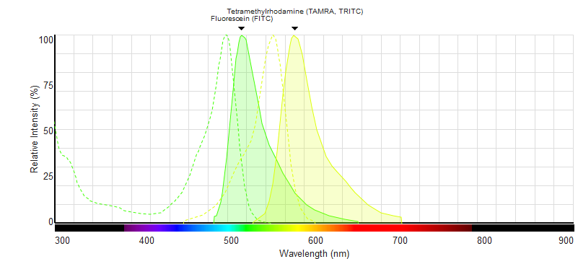
Fluorescence in nucleic acids
Very low intrinsic fluorescence, thus:
Fluorescent base – 2-aminopurine
Fluorescent labels – FITC, TAMRA, …
Fluorescent ligand – EtBr, porphyrins, …
ThermoFisher Scientific
Fluorescence spectra viewer

Slide 33
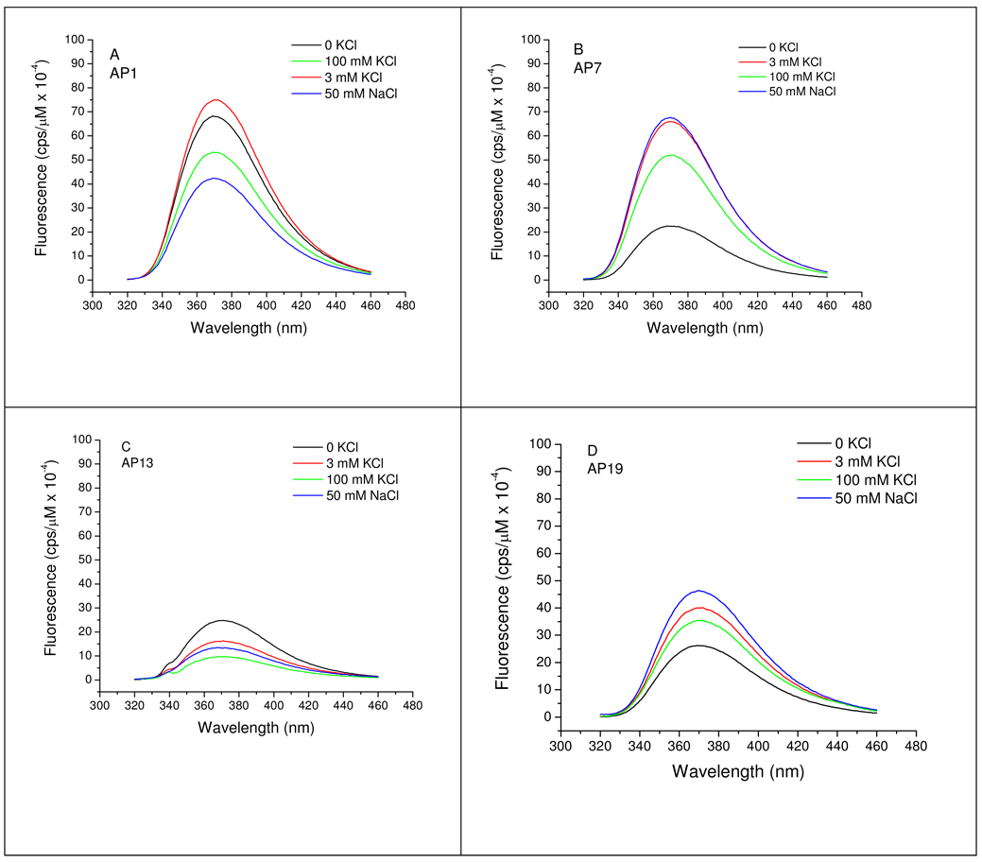
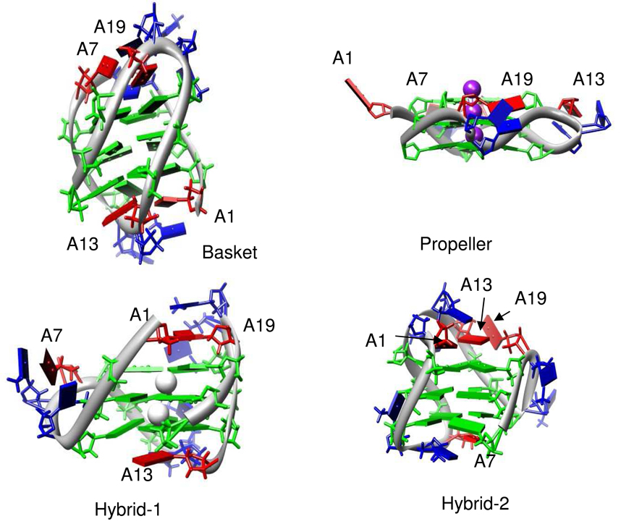
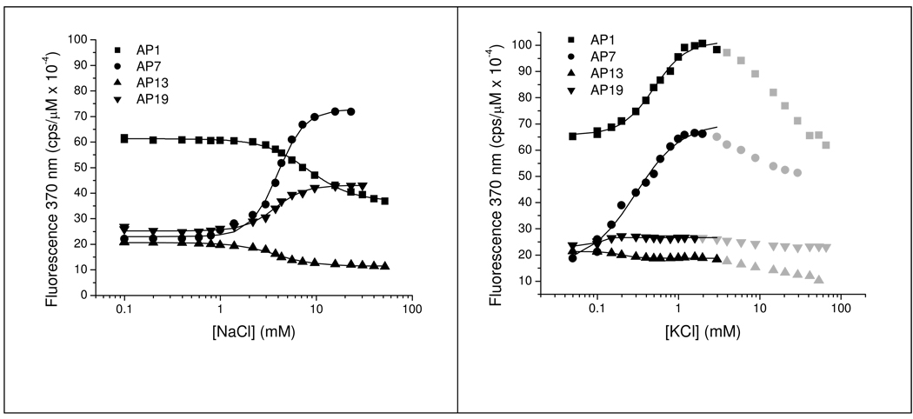
Fluorescence – guanine quadruplex with 2-AP
Na⁺ and K⁺-dependent fluorescence emission spectra of 2-AP derivatives of Tel 22 as a function of cation concentration.
Gray et al., 2010, Biochemistry

Slide 34
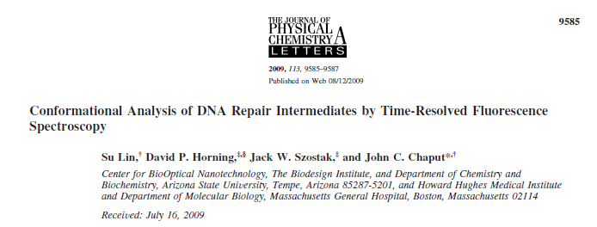
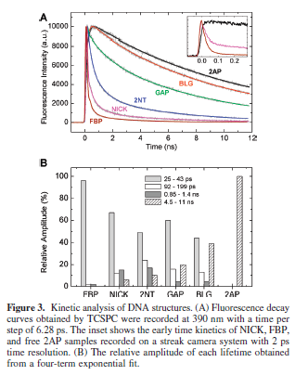
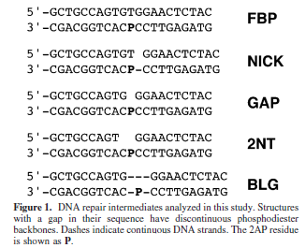
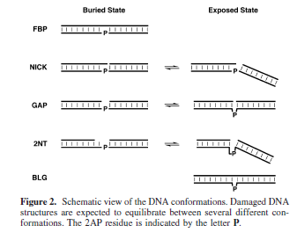
Time-resolved fluorescence

Slide 35
Foerster (Fluorescence) resonance energy transfer (FRET)
Nonradiative
relaxation
Nonradiative
relaxation
3’
FRET
FRET might occur when the emission band of the donor overlaps with the excitation band of the acceptor and the molecules are close enough.
FRET range 1-10 nm
Various FRET pairs, characterized by R₀ (distance where FRET is 50% for this pair)
FRET efficiency E = 1 / (1 + r / R₀)⁶
2’
1’
0’
3’
2’
1’
0’
absorption
fluorescence
fluorescence
3
3
2
2
1
1
0
0
Donor
Acceptor

Slide 36
Foerster (Fluorescence) resonance energy transfer (FRET)
FAM
emission
TEMPERATURE
TAMRA
emission
FAM – GQ – TAMRA
150 mM K
Excitation: 480 nm

Slide 37
Fluorescence polarization/anisotropy (FP/FA)
Difference in the intensity of the sample-emitted light with polarization parallel and perpendicular to the polarization of the excitation light.
  requirements: molecules are fluorescent
  FA provides information on molecular size (monomer x dimer) and shape, local viscosities of a fluorophore’s environment and allows measurement of kinetics parameters of reactions.
  often as a time-resolved method for rotational velocities measurement– short pulse of light (10⁻⁹ sec) followed by fluorescence measurement over time
  in this case the molecule must be spherical to avoid various rotational velocities in different directions and the fluorophore must be firmly attached to prevent rotation of the fluorophore only

Slide 38
Fluorescence polarization/anisotropy
z
significantly excited are only the molecules whose transition dipoles are parallel to the polarization of excitation light
Linearly polarized
excitation light
x
SAMPLE
POLARIZER
SOURCE
I_{parallel}
Fluorescence anisotropy
r = I_{parallel} – I_{perpendicular} / I_{parallel} + 2I_{perpendicular}
Parallel and perpendicular means orientation towards excitation light
I_{perpendicular}
y
DETECTOR

Slide 39
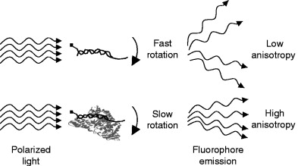
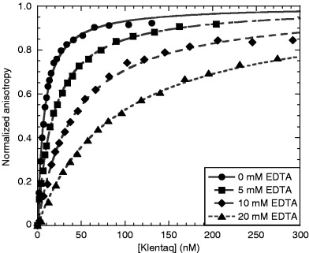
Fluorescence polarization anisotropy
The effects of EDTA on the binding of Klentaq DNA polymerase to primed‐template DNA (13/20‐mer DNA)
LiCata et al., 2007, Methods Cell Biol

Slide 40
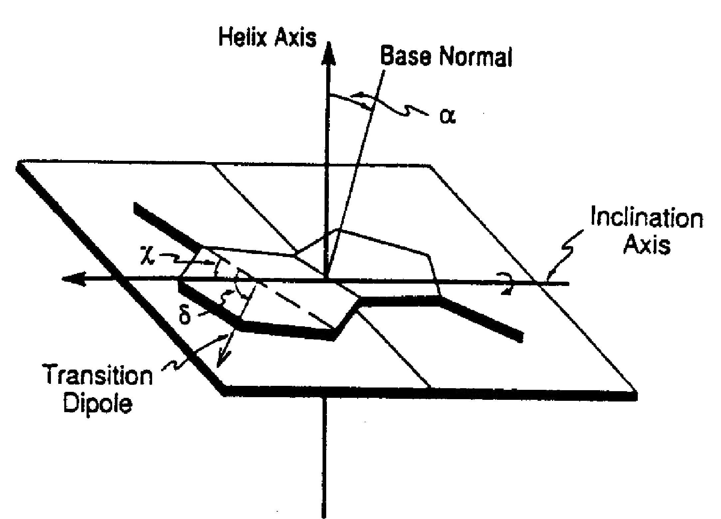
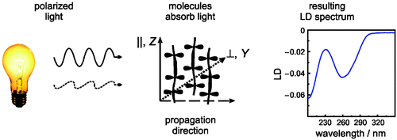
Linear dichroism (LD)
Difference in absorption of the light linearly polarized parallelly and perpendicularly to the orientation of the molecules
  requirements: molecules are oriented and molecules absorb in the region of interest
  orienting the molecules: gel, electric field, flow (rotation)
  LD is sensitive to the orientation of absorbing parts (nucleobases) towards the orientation of the molecule – e.g. base inclination in NA
Bulheller et al., 2007, Phys Chem Chem Phys
Rodger et al., 2006, Phys Chem Chem Phys

Slide 41
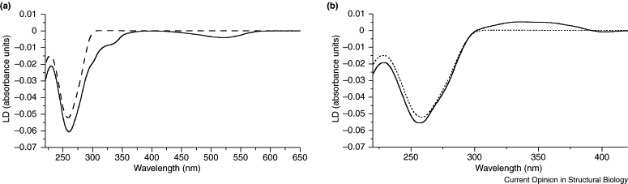
LD DNA + ligand
LD of DNA and DNA–ligand systems. (a) LD of calf thymus DNA (1000 μM base, dashed line) and the DNA plus an ethidium bromide intercalator (50 μM, solid line). (b) LD of calf thymus DNA (1000 μM base, dashed line) and the DNA plus a minor groove binder (diaminophenyl indole, 50 μM, solid line)
Dafforn et al., 2004, Curr Opin Struct Biol

Slide 42
Circular dichroism (CD)
Difference in absorption of left-handed circularly polarized light and right-handed circularly polarized light by a molecule
  requirements: molecules are chiral (sugar in NA), thus optically active and molecules absorb in the region of interest
  CD is sensitive to the mutual orientation of absorbing parts (nucleobases) towards each other – base conformations (syn x anti) – secondary structure of DNA
  optical activity = ability of the molecule to differentially interact with left-handed and right-handed circularly polarized light
  Optical rotatory dispersion (ORD) – angle of rotation of the linearly polarized light after passing through the optically active molecule – ORD in whole range of wavelenghts, with anomalous ORD, where molecule absorbs – more difficult interpretation than CD
  Cotton effect – CD / ORD band – positive x negative

Slide 43
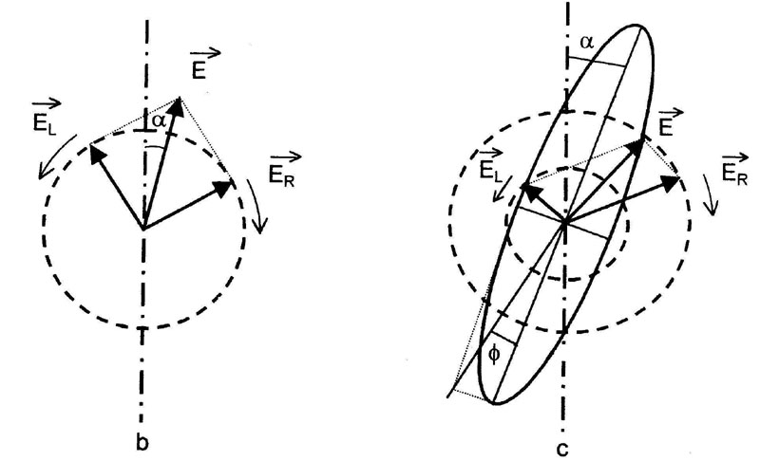
Circular dichroism (CD)
  Difference in absorbance: ΔA = A_{L} – A_{R}
  When known concentration, difference in molar absorption Δε = ε_{L} – ε_{R} = ΔA / lc (Beer-Lambert law)
  Ellipicity – the angle that describes the extent of change of the linearly polarized light into a elliptically polarized light (0 for linearly polarized, 45° for circularly polarized)
  tan φ = (E_{L} – E_{R}) / (E_{L} + E_{R}) = 3298 * Δε
  CD can be calculated but the results do not fit well with the experiment

Slide 44
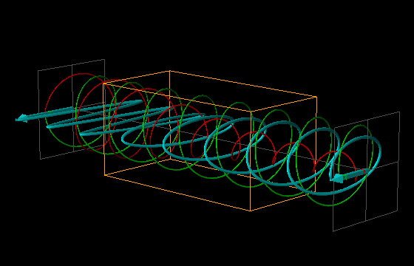
Applied Photophysics Ltd.

Slide 45
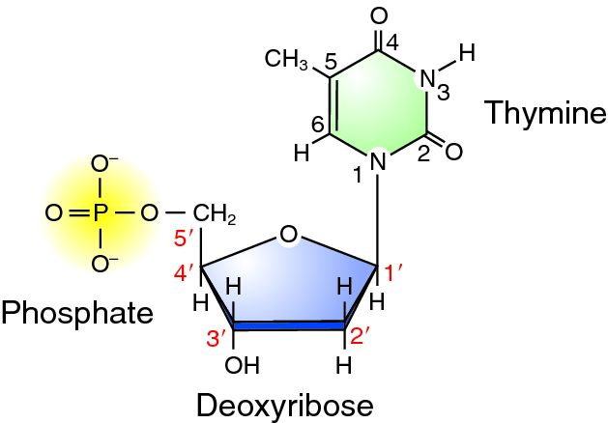
Circular dichroism – DNA / RNA
MUTUAL ORIENTATION OF BASES
ABSORPTION
CHIRALITY

Slide 47
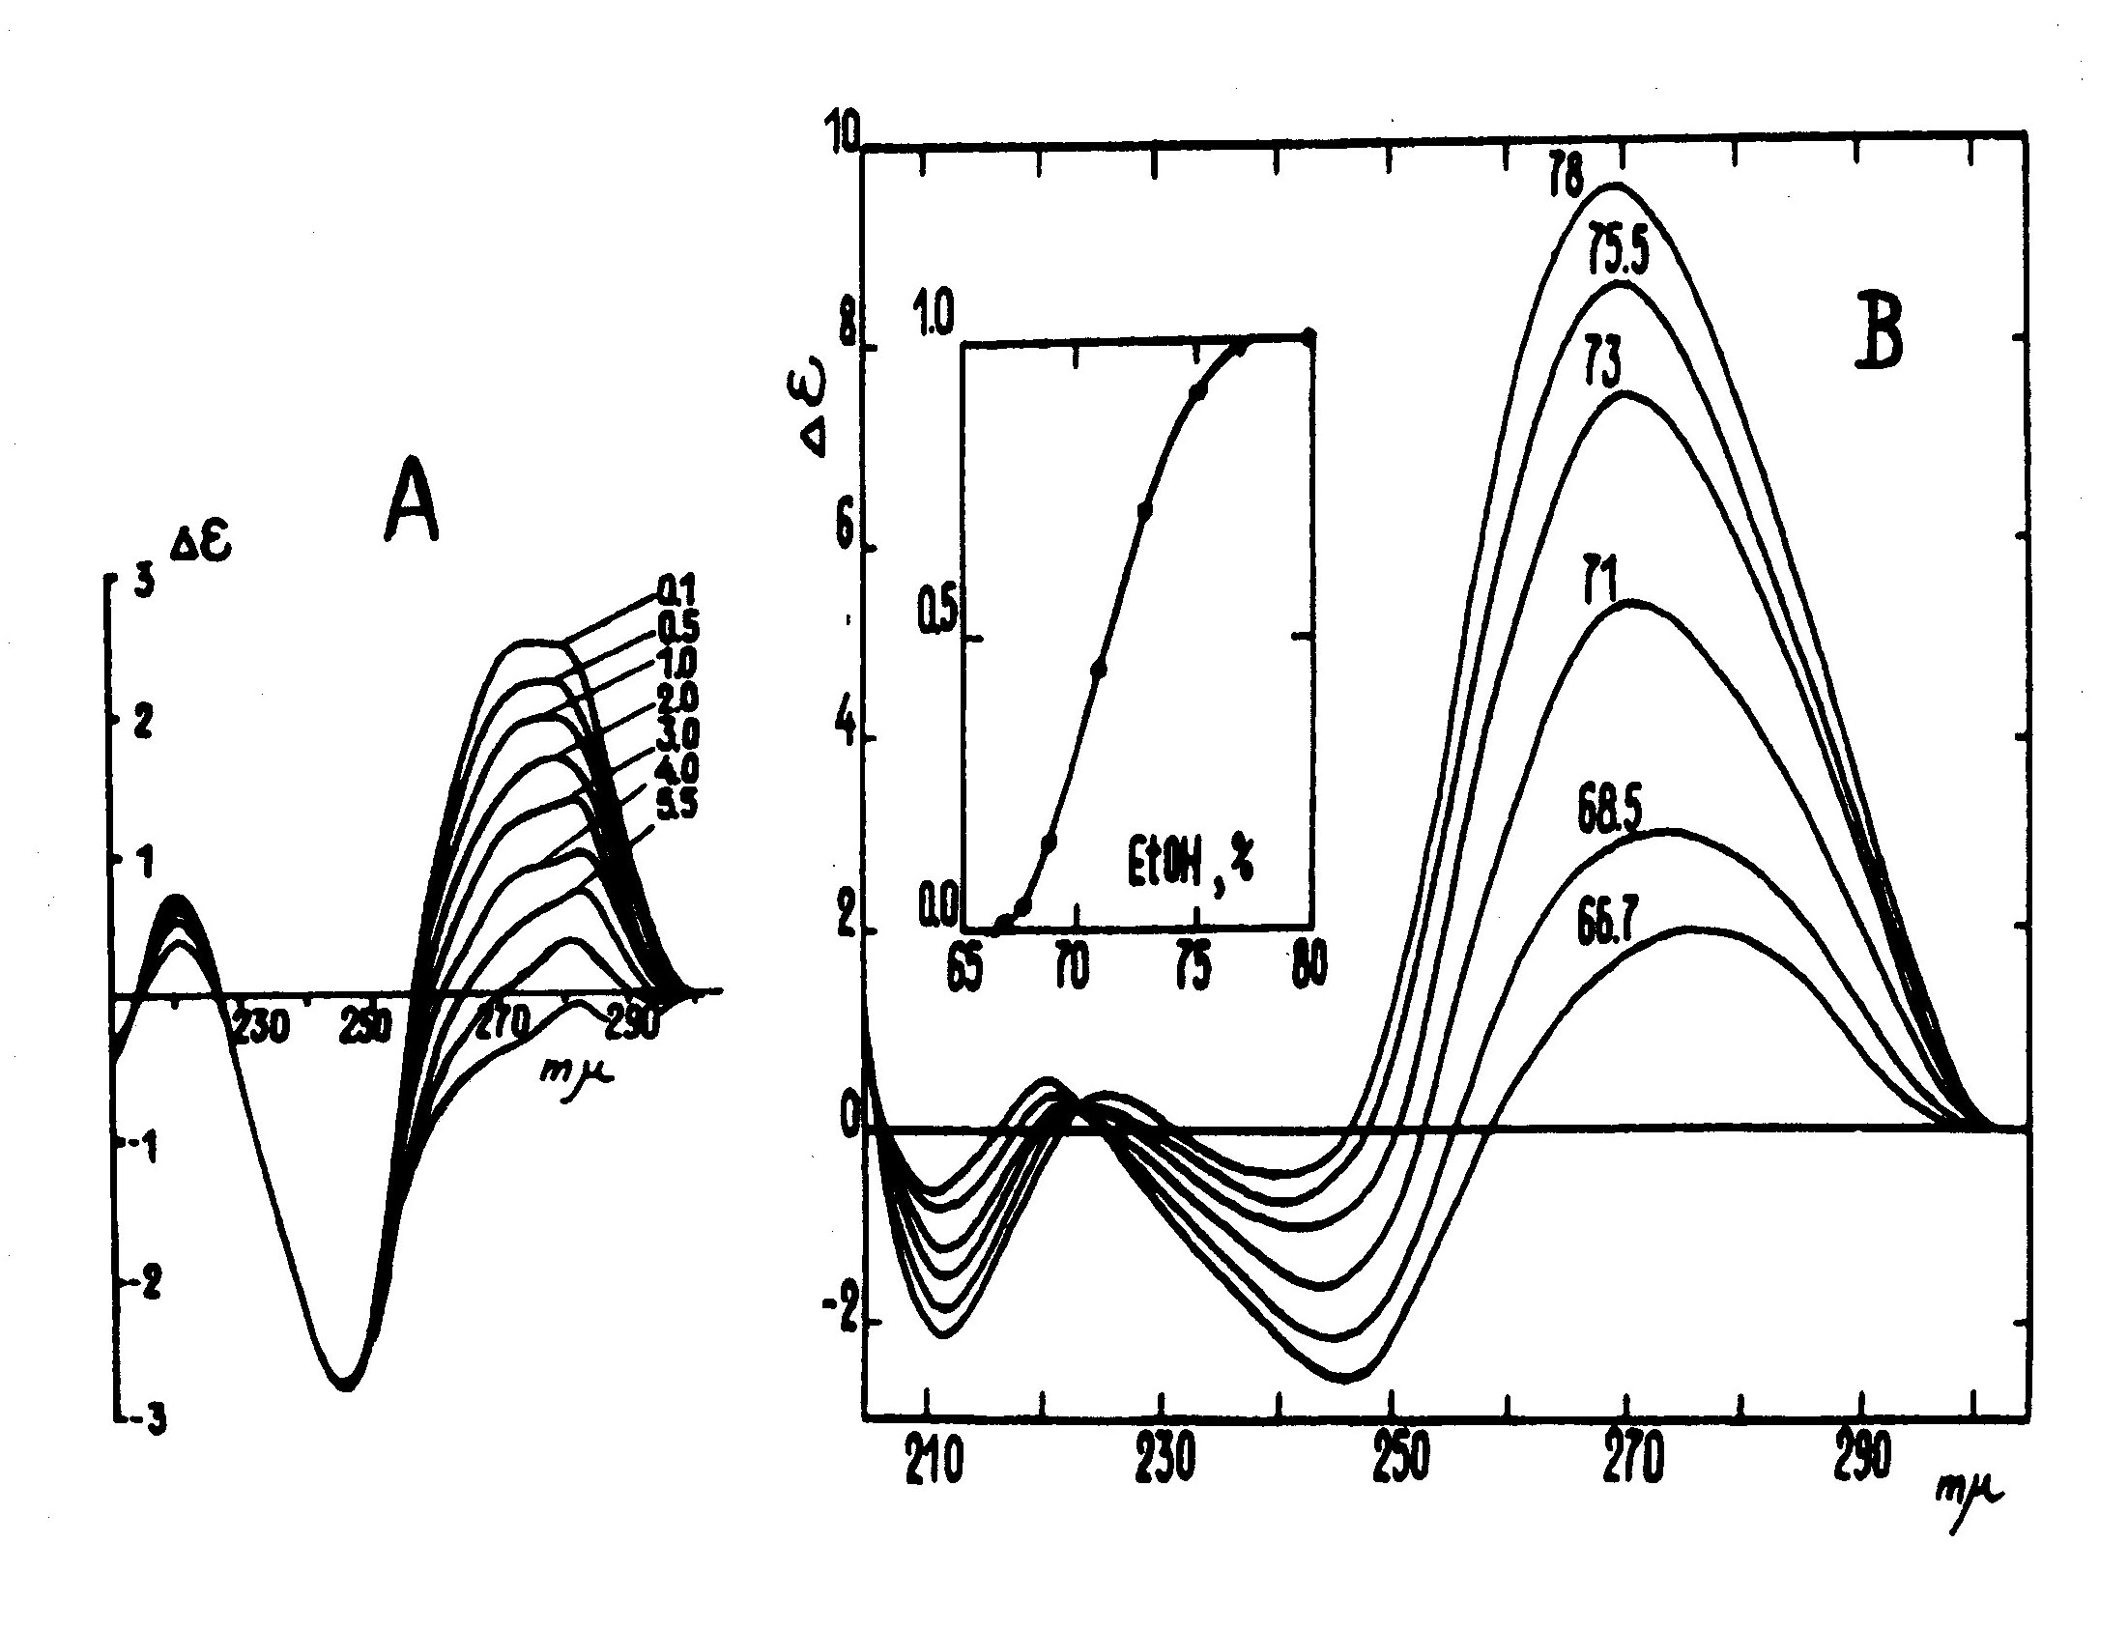
Transition cooperativity
NON-COOPERATIVE
TRANSITION
COOPERATIVE TRANSITION
LINEAR CHANGES
OF SIGNAL
SIGMOIDAL CHANGES
OF SIGNAL
ISODICHROIC POINT

Slide 48
CD – NA melting

Slide 49
Molecularity

Slide 50
Vibrational / infrared CD (VCD/IRCD)
Difference in absorption of left-handed circularly polarized light and right-handed circularly polarized light in a region of vibrational transitions (λ = 1-5 um).
compared to eCD, IRCD shows well differentiated bands belonging to specific functional groups
The vibration CD and absorption spectra of homoduplex of d(GC)₁₀ as the right-handed B-form and the left-handed Z-form.
Keiderling et al., 1989, Biomol Spec

Slide 51
Thank you

