Slide 1

LAND SURVEY OFFICE
(LSO)
PRAHA 2010

Slide 2
Organisational chart of the COSMC sector
CZECH OFFICE FOR SURVEYING, MAPPING AND CADASTRE
(COSMC)
Nr. of cadastral
workplaces
CADASTRAL
OFFICE
for the capital Praha
1
SURVEY AND CADASTRAL
INSPEKTORATE
IN BRNO
for the South-Bohemian Region
10
IN ČESKÉ BUDĚJOVICE
LAND SURVEY
OFFICE
(LSO)
for the Region Karlovy Vary
3
IN LIBEREC
for the Region Hradec Králové
5
IN OPAVA
for the Region Liberec
6
IN PARDUBICE
for the Region Plzeň
12
IN PLZEŇ
for the Region Pardubice
4
IN PRAHA
for the Middle-Bohemian Region
13
for the Region Ústí n. L.
9
for the South-Moravian Region
11
9
RESEARCH INSTITUTE OF GEODESY, TOPOGRAPHY
AND CARTOGRAPHY
for the Moravia-Silesian Region
for the Region Olomouc
6
for the Region Vysočina
9
for the Region Zlín
8

Slide 3


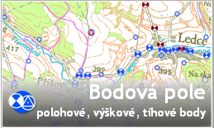
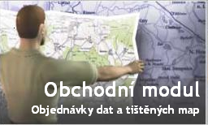
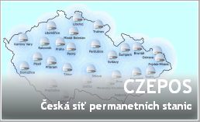

Land Survey Office
- administrative body for surveying in the Czech Republik
administration of geodetic control
of the Czech republik;
surveying at the state boundaries;
administration of ZABAGED®;
maintaining of a digital terrain models;
creation of orthophotographic representation of the Czech republik;
production of state map series;
standardisation of geographical names;
managing of the Central archives of surveying, mapping and cadastre
Data extending
and services

Slide 4
Organisational chart of the LSO
* employees
Director
total 433*
Internal auditor
1*
68*
Section for administration
Section for land surveying
363*
8*
Personal department
Department of geodetic
control
79*
8*
Department of IT
administration
Department of administration
ZABAGED
22*
17*
Department of economy
Department of updating
ZABAGED
89*
34*
Department of logistics
Department of cartography
and polygraphy
85*
10*
Central Archives for Land Survey and Cadastre
Department of geographic data provision
36*
7*
Secretariat of Commission
for Geographic Names
Department of land
surveying Pardubice
34*
Notes:
The Land Survey Office has two sections and 10 departments. It has about 450 employees.
The Land Survey Office is located in Prague, its department of cartography and polygraphy is 70 km southward Prague in Sedlčany.
There are 7 detached departments in regions, which activities I will mention later.

Slide 5
Contemporary conditions
  2004 – organisational changes;
  till 2005 – period of digitalisation;
  after 2005 – period of updating and data capture;
  internal changes - new technologies;
  reducing of the staff 2004 : 523
  2010 : 433 (- 90 17%);
  number of users increases;
  budget LSO: 2009 - 230 mil Kč ( 8,8 mil €);

Slide 6
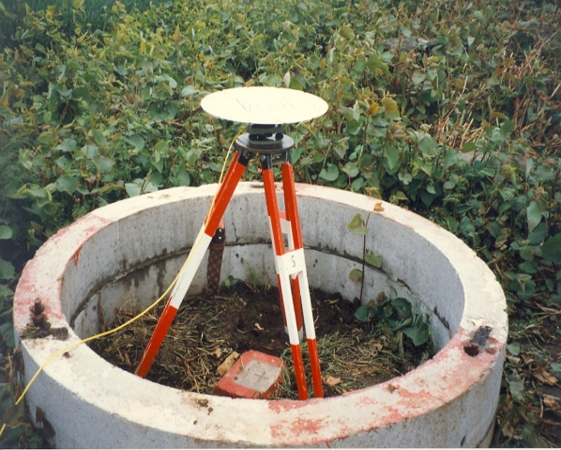
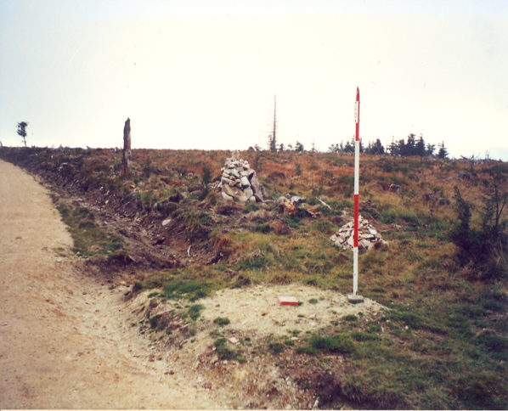
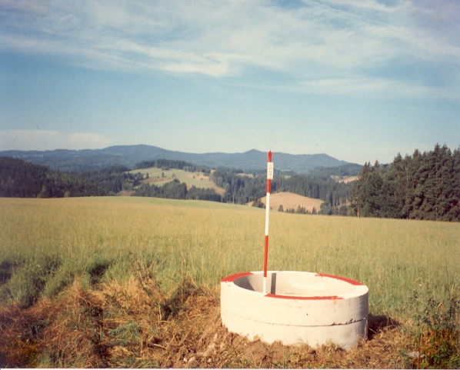
Administration of geodetic control
maintenannce and renewal of reference frame
Geodetic control:
- 28 000 trigonometric points,
- 83 000 leweling points,
- 500 gravimetric points.
implementing of a dynamic maintenance based on the communication with users – mostly private surveyors

Slide 7
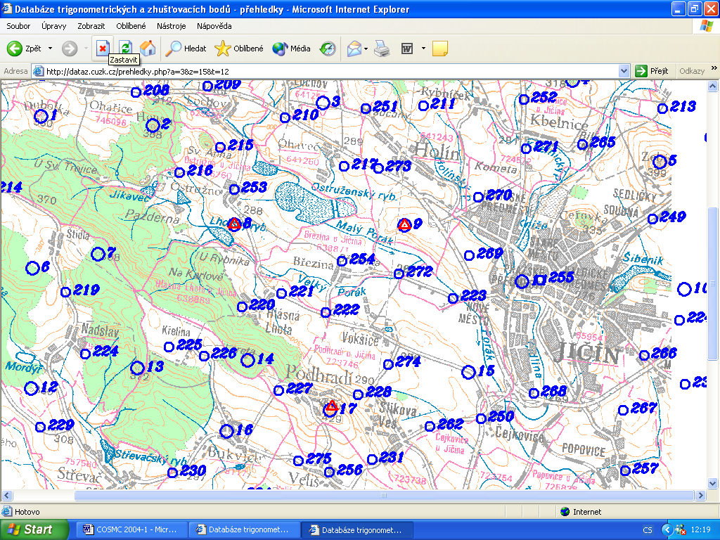
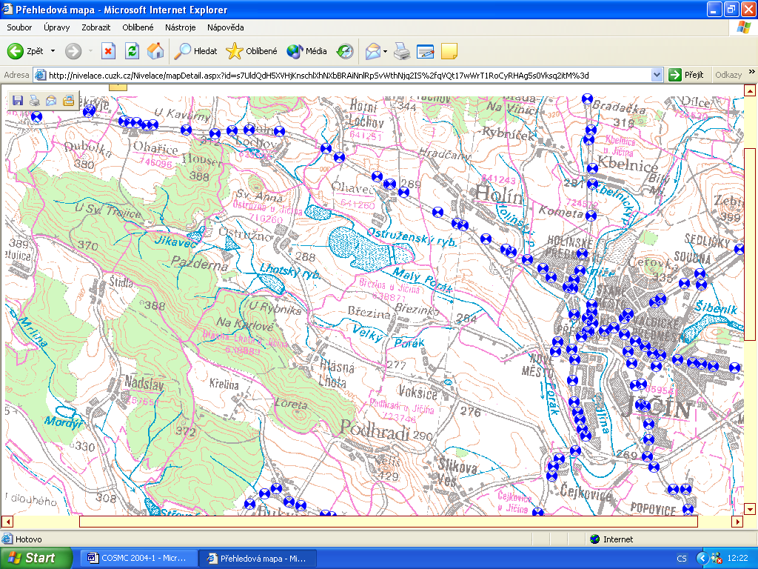
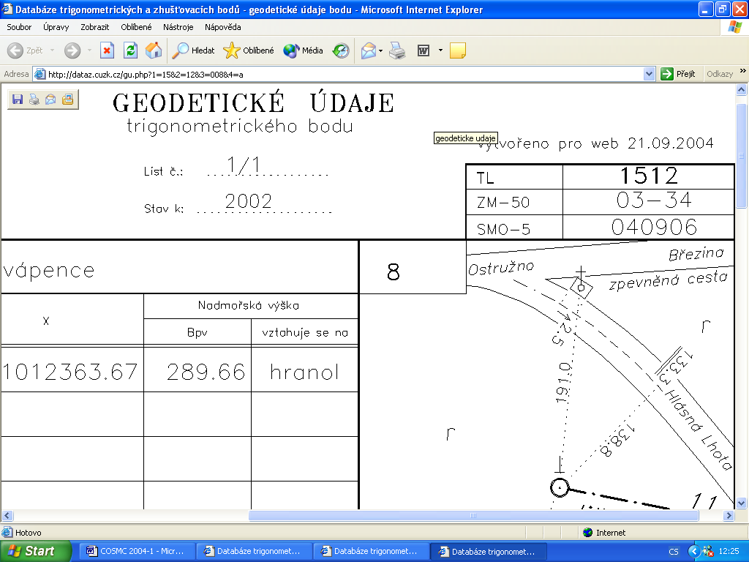
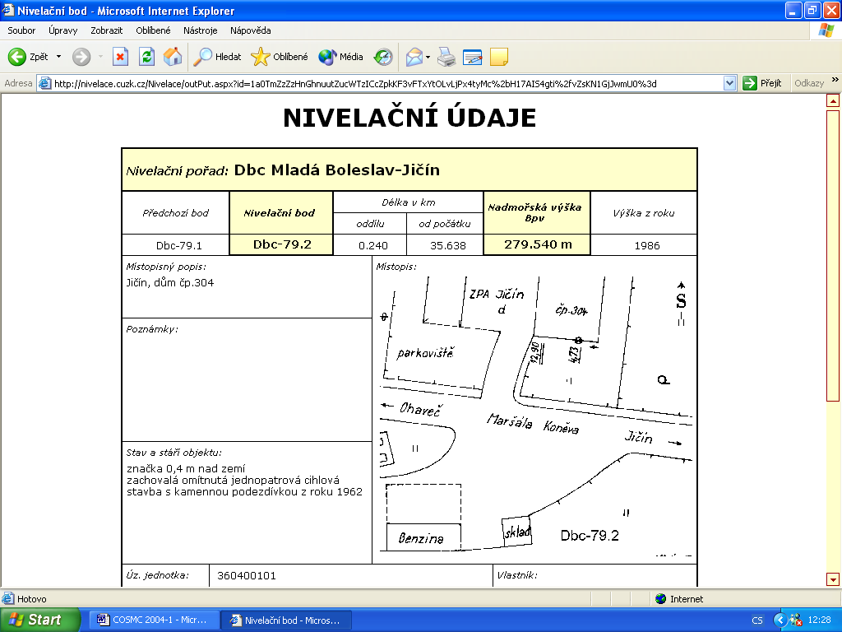
2 databases of trigonometric, levelling and gravimetric control
stations published on the Internet, free of charge
http://dataz.cuzk.cz
http://nivelace.cuzk.cz
www.cuzk.cz

Slide 8
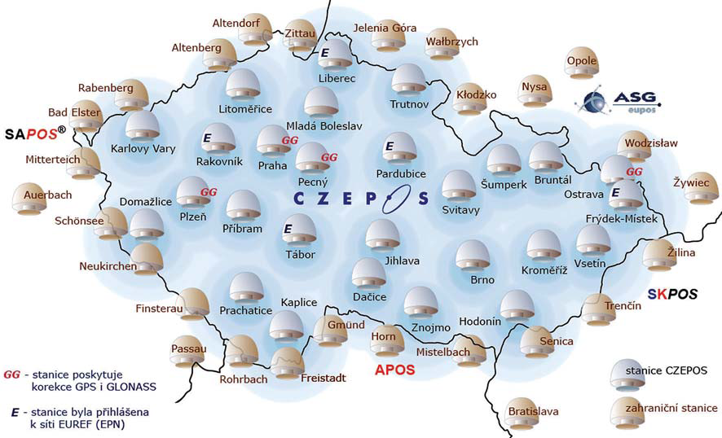
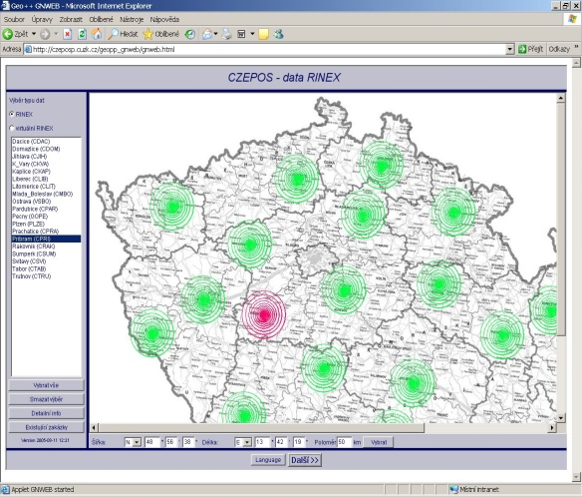
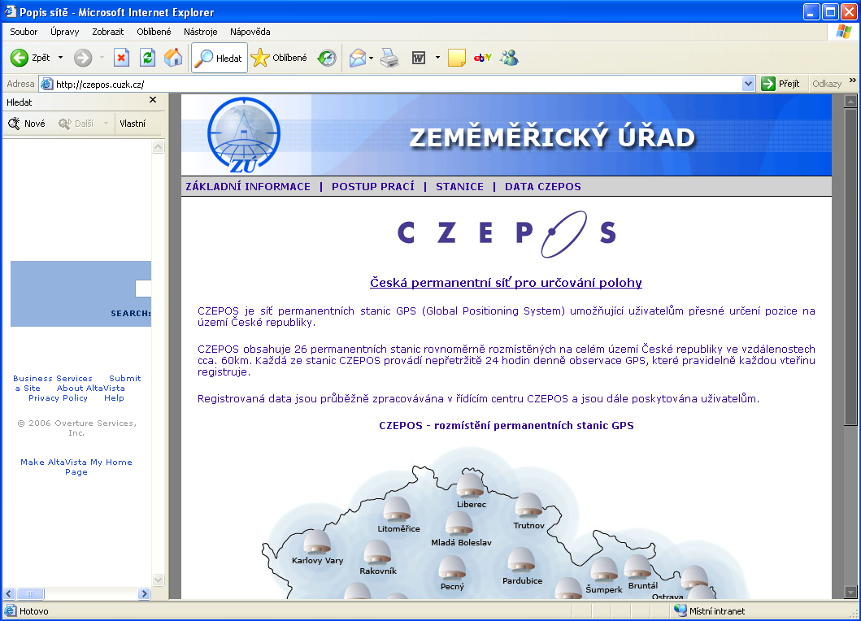
CZEPOS - Czech Network of the Permanent GNSS Stations

Slide 9
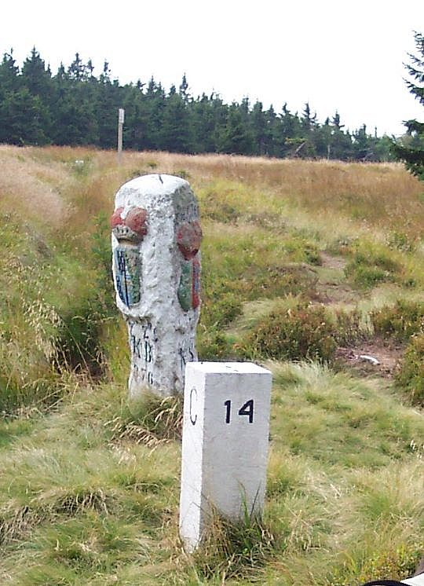
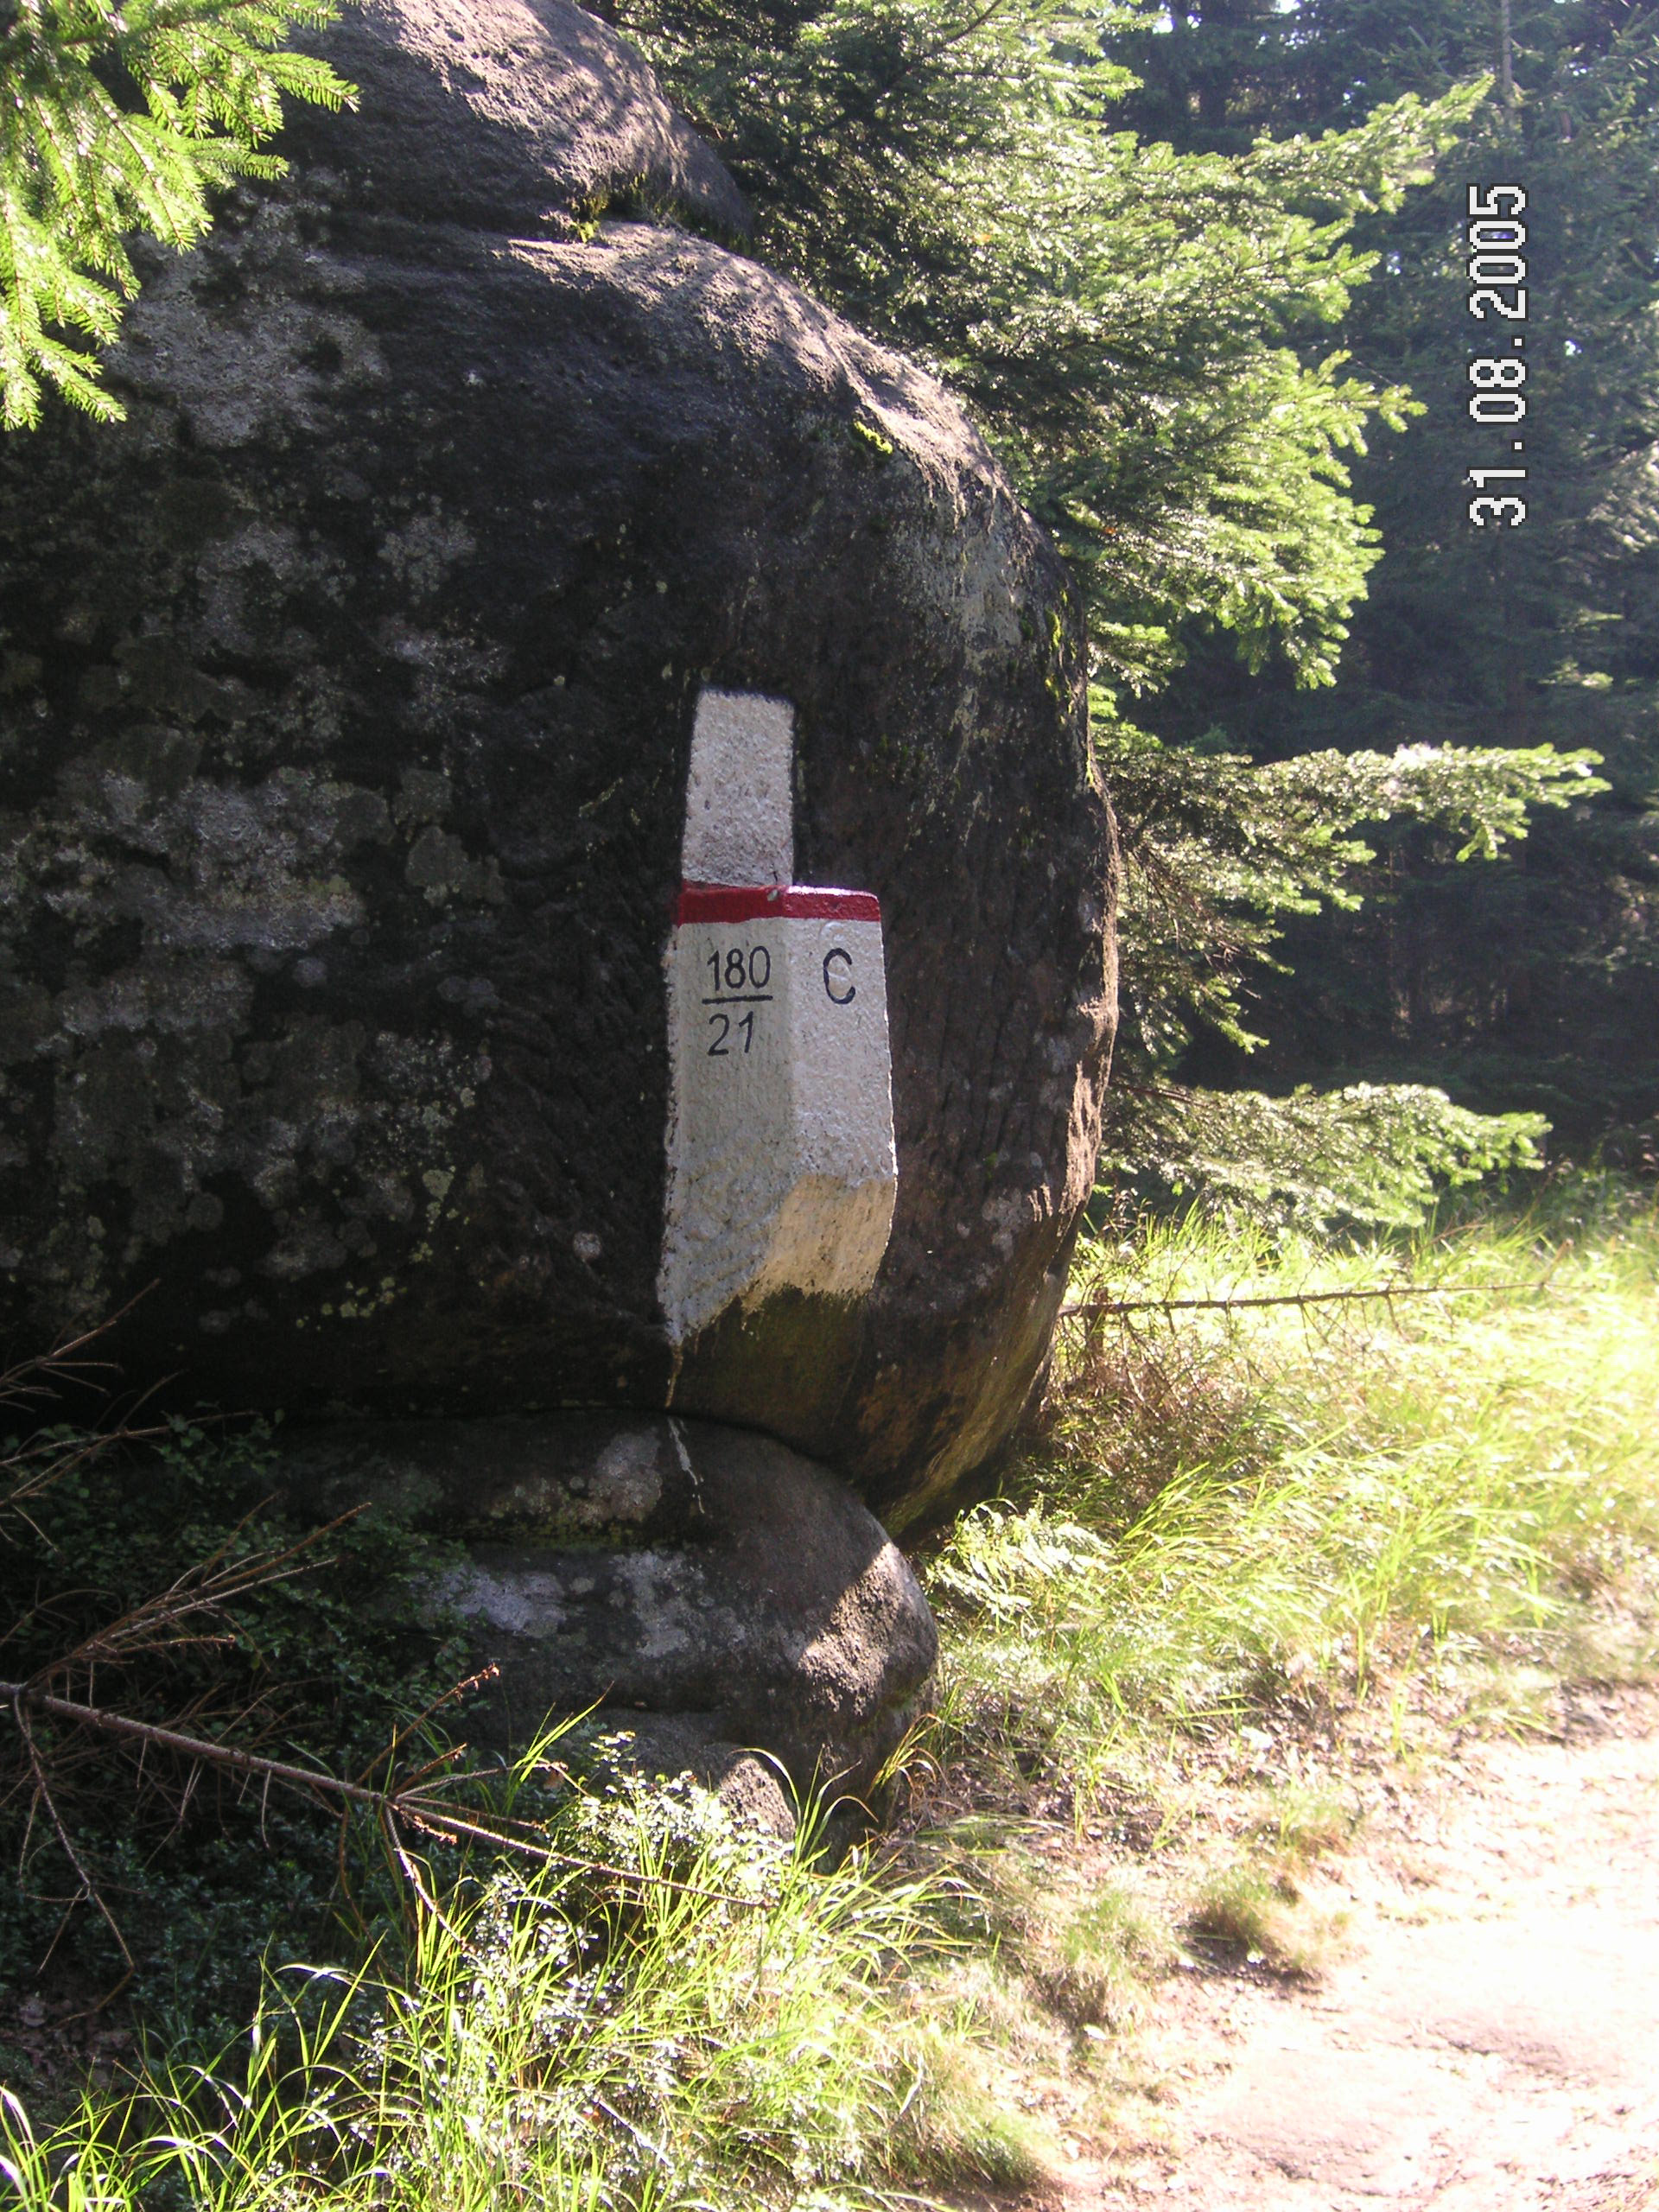
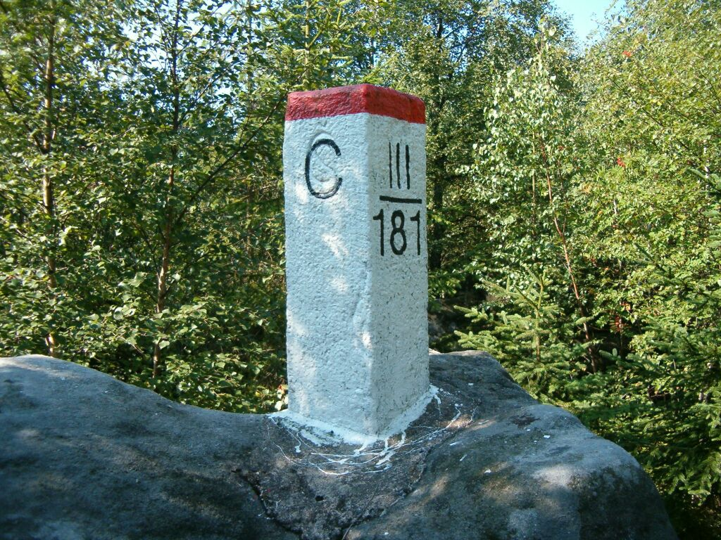
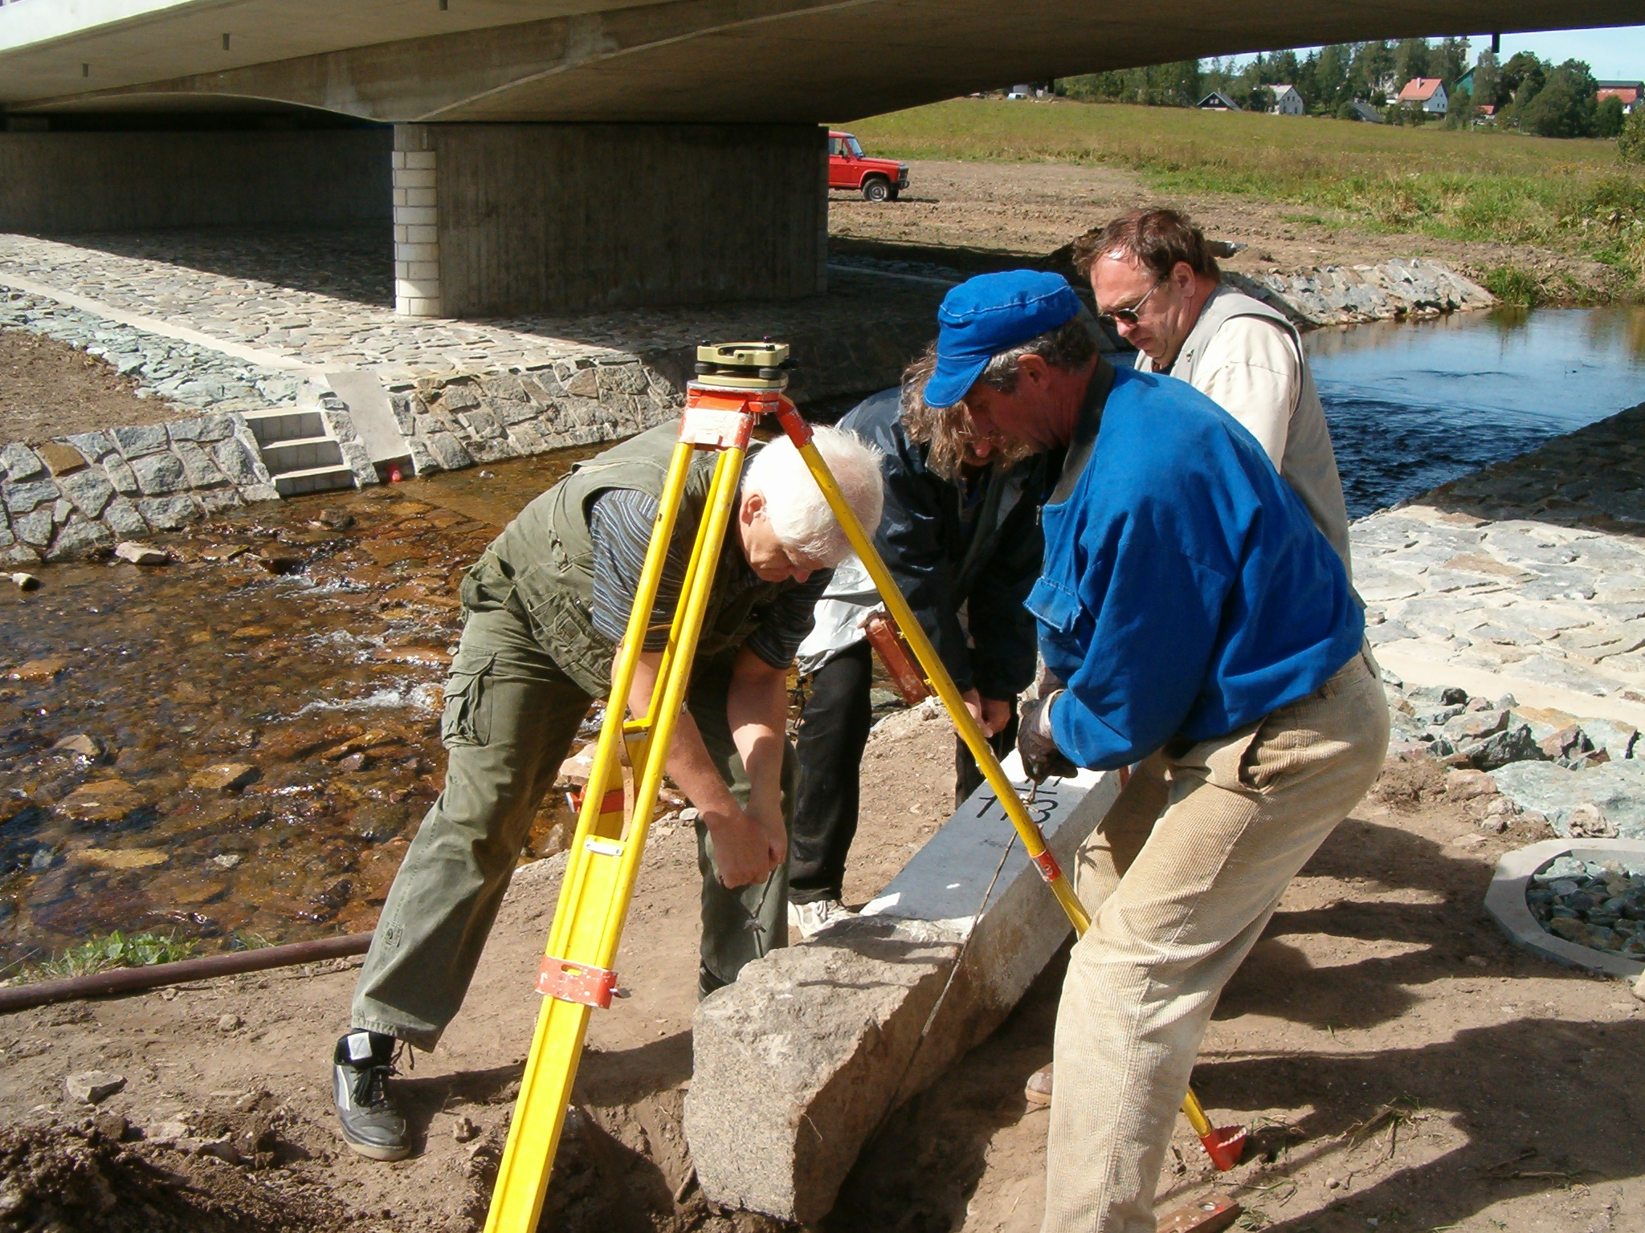
Surveying and maintenance of the state boundaries
period of transformation and updating of state boundaries docunmentation from a graphical to a digital form and specifications of positioning coordinates of all break point of the state border,
state border documentration administrator – Ministry of interior,
processing coordination by the international boundary commissions of neighbour countries.

