Slide 1
Facilitating Volunteered Geographic Information Through SDI Policy Frameworks.
Associate Professor Kevin McDougall
Head, Surveying and Spatial Science, USQ

Slide 2
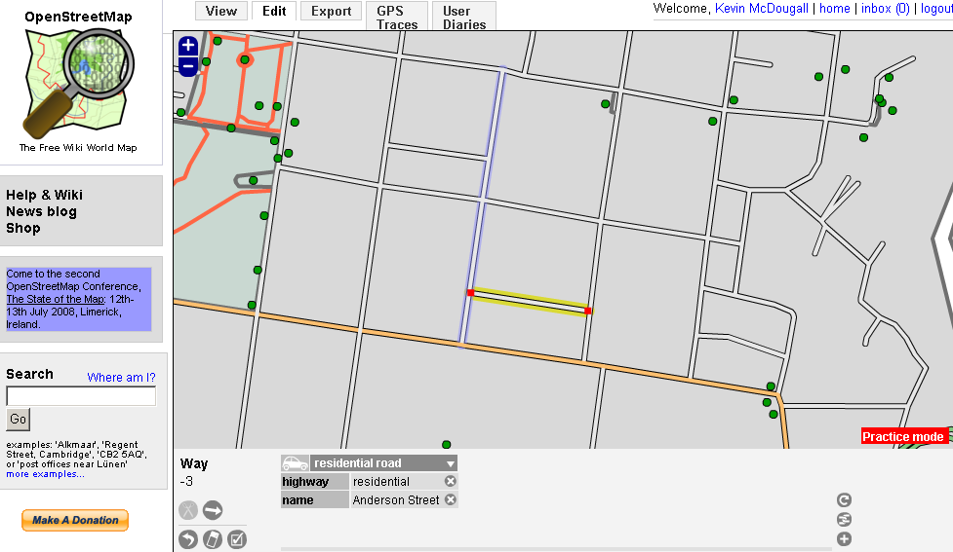
Overview of Presentation
Technology as a Change Driver
Trends in Spatial Data Collection and Utilisation – Public Sector, Private Sector and Individuals
SDI and Volunteered Geographic or Spatial Information
Adapting SDI policy frameworks
Future challenges and innovation

Slide 3
Technology Driving Change
In 2000 developing countries accounted for around one-quarter of the world’s 700 million mobile phones by the beginning of 2009 that share had grown to three-quarters but the number had risen to over 4 billion.
MySpace, YouTube and Facebook had over 250 million visits in the last 2 months – 6 years ago they didn’t exist
5 years ago we were talking about convergence – it’s here plus more
Average American teenager sends over 2,200 text message a month
iTunes Apps Store opened in July 2008 there are now over 300,00 Apps available

Slide 4
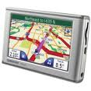
Digital Mapping
Seamless / Scalable / Multi-dimensional
Internet
DCDB
SDI Ver 1
SDI Ver 2
SDI Ver 3
1980
1990
2000
2010
Information & Communication Age

Slide 5
Where to in the Future..
“as we know, there are known knowns; there are things we know we know. We also know there are known unknowns; that is to say we know there are some things we do not know. But there are also unknown unknowns -- the ones we don't know we don't know”
Defence Secretary Donald Rumsfeld

Slide 6
Trends in Spatial Data Utilisation
CAPTURE
BUILD
MAINTAIN
RE-USE
IMPROVE

Slide 7
Spatial Data Infrastructure (SDI) Trends and Issues
Established by governments, primarily at national and state levels
Policy direction through National Mapping Agencies and state government spatial information council (co-ordination roles)
Increased focus on local government and private data holdings, and citizens particularly for emergency response management

Slide 8
Traditional Top Down SDI National Policy and Producer Driven
Less detailed data
National SDI
State SDI
POLICY DRIVEN
Local SDI
More detailed Data
(Rajabifard et al)

Slide 9
Bottom Up SDI User Driven
Less detailed data
National SDI
State SDI
USER DRIVEN
Local SDI
More detailed Data
(Rajabifard et al)

Slide 10
So – What Does This Mean?
We need to recognise that current systems/institutional processes are/were not designed for a dynamic and demanding information environment
Government bureaucracies are still the warehouse/custodian of much of our fundamental data – but have a significant degree of institutional inertia
May not necessarily be models of innovation or more responsive information management
Users now more interactive and often driving change

Slide 11
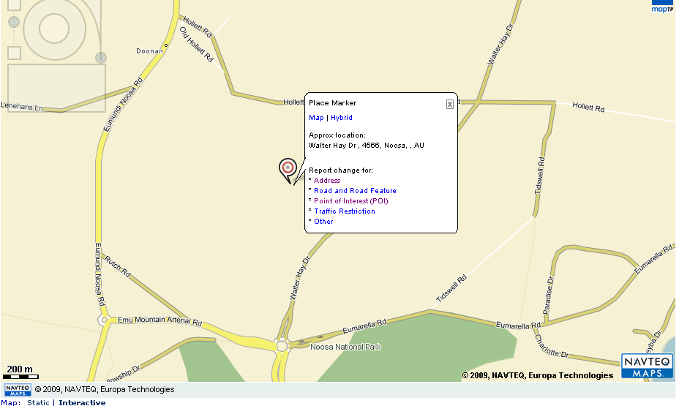
Some Issues in Volunteered Geographic Information
Non-geographic/spatial users supplying data
Large variations in quality
Greater level of subjectivity
Multiple entries
Possible IP issues
Possible legal issues
Existing data standards not designed for ad-hoc users
Metadata variable

Slide 12
Traditional SDI versus VGI
 | Government-centric SDI | User-centric VGI
SDI Structure | Highly structured | Ad-hoc and simplistic
Standards | Close adherence to standards | Loose based on communication standards
Maturity of data holdings | Highly mature | New and current but variable
Spatial Accuracy | Complying with mapping standards | Variable
Metadata | Contain detailed metadata | Few standards – ICT based
Openness | Highly controlled | Often new data sets
Data Update | Often slow and overly bureaucratic | Fast and flexible
Potential data maintenance and collection base | Limited to the budget and staffing | Potentially a huge user and contributor base
Adaptability | Low – retrained by mandate, resources and bureaucracy | High

Slide 13
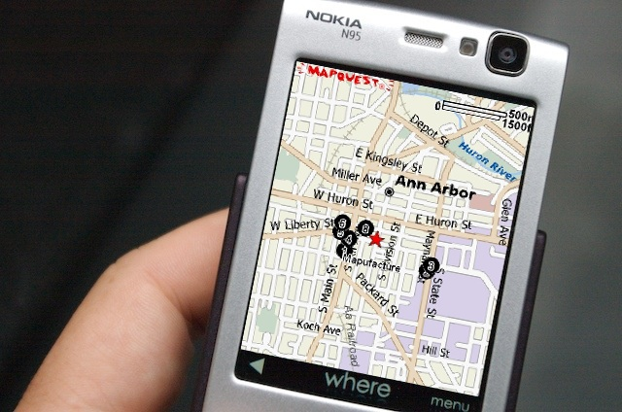
Adapting SDI Policy Framework for VGI
SDI Governance
Access arrangements
Standards
Data Sharing
Data Quality and Reuse

Slide 14
SDI Institution Governance
SDI governance is put in place to improve institutional and data management arrangements to support SDI
Most existing governance arrangements include regulators, large industry organisations, government stakeholders and value adders – most if not all spatially focussed
Future governance needs to include community groups with public interest roles
Non-spatial organisations representative of larger business users
Collect user input as part of the governance and development cycle

Slide 15
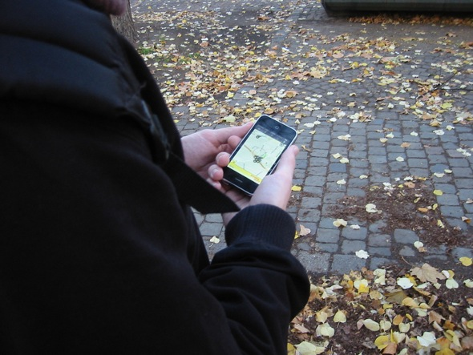
SDI Technical Governance
Increasing levels of complexity in managing sources of spatial information
Moves towards technical governance through use of registries
Procedures for publishing, managing, discovering and using spatial data
Roles and registration of contributors - profiles

Slide 16
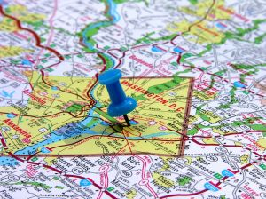
Access Policies
Trend toward greater access to fundamental information to the community
Access arrangements may need to vary depending on user registration
Volunteers may access differing versions or themes of data to improve value of their contributions
View access versus contribute access
Possibility to edit previous contributions and record history
Need to be transparent and dynamic

Slide 17
Data Standards
Move to greater interoperability and open standards
Review approached to metadata
Volunteers less likely to provide spatial metadata
Registration of volunteers to assist metadata collection and validation
Automate collection of metadata through user profiles (GeoNode)
May require greater collaboration with Telcos to assist validation

Slide 18
Legal Framework
Privacy – need to protect users
Copyright – does basic spatial location attract a copyright requirement – decision on copyright needs to be understood.
Traceability of data – particularly for emergency events
Liability
Register users and establish agreements on entry
Current arrangements do not adequately address volunteered information – need to look to facebook and others

Slide 19
SDI, VGI and Web 3.0
Authoritative SDI still required in the near future as underlying foundation
Need to open up public data access and entry of data
Move to networked data under Web 3.0 – linked data with geographical position or tagging of data
Data models needed to improve data reliability and accuracy
May distinguish user entry
Registered vs non-registered user
Trusted vs non-trusted

Slide 20
Some Challenges for Mapping Agencies
Need to develop concept of trusted volunteered users
Direct deposition of data in a digital form
Point location and attributes
Boundary and attributes
History and editing
Validation and acceptance procedures
Focus on data improvement and maintenance
Who will pay for this process – client, government or value adder
Perhaps a new business model – shared data model and costing model

Slide 21
Conclusions and Challenges
Traditional government and private sector mapping organisations need to acknowledge the power and capability of users
Greater use of mobile technologies and positioning systems to improve the currency and positional quality
Better collaborative models need to be established across government-private sectors to reduce duplication of data collection and improve reliability
Policy frameworks must adapt to changing user and technology drivers

Slide 22
Facilitating Volunteered Geographic Information Through SDI Policy Frameworks.
Associate Professor Kevin McDougall
Head, Surveying and Spatial Science, USQ

