Slide 1
Digital Earth in Big Data Era
Smart and with People
Milan KONEČNÝ
Laboratory on Geoinformatics and Cartography
MU BRNO
ICA Commission CEW&CM
Former President ICA
Vice-President IEAS
Member of Silk Road Data Initiative (ISDE)

Slide 2
Origin of Digital Earth and First Definitions
2. Digital Earth SWOT Analysis in EU (JRC Ispra)
3. Digital Earth Vision 2020
Big Data Concepts
Adaptive Cartography and Context-based Cartography. Cognitive Style
Neogeography, VGI and Social Media Geographic Information
Social Media Geographic Information(SMGI)

Slide 3
1. Origin of “Digital Earth” Concept
Al Gore,
January 31, 1998
Given at the California Science Center, Los Angeles, California
Understanding our planet in the 21st century
A “multiresolution, three-dimensional representation of the planet, into which we can embed vast quantities of geo-referenced data,” “navigating through both space and time to view natural, cultural and political information about the planet, virtual reality installations in museums, improved access to public domain data”, and “a digital marketplace for companies selling a vast array of commercial imagery and value-added information services.
As a direct result of Al Gore’s policy position in 1998, the Digital Earth initiative was established. This was quickly adopted internationally through and an increasing community of international enthusiasts is constructing major components of the Digital Earth vision.

Slide 4
BACKGROUND
The concept of Digital Earth originated with Gore’s
a) A multi-resolution, three-dimensional representation
of the planet
b) A new framework for integrating a wide variety of
geo-referenced data, including natural, cultural and
historical components, not limited to 3D space, but
also able to deal with time.
c) Excellent for modelling processes, be it short term
hazards, or long term climate change, geological
processes, etc.

Slide 5
Prof. Lu Yongxiang, the president of International Society for Digital Earth
described Digital Earth as “a fundamental work of the Earth Sciences. As a common framework for describing Earth's information in the temporal and spatial domains, Digital Earth is at present mainly used for information integration of Earth Observation Systems and provides functions for data's acquisition, storage, transfer, analysis, and processing. Its emphases are on establishing a unified coordinate system and on developing multi-dimensional dynamic virtual display.” (1999)
Prof. Xu Guanhua
believed that “Digital Earth is located at the interdisciplinary forefront of earth science, space science and information science and technologies, and it will be a fruit of natural science and social science, and closely associated with human requirements. As a powerful supporting tool, Digital Earth can play a key role in new economic growth and in global sustainable development. It is the inevitable outcome of science, economy, politics, and society and their historical development.” (1999)

Slide 6
Prof. Michael Goodchild (2008)
digital Earth includes four aspects: visualisation, ease of use, interoperability and mashups, modelling and simulation
Prof. Chen Shupeng and Prof. van Genderen (2008)
digital earth should have five phases: Data extraction, Information extraction, Knowledge extraction, Modelling, and Decision making
Prof. Li Deren
Key technology of the digital earth consists:
· High Resolution Satellite Image
· Broadband Networks and Data Standards
· Spatial Information Technology and SDI (Spatial Data Infrastructure)
· Science Computation
· Vast Storage and Metadata

Slide 7
Alexander Martynenko, Russia:
“Today, at the boundary of millennia, the Electronic Earth appears as the prior direction of scientific and technical progress. Its goal is the cartographic representation of the real world and creation of the global computer model of the Earth, comprised of millions of space images and electronic maps of various subjects and scales, themes and also reference information.

Slide 8
Martynenko-2
This fundamental problem can be solved by cartographers from different countries, who should meet in the 21 century as partners, possessing new ideas, courage and intellectual technologies for creating and application of maps.“

Slide 9
Platforms of Digital Earth
Scientific Platform (SP)
Scientific projects relating to digital earth science and various practices of earth science
Commercial Platform (CP)
Digital earth software developed in commercial corporations

Slide 10
Three points of view:
-international general, scientific and research discussion about the role of Digital Earth as an Integrative Concept and SDIs as an Engines
-Big Data – potentials of Geoinformatics (RS, GIS,VGE,..) in solving of Contemporary Problems
- The challenges for development of data strategies for National (Mapping) Organizations, wide public society and their potential cooperation via volunteer society efforts (Volunteer Geographic Information)

Slide 11
Data, Information and Knowledge
Perhaps sometimes in the future
WISDOM
Deliver to People
How?

Slide 12
2. Digital Earth SWOT Analysis
in EU (JRC Ispra)

Slide 13
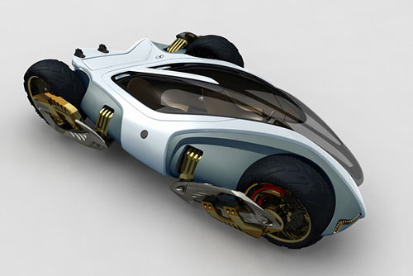
DE Vision – a SWOT analysis - STRENGTHS
DE is a very useful metaphor
DE displays some of the characteristics of “magic concepts”
DE has a global dimension, inclusive of multiple applications and themes
DE has a strong political backing since the beginning
DE has a strong technological component
DE provides a flexible framework to adapt to evolving technologies
Magic Tricycle - Car Design News™ 2008
Notes:
DE is a very useful metaphor, easy to understand, and providing a powerful way to convey a concept;
DE displays some of the characteristics of “magic concepts”, like governance, which have an overwhelmingly positive connotation, and can advertise, focus and legitimise certain way of looking at the world, and help mobilise resources and political support;
DE has a global dimension, inclusive of multiple applications and themes, and potentially embracing all mankind as the stakeholder;
DE has a strong political backing since the beginning particularly in the US, and China;
DE has a strong technological component, harnessing developments in internet technologies, data availability, and visualisation methods among others;
DE provides a flexible framework to adapt to evolving technologies such as sensor networks, and mobile phones

Slide 14
DE Vision – a SWOT analysis – WEAKNESSES (1/2)
DE encapsulates many different concepts
e.g. information system, infrastructure to visualise a access geo-information, a virtual model of the Earth (or parts of it), an approach to explore the Earth system
The DE Vision has
Ambiguities on its nature: political, vs. academic, vs. a technological initiative
Ambiguities on main target audience: policy-makers and planners vs. scientific community or the general public
Unclear research focus, which may reduce interest in the scientific community
DE has uneven visibility in different regions of the world
Notes:
DE encapsulates many different concepts. It is sometimes presented as an information system or an infrastructure to visualise and access geo-information, a virtual model of the Earth (or parts of it), or an approach to explore global issues and the Earth system;
DE has uneven visibility in different regions of the world, which is then reflected in different thematic priorities;
There is some ambiguity on the nature of the DE vision: political, vs. academic, vs. a technological initiative, and the main target audience: policy-makers and planners vs. scientific community or the general public;
The vision has an unclear research focus, which may reduce interest in the scientific community;

Slide 15
DE Vision – a SWOT analysis – WEAKNESSES (2/2)
Unclear relationships and added value of DE in relation to other initiatives such as GEOSS, SDIs, Eye on Earth,..
Original DE vision does not properly reflect recent changes in society including
major role of the private sector (Google, Microsoft), and
emergence of social networks (Facebook) at the global level
Because of the uncertainties above, it is difficul to communicate clearly what DE is, and how it will be put into practice
This difficulty in communicating the concept makes harder to consolidate links and collaborations with other initiatives and to develop a DE community with active members from different disciplines
Notes:
The relationships and added value of DE in relation to other initiatives such as GEOSS and Spatial Data Infrastructures (SDIs) at different levels are not clear;
The original DE vision does not properly reflect changes in society including the major role of the private sector (Google, Microsoft), and the emergence of social networks at the global level;
Because of the uncertainties above, it is difficult to communicate clearly what DE is, and how it will be put into practice;
This difficulty in communicating the concept, makes it harder to maintain links and collaborations with other initiatives such as GEOSS, and develop a DE community with active members from different disciplines to complement the active support of the Chinese Academy of Science.

Slide 16
DE Vision – a SWOT analysis –OPPORTUNITIES (1/2)
The increased availability of digital content from public, private sectors and citizens supports the vision of DE
Developments in technology and policy foster increased data access and sharing
ISDE with 10 years of history, strong political backing, and the support of the Chinese Academy of Science provide a sustainable platform for achieving the vision
Increasing profile of DE within the scientific community through symposia and the inclusion of the IJDE in the scientific citation index
Increasing recognition of the need to build bridges across different related initiatives, as witnessed by the membership of the ISDE in GEO
Multiple research and government funding opportunities available to develop components and applications of DE
Notes:
The increased availability of digital content from both public and private sectors, including that provided by the general public (e.g. volunteered geographic information) supports the vision of DE;
Developments in technology and policy foster increased data access and sharing;
The existence of the ISDE with 10 years of history, strong political backing, and the support of the Chinese Academy of Science provide platform for achieving the vision;
Increasing profile of DE within the scientific community through symposia and the inclusion of the International Journal of Digital Earth (IJDE) in the scientific citation index;
Increasing recognition of the need to build bridges across different related initiatives, as witnessed by the membership of the ISDE in GEO;
Multiple research and government funding opportunities available to develop components and applications of DE;

Slide 17
DE Vision – a SWOT analysis –OPPORTUNITIES (2/2)
Profiling DE as a central vision space where ‘Geo-Imagineers’ can think out-of-the-box:
where they can extend and modify the vision of DE by incorporating innovative ideas and edge-cutting technologies, combining disciplines, and
ultimately feeding new ideas and requirements into research projects and more practically oriented initiatives
Notes:
Profiling DE as a central vision space where ‘Geo-Imagineers’ can think out-of-the-box: where they can extend and modify the vision of DE by incorporating innovative ideas and edge-cutting technologies, combining disciplines, and ultimately feeding new ideas and requirements into research projects and more practically oriented initiatives.

Slide 18
DE Vision – a SWOT analysis - THREATS
No shared ownership over the vision of DE
Existing leaderships do not always recognize the importance and power of the DE vision as a mechanism to advance the realisation of DE
Initiatives are sometimes competing for resources rather than exploiting synergies
Private sector’s own vision and interpretation of DE, and the resources at its disposal, may overshadow and make irrelevant governmental or academic efforts in this area
Because the success of the private sector’s mass market applications, the need for research and development in the area of DE may become less evident to the funders of public sector research programmes
Notes:
There is no shared ownership over the vision of DE, and the leadership in relevant supra-national and global initiatives do not always recognize the importance and power of the DE vision as a mechanism to advance the realisation of DE. As a result, initiatives are sometimes competing for resources rather than exploiting synergies;
The private sector’s own vision and interpretation of DE, and the resources at its disposal, may overshadow and make irrelevant governmental or academic efforts in this area;
Because the success of the private sector’s mass market applications, the need for research and development in the area of DE may become less evident to the funders of public sector research programmes.

Slide 19
Topics of European Interest
Citizens’ Involvement in the
Development and Use of DE
Governance
Integration of Scientific
Research into DE
Notes:
An enhanced contribution from Europe to the development of DE cannot of course address all the issues identified above. It should however, work on some of these aspects, building on the opportunities and strengths and contribute towards reducing perceived weaknesses or potential threats. In some instances, it may even not be desirable or possible to resolve an issue identified. For example, we may have to accept that there will not be one DE but many reflecting the priorities of different stakeholders. They should however be connected or represent different views of the same underlying information resource base.
With these considerations in mind, we have identified three main topics on which we feel Europe has the opportunity to make a significant contribution.

Slide 20
European Proposals
global change and climate change, land-use change, sea level rise, environmental degradation, urban spread, natural resource depletion, and their impacts on society and economy
The role of private citizens’ involvement in the development, use, and management of DE
CITIZENS
involvement
Pilots and Events
Joint conferences and workshops
METHODOLOGIES
connect
Bring together methods and tools
Integration of scientific research into DE
Trust & Reliability in information content
support
GOVERNANCE
Pilots & Projects
European DE research Network (EDEN)– technological component
Distributed’ vs. ‘centric’ approaches
Multifacet: Public vs Private vs Citizens
Multilevel
implementation
Research & Position Papers
European Special Interest Group
European DE research Network (EDEN)– socio-economic component
Notes:
20
Figure 2 summarises the proposed activities in relation to the three main topics of the European perspective.

Slide 21
Digital Earth Vision 2020
Digital Earth
What does that mean DE should look like in 5-10 years?
immediate towards our vision:
• be immediate, precise and interactive
• offer access to comprehensive 4D information anywhere and anytime,
and be mobile accessible
• be predictive and retrospective, and offer realistic vizualisations with metric integrity of information

Slide 22
• incorporate sound and other qualities, as well as vision
• integrate data from all available sources
• bring together database designers, modellers, simulators, gamers, roboticists and visualisers
• support multidisciplinary research by connecting across data sets
• empower citizens to facilitate, innovate and interact
• blur the boundary of government versus private ownership

Slide 23
4. Big Data Concepts

Slide 24
Big Data: buzz word or reality?
Information superhighway,
SDI´s,
System of Systems concepts (GEO, GEOSS,..)

Slide 25
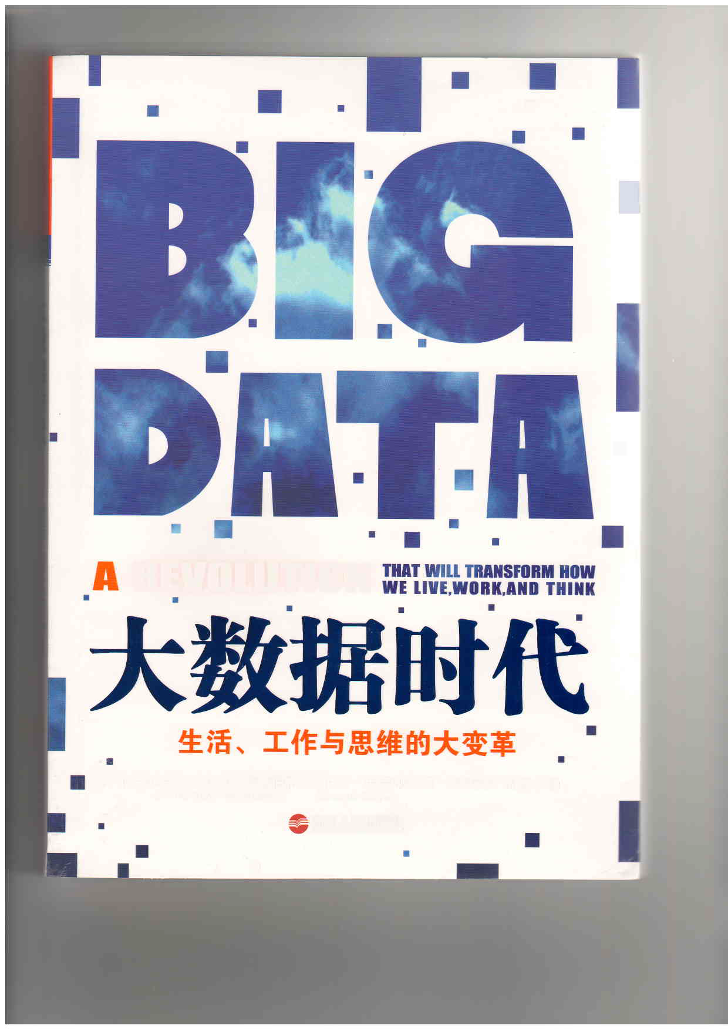

Slide 26
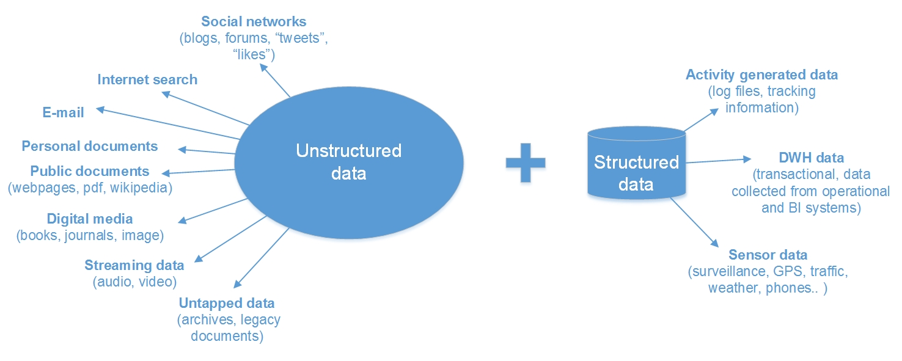
(Bandrova, Konecny, Yotova, 2014)

Slide 27
BD: Definitions

Slide 28
Zucker, S., (2014) :
“a popular term used to describe the exponential growth and availability of data, both structured and unstructured” .
”There is no rigorous definition of big data. Initially the idea was that the volume of information had grown so large that the quantity being examined no longer fit into the memory that computers use for processing, so engineers needed to revamp the tools they used for analyzing it all” (Mayer-Schönberger V., Cukier K., 2013).

Slide 29
Today era of terabytes or petabytes and this trend leads to new challenges in geoinformatics and cartography for gathering, storing, analyzing and visualizing the spatial information and data.
It will not happen first time in the history of cartography that it is one of few visualizing disciplines to use BD for correct analyzing of huge amount of data and their presentation and visualization on different levels of preciseness according to wishes of potential users.

Slide 30
“Big Data” BD:
It is the ability of society to harness information in novel ways to produce useful insights or goods and services of significant value .
The bridge between BD and the society cannot be done only by the existing technologies and computers.
The presence of professionals should be more active in the process of transforming BD in useable variant to users and society.

Slide 31
BD needs to establish teams with people coming from branches which did not work together to now.
Design new complex approaches.
Geographers (physical and human and economical ones), cartographers and geoinformatics + RS want to add their knowledge to enhance such linkages and develop paradigma for and supportive approaches of higher level usage of BD in everyday decision making, solving problems and improvement of life of inhabitants.

Slide 32
The Professional Places in BD Era (Bandrova, Konecny, Yotova, 2014)

Slide 33
From Big to Smart Spatial Big Data with Support of VGEs
IGC , August 22 2016, Beijing, P.R. China
Yaochen QIN, Fun QIN, Milan Konecny
Henan University, College of Environment & Planning, Kaifeng, China Masaryk University, Institute of Geography, Laboratory on Geoinformatics and Cartography, Brno, Czech Republic

Slide 34
2. Many faces of
SMART
Meanings?

Slide 35
Smart versus „Stupid“ or better saying less smart?
Approach in Administration to make documents smart
Business approaches (fast, etc…)
In Geography, Geoinformatics, Remote Sensing: very strong development line of Smart Cities academician Deren Li)

Slide 36
1 Smart city and its application(Deren Li, 2015)
* What is a smart city?
A smart city is built upon the infrastructure of the digital City. It integrates the real world and the digital world with the internet of things, and perceives the states of everyone and everything in the real world. Then the sensed data is transferred to the cloud computing center for computation and understanding, providing intelligent service for economic development, city management and publics.
The smart city is a key component of the smart earth.
Smart city=digital city+internet of things +cloud computing
Cyber physic space Cyber space
Do everything on web See everything on web

Slide 37
The development of the smart city
Informational-ized city
Digital city
Intelligent city
1993
1998
2006
2009
The "information superhighway" starts the information era
of the cities
“The build of the digital comfortable community” marks the construction of the digital city and digital earth
The new information technologies such as internet of things and cloud computing integrates the digital
city system.
IBM proposed a new concept: “smart city”, marking the digital city into a new stage.
The smart city is based on the information infrastructure and the digital city,
It pays more attention on the integration of the digital city with the real city
through ubiquitous sensor networks, puts more emphasis on the intelligent
control and the automatic feedback. It is a more advanced stage of the
digital city, and a high-degree integration of the industrialization
and information technology.

Slide 38
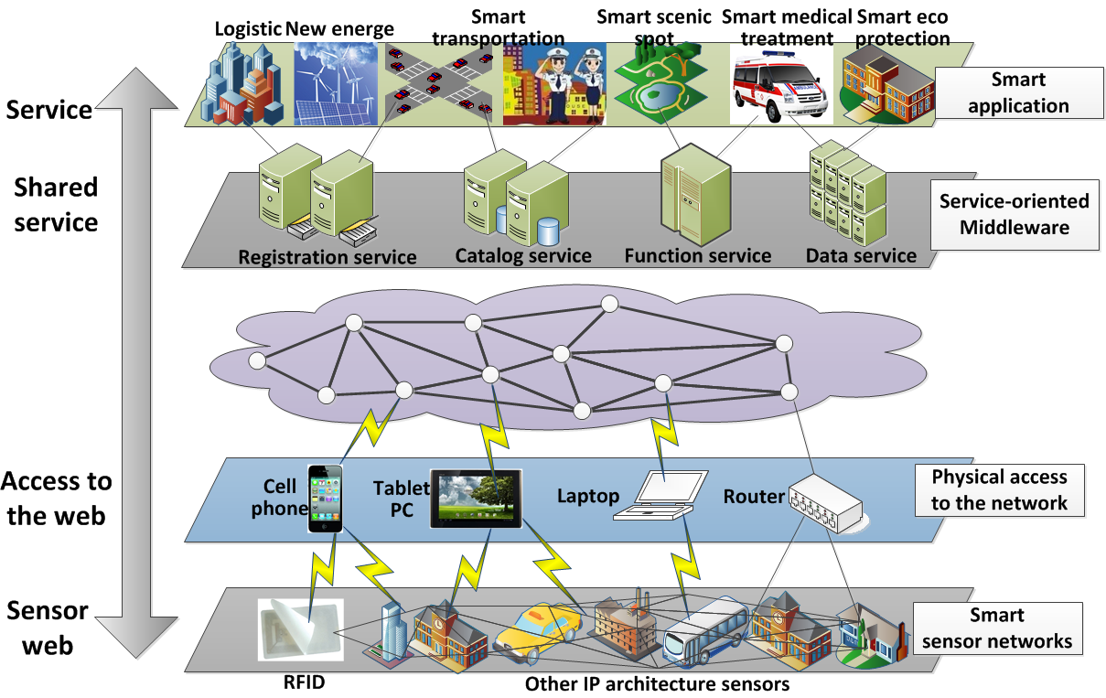
Internet of things
Realize the interoperability between human and human, human and machine, machine and machine.

Slide 39
BIG Data and GIS and Maps
Big Data first made mainstream headlines in 2011. When traditional intelligence had failed to trace Osama bin Laden, it was Big Data analysis that pulled disparate spatio-temporal data in real-time to pinpoint his location. This information was used in conjunction with satellite imagery and next generation drone data to support intelligence operations (GIS Lounge).

Slide 40
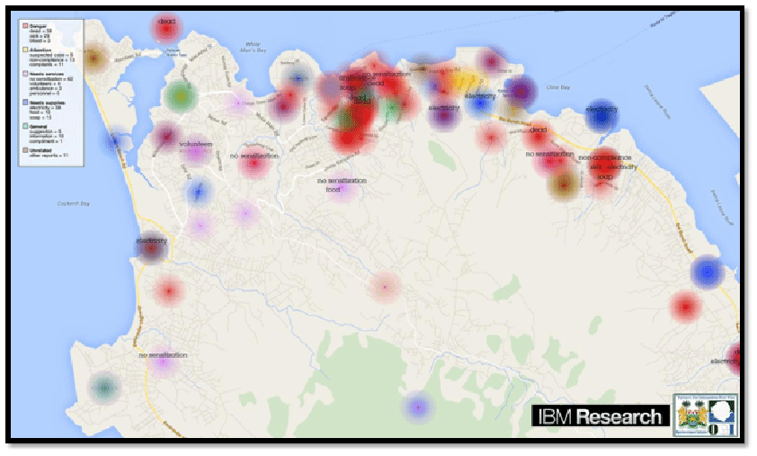
Kalev Leetaru’s Bin Laden mapping – War 2.0

Slide 41
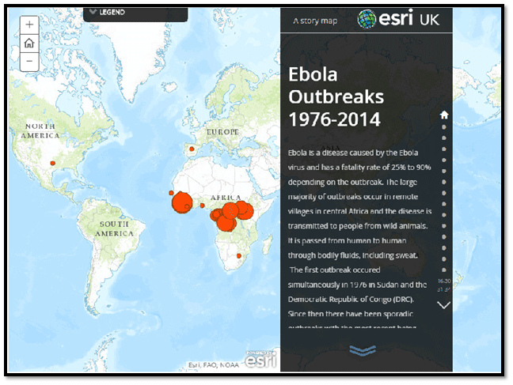
The IBM Ebola tracker. IBM’s Ebola heat map uses Big Data technology in combination with a GPS app to track and fight Ebola.

Slide 42
Big Data are increasingly critical for scientific research and discovery, presenting particularly significant challenges and notable opportunities for transdisciplinary, international research programmes.
Such efforts aim to guide research and produce research results and data in ways that improve decision-making on critical issues for humankind and the environment. ‚CODATA Workshop, June 9, 2014, Beijing

Slide 43
Recommendations
Respond to the importance of Big Data for international science programmes:
Scientific Big Data are important for knowledge discovery in advanced sciences: this importance should be recognized and acted upon.
Addressing the combined challenges posed by data volume, complexity and heterogeneity will bring significant benefits to international science programmes and allow them to take advantage of the Big Data age to develop new knowledge, especially on a cross-disciplinary basis.

Slide 44
2. Exploit the benefits of Big Data for society:
Sponsors of international research programmes need to encourage activities that exploit Big Data to promote applied research for the benefit of society and to make provision to promote and support such activities.
Research funders, national academies, universities and other research performing institutions should formulate strategies to exploit Big Data for knowledge discovery.

Slide 45
3. Improve understanding of Big Data through international collaboration:
Research into the methodologies, theories, technologies and practical applications of Big Data for international science programmes should be strengthened.
This must involve a broad range of experts and research disciplines. Sustained international collaboration will also be essential to achieve this.

Slide 46
4. Promote a universal approach to Big Data:
The knowledge generated by the exploitation of Big Data in international science programmes stands to benefit all humanity. This depends, however, on the widest possible access to and participation in the creation of that knowledge.

Slide 47
5. Encourage capacity building and skills development:
The commercial potential of Big Data and data analytics has been much publicized, as has the pressing need for skills development in data science. This undoubtedly holds true in a research context also. We call on the partners to this initiative to collaborate with appropriate national and international organizations to advance an agenda for capacity building and skills development in (Big) Data Science. This involves prioritization of data science in educational regimes and developing the career paths of early career data scientists

Slide 48
6. Foster development of policies to maximize exploitation of Big Data:
Big Data raise new and more complex access and use problems than previously encountered with scientific data activities.
Policies, guidelines and, where necessary, international agreements should be developed to maximize the collection, sharing and potential exploitation of Big Data for scientific research.
….. on an international and multi-disciplinary basis.

Slide 49
5. ADAPTIVE CARTOGRAPHY and CONTEXT-BASED CARTOGRAPHY
Cognitive Style

Slide 50
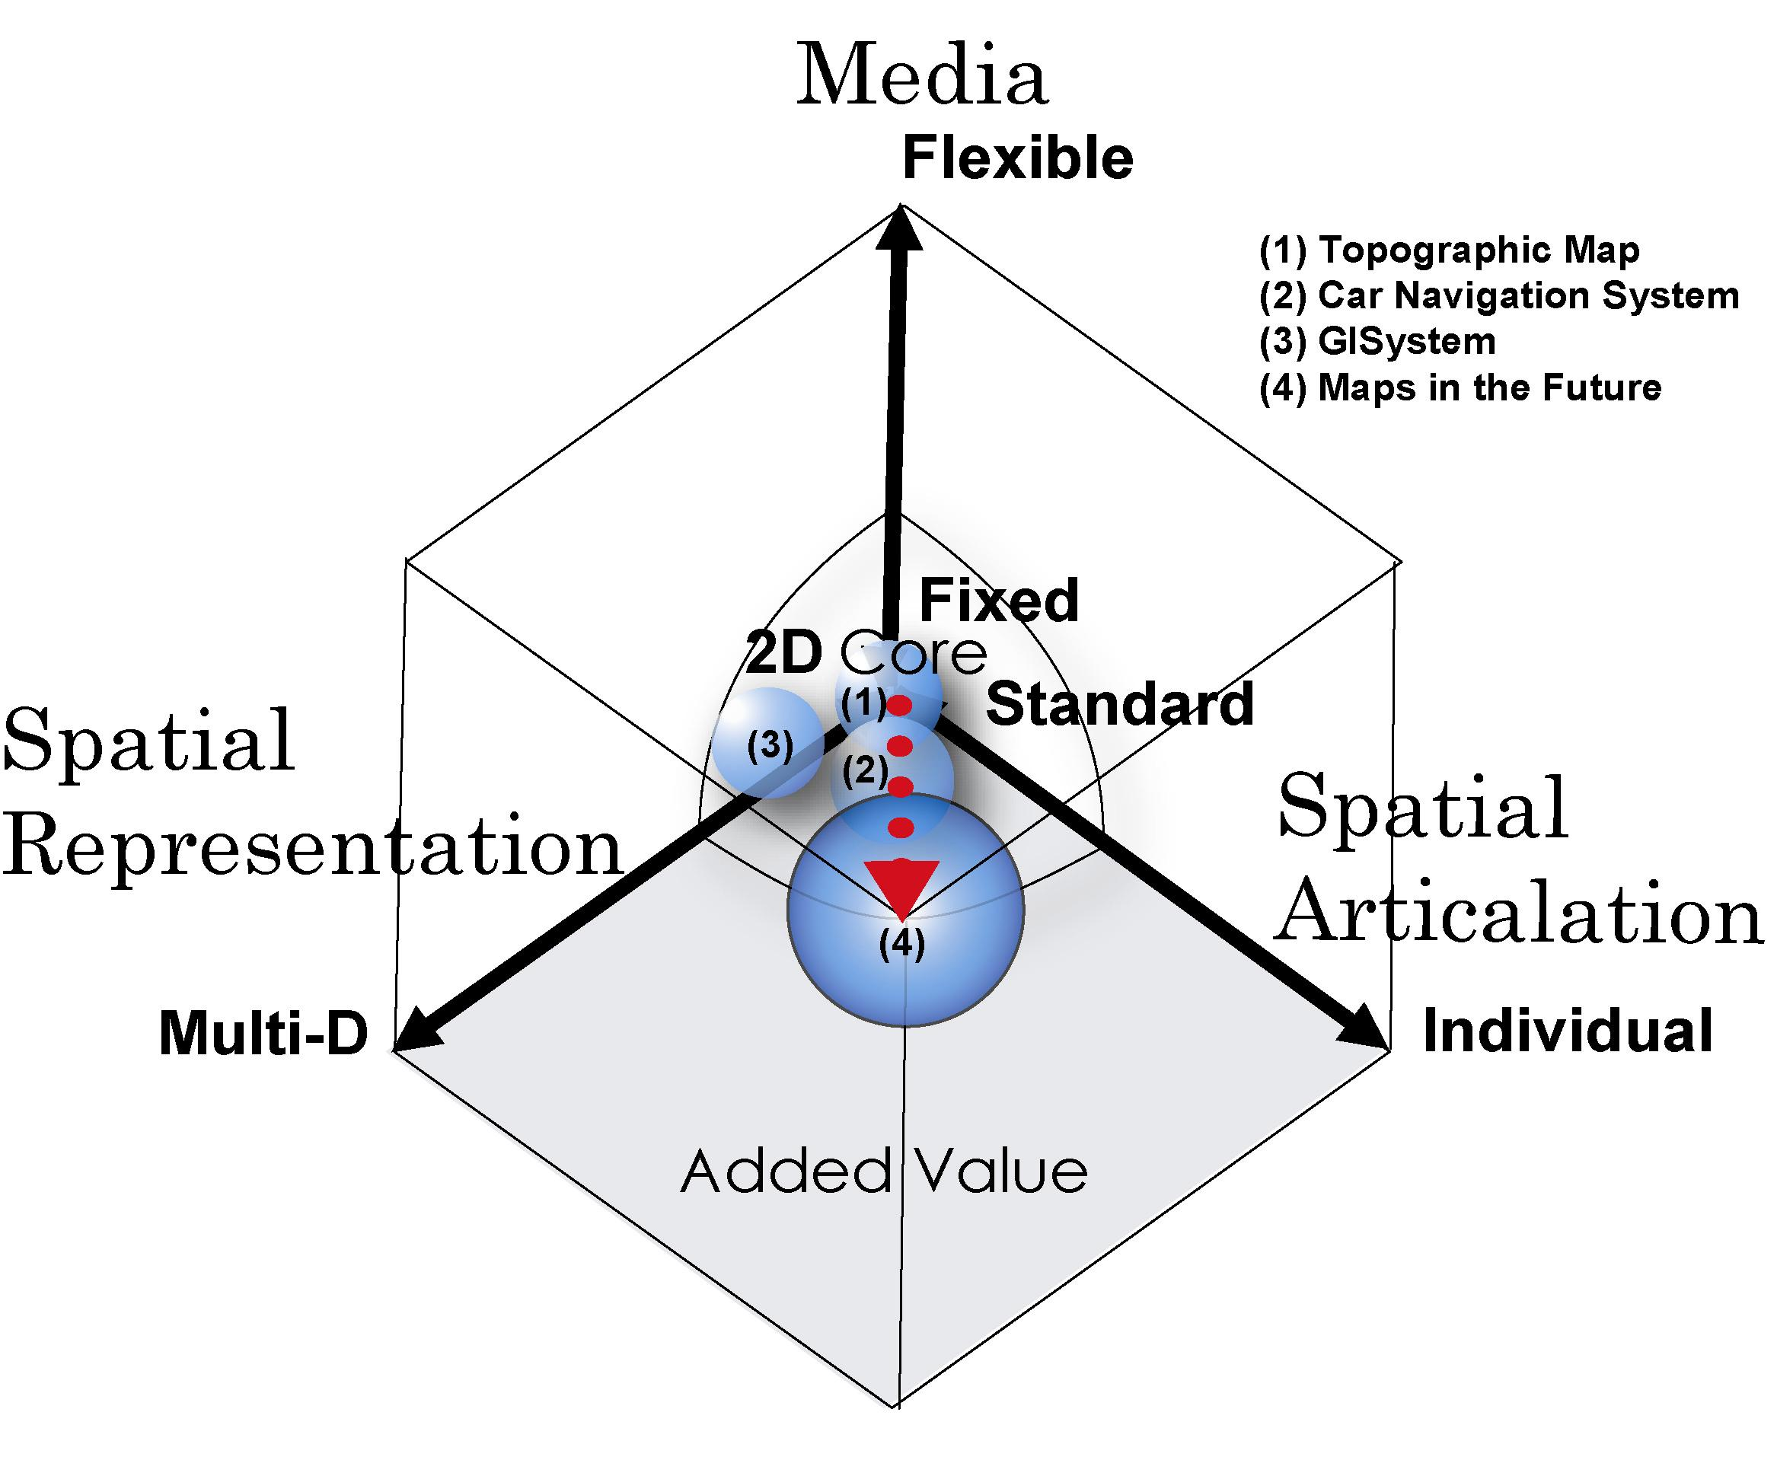

Slide 51
Disaster management cycle
User requirements and specifics differ within EM cycle
Better cartographic support in all stages
Consequences: minimizing of losses

Slide 53
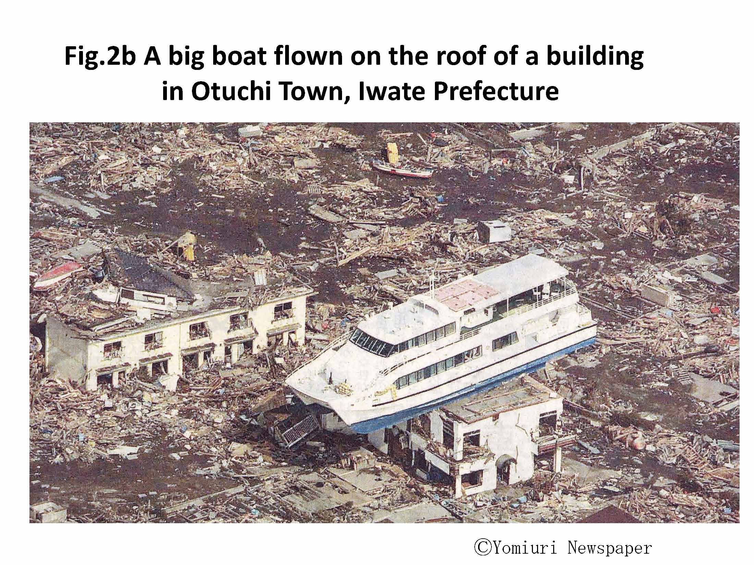
Sunji Murai, 2011

Slide 54
Kamaishi City, Iwate Prefecture constructed huge breakwaters 2km long, 20m thick, 8m above sea level and 65m deep, which have been registered as the deepest breakwaters in the Guinness World Records (see Fig.4a and 4b).

Slide 55
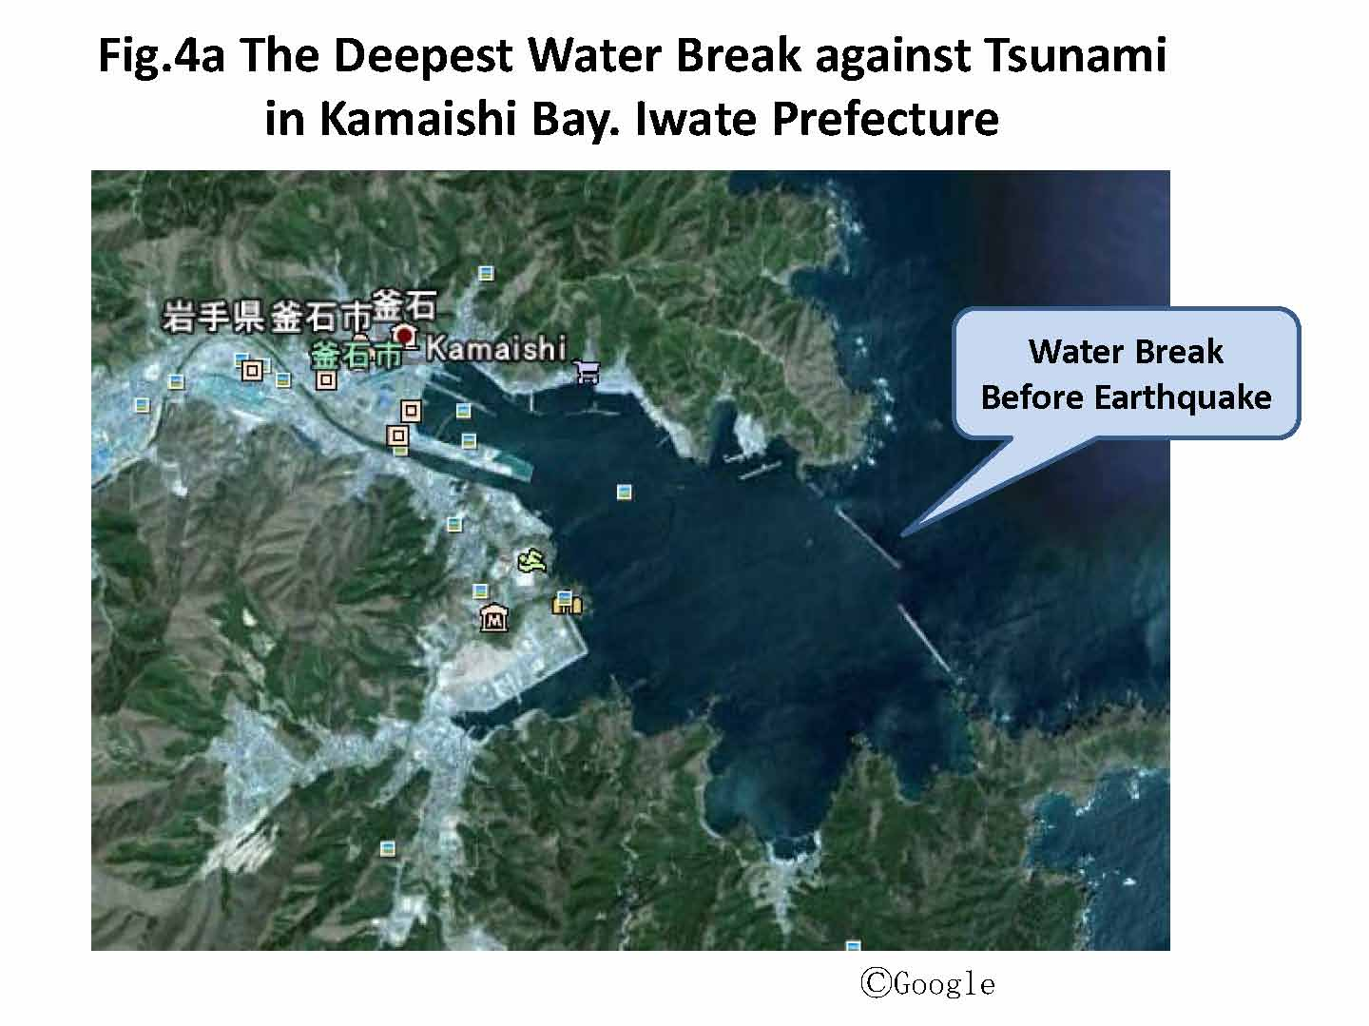
Sunji Murai, 2011

Slide 56
Sunji Murai, 2011

Slide 57
ADAPTIVE CARTOGRAPHY Adaptability of Cartographic Representation
Context-Based Cartography
The subject-matter of adaptive cartography is automatic creation of correct geodata visualization with regard to situation, purpose and the user.
Adaptive maps are still maps in the conventional sense – they are correct and well-readable medium for transfer of spatial information. The user controls map modifications indirectly via modification of context.

Slide 58
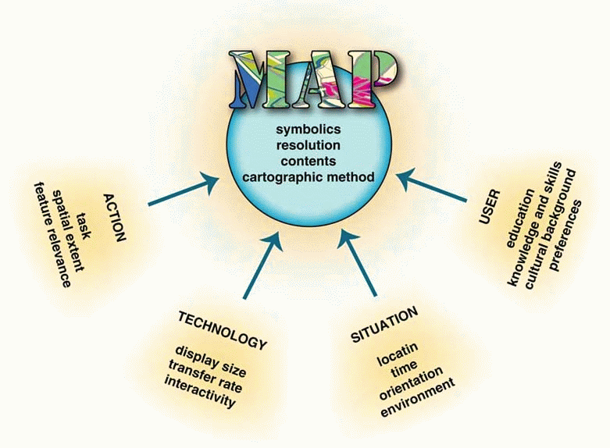
Adaptabile Geovizualization
Figure: Examples of changes in visualization according to change of context (Friedmanová, Konečný and Staněk 2006)

Slide 59
Personality of map users Cognitive style
Cognitive style or "thinking style" is a term used in cognitive psychology to describe the way individuals think, perceive and remember information, or their preferred approach to using such information to solve problems. Cognitive style differs from cognitive ability….
(Konecny et al., 2011 Usability of selected base maps for crises management – users perspectives. Applied Geomatics, DOI 10.1007/s12518-011-0053-1. Springer JW. 2011, pp. 1-10. ISSN 1866-9298.)

Slide 60
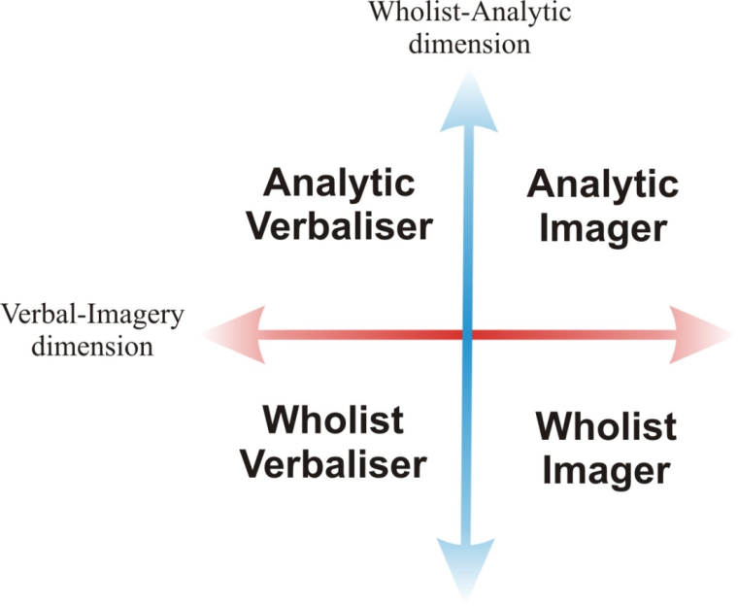
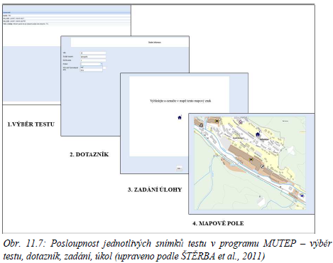
Cognitive Aspects of Geovisualization
Interdisciplinary research.
Theory of cognitive styles.
Concept and design of test environment (MuTeP).
International cooperation.

Slide 61
6. Neogeography, VGI and Social Media Geographic Information

Slide 62
VGI Volunteer Geographic Information
How to manage volunteer geographic information? Chaos or help?

Slide 63
Volunteer geographic information VGI:
“The terms, “crowdsourcing” and “collective intelligence” draw attention to the notion that the collective contribution of a number of individuals may be more reliable than those of any one individual.
The term VGI refers specifically to geographic information and to the contrast between the actions of amateurs and those of authoritative agencies.” Goodchild (2009, p. 18)

Slide 64
7. Social Media Geographic Information (SMGI)

Slide 65
Michele Campagna, Cagliari, Italy:
Social Media Geographic Information (SMGI)
the opportunities offered by the analysis of social media data for
knowledge building and decision-making support in Geodesign.
Geodesign: term identifying an approach to planning and design deeply rooted in geographic analysis and able to inform collaborative decision-making.

Slide 66
Currently, two major categories of spatial data resources may be considered suitable for Geodesign
approaches, namely
Authoritative Geographic Information (A-GI) from Spatial Data Infrastructures (NEBERT 2004) and
spatial User Generated Contents (UGC), commonly referred
to as Volunteered Geographic Information (VGI) (GOODCHILD 2007).

Slide 67
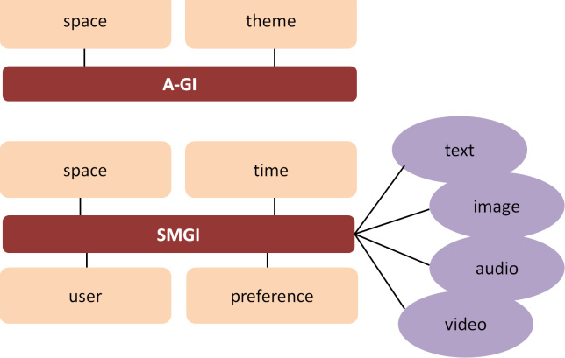
Fig. 1: Differences between A-GI (up) and SMGI (down) data models
Michele Campagna, Pierangelo Massa, Roberta Floris, The Role of Social Media Geographic Information (SMGI) in Geodesign.
p. 164, 2016

Slide 68
New info sources: Big Geospatial data
Volunteered
GI
Remote
Sensing
LAT/LBS
POS
Digital
Earth
SDI
Strategic response planning and management
SENSORS
networks
Social Network
GI

Slide 69
Czech example of VGI
National volunteer activity
ZMAPUJ TO,
i.e.
Put it on the map
http://www.zmapujto.cz/

Slide 70
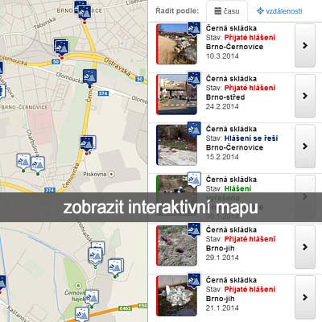
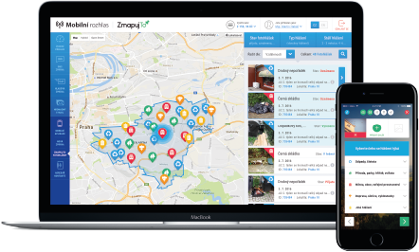
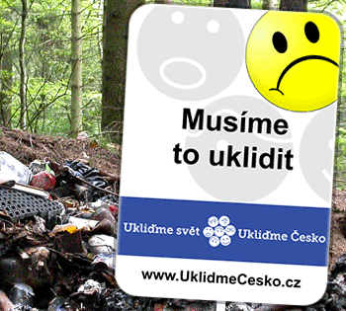
We have to clean it up

Slide 71
Hui Lin, Brno, 2011:
What are we looking for?
Feeling it in person
Knowing it beyond reality
A new framework for the communication of geographic Information and knowledge.

Slide 72
Hui Lin:
As the geographic language
Maps provides geographic environmental information with its graphic symbols. It is also the base for the development of GIS. Currently it is still with us everywhere with the digital networks.
GIS has led the development of geographic environmental analysis with its geo-database for over 40 years and it currently shows the bottleneck of geographic modeling.
VGE studies show a new platform for geographic knowledge sharing, with the integration of map symbols and image in its database and the model management as the “double core” system.

Slide 73
Let’ s go to cooperate
Milan Konecny
konecnymilan3@gmail.com

Slide 74
BOLSHOJE SPASIBO !!!!!
O Brigado
Bardzo Dziekuje
Chvala
THANK YOU
Muchas Gracias
Terima KasimO Brigada
Kammsa Hamida
Aligator
SHUKRAN
BLAGODARJA
DĚKUJI ( in Czech)

Slide 76
