Slide 1
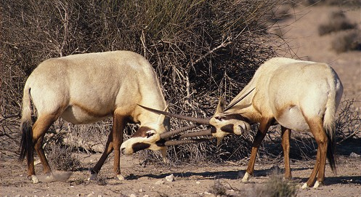
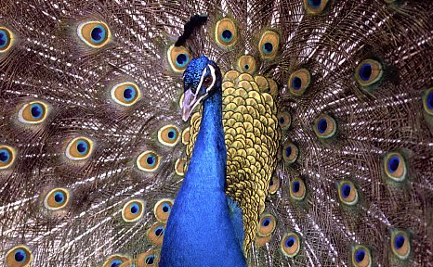
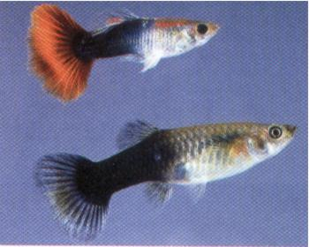
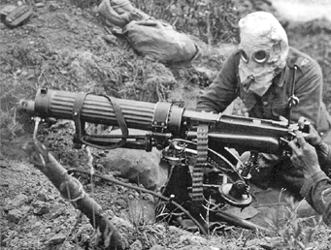
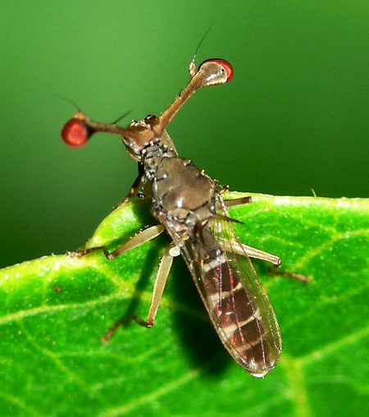
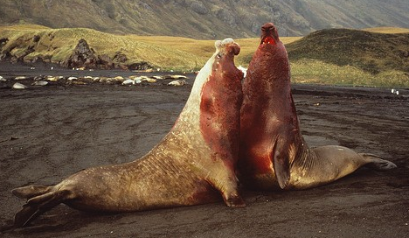
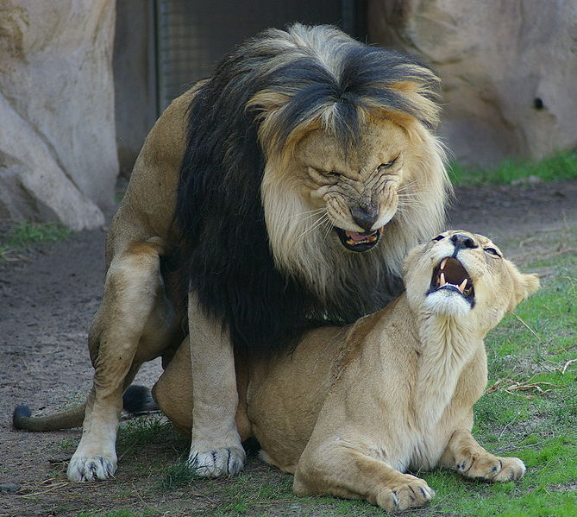
CONFLICT AND COOPERATION II.
Notes:
1

Slide 2
natural theology: nature precisely tuned for some function,
traits perfectly adapted by the Creator („argument from design“)
× traits often suboptimal (cf. inverse eye, laryngeal nerve)
if fitness depends on abundance of other species, interactions between
individuals or frequences of other genotypes, selection may not
necessarily result in fitness increase (see frequency-dependent sel.)
ie. there may be no „best“ solution
selection can result in the decrease of fitness of all organisms –
contradiction to Fisher´s fundamental theorem of natural selection
→ in this situation we cannot use simple arguments of optimization
→ GAME THEORY

Slide 3
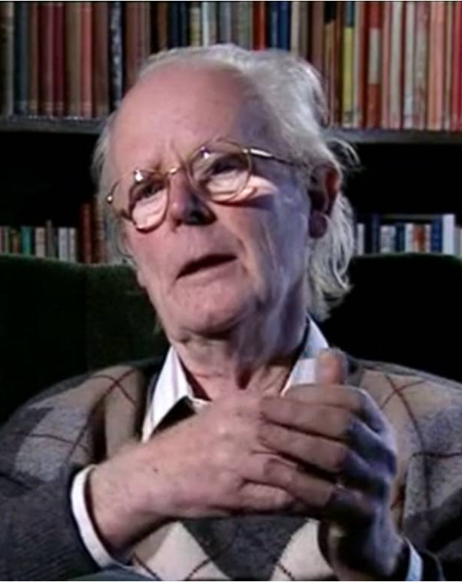
Game theory
1944 (John von Neumann a Oskar Morgenstern), 1950s
in biology William Hamilton (1967), John Maynard Smith
economy, applied mathematics, politology, philosophy, informatics,...
8 game theory experts were Nobel Prize winners
biology: J. Maynard Smith (Crafoord Prize)
J. Maynard Smith

Slide 4
Evolutionary game theory:
phenotype, not corresponding genes
assumption: asexual population, ignoring species biology
contrary to other branches (eg. economy) obvious advantage in that
benefit can be expressed as the number of genome copies in next
generations, ie. a strategy increasing player´s fitness will spread
in the population by natural selection
strategy = phenotype
eg. body size, growth rate, behaviour, growth in varied environments etc.
payoff matrix: benefit = more offspring = higher fitness

Slide 5
John Maynard Smith, George Price (1973):
evolutionarily stable strategy (ESS) = strategy which, if fixed in a population, does not allow any alternative strategy to invade it (due to natural selection)
evolution to a particular ESS depends on initial conditions
strategy:
pure → only 1 type of behaviour
mixed → more types of behaviour
games:
symmetric → all players same
asymmetric → different players

Slide 6
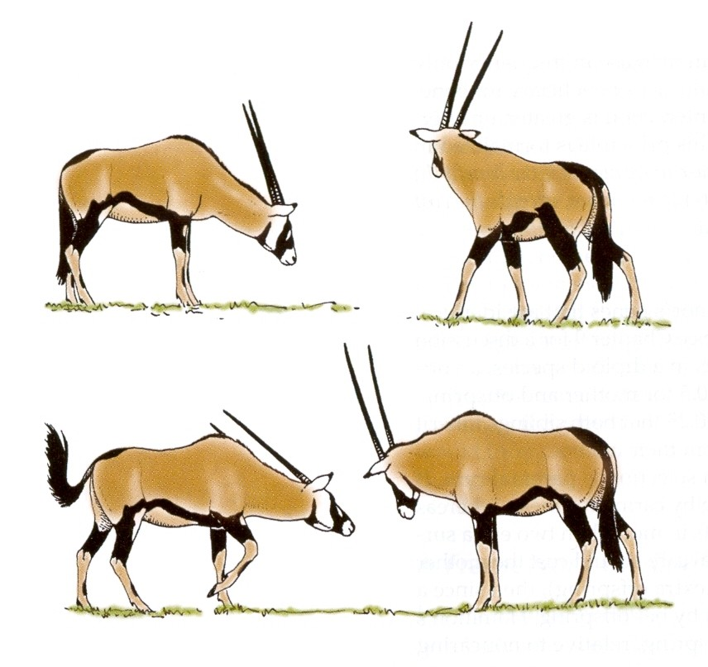
AGGRESSION AND ALTRUISM
Ritualization:
traditional explanation of ritualization as species´ advantage
individual advantage?
dominant male
subordinate male
increased expression of subordination
Why don´t males try to kill other males?

Slide 7
Symmetric models – Hawk and Dove
Hawk: always attacking
Dove: never attacking
both attacking, one loses (zero benefit), both losing due to risk of injury
Hawk is attacking (gain)
payoff matrix:
 | H | D
H | (V-C)/2 | V
D | 0 | V/2
Dove is escaping
(no gain)
both Doves are waiting, then one escapes (no gain) and the other wins (V)
Is Hawk or Dove ESS?

Slide 8
Eg.: V = 1, C = 2
payoff matrix:
average gain of H:
(1 – 1/2)/2 = 1/4
 | H | D
H | -1/2 | 1
D | 0 | 1/2
average gain of D:
(1/2 – 0)/2 = 1/4
Conclusion: neither Hawk nor Dove are evolutionarily stable
⇒ mixed strategy (in this case D : H = 1 : 1)
if we add a delay penalty of -1/4 to both Doves, the average Dove payoff
will be (1/2 – 0 – 1/4)/2 = 1/8
⇒ the Hawk strategy will be more favourable and its frequency will
increase → in this case equilibrium of a mixed strategy or D : H
polymorfism would be 1 : 2

Slide 9
group selection (Dove population): works only in the case of conscious
behaviour (conspiracy) – mostly only in humans and only
theoretically (in practice usually betraying)
Doves is never ESS ...
... but what about Hawk?
→ only if V > C
eg. V = 2, C = 1
payoff matrix:
average gain of H:
(2 – 1/2)2 = 3/4
 | H | D
H | 1/2 | 2
D | 0 | 1
average gain of D:
(1 – 0)/2 = 1/2

Slide 10
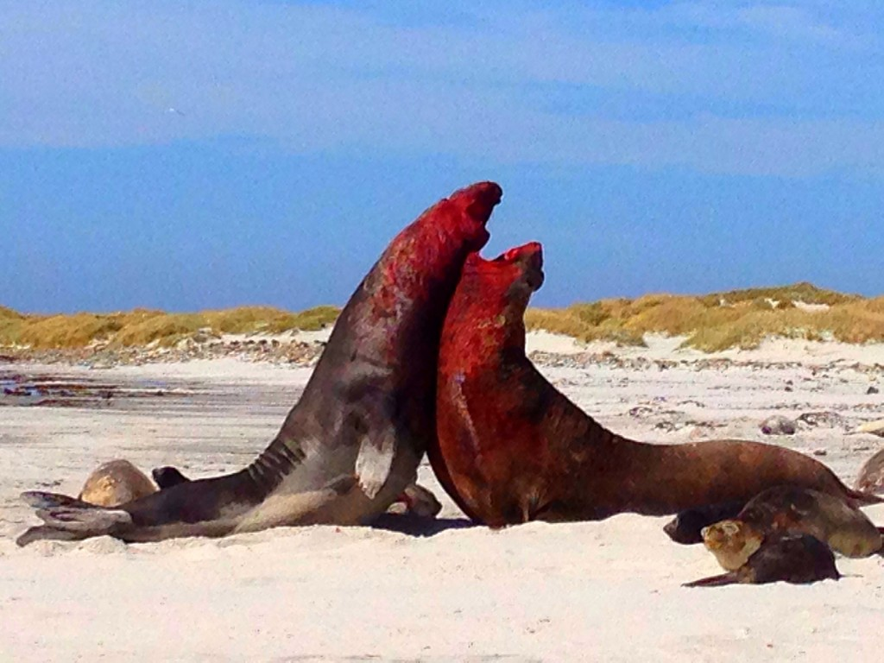
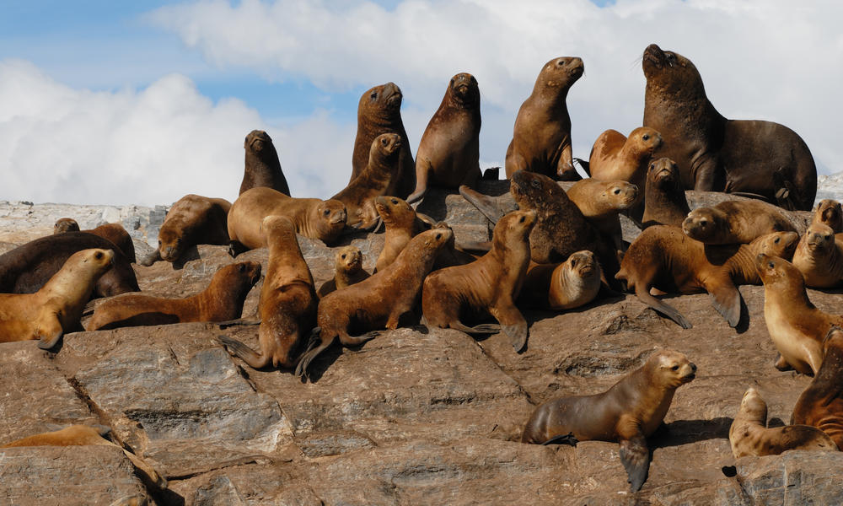
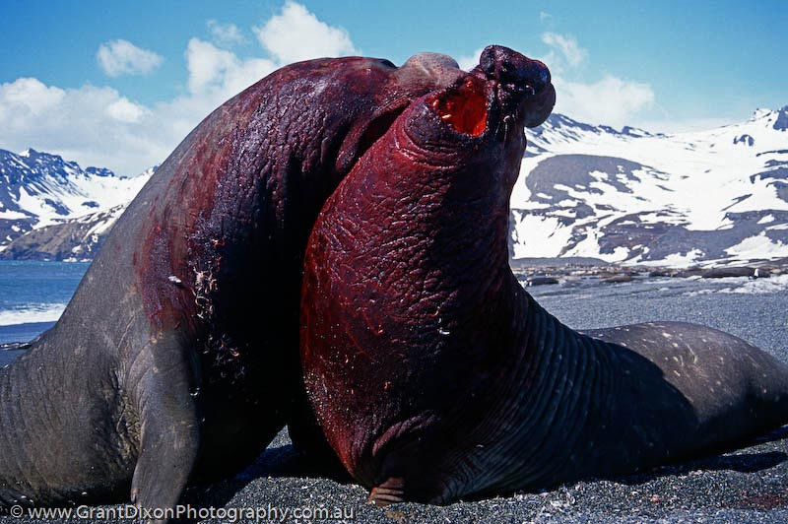
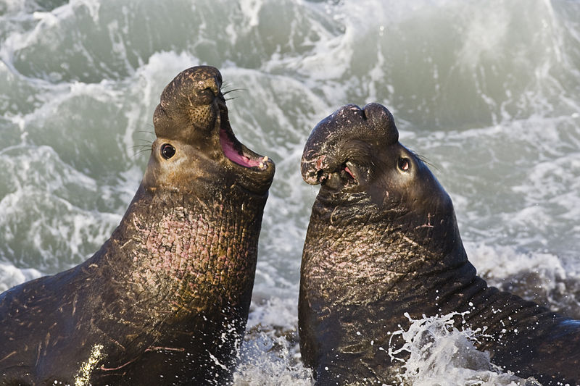
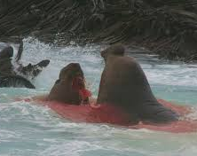
Eg.: pinnipeds:
though frequent injuries but payoff high (harem system ⇒ the winner
takes all)
therefore aggressiveness pays off males
but sometimes alternative strategies

Slide 11
Conditional symmetric strategies:
For example we can imagine the following alternative strategies:
Retaliator: starts as Dove, if attacked → retaliation
if you meet Dove behave as Dove, if you meet Hawk play Hawk
Bully: starts as Hawk, when retaliated – escape
play Hawk but if you meet Hawk, play Dove
Prober-retaliator: retaliator which sometimes tries conflict
closest to ESS is a mixed strategy of Retaliator, Prober-retaliator, and Dove
Conclusion: don´t behave as Bully, repay good with good
but repay aggression with aggression!

Slide 12
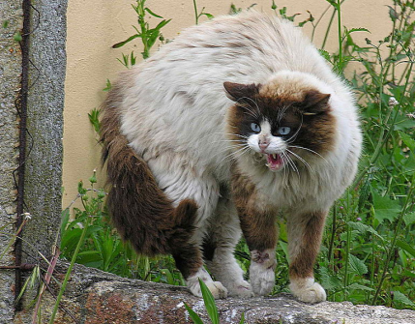
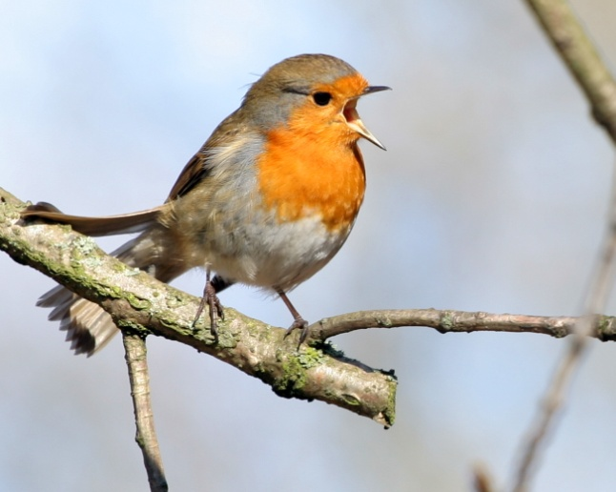
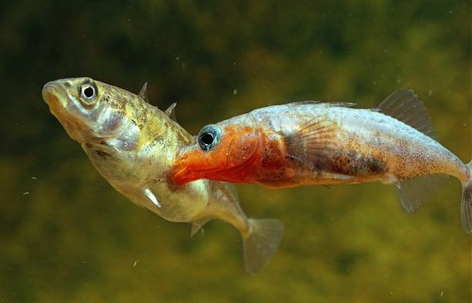
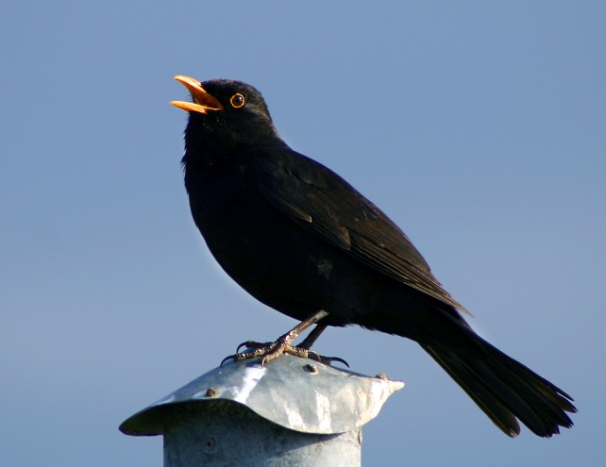
Assymetric models
one opponent weaker or smaller
one opponent has less to lose
one opponent sooner at the locality = Lord of the Mountain
principle
burgeois strategy:
if you are the resident, attack (play Hawk); if you are the intruder, retreat (play Dove)
... eg. territory defence (passerines, sticklebacks)

Slide 13
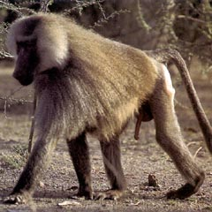
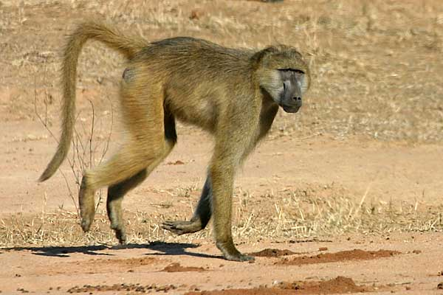
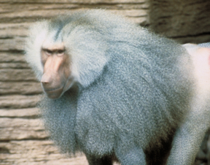
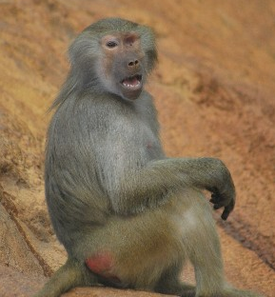

male B
female C
male A
female D
male B
male A

Slide 14
Three strategies in the population:
there may be no equilibrium → cycles
eg. „rock-paper-scissors“ game:
rock beats scissors, scissors beats paper, paper beats rock
payoff matrix:
 | rock | scissors | paper
rock | ε | 1 | -1
scissors | -1 | ε | 1
paper | 1 | -1 | ε
depends on ε value:

Slide 15
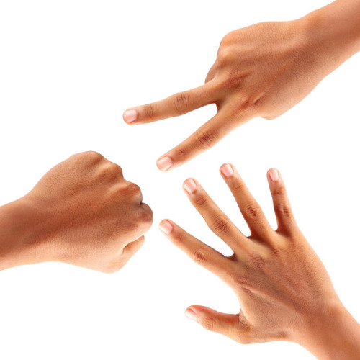
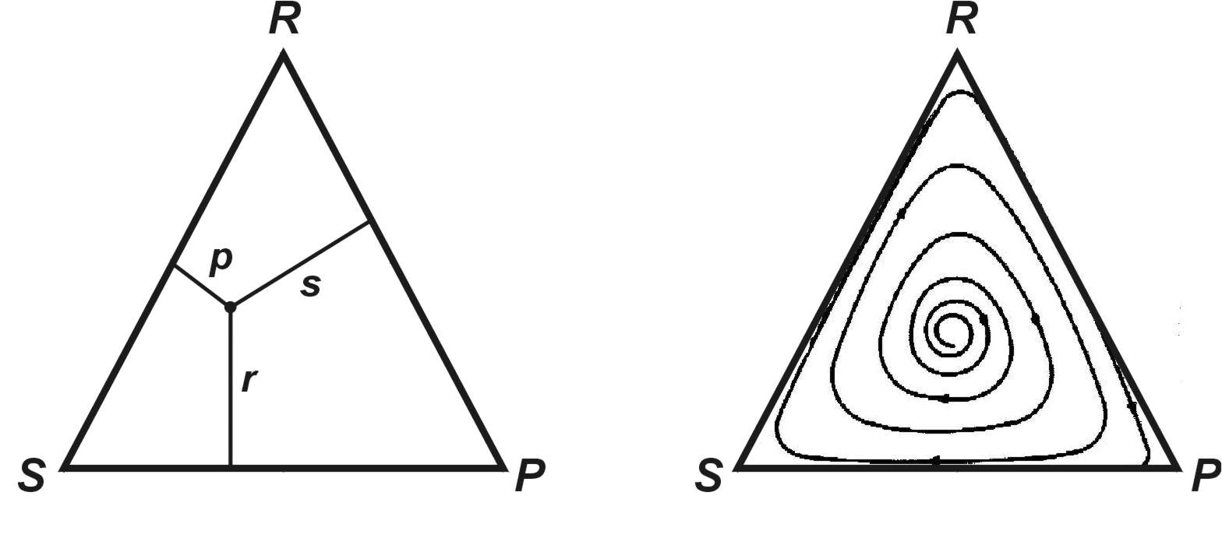
If game cost is low (ε < 0)
→ stable polymorphism
or mixed strategy
 | rock | scissors | paper
rock | ε | 1 | -1
scissors | -1 | ε | 1
paper | 1 | -1 | ε
rock
population state given by intersection of p, r, s, ie. sum of frequencies
p + r + s = 1
scissors
paper

Slide 16
If game payoff is low (ε > 0)
→ strategies are cycling, no ESS
genetically unstable polymorphism
 | rock | scissors | paper
rock | ε | 1 | -1
scissors | -1 | ε | 1
paper | 1 | -1 | ε
trajectory

Slide 17
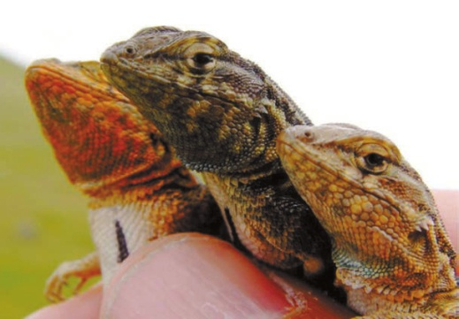
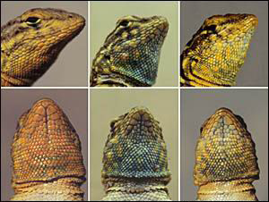
Eg.: Uta stansburiana:
orange throat: large territory, several females
blue throat: small territory, one female → but easier defence against
sneakers
yellow throat: no territory, „stealing“ of copulations
orange throat: big, territorial, several females
yellow throat: non-territorial, mimics females – stealing copulations
blue throat: smaller, territorial, single female

Slide 18
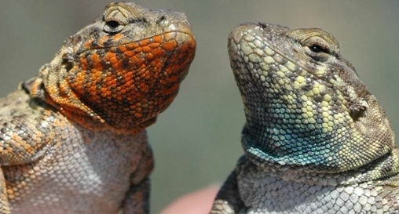
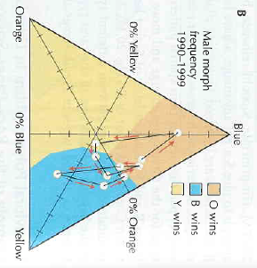
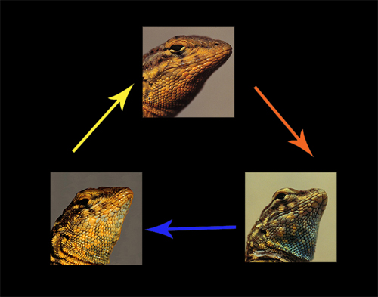
each strategy prevails for 4-5 years → cycles
trajectory of cycles

Slide 19
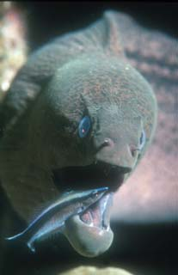
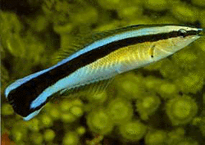
RECIPROCAL ALTRUISM
kin altruism (kin selection)
altruism between non-relatives
sometimes altruism only imaginary (benefit for „altruists“, manipulation etc.)
Robert Trivers (1971): reciprocal altruism
especially in stable groups
reciprocal altruism between species = mutualism

Slide 20
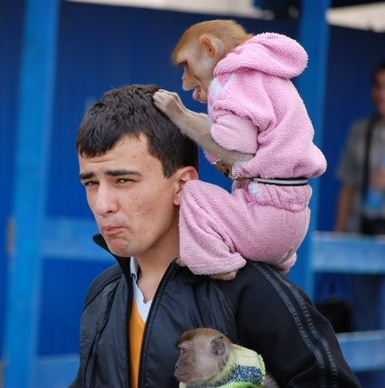
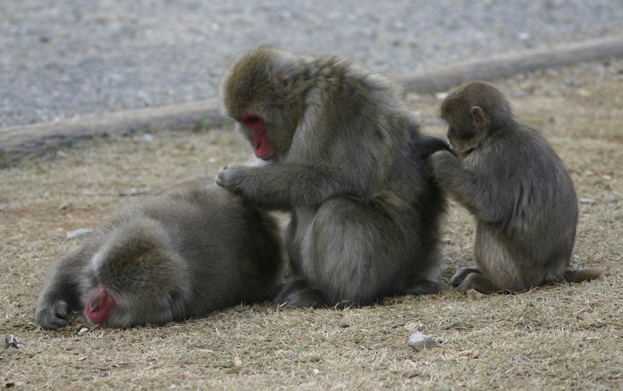
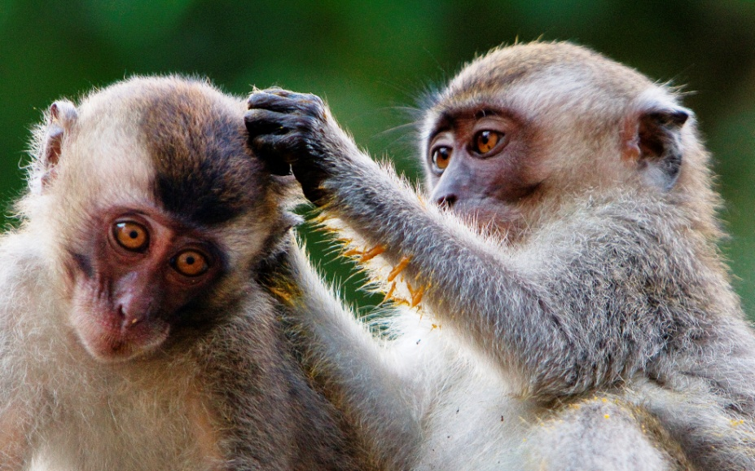
Eg. removing parasites → possible strategies:
Sucker: always helps
Cheat: never helps, abuses others
Grudger: helps only in some situations

Slide 21
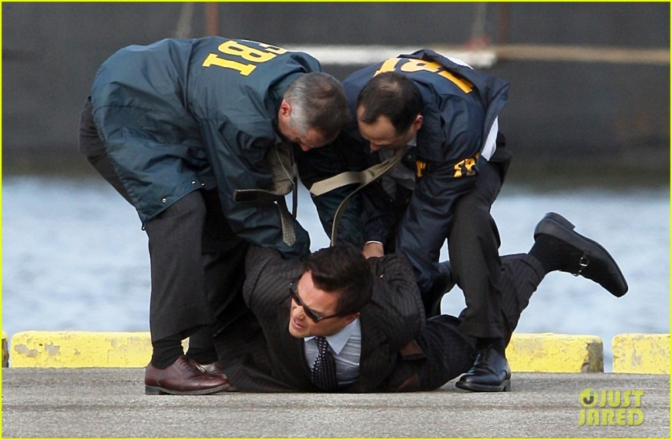
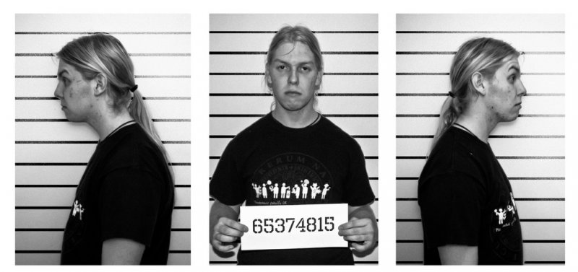

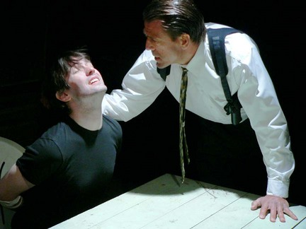
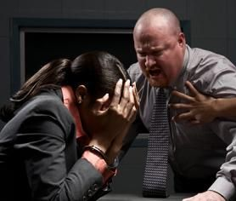
Prisoner´s dilemma

Slide 22
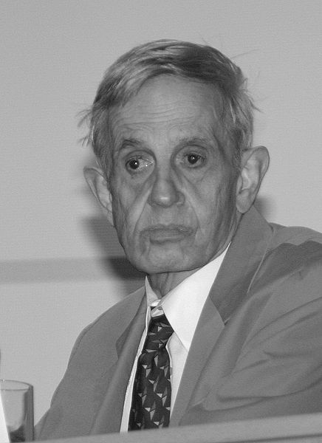
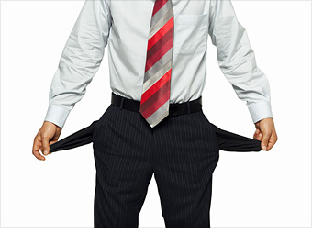

a type of so called Nash equilibrium = situation when none
of the players can unilaterally improve his/her position
(it depends on action of other players)
basic scheme of the game:
John Forbes Nash
C
B
♥
♣
coope-
rate
defect
?
C
300
-100
♥
♣
JÁ:
B
500
-10
problem: we don´t know other player´s step
Conclusion: when we don´t know what other player does it is better to defect
In other words, in the Prisoner´s dilemma defect is the only Nash equilibrium

Slide 23
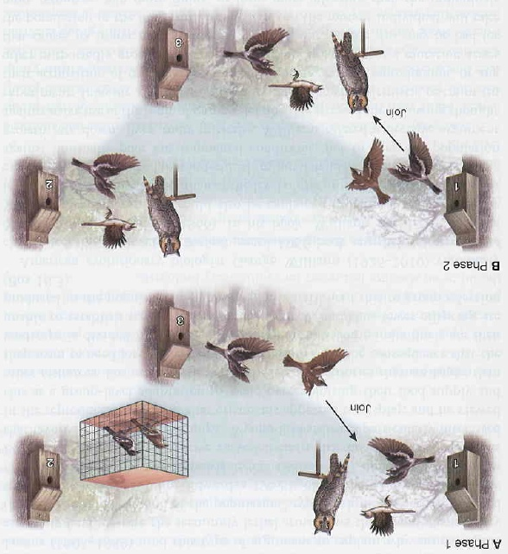
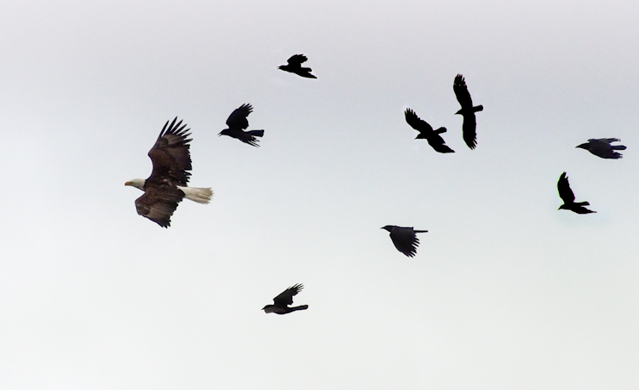
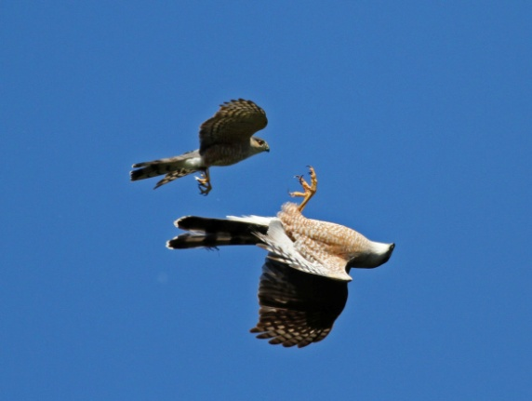
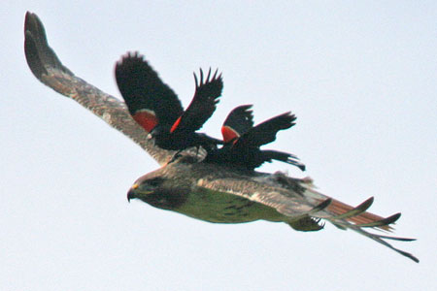
Eg.: bird mobbing
help only to those which helped previously

Slide 24
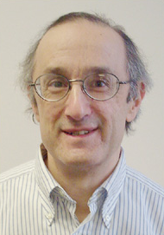
Robert Axelrod: in the 1970s and 1980s computer
tournament
14 programs = 13 strategies + 1 random (7 „bad“ strategies)
each game: 200 random encounters with other strategies
including own strategy
225 independent games
points based on Prisoner´s dilemma: 5, 3, 1, 0 ⇒ min. 0, max. 15 000 points
winner = Tit for Tat (TfT):
during first encounter cooperation, then repeating the step of a previous
opponent
subsequently Tit for Two Tats (J. Maynard Smith): first two steps
cooperation, then normal TfT → if it would be included in the original
tournament it would win
Robert Axelrod

Slide 25
R. Axelrod – 2nd tournament:
62 + 1 strategies, only 15 „good“
winner = again Tit for Tat
Why Tit for Two Tats did not win?
3rd tournament:
same strategies as in 2nd tournament
instead of points increasing/decreasing of the number of program copies
(simulation of evolution)
always victory of „good“ strategies, in 5 of 6 games TfT
Caution! Tit for Tat is not ESS! (possible coexistence with
other strategies, eg. Tit for Two Tats)
„Good“ strategies must be at a certain critical frequency:
random drift
relativeness
viscosity

Slide 26
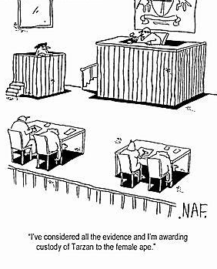
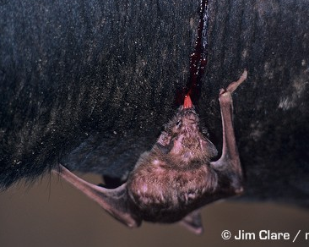
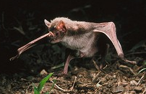

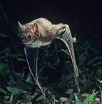
Computer simulations and existence of altruism in nature itself seem
to be in contradiction both to results of Prisoner´s dilemma and
psychological practice
Non-zero-sum games
zero-sum game:
eg. football matches (but not always – see
R. Dawkins: Premier League 1977)
non-zero-sum game:
divorce
common vampire bat (Desmodus rotundus)
Desmodus rotundus

Slide 27
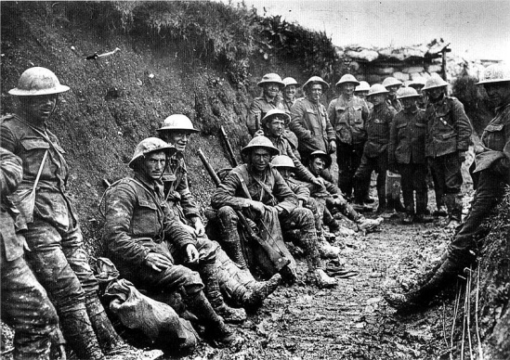




Time perspective
Axelrod´s tournament: repeating games = repeated Prisoner´s Dilemma
we don´t know end of the game ⇒ cooperation
we know end of the game ⇒ defection
Eg.: World War I – strategy „Live-and-let-live strategy“

Slide 28









SEXUAL SELECTION
Why are males so conspicuous?
Darwin (1871): sexual selection
Trachops
cirrhosus
„chuck“
chuck!
Engystomops pustulosus

Slide 29



Sexual reproduction → cooperation but also conflict between individuals
of the same sex as well as between sexes
mother
sexual conflict
father
parent-offspring conflict
sibling 1
sib-sib conflict
sibling 2
If the partners are not relatives none of them is interested
in survival or reproductive success of the other!!

Slide 30

Primary cause of sexual selection = different parental investments
cheap sperm × expensive eggs
cheap sperm cell
expensive ovum
operational sex ratio = number of reproducing males and females →
male-biased because males copulate more often
⇒ males limited by number of females, females limited by number of eggs or offspring ⇒ conflict of reproductive interests (Trivers 1972)

Slide 31



range of reproductive success in males almost always higher than in females
Conclusion: sexes differ in reproductive behaviour:
males are (mostly) competitive
females are (mostly) choosy

Slide 32





Strength of sexual selection is not the same in various species:
monogamous species: weak selection, no or moderate dimorphism
polygamous species: strong selection, strong dimorphism
polygyny
polyandry
promiscuity
polygynandry
gibbon: monogamous
chimp: promiscuous
gorilla: polygynous
… what about humans?

Slide 33




Sometimes females brighter, eg. phalaropes:
red phalarope
red-necked phalarope

Slide 34




Intrasexual selection
Males compete – directly ...
direct combat

Slide 35






Males compete – directly ...
displaying
eg. mating calls, leks
manakin dances
bowers of bowerbirds etc.

Slide 36



Alternative strategies:
marine iguana: fast transmission of sperm during short copulation
of subordinate males
non-territorial males – „stealing“ of copulations („sneakers“):
Uta stansburiana, salmons, sunfish, cichlids, bitterling
sneakers
Lamprologus callipterus (Lake Tanganyika)
bitterling

Slide 37

often mimicking females (smaller size, colouration): cichlids, salmons
satellite male
female
bluegill Lepomis macrochirus
(North America)
consequences of existence of non-territorial males:
for territorial (dominant) males negative
for females negative (reduction of offspring fitness), ambivalent but also positive
(increased number of fertilized eggs, variation of offspring, and genetic
compatibility)

Slide 38



… and indirectly
prevention of fertilisation by other males
guarding of female
copulatory plugs (rodents, insects, scorpions)
hooked plugs
Vaejovis punctatus

Slide 39


… and indirectly
prevention of fertilisation by other males
breaking of copulatory organ in female´s duct (spiders):
eg. spider Tidarren argo breaks off one of his pedipalps, adhers to
female´s epigyne ∼ 4 h
chemical repelents in sperm (Drosophila, snakes)
Nephilengys malabarensis

Slide 40

Drosophila: proteins of accessory glands in sperm →
increase of egg production, plug, repellent effects
4 transgenic lineages
Tr. 1 a 2:
no sperm
Tr. 3: sperm, copulation
Tr. 4: sperm, no copulation
effect of seminal proteins decreases female survival
conflict between reproductive interests of males and females!!

Slide 41





… and indirectly
prevention of fertilisation by other males
prolonged coupling after copulation (canids)
removing sperm of preceding male(s)
copulatorz organ of
Argia damseflies:
male
female

Slide 42





… and indirectly
sperm competition
prolonged intercourse
larger ejaculate → larger testes:
chimp > human > gorilla > gibbon
promiscuous primates (blue)
human
polygynous primates
(green)
monogamous primates (red)

Slide 43




… and indirectly
infanticide
killing youngsters: felids (lion, domestic cat)
rodents (mouse, brown rat, lemmings, hamsters, meadow vole):
Bruce effect = abortion triggered by odour of unfamiliar male
although male benefit is clear it is female strategy – prevention of
probable future infanticide (thwarted investment)

Slide 44




Intersexual selection
Females choose...
… but based on what?
1. direct benefit
male care for offspring:
larger territory (⇒ more sources)
bringing food
nest building

Slide 45


How to secure male care?
→ delaying copulation – „the Concord fallacy“
3 possible male strategies:
„Daddy“ – remains with the female
„If not you, then other“ – escapes before copulation, looks for more
permissive females
„Lad“ – escapes after copulation
hiding eggs

Slide 46


2. sensory bias
= preference occurs before emergence of the male trait
eg. stronger response to superstimuli
Eg.: swordtails of the genus Xiphophorus:
females of „non-sworded“ species prefer males with the „sword“
preference of females of the genus Priapella stronger than preference
of own species´ females
Xiphophorus helleri
Priapella intermedia

Slide 47

Eg. túngara frogs of the genus Engystomops:
chuck!
“chuck“ emerges
preference emerges

Slide 48


3. indirect benefit
male investment = only genes contributed
„sexy sons“ hypothesis: R. A. Fisher (1915, 1930):
runaway sexual selection
a male trait may not render a benefit to an individual but for some reason
it is preferred by females ⇒ it is advantageous to produce offspring
with such males (sons will be attractive for other females)

Slide 49



prerequisite = strong linkage between the gene for female preference
and that for male trait (both genes in both sexes but different expression)
correlation between intensity of red colour and preference for red in three-spined stickleback
„snowball effect“ – runaway process ⇒
origin of extraggerated or eccentric structures
this process ends when ekvilibrium between female selection and normal (environmental) selection

Slide 50




„good genes“ hypothesis:
preferred trait indicates high genetic quality of the offspring
Eg.: three-spined stickleback, great tit, scarlet rosefinch, barn swallow

Slide 51



peacock (Pavo cristatus): correlation between size and number of „eyes“
and fitness of descendants

Slide 52


Anders Pape Møller: barn swallow (Hirundo rustica)
shorter pre-copulatory phase
more second egg-laying
more offspring

Slide 53



handicap principle:
Amotz Zahavi (1975)
indication of high viability („good genes“)
despite the handicap
handicap necessary for the information to be
reliable, ie. to prevent the male from “lying“
babbler
Amotz Zahavi
the ornament helps to easily uncover a defect
Arabian babbler
(Turdoides squamiceps)

Slide 54




handicap model:
bright coloration, complex ornaments, structures filled with blood,
toxic nature of chemical signals etc.
waterbuck
(Kobus ellipsiprymnus)

Slide 55



Malte Andersson: long-tailed widowbird (Euplectes progne)
highest reproductive success in males with elongated tail feathers
relatively lower costs for genetically high-quality males
increasing fitness

Slide 56



handicap model – bright males hypothesis
William Hamilton and Marlene Zuk (1982):
problem of repeated preference of certain trait → depletion of variation
= the “lek paradox“
a solution can be variation of a selective optimum – eg. pathogens
sexual selection favours “fairly“ signalizing traits
state of health, ie. the ability to cope with parasites and pathogens
animals with “bad genes“ cannot effectively struggle with infection

Slide 57



hypothesis: males of more parasitized species are, in general, brighter
→ some passerine species
Eg.: bald uakari (Cacajao calvus)
in healthy individuals red colour
in individuals with malaria pale colour
in species from non-malarial areas dark coloration

Slide 58


Extra-pair copulations, EPC
(extra-pair paternity, EPP; extra-pair fertilization, EPF)
males: increase number of fertilized eggs
females: increase quality of offspring by mating with males possessing
better genes than their partners ⇒ increase of offspring fitness

Slide 59


Eg.: great reed warbler: span of song repertoire correlated with fitness
→ in all observed EPPs biological fathers had broader song repertoire
than partners
⇒ indirect benefit of females through higher fitness of descendants
great reed warbler
(Acrocephalus arundinaceus)
acquiring good or complementary genes?

Slide 60
EPC in humans:
Univ. of Western Australia: 28% males, 22% females – extramarital sex
France, Great Britain, USA: 5–52%
EPP: difficult estimate, overal ∼2 %, Yanomami ∼10 %,
Himba (Namibia) ∼17 %
ethnic differences: eg. Michigan: 1,4% in Caucasians,
10,1% in Afro-Americans
South-American Indians (eg. Mehinaku, Kaingang, Araweté, Curripaco, Tapirapé,
Yanomami, Bari, Matis, Aché): partible paternity
Canelo (central Brazil): generally more than 12 potential fathers
60% males transiently in polyandric bonds
copulation with multiple males is often part of public ritual

Slide 61


intersexual differences in jealousy:
males: physical cuckoldry (risk of EPP)
females: spiritual affinity (risk of mate´s leaving)

