Slide 1
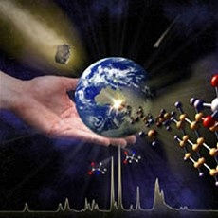
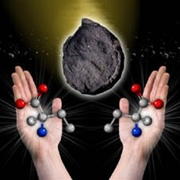
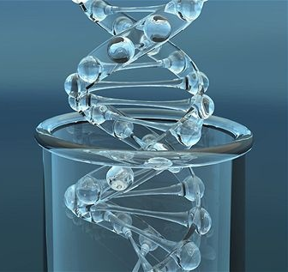
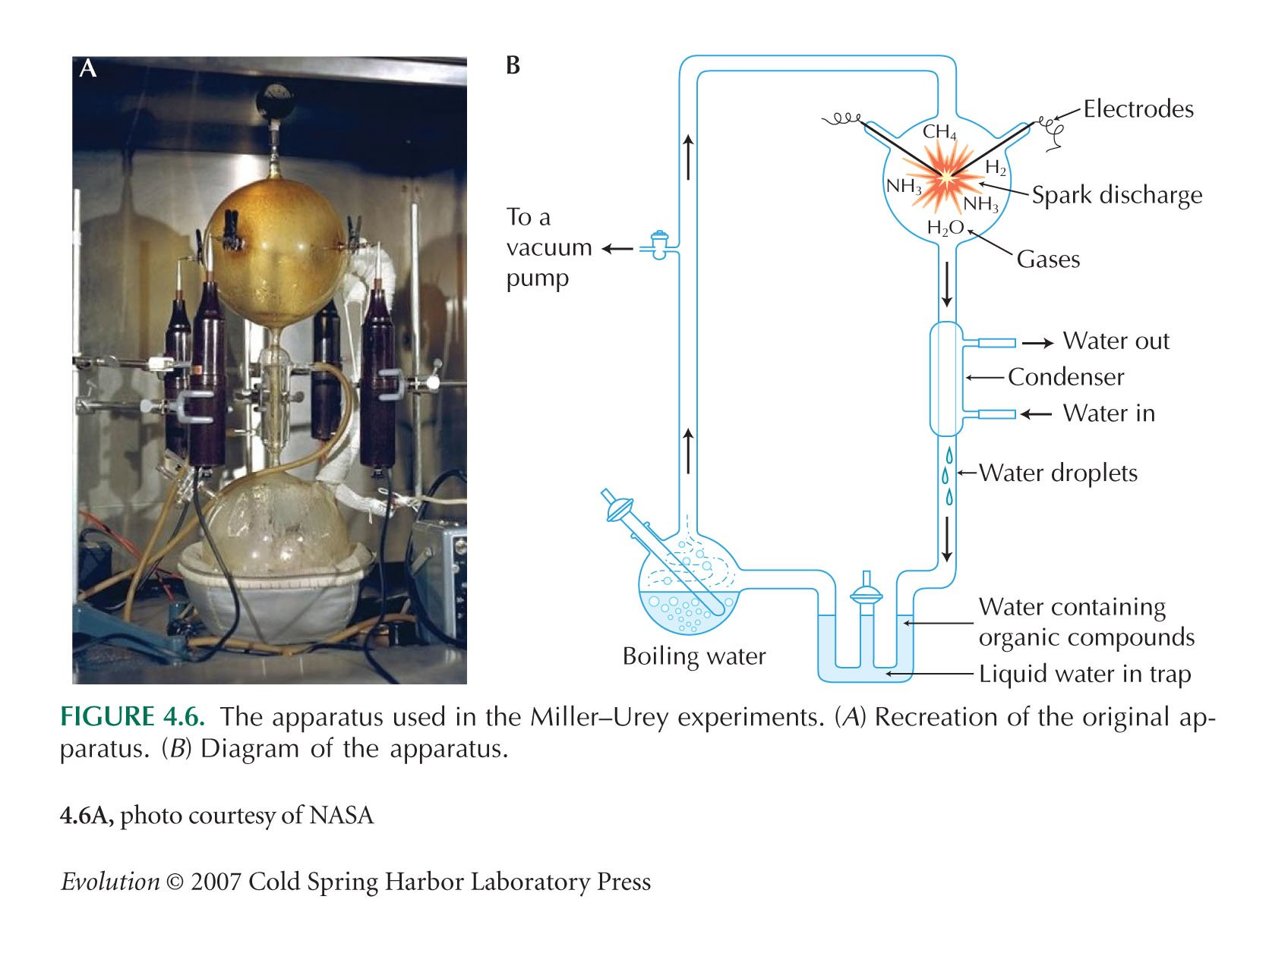
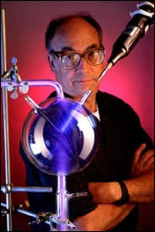
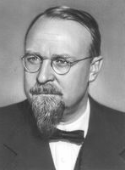
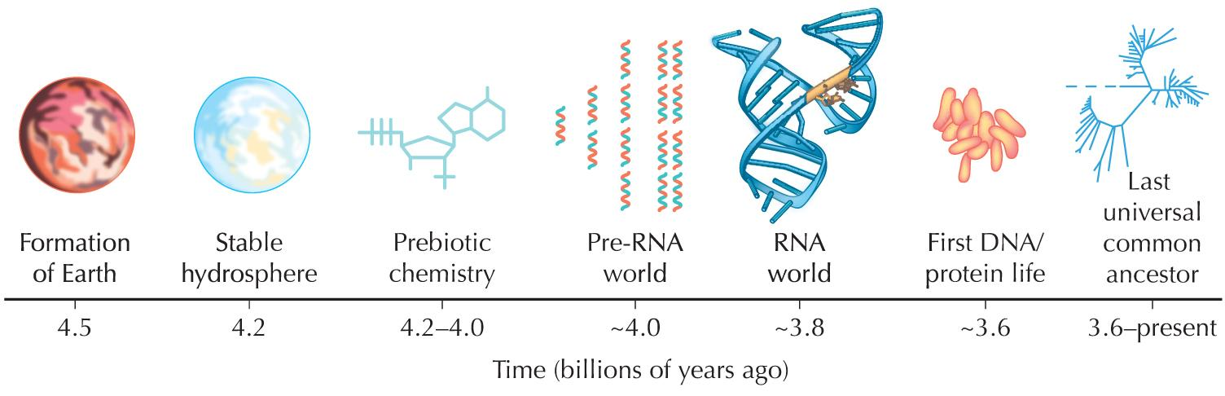
ORIGIN OF LIFE

Slide 2
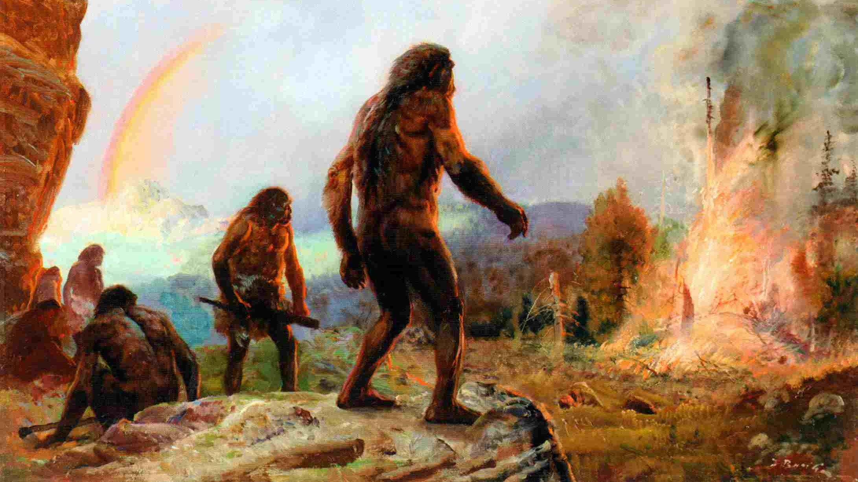
Origin of life is to large extent outside evolutionary biology
→ in essence, it is interdisciplinary study: chemistry (nature of
substances composing organisms), geology, study of atmosphere
(nature of environment in which life has emerged) etc.
Actually, what is life?

Slide 3
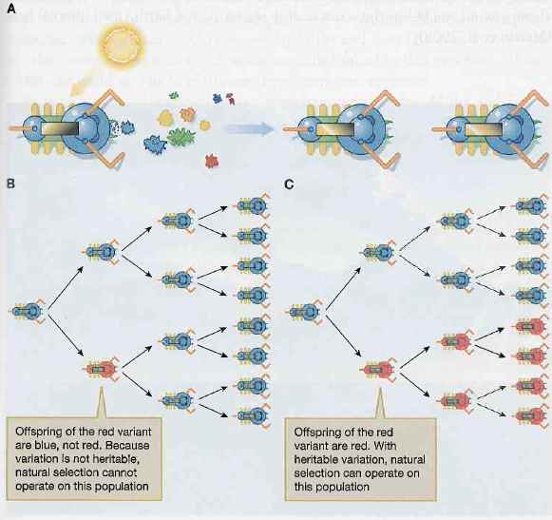
What is life?
prerequisite: ability to accumulate substances and their organization in more complex structures
definitions: phenotypic
evolutionary
Muller (1966): autoreproduction
variability
inheritance
Barton et al. (2007):
autoreproduction and natural selection
prerequisite: metabolism
prerequisite: memory of the system
J. Maynard Smith & Eörs Szathmáry
(1999):
prerequisite: heritable variation

Slide 4
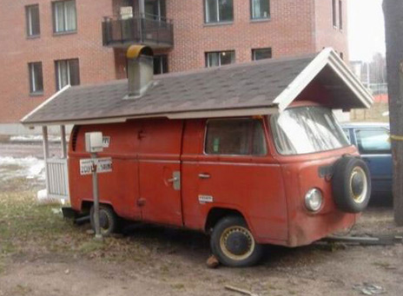
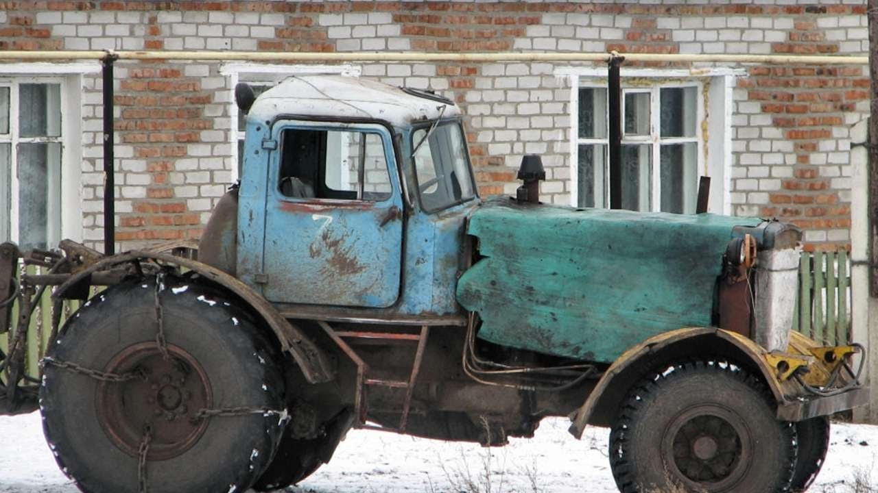
Problem of study of the origin of life:
J. Monod: evolutionary tinkering, always short-term advantage or
coincidence, never long-term perspective × assessment of evolution
from backward view, with respect to long-term consequences
⇒ present-day life cannot help with solving
criticisms from creationists: nobody has succeeded to create life in the tube

Slide 5
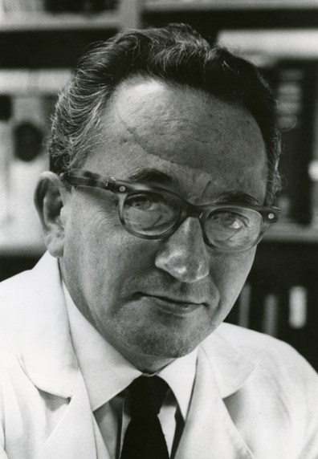
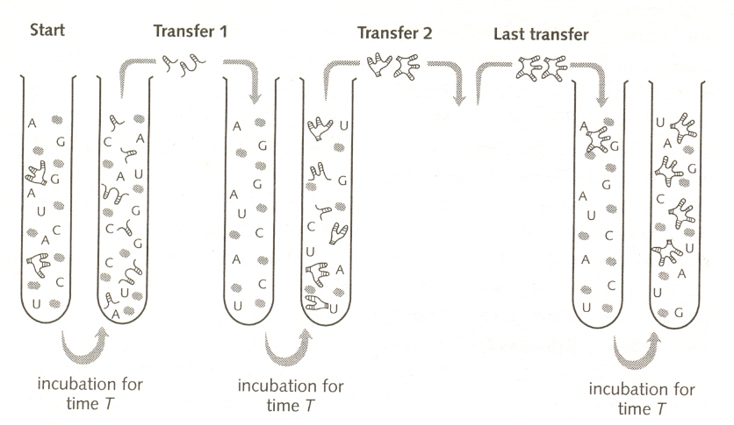
Evolution in the tube:
Sol Spiegelman et al. (1970):
RNA (template ∼ 4500 bp) and bacteriophage Qβ replicase,
+ nucleotides
Sol Spiegelman

Slide 6
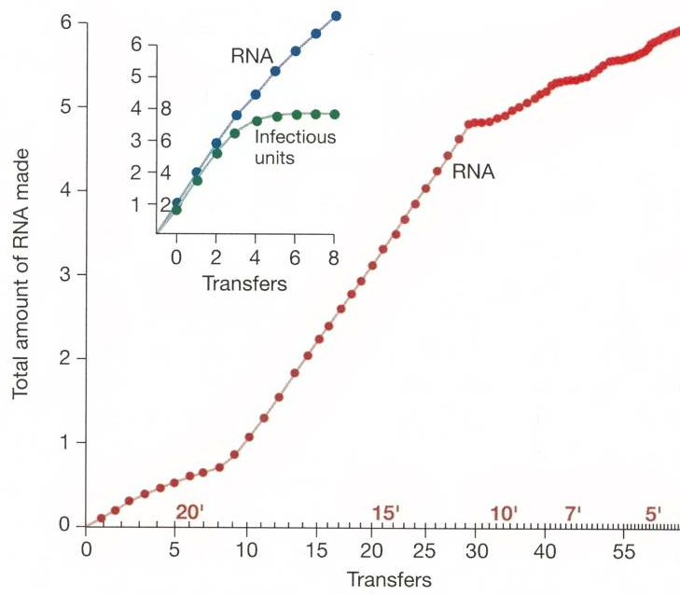
⇒ evolution → „Spiegelman´s monster“:
→ reduction of size after 74th transfer to 218 bp ≈ 5% size of the original RNA*) ⇒ increase of replication rate
decrease of the ability to infect E. coli
*) Oehlenschläger a Eigen (1997):
finally only 48-54 bp (∼ binding
site for RNA replicase)
after 4th transfer reduction of infectiousness
Sumper a Luce (1975):
origin of the „Spiegelman´s monster“ even without template (only RNA bases and Qβ replicase)
But these experiments
don´t explain origin of life
(enzyme supplied)

Slide 7
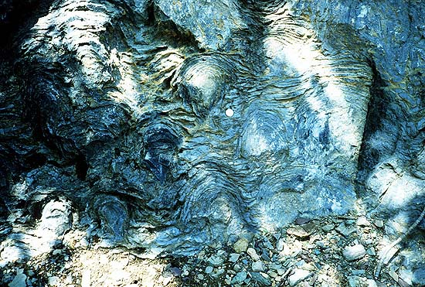
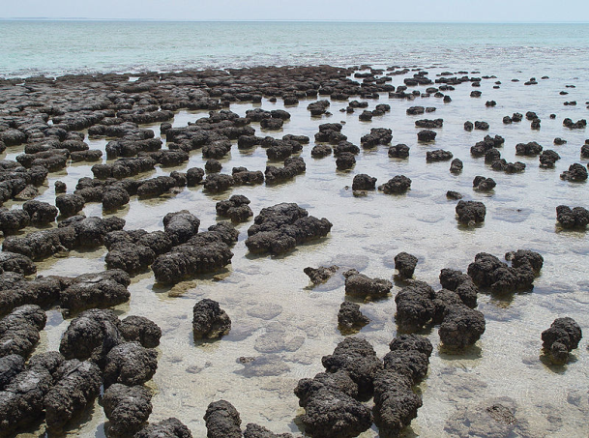
ORIGIN OF LIFE
According to radiometric measurements age of Earth ∼ 4,54 ± 0,04 GYA
(but according to some theories Earth has been created secondarilly and so
it is younger)
lower limit: oldest rocks
gneiss in Great Slave Lake (Canada) – 4 GY
zircon crystals (Australia) – 4,3 GY
some meteorites – 4,5 GY
end of bombarding of Earth – ∼4 GY
upper limit: microfossils, chemical fossils
chert in Warrawoona Group (Z Australia)
3,45 GY: resemblance to present stromatolites
... now questioned
Precambrian stromatolites
Siyeh Formation, Glacier Natl. Park
present-day stromatolites
Shark Bay, W Australia

Slide 8
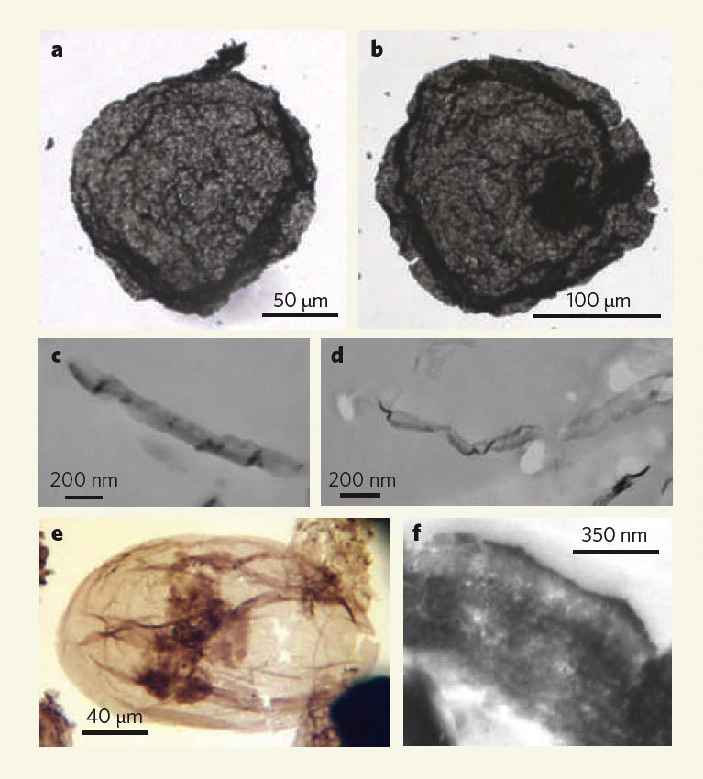
chemical fossils – kerogen = organic matter created by decay and transformation of living organisms
Greenland glacier: 3,85 GY, confirmed by C¹²/C¹³ ratio
Conclusion: life has probably emerged during 200 MY between
4 and 3,8 GY
Emmanuelle Javaux et al. (2010):
„acritarchs“ - 3,2 GYA
(Agnes gold mine, Moodies Group, S Africa) before – 1,8 GYA
není jisté, zda jde o eukaryota
nucleus?
cell wall
more complex cell structures
1,4 GYA

Slide 9
How has life arisen?
origin of simple organic molecules → chemical evolution,
primitive metabolism
origin of autoreplication, compartmentation and origin of cells, ...
First chemical experiments:
1828: ammonium chloride + silver cyanate + heat → urine
(= Wöhler synthesis)
1850s: formamide + H₂O + UV, electricity→ alanine
formaldehyde + NaOH → saccharides
⇒ evidence against vitalism (claims that chemistry in living systems is
fundamentally different from non-living, ie. organic ≠ inorganic)

Slide 10
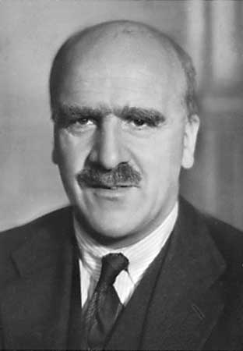
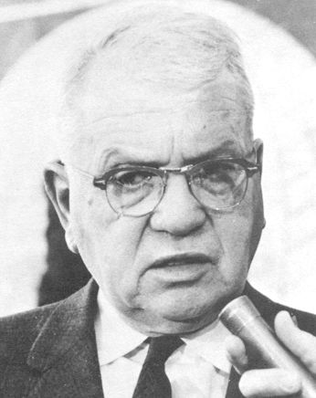
Chemical evolution
Alexandr Ivanovich Oparin (1924)
J. B. S. Haldane (1928)
reducing atmosphere:
hydrogen, water, methane, ammonia
Stanley L. Miller, Harold C. Urey (1953):
methane + ammonia + H₂ + H₂O
→ 10-15 % carbon in organic compounds
2 % carbon → amino acids, lipids, carbohydrates
building components of nucleic acids
A.I. Oparin
J.B.S. Haldane
H.C. Urey
S.L. Miller

Slide 11
„atmospheric“ part: spark discharges simulate lightnings and supply energy
cooling and condensation of gases
„oceanic“ part: water evaporates by heating; H₂, CH₂ and NH₃ added
in the „ocean“ organic compounds emerge

Slide 12
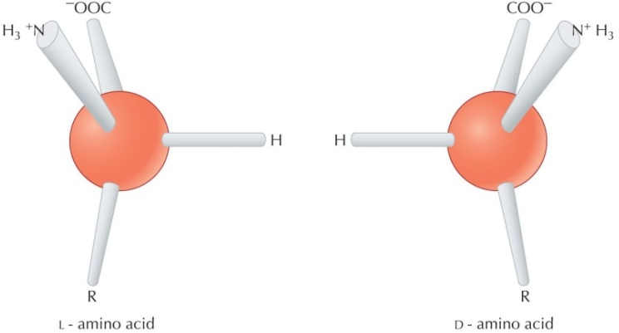
Problems:
according to current knowledge the atmosphere then less reducing:
CO₂, N₂, H₂O and others ⇒ consequently much less molecules arising
not all nucleotides synthesized
phosphorus in nature rare
some compounds in minimal amounts
some products highly unstable (eg. along with ribose also other
carbohydrates inhibiting ribose
synthesis are produced)
limited production of long polymers
origin of both D and L AA and NA stereoisomers
spontaneous origin of ramose, not linear, lipids

Slide 13
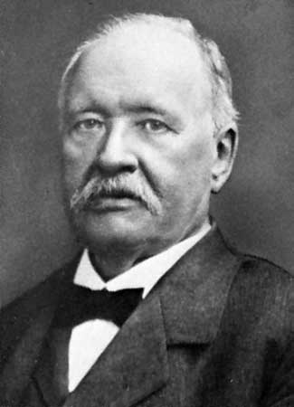
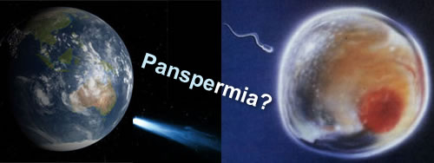
Where has life originated?
Darwin: „hot little pond“, prebiotic soup
alternatives:
extraterrestric origin:
panspermia: Svante August Arrhenius
existence of organic compounds in universe (comets, meteorites):
eg. Murchison meteorite (1969, Australia): 4,6 GYA; many compounds
as in the Miller-Urey experiment
bubbles: clouds, sea spume
Thomas Gold (1970): life deep under beneath the surface –
existence of extremophilic archaebacteria up to 5 km beneath surface
S. A. Arrhenius

Slide 14
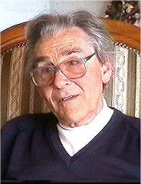
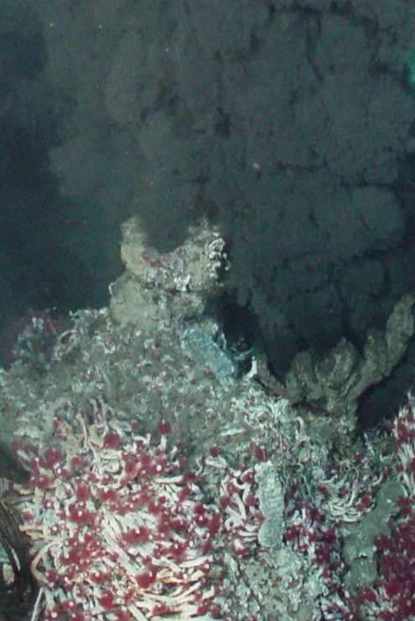
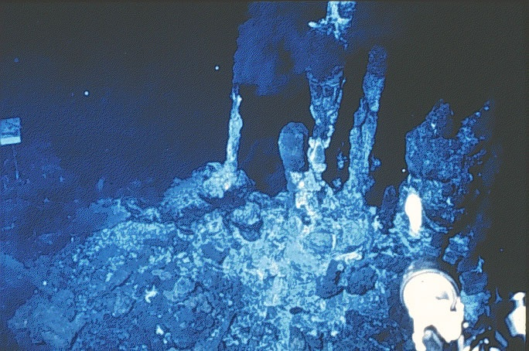
hydrotermal vents = “black smokers“
Günter Wächtershäuser
thermal energy rather than Sun
chemical synthesis: carbon fixation by chemical energy
protection against UV radiation and meteorite impacts
fixation of unstable molecules by cold water around
the vents
G. Wächtershäuser
1977: thermophilic bacteria and archaebacteria, three-meter tube worms, bivalves, starfish, barnacles, limpets, crabs, annelids, shrimps

Slide 15
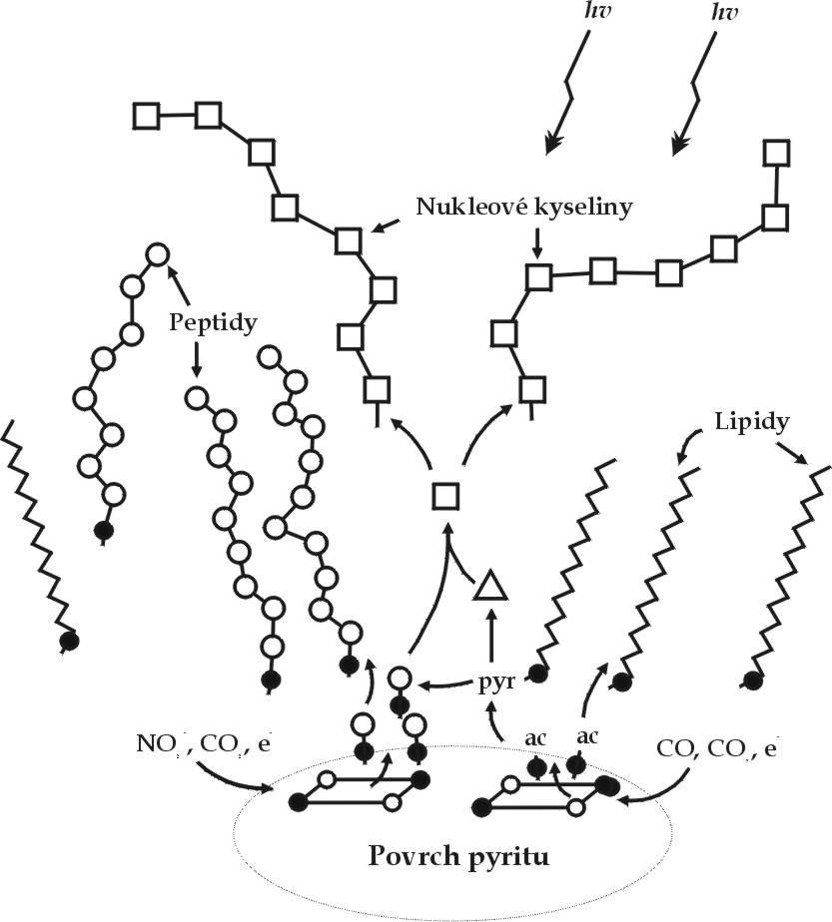
G. Wächtershäuser:
life on the pyrite surface = the Fe-S world hypothesis
„prebiotic pizza“
on the pyrite surface molecule clusters [2Fe-2S] or [4Fe-4S] → potential
precursors of ferredoxins, pyridoxalphosphates, folates, and cofactors
(NAD)
central role of acetyl-CoA
chemoautotrophy
Advantages of flat surface:
thermodynamics: lower entropy
kinetics: higher probability of molecule colisions
supply of ions to reactions (not clay!)
production of linear lipids
easier removing of water molecules

Slide 16
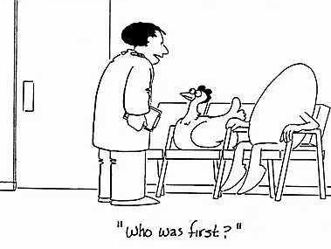
Origin of replicators – RNA world
Experiments of Spiegelman, Sumper and others have shown that on the
replicátor level there is not only heredity and mutation but also selection
but WHAT was replicated?
proteins
DNA
RNA
something else
?

Slide 17
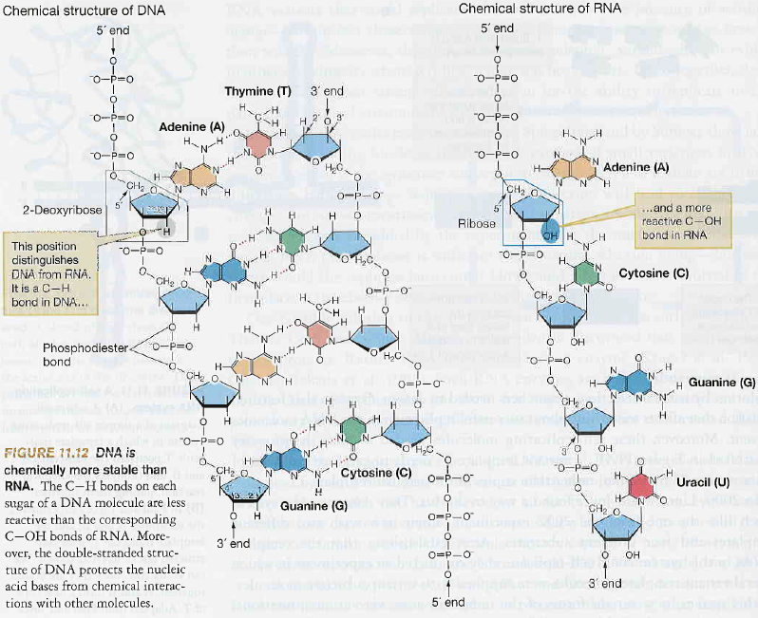

Slide 18
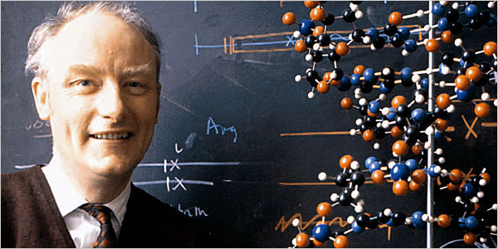
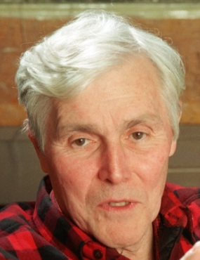
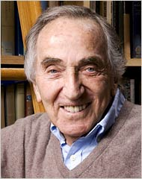
Origin of replicators – RNA world
Experiments of Spiegelman, Sumper and others have shown that on the
replicátor level there is not only heredity and mutation but also selection
but WHAT was replicated?
proteins
DNA
RNA
something else
F. Crick
Francis Crick, Carl Woese, Leslie Orgel (1967):
dual role of RNA: heredity + enzyme
= ribozyme
C. Woese
L. Orgel

Slide 19
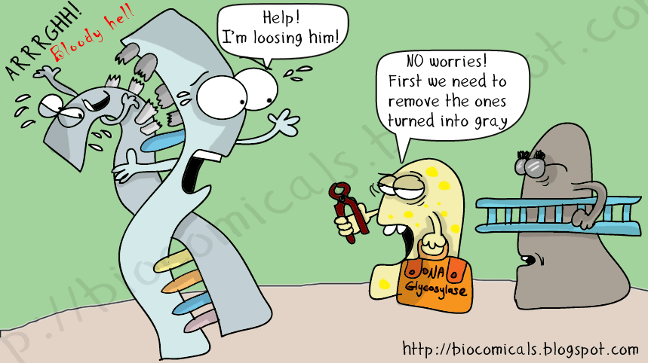
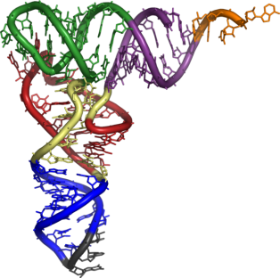
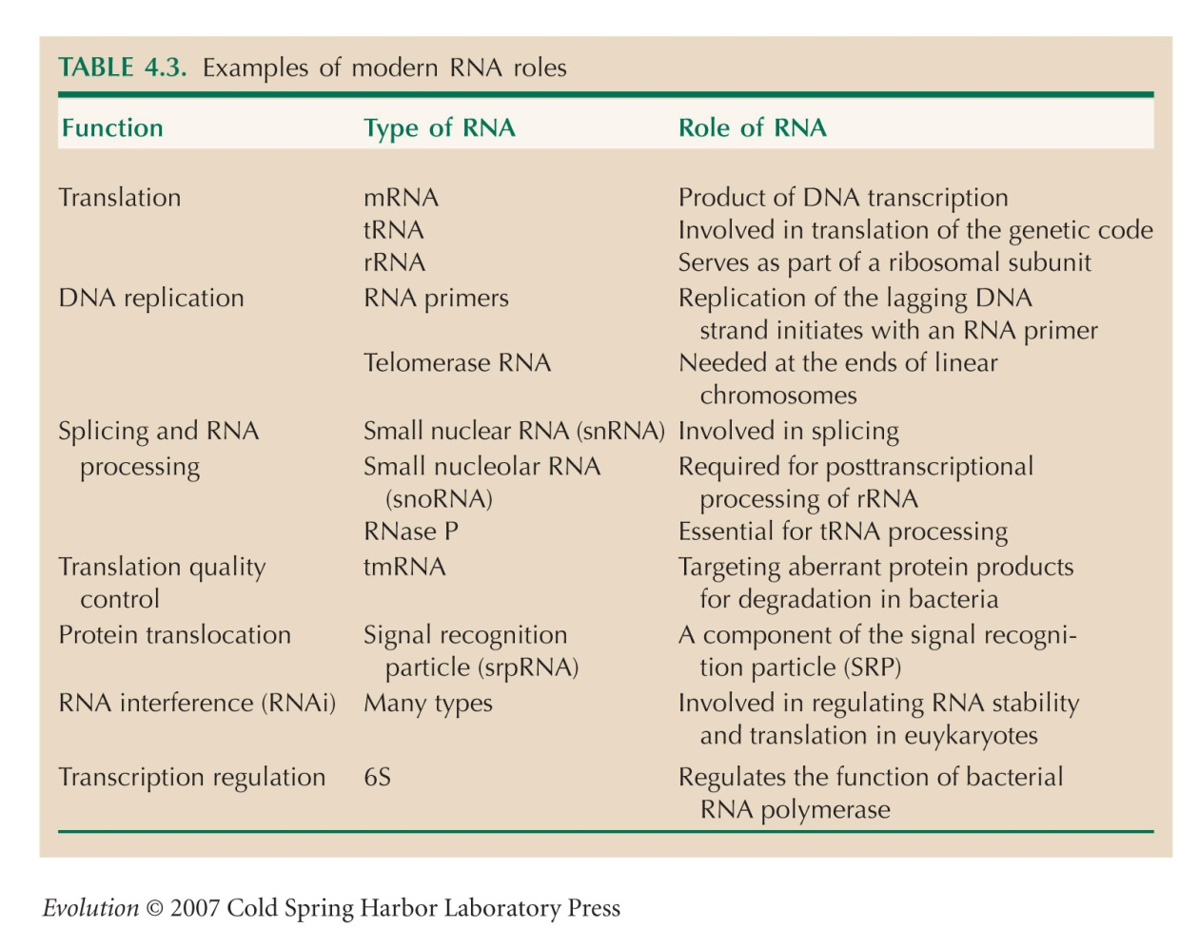
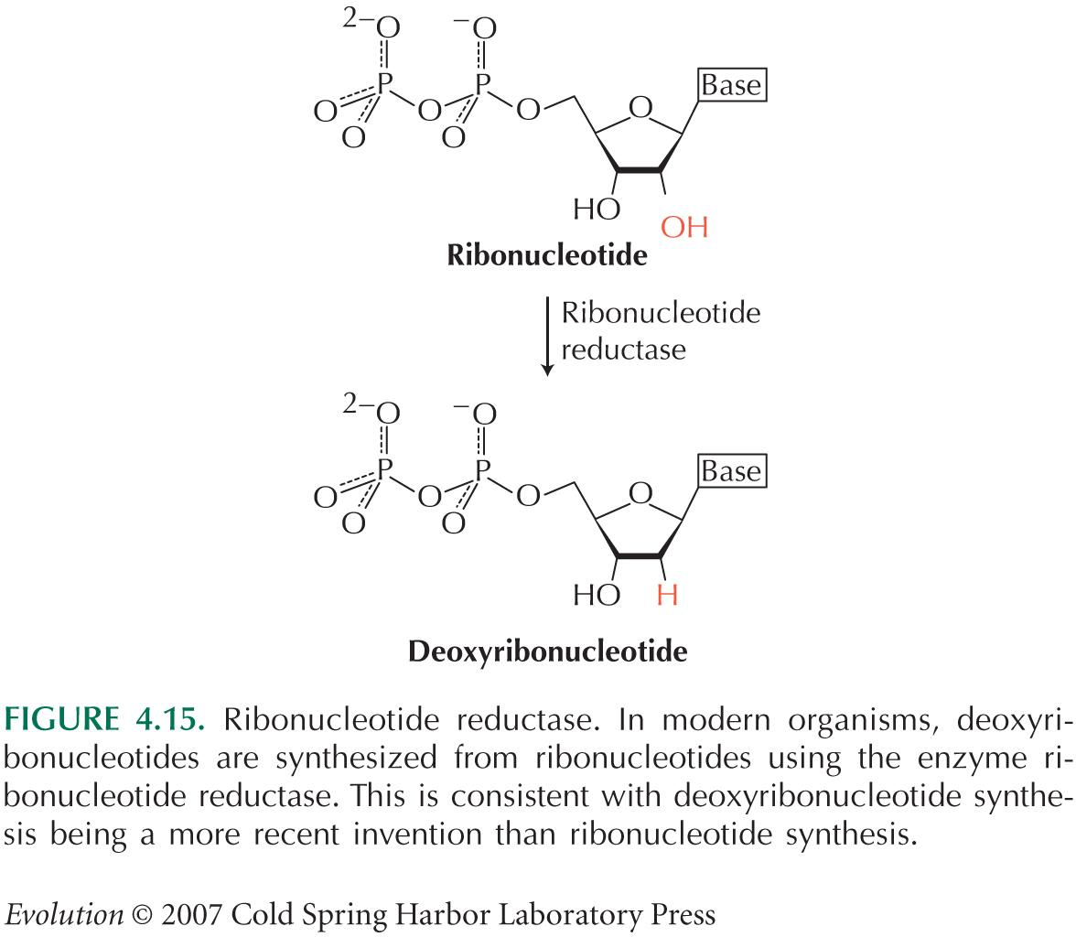
RNA characteristics:
simpler than DNA
absence of complex repair mechanisms
ability to build multiple 3D conformations
more reactive than DNA (OH-group on 2´ carbon)

Slide 20
many functions have arisen long ago
RNA as „molecular fossils“
many essential coenzymes, eg. NAD⁺, flavin adenin dinucleotide (FAD)
= ribonucleotide derivates
deoxyribonucleotides arise from ribonucleotides
RNA primer is used during DNA replication
ATP = ribonucleotide

Slide 21
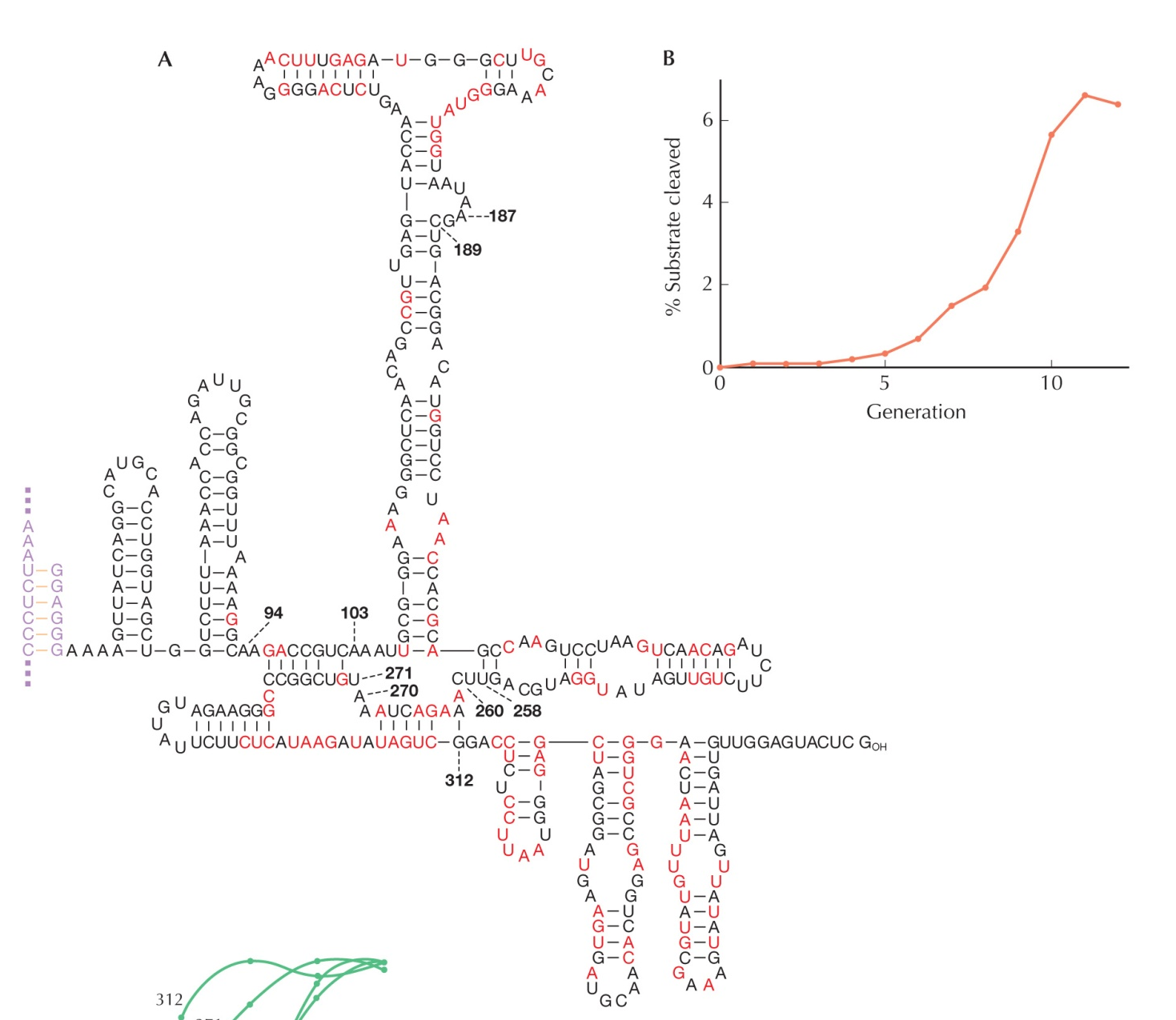
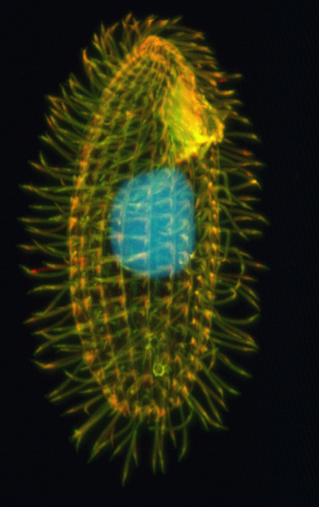
Kruger et al. (1982): self-cleaving of intron in pre-mRNA of Tetrahymena

Slide 22
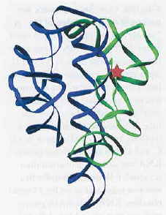
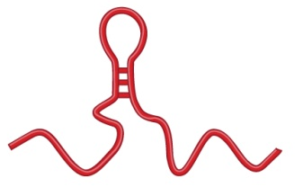
Kruger et al. (1982): self-cleaving of intron in pre-mRNA of Tetrahymena
Zaug a Cech (1986): IVS (intervening sequence) → ribozyme
ribozyme active site
ligase activity
polymerase activity

Slide 23


ability to replicate also other RNAs
compartmentation necessary
Doudna a Szostak (1989): modification of IVS → catalysis of synthesis of
complementary strand according to external template –
max. 40 nucleotides, only 1% complete
Doudna (1991):
three-subunit ribozyme from sequence of sunY of T4 bacteriophage

Slide 24
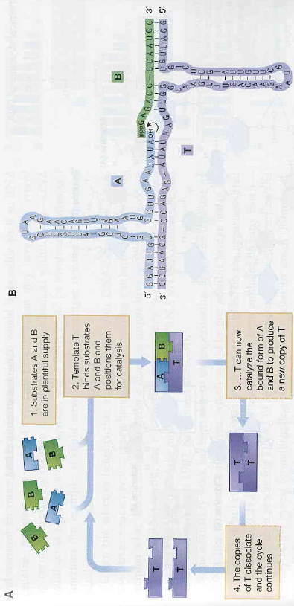
Paul & Joyce (2002):
R3C ribozyme – ligation of two RNA molecules
R3C modified so that the ligation product is identical to R3C → catalysis
of own replication
× only two rounds of replication and absence of selection (no variation)
→ these problems later solved (Lincoln & Jozce 2009)

Slide 25
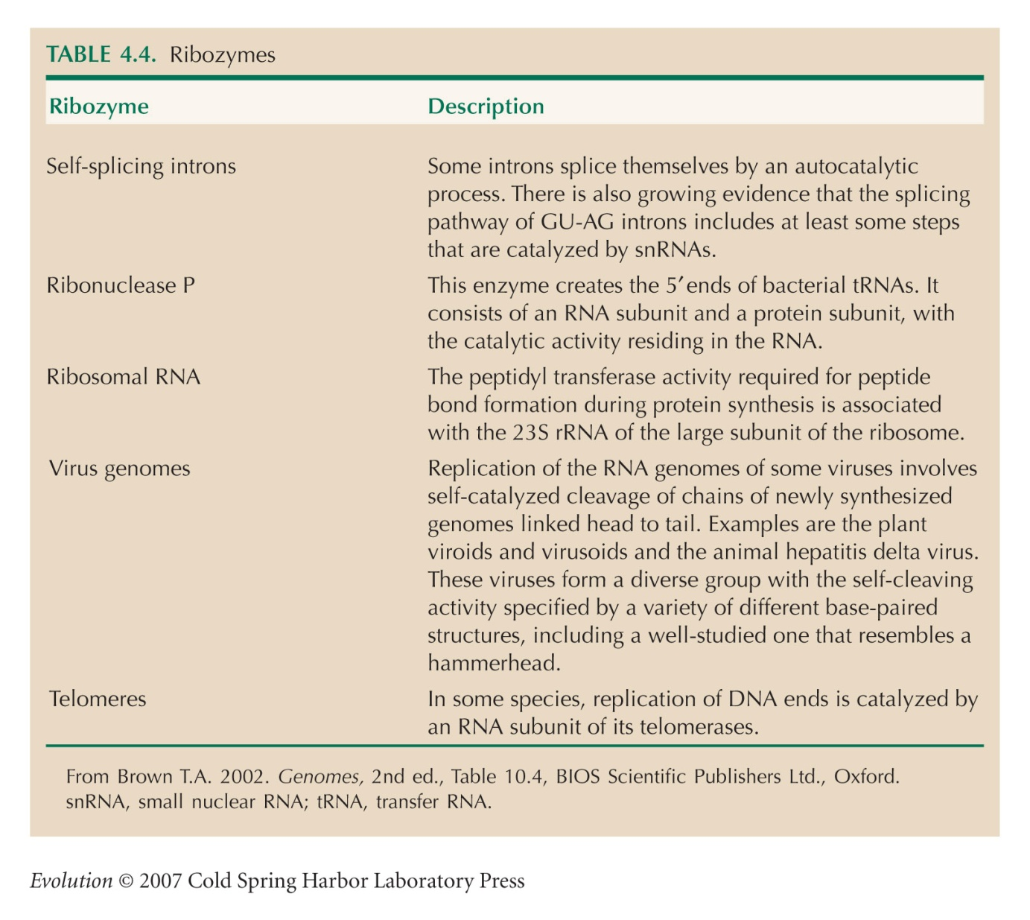
Some known natural ribozymes:
peptidyl transferase 23S rRNARNase P
introns of groups I and II
hairpin ribozyme
GIR branching ribozyme
leadzyme
hammerhead ribozyme
HDV ribozyme
mammal CPEB3 ribozyme
VS ribozyme
glmS ribozyme
CoTC ribozyme

Slide 26
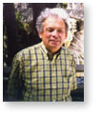
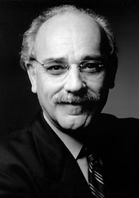
Alternatives to nucleic acids:
Alexander Graham Cairns-Smith: crystalic clay as „urgene“
– initially anorganic replication, a kind of „scaffold“
Julius Rebek: autoreplication using AATE
(amino adenosin triacid esther)
Ronald Breaker (2004): DNA can bahave
as ribozymes
A.G. Cairns-Smith
J. Rebek

Slide 27
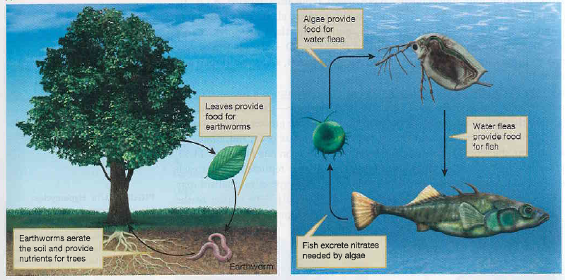
Problem of ribozyme-aided replication:
Manfred Eigen (1971):
individual genes will compete
without repair mechanisms maximum size of replicating molecules ≈ 100 bp
length of DNA segment encoding functional enzyme much exceeds 100 bp
= Eigen paradox
hypercycles = stable coexistence of two or more cooperating replicators

Slide 28
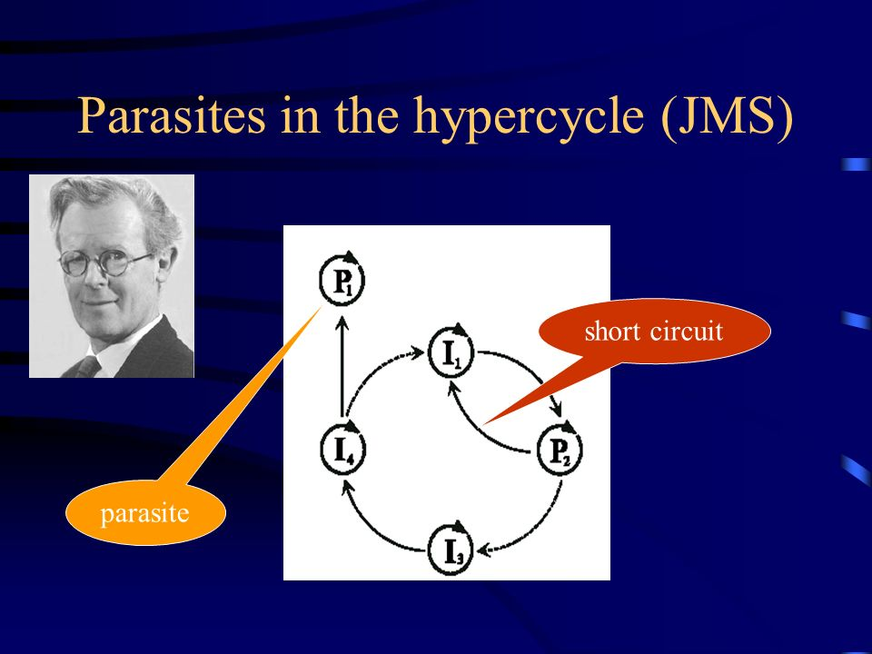
hypercycles:
molecular mutualism: reciprocal altruism (win-win relationship)
competition of the whole systém with other cycles
risk of systém „parasitation“ ⇒ need for compartmentation

Slide 29
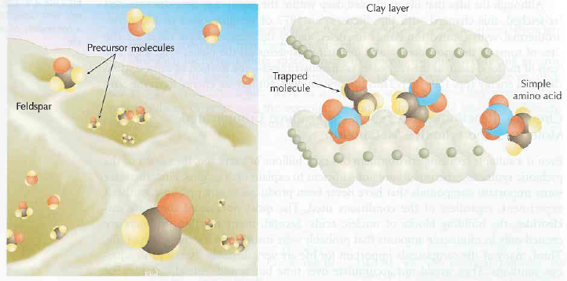
Compartmentation and origin of cells
role of tiny crevices and unevenness of the mineral surface
clay layers
protection, increase of
concentration
felspar

Slide 30
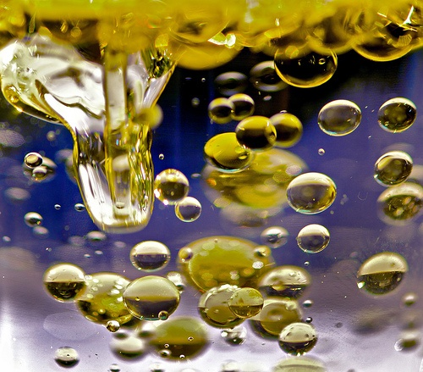
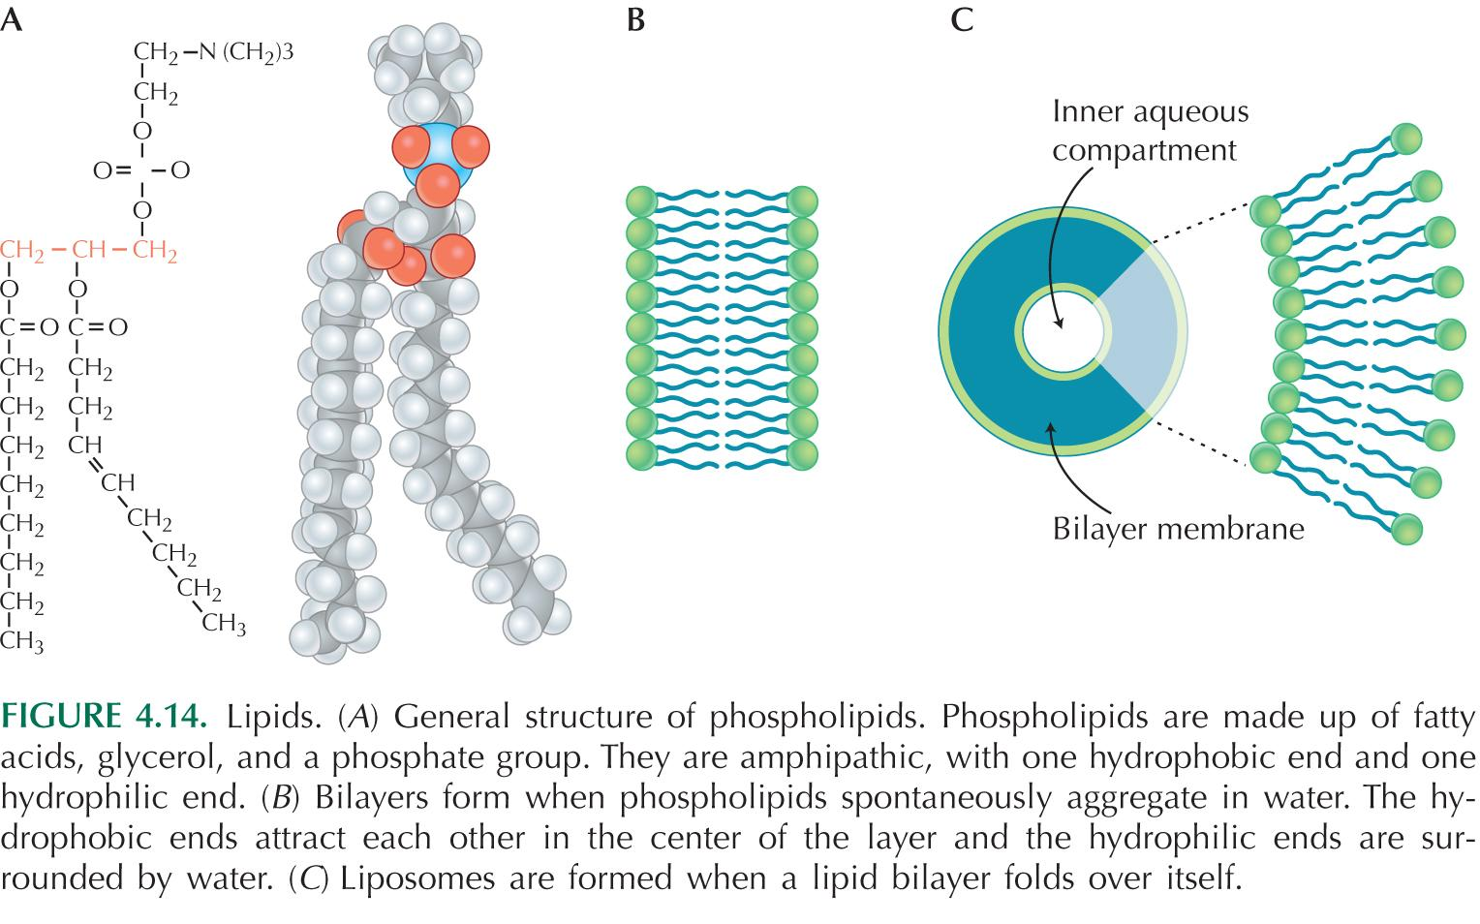
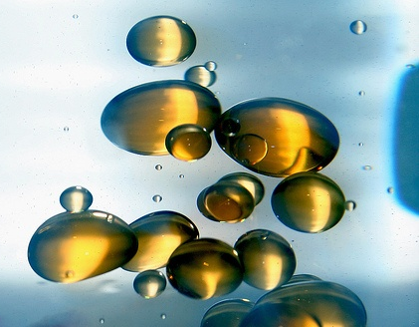
Compartmentation and origin of cells
role of tiny crevices and unevenness of the mineral surface
proteins: microspheres (Sidney W. Fox)
lipids: spontaneous production of liposomes
spontaneous production of lipidic membranes: „oil on water“ → „water on oil“
semi-cell → proto-cell → cell

Slide 31
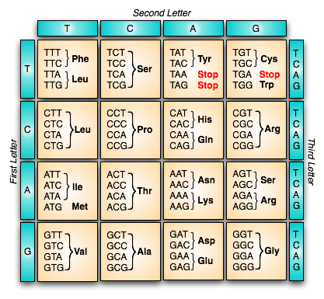
Origin of chromosomes and genetic code
fusion of replicators ⇒ longer replication ⇒ selective disadvantage
possible benefits:
1. reduction of competition between functionally connected replicators
2. products of functionally connected replicators at the same place
genetic code: redundant, redundancy random (Ser, Arg, Leu: 6 codons × Met, Trp: 1 codon)

Slide 32



chemically related AAs → similar code
genetic code is not by far „universal“ – exceptions in some organisms
(eg. Mycoplasma) or organelles (mitochondria)
AAs perhaps initially helped to stabilize RNAs or
as enzymatic co-factors enhancing RNA activity
→ step by step emergence of function in translation system
emerging protein
bond of AA
tRNA
P site
A site
anticodon
ribosome
mRNA

Slide 33
Association AAs and RNAs:
synthesis of proteins governed by RNA
mapping of RNA sequence onto AA
origin of tRNA
„frozen accident“ – F. Crick (1968)
some RNA molecules evolved ability to transfer AA to other RNA
selection gradually favours one or more RNAs for each AA
association between AA and RNA random
stereochemical theory: Carl Woese
different RNAs tend to preferentially bind particular AAs
→ some experiments show that RNA molecules may be selected
according to their preferential bond to particular AAs

Slide 34
Transition RNA → DNA
RNA world: RNA = both genotype and phenotype
with translation proteins adopt most catalytic RNA functions
(they can create broader range of polymers) ⇒ much more diverse
catalytic activities → eg. no RNA molecule can catalyze redox
reactions or break C–C bonds
DNA advantages:
lower reactivity ⇒ higher stability ⇒ longer genes
division of labour between RNA and DNA
with loss of genetic function RNA could have carry out catalytic and
structural functions with smaller restrictions

Slide 35





Origin of eukaryotic cell

Slide 36


Slide 37


Thomas Cavalier-Smith:
loss of cell wall ⇒ necessity to create endoskeleton ⇒ flexibility, movement, fagocytosis
invagination of membrane → ER
Prokaryotic cytoskeleton:
FtsZ: tubuline analogue, function in cell division
MreB: actin analogue, rod-shaped cell shape
Crescentin: analogue of intermediary microfilaments, helix creation
MinD, ParA: no analogue, cell division, separation of plasmids
microfilaments
microtubules
exaptation

Slide 38


Origin of cell organelles:
Konstantin Sergeyevich Merezhkovsky (1905, 1909):
term symbiogenesis
chloroplasts = originally alien organisms
(Andreas Schimper, 1883: similarity between chloroplasts and cyanobacteria;
Richard Altmann, 1890: mitochondria [bioblasts] = originally bacteria)
first animal cell: anucleate amoeba + bacterium (nucleus)
Lynn Margulis (1966, 1970): endosymbiosis
mitochondria: bacteria related to rickettsias or other
α-proteobacteria (eg. Rhodospirillum),
gradually loss of photosynthesis
chloroplasts: cyanobacteria, loss of respiration
K.S. Merežkovskij
Lynn Margulisová

Slide 39

nucleus
primary plastid
mitochondrion

Slide 40
Theories of the origin of nuclear membrane:
1. fusion of vesicles of cytoplasmatic membrane
2. fusion of eubacterium and archaebacterium (archaebacterial membrane
= nuclear, bacterial membrane = cellular)
3. viral origin (several alternatives) ... controversial
4. first origin of the 2nd cytoplasmatic membrane, from the inner eventually
nuclear membrane

Slide 41


Slide 42

Transfer of genes to nucleus:
eg. neoSTLS2 gene, tobacco chloroplast → in 16 of 250 000 (≈ 1/16 000)
daughter cells transfer of the gene to nucleus ⇒ kanamycin resistence

Slide 43




peroxisomes: G+ bacteria
microtubules: spirochaetes
× současné poznatky nepotvrzují
spirochaetes
Mixotricha paradoxa
secondary and tertiary endosymbiosis
→ complex plastids: eg. euglena + green alga

Slide 44

Secondary endosymbiosis:
loss of cellular content of primary host

Slide 45

Secondary endosymbiosis:

Slide 46


Tertiary endosymbiosis:

Slide 47




sometimes the existence of a secondary endosymbiont can be revealed
only according to presence of its DNA (eg. chlamydia genes in plant
plastids and primary algae)
in other cases endosymbionts still able of independent life,
eg. photosynthetic algae (chlorellas, dinoflagellates, haptophytes)
in cells of corals, foraminiferans, radiolarians, and some ciliates
Protoperidinium
Chlorella
Ceratium
haptophyte
Gephyrocapsa

Slide 48




„kleptoplastids“ (eg. ciliate Myrionecta rubra, dinoflagellate of the genus Dinophysis, marine gasteropod Elysia viridis)
Myrionecta
rubra
Elysia viridis
Dinophysis
caudata

Slide 49

Origin of multicellular organisms

Slide 50




slime molds, eg. Dictyostelium discoideum
24 h fruiting body
sorus
20-22 h
stalk
16 h „finger“
8000–500 000 cells
18 h „Mexican hat“
10 h loose aggregate
„slug“
12 h tight aggregate

Slide 51


How can „slug“, composed of independent amoebas, orient itself in its
environment?
cAMP (cyclic adenosine monophosphate): emission in area of the densest
aggregation → signal for „downstream“ cells → gradual aggregation
production of protein enabling mutual attachment of amoebas
reaction to external stimuli: light, teperature, oxygen and ammonium
in the soil
cAMP emission

Slide 52


Advantages of D. discoideum aggregation?
production of coat made of cellulose and substances rich of proteins →
protection against nematodes – only on the “slug“ surface
faster movement
direction of „slug“movement
nematode
„slug“ protected by coat and size

Slide 53

Tree of life:
Last Universal Common Ancestor (LUCA)
we can know nothing about organisms before LUCA

Slide 54


Slide 55

?
?
?

Slide 56
Eubacteria (E. coli)
mitochondria (cows)
β
chloroplasts (tobacco)
Archaea (Sulfolobus)
Eukaryotes (plants, fungi)
ATPase
Eubacteria (E. coli)
chloroplasts (tobacco)
α
Archaea (Sulfolobus)
Eukaryotes (plants, fungi)

Slide 57


Horizontal transfer of genes
reticulate evolution
⇒ no LUCA of recent organisms × trees for individual genes can have LUCA

Slide 58


Where to place viruses on the Tree of Life?
1. relics of pre-cellular world: some processes and genes ancient
many genes only very distantly related to their cellular counterparts
× how could they independently exist in pre-cellular world?
2. similarity with transposons → „escaped“ parts of cellular organisms
– (eg. RNA or DNA elements, plasmids)
3. originally free-living organisms
eg. mimivirus: genome size = 1,2 Mb, > 900 proteins, ie. more than
some bacteria and archaebacteria!
mimivirus

Slide 59




Increase of complexity:
Stephen Jay Gould:
evolution moves as a drunk person which cannot
return to the starting point however he wants
even at present most organisms prokaryotic
secondary simplification (eg. parasites)
×
John Maynard Smith a Eörs Szathmáry:
the contingent irreversibility theory): steady tendency to increase
of complexity
major transitions
complexity emrges withou selection

Slide 60

Major transitions in evolution:
origin of replicators
compartmentation, origin of cell
origin of chromosomes
origin of genetic code, DNA
origin of Eukaryotes
origin of sex
multicellularity
societies
origin of language
Individuals cease to reproduce independently
Bigger size → bigger pray, specialization, division of labour
Origin of more effective ways of acquiring, processing,
transmission, and saving of informations

Slide 61
But advantages of a transition to a „higher level“
do not imply group selection!
conflict of selections at different levels:
replication control × B chromosomes, transposition
fair meiosis × meiotic drive
differentiation of somatic cells × oncogenic growth
non-reproducing castes × egg-laying workers

