Slide 1
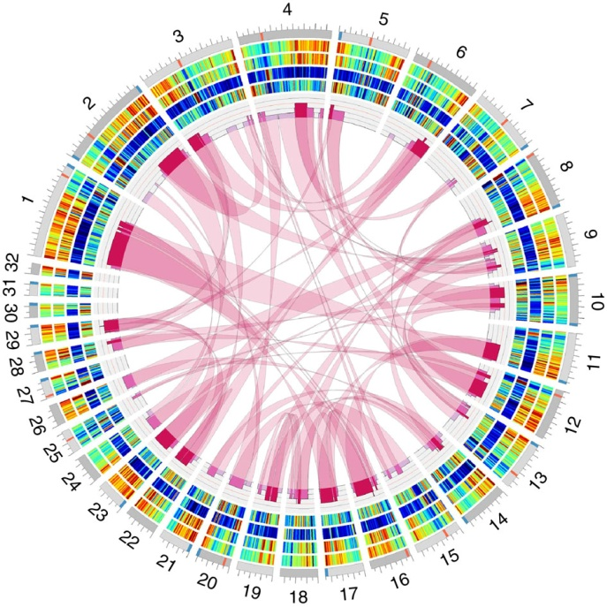

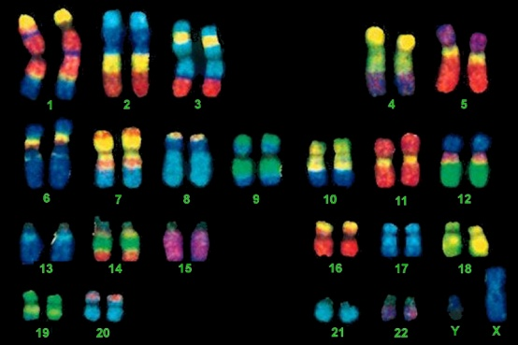
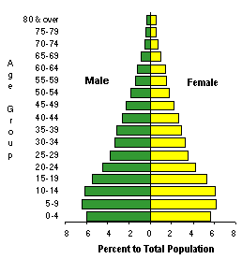
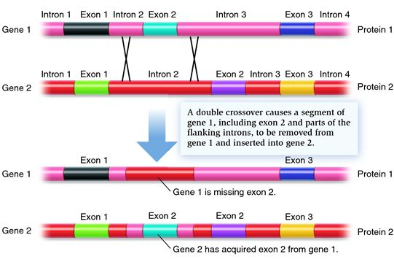

EVOLUTION OF GENETIC
SYSTEMS

Slide 2
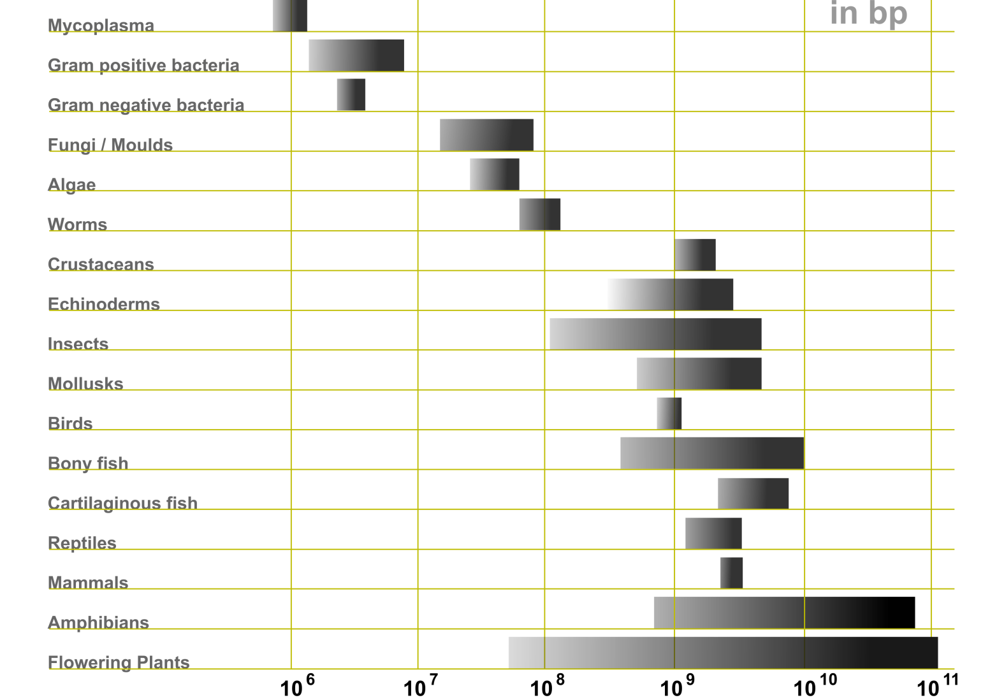
EVOLUTION OF THE GENOME
Genome size and C-value:
C-value = amount of DNA in haploid genome (pg, bp)
Prokaryotes:
6×10⁵ – 10⁷ bp (20-fold span)
smalles: Mycoplasma genitalium 525 genes, the smallest fuctional
artificially synthesized genome ≈ 473 genů (modified from M. mycoides)
largest: some G+ bacteria, cyanobacteria

Slide 3
Eukaryotes:
8,8×10⁶ – 6,9×10¹¹ bp (80 000-fold span!)

Slide 4
no relation between genome size and organismal complexity or number
of genes
large differences even in related organisms:
Paramecium caudatum (8 600 000 kb) × P. aurelia (190 000 kb)
human: ca. 6×10⁹ bp (∼ 6,5 pg DNA)
× Amoeba proteus: 2,9×10¹¹ bp
Polychaos dubium (Amoeba dubia): 6,7×10¹¹ bp
⇒ C-value paradox (C-value enigma)

Slide 5
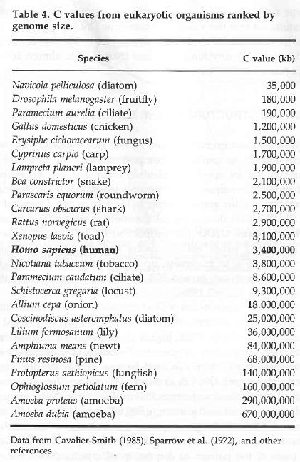
closely related species!
marbled lungfish:
> 40× larger than human
almost 200× larger than human

Slide 6
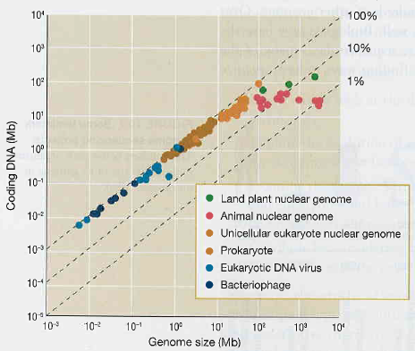
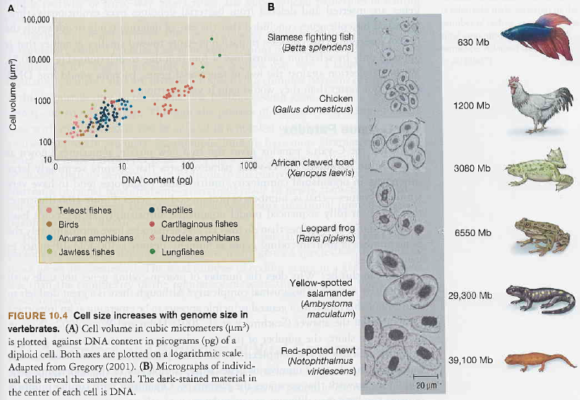
C-value paradox:
large genomes include large
amount of non-coding DNA
the larger the genome, the larger the cell
large genomes ⇒
large cells ⇒ influence on:
cell division speed
metabolism efficiency
rate of ions/proteins
exchange
body size

Slide 7
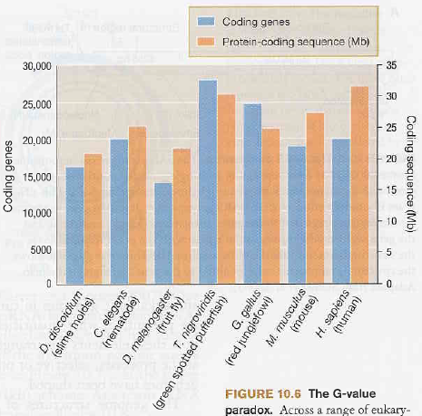
G-value paradox:
despite diversity of organismal complexity, metazoans tend to have
similar numbers of protein-coding genes (G-value)
No dependency on the total number of genes but on complexity of gene
regulation networks – organisms with similar number of genes may
have very different patterns of gene regulation networks

Slide 8
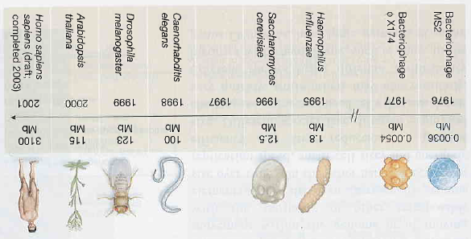
whole genome sequence
How many coding genes are in the human genome?
before 2001 (draft version of the genome) estimates from 50 000 till
> 140 000 (max. 212 278) genes
Int. Human Genome Sequencing Consortium (IHGSC) 2001:
30 000–40 000 protein coding genes
IHGSC 2004: 20 000–25 000 protein coding genes
Ensembl – May 2012: 21 065 coding genes
Ensembl – January 2013: 20 848 coding genes
Ensembl – February 2014: 20 805 coding genes
Ensembl – December 2014: 20 364 coding genes

Slide 9
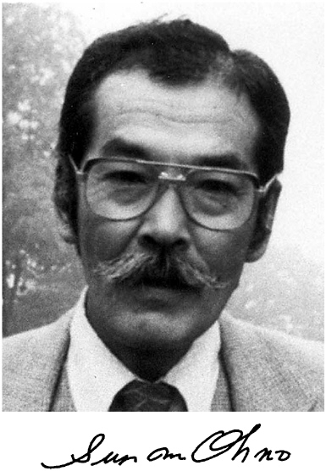

Repetitive DNA:
Highly repetitive = satellite
Moderately repetitive = minisatellites, microsatellites
Transposable elements, retroelements (SINE, LINE)
Why does repetitive DNA exist?
Cavalier-Smith (1978): there must be some function
Doolittle and Sapienza, Orgel and Crick (1980): repetitive DNA is „selfish“
Susumu Ohno (1972): „junk DNA“
„junk“ ≠ „garbage“ ⇒ in future it may gain some function

Slide 10
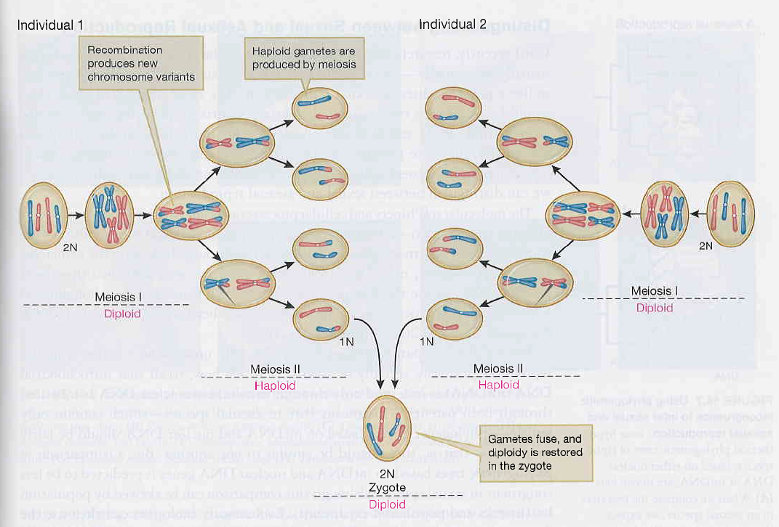
EVOLUTION OF SEX
sex = meiosis, recombination
amphimixis

Slide 11
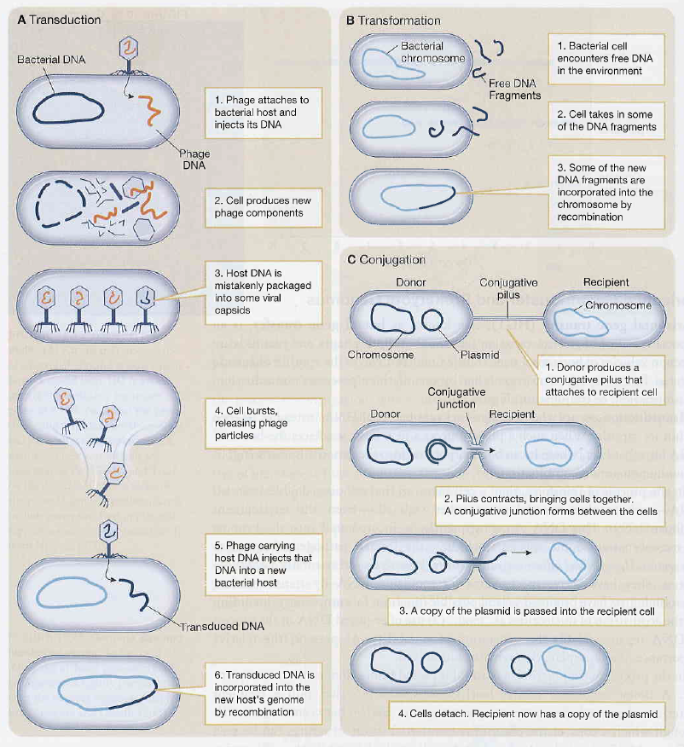
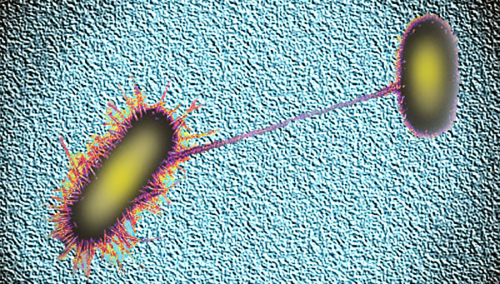
„sex“ in Prokaryotes:
conjugation
transformation
transduction
conjugation in E.coli:

Slide 12
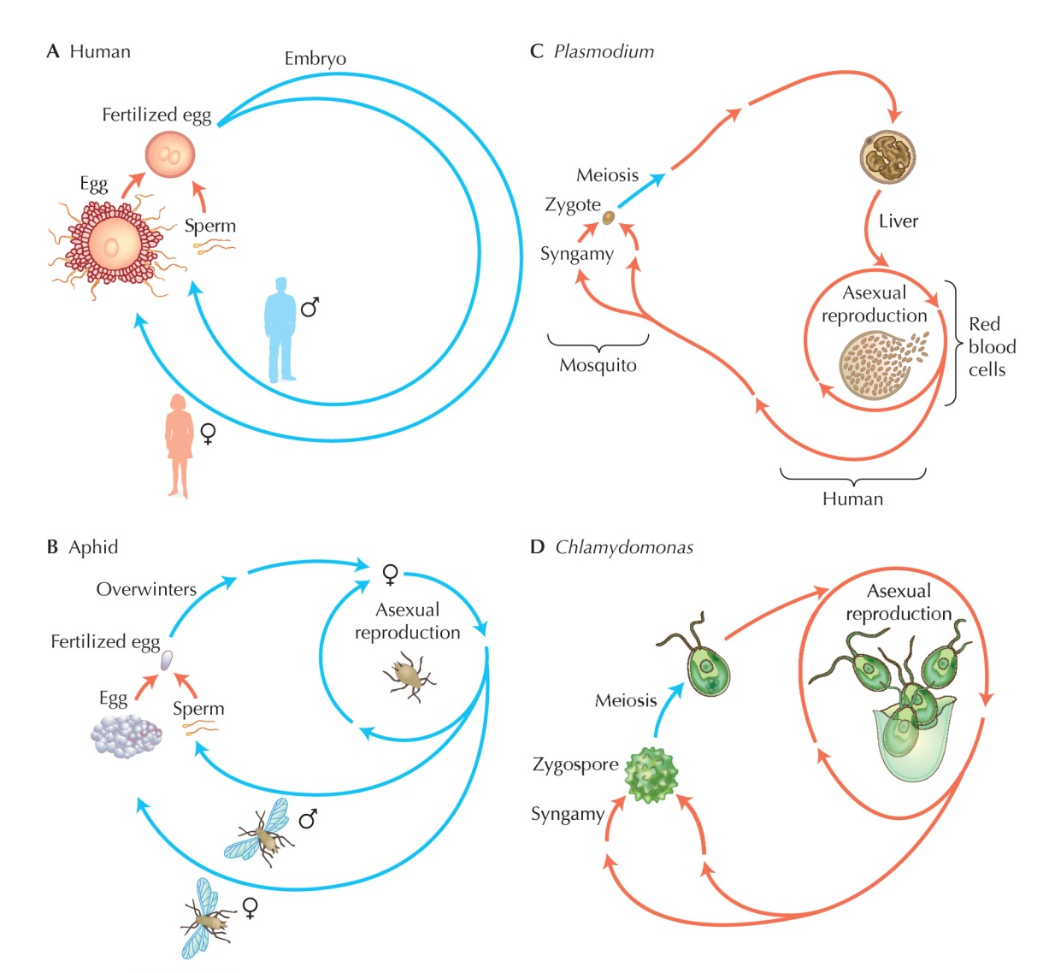
sex at the end of life cycle
no division in haploid stage
most of life in haploid phase
facultative sex
sex triggered by starving (shortage of N₂)

Slide 13
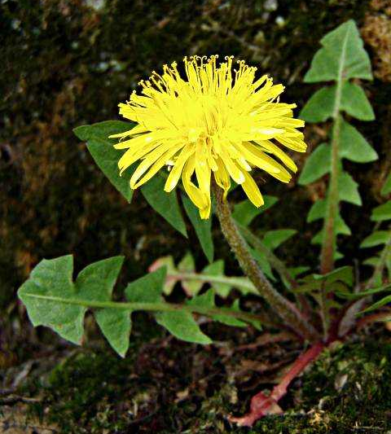
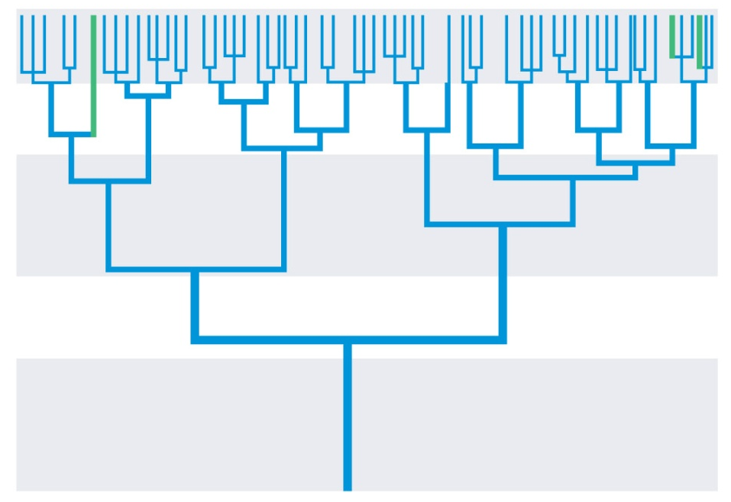
phylogenetic position of asexual taxa:
mostly recent lineages
taxa scattered
T. officinale
most asexual lineages arised recently from sexual; eg. dandelion Taraxacum officinale: non-functional stamina, yellow colour

Slide 14
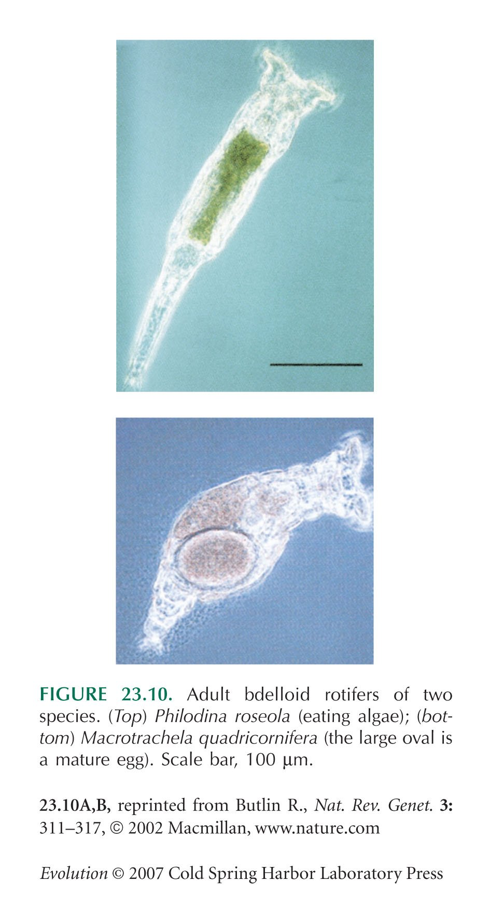
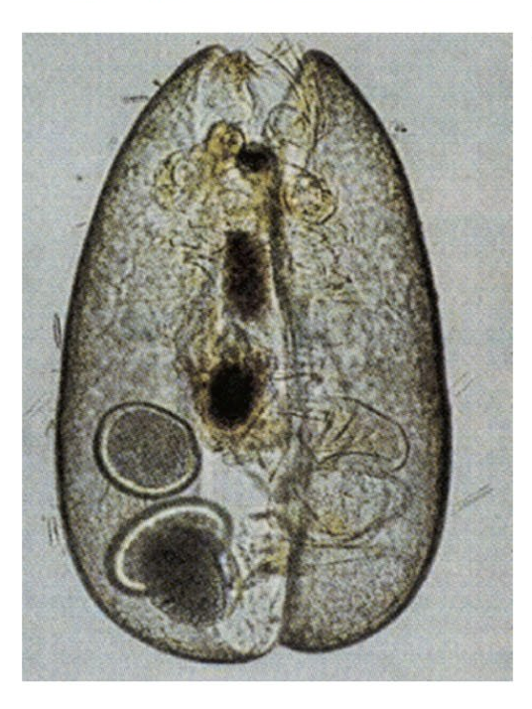
exceptions:
Bdelloidea rotifers:
fossils in amber 35-40 MY
existency ∼100 MY
ostracods:
asexual ∼100 MY
× recently males found
Philodina roseola
eggs
Macrotrachela quadricornifera
Darwinula stevensoni

Slide 15
Disadvantages of sexual reproduction
time and energy necessary for finding a partner (finding itself may be
a problem), further effort before copulation
increased risk of predation or parasitation, transmission of venereal
diseases
susceptibility to extinction at low N_{e}
lower capability of colonization
complex meiotic molecular machinery
meiosis: 10-100 h × mitosis: 15 min – 4 h
impact of sexual selection on males → reduction of population fitness
eg. Soay sheep (St. Kilda): males die during the first winter
× females and castrated males several years

Slide 16
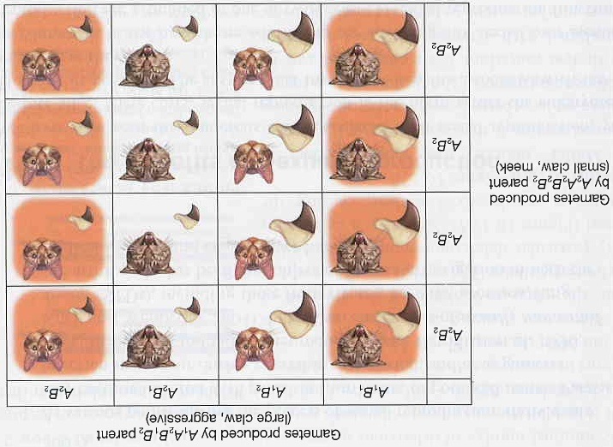
Disadvantages of sexual reproduction:
break-up of advantageous allele combinations by recombination
Eg.: A₁ (dominant) = large claws, A₂ (recessive) = small claws
B₁ (dominant) = agressive, B₂ (recessive) = meek
disadvantageous
combinations
advantageous
combinations
advantageous
combinations

Slide 17
Disadvantages of sexual reproduction:
action of selfish elements (conflict of genes) → reduction of population
fitness (B chromosomes, transposons)
from the sexual female´s point of view
disadvantage, because the offspring
have only 1/2 of her genes
haploid gametes
N
N
2N
diploid sexual females
N
N
2N
2N
2N
diploid asexual females
diploid offspring

Slide 18
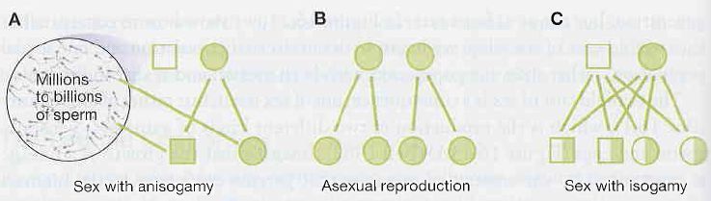
J. Maynard Smith: What is the fate of sexual and asexual
population?
assumptions: way of reproduction has no effect on
1. number of descendants (eg. when males take care of offspring)
2. probability of offspring survival
frekvence
asexuálů
if sexual individuals prevail in the population
the number of asexual females is rougly doubled in each generation
F × M
↓
F × M F × M
↓ ↓
F × M F × M
F × M F × M
F
↓
F F F F
↓ ↓ ↓ ↓
F F F F
F F F F
F F F F
F F F F
1/3
1/2
2/3
⇒ twofold cost of sex, ie. 50% selective disadvantage of
sex (not for isogamy! → so rather cost of males)

Slide 19
ad 2) effect of environment
experiment with Tribolium castaneum: competition, insecticide,
reproductive advantage of „asexuals“
sexual
simulation of asexuality
1.0
1.0
konc. malathionu
konc. malathionu
1 ppm
1 ppm
0.5
3 ppm
0.5
3 ppm
5 ppm
5 ppm
10 ppm
10 ppm
0
0
1.0
1.0
konc. malathionu
konc. malathionu
1 ppm
1 ppm
3 ppm
3 ppm
0.5
5 ppm
0.5
10 ppm
5 ppm
10 ppm
0
0
at first prevalence of asexuals, eventually fixation of sexuals
faster at higher insecticide concentrations
offspring of sexuals have higher fitness ⇒ assumption 2 is not valid

Slide 20
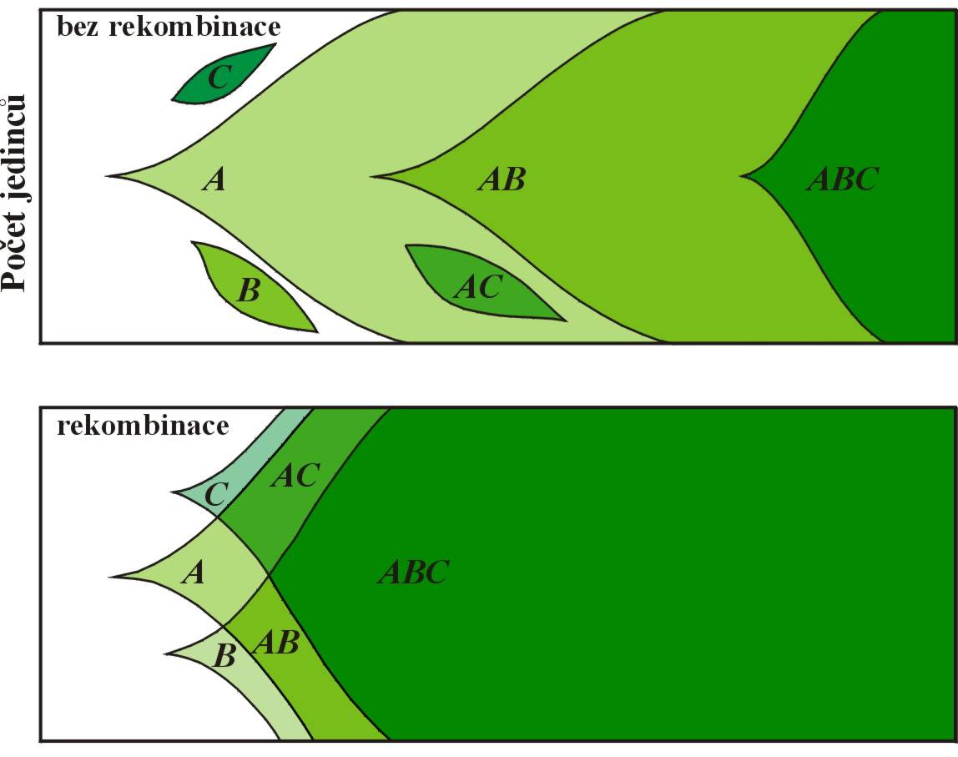
Advantages of sexual reproduction
1. Fisher-Muller argument:
individuals AB arise only when mutation B emerges in individuals A
čas
advantageous alleles A, B a C arise in 3 different individuals
recombination combines various advantageous alleles which can arise simultaneously in the population

Slide 21
Effects of recombination:
1 locus → max. 2 variants of gametes (heterozygote)
2 loci → 4 variants: gametes AB/ab → ab, aB, Ab, AB
10 loci → 2¹⁰ = 1024 different gametes and 2^{n-1}(2^{n}+1) = 524 800
diploid genotypes
for population genetics the only consequence of sex is linkage equilibrium – when it is reached sex loses sense
every model explaining advantage of sex must include a mechanism
which eliminates some gene combinations (LD arises), and explain why genes causing LD are favoured by selection
Sexual reproduction increases variation and hence rate of evolution
but this advantage mostly in long-term perspective,
asexuality in the short-term more advantageous

Slide 22
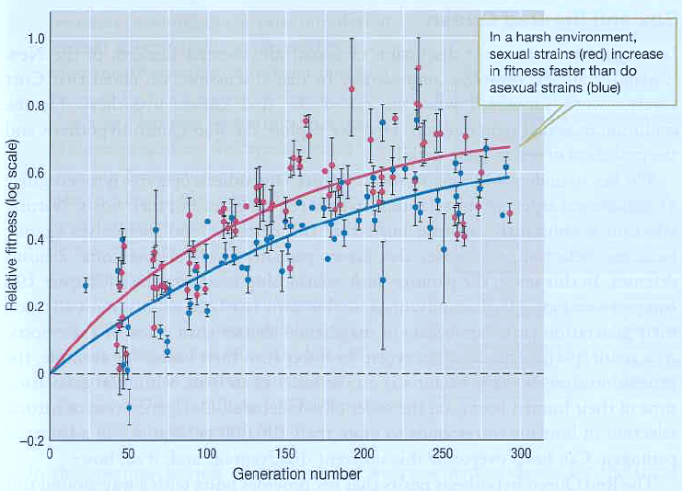
Eg.: yeast Saccharomyces cerevisiae
favourable environment: abundance of glucose, optimal temperature
→ no difference
unfavourable environment: shortage of glucose, high temperature

Slide 23
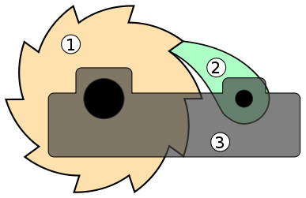
2. Elimination of deleterious mutations I.
Muller’s ratchet:
The only way how to escape from deleterious mutations either
back mutation, or
mutation which invalidate effect of the previous mutation
ratchet
gear
pawl
base

Slide 24
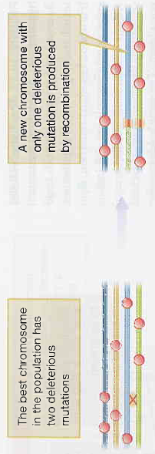

accumulation of deleterious mutations
small population ⇒ role of drift (stochastic process)
with sex chance to avoid „ratchet“
with increase of genotype frequencies without deleterious mutations spread of genes responsible for sex
best when mutations are only slightly deleterious
0
1
2
3
4
5
6
7
8
9
10
Frekvence
0
1
2
3
4
5
6
7
8
9
10
0
1
2
3
4
5
6
7
8
9
10
„ratchet“
Počet mutací

Slide 25
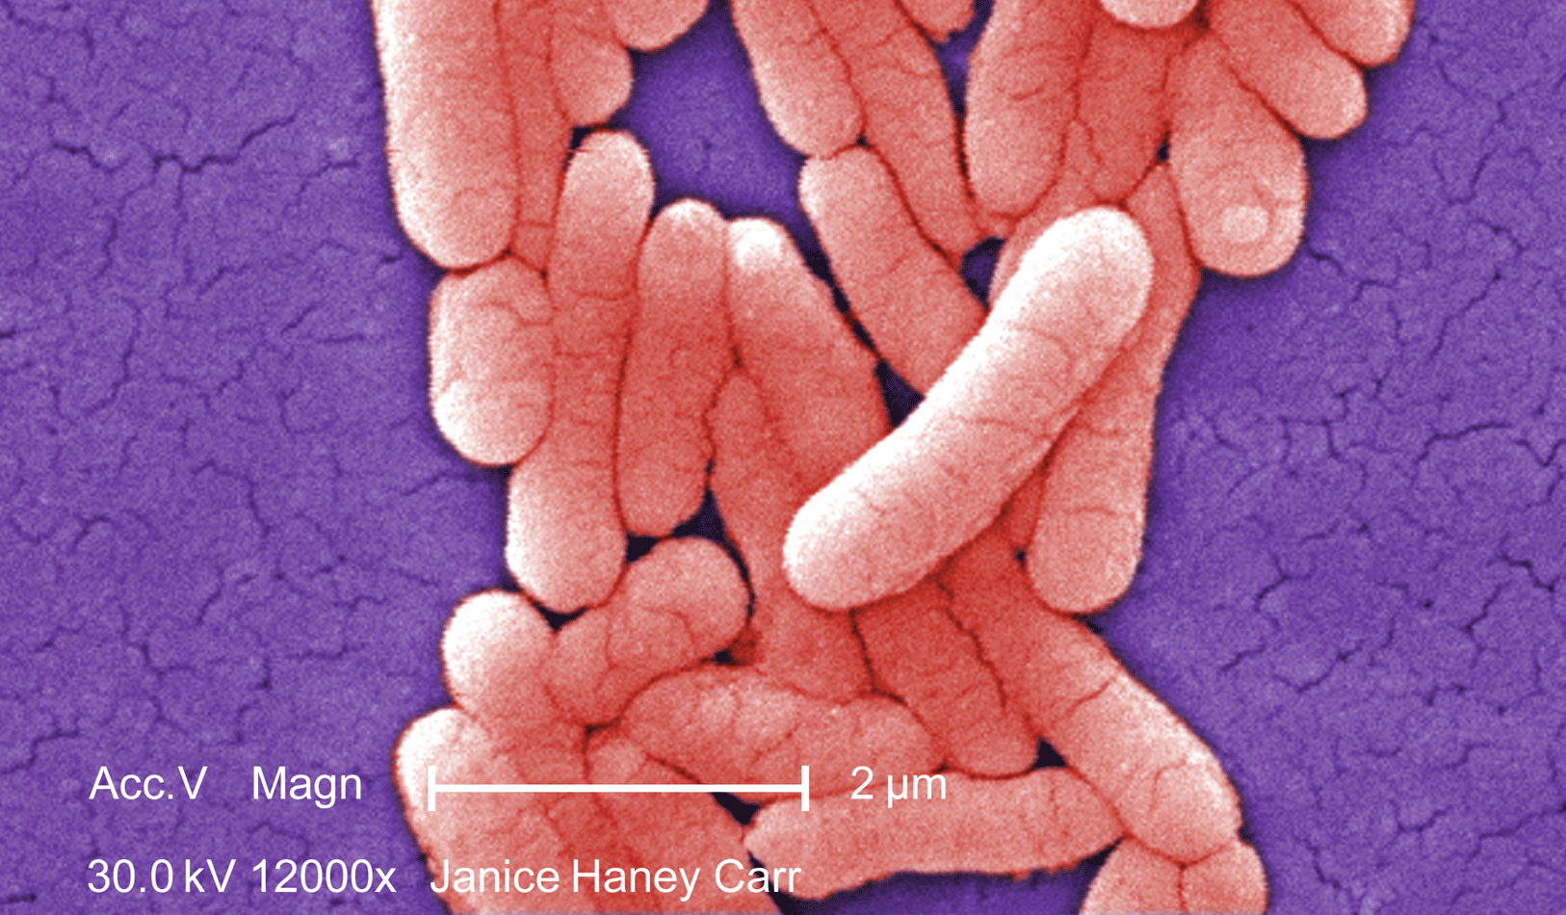
Andersson and Hughes (1996) - Salmonella typhimurium
444 experimental cultures, each from 1 individual → growth overnight
repetition ⇒ repeated drift, total of 1700 generations
comparison with a free-living strain
→ 5 cultures (1%) with significantly reduced fitness,
none with higher
Lambert and Moran (1998) – comparison of fitness of bacteria living within
insect cells with free-living species
9 species of bacteria living only in insect cells
each species had its free-living relative counterpart
thermal stability of rRNA genes
did endosymbionts accumulated deleterious mutations?
→ in all cases rRNA of endosymbionts by 15 - 25% less stable

Slide 26
3. Elimination of deleterious mutations II.
Kondrashov´s model:
Alexey S. Kondrashov (1988)
assumption that deleterious mutations act
synergically → epistasis
„truncation selection“ (deterministic
process)
since in sexuals proportion of deleterious
mutations exceeding T value is higher
than in asexuals, elimination of these
mutations is faster in the former
(recombination combines them)
question if frequencies of deleterious
mutations are sufficiently high (at least
1/generation/genome)
model proven in E. coli and S. cerevisiae
prahová hodnota T
a)
Fitness
b)
0
1
2
3
4
5
6
T
Pohlavní
Frekvence
0
1
2
3
4
5
6
c)
T
Nepohlavní
Frekvence
0
1
2
3
T
4
5
6

Slide 27
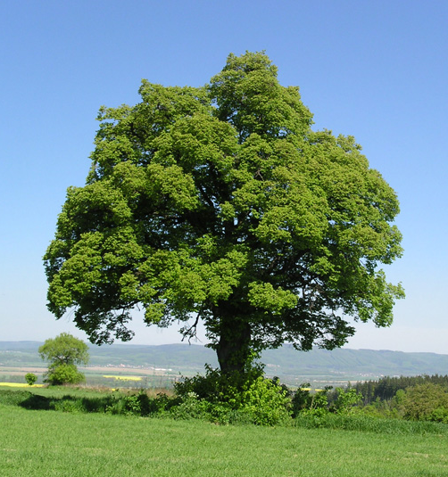
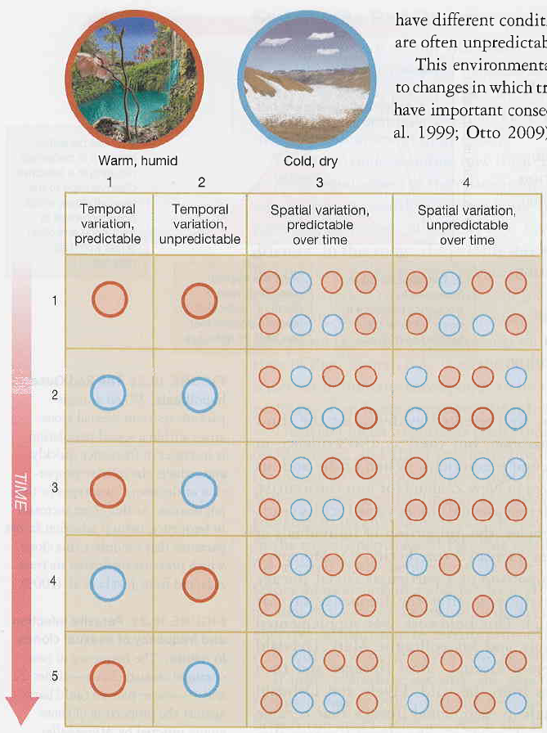

4. Unpredictable environment –
lotery model, elm-oyster model
biotope divided into local sites to which descendants randomly „distributed“
→ only best adapted ones survive, parents cannot know a priori which
of them will do
analogy with purchase
of a lottery ticket

Slide 28
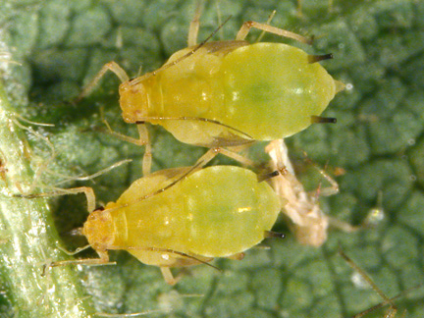
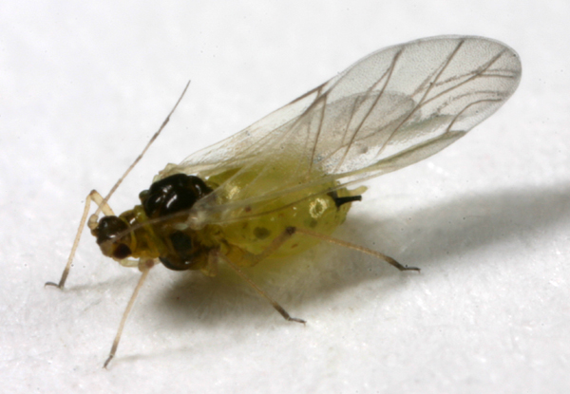
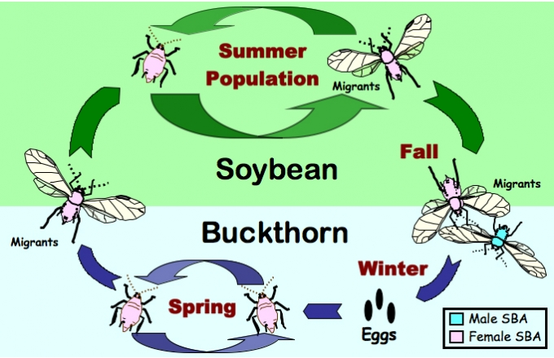
Eg. aphids:

Slide 29
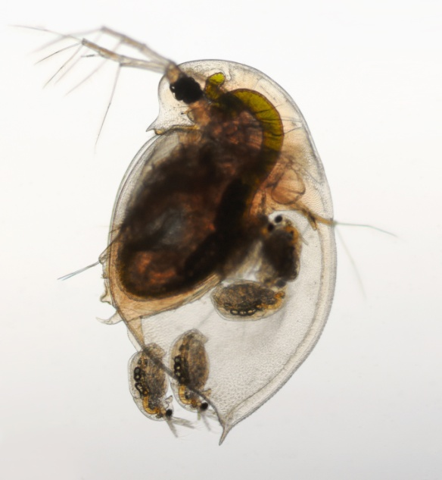
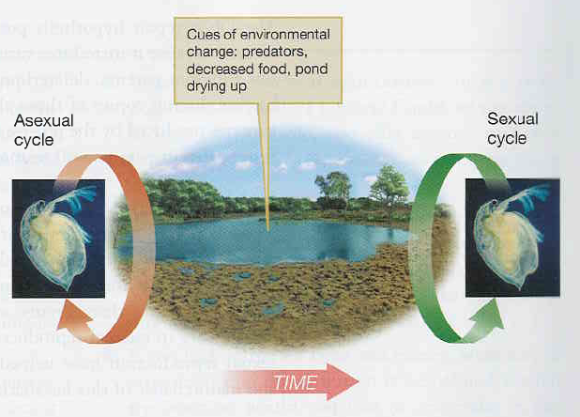
Eg. Daphnia:
new predator, dearth of food, pond drying up ⇒ transition to sexual reproduction

Slide 30
5. Unpredictable environment –
elbow room model
assumption that in heterogenous and homogenous biotopes genotypes can
differ in usage of limited sources
competition among siblings → more descendants of sexual parents can
coexist at the same site because competition of asexual offspring is
more intense
Problem: models 4 and 5 are valid only for organisms
with high fertility
Fluctuation of environment:
itself does not maintain sex → fluctuation of epistasis necessary
eg. 2 loci: alternatio of association cold-wet and warm-dry ↔
cold-dry and warm-wet
this model can work eg. in parasite-host interaction

Slide 31

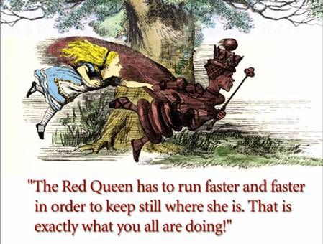
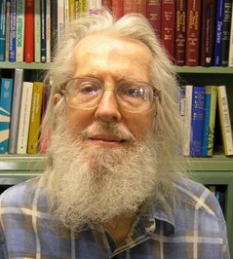
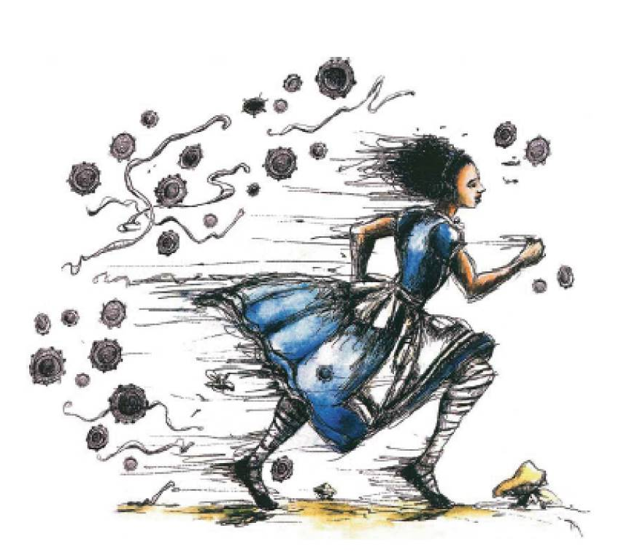
5. Red Queen hypothesis
William D. Hamilton
based on the Red Queen hypothesis (Leigh Van Valen)
W.D. Hamilton
L. Van Valen

Slide 32
fluctuation of epistasis
fitness and gene frequencies cycles
coevolution of parasite and host ⇒ arms races
multilocus „gene-for-gene“ relation
oscillation of gene frequencies higher in asexual individuals
Populace hostitele
Populace hostitele
Populace hostitele
Rezistence vůči parazitovi
s genotypem II
Rezistence vůči parazitovi
s genotypem II
Rezistence vůči parazitovi
s genotypem II
Rezistence vůči parazitovi
s genotypem I
Rezistence vůči parazitovi
s genotypem I
Rezistence vůči parazitovi
s genotypem I
Populace parazita
I
II
I
II
I
II

Slide 33
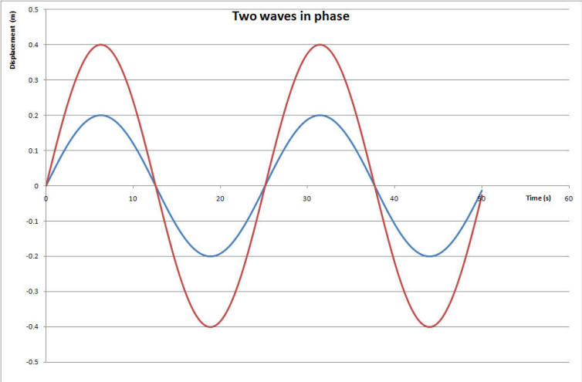
asexual
sexual
extinction
model assumption: in heterogonous organisms (changing of sexual and
asexual reproduction) and organisms with facultative sexuality
sexual reproduction more frequent in case of increased parasitation

Slide 34
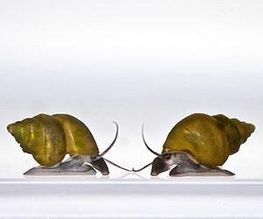

Curtis Lively (1992): freshwater gastropod Potamopyrgus antipodarum
New Zealand lakes and rivers
both sexual and asexual females
Potamopyrgus antipodarum
Lake Alexandria, South Island, New Zealand
12 parasitic trematode species (host castration ⇒ strong selection)
66 lakes
number of males as indicator of sexual reproduction

Slide 35
Lively et al. (1992):
0.40
correlation with number of parasites
0.30
0.20
0.15
Frekvence samců
0.10
male frequency
0.05
0.01
0.00
Počet parazitů
number of parasites

Slide 36
EVOLUTION OF SEX RATIO
sex ratio often 1:1 → why to waste for males?
R. A. Fisher (1930)
frequency-dependent selection
condition for validity of Fisher´s argument:
1. random mating
2. same costs of both sexes

Slide 37
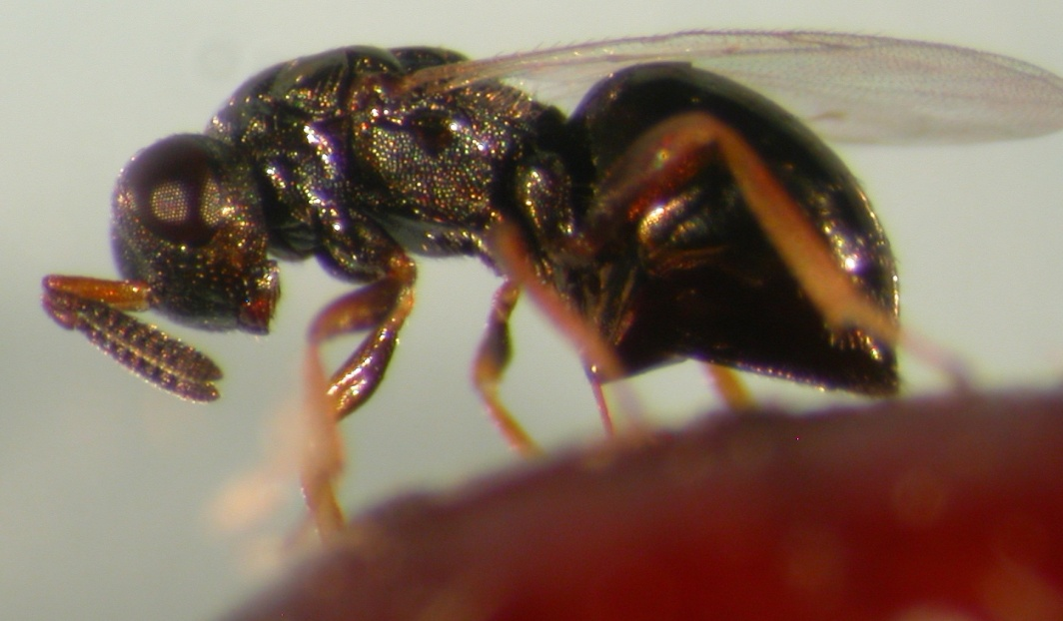
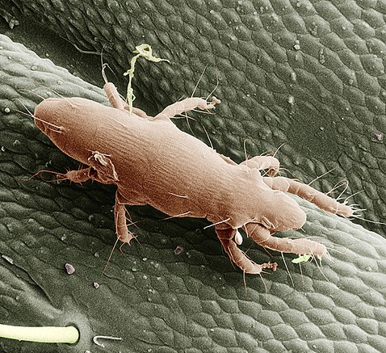
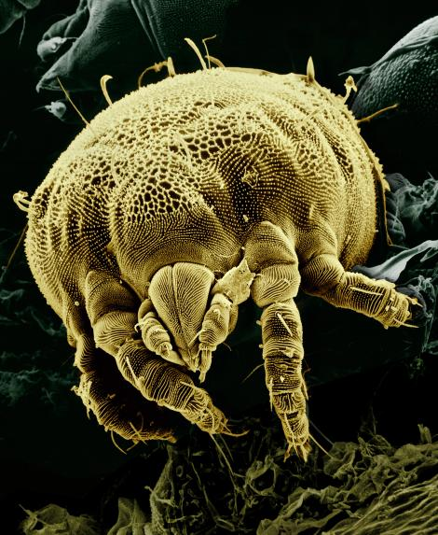
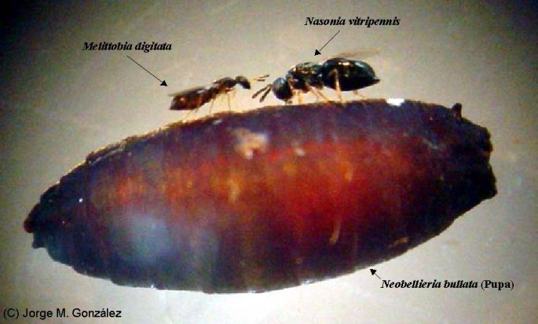
ad 1) Local mating competition:
mites Adactylidium, Pyemotes ventricosus, Acarophenax tribolii
parasitoid wasps (eg. Nasonia vitripennis)
Pyemotes
ventricosus
Nasonia vitripennis
Acarophenax tribolii

Slide 38
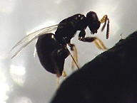
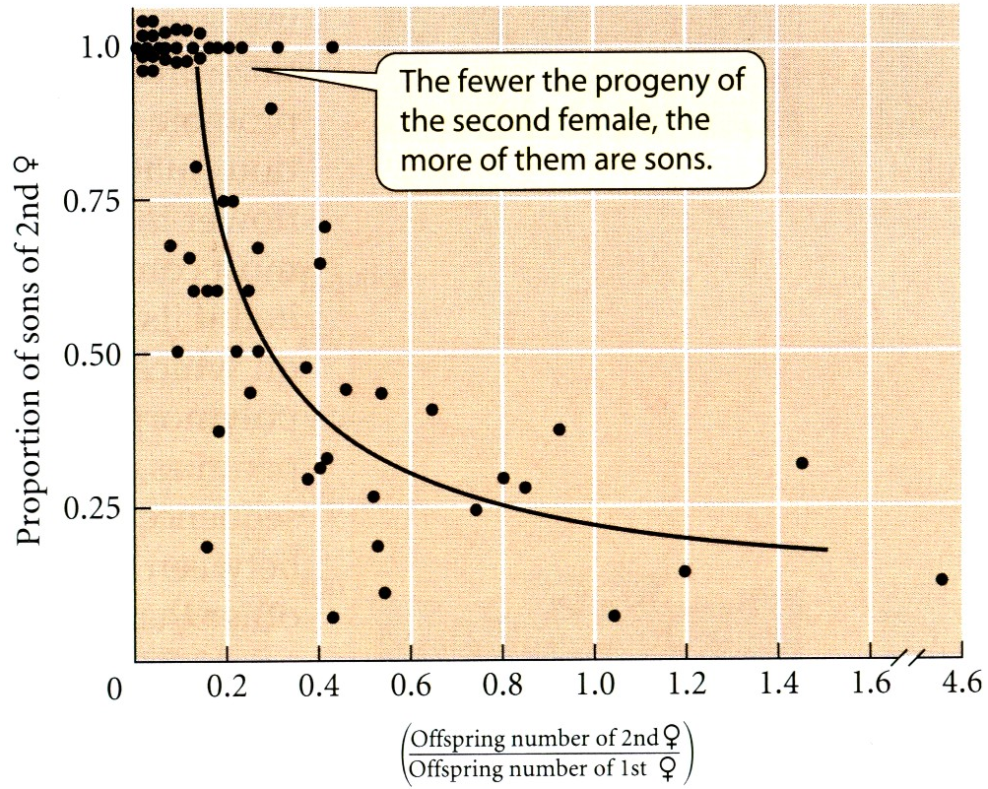
theoretical prediction: with increasing number of egg laying females
percentage of sons increases
čím méně vajíček 2. matky než 1. matky, tím větší zastoupení synů 2. matky

Slide 39


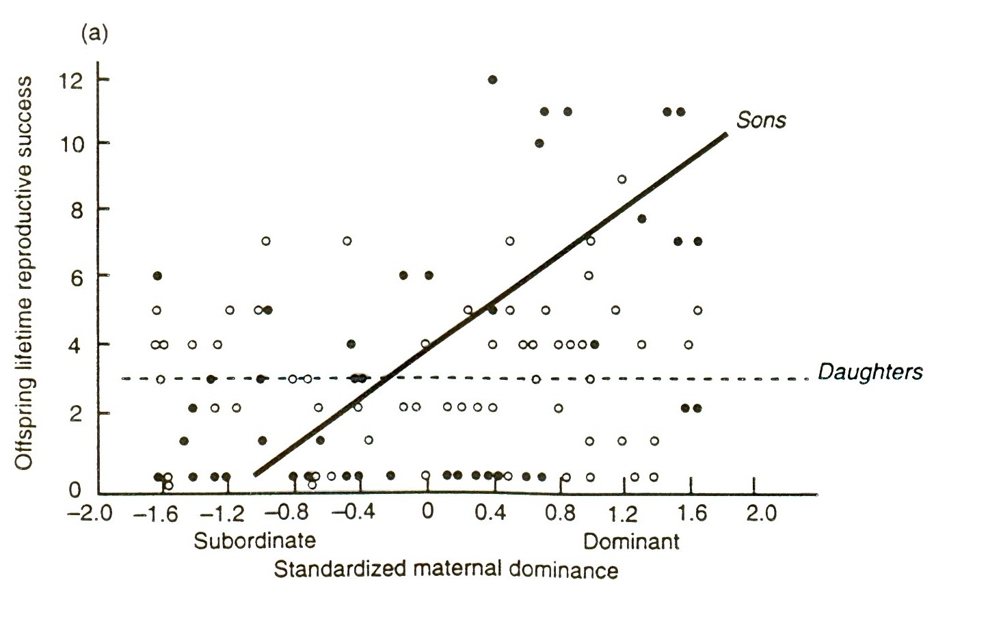
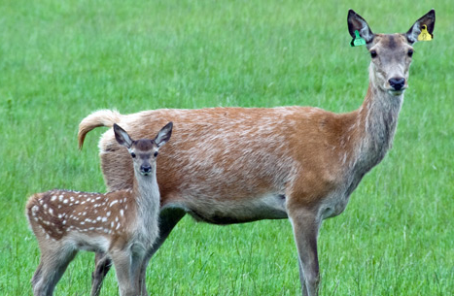
ad 2) Trivers-Willard hypothesis:
Robert L. Trivers, Dan Willard
investment in sex ensuring higher fitness
in next generation
dominant mother → investment in sons
and vice versa
sex ratio bias or unequal parental investment
Eg.: deers
R.L. Trivers
D. Willard
sons of dominant mothers have higher fitness

