Slide 1
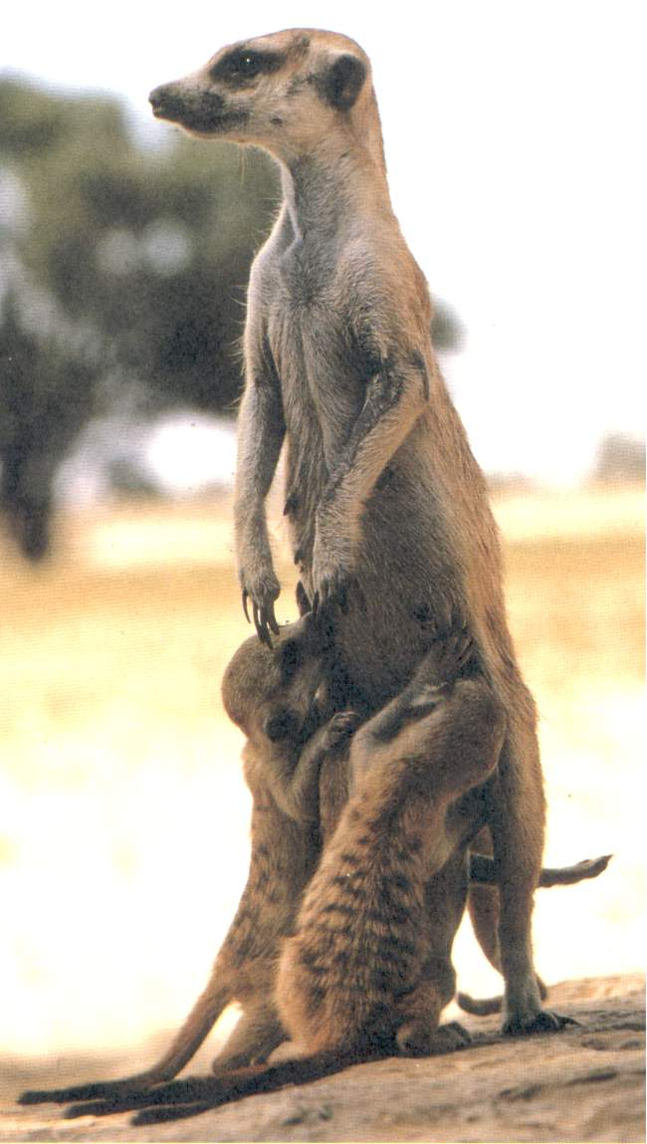
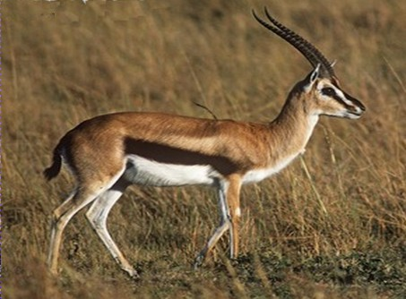

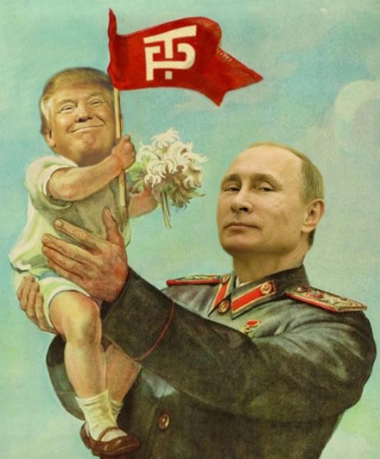
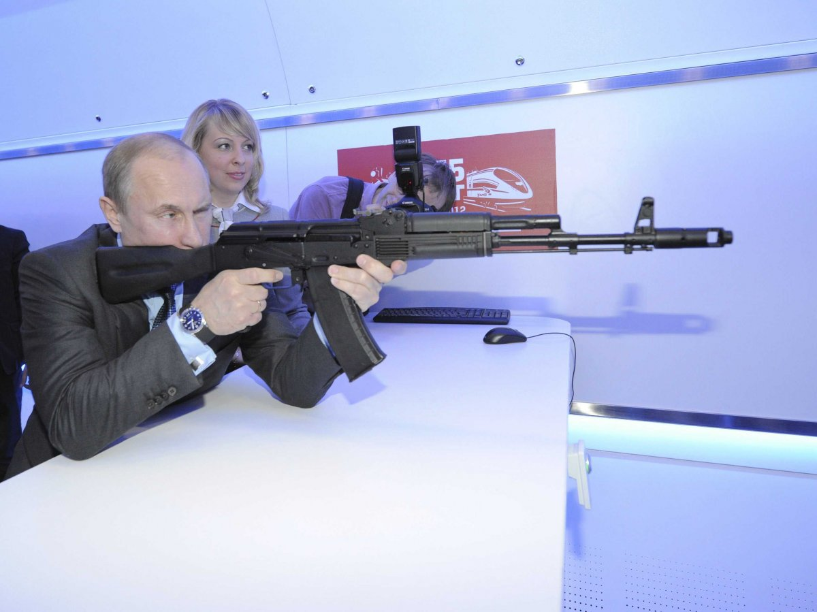
CONFLICT AND COOPERATION I.

Slide 2
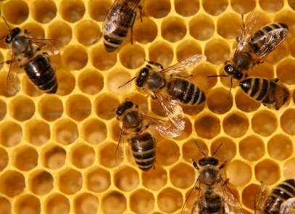
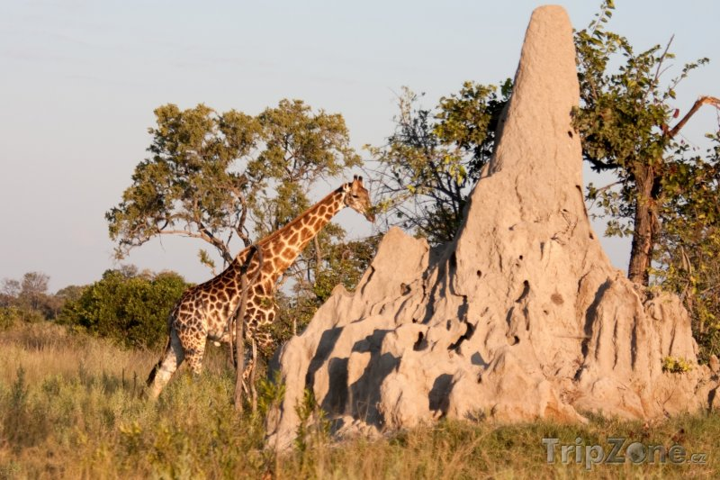
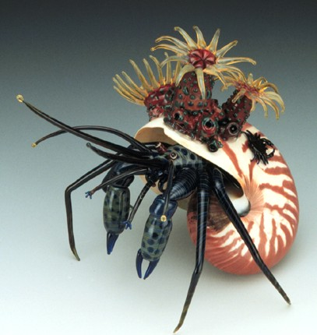
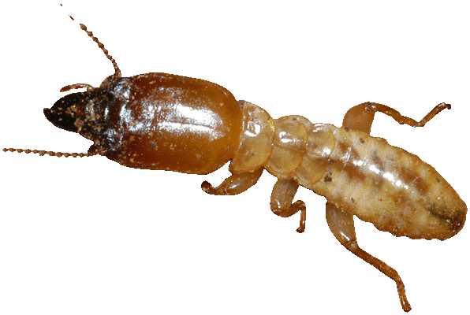
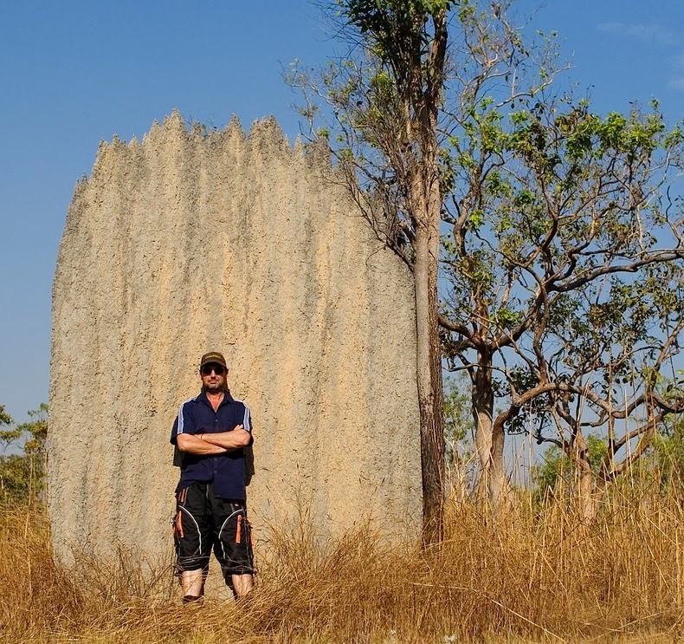
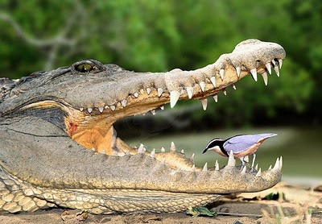
natural selection essentially a competitive process ⇒
cooperation between organisms is one of nature´s most peculiar features
social insects, humans
mutualism

Slide 3
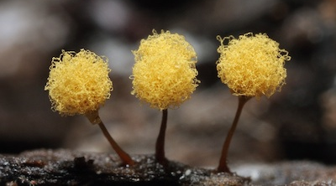
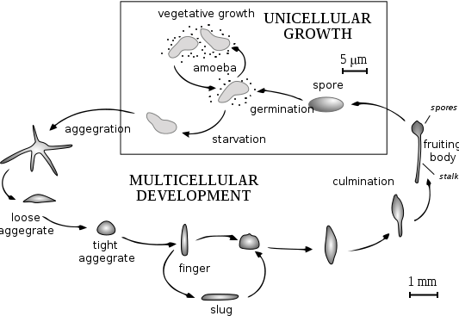
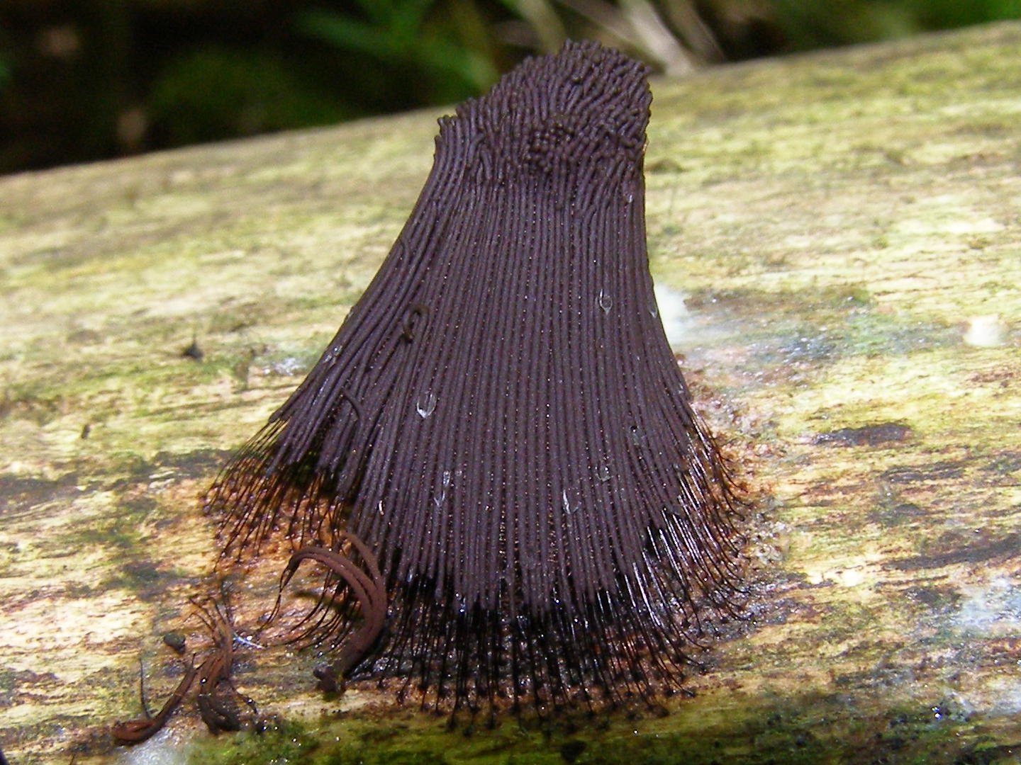
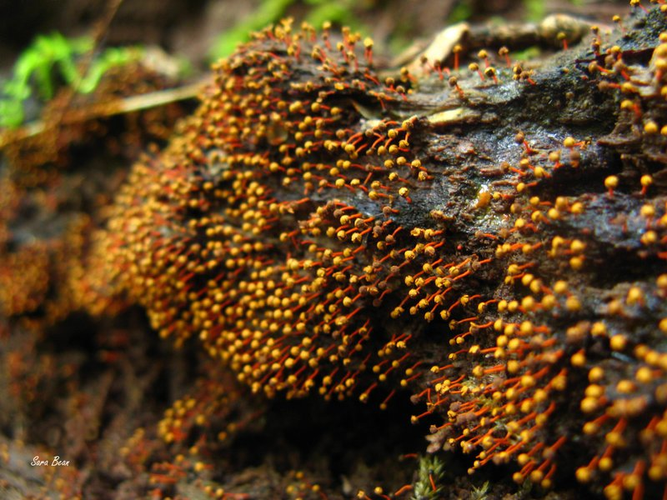
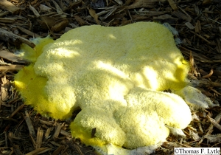
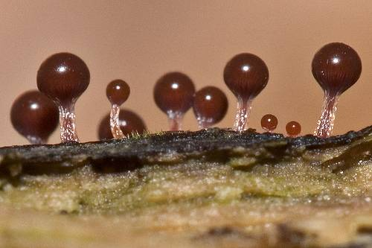
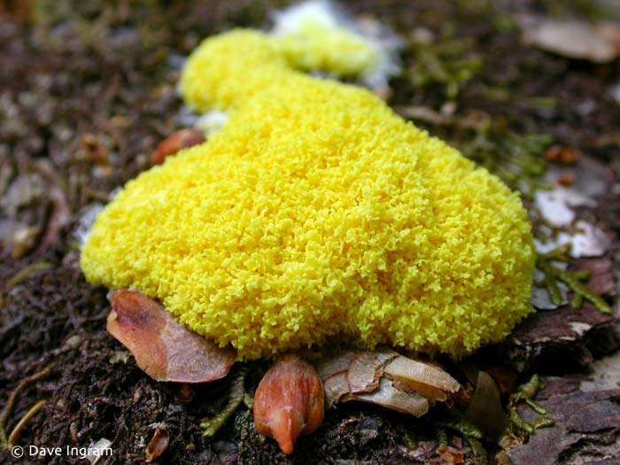
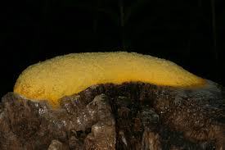
Eg.: slime molds

Slide 4
How can, in spite of conflict between organisms,
cooperation evolve?
Charles Darwin: struggle for life
but also cooperation between a cow and her calf (cooperation between
relatives))
Neodarwinism: evolution in populations, selection affects individuals
× till the 1960s, this assumption rather implicit (cf. Wright´s „interdemic
selection“)
Darwin, Wallace, Konrad Lorenz etc.: „benefit of species“, „survival
of species“....

Slide 5
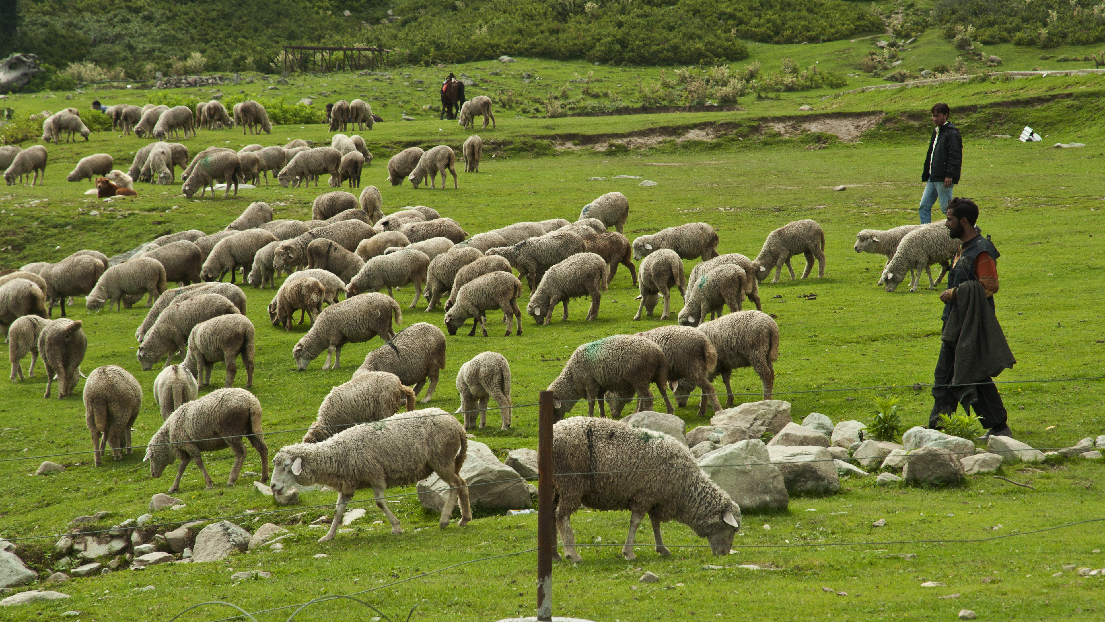
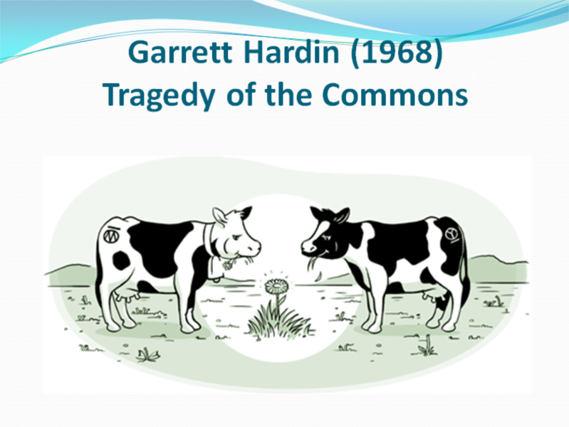
William Forster Lloyd (1833) → Garrett Hardin (1968):
Tragedy of the commons
adding 1 sheep to the herd ⇒ direct benefit for the owner
× costs (drop of pasture) shared by the whole group
⇒ if people behave with respect to their benefit independently and
rationally, eventually the sources are necessarilly depleted
Solution = voluntary restriction by herders →
Why should such behaviour be favoured by selection?

Slide 6
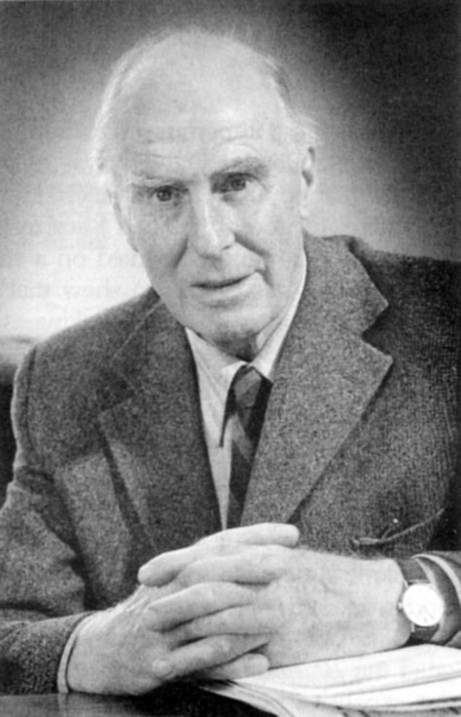
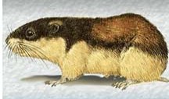
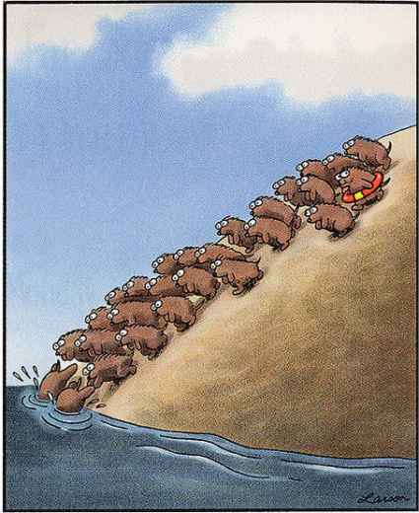
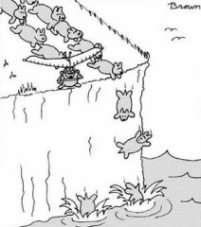
1962 – Vero Copner Wynne-Edwards:
Animal Dispersion in Relation to Social Behaviour
flocking, dispersion, restriction of reproduction, altruism
cooperation explained as the selection of whole groups rather than
individual selection (in extreme form „adaptation for species´ survival“)
cheater
cheater
V. C. Wynne-Edwards

Slide 7
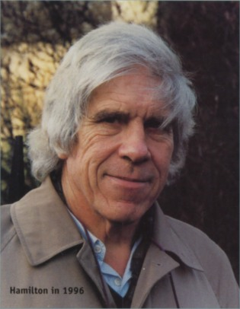
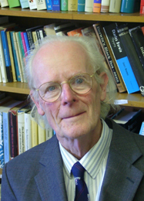
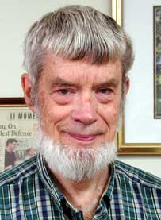
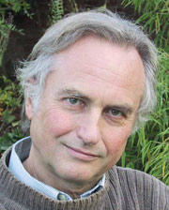
reaction:
1964: William D. Hamilton,
John Maynard Smith
1966: George C. Williams
1976: Richard Dawkins
kin selection
příbuzenský výběr
genes are important!
důležité jsou geny

Slide 8
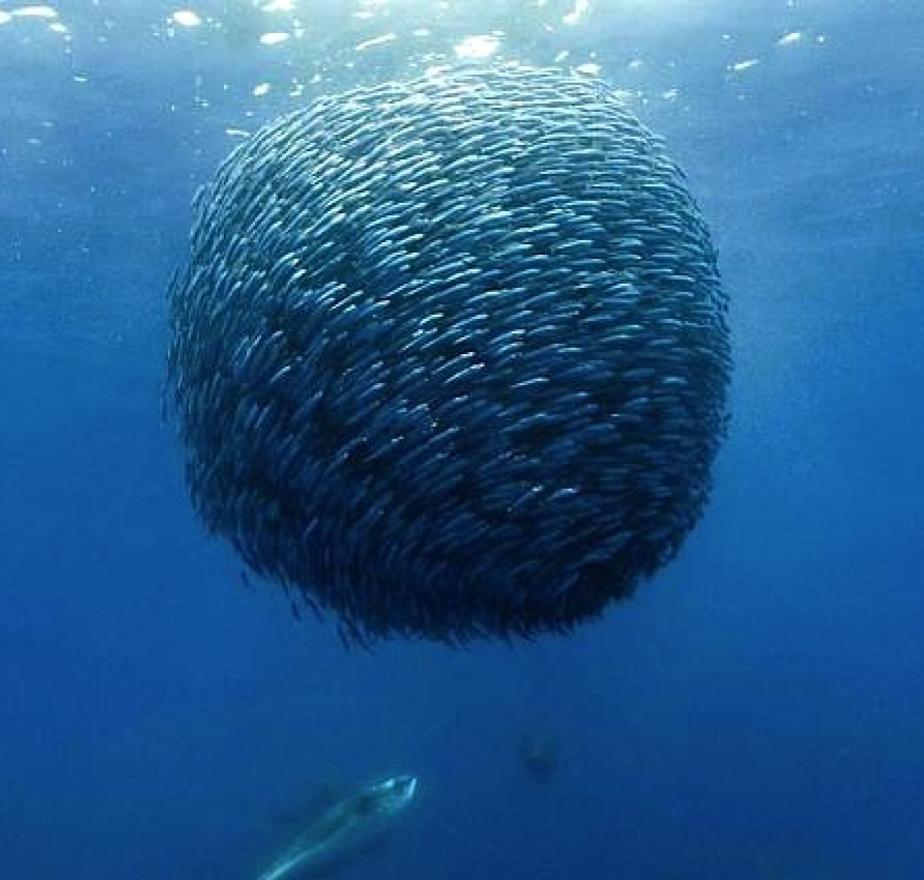
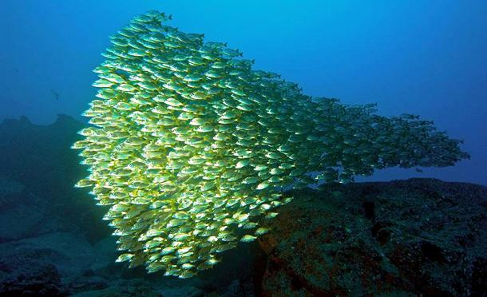
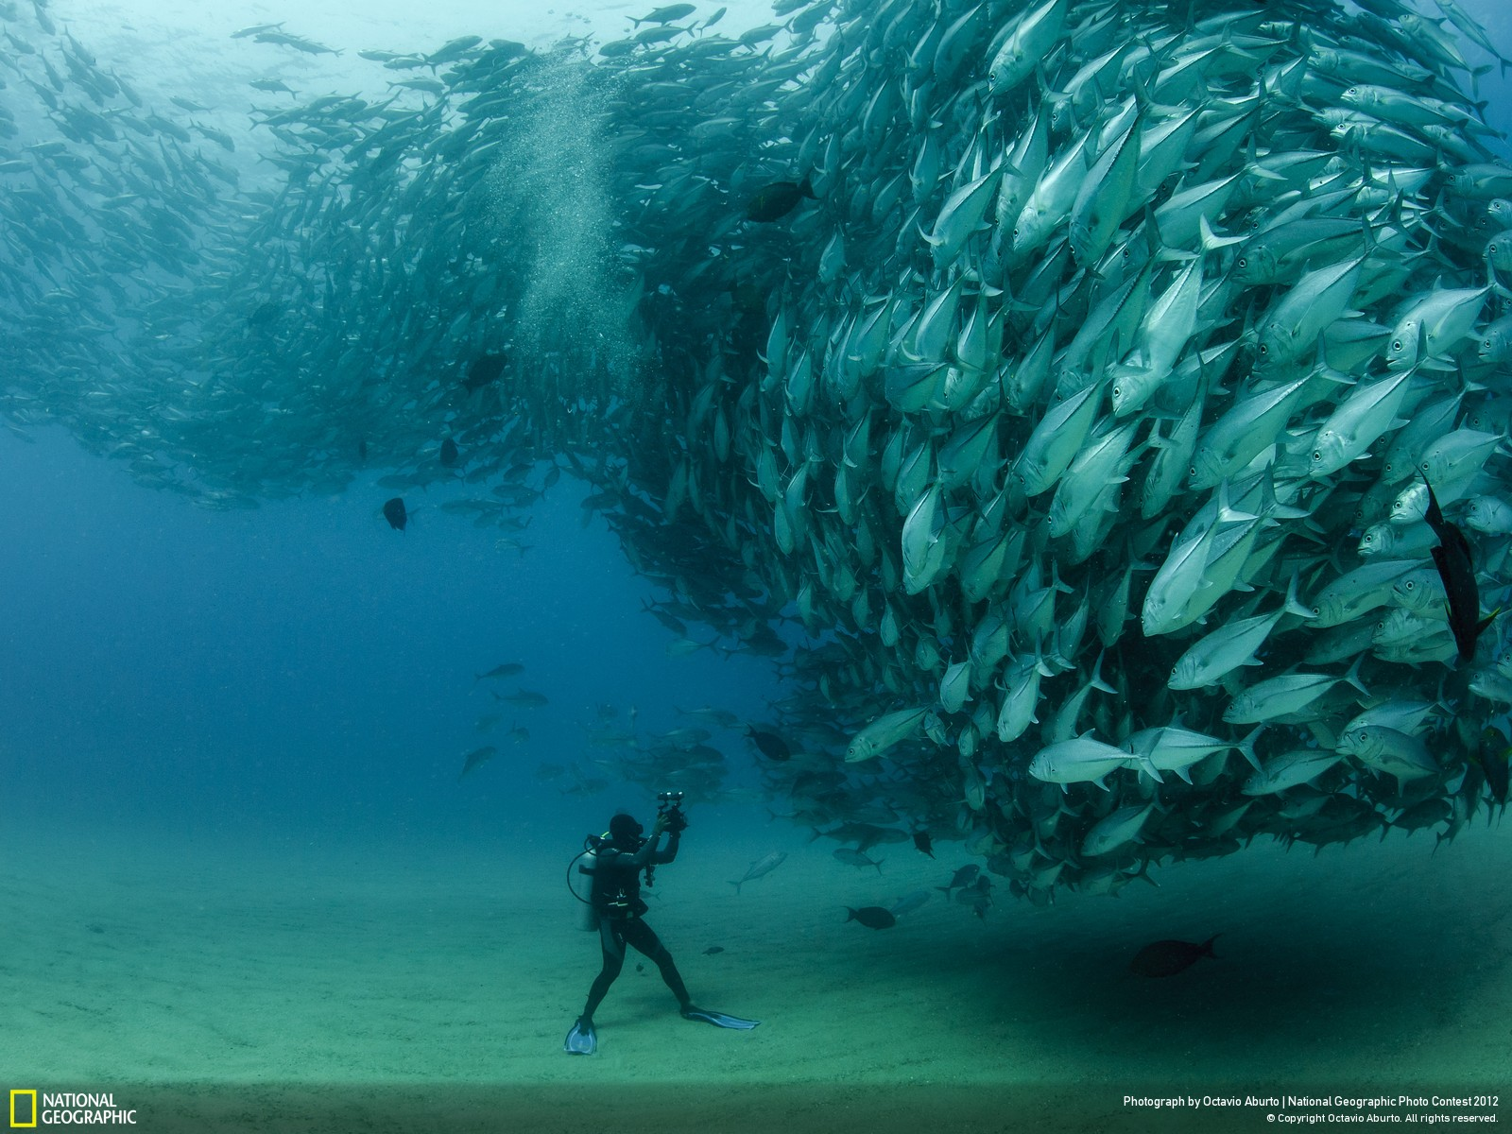
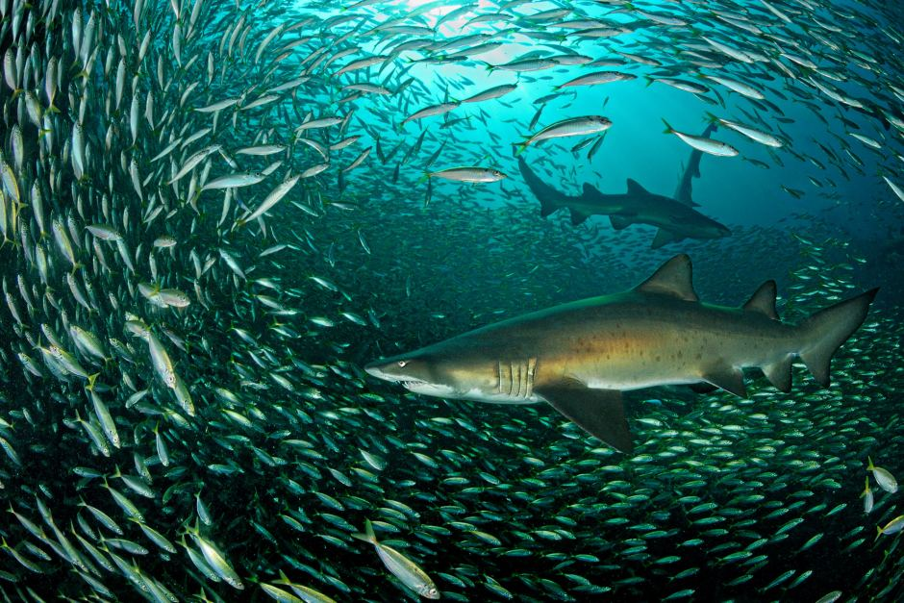
GROUP SELECTION
V.C. Wynne-Edwards:
dispersion in order to avoid depletion of sources
production of fewer offspring than potentially possible
alarm calls, fish shoals

Slide 9
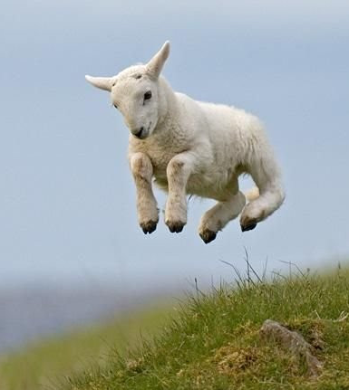
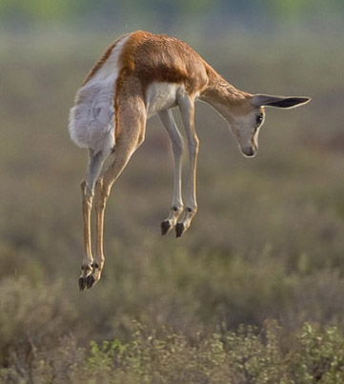
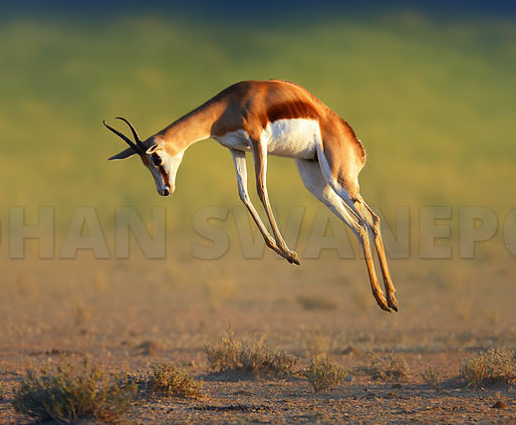
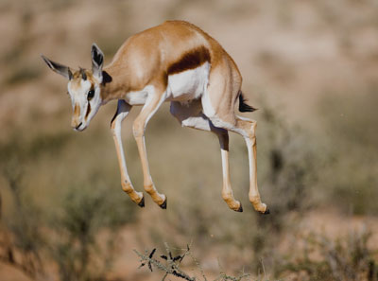
„stotting“
Thomson´s gazelle, springbok, mule deer, pronghorn etc.
Individual advantage!
https://www.youtube.com/watch?v=qr5Sru8gGSk
https://www.youtube.com/watch?v=jMIiB9DnRXg

Slide 10
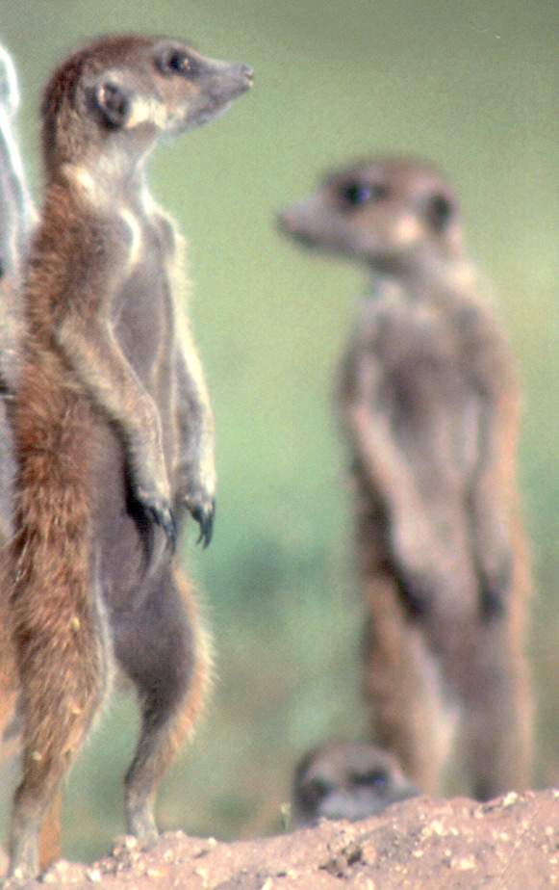
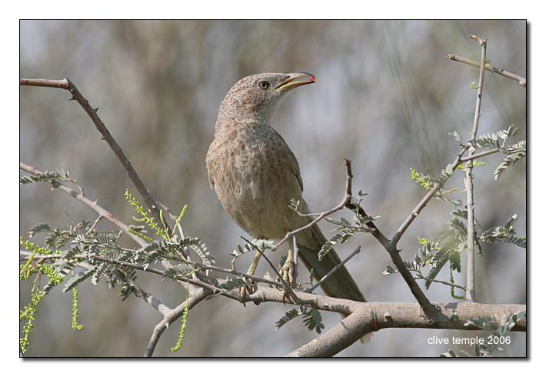
guards of the Arabian babbler (Turdoides squamiceps)
and meerkats (Suricata suricatta)
sentinel
T. squamiceps
alpha male
Individual advantage!
Suricata suricatta

Slide 11
Theoretical arguments against group selection:
altruism = behaviour increasing recipient´s fitness and,
at the same time, decreasing donor´s fitness
Wynne-Edwards´ population of altruists
spread of „selfish“ allele in the population
A
A
A
A
S
S
S
A
A
A
A
A
S
A
A
A
A
A
A
S
A
S
S
S
A
A
S
S
A
A
A
A
S
S
S
A
infiltration of selfish individual
fixation of „selfish“ allele

Slide 12
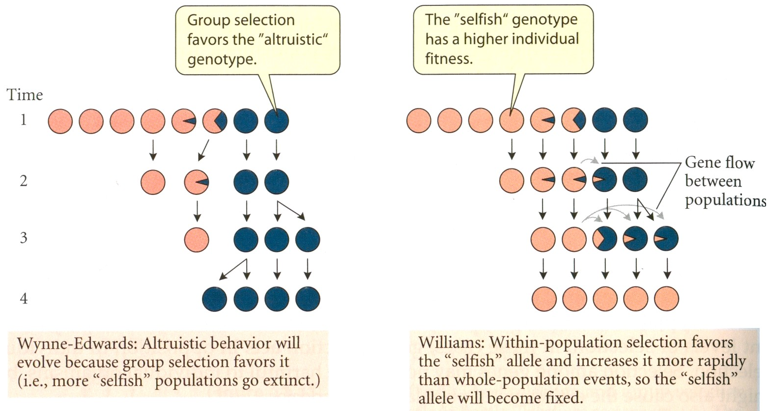
Low heritability and longer generation time of the group relative to
heritability and generation time of individuals ⇒ changes at the
individual level much faster
⇒ infiltration of selfish individuals, extinction of the altruistic
population

Slide 13
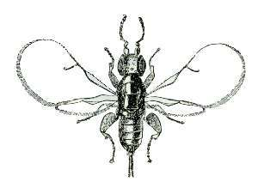
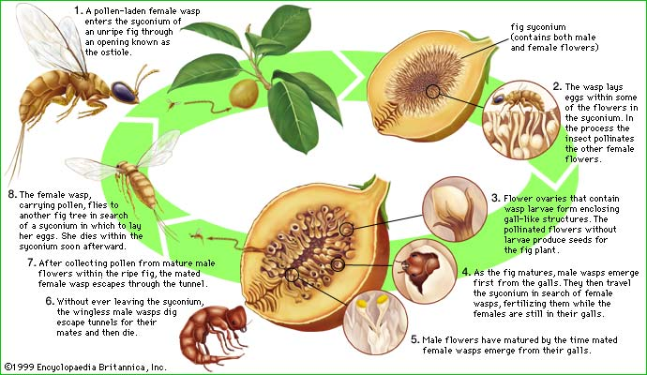
Conditions for group selection:
rapid alternations of extinction and re-creation of demes
Eg.: fig wasps (Agaonidae)
virtually no migration:
c … cost for an individual
(b – c) … benefit for the group
island model:
Conclusion: interdemic (group) selection will be stronger than intrademic
(individual) selection only if the group benefit relative to the individual
cost is higher than the average number of migrants per generation.

Slide 14
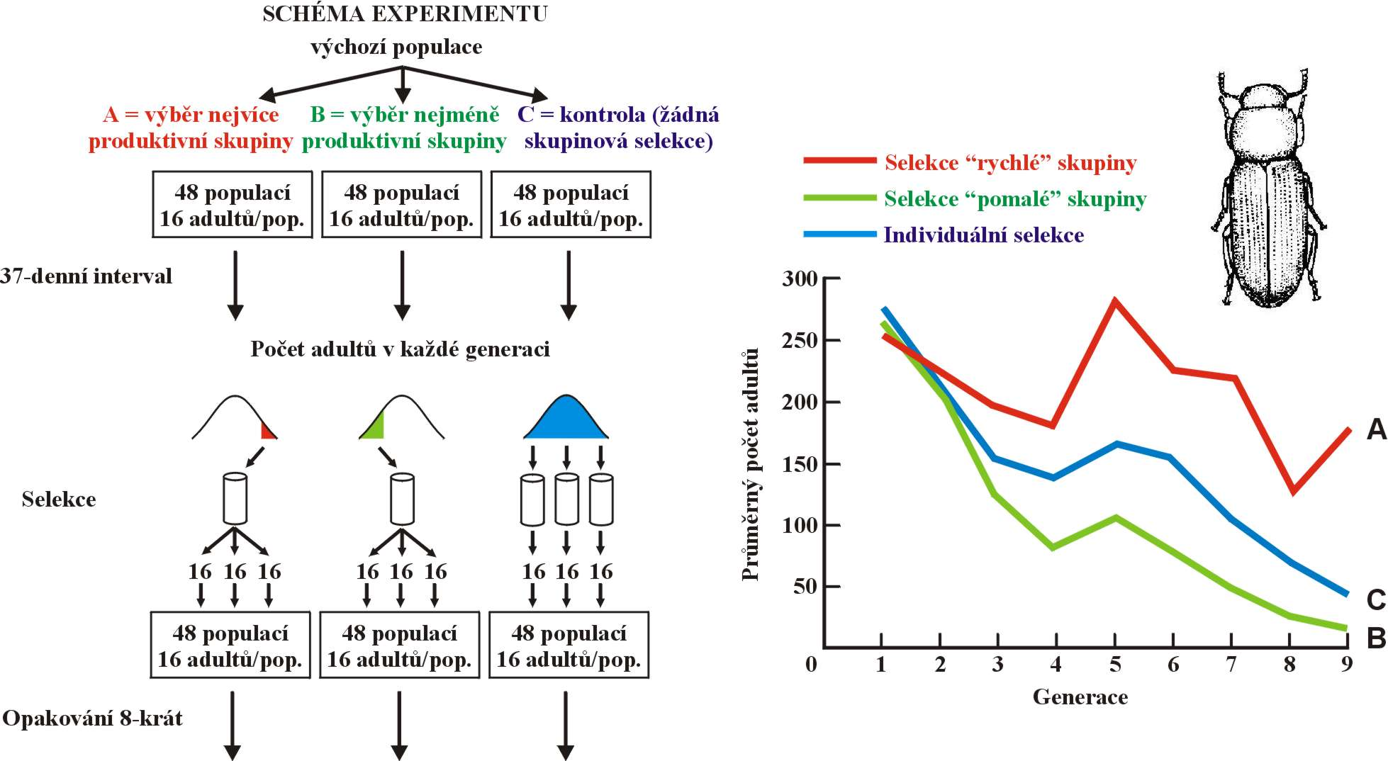
Michael Wade (1977): group selection experiment in the red flour
beetle (Tribolium castaneum)
fast-growing group
slow-growing group
individual selection
But in nature the role of group selection probably minimal

Slide 15
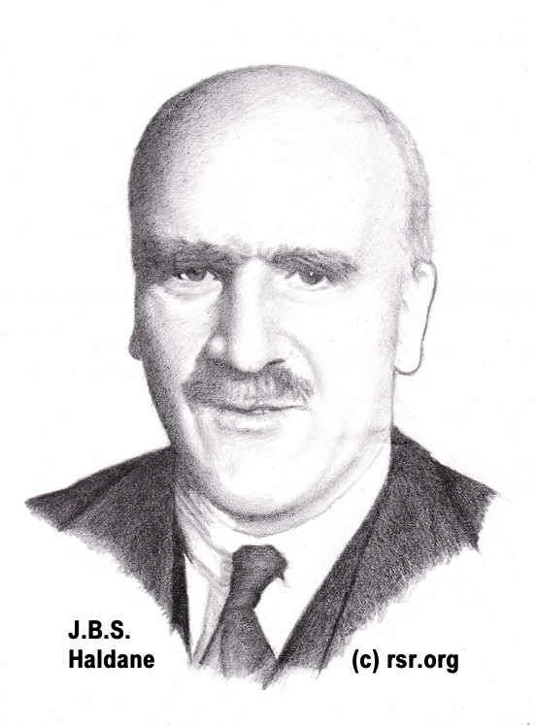
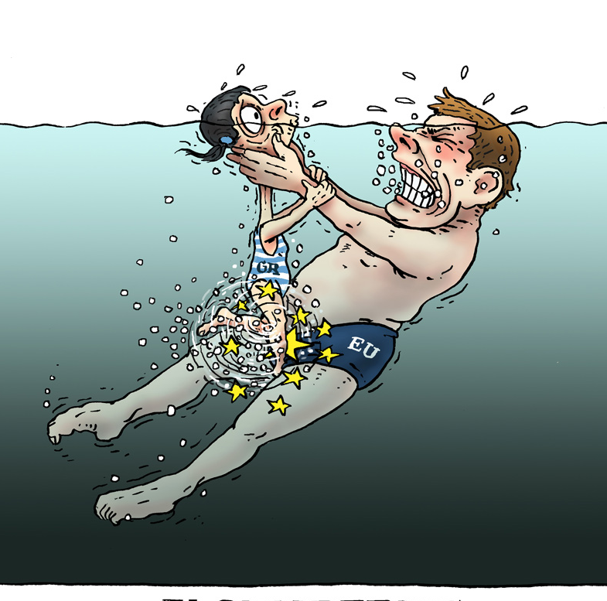
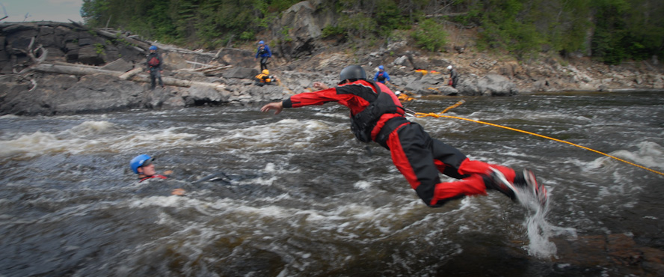
KIN SELECTION
If I rescued my two brothers from drowning in the river, it would be the same as to rescue myself!

Slide 16
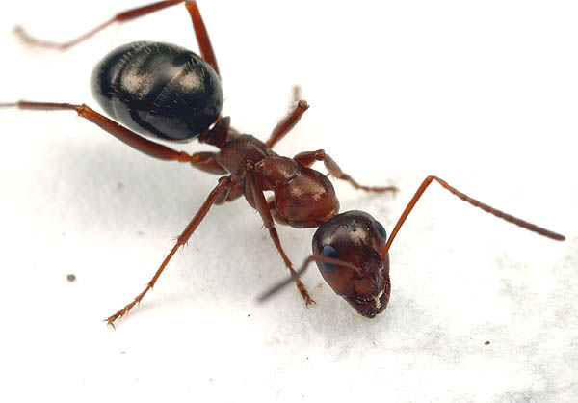
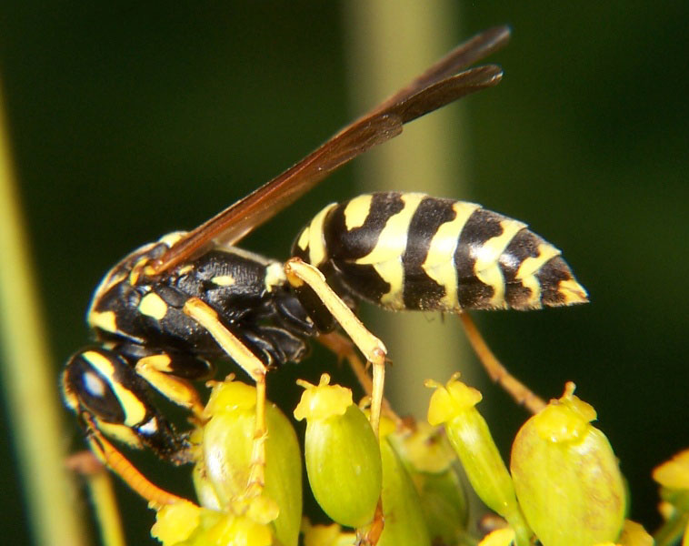
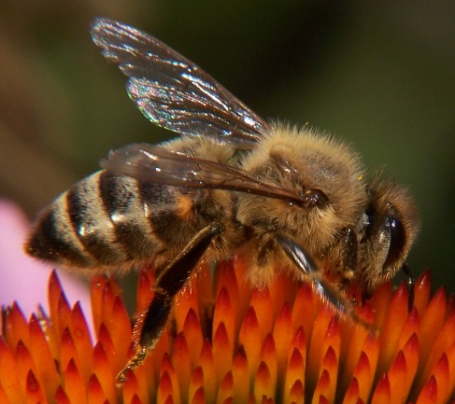
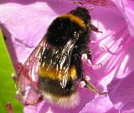
William Hamilton (1964):
Hymenoptera: haplo-diploid system of sex determination:
females 2N, males N
⇒ relationship:
worker – worker = ¾
queen – descendants = ½
worker – drone = ¼
inclusive fitness = fitness of an individual and his/her relatives
altruism between relatives = kin altruism

Slide 17
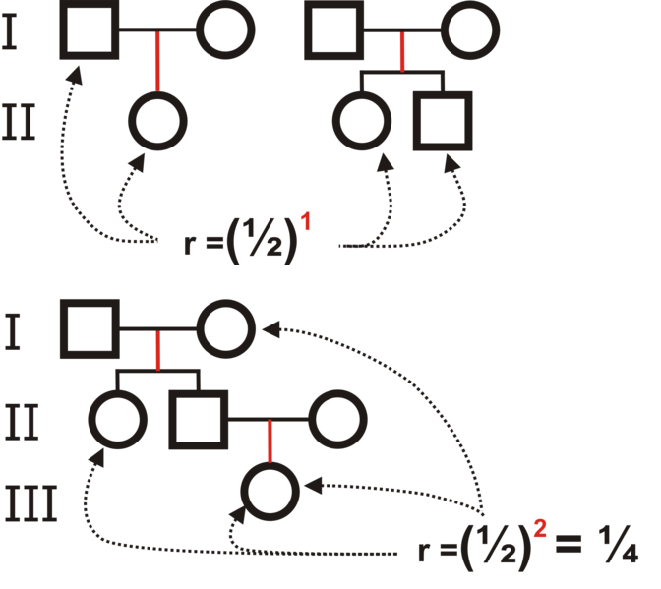

coefficient of relationship:
Degree of relationship | Relationship | Coefficient of relationship (r)
0 | identical twins; clones | 100%^{[4]}
1 | parent-offspring^{[5]} | 50% (2⁻¹)
2 | full siblings | 50% (2⁻²+2⁻²)
2 | 3/4 siblings or sibling-cousins | 37.5% (2⁻²+2⋅2⁻⁴)
2 | grandparent-grandchild | 25% (2⁻²)
2 | half siblings | 25% (2⁻²)
3 | aunt/uncle-nephew/niece | 25% (2⋅2⁻³)
4 | double first cousins | 25% (2⁻³+2⁻³)
3 | great grandparent-great grandchild | 12.5% (2⁻³)
4 | first cousins | 12.5% (2⋅2⁻⁴)
6 | quadruple second cousins | 12.5% (8⋅2⁻⁶)
6 | triple second cousins | 9.38% (6⋅2⁻⁶)
4 | half-first cousins | 6.25% (2⁻⁴)
5 | first cousins once removed | 6.25% (2⋅2⁻⁵)
6 | double second cousins | 6.25% (4⋅2⁻⁶)
6 | second cousins | 3.13% (2⁻⁶+2⁻⁶)
8 | third cousins | 0.78% (2⋅2⁻⁸)
10 | fourth cousins | 0.20% (2⋅2⁻¹⁰)^{[6]}

Slide 18
dependence on degree of relationship between donor and recipient
(= on probability they share genes)
Hamilton´s rule:
rb > c
r = relationship; b = benefit; c = cost
relation between relationship and group selection:

Slide 19



Eusociality:
Hymenoptera
Isoptera (termites)
mammals: naked mole-rat (Heterocephalus glaber),
Fucomys mole-rats (Bathyergidae)
Florida scrub jay (Aphelocoma coerulescens)
(Florida): c = 7%, b = 14%
H. glaber
Fukomys sp.

Slide 20
INTRAGENOMIC CONFLICT
conflict between individuals within populations
conflict between relatives (siblings, mother – descendant)
conflict between males and females (sexual selection)
cooperation and conflict at the genomic level:
George Williams:
body mortal × genes (almost) immortal
„gene view“

Slide 21



Richard Dawkins:
the term selfish gene (book The Selfish Gene, 1976):
body only as a vehicle for spreading replicators (genes)
which cannot spread on their own
therefore selection affects genes rather than the whole organism
genes must cooperate (the eight analogy)
BUT! the term „selfish“ must be understood as a metaphor!
sometimes some genetic element behaves „unfair“
→ ultraselfish DNA

Slide 22

Law of segregation
Aa
A
a
Gregor Mendel
50%
50%

Slide 23
Intragenomic conflict results in higher frequency of some
genomic elements in the next generation
?!
Aa
A
a
Gregor Mendel
drive
95%
5%
segregation (transmission) distortion
drag

Slide 24
Intragenomic conflict may have many forms, eg.:
Interference
= prevention of transmission of an alternative allele
Gonotaxis
= preferential transmission to germinal lineage
Overreplication
eg. transposons
MEIOTIC DRIVE
gonotaxis: mutant allele gets to ovum whereas normal allele gets to the polar body
Ex.: R2d2 locus (responder to drive)
mouse chromosome 2
increased number of 127 kb core element
→ gonotaxis against low-copy variant
R2d2 includes the Cwc22 gene
(spliceosomal protein)
D
polar body
D
ovum

Slide 25
Intragenomic conflict may have many forms, eg.:
Interference
= prevention of transmission of an alternative allele
Gonotaxis
= preferential transmission to germinal lineage
Overreplication
eg. transposons
MEIOTIC DRIVE
driver
interference: normal allele eliminated from transmission to the next generation
D

Slide 26


Interference
1. Autosomal
SD (segregation distorters) genes:
males Drosophila melanogaster
preferential transmission 95–99%
distorter and responder
spermatogenetic block in cells with
disabled allele
often emergence of modifiers
SD genes = „outlaw genes“
„Spore killers“ (sk genes):
Neurospora crassa

Slide 27

t haplotype:
male house mouse
∼ proximal third of Chromosome 17
preferential transmission 95–99%
4 paracentric inversions ⇒ recombination only 2%
responder + several distorters
t/t males sterile ⇒ more than 15 lethal genes

Slide 28
diverse genetic structure leads to different drive results:
distorters
respoder
highest transmission distortion when complete t haplotype and normal chromosome combination
both chromosomes normal ⇒ 1:1 segregation
© Vesmír 2006/12

Slide 29

TRD mechanism different from drosophila:
responder = Smok (fused gene)
regulation of gene cascade involved
in flagellum formation
distorter
responder
© Vesmír 2006/12

Slide 30




2. Maternal-effect killers
♀ M/+ ♂ +/+
×
Medea gene:
Maternal-Effect Dominant Embryonic Arrest
Tribolium castaneum
mother M/+
the gene eliminates all descendants who
do not possess it – the +/+ individuals die
in the second larval instar
M/+ +/+

Slide 31

3. Sex-biased inheritance
uniparentally inherited genes are interested just in reproduction of
the particular sex ⇒ sex ratio distortion
X chromosome drive ⇒ female-biased sex ratio ⇒ selection will favour
return to the original state
cytoplasmic male sterility (CMS)
in 5-10% populations of monoecious plants
mixed populations with sterile male plants
this sterility caused by mutant mitochondrial
genome
advantage when the plants with sterile male sex invest more to pollen
than to seeds ⇒ transmission of more mitochondria

Slide 32
mtDNA
CMS
male
female
×
×
×
×
×
×
×
×
×
×
if mother has 1 son and 1 daughter number of copies of her mtDNA remains the same
if mtDNA causes exklusive daughter production number of her copies is doubled in each generation

Slide 33

similar effect is caused by Wolbachia
intracellular parasite of arthropods
killes males who do not possess Wolbachia
reduction of competition for sources –
kin selection
besides killing males Wolbachia can have other phenotypic effects:
feminisation: infected males are developing as females or infertile
pseudofemales
parthenogenesis: eg. in Trichogramma wasps males rare (likely due to
wolbachias) → wolbachias help females to reproduce
parthenogenetically, ie. without males
cytoplasmic incompatibility: inability of males with wolbachias to reproduce
with females which does not possess them or which have wolbachias
of other strain → reproductive barier, speciation

Slide 34



Overreplication
Transposable elements (transposons)
incorporating of copies to other genome site
(Barbara McClintock: „jumping genes“ in maize)
usually not removed from genome
→ molecular fossils
usually huge numbers
human: > half of genome
horizontal transfer, also between species
in some cases effect on gene regulation

Slide 35
1. DNA elements
„cut-and-paste“
enzyme transposase
Ac a Ds elements in maize (B. McClintock), mariner in animals,
P elements in Drosophila
2. Retroelements
„copy-and-paste“
through RNA stage, reverse transcription (reverse transcriptase)
template stays at the original place ⇒ increase of copy numbers
reverse transcription
RNA
DNA
novel site

Slide 36
Retroelements
LTR-retrotransposons: copia in D. melanogaster
retroposons: LINE – L1 in human: 17% of genome
SINE: short, do not code for own reverse transcriptase
Alu sequence in human – 12% of genome; B1, B2 in mouse
3. MITE (miniature inverted-repeat transposable elements)
Stowaway, Tourist

Slide 37








gene effects can extend outside organisms –
R. Dawkins: The Extended Phenotype
Eg.: cases of caddisfly larvae, spider webs
chloral hydrate
LSD
normal
amphetamine
mescaline
caffeine
marihuana (THC)

Slide 38


flukes: parasited individuals bulid thicker shells
Toxoplasma gondii: decrease of host´s reaction time

Slide 39


similarly parasitic flukes:
eg. abdomen of parasited ant Cephalotes atratus turns red
so that resembles edible berry (other species change
ants´ behaviour → they climb up a grass blade where
they are eaten by cattle or sheeps)

Slide 40

ant Monomorium santschii: absence of workers
→ invasion of foreign ant nests, „command“ to kill
own queen and to adopt the invader queen

Slide 41





Duke of Burgundy (Hamearis lucina) caterpillars:
on head an organ producing a narcotic nectar; another pair
of glands causing increased aggressiveness against
all organisms except the carerpillar itself →
protection („bodyguard“), several days of ants´drug
addiction, ants do not leave the caterpillar

