Slide 1



Functional Genomics and Proteomics
National Centre for Biomolecular Research
Faculty of Science Masaryk University
Protein characterization by mass spectrometry
C7250
Part V
Zbyněk Zdráhal
RG Proteomics, CEITEC-MU
Proteomics CF, CEITEC-MU
NCBR FS MU
zdrahal@sci.muni.cz
Notes:
nfsnf

Slide 2
Proteomic MS applications

Slide 3
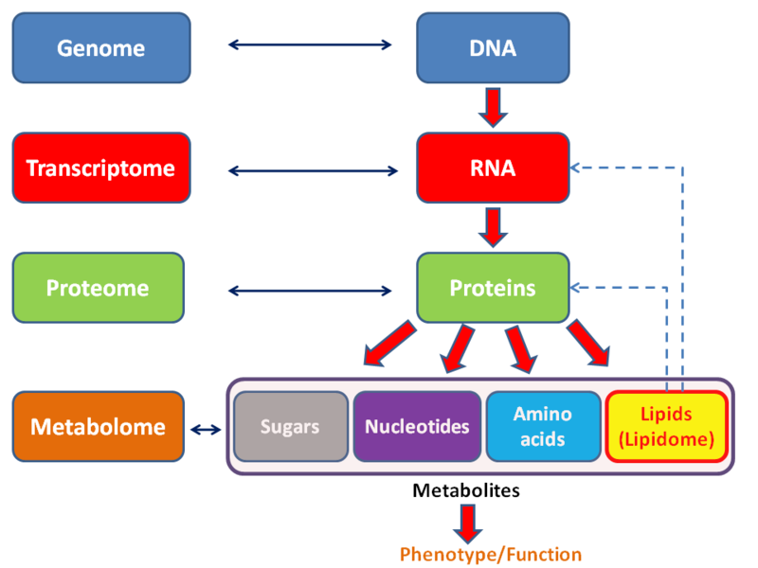
C7250
http://en.wikipedia.org/wiki/File:Metabolomics_schema.png

Slide 4
C7250
Proteomics – discipline dealing with proteome analysis
what might happen
what is really happening
Transcriptomics
Proteomics
Genomics
mRNA
protein
functional
protein
DNA
transcription
posttranscriptional modifications
(alternative splicing etc.)
translation
posttranslational mods
Protein complexes

Slide 5
C7250
Proteomics - Why?
several proteins/proteoforms might form from each gene, not possible to
indicate them by DNA/RNA analysis
there no direct correlation between mRNA content and final content of
proteins
functionality of protein depends frequently on its interaction with other
proteins or DNA/RNA
only at protein level epigenetics factors of gene expression regulation are
detectable

Slide 6

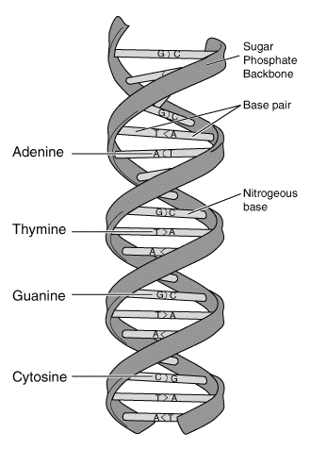

C7250
Proteome analysis
characterization of all proteins including all their forms in cell (tissue, organisms) at given time under given conditions
proteome
YY-protein
The Desperate Man, Gustave Courbet, 1844-45
protein
protein
protein
protein
protein
protein
protein
protein
protein
protein
protein
protein
X
protein
protein-X
protein
protein
protein
protein
protein
protein
protein
protein
protein
protein
W-protein-Z
protein
protein
Genome
protein
protein
protein
protein

Slide 7
C7250
Genome versus Proteome
relatively stable all proteins including
DNA sequence all their forms in cell (tissue, organisms) at given time under given conditions
4 basic building units 20 basic building units
efficient analytical techniques necessity of development of developed (PCR, NGS) sensitive and reliable techniques for identification and quantitation

Slide 8
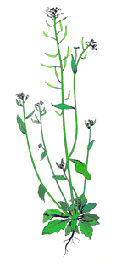
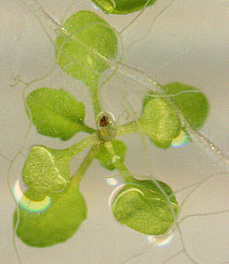

C7250
Arabidopsis thaliana
Mouse-ear cress
Genome 0.135 x 10⁹ bp, ~ 27 000 geness
32 000 proteins
human genome - 3.3 x 10⁹ bp, ~ 21 000 genes
http://www.uniprot.org/taxonomy/complete-proteomes
http://users.rcn.com/jkimball.ma.ultranet/BiologyPages/G/GenomeSizes.html

Slide 9
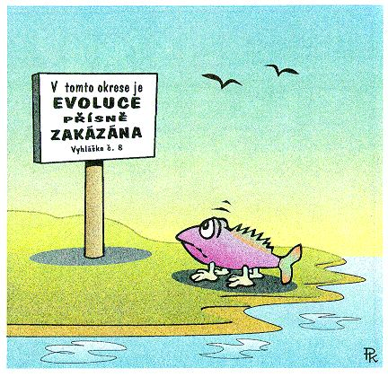
„Evolution is strictly prohibited in this district“

Slide 10
C7250
MALDI-MS profiling
Identification of microorganisms by MALDI-MS
cultivation
peptide/protein
extraction
MALDI MS
(3 – 20 kDa)
microorganism identification
taxonomy
PCA analysis
database of MALDI-MS profiles

Slide 11
MALDI-MS spectra (profiles) of selected bacteria
C7250
a.i.
a.i.
Sphingomonas paucimobilis
2500
2500
2000
2000
Aeromonas hydrophila
1500
1500
Pseudomonas aeruginosa
1000
1000
500
Alcaligenes faecalis
500
0
0
5000
5000
7000
7000
9000
9000
11000
11000
m/z
m/z

Slide 12
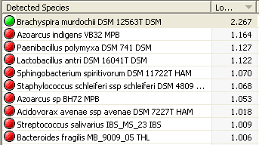
C7250
Graphical expression of MALDI-MS bacteria profile similarity
Staphylococcus saprophyticus CCM 3317 CCM
Staphylococcus epidermidis CCM 7221 CCM
Staphylococcus epidermidis CCM 2446 CCM
identification based on comparison of measured profile with database profile
Staphylococcus epidermidis CCM 2124 CCM
Peptostreptococcus anaerobius CCM 3790 CCM
Serratia rubidaea CCM 3412 CCM
Streptococcus mitis CCM 7411 CCM
Finegoldia magna CCM 3785 CCM
Corynebacterium urealyticum CCM 4186 CCM
Corynebacterium urealyticum CCM 3976 CCM
Corynebacterium urealyticum CCM 3975 CCM
Corynebacterium pilosum CCM 6140 CCM
Campylobacter jejuni ssp jejuni CCM 7212 CCM
Campylobacter jejuni CCM 6214 CCM
validated method in clinical practise
Campylobacter jejuni ssp jejuni CCM 6191 CCM
Campylobacter jejuni ssp jejuni CCM 6189 CCM
Campylobacter coli CCM 6211 CCM
Campylobacter fetus subsp fetus CCM 5682 CCM
Campylobacter fetus subsp fetus CCM 6210 CCM
Campylobacter fetus subsp fetus CCM 5683 CCM
1000
900
800
700
600
500
400
300
200
100
0
Distance Level
L. Tvrzová, A. Teshim, I. Sedláček, M. Lexa, A. Voráč, O. Šedo,, A. Kostrzewa, T. Meier

Slide 13
C7250
4
x10
MALDI-MS profiling of beer
2.5
2564
Intens. [a.u.]
3281
2.0
2812
3623
1.5
5589
6225
1.0
7239
10014
10305
9851
10144
9690
0.5
2000
3000
4000
5000
6000
7000
8000
9000
10000
Brewery 3 bottle 5
MALDI-TOF MS fingerprint containing proteins
Brewery 3 bottle 4
Brewery 3 bottle 3
Brewery 3 bottle 2
Brewery 3 bottle 1
Brewery 2 bottle 2
cooperation with FCH BUT Brno
prof. Márová
Brewery 2 bottle 1
Brewery 2 bottle 5
Brewery 2 bottle 4
Brewery 2 bottle 3
Brewery 1 bottle 2
Brewery 1 bottle 1
Brewery 1 bottle 5
Brewery 1 bottle 4
Brewery 1 bottle 3
1000
900
800
700
600
500
400
300
200
100
Distance Level

Slide 14
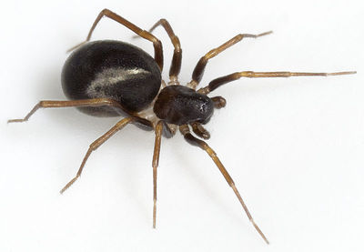



MALDI-MS profiling of spider venoms
C7250
evolution of food specialisation in spiders
species adaptations
ant-eating spiders
Z. merlijni
cooperation with prof. Pekar, FS MU
Pekár S. et al., J. Anim. Ecol., 81 (4), 838-848 (2012)
Bočánek O. et al., Toxicon, 133, 18-25 (2017)
Pekár S. et al. Mol. Ecol., 27 (4), 1053-1064 (2018)

Slide 15
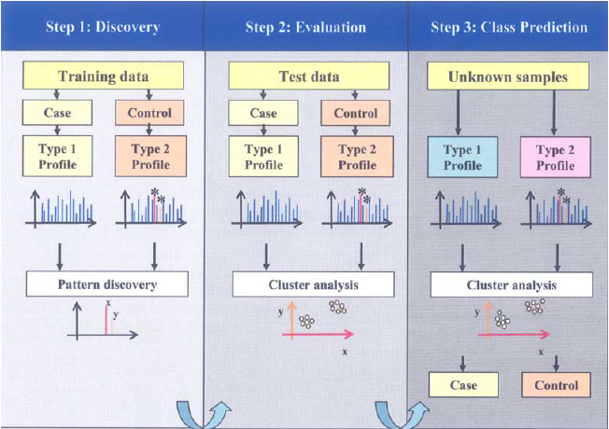
MALDI-MS profiling–early detection of diseases
(peptide profiling, pattern profiling)
C7250
Patient
no or minimal sample prep
(ionex, IMAC, affinity sorbents)
MALDI MS, SELDI MS
(3 – 20 kDa)
profile analysis
high number of factors influencing protein composition
not related with diagnosed disease
high profile variability
no strict limits for clear positive/negative disease detection
!

Slide 16
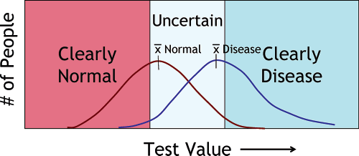
C7250
J. LaBaer et al., J. Proteome Res., 4 (4) 1053-1059 (2005).
M. Ehmann et al., Pancreas, 34 (2) 205-214 (2007).

Slide 17
C7250
MS-based approaches for biomarker searching
direct MS analysis
(MALDI MS, SELDI MS)
biomarker identification
Separation
GE. LC
Pattern profiling
comparison of peptide (protein) profile of sample „healthy“ vs. patient
(bez identifikace, statistická analýza)
comparison of protein (peptide) content of sample „healthy“ vs patient
MS
MS/MS
identification of differentialy regulated proteins
early disease detection
biomarker specifity!!!
specific antibody
Immunodetection
SRM, SWATH/Protein arrays

Slide 18

Glycan profiling and structural analysis of glycans
C7250
3x
4x
4x
5x
x10
4
1899.8
NSCLC - Bronchoalveolar Carcinoma
1.5
3x
5x
6x
Intens. [a.u.]
1.0
2264.9
0.5
2045.8
2191.8
2410.9
2630.0
2776.1
2995.2
3141.2
3360.3
3506.3
3871.5
4017.6
4090.5
3725.4
0
3x
x10
4
1899.8
4x
Bronchoalveolar Adenocarcinoma
5x
6x
6
3x
Intens. [a.u.]
2264.9
4
2630.0
2995.2
3360.3
3725.4
2
2118.8
2468.461
3141.2
4090.5
0
3x
4x
5x
Large Cell Carcinoma
3x
x10
4
2630.0
2776.1
3x
MALDI-TOF-MS spectra of N-glycans after desialylation
4
2410.9
4x
5x
2045.8
2264.9
2922.1
3
2557.0
Intens. [a.u.]
2118.9
2191.9
Man;
Gal;
GlcNAc;
Fuc
2
1899.8
2248.9
2395.0
3068.2
1954.8
2102.8
2467.9
2614.0
2703.1
2483.9
2760.1
3141.1
3287.3
3433.3
3506.3
3652.5
3798.5
4017.6
1
3944.5
4163.7
Lattová E., J. Proteome Res., 15 (8), 2777-2786 (2016)
0
2000
2500
3000
3500
4000
m/z

Slide 19
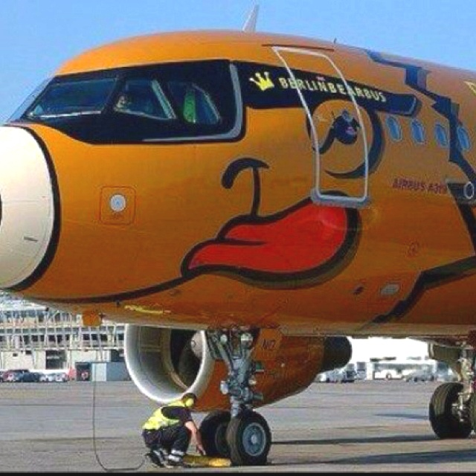

Slide 20
C7250
Comparison of human cancer cell line proteome and transcriptome
10 mg proteins
126 frakcí
72 frakcí
Protein fractionation
Peptide fractionation
N. Nagaraj et al., Mol. Syst. Biol., 7, 548 (2011).

Slide 21
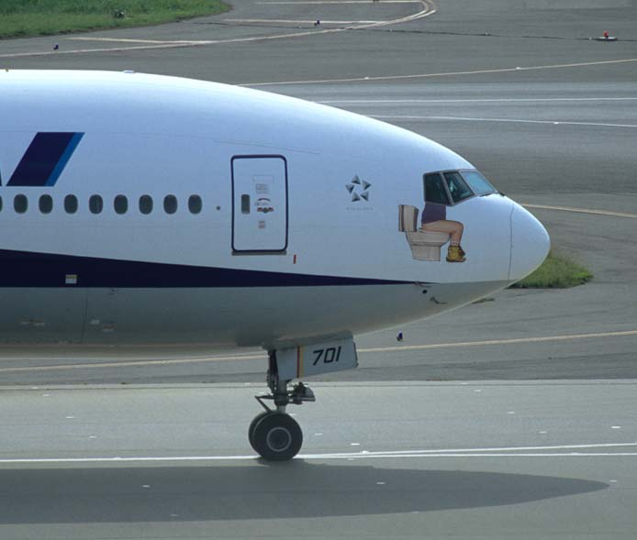

Slide 22
C7250
Relative quantification by MS
isotopically labeled tag approaches
(comparison of limited number of samples, up to 10)
protein quantification
replica 1
100%
replica 2
replica 3
label-free approaches
(comparison of unlimited number of samples, lower accuracy)
Targeted quantification of selected proteins by MS
MRM, SWATH

Slide 23
C7250
Characterization of proteome changes
differential (expression) proteomics
image analysis of 2-D gels
LC-MS/MS of selected spots with different intensity
B
identification (MS) separated from quantification (spot intensity on gel)
mixed spots
Acidithiobacilus ferrooxidans grown on ferrous iron (A) and elemental sulfur (B)
cooperation with Department of Biochemistry, FS MU
P. Bouchal et al., Proteomics 2006, 6, 4278–4285.

Slide 24

C7250
Search for marker proteins for chicken salmonella infection
relative quantification
control
infected
gut wall sample
protein isolates
tryptic digestion
reductive alkylation
LC-MS/MS
data processing

Slide 25
C7250
identification more than 2300 protein
quantification for more than 1900
infected/
control
Accession | Description
363741657 | PREDICTED: syntenin-2-like [Gallus gallus] |  | 41.032
118095649 | PREDICTED: beta-1,3-galactosyl-O-glycosyl-glycoprotein beta-1,6-N-acetylglucosaminyltransferase 3 [Gallus gallus] |  | 34.036
4927286 | alpha enolase [Bos taurus] |  | 33.575
112491068 | Chain A, Crystal Structure Of A M-Loop Deletion Variant Of Ment In The Cleaved Conformation |  | 30.221
56118294 | ribonuclease homolog precursor [Gallus gallus] |  | 25.497
363741459 | PREDICTED: protein-glutamine gamma-glutamyltransferase E [Gallus gallus] |  | 24.786
clarifying of mechanisms of molecular processes
search for marker proteins for early detection
confirmation by real-time PCR
cooperation with VRI Brno
Matulova M. et al., Vet. Res., 44:37 (2013)

Slide 26
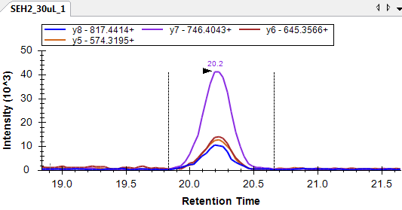
C7250
Quantification of enterotoxins
targeted analysis of selected protein
MRM
selection of peptides suitable for MRM
absolute quantification by AQUA peptides
result- amount/concentration of given protein in sample

Slide 27
SWATH MS
Q-TOF, MS/MS < 10 ppm
C7250
m/z
Retention time
classic DB searching not possible
comparison with libraries of ref. MS/MS spectra
Relative and absolute quantification
all MS/MS spectrum
Gillet et al, MCP, 11, 1-17 (2012)

Slide 28
C7250
Shot gun vs SRM vs SWATH
Liu et al, Expert Rev. Mol. Diagn., 13(8), 811 (2013)

Slide 29
C7250
Liu et al, Expert Rev. Mol. Diagn., 13(8), 811 (2013)

Slide 30
C7250
Liu et al, Expert Rev. Mol. Diagn., 13(8), 811 (2013)

Slide 31
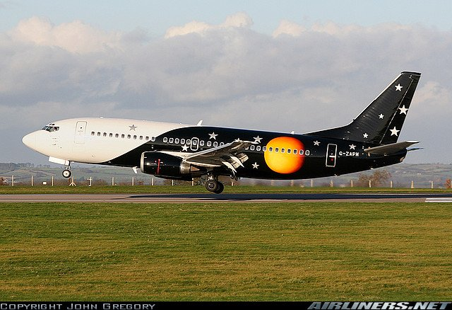

Slide 32
C7250
Phosphoproteome analysis – four fractionation approaches
ERLIC - Electrostatic Repulsion-Hydrophilic Interaction Chromatography
Chen et al., J. Chromatogr. B, 879, 25 (2011)

Slide 33
Phosphoproteome analysis – four fractionation approaches
C7250
Each method – over 4000 phoshopeptides
In total – 9069 phosphopeptides – 9463 sites / 3260 proteins
Chen et al., J. Chromatogr. B, 879, 25 (2011)

Slide 34
Phosphoproteome analysis– quality and quantity
C7250
Porcine muscle
Postmortem changes
160 phosphoproteins with 784 sites identified
184 phosphorylation sites on 93 proteins had their phosphorylation levels significantly changed.
Huang et al., J. Proteomics, 106, 125 (2014)

Slide 35
C7250
Phosphoproteome analysis– quality
Comparison of identified peptides in replicas
Huang et al., J. Proteomics, 106, 125 (2014)

Slide 36
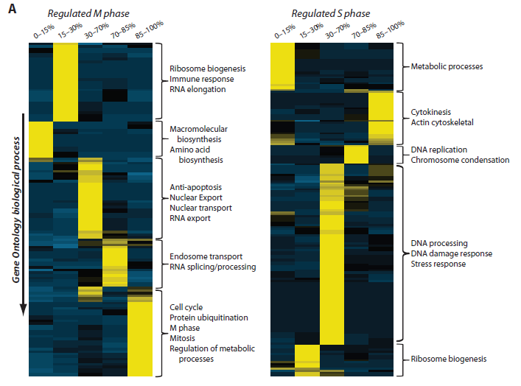
CG010
Phosphoproteome analysis
Olsen J.V. et al., Sci. Signal., 3 (104) ra3 (2010)
quantified 6027 proteins
quantified 20,443 unique phosphorylation sites
- HELA cells
- SILAC labeling
- TiO₂ enrichment
- LC-MS/MS (Orbitrap)
The panels show the phenotypic phosphoproteome comparison organized by GO biological process for mitotic (left) and S phase (right) cells. Proteins involved in metabolic processes have high-occupancy phosphorylation sites during mitosis, but low-occupancy sites during S phase (color scale: yellow, high overrepresentation; dark blue, high underrepresentation).

Slide 37
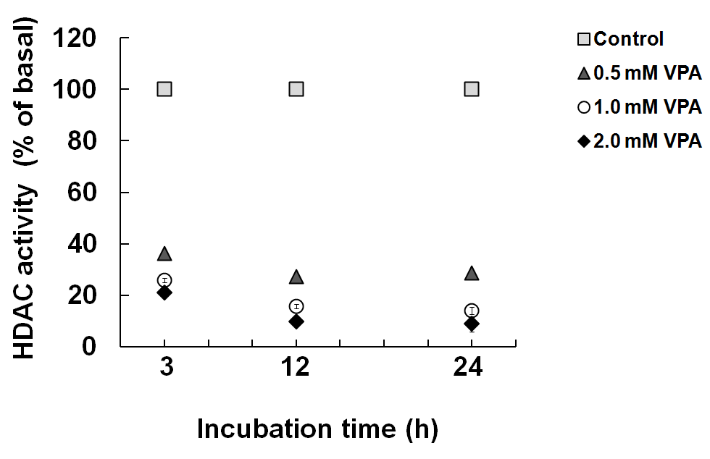
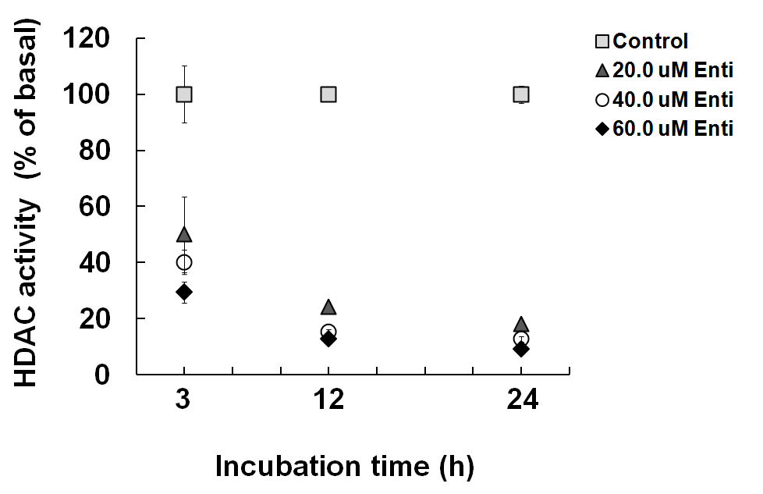
C7250
Characterization of effect of histone deacetylase inhibitors
to establish a set of methods
- HDAC Fluorimetric Cellular Activity Assay Kit
- MALDI-MS of N-terminal part of histones (after Glu-C digestion)
- AUT-AU 2-D GE combined with LC-MS/MS analysis
Total HDAC inhibiton effect
Valproic acid
Entinostat
B-CLL MEC-1 cells
Činčárová et al, Mol. Biosyst. (2012)

Slide 38
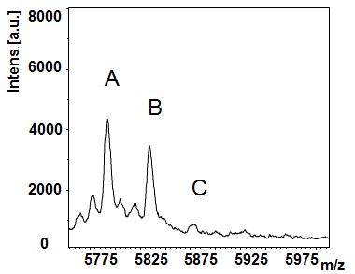
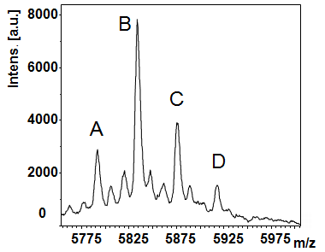
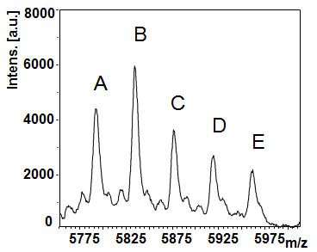
C7250
Characterization of effect of histone deacetylase inhibitors
MALDI-MS of Histone H4 acetylated forms
N-terminal fragment (1-53 AA)
control
Valproic acid
Entinostat
A E 0 4 acetylations

Slide 39
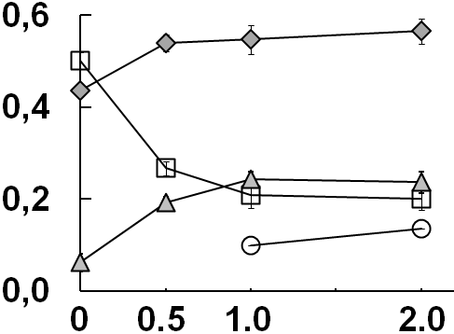
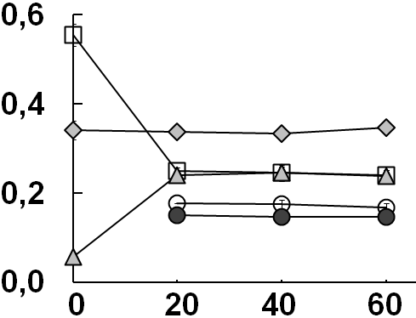
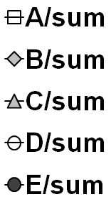
C7250
Characterization of effect of histone deacetylase inhibitors
Changes of particular H4 acetylated forms vs inhibitor concentration
(24h treatment)
Valproic acid
Entinostat
Ratio
VPA [μM]
Enti [μM]
A E 0 4 acetylations

Slide 40
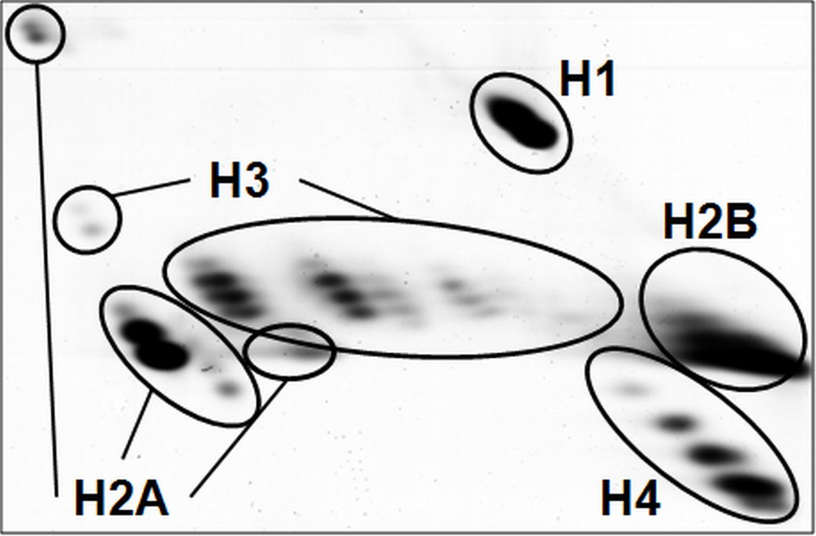
C7250
Characterization of effect of histone deacetylase inhibitors
AUT-AU 2-D GE of histone extract

Slide 41
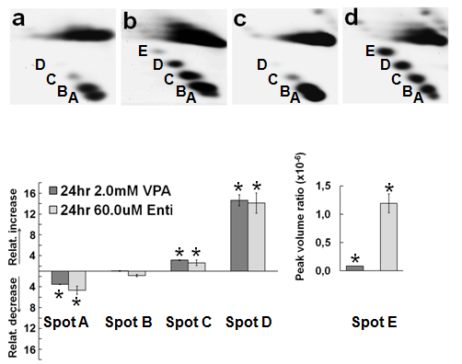
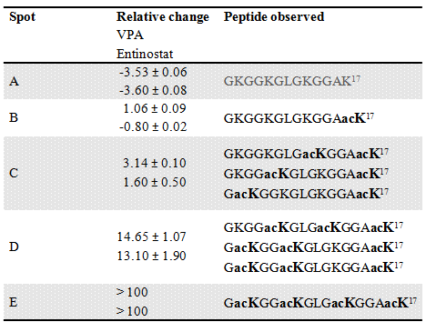
C7250
Characterization of effect of histone deacetylase inhibitors
AUT-AU 2-D GE of histone extract
ctrl
VPA
ctrl
ENTI
A E 0 4 acetylations

Slide 42
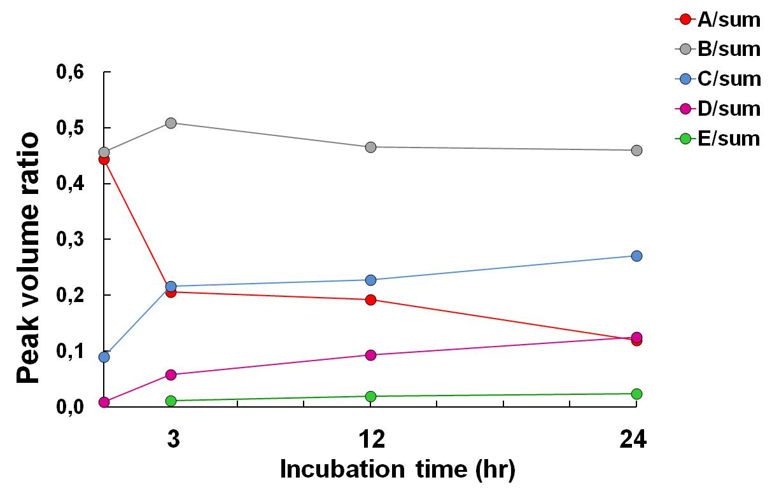
C7250
Characterization of effect of histone deacetylase inhibitors
Changes of histone H4 acetylated forms in dependence on incubation time
(2 mM VPA)
MALDI-MS
2-D AUT-AU GE
Incubation time (hr)
peak intensity
spot intensity

Slide 43

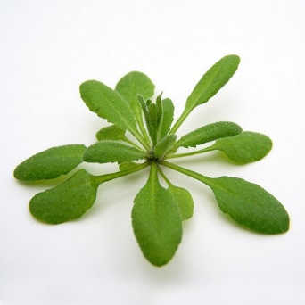


Characterization of Post-Translational Modifications of Histones
LC-MS/MS
histone extraction
TCA precipitation
derivatization
at protein level
tryptic digestion
derivatization
at peptide level
e.g. in Sidoli S. et al., J. Vis. Exp. 111:e54112 (2016).

Slide 44
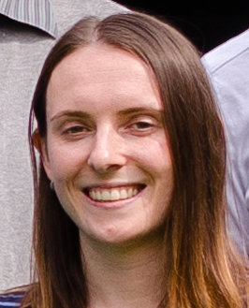

C7250
Filter-Aided Sample Preparation Procedure for Mass Spectrometric
Analysis of Plant Histones
human histone extract after TCA precipitation re-dissolved in MilliQ water
human recombinant histone standards
A. thaliana histone extract after TCA precipitation re-dissolved in SDS
A. thaliana histone extract after TCA precipitation re-dissolved in MilliQ water
A. thaliana histone extract in sulfuric acid diluted in MilliQ water
Ledvinova D.. et al, Front. Plant Sci., 9, article 1373 (2018)

Slide 45
C7250
Filter-Aided Sample Preparation Procedure for Mass Spectrometric
Analysis of Plant Histones
Ledvinova D.. et al, Front. Plant Sci., 9, article 1373 (2018)

Slide 46

Inter-individual variations of Histone Modification Patterns
C7250
cooperation with Prof. Fajkus group, CEITEC-MU
two Arabidopsis thaliana ecotypes Columbia 0 (Col-0) and Wassilewskija (Ws)
grown from seeds collected from a single parent plant (Single) and a set of parent plants (Mixed).
mixed
single
Brabencova S. et al, Front. Plant Sci., 8, article 2084 (2017)

Slide 47


Slide 48
C7250
Charakterization of protein complexes
functional proteomics
> 80% proteins is functional only as a part of complex
~ 10000 types of interactions
Aloy P., Russell R. B.: Nat. Biotechnol. 22 (10), 1317-1321 (2004)
sample
(cells)
search for new intraction partners
study of „whole“ complex
complex
purification
MS/MS
analysis
confirmation of
true interaction
partners
separation
digestion

Slide 49
C7250
Purification of protein complexes
in vivo expression of bait protein with a tag
high degree of complex purity
loss of weakly binded interaction partners
T. Köcher, G. Superti-Furga: Nat. Methods, 4(10), 807-815 (2007).

Slide 50
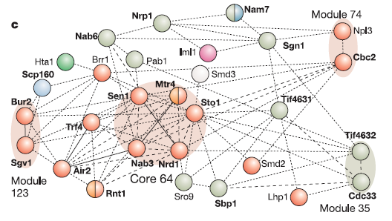
C7250
MS capabilities in protein complex analysis
identification of individual complex members including their PTMs
confirmation of interaction partners (exclusion of nonspecific interactors)
determination of complex stoichiometry
determination of 3D structure of complex (cross-linking)
Gavin A.-C. et al.: Nature, 440 (30), 631-636.

Slide 51

C7250
Identification of individual interaction partners
ctrl
complex
ctrl
complex
sample prep
digestion in gel
LC-MSMS
digestion in solution
LC-MSMS
possibility to label samples by tags for relative quantification and to pool the samples for further processing

Slide 52
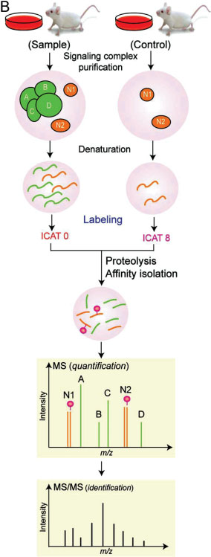
Confirmation of true interaction partners
C7250
non-specific interaction 1:1
W. Yang et al., Proteomics 2008, 8, 832–851

Slide 53
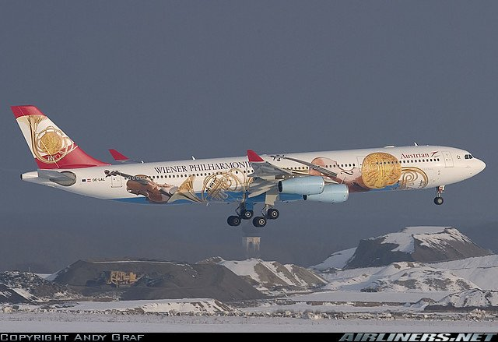

Slide 54
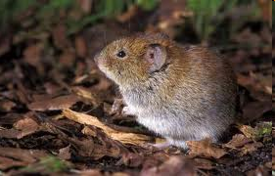
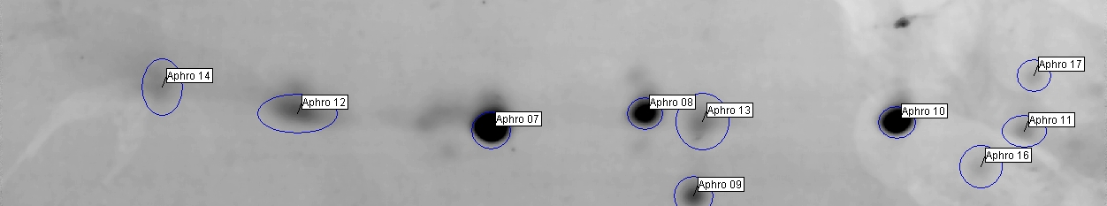
C7250
Sequence confirmation and determination of OBP protein isoforms
de novo sequencing
saliva
2D gel electrophoresis
MS/MS of selected spots
Myodes glareolus
unknown genome
no antibodies
Obp3A
Obp3B
Obp2
cooperation with prof. Stopka FS CU, Prague
Stopková R., Zdráhal Z., Ryba Š. et al, BMC Genomics 2010, 11:45

Slide 55
C7250
Sequence confirmation and determination of OBP protein isoforms
RNA analysis
(FS CU Prague)
proteomic analysis
(FS CU/Proteomics CF)
RNA isolation
cDNA synthesis
PCR with Aphrodisin primers
(hamster)
purification
cloning
sequencing
initial
aminoacid sequence
protein isolation
2D GE
in-gel digestion
MALDI-MS/MS
de novo
corrected AA sequence
(Blast, new proteins)
database of OBP protein sequences
identification of protein isoforms

Slide 56
C7250
Sequence confirmation and determination of OBP protein isoforms
MALDI-MS/MS a LC-MS/MS
manual spectra interpretation
original sequence - QAELEGKWVTTAIAADNIDTIEEEGPMR (OBP3)
DAELEGTWYTTAIAADNVDTIEEEGPLR
HAELEGTWYTTAIAADNVDTIEEEGPLR
m/z 3079.4
DAELEGTWYTTAIAADNVDTIEEEGPLR
MALDI-MS/MS

Slide 57


Slide 58
C7250
MS Imaging

Slide 59
C7250
MALDI-MS imaging
samples:
fresh frozen tissue sections
individual cells or clusters of cells isolated by laser-capture microdissection or contact blotting of a tissue on a membrane target.
MS analysis
scanning of sample area point by point
image corresponds to planar distribution of individual m/z
distribution of peptides (proteins, lipids,...)

Slide 60
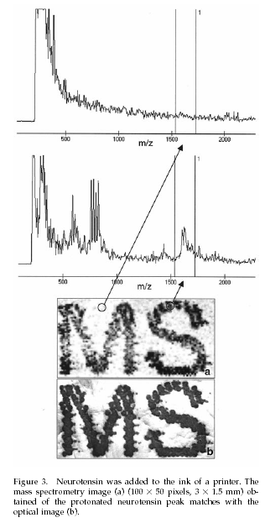
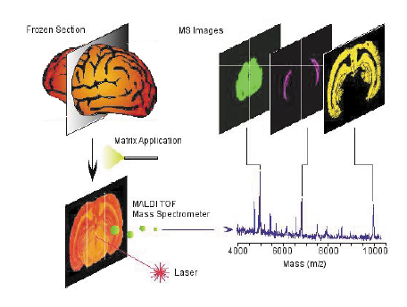
C7250
MALDI-MS imaging
M. Stoeckli, T.B. Farmer, R.M. Caprioli: J Am Soc Mass Spectrom, 10, 67–71 (1999)

Slide 61
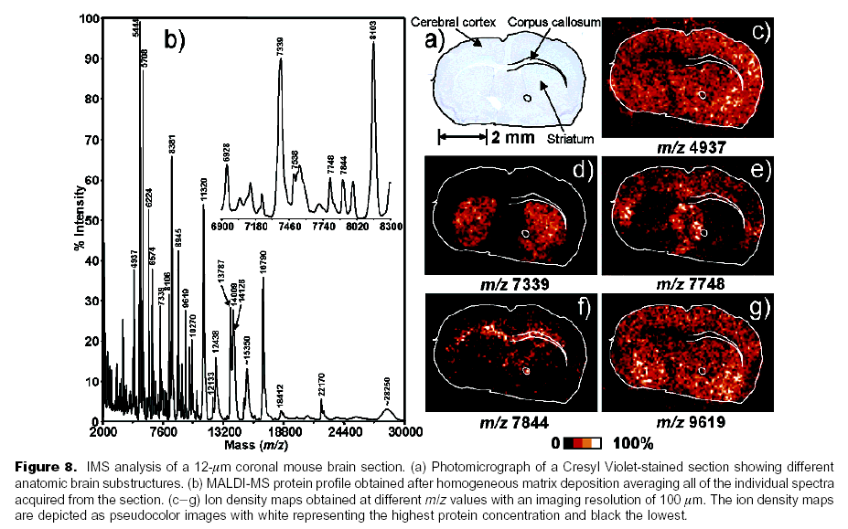
C7250
MALDI-MS imaging
Chaurand et al:Anal. Chem.2004, 76,1145-1155

Slide 62
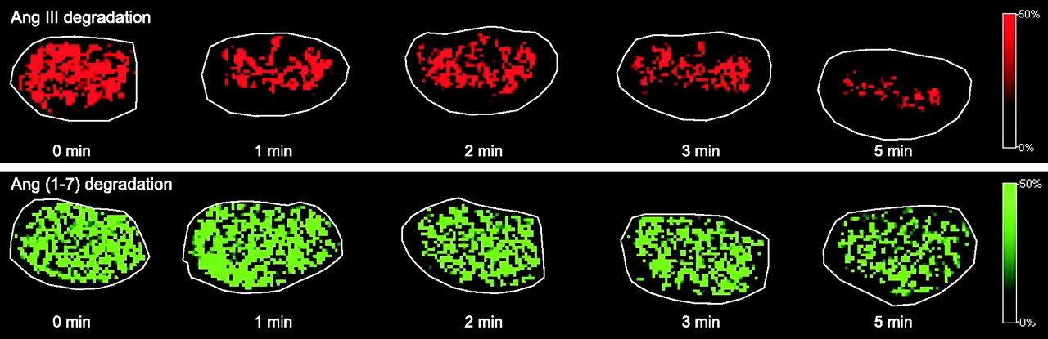
C7250
Degradation of Ang III and Ang-(1–7) in mouse kidney sections.
Grobe N. et al, Am. J. Physiol. Endocrinol. Metab., 302 (8), E1016 (2012)

Slide 63
The end

