Slide 1
Volcanoes
8

Slide 2
In this lesson you are going to:
revise the vocabulary
learn how to talk about the past
revise the system of tenses (present x past x future)
revise questions
write!

Slide 3
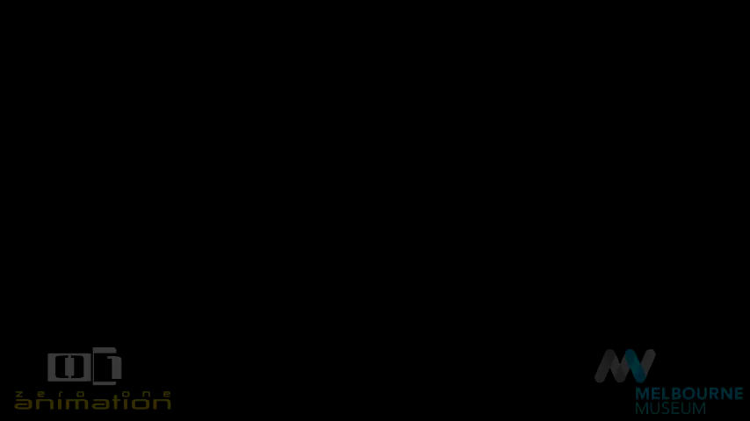
Mount VESUVIus

Slide 4
Narrative tenses (the past)
I had analysed the fossil when the volcano erupted.
I was analysing the fossil when the volcano erupted.
I analysed the fossil when the vulcano erupted.
I had been analysing the fossil when the volcano erupted.
The fossil had been analysed when the volcano erupted.
The fossil was analysed when the vulcano erupted.
The fossil was being analysed when the volcano erupted.

Slide 5
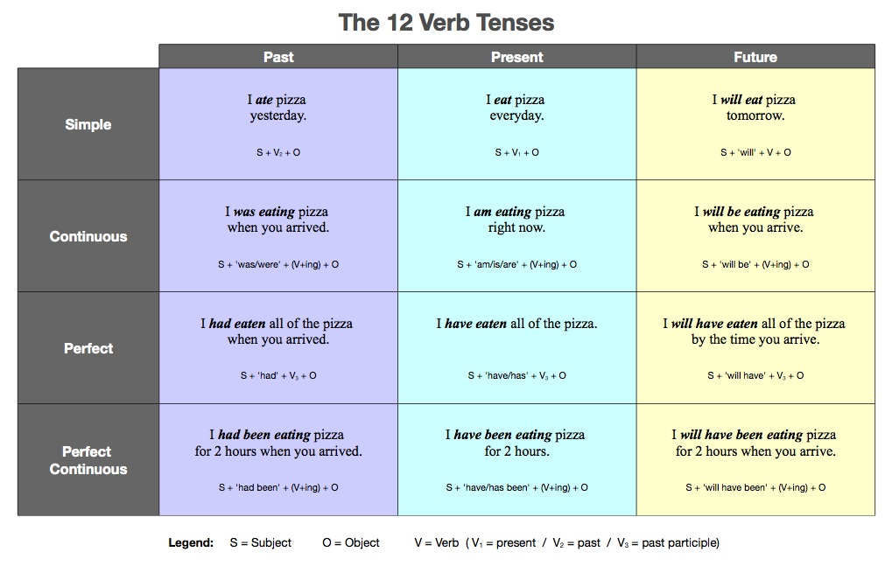

Slide 6
sources
https://russian.stackexchange.com/questions/8571/is-it-possible-to-translate-english-tenses-into-russian-tenses
https://howjsay.com/search?word=vesuvius&submit=
https://www.youtube.com/watch?v=dY_3ggKg0Bc
https://www.youtube.com/watch?v=WgktM2luLok

