Slide 1
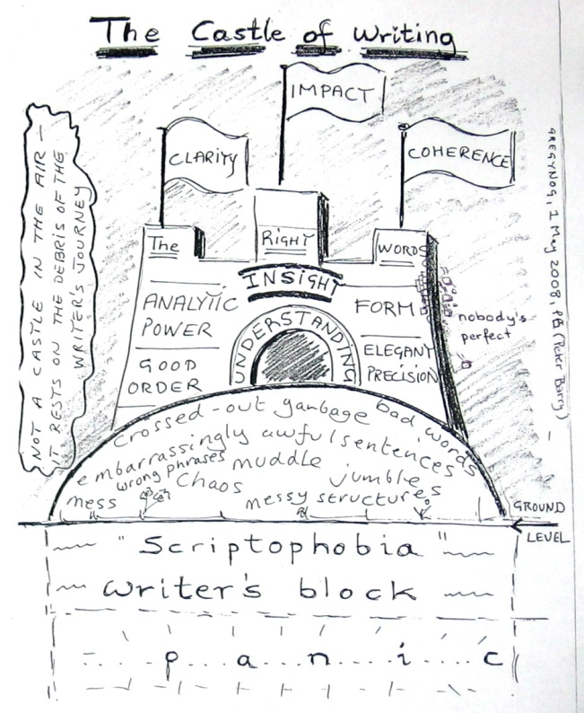

S4001
International Performance
Course
Autumn Term 2018

Slide 3
Academic Writing Introduction
What
Who
Why

Slide 4
Academic Writing Introduction
  What is the writing about?

Slide 5
Academic Writing Introduction
  Who is writing? Who is the audience?

Slide 6
Academic Writing Introduction
  Why is the writing done?

Slide 7
expert scientific student general

Slide 8
expert scientific student general

Slide 9
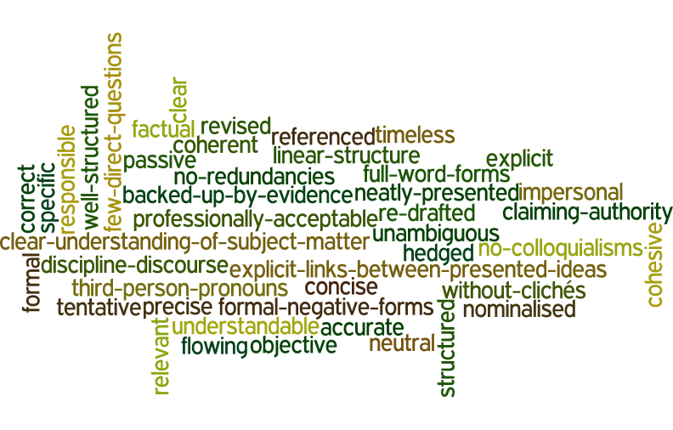

Slide 10
neatly presented cohesive with full forms of words
objective correct without redundancies
explicit factual with flowing structure
hedged unambiguous without clichés
frequent third person pronouns accurate responsible
well structured neutral backed up by evidence
professionally acceptable revised understandable
linear structure timeless specific
without colloquialisms re-drafted referenced
precise clear nominalised
claiming authority formal tentative
more frequent passive voice impersonal no negative forms
with explicit links between presented ideas coherent
with clear understanding of the subject matter concise
relevant within the discourse of your discipline

Slide 11
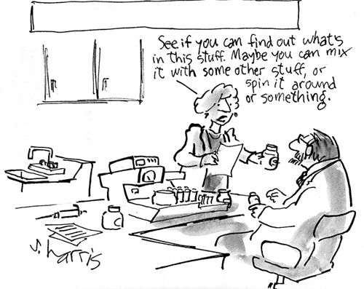
style
(Adapted from: http://www.chemistry-blog.com/category/fun/page/2/)

Slide 12
style
a) It rained cats and dogs yesterday, didn´t it?
b) What a downpour last night!
c) The UK Meteorology Office monitored a heavy rainfall with the rate of precipitation reading 46 millimetres per hour on 24th March 2011 in North Cumbria.
d) She was standing there in the storm waiting for deafening thunder to come, feeling the water cooling the air and thinking of how heavy the drops of water must be so that they could fall down from the dark clouds and make her feel refreshed and so light that she could fly, and make her full of energy, make her appreciate the eternal life it delivers, when finally she realised this precipitation was indeed a friend, her only true friend.

Slide 13
style
It rained cats and dogs yesterday, didn´t it?

Slide 14
style
What a downpour last night!

Slide 15
style
The UK Meteorology Office monitored a heavy rainfall with the rate of precipitation reading 46 millimetres per hour on 24th March 2011 in North Cumbria.

Slide 16
style
She was standing there in the storm waiting for deafening thunder to come, feeling the water cooling the air and thinking of how heavy the drops of water must be so that they could fall down from the dark clouds and make her feel refreshed and so light that she could fly, and make her full of energy, make her appreciate the eternal life it delivers, when finally she realised this precipitation was indeed a friend, her only true friend.

Slide 17
concise writing

Slide 18
concise writing
Concise writing presents information that is important to the reader. There are no unnecessary words, sentences or paragraphs. Redundant expressions and structures are eliminated or replaced wordy with more concise words or phrases that have the same meaning.
Adapted from: Cooper, P. (2011): Academic Writing and Czech Universities

Slide 19
Chromatography is an experimental technique used by chemists as a means to help them separate different compounds in experimental samples using the affinity of the compound for the mobile phase as well as the affinity of the compound for the stationary phase.
[42 words]

Slide 20
Chromatography is an experimental technique used by chemists as a means to help them separate different compounds in experimental samples using the affinity of the compound for the mobile phase as well as the affinity of the compound for the stationary phase.
[42 words]
Chromatography is an experimental technique used by chemists to separate compounds in experimental samples using the affinity of the compound for the mobile phase as well as the affinity of the compound for the stationary phase.
[36 words]

Slide 21
Chromatography is an experimental technique used by chemists as a means to help them separate different compounds in experimental samples using the affinity of the compound for the mobile phase as well as the affinity of the compound for the stationary phase.
[42 words]
Chromatography is an experimental technique used by chemists to separate compounds in experimental samples using the affinity of the compound for the mobile phase as well as the affinity of the compound for the stationary phase. [36 words]
Chromatography is used to separate compounds using the affinity of the compound for the mobile phase as well as the affinity of the compound for the stationary phase. [28 words]

Slide 22
[42 words]
Chromatography is an experimental technique used by chemists as a means to help them separate different compounds in experimental samples using the affinity of the compound for the mobile phase as well as the affinity of the compound for the stationary phase.
[42 words]
Chromatography is an experimental technique used by chemists to separate compounds in experimental samples using the affinity of the compound for the mobile phase as well as the affinity of the compound for the stationary phase. [36 words]
Chromatography is used to separate compounds using the affinity of the compound for the mobile phase as well as the affinity of the compound for the stationary phase. [28 words]
Chromatography separates compounds based on the affinity of the compound for the mobile phase relative to the stationary phase.
[19 words]

Slide 23
formality

Slide 24
formality
Essential measures should be undertaken at the earliest opportunity.
b) You should do whatever you have to as soon as you can.
c) One should undertake any necessary measures at the earliest opportunity.

Slide 25
de-personalisation

Slide 26
On self-mention in academic articles: Frequency of self-mention forms per discipline (Ø per 10,000 words).
Discipline | Total | Citation | I | Me | My | We | Us | Our | Other
Physics | 64,6 | 8,7 | 0,0 | 0,1 | 0,0 | 39,3 | 0,6 | 14,4 | 1,4
Marketing | 61,3 | 6,9 | 1,6 | 0,0 | 0,7 | 31,0 | 1,1 | 18,9 | 0,6
Biology | 56,2 | 22,6 | 0,0 | 0,1 | 0,1 | 24,0 | 1,1 | 7,2 | 0,7
Philosophy | 52,7 | 3,1 | 35,6 | 2,5 | 7,7 | 1,4 | 0,2 | 0,6 | 0,0
Electronic eng. | 44,4 | 10,7 | 0,0 | 0,0 | 0,0 | 23,3 | 0,4 | 8,6 | 0,5
Mechanical eng. | 17,8 | 9,6 | 0,0 | 0,0 | 0,0 | 5,5 | 0,0 | 1,4 | 0,4
Overall | 50,5 | 8,3 | 11,2 | 0,8 | 2,4 | 17,8 | 0,8 | 8,3 | 1,1
Adapted from: K. Hyland/English for Specific Purposes 20 (2001) 207-226

Slide 27
All manuscripts must…be written in objective third person point of view throughout (Use "the authors" or "the researchers" NOT "I" or "we")…
(Adapted from: http://www.igi-global.com/publish/contributor-resources/before-you-write/)

Slide 28
passive vs active

Slide 29
Percentages of voice per section in the processes of three types of sciences
in 21 research articles.
 | Introduction |  | Method |  | Results |  | Discussion
 | A | P | A | P | A | P | A | P
Physical sciences | 63,0 | 37,0 | 26,0 | 74,0 | 72,0 | 28,0 | 71,0 | 29,0
Biological sciences | 74,0 | 26,0 | 38,0 | 61,05 | 68,0 | 32,0 | 79,0 | 21,0
Social sciences | 84,0 | 16,0 | 46,0 | 54,0 | 77,0 | 23,0 | 85,0 | 15,0
A=active, P=passive Source: I.A.Martinez/English for Specific Purposes 20 (2001) 227-247)
NOTE: To read more on passive: Lilita Rodman: The passive in technical and scientific
writing; http://www.jaconlinejournal.com/archives/vol2/rodman-passive.pdf

Slide 30
Percentages of voice per section in the processes of three types of sciences
in 21 research articles.
 | Introduction |  | Method |  | Results |  | Discussion
 | A | P | A | P | A | P | A | P
Physical sciences | 63,0 | 37,0 | 26,0 | 74,0 | 72,0 | 28,0 | 71,0 | 29,0
Biological sciences | 74,0 | 26,0 | 38,0 | 61,05 | 68,0 | 32,0 | 79,0 | 21,0
Social sciences | 84,0 | 16,0 | 46,0 | 54,0 | 77,0 | 23,0 | 85,0 | 15,0
A=active, P=passive Source: I.A.Martinez/English for Specific Purposes 20 (2001) 227-247)
NOTE: To read more on passive: Lilita Rodman: The passive in technical and scientific
writing; http://www.jaconlinejournal.com/archives/vol2/rodman-passive.pdf

Slide 31
We should reject this conclusion for two reasons.
vs
This conclusion should be rejected for two reasons.
…
It is unclear at this time as to what extent cremophore is responsible for these side effects, but similar hypersensitivity reactions in dogs have been attributed to histamine release by cremophore EL.

Slide 32
Experts presented and discussed a total of ten
innovative papers during the two-day workshop sessions.
vs
A total of ten innovative papers
were presented and discussed
during the two-day workshop sessions.

Slide 33
To measure the number of gene copies the cellular DNA
is broken into small pieces, the double strands are denatured
(separated into single strands) by boiling, and a small amount of
the radioactively labeled complementary DNA is added
to the mixture under experimental conditions.

Slide 34
nominalisation

Slide 35
You can understand something better if it is repeated.

Slide 36
You can understand something better if it is repeated.
Comprehension is aided by repetition.

Slide 37
This can serve as a template,
thanks to which proteins can be synthesised.
This can serve as a template
for the synthesis of proteins.

Slide 38
The body temperature rose suddenly,
as a consequence, the invading pathogen
grew less quickly.
The sudden rise in body temperature may also have caused the inhibition of the growth
of the invading pathogen.

Slide 39
The body temperature rose suddenly,
as a consequence, the invading pathogen
grew less quickly.
The sudden rise in body temperature may also have caused the inhibition of the growth
of the invading pathogen.

Slide 40
Incomplete implementation of strategized
programmatics was designated to maximize acquisition
of awareness and utilization of communication skills pursuant to standardized review and assessment
of linguistic development.
Adapted from: http://stevenpinker.com/files/pinker/files/why_academics_stink_at_writing.pdf

Slide 41
Incomplete implementation of strategized
programmatics was designated to maximize acquisition
of awareness and utilization of communication skills pursuant to standardized review and assessment
of linguistic development.
Adapted from: http://stevenpinker.com/files/pinker/files/why_academics_stink_at_writing.pdf

Slide 42
coherence and cohesion

Slide 43
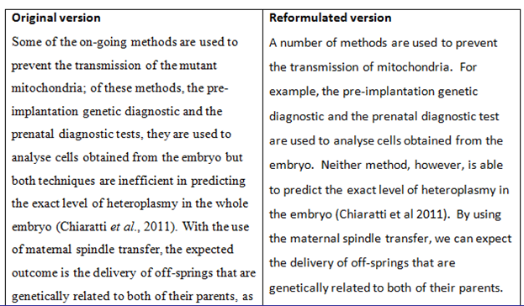
Reformulation (ii)
Adapted from: Ellwood, C.(2011)
Notes:
What did students notice? What they liked about this?

Slide 44
Reformulation (ii)
Adapted from: Ellwood, C.(2011)
Notes:
What did students notice? What they liked about this?

Slide 45
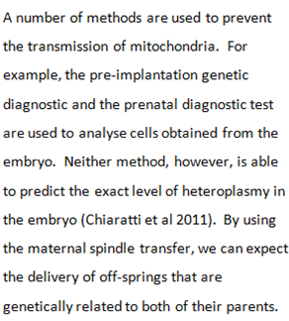

Slide 46
hedging language of caution tentative language
Academic writing might give the impression that it is factual, conveying precise, accurate and objective facts and information. “However, it is now recognised that an important feature of academic writing is the concept of cautious language, often called hedging.“ In other words, it is necessary to make decisions about your stance on a particular subject, or the strength of the claims you are making.”
Adapted from: Cooper, P. (2011): Academic Writing and Czech Universities

Slide 47
Hedge Class | Function
Shields Devices that take responsibility for the claim made away from the author. They function as a tool protecting the author from any criticism. The writer aims at not being on record with regard to the propositions expressed in the text. | Responsibility shifting e.g. …([1], [2], [3],)…, …it is shown in [3]…, Romanowska found…, …we refer reader to [3, 4]…, …see [10]…
 | Speaking facts The writer shields his/her claims through stating “the commonly accepted” view. e.g. Definition 1…, A map is…, …is defined to be…, …space is said to be…
Mitigators The author admits his/her responsibility for the claims made. The writer takes stance while using mitigators, but decides to weaken his/her propositions for various reasons. | Approximation e.g. …some…, …more…, Several, …similar…
 | Possibility e.g. …may…, …can…, …possible…
 | Understatement By using these devices, authors lessen the importance and the validity of their claims. e.g. …notions…, …concept…
 | Admitting incompleteness e.g. …briefly…, however,…

Slide 48
Introductory verbs | e.g. seem, tend, look like, appear to be, think, believe, doubt, be sure, indicate, suggest
Modal verbs | e.g. would, may, might, could
Frequency adverbs | e.g. often, sometimes, usually
Modal adverbs / adjectives | e.g. probably, possibly / probable, possible
Modal nouns | e.g. assumption, possibility, probability
“That” clauses | e.g. It could be the case that…. It might be suggested that…
“To”-clause + adjective | e.g. It may be possible to obtain

Slide 49
In addition, to the best of our knowledge,
there is no facile and practical method for the synthesis of this compound in the literature.

Slide 50
This system prevents attacks on both server and client sides.
According to simulation studies, under some circumstances this system may reduce certain types of attacks on both server and client sides.
It could be concluded that some evidence seems to suggest that this system might, under some circumstances, have the tendency to reduce at least certain types of attacks on both server
and client sides

Slide 51
The fluorescence lifetime measurement of the diol/carbonate pair will be complete in two months.
The fluorescence lifetime measurement of the diol/carbonate pair is expected to be complete in two months.
It is estimated that in the next fifty years the world’s population might again grow 40-50% and if we continuously used the amount of water that we are currently using the water supply may significantly diminish.
In the next fifty years the world’s population will again grow 40-50% and if we continuously use the amount of water that we are currently using the water supply will significantly diminish.
Adapted from: Robinson, M., Stoller,F. (2008): pp.594-596

Slide 52
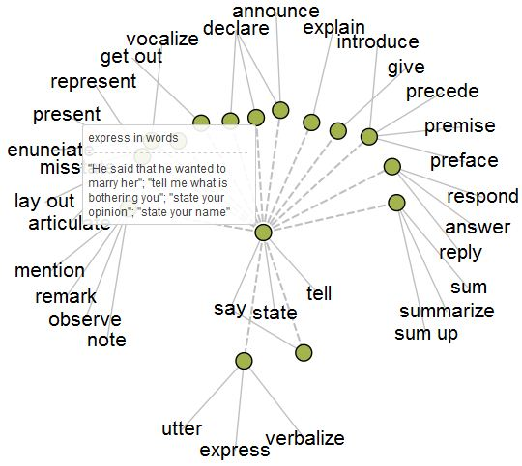
accuracy and precision

Slide 53
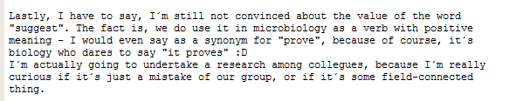

Slide 54
In their …………. study, Lakhina, Crovella and Diot ….
important
small scale
ambitious exploratory
significant preliminary
limited impressive
original rigorous remarkable simple
useful complex
traditional modest (Adapted from: Morley,J. et al: University Writing Course, Express Publishing, Newburry, 2009,p.101)

Slide 55
The noble gases, namely neon and radon, are under standard conditions odourless and colourless.
Herbivores that feed mainly or only on plants form an important link in the food chain.

Slide 56
The noble gases, for example neon and radon, are under standard conditions odourless and colourless.
Herbivores, which feed mainly or only on plants, form an important link in the food chain.

Slide 57
It is ….
certain
almost certain
very probable / highly likely probable / likely
possible
unlikely
very / highly unlikely
…that we will experience similar reactions when acids are used.
Adapted from: Štěpánek, L., deHaaff, J.(2011): Academic English, Grada, Praha, p.29

Slide 58
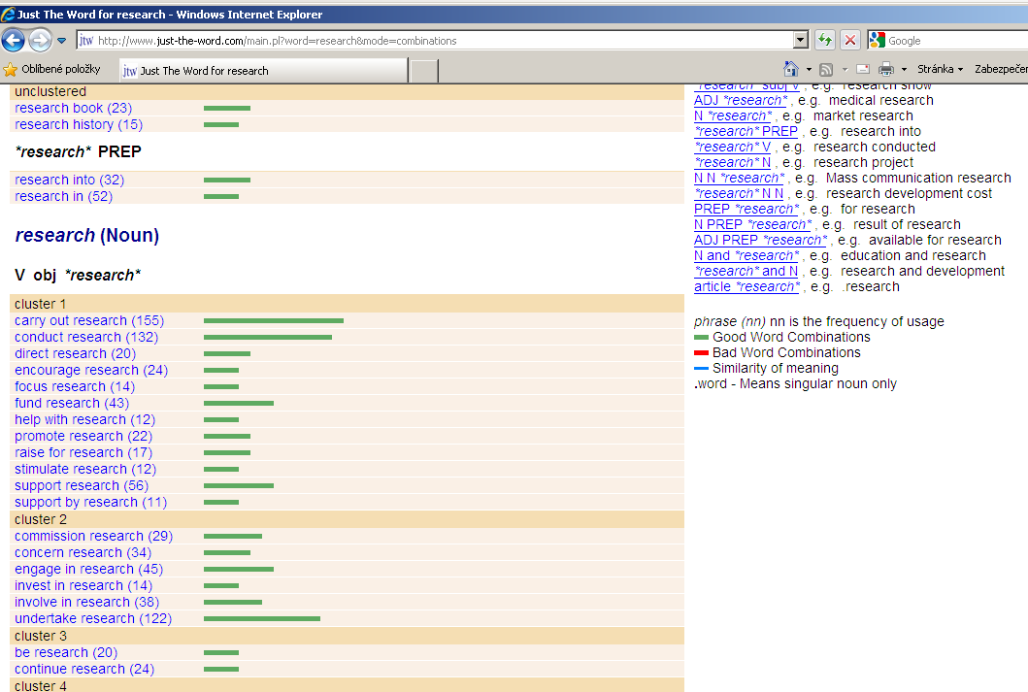
words
Just the word
Phrasebank
UEFAP
Academic Word List - AWL
Wikipedia Google
Thesaurus / Synonyms
Online dictionaries
Google translator

Slide 59
titles
A
B
C
D

Slide 60
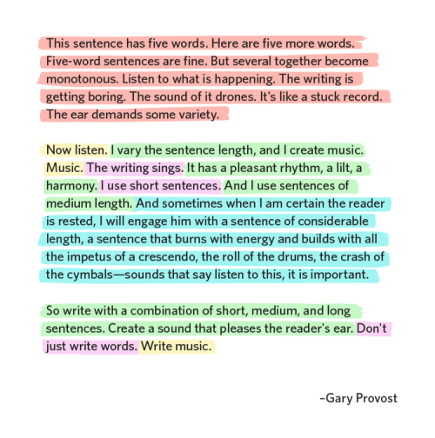
sentences

Slide 61
Since it was, as mentioned, a test, we did not try to achieve the best results, we just wanted to verify the idea of time characteristics.
The(Our) intention was to verify (its) time characteristics
(of…) by means of a (…) test.

Slide 62
paragraphs

Slide 63
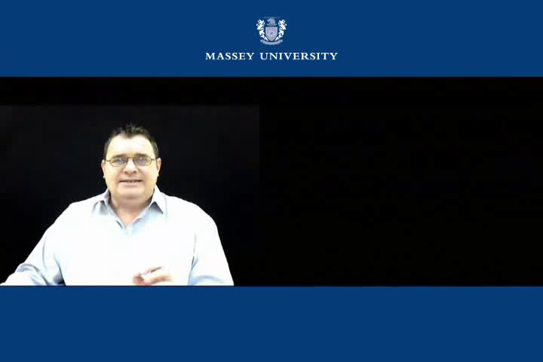
Adapted from: https://www.youtube.com/watch?v=vN4afrr33Ac

Slide 64
parallel structures…

Slide 65
This report was researched by Steve, written by Joan,
and the editing was done by Justin.
This report was researched by Steve, written by Joan,
and edited by Justin.
Writing essays is not easy because it takes time and care and careful thinking.
Writing essays is not easy because it takes time, care and thought.
Many gases are invisible, odourless, and they have no taste.
Many gases are invisible, odourless, and tasteless.

Slide 66
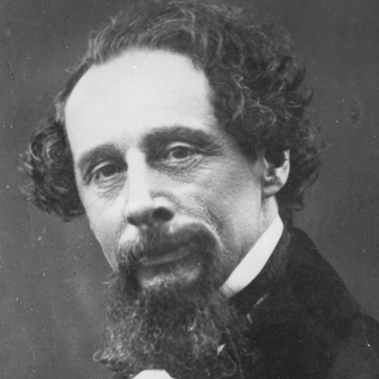

It was the best of times, it was the worst of times,
it was the age of wisdom, it was the age of foolishness,
it was the epoch of belief, it was the epoch of incredulity,
it was the season of Light, it was the season of Darkness,
it was the spring of hope, it was the winter of despair.
Charles Dickens: A Tale of Two Cities, 1859

Slide 67
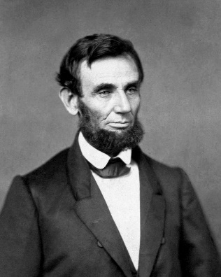
A house divided against itself cannot stand.
I believe this government cannot endure, permanently half slave
and half free.
I do not expect the Union to be dissolved.
I do not expect the house to fall.
But I do expect it will cease to be divided.
It will become all one thing, or all the other.
Abraham Lincoln, 1858

Slide 68
abstracts
The present study was conducted to determine the prevalence of Listeria monocytogenes in smoked fish in Sokoto, Nigeria. A total of 115 different species of smoked fish from the various retail outlets and market places within the metropolis were analysed for the presence of L. monocytogenes using ISO culture method. Out of the 115 samples analysed, 29 (25%) were positive for L. monocytogenes. Other Listeria species isolated in this study were L. grayi 13 (11%), L. innocua 10 (9%) and L. ivanovi 15 (13%). The remaining 48 (42%) of the sample were negative for Listeria species. The study shows that L. monocytogenes and other Listeria species are common contaminant of smoked fish, and this may pose serious public health implications. (Salihu et al., 2008)
Adapted from: Štěpánek, L., deHaaff, J.(2011): p.172

Slide 69
…..was conducted to determine …..
…. were analysed …...
…% were positive for
…. were ...%
…% were negative for …
The study shows that ….are …
…. this may pose ....

Slide 70
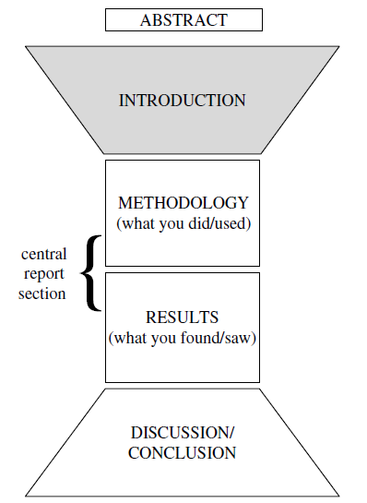

Slide 71
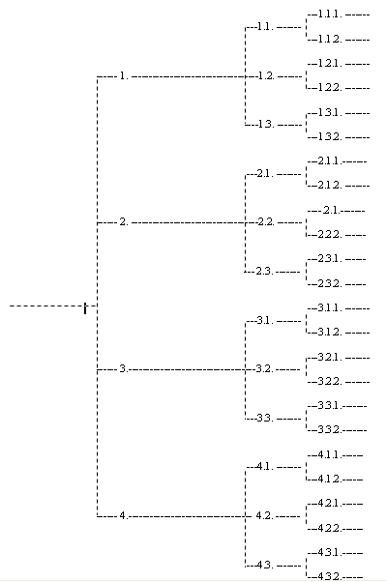

Slide 72
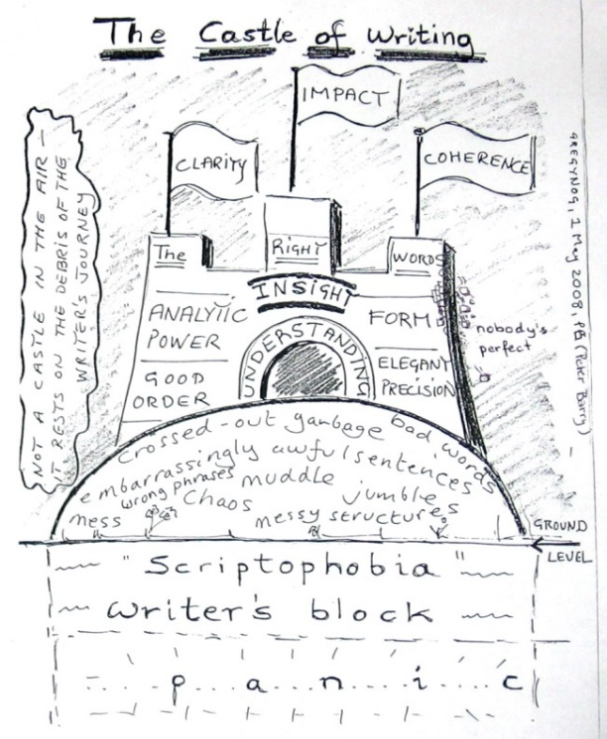
- audience
- complexity of the language
- drafting processes
- details
…keep writing…

Slide 73
Reading:
Brooks and Grundy, 1990:92 in Morgan, J. (2007): Academic Writing Course materials, MU
Caplan, N. A. (2012): Grammar Choices for Graduate and Professional Writers (Michigan Series in English for Academic & Professional Purposes) 1st Edition. The University of Michigan press.
Cooper, P. (2011): Academic Writing and Czech Universities, a lecture
Craswell, G., Poore, M. (2012): Writing for Academic Success , Second Edition
Glasman-Deal, H. (2010): Science Research Writing for Non-Native Speakers of English, Palgrave Macmillan,
Glasman-Deal,H.,(2010): Science Research Writing for Non-native Speakers of English, Imperial College Press, London
Graff, G., Birkenstein, C. (2010): They Say / I Say: The Moves That Matter in Academic Writing. W.W. Norton and comp.
Hradilová,A., Štěpánek,L. (2007): Academic Writing Course materials, MU
Hyland, K. (2001): English for Specific Purposes, https://www.researchgate.net/publication/226497899_English_for_Specific_Purposes
Morley, J. et al. (2009): University Writing Course, Express Publishing, Newburry,
Ochsner, A. (2013): Introduction to Scientific Publishing: Backgrounds, Concepts, Strategies. Springer Heidelberg New York Dordrecht London.
Robinson, M., Stoller,F. (2008): Write like a Chemist, OUP, Oxford
Robinson, M.S.,(2008) Using the ACS Journals Search To Validate Assumptions about Writing in Chemistry and Improve Chemistry Writing Instruction, Journal of Chemical Education, Vol. 85, No. 5,
Schimel, J. (2012). Writing Science Oxford University Press.
Swales, John M. and Feak, Christine B. (2001): Academic Writing for Graduate Students: Essential Tasks and Skills. The University of Michigan press.
Sword, H (2012). Stylish Academic Writing. Harvard University Press Cambridge, Massachusetts & London, England.
Štěpánek, L., deHaaff, J.(2011): Academic English, Grada, Praha
Taylor, R. B.(2011) Medical Writing A Guide for Clinicians, Educators, and Researchers. Springer.
Wager, E. (2015): Getting Research Published: An A-Z of Publication Strategy, Third Edition, CRC Press
Zeiger, M. (2000): Essentials of Writing Biomedical Research Papers. Second Edition 2nd
http://www.uefap.com/writing/feature/intro.htm
https://www.dlsweb.rmit.edu.au/lsu/content/4_WritingSkills/writing_pdf/vocabulary.pdf
http://www.srhe.ac.uk/downloads/events/36_Academic_Writing-Dr_Rowena_Murray.pdf

