Slide 1


Slide 2
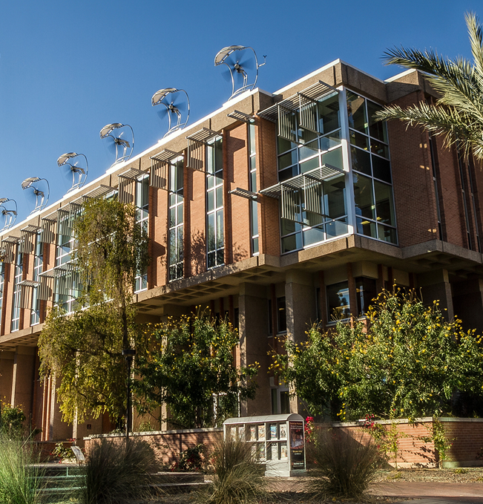
First-Ever School of Sustainability in the U.S.A.
sustainability at ASU
Change Agents
protect our present
and ensure our future

Slide 3
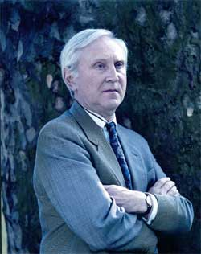
Sustainability is
“Treating the world
as if we intended to stay”
Sir Crispin Tickell
People
Planet
Profit

Slide 4
SOS students are making a positive impact
  Identify issues that threaten the economy, society, our planet
Determine stakeholders
Find solutions
“The very world that we depend on is now depending on us for a little bit more care, restoration, and positive transformation
of its environment.” Dania Lascola, SOS300
Notes:
School of sustainability Title Slide

Slide 5
how do we:
design healthy cities?
secure energy for a growing population?
ensure clean water?
provide enough food?
promote sustainable development?
understand and impact social transformation?
mitigate and adapt to climate change?

Slide 6
05-01-15: Joint study by the International Center for Tropical Agriculture and the CGIAR Research Program on Climate Change, Agriculture and Food Security:
Coffee is sensitive to temperature increases, which reduce growth and make it more susceptible to pests. With global temperatures forecast to increase by 2C-2.5C over the next few decades, major coffee producing countries will suffer serious losses, reducing supplies and driving up prices. Coffee is the key source of revenue for an estimated
25 million farmers in more than
60 tropical countries.
10-29-14: www.theguardian.com:
Eight crops we’re losing to increased temperatures and water shortages:
Corn
(and the animals that eat corn)
Coffee
Chocolate
Seafood
Maple syrup
Beans
Cherries
Wine grapes

Slide 7
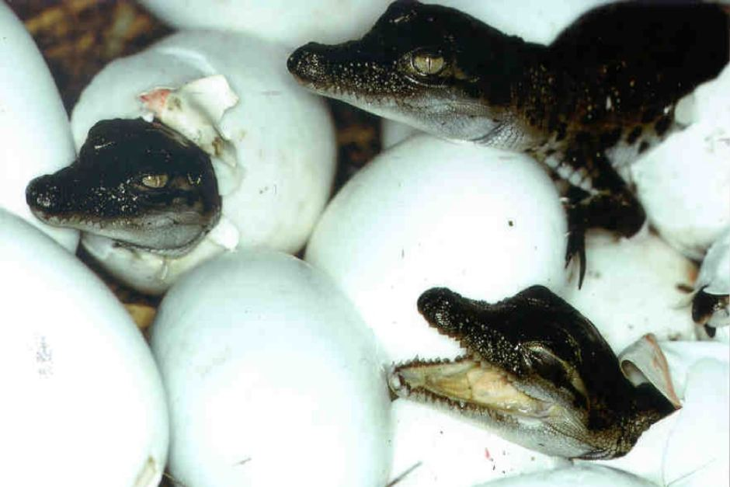
www.livescience.com Rising temperatures are forcing the birth of more female crocodiles and fewer males. Crocodile gender is determined by temperature during incubation, only a 0.5 Celcius degree difference.
Warming climates are producing more female hatchlings, which could lead to eventual extinction of the species.
Photo: www.abc.net.au

Slide 8
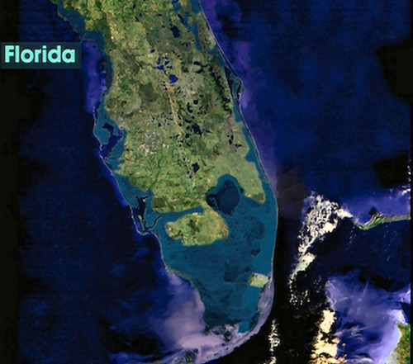
Climate Refugees: The IPCC estimates that temperatures will rise 3-10 degrees over the next hundred years
Water expands as it
warms
Average sea level
around the world has
already risen 4 to 8
inches in the past
100 years
Sea levels expected to
rise another 19 inches
by 2100, causing the
displacement of billions
of people and trillions
of dollars in property
losses
Sources: http://hdgc.epp.cmu.edu/teachersguide/teachersguide.htm
http://www.ipcc.ch/index.html

Slide 9
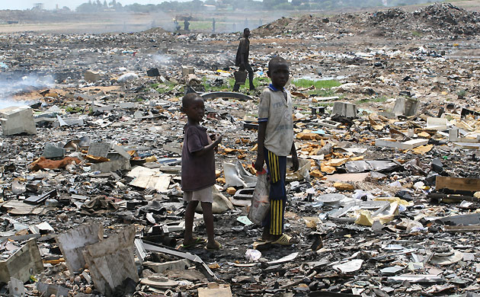
SOS110 Sustainable World
The U.S. exports electronic waste (e-waste) to Kenya, India,
and China
Residents of Guiyu, China,
one of the
world's largest
e-waste sites,
have a 68%
cancer rate
Consumerism
Product Design
Responsibility / Policy

Slide 10
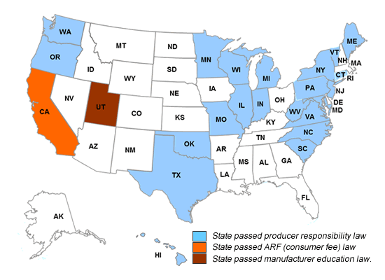
Electronic Waste Laws
Source: electronicstakeback.com

Slide 11
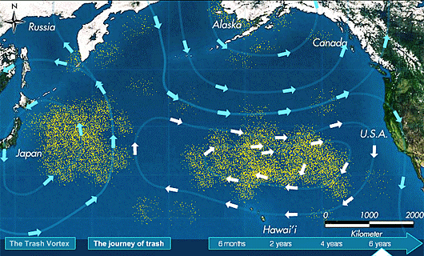
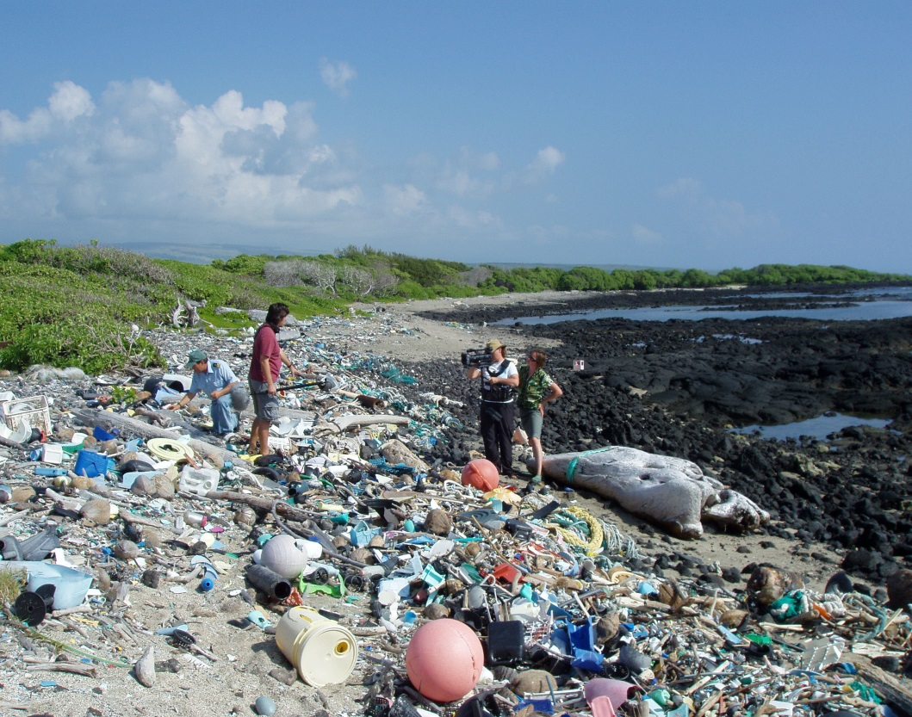
Plastic Garbage Patches
http://www.youtube.com/watch?v=tnUjTHB1lvM
Photo: westhawaiitoday.com
Image: scoopit.com
Eleven large gyres on Earth’s oceans
Pacific gyre: estimated to be twice the size of Texas
15 feet deep on average, depths up to 90 feet

Slide 12
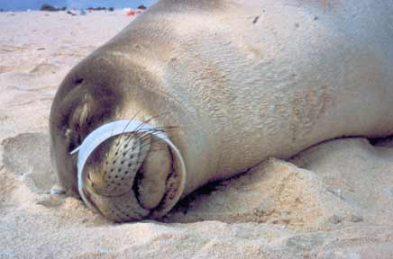
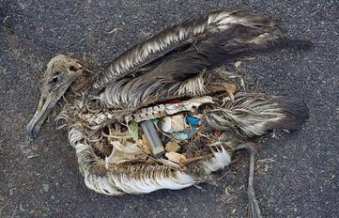
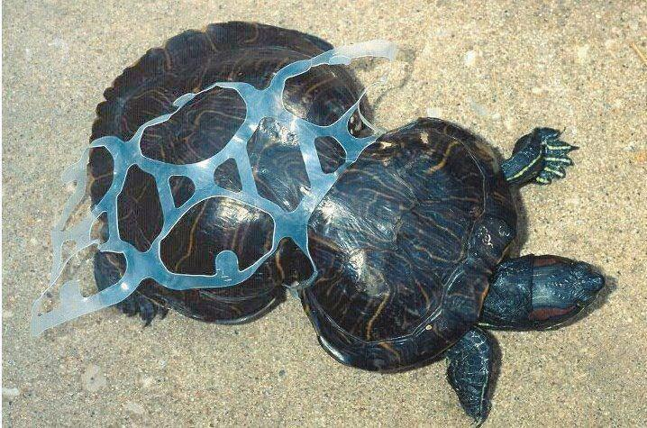
Photo: serc.carleton.edu
Photo: ecology.com
Marine life (our food chain)
severely affected by trash
Photo: flashsparkle.blogspot.com

Slide 13

Dutch Boy Mopping Up a Sea of Plastic
Boyan Slat, born in 1995
Idea came to him at
the age of 16 while
diving in Greece
"I saw more plastic
bags than fish"
In just 40 years,
millions of tonnes
of plastic have
entered the oceans
Slat invented an
array of floating
barriers, anchored to the sea bed, to
catch and concentrate the floating debris
Photo credit: TheOceanCleanup.com
Source: http://www.bbc.com/news/magazine-29631332

Slide 14
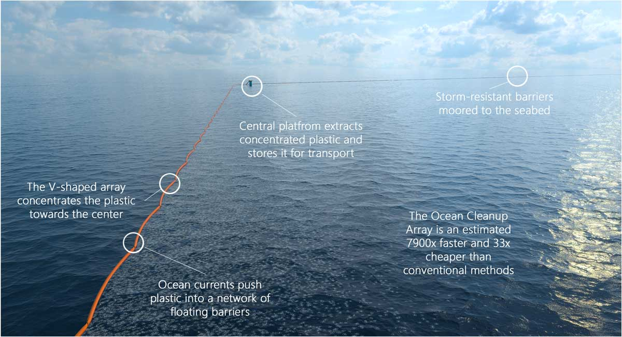
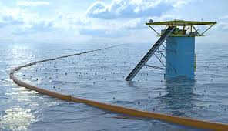
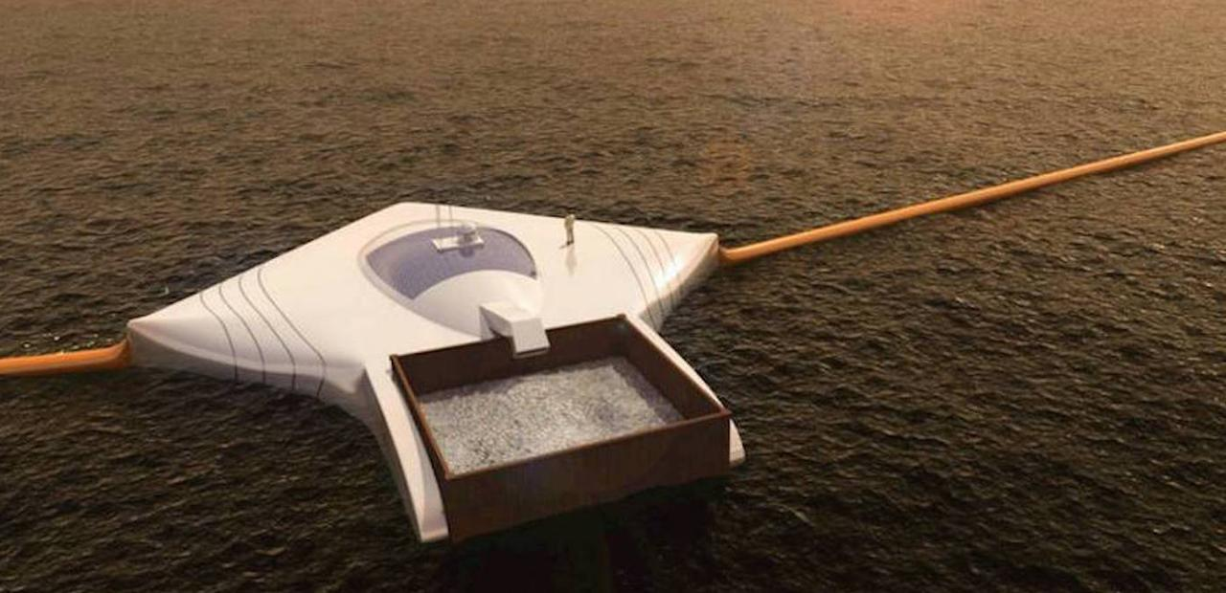

Slide 15
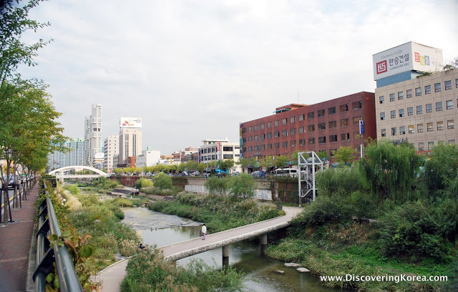
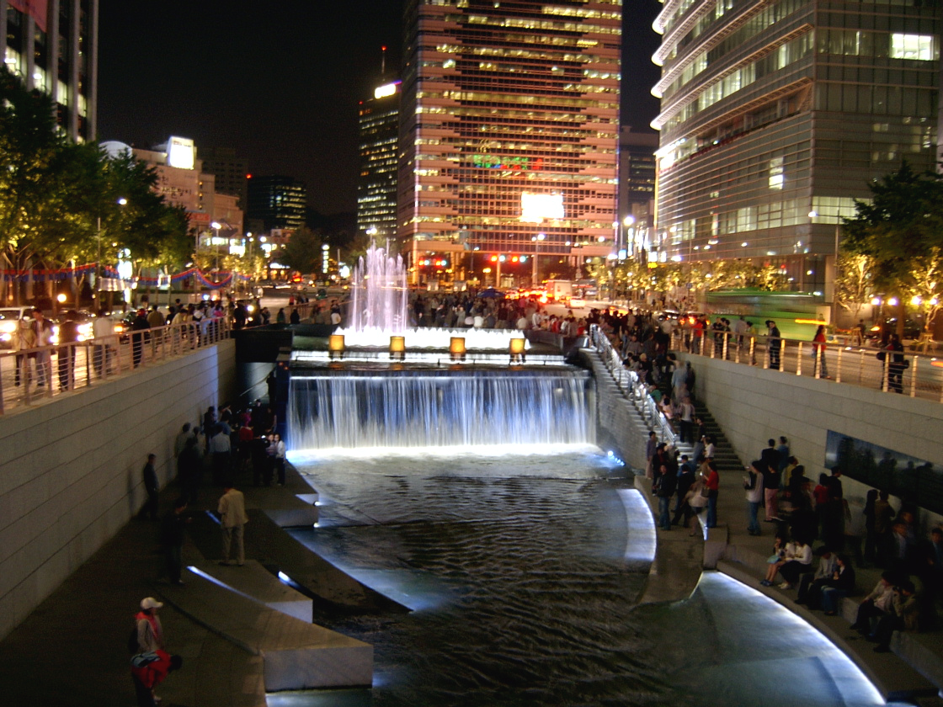
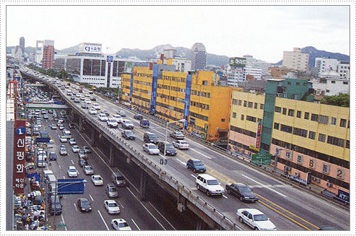
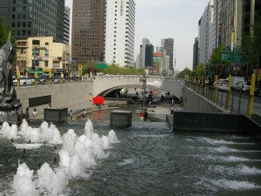
SOS111 Sustainable Cities
Cheonggyecheon River
Mayor
Lee Myung-Bak

Slide 16
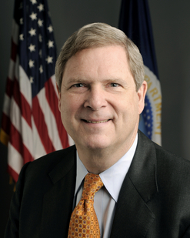
U.S. Secretary of Agriculture,
Tom Vilsack, talks to SoS 9-4-14
"Nearly 40% of food in the U.S. goes
to landfill …. we are not just wasting
food, but also water, energy and
resources that were used to grow that food.”
“Each year fewer Americans – less than 1% – claim farming as an occupation…”

Slide 17
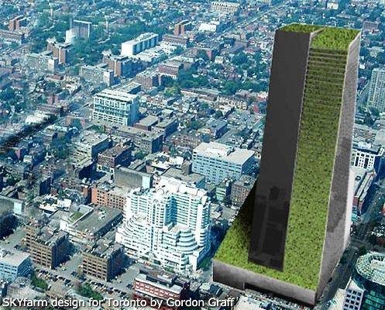
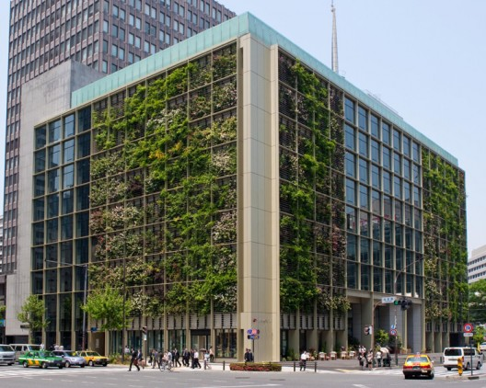
How will we feed 9.6 billion people, 75% living in megacities, in 2050?
Image: Gordon Graff
Pasona offices in Tokyo:
20% of building space dedicated to growing fresh vegetables
Photo : Kono Designs

Slide 18
Written by an ASU School of Sustainability student regarding Overconsumption of Goods in Developed Nations
“…This type of differing consumption will not be an easy change for our nation. Yet, the first step can be made in academia. Bridging academia gaps, and understanding that all aspects of life are interrelated is the first step towards progress.
Sustainable schools are aiding in this goal by creating transdisciplinary majors.
With education our globe can not only envision change but share this image together.”

Slide 19
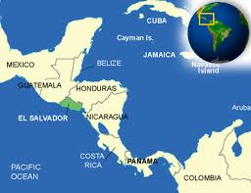
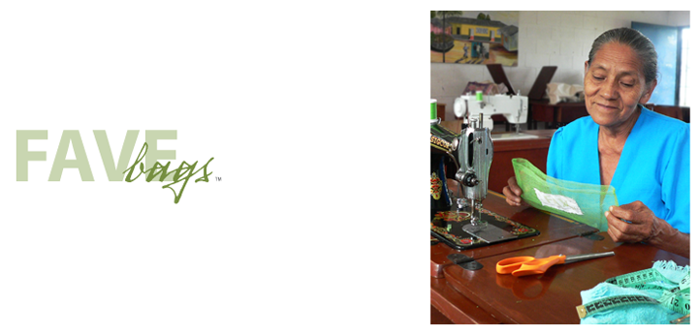
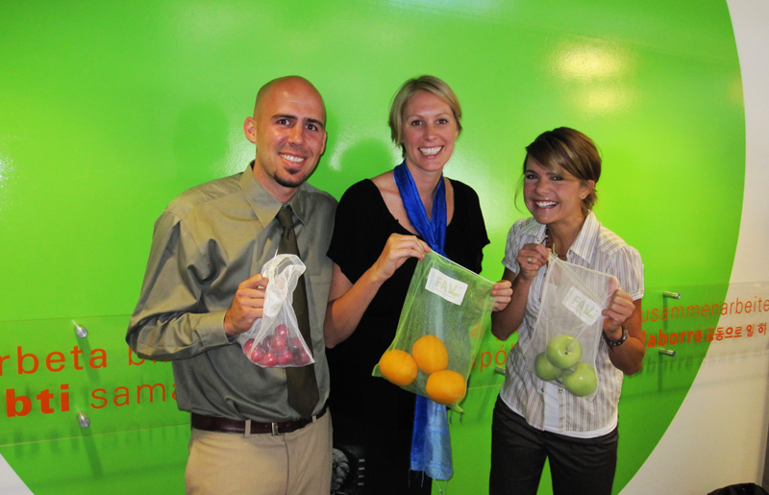
Solutions
Photo: www.favebags.com
Every year the average person throws away 600 plastic bags
25% of litter in storm drains is plastic

Slide 20
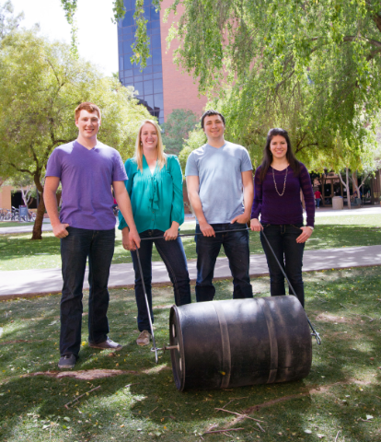
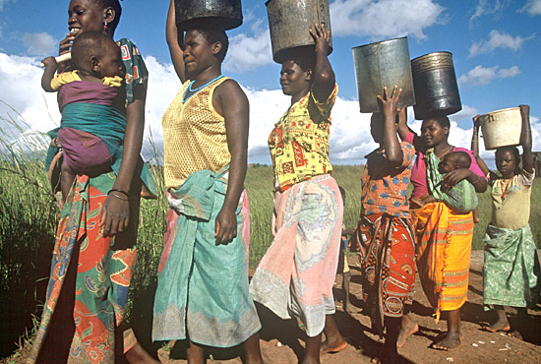
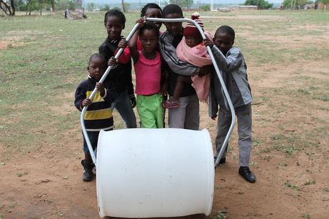
Solutions
Photos: www.safesipp.org

Slide 21
Bachelor of Arts degree
* available in-person or online *
Society and Sustainability
Policy and Governance in Sustainable Systems
International Development and Sustainability
Sustainable Urban Dynamics
Bachelor of Science degree
Sustainable Energy, Materials, and Technology
The Economics of Sustainability
Ecosystems Sustainability

Slide 22
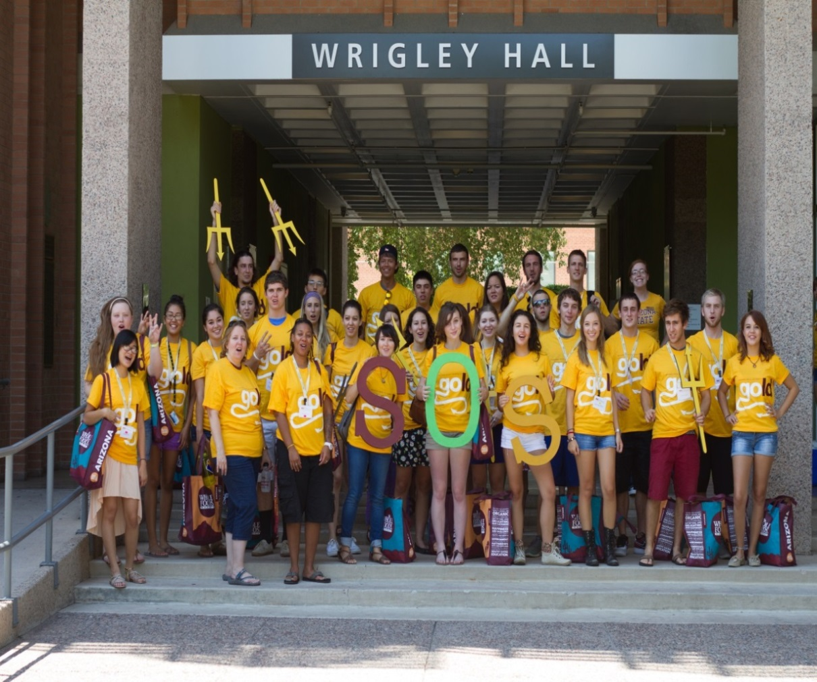
SOS is
a small college
(a family atmosphere)
with the resources of a large university!
Student Showcases
Free Movies
Free Guest Lectures
Free Field Trips

Slide 23
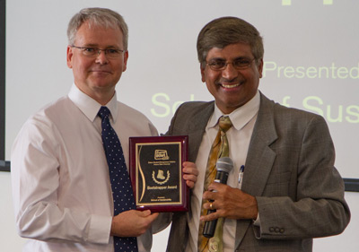
Real-World Learning
Applied / Capstone Experience
Internships
Research Opportunities
Workshops
Service Learning
Field Experience
Study Abroad
Dr. Christopher Boone, Dean of the School of Sustainability, accepting the Bootstrapper Award for college with
highest percentage of student entrepreneurs

Slide 24
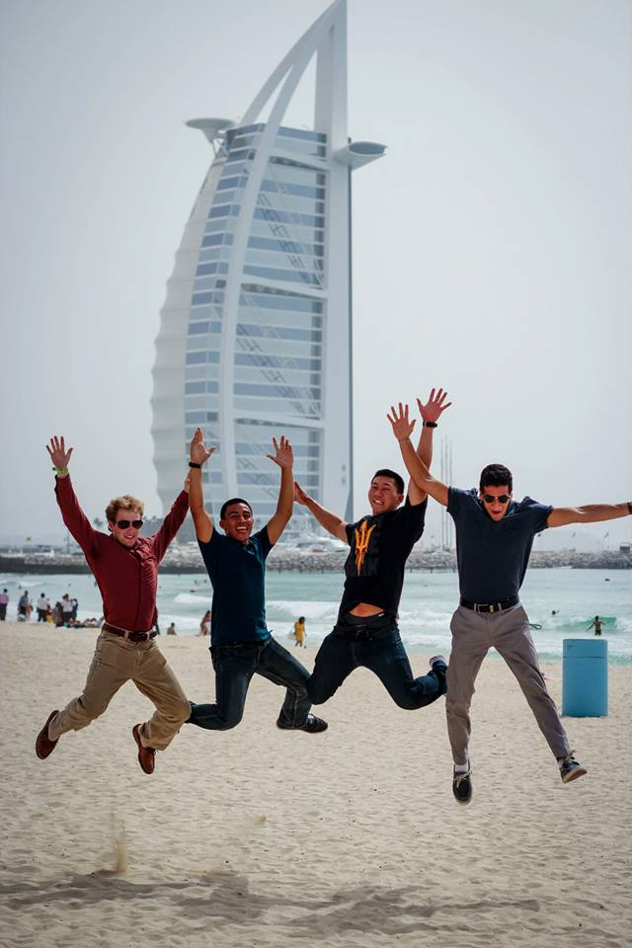
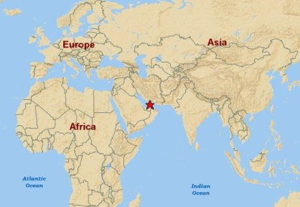
International
Summer Classes
Dubai
(United Arab Emirates)
  Sustainability, Tourism and Culture

Slide 25
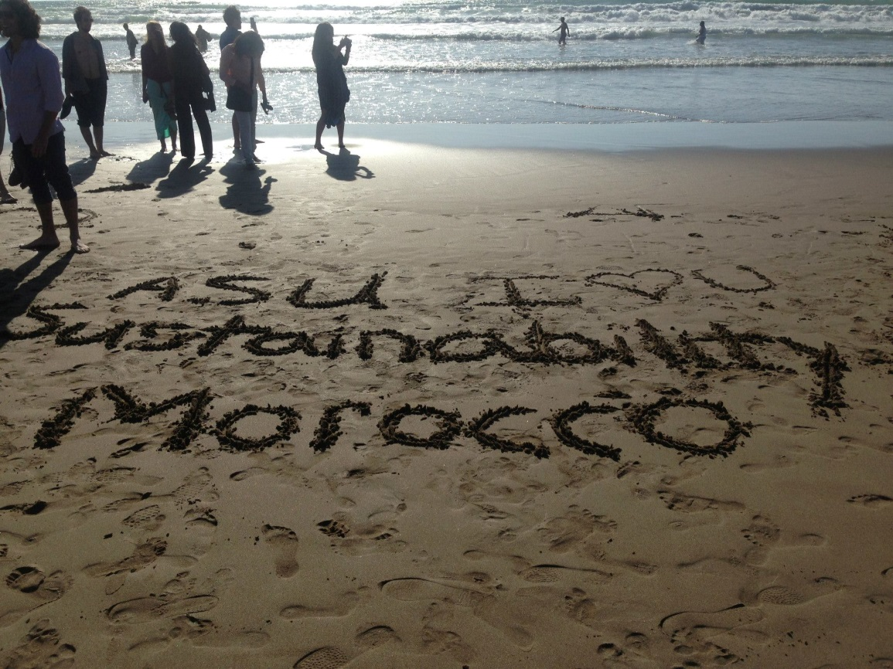
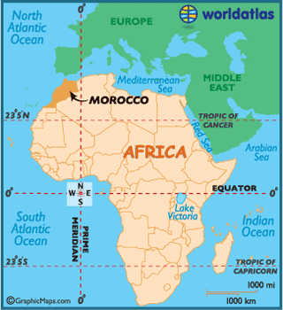
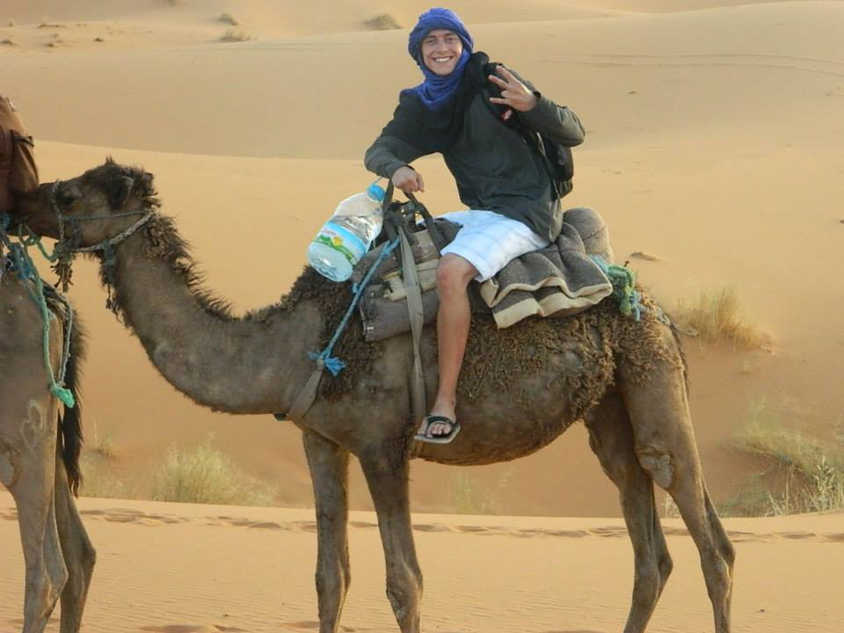
International
Summer Classes
Spain & Morocco
  Energy, Sustainability
  across the Mediterranean

Slide 26
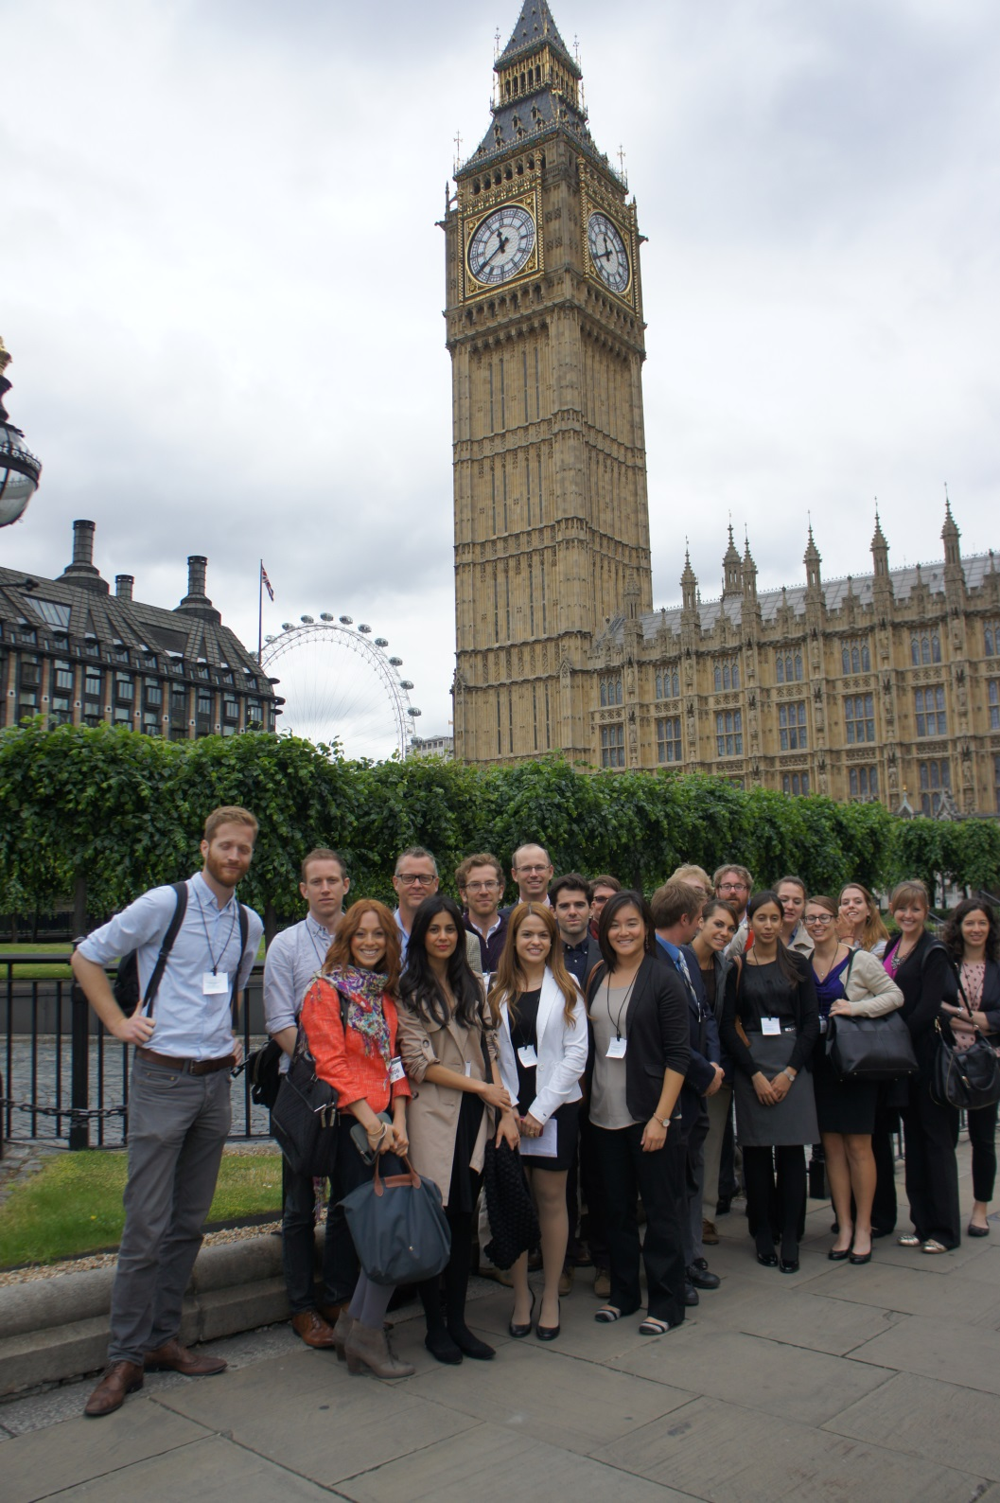
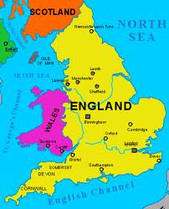
International
Summer Classes
Washington DC & London
  Comparing Sustainability across Cultures and Governments

Slide 27
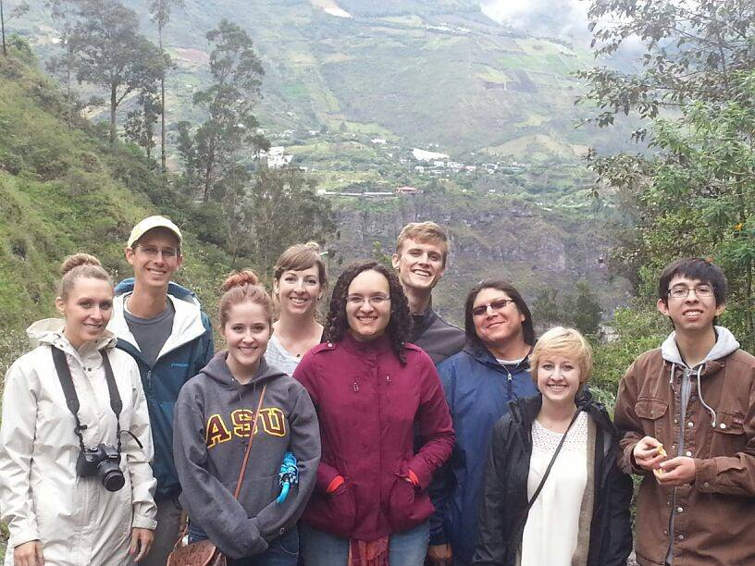
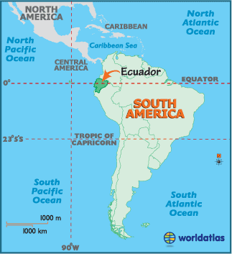
International Summer Classes
Equador
  Diversity and Sustainability
  in the Andes

Slide 28

International Summer Classes for 2016
England & France
Morocco
Hong Kong
Nepal
South Africa
United Kingdom & Denmark
Image : earthobservatory.nasa.gov

Slide 29

Connect the dots
Create and thrive in a relatively small school with about 500 fellow students
Impact the world with internships
Make a difference with a career you believe in

Slide 30
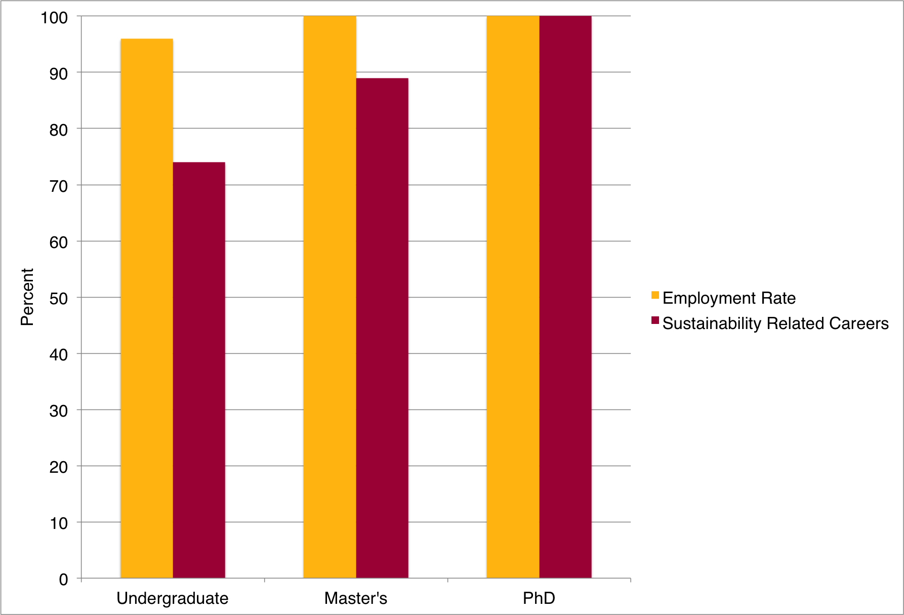
Alumni Employment

Slide 31
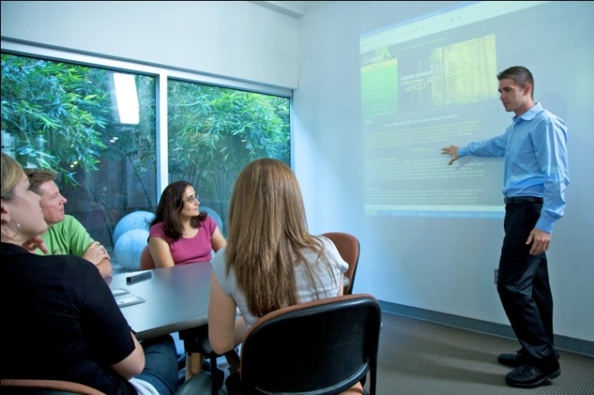
The world’s first
so the world lasts
Agriculture
Architecture
Art
Auto Industry
Civic Service
Consulting
Corporate
Design
Energy
Fashion
Field Work
Global Trade
Government
Healthcare
International Aid/Ethics
Legal
Marine Biology
Media
Policy
Product Design
Public Transportation
Publishing
Research
Teaching
Technology
Water

Slide 32
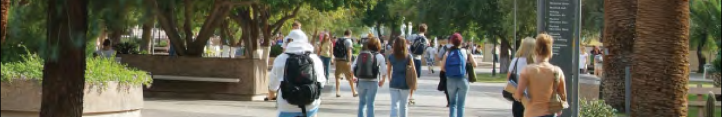
alumni
Making a Difference
Consulting (Accenture, Blu Sky Consulting, Green Order, American Global Manufacturing)
Corporate Sustainability/Corporate Social Responsibility (Dell, Nike, REI, Coca-Cola, Intel)
Education (teaching, research, administration, operations, student affairs)
Energy (SRP, APS, FirstSolar, Heliae Development LLC, Abeinsa EPC)
Entrepreneurship (Carbon Roots, Ollie the Trolley, Beat Streat)
Event Planning (Opportunity Green)
Fashion and Apparel (Nike, Adidas, American Apparel)
Food and Agriculture (Atlasta, Roosevelt Row, EcoScraps, local farmer’s markets)
Marketing/Media (Greenbiz, Grist, 3BL, earth911, MSM)
Military (US Army Corps of Engineers)
NGO (Natural Resource Defense Fund, Greenpeace, Environmental Defense Fund)
Nonprofit (Phoenix Zoo, Global Reporting Initiative, Sierra Club, Americorps, Peace Corps)
Non-sustainability jobs in Sustainability Companies (Dixon, YouChange)
Policy, Government, Regulatory Agencies (United Nations, EPA, ADEQ)
Research and Development (Argonne National Laboratory, Maplecroft, Globescan)
Socially Responsible Investing (Vanguard, Fidelity, Goldman Sachs)
Stakeholders (BSR, CERES, Net Impact, etc)
Standards Organizations (UL Environment, Fair Trade, Blue Angel)
Waste and Recycling (Waste Management, SteriCycle, ADEQ)

Slide 33
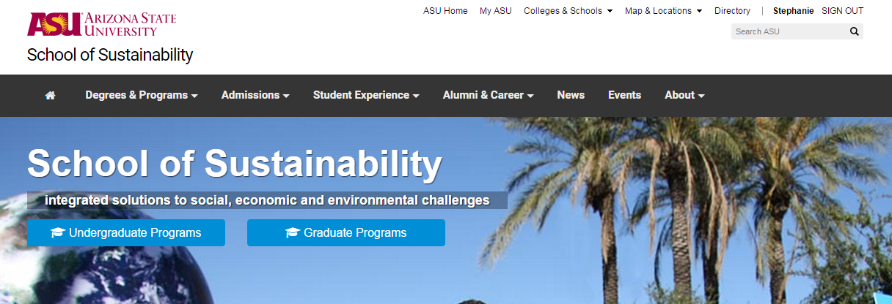
Upcoming Events
Stay up-to-date on upcoming School of Sustainability and Julie Ann Wrigley Global Institute of Sustainability events at
http://schoolofsustainability.asu.edu/events/

Slide 34
It’s bold to be Gold
Ranking |  | Category | Source
#1 in U.S. | #1 in Arizona | Most Innovative | U.S. News & World Report
#2 in U.S. | #1 in Arizona | Best for Veterans | College Factual
#5 in U.S. | #1 in Arizona | Recruiting New Hires | Wall Street Journal
#5 in U.S. | #1 in Arizona | Best Qualified Graduates | Wall Street Journal
#6 in U.S. | #1 in Arizona | Fulbright Scholars | The Chronicle of Higher Education
#7 in U.S. | #1 in Arizona | “Best Bang for the Buck” | Washington Monthly University Rankings
#8 in U.S. | #1 in Arizona | Best International Choice | International Education
#14 in U.S. | #1 in Arizona | Peace Corps Volunteers | Peace Corps Top Colleges & Universities
Top 22 in U.S. (of 832) | #1 in Arizona | 2014 Green Honor Roll Perfect Score of 99 | The Princeton Review
#33 in world | #1 in Arizona | Patents issued to researchers | National Academy of Inventors
#49 in U.S. | #1 in Arizona | Public Good | Washington Monthly
#79 in world | #1 in Arizona | Top 100 World Universities | Academic Ranking of World Universities
One of the Top 15% Best Universities in the U.S. |  |  | The Princeton Review 2014
‘Best Buy’ Public Colleges |  |  | FISKE Guide to Colleges 2015
America’s Best College Buys |  |  | Forbes Investment Report
Volunteering, Service Learning, and Civic Engagement |  |  | President’s Higher Education Community Service Honor Roll

Slide 35
discover and apply knowledge
to solve global challenges
Brigitte.Bavousett@asu.edu

Slide 36
Your interests…
Your college experience…
Your career….
School of Sustainability
Get into a career you
feel great about...
Notes:
School of sustainability Title Slide

Slide 37
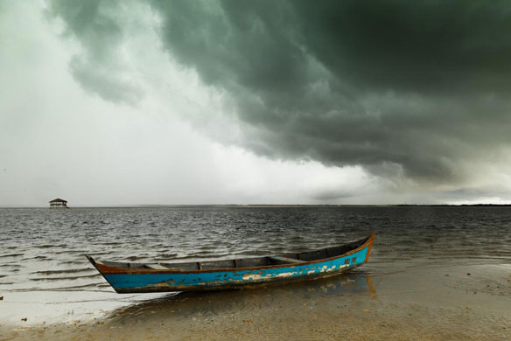
Geography
Geographic Information System (GIS) Specialists
computer-based mapping
Coastal Zone
Managers manage environmentally
sensitive areas
Area Specialists
study specific countries to help the government set policy
A Chevron oil spill from a leaking well off the Brazilian coast northeast of Rio de Janeiro. Photo credit: Brian Hodges

Slide 38
Sociology
Environmental Policy
Environmental Law
Urban Planner
Environmental Communications
Participatory Resource Management Specialist
Environmental Conflict Mediator
Non-governmental Organization Campaign Director
Human Dimensions Scientist
How do we handle:
protecting the natural ecosystem; social patterns of natural resource and energy use; impacts of toxic exposure on humans and ecosystems; racism and environmental justice.

Slide 39
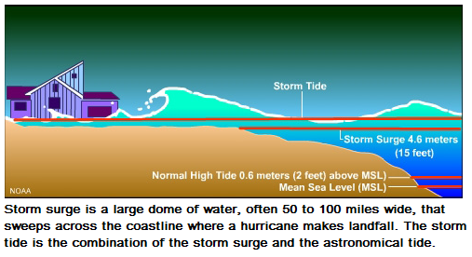
Mathematics and Statistics
Statisticians provide
models that help find resources,
predict storm surges,
understand complex biosystems
and forecast weather
Statisticians develop
models to predict epidemics and to compare strategies to combat epidemics
Graphic credit: newspaper.li

Slide 40
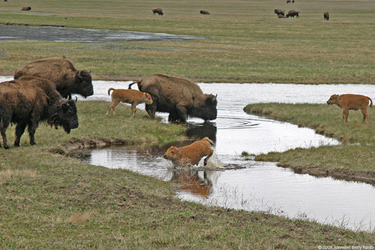
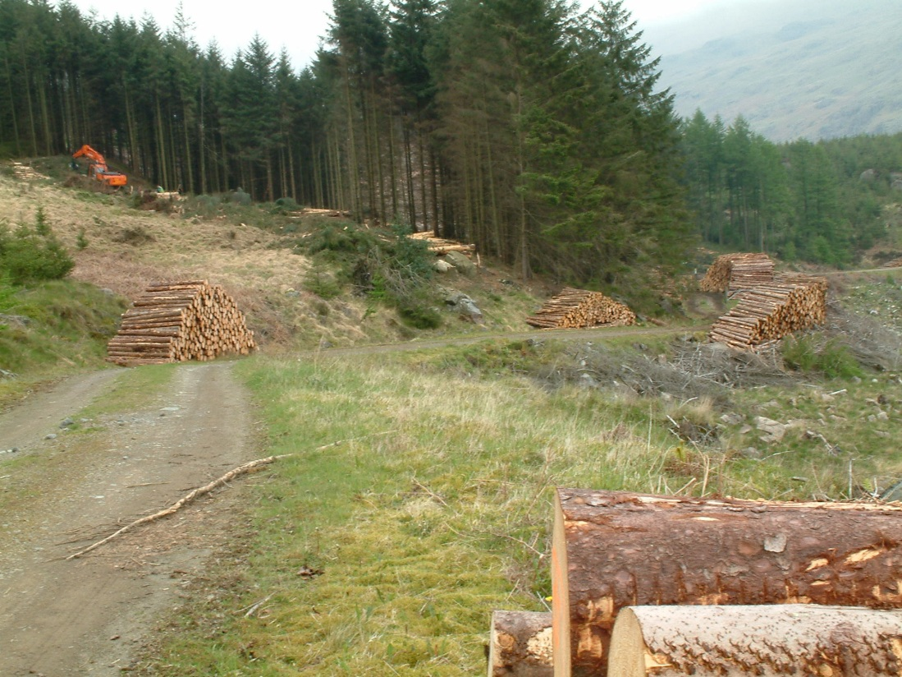
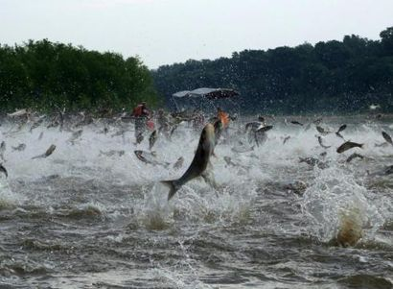
Ecology
Environmental Consultants
Natural Resource Managers
Restoration Ecologists
Photo credit: National Geographic
Photo credit: post-journal.com
Photo credit: Harter Fell

Slide 41

Chemical Engineering
Green chemical engineers
design chemical products
and processes that reduce
or eliminate hazardous substances
formulators of green (safer) household products and cosmetics designers of building materials and energy efficient devices
developers of new pharmaceuticals
chemistry teachers
Photo credit: gocollege.com

Slide 42
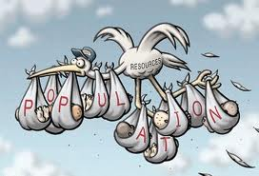
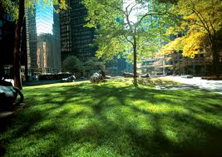
Psychology
understanding
environmental beliefs, attitudes and values
the psychology of risk appraisal and communication
human relations with
other species
quantifying psychological benefits people receive
from green- and open-space
natural disaster preparedness and resilience
social marketing
assessing the value of "ecological services"
Image credit: ufi.org
Photo credit: theinformedtenant.com

Slide 43
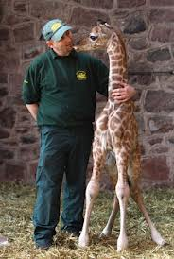


Biology
From developing new vaccines
for tropical diseases to finding
ways to increase agricultural yields,
biologists are at the forefront of
fighting illness and malnutrition
Park Rangers
Zoo Biologists
Management And
Conservation Biologists
Science Advisors
Trained professionals study and address the economic impacts of biological issues, such as species extinctions, forest protection, and environmental pollution.
Photo credit: newspaper.li
Photo credit: buzzle.com
Photo credit: modcloth.com

Slide 44

Geosciences
Atmospheric Scientists
Economic Geologists
Environmental Geologists

Slide 45



Engineering
Civil Engineers
Mechanical Engineers
Electrical Engineers
Computer Engineers
Biomedical Engineers
Image credit: cleantechnica.com
Image credit: asulightworks.com
Photo credit:
biomedicalengineeringproject.biz

Slide 46
Our Faculty and Our Students
… are doing amazing things all over the world…
discovering new species in Venezuela
conducting irrigation research in India
lecturing on environmental history in Slovenia
studying sustainable development in Ghana
SOS Students won Edson Student Entrepreneur Initiative’s
Bootstrapper Award
Graduate Student Lt. Col. (retired) Joe Knott honored as
White House Champion of Change
Professor Sander van der Leeuw named
United Nations Champion of the Earth
92% Average for Student Retention

Slide 47

Questions?
Brigitte.Bavousett@asu.edu

Slide 48
2015
BA in Sustainability online
Master of Sustainability Leadership online
Concurrent Master’s degree with ASU-Thunderbird
Master of Global Affairs & Management
2012
Master of Sustainable Solutions
Walton Sustainability Solutions Service
2010
Concurrent Master’s degrees with Master of Urban & Environmental Planning, Master of Public Policy, Master of Public Administration
2007
University-wide Minor in Sustainability
PhD, Master’s students enroll
Law & Sustainability program
2014
2004
Executive Master of Sustainability Leadership
Temazon retreat
2013
Energy & Sustainability certificate
2000
Global Institute of Sustainability
2011
BA in Business and Sustainability online
Food systems sustainability certificate
PhD IGERT in Urban Ecology
2008
BA in Public Service and Public Policy Sustainability concentration
BS in Engineering with Sustainability concentration
Concurrent Master’s degree with the Master of Legal Studies
2006
BA & BS in Sustainability students enroll
BA in Business w/ Sustainability concentration
School of Sustainability
2002
Michael M. Crow as 16th President
PhD Sustainability concentration in Complex Adaptive Systems
1997
Central Arizona Phoenix Long-Term Ecological Research Project

Slide 49





SOS Incoming Student Camp

Slide 50

Residential Community
a sense of belonging on campus
study and socialize with fellow
students in SOS
get to know and interact informally
with faculty on a regular basis
learn about campus resources and
services that will help you succeed
participate in special academic and
extracurricular activities such as:
  coffee with the School Director
  field trips (hands-on learning)
  campus sustainability projects
  community gardens

Slide 51
Differences Between BA vs. BS
 | BA | BS
Second Language | 202-level | 102-level
Math | Pre-Calculus and Introduction to Applied Math for the Life and Social Sciences | Calculus and Introduction to Applied Math for the Life and Social Sciences
Tracks | Society & Sustainability | Sustainable Energy, Materials, & Technology
 | Policy & Governance in Sustainable Systems | Economics of Sustainability
 | International Development & Sustainability | Sustainable Ecosystems
 | Sustainable Urban Dynamics
Notes:
51

Slide 52

Careers
Industry
Non-Governmental Organizations
Non-Profits
Utilities
Regulatory Agencies
Higher Education
Government
Notes:
52

Slide 53

Promoting human prosperity and well-being for all, while protecting and enhancing the Earth’s
life-support systems.
ASU School of Sustainability Board of Directors
Image : psychcentral.com

Slide 54
Freshman Admission Requirements (BA/BS)
Admit | Meet ASU admission requirements. Have a minimum high school ABOR GPA of 3.30; AND A high school class rank in the top 15 percent of class; OR An SAT combined score of 1140 or higher; OR An ACT combined score of 25 or higher. No high school math competency deficiency.
In Review | Meet ASU admission requirements. Have a minimum high school ABOR GPA of 3.00; AND A high school class rank in the top 25 percent of class; OR An SAT combined score of 1040 or higher; OR An ACT combined score of 22 or higher. No high school math competency deficiency.

Slide 55
Transfer Admission Requirements (BA/BS)
Admit | Students (with 12 or more transfer hours after high school graduation) are required to have a cumulative transfer GPA of 3.30 or higher.
In Review | Students (with 12 or more transfer hours after high school graduation) are required to have a cumulative transfer GPA of 2.75 or higher. The following criteria must be met: 3.0 or greater in the most recent semester; AND SOS 101 or particular math course w/ “B”; AND SOS 110 or environmental science related course w/ “B”; AND SOS 111 or sustainability related course w/ “B”; AND ENG 101, 105, 107 or similar course w/ “C”.

Slide 56

Two of the observations showing that CO2 is trapping more heat:
Satellites measure less heat escaping to space
Surface measurements find this heat is
returning to Earth to
warm the surface
Photo credit: www.telegraph.co.uk
Source: www.skepticalscience.com

Slide 57


