Slide 1
Introduction to the Sustainable Development Goals
Information for users
How to use this resource:
This PowerPoint has been designed to introduce you to the Sustainable Development Goals.
Generic resources for the Sustainable Development Goals can be found at www.globalgoals.org
and we encourage you and your communities to learn about the goals, choose one that you can focus on and start taking small actions together. If you do this, we would love to hear about it!
Email us at education@caritas.org.au
It is our hope that you will use these slides in a way that best suits your purposes. As such, the slides are editable so that the content is flexible for you to adapt to your needs. If you do edit this presentation, please ensure content and photos from this resource remain with the appropriate credit to Caritas Australia and the photographers.
Last updated September 2016

Slide 2
SUSTAINABLE DEVELOPMENT GOALS AND THE AUSTRALIAN CURRICULUM
The Sustainable Development goals present an opportunity to connect with a global movement to act responsibly for our world, and address a core Australian Curriculum intention – to develop active and informed global citizens who are able to think critically and and contribute meaningfully. For Catholic Schools, this is connected to Catholic Social Teaching Principles and the mandate of the Christian faith to stand in solidarity with children, women and men who are most vulnerable to extreme poverty and injustice. Caritas Australia’s work provides a wealth of case studies demonstrating how a faith based organisation is working towards these global goals.
Broadly, the Sustainable Development Goals (SDGs) will be rich content for teaching and learning in the Civics and Citizenship, Economics and Business and Geography curriculums and in addressing the Cross Curricular Priorities and General Capabilities.
For example:
Ethical Understanding: exploring the types of participation that Australia has in the Asia region and internationally (for example, exchange programs, peacekeeping, election monitoring, health programs, disaster management). Asia and Australia’s Engagement with Asia: Investigating Australia’s involvement with the United Nations (for example, representation in the organisation and adherence to conventions and declarations that Australia has ratified) exploring the provision of Australian government or non-government aid to a country in the Asia and Pacific region or elsewhere in the world and analysing its effects on places in that country. Intercultural Understanding: researching connections between Australia and countries in the Asia and Pacific regions (for example, in terms of migration, trade, tourism, aid, education, defence or cultural influences) and explaining the effects of at least one of these connections on their own place and another place in Australia.
Notes:
Find more information about the Sustainable Development goals at http://www.caritas.org.au/learn/sdg and the ‘Caritas Internationalis and the SDGs’ report at http://www.caritas.org.au/docs/default-source/publications-and-reports/ci_sustainable_development_goals_en_web.pdf?sfvrsn=2

Slide 3
Sustainable development goals and the Australian curriculum
Civics and Citizenship Curriculum Key ideas:
How societies and economies operate and how they are changing over time.
The ways people, places, ideas and events are perceived and connected.
How people exercise their responsibilities, participate in society and make informed decisions?
Foundation Year Inquiry questions:
How can we look after the places we live in?
Year 2:
How are people connected to their place and other places, past or present?
How has technology affected daily life over time and the connections between people in different places?
Year 3 History:
What is the nature of the contribution made by different groups and individuals in the community?
How and why are places similar and different?
What would it be like to live in a neighbouring country?
Year 4:
How can people use environments more sustainably?
Notes:
Find more information about the Sustainable Development goals at http://www.caritas.org.au/learn/sdg and the ‘Caritas Internationalis and the SDGs’ report at http://www.caritas.org.au/docs/default-source/publications-and-reports/ci_sustainable_development_goals_en_web.pdf?sfvrsn=2

Slide 4
Sustainable development goals and the Australian curriculum
Year 5
How have individuals and groups in the past and present contributed to the development of Australia?
What is the relationship between environments and my roles as a consumer and citizen?
Year 6:
How have experiences of democracy and citizenship differed between groups over time and place, including those from and in Asia?
How has Australia developed as a society with global connections, and what is my role as a global citizen?
Year 6 Geography:
Australia’s connections with other countries and how these change people and places.
caritas/org.au/schools
Notes:
Find more information about the Sustainable Development goals at http://www.caritas.org.au/learn/sdg and the ‘Caritas Internationalis and the SDGs’ report at http://www.caritas.org.au/docs/default-source/publications-and-reports/ci_sustainable_development_goals_en_web.pdf?sfvrsn=2

Slide 5
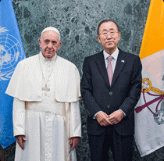

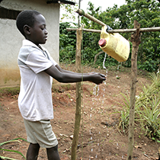
Introduction to the sustainable development goals
Educational resource for Primary Schools
Notes:
Photo information: Pope Francis and Ban Ki Moon (Reuters), Graphic from globalgoals.org, Child at a tippy tap in Uganda (Photo credit: Sean Sprague).

Slide 6
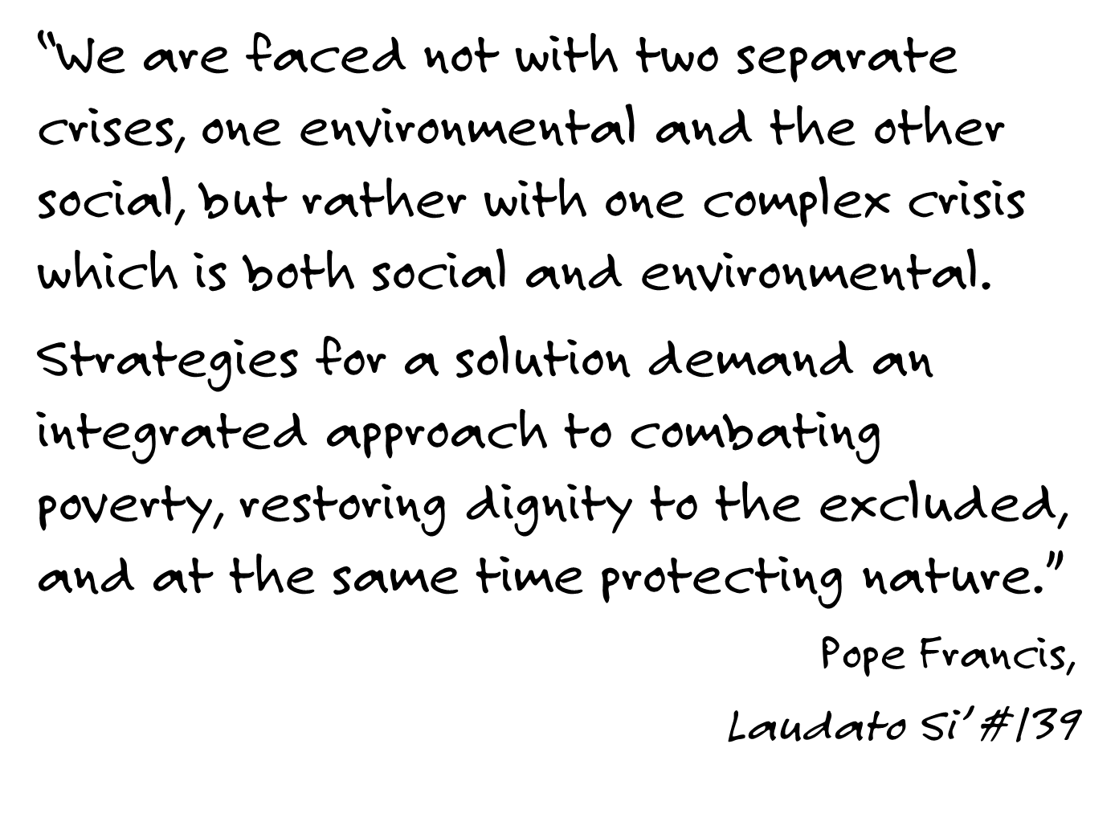

Slide 7
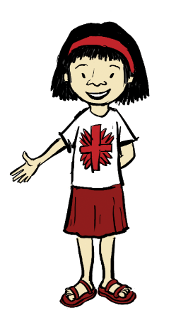
The millennium development goals
In 2000, 189 United Nations member states, including Australia came up with a set of 8 goals aimed at halving world poverty by 2015.
The target of halving the proportion of people living on less than $1 a day by 2015. This goal was achieved.

Slide 8
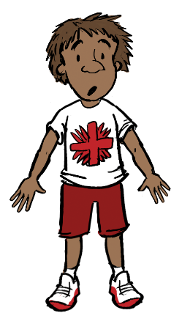
Were The millennium development goals achieved?
However, extreme poverty and hunger have not been eradicated.
There are still 800 million people in our world living in extreme poverty.
So, a new set of goals had to be made.
Notes:
Photos (Clockwise): Cambodian children in an immersion class 2009. Credit: Caritas Australia Beans grown under Caritas Australia's 'promoting sustainable change' (Kampong Chhang) program, Cambodia. Credit: Nile Sprague The village of Chawir is located in Canton Migami, south-central Chad. Like almost everywhere in the area, the locals are almost exclusively women and children. Credit: Caritas Switzerland Tjanpi Desert Weavers draw on traditional weaving practices to support livelihoods. Here, Jennifer Mitchell, Yangi Yangi Fox, Renee Fox and Nyanu Tjanpi weave beautiful crafts. Credit: Caritas Australia

Slide 9
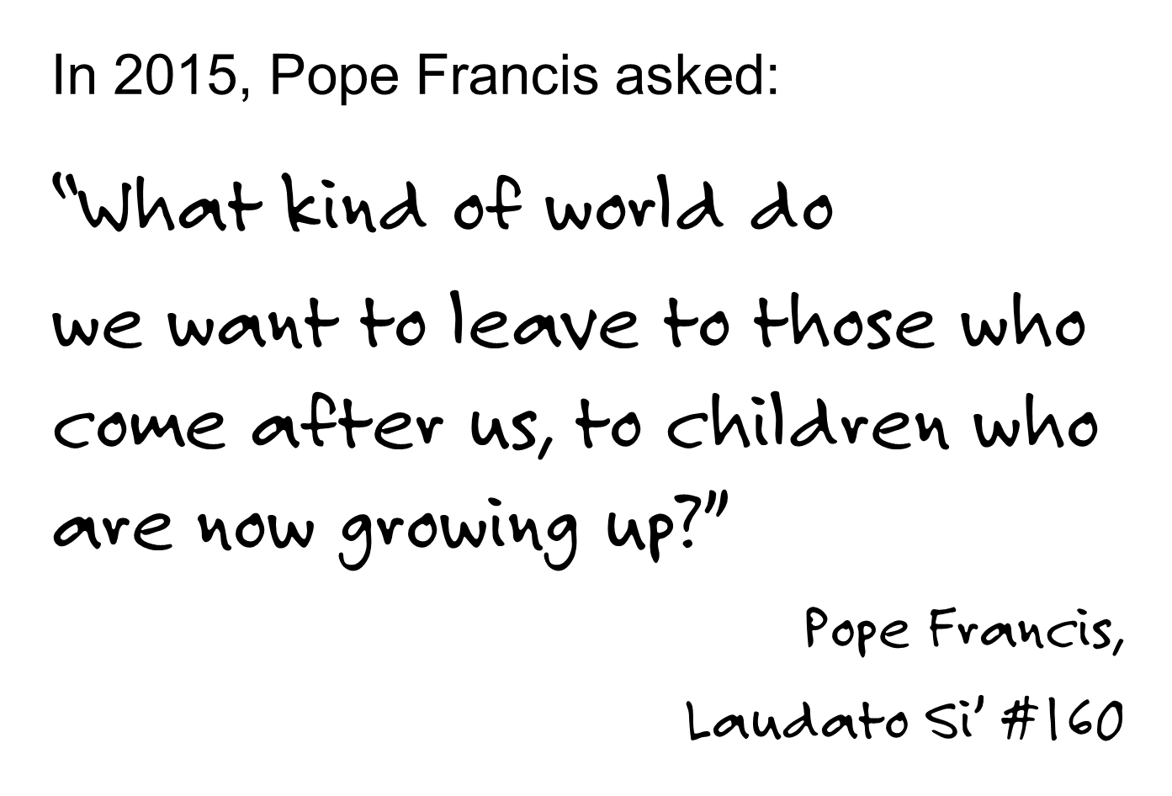
Notes:
Activity: Draw, write, discuss, paint or sing: What kind of world do you want?
What can you do now, in your part of the world to achieve that?

Slide 10


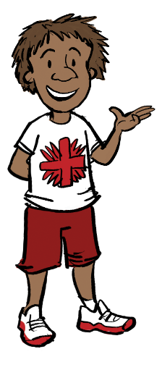
Notes:
Activity: Draw, write, discuss, paint or sing: What kind of world do you want?
What can you do now, in your part of the world to achieve that?

Slide 11
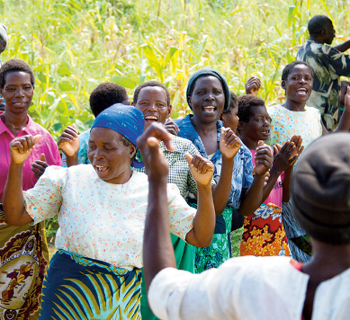
What kind of world do you want?
A world without poverty, hunger and inequality.
A world with global access to water and sanitation, education and clean energy where people can live safely and fulfil their true human potential.
A world where our environment is protected, peace can flourish and we all work together towards a sustainable future.
Photo credit: Andrew Garrick

Slide 12
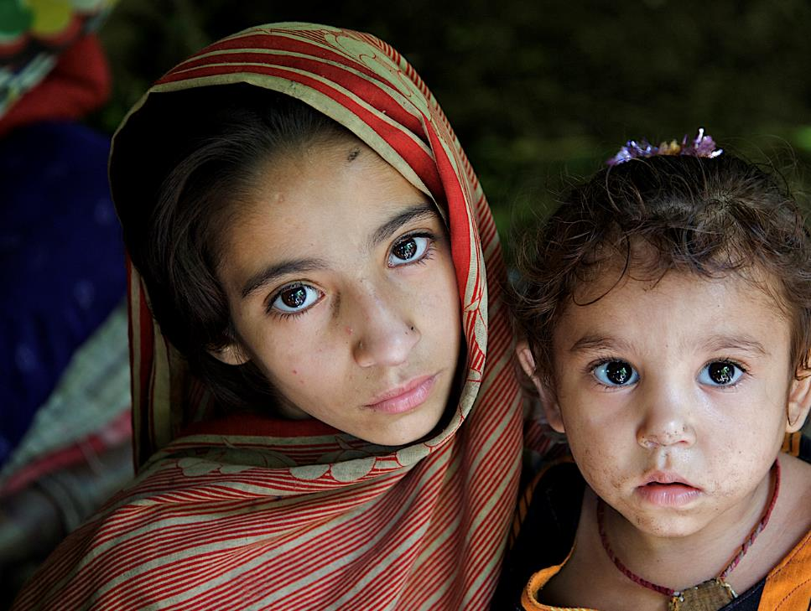
Caritas Australia’s Vision
A just and fair world,
A world in balance,
At peace and
free of poverty;
A world, which
the Church in
Australia helps build,
where all human beings
can live in dignity and communities are architects of their own development.
PHOTO CREDIT: Asad Zaidi/Catholic Relief Services

Slide 13
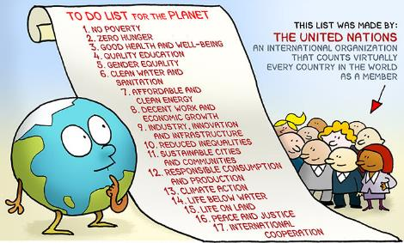
INTRODUCING THE SUSTAINABLE DEVELOPMENT GOALS
In 2015, world leaders gathered again to introduce a new set of goals
17 goals were designed for everyone, everywhere to work towards a better, fairer world.
It’s kind of like a long ‘to-do’ list for all of us!
Notes:
Cartoon credit: Margaret de Heer, http://www.margreetdeheer.com/eng/globalgoals.html

Slide 14
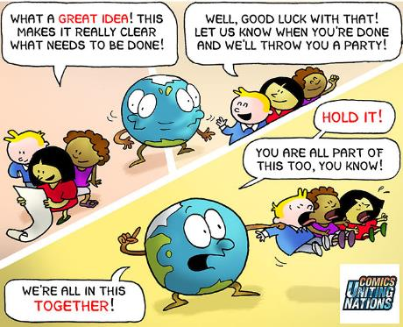
INTRODUCING THE SUSTAINABLE DEVELOPMENT GOALS
17 goals to achieve 3 extraordinary things in the next 15 years:
End extreme poverty.
Fight inequality and injustice.
Fix climate change.
To realise these Goals everyone needs to take part.
Notes:
Cartoon credit: Margaret de Heer, http://www.margreetdeheer.com/eng/globalgoals.html

Slide 15
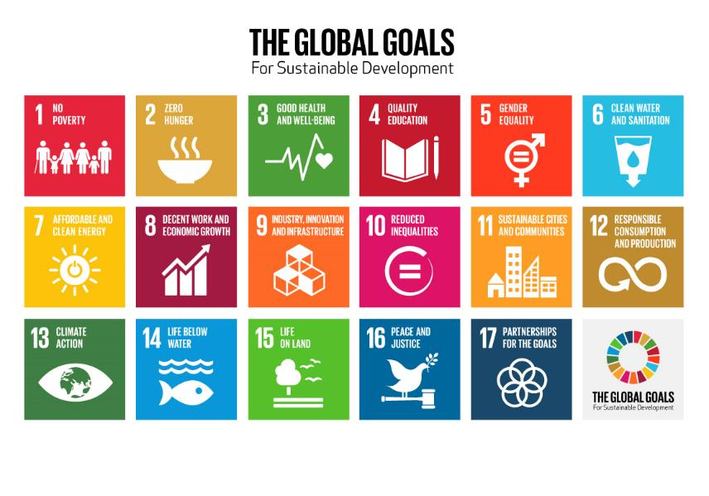
Notes:
Source: http://www.globalgoals.org/resource-centre/the-basics/

Slide 16
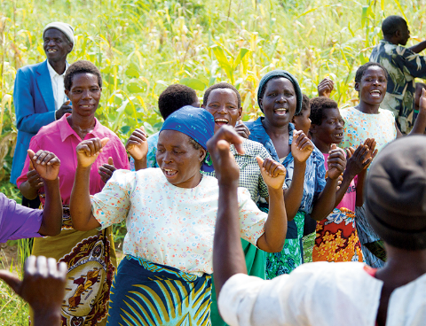
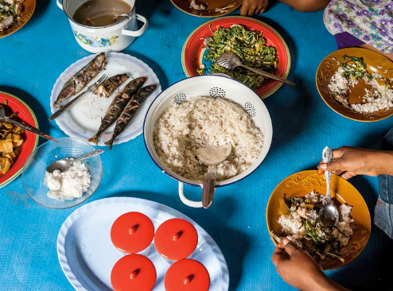
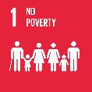
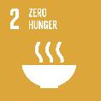
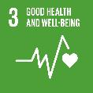
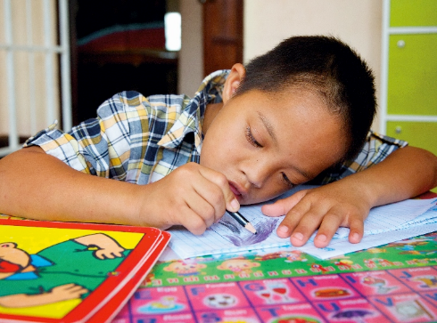
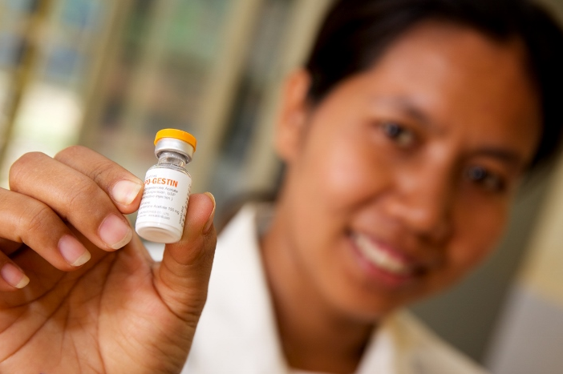

2 ZERO HUNGER
Indonesia: Caritas Australia helps train people in farming so they have better access to food.
Malawi: Women performing a traditional song and dance.
Laos: Hum Noy concentrating on his school work.
Cambodia: Sreymom receiving medical training at the Mondulkiri Community Health Centre.
4. QUALITY EDUCATION
Notes:
Photo Credits: Goal 1 - Andrew Garrick; Goal 2- Mie Cornoedus; Goal 3- Richard Wainwright; Goal 4 - Richard Wainwright

Slide 17
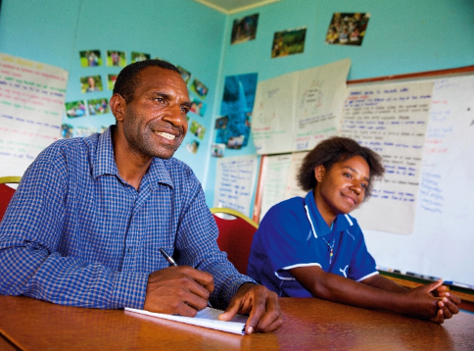
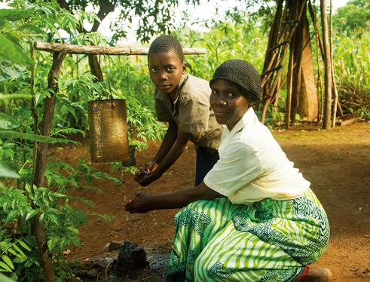
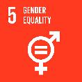
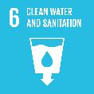
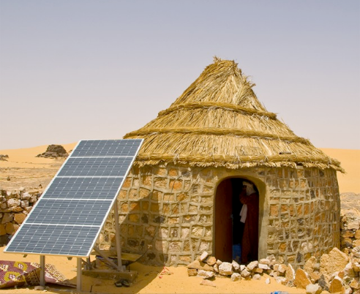
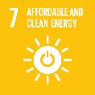
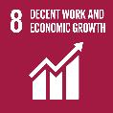
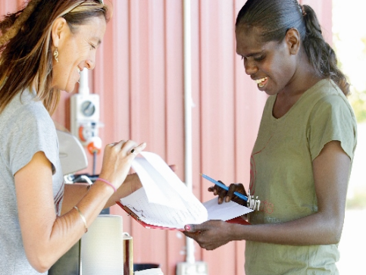
5 GENDER EQUALITY
6 CLEAN WATER AND SANITATION
Papua New Guinea: Dominic taking notes during a community conversations training workshop.
Malawi: Doney and her son, Junior, using the hand washing facility.
Darfur: Solar panels now provide the energy for a pump to provide 15 standpipes in the Khamsa Dagaig with water from the well.
Australia: Evangeline at the Djilpin Arts Ghunmarn culture centre.
7 AFFORDABLE AND CLEAN ENERGY
8 DECENT WORK AND ECONOMIC GROWTH
Notes:
Photo credits: Goal 5 - Richard Wainwright; Goal 6 - Andrew Garrick and Andrew McClymont; Goal 7 - Annie Bungerouth/ACT-Caritas; Goal 8 - Danielle Lyonne

Slide 18
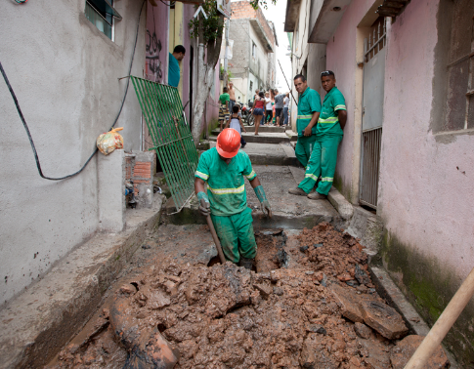
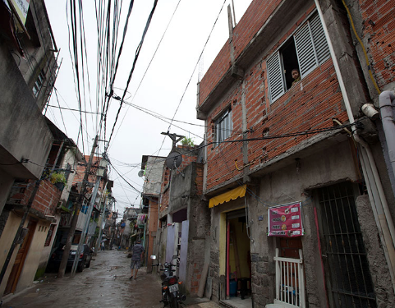
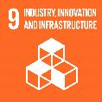
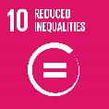
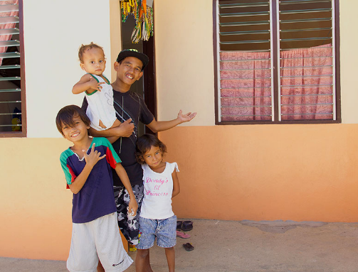
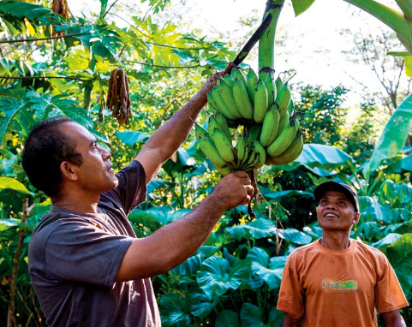
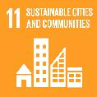
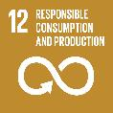
Brazil: Poverty has led to people living in shanty towns or favelas near large cities. Caritas Australia works with people so they have a safe and secure home to live in.
Brazil: A Caritas Australia supported program has helped install basic services such as sewerage, clean water, and electricity, into the favela.
9 INDUSTRY, INNOVATION AND INFRASTRUCTURE
10 REDUCED INEQUALITIES
Philippines: Archie now has hope for the future.
Indonesia: Vinsen, through the Sustainable Agricultural Program has learned to grow sustainable crops in changing weather patterns.
11 SUSTAINABILE CITIES AND COMMUNITIES
12 RESPONSIBLE CONSUMPTION AND PRODUCTION
Notes:
Photo credits: Goal 9 - Erin Johnson; Goal 10 - Erin Johnson; Goal 11 - Raphael Meting; Goal 12 - Mie Cornoedus

Slide 19
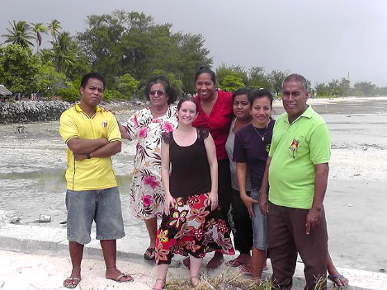
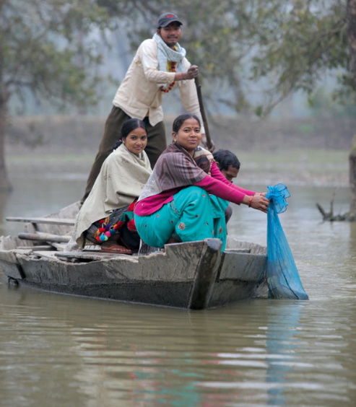
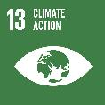
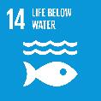
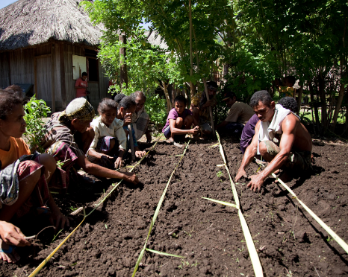
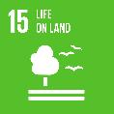

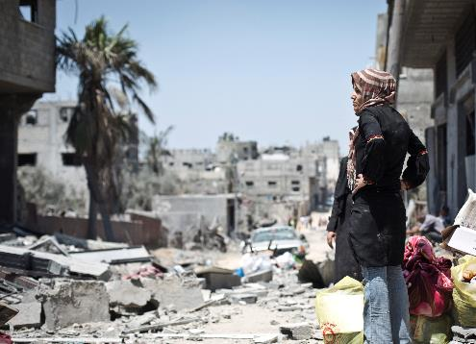
Kiribati: Caritas Australia works with people to raise awareness about the impact of climate change and rising sea levels on people living on low-lying islands.
Nepal: Sarita and her family now have a steady income thanks to the Fish Raising Group.
14 LIFE BELOW WATER
Timor-Leste: Group tending to crops.
Gaza: A woman of the Shejaia neighbourhood is looking at her destroyed house. Caritas works to build peace and support people in countries experiencing war.
15 LIFE ON LAND
16 PEACE, JUSTICE AND STRONG INSTITUTIONS
Notes:
Photo credits: Goal 13 – Caritas Australia; Goal 14 - Stephen Kadlec; Goal 15- Marden Dean; Goal 16- Virginie Nguyen Hoang/Secours Catholique

Slide 20
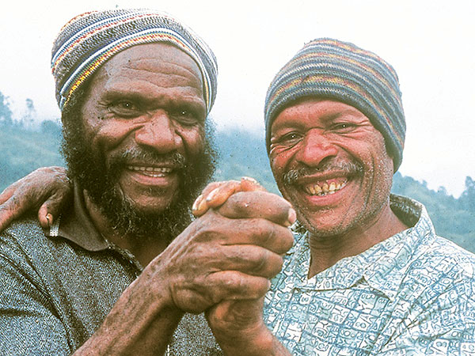
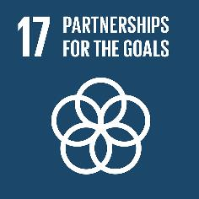
Papua New Guinea: Luhaie and Christopher working together for the common good.
Notes:
Photo credit: Goal 17 – Caritas Australia

Slide 21

How are the SDGs Different to the MDGs?
The Millennium Development Goals (MDG) focused on poverty in developing countries, and set targets for low-income countries to achieve, rather than holding rich countries responsible for their actions.
The MDGs also only focused on national averages, which meant they didn’t look at the growing inequalities within a country.

Slide 22
How are the SDGs Different to the MDGs?
The Sustainable Development Goals (SDG) have been developed collaboratively – with governments, organisations and people from developed and developing countries sharing their thoughts.
This is similar to the Catholic Social Teaching principles of Subsidiarity and Participation, which looks at how people can be involved in the decisions that affect them.
It is important that leaders listen to what everybody has to say.
It is important that we join in the discussion.

Slide 23
What is different about these goals?
The SDGs cover many issues that affect us all.
They suggest a way that we can all work together to improve the future for everyone.
They highlight our shared responsibility.

Slide 24
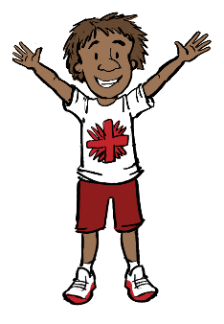
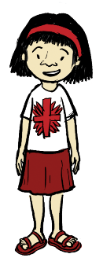
Caritas Australia and the sustainable development goals
The SDGs include goals that look at what people need to grow and be a whole person - not just money or material needs - but social, emotional and spiritual needs too. Caritas Australia calls this Integral Human Development and they keep this in mind when developing programs.
Caritas Australia’s work focuses on partnering with local communities - walking alongside, finding and improving strengths and building skills.

Slide 25
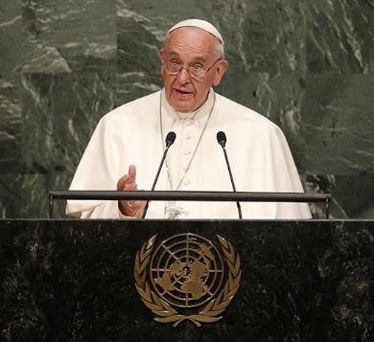
Pope francis and the Sustainable Development Goals
Pope Francis addressed the United Nations general assembly when the goals were adopted in 2015.
He emphasised the connection between human dignity, development and the environment.
Photo credit: CNS photo/Mike Segar, Reuters

Slide 26
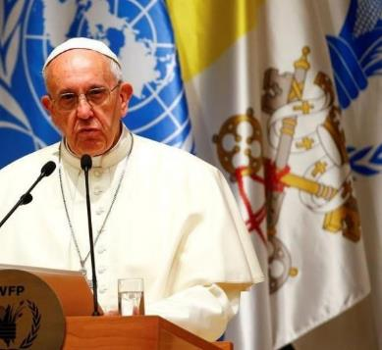
Pope francis and the Sustainable Development Goals
Pope Francis reminds us that focusing on the poor is part of looking after the environment. This is because “the human environment and the natural environment deteriorate together” (Laudato Si’ #48).
The new global goals look at how the human environment and natural environment are connected.
Photo credit: Reuters Tony Gentile

Slide 27
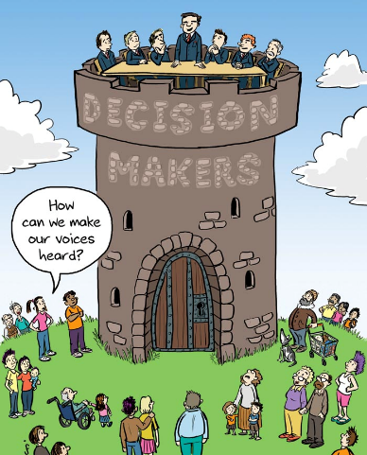
Get involved
All participating governments, including Australia are committed to forming sustainable development strategies based on the goals, as of January 2016.
However, they are voluntary- there are no laws to make sure they happen.
This means faith groups and civil society must make sure decision makers know we care about achieving the global goals.

Slide 28
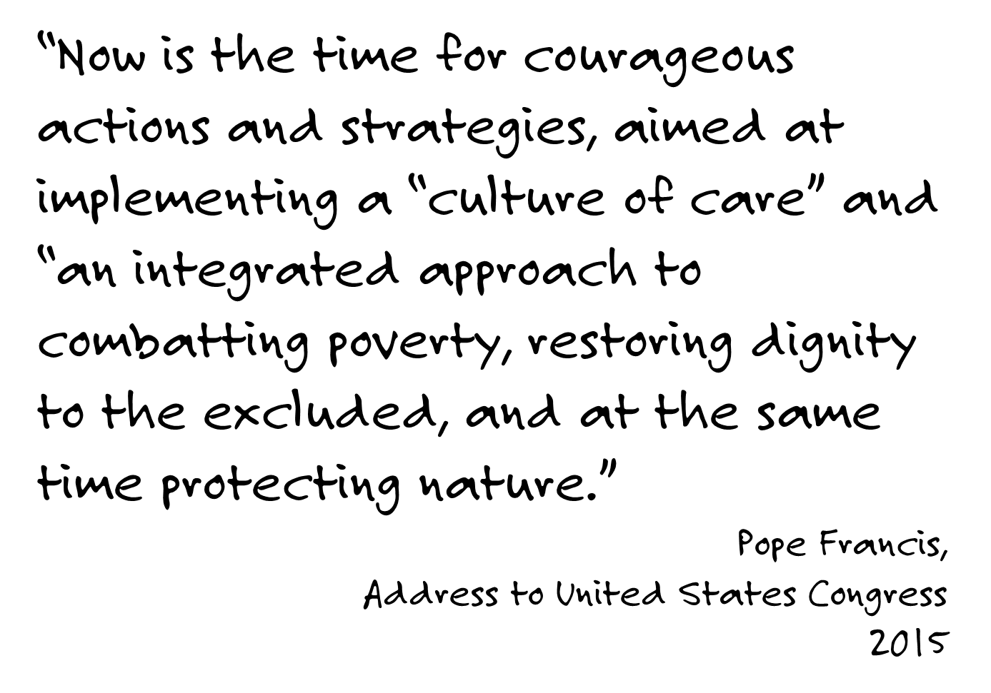

Slide 29


Play your part
It’s going to take everyone everywhere, to work together, for the common good.
What will you do?
Can you choose a goal for your community and start making a plan?
What can you do today?
Notes:
Choose a goal for your class, school or community group.
Make a plan for how you will work towards this goal personally, locally and globally.
Cartoon credit: Margaret de Heer, http://www.margreetdeheer.com/eng/globalgoals.html

Slide 30


What you can do now
Act… Join our Campaign for Australian Aid.
Make changes at home and in your community for environmental sustainability. Find out more with the
Our Common Home campaign.
Learn… Discover more about Caritas Australia and their Integral Human Development approach.
Pray… for our brothers and sisters around the world experiencing extreme poverty and injustice.
Notes:
Cartoon credit: Margaret de Heer, http://www.margreetdeheer.com/eng/globalgoals.html

Slide 31


