Slide 1

Ecotoxicology
HAZARDS & RISKS
Ludek Blaha + ecotox colleagues

Slide 2
Ecotoxicology
Science of doses / concentrations
HAZARDS vs RISKS

Slide 3
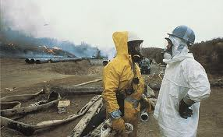
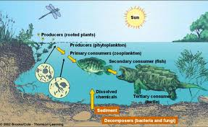
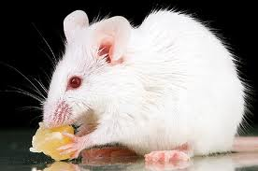
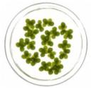
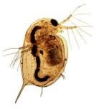

Assessment of chemical hazards
…to…
Humans Other organisms
(TOXICOLOGY) (ECOtoxicology)

Slide 4
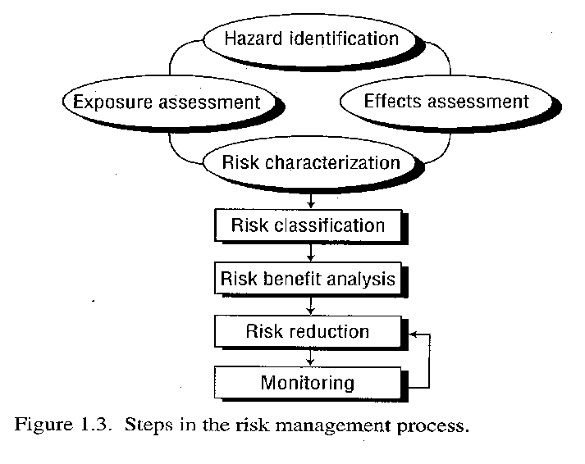
ASSESSMENT and MANAGEMENT of RISKS
isk ASSESSMENT →
MANAGEMENT →

Slide 5
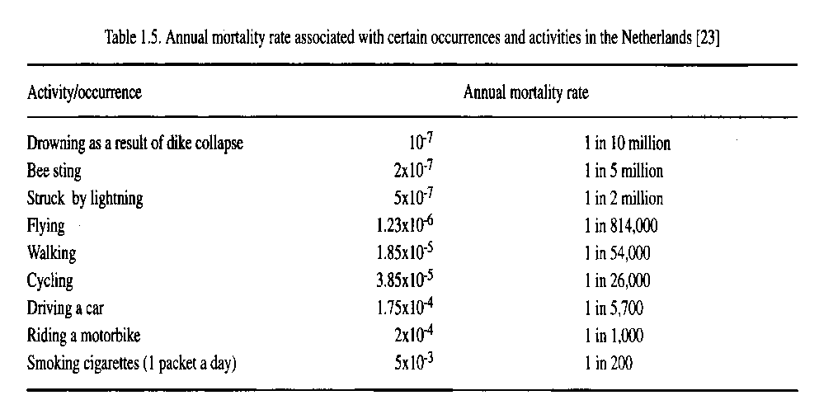
WHAT IS HAZARD ? RISK?
RISKS
(Probability of the
actual occurrence of hazard
under specific situation)
HAZARDS
(Inherited properties of
stressors … including chemicals)

Slide 6
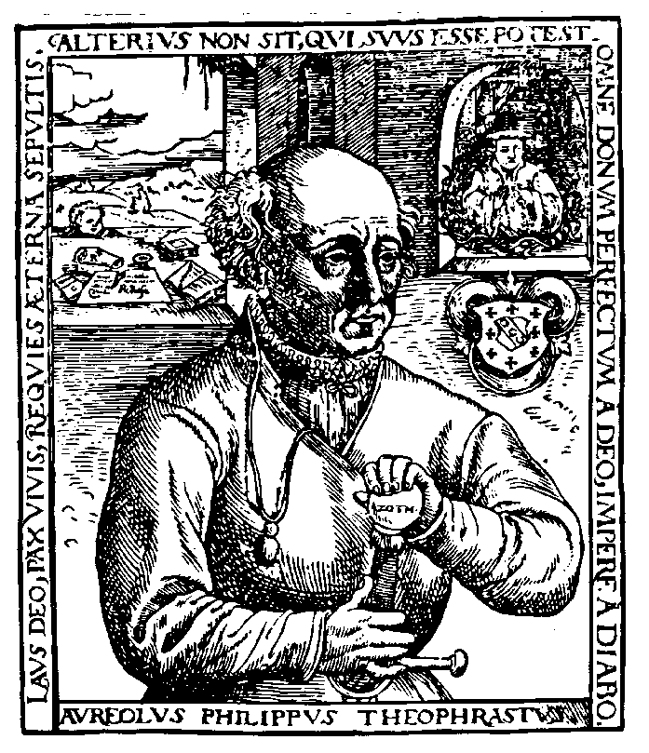
(Eco)Toxicology – science of „doses“
Paracelsus (1493 - 1541)
‘What is there which
is not a poison?
„Cause-effect paradigm“
All things are poison and nothing without poison.
Solely the dose determines that a thing is not a poison.

Slide 7

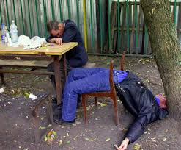
Toxicology – ultimate goal ?
To identify (or predict)
safe vs hazardous levels

Slide 8


„magnitude“ or „impact“ of actual risk
Vs.
Example - „P“ (probability) is the same for both events
- impact is very different
In ecotoxicology – e.g. fish species:
10% risks of malformations … is compensated by large numbers of eggs
10% risks of feminization → much large impact on population

Slide 9

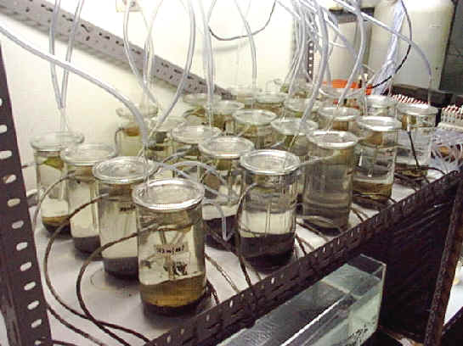
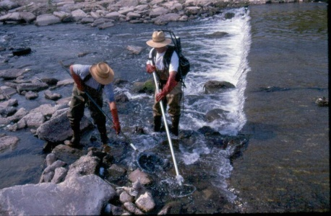
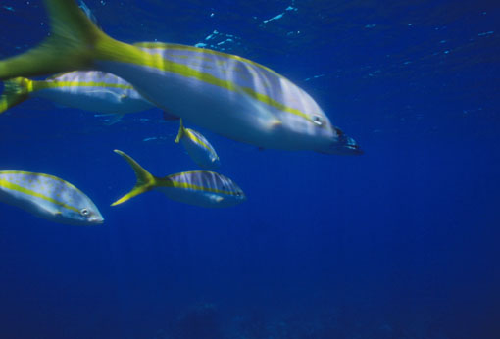
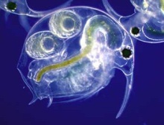
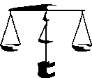
Cause – effect → Risk assessment
Exposure
(resulting from load)
Effects
(what exposures cause effects ?)
Atmospheric
Deposition
WWTP
Erosion
& Runoff
Laboratory (and field) studies
Ecotoxicity tests
Untreated discharges
Predicted Environmental
Concentration (PEC)
effective concentrations
(PNEC)

Slide 10
Ecotoxicology: what approaches are available?
Time: NOW !
PROSPECTIVE
RETROSPECTIVE
DISASTERS
PREDICTIONS for future
Bioassessment
Field assessment
Monitoring
Bioassessment
Field assessment
Monitoring
Most common in practice
Lab studies
BIOASSAYS
Lab studies
BIOASSAYS
Simulated small
ecosystems

Slide 11

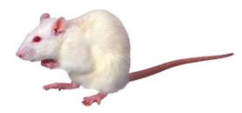

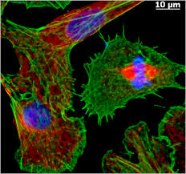
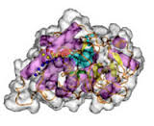

Hazard assessment
Traditionally – Evaluation of adverse effects using the whole organism models
+
Adverse Effects
Death
Altered Reproduction
Inhibition of Growth
Tumorigenicity
Skin irritation
…
Chemical
Organism
REGULATORY FOCUS
(APICAL ENDPOINTS)

Slide 12
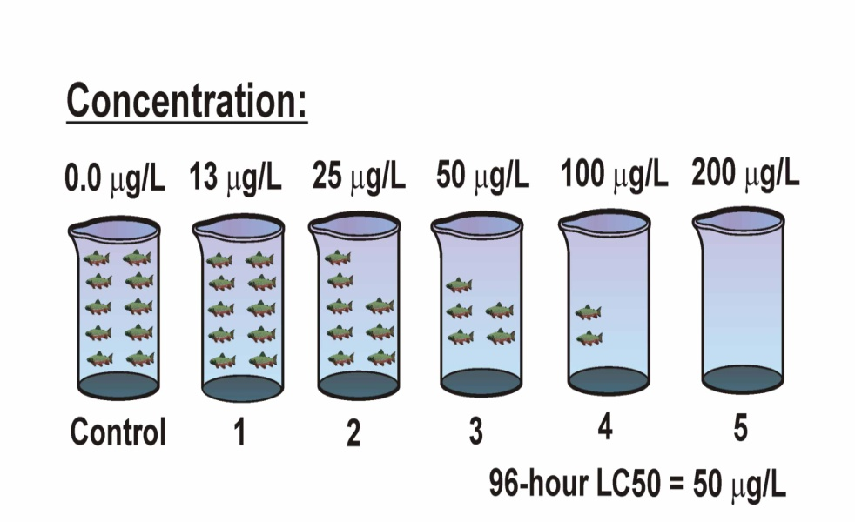
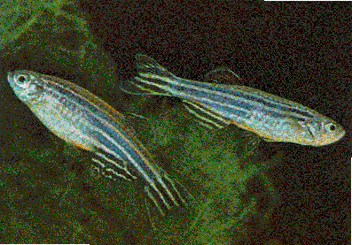
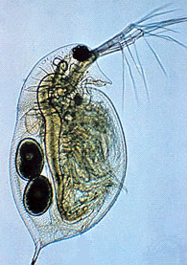
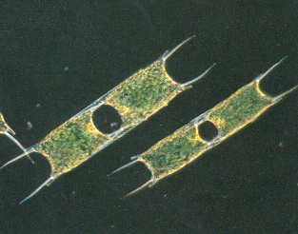
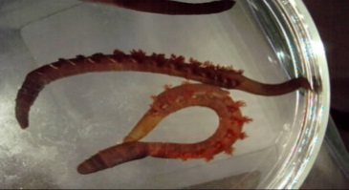
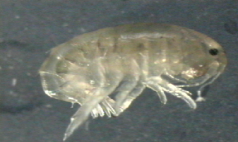
(Eco)Toxicology methods 1 - standardized assays
Exposure
to toxicant (for defined time)
Effective doses
Effective concentrations

Slide 13
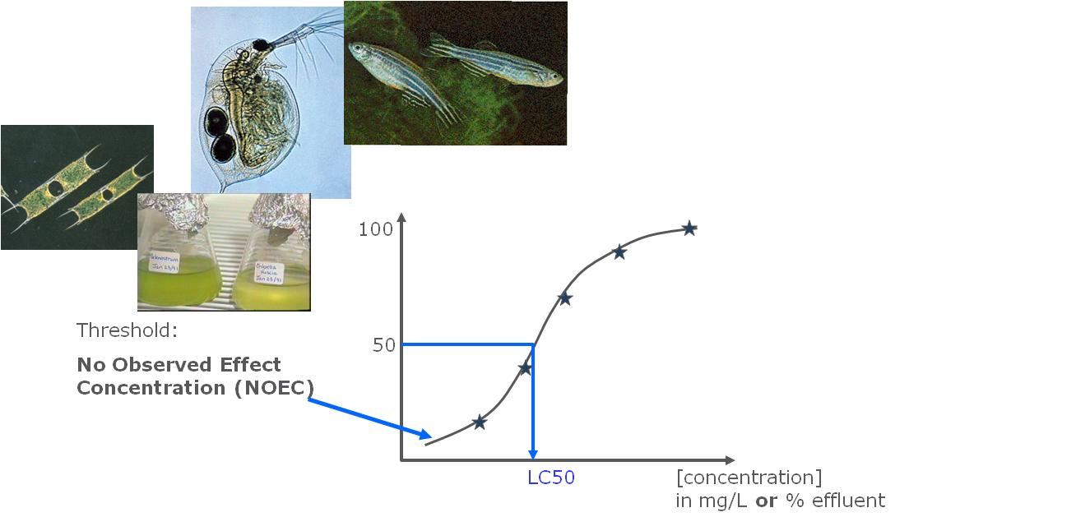
Ecotoxicology in current practice
Most legislations on chemicals)
(e.g. REACH, Pharmaceuticals, Pesticides)
  have very simple (basic) requirements
    EC50 from acute toxicity
    Of 3 basic assays
      Algae
      Daphnia
      Fish
  Ecotox database:
  www.epa.gov/ecotox

Slide 14
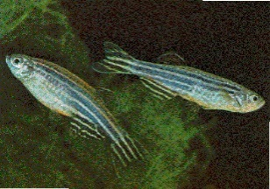
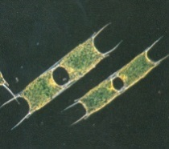
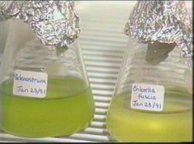
Laboratory data and results
How are
LC50 from
ecotox assays
used ?
100
Threshold:
TOXICOLOGY No Obervable Adverse
Effect Level (NOAEL)
ECOTOXICOLOGY No Observed Effect Concentration (NOEC)
50
LD50
LC50
[concentration] in mg/L or % effluent

Slide 15
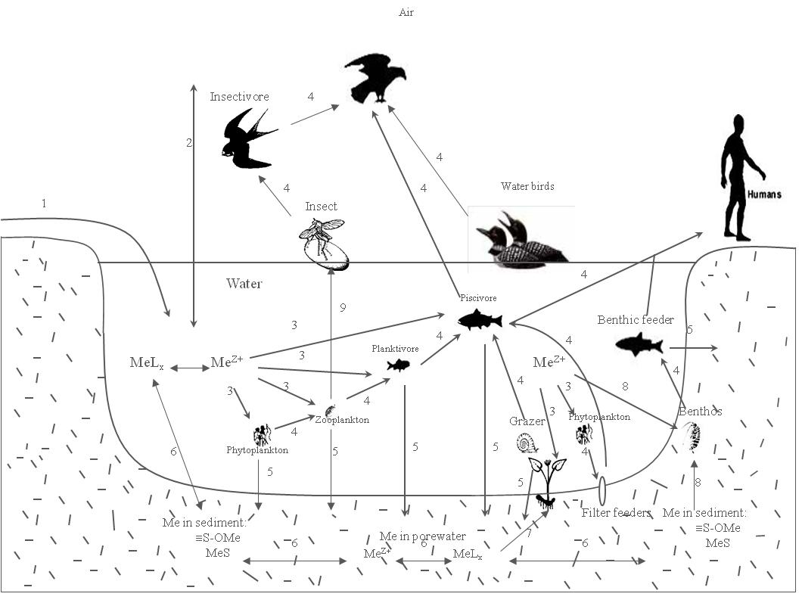
Ecotoxicology in current practice
How to extrapolate 3 (or few more) EC50 values to get legally binding safe concentration, which is protecting virtually all organisms?
PNEC
(Predicted No Effect Concentration)
“value recommended by scientists”
EQS
(Environmental Quality Standard)
“value that occurs in legislation”
?
?

Slide 16
Extrapolation for Risk Assessment
(Eco)Toxicological data
Assessment /
Extrapolation factors
Species sensitivity distribution (SSD)
Data
Assessment factor
L(E)C50 short-term toxicity tests
1000
NOEC for 1 long-term toxicity test
100
NOEC for additional long-term
toxicity tests of 2 trophic levels
50
NOEC for additional long-term
toxicity tests of 3 species of 3
trophic levels
10
Protection level: 95%
[C]
HC5 = 95% protection level
PNEC

Slide 17
Regulatory approach: risk assessment and management
Hazard
Exposure assessment
Dose (or PEC)
Effect assessment
TDI (or PNEC)
Risk characterisation
RQ = Dose / TDI
(or PEC / PNEC)
RQ < 1
RQ > 1
Risk management

Slide 18
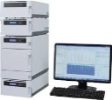
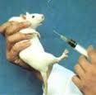

Regulatory approach: risk assessment and management
§ EU Directive 98/83/EC
(in addition to others)
pesticide in drinking water
Hazard
Exposure assessment
Dose (or PEC)
Effect assessment
TDI (or PNEC)
No pesticide
in DW
>0.1 μg/L
Risk characterisation
RQ = Dose / TDI
(or PEC / PNEC)
DW in city of Bruno …
atrazine 0.15 μg/L
RQ < 1
RQ > 1
RQ = 0.15/0.1 = 1.5
DWTP company
$$ for penalty
$$ for DWTP improvement
$$ lobbying to affect
legislation
Risk management

Slide 19
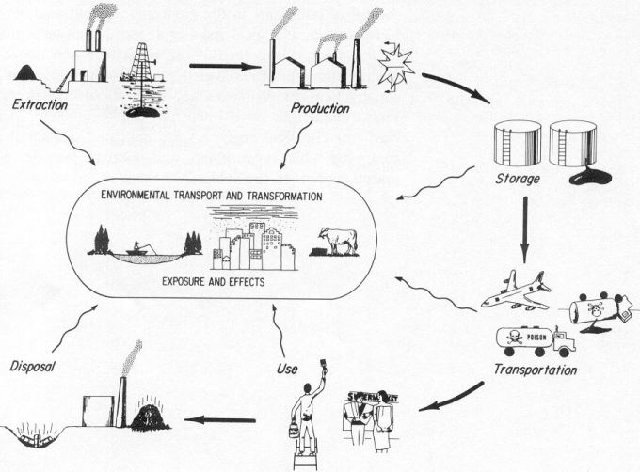

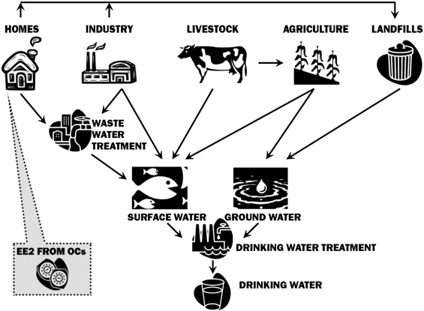
Chemical laws („bulk“)
§§
Industrial chemicals
Cosmetics
PPP (pesticides)
Biocides
Human
pharmaceuticals
Veterinary
pharmaceuticals
REACH
(ECHA)
PPP
(EFSA)
nano nano nano nano
MPs
(EMA)
MIXTURES!
§§
AIR
Two §§ approaches:
Prospective
(chemicals…)
Retrospective
(mixtures …)
WFD – surface w.
GWD – ground w.
Air quality
Food and feed
Soil & Sediments
Wastes
SOIL
WATER

Slide 20
Notes on practical testing
Testing chemicals
  Traditional / bioassays developed to assess individual chemicals
  Advantages: Standardized approaches
  Disadvantage: Limited ecological relevance
    often acute tests only
    „too standardized…“ (? Less representative ?)
    does not assess/consider bioavailability
    no consideration of mixture effects
    no consideration of specific modes of action
    no consideration of ecological situation
Example: Acute (96h) fish toxicity assay with ethanol
  No deaths (but fish are passive – slow swimming) → OK ?
  Real life: easy prey → population decline

Slide 21
Notes on practical testing
Testing toxicity of natural contaminated matrices
  Rather new in ecotoxicology – many open challenges
    Whole effluent toxicity testing (WET)
    Contact soil toxicity assays
  More complex and more complicated
    „cause-effects“ often not clear
      Natural variability in matrices
      Algal tests - nutrients (Nitrogen, Phosporus) >> Toxic compounds

Slide 22
Results of ecotoxicology
WHAT IS IT GOOD FOR ?
SOLVING PRACTICAL PROBLEMS

Slide 23
Example 1
Application of ecotoxicity
results (ECx → EQs)
in regulatory context
European
Water FrameworkDIRECTIVE

Slide 24
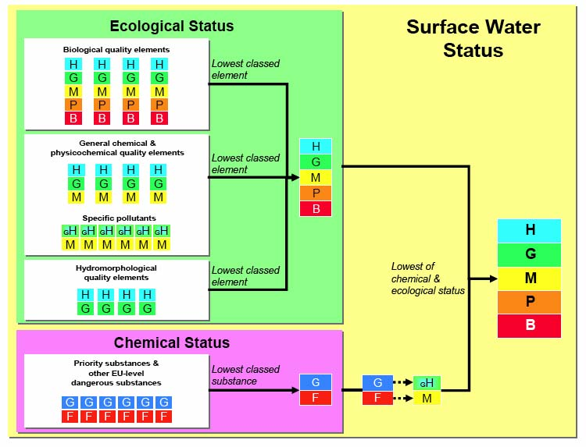
EQS in reality – example EU Water Framework Directive

Slide 25
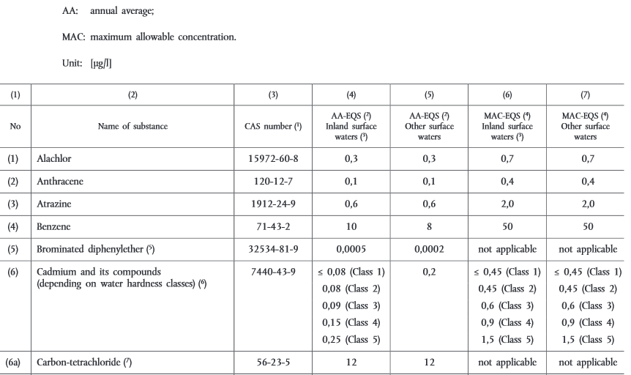
List of priority compounds EU WFD (selection/examples)
  Most recent (2015) 44 priority compounds (table here)
  + additional “watch list” → see further
PRACTICE:
Chemical measurements vs limits (EQs)

Slide 26
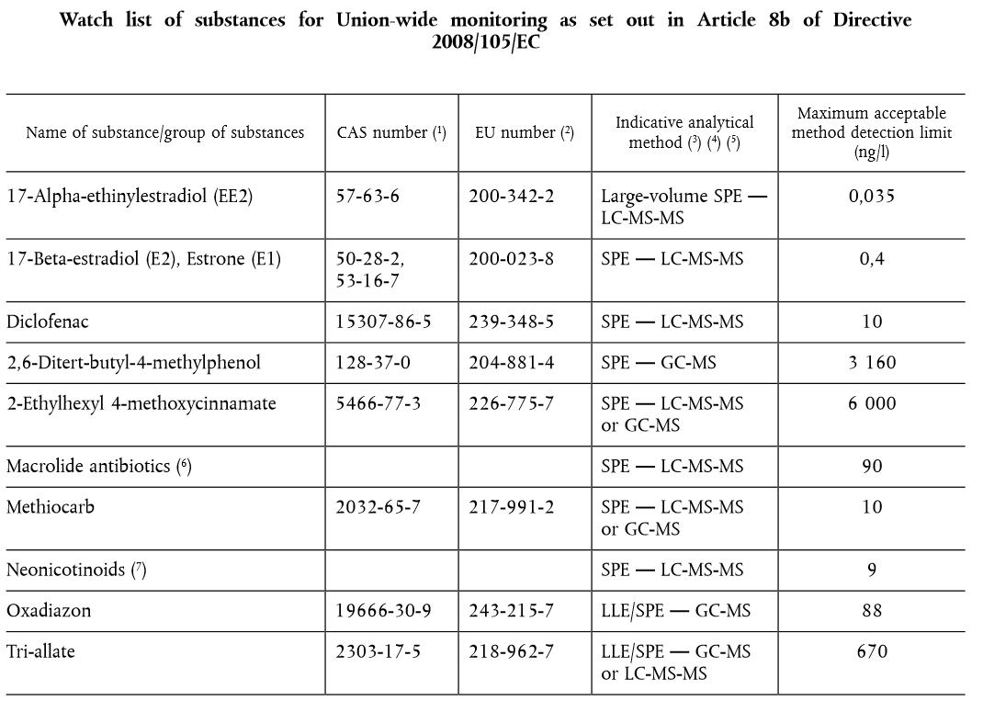
http://eur-lex.europa.eu/legal-content/EN/TXT/PDF/?uri=uriserv:OJ.L_.2015.078.01.0040.01.ENG

Slide 27
Another example where
ecotoxicology results are used
European strategy
how to deal with chemicals
REACH

Slide 28
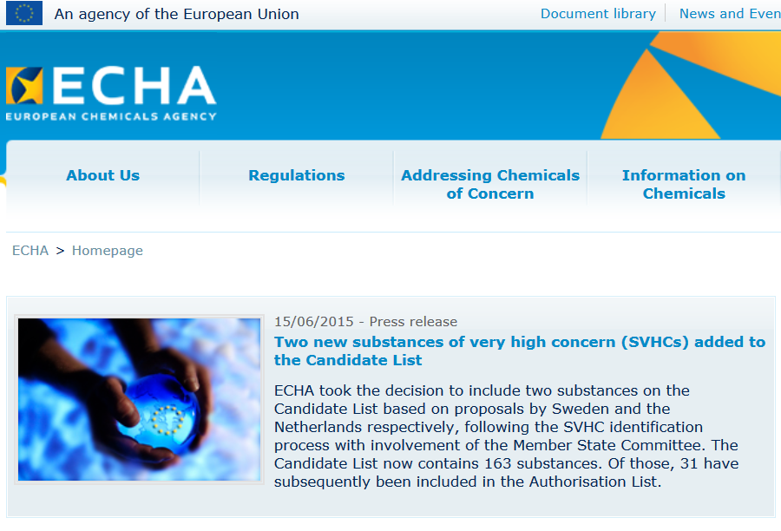
REACH
Registration, Evaluation and Authorisation
of Chemicals
  27-2-2001: White Paper on the Strategy for Future Chemicals Policy
  23-10-2003: Commission’s proposal REACH
  December 2008: Pre-registration mandatory (all chemicals in EU must be registered at ECHA
  European Chemicals
  Agency
  (http://echa.europa.eu)

Slide 29
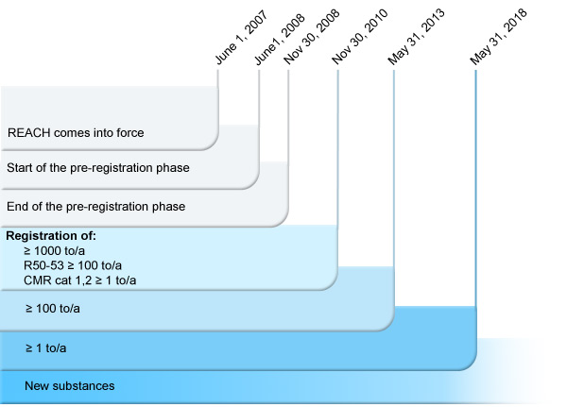
Existing substances and REACH
  > 95,000,000 known chemicals
  (…and counting http://www.cas.org/)
  100,000 substances in EINECS (i.e. commercial use)
  30,000 relevant for REACH
  cc 3000 HPVCs (High Production Volume Chemicals)

Slide 30
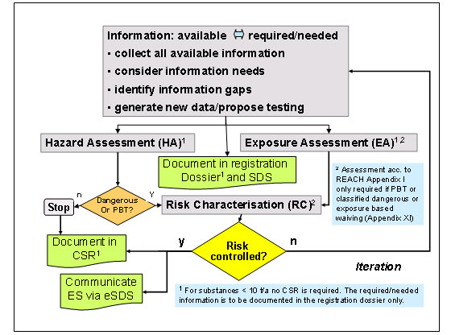
REACH legislation in EU
Registration, Evaluation and Authorisation and Restriction of Chemicals

Slide 31

REACH: what data type must be registered?
Physico-chemical properties, e.g.:
  Vapour pressure, boiling point, Kow,…
Human toxicology, e.g.:
  Acute and chronic toxicity, skin irritation, carcinogenity,…
Environment/ Ecotoxicological information, e.g.:
  Acute and/or chronic toxicity for aquatic organisms, biodegradation, …

Slide 32
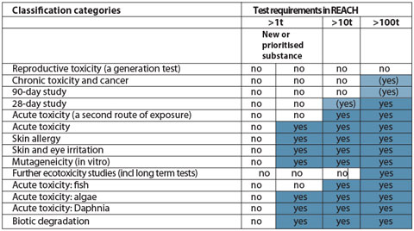
REACH: testing
Total costs: 2,8 to 5,6 billion € (industry pays)
Testing costs (50-60% of total): 86% for Human, 14% Ecotox

Slide 33

What assays and how exactly?
Depends on legislation (… of course !)
… but current EU legislations tend to be harmonized
(use similar approaches)
→ example of REACH
Assays must be STANDARDIZED
for REACH should follow OECD Guidelines
Other standardization agencies
(also include toxicity tests) e.g. ISO, ASTM

Slide 34
OECD guidelines for testing of chemicals
Organization for Economic Cooperation Development
5 main sections
  Section 1: Physical Chemical Properties
  Section 2: Effects on Biotic Systems
  (i.e. Ecotoxicity)
  Section 3: Degradation and Accumulation
  Section 4: Health Effects
  (i.e. Toxicity)
  Section 5: Other Test Guidelines

Slide 35
OECD guidelines (examples – selection)
SECTION 2 - Aquatic organisms
Test No. 201: Alga, Growth Inhibition Test | 11 July 2006
Test No. 221: Lemna sp. Growth Inhabition Test | 11 July 2006
Test No. 202: Daphnia sp. Acute Immobilisation Test | 23 Nov 2004
Test No. 211: Daphnia magna Reproduction Test | 16 Oct 2008
Test No. 203: Fish, Acute Toxicity Test | 17 July 1992
Test No. 204: Fish, Prolonged Toxicity Test: 14-Day Study | 04 Apr 1984
Test No. 210: Fish, Early-Life Stage Toxicity Test | 17 July 1992
Test No. 212: Fish, Short-term Toxicity Test on Embryo and Sac-Fry Stages | 21 Sep 1998
Test No. 215: Fish, Juvenile Growth Test | 21 Jan 2000
Test No. 229: Fish Short Term Reproduction Assay | 08 Sep 2009
Test No. 230: 21-day Fish Assay | 08 Sep 2009
Test No. 231: Amphibian Metamorphosis Assay | 08 Sep 2009

Slide 36
OECD guidelines (examples – selection)
SECTION 4 – Human health effects
Test No. 401: Acute Oral Toxicity
Test No. 402: Acute Dermal Toxicity
Test No. 403: Acute Inhalation Toxicity
Test No. 404: Acute Dermal Irritation/Corrosion
Test No. 405: Acute Eye Irritation/Corrosion
Test No. 406: Skin Sensitisation
Test No. 407: Repeated Dose 28-day Oral Toxicity Study in Rodents
Test No. 408: Repeated Dose 90-Day Oral Toxicity Study in Rodents
Test No. 409: Repeated Dose 90-Day Oral Toxicity Study in Non-Rodents
Test No. 410: Repeated Dose Dermal Toxicity: 21/28-day Study
Test No. 411: Subchronic Dermal Toxicity: 90-day Study
Test No. 412: Subacute Inhalation Toxicity: 28-Day Study

Slide 37
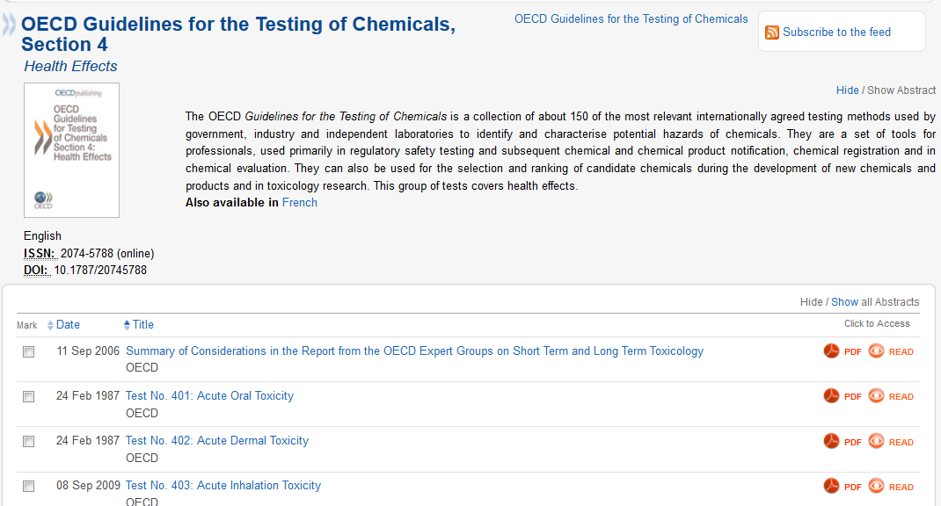

Try it! … download and study
your guideline for free!

Slide 38
Risks of chemicals: a balancing act …. between perception, uncertainties, science and pragmatism?
Final considerations

Slide 39

SOCIETY – RISKS vs BENEFITS (!)
Other Social Needs
Science
Other Sciences
Time to benifit
Technology
Other Technologies
Practice
Other Laws and Regulations
Local
Global
Value

Slide 40

Society is a balancing act …
Scientists should
contribute (provide valid data)
for decision making
Scientists

Slide 41
WRAP UP and take home message – part 2
What are hazards vs risks?
  Risk assessment and management?
  IMPACTS of risks? Risks vs benefits?
How are the risks calculated
  By comparing EXPOSURES (PEC) with HAZARDS (PNEC)
How are hazards assessed?
  By toxicity assays
    there are 3 most widely used!
    They must be done by standardized approaches (OECD guidelines)
  What are results of toxicity assays (ICx, NOEC, LOEC)?
  How are the results used?
    Predictions of PNEC (by application of AFs)
    Regulatory acceptance → EQS
Know examples of ecotox applications
  PNEC (EQs) in Water framework directive
  Predictive risk assessment in REACH regulation

