Slide 1
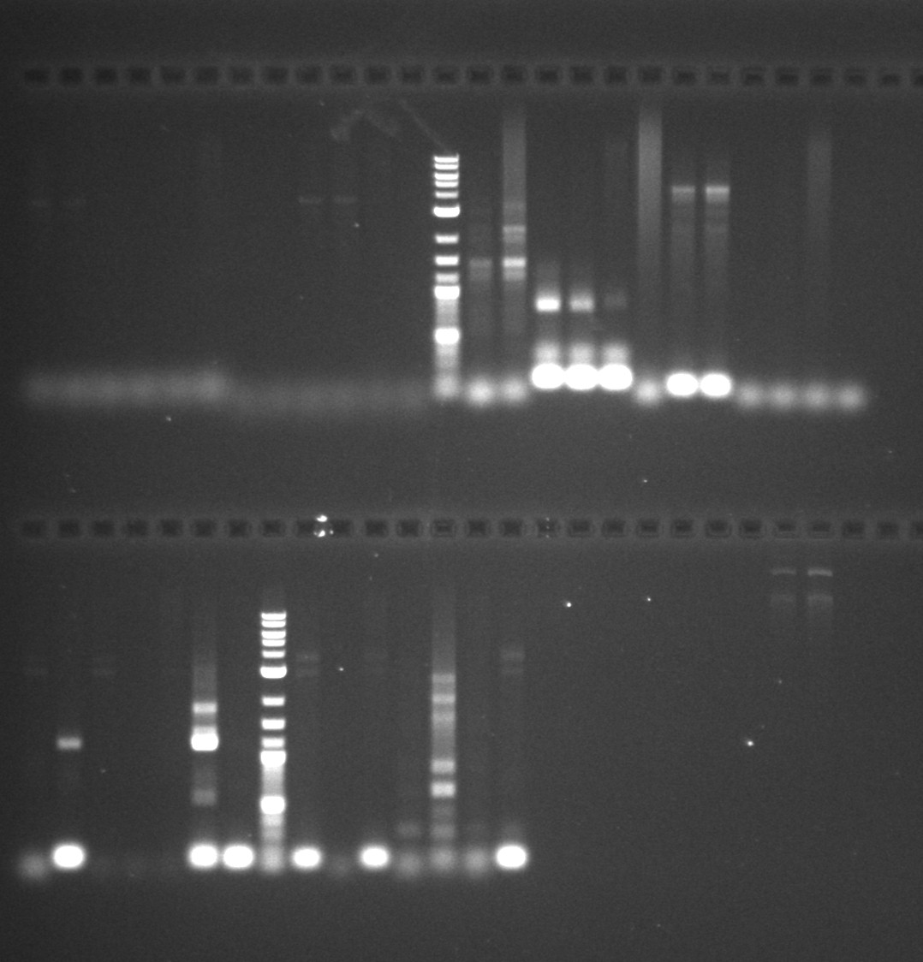
Pozitivní kontroly
1 – plazmid pT181
3 – plazmid pUSA300 HOUMR-like
JB – DNA z S. aureus Jevons B
T5*
C4*
C5*
-kon*
T4*
+kon*
-
T4
C4
T5
+
C5
1 kbp marker
BBT3
BBT2
BBC3
BBC2
+BB
-BB
BTT3
BTT2
BTC3
BTC2
BT+
BT-
T5B
CIB
T1B
-B
+1B
C5B
NNB
1 kbp marker
TI*
-
1+*
CI*
NN*
C5*
T5*

