Slide 1
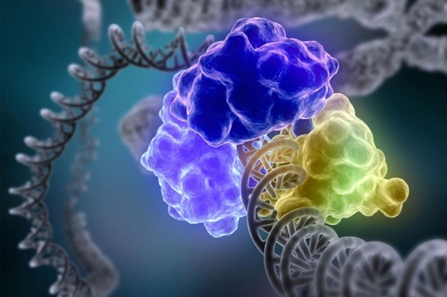
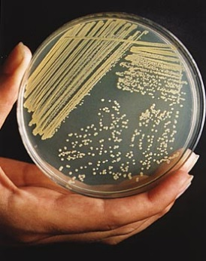
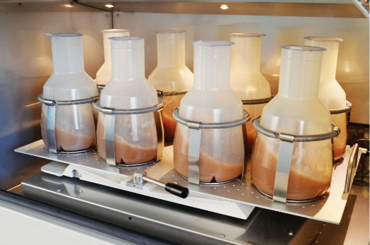
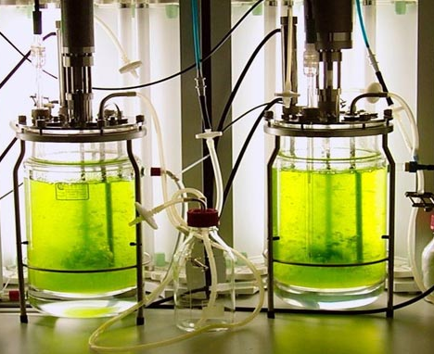
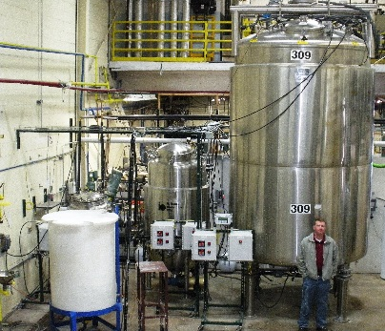
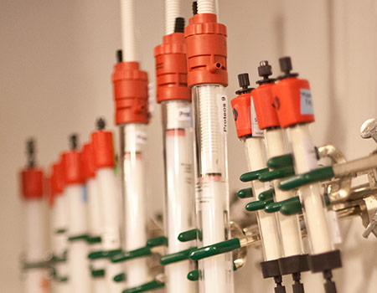
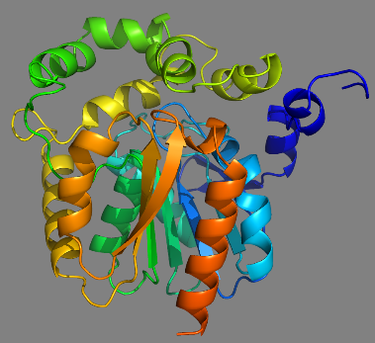
PREPARATION OF RECOMBINANT PROTEINS
Bi7430c Molecular Biotechnology Practicals

Slide 2
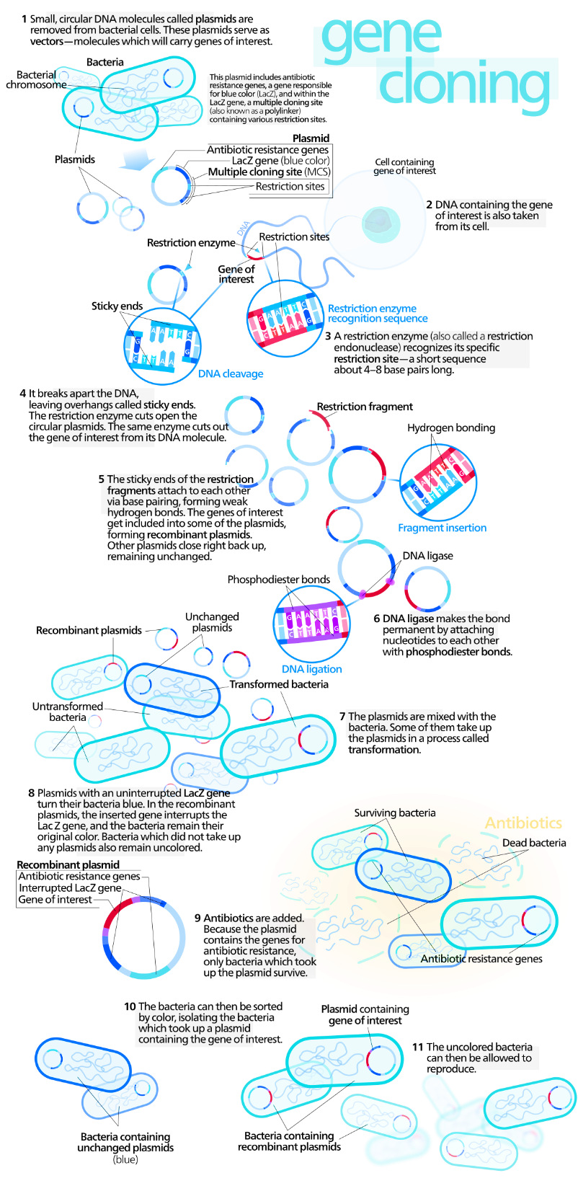
1
7
2
8
3
9
4
10
5
11
6

Slide 3
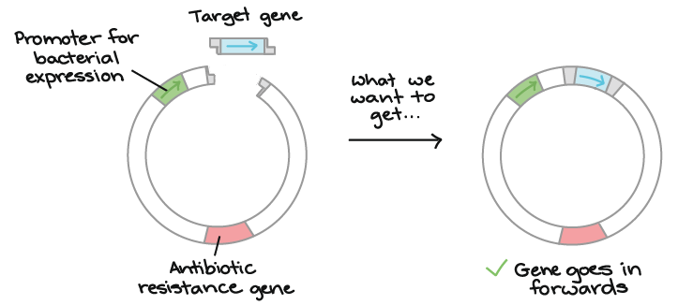
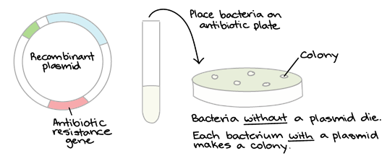
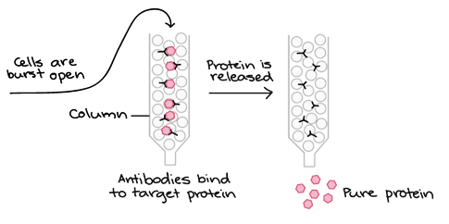
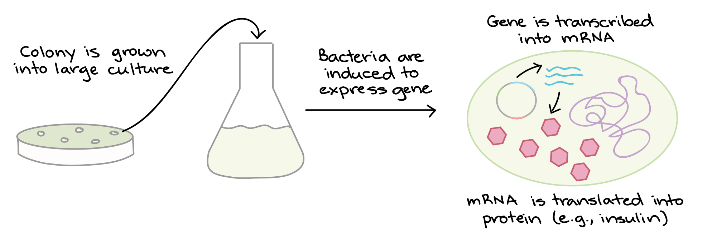
LIGATION OF TARGET GENE INTO PLASMID
TRANSFORMATION AND SELECTION
CULTIVATION AND EXPRESSION
PURIFICATION

Slide 4
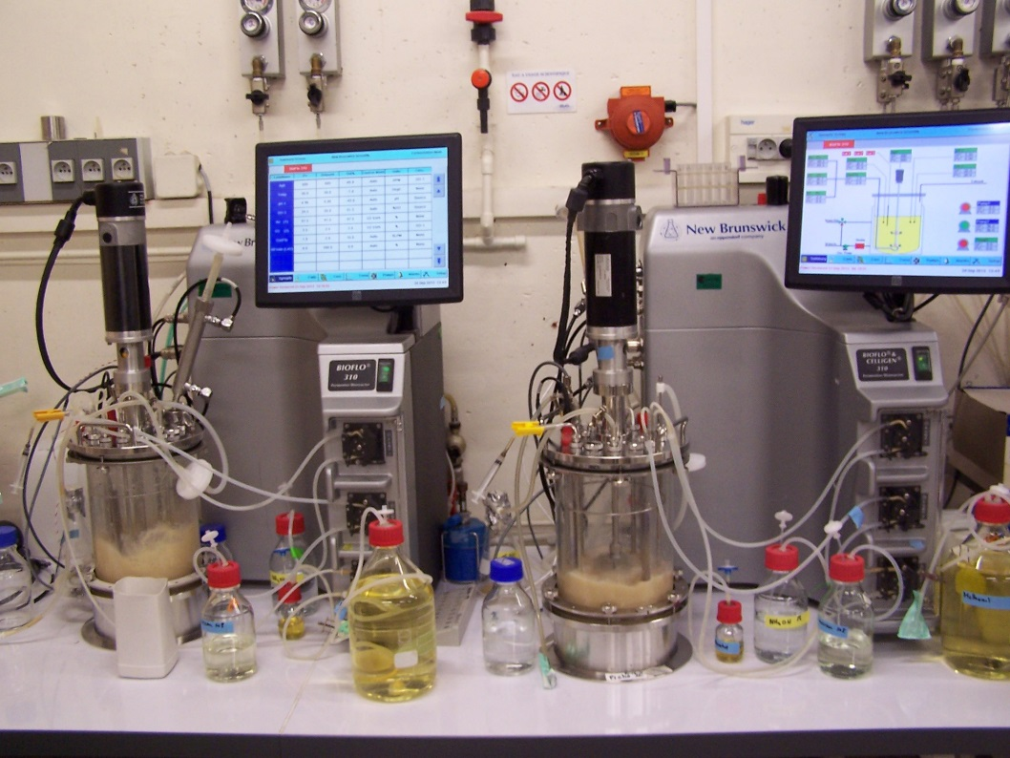
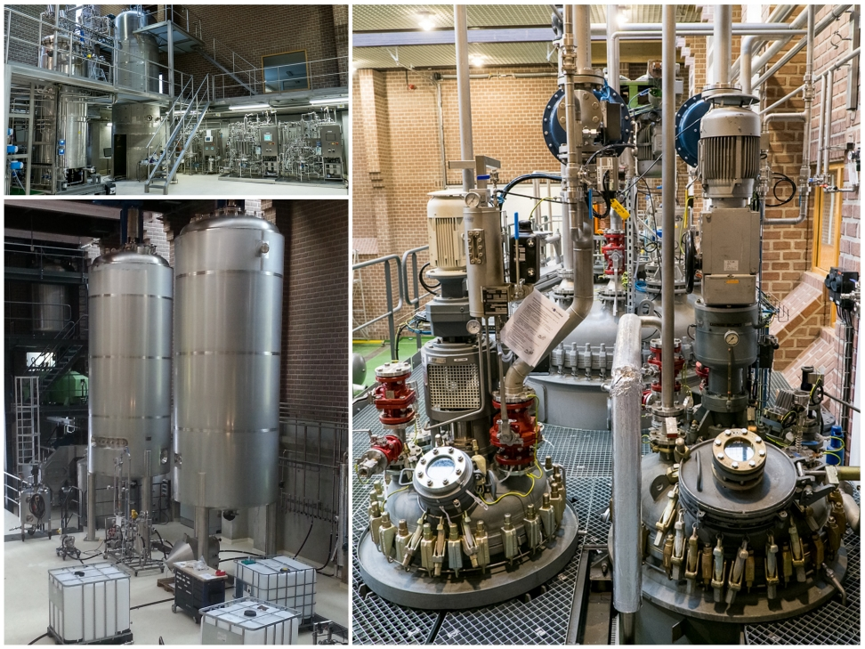
SCALE-UP
shake flasks – up to 1L (uncontrolled conditions)
laboratory fermentor – up to 10L (sterilized whole with medium, tubes, filters...)
pilot scale – hundreds of L
industrial bioreactor – thousands of L (sterilized with steam through pipes)

Slide 5
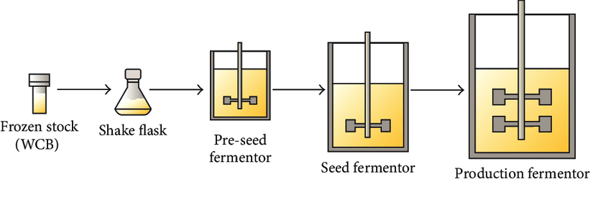
MANUFACTURE
a cell line is established from a single clone and is used to make-up the master cell bank (MCB)
MCB must be characterized and tested for contaminants (bacteria, fungi, mycoplasmas, viruses)
cells from MCB are expanded to form the working cell bank (WCB), which is characterized for cell viability prior to use in the manufacturing process

Slide 6
CONDITIONS TO CONTROL
factors influencing the growth of microorganisms and production of metabolites
  temperature
  concentration of oxygen
  pH
  pressure
  extracellular concentration of substances and water
  agitation
  production medium

Slide 7
TEMPERATURE
psychrophiles
mezophiles – E. coli (5 to 40°C)
thermophiles
↑t = ↑growth and synthesis of metabolites
above 45°C proteins losing 3D structure
above 60°C half of proteins denatured
solidification of lipids in membranes
growth is proportional to temperature
denaturation of proteins
growth
temperature
1 2 3

Slide 8
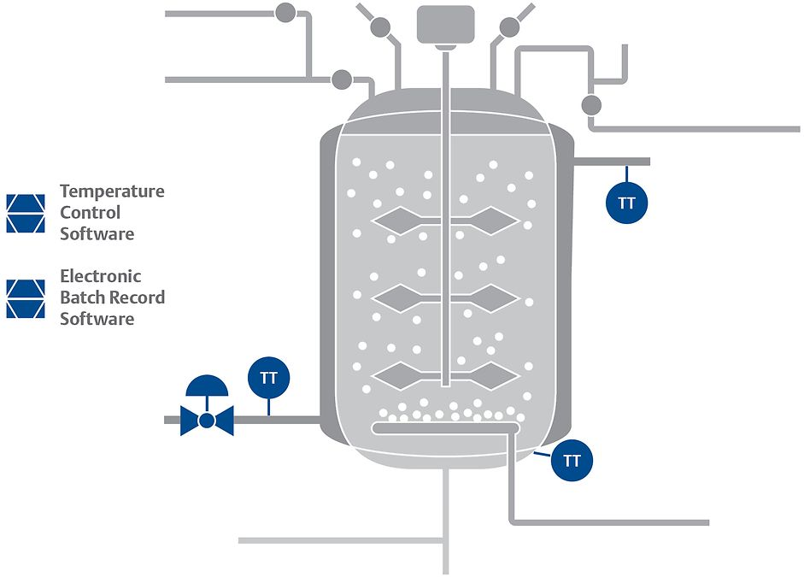
TEMPERATURE
t measurement
  thermometer
t maintenance
  thermal jacket
  water in/out
across all operating processes, temperature variations of as little as 1°C can limit production

Slide 9
OXYGEN
aerobic – supply of oxygen necessary
  agitation and aeration
  shape of cultivation flask
  increased pressure
  additives
microaerophile
  hard to maintain standard conditions
anaerobic
  facultative (S. cerevisiae +O₂ = growth and production of acids, -O₂ = ethanol)
  obligatory – complete elimination of O₂ during cultivation is necessary; N₂ and CO₂ atmosphere

Slide 10
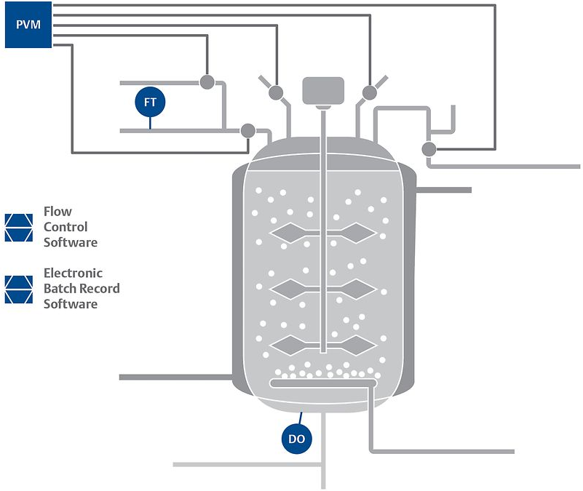
OXYGEN
fostering the optimal growth environment within a bioreactor requires adding the right amounts of reactant gasses to a vessel to support a cell culture
the amounts of gasses (oxygen) vary depending on the size and growth stage of a culture

Slide 11
pH
H⁺ interact with proteins and lipids in the cell membrane
if the difference between extracellular and intracellular pH increases, energetic demand on cells grow to maintain the intracellular pH
filamentous fungi – can withstand even lower pH
yeasts – pH usually 4 to 7
bacteria – pH usually 4 to 9
mammalian cells – very sensitive to pH changes
some microorganisms have different pH optimum for growth and production of metabolites (A. niger growth 5-7, citric acid production 2-3, gluconic acid 5-6)

Slide 12
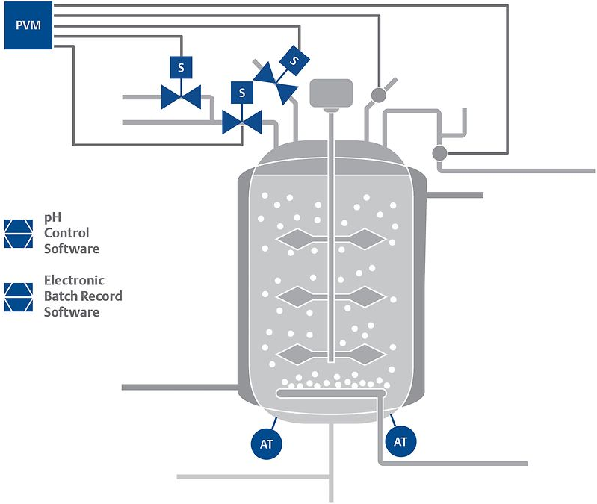
pH
pH measurement
  electrode
pH maintenance
  acid (phosphoric acid)
  base (ammonium)
metabolic changes in organisms and improperly calibrated sensors can result in ineffective pH control and negatively impact an operation

Slide 13
PRESSURE
obligatory basophiles
  they can not withstand atmospheric pressure
  marine microorganisms found in oceans are not suitable for laboratory/industrial use
lots of microorganisms can form spores that are resistant to high pressures and temperatures – problems with sterilization

Slide 14
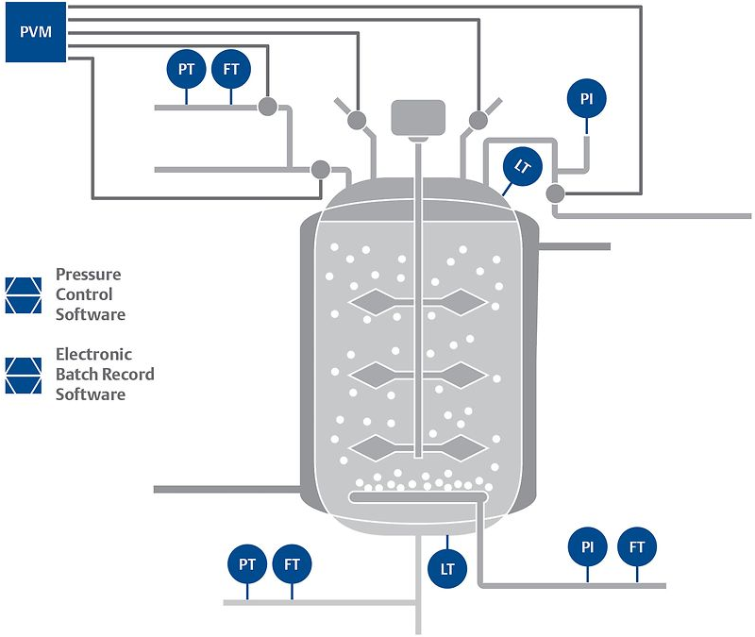
PRESSURE
precise control of the pressure is necessary for ensuring adequate delivery of oxygen from a gas stream to cell culture
even slight variations in local pressures can stunt cellular growth and limit product formation

Slide 15
EXTRACELLULAR CONCENTRATION OF SUBSTANCES
halophiles – tollerant up to 25% of NaCl
osmophiles – especially fungi (growth even on solid substrates like fermented soya, using only atmospheric moisture)
very high concentration of substrates in extracellular environment
  dehydration of cells
  inhibition of important enzymes in cells
  sweet wine – osmotolerant yeasts

Slide 16
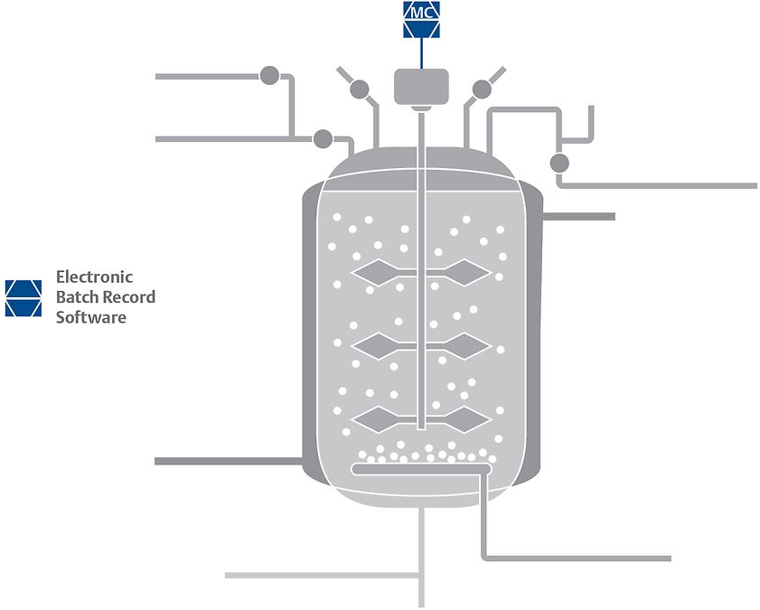
AGITATION
agitation and rocking processes help transfer nutrients and oxygen to a cell culture within a bioreactor
while these mixing processes are critical to achieving optimal productivity, imprecise and ineffective machinery can lead to excessive spinning or shaking – and destroy a cell culture (filamentous fungi)

Slide 17
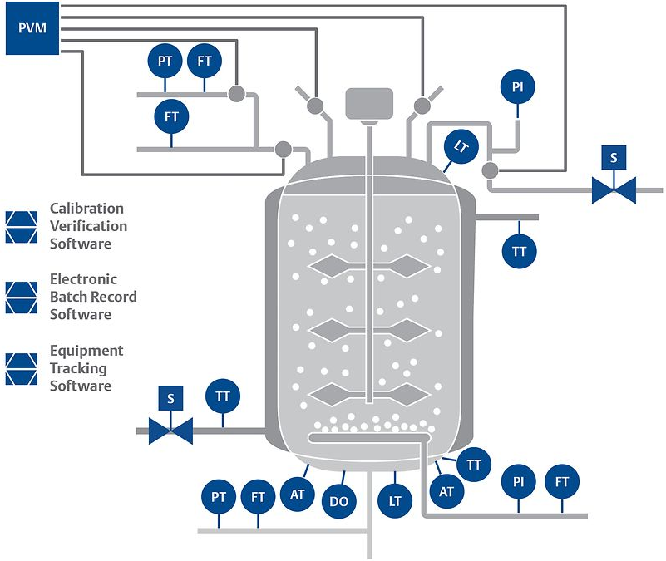
CALIBRATION!
for life sciences manufacturers, calibration issues can result in deviations and quarantined batches and requires increased maintenance
lack of traceability can result in potential compliance issues

Slide 18
MEDIUM
nutrition sources
  sources of proteins, vitamins, mineral and carbohydrates
  peptone (hydrolysed protein), tryptone (digested casein), yeast extract
energy sources
  sources of carbohydrates
  glucose, glycerole
essential minerals
  sources of micro and macro minerals
  present in peptone and meat extract
buffering agents
  maintain optimum pH
  specific amino acids, phosphates, citrates and zwitterions
selective agents
  allow the growth of only specific bacteria
  antibiotics, tellurites, azides, bile salts
solidifying agents
  agar plates, gelatin
specific substances such as growth factors, enzymes may be incorporated into the medium for specific bacteria
commercial or DIY
  LB (Miller/Lennox/low salt)
  minimal salt/mineral (M9)
  Terrific Broth TB
  SOB
  SOC
commercial
  EnPresso™ B Growth System (5x more protein compared to traditional culture media)

Slide 19
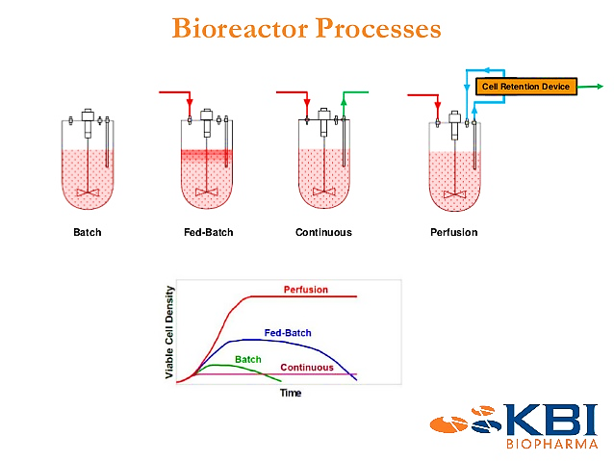
OPERATION MODES
Characteristics | Batch | Fed-batch | Continuous
Cultivation system | Closed-type | Semi-closed type | Open type
Addition of fresh nutrition | No | Yes | Yes
Volume of culture | Constant | Increases | Constant
Removal of wastes | No | No | Yes
Chance of contamination | Minimum | Intermediate | Maximum
Growth phase | Lag, log, stationary, decline | Lag, log, stationary, decline | Lag and log
Log phase | Shorter | Longer | Longest, continuous
Density of bacteria | Changes with time | Changes with time | Remains same
Product yield | Low | Medium | High

Slide 20
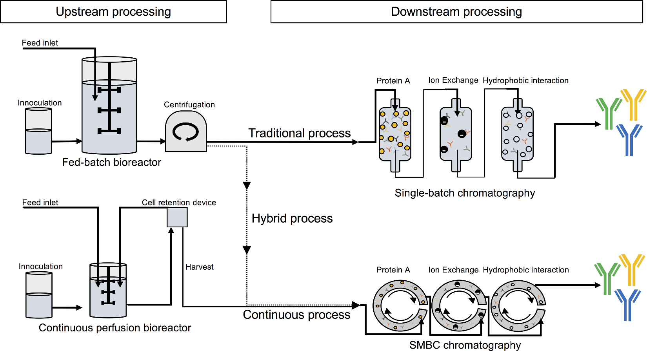
PROCESSING

