Slide 1
NATURAL POLYMERS
Polysaccharide II CELLULOSE 1
Cellulose is the most widespread BIOPOLYMER on Earth, up to 1,5×10⁹ tons per annum is arising
Dr. Ladislav Pospíšil

Slide 2
Time schedule
LECTURE | SUBJECT
1 | Introduction to the subject – Structure & Terminology of nature polymers, literature
2 | Derivatives of acids – natural resins, drying oils, shellac
3 | Waxes
4 | Plant (vegetable) gums, Polyterpene – natural rubber (extracting, processing and modification), Taraxacum_kok-saghyz
5 | Polyphenol – lignin, humic acids
6 | Polysaccharides I – starch
7 | Polysaccharides II – celullosis
8 | Protein fibres I
9 | Protein fibres II
10 | Casein, whey, protein of eggs
11 | Identification of natural polymers
 | Laboratory methods of natural polymers’ evaluation

Slide 3
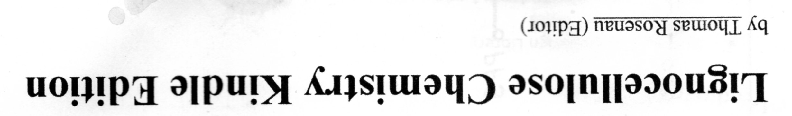
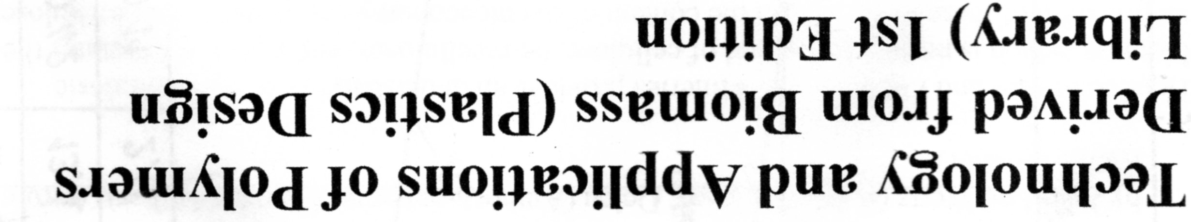
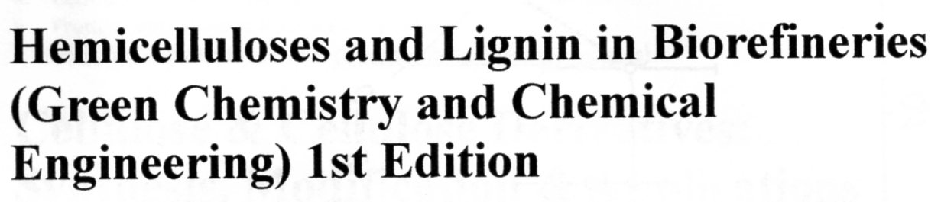
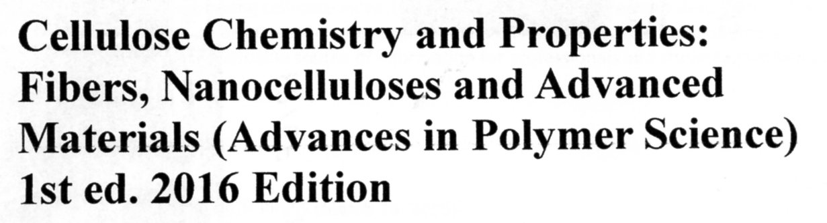
LITERATURE 1

Slide 4
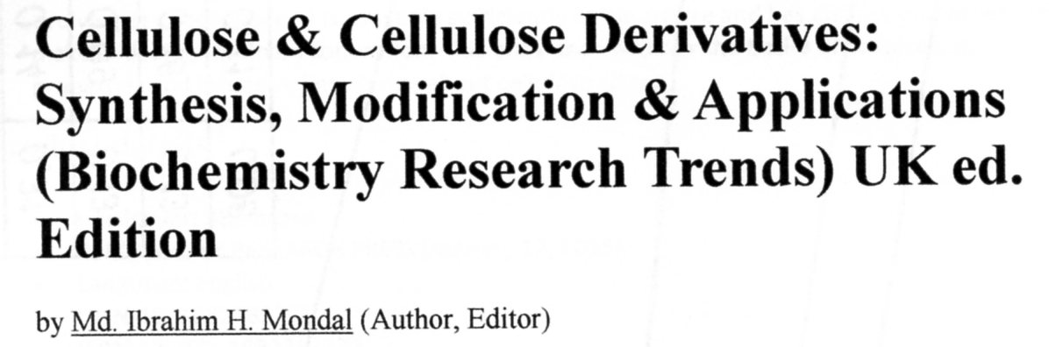
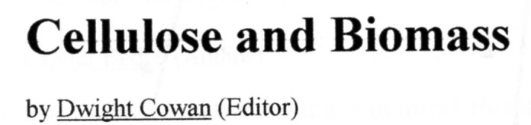
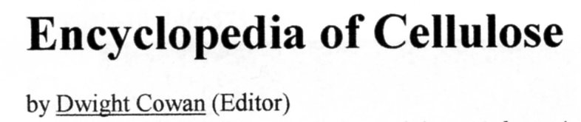
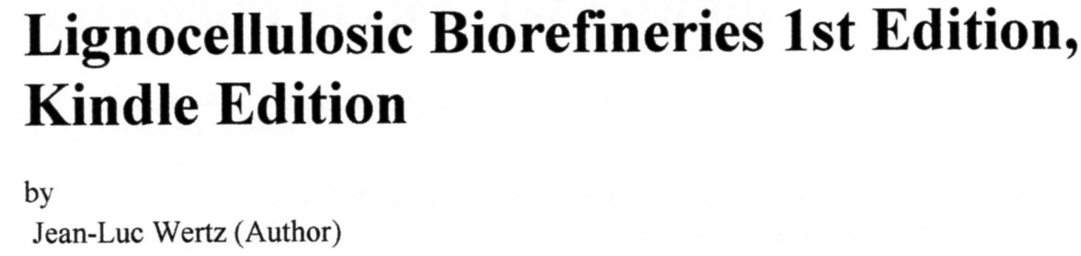
LITERATURE 2

Slide 5
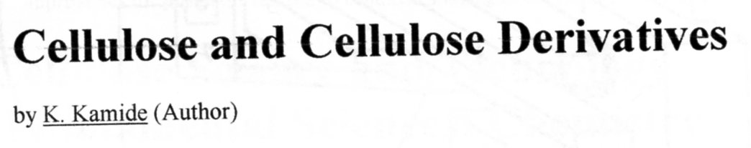
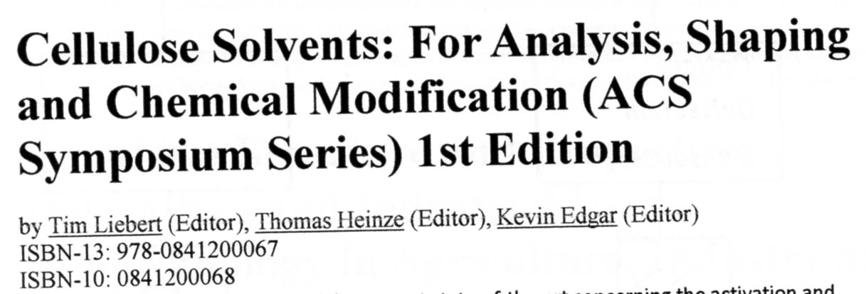
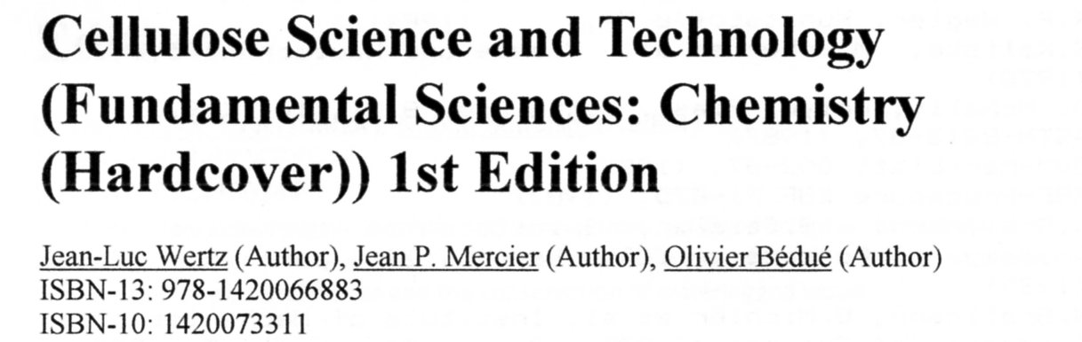
LITERATURE 3

Slide 6
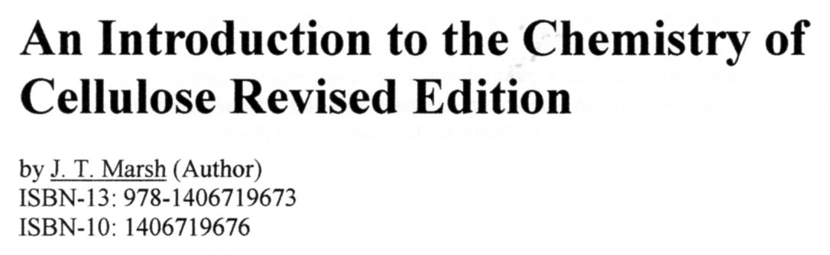
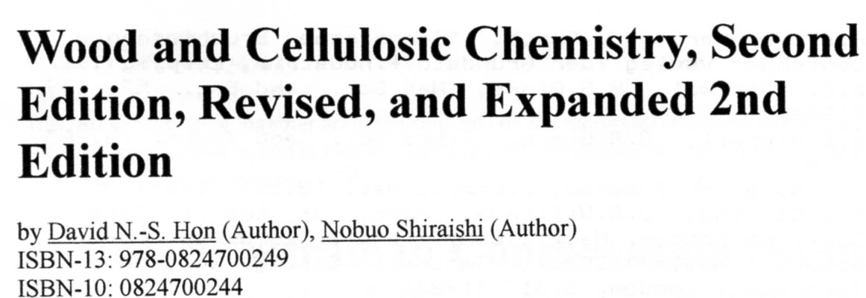
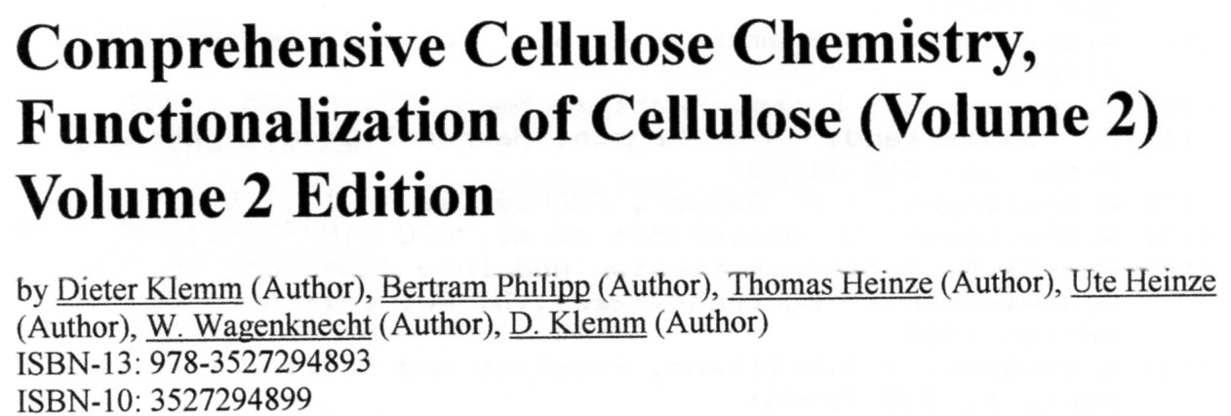
LITERATURE 4

Slide 7
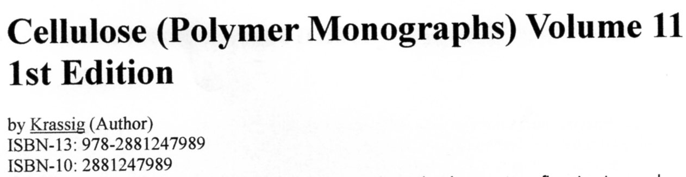
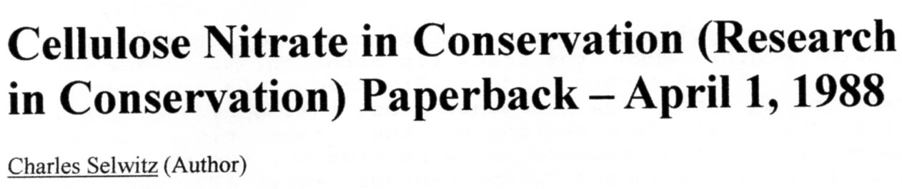
LITERATURE 5
Cellulose
ISSN: 0969-0239 (Print) 1572-882X (Online)
Description
Cellulose is an international journal devoted to the dissemination of research and scientific and technological progress in the field of cellulose and related naturally occurring polymers. The journal is concerned with the pure and applied science of cellulose and related materials, and also with the development of relevant new technologies. This includes the chemistry, biochemistry, physics and materials science of cellulose and its sources, including wood and other biomass resources, and their derivatives. Coverage extends to the conversion of these polymers and resources into manufactured goods, such as pulp, paper, textiles, and manufactured as well natural fibers, and to the chemistry of materials used in their processing. Cellulose publishes review articles, research papers, and technical notes. hide
Cellulose is an international journal devoted to the dissemination of research and scientific and technological progress in the field of cellulose and related naturally occurring polymers. The journal is concerned with the pure and applied science of cellulose and related materials, and also with the development of relevant new technologies. This includes the chemistry, biochemistry, physics and materials science of cellulose …

Slide 8
Cellulose Chemistry
Supramolecular stucture of Cellulose
Natural abundance of Cellulose
Solubility of Cellulose
Production of Cellulose
Use of Cellulose
Modification of Cellulose
Nanocellulose

Slide 9
Natural Fibres
Inorganic Fibres
Asbestos Fibres
Plant (Cellulose) Fibres
Animal
(Proteine) Fibres
Leaf Fibres
Sisal Fibres
Manila Hemp Fibres
Pineapple Fibres
Bast/Stalk Fibres
Insects
Fibres
Vertebrate Animal Hair Fibres
Seed Fibres
Flax Fibres
Hemp Fibres
Jute Fibres
Ramie Fibres
Kenaf Fibres
Natural Silk
Fibres
Cotton Fibres
Kapok Fibres
Coconut Fibres
Wool Fibres
Angora wool
Camel wool
Etc.

Slide 10
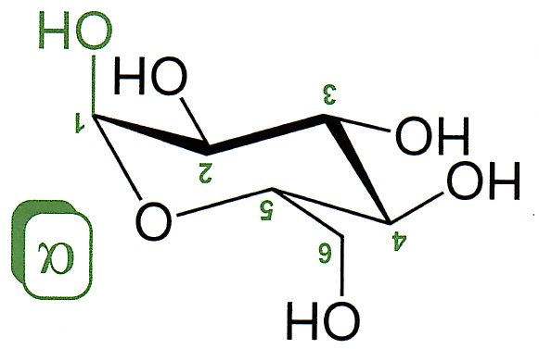
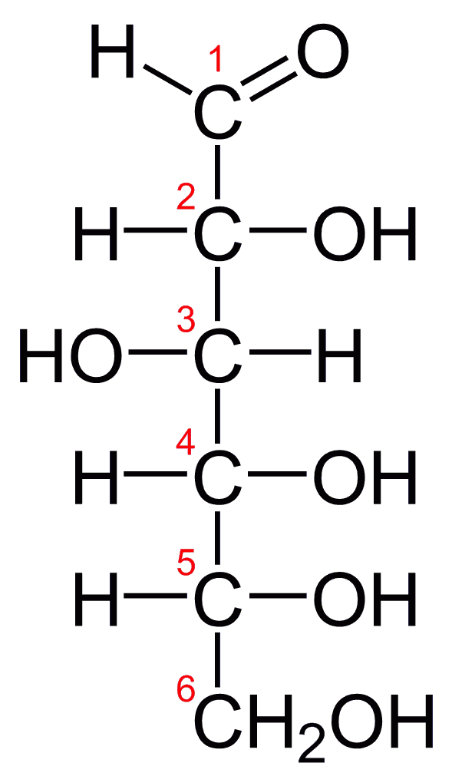
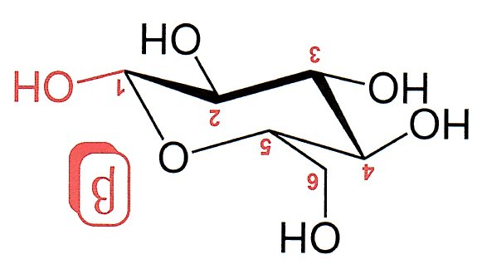

Slide 11
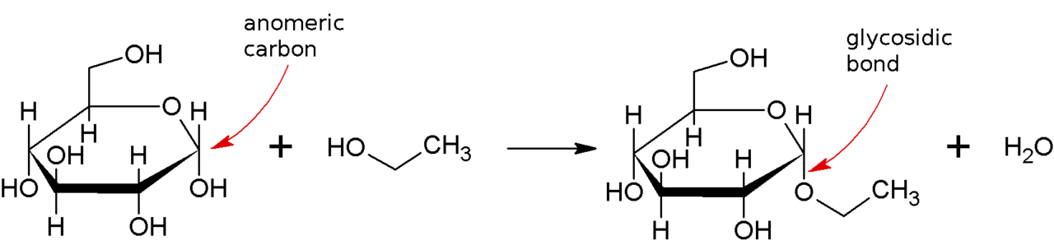
Formation of the Glykosidic Bond (Linkage)
HEMIACETAL Formation
A glycosidic bond is formed between the hemiacetal or hemiketal group of a saccharide (or a molecule derived from a saccharide) and the hydroxyl group of some compound such as an alcohol. A substance containing a glycosidic bond is a glycoside.
HEMIACETAL is able further react with another nucleophilic Group and so form ACETAL and to eliminate Water.
When is the further Reagent a Saccharide whit suitable –OH Group, the POLYSACHARIDE is step by step forming
acetal

Slide 12
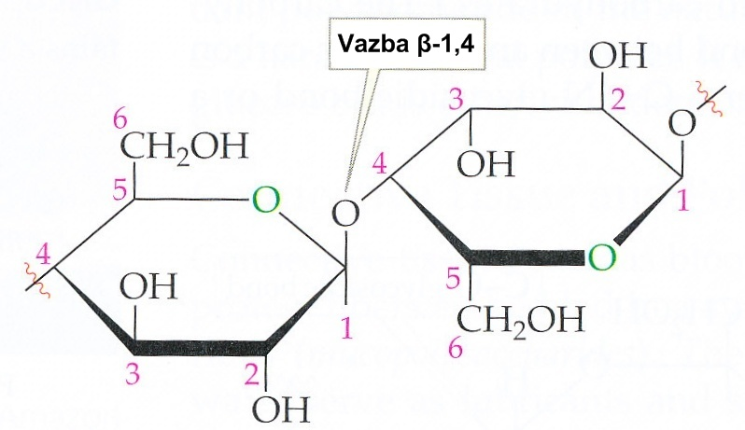
Cellulose
  ß-D-Glucose, ß-1,4 glycosidic Bond
  It forms the structure Skeleton of Plants
  It is not cleaved by Humans
Bond

Slide 13
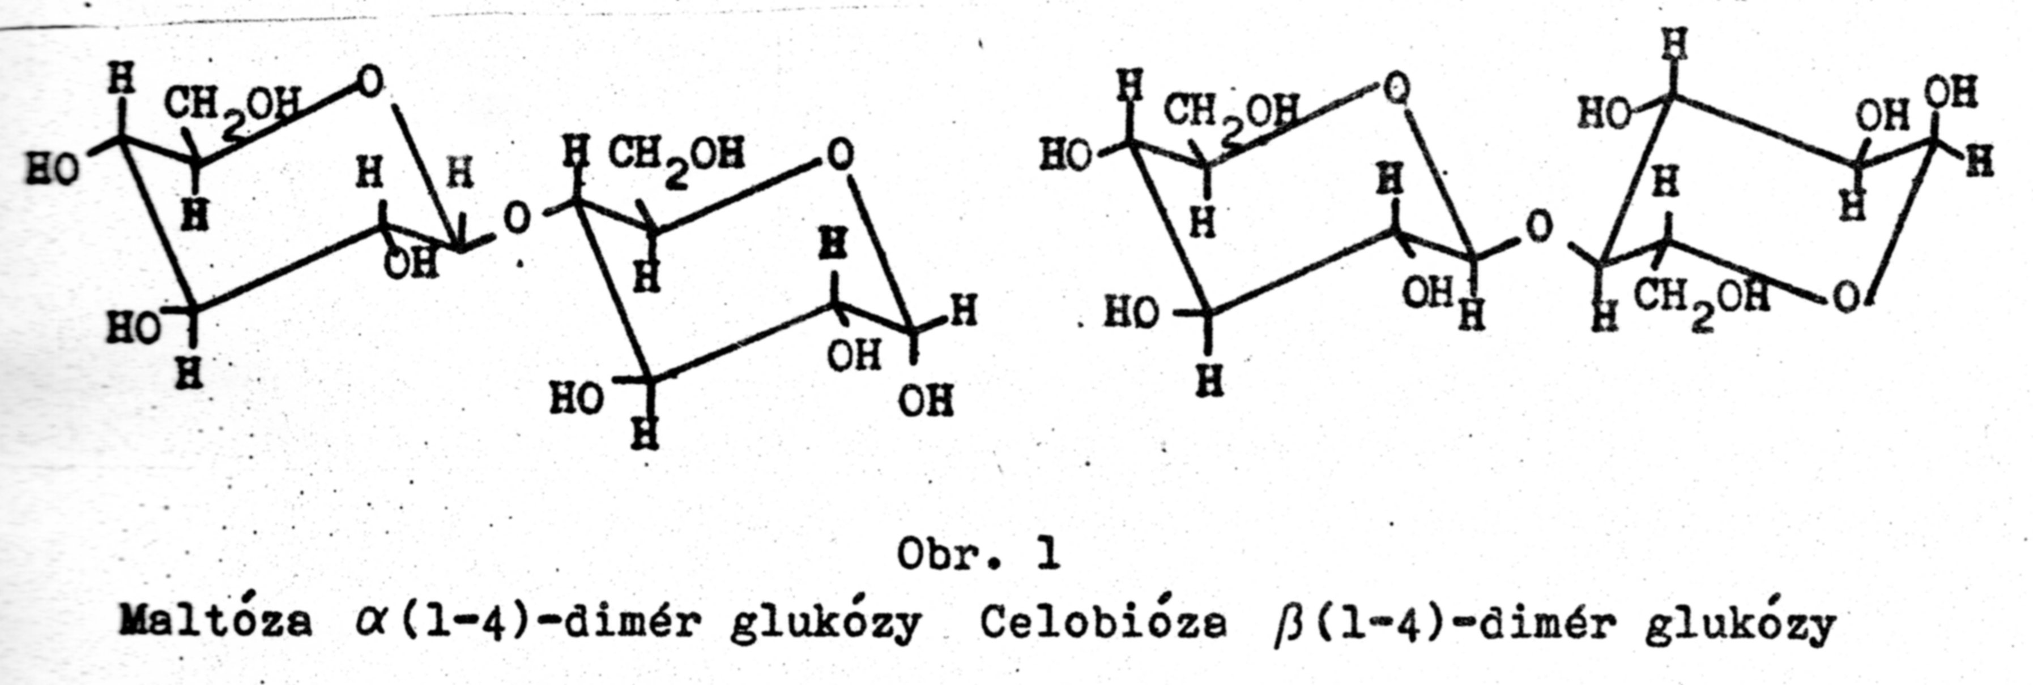
C1
C4 α
C1
C4 β
Maltose is the repeating unit of STARCH: α(1−4) dimer of GLUCOSE
Cellobiose is the repeating unit of CELLULOSE: β(1−4) dimer of GLUCOSE

Slide 14
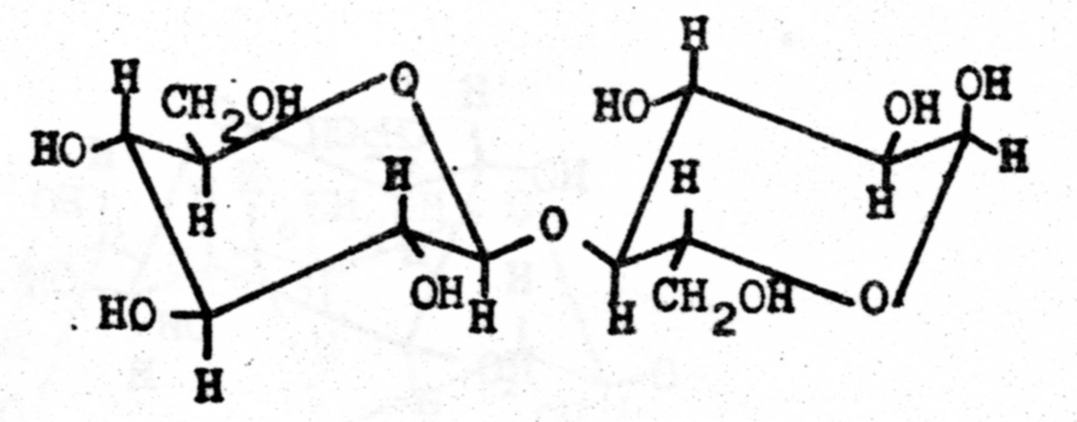
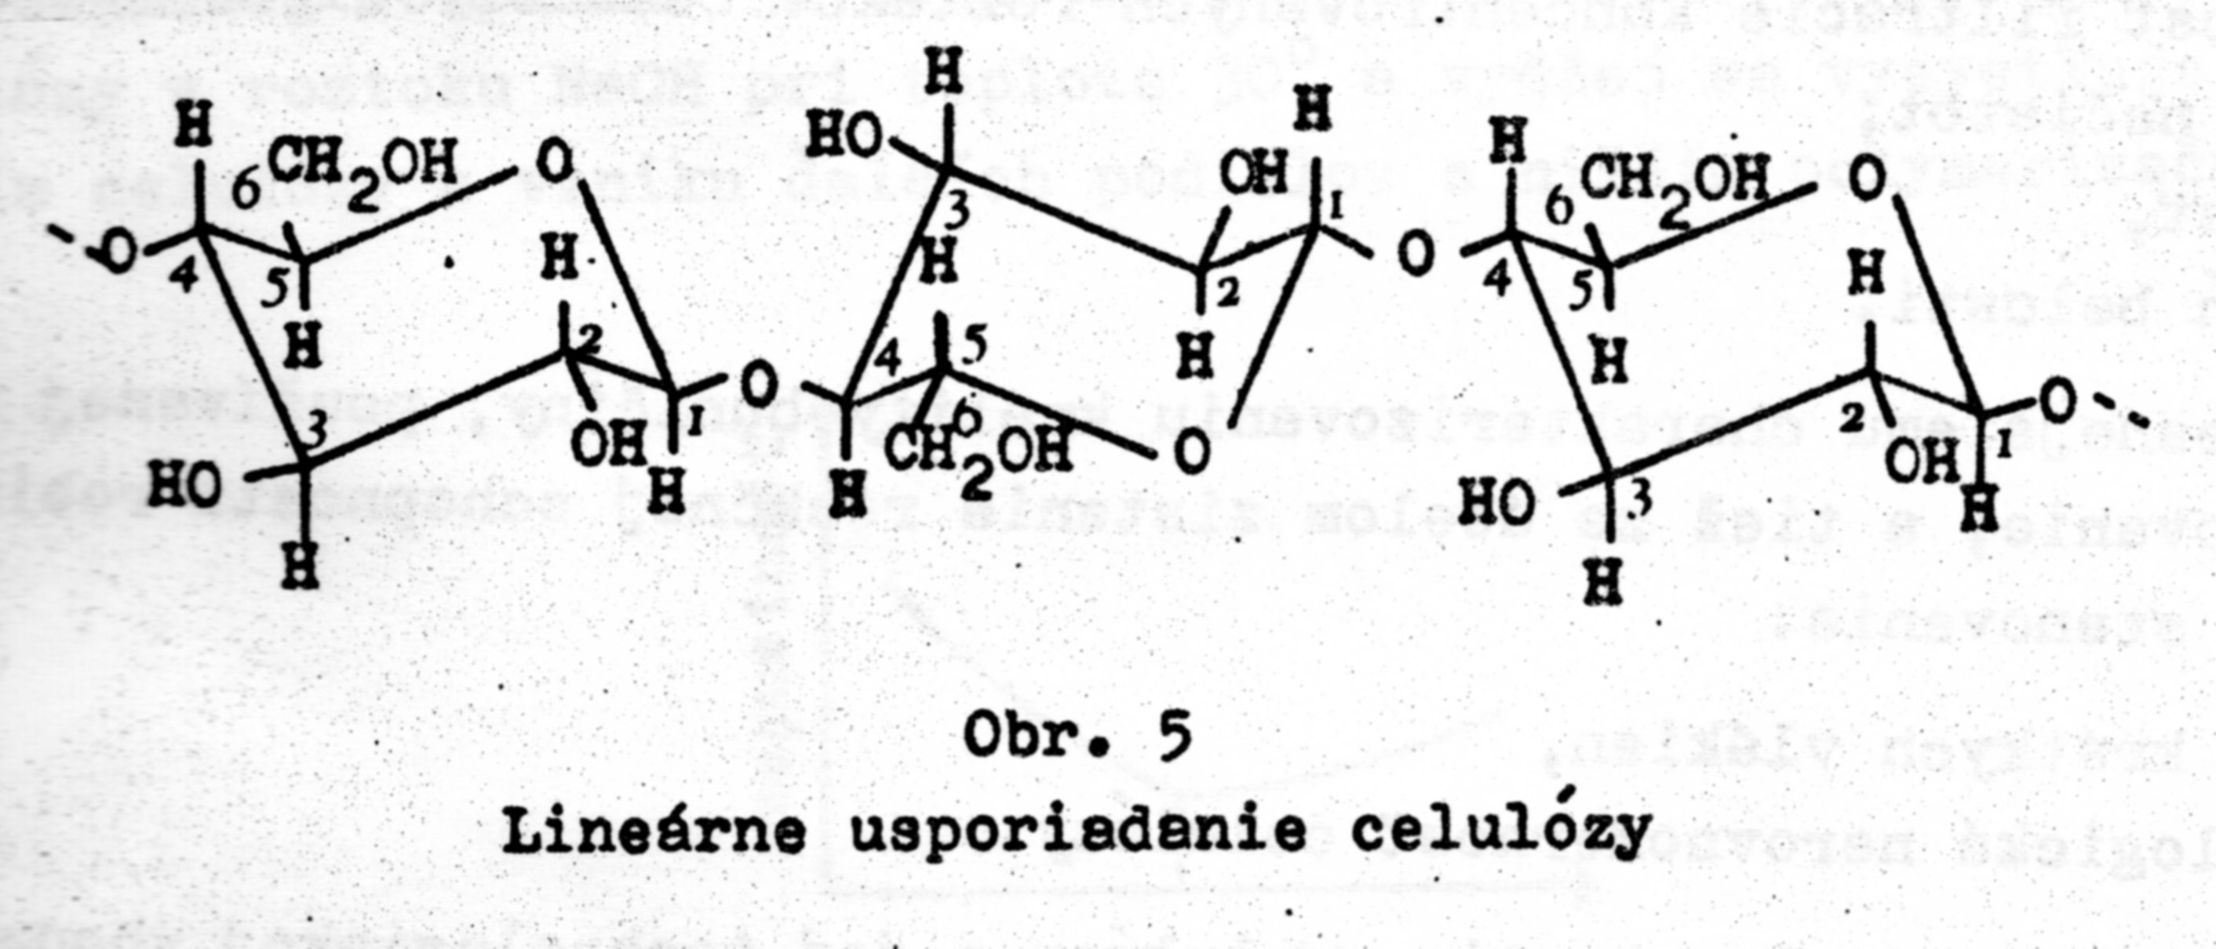
Cellobiose
Linear Structure of CELLULOSE

Slide 15
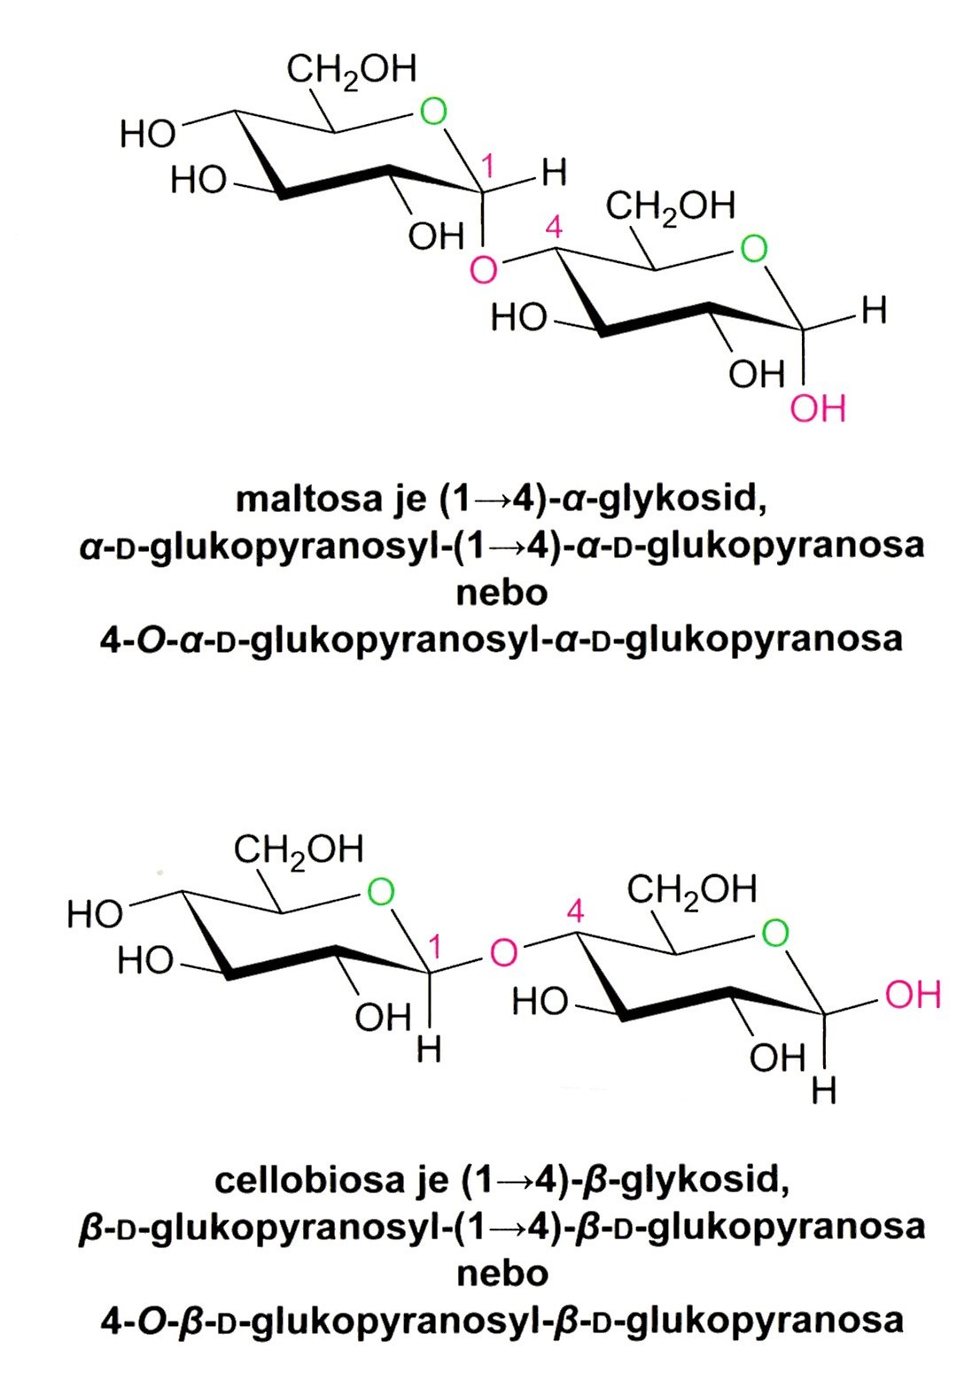
Maltose is the repeating unit of STARCH: α(1−4) dimer of GLUCOSE
Cellobiose is the repeating unit of CELLULOSE: β(1−4) dimer of GLUCOSE

Slide 16
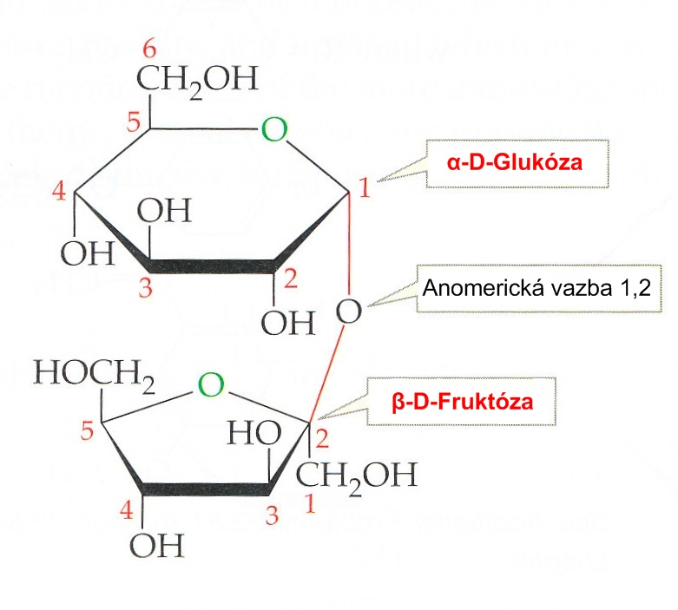
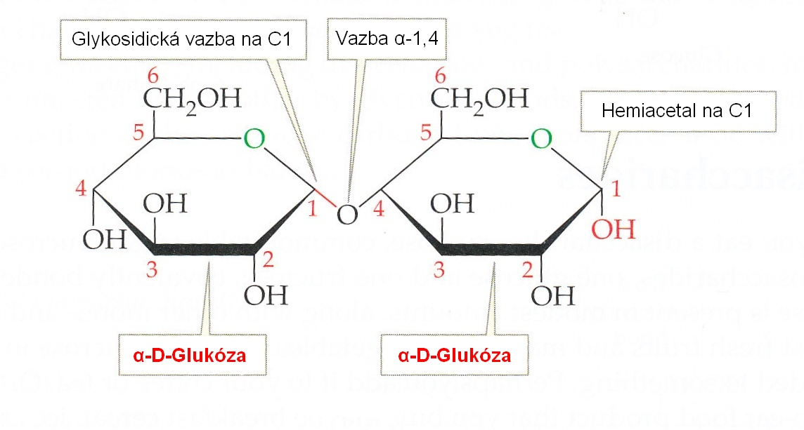
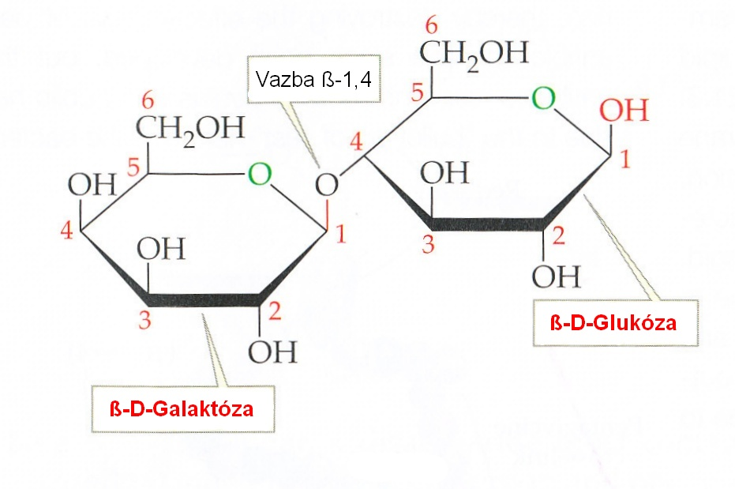
Survey of the most important disaccharides
Saccharose
The Bond arose via Hemiacetal HYDROXYLS from both constituent Parts
beet-sugar, cane-sugar
no reducing
Maltose
Product of the Starch molecule Cleavage
The Bond arose via Hemiacetal HYDROXYL from one constituent Molecule and NON Hemiacetal HYDROXYL from the other constituent Molecule
Lactose
Reducing Sugars

Slide 17
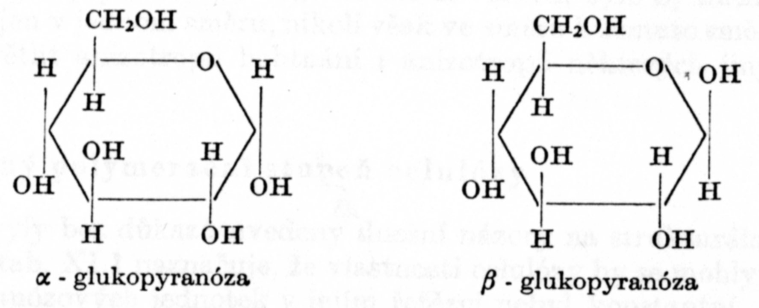
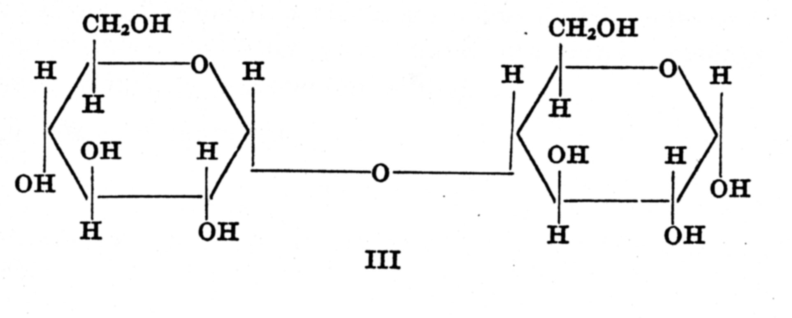
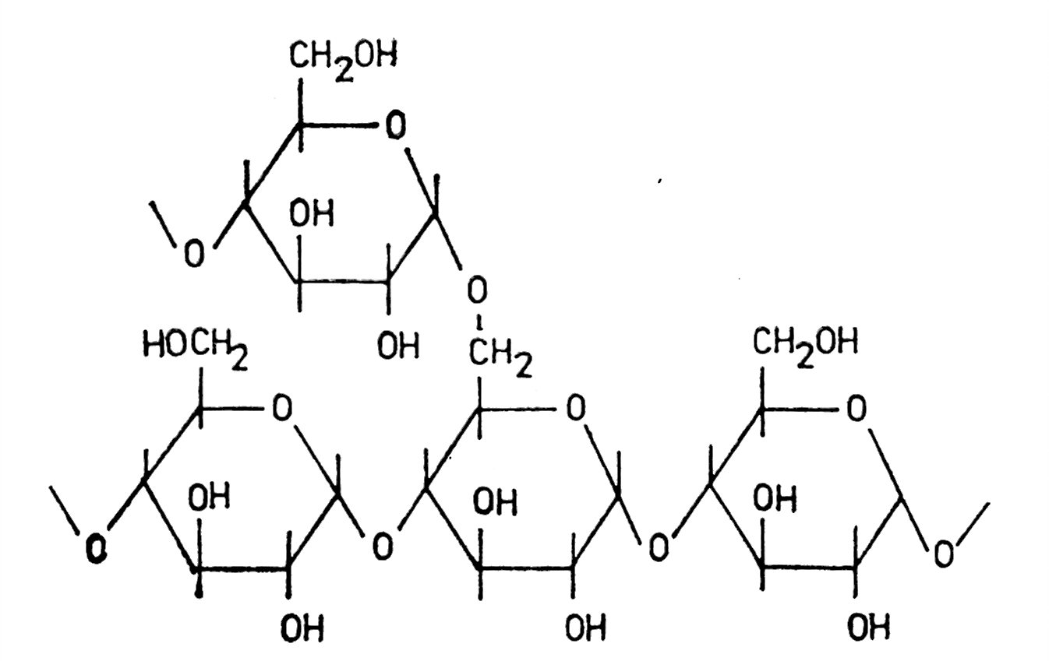
The Path from GLUKOSE to MALTOSE and finally to STARCH
H

Slide 18
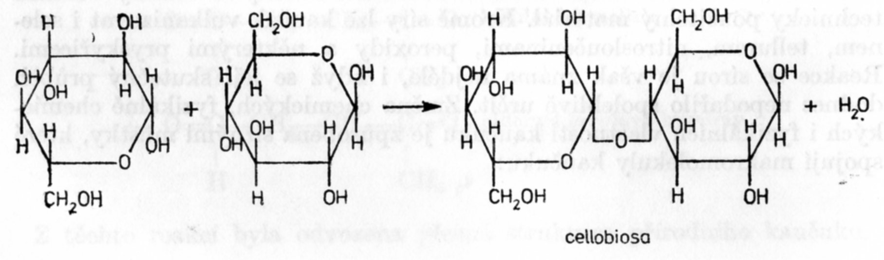
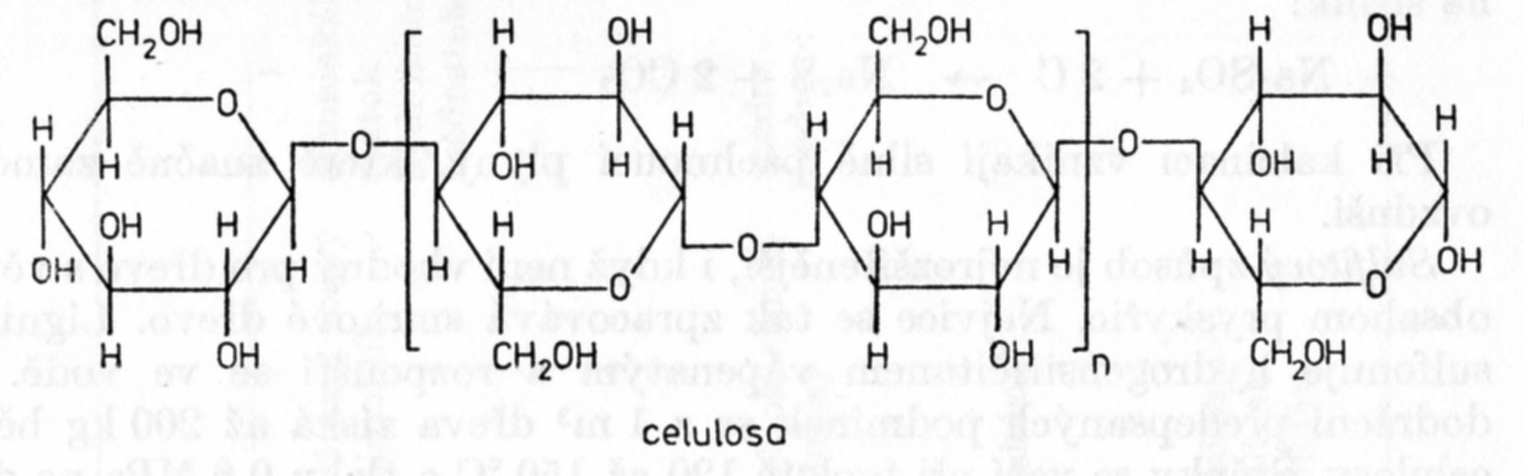
The Path from GLUKOSE to CELLOBIOSE and finally to CELLULOSE

Slide 19
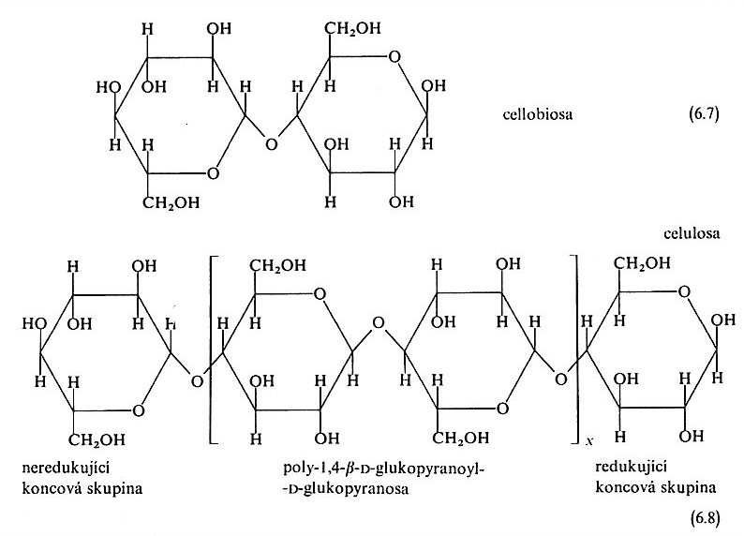
Cellulose Chemistry I/1
Cellulose belong to the Polysaccharides
Cellulose form the main Part of the BIOMASS
Poly-(β−D-glucose) (Simplified Name)
Poly-1,4-β−D-glucopyranoyl-D-glucopyranose
C4
C1

Slide 20
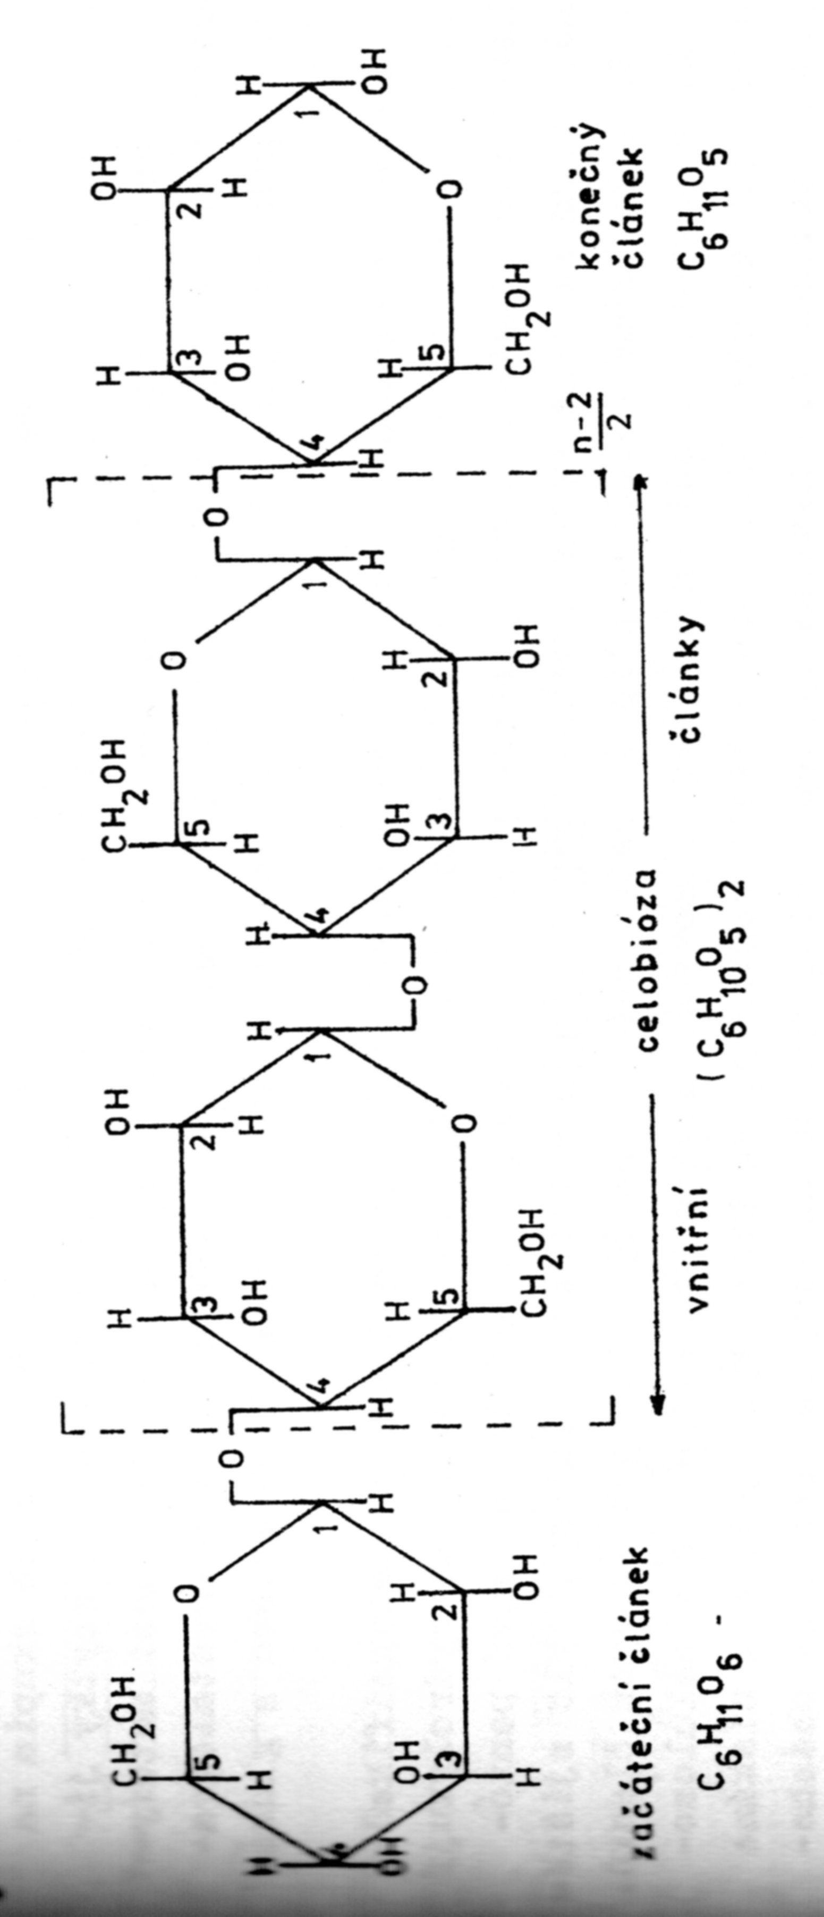
Cellulose Chemistry I/2
It is the REDUCING FORM, but due to very low Concentration (the Macromolecule End Group only) CELLULLOSE is only very low reducing Polysaccharide
Beginning Segment
Final
Segment

Slide 21
Cellulose Chemistry I/3
CELLULOSE is the High REDUCING POLYSACCHARIDE AFTER HYDROLYSE to GLUCOSE ONLY (ß-D-GLUCOSE )

Slide 22
Cellulose Chemistry I/4
CELLULOSE as the reducing Polysaccharide is used for DEGREE OF POLYMERIZATION DETERMINATION BY END GROUPS METHOD, but which is assumed as LOW PRECISSE

Slide 23
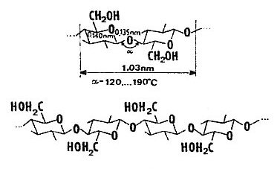
Cellulose Chemistry II

Slide 24
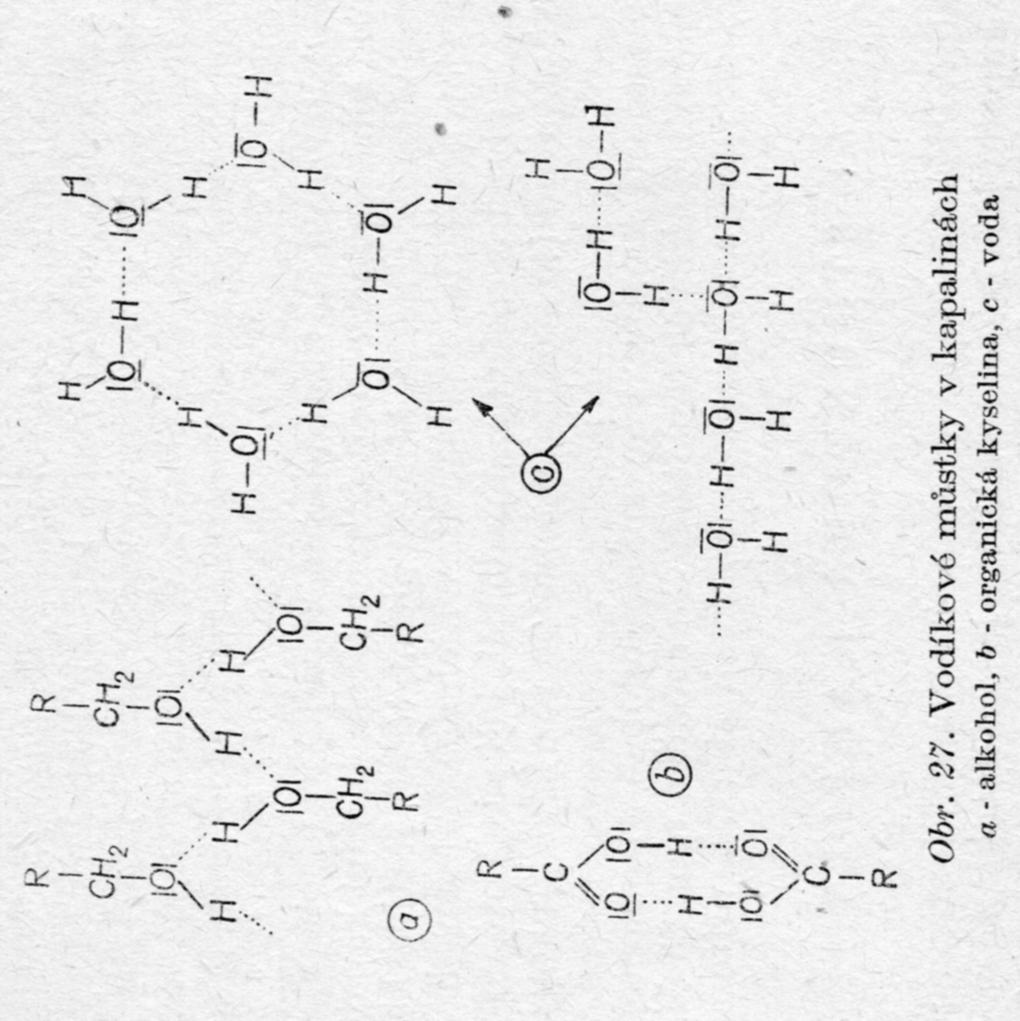
Revision is necessary!
Hydrogen Bonds do not have Strength as high as classical Chemical Bond has.
Hydrogen Bonds are easy broken.
The new such Bond are restored immediately afterwards and there is Steady Association degree via Hydrogen Bonds at given Temperature
Hydrogen Bonds in Liquids: a) Alcohol, b) Organic Acid, 3) Water

Slide 25
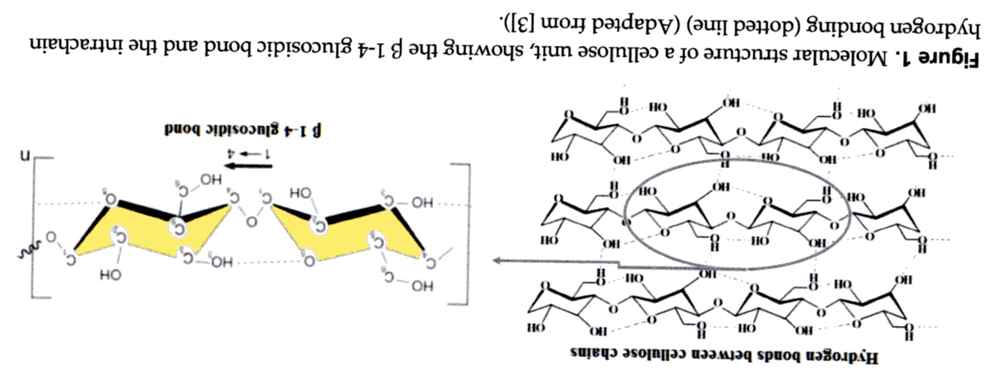
Cellulose Chemistry III/1
Hydrogen Bonds are as inside one Molecule, so between two neighbouring Molecules
Secondary Structure (Interaction in one Macromolecule Chain)
Tertiary Structure (Interaction between two or more Macromolecule Chain)

Slide 26
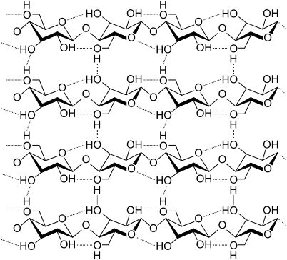
Cellulose Chemistry III/2
Once more Interactions both in one Macromolecule Chain and between two or more Macromolecule Chain)

Slide 27
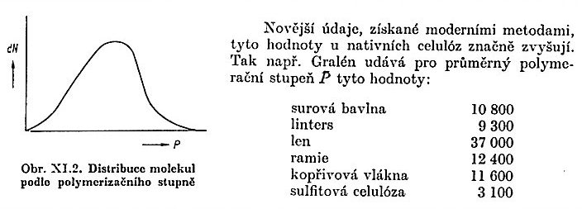
Cellulose Chemistry IV
Short Fibers in the Cotton, which are not able to be spun to Thread (Waste Fibers, employed for the Chemical polymeranalogic modifiCaTION of Cellulose )
Cellulose DEGREE OF POLYMERIZATION – NATIVE Cellulose
Raw Cotton
Linters
Flax
Ramie
Nettle
Sulfite Cellulose
DEGREE OF POLYMERIZATION DISTRIBUTION – AN EXAMPLE ONLY!
P = M/162
Mean M_{w} (other Source accordingly)
Cotton 1,78 – 2,43 x 10⁶
Sulfite Cellulose 0,60 x 10⁶
Viscose Fibres 0,23 x 10⁶
ANOTHER SOURCE (P):
Cotton 15 000
Sulfite Cellulose 5 – 9000
Viscose Fibres 300

Slide 28
Alpha, beta and gamma celluloses have the same chemical structure, but celiluloses differ polymerisation degree (DP) and celluloses have diffrent solubility in 17,5% NaOH. Alpha cellulose doesn't dissolve in 17,5% NaOH and DP above 200. Beta cellulose dissolve in 17,5% NaOH and DP 30-200, but we can precipitated again from NaOH solution. Gamma cellulose dissolve in 17,5% NaOH and DP 10-30, but we can't precipitated again from NaOH slolution
The alpha-cellulose is usually measure with the TAPPI's methods, but not the beta and gamma celluloses. I suppose that the alpha is the most plentiful of these ones but I am interested to know what is the difference between these celluloses according to their chemical structure.

Slide 29
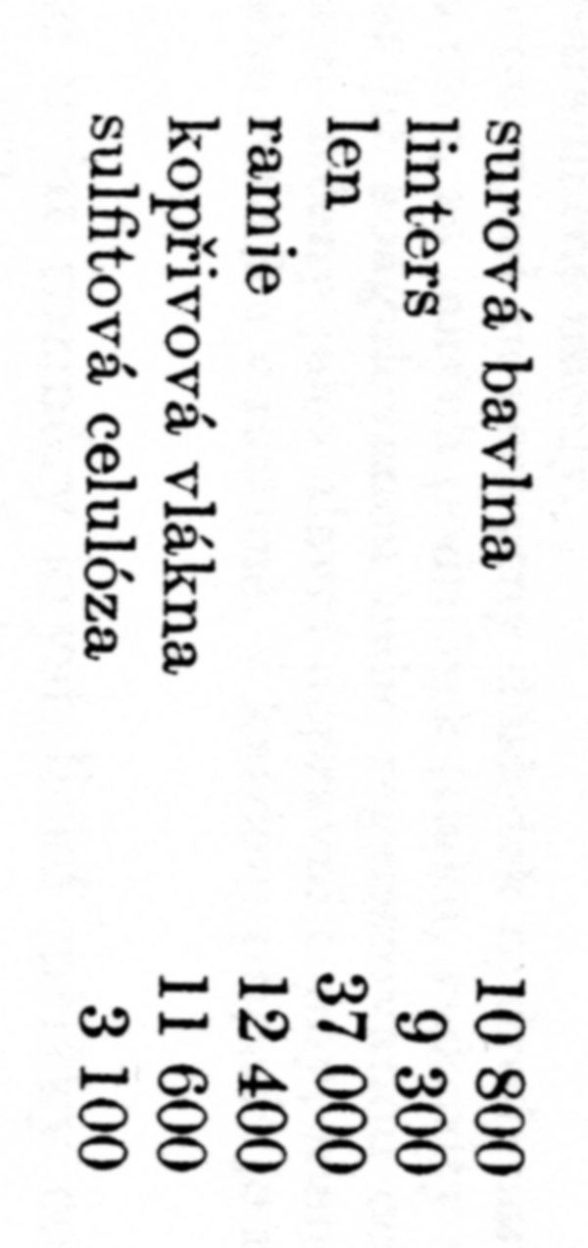
Cellulose Chemistry III b
Raw Cotton
Linters
Flax
Ramie
Nettle
Sulfite Cellulose
In GENERAL:
Bast Fibre and Cotton > HIGH P,
Woody plant – LOWER P,
REGENERATED Cellulose - LOW P
Linters =short Cotton Fibers, which are not able to be spun to Thread
DEGREE OF POLYMERIZATION of various Celluloses
Cellulose | P | Cellulose | P
Ramie | 3 500 – 4 600 | Pine | 1 000 – 1 200
Egyptian Cotton | 3 000 – 4 000 | Viscose Fibres | 250 – 800
Linters | Approx. 1 400 | α− Cellulose | >200
Linters boliled off | 1 200 – 1 300 | β− Cellulose | 30 - 200
Linters bleached | Approx. 700 | γ− Cellulose | 10 - 30
Beech | 1 200 – 1 400 | Beech bleached | 700 – 1 300
Poplar | 1 200 – 1 400 | Straw | Approx. 800

Slide 30
Cellulose Chemistry IV
The Figures of MW and P are different in different Source, except for COTTON
What could be the Reason:
  Various Natural Sources,
  Various viscose Fibre Grades (veRY PROBABLY),
  Various Measurement Methods
What is usually missing:
  MWD
  Given of type MW (M_{n} or M_{w})

Slide 31
CELLULOSE PHYSICS I
DENSITY approx. 1,5 g/cm³
  This is an Effect of heteroatoms > higher Density then most of the SYNTHETIC POLYMERS (an Exception is e.g. PVC, PET and PA)
  The Effect of Crystallinity > higher Density then Amorphous Parts of Macromolecules
TENSILE STRENGHT approx. 300 Mpa
  The Effect of an Fibre Orientation and Crystallinity
  The TENSILE STRENGHT is LOWER at wet Conditions > the Effect of Water on Lowering an Interaction between a Fibrils, formed by Macromolecules
WATER SORPTION is high approx. 7 % w/w at 20 °C a 65 % RH (relative Humidity)

Slide 32
Cellulose Solubility
Solvent | Solubility | Associated Process
Water | Insoluble | Water Sorption, without Change of P_{n}
Solutions of some inorganic Salts (ZnCl₂, AlCl₃, SnCl₄ etc.) | Soluble | Part Hydrolysis >Change of P_{n}
Inorganic Acids (HCl, H₂SO₄, H₃PO₄ etc.) | Soluble | Part Hydrolysis >Change of P_{n}
Hydroxides of alkalic Metals | Soluble | Alcoholates Formation
Amine Complexes – Schweitzers Reagent | Soluble | Copper complexes formation
Alkylamines | Soluble | I do not know

Slide 33
Cellulose Solubility in 17,5 % w/w NaOH Water Solution after Wood delignification
Solvent 17,5 % w/w NaOH Water Solution | Solubility | Associated Process
Cellulose | Insoluble
β Cellulose | Soluble | By Acidification of Filtrate by Acetic Acid precipitate from the Solution Chains having P_{n} > 200, arisen during Delignification
γ Cellulose | Soluble | It remains in the Solution after Precipitation β cellulose and it is necessary to precipitate it using EtOH. It contains HEMICELLULOSES.

Slide 34
Cellulose Solubility in 17,5 % w/w NaOH Water Solution after Wood delignification – INTERNATIONAL NORM
INTERNATIONAL NORM | ISO 692
English Denomination | Determination of alkali solubility
Date of Issue | 1.10.1993

Slide 35
Melting Points & Solubility of Saccharides and Cellulose
You can find also other Figures related to Temperature of Cellulose Decomposition!
It is given by:
Air or Inert Gas (Nitrogen, Helium etc.),
Presence of the transition Valence Elements (mainly Fe⁺³, Mn⁺², Co⁺² etc.), which catalyse this Oxidation
Substance | Melting point (°C) | Solubility in Water (% w/w)
Glucose | 146 | Approx. 909 - 1 200 g/L
Cellobiose | 203 (Decomposition) | Approx. 12 g/L
Cellotriose | 238 (Decomposition) ??? | 25 - 50
Cellotetrose | 251 (Decomposition) ??? | 12,5 - 25
Cellopentose | > 226 (Decomposition) | 5
Cellulose | 270 (Decomposition) | Insoluble

Slide 36
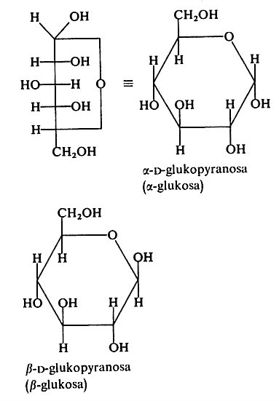
STARCH versus CELLULOSE I
STARCH is Polymer of α-D-glukopyranose
CELULLOSE is Polymer of β-D-glukopyranose

Slide 37
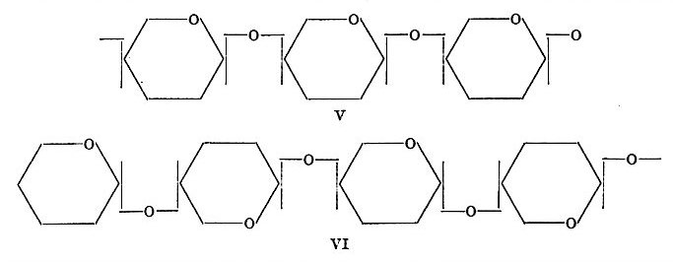
STARCH (linear AMYLOSE) versus CELLULOSE II
STARCH is Polymer of α-D-glukopyranose
CELULLOSE is Polymer of β-D-glukopyranose

Slide 38
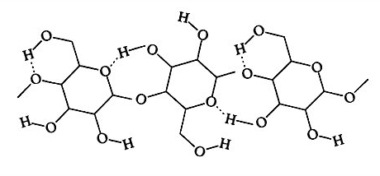
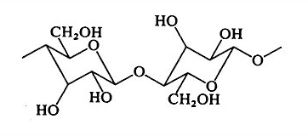
Strong Interactions via
Hydrogen Bonds
Other Possibility to represent Cellulose

Slide 39
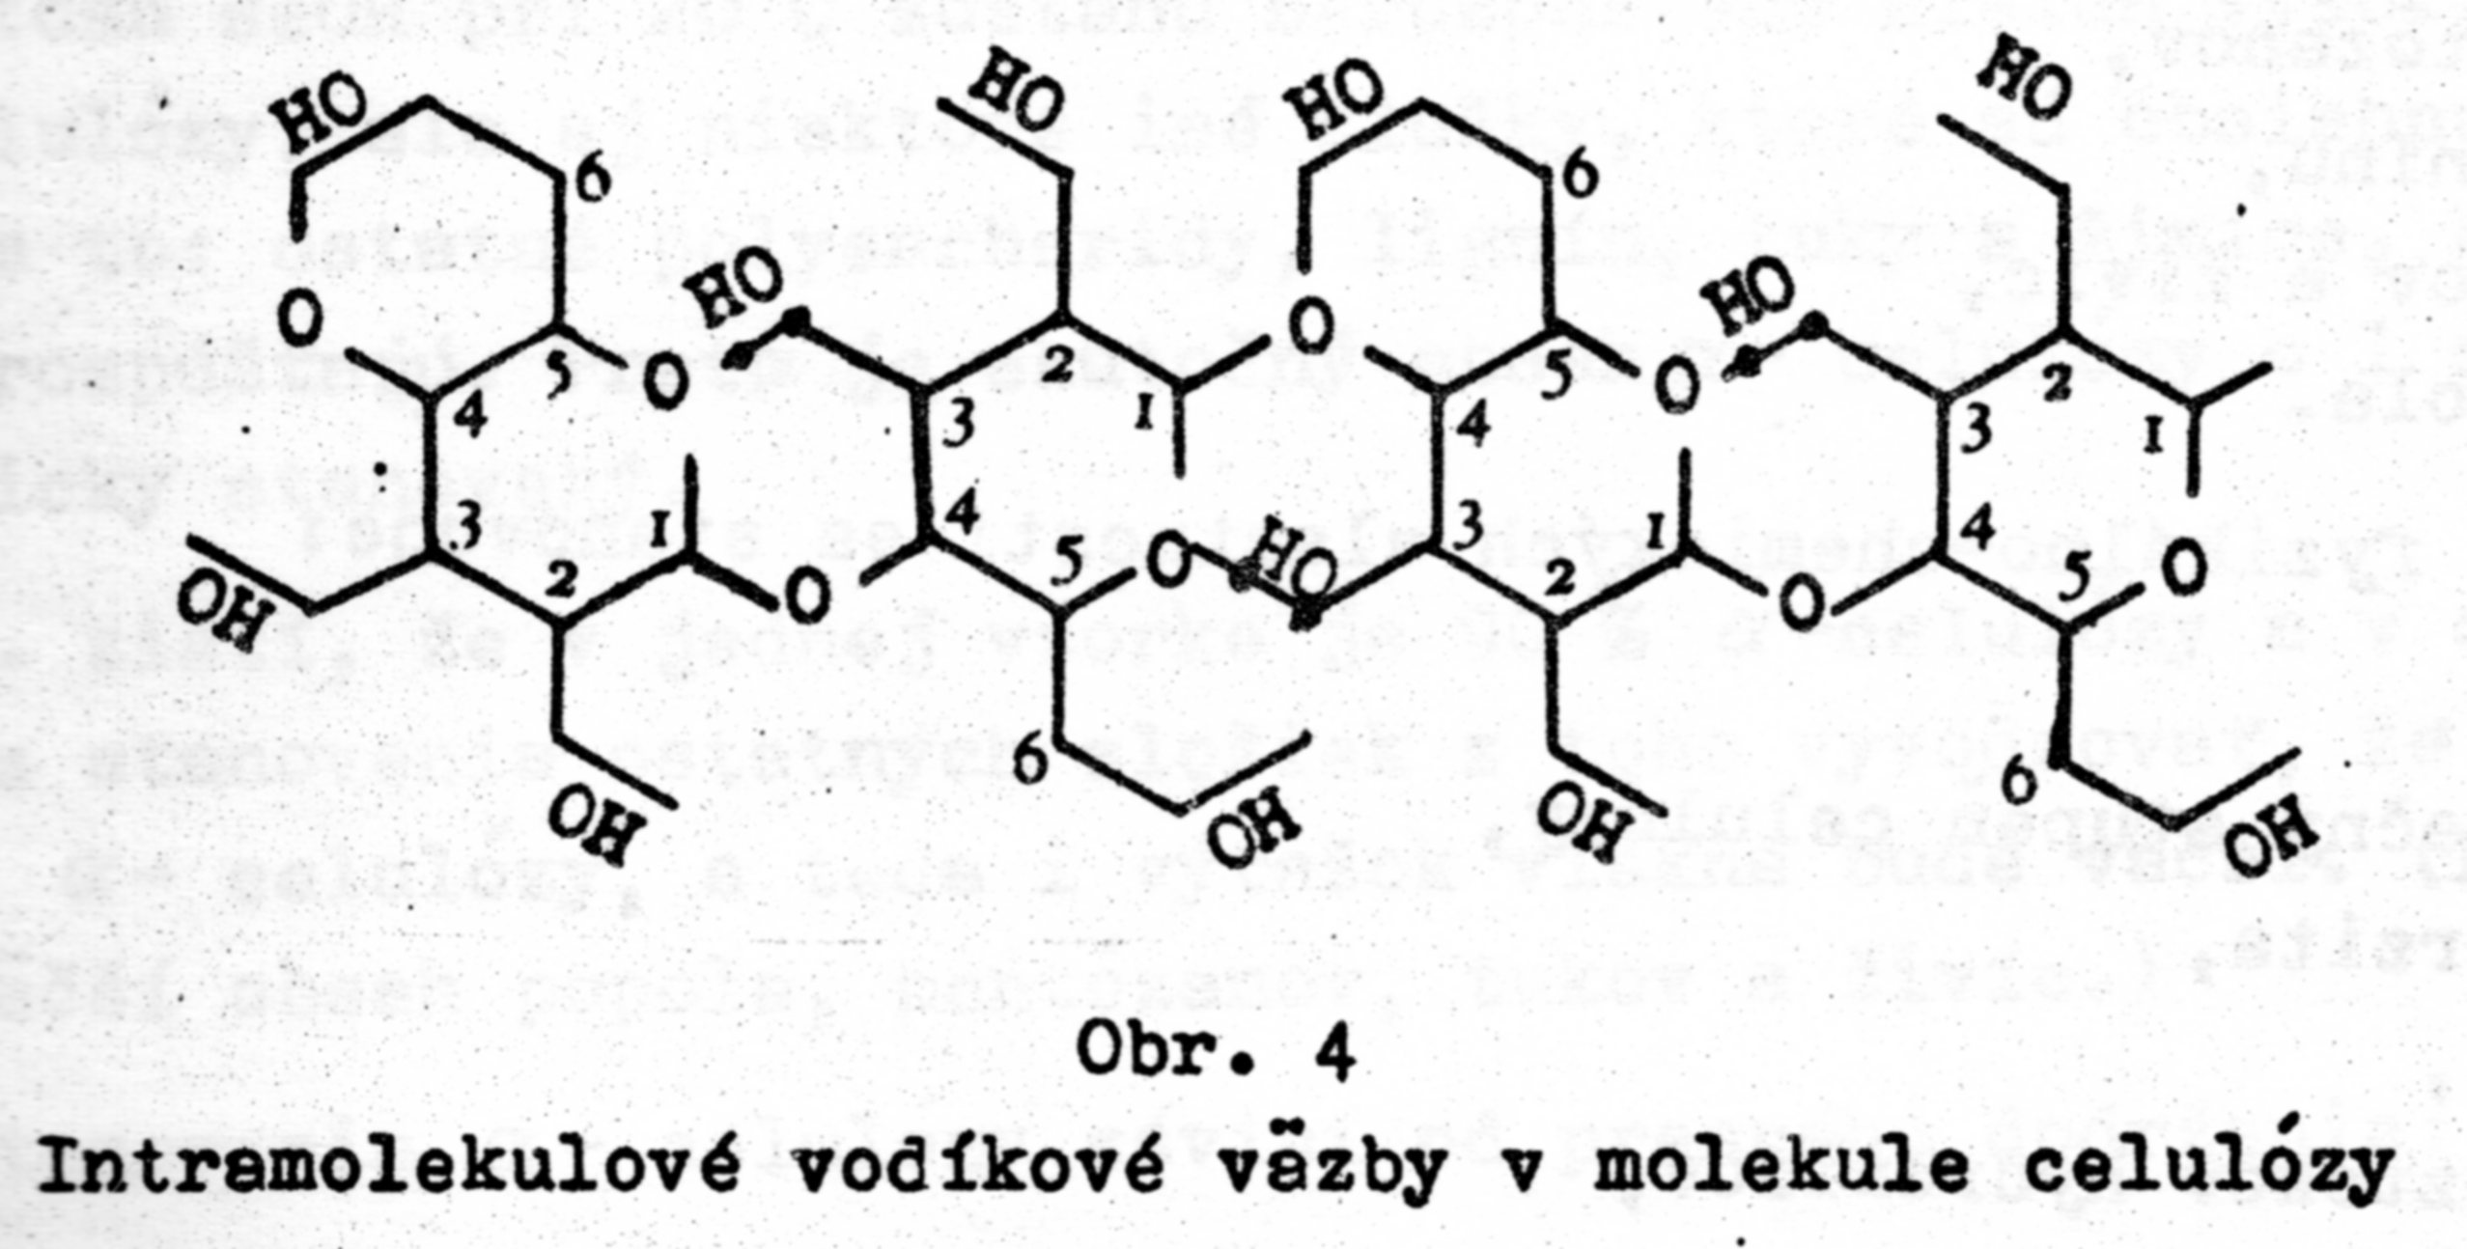
Strong Interactions via
Hydrogen Bonds

Slide 40
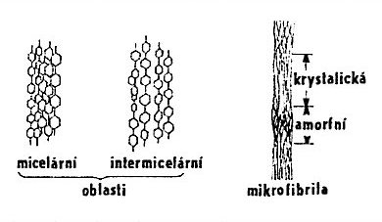
Supermolecular Structure of Cellulose I
crystalline
AMORPHOUS
Space between the Microfibrils is filled by HEMICELLULOSE & LIGNIN
Micellar Intermicellar
REGIONS
Microfibril
Hierarchy of STRUCTURES in CELLULOSE:
Macromolecule,
Microfibril,
Fibril,
LAMELAE.
Colourless inert Substance Insoluble in Water
, Density 1,55 g/cm³
AMORPHOUS CELLULOSE:
easy to swell
is more reactive than the crystalline one

Slide 41
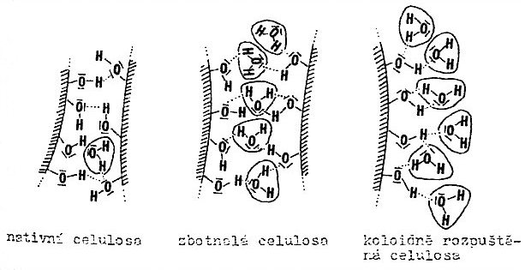
Supermolecular Structure of Cellulose II
Native Cellulose
Swollen Cellulose
Colloidal Solution of Cellulose
Strong Interactions via
Hydrogen Bonds

Slide 42
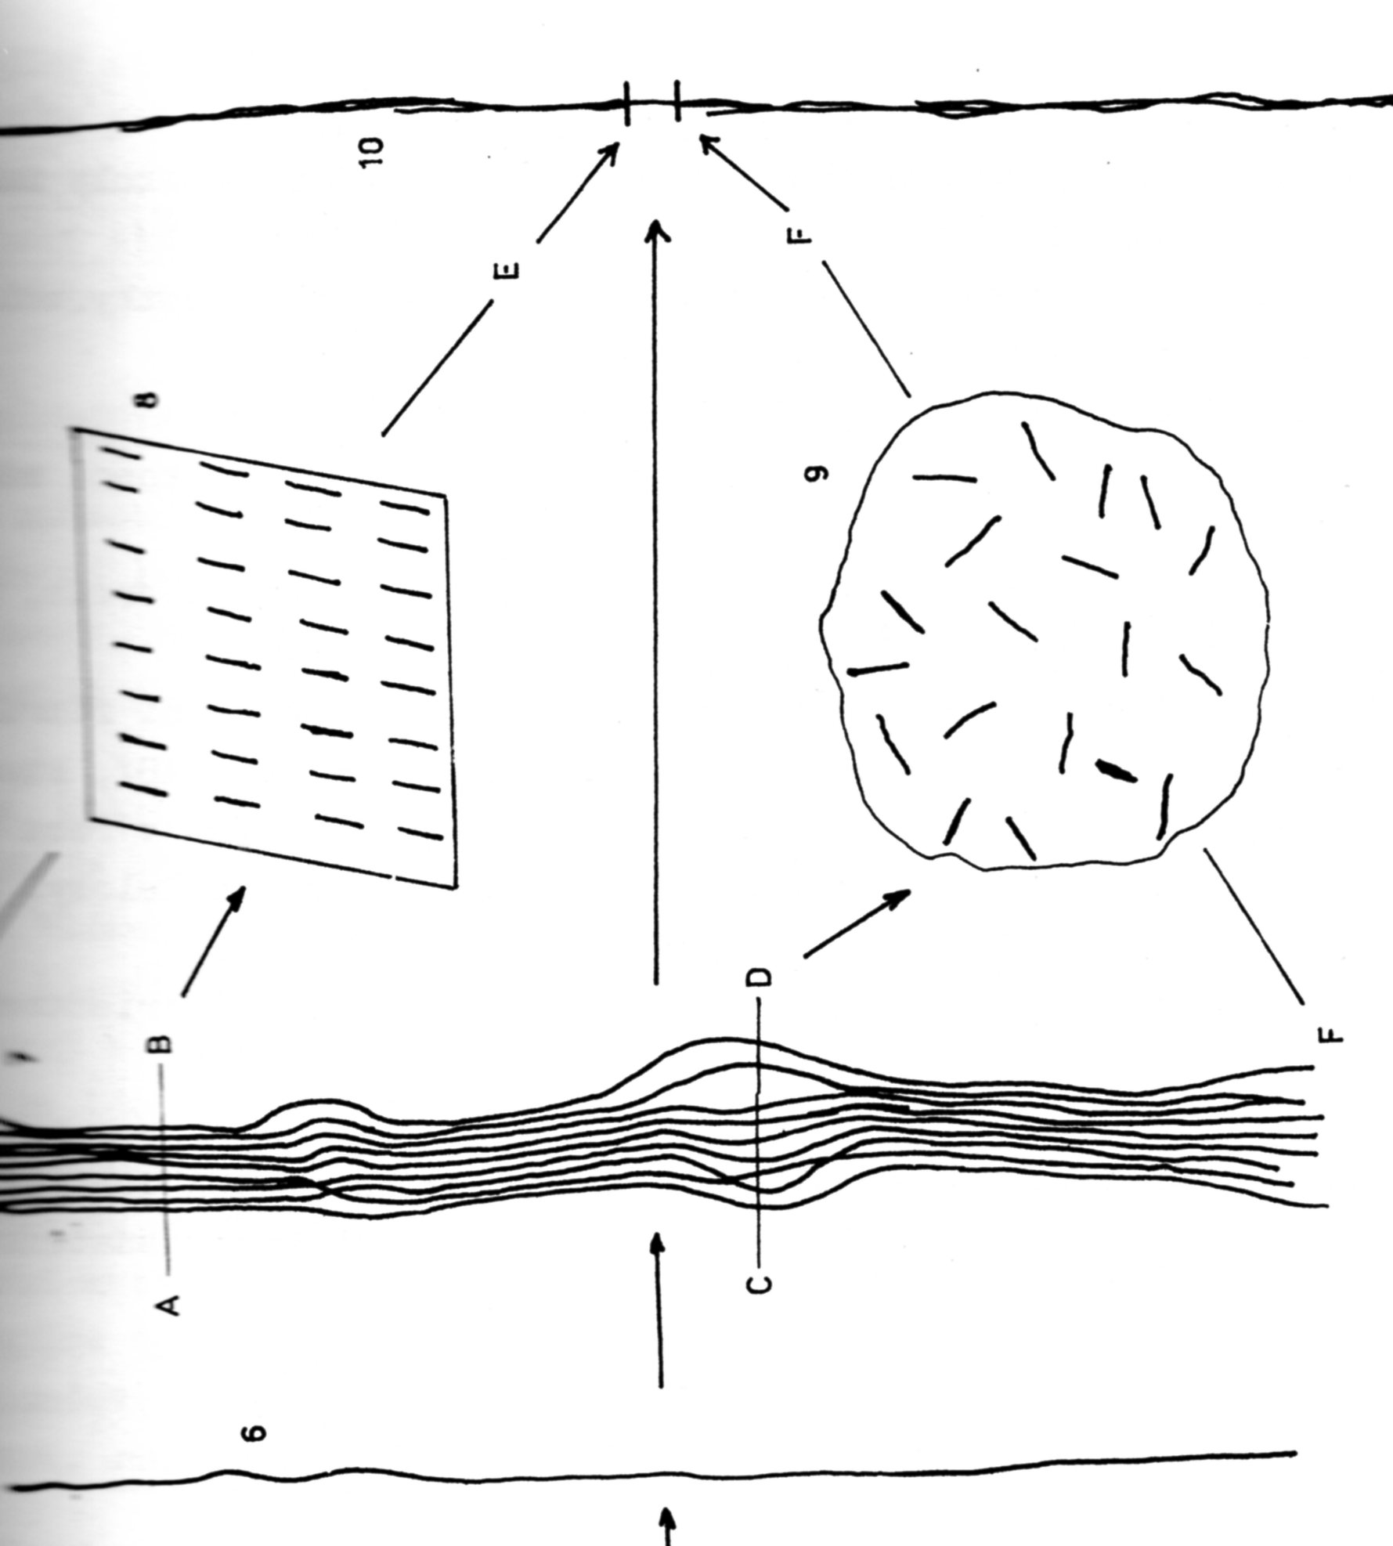
Supermolecular Structure of Cellulose III
A – B > Crystalline Part
C – D > Amorphous Part
8 Crosscut through the CrystallinePart
9 Crosscut through the Amorphous Part, which is PARTLY (lengthwise) ORIENTED > NEMATIC STRUCTURE
10 Bundle (ELEMENTARY FIBRIL, MICROFIBRIL)
MADE OF SEVERAL MaCromoleCulES
MICROFIBRIL:
THICKNESS is usually 3 – 30 nm
LENGTH is usually Units of Microns

Slide 43
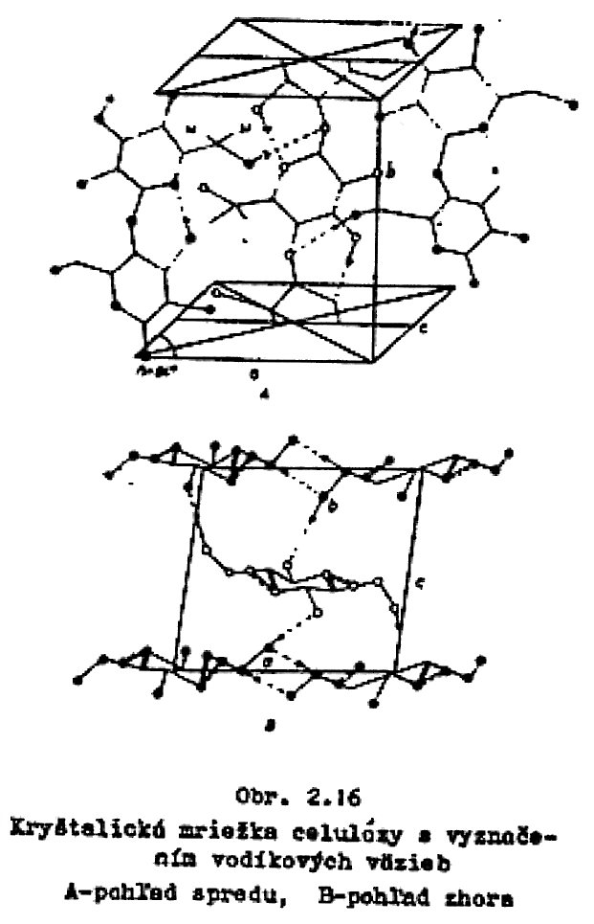

Crystalline Structure of Cellulose I
Basic Cell of Cellulose
Crystal lattice of Cellulose with marked Hydrogen Bonds
Strong Interactions via
Hydrogen Bonds

Slide 44


Crystalline Structure of Cellulose II
I – Native Cellulose
II – REGENERATED Cellulose
III – It is formed via Action of Ammoniac or Amine on I or II Cellulose
IV –by Heat Treatment + Glycerine on I or II Cellulose
X – via Action of HCl, H₂SO₄, H₃PO₄
Scheme of Transition between Individual Polymorphid Forms of Cellulose

