Slide 1
NATURAL POLYMERS
Polysaccharide II CELLULOSE 2
Cellulose is the most widespread BIOPOLYMER on Earth, up to 1,5×10⁹ tons per annum is arising
Dr. Ladislav Pospíšil

Slide 2
Time schedule
LECTURE | SUBJECT
1 | Introduction to the subject – Structure & Terminology of nature polymers, literature
2 | Derivatives of acids – natural resins, drying oils, shellac
3 | Waxes
4 | Plant (vegetable) gums, Polyterpene – natural rubber (extracting, processing and modification), Taraxacum_kok-saghyz
5 | Polyphenol – lignin, humic acids
6 | Polysaccharides I – starch
7 | Polysaccharides II – celullosis
8 | Protein fibres I
9 | Protein fibres II
10 | Casein, whey, protein of eggs
11 | Identification of natural polymers
 | Laboratory methods of natural polymers’ evaluation

Slide 3
Cellulose natural Abundance in WOOD
WOOD
Polymeric Substances
(90 – 97 % w/w)
Associated Substances (3 – 10 % w/w)
Polysaccharide Part
HOLOCellulose
AROMATIC Part
LIGNIN
(25 – 35 % w/w)
Inorganic Substances
Organic Substances
Cellulose
(45 – 50 % w/w)
HEMICellulose
The only approx. 1/3 of the whole Tree is Cellulose, including a Root and a Tree stump!

Slide 4
Cellulose natural Abundance in WOOD–another Scheme
Polymeric Substances
(90 – 97 % w/w)
Polysaccharide Part
HOLOCellulose
(70 % w/w)
AROMATIC Part
LIGNIN
(18 – 28 % w/w)
HEMICellulose
&
Polyuronide
(20 – 30 % w/w)
Polyuronide
Cellulose
(40 – 47 % w/w)
Pectine
Wood Gums
Alginate
Real (Pure)
HEMICellulose

Slide 5
Occurrence of the Associated Substances in WOOD
Substance
Saccharide
Essential/ethereal oil (terpeny)
Tannine
Sterols (it belongs to TERPENOIDES)
Inorganic Substances (Ash)
Fats, Oils, Waxes
Resinous Acids (e.g. Abietic Acid, which is a Part Resins)
Proteins
Aliphatic Acids

Slide 6
Cellulose natural Abundance
Chemical Composition of COTTON versus WOOD
Component % w/w | COTTON Linters | Coniferous Tree | Broad Leaf Tree
HOLOCellulose | 90 – 94 | 50 – 58 | 52 – 54
Pentosanes | 1,5 – 2,0 | 11 | 25
Lignin | 2,0 – 3,0 | 26 – 28 | 17
Pektines | 2,0 | 1,0 | 1,5 – 2,0
Proteins | 1,5 – 2,0 | 0,5 – 0,8 | 0,5 – 0,8
Fats & Waxes | 0,5 – 1,0 | 1,0 – 2,0 | 1,0 2,0
Ash | 1,0 | 0,25 – 0,5 | 0,25
Linters =short Cotton Fibers, which are not able to be spun to Thread
HEMICellulose
PDM = MEAN DEGREE OF POLYMERIZATION
Polyuronide
Cellulose Sort (Source) | PDM
Cotton | 1750 – 3356
Wood | 650 – 1256
REGENERATED Cellulose | 200 - 500
Hexosane
Pentosane

Slide 7
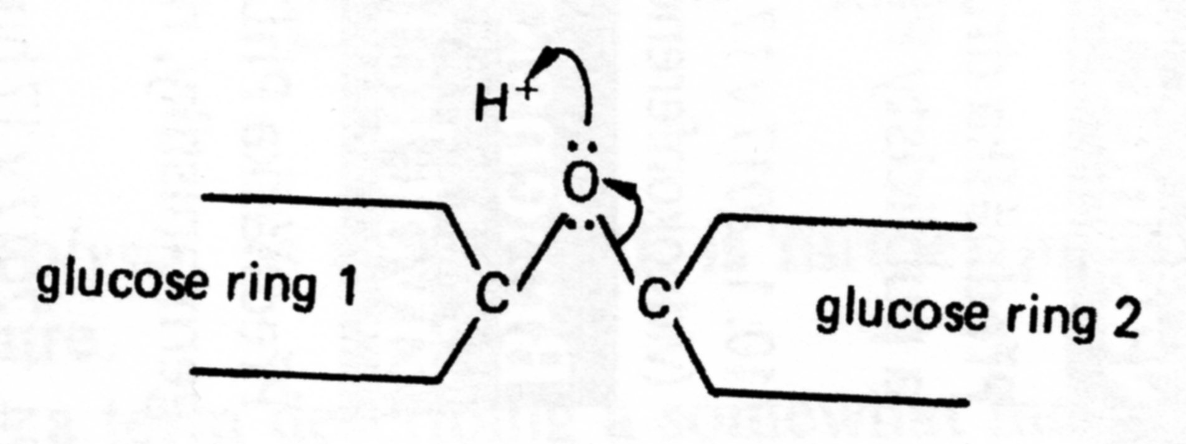
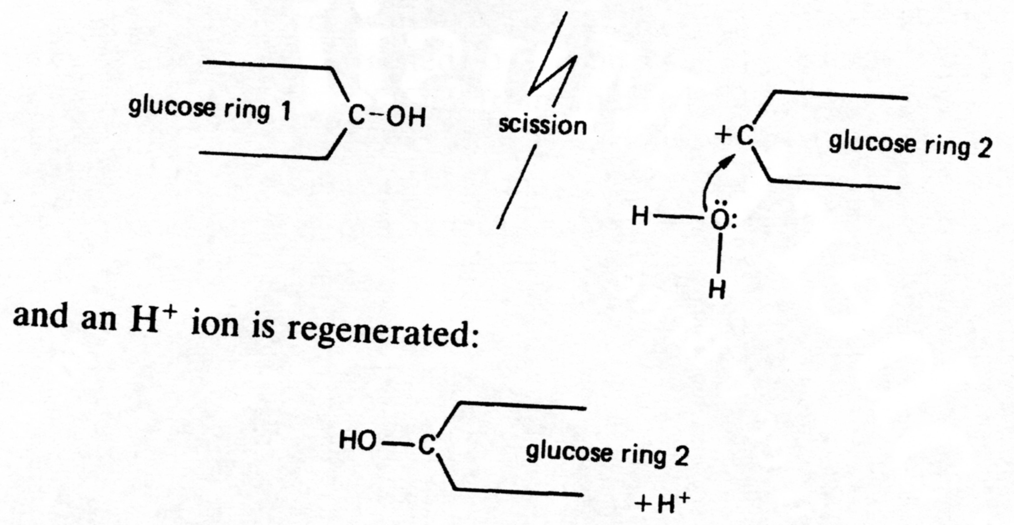
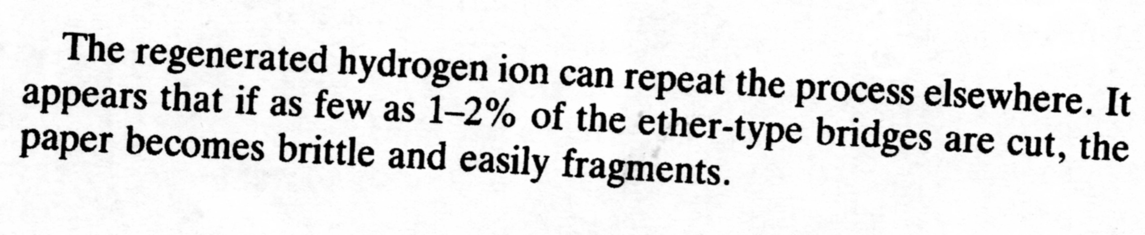
DEGRADATION of PAPER based on Cellulose 1

Slide 8
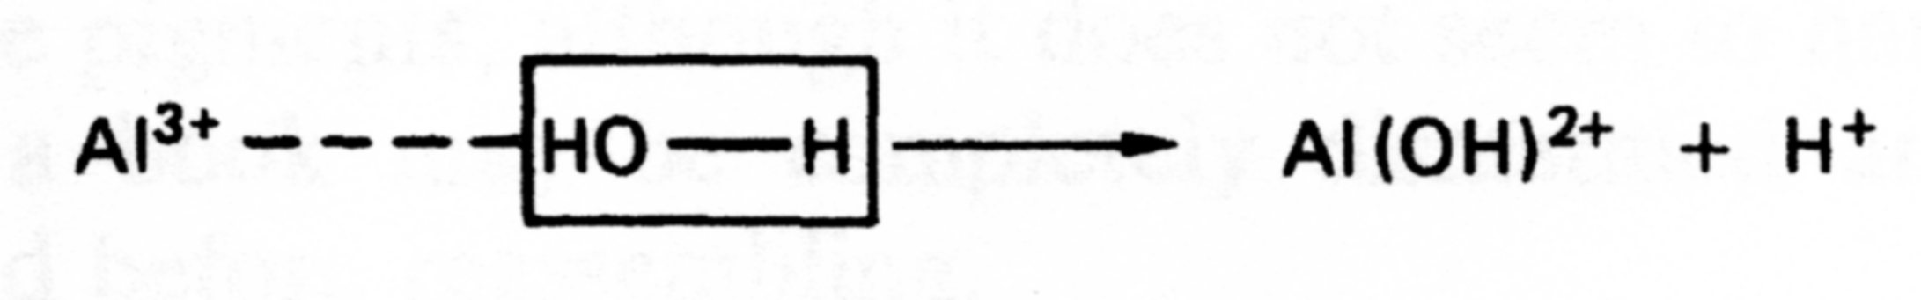
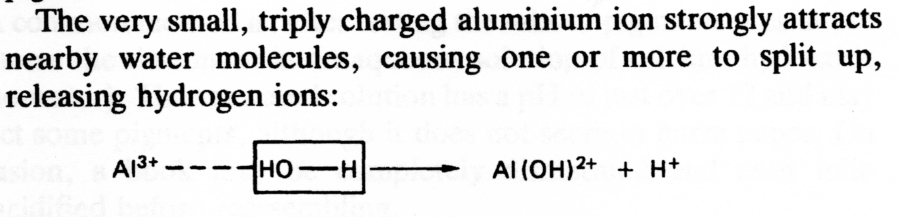
DEGRADATION of PAPER based on Cellulose 2

Slide 9
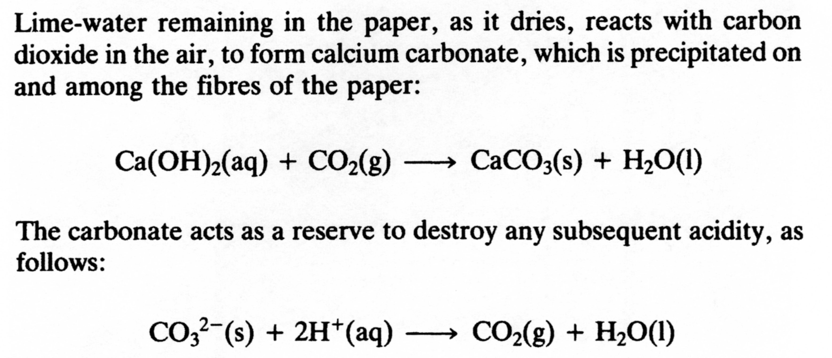
DEACIDIFICATION of PAPER based on Cellulose 1

Slide 10
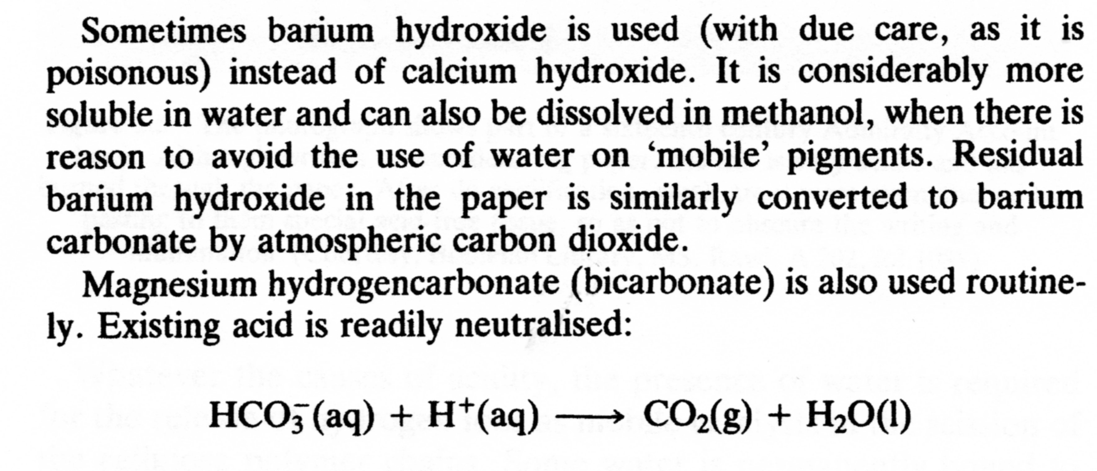
DEACIDIFICATION of PAPER based on Cellulose 2

Slide 11
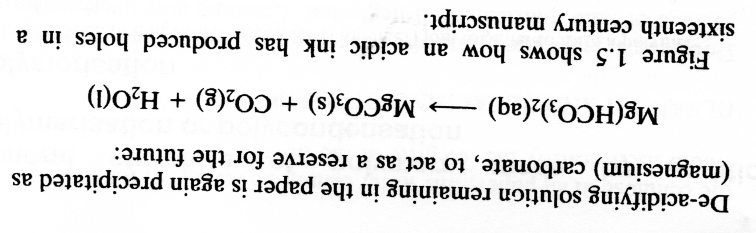
DEACIDIFICATION of PAPER based on Cellulose 3

Slide 12
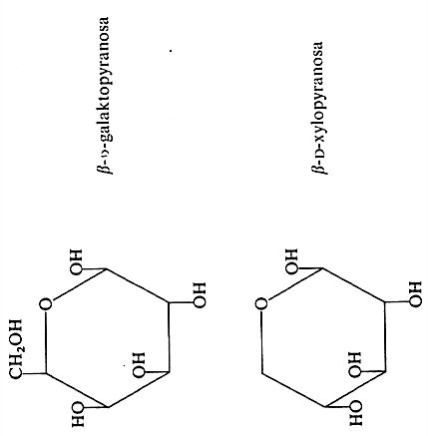
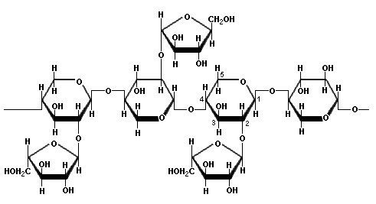
PENTOSANE – an Example
XYLANE - belongs to HEMICELULOSES

Slide 13
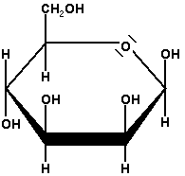
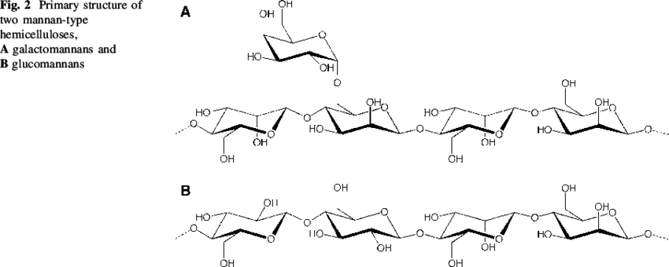
PENTOSANE – an Example
MANAN - belongs to HEMICELULOSES
Manose

Slide 14
MAIN of the Associated Substances in Cellulose 1
Hemicelulose
Lignin
Essential/ethereal oil (terpeny) (in Wood)
! COTTON Fibres have almost no Hemicelluloses or LIGNIN !

Slide 15
LIGNIN - DETERMINATION
INTERNATIONAL NORM | ISO/AWI Standard
English Denomination | Pulps -- Determination of lignin content -- Acid hydrolysis method
Date of Issue | Under development (18. 1. 2018)

Slide 16
MAIN of the Associated Substances in COTTON Cellulose 1
Chemical Composittion of COTTON
Component | Content (% w/w)
Cellulose | 95,3
Saccharides | 0,18
Reduced Saccharides | 0,04
Nitrogen Compounds | 0,17
Waxes | 0,73
Pectines | 1,20
Water extractable Compounds | 3,07
Organic Acids | 0,20
Ash | 0,86
The Figures from different Sources could be a bit different, what is PROBABLY due to COTTON sort
The Rest to 100 % is probable HUMIDITY
Cellulose & Associated Substances Concentration in COTTON
Componenet | Cellulose | Pectines | Proteins | Waxes | Ash
Primary Wall | 54 | 9 | 14 | 8 | 3
Secondary Wall | 96 | 1 | 1,1 | 0,4 | 1,0
COTTON Fiber | 94 | 1,2 | 1,3 | 0,6 | 1,2

Slide 17
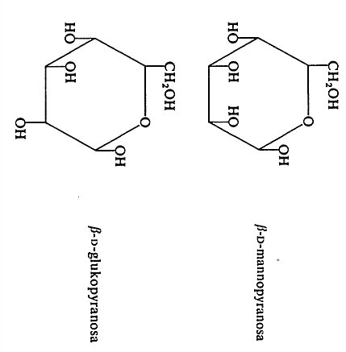
Hemicelulose – what are composed of? 1
The same Unit as the CELULOSE is

Slide 18
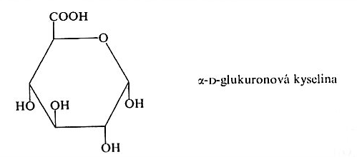
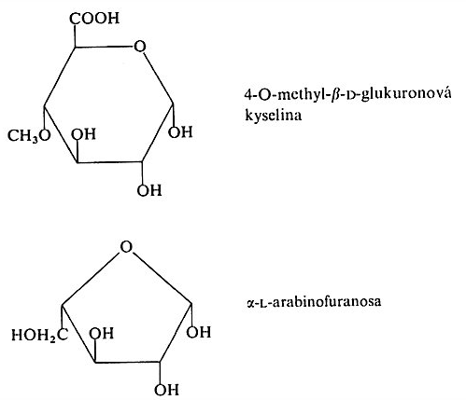
Hemicelulose – what are composed of? 2
ATTENTION: this is FURANOSE!
The five atoms Curcle only!

Slide 19
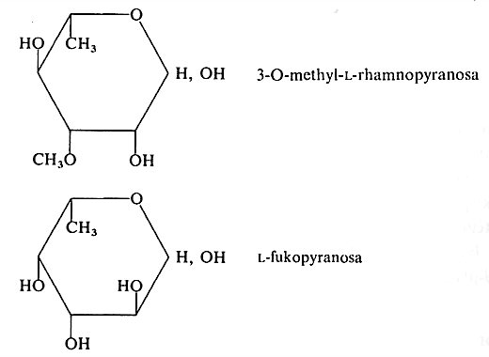
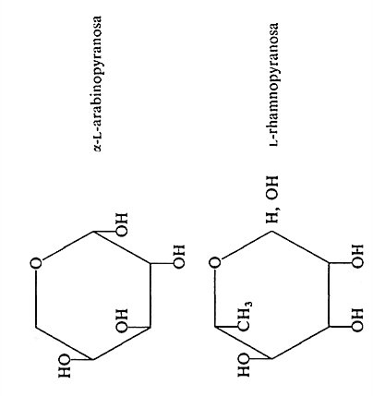
Hemicelulose – what are composed of? 3

Slide 20
Hemicellulose
There is approx. 17 – 41 % w/w of Hemicelulose in the Wood, more in the broad-leaved Trees
Polysaccharides with lower MEAN DEGREE OF POLYMERIZATION (approx. 100 – 200)
They are more easy to hydrolyse by both Acids and Bases
The short side Chains are frequently present
Hemicelluloses are sorted accordingly to their main building Components as follows:
  Xylan (mostly broad-leaved Trees)
  Mannan (mostly coniferous tree)
  Galactan (mostly coniferous tree)

Slide 21
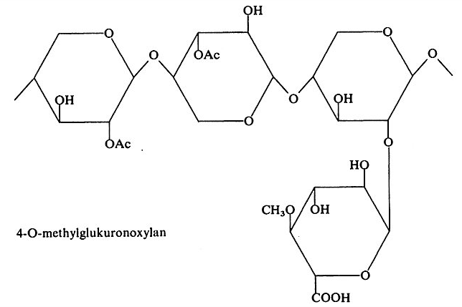
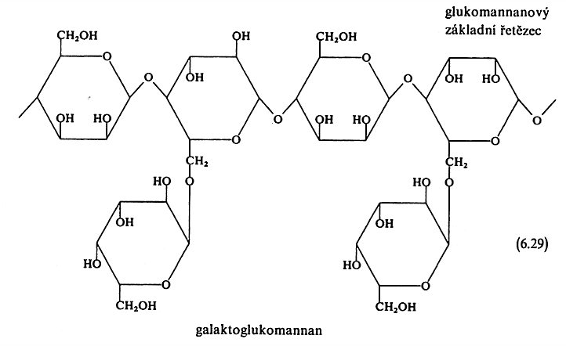
Hemicellulose
mostly broad-leaved Trees
mostly coniferous tree

Slide 22
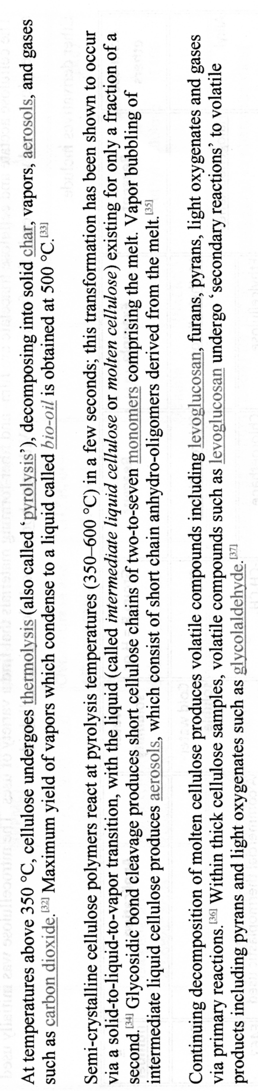
CELLULOSE - Thermic Degradation 1

Slide 23
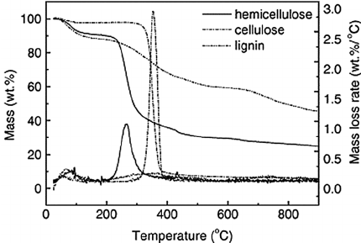
CELLULOSE - Thermic Degradation 2

Slide 24
Production of Cellulose I
WOOD
Polymeric Substances
(90 – 97 % w/w)
Associated Substances (3 – 10 % w/w)
Polysaccharide Part
HOLOCellulose
AROMATIC Part
LIGNIN
(25 – 35 % w/w)
Inorganic Substances
Organic Substances
Cellulose
(45 – 50 % w/w)
HEMICellulose
Bast/Stalk Fibres
Leaf Fibres
Seed Fibres
Flax Fibres
Hemp Fibres
Jute Fibres
Ramie Fibres
Kenaf Fibres
Sisal Fibres
Manila Hemp Fibres
Pineapple Fibres
Cotton Fibres
Kapok Fibres
Coconut Fibres

Slide 25
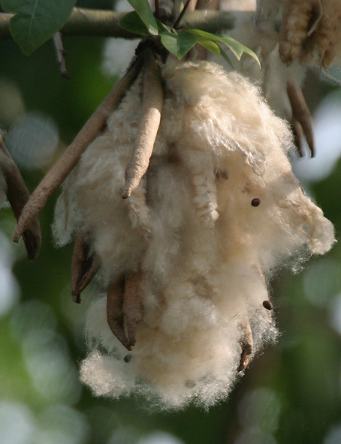
Production of Cellulose II
Seed Fibres – Cotton > the Harvesting and Cleaning are only necessary
The Fibre has already
Sufficient Fineness
(tex, denier),
it is Fibre diameter
Fibre length and Fineness
Are different according
to Place of growing
(Egypt, Asia)

Slide 26
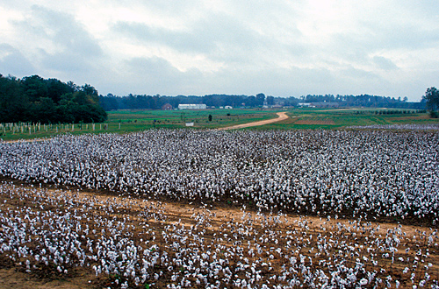
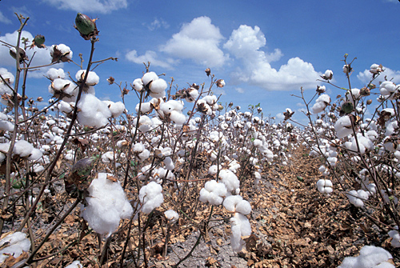
Cotton Field
Cotton entered Europe during 18. and 19. Centuries
Harvesting by Hand or by Machine

Slide 27
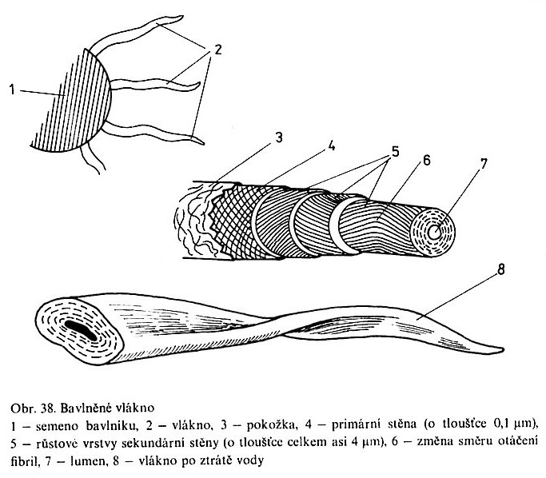
Morphology of the Cellulose Fibre 1
1) Cotton Seed, 2) Fibre, 3) Skin, 4) Primary Wall (approx. 0,1 mm), 5) Secondary Wall (approx. 4 mm), 6) Change of Fibrils’ Turning, 7) Lumen, 8) Fibre after lost of Water
Zkroucení „do vrtule“

Slide 28
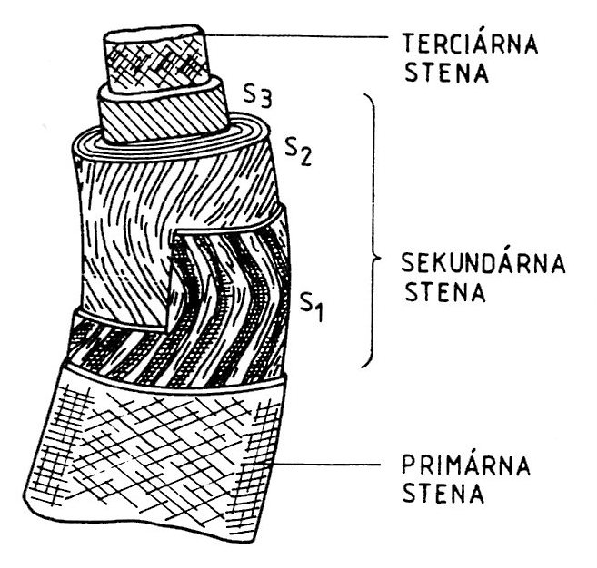
Morphology of the Cellulose Fibre 2
Tertiary
Wall
Secondary Wall
cellulose 91.00%
water 7.85%
protoplasm, pectins 0.55%
waxes, fatty substances 0.40%
mineral
salts 0.20%
Primary Wall

Slide 29
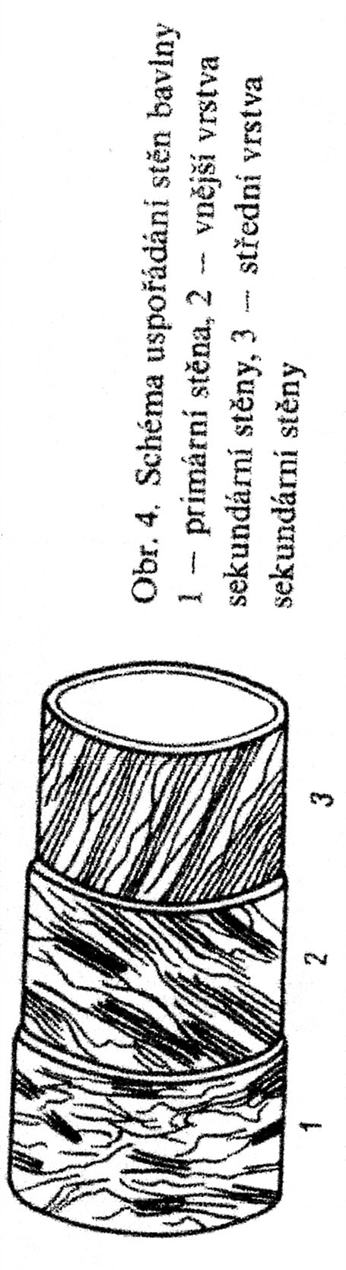
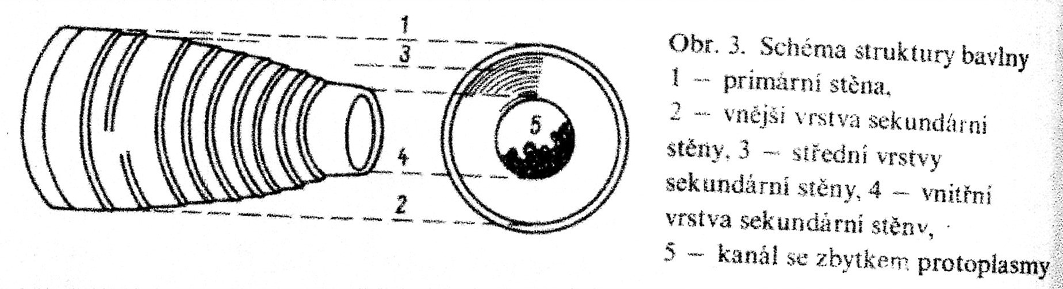
Morphology of the Cellulose Fibre 3
1) Primary Wall (approx. 0,1 μm), 2) Outer Part of Secondary Wall (approx. 4 μm), 3) Middle Part of Secondary Wall 4) Inner Part of Secondary Wall Lumen, 5)Chanel with Rest of the Protoplasm
SCHEMA OF THE ARRAGAMENT OF THE COTTON WALLS
1) Primary Wall, 2) Outer Part of Secondary Wall, 3) Middle Part of Secondary Wall

Slide 30
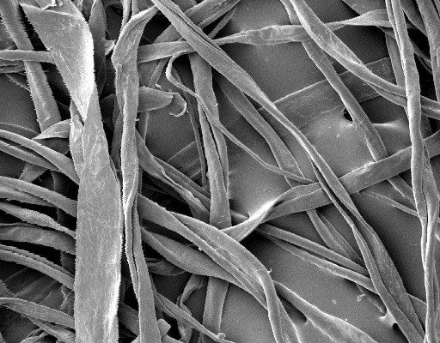
PROPERTIES OF THE COTTON SINGLE FIBER
Fairly uniform in width, 12–20 micrometers;
length varies from 1 cm to 6 cm (½ to 2½ inches);
typical length is 2.2 cm to 3.3 cm (⅞ to 1¼ inches).
cellulose 91.00%
water 7.85%
protoplasm, pectins 0.55%
waxes, fatty substances 0.40%
mineral salts 0.20%
SEM, Magnification
approx. 1000x

Slide 31
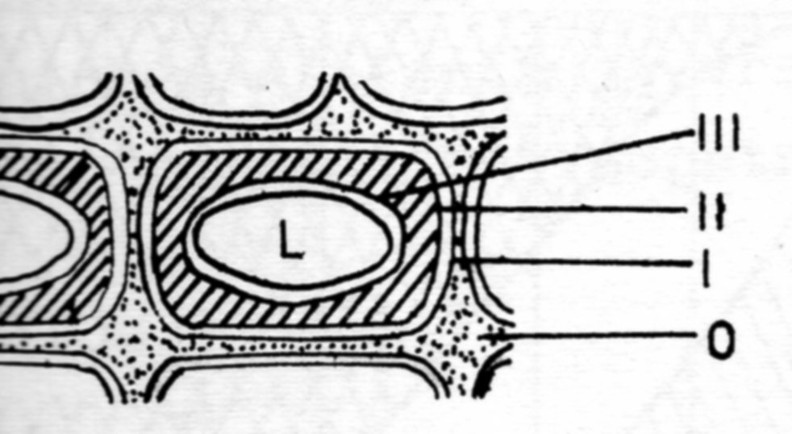
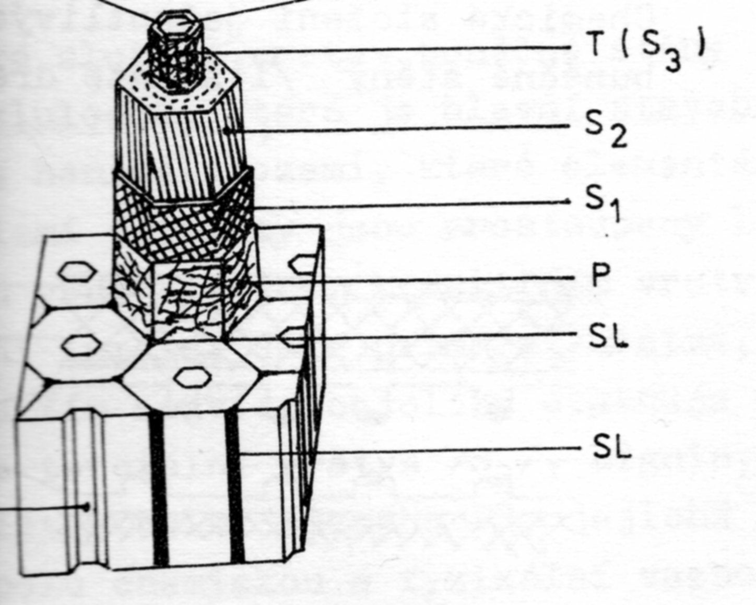
Morphology of WOOD 1
L – Cell lumen (Air))
SL – middle Lamella (LIGNIN)
P – Primary Wall
S1, S2 – Secondary Wall
T (S3) – Tertiary Wall
B – warted Layer
O – middle Lamella (LIGNIN)
I – Primary Wall (P)
II – Secondary Wall (S)
III –Tertiary Wall (T)
L – Cell lumen (Air)
B
L

Slide 32
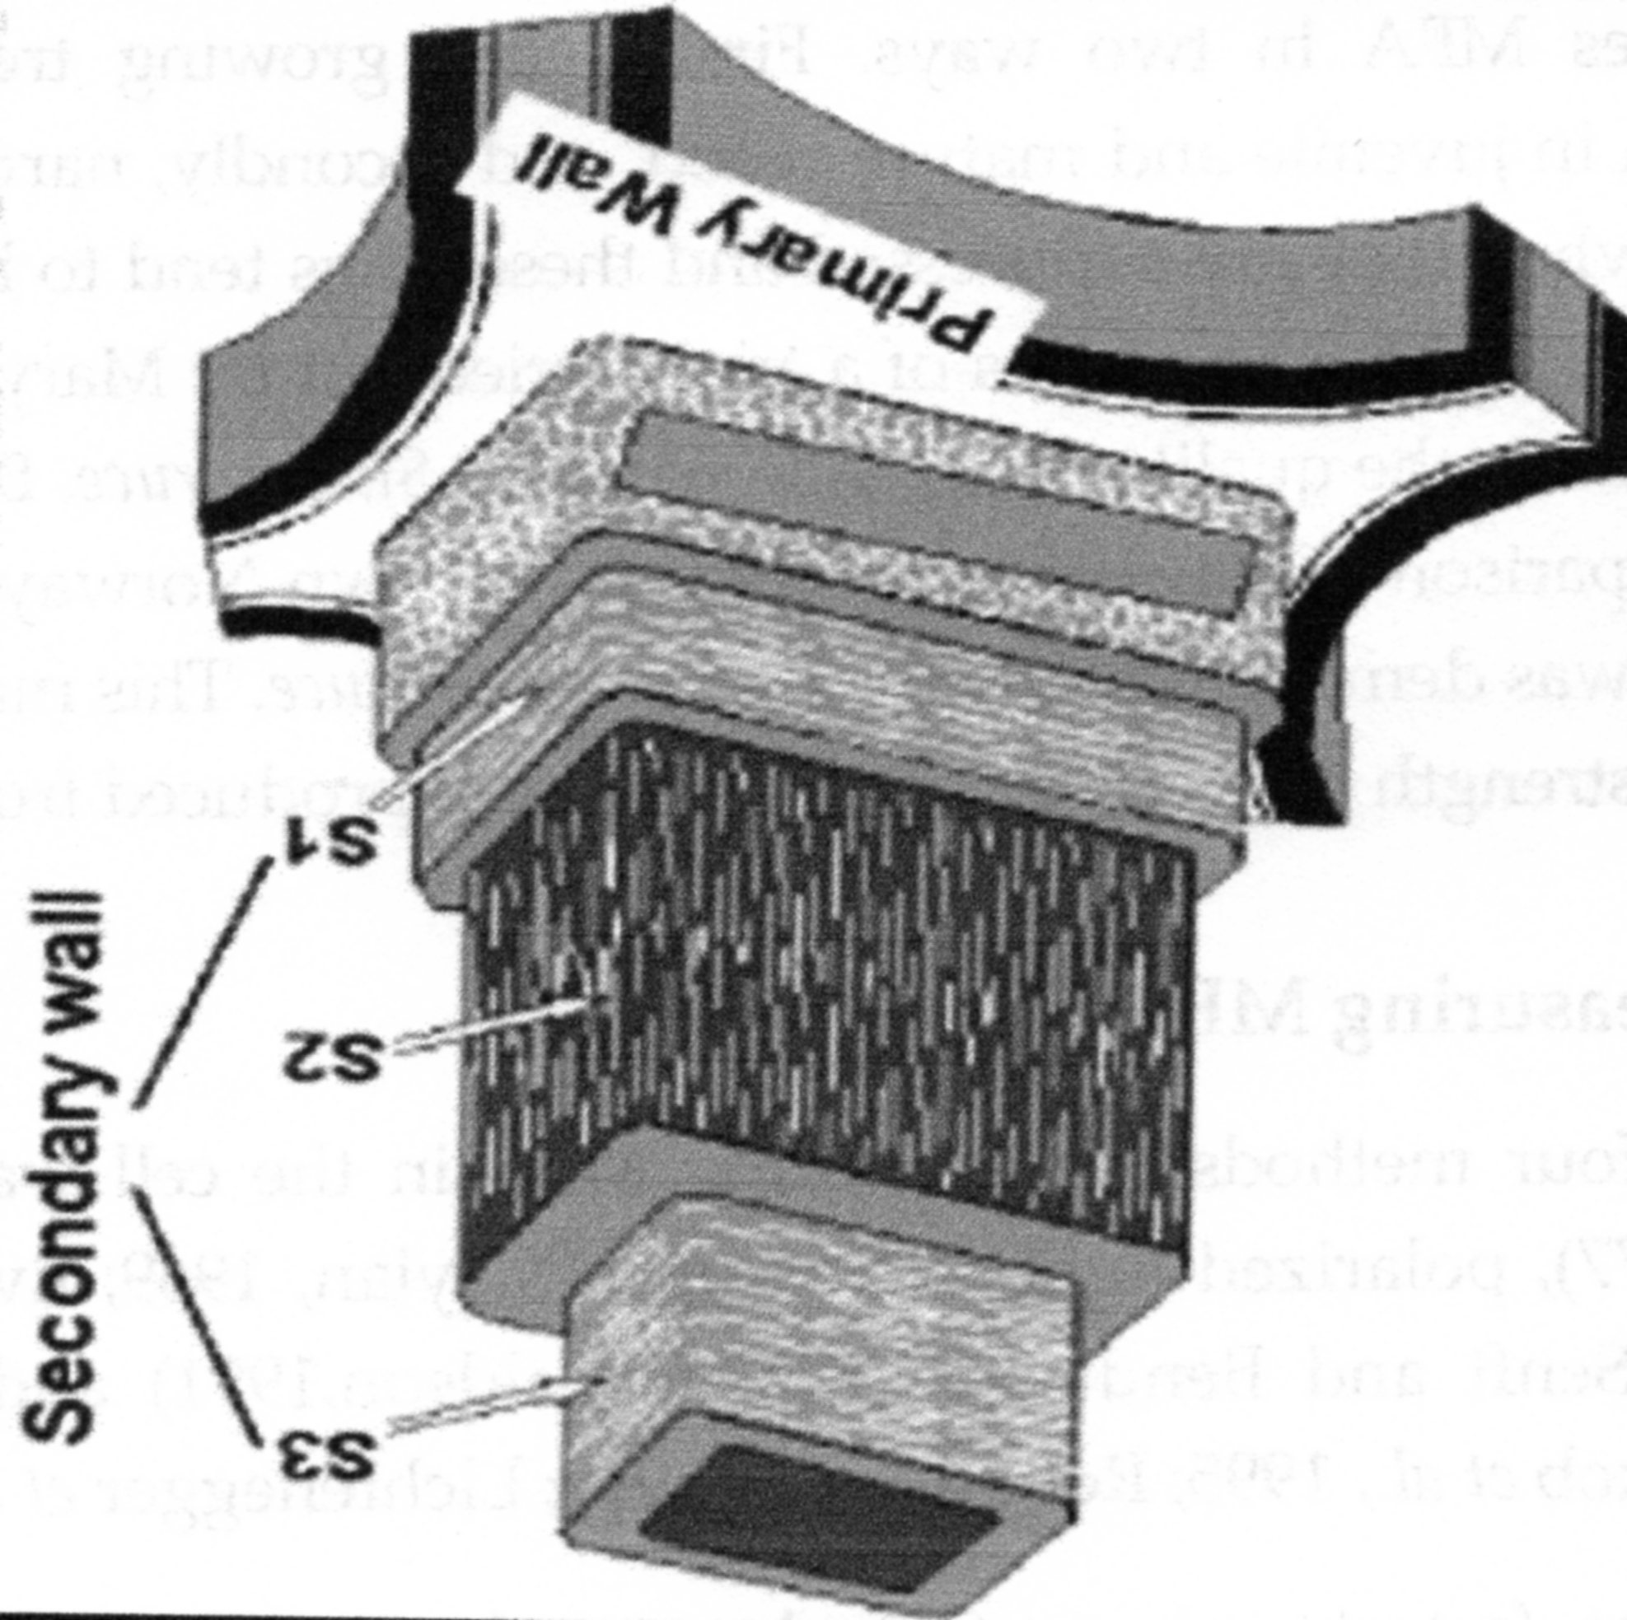
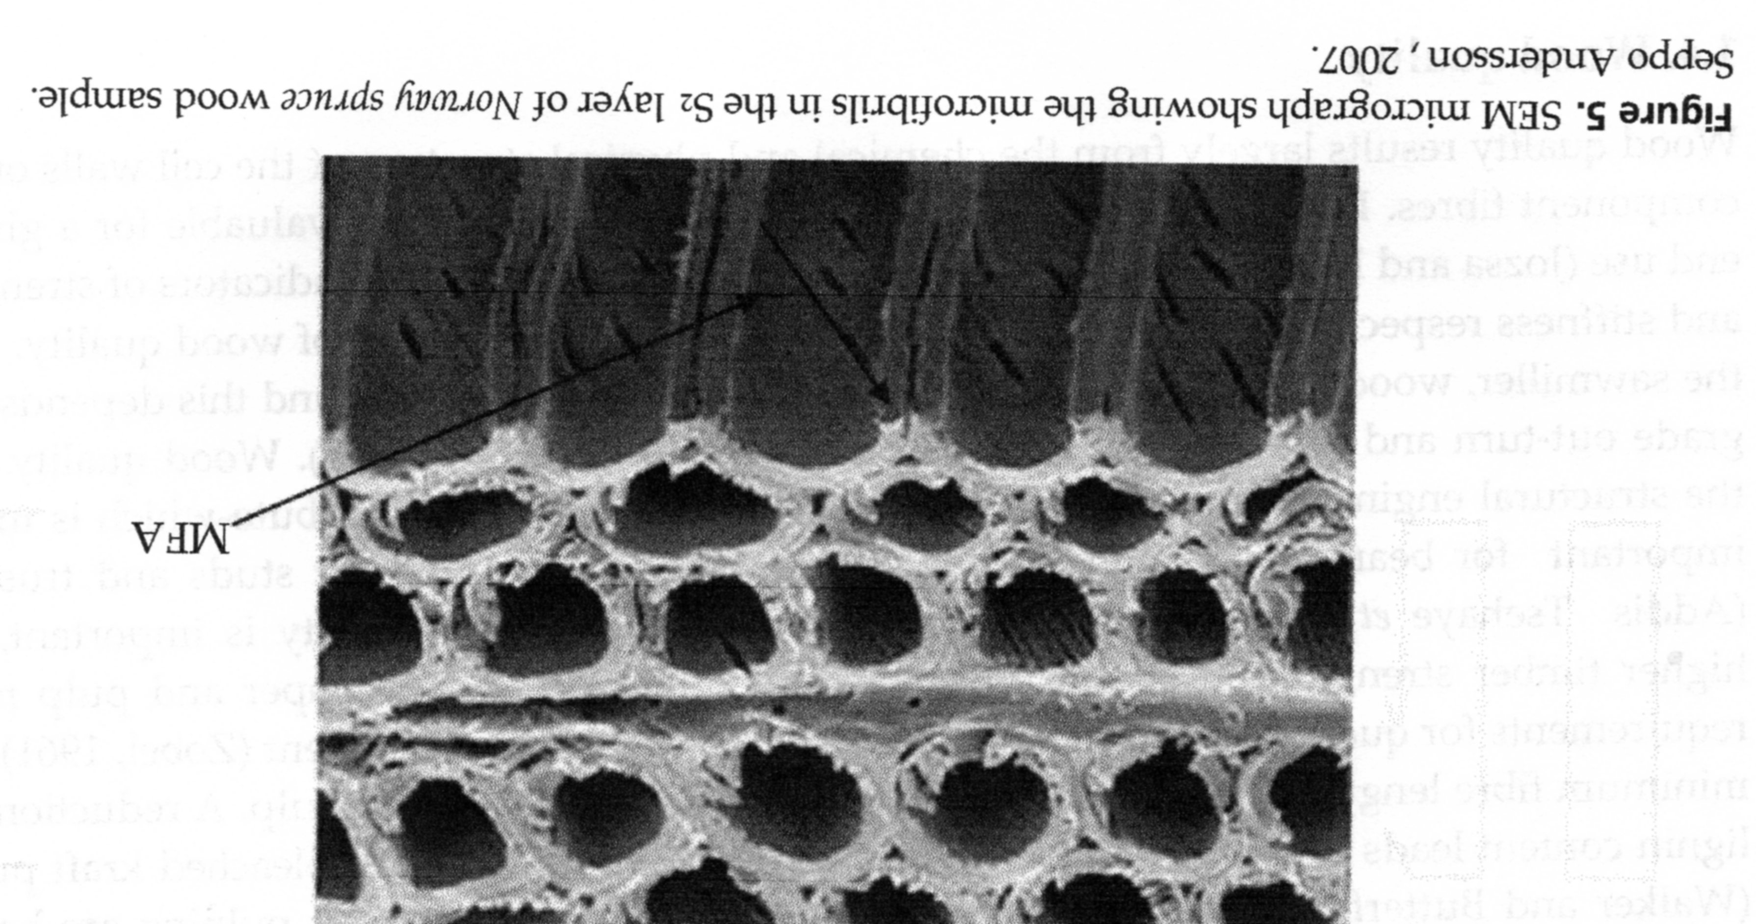
Morphology of WOOD 2
Pay Attention to:
DIFFERENT Fibrils Orientations in DIFFERENT Walls S1, S2 a S3
Tracheids

Slide 33
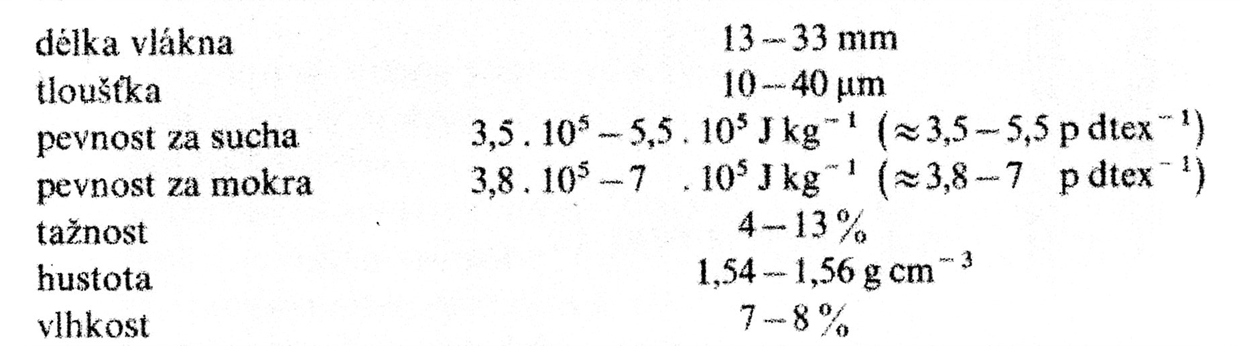
Morphology of Cellulose Fibre 4
Fibre Length
Fibre thickness
Tensile Strength at Dry
Tensile Strength at Wet
Ductility
Density
Moisture Content
Textile Units!
SI Units
cN dtex⁻¹ =
cca. p dtex⁻¹
OLD Units
p = pond = g*9,81 = 0,0098 N = 0,98 cN
dtex = Mass of the 10 km of Fibre expressed in grams (g)

Slide 34
Cellulose Production III
Herb (Plant) Bast/Stalk – Flax, Hemp, Jute
It is necessary to remove BIOLOGICALY Pectins and then to remove Wooden Part of the Stalk
Fibre is long, but rough
Tensile Strength is higher then Cotton
It is necessary to fine the Fibres for Textile utilisation
Yield rate of Fibre is low, approx. 10 % w/w of the Whole Plant
Flax = Plant
Linen = Fibre

Slide 35
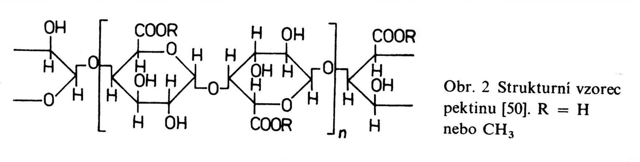

Flax Stalk – CROSSCUT
The stem varies from 60 to 120 cm in length and consists of fiber bundles lying between the outer BARK and a WOODY CORE. The INDIVIDUAL FIBERS, 10 to 40, are held together in the bundles by PECTINS. The bundles lie around the core and are attached to it and one another by pectins.
Structure Formula of PECTIN
R = H or –CH₃

Slide 36
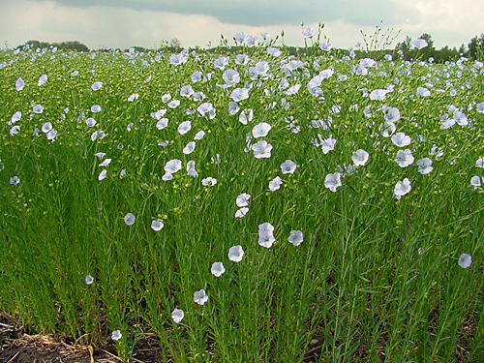
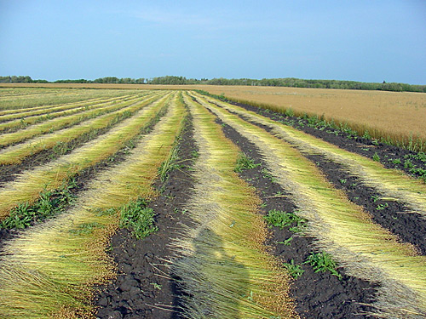
FLAX is in Bloom
Flax is harvested in Europe from the Turn of Millennium since
Dew-retting of Flax on the Field

Slide 37
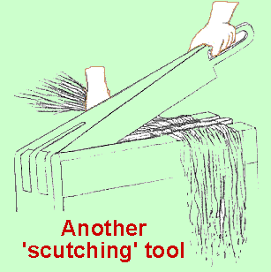
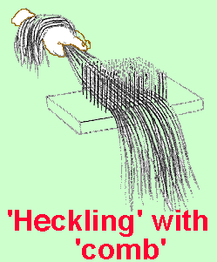
Cellulose Production III B
HISTORICAL Method of Linen gaining

Slide 38
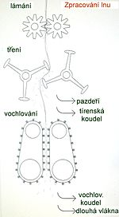
CURRENT Industrial Method of Linen gaining
Brokening
Flax Processing
Scutching
Flax scotch
Flax Tow
Heckling
Heckled Tow
Long Fibres

Slide 39
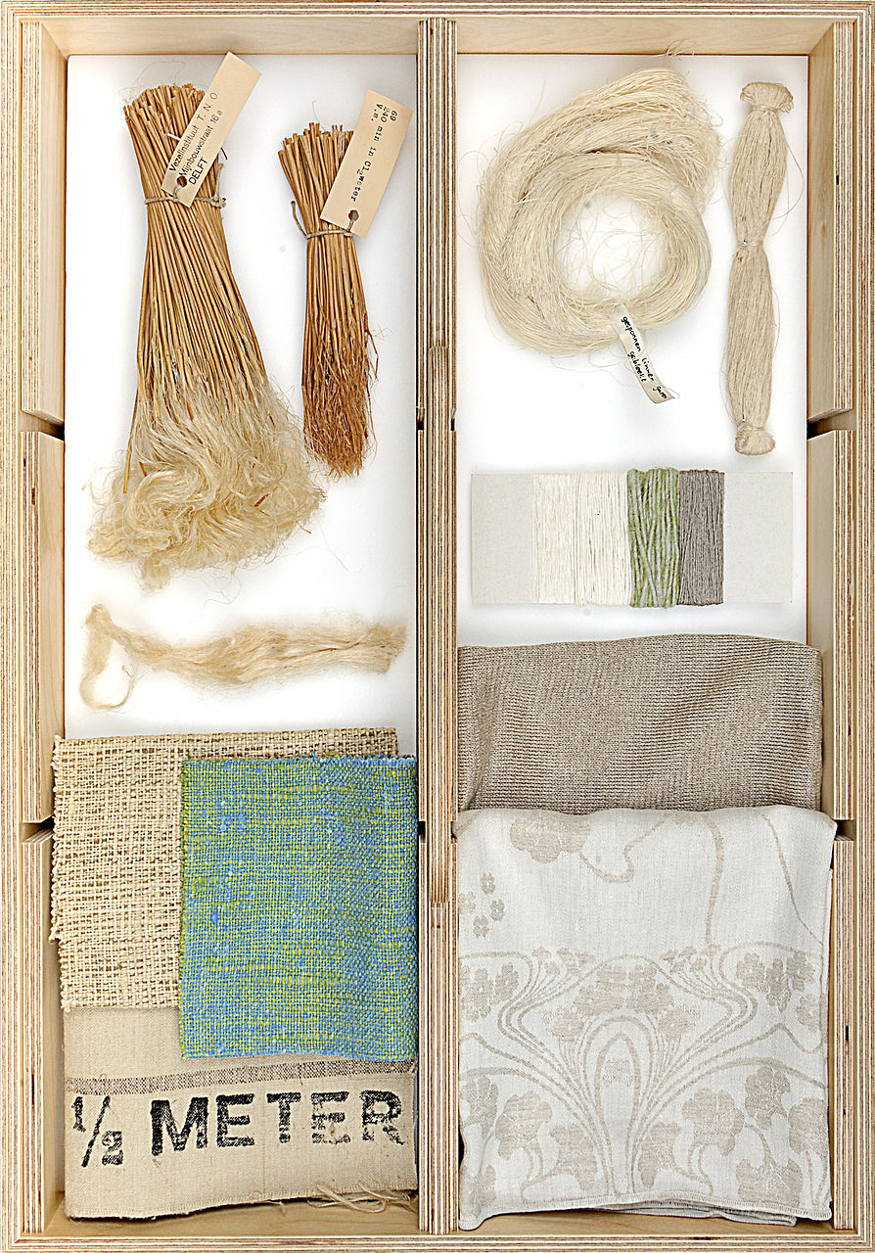
Flax & Linen:
Stalk,
Fiber,
Weaving yarn,
Fabric

Slide 40
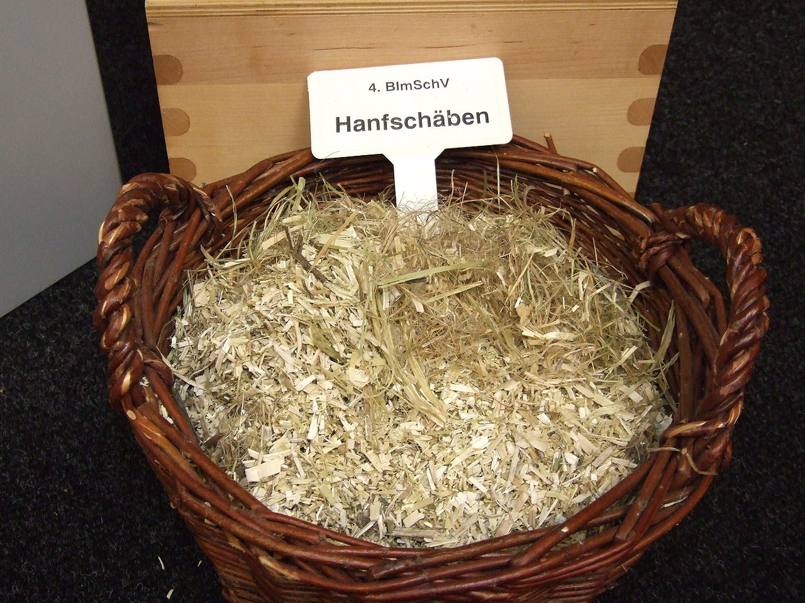
Hemp scotch

Slide 41
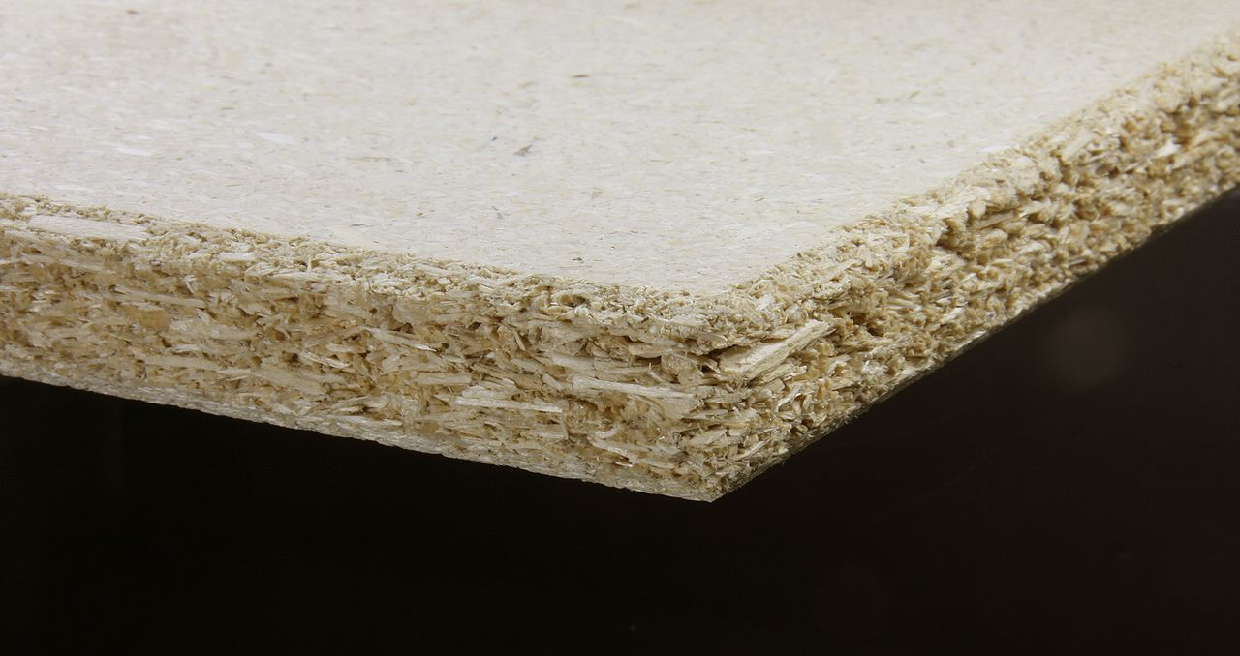
Hemp scotch Board
It has the better Mechanical Properties then Wood Fibres one

Slide 42
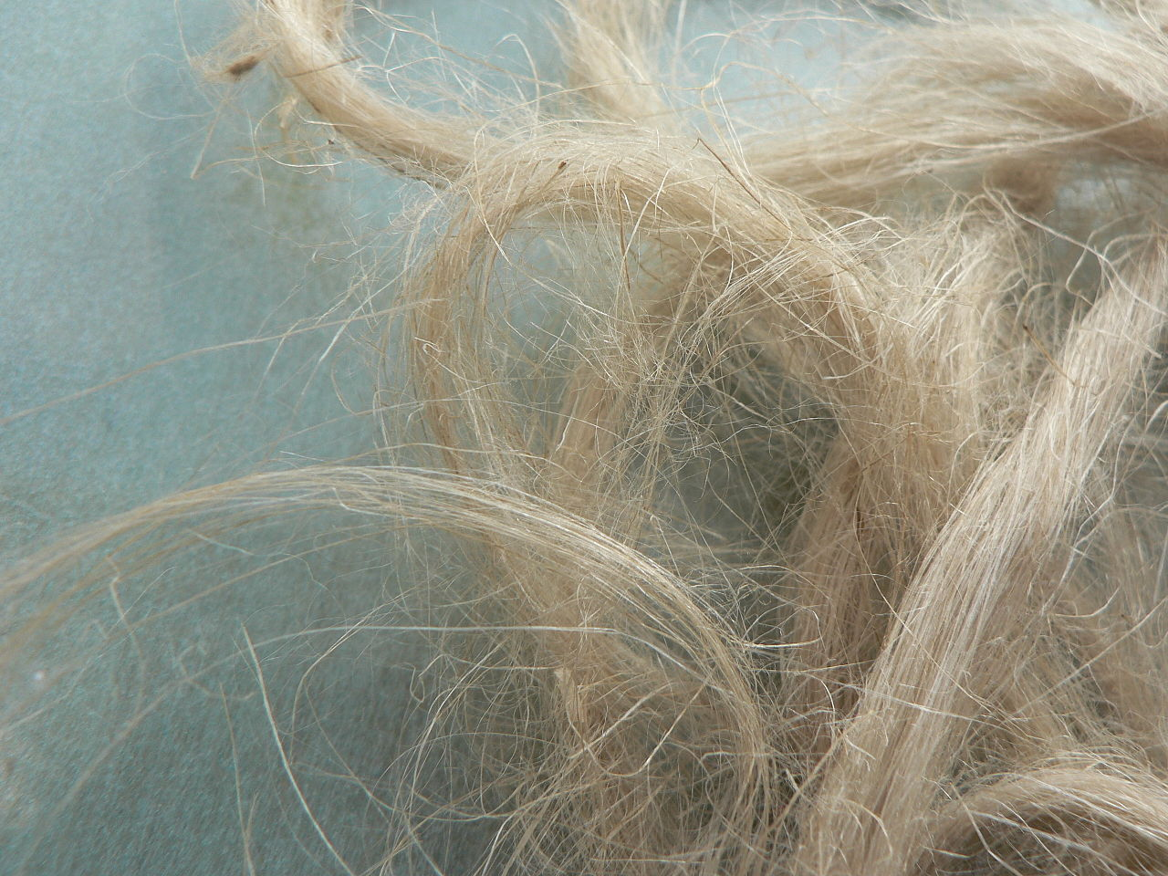
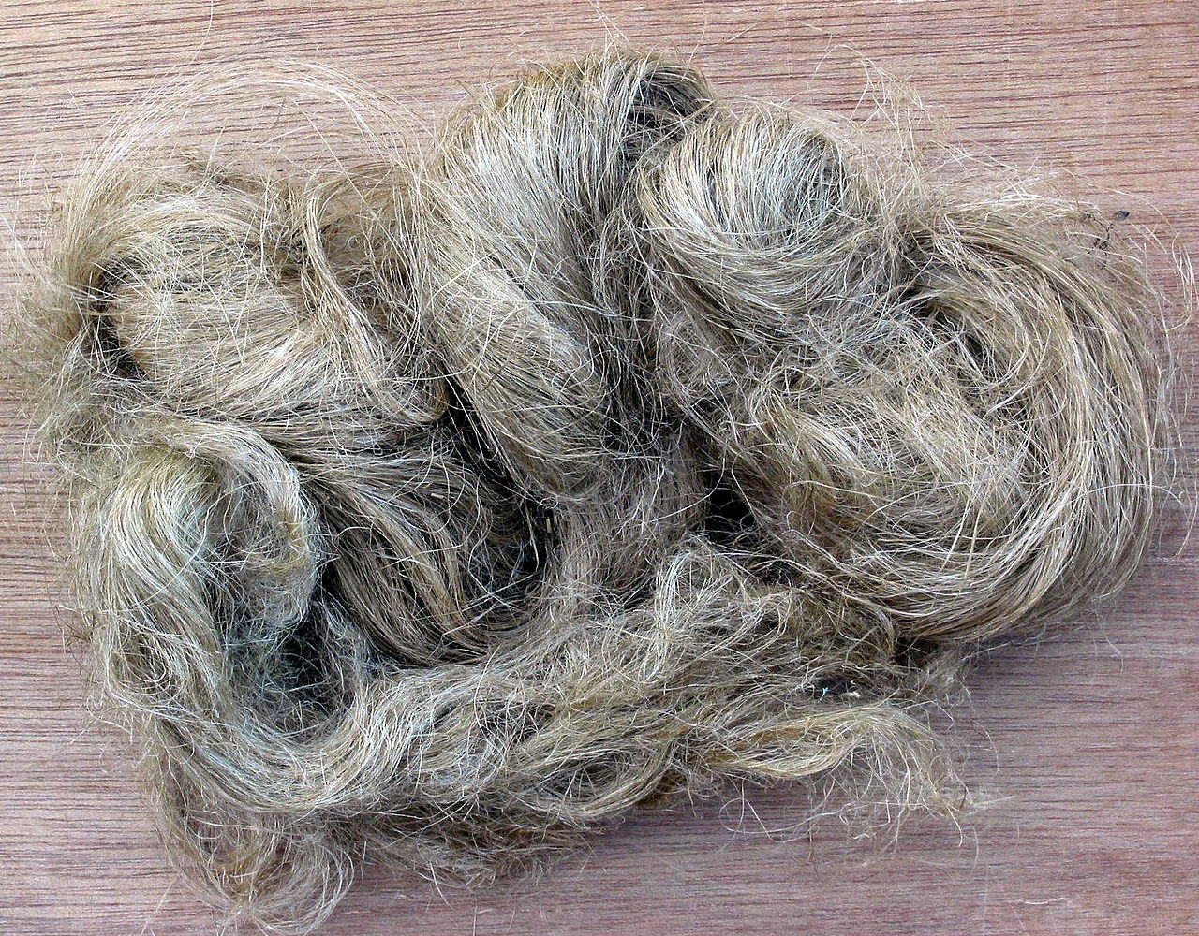
Flax scotch
The similar Fibres, but Hemp has different Colour
Hemp scotch

Slide 43
Cellulose Production IV – WOOD
Natronový postup s NaOH (listnaté dřevo, sláma, odpad)
Sulfitový postup (smrk, listnaté dřevo)
Sulfátový postup (buk, bříza, borovice, sláma, odpad)
Výtěžky jsou jen cca. 25 % hmot. (údaje se liší podle zdroje i podle typu dřeva) z celkové ve dřevě obsažené celulóze

Slide 44
Soda pulping
is a chemical process for making wood pulp with sodium hydroxide as the cooking chemical. In the Soda-AQ process, anthraquinone (AQ) may be used as a pulping additive to decrease the carbohydrate degradation. The soda process gives pulp with lower tear strength than other chemical pulping processes (sulfite process and kraft process), but has still limited use for easy pulped materials like straw and some hardwoods.^{[1]}
5 – 12 % NaOH
150 – 180 °C
700 – 1000 kPa
3 – 6 hodin

Slide 45
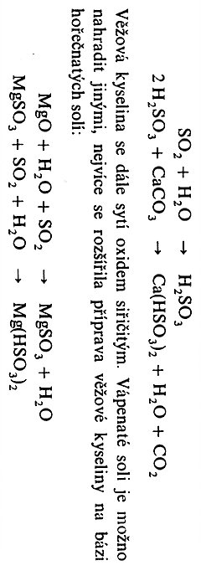
The sulfite process produces wood pulp which is almost pure cellulose fibers by using various salts of sulfurous acid to extract the lignin from wood chips in large pressure vessels called digesters. The salts used in the pulping process are either sulfites (SO₃²⁻), or bisulfites (HSO₃⁻), depending on the pH. The counter ion can be sodium (Na⁺), calcium (Ca²⁺), potassium (K⁺), magnesium (Mg²⁺) or ammonium (NH₄⁺).
Ca(HSO₃)₂, SO₂
130 °C
300 – 400 kPa
3 – 6 hodin
It is possible to substitute Ca⁺² by Mg⁺² or by NH₄⁺

Slide 46
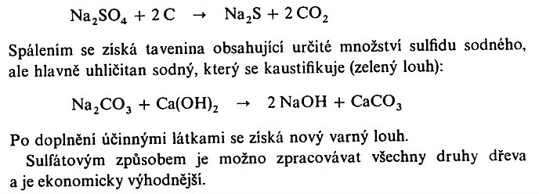
Sulphate Process
Na₂SO₄, Na₂CO3, Na₂S, Na OH
150 – 180 °C
700 – 1000 kPa
3 – 6 hodin
It is possible to get back from the Melt of the NaS, but most importantly Na₂CO₃, which is Caustificied as follows:
The new Cooking Liquor is possible to get via this Procedure
The Sulphate Process is suitable to be employed for all Kinds of Wood and has the Best Economy of Cellulose Production

Slide 47
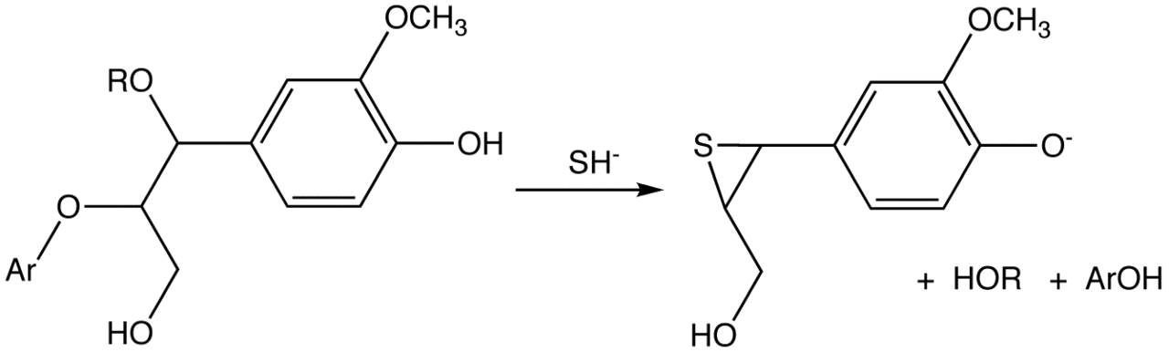
DELIGNIFICATION of Wood by DEPOLYMEROISATION
Sulfate Process

Slide 48
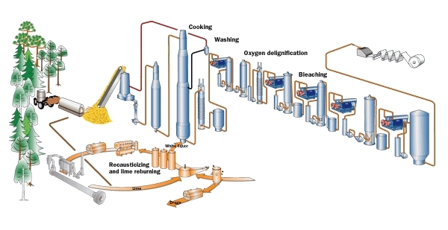
Sulphate Process
White Liquor

Slide 49
Utilisation of Cellulose (Pulp)
The pulp papermaking process
Textile Production
Pharmacy
Regenerated Cellulose
DERIVATIVES of CELLULOSE
  Esters
  Nitrates
  Alkyl (aryl)cellulose
  Carboxymethylcellulose
  Hydroxyethylcellulose

Slide 50
The pulp papermaking process
Paper is a thin material produced by pressing together moist fibres of cellulose pulp derived from wood, rags or grasses, and drying them into flexible sheets.
Paper is the Sheet Material with having the Weight up to 250 g/m², made of Fibres and the Additives, which determine its Specification.
Cardboard and Paperboard > 250 g/m²

Slide 51
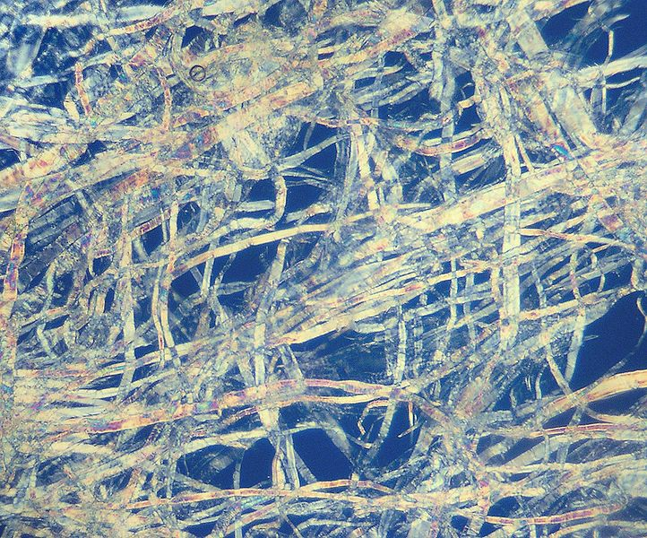

The pulp papermaking process
PAPÍR
Paper 800x
Pulp 200x

Slide 52

The wood pulp papermaking process
Mechanical wood pulp – mechanical Wood Pulping & Fibre Sorting & Bleaching >>> Lowcost Papers,e.g. Newspapers and Lavatory Paper

Slide 53

Stalk Fiber 1
Jute,
Magnification 180x

Slide 54

Stalk Fibers 2 & 3
Flax,
Magnification 180x
Hemp,
Magnification 180x

Slide 55

LEAF FIBER 1 – SISAL NATIVE

Slide 56

LEAF FIBER 1 – SISAL NATIVE

Slide 57

LEAF FIBER 3 – SISAL AFTER EXPOSURE IN OUDOOR approx. 3years

Slide 58

LEAF FIBER 3 – SISAL AFTER EXPOSURE IN OUDOOR approx. 3 years

Slide 59
LEAF FIBER 4 – SISAL Influence of the Outdoor Exposure EXPOZICE
In the Outdoor approx. 3 years
NATIVE
Magnification 1000x, SEM

Slide 60
LEAF FIBER 4 – SISAL Influence of the Outdoor Exposure EXPOZICE
In the Outdoor approx. 3 years
NATIVE
Magnification 200x, SEM

