Slide 1
NATURAL POLYMERS 4 Proteins’ Fibres III ELASTIN
Dr. Ladislav Pospíšil
29716@mail.muni.cz

Slide 2
Where is ELASTIN found in the Human Body?
Great amount of the ELASTIN is found in the Blood Vessel near to the Heart, further in the Ligaments, in the Skin and in the Tendons.
Elastin is the not soluble Scleroprotein, its Name is derived from its elastic Properties
Scleroprotein is the Denomination for the any Protein having approximately the fibrilar Shape
Scleroprotein are Water insoluble and e.g. Elastin, Keratin and Fibroin belong to this Group

Slide 3
What is the Difference between ELASTIN and COLLAGEN
COLLAGEN is the crystalline α helix, creating whole Hierarchy of Structures from the primary > secondary > tertiary > quaternary
ELASTIN is AMORPHOUS CROSSLINKED Scleroprotein, which does not creating Helixes (neither α no β) neither β Sheets

Slide 4
ELASTIN – the primary Structure 1
Composition of the ELASTIN is rich in Amino acids, especially in GLYCINE, ALANINE, PROLINE, VALINE and LEUCINE.
ELASTIN contains also relatively many basic Lysine's Rests and ELASTIN has therefore Isoelectric Point lower than 10.
LYSIN (Lys, K)

Slide 5
ELASTIN – primary Structure 2
Amino acids’ Composition of the TROPOELASTIN The Number of the Particular Amino acids the Molecule
Asparagine | 2 | Proline | 87 | Leucine | 37
Hydroxyproline | 9 | Glycine | 267 | Thyrosine | 13
Serine | 8 | Alanine | 174 | Phenylalanine | 22
Glutamine | 15 | Valine | 97 | Lysine | 38
Threonine | 11 | Isoleucine | 15 | Arginine | 6

Slide 6
ELASTIN – primary Structure 3
Two Sequences LAAALAAL or LAALAAAL are necessary for the Creating the Bond between the ELASTIN Molecules of the ELASTIN
Approx. 400 Amino acids
+ GGVIG---LAALAAAL---LAALAAAL----------------LAALAAAL---G-----
> 150 < Amino acids
Marking of the Amino acids in this Sequence above:
G – Glycine, V – Valine, I – Isoleucine, L – Lysine, A - Alanine
Sequences which are able to create the Bonds between the ELASTIN Molecules are separated by approx. 150 Amino acids
The RIGHT MARKING IS:
Lysine K, and not L!
L is the RIGHT MARKING for LEUCIN
ATTENTION! The right one Letter Marking for the LYSINE (K) is not used here!
ELASTIN Molecule is created of approx. 400 Amino acids

Slide 7
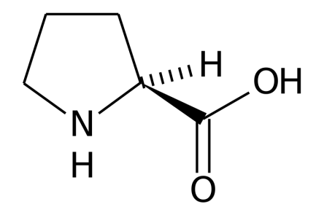
Biogenic Amino acids
Glycine (Gly, G)
Alanine (Ala, A)
Valine (Val, V)
Proline (Pro, P)
Leucine (Leu, L)

Slide 8
A biogenic amine is a biogenic substance with one or more amine groups. They are basic nitrogenous compounds formed mainly by decarboxylation of amino acids or by amination and transamination of aldehydes and ketones. Biogenic amines are organic bases with low molecular weight and are synthesized by microbial, vegetable and animal metabolisms. In food and beverages they are formed by the enzymes of raw material or are generated by microbial decarboxylation of amino acids
Importance in food
Biogenic amines can be found in all foods containing proteins or free amino acids and are found in a wide range of food products including fish products, meat products, dairy products, wine, beer, vegetables, fruits, nuts and chocolate. In non-fermented foods the presence of biogenic amines is mostly undesired and can be used as indication for microbial spoilage. In fermented foods, one can expect the presence of many kinds of microorganisms, some of them being capable of producing biogenic amines.
They play an important role as source of nitrogen and precursor for the synthesis of hormones, alkaloids, nucleic acids, proteins, amines and food aroma components. However, food containing high amounts of biogenic amines may have toxicological effects.

Slide 9
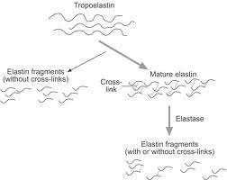
What is creating the Crosslinking in the ELASTIN
Tropolelastin keeps partially its GLOBULAR STRUCTURE
ELASTIN has after Crosslinking mainly the fibrilAr STRUCTURE
already

Slide 10
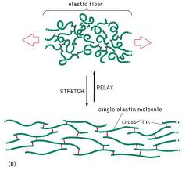
Reversible Deformation of the ELASTIN
ELASTIN keeps partly its GLOBULAR STRUCTURE before Deformation
ELASTIN is elastic in the HYDRATED STATE only, it is not so for the Dry ELASTIN !
Water acts as a LUBRICANT between the ELASTIN Molecules.
ELASTIN has mainly the fibrilAr STRUCTURE after the DEFORMATION
It resembles VULCATISATION of the RUBBER! The RUBBER is also reversible crosslinked.

Slide 11
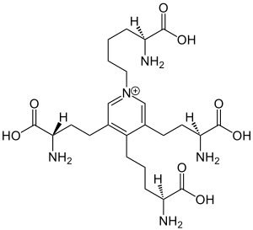
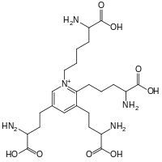
What is the PRINCIPLE of the ELASTIN’S Elasticity
The smaller Molecules so called TROPOELASTIN are crosslinked by assistance of the ENZYMATIC CATALYSIS by the Desmosine and Isodesmosine Molecules
Crosslinking is done via LYSINE in the ELASTIN Molecules, which create these Crosslinking
Compounds

Slide 12
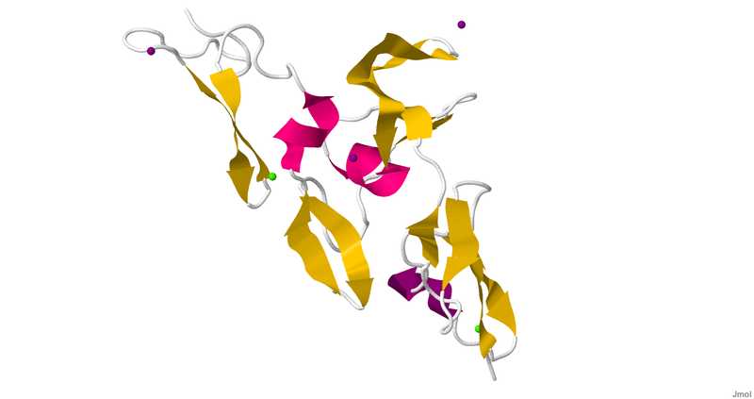
What is creating the actual ELASTIC FIBRE
Fibrillin is a glycoprotein, which is essential for the formation of elastic fibers found in connective tissue. Fibrillin is a major component of the microfibrils that form a sheath surrounding the amorphous elastin.
Fibrillin + Elastin

Slide 13
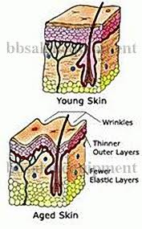
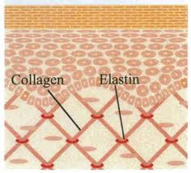
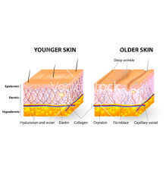
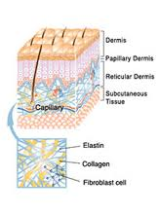
ELASTIN in the Human Skin

Slide 14
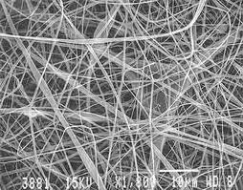
ELASTIN in the Human Skin
The Skin growing old or the old Skin is not more able to create the elastic Fibres of the ELASTIN in the Human Skin already. These Fibres are cleaved by Enzyme ELASTASE. The Skin is loosing its Elasticity and the Wrinkles ate created ….

Slide 15
COACERVATION
COACERVATION is the REVERSIBLE PROCESS, when the Secondary Structure of the Polymer Chain is changed
These changed Secondary Structures can then create by Aggregation the Reversible Tertiary Structures
These changed Structures are called COACERVATE

Slide 16
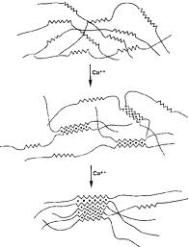
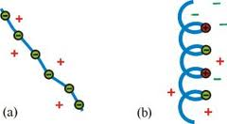
COACERVATION of the TROPOELASTINE
The Change of the Secondary Structure
THESE PICTURES ILLUSTRATE THE TERMS „COACERVATION and COACERVATE „ ONLY.
They are not related directly to ELASTIN.
The Change of the TERTIARY
STRUCTURE
Tropoelastin aggregates at physiological temperature due to interactions between hydrophobic domains. This process is reversible and thermodynamically controlled.

Slide 17
Tropolelastin > ELASTIN > α ELASTIN
ELASTIN is very resistant from the chemical Point of Viiew. For Example, it is resistant to the short Time Action of the 80 % w/w H₂SO₄ or 4-N NaOH.
The so called α ELASTIN (MW » 60000 - 80000) is Water soluble after partial Hydrolysis.
The α ELASTIN can then associate by some Chain Sequences > COACERVATION
β ELASTIN arises from the ELASTIN after the very intensive scission besides the α ELASTIN.
COACERVATION does not occur for the β ELASTIN , probably its Molecules are too short (MW ≈ 5000) and they are not rich enough of the Sequences able to form the Associates
Standard ELASTIN is not able to do COACERVATION

Slide 18
ELASTIN in the HIDE & LEATHER
The TECHNICAL IMPORTANCE of the ELASTIN is low in general
ELASTIN forms the smaller Part then the COLLAGEN in the Hide, occurring in the outer Part of the Hide and in the Under hide connective tissue
ELASTIN is resistant to the most technological Steps of the Hide Tannin to Leather, except for the enzymatic Bate
ELASTIN can contribute to the Leather Elasticity, abut there are not common View on this Phenomena. Some View exist, the ELASTIN should be removed during Tannin.
Analytical Monitoring of the ELASTIN after Tannin is based on the Determination of the VALINE after Hydrolysis of the Leather, because there are approx. 18 % w/w of the VALINE there (the highest Concentration in all the Proteins)

Slide 19
The Importance of the ELASTIN in the Nutrition
ELASTIN has the low Importance in the Nutrition due to its chemical and enzymatic Resistance, this Protein is hardly to be digest
ELASTIN must be cleaved by enzymatic or chemical partly cleaved if should be used the Animal Feed

