Slide 1
NATURAL POLYMERS 4
Plant (vegetable) GUMS
Dr. Ladislav Pospíšil
29716@mail.muni.cz

Slide 2
Time schedule
LECTURE | SUBJECT
1 | Introduction to the subject – Structure & Terminology of nature polymers, literature
2 | Derivatives of acids – natural resins, drying oils, shellac
3 | Waxes
4 | Plant (vegetable) gums, Polyterpene – natural rubber (extracting, processing and modification)
5 | Polyphenol – lignin, humic acids
25.10. & 1. 11. | Polysaccharides I – starch
8.11. & 15. 11. | Polysaccharides II – celullosis
22. & 22. 11. | Protein fibres I
29. 11. & 6. 12. | Protein fibres II
13. & 20. 12. | Casein, whey, protein of eggs
20. 12. | Identification of natural polymers
 | Laboratory methods of natural polymers’ evaluation

Slide 3
A bit of TERMINOLOGY is NECESSARY
POLYTERPENES
Rubber – Vulcanization – Vulcanized Rubber (Hard Rubber)
Plant (vegetable) GUMS = POLYSACCHARIDES = Mucilage (GUM)

Slide 4
Survey of the Plant (vegetable) GUMS
Monosaccharide | Arabic Gum | Traganth |  | Cherry gum | Plum gum | Peach gum
 | % w/w
Glucoronic acid | 16 |  | --- | 12 | 15 | 7
Galactonoric acid | --- |  | 43 | --- | --- | ---
Arabinose | 19 |  | 3 | 55 | 34 | 43
Galactose | 52 |  | 4 | 21 | 40 | 36
Rhamnose | 14 |  | --- | Traces | --- | Traces
Xylose | --- |  | 40 | --- | 11 | 14
Manose | --- |  | --- | 10 | --- | ---
Fucose | --- |  | 10 | --- | --- | ---

Slide 5
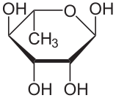
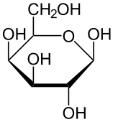
Rhamnose
Galaktose
prevailing form in the water – there can be also one HEXOSA and two PENTOSES

Slide 6
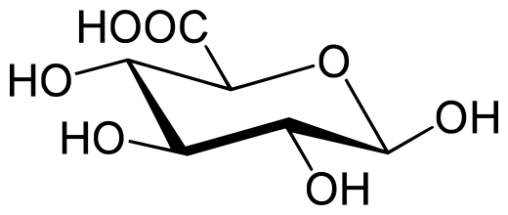
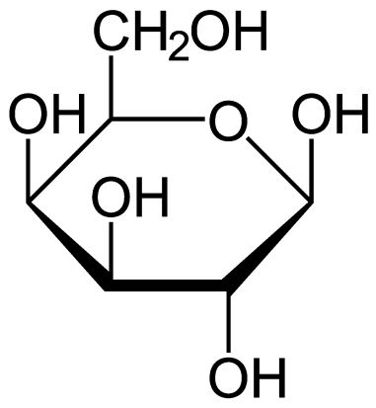
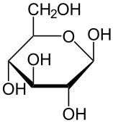
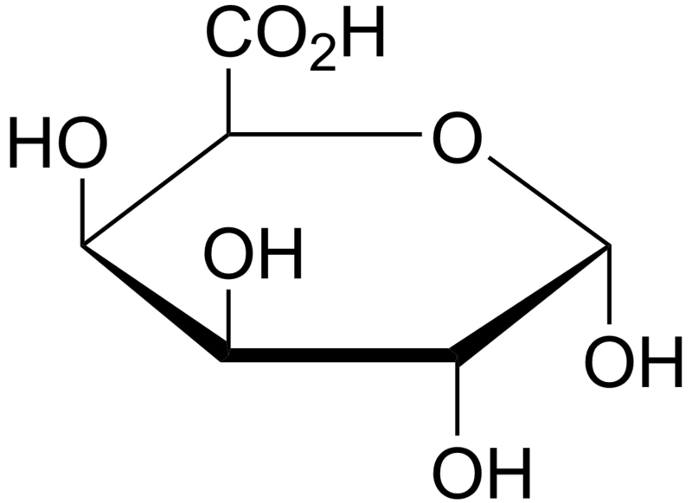
Glucoronic acid
Galactose
Two different types of saccharides’
formulas
Galactonoric acid
β D gluCOSE

Slide 7
Plant (vegetable) GUMS and so called „E“ Food Additives
Most of the Plant (vegetable) GUMS belongs to the „E“ Food Additives!
The List of „E“ Food Additives is available on Internet, e.g. https://www.food.gov.uk/science/additives/enumberlist (Open!)
They are used as (act so):
  Thickener
  Emulsifier
  Stabilisers of the Rheological Properties
  Bonding agent of the Pills and Tablets in Pharmacy
  …………..

Slide 8
Plant (vegetable) GUMS = Mucilage (GUM) 1
They are got by collecting of the dry Exudates from the Tree lesions fruit Trees
Their Difference from RESINS is, that they are soluble in Water or at least are strongly swelling
The most common Plant (vegetable) GUMS:
Arabic gum
Tragant
Fruit Trees Gums
  Cherry,
  Plum,
  Peach.

Slide 9
Plant (vegetable) GUMS = Mucilage (GUM) 2
They are frequently contaminated by Protein substances
The acid part is oxidised saccharides (Glucoronic acid, Galacturic acid), often as salts Ca⁺², Mg⁺², Na⁺
The Acid hydrolysis >possibility of the Decomposition to Saccharides > approved by HPLC analysis
The Solubility DEPENDS also on pH

Slide 10
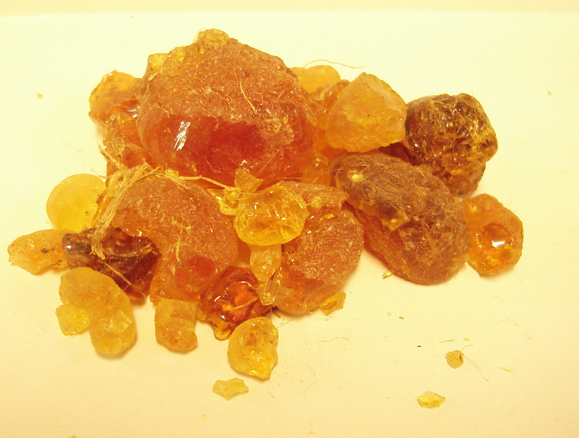
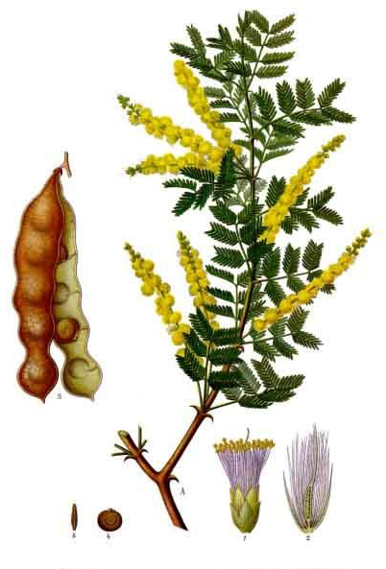
Arabic GUM (E 414) – the most frequent Plant (vegetable) GUMS
Acacia senegal
It looks like the RESIN!

Slide 11
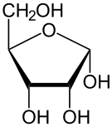

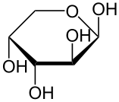
Arabic GUM (E 414)
Gum arabic is a complex mixture of glycoproteins and polysaccharides. It is the original source of the sugars arabinose and ribose, both of which were first discovered and isolated from it, and are named after it.
arabinose
D Ribose as PENTOSE
It exists also β D Ribose and Ribose as HEXOSE

Slide 12
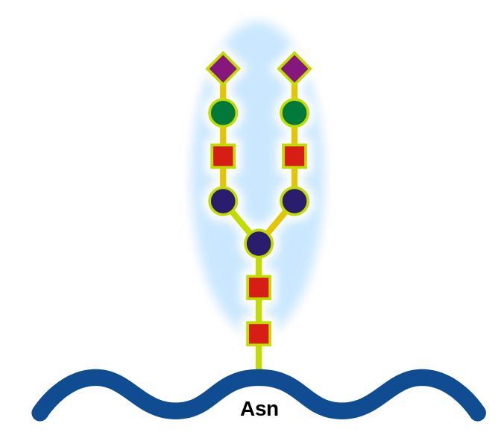
Arabic GUM (E 414)
CONTAINS:
  Polysaccharides
  Glycoproteins- proteins with the bound Saccharides
Galaotóse – the main Component

Slide 13
Arabic GUM (E 414)
The Branched structure
The Molecular weight is approx. 250 000 to 1 000 000 Da
Solubility in Water up to40 % w/w
NONFOOD USE
GLUE (paper, books’ binding)
Colour binding (aquarelle, tempera, pastel)
Tempera
Emulsion water dilutable, e.g. EGG TEMPERA, OIL TEMPERA
Arabic GUM acts here EMULSION STABILISER

Slide 14
Tragacanth E413
Plant mucilages having origin from some Asiatic plants sorts of the Plant called Milk-vetch (especially Astragalus gummifer, Astragalus adscendens a Astragalus microcephalus)
It is used as a EMULSION STABILISER, thickening agent for Candy, Sauce a Salad dressing
Colour binding (aquarelle, tempera, pastel) or finishing substance in the textile industry
It is hard to solute in water, it mostly swells only, it does not solute entirely and forms a gel only
It is used for making the pastels

Slide 15
Fruit Trees gums
Similar to Arabic gum and Tragacanth
  Cherry
  Peach
  Sour Cherry
  Apricot
They mostly swells in Water only (demonstration)
Insoluble in EtOH (demonstration)
The darker Colour > limitation to dark pigments use
Films are relatively (in comparison to Arabic gum) more elastic

Slide 16
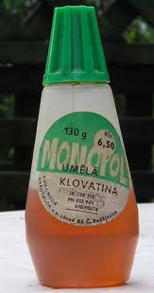
Artifical Mucilage (GUM)
Glue for paper on the DEXTRINE basis
Colour is like the genuine Mucilage
Connections are relatively brittle

