Slide 1
NATURAL POLYMERS 4 Hyaluronic acid
Dr. Ladislav Pospíšil
29716@mail.muni.cz

Slide 2
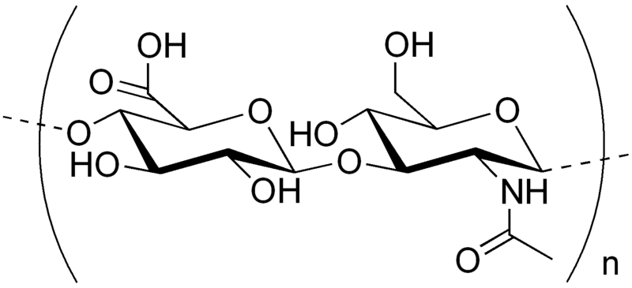
HYALURONIC ACID 1
Hyaluronic acid is an naturaly existing anionic, nonsulfated glycosaminoglycan and can be very large, with its molecular weight often reaching the millions. Hyaluronic acid is a polymer of disaccharides, themselves composed of D-glucuronic acid and N-acetyl-D-glucosamine, linked via alternating β-(1→4) and β-(1→3) glycosidic bonds. Hyaluronic acid can be 25,000 disaccharide repeats in length. Polymers of hyaluronic acid can range in size from 5,000 to 20,000,000 Da in vivo. The average molecular weight in human synovial fluid is 3–4 million Da, and hyaluronic acid purified from human umbilical cord is 3,140,000 Da. Hyaluronic acid is also a major component of skin, where it is involved in tissue repair.
Despite its simple primary Structure, exhibits the Hyaluronic acid very different biological Effects depending on the Molecular Weight and its space Arrangement.

Slide 3
HYALURONIC ACID 2
It was originally extracted from the Cockscomb
The synthetic biotechnological Manufacture are mostly used now, what led to the more widely spread use of the HYALURONIC ACID
HYALURONIC ACID has the Ability to bind up to 1000 % w/w of the Water, so approx. 100 g Water can be bound by only 1 g of the HYALURONIC ACID – it is hardly to believe!
HYALURONIC ACID can be used for Spinning to NANOFIBRES

Slide 4
HYALURONIC ACID - BIOFUNCTION
• It prevents the Cell from infiltration of the Viruses and Bacteria to the Cell
• It modulates the Inflammation by induction of the Cytokines and Chemokines*** releasing, it quenches the free Oxygen Radicals, influencing teh Proliferation and Differentiation of the Cells
• It prevents the Collagen Deposition and so encourages cicatricial free Healing of the Tissue
• The analgesic Effect was also described
• ……………..
*** small Proteins of the Cell, which have the Signal Function in the Cell

Slide 5
HYALURONIC ACID - USE
Medical uses
Hyaluronic acid has been used in attempts to treat osteoarthritis of the knee via injecting it into the joint. It has not been proven, however, to generate significant benefit and has potentially severe adverse effects.
Dry, scaly skin such as that caused by atopic dermatitis may be treated with skin lotion containing sodium hyaluronate as its active ingredient.
Hyaluronic acid has been used in various formulations to create artificial tears to treat dry eye.
Healing of the Burns
Ophthalmology Surgery
Aesthetic Surgery - filling of the Wrinkles etc.
Healing of the Wounds
Cosmetic uses
Hyaluronic acid is a common ingredient in skin-care products. Hyaluronic acid is used as a dermal filler in cosmetic surgery. It is typically injected using either a classic sharp hypodermic needle or a cannula. Complications include the severing of nerves and vessels, pain and bruising. In some cases hyaluronic acid fillers result in a granulomatous foreign body reaction

