Slide 1
NATURAL POLYMERS
Identification of the NTURAL POLYMERS
RNDr. Ladislav Pospíšil, CSc.

Slide 2
Time schedule
LECTURE | SUBJECT
1 | Introduction to the subject – Structure & Terminology of nature polymers, literature
2 | Derivatives of acids – natural resins, drying oils, shellac
3 | Waxes
4 | Plant (vegetable) gums, Polyterpene – natural rubber (extracting, processing and modification), Taraxacum_kok-saghyz
5 | Polyphenol – lignin, humic acids
6 | Polysaccharides I – starch
7 | Polysaccharides II – celullose
8 | Protein fibres I
9 | Protein fibres II
10 | Casein, whey, protein of eggs
11 | Identification of natural polymers
 | Laboratory methods of natural polymers’ evaluation

Slide 3
Melting Point
Separation Methods
  Distillation
  Chromatography
  Electrophoresis
Spectroscopic Methods
  Mass Spectroscopy
  FTIR Spectroscopy
  NMR Spectroscopy
  UV Spectroscopy

Slide 4
Principal Problems of the Natural Compounds & Polymers Analysis and Determination
They are chemical Individuals
They can Place of the Plant (Source Cultivation, e.g Resins
The Influence of the „Aging“, e.g. Drying Oils
The Natural Compounds are frequently found as a Mixtures with the other Natural Substances (Polymers)
The only small Quantities are frequently available for the Analysis
………………..

Slide 5
Metling Point
The Behaviour after heating on Microscope’s Hot Stage it is possible to differ between particular Natural Polymers (Oligomers) accordingly:
Waxes – 50 – 90 °C
Resins - from approx. 120 °C up
Polymerised Oils - from approx. 160 °C up
Egg Yellow - from approx. 200 °C up
This PRELIMINARY differentiated Samples is possible to analyse using the more Sophisticated Methods

Slide 6
Separation Methods
Distillation – e.g. Manufacturing of the Turpentine and Colophony form the Pine Rosin
Extraction – the Wood’s Rosins
Chromatography – Amino acids Separation using Thin Layer Chromatography (TLC)
Electrophoreses - Amino acids Separation using the Electric Field (is the motion of dispersed particles relative to a fluid under the influence of a spatially uniform electric field)
………………………

Slide 7
Separation Methods - Distillation
Disadvantages:
  The bigger Quantity of the Sample is needed
  Not possible to use Solid State Materials
  The Separation is not so „SHARP“ as the Chromatography
Advantages:
  The bigger Quantity of the Sample is got, with which is possible to do further Work,
  It is simple from the Instrumentation point of View, but there are the very complicated Machines also (e.g. Spin Band Column)

Slide 8
Separation Methods - Chromatography
Disadvantages :
  The bigger Quantity of the Sample is NOT got, with which is possible to do further Work ( the so called PREPARATIVE Chromatography is not widespread now),
It is NOT simple from the Instrumentation point of View
Advantages :
  The bigger Quantity of the Sample is NOT needed
  The Separation is VERY „SHARP“ up to Individuals
  It is possible to use Solid State Materials, if they are Soluble in the proper Solvent
  A lot of the Chromatography Methods are available now, a lot of the Detection Methods are possible to be used

Slide 9
Chromatography – the basic Methods
Paper (probably the oldest one)
TLC – Thin Layer Chromatography
Gas (GC)
Liquid (HPLC)
Gel permeation (GPC)
Ion exchange
……..

Slide 10
Chromatographic Terms
ANALYTIES - složky vzorku, které mají být chromatograficky rozděleny
Analytic Chromatography – chromatografie sloužící k zjištění existence analytu (tzv. kvalitativní stanovení) a k určení jeho koncentrace ve vzorku (tzv. kvantitativní stanovení).
Chromatograph – přístroj sloužící k chromatografické separaci složek vzorku
Chromatogram – záznam z chromatografu znázorňující jednotlivé analyty nejčastěji ve formě tzv. chromatografických píků (zón) oddělených navzájem základní linií
Chromatographic Separation – rozdělení vzorku na jednotlivé složky (analyty) na základě rozdílné distribuce mezi mobilní a stacionární fázi
Mobil Phase – neboli eluent, je fáze pohybující se chromatografickým systémem. Tato fáze přivádí vzorek do stacionární fáze, kde dochází k jeho separaci
Retention Time – čas, který složka potřebuje k průchodu chromatografickým systémem
Preparative Chromatography – slouží k izolaci čistých (nebo alespoň čistějších) složek vzorku, které jsou dále použity (k chemické reakci, další separaci apod.)
Stacionary Phase – je fáze ukotvená na místě, přes kterou prochází mobilní fáze a také složky vzorku. Jde např. o tenkou vrstvu silikagelu (při tenkovrstevné chromatografii) či kolona. Zde dochází k separaci v důsledku distribuce vzorku mezi stacionární a mobilní fázi

Slide 11
Classification of the Chromatographic Method according to the Arrangement
Column chromatography
Paper chromatography
Thin layer chromatography (TLC)

Slide 12
Classification of the Chromatographic Method according to the Arrangement
Column chromatography
is a separation technique in which the stationary bed is within a tube. The particles of the solid stationary phase or the support coated with a liquid stationary phase may fill the whole inside volume of the tube (packed column) or be concentrated on or along the inside tube wall leaving an open, unrestricted path for the mobile phase in the middle part of the tube (open tubular column). Differences in rates of movement through the medium are calculated to different retention times of the sample.

Slide 13
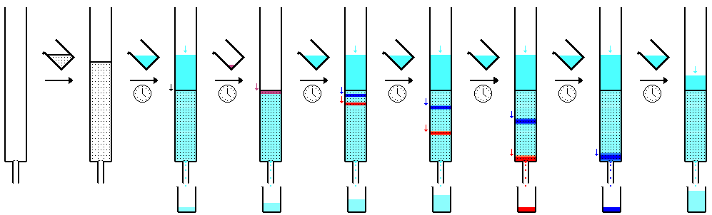
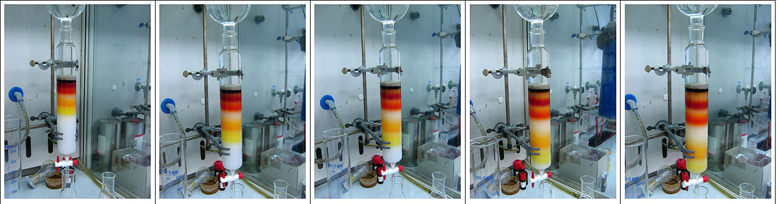
Classification of the Chromatographic Method according to the Arrangement
Column chromatography

Slide 14
Rozdělení chromatografických metod podle uspořádání
Thin layer chromatography (TLC)
is a widely employed laboratory technique used to separate different biochemicals on the basis of their size and is similar to paper chromatography. However, instead of using a stationary phase of paper, it involves a stationary phase of a thin layer of adsorbent like silica gel, alumina, or cellulose on a flat, inert substrate. TLC is very versatile; multiple samples can be separated simultaneously on the same layer, making it very useful for screening applications such as testing drug levels and water purity. Possibility of cross-contamination is low since each separation is performed on a new layer. Compared to paper, it has the advantage of faster runs, better separations, better quantitative analysis, and the choice between different adsorbents. For even better resolution and faster separation that utilizes less solvent, high-performance TLC can be used. An older popular use had been to differentiate chromosomes by observing distance in gel (separation of was a separate step).

Slide 15
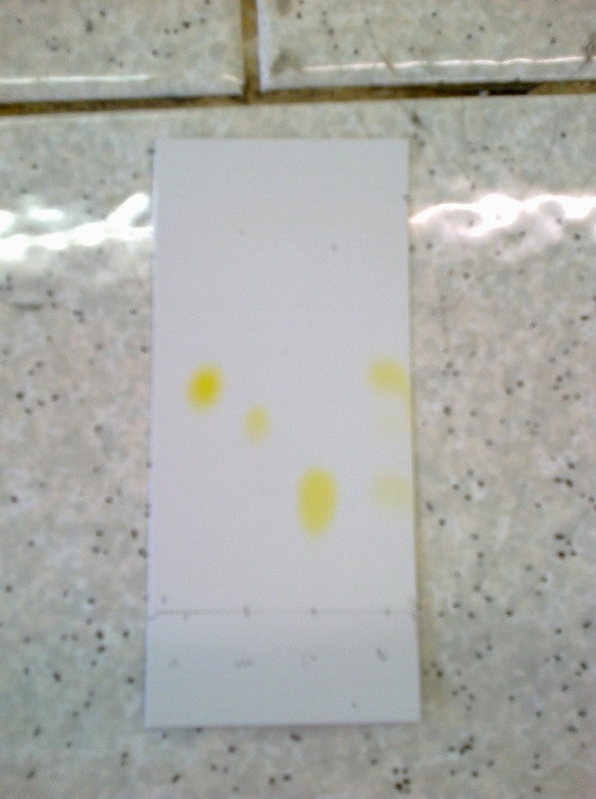
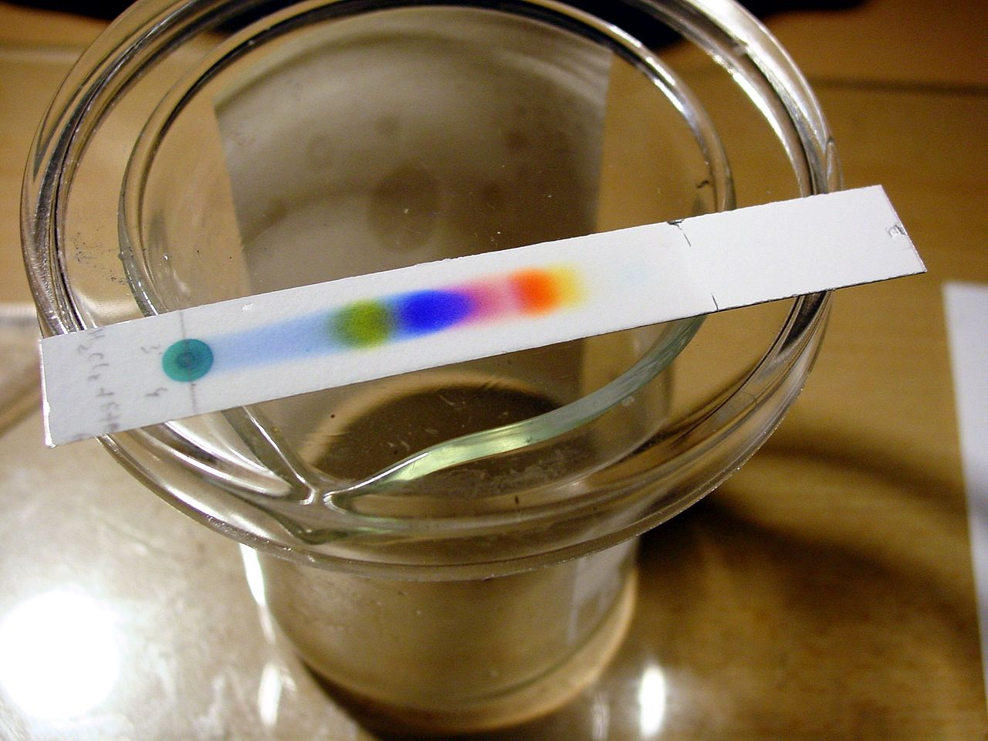
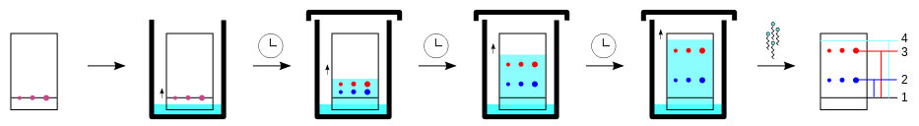
Classification of the Chromatographic Method according to the Arrangement
Thin layer chromatography (TLC)

Slide 16
Classification of the Chromatographic Method according to the Arrangement
Paper chromatography
is an analytical method used to separate colored chemicals or substances. It is primarily used as a teaching tool, having been replaced by other chromatography methods, such as thin-layer chromatography. A paper chromatography variant, two-dimensional chromatography involves using two solvents and rotating the paper 90° in between. This is useful for separating complex mixtures of compounds having similar polarity, for example, amino acids. The setup has three components. The mobile phase is a solution that travels up the stationary phase, due to capillary action. The mobile phase is generally an alcohol solvent mixture, while the stationary phase is a strip of chromatography paper, also called a chromatogram. A chromatographic method is called adsorption chromatography if the stationary phase is solid

Slide 17
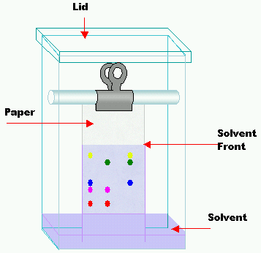
Classification of the Chromatographic Method according to the Arrangement
Paper chromatography

Slide 18
Classification of the Chromatographic Techniques according to the by physical state Mobile Phase
GC, gas chromatography)
Mobile Phase is a Gas. It is a common type of chromatography used in analytical chemistry for separating and analyzing compounds that can be vaporized without decomposition.
LC, HPLC, liquid chromatography)
Liquid chromatography (LC) is a separation technique in which the mobile phase is a liquid and the Stacionary Phase is the Solid State Material, alternatively Liquid bonded on the Solid State Material.

Slide 19
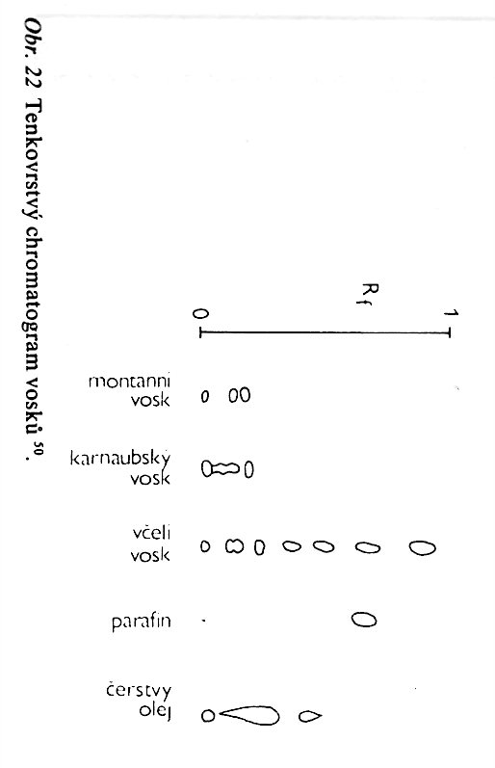
TLC Chromatography – without any
Pre-treatment of the Samples (e.g. By Hydrolysis)
Bee Wax
Fresh Oil of the Unknown Origin
Montane Wax
Carnauba Wax
Paraffin
TLC Chromatography of WAXE’S

Slide 20
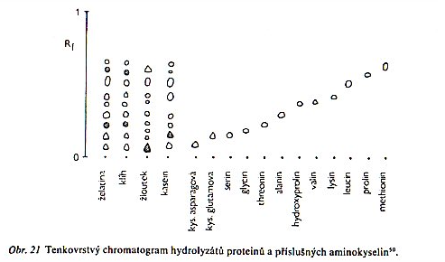
TLC Chromatography – after the
Pre-treatment of the Samples (here are the Amino acids treated by Hydrolysis)
Gelatin
Kasein
Eggs Yellow
Animal Glue
TLC Chromatography of Amino acids and some hydrolysed Proteins

Slide 21
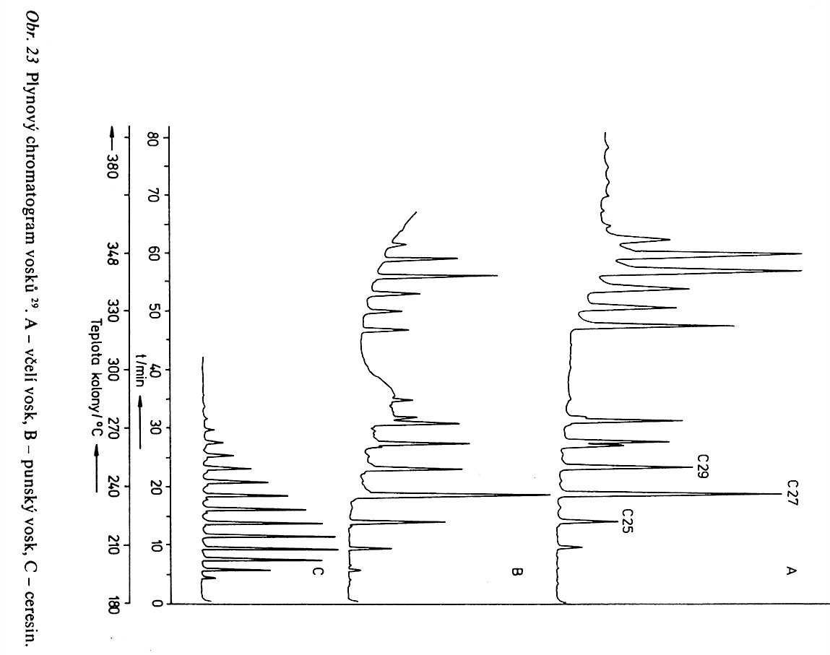
GC of some Waxes after Saponification and Methylation of the acids to the Methyesters
Bee Wax
Punic Wax
Ceresine

Slide 22
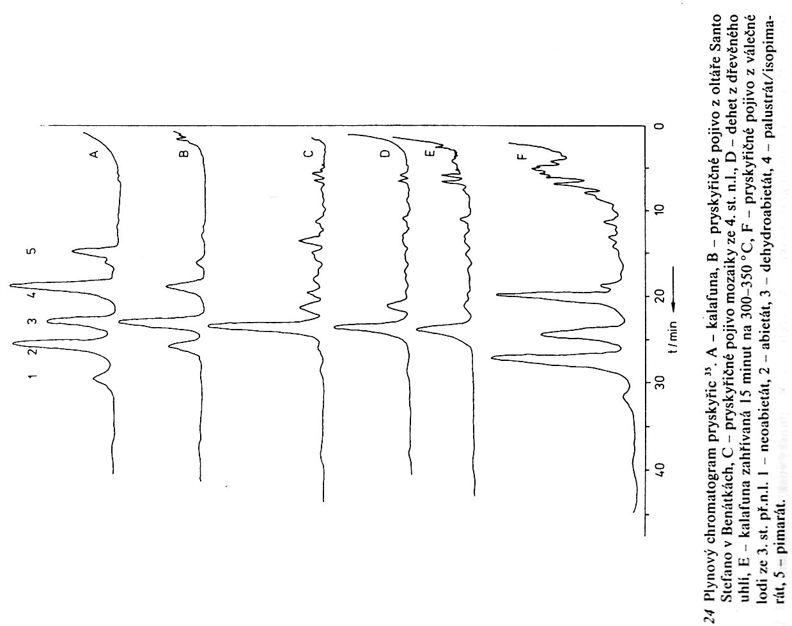
GC of some RESINS after Saponification and Methylation of the acids to the Methyesters
Colophone
Resin Binder – Painting on the high Altar (Santo Stefano, Venice, Italy)
Resin Binder – Mosaic, 4. Century B.C.
Wood Coal Tar
Colophone after Heating
(15 Minutes & 300 – 350 °C)
Resin Binder – War Ship,
3. Century B.C.

Slide 23
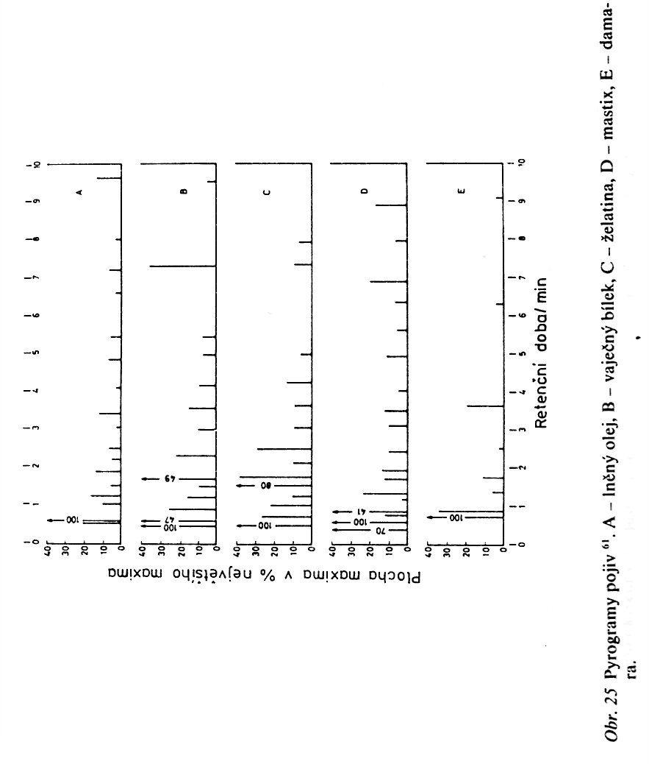
GC of some Binder Oils
after Pyrolysis at 600 °C
Linseed/Flaxseed oil
Eggs White
Gelatin
Mastix
Damara
Retention time (Minutes)

Slide 24
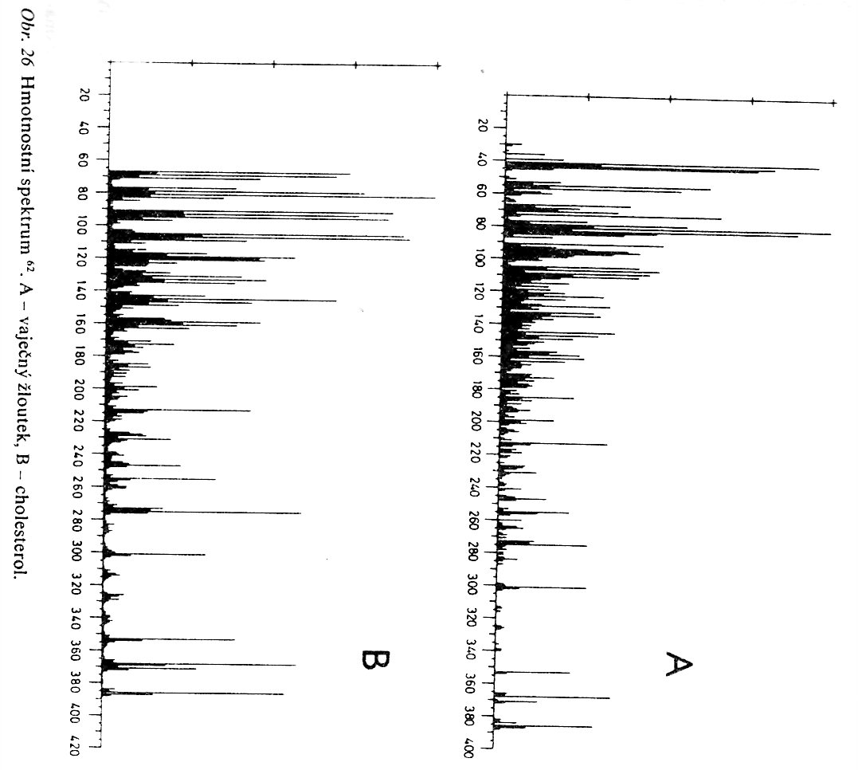
GC & Mass Spectroscopy 1
Eggs Yellow
Cholesterol

Slide 25
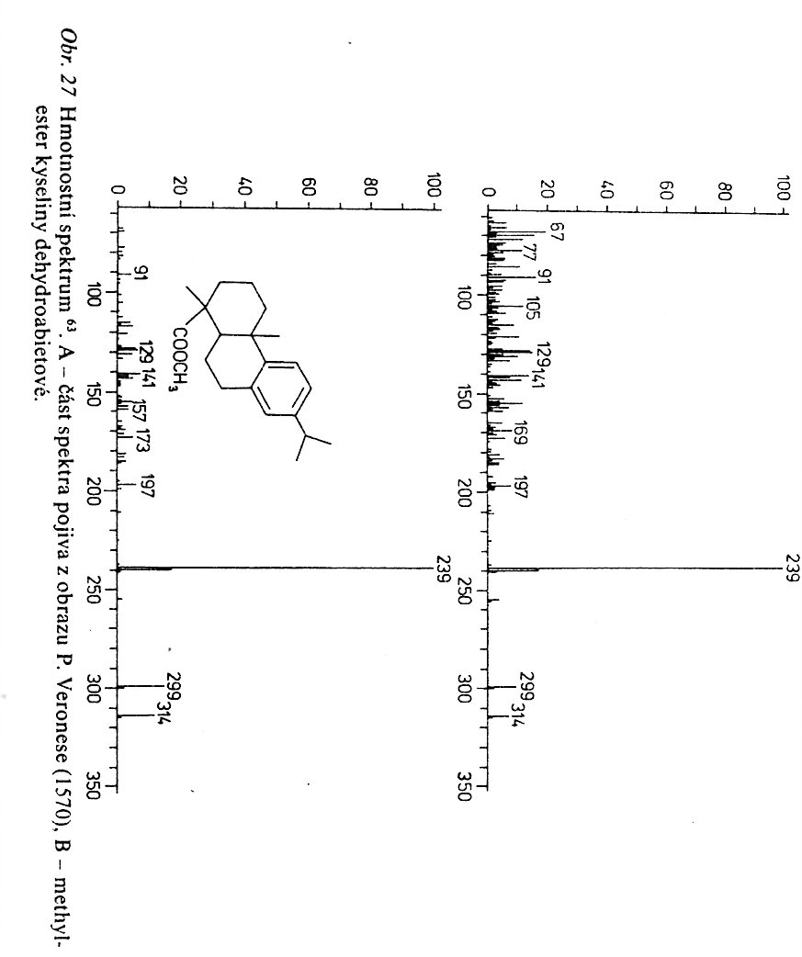
GC & Mass Spectroscopy 2
Painting by P. Veronese (1570)
Dihydroabietic acid methylester

Slide 26
  Electrophoresis
Elektroforéza je soubor separačních metod, které využívají k dělení látek jejich odlišnou pohyblivost ve stejnosměrném elektrickém poli. Na principu rozdílných elektroforetických mobilit se při ní dělí nabité molekuly (ionty).
V roce 1892 bylo publikováno, že anorganické částice v koloidním roztoku pod vlivem elektrického pole nenáhodně putují. Nedlouho poté byl tento jev popsán i u proteinů ve vodných roztocích.
V roce 1948 byl Nobelovou cenou oceněn švédský chemik Arne Tiselius, který ve 30. letech minulého století postavil aparaturu separující proteiny krevního séra na základě jejich elektroforetických mobilit.

Slide 27
  Electrophoresis 1
Electrophoresis (from the Greek "Ηλεκτροφόρηση" meaning "to bear electrons") is the motion of dispersed particles relative to a fluid under the influence of a spatially uniform electric field.
Electrophoresis of positively charged particles (cations) is called cataphoresis, while electrophoresis of negatively charged particles (anions) is called anaphoresis.
Electrophoresis is a technique used in laboratories in order to separate macromolecules based on size. The technique applies a negative charge so proteins move towards a positive charge.
Suspended particles have an electric surface charge, strongly affected by surface adsorbed species, on which an external electric field exerts an electrostatic Coulomb force. According to the double layer theory, all surface charges in fluids are screened by a diffuse layer of ions, which has the same absolute charge but opposite sign with respect to that of the surface charge.

Slide 28
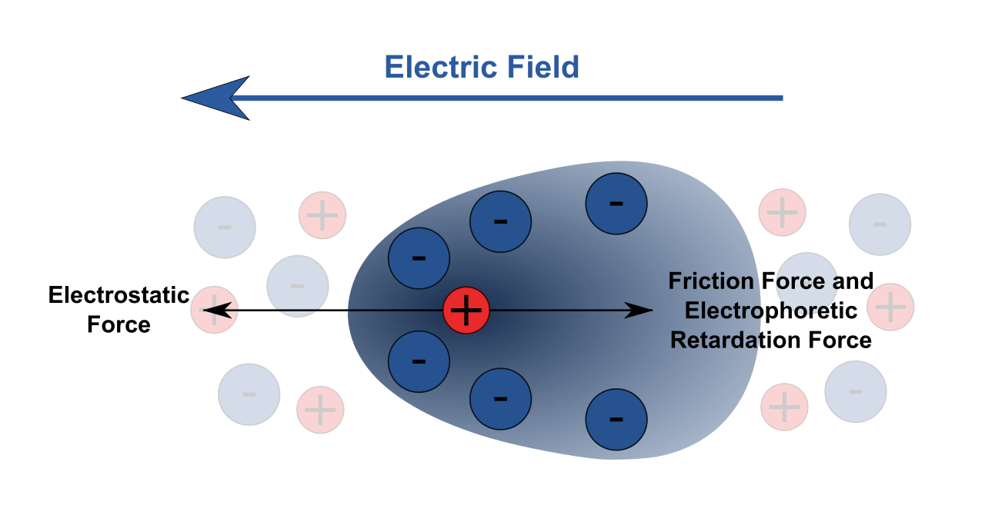
  Electrophoresis 2

Slide 29
Capilary Gel Electrophoresis
is a process which enables the sorting of molecules based on size. Using an electric field, molecules (such as DNA) can be made to move through a gel made of AGAROSE or POLYACRYLAMIDE. The electric field consists of a negative charge at one end which pushes the molecules through the gel, and a positive charge at the other end that pulls the molecules through the gel. The molecules being sorted are dispensed into a well in the gel material. The gel is placed in an electrophoresis chamber, which is then connected to a power source. When the electric current is applied, the larger molecules move more slowly through the gel while the smaller molecules move faster. The different sized molecules form distinct bands on the gel.
Gel electrophoresis uses a gel as an anticonvective medium and/or sieving medium during electrophoresis, the movement of a charged particle in an electrical field. Gels suppress the thermal convection caused by application of the electric field, and can also act as a sieving medium, retarding the passage of molecules; gels can also simply serve to maintain the finished separation, so that a post electrophoresis stain can be applied.
Shorter molecules move faster and migrate farther than longer ones because shorter molecules migrate more easily through the pores of the gel.
Gel Electrophoresis is the most wide spread Electrophoresis Method now.

Slide 30
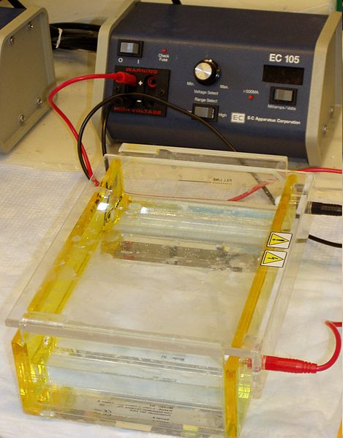
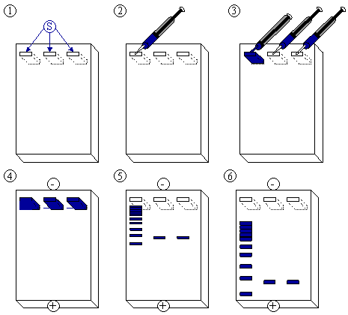
  Electrophoresis

Slide 31
FTIR Spectroscopy
Advantages:
  Dosti univerzální technika (pevné látky, kapaliny, plyny, roztoky, KBr technika, vícenásobný odraz, …)
  Malé množství vzorku
  Možnost spojení s mikroskopií
  …………….
Disadvantages:
  Instrumentálně i vzdělanostně náročné
  Spektrum závisí i na technice měření
  ……………..

Slide 32
FTIR Spectroscopy
Advantages:
  General-purpose (universal) Method (Solid State Materials, Liquids, Gases, Solutions, KBr Technique, Multireflection technique. ………..
  Small Quantity of the Sample is needed
  It is possible to be connected to Optical Microscope
  …………….
Disadvantages:
  It is demanding as to Operator’s Qualification and Instrumentation
  Spectrum depends on the Measurement Technique also
  ……………….

Slide 33
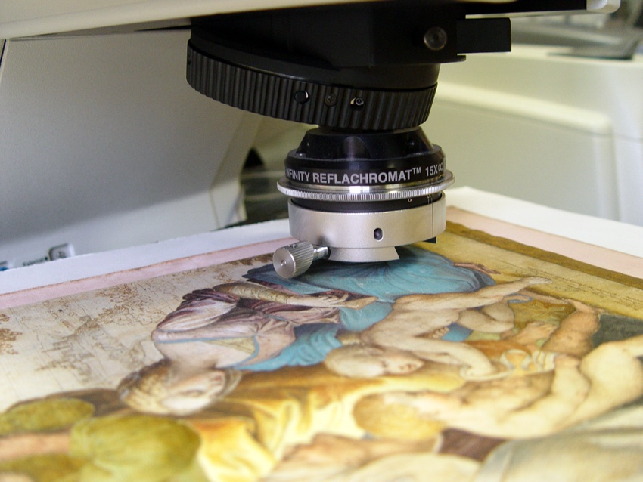
FTIR Spectroscopy is possible to be connected to Optical Microscope

Slide 34
FTIR connected to Optical Microscope – AN EXAMPLE (see previous slide, please)

Slide 35
FTIR connected to Optical Microscope – AN EXAMPLE (see BEFORE LAST slide, please)

Slide 36
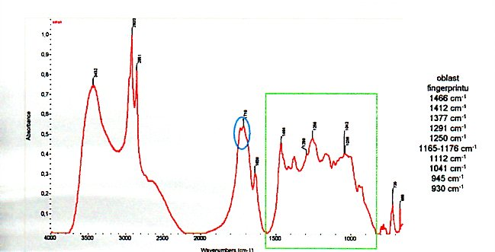
FTIR Spectrum SHELAC

Slide 37
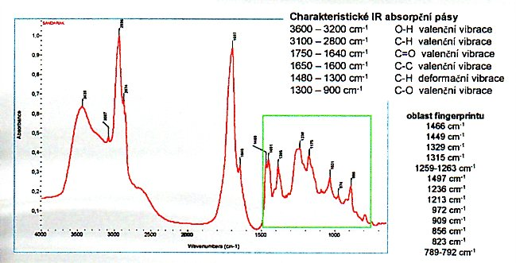
FTIR Spectrum SANDARAK

Slide 38
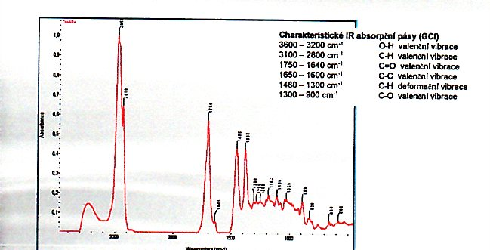
FTIR Spectrum DAMARA

Slide 39
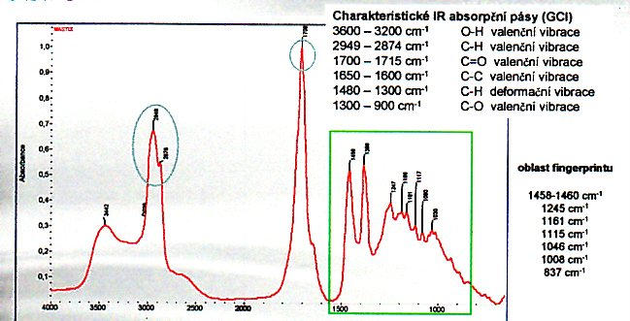
FTIR Spectrum MASTIX

Slide 40
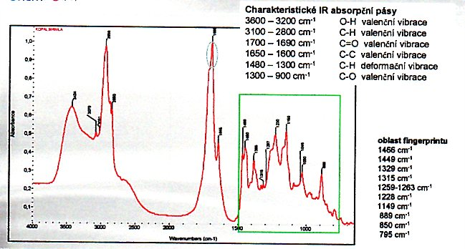
FTIR Spectrum COPAL

Slide 41
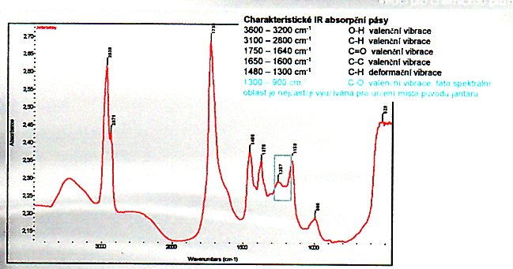
FTIR Spectrum Amber (Baltic See Region)

Slide 42
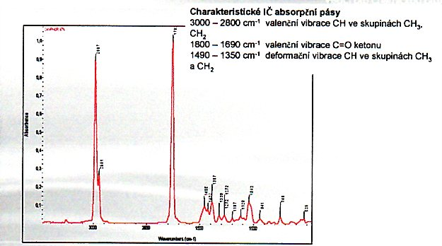
FTIR Spectrum Camphor

Slide 43
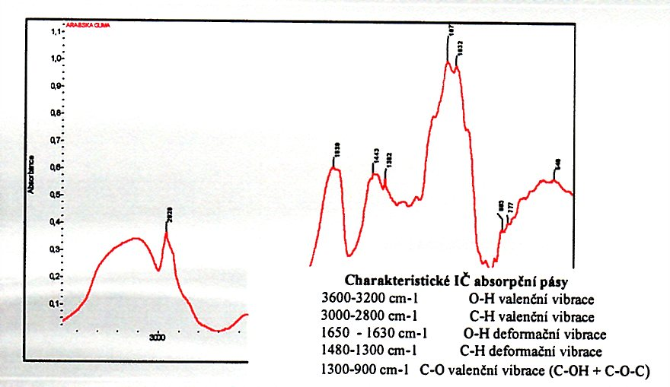
FTIR Spectrum Arabic Gum

Slide 44
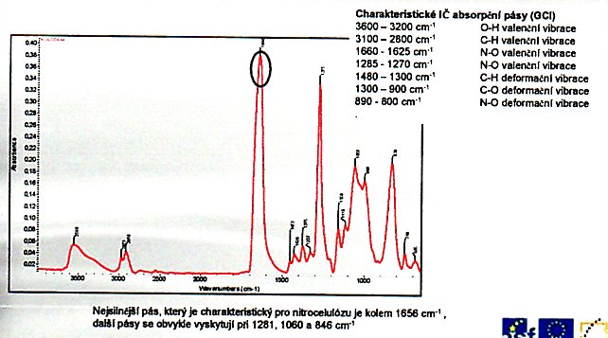
FTIR Spectrum NITROCELLULOSE

Slide 45
FTIR Spectrum Cellulose, NITROCELLULOSE and Cellulose triacetate

Slide 46
FTIR Spectrum Cellulose, Starch, Dextrin, Cellulose with Lignin

Slide 47
FTIR Spectrum Cellulose (Paper) and Cellulose (Jute Canvas)

Slide 48
FTIR Spectrum Kasein and Kasein Glue (Ca Salt)

Slide 49
NMR Spectroscopy
Advantages:
  Hydrogen, Carbon etc. Spectra can be measured
  Detail Information about the Molecular Structure
  The many Simulation Software's (Methods) are available now
  …………….
Disadvantages:
  It is demanding as to Operator’s Qualification and Instrumentation
  MOSTLY it is necessary to work with Liquid or Solution, but Solid State NMR is also possible
  …..

Slide 50
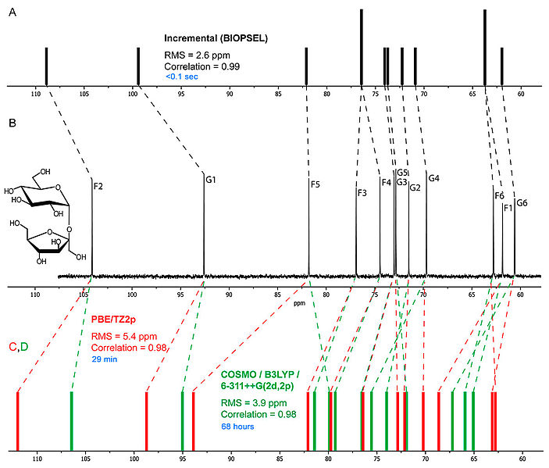
Comparative prediction of the 13C NMR spectrum of sucrose using various methods. Experimental spectrum is in the middle. Upper spectrum (black) was obtained by empirical routine. Lower spectra (red and green) were obtained by quantum-chemical calculations in PRIRODA and GAUSSIAN respectively. Included information: used theory level/basis set/solvent model, accuracy of prediction (linear correlation factor and root mean square deviation), calculation time on personal computer (blue

