Slide 1
NATURAL POLYMERS 1 Introduction to the subject
Dr. Ladislav Pospíšil
29716@mail.muni.cz

Slide 2
Who I am and what I am coming from
Since 1. 10. 1974 up to 31. 12. 2014
POLYMER INSTITUTE BRNO, Ltd., Brno, Czech Republic (Industrial Research)
Since then:
My one man company, working for various industrial companies converting plastisc
I give lectures at:
Brno University of technology, Faculty of Chemistry,
Masaryk University, Fakulty of Science,
University Tomas Bata, Fakulta of Technologická (not regulary)

Slide 3
Subject of the Lectures
The Subject gives the Students a GENERAL KNOWLEDGE about the NATURAL POLYMER which are usable for the application in the chemistry usable for a Conservator and Restorer, but also in the other fields of polymer chemistry, its history, present situation and future
Students will be able to CHOICE PROPER POLYMER MATERIALS, eventually their combinations for the Applications in the chemistry of the Conservator and Restorer, but also in the other fields of polymer chemistry
To UNDERSTAND CHEMICAL REACTION NATURAL POLYMERS and make sence of their influence on the Properties of by this way modified NATURAL POLYMERS
To INFORM students also about the Industrial PROCESSING OF NATURAL POLYMERS
To UNDERSTAND DIFFERENCES BETWEEN SYNTHETIC AND NATURAL POLYMERS
To be able independently ANALYZE ROLE of NATURAL POLYMERS now days
To stimulate the students’ interest for the more detail studying of the NATURAL POLYMERS chemistry
To be able independently compliment knowledge in this field

Slide 4
How to integrate this Lectures into the CONTEXT with the other Subjects?
Macromolecular chemistry - the basic Lectures (source of Knowledge > General Texbook)
NATURAL POLYMERS > the Development and the Supplement to the only one basic Lecture there (source of Knowledge > Specialized Textbook)
Saccharides > Specialization on the definite chemical field (source of Knowledge > Monograph)
Mono a disaccharides > narrowing of the Specialization (source of Knowledge > Specialized Monograph)
Analysis of the Monosaccharides > very narrow Specialization (source of Knowledge > Very Specialized Monograph)
HPLC of the Saccharides > very narrow Specialization (source of Knowledge >Original Journals)

Slide 5
Time schedule
LECTURE | SUBJECT
1 | Introduction to the subject – Structure & Terminology of nature polymers, literature
2 | Derivatives of acids – natural resins, drying oils, shellac
3 | Waxes
4 | Plant (vegetable) gums, Polyterpene –natural rubber (extracting, processing and modification)
5 | Polyphenol – lignin, humic acids
25.10. & 1. 11. | Polysaccharides I – starch
8.11. & 15. 11. | Polysaccharides II – celullosis
22. & 22. 11. | Protein fibres I
29. 11. & 6. 12. | Protein fibres II
13. & 20. 12. | Casein, whey, protein of eggs
20. 12. | Identification of natural polymers
 | Laboratory methods of natural polymers’ evaluation

Slide 6
System of Study
Lectures are inputted to the information system MU, FCI
Examination is done by colloquium
TIME LIMIT for the Examination – will be agreed
Questions and Comments are sent to my Attention in written (29716@chemi.muni.cz)
…………………

Slide 7
Recommended Literature NO specialized Textbook
John McMurry:
Organic chemistry
Chapter 25: Biomolecules: Saccharides
Chapter 26: Biomolecules: Aminoacids, Peptides and Proteins
Chapter 27: Biomolecules: Lipids

Slide 8
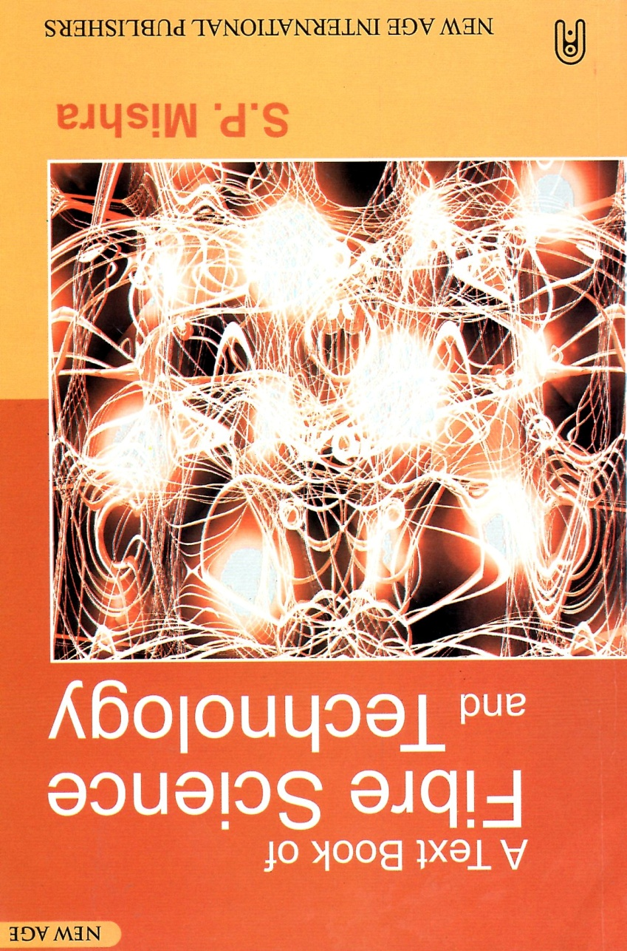
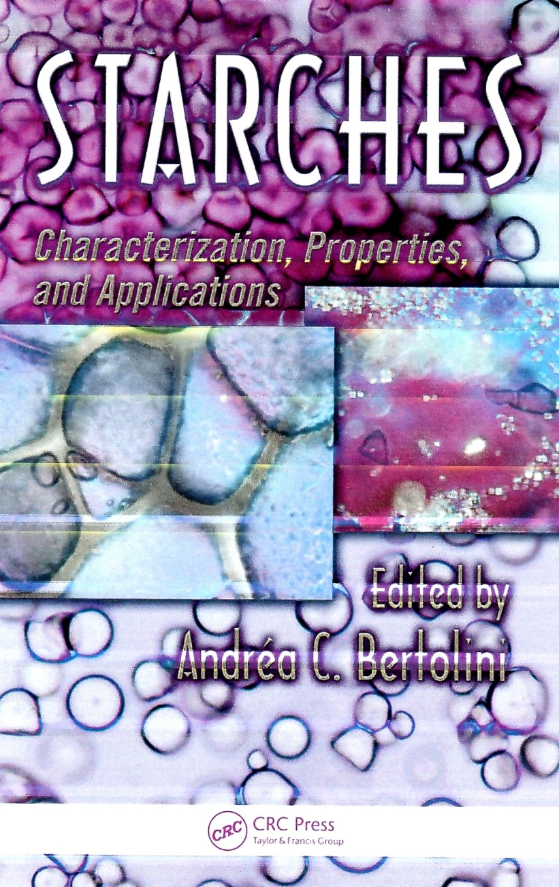
New acquired literature 1

Slide 9
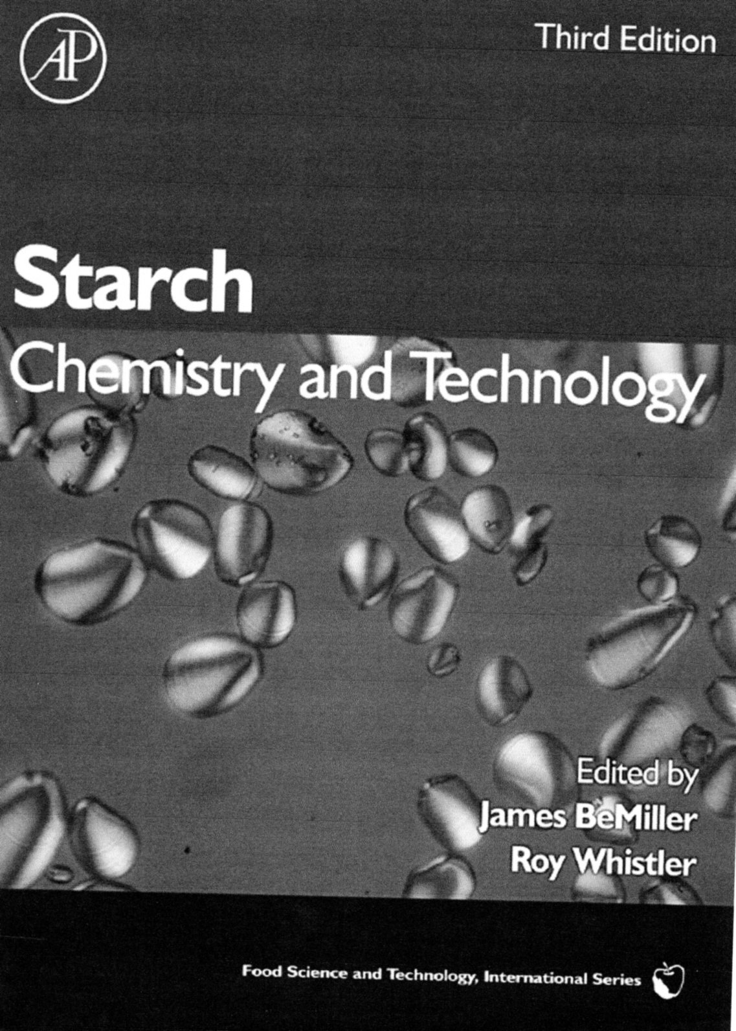
New acquired literature 2

Slide 10
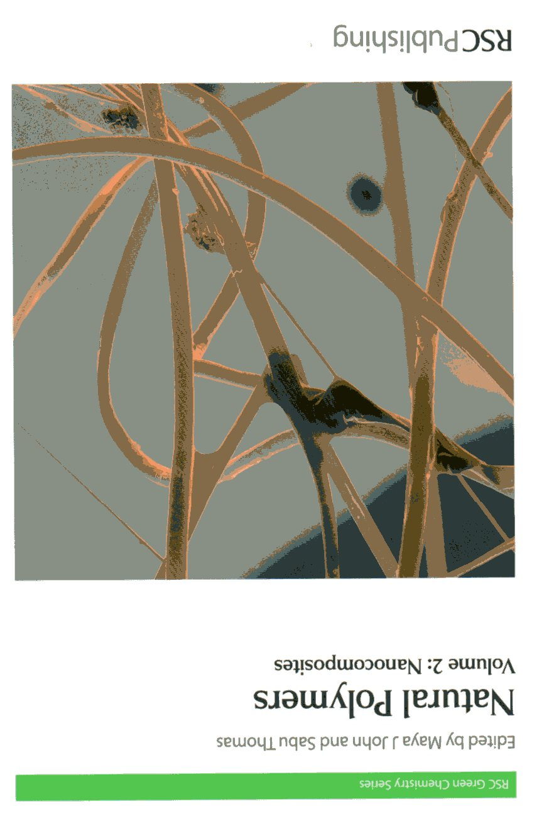
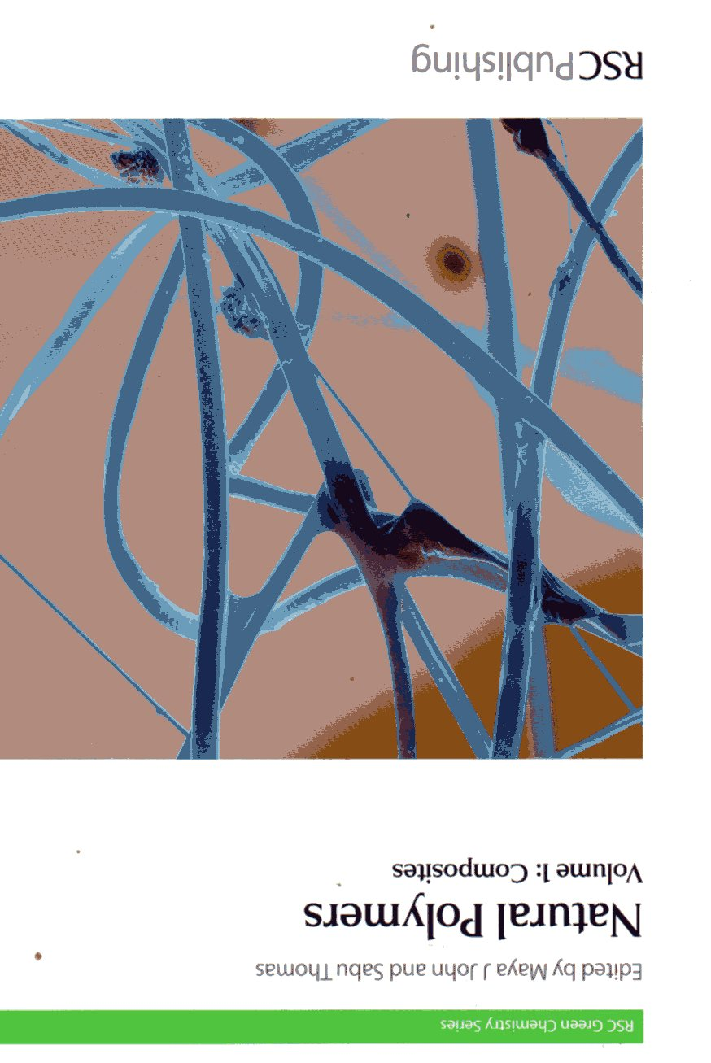
New acquired literature 3

Slide 11
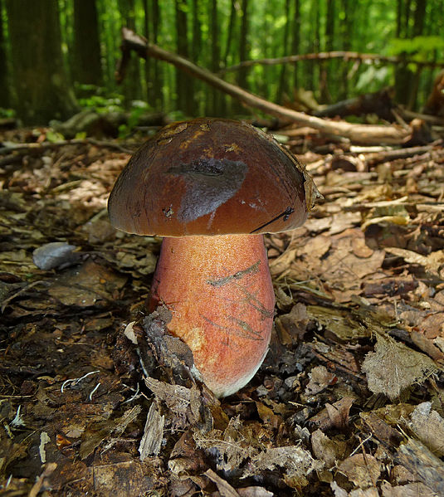
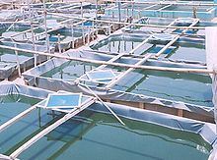
Biomass is the mass of living or/and dead biological organisms in a given area or ecosystem at a given time. Biomass can refer to species biomass, which is the mass of one or more species, or to community biomass, which is the mass of all species in the community. It can include microorganisms, plants or animals.^{[4]} The mass can be expressed as the average mass per unit area, or as the total mass in the community.
Biomass most often refers to plants or plant-based materials that are not used for food or feed, and are specifically called lignocellulosic biomass.^{[2]} As an energy source, biomass can either be used directly via combustion to produce heat, or indirectly after converting it to various forms of biofuel.

Slide 12
What is and what is NOT the Matter of our Subject here
What is NOT
What is
NATURAL oligomers
Waxes
NATURAL POLYMERS
Modification of NATURAL POLYMERS
Use (Utilization) of NATURAL POLYMERS
Enzymes
Hormons
Nucleic acids
Lowmolecular natural substances

Slide 13
NATURAL POLYMERS – historical Basis of the Polymer chemistry and Plastics
Celluloid > nitrocellulose and camphol
Galalith > casein crosslinked by formaldehyde
Viscose fibre > regenerated cellulose
……………….

Slide 14
Synthetic versus Natural products
Natural products
Modified Natural products
Syntetic products

Slide 15
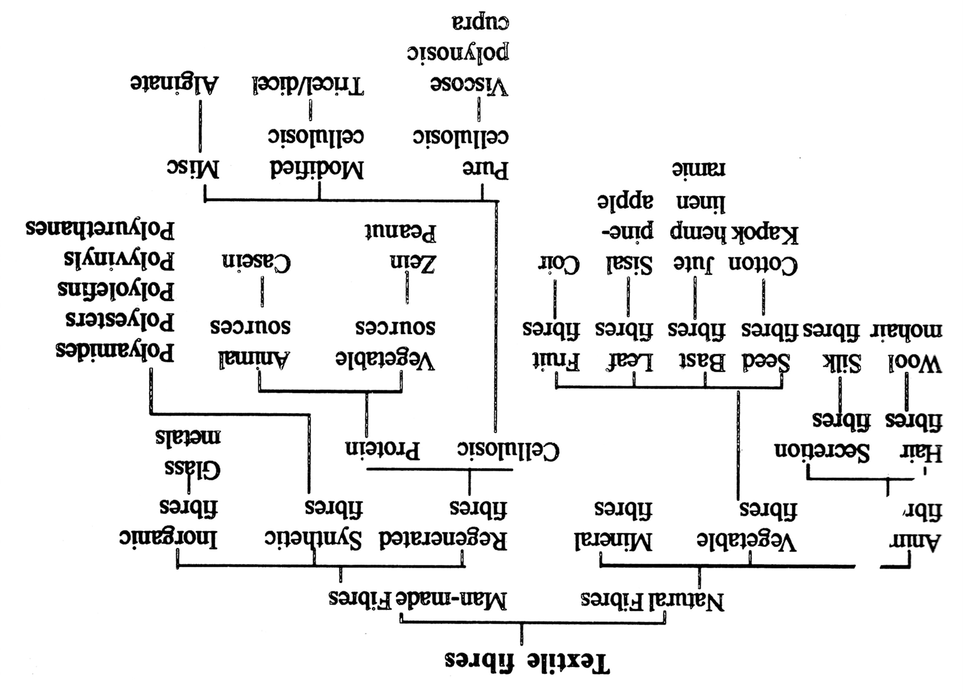
Textile fibres are often NATURAL POLYMERS!

Slide 16
NATURAL Products Characteristics
After SEPARATION and possible CLEANING are possible to be used as are so, as they got from the NATURAL RESOURCES
EXAMPLES:
Cellulosic fibres > Cotton (approx. 98 % w/w of Cellulose)
Starch > Separation from plants (potatoes, wheat, maize)
Collagen

Slide 17
Modified NATURAL Products
After SEPARATION and potential CLEANING are subjected to chemical reaction (reactions), by this is got the final Product
EXAMPLES:
Cellulosic fibres > xanthate > precipitation> textile fibres
Starch > acid + heat > dextrin paper glue
Collagen > denaturation > animal glue and gelatine

Slide 18
Synthetic products
Resulting product is got by intentional human endeavour from the artificial substances (monomers)
EXAMPLES:
Ethylene > polyethylene
Butadiene + styrene > butadiene-styrene rubber
Dimethyl terephthalate + ethylenglykol > PETP (PET) Polyethylene terephthalate

Slide 19
Importance of the NATURAL POLYMERS in the past (history), at present and in the future
HISTORY: dominance of NATURAL POLYMERS (especially modified)
At present: minority role as the technical PLASTICS, competition in the area of glues remains, transfer of importance into food industry, cosmetics and drugs
FUTURE:
Development of the modified NATURAL POLYMERS (probably without paper industry)
Endeavour to chemical exploitation of the Biomass
Energy utilisation (biogas, wood gas)

Slide 20
Is ANY USE natural resources of sense?
What is YOUR MEANING about these utilizations:
Biodiesel,
Polylactic acid (PLA),
Bioethanol,
Ethylene made of bioethanol,
…………….

Slide 21
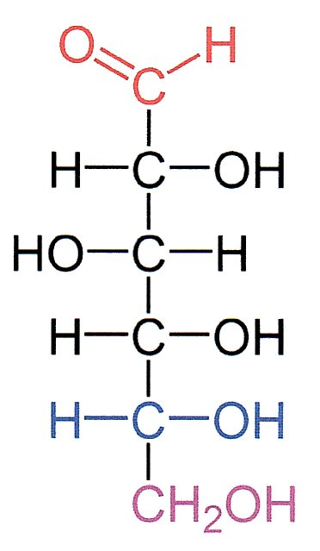
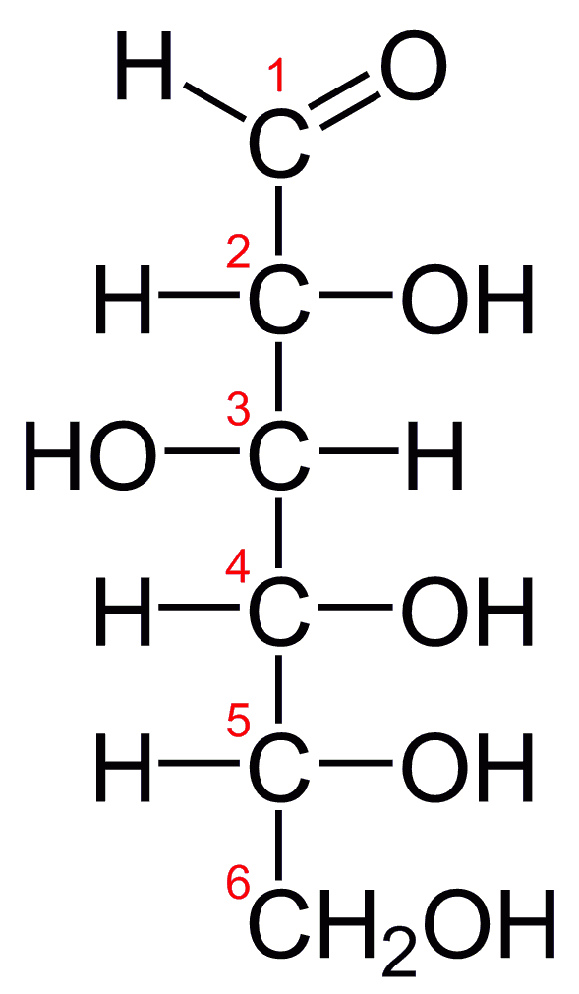
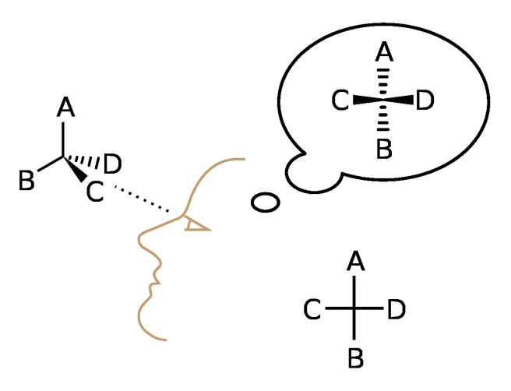
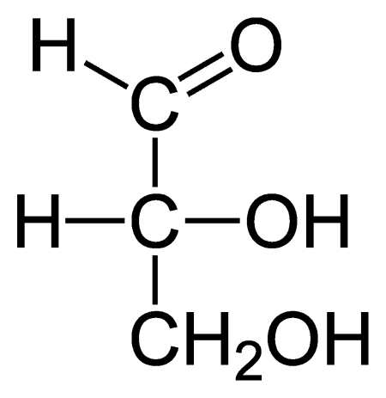
What is right to revive yourself 1 ?
Fischer projection
D-Glucose ones more :
C1 is up,
-OH on C5 is right
Fischer projection of
D-Glucose
Fischer projection of
D-Glyceraldehyde

Slide 22
What is right to revive yourself 2 ?
Mutarotation is the change in the optical rotation because of the change in the equilibrium between two anomers, when the corresponding stereocenters interconvert. Cyclic sugars show mutarotation as α and β anomeric forms interconvert.^{[1]} The optical rotation of the solution depends on the optical rotation of each anomer and their ratio in the solution.
Example
For example, if a solution of β-D-glucopyranose is dissolved in water, its specific optical rotation will be +18.7. Over time, some of the β-D-glucopyranose will undergo mutarotation to become α-D-glucopyranose, which has an optical rotation of +112.2. The observed rotation of the sample is the weighted sum of the optical rotation of each anomer weighted by the amount of that anomer present.

Slide 23
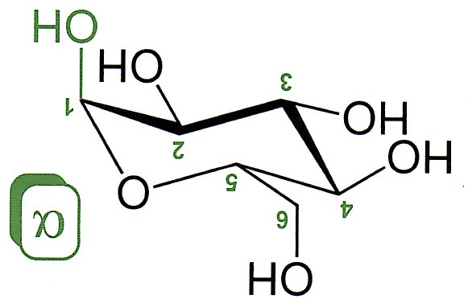
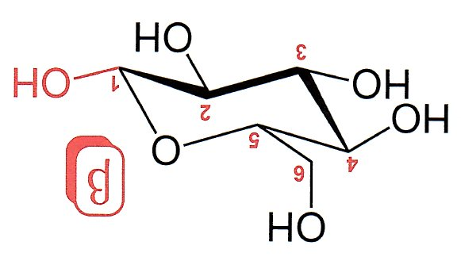
What is right to revive yourself 3 ?
Bonds -OH on C1 and bond C5-C6 are TRANS
α – D – glucopyranose (cyklic form of glucose)
β – D – glucopyranose (cyklic form of glucose)
Bonds -OH on C1 and bond C5-C6 are CIS

Slide 24
What is right to revive yourself 4 ?
α – D – glucopyranose (cyclic form of glucose, should be of approx. 37 % molar ) is in the equilibrium with
β – D – glucopyranose (cyclic form glucose, should be of approx. 37 % molar ) and these both forms further to it coexist with linear form (this should be of approx. 0,002 % molar )
Form D prevails in the nature

Slide 25
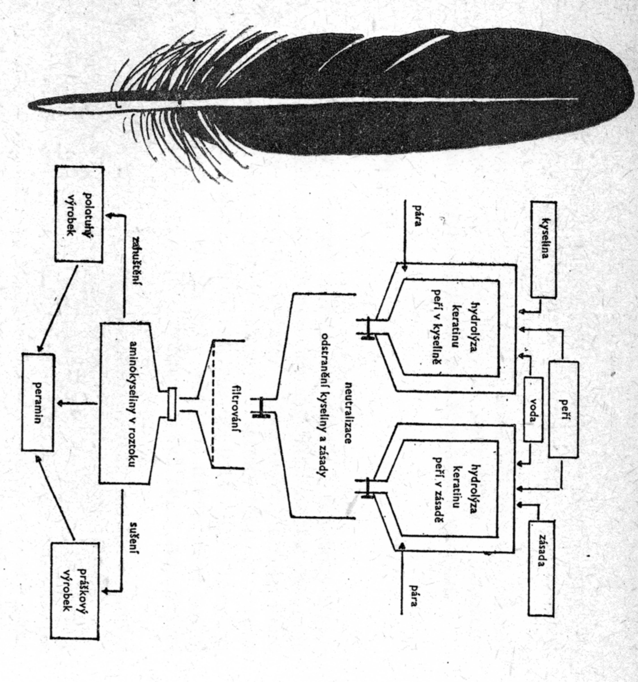
It is the long Way from the Ideas to Implementation
Utilisation of the waste Feathers as the Source of Amino acids
Feathers
Acid
Base
Water
HYDROLYSIS
Of Feathers
HYDROLYSIS
Of Feathers
Scheme published in the Yearbook „Young technician“ in the year 1962 already!
Steam
Steam
Neutralisation of waste Acid or Base
Filtration
Thickening
Solution of AMINOACIDS
Drying
Protein-vitamin feeding paste
Protein-vitamin feeding dry Matter
TRADE NAME

Slide 26
SIMILAR Project underway NOW! Biopolymers in the Academy of Science of the Czech Republic
The Institute of Chemical Processes Fundamentals > Biorefinery Research Centre of Competence
Centre can supply e.g. basic data, so industrial Participants can be suppliers of the edible collagen and the other protein hydrolysates for the Nutrition

