Slide 1
NATURAL POLYMERS fibrous PROTEINS I COLLAGEN
Dr. Ladislav Pospíšil

Slide 2
Time schedule
LECTURE | SUBJECT
1 | Introduction to the subject – Structure & Terminology of nature polymers, literature
2 | Derivatives of acids – natural resins, drying oils, shellac
3 | Waxes
4 | Plant (vegetable) gums, Polyterpene – natural rubber (extracting, processing and modification), Taraxacum_kok-saghyz
5 | Polyphenol – lignin, humic acids
6 | Polysaccharides I – starch
7 | Polysaccharides II – celullose
8 | Protein fibres I
9 | Protein fibres II
10 | Casein, whey, protein of eggs
11 | Identification of natural polymers
 | Laboratory methods of natural polymers’ evaluation

Slide 3
Repeating of the Basic Terminology related to PROTEINS (Lecture 8)
fibrous PROTEINS
Manufacture of the Gelatine and Animal Glue
Tanning industry
Skin (Hide) versus Leather
Tanning Procedure
Leather and Conservator – Restorer

Slide 4
Repeating of the Basic Terminology related to PROTEINS (Lecture 8)

Slide 5
Structure Hierarchie of Peptides and Proteins
Primary structure – the Amino acids Sequence of the Protein
Secondary structure – No covalent Interactions in the Backbone of the one Polypeptide (Protein) Chain, usually the near Parte of the Backbone (α – Helix and/or β − Sheet)
Tertiary structure – various Interactions between the Backbones of more then the one Polypeptide (Protein) Chain of Chains or remote NO neighbouring) Segments of one Chain
Quaternary structure – Interactions between the Chain Bundles, between the Tertiary structures
Tertiary & Quaternary Structures – we give attention to this in the next Lesson!

Slide 6
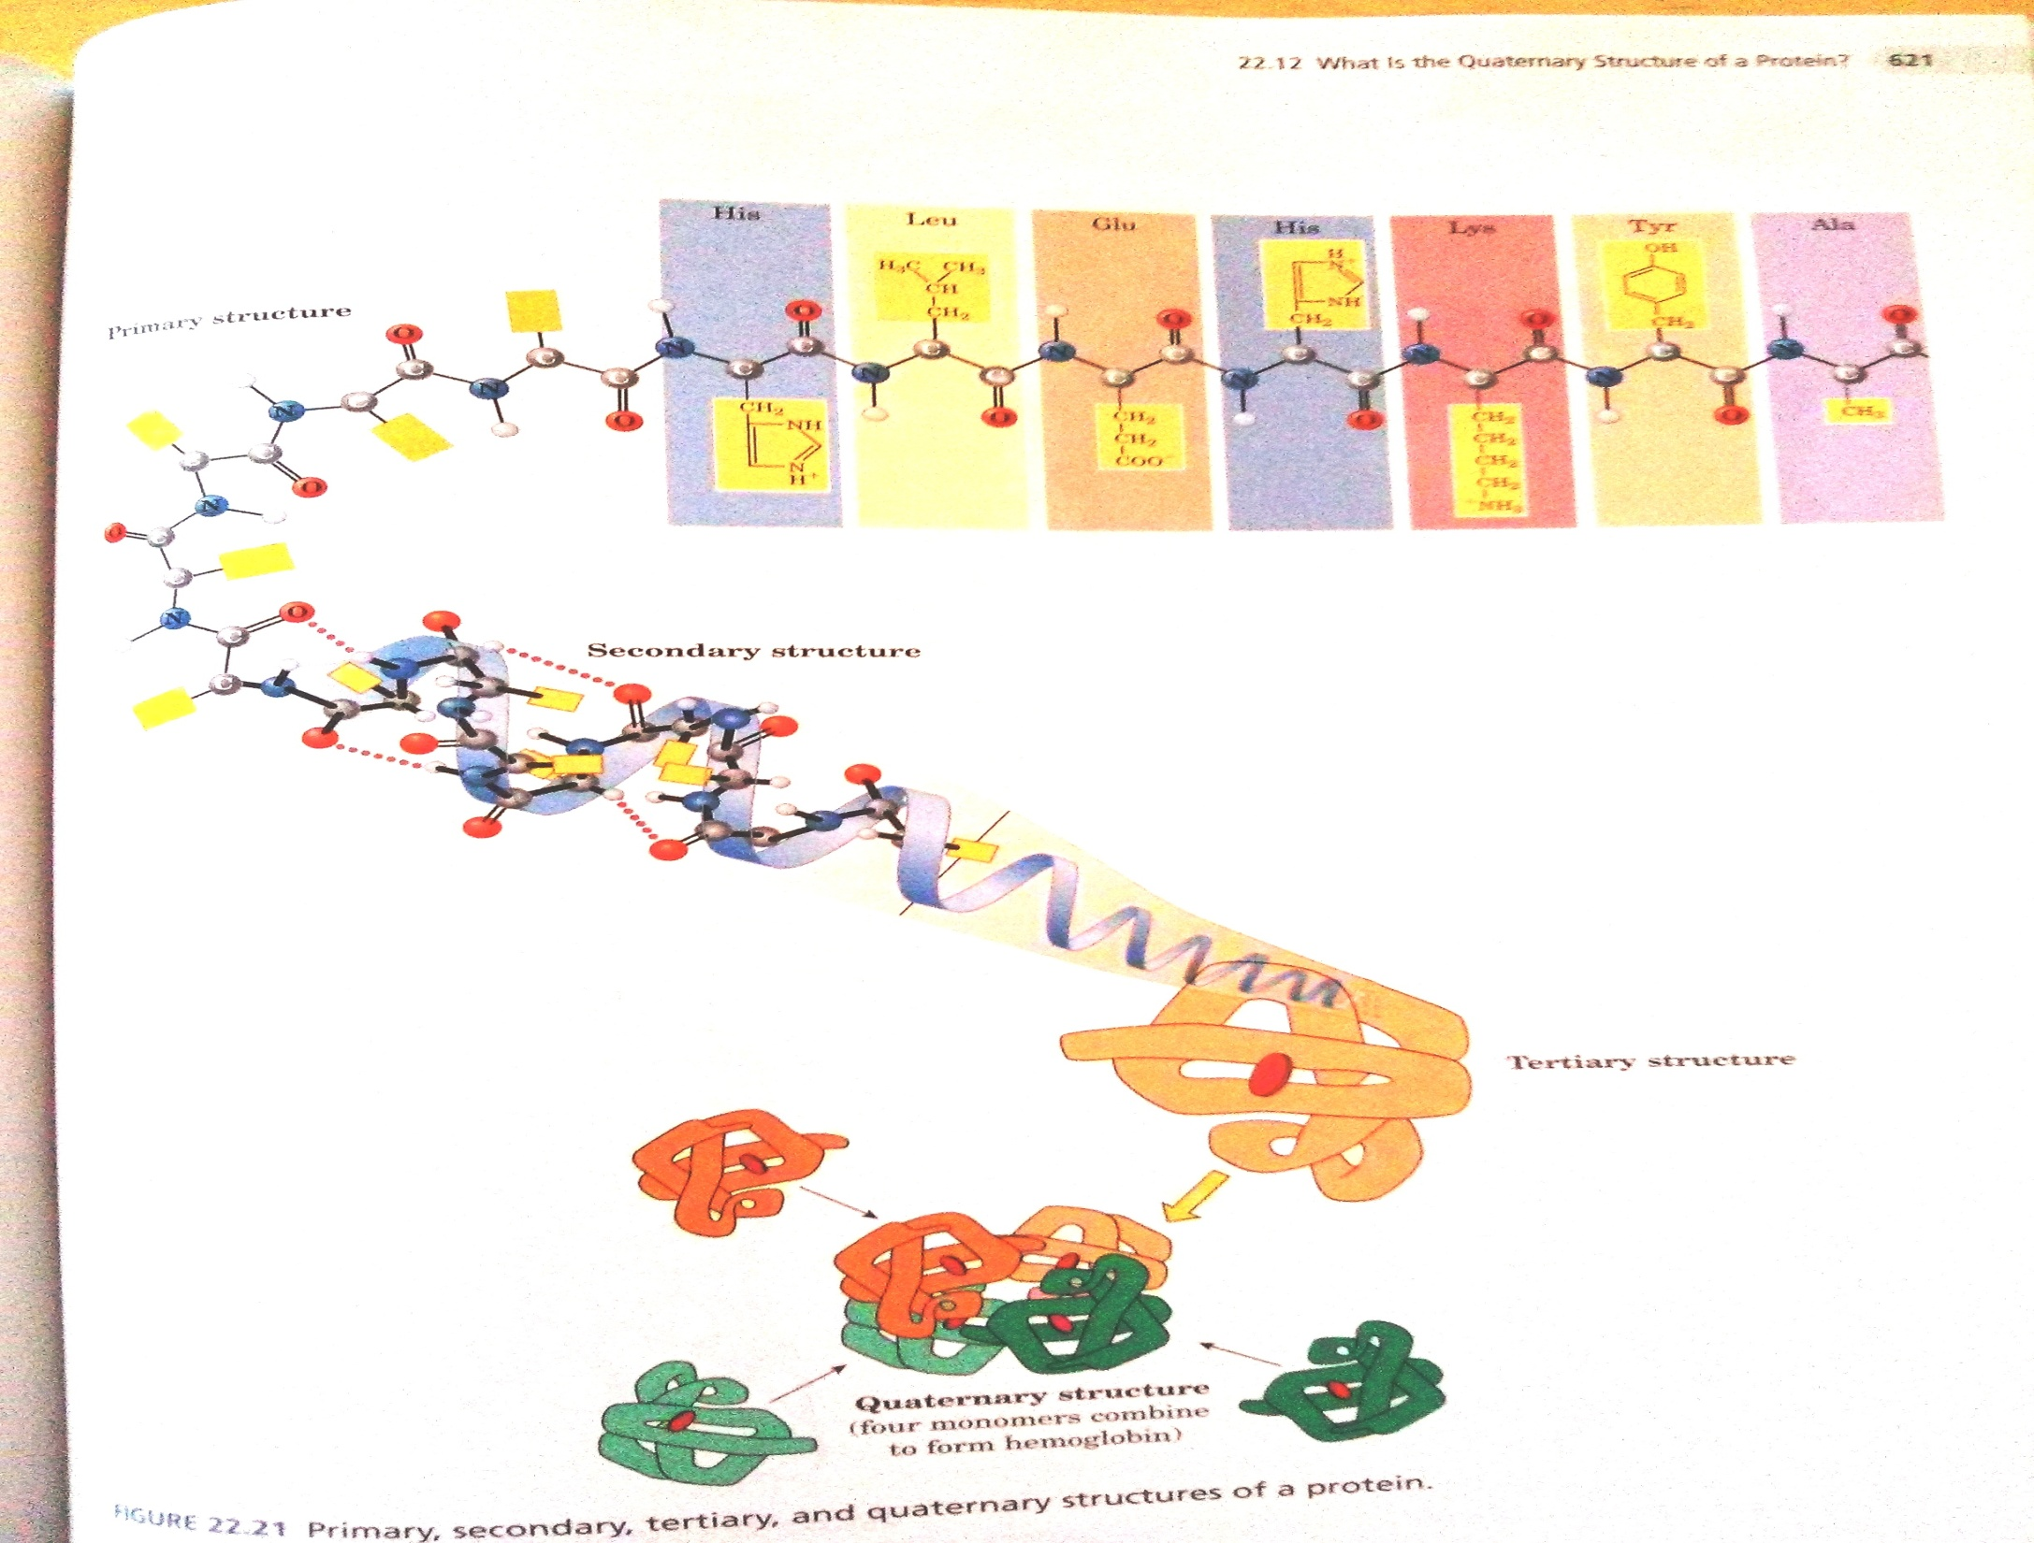

Slide 7
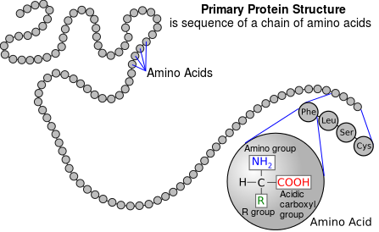
PRIMARY STRUKTURE of Proteine I

Slide 8
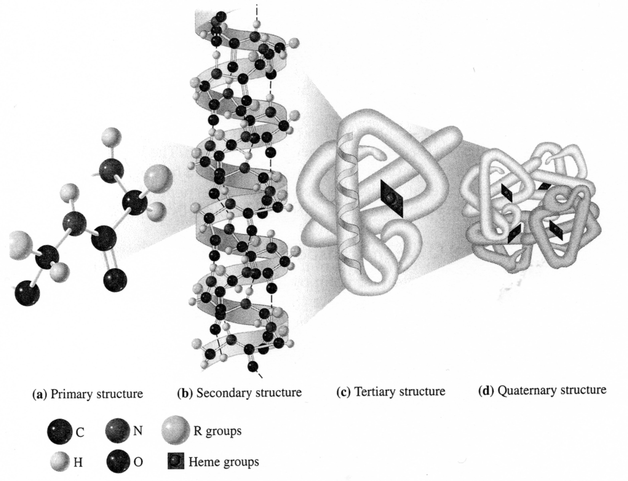
Protein SECONDARY STRUCTURE I

Slide 9
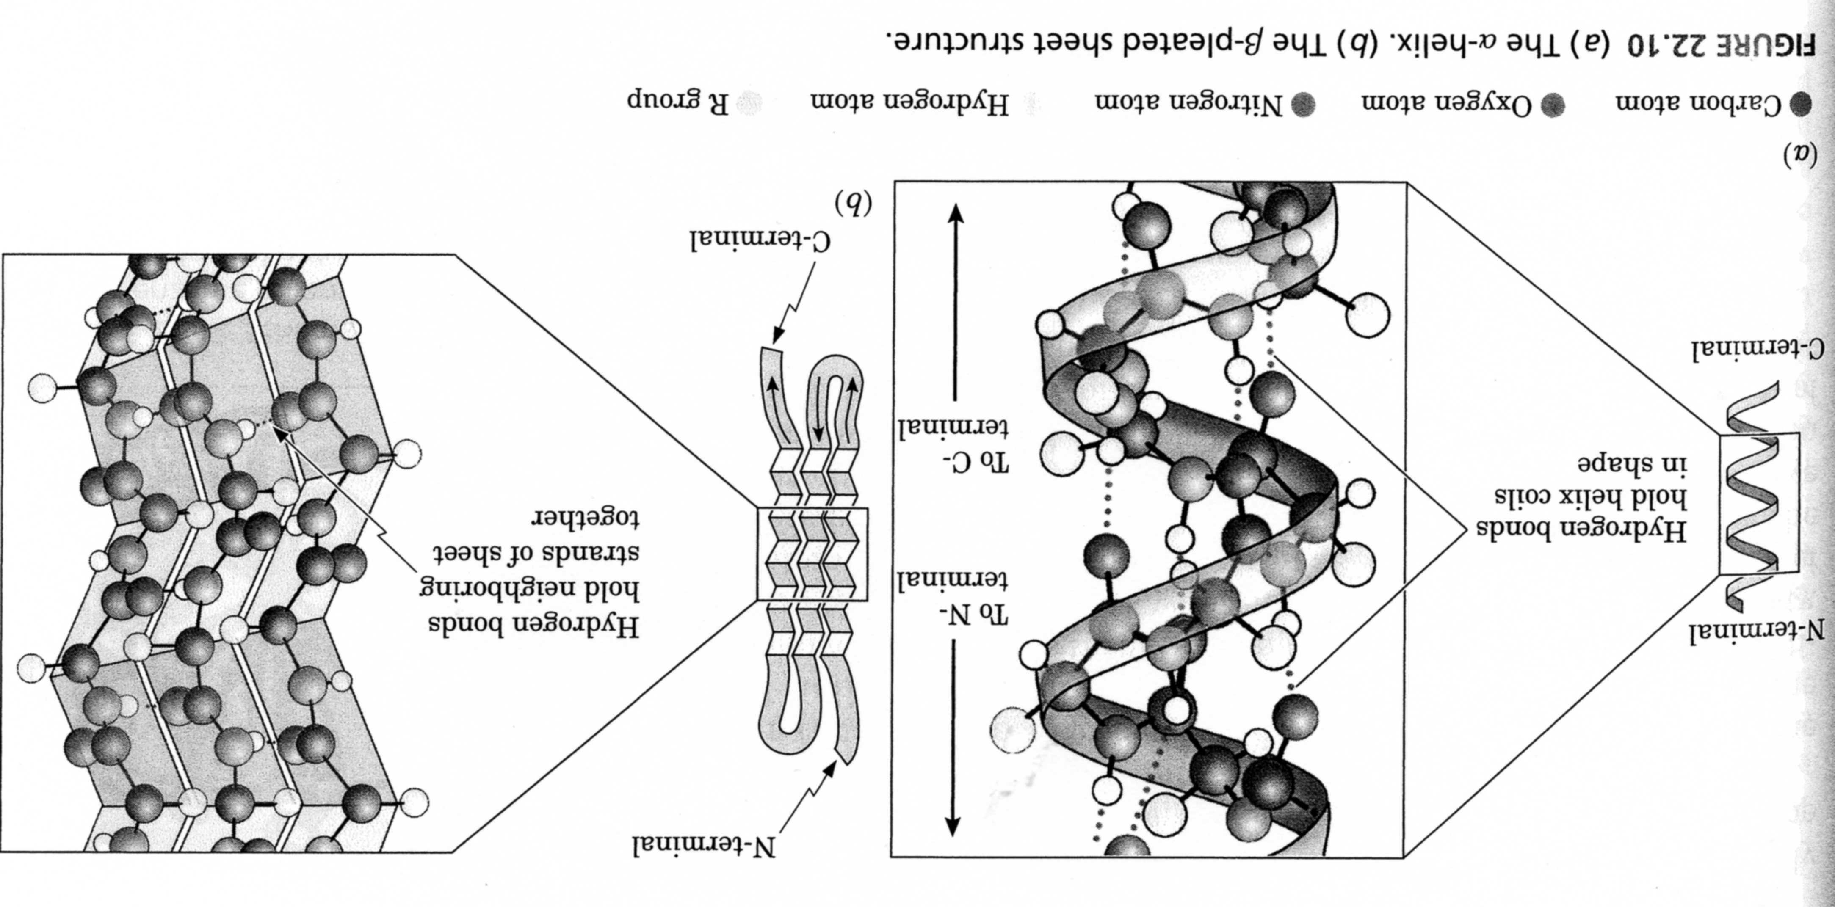
Protein SECONDARY STRUCTURE II A
Left-handed Helix

Slide 10
Proteins dividing – the Occurrence of other Components in Macromolecule accordingly
Simple protein – they are broken by Hydrolysis to Amino acids only
Compound protein – they are broken by Hydrolysis to Amino acids, Saccharides, Fats, …
LIPOPROTEINE (Fats)
GLYKOPROTEINE (Saccharides)
FOSFOPROTEINE (Phosphate groups > KASEIN)
CHROMOPEROTEINE (Colorants, e.g. Haemoglobin, Melamine)

Slide 11
Proteins dividing – Macromolecules’ Solubility in Water of accordingly
SOLUBLE (SFEROPROTEINE)
HEAT > COAGULATION
Albumin > Egg white
Glutelin > Glutelin from Wheat
UNSOLUBLE (SKLEROPROREINE)
Keratin α and β
Collagen

Slide 12
Proteins dividing – Macromolecules’ Shape and Supermolecular Structure accordingly
FIBRILAR > natural/genuine Silk, Hair, animal Hair, Muscles, fibrous connective Tissue
GLOBULAR > ENZYM, Egg white, Milk white, INSULIN, …

Slide 13
fibrous PROTEINS

Slide 14
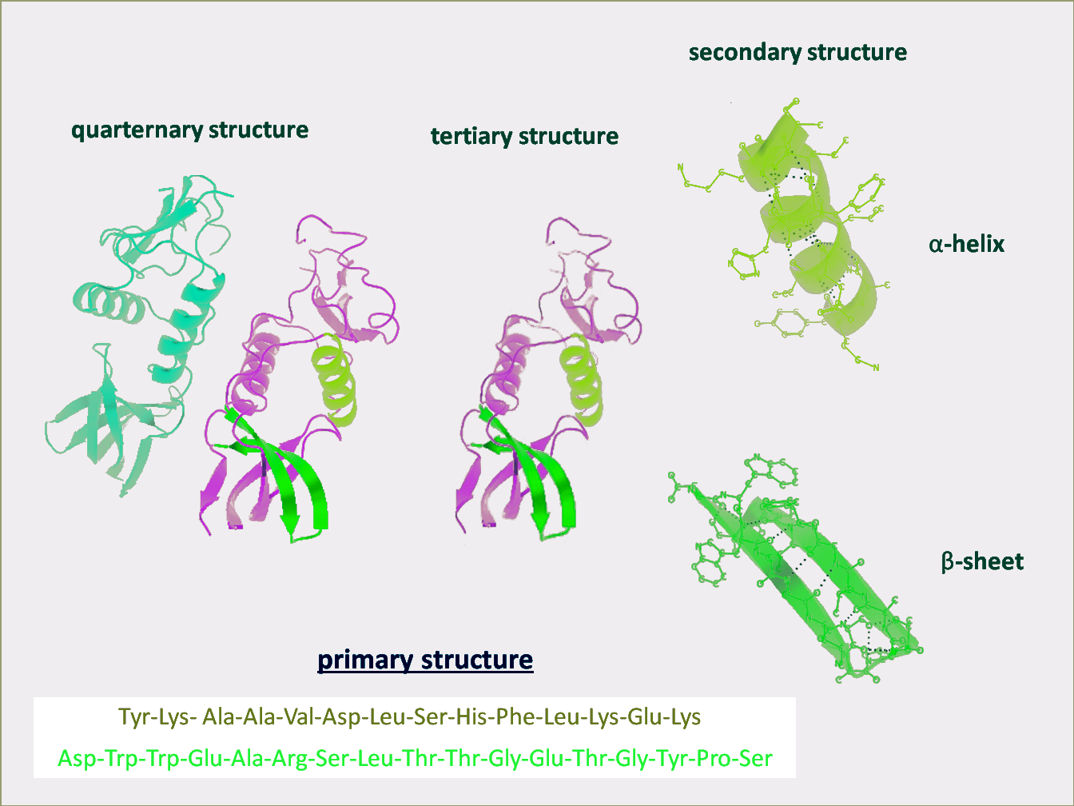
Interaction in ONE maCromoleCulE
Two possible Structures
Interaction between MORE THEN ONE MACROMOLECULE
Interaction between MORE THEN ONE PROTEIN

Slide 15
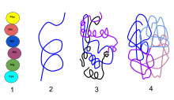
Interaction between MORE THEN ONE MACROMOLECULE
Functional proteins have four levels of structural organization: 1) Primary Structure : the linear structure of amino acids in the polypeptide chain 2) Secondary Structure : hydrogen bonds between peptide group chains in an alpha helix or beta 3) Tertiary Structure : three-dimensional structure of alpha helixes and beta helixes folded 4) Quaternary Structure : three-dimensional structure of multiple polypeptides and how they fit together

Slide 16
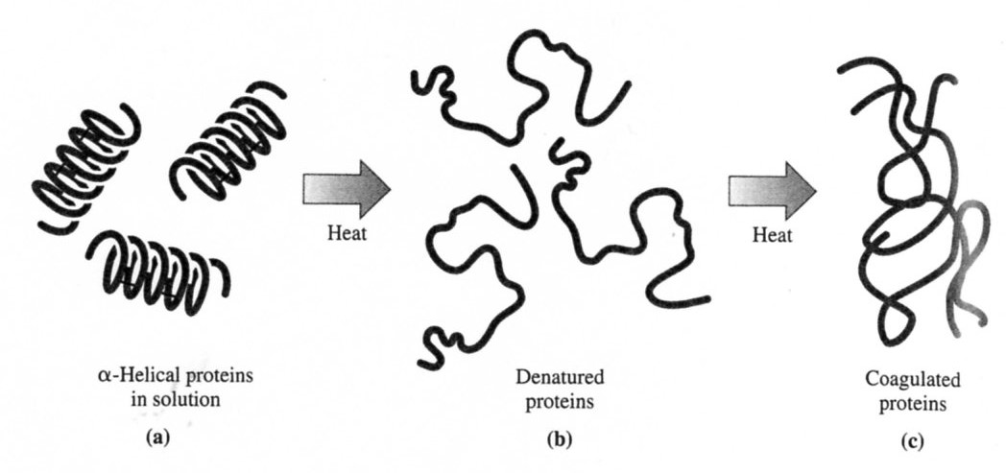
DenaturaTION and COAGULATION of Proteines
DENATURATION is the disintegration OF THE PROTEIN STRUCTURE
Coagulation is the Formation of the UNSOLUBLE Protein Form from the initially SOLUBLE Protein Form by Influence of the Physical Factors, e.g. Heat (e.g. Egg White at Cooking Egg) or by Influence of the Chemical Reagents.
Coagulation is one of the Forms of DenaturATION
Coagulation by Heat is usually Irreversible

Slide 17
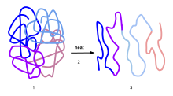
2
3
1
Process of Denaturation:
Functional proteins showing a quaternary structure
When heat is applied it alters the intramolecular bonds of the Proteins’
Unfolding of the polypeptides (Proteins)

Slide 18
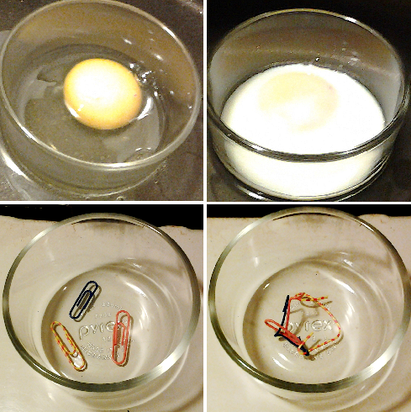
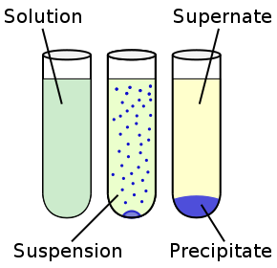
Denaturation is a process in which proteins or nucleic acids lose the quaternary structure, tertiary structure and secondary structure which is present in their native state, by application of some external stress or compound such as a strong acid or base, a concentrated inorganic salt, an organic solvent (e.g., alcohol or chloroform), radiation or heat.^{[3]} If proteins in a living cell are denatured, this results in disruption of cell activity and possibly cell death. Denatured proteins can exhibit a wide range of characteristics, from loss of solubility to communal aggregation
CoagulaTION BY HEAT
ANALOGY with paper Clips

Slide 19
IUPAC definition
Process of partial or total alteration of the native secondary, and/or tertiary, and/or quaternary structures of proteins or nucleic acids resulting in a loss of bioactivity.
Note 1:
Denaturation can occur when proteins and nucleic acids are subjected to elevated temperature or to extremes of pH, or to nonphysiological concentrations of salt, organic solvents, urea, or other chemical agents.
Note 2:
An enzyme loses its catalytic activity when it is denaturized.^{[2]}

Slide 20
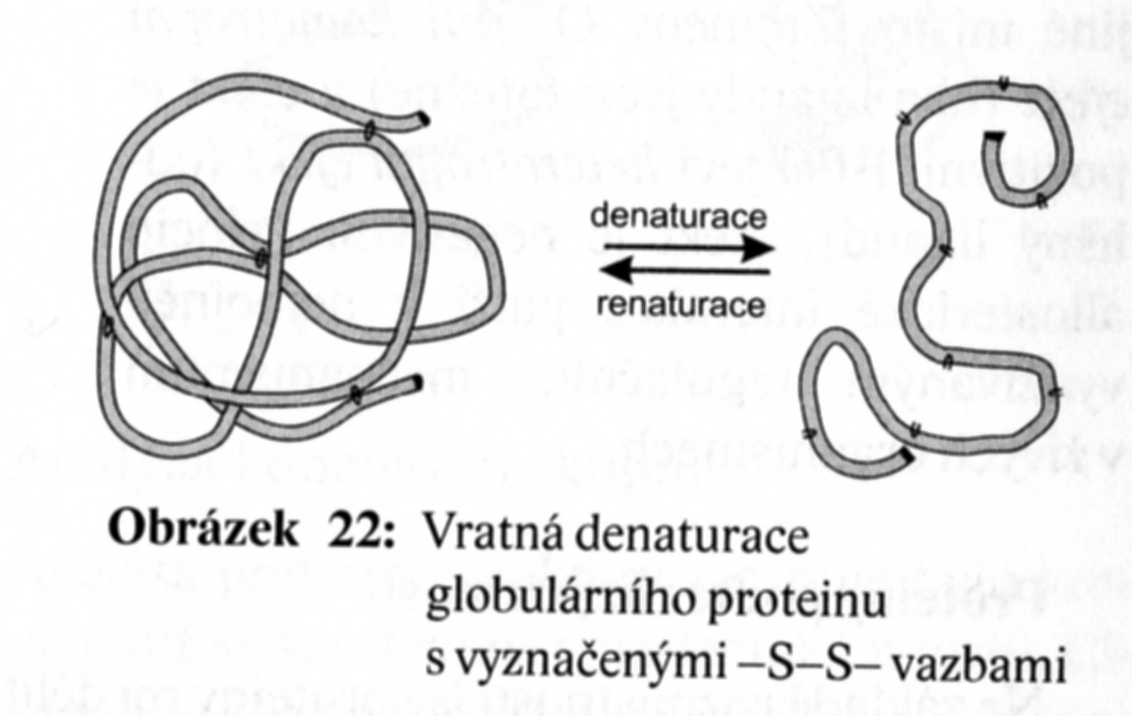
DenaturaTION CAN BE REVERSIBLE > RENATURATION
DENATURATION
RENATURATION
REVERSIBLE DenaturaTION (=RENATURATION) of the Globular Protein with marked –S-S- Bonds

Slide 21
Reversibility and irreversibility
In very few cases, Denaturation is reversible (the proteins can regain their native state when the denaturing influence is removed). This process can be called Renaturation.
This understanding has led to the notion that all the information needed for proteins to assume their native state was encoded in the primary structure of the protein, and hence in the DNA that codes for the protein, the so-called "Anfinsen's thermodynamic hypothesis".
One example of Renaturation is that an egg white can be uncooked using vitamin C or sodium borohydride (VERY CURIOUS PROCEDURE).

Slide 22
EXAMPLES Reversibility and Irreversibility COAGULATION
REVERSIBLE
IRREVERSIBLE
GELLATINE (it is COLLAGEN with lower MW)
Temperature Increasing > Dissolving > SOL
Temperature Decreasing > Solidification > GEL
TEMPERATURE OF COAGULATION = TEMPERATURE, at which (at given Concentration) COAGULATION occurs, it is Transition SOL >> GEL occurs by Temperature Decreasing
EGG WHITE
Temperature Increasing (over approx. 60 °C) > Solidification > Transition SOL >> GEL
TEMPERATURE OF COAGULATION = TEMPERATURE, at which (at given Concentration) COAGULATION occurs, it is Transition SOL >> GEL occurs by Temperature Increasing

Slide 23
COLLAGEN as the EXAMPLE of the fibrous PROTEINS
SKIN, BONES, CARTILAGE, TENDON, VASCULAR WALLS, CORNEA, …
Glycine 27 % w/w, Proline 15 % w/w, Sequnce (GLY-X-Y)_{n}
15 Types of COLLAGENS have been described up to now, they are different as to the Occurence and the Abundance of the particular Aminoacids
TropoColLagen –THREE mutually coiled Backbones
TropoColLagen > SELF ARRANGEMENT into COLLAGEN FIBRILS > Crosslinking via Hydrogen Bonds > COLLAGEN FIBERS > BUNDLES of FIBERS
DEGRADATION of COLLAGEN by ENZYME ColLagenASE > SKIN AGEIN

Slide 24
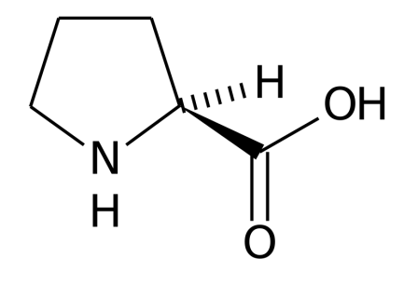
GLYCINE (Gly, G)
PROLINE (Pro, P)
LYSINE (Lys, L)
This Group of the Amino acids is important for the Hydrogen Bonds between the COLLAGEN Molecules

Slide 25
PRIMARY STRUCTURE Proteins II – COLLAGEN as the EXAMPLE (Numbers of particular Amino acids in the Macromolecules are given bellow )
AMK | Typ I |  | Typ II | Typ III | Typ IV | Typ V
 | alfa1 | alfa2 |  |  |  | A | B
3-Hyp | 1,0 | 0,0 | 2,0 | — | 11 | 2,5 | 2,9
4-Hyp | 96 | 86 | 99 | 125 | 130 | 109 | 109
Asp | 46 | 44 | 42 | 42 | 51 | 51 | 50
Thr | 20 | 20 | 20 | 13 | 23 | 26 | 19
Ser | 42 | 43 | 27 | 39 | 37 | 31 | 26
Glu | 74 | 66 | 89 | 71 | 84 | 84 | 91
Pro | 129 | 113 | 121 | 107 | 61 | 97 | 118
Gly | 330 | 336 | 333 | 350 | 310 | 319 | 322
Ala | 112 | 102 | 100 | 96 | 33 | 52 | 46
Val | 20 | 32 | 18 | 14 | 29 | 27 | 18
Gys 1 | - | - | - | 2 | 8 | - | -
Met | 8 | 6 | 9 | 8 | 10 | 11 | 8
Ile | 6 | 16 | 9 | 13 | 30 | 16 | 19
Leu | 18 | 32 | 26 | 22 | 54 | 35 | 39
Tyr | 2 | 2 | 1 | 3 | 6 | 18 | 2,1
Xhe | 12 | 10 | 13 | 8 | 27 | 14 | 12
Hyl | 4,3 | 8 | 20 | 30 | 10 | 18 | 20
Lys | 30 | 22 | 2 | 6 | 10 | 11 | 7,3
Arg | 49 | 51 | 51 | 46 | 33 | 68 | 50

Slide 26
COLLAGEN OCCURENCE IN HUMAN BODY
Type | Molecular Composition | OCCURENCE
I | [alfa1(I)]2alfa2 | SKIN, BONES, CARTILAGE, TENDON, VASCULAR WALLS, CORNEA
II | [alfa1(II)]3 | Hyalin CARTILAGE
III | [alfa1(III)]3 | The same as the Type I, formely called Retikuline
IV | [alfa1(IV)]3 | Basal Membranes
V |  | Neoplasm etc.
VI |  | Interstitial Tissues
VII |  | Epithel Tissues
VIII |  | Some Endotel Cells
IX |  | CARTILAGE together with Type II
X |  | Part of the Hypertrofic and Mineralised CARTILAGE s
XI |  | CARTILAGE
XII |  | OCCURENCE together with Types I and III

Slide 27
Amino acids Sequence alfa1 Chain of the Skin Collagen (N-terminal and C-terminal Regions are given separately)
Glu-Met-Ser-Tyr-Gly-Tyr-Asp-Glu-Lys-Ser-Ala-Gly-Val-Ser-Val-Pro–
Gly-Pro-Met-Gly-Pro-Ser-Gly-Pro-Arg-Gly-Leu-Hyp-Gly-Pro-Hyp-Gly-Ala-Hyp-Gly-Pro-Gln-Gly-Phe-Gln-Gly-Pro-Hyp-
Gly-Glu-Hyp-Gly-Glu-Hyp-Gly-Ala-Ser-Gly-Pro-Met-Gly-Pro-Arg-Gly-Pro-Hyp-Gly-Pro-Hyp-Gly-Lys-Asn-Gly-Asp-Asp-
Gly-Glu-Ala-Gly-Lys-Pro-Gly-Arg-Hyp-Gly-Gln-Arg-Gly-Pro-Hyp-Gly-Pro-Gln-Gly-Ala-Arg-Gly-Leu-Hyp-Gly-Thr-AJa-
Gly-Leu-Hyp-Gly-Met-Hyl-Gly-His-Arg-Gly-Phe-Ser-Gly-Leu-Asp-Gly-Ala-Lys-Gly-Asn-Thr-Gly-Pro-AIa-Gly-Pro-Lys-
Gly-Glu-Hyp-Gly-Ser-Hyp-Gly-Glx-Asx-Gly-Ala-Hyp-Gly-Gln-Met-Gly-Pro-Arg-Gly-Leu-Hyp-Gly-Glu-Arg-Gly-Arg-Hyp-
Gly-Pro-Hyp-Gly-Ser-Ala-Gly-Ala-Arg-Gly-Asp-Asp-Gly-Ala-Val-Gly-Ala-Ala-Gly-Pro-Hyp-Gly-Pro-Thr-Gly-Pro-Thr-
Gly-Pro-Hyp-Gly-Phe-Hyp-Gly-Ala-Ala-Gly-Ala-Lys-Gly-Glu-Ala-Gly-Pro-Gln-Gly-Ala-Arg-Gly-Ser-Glu-Gly-Pro-Gln-
Gly-Val-Arg-Gly-Glu-Hyp-Gly-Pro-Hyp-Gly-Pro-Ala-Gly-Ala-Ala-Gly-Pro-Ala-Gly-Asn-Hyp-Gly-Ala-Asp-Gly-Gln-Hyp-
Gly-Ala-Lys-Gly-Ala-Asn-Gly-Ala-Hyp-Gly-Ile-Ala-Gly-Ala-Hyp-Gly-Phe-Hyp-Gly-Ala-Arg-Gly-Pro-Scr-Gly-Pro-Gln-
Gly-Pro-Ser-Gly-Ala-Hyp-Gly-Pro-Lys-Gly-Asn-Ser-Gly-Glu-Hyp-Gly-Ala-Hyp-Gly-Asn-Lys-Gly-Asp-Thr-Gly-Ala-Lys-
Gly-Glu-Hyp-Gly-Pro-Ala-Gly-Val-Gln-Gly-Pro-Hyp-Gly-Pro-Ala-Gly-Glu-Glu-Gly-Lys-Arg-Gly-Ala-Arg-Gly-Glu-Hyp-
Gly-Pro-Ser-Gly-Leu-Hyp-Gly-Pro-Hyp-Gly-Glu-Arg-Gly-Gly-Hyp-Gly-Ser-Arg-Gly-Phe-Hyp-Gly-Ala-Asp-Gly-Val-Ala-
Gly-Pro-Lys-Gly-Pro-Ala-Gly-Glu-Arg-Gly-Ser-Hyp-Gly-Pro-Ala-Gly-Pro-Lys-Gly-Ser-Hyp-Gly-Glu-Ala-Gly-Arg-Hyp-
Gly-Glu-Ala-Gly-Leu-Hyp-Gly-Ala-Lys-Gly-Leu-Thr-Gly-Ser-Hyp-Gly-Ser-Hyp-Gly-Pro-Asp-Gly-Lys-Thr-Gly-Pro-Hyp-
Gly-Pro-Ala-Gly-Gln-Asp-Gly-Arg-Hyp-Gly-Pro-Ala-Gly-Pro-Hyp-Gly-Ala-Arg-Gly-Gln-Ala-Gly-Val-Met-Gly-Phe-Hyp-
Gly-Pro-Lys-Gly-Ala-Ala-Gly-Glu-Hyp-Gly-Lys-AIa-Gly-Glu-Arg-Gly-Val-Myp-Gly-Pro-Hyp-Gly-Ala-Val-Gly-Pro-Ala-
Gly-Lys-Asp-Gly-Glu-A]a-Gly-Ala-Gln-Gly-Pro-Hyp-Gly-Pro-Ala-Gly-Pro-A,.-Gly-Glu-Arg-Gly-Glu-Gln-Gly-Pro-Ala-
Gly-Ser-Hyp-Gly-Phe-Gln-Gly-Leu-Hyp-GIy-Pro-Ala-Gly-Pro-Hyp-Gly-Glu-Ala-Gly-Lys-Hyp-Gly-Glu-Gln-Gly-Val-Hyp-
Gly-Asp-Leu-Gly-Ala-Hyp-Gly-Pro-Ser-Gly-Ala-Arg-Gly-Glu-Arg-Gly-Phe-Hyp-Gly-Glu-Arg-Gly-Val-Glu-Gly-Pro-Hyp-
Gly-Pro-Ala-GJy-Pro-Arg-Gly-Ala-Asn-Gly-Ala-Hyp-Gly-Asn-Asp-Gly-Ala-Lys-Gly-Asp-Ala-Gly-Ala-Hyp-Gly-Ala-Hyp-
Gly-Ser-Gin-Gly-Als-Hyp-Gly-Leu-Gin-Gly-Met-Hyp-Gly-Glu-Arg-Gly-Ala-Ala-Gly-Leu-Hyp-Gly-Pro-Lys-Gly-Asp-Arg-
Gly-Asp-Ala-Gly-Pro-Lys-Gly-Aln-Asp-Gly-Ala-Pro-Gly-Lys-Asp-Gly-Val-Arg-Gly-Leu-Thr-Gly-Pro-Ile-Gly-Pro-Hyp-
Gly-Pro-Ala-Gly-Ala-Hyp-Gly-Asp-Lys-Gly-Glu-Ala-Gly-Pro-Ser-Gly-Pro-Ala-Giy-Thr-Arg-Gly-Ala-Hyp-Gly-Asp-Arg-
Gly-Glu-Hyp-Gly-Pro-Hyp-Gly-Pro-Ala-Gly-Phe-Ala-Gly-Pro-Hyp-Gly-Ala-Asp-Gly-Gln-Hyp-Gly-Ala-Lys-Gly-Glu-Hyp-
Gly-Asp-Ala-Gly-Ala-Lys-Gly-Asp-Ala-Gly-Pro-Hyp-Gly-Pro-Ala-Gly-Pro-Ala-Gly-Pro-Hyp-Gly-Pro-Ile-Gly-Asn-Val-
Gly-Ala-Hyp-Gly-Pro-Hyl-Gly-Ala-Arg-Gly-Ser-Ala-Gly-Pro-Hyp-Gly-Ala-Thr-Gly-Phe-Hyp-Gly-Ala-Ala-Gly-Arg-Val-
Gly-Pro-Hyp-Gly-Pro-Ser-Gly-Asn-Ala-Gly-Pro-Hyp-Gly-Pro-Hyp-Gly-Pro-Ala-Gly-Lys-Glu-Gly-Ser-Lys-Gly-Pro-Arg-
Gly-Glu-Thr-Gly-Pro-Ala-Gly-Arg-Hyp-Gly-Glu-Val-Gly-Pro-Hyp-Gly-Pro-Hyp-Gly-Pro-Ala-Gly-Glu-Lys-Gly-Ala-Hyp-
Gly-Als-Asp-Gly-Pro-Ala-Gly-Ala-Hyp-Gly-Thr-Pro-Gly-Pro-Gln-Gly-Ile-Ala-Gly-Gln-Arg-Gly-Val-Val-Gly-Leu-Hyp-
Gly-Gln-Arg-Gly-Glu-Arg-Gly-Phe-Hyp-Gly-Leu-Hyp-Gly-Pro-Ser-Gly-Glu-Hyp-Gly-Lys-Gln-Gly-Pro-Ser-Gly-Ala-Ser-
Gly-Glu-Arg-Gly-Pro-Hyp-Gly-Pro-Met-Gly-Pro-Hyp-Gly-Leu-AlarGly-Pro-Hyp-Gly-Glu-Ser-Gly-Arg-Glu-Gly-Ala-Hyp-
Gly-Ala-Glu-Gly-Ser-Hyp-Gly-Arg-Asp-Gly-Ser-Hyp-Gly-Ala-Lys-Gly-Asp-Arg-Gly-Glu-Thr-Gly-Pro-Ala-Giy-Ala-Hyp-
Gly-Pro-Hyp-Gly-Ala-Hyp-Gly-Ala-Hyp-Gly-Pro-Val-Gly-Pro-Ala-Gly-Lys-Ser-Gly-Asp-Arg-Gly-Glu-Thr-Gly-Pro-Ala-
Gly-Pro-Ile-Gly-Pro-Val-Gly-Pro-Ala-Gly-AIa-Arg-Gly-Pro-Ala-Gly-Pro-Gln-Gly-Pro-Arg-Gly-Asx-Hyl-Gly-Glx-Thr-
Gly-Glx-Glx-Gly-Asx-Arg-Gly-Ile-Hyl-Gly-His-Arg-Gly-Phe-Ser-Gly-Leu-Gln-Gly-Pro-Hyp-Gly-Pro-Hyp-Gly-Ser-Hyp-
Gly-Glu-Gln-Gly-Pro-Ser-Gly-Ala-Ser-Gly-Pro-Ala-GIy-Pro-Arg-Gly-Pro-Hyp-Gly-Ser-Ala-Gly-Ser-Hyp-Gly-Lys-Asp-
Gly-Leu-Asn-Gly-Leu-Hyp-Gly-Pro-Ile-Gly-Hyp-Hyp-Gly-Pro-Arg-Gly-Arg-Thr-Gly-Asp-Ala-Gly-Pro-Ala-Gíy-Pro-Hyp-
Gly-Pro-Hyp-Gly-Pro-Hyp-Gly-Pro-Hyp-Gly-Pro-Pro-
Ser-Gly-Gly-Tyr-Asp-Leu-Ser-Phe-Leu-Pro-Gin-Pro-Pro-Gin-Gin-Glx-Lys-Ala-His-Asp-Gly-Gly-Arg-Tyr-Tyr

Slide 28
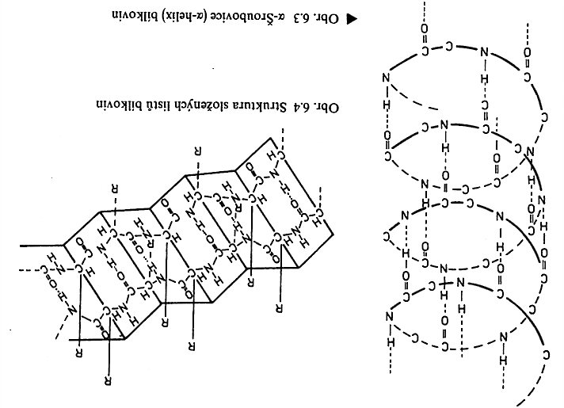
Protein SECONDARY STRUCTURE II B
β Folded Sheet
Left-handed α Helix

Slide 29
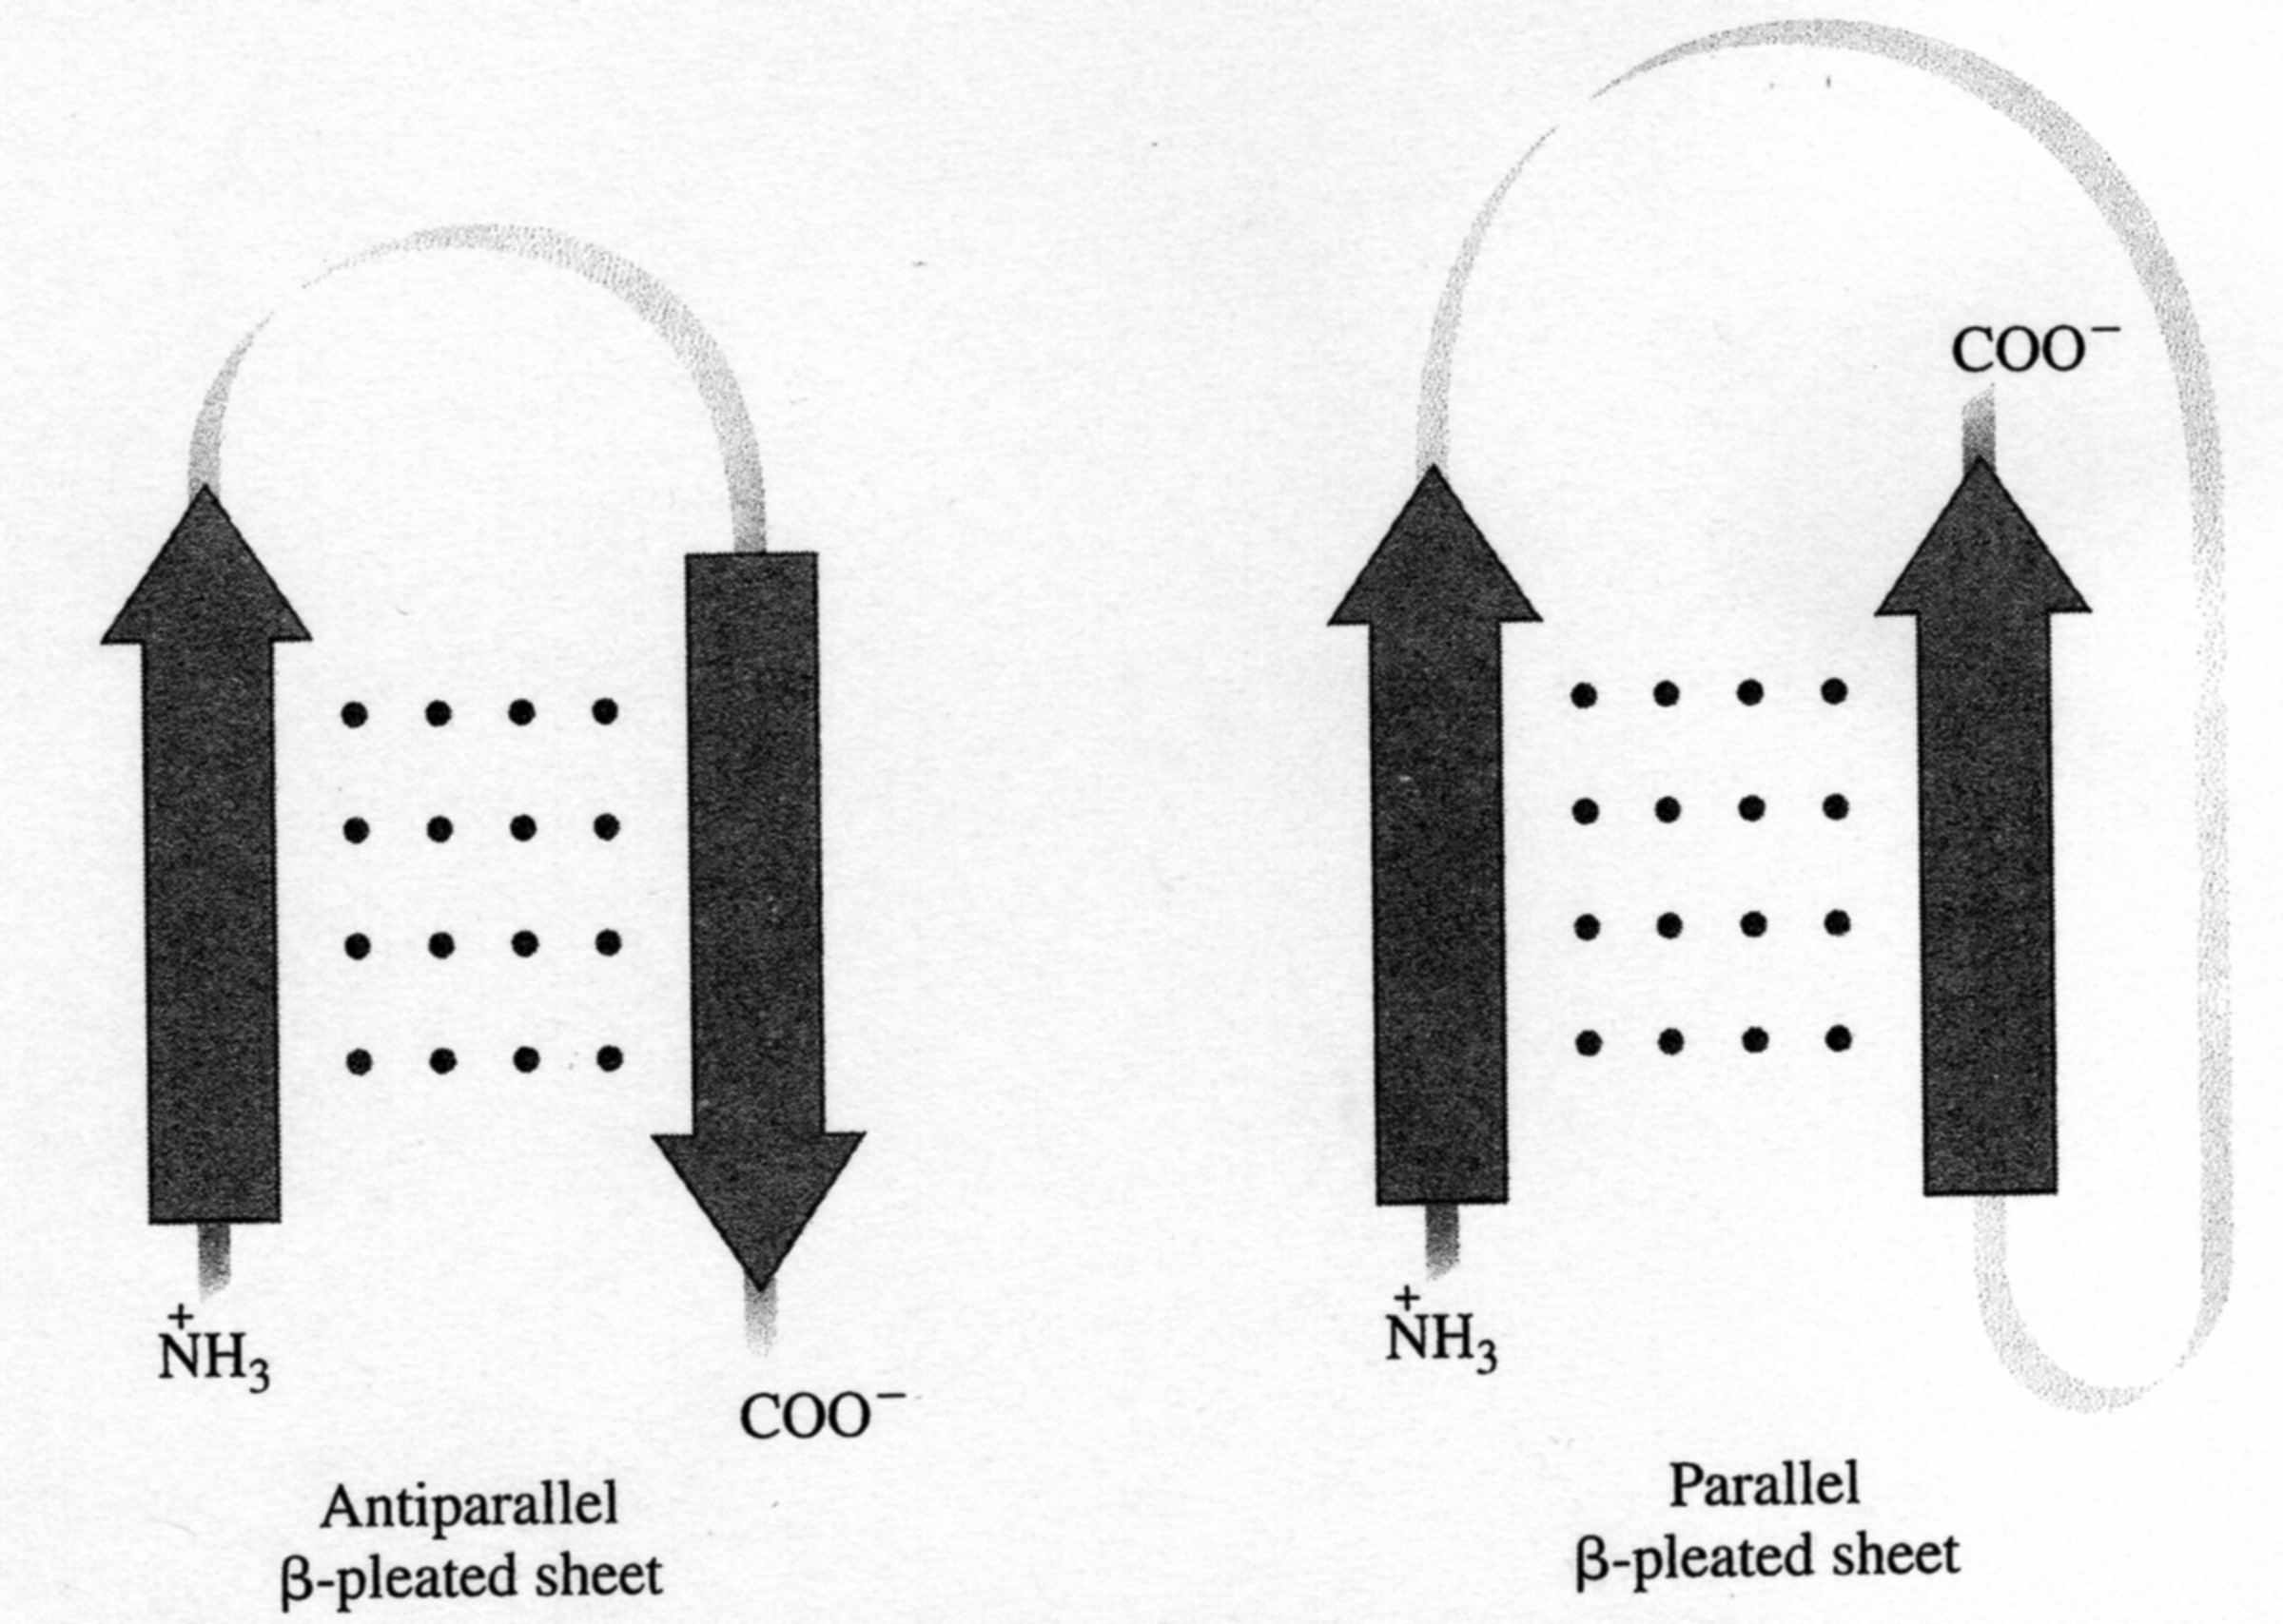
β Folded Sheet

Slide 30
SECONDARY STRUCTURE of Proteins II COLLAGEN as the EXAMPLE
The Conformation of the SECONDARY STRUCTURE (α-Helix, β- Sheet, Statistic Coil) has the Influence on the IR Wave Number of the Amide Group Peak in the IR Spectrum.
It is a bit unusual Wave Number Unit, but it is right!
It is the same Figure as the usual Unit cm⁻¹.
COLLAGEN is the α-Helix.
IR Spectrum (Wave Number) of the Amide Bond (10² m⁻¹)
Structure | Amide I | Amide II
α − Helix | 1650 1652 | 1515 1546
β−Structure | 1630 1645 | 1530 1550
Statistic Coil | 1656 | 1535

Slide 31
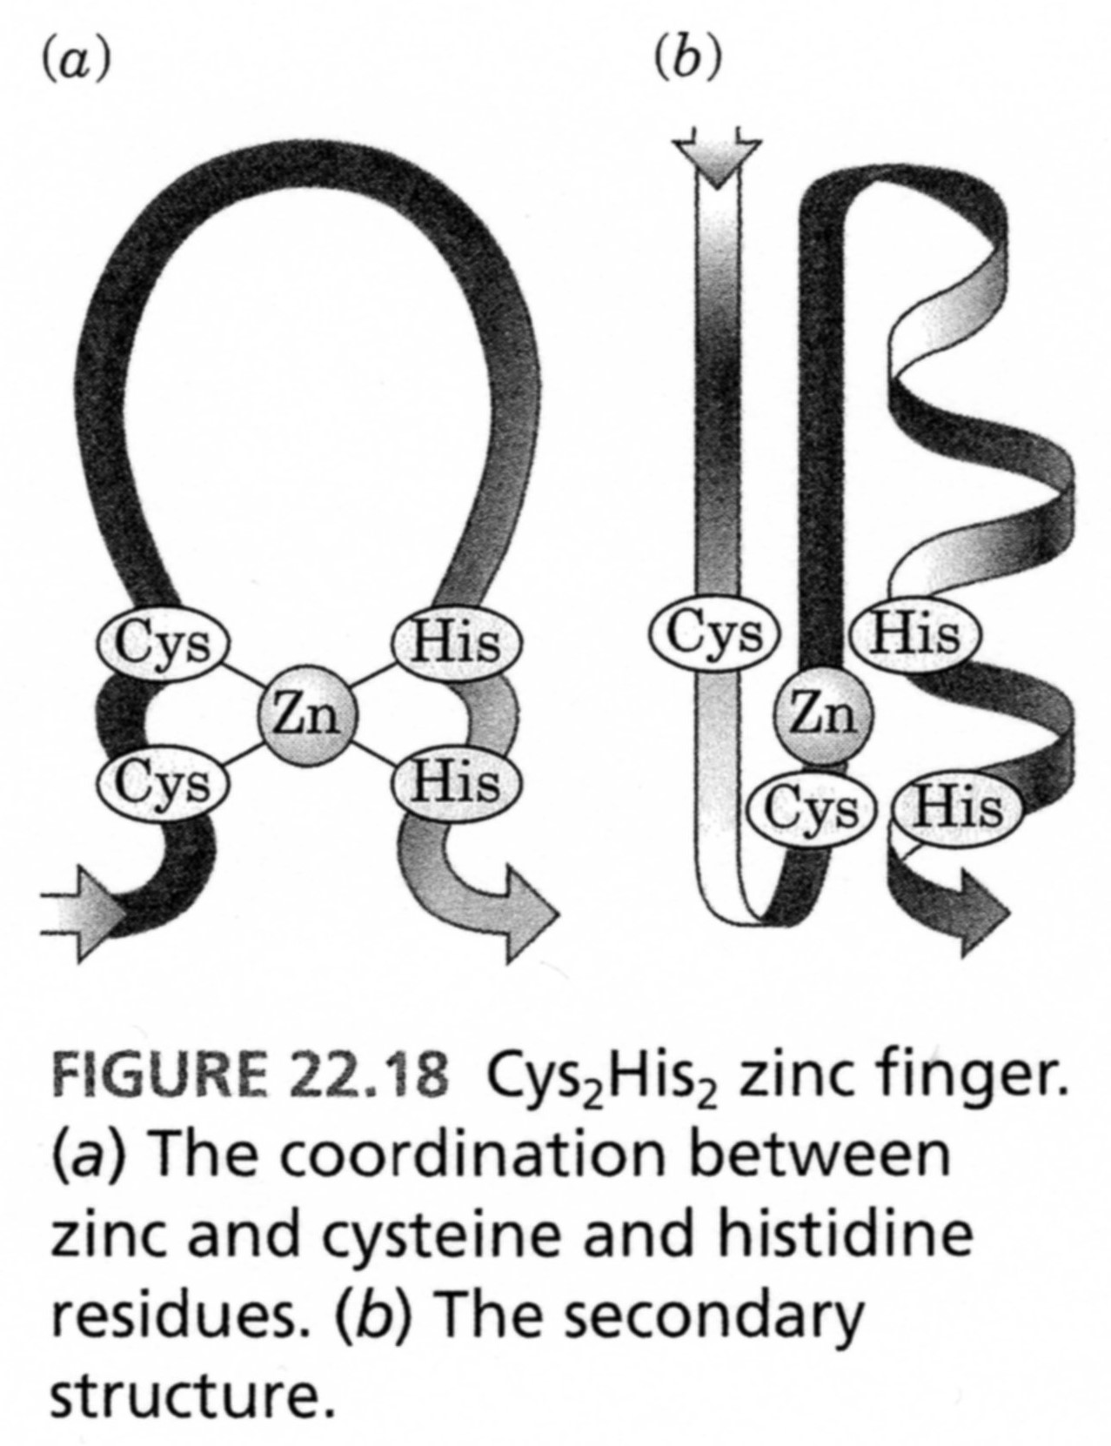
These Interactions are in the ONE MOLECULE, so it is SECONDARY STRUCTURE

Slide 32
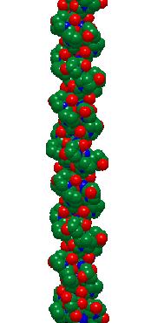
TERTIARY STRUCTURE of Proteins II COLLAGEN as the EXAMPLE three Coils arranged to the next combined coiled Chain

Slide 33
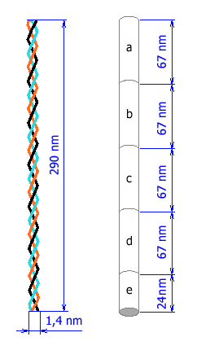
TERTIARY STRUCTURE of Proteins II COLLAGEN as the EXAMPLE three Coils arranged to the next combined coiled Chain
Schematic representation of the COLLAGEN Triple helix Molecule. The marked Intervals on the right (a, b, c, d) are 67 nm, what is the Distance over which are the particular Molecules in the Triple helix shifted each to another .

Slide 34
TERTIARY STRUCTURE of Proteins II COLLAGEN as the EXAMPLE three Coils arranged to the next combined coiled Chain
SECUNDARY STRUCTURE

Slide 36
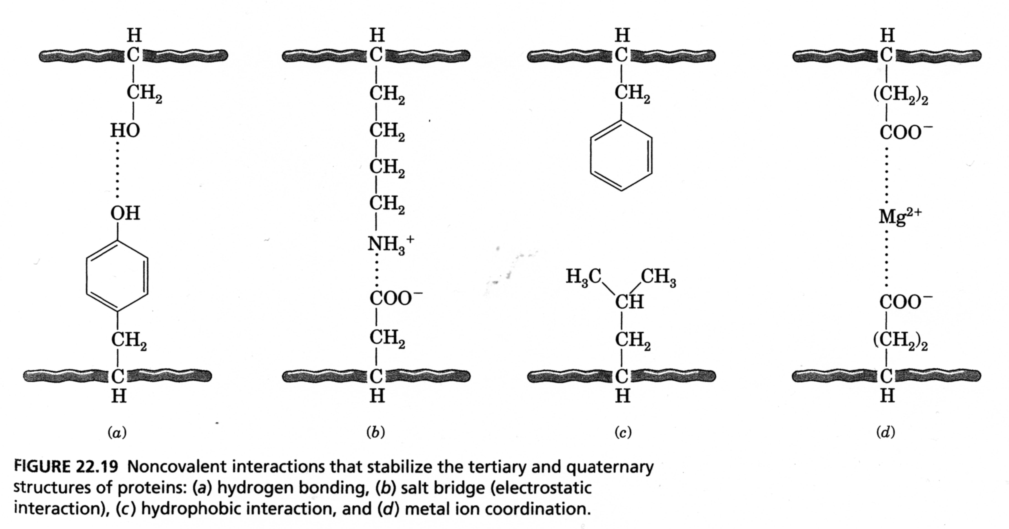
TERTIARY STRUCTURE Proteins V

Slide 37
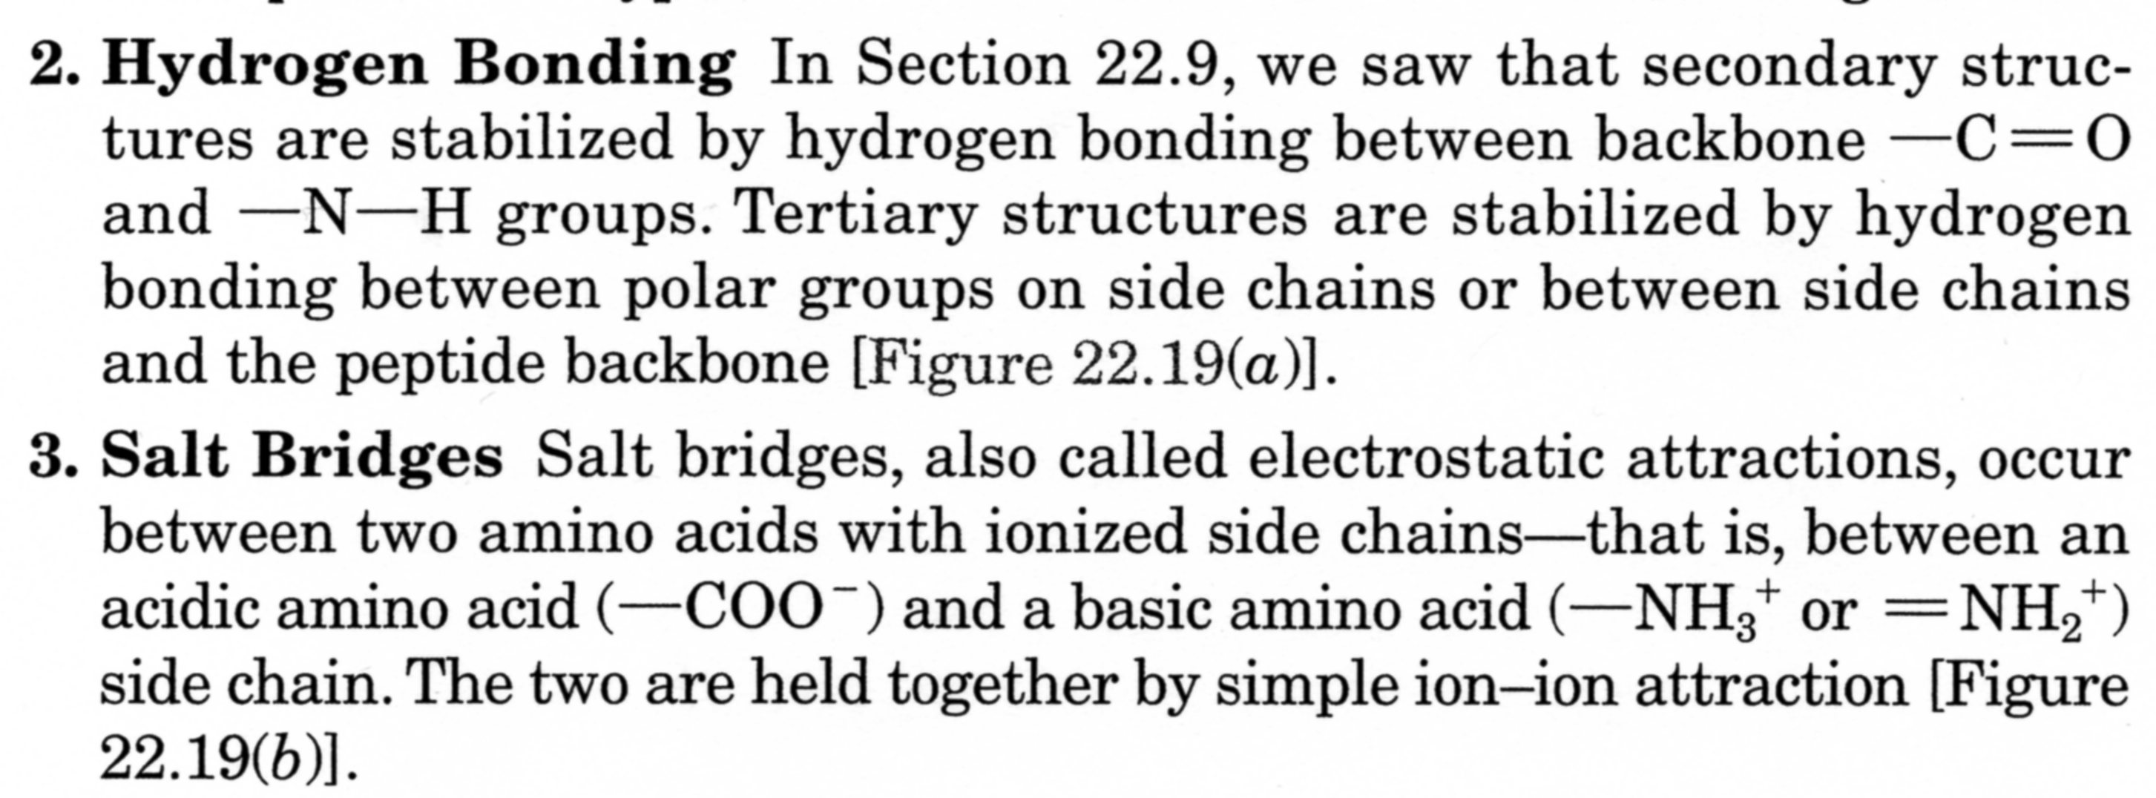

Slide 39
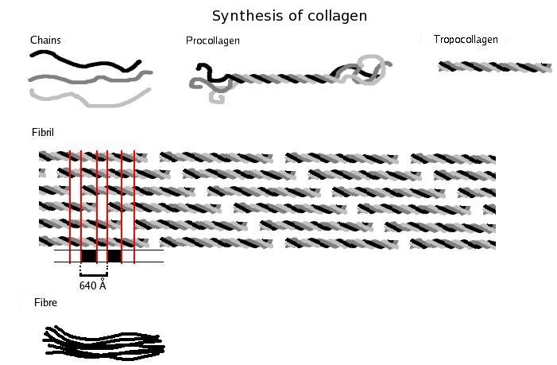
NON-HELIX Prolongation
= it is NOT coiled to Helix
By NON-EZYMATIC Degradation of the NON-HELIX Prolongation
Is increased the BIOCOMPATIBILY, it is the ANTIGENITY is suppressed

Slide 40
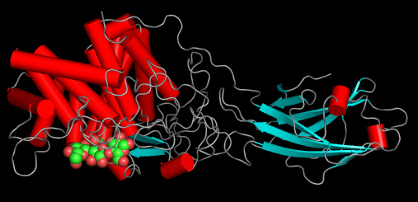
QUOTERNARY STRUCTURE Proteins I CELULASE as the EXAMPLE
The Interaction between the folded up Fibrous Structures coiled to the Helix as the TERTIARY STRUCTURE already.
An Example – COLLAGEN - they are PARALEL bundles of TERTIARY STRUCTURE. It is called ASSOCIATES ARISING sometimes.
It is typical for the ENZYME, where they are not PARALEL bundles, but they are globulAr STRUCTURES.
One Enzyme from the „CELULASE“ Group

Slide 41
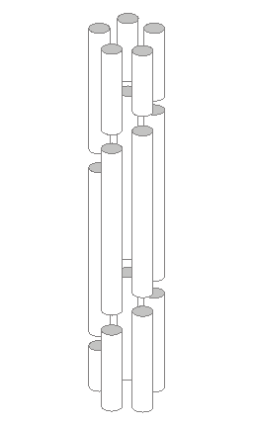
QUOTERNARY STRUCTURE Proteins I COLLAGEN as the EXAMPLE
The Interaction between the folded up Fibrous Structures coiled to the Helix as the TERTIARY STRUCTURE already.
An Example – COLLAGEN - they are PARALEL bundles of TERTIARY STRUCTURE.
The Microfibril Model created as the Consequence of Interaction polar an d hydrophobic Side Chains. Five Tropocollag Molecules are shifted each to another 4 nm here and they are creating a Cylinder Structure so.

Slide 42
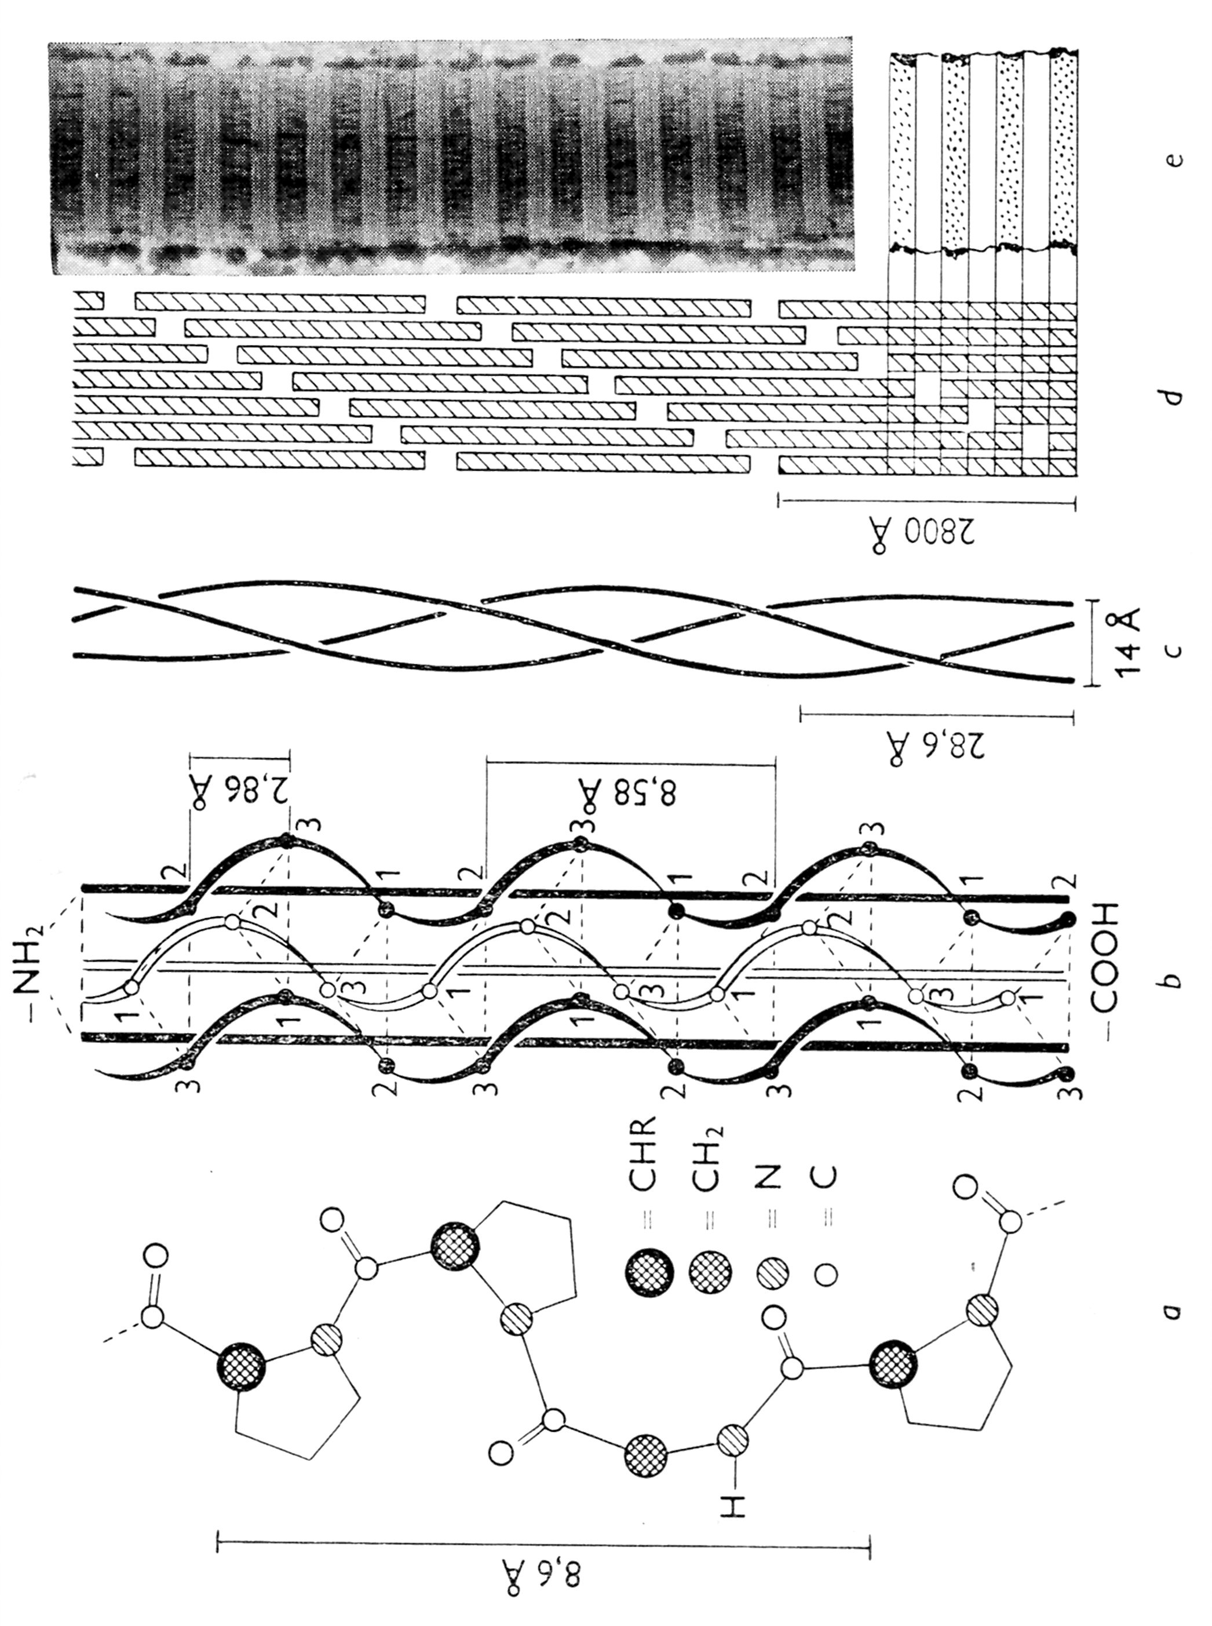
COLLAGEN – Hierarchy of the Structures
SECONDARY
= one Helix
QUOTERNARY
TERTIARY – two different Representations
THREE HELIXES
Left Picture – SIMPLIFIED
RIGHT PICTURE - REALITY

Slide 43
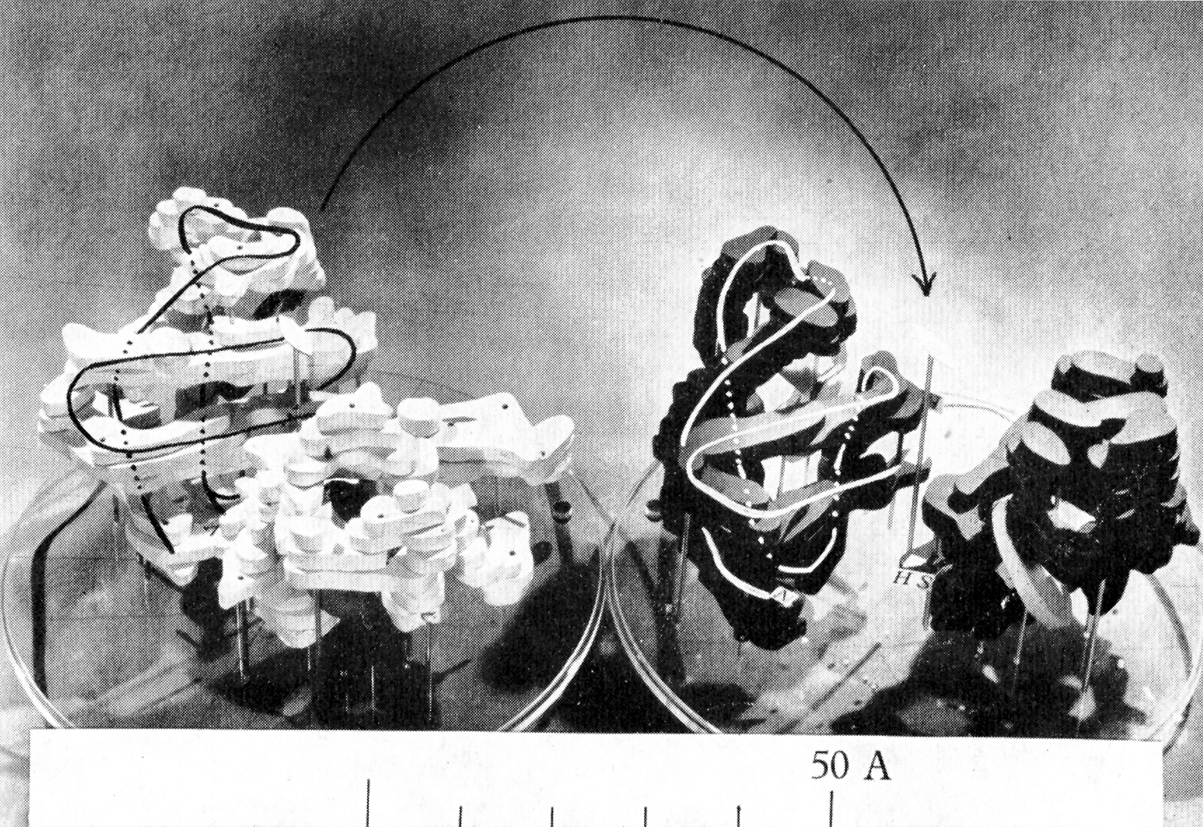
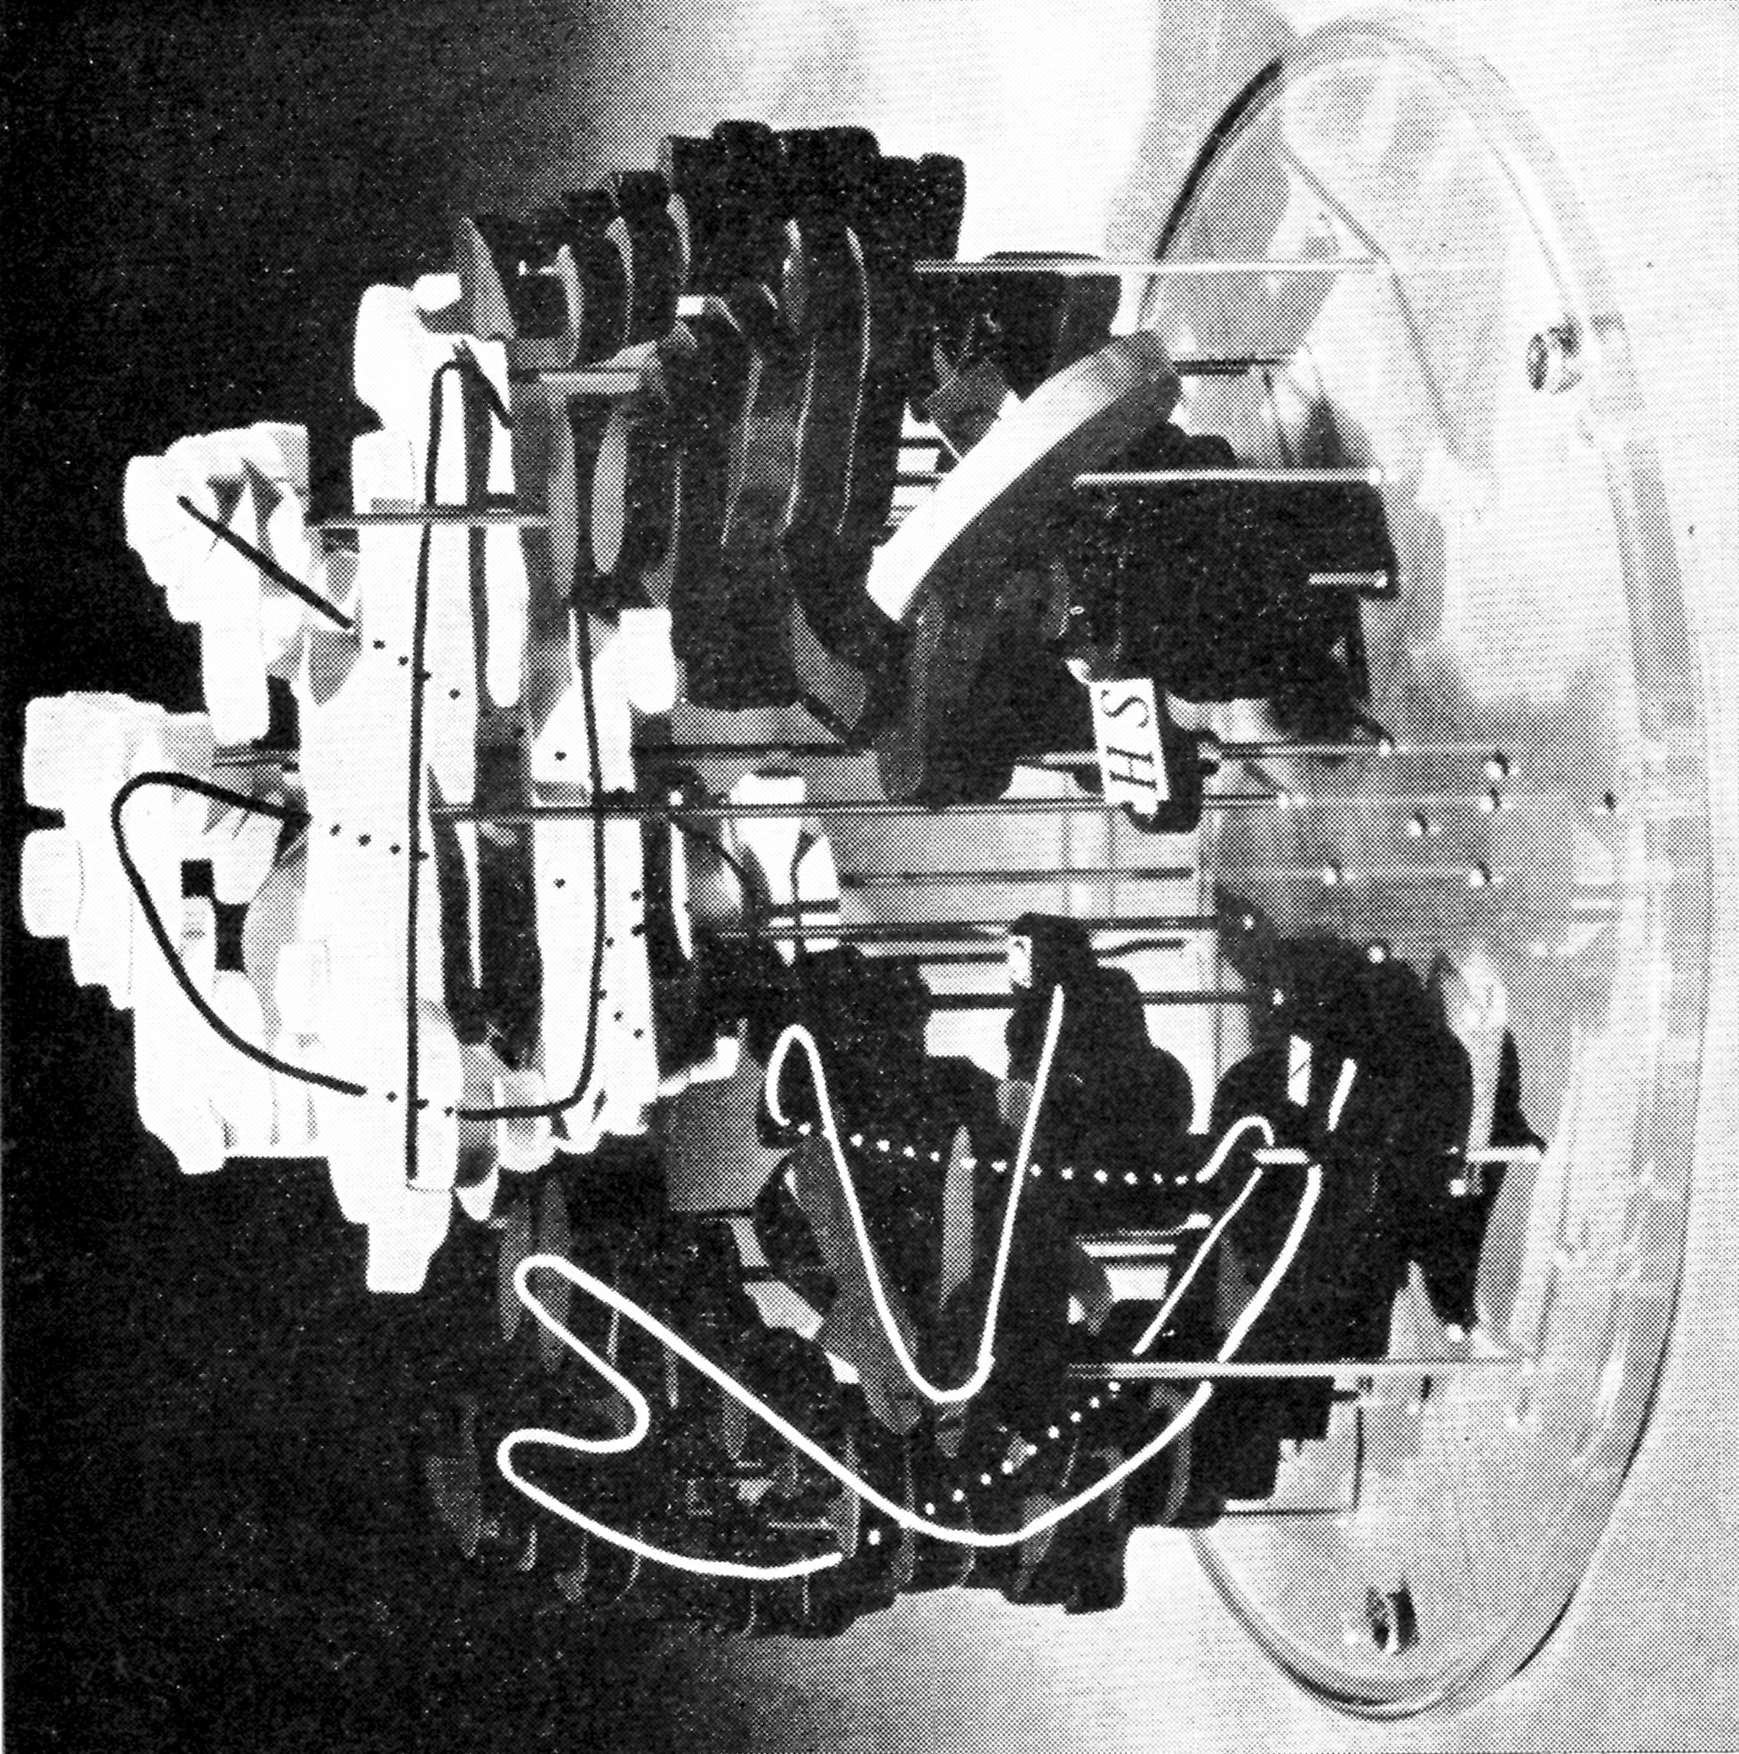
The EXAMPLE of Creation of the QUOTERNARY STRUCTURE - HEMOGLOBINE
QUOTERNARY STRUCTURE
Three Parts - Tertiary Structures, which create the QUOTERNARY STRUCTURE

Slide 44
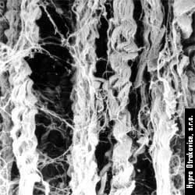
QUOTERNARY STRUCTURE Proteinů III COLLAGEN as the EXAMPLE
The Interaction between the folded up Fibrous Structures coiled to the Helix as the TERTIARY STRUCTURE already.
An Example – COLLAGEN - they are PARALEL bundles of TERTIARY STRUCTURE.
These PARALEL bundles of TERTIARY STRUCTURE form QUOTERNARY STRUCTURE
COLLAGEN - PARALEL bundles of TERTIARY STRUCTURE

Slide 45
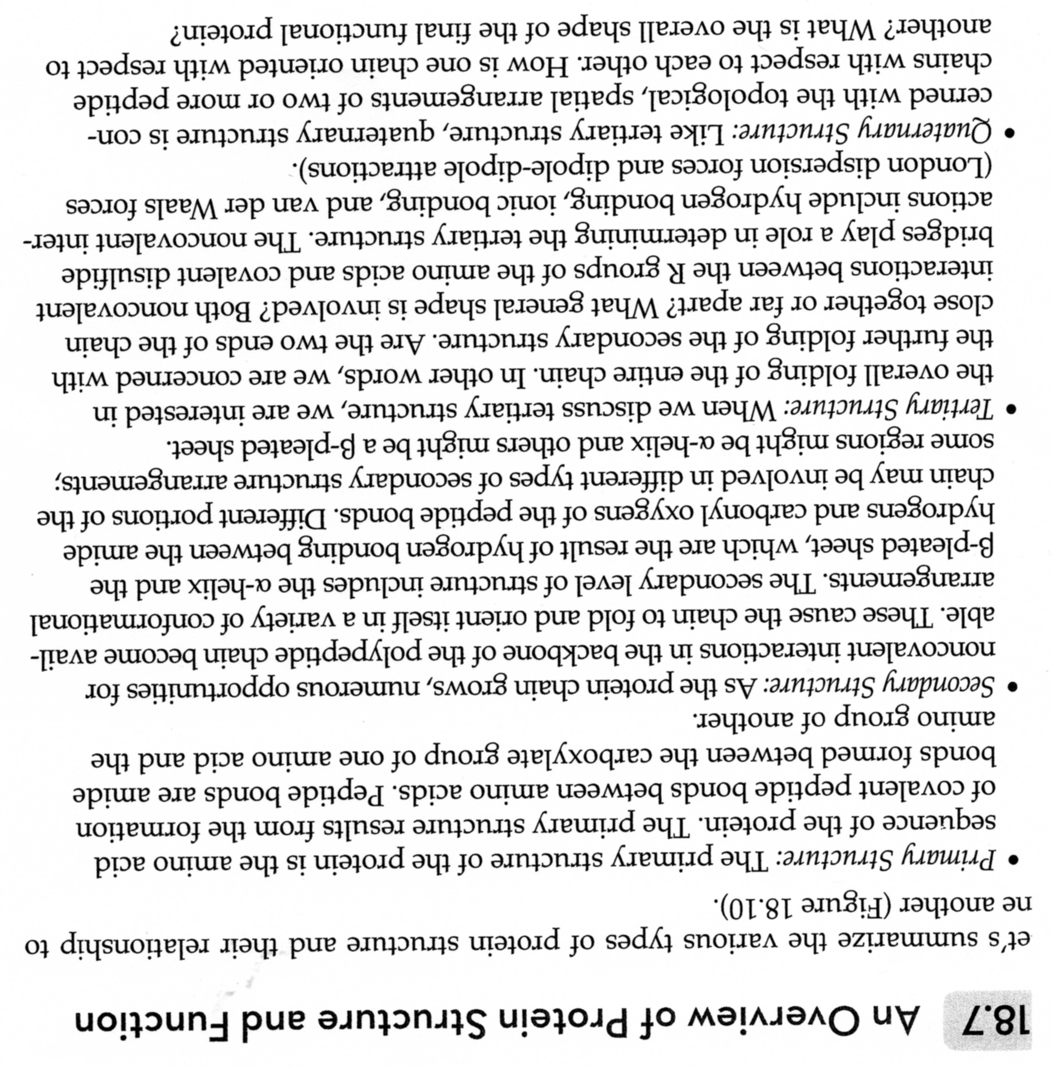

Slide 46
COLLAGEN – Cross Bonds IN VIVO
The Bonds are based on the Reactions of the Oxidised – HN₂ in Lysine with –OH Group and Reactions between arisen Groups
Reactions are mainly INTRAMOLECULAR, but also INTERMOLECULAR
There is less Cross Bonds in so called YOUNG COLLAGEN > Higher Solubility
There is more Cross Bonds in so called OLD COLLAGEN > Lower Solubility
Lysine

Slide 47
COLLAGEN – REACTIONS IN VITRO 1
ACYLATION using acetanhydride
Esterification (various reagents)
Deamination (-NH₂ > -OH)
Deguanidisation
(Removing the End from the Arginine
and cleavage H₂N – CO – NH₂)
guanidin

Slide 48
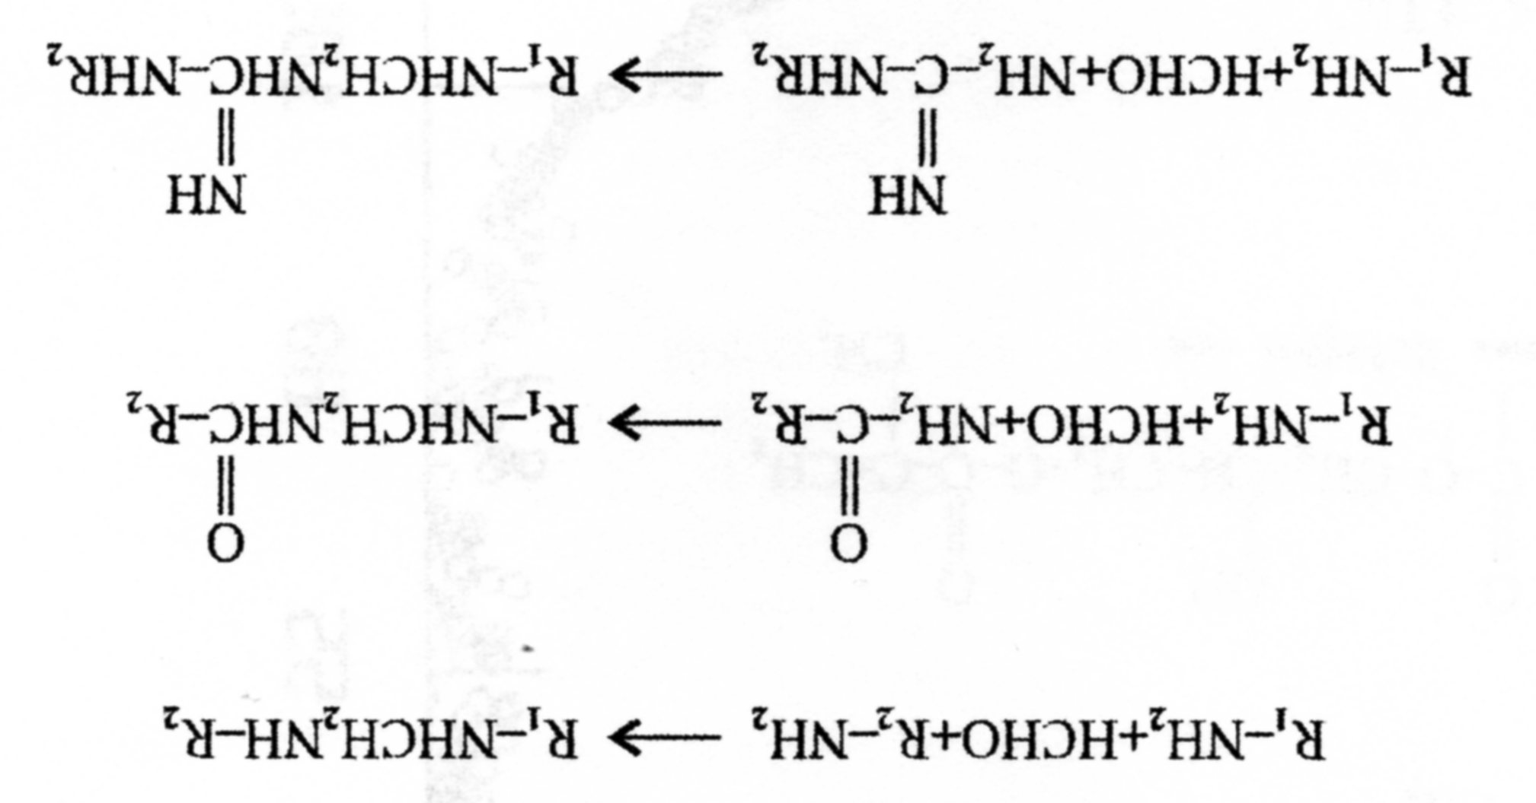
COLLAGEN – REACTIONS IN VITRO 2
Aldehydic Condensation
Oxidation by Periodate >
5-hydroxylysine > ALDEHYDE > REACTION

Slide 49
COLLAGEN – Reaction with Synthetic Polymers IN VITRO 1
Effort to enhance the COMPATIBILITY of the NATURAL & SYNTHETIC POLYMERS

Slide 50
COLLAGEN – Hierarchy of Structures & USE
Structure Level | Branch of Use/Products
Fibres’ Tissue | Leather, Wounds’ Covering, Skin Implants, Vessels Substitutes,
Fibres | Casing for Meat Products, Packaging Films, Membranes, Powder for Wounds’ Covering, Capsule for Medicines
Fibrils | Biocompatible Plastic or Ceramic Composites for Surgery
Macromolecules | Native Collagen, Derivatives of Collagen for Medicine & Cosmetic Use
Polypeptides | Animal Glue, Gelatine, Hydrolysate of Collagen, Capsule for Medicines, Thickener, Animal feed ...

Slide 51
COLLAGEN – Medicine Use 1
COLLAGEN Medicine Preparations – Sort and Use accordingly
Products | Use
Catgut | Surgery Sewing, Wounds’ Covering, Wounds’ Covering
Fibres – From the Solutions From the Suspensions From the Membranes | Skin Implants, Haemostatics, Vessels Substitutes,
Collagen Sheets – Genuine skin Membranes Nonwoven Textiles Foams Sponge | Implants, Fillers for Implants
Vessels/Organs | Connective tissues healing (“Reparations”), Tissues’ Glue
Collagen Powder, Glue, Sprays, Face Powder | Face Skin Care

Slide 52
Resorption is controlled by chromium salts Crosslinking at Tanning > slower Biodegradation (Resorption ) in living Organism
UNCROSSLINKED by chromium salts Crosslinking at Tanning > FASTER Biodegradation (Resorption ) in living Organism

Slide 53
The Discussion is on stream now, if the COLLAGEN degradated Chains are harmful for the Humans Organism or not.
It is sought in some Sources now, that COLLAGEN „CATGUT“ is allowed for the Veterinary use only.
There are not any such bans for „CATGUT“ at the Internet pages of the „CATGUT“ Suppliers up to now (year 2018).

Slide 54
Catgut Chromic Suture | Catgut suture
Catgut or gut suture is an absorbable suture usually manufactured from the intestine of sheep or goat.
Catgut suture are composed of highly purified connective tissue derived from either beef or sheep intestines. The membrane is chemically treated and slender strands are woven together to form a suture. The grinding process creates a strand of uniform diameter. The suture strand is then further polished to achieve maximum smoothness, for reliability and strength.
Catgut suture are available in the form of plain catgut or chromic catgut.
Plain catgut is usually having shorter absorption periods and is absorbed more rapidly in infected areas.
The percentage of collagen in the catgut suture often determines the quality of the suture. Higher percentages of collagen allow for: superior tensile strength, longer absorption times, and lower reactions in vivo. Plain catgut is available in ivory colour.

Slide 55
Catgut Chromic Suture | Catgut suture
Chromic catgut is treated with chromium salt solution to resist body enzymes and slower the absorption process thus supporting the wound for longer periods.
Chromic gut is chromicised before it is spun into strands. This allows control over the amount of chromic content for an even absorption rate.
The chromic content not only increases the tensile strength, but also reduces tissue irritation.
Catgut sutures are sterilized by a sterilizing fluid containing EO (ethylenoxide), distilled water and isopropyl alcohol.

Slide 56
Distinctive Characteristics of Catgut Chromic Sutures
Absorption within 60-90 days for chromic suture and 60-70 days for plain gut suture.
Allows for smooth passage through tissue.
Packed in IPA to retain memory & increase pliability.
Uniform chrome content provides required wound support and absorption.
Catgut suture are available from U.S.P Sizes 5-0 to 2
General closure, Ophthalmic, Orthopaedics, Obstetrics/Gynaecology and Gastro-intestinal Tract Surgery.

Slide 57
COLLAGEN – Solubility 1
Some cosmetics include soluble or hydrolyzed collagen. In this case, the collagen molecules have been broken down into much smaller fragments, which are able to penetrate the skin’s surface.
COLLAGEN SOLUBILITY DEPENDS ON:
MW > hydrolysable Types are more soluble, even in the Water,
pH,
…………..

Slide 58
COLLAGEN – Solubility 2
ISOELECTRIC POINT of COLLAGEN: approx. pH7
SOL 28 °C GEL
GEL 34 °C SOL
Transition SOL GEL is NOT the one POINT CHARACTERISTIC, it is NOT Reversible Process!
It is called „INVERS PROCESS“, because some Changes in the Macromolecular Conformations can occur during this Process.

Slide 59
COLLAGEN – Nanofibres 1 (Courtesy of the CONTIPRO Ltd.)

Slide 60
COLLAGEN – Nanofibres 2 (Courtesy of the CONTIPRO Ltd.)

Slide 61
COLLAGEN – Nanofibres 3 (Courtesy of the CONTIPRO Ltd.)

Slide 62
COLLAGEN – Prices on the World Market Grades for Cosmetic, Water-soluble
US $12 - 18 / Kilogram
100% Soluble In Water Solubility Hydrolyzed Collagen For Hair
Supply Ability: 300 Ton/Tons per Month Fish Collagen
Country of Origin: China (PRC)
US $12 - 18 / Kilogram
FOOD GRADE
Supply Ability: 300 Ton/Tons per Month Fish Collagen
Country of Origin: China (PRC)

Slide 63
COLLAGEN as the Basic Substance for Chemical Reactions
The Reaction point is the Amino-group (-NH₂)
ARTICLE (e.g.):
Synthesis and properties of some GELATIN derivatives with substituents at the amino groups
J. Chem. Techn. and Biotechnology, 15, (1965), 479
If possible – POLYMERANALOGIC CHANGES (REACTIONS), it is without changes of the MW,
They were mostly the Modifications for Photographic Emulsions > PATENTS,
The Substrates for Cultivation of the Cells’ Cultures are the main Subject now (Patents, Publications etc.)

Slide 64
COLLAGEN as the Basic Substance for Chemical Reactions
Chemical Modification (see Slide No. 47 also)
Reaction with monofunctional Reagents
Acylation (acetanhydride + amino-groups)
Esterification (dimethylsulphate, anhydrous methanol) – the Swelling Curve is changing, Structure and Insolubility is remained
Deaminace (Mixture of Sodium Nitrite and Ice acetic acid) – Amino-groups → Hydroxyl Groups; the Swelling Curve is changing
Deguanidinace – Arginine → Ornithine + Urea or Citrulline + Ammonium

Slide 65
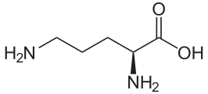
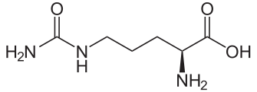
Ornitine
Citrulline

Slide 66
COLLAGEN as the Basic Substance for Chemical Reactions
Chemical Modification
Reactions going to Crosslinked Gel Forming
Higher Flexibility, Resistance to Enzymes Proteases, lower Swelling Degree → better Product
Aldehyde Condensation (Glutaraldehyde forms Bridges) → Double Schiff Base – higher Resistance to to Acid or Basic High temperature Hydrolysis
Oxidation by Periodate (5-hydroxyproline → Aldehyde → + amino Groups of Lysines →Network → higher Mechanical Strength

Slide 67
COLLAGEN as the Basic Substance for Chemical Reactions
Chemical Modification
Reaction with Synthetic Polymers (Surface Immobilisation)
Covering of the Porous COPOLYMER of Polyethylene with Acrylic acid by COLLAGEN bond to the Surface by the Covalent Bond amide Bond (between Carboxylic Groups of the Acrylic acid and the Amino groups of the COLLAGEN Molecule) → INCREASING OF THE IMPLANTATES’ BIOCOMPACTIBITY
AN EXAMPLE
The Covering of the Vessels Substitutes knitted from PET Fibres

Slide 68
COLLAGEN Medical Applications 1
Catgut Chromic Suture – Resorption is controlled by the Chromium Salts crosslinking
Split leather, Nonwoven Textiles, Fixed Foams → Radiation-Chemical Sterilisation → Wounds’ & Burns Covering
Spray Bandage on Wounds (COLLAGEN Powder )
Blood Vessel Reparation, Tendon Replacement
Cells’ Cultures Growing in vitro
…………………

Slide 69
COLLAGEN Medical Applications 2
COLLAGEN inside covered Teflon hose > Blood Vessel Replacement
Combination with Calcium Phosphate → Bones and Tooth Replacement
Injection of the Microcapsules impregnated with effective Substance – Wound Healing
COLLAGEN Glue in Surgery
………….

Slide 70
COLLAGEN based Articular Preparation nutrition & regeneraTION of the Articular Cartilage
ORLING Company (Czech Republic) accordingly:
Pure native Collagen is as the Rope coiled from the Three Fibres, which is non-specifically split during Digestion. The Results are split Chains, which are of various Length whenever.
Hydrolysed Collagen is called Collagen Peptides. If the Collagen is split by Enzymes COLLAGENASE, the pure native Collagen is changed to the Collagen Peptides of the same Length every time.
The Biological Activity of the Pure native Collagen and of the Collagen Peptides is different, what was proved by many scientific Studies.

Slide 71
Manufacture of GELATIN & ANIMAL GLUE
TANEX Company, Czech Republic
The Pictures were taken during Students’ Excursion to this Glue Plant Company

Slide 72
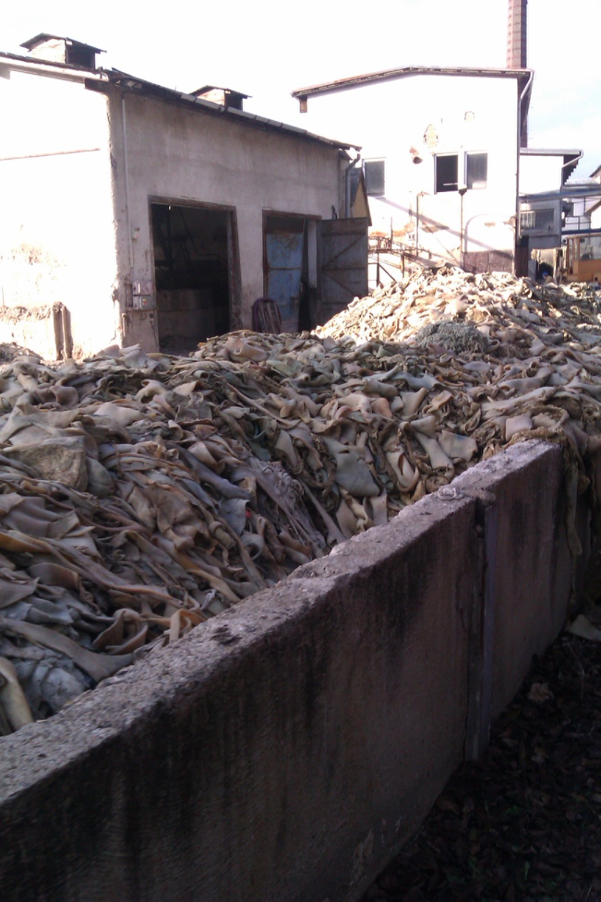
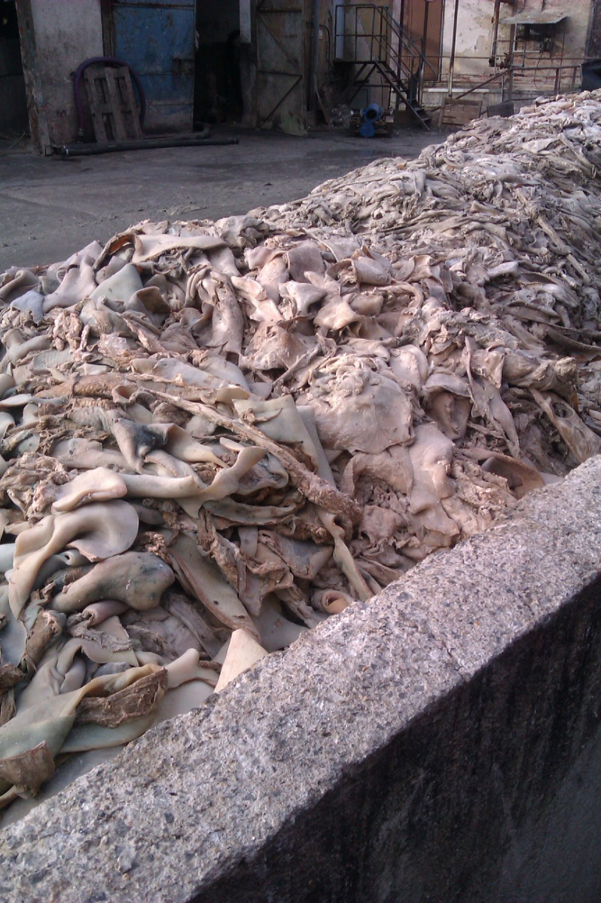
Manufacture of GELATIN & ANIMAL GLUE The Raw Materials are not looking too atractive 1!
Abattoir by-products from the Pig livestock
Skin, Ears etc.

Slide 73
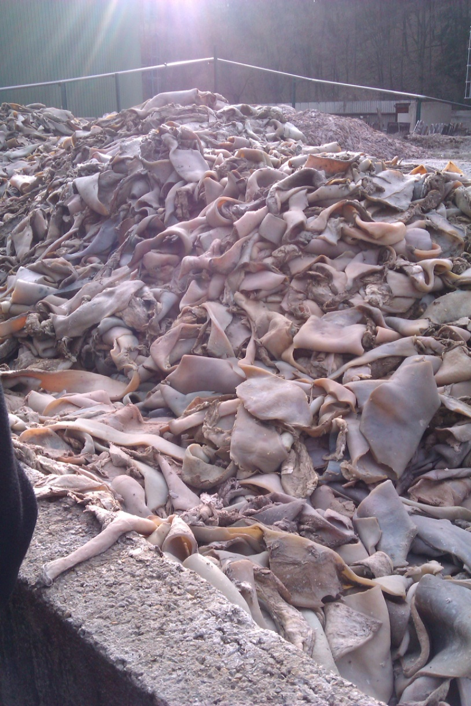
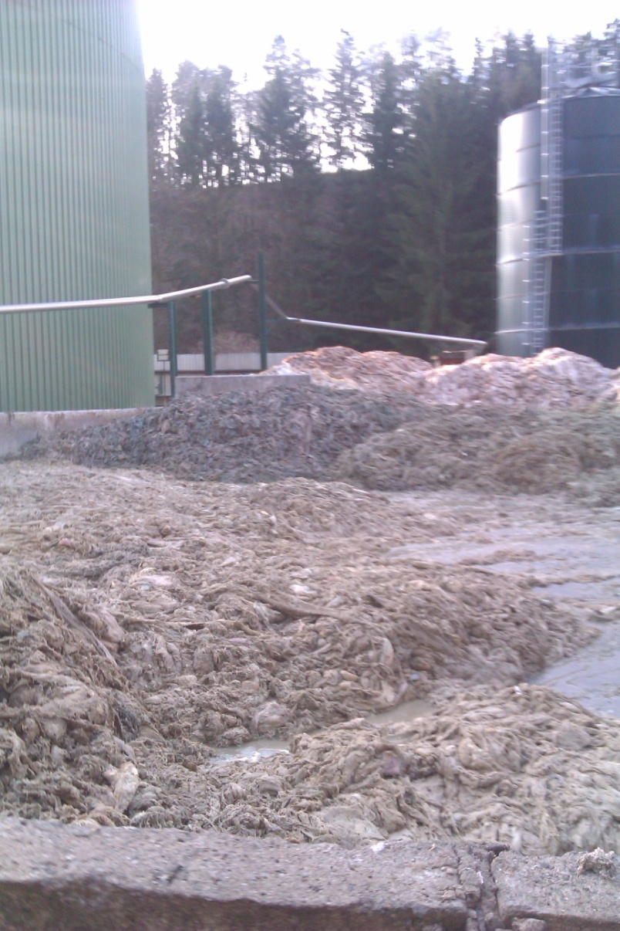
Manufacture of GELATIN & ANIMAL GLUE The Raw Materials are not looking too atractive 2!
Abattoir by-products from the Pig livestock
Skin, Ears etc.

Slide 74
Manufacture of GELATIN & ANIMAL GLUE BASIC SCHEMA
COLLAGEN
GELATIN

Slide 75
Example of the GELATIN & Animal Glue Making 1
Parameters | Sequence of Leaching (Lixiviating)
 | 1 |  | 2 | 3 |  | 4
Product | Edible & Photographic GELATIN |  | GELATIN Quality | GELATIN 2. Quality |  | Technical GELATIN & Animal Glue
Temperature (°C) | 50 – 55 |  | 60 – 65 | 70 – 75 |  | 85 - 100
Time (hours) | 5
pH | 5 - 7
Concentration (% w/w) | 3 - 8 | 3 - 8 |  |  | 10 |  | > 12
Better Raw Material & Mild Manufacturing Conditions > GELATIN
Worse Raw Material & „Rough“ Manufacturing Conditions > Animal Glue

Slide 76
Example of the GELATIN & Animal Glue Making 2
Parameters | Sequence of Leaching (Lixiviating)
 | 1 | 2 | 3 | 4
Product | Edible & Photographic GELATIN | GELATIN Quality | GELATIN Quality | Technical GELATIN & Animal Glue
Temperature (°C) | 60 – 65 | 80 – 85 | 95 – 100 | 100
Time (hours) | 8
pH | 5 - 7
Concentration (% w/w) | 8
Raw Materials:
Abattoir by-products from the Pig livestock (Animal Glue)
Bones from Abattoir (Bone Glue)
Wastes from the Tannery (Animal Glue)

Slide 77
Manufacture of GELATIN & ANIMAL GLUE TECHNOLOGICAL STEPS
Washing of the Fleshings (Removing of the Preservatives, usually Ca(OH)₂) and acidification to pH = 6,2 – 6,5 using HCl or H₂SO₄
„Cooking“ of the GELALTIN & GLUE > transformation of the COLLAGEN to so called GLUTINE SOLUTION (NOT GLUTENE!) in several Stages, up to the Rest only about 2 – 5 % w/w of the original Charge
Filtration to remove the Impurities
Preservation and Bleaching by SO₂ or H₂O₂
Thickening in the Evaporator
Chilling and Forming
Drying to the Water Content 12 – 15 % w/w
Cutting to small Cubes od Milling to Powder

Slide 78
Manufacture of GELATIN & ANIMAL GLUE TECHNOLOGICAL WASTES and their USE
Skin Fat > Refining (Purification) > Sale or use for the SOAK Manufacture
Impurities filtered out > Biogas or Burning or approved waste Dump

Slide 79
Bone & Animal Glue and GELATIN In the Work of the CONSERVATOR – RESTORER I
Wood Gluing,
Book Binding,
Paints binding Agent,
Undercoat (Primer, Primer Coat) for Painting
Binding Agent for the Nonwoven Textile
Photographic Plates and Films (FORMELY)
Casting Moulds
Undercoat for the Contact Gilding (Covering by very thin Gold Foils)

Slide 80
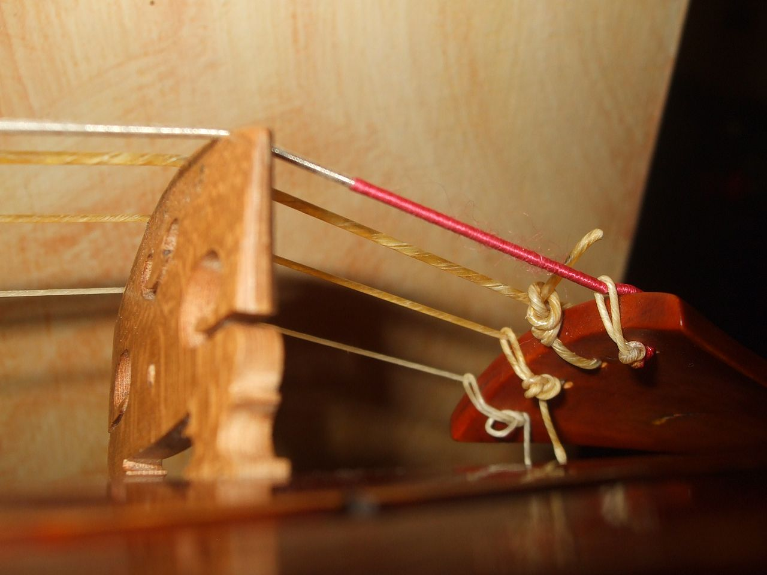
COLLAGEN and CONSERVATOR – RESTORER
Detail
Technická želatina
Catgut (STRINGS) for the Bowed Instruments
are made of COLLAGEN forming the animal's gut (usually Sheep or Goat)

Slide 81
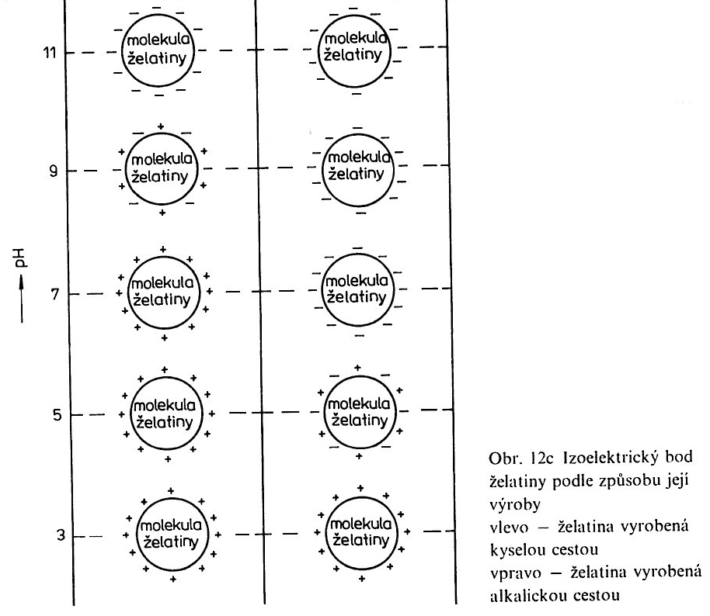
GELATIN - Clarifying of Wine and fruit Juice
Clarifying = the Measure to remove the Substances forming Wine lees (Haze)
The Structure Formula of PECTIN
R = H or
–CH₃
Isoelectric Point of GELATIN the Manufacturing Technology accordingly:
On the Left – acid catalysis
On the Right – basic catalysis
The main Haze forming Substance in Wine is PEKTIN

Slide 82
From the QUALITY POINT OF WIEV, the LOWEST MW HAS:
GLUE FOR THE Wall House Painting
For the Interior Painting is added go get for the Painting Cohesion
Because having the lowest MW, it is the most Degradated COLLAGEN, it is soluble even at room Temperature in the cold Water

Slide 83
Tannery
3.1 HIDE versus Leather
3.2 Tanning of HIDE technology

Slide 84
1 Skin versus Leather

Slide 85
HIDE versus Leather
Detail
Technická želatina
HIDE = it is that, what is taken after the Slaughter of the Animal
Outer HIDE
True inner HIDE
LEATHER = it is that, what is gained after Tanning of the HIDE
Fleshings (Under HIDE connective Tissue
RAW HIDE transversal sectional View
True Inner HIDE is the principal Part of the the HIDE for the Manufacture of the LEATHER
Outer HIDE & Fleshings (Under HIDE connective Tissue are removed during Processing of the HIDE to LEATHER

Slide 86
HIDE COMPOSITION - CROSSCUT
Detail
Technická želatina
Proteins
fibrous (Collagen)
Globularní (e.g. Albumine, they are removed before Tanning)
Fats
Water
Inorganic Substances
Outer HIDE
True inner HIDE
Fleshings (Under HIDE connective Tissue
RAW HIDE transversal sectional View
Processing of the HIDE to LEATHER = HIDE TANNING

Slide 87
HIDE – Composition of the True Inner HIDE
Detail
Technická želatina
COLLAGEN
FIBRES FORM THREEDIMENSIONAL STRUCTURE
Outer HIDE = PAPILLARY LAYER
True Inner HIDE = RETIKULARY LAYER
Ratio of the PAPILARY LAYER versus RETIKULAR LAYER Thicknesses determines the HIDE QUALITY and is different for various Animals

Slide 88
CONTRACTION TEMPERATURE HIDE VERSUS LEATHER
COLLAGEN CONTRACTION TEMPERATURE for various Tanning Procedures
Tanning Procedures | CONTRACTION TEMPERATURE (°C)
COLLAGEN without Tanning | 58 – 68
Fur Tawing | 49 – 63
Formaldehyde Tanning | 63 – 73
Tannine Tanning | 70 – 87
Basic Tanning by Aluminium Salts | 74 – 81
Basic Tanning by Chromium Salts | 77 - 100
CONTRACTION TEMPERATURE is:
Release of the Hydrogen Bonds between COLLAGEN FIBERS caused by the increased Temperature and the CONTRACTION (SHINKAGE) so released Fibres
This Process is IRREVERSIBLE

Slide 89
HIDE VERSUS LEATHER
Detail
Technická želatina
LEATHER is more resistant against to Microorganisms in the humid Conditions
LEATHER has the higher chemical Resistance and lower Swelling in the Water
LEATHER has better and advantageous mechanical Properties and is soft and pliable if it is Dry
LEATHER has higher CONTRACTION TEMPERATURE

Slide 90
3.2 Technology Steps at HIDE Tanning

Slide 91
Technology Steps at HIDE Tanning
Preservation
Soaking (Liming)
Leaching (Unhairing and scudding) in the Solution Sodium Sulfite and Lime (Ca(OH)₂) to remove Fur and the so called depilated raw Hide.
Piling of Hides
Scraping – connective Tissue and Muscles Rest are cut off
Decalcification of Clearings(Deliming) –see 3, Removing of the Ca Salts
Bating & Pickling– Preparation for Tanning
Tanning
Greasing

Slide 92
COLLAGEN – Cross Bonds IN VITRO 1
COLLAGEN modification Reactions are used in transformation of the HIDE to LEATHER and GELATIN Modification.
Irreversible Process occurs during forming of the Cross Bonds between COLLAGEN Molecules. So called TANNING AGENTS are necessary for this CROSSLINKING of the COLLAGENs Molecules.
TANNING AGENTS are the di or tri or multifunctional Substances.
The HIDE is changed (transformed) to LEATHER by Reaction of COLLAGENs Molecules with these TANNING AGENTS.
The chemical and physical Changes occurred during TANNING.

Slide 93
COLLAGEN – Cross Bonds IN VITRO 2 are the CHEMICAL BASIS of the Tanning of the HIDE to LEATHER
INORGANIC COMPOUNDS – coordination Compound (Complex) based on the Cr, Al, Zr, Fe etc. And heteropolyacids of the Si, P, W, Mo
ORGANIC COMPOUNDS – Tannins of the Plant Origin, Aldehydes, Chinons, Syntanes, Fats, Sulfochlorites, some synthetic Polymers
Tanning by heavy Metals, Aldehydes, Chinons is possible to compare with the Cross Bonds IN VIVO. The most important are Salts of Cr and Zr, Tannins of the Plant Origin, Aldehydes, Syntanes.

Slide 94
Tanning of the HIDE to LEATHER
Detail
Technická želatina
HIDE Tanning is the CHEMICAL PROCESS, when functional Groups of the COLLAGEN react with Tanning Substance (Reagent)
Tanning Substances (Reagents)
TANNINS (HYDROLYSABLE OR Condensed) > Vegetable Tanning
potassium aluminium sulphate
Chromium COMPOUNDS

Slide 95
Tanning of the HIDE to LEATHER Similarity with Vulcanisation of the RUBBER to VULCANISED RUBBER
Detail
Technická želatina
Tanning of the HIDE is the CHEMICAL REACTION, when react COLLAGENs functional Group with the Tanning Substances and forms NETWORK BETWEEN MACROMOLECULES OF COLLAGEN
VULCANISATION of Rubber to VULCANISED RUBBER is the CHEMICAL REACTION called VULCANISATION which forms NETWORK BETWEEN MACROMOLECULES OF POLYIZOPRENE

Slide 96
Vegetable Tanning of the HIDE to LEATHER 1 A
Basis is the Interaction of –OH or SO₃⁻² Groups of Tannin with side Chain Groups on the COLLAGEN Chain forming the COVALENTN or Hydrogen Bond
------ OH ⁻

Slide 97
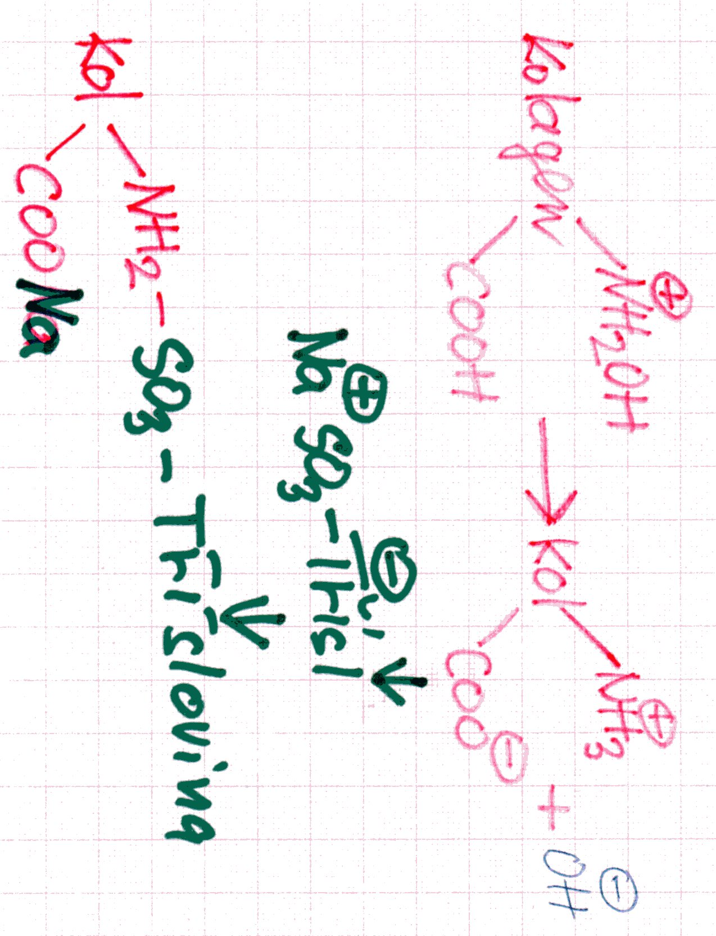
Vegetable Tanning of the HIDE to LEATHER 1 B
Detail
Technická želatina
Basis is the Interaction of –OH or SO₃⁻² Groups of Tannin with side Chain Groups on the COLLAGEN Chain forming the COVALENTN or Hydrogen Bond
H₂O
------- SO₃⁻²

Slide 98
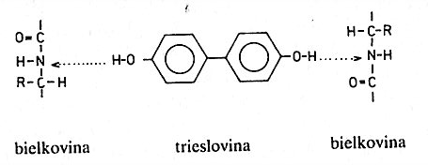
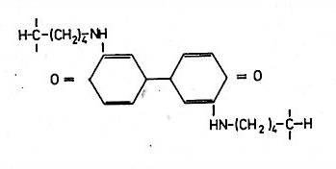
Vegetable Tanning of the HIDE to LEATHER 2
Hydrogen Bond WITH imidogroups
COLLAGEN
TANNIN
COLLAGEN
Covalent Bond of CHINONE to AMINOGROUPS
Covalent Bond of CHINONE to AMINOGROUPS +
Hydrogen Bond WITH imidogroups

Slide 99
chromium TANNING HIDE to LEATHER 1
Basis is Interaction of COLLAGEN Group –COOH via Forming CHROMIUM COMPLEX COMPOUND
Chromium(III) sulfate ([Cr(H₂O)₆]₂(SO₄)₃) has long been regarded as the most efficient and effective tanning agent.

Slide 100
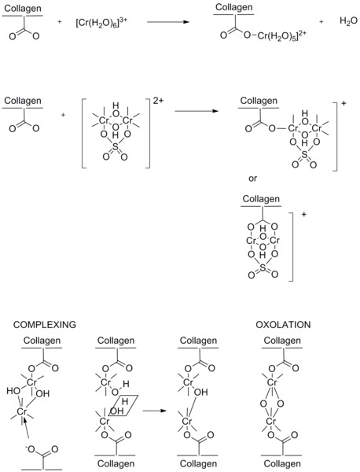
Detail
Technická želatina

