Slide 1
NATURAL POLYMERS fibrous PROTEINS II
KERATIN & FIBROIN
Dr. Ladislav Pospíšil

Slide 2
Time schedule
LECTURE | SUBJECT
1 | Introduction to the subject – Structure & Terminology of nature polymers, literature
2 | Derivatives of acids – natural resins, drying oils, shellac
3 | Waxes
4 | Plant (vegetable) gums, Polyterpene – natural rubber (extracting, processing and modification), Taraxacum_kok-saghyz
5 | Polyphenol – lignin, humic acids
6 | Polysaccharides I – starch
7 | Polysaccharides II – celullose
8 | Protein fibres I
9 | Protein fibres II
10 | Casein, whey, protein of eggs
11 | Identification of natural polymers
 | Laboratory methods of natural polymers’ evaluation

Slide 3
Keratin
Fibroin

Slide 4
Keratin

Slide 5
Where is found KERATIN?
The Skin Structures – Hair, Feathers, Animal Hair, Bristle
ENDS of the Fingers and Limb – Nails, Claw, Hooves
OBJECT from the Horny Tissue – Horns
Outer Skin (Humans) - Horny Tissue like Layer (old Skin)

Slide 6
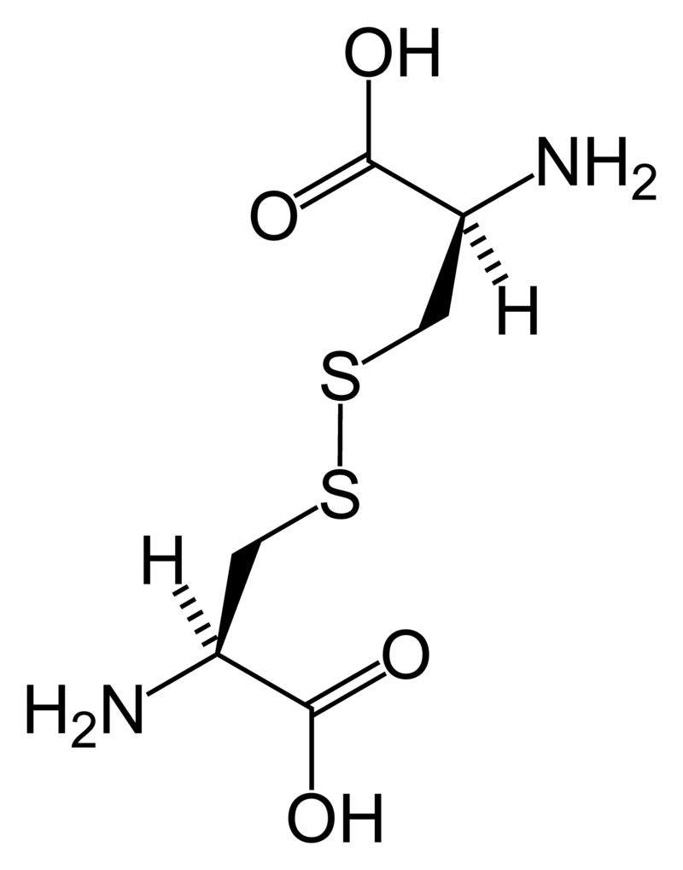

What is KERATIN characterized by 1
The PROTEIN’S Chains are CROSSLINKED via SULFIDIC BRIDGES (-S–S-) formed via – SH Groups of CYSTEINE and the CYSTINE is the Result

Slide 7
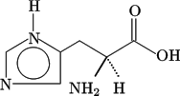


What is KERATIN characterized by 2
RATIO (approx.) of the three Main AMINO ACIDS in the KERATIN
AMINOKYSELINA | PODÍL | VZOREC
HISTIDINE | 1
LYZINE | 4
ARGININE | 12

Slide 8
What is KERATIN characterized by 3
WATER INSOLUBLE
RESISTANT TO DILUTED ACIDS
NONRESISTANT TO BASIS (e.g. NaOH, KOH etc.) > to clean the Keratin made Brush in the NaOH must be done very carefully, because the natural Bristles can be dissolved entirely!
The most important KERATIN Fiber is the Sheep's Wool

Slide 9
What is KERATIN characterized by 4/1
Composition of the AMINO ACIDS in the KERATINS of various Origin
AMINO ACID | Human’s Skin | Human’s Hair | Horny Tissue | Hen's Feathers | Pig’s Bristle
Glycine | 10,4 | 4,1 – 4,2 | 9,6 | 7,2 | NA
Alanine | 4,3 | 2,8 | 2,5 | 5,4 | NA
Valine | 3,3 | 5,9 | 5,5 | 5,8 | 5,9
Leucine | 8,3 | 6,4 – 8,3 | 8,3 | 7,4 – 8,0 | 8,3
Isoleucine | 3,3 | 4,7 – 4,8 | 4,8 | 5,3 – 6,0 | 4,7
Phenyalanine | 4,0 | 2,4 – 3,6 | 4,0 | 4,7 – 5,3 | 2,7
Tyrosine | 4,7 | 2,2 – 3,0 | 5,6 | 2,0 – 2,2 | 3,5
Serine | 11,5 | 7,6 – 10,6 | 6,1 | 4,4 – 4,8 | NA
Methionine | 1,6 | 0,7 – 1,0 | 2,2 | 0,4 – 0,5 | 0,5
Proline | 2,7 | 4,3 – 9,6 | 8,2 | 8,8 – 10,0 | 9,6
Arginine | 5,7 | 8,9 – 10,8 | 10,7 | 6,5 – 7,5 | 10,9
Histidine | 1,6 | 0,6 – 1,2 | 1,1 | 0,7 | 1,1
CYSTINE | 1,5 | 16,6 – 18,0 | 15,7 | 6,8 – 8,2 | 14,4
SOFT KERATIN - Hen's & Chicken Feathers is easily cleaved by Inorganic acids and Bases to Amino acids > ANIMALS’FEEDING

Slide 10
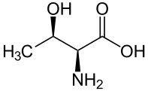
What is KERATIN characterized by 4/2
Composition of the AMINO ACIDS in the KERATINS of various Origin
AMINO ACID | Human’s Skin | Human’s Hair | Horny Tissue | Hen's Feathers | Pig’s Bristle
Asparagic acid | 9,35 | 3,9 – 7,7 | 7,9 | 5,8 – 7,5 | 8,9
Triptophane | 1,0 | 0,4 – 1,3 | 0,7 | 0,7 | NA
Lysine | 5,2 | 1,9 – 3,1 | 3,6 | 1,7 | 3,8
Threonine | 4,3 | 7,0 – 8,5 | 6,1 | 4,4 – 4,8 | NA
Glutamic acid | 15,3 | 13,6 – 14,2 | 13,8 | 9,7 | 17,9
AMIDIC NITROGEN | 0,9 | 1,2 | 1,1 | 1,1 | NA
TOTAL NITROGEN | 19,6 | 15,5 – 16,9 | 16,9 | 16,2 | NA
TOTAL SULPHUR | 0,8 | 3,0 – 4,0 | 5,2 | 3,9 | NA
NA – Not Available
CYSTINE > contains –S-S- Bond
Threonine
SOFT KERATIN - Hen's & Chicken’s Feathers is easily cleaved by Inorganic acids and Bases to Amino acids > ANIMALS’ FEEDING

Slide 11
What is KERATIN characterised by 4/3
KERATIN Composition it so different for the different Parts of the Human or Animal Bodies and also for different Animals (It is not given in the previous Table)
KERATIN is sometimes sorted to SOFT (approx. 2 % w/w of Cystine) and HARD (up to 20 % w/w of Cystine)
SOFT KERATIN - Hen's & Chicken’s Feathers is easily cleaved by Inorganic acids and Bases to Amino acids > ANIMALS’FEEDING

Slide 12
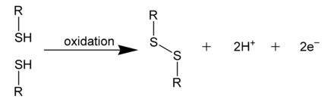
What is KERATIN characterized by 5
Ability to form Connection between Fibres by Chemical Bond > it is Analogue to Rubber Crosslinking or to the Hide Tanning
Two Cysteines > one CYSTINE

Slide 13
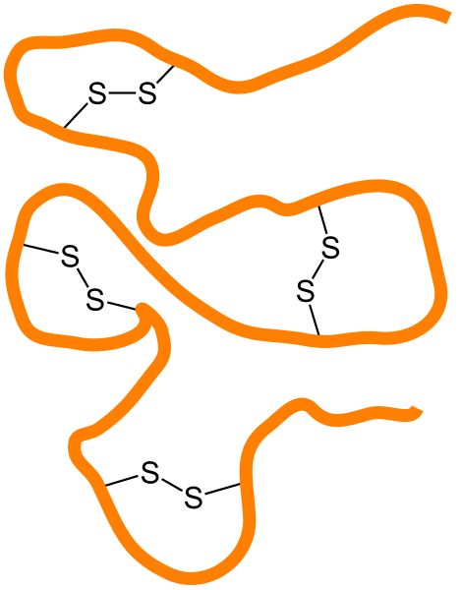
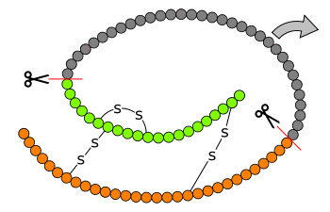
What is KERATIN characterized by 6
Enzymatic Cleavage of the Backbone
These Bonds are the Principle of the Permanent wave of Hair

Slide 14
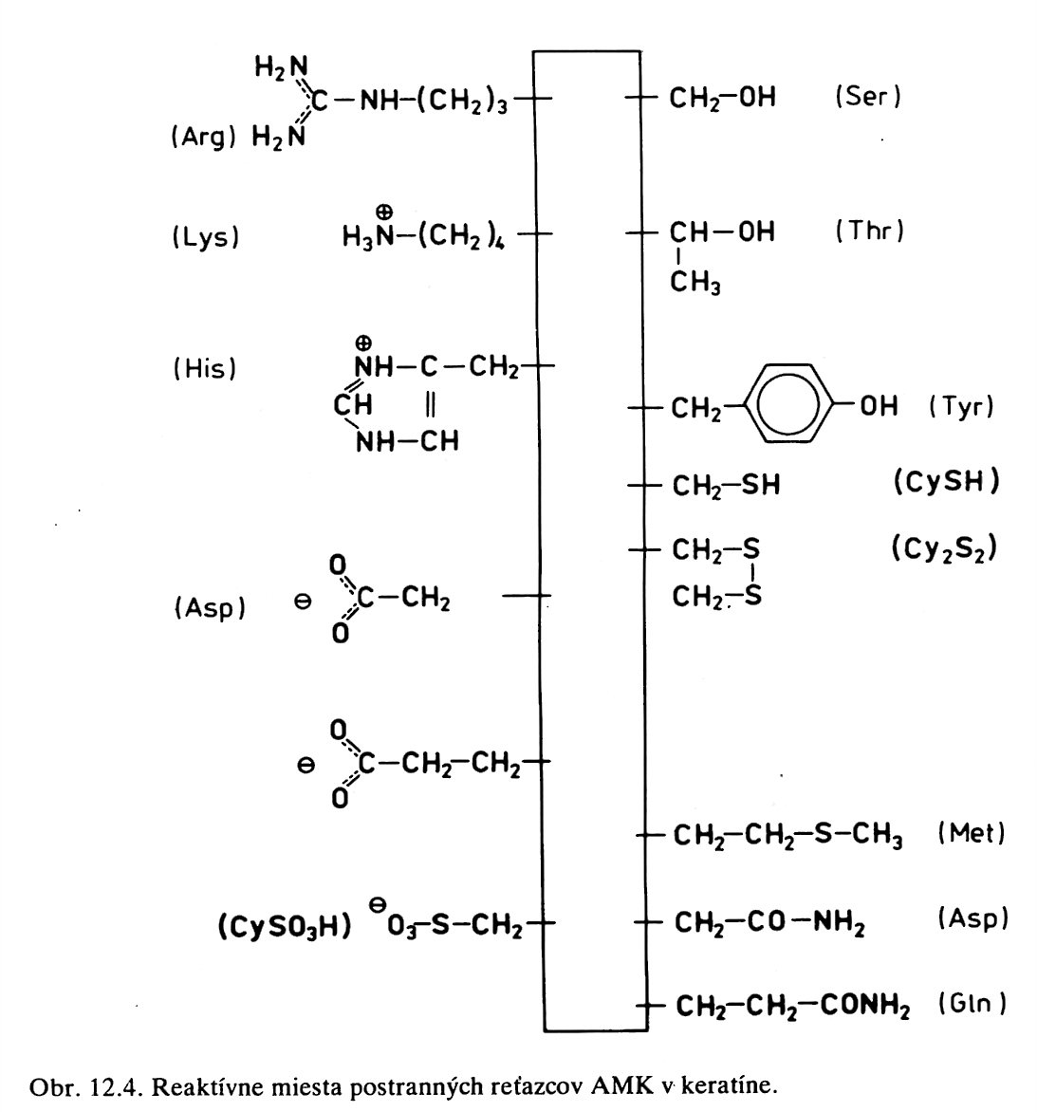

What is
KERATIN characterized by 7
KERATIN is so very chemicaly reactive
Fibre
ASPARAGINE
The reactive Sites of the KERATIN’S Amino acids

Slide 15
What is KERATIN characterized by 8/1
AMINO ACIDS in the KERATINS- Dividing into various Groups (the Sheep's Wool )
AMINO ACID Group | AMINO ACID | AMINO ACID Content (mg/g Wool)
Kationic | Arginine | 570
 | Lysine | 228
 | Histidine | 66
Anionic | Asparagic acid | -----------------
 | Glutamic acid | 772
Alcoholic -OH | Serine | 888
 | Treonine | 528
Phenolic –OH | Tyrosine | 300
Sulphur | Cystein | 24
 | Cystin | 500
 | Methionine | 29
 | Cysteinsulfonic acid | 15

Slide 16
What is KERATIN characterized by 8/2
AMINO ACIDS in the KERATINS- Dividing into various Groups (the Sheep's Wool )
AMINO ACID Group | AMINO ACID | AMINO ACID Content (μg/g Wool)
Polar covalent Bond | Asparagine | ------------------
 | Glutamine | 822
Nonpolar covalent Bond | Alanine | 438
 | Valine | 487
 | Leucine | 643
 | Isoleucine | 275
 | Proline | 570
 | Phenylalanine | 239
 | Tryptophane | 32
 | Glycine | 749

Slide 17

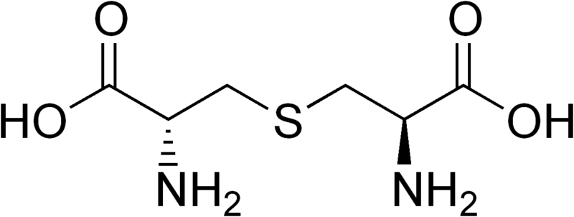
What is KERATIN characterized by 9
AMINO Acid | Formula
Cisteine
Cistine | It is formed only by the Reaction of two Cisteine Molecules by intermolecular or intramolecular Way
Methionine
Cysteinsulfonic acid | It is formed only by the Reaction (OXIDATION) –S-S- Bringe (Bond) in Cistine
Lanthionine (two ALANINES bonded via –S- )

Slide 18
Value of Heat of Hydration for Wool with Water and Alcohols at 20 °C
Hydration Agent | Moly Volume at 20 °C (cm³/mol) | Heat of Hydration (J/g)
Water | 30 | 100
Methanol | 67 | 91
Ethanol | 97 | 54
Acetic acid | 95 | 119
Why the wet Wool provides Heat?
The molar volume, symbol V_{m}, is the volume occupied by one mole of a substance (chemical element or chemical compound) at a given temperature and pressure. It is equal to the molar mass (M) divided by the mass density (ρ). It has the SI unit cubic metres per mole (m³/mol), although it is more practical to use the units cubic decimetres per mole (dm³/mol) for gases and cubic centimetres per mole (cm³/mol) for liquids and solids.

Slide 19
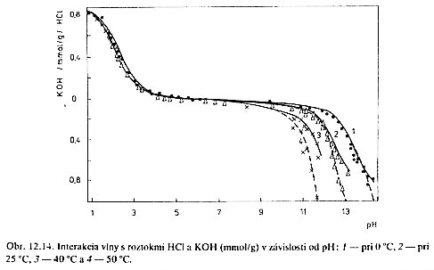
The Sorption Properties of the KERATIN
PAY ATTENTION TO THIS! Y Axis is the POSITIV ONE in both Directions!
The Interaction of the WOLL with HCl and KOH Solutions (mmol/g) in Dependance on pH Value: 1 – at 0°C, 2 - at 25°C, 3 - at 40°C, 4 - at 50°C

Slide 20
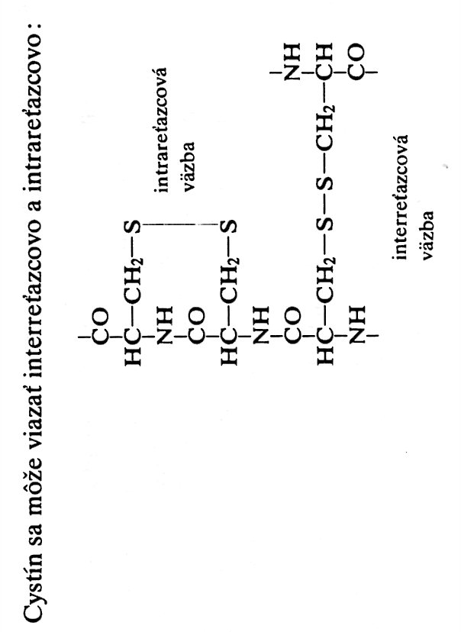
KERATIN Reactivity 1
It is based on the Reactions of the CYSTEIN CYSTEINU
CYSTINE can create both INTERMOLECULAR and ITRAMOLECULAR Bonds
Two Cysteines > one CYSTINE

Slide 21
KERATIN Reactivity 2
It goes on preferably the
DISULFIDIC BRIDGE (Bond)
Hydrolysis of the DISULFIDIC BRIDGE (Bond)
Oxidation
Reduction

Slide 22
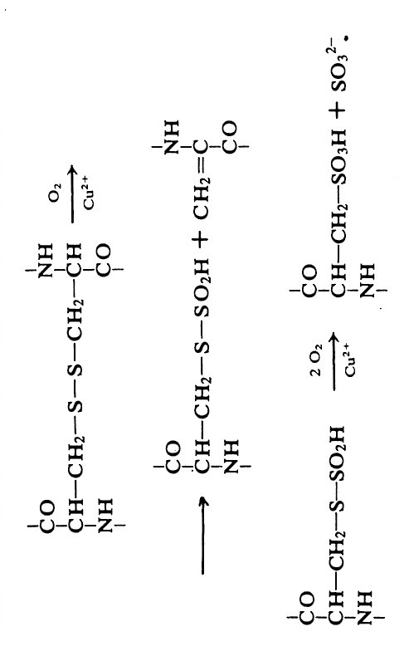
KERATIN Reactivity 3
CYSTEINSULFONIC ACID arises only by Reakction (OXIDATION) –S-S- BRIDGE (Bond) of the CYSTINE

Slide 23
The four Fractions of the KERATIN 1
The Observation of the Reaction of the Wool with Bases (Alkali), Hyhrogensulfite, Formaldehyde and Thioglycolic acid was revealed, that Cystine in the Wool is possible to divide into two primary Parts (A+B) and (C+D) and four secondary Parts( A, B, C, D). The various Behaviour of the particular Parts of the Cystine is explained so, that Cystine is in the Wool bonded with various Amino acids, which have various Sidegroups. The most reactive Part (A+B) je either near to or surrounded by polar Sidegroups, whereas less reactive Part is connected with nonpolar Sidegroups.

Slide 24
The four Fractions of the KERATIN 2
Creation of the new BRIDGES (Bonds)
Except for minor Exceptions is the Wool different from another textile Fibres by that, containing Covalent Cross Bonds which connect the main Peptide Bonds of the Backbone. As a Consequence (Result) of this, the Wool is insoluble in the Polar Solvents and is swollen by in such Solvents, having relatively high wet Strength. These Properties can be changed by cleavage of the disulphide Bonds. The wet Strength is decreased in direct proportion to the Number of the ruptured Cross Bonds. The Endeavour is focused for long time already to establish (constitute) a new Cross Bonds, more resistant than disulphide Bonds.
The Constitution of the new Cross Bonds in the Wool has not only scientific Importance, but also a practical one also. So e.g. by the Constitution of the new Cross Bonds is lowered a Tendency to Wool felting power as the Results of the lower elasticity of the Wool Fibres. The Resistance to Alkali and the common clothes Moth is also increased.
The Cross Bonds can be constituted in the Wool by scission of the disulphide Bonds and their replacing by other, more resistant Bonds. The Way is the Reaction with polyfunctional Compounds, which can react other reactive amino Groups, amide Groups, carboxylic Groups, Phenolic Groups.

Slide 25
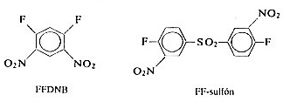
KERATIN Crosslinking 1
Crosslinking Reagents

Slide 26
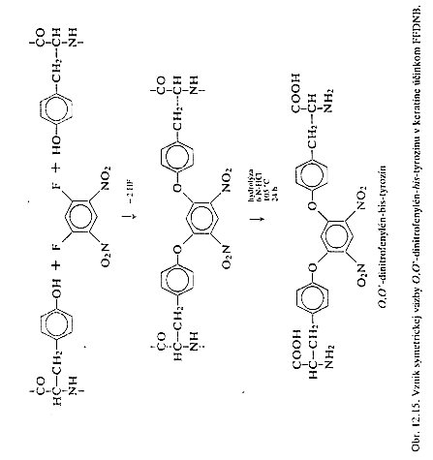
KERATIN Crosslinking 2
HF must removed (neutralised) by some Way!

Slide 27
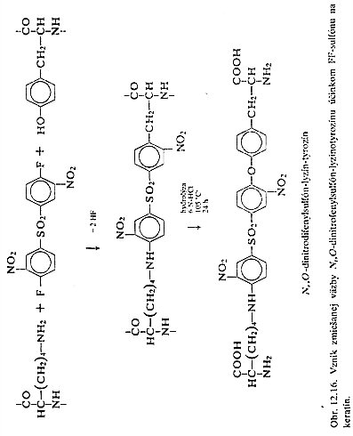
KERATIN Crosslinking 3
HF must removed (neutralised) by some Way!
ovat

Slide 28
KERATIN Crosslinking 4 - FORMALDEHYDE
R-NH₂ + HCHO R.NHCH₂OH
R-NH.CH₂.OH + H₂N-CO-R’ R-NH.CH₂-NH-COR’
The Optimal reaction Course at Proteins is with 4 % w/w Formaldehyde at 70 °C and pH 3 – 7.
The Cross Bonds in the Wool in the Acid Environment are created by Reaction of the Glutamic acid with the Guanidyl Residue from Arginine. The Cross Bonds created by this way are Resistant to Alkali, but are broken by Acids. The Wool Solubility in Alkalis so treated Wool deceases from approx. 13 % w/w.
AMINO ACIDS presented In the Equations are written as the Functional Groups only! The Formulae are not corresponding to the AMINO ACIDS presented bellow.

Slide 29

Glutamic acid (Glu, E)
Arginine (Arg, R)

Slide 30
KERATIN Reakctions – Grafting of other Monomers
Creation of the POLYMERS in the Fibre
The POLYMERISATION from the Solution or form the Gas Phase creates the Increase of the Wool Weight, Strength and Decrease of the felting Power. The most well known is the Ethylenesulphide, especially in the Presence of various Catalysts (Peroxides, Per sulphate).
The Ethylenesulphide reduces the Disulphidic Bonds at first and then the POLYMERISATION in the Fibre start and goes on.
The Methylmethacrylate and the Metacrylic acid are also suitable for this POLYMERISATION in the Fibre.
R-CH₂-SH + n (CH₂)S RCH₂S(CH₂.CH₂.S)_{n-1}.CH₂CH₂SH

Slide 31
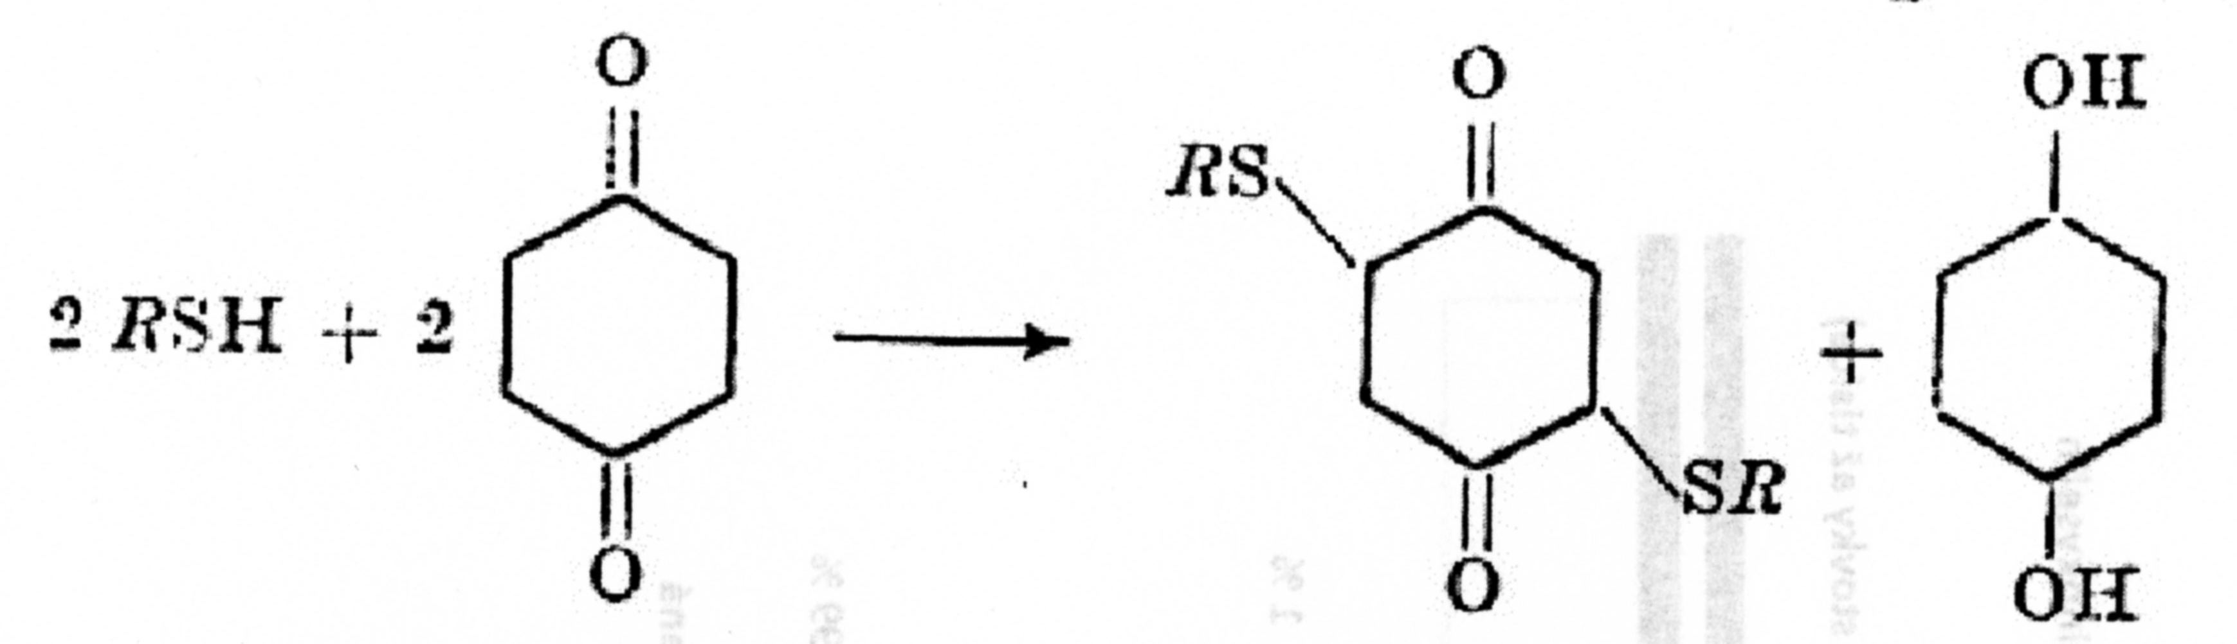
KERATIN Crosslinking - Quinone
Benzoquinone reacts with the Amino group or with the –SH Group as follows:
The Optimal reaction Course is at pH 3 – 7. Reaction with Quinone is employed for the Wool increase of Strength since a long time ago. The Quinone treated Wool is more resistant to chemicals and has lower tendency to the felting Power. The Tensile Strength Increase is higher than using other Reagents able to create the Cross Bonds. It is explained by the easy ability of the Benzoquinone polymerise in the Wool.

Slide 32
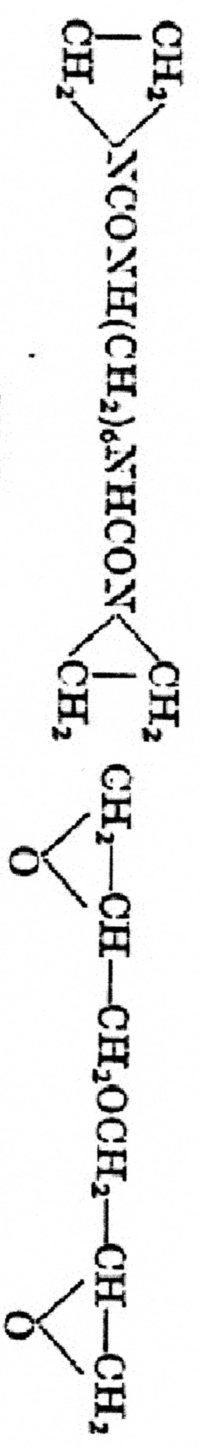
KERATIN Crosslinking – Polyfunctional Alkylation Reagents 1
Chlormethylethers react with the Wool in the organic Solvents Medium and creates the Cross Bonds.
The Reaction goes PROBABLY as follows:
RNH₂ + ClCH₂OCH₂Cl > RNHCH₂OCH₂Cl + R₁COOH > RNHCH₂OCH₂OOCR₁
The other bifunctional Reagents, e.g. Ethyleneimis, 1,3-difluoro-4,6-dinitrobenzen, bisepoxides, were tested also:
It was revealed by this that in the acetylated Wool cannot be created the Cross Bonds, whereas in the esterified Wool it was possible.

Slide 33
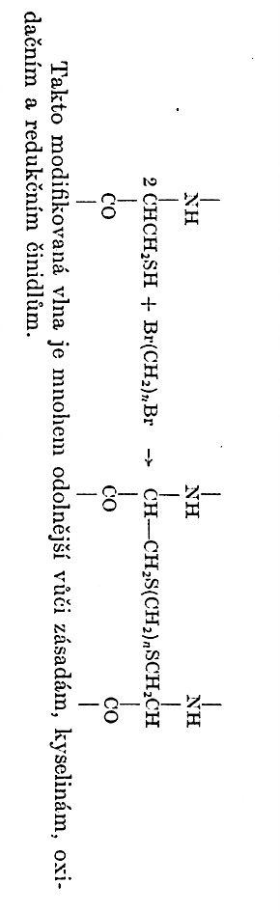
KERATIN Crosslinking – Polyfunctional Alkylation Reagents 2
So modified Wool is much more resistant to Bases, Acids, Oxidising Agents a Reduction agents

Slide 34
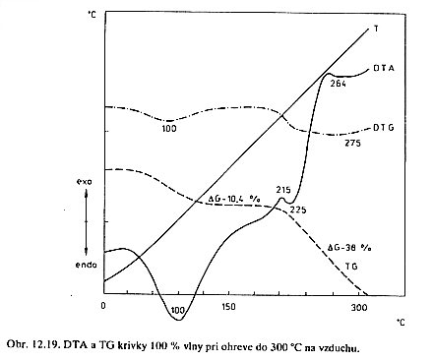
Phase Transitions of KERATIN 1
α Keratin (Coil) > β Keratin (Folded (Pleated) Sheet)
Evaporation of the Water
DTA and TG Curves 100 % w/w of Wool heating up to 300 °C in Air
The greatest Decrease of the Phase Transition Temperature of KERATIN goes with Increase of the Water Content in the interval 12 – 17 % w/w.
The Phase Transition Temperature of the α KERATIN goes in Temperature Region 210 – 213 °C. The Phase Transition Temperature of the enlarged (strained) β KERATIN Wool Fibre (β Keratin (Folded (Pleated) Sheet) into Amorphous KERATIN is in the Temperature Region 220 – 225 °C.
It is clear from this, that the β Keratin (Folded (Pleated) Sheet is more resistant to the Influence of the Temperature.

Slide 35
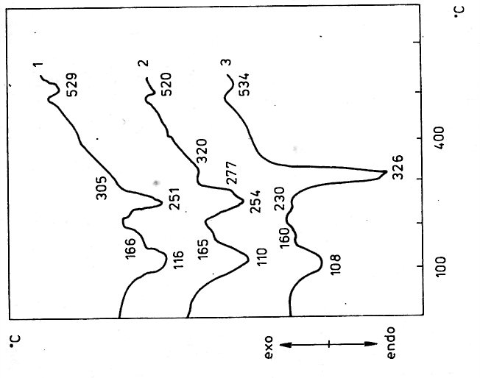
Phase Transitions of KERATIN & FIBROIN 2
On Air > OXIDATION > Burning already at approx. 230 °C
FIBROINE is more Temperature stable than KERATIN
(Phase Transition Temperature )
1
2
3
DTA and TG Curves 100 % w/w of Wool heating up to 300 °C in Air
α Keratin (Coil) > β Keratin (Folded (Pleated) Sheet)
DTA Curves in the NITROGEN: 1) Human Hair, 2) Mohair Wool, 3) Natural/Genuine silk
Evaporation of the Water
Decomposition in NITROGEN is only at higher Temperature and is more slowly

Slide 36
Keratin Colouring
The so called REACTIV COLOURS creates covalent Bonds with the functional Groups of Keratin.
The REACTIV COLOURS can either ACIDIC or BASIC.
The Decrease of the Reactivity to the ACIDIC REACTIV COLOURS is achieved by Decrease of the –NH₂ Groups in the Side Chains of the Amino acids. The chemical Reactions are as follows:
-V-NH₂ + HNO₂ > -V-OH + N₂ + H₂O
-V-NH₂ + (CH₃CO)₂O > -V-NH-CO-CH₃ + CH₃COOH
The Decrease of the Reactivity to the BASIC REACTIV COLOURS and so to INCREASE the Affinity to the ACIDIC REACTIV COLOURS is achieved by ESTERIFICATION of the –COOH Groups (Asparagic acid, Glutamic acid) by Alcohols, Epoxides, Alkylhalogenides, Diazomethane, Alkylsulphone acid.
The Quantity of the esterificated –COOH Groups decreased accordingly with the MW of the Alcohol. So the MeOH gives 67 %, but propanol gives 54 % only.

Slide 37
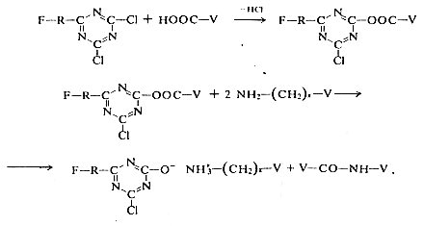
REACTIV COLOURS for KERATIN

Slide 38
Preservation of Keratinu against to clothes Moth
Pest Hindrance of Wool and Furs against to clothes Moth are employed either Substances without bond to the Keratin Molecules or the Substances directly bonded to the Keratin Molecules.
These bonded Substances are usually Chlorine containing Compounds, e.g. dichlorodiphenyltrichlormethan. This Compound is bonded to Keratin irreversibly and is impossible to extract it. This Bond is also hydrolytic stable.
There are also other Possibilities to get permanent Resistance to clothes Moth. The Situation is changed from time to time, because new Data regarded to the Danger to Humans.
An well known Example is so called DDT (Substance without bond to the Keratin Molecules), which was banned years ago already.

Slide 39
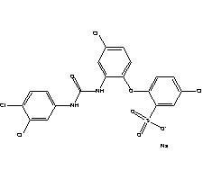
Preservation of Keratinu against to clothes Moth – an EXAMPLE of the Reactiv (PERMANENT) Substance directly bonded to the Keratin Molecules
MITIN FF

Slide 40
Sheep's Wool - Structure of the KERATIN Part
It can be in two Chains’ Secondary Structures:
  α Left-handed Helix
  β Folded (Pleated) Sheet
  α Helix is changing during elongation at higher Temperature (approx. 85 °C) to β Folded (Pleated) Sheet
  β Folded (Pleated) Sheet forms the INTERFIBRES’ PART between α Left-handed Helixes and their Aggregate (Complex) creates the MACROSCOPIC Sheep's Wool Fibre
  Sheep's Wool Fibre is so Composite Structure, where are some Components and cross Design (Bonds between particular Macromolecules)

Slide 41
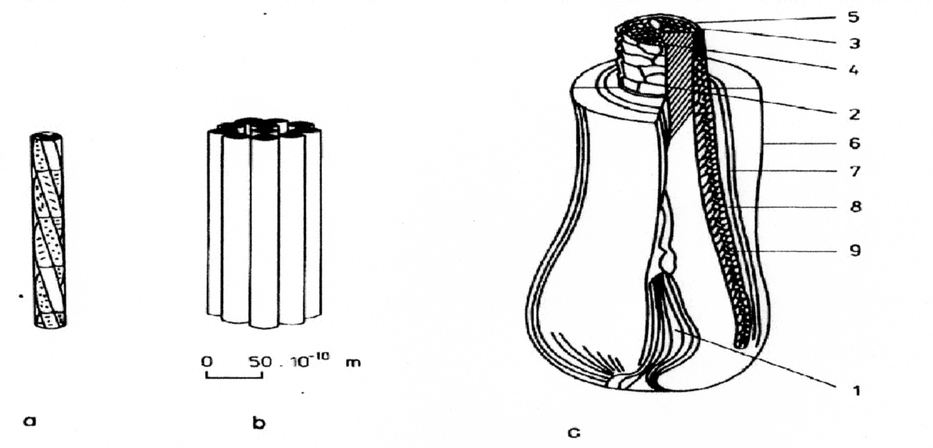
Sheep's Wool - Structure Hierarchy 1
Left-handed α triple Helix
The Model of the a KERATIN in the Sheep's Wool Fibre:
Protofibril composed from three α Helixes
Microfibril composed from eleven Protofibrillas
Cross Cut of the Sheep's Wool Fibre with Dividing of the Core Part into ORTHO and PARA Share (Part):
  Papilla
  Wool Fibre
  Para Part of the Core Share (Part)
  Wool Cuticle
  Outer Sheath of the Wool’s Root
  Henley’s Layer
  Huxley’s Layer
  Inner Sheath of the Wool’s Root

Slide 42
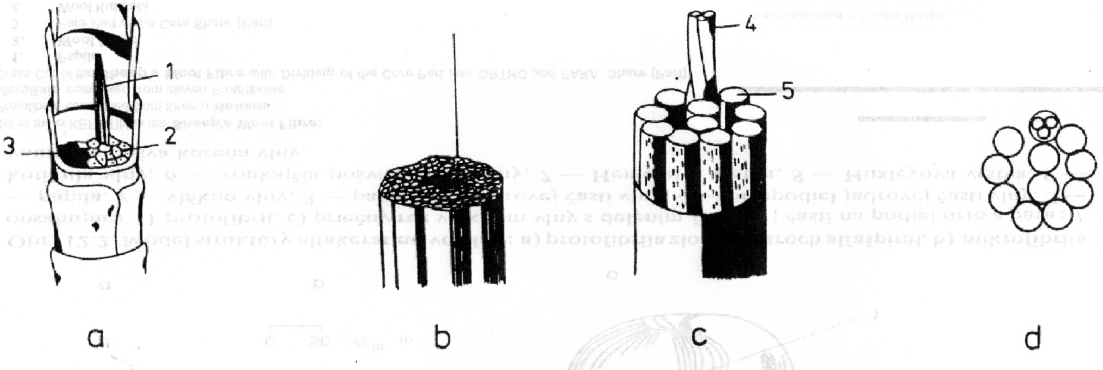
Sheep's Wool - Structure Hierarchy 2
Left-handed α triple Helix
The Model of the Sheep's Wool Fibre:
  Wool Fibre
  Fibrilla (Fibril)
  Microfibril
  Microfibril Cross Cut
    Cortex Cell
    ORTHO Cortex
    PARA Cortex
    Left-handed α triple Helix
    Protofibril

Slide 43
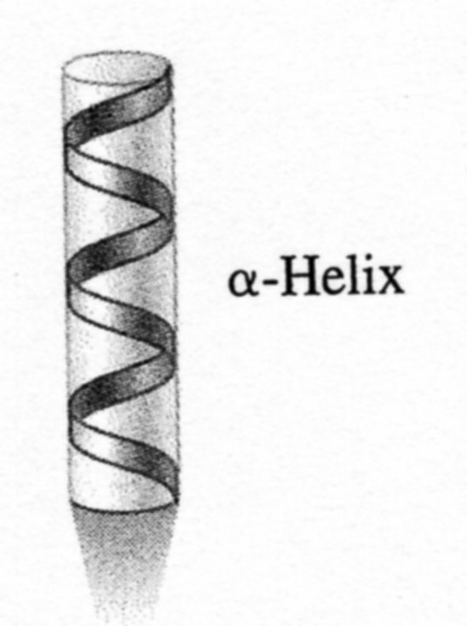
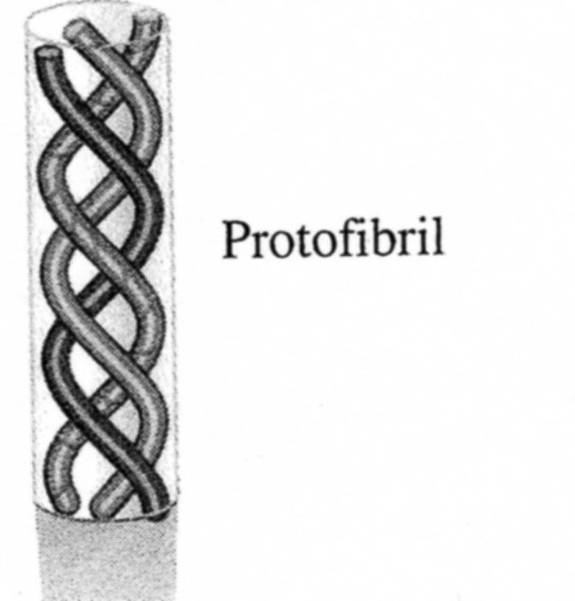
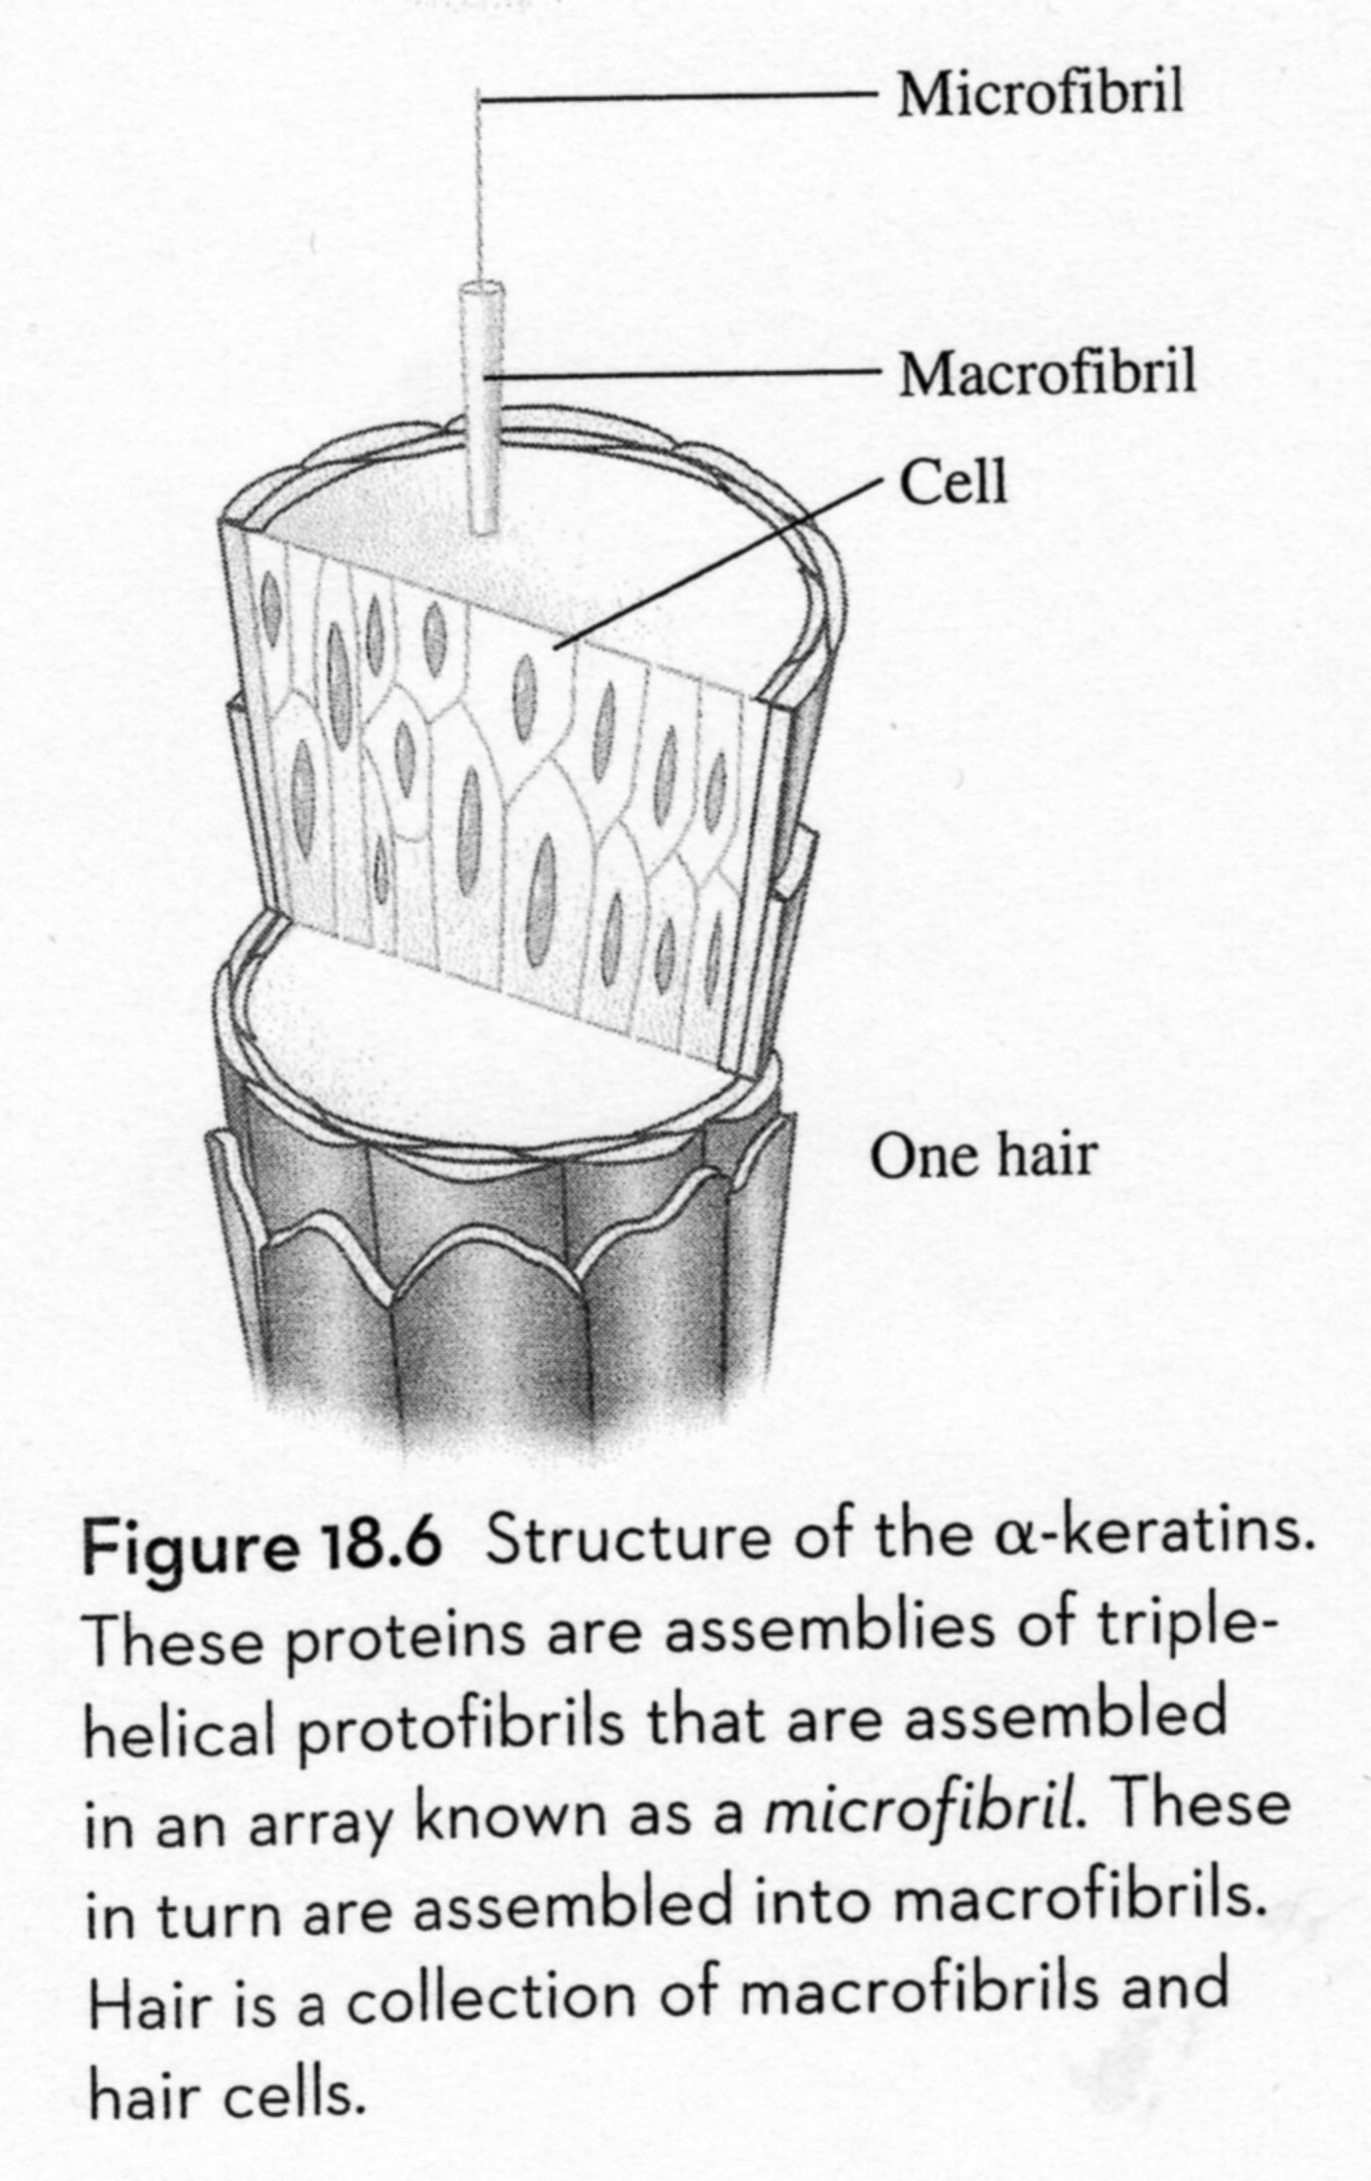
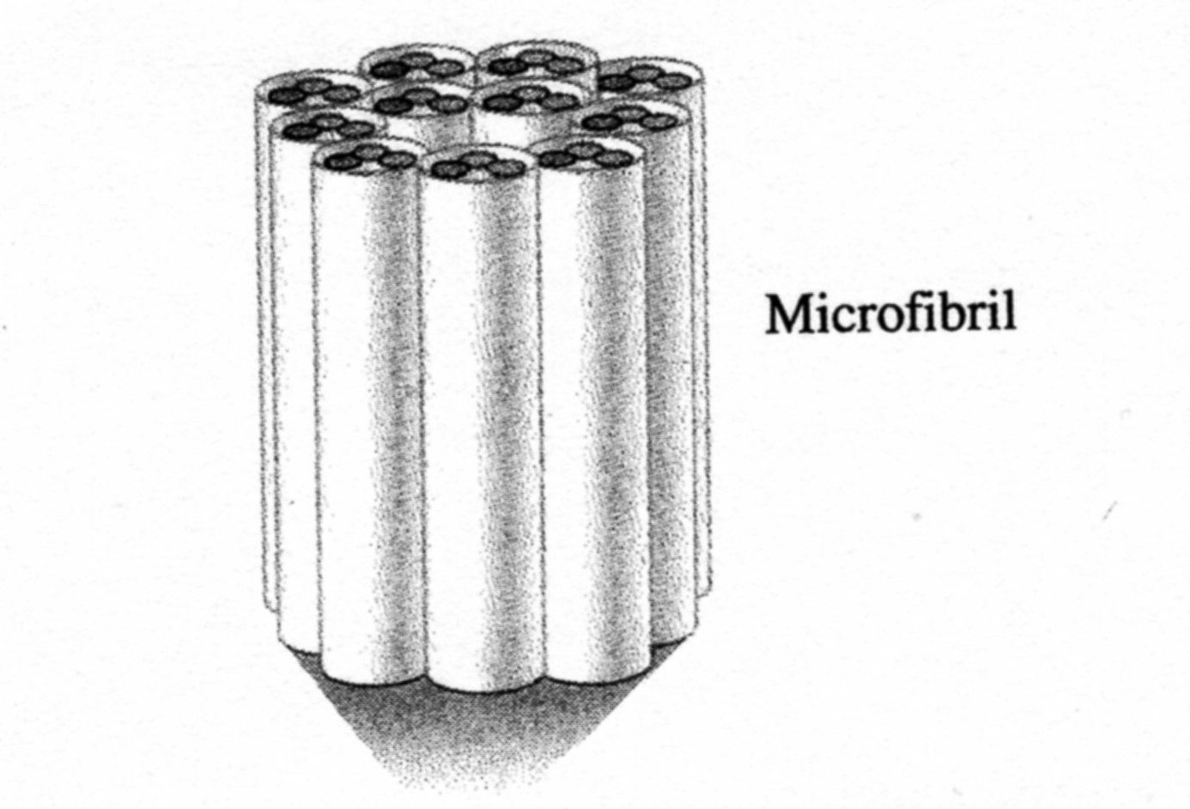
Sheep's Wool - Structure Hierarchy 3
Left-handed α Helix

Slide 44
Sheep's Wool – Fibre's Morphology
Outer Sheath = CUTICLE = cell Wall which creates Scale Surface of the Fibre oriented Points (Darts)
Inner Sheath = CORTEX = cortical Part formed by Fibres oriented in the Fibres Direction
Pith = Medulla = it cerates inner Part of the Fibre and is divided into closed Air Bubbles > it is the Reason of the Thermal isolation properties Part of the Wool

Slide 45
TECHNICAL IMPORTANCE OF THE WOOL CONSTITUTION
It is well known, that the Content of some Amino acids (e.g. Cystine, Cysteine, Tyrosine, Lanthionine) is influenced (DESREASED) by the Weather.
The Wool can be seriously damaged during Processing. So the Alkalic washing Bath or the Colouring in the neutral Bath at high Temperature or at high Pressure. The Damage is the hydrolytic Cleavage of the Peptide Bonds. The Carbonisation of the Wool by H2SO4 or by the Acid Salts at 100 – 130 °C has the same undesirable Effect. The Bleaching of the Wool by oxidation Substances can create the irreversible Oxidation of the Cysteine.
It is well known, that the Wool is very Elastic, it can be strained up to 60 – 70 %. If the strained Wool is left in the cold Water, the Wool is shrunk back to the initial Length. If the Wool is stretched out in the hot Water or in the Steam and then cold in that stretched State, it keeps the elongated (stretched) length. This Phenomena is the Principle of the so called „ Crabbing“ and the Manufacture of the elastic Wool Fabric. It is usually explained so, that the α Configuration is transformed to the β Configuration at simultaneous Orientation in the Longitudinal Axis. The Hydrogen Bonds between Backbones are released by Action of the hot Vapour or the hot Water and the Backbones can slip one on the other to the new Equilibrium State. In that new Equilibrium State can arise new Hydrogen Bonds between Backbones and new stable Configuration.
The Wool give in so called „ Felting“. It is sometime desirable, sometime undesirable. To prevent Wool against „ Felting“, there are many Modifications. The most of them is based on the Surface chemical modification, mostly on chloration. The Care must be paid to side Reactions, which can lead to undesirable Wool Damages.

Slide 46
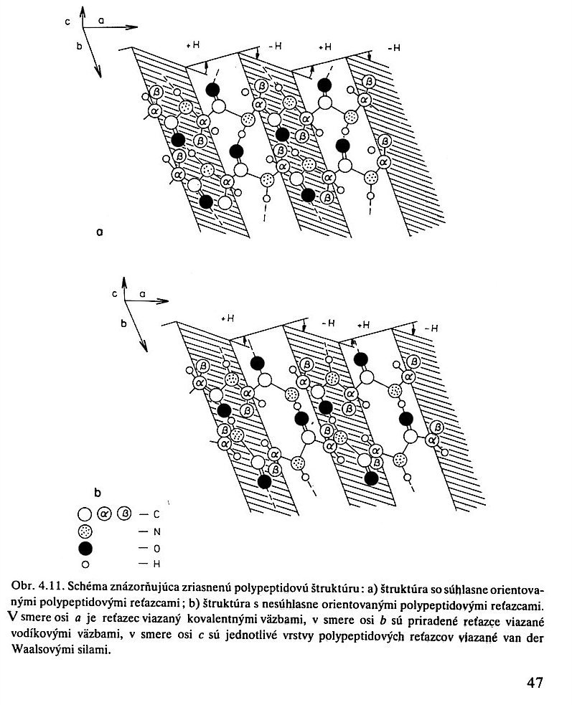
Sheep's Wool - β Keratin (Folded (Pleated) Sheet)
Schema showing the Protein’s β Keratin (Folded (Pleated) Sheet) Structure
PARALEL arrangement
ANTIPARALEL arrangement
The Backbone is bonded by the Covalent Bonds in the a Axis Direction.
The Backbone is bonded by the Hydrogen Bonds in the b Axis Direction.
The Backbone is bonded by the Wan der Waals Forces in the c Axis Direction.

Slide 47
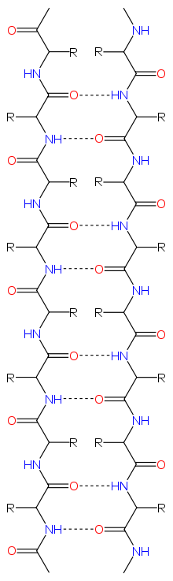
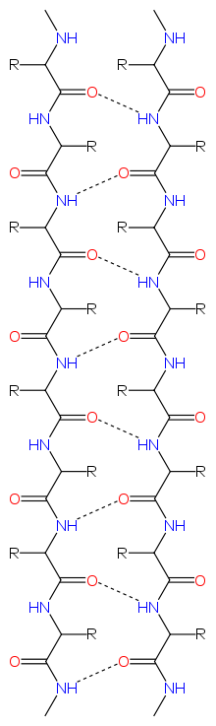
Sheep's Wool - β Keratin (Folded (Pleated) Sheet)
ANTIPARALEL arrangement
PARALEL arrangement

Slide 48
Sheep's Wool - Composition
Component | % w/w | Remark
Main Fibre (keratin) | Rest up to 100 % w/w
Sheep’s FAT (LANOLIN) | 5 – 15 | Acid Esters Mixture (it is stated up to 36) with Alcohols (it is stated up to 23 aliphatic), Sterols (mainly Cholesterol)
Impurities | 5 – 20
Plant Rest | 1 – 5
Moisture | 8 - 12

Slide 49
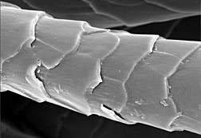
Scale like Structure of the Sheep's Wool

Slide 50
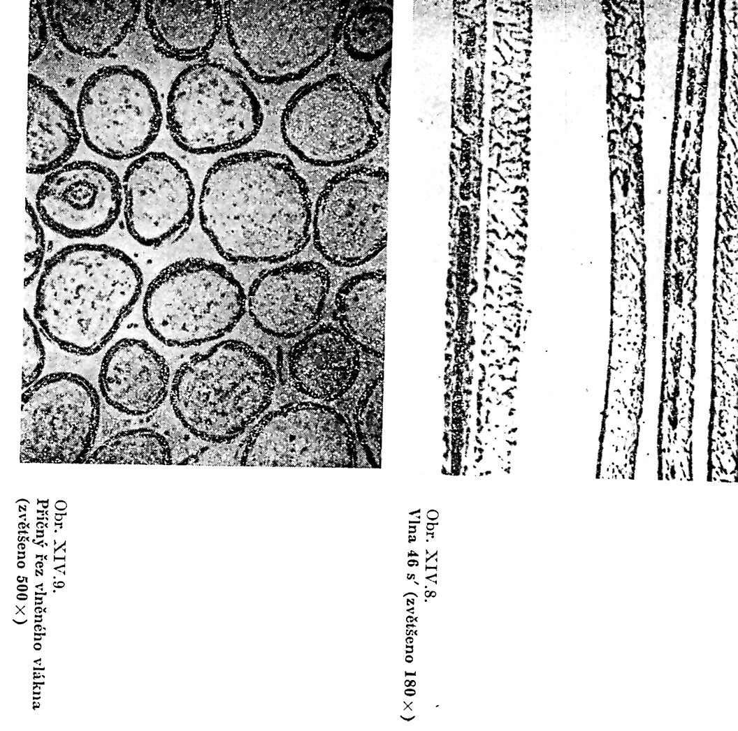
Optical Microscop, it is not given, which Animal is the Source
Wool
Magnificatin
180 x
Wool Cross Cut
Magnificatin
500 x

Slide 51
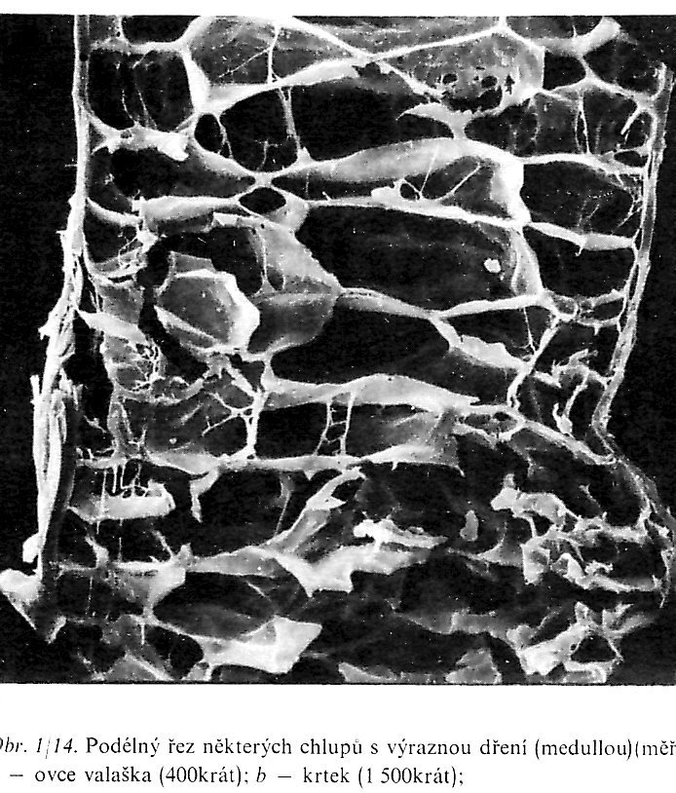
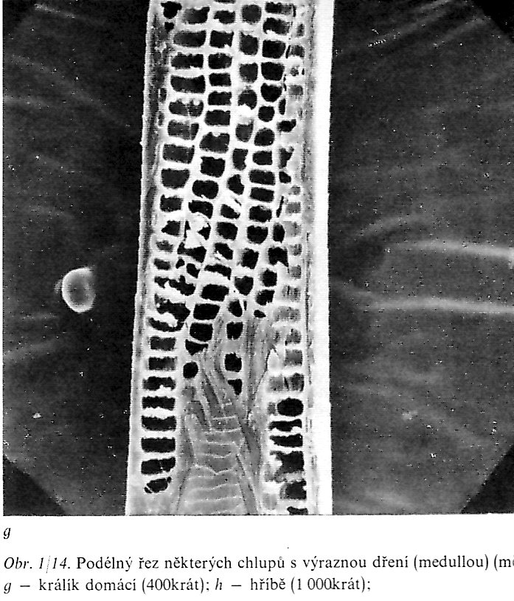
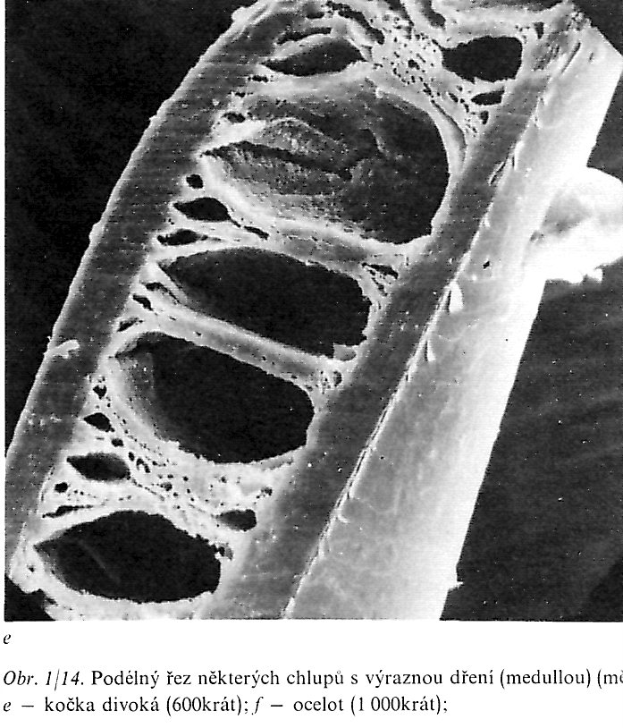
Inner Structure Sheep's Wool and other Animals’ Hairs
KUTIKULA
CORTEX
Wild Cat
Sheep
Rabbit
MEDULA

Slide 52
UNDERHAIR is the fine, thick, usually unmarked coloured and functions as the ISOLATION LAYER. It is constituted from the fine, dense grown short Fibres. It forms the typical structure, called WOLL of some domestic or wild Animals (Sheep, Camel, Rabbit, Lama etc.). The UNDERHAIR function is the thermal Insulation during both Summer (Heat) and Winter (Cold).
GUARD HAIR is the long, rough, straight Hair, which overhangs UNDERHAIR and functions as the Guard. GUARD HAIR is of various Length and thick and is carries out the typical Colour of the particular Animal’s Colour.

Slide 53
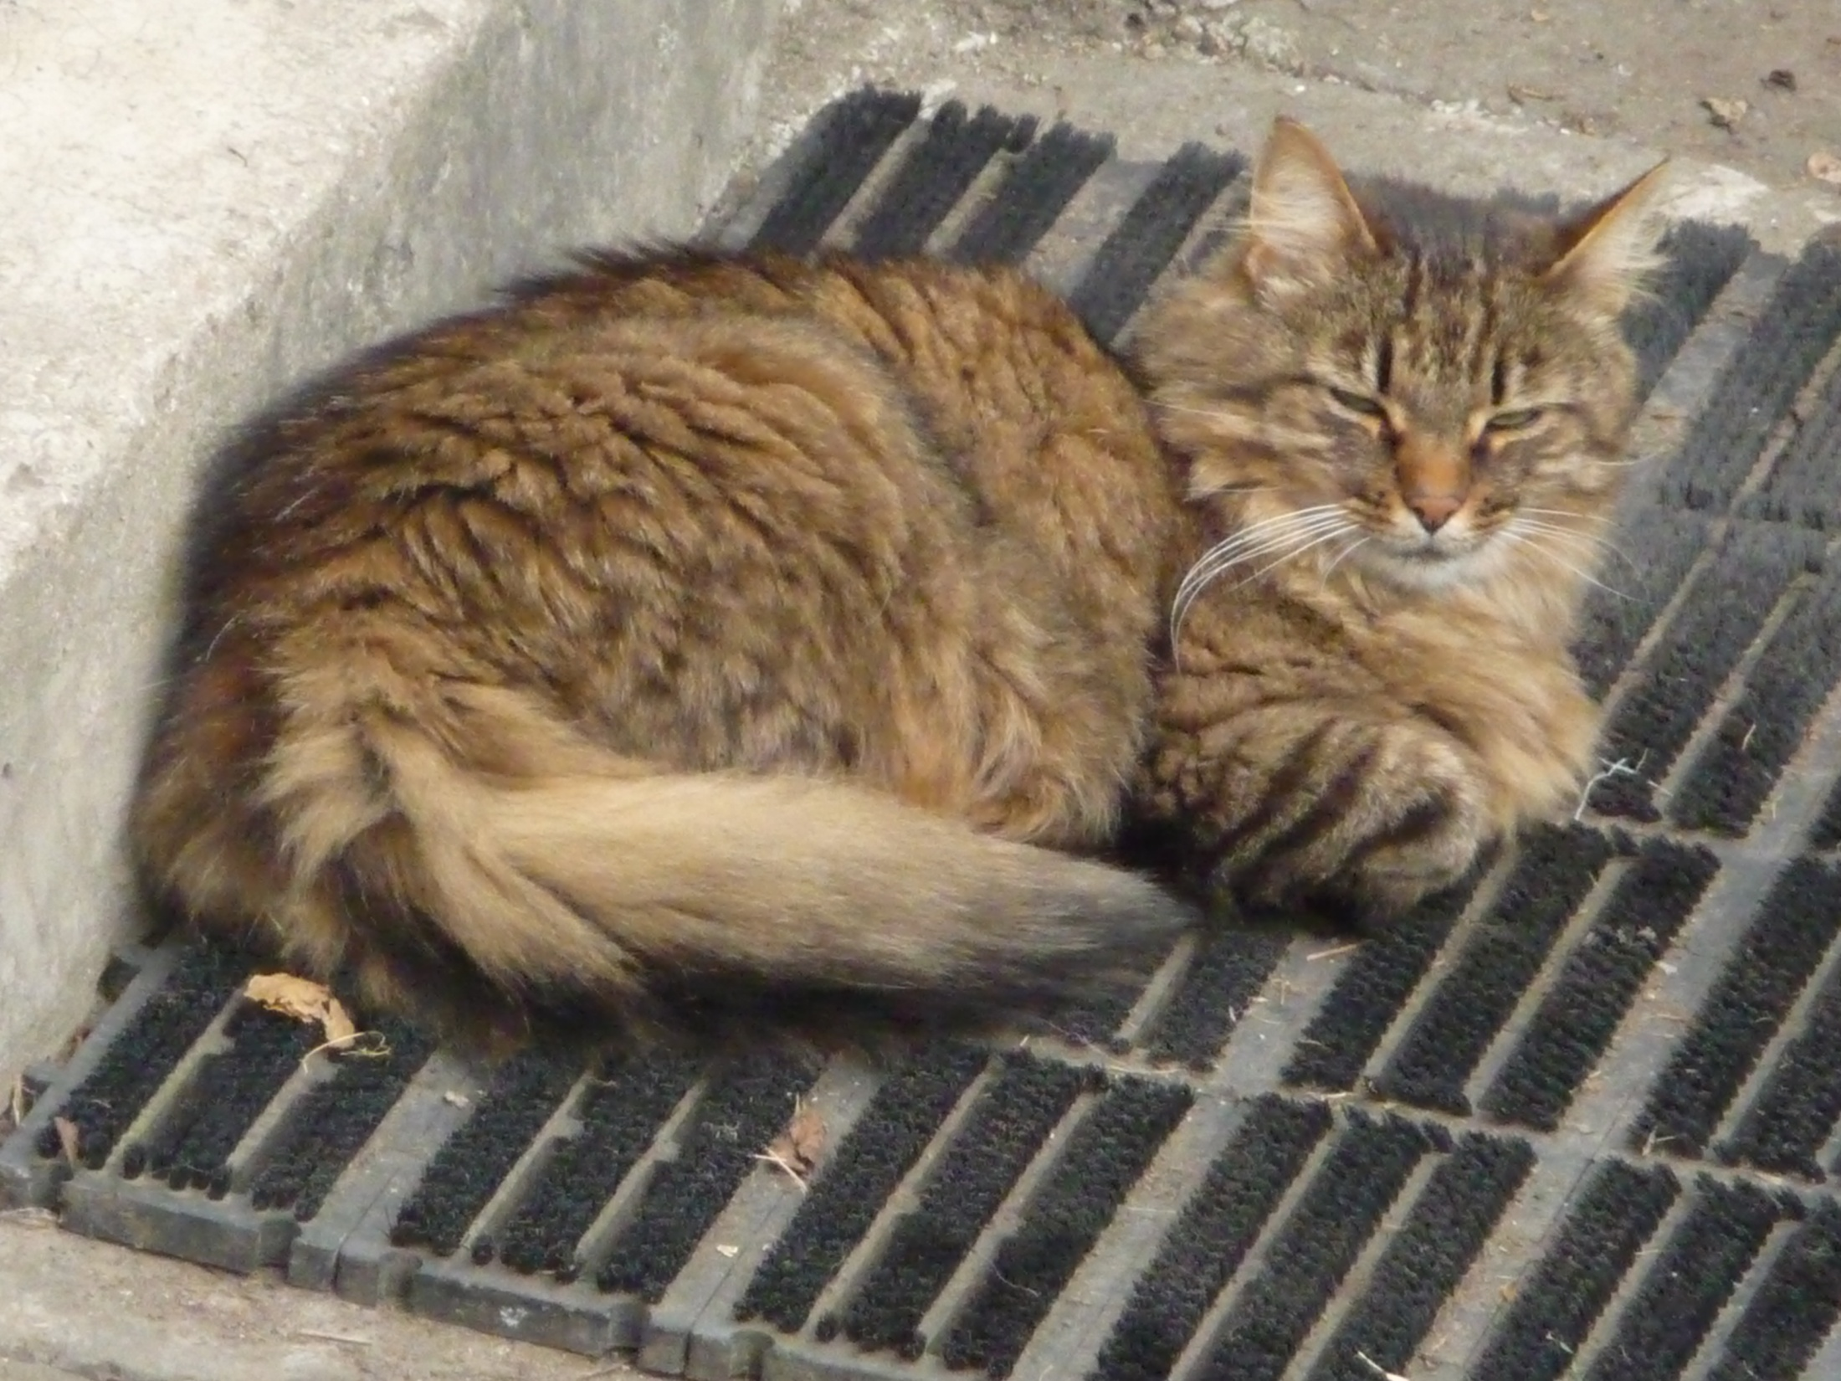
Cat Male Hugo is the HOME CAT, but well hairy for the outdoor Life

Slide 54
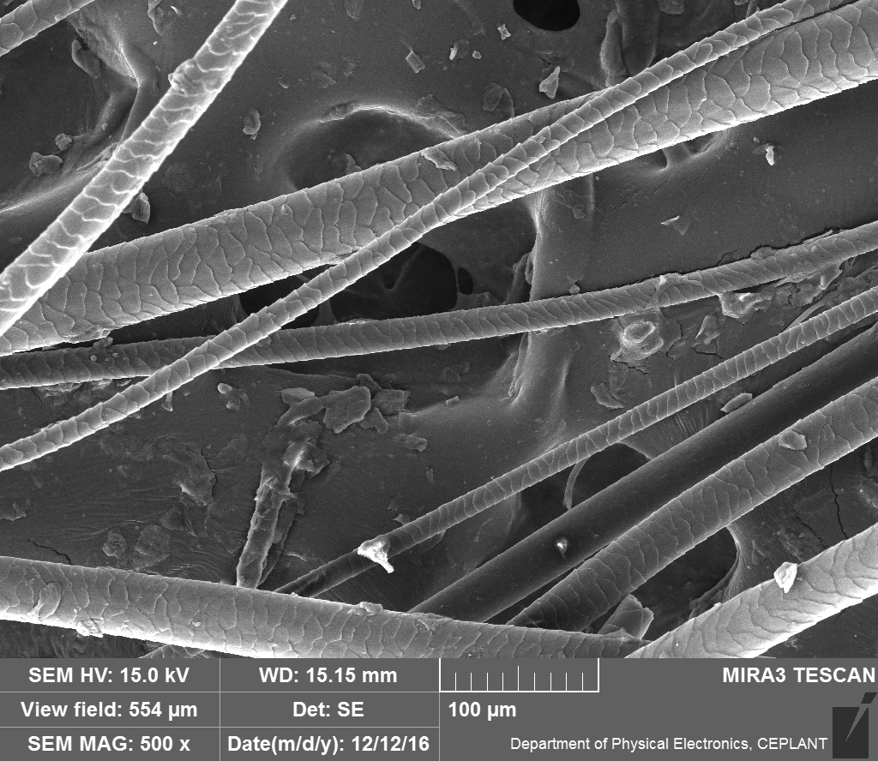
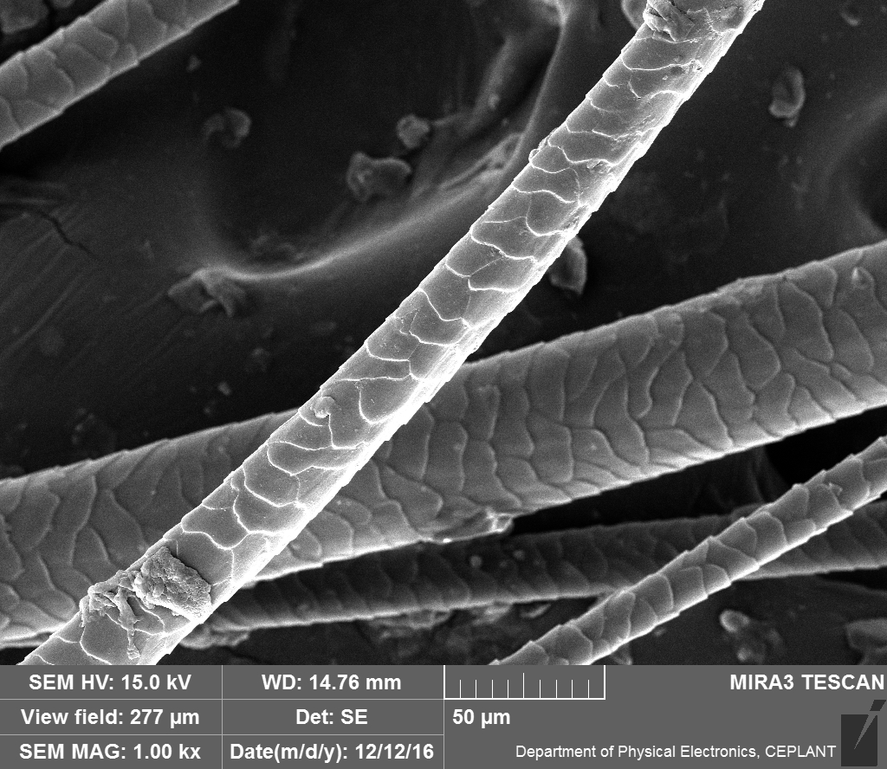
Hugo’s Hair
GUARD HAIR
UNDERHAIR

Slide 55
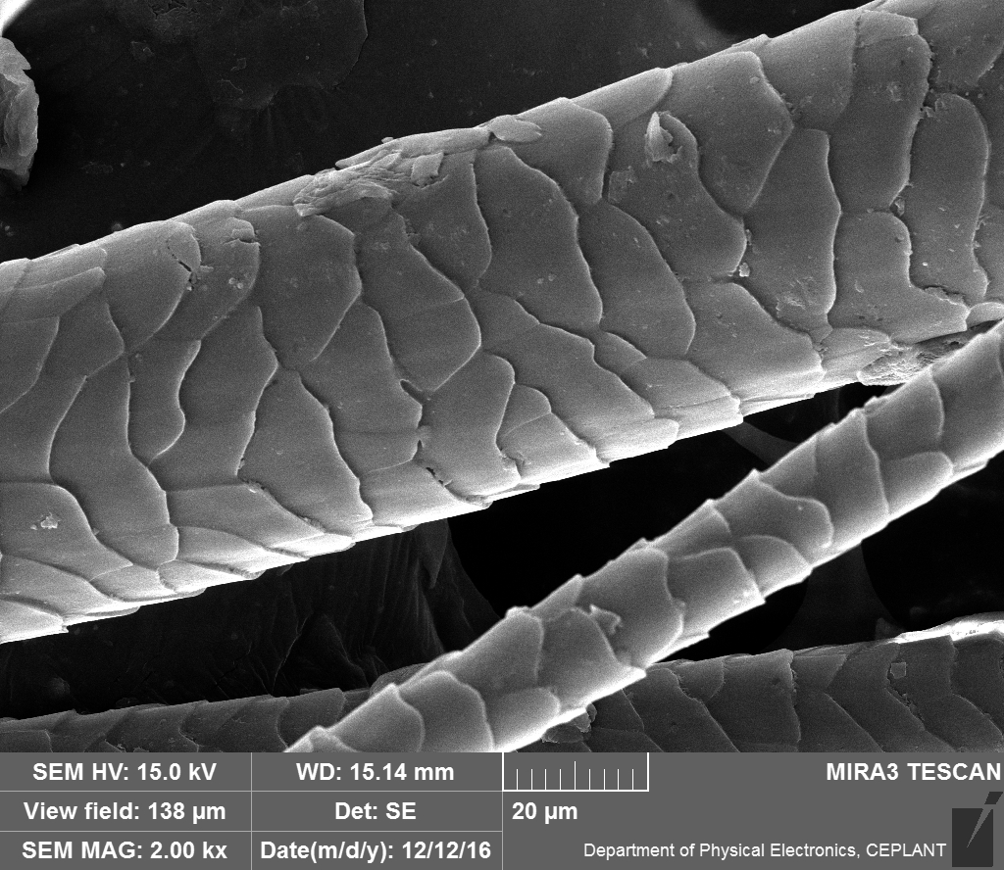
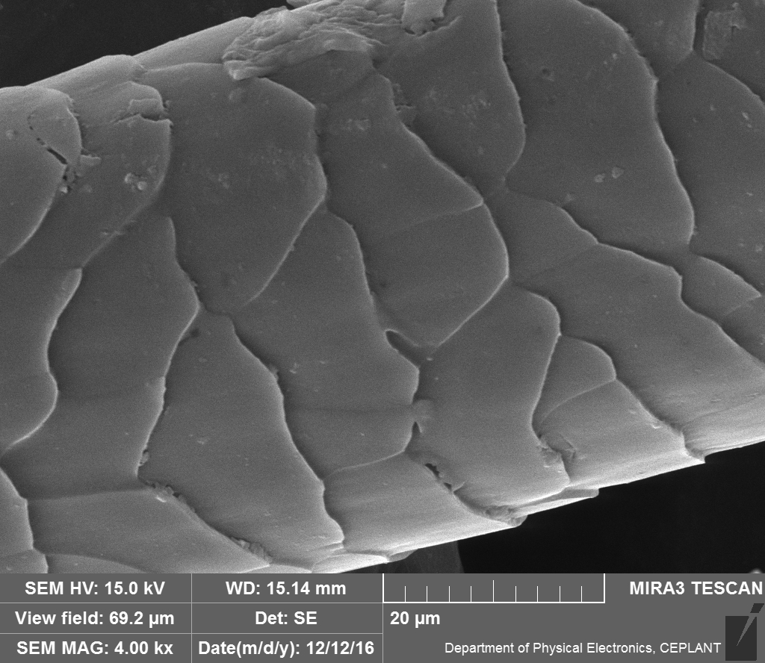
GUARD HAIR
Hugo’s Hair

Slide 56
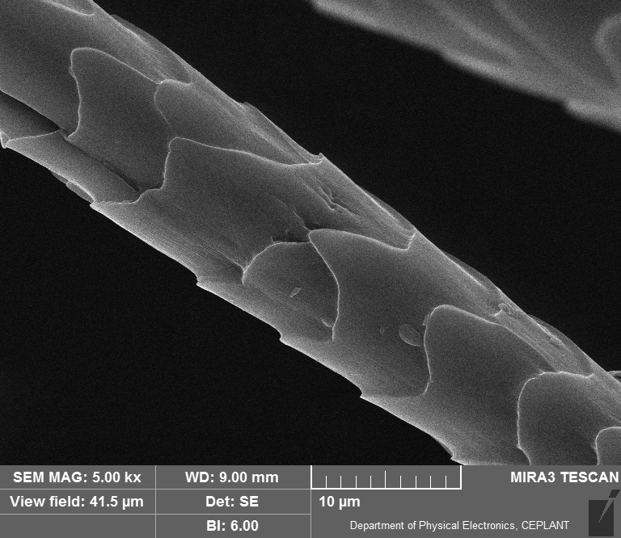
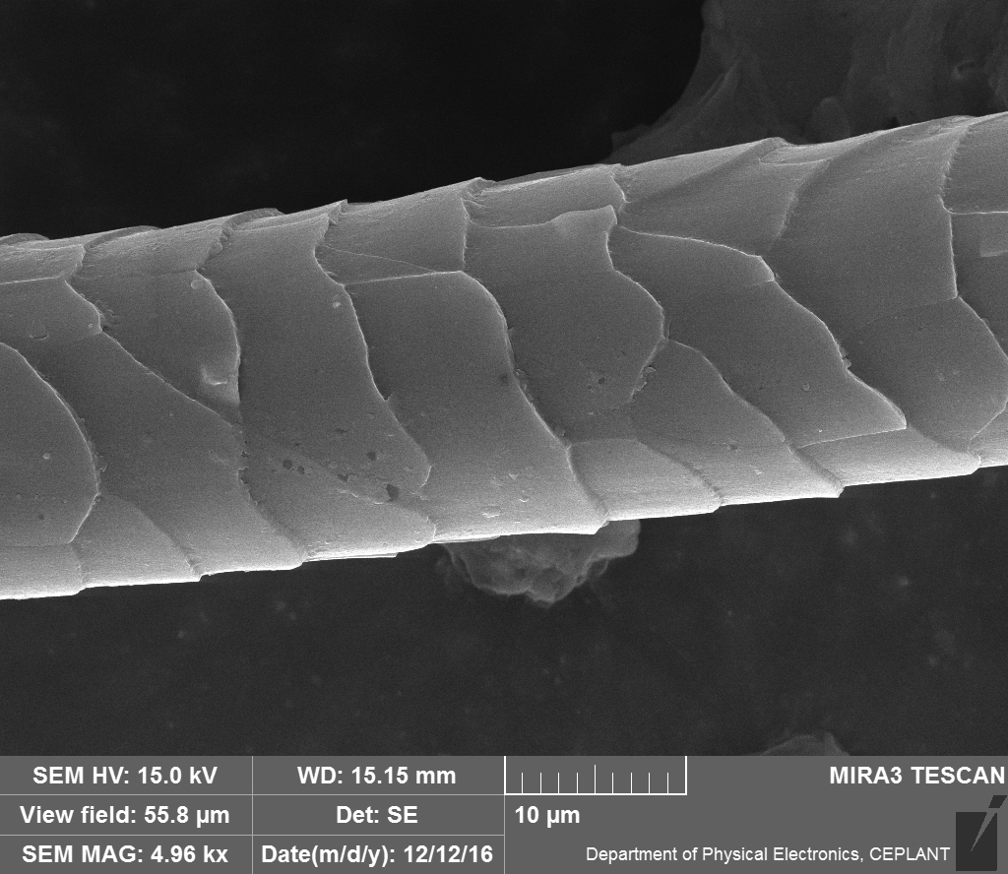
Hugo’s Hair UNDERHAIR
Rabbit – unknown Origin

Slide 57
Main Sources of the KERATIN Fibres
Sheep
VICUNA, that is Lama vicugna (Vicugna vicugna) it is the wild Species of Llama
Lama pacos, that is Alpaka – domesticated Llama with silky Fleece
Mohair from angora Goat
Angora Rabbit
………………

Slide 58
From the Sheep’s Wool to the Felt
NONWOVEN TEXTILE
Wet Felting
Needle Felting
Sheep’s Wool is very suitable for the Felting, because having small scale KUTIKULA

Slide 59
Fibre’s „Thickness“ dtex
dtex – it is not any REAL THICKNESS!
dtex - it is the Mass of the 10 km of Fibre expressed in Grams
The English Unit is denier, what is the Mass of the 10 000 yards (approx. 9000 m) of Fibre expressed in Grams
The Units dtex and denier are used for Expression of the Textile Fibres Strength. Its Strength is measured as the Force (N), not as the Mechanical Stress (N/m²)
So called „Textile Strength“ is then expressed as (in) cN/dtex (cN/denier)

Slide 60
Sheep’s Wool Strength
Fibre | Tensile Strenght (cN/dtex) | Elongation at Break (%) | E-Modulus (N/tex) | Moisture uptake (%)
Woll | 0,90 – 2,18 | 25 – 35 | 0,34 | 16 –18
Polyester | 4,00 – 6,50 | 15 – 40 | 9 –11,5 | 0,5 – 0,8
Viscose | 1,80 – 3,50 | 15 – 30 | 5,4 | 26 – 28
The Source don’t get Information, if these Values are for Measurement „At dry“ or „At wet“.
PROBABLY IT COULD BE „At dry“, because Values „At wet“ are usually lower then state here.

Slide 61
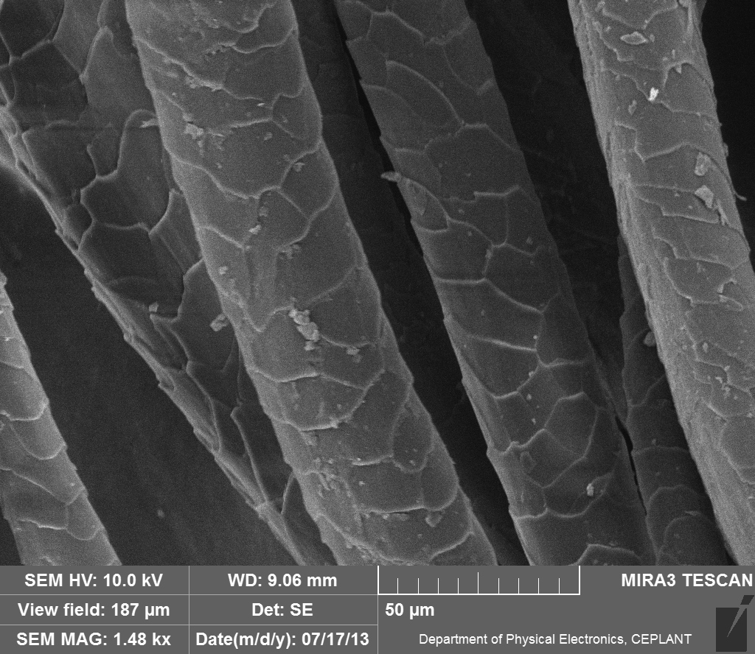
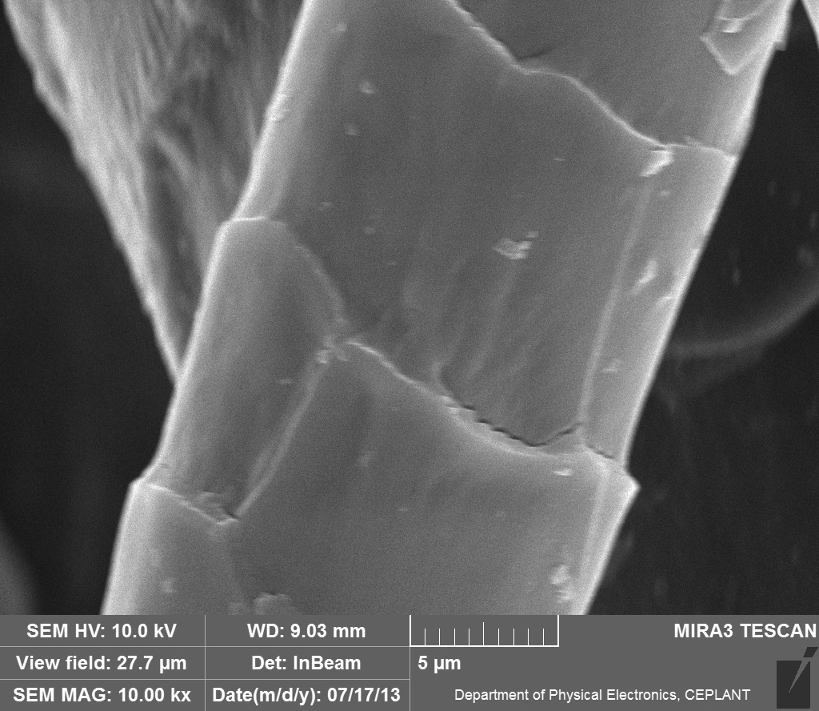
Sheep’s Wool, coloured, treated,
TEXTIL FIBER
SEM – by Courtesy of Miss
Mgr. Gabriela Vyskočilová
Typical SMALL SCALE on the Surface

Slide 62
Treatment of the Sheep’s Wool
WOOL CARBONIZATION – removal of Dirt from the Wool using concentrated H₂SO₄
Modification against Felting up (Removing of the SMALL SCALE on the Surface by Oxidation and Mechanical Separation)
…………….

Slide 63
WOOL CARBONIZATION is the chemical Process, which Reason is removal from the Sheep’s Wool all the Plant (vegetable) Impurities
E.g. Straws and Culms, Leafs, Grass etc. WOOL CARBONIZATION can be done at Dry or at Wet Conditions.
Wet Process
The strong inorganic Acid is used most frequently, e.g. (H₂SO₄ or HCl) or the Salt with acid Reaction, e.g. (NH₄)₂SO₄). The Wool is resistant for short Time even at high temperature, e.g. Approx. 15 minutes at 90 -110 °C. The Plant (vegetable ) Impurities (Cellulose based material) are carbonised and change to Brittle State. The Products arisen are easy to crush and the remove. It is possible and mostly done to carbonise both Fabric and Flocks.
Dry Process
The Vapour of HCl is mostly used for this technology. This Procedure is employed less frequently then the Wet Process, despite it is Efficient and fast.
The Machinery is expensive , because of Corrosiveness of the HCl , which is also Hazardous Chemical.

Slide 64
2. LANOLIN

Slide 65
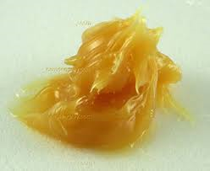
LANOLIN
LANOLIN is further purified for the Cosmetic use to be Colourless
Raw Sheep’s Wool from one Sheep (one cutting) contains approx. 100 – 300 ml of Lanolin
It is nothing special on the first Sight
It is NOT a Glyceride!

Slide 66
Lanolin also called wool wax or wool grease, is a wax secreted by the sebaceous glands of wool-bearing animals. Lanolin used by humans comes from domestic sheep breeds that are raised specifically for their wool. Historically, many pharmacopoeias have referred to lanolin as wool fat (adeps lanae); however, as lanolin lacks Glycerides (glycerol esters), it is NOT a true fat. Lanolin primarily consists of sterol esters instead. Lanolin's waterproofing property aids sheep in shedding water from their coats. Certain breeds of sheep produce large amounts of lanolin. There is an inverse correlation between wool fiber diameter and lanolin content.
Lanolin's role in nature is to protect wool and skin from climate and the environment; it also plays a role in skin (integumental) hygiene. Lanolin and its derivatives are used in the protection, treatment and beautification of human skin.
A typical high-purity grade of lanolin is composed predominantly of long chain waxy esters (approximately 97% by weight) the remainder being lanolin alcohols, lanolin acids and lanolin hydrocarbons
An estimated 8,000 to 20,000 different types of lanolin esters are present in lanolin, resulting from combinations between the 200 or so different lanolin acids and the 100 or so different lanolin alcohols identified so far.

Slide 67
Lanolin and its many derivatives are used extensively in both the personal care (e.g., high value cosmetics, facial cosmetics, lip products) and health care sectors such as topical liniments. Lanolin is also found in lubricants, rust-preventive coatings, shoe polish, and other commercial products.
Lanolin, when mixed with ingredients such as neatsfoot oil, beeswax and glycerine (glycerol), is used in various leather treatments, for example in some saddle soaps and in leather care products

Slide 68
3. FIBROIN

Slide 69
Where can be found FIBROIN?
Natural/Genuine Silk produced by Silkworm
Spider's is Protein Fibre from the Secret of Spiders Species Argiope and Nephila
Secret of the night Butterflies

Slide 70
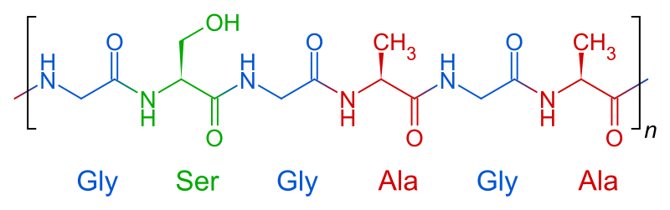
Natural/Genuine Silk
Most of the Natural/Genuine Silk is gained from the Secret produced by Silkworm Moths. It is called „Endless“ natural textile Fibre
This FIBROIN has the typical PRIMARY STRUCTURE, as shown bellow:

Slide 71
Fibre’s Properties | Natural/ Genuine Silk | Polyamide (PA 6) | Polyester (PETP) | Viscose (CV)
Density (g/cm³) | 1,25 | 1,14 | 1,33 | 1,52
dtex | 1,17 | 1,0 | 1,1 | 1,4
Strength DRY (cN/dtex) | 3-5 | 3,6-7,5 | 3,8-7,2 | 1,8-3,0
Strength WET (% of the DRY) | 85 | 85 | 95-100 | 60
Elengation (%) | 24 | 23-55 | 50-70 | 15-30
Water uptake (%) | 30 | 3-4,5 | 0,3-0,4 | 28
World Consumption approx. (1000 t) | 107 | 3.500 | 14.500 | 500
TYPICAL FIGURES ARE GIVEN IN THIS TABLE!

Slide 72
AMINO ACIDS COMPOSITION of some grades ot the Natural/Genuine Silk (the very minor Amino acids are not given)
AMINO ACID | Bombyx mori | Tussah Caligula | Tussah II | Anaphe | Chrasopha flava
Glycine | 43.6 | 23.6 | 23.9 | 41.7 | 23.5
Alanine | 29.6 | 39.4 | 47.2 | 52.1 | 50.2
Serine | 11.7 | 10.5 | 14.8 | ----- | 40.7
Asparagic acid | 1.4 | 4.2 | 7.5 | ----- | -----
Glutamic acid | ----- | ----- | 1.5 | ----- | -----
Tyrosine | 4.8 | 4.4 | 10.6 | ----- | -----
Histidine | 0.4 | 2.2 | 1.6 | ----- | -----
Arginine | 1.7 | 9.2 | 5.4 | 2.1 | 1.8
Proline | 0.4 | 0.3 | 0.4 | ----- | -----
Tryptophan | 0.4 | 2.0 | 2.7 | ----- | -----

Slide 73
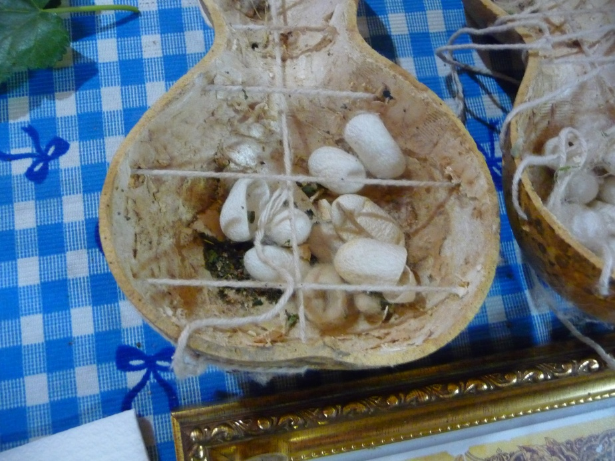
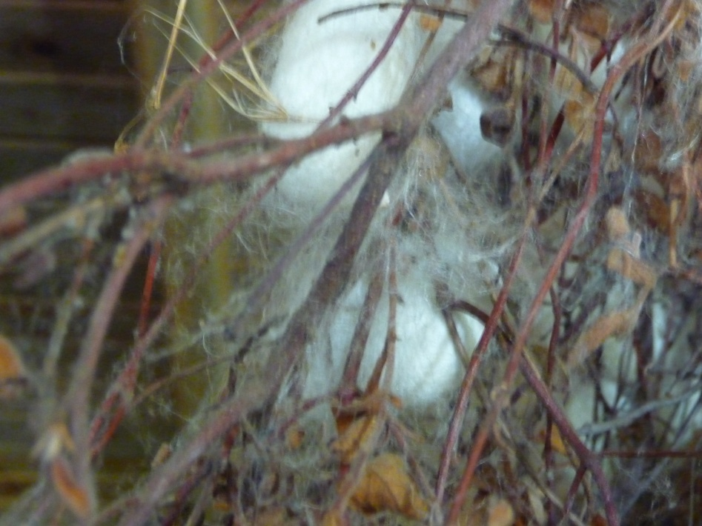
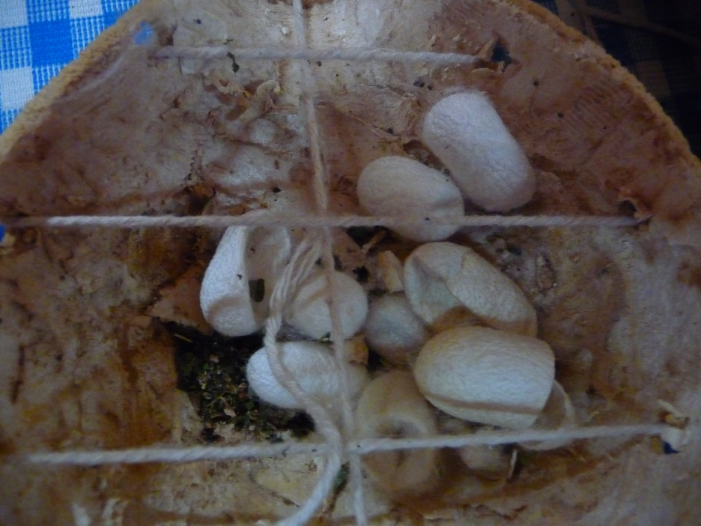
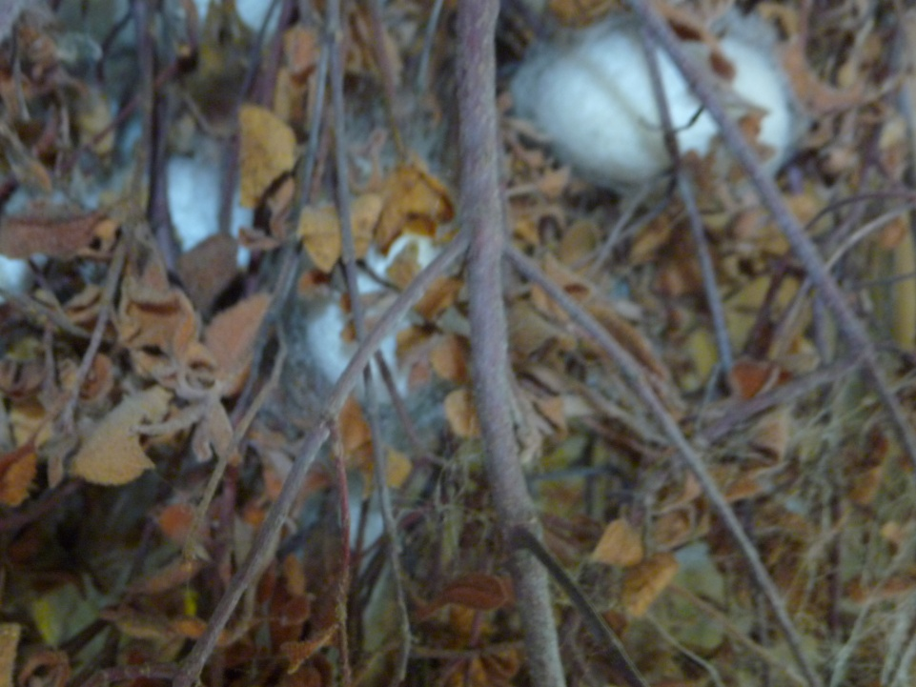

Slide 74



Slide 75


Slide 76



Slide 77
Silk fibres are a continuous protein fibre created from natural processes and extracted from cocoons, which means that these fibres can retain the properties that are associated with the chemicals produced by the silkworm. When secreted by the silkworm, the natural state of the fibre is a single silk thread made up of a double filament of protein material (fibroin) glued together with sericin, an allergenic and gummy substance that is normally extracted during the processing of the silk threads.
Extracting Raw Silk
The production process of silk can seem deceptively simple but indeed has several steps. In fact, the process of creating silk fibres of the highest quality take a few weeks to complete.

Slide 78
First, the new born larvae of the silkworms are kept in a warm and stable environment and given plenty of mulberry leaves, their favourite diet.
The silkworms naturally produce cocoons around themselves to pupate. This process is done through “spinning”: the worm secretes a dense fluid from its gland structural glands, resulting in the fibre of the cocoon.
The cocoons are sorted carefully according to size and quality.
Boiling water with soap is used unravel the silk fibres from the cocoon. This is known as the degumming process.
The outer shell of the cocoon is fed into into the spinning reel, which is still often operated manually
The long fibre thread that are extracted from the cocoon are then cleaned and stripped from any deficiencies.

Slide 79
The degumming process
The Fibre is connected by Sericine in the COCOONS, which is the SOLUBLE GLYCOPROTEINE „guarding“ (protecting) the FIBROIN
SERICIN is dissolved in the boiling Water and so are the Fibres released
The Fats and Waxes are dissolved also
The only approx. 1 % w/w is the Ash (inorganic Materials) in the Fibre, the Rest are Proteins.

Slide 80

Natural/Genuine Silk
SECUNDARY STRUCTURE
  Keratin folded
  (Pleated) Sheet
Schema showing the Protein’s β Keratin Folded (Pleated) Sheet Structure
PARALEL arrangement
ANTIPARALEL arrangement
The Backbone is bonded by the Covalent Bonds in the a Axis Direction.
The Backbone is bonded by the Hydrogen Bonds in the b Axis Direction.
The Backbone is bonded by the Wan der Waals Forces in the c Axis Direction.

Slide 81


Natural/Genuine Silk Fibre is very COMPLICATED (COMPLEX) STRUCTURE
PRIMARY FIBRES
SECUNDARNÍ FIBRES
It is so called TWINFIBRE CONNECTED BY SERICINE (so called Silk Glue) of Length approx. 3000 – 4000 m
a)
b)
Hydrogen Bond of the FIBROIN’s
a) The Crosscut of the Natural/Genuine Silk Fibre
Sericine Skin
Sericine’s Core
Fibroin’s Fibre Cubicula
Fibroin’s Fibre Core
Fibroin’s Fibre central Part (Zone)
b) Longitudinal cut of the Natural/Genuine Silk Fibre
Fibroin’s Fibre Skin
Fibroin’s Fibre Core
Fibroin’s Fibre central Part (Zone)
c) Polypeptide Chains of Fibroine in the ANTIPARALEL CONFORMATION
c)

Slide 82
Phase Transitions of KERATIN & FIBROIN 2
On Air > OXIDATION > Burning already at approx. 230 °C
FIBROINE is more Temperature stable than KERATIN
(Phase Transition Temperature )
1
2
3
DTA and TG Curves 100 % w/w of Wool heating up to 300 °C in Air
α Keratin (Coil) > β Keratin (Folded (Pleated) Sheet)
DTA Curves in the NITROGEN: 1) Human Hair, 2) Mohair Wool, 3) Natural/Genuine silk
Evaporation of the Water
Decomposition in NITROGEN is only at higher Temperature and is more slowly

Slide 83
CHEMICAL REACTIONS AND SOLUBILITY OF THE FIBROIN 1
Decomposition by Acids (more Efficient) and Alkali
OXIDATION (Chlorine)
ACETANHYDRIDE, ALKALIC METALLS AND ALKALIC EARTH SALTS
HEAVY METALLS SALTS, MAINLY STANNUM (TIN) > Natural/Genuine Silk takes up 100 % w/w > „WEIGHTING“ of the Natural/Genuine Silk
Formation of the Cross Bonds

Slide 84
CHEMICAL REACTIONS AND SOLUBILITY OF THE FIBROIN 2
Decomposition by Acids (more Efficient) – hot concentrated HCl dissolves Natural/Genuine Silk in 30 minutes QUANTITAVELY
OXIDACTION – H₂O₂, KMnO₄ at higher concentration damages Natural/Genuine Silk
CHLORINE
ACETANHYDRIDE, ALKALIC METALLS and ALKALIC EARTH SALTS and also e.g. ZnCl₂ dissolves Natural/Genuine Silk (similar as the PA6)
Formation of the Cross Bonds – via more complex organic Substances

Slide 85

Natural/Genuine Silk Fibre
OPTICAL MICROSCOPY
Natural/Genuine Silk Magnificatin
180 x
Natural/Genuine Silk (CROSS CUT) Magnificatin
500 x

Slide 86


Natural/Genuine Silk Magnificatin
180 x
Fibre’s Thickness of the Sheep’s Wool and Natural/Genuine Silk at the same Magnification
Sheep’s Wool
Magnificatin
180 x

Slide 87
SUROVINOVÝ VÝZNAM Natural/Genuine Silk Fibre
Natural/Genuine Silk is the very exclusive textile raw Material
Annual World Production is only approx. 300 000 t/annum
China is the principal Producer now
There were many Attempts to start the Natural/Genuine Silk Production in Europe, but they ended unsuccessfully

