Slide 1
NATURAL POLYMERS 4
POLYTERPENES
Dr. Ladislav Pospíšil
29716@mail.muni.cz

Slide 2
Time schedule
LECTURE | SUBJECT
1 | Introduction to the subject – Structure & Terminology of nature polymers, literature
2 | Derivatives of acids – natural resins, drying oils, shellac
3 | Waxes
4 | Plant (vegetable) gums, Polyterpene – natural rubber (extracting, processing and modification), Taraxacum_kok-saghyz
5 | Polyphenol – lignin, humic acids
6 | Polysaccharides I – starch
7 | Polysaccharides II – celullosis
8 | Protein fibres I
9 | Protein fibres II
10 | Casein, whey, protein of eggs
11 | Identification of natural polymers
 | Laboratory methods of natural polymers’ evaluation

Slide 3
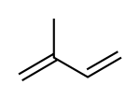
Isoprene – The basic molecular formula of terpenes
Systematic IUPAC name | 2-methyl-buta-1,3-dien
The other name | 2-methyl-1,3-butadien
Summary Formula | C₅H₈
Terpenes – the main component of RESINS
Nomenclature | Number of Carbon atoms | Physical State at Standard temperature (i.e. 23 °C)
Monoterpenoid | 10 | Liquid
SESQUITERPENOID | 15 | Liquid
Diterpenoid | 20 | Solid State
TRITERPENOID | 30 | Solid State

Slide 4
A bit of TERMINOLOGY is NECESSARY
POLYTERPENE = POLYISOPRENE
Rubber > Vulcanization > Vulcanized Rubber
Plant (vegetable) GUMS = POLYSACCHARIDES = Mucilage (GUM)

Slide 5
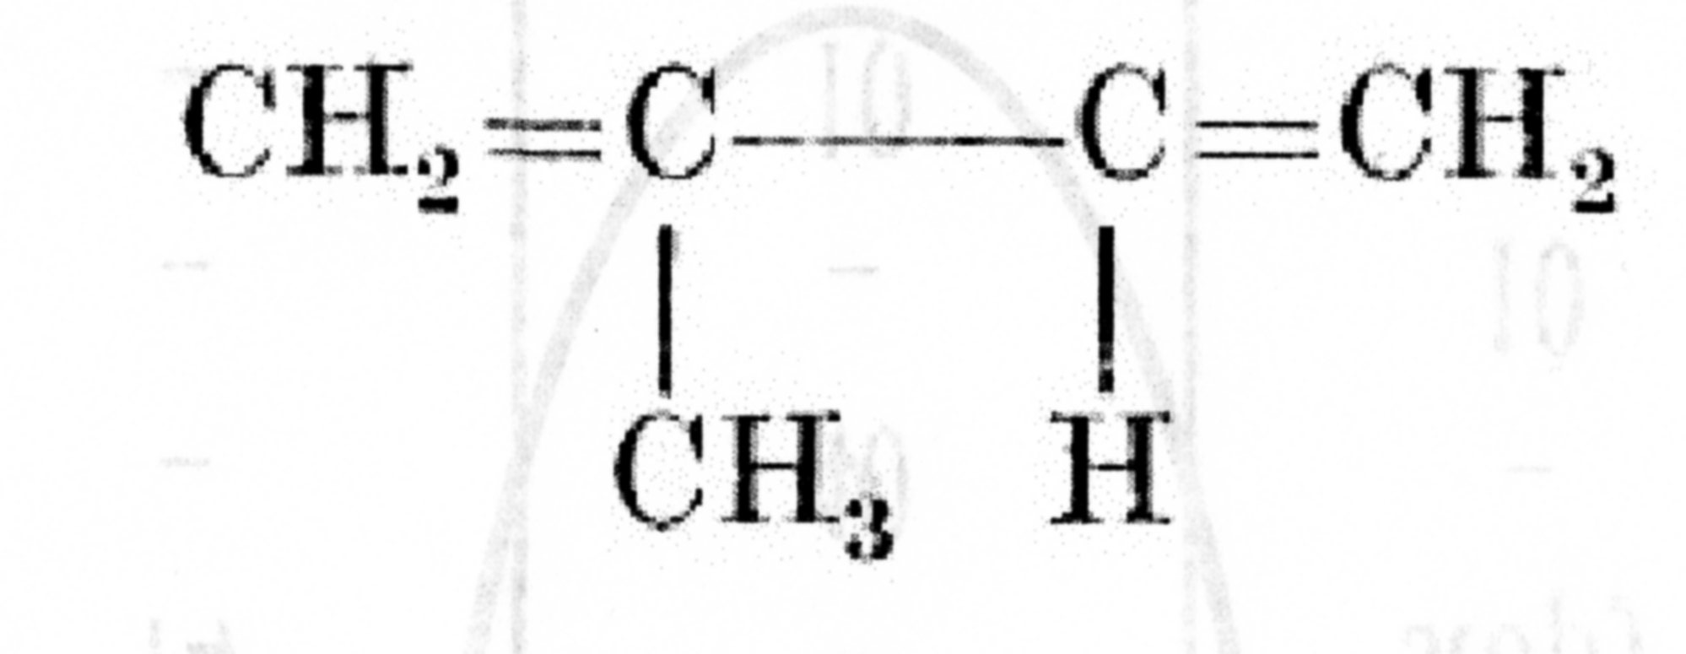
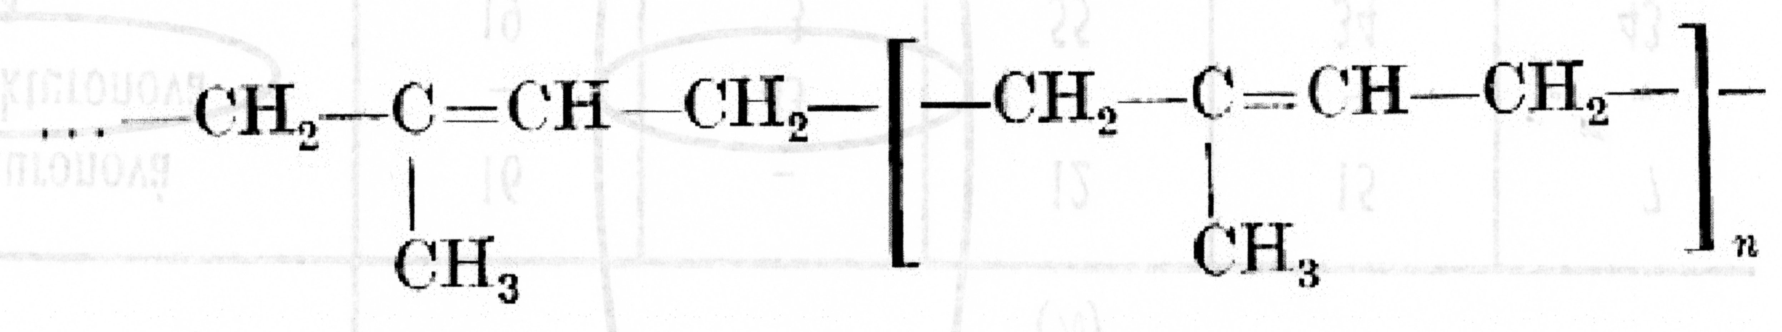
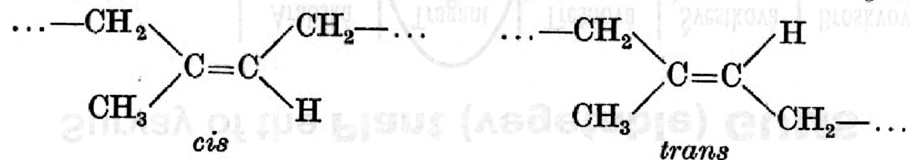
Composition of the NATURAL RUBBER – it is polymer made of ISOPRENE hydrocarbon (2-methyl-buta-1,3-dien)
Structure formula of the POLYISOPRENE
Cis-POLYISOPRENE
NATURAL RUBBER
trans-POLYISOPRENE
Gutta-percha

Slide 6
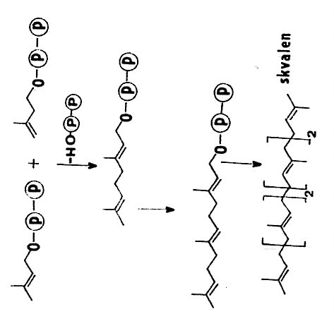
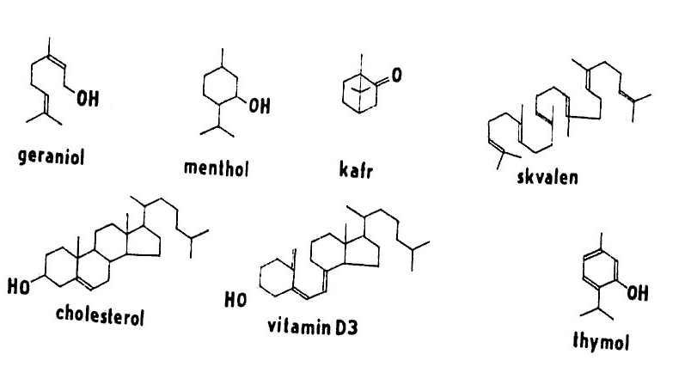
Three step enzymatic synthesis of the TERPENOIDes
CONDENSATION „HEAD – TAIL“of two UNITS of so called „ACTIVE ISOPRENE“
1
2
3
TERPENOIDES

Slide 7
POLYTERPENE = POLYISOPRENE
Appearance in NATURE
POLYTERPENE - are contained in approx. 2000 plants from various geographic regions
Trees, Bush, Herbs
The most important is the Tree: Hevea brasiliensis
HOPEFUL HERB: Taraxanum koksagyz

Slide 8
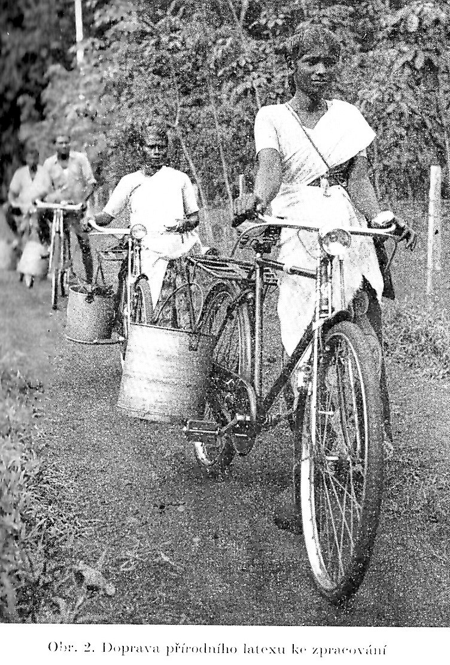
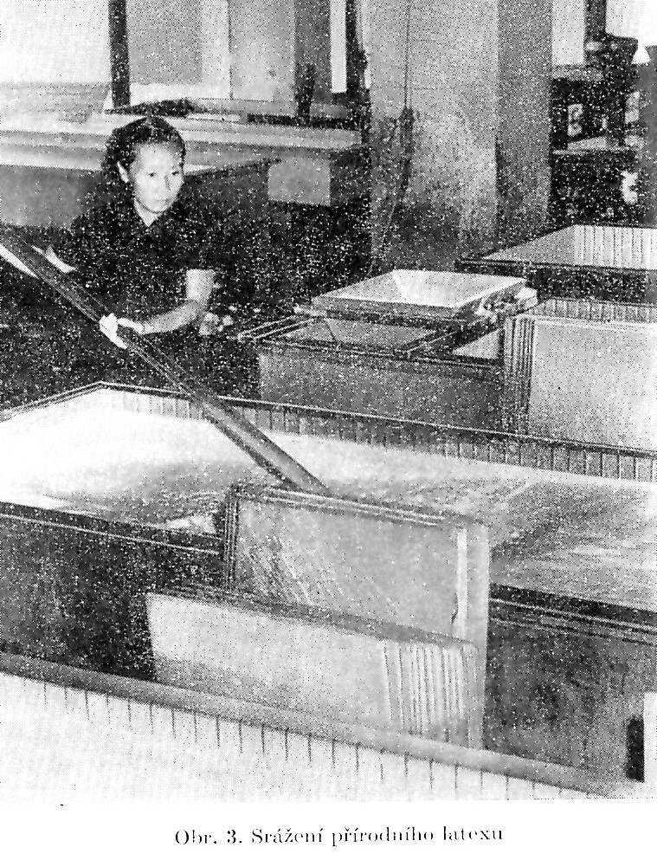
Perhaps historical Pictures!

Slide 9
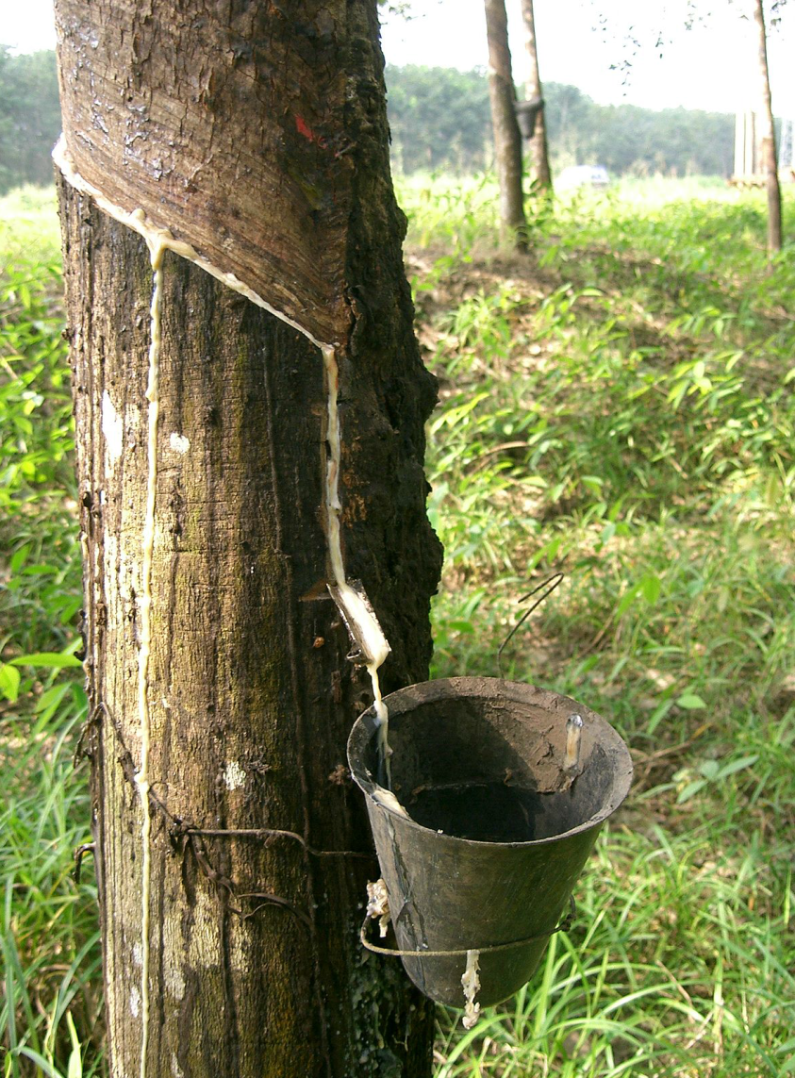
POLYTERPENE = POLYISOPRENE
Extracting in Nature > „Field latex"
Latex (approx. 25 – 35 % w/w of Rubber)
Coagulation by acids (formic, acetic) > CREPE RUBBER
Drying & Preservation over a Fire> Ribbed Smoke Sheet
Calendring and Stabilisation against oxidation and Microorganisms
Expedition

Slide 10
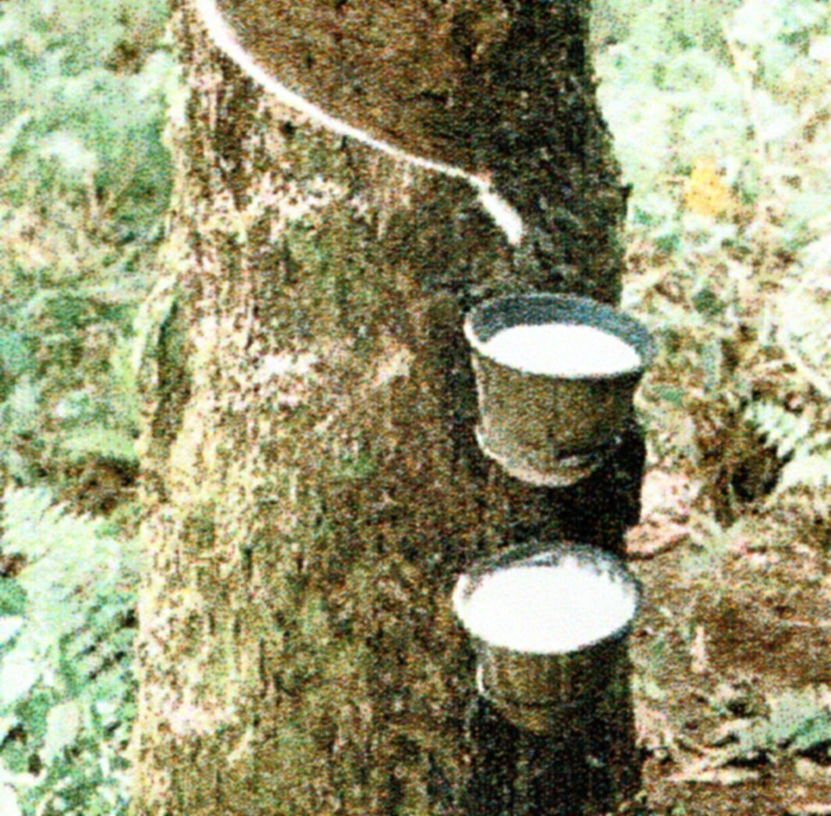

Slide 11
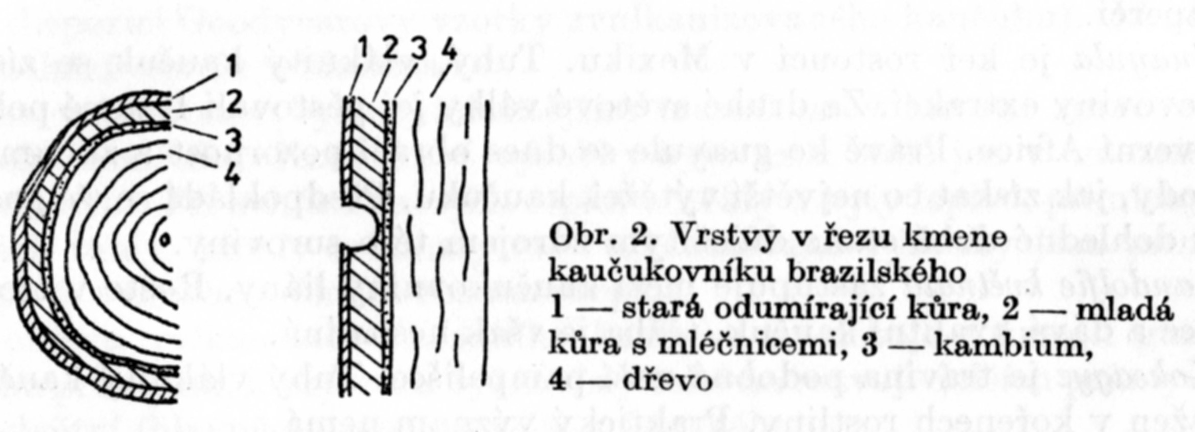
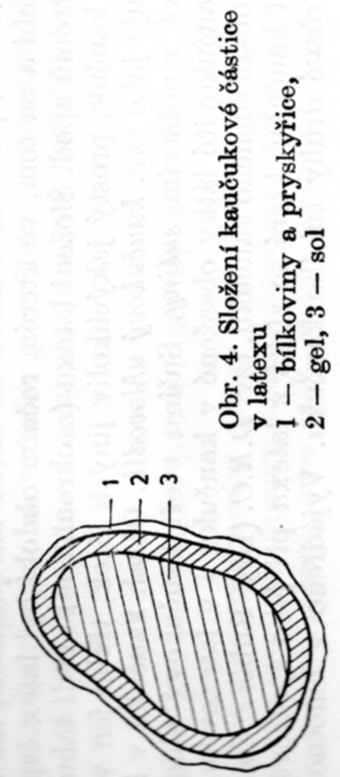
The Layers in the Cross Section s of the Hevea brasiliensis tree stem:
The old dead Bark
The young Bark – the Rubber Latex source
The Cambium
WOOD
The Composition of the Rubber Latex Particle:
Proteins and Resins
Gel of the Latex
Sol of the Latex

Slide 12
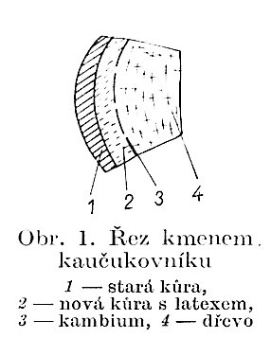
Latex (approx. 25 – 35 % w/w of Rubber)
Rubber (approx. 25 – 35 % w/w)
Water (60 – 75 % w/w)
Proteins ( 2 % w/w)
Saccharides
Inorganic Matter
Resins
The Cross Section s of the Hevea brasiliensis tree stem:
The old dead Bark
The yongh Bark – the Rubber Latex source
The Cambium
WOOD

Slide 13
Composition of the NATURAL RUBBER
 | Values’ Range | MEAN VALUES
 |  | Smoked Sheets | Crepes
Water (% w/w) | 0,3 - 1,2 | 0,61 | 0,42
Acetone extract (% w/w) | 2,5 – 3,2 | 2,9 | 2,7
Proteins (% w/w) | 2,5 – 3,5 | 2,8 | 2,8
Ash content (% w/w) | 0,15 – 0,90 | 0,38 | 0,30
RUBBER (% w/w) | 92 – 94 | 93,8 | 93,6
Chlorides (% w/w) | 0,002 – 0,010 | 0,006 | 0,003
Sulfates (% w/w) | 0,02 – 0,05 | 0,03 | 0,04
Sterols (% w/w) | --- | 0,5 | 0,5
Higher fatty acids (% w/w) | --- | 1,4 | 1,1
Cuprum (ppm) | 2 – 10 | 5 | 4
Manganese (ppm) | 0,8 – 4,0 | 1,5 | 1

Slide 14
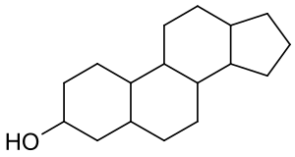
Sterols, also known as steroid alcohols, are a subgroup of the steroids and an important class of organic molecules. They occur naturally in plants, animals, and fungi, and can be also produced by some bacteria (however likely with different functions). ^{[1]} The most familiar type of animal sterol is cholesterol, which is vital to cell membrane structure, and functions as a precursor to fat-soluble vitamins and steroid hormones.

Slide 15
COMPOSITION of the NATURAL RUBBER
Component | Content ( % w/w)
Rubber hydrocarbon | 35
Water | 60
Resins & Fatta acids | 2
Proteins | 1,8
Inorganic substances & the other components | 1,2
Dependance of the Density and Viscosity on the Content of the Rubber hydrocarbon
Rubber hydrocarbon ( % w/w) | Density (kg/m³) | Viscosity (m.Pa.s)
20 | 996 | 2,5
30 | 983 | 4,0
40 | 972 | 5,5
50 | 959 | 7,5
60 | 948 | 27

Slide 16
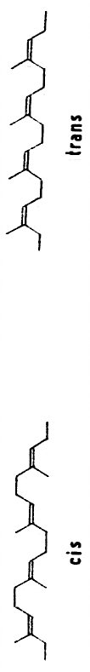
POLYTERPENE = POLYISOPRENE
IZOMERs
cis
trans
Gutta-percha
NATURAL RUBBER
It does NOT vulcanize!
BETTER resistance to oxidation (weathering)
NOT Elastic at normal temperature
Soft and elastic at temperature over approx. 50 °C
TERMOPLAST
It is gained from another plant then NATURAL RUBBER
Vulcanization
LOWER resistance to oxidation (weathering)
Elastic at normal temperature

Slide 17

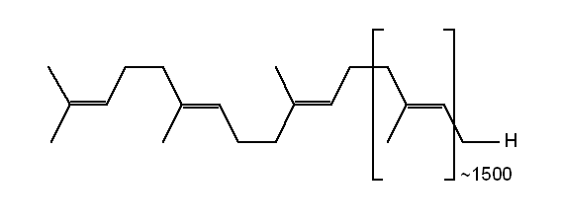
Gutta-percha - various presentations of the MAIN CHAIN in the Literature
trans-1,4 polyisoprene
designation is related to the MAIN CHAIN

Slide 18
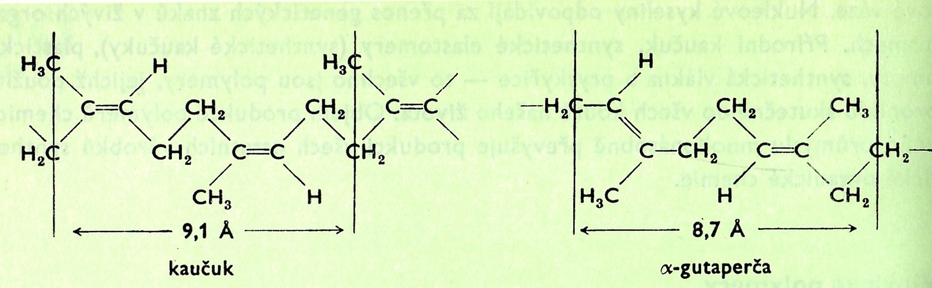
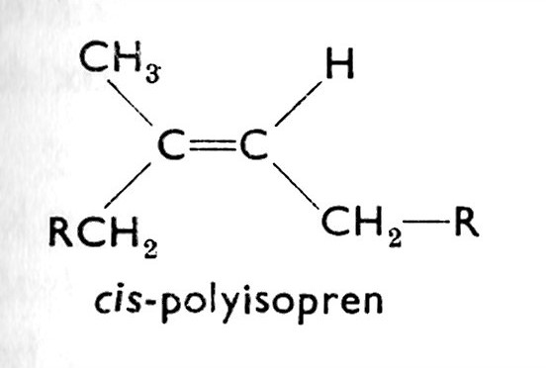
Gutta-percha versus NATURAL RUBBER
Various presentations of the MAIN CHAIN in the Literature
R is here the CONTINUATION of the MAIN CHAIN

Slide 19
Gutta-percha versus BALATA GUM
BALATA is very similar to Gutta-percha, but only as to the Physical Properties, not as to the chemical Point of view
BALATA is more soft > it was used for Chewing Gums, but a synthetic food analogue is used now
Its importance and use are marginal and decreasing now
Manilkara bidentata is a species of Manilkara native to a large area of northern South America, Central America and the Caribbean. Common names include bulletwood, balata, ausubo, massaranduba, and (ambiguously) "cow-tree".
Balata is a large tree, growing to 30–45 m (98–148 ft) tall.
Its latex is used industrially for products such as chicle Chicle is a natural gum >
POLYSACCCHARIDE, not POLYTERPENE!

Slide 20
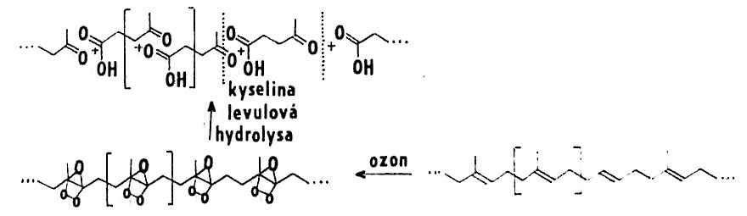
POLYTERPENE = POLYISOPRENE
How was the Structure discovered
It is demonstrated at Gutta-percha here, but it is the Trans Structure!

Slide 21
Processing of the NATURAL RUBBER
Before Vulcanisation
„Mastication “ –cleavage of the chains to shorter parts using mechanical energy and oxygen
Addition of the other components and kneading (homogenisation of the mixture:
  Fillers (mostly Carbon black, amorphous SiO₂, ……)
  Plasticizers,
  Pigments,
  Antioxidants a antiozonants
  Vulcanization agents (sulphur, accelerators, …)
  Lubricants

Slide 22
Processing of the NATURAL RUBBER
One typical Mixture composition
Component | PARTS (not % w/w) | Function
NATURAL RUBBER | 40
Synthetic RUBBER 1 | 30 | Modification of Properties
Synthetic RUBBER 2 | 30 | Modification of Properties
ZnO | 3 – 4 | Vulcanization accelerator
Stearic acid | 2 | Lubricant
Carbon black stiffening | 30 | Modification of Properties
Plasticizers | 4
Sulphur | 2 – 3 | Vulcanization
Antioxidants and antiozonants | 1,5 | Protection against oxygen and ozone
People working with Rubber and PVC ussualy do not calculate % w/w, but using PARTS!

Slide 23
What interesting did I personally
DOCUMENTS FOR THE Court-appointed Expert
Black spot on the fairing of the Racer (motorcycle)
Is it Spot the ASPHALT or Tyre rubber?
SEM + EDX analysis of Elements in the Spot
„What was my Target“
  SULPHUR Vulcanization
  ZINC Vulcanization accelerator
RESULT: NO ZINC, NO SULPHUR, it MUST BE ASPHALT

Slide 24
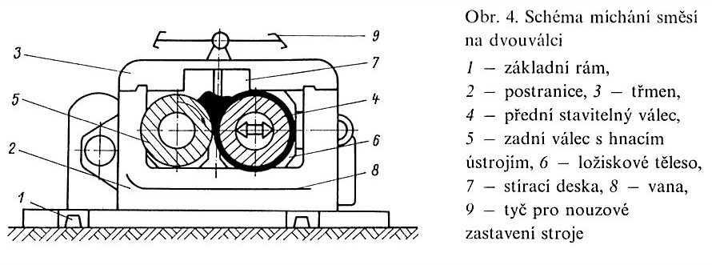
Two Roll Mill (Rubber, PVC, etc.)
Diagram of the TWO ROLL MILL and Scheme of the Mixing and/or Mastication using it:
Main Frame
Side part of Frame
Shackle
Front adjustable Roll
Rare Roll with Drive
Bearing body
Doctor blade (scrubbing of the material covering the Roll)
Vessel
Emergency stop handle

Slide 25
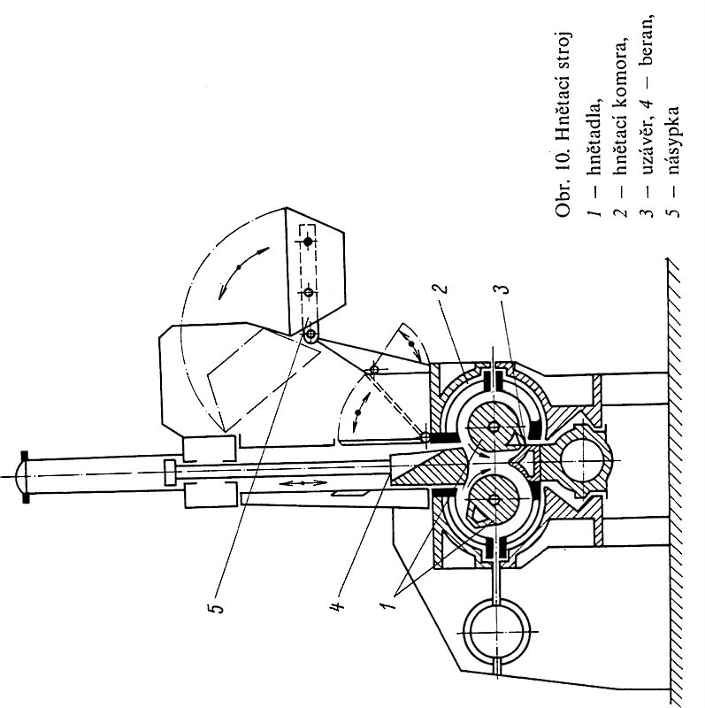
BUNBARY Mixer (kneading machine) (The Inventor of this Machine was Mr. BUNBARY)
Kneading machine:
Mixing Blades
Mixing Chamber
Discharge stopper
Stopper
Hopper

Slide 26
NATURAL RUBBER is for longest time used HYDROCARBON POLYMER!
The first use of rubber was by the indigenous cultures of Mesoamerica. The earliest archeological evidence of the use of natural latex from the Hevea tree comes from the Olmec culture, in which rubber was first used for making balls for the Mesoamerican ballgame. Rubber was later used by the Maya and Aztec cultures - in addition to making balls Aztecs used rubber for other purposes such as making containers and to make textiles waterproof by impregnating them with the latex sap.
Charles Goodyear developed vulcanization in 1839, although Mesoamericans used stabilized rubber for balls and other objects as early as 1600 BC

Slide 27
Various Descriptions of VULKANISATION
See the following three slides

Slide 28
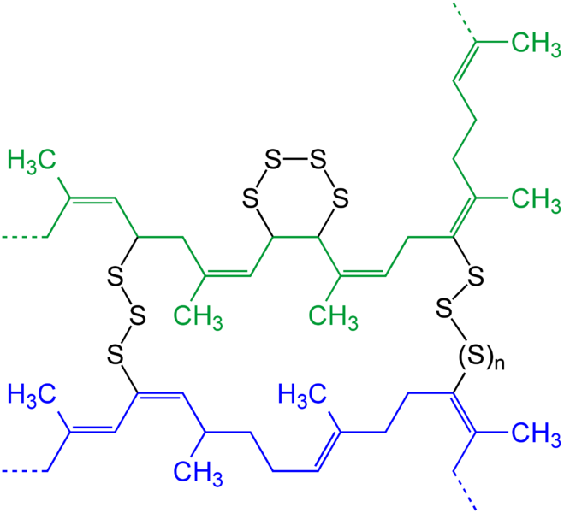
VULKANISATION NATURAL RUBBER
By elementary Sulphur 1
Mixtures with NATURAL RUBBER VULKANISE at Temperatures approx. 150 – 180 °C.
Synthetic Rubbers VULKANISE at Temperatures approx. 180 –220 °C.
VULKANISATION USSUALY DOES NOT GO BY REACTION OF THE DOUBLE BONDS, THEY ARE USSUALY MAINTAINED > SENSITIVITY TO OZONE

Slide 29
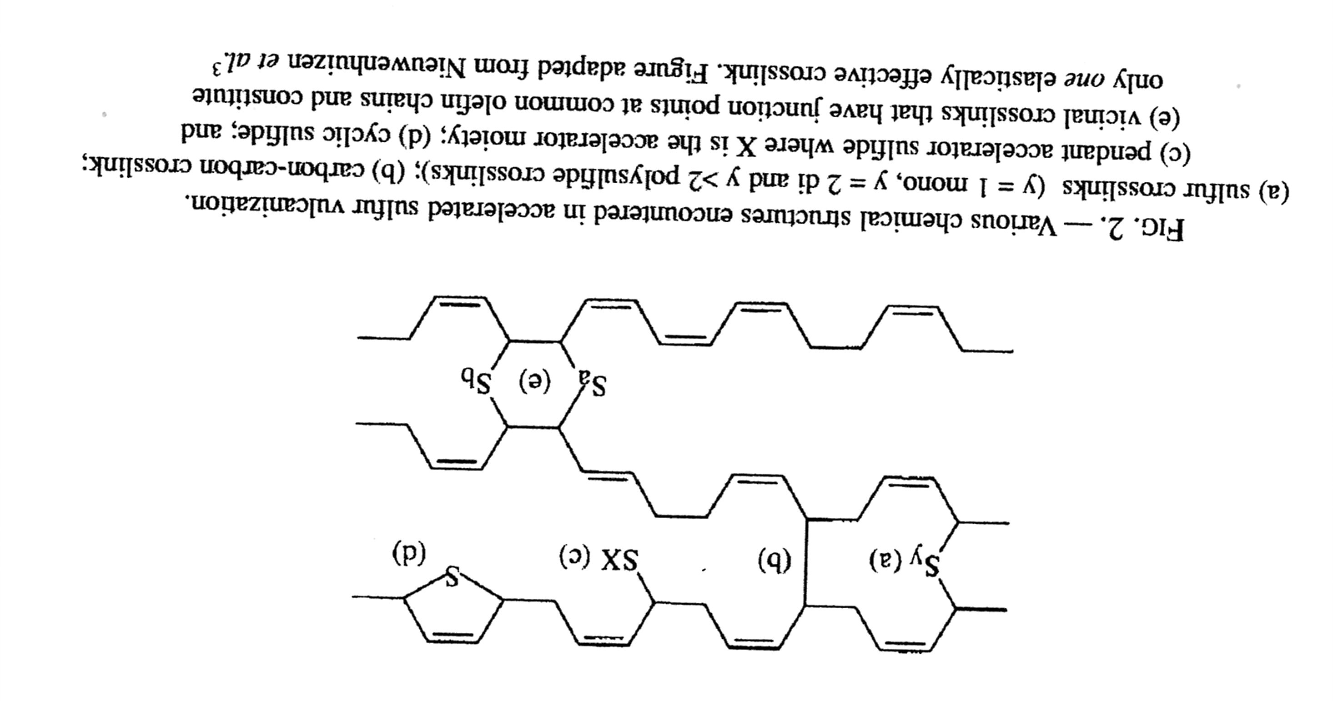
VULKANISATION NATURAL RUBBER
By elementary Sulphur 2
Accelerator
It is possible to VULKANISE by Sulphur Compounds also (here SX)!
Vicinal crosslinks =
CROSSLINKING at neighbouring Carbons
THE ONLY THIS CROSSLINKING FORMS THE ELASTIC BEHAVIOUR

Slide 30
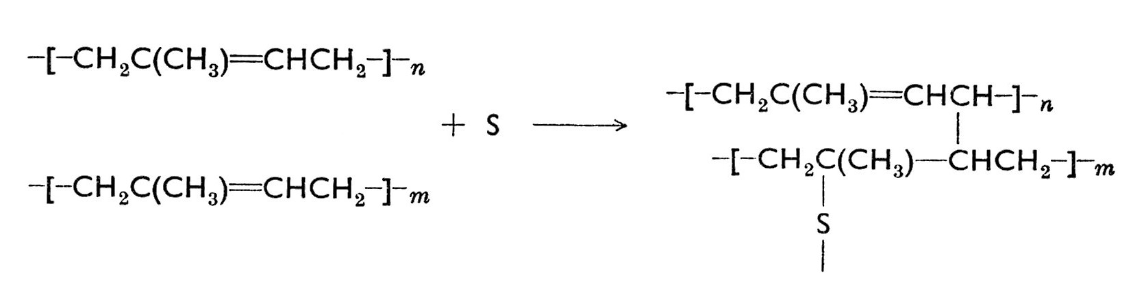
VULKANISATION NATURAL RUBBER
By elementary Sulphur 3
It is considered also the Bond C-C, on which one Double bond „was employed“, but it is NOT USSUAL!
SULPHUR as the Atom is written as a Simplification only!
You can meet so many various Schemes of the VULKANIZATION .
, The Schemes 2 and 3 are PROBABLY the most realistic.

Slide 31
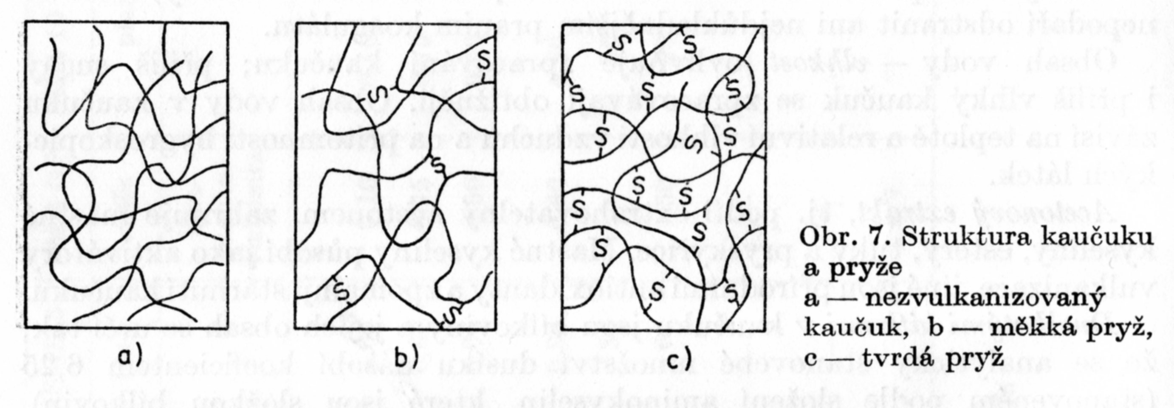
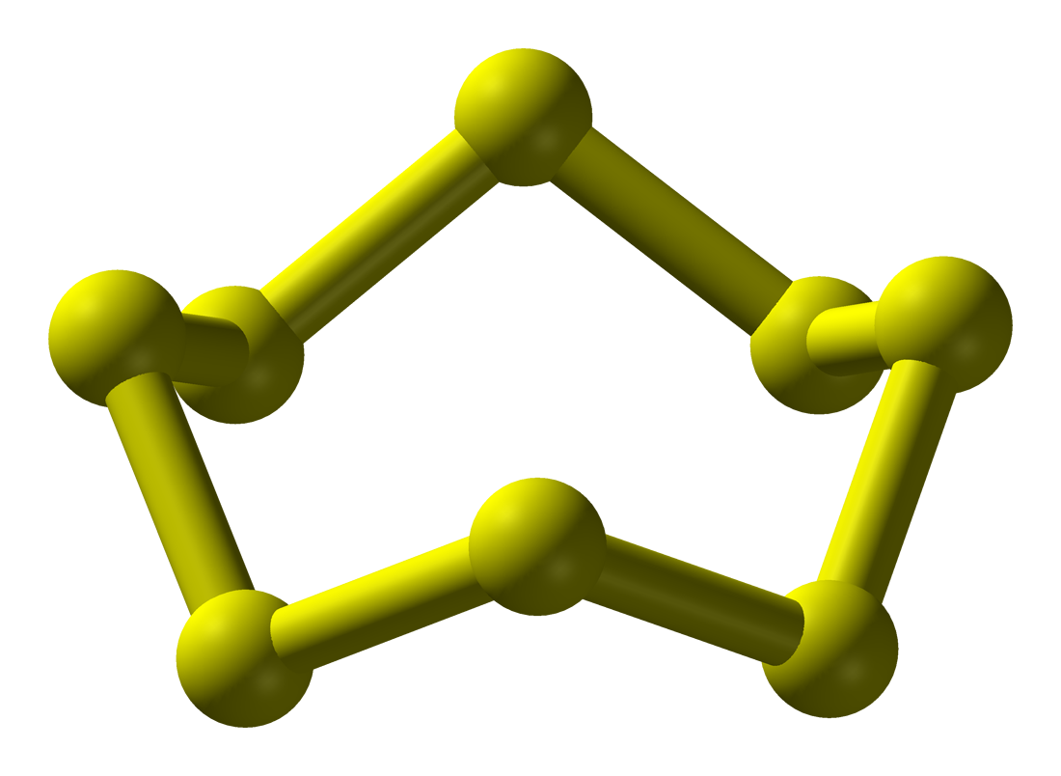
VULKANISATION NATURAL RUBBER
By elementary Sulphur 4
Sulphur is not one Atom, but CHAIN OF ATOMS, usually eight
The Structure of the Rubber and Vulcanise Rubber:
Rubber before Vulcanisation
Soft Vulcanised Rubber
Hard Vulcanised Rubber

Slide 32
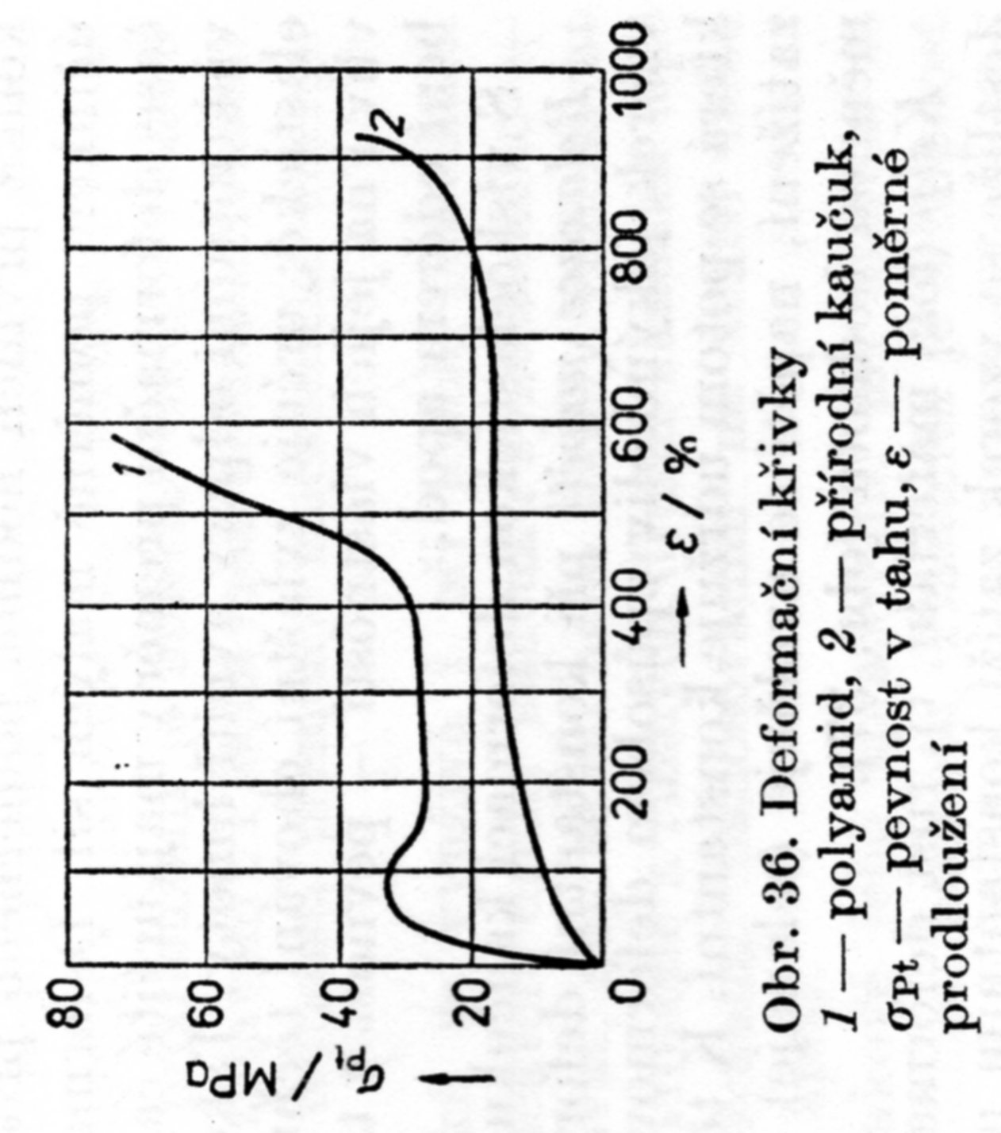
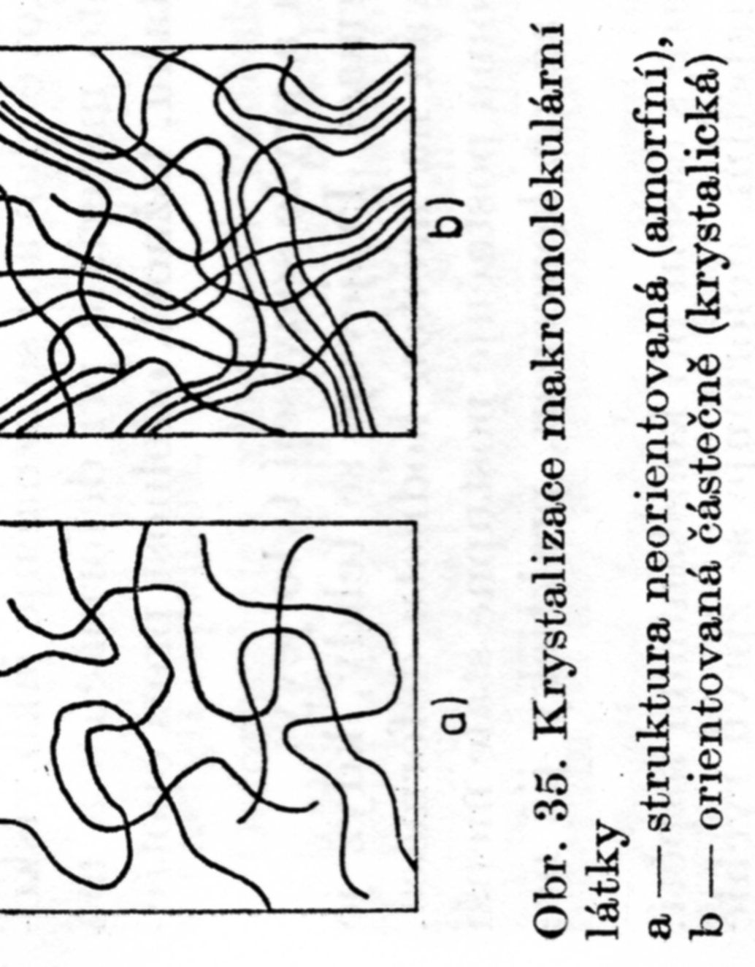
CRYSTALLISATION OF NATURAL RUBBER
The Macromolecules having the Long Chains, e.g. NATURAL RUBBER, have good possibility to be extended by hundreds percent.
The Development of the Crystallisation is clearly shown at the Stress – Strain Curves.
The Molecules are self-aligning after initial Deformation and in this Stage of the Deformation Curve is the only low Load sufficient to do high Deformation.
This Deformation and also Crystallinity is lost after Breakage of the Sample or Releasing the Mechanical Stress.
Deformation Curves
Polyamide
NATURAL RUBBER
σ_{Pt} – stress, ε − relative deformation
Unoriented amorphous Structure
ORIENTED semi-crystalline Structure

Slide 33
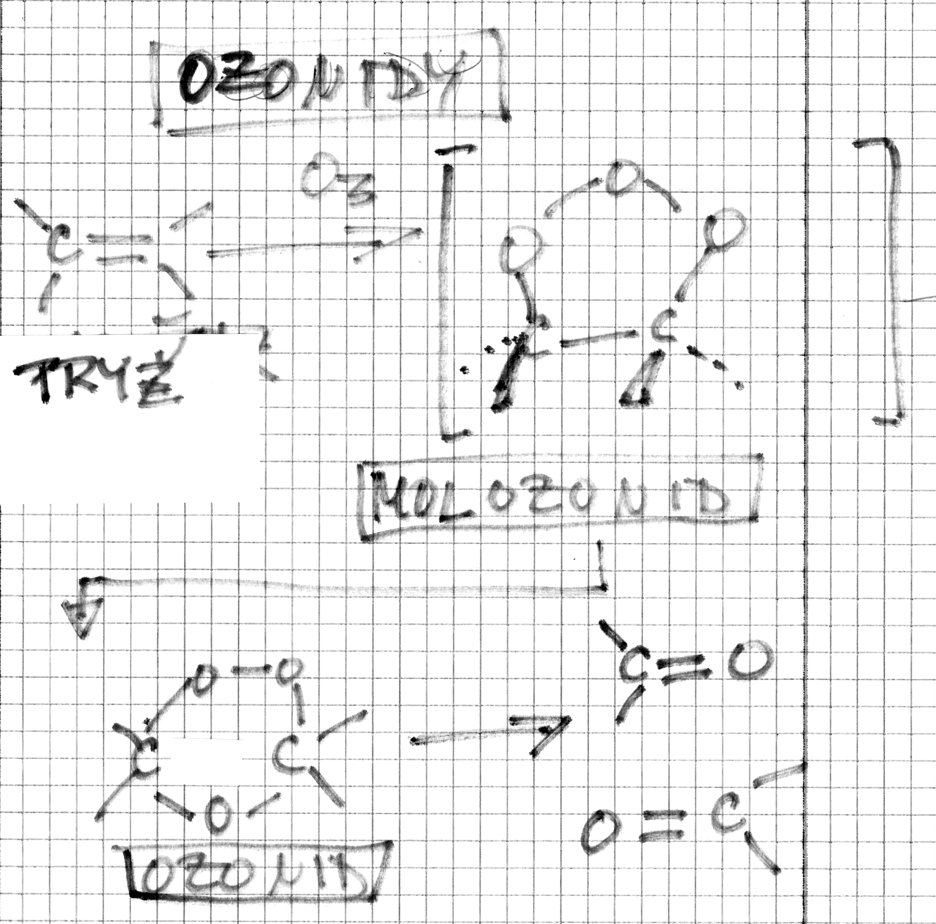
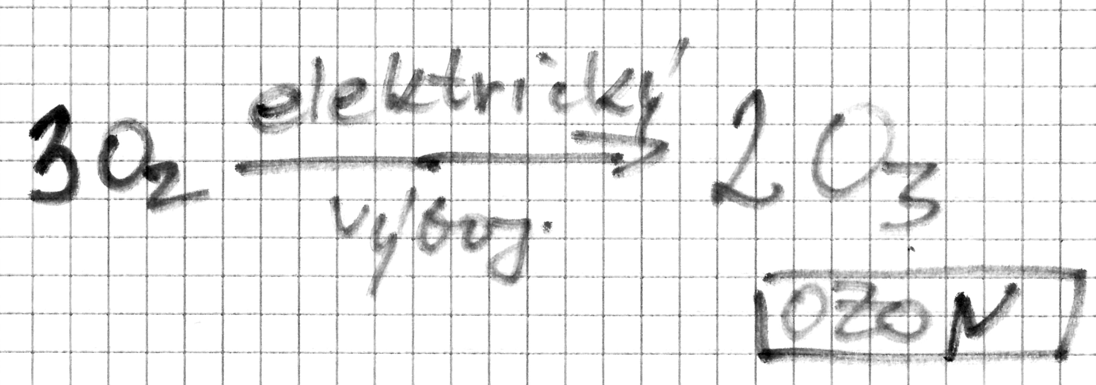
Degradation of Rubber by Ozone
Ozone is the Natural part the atmosphere and is formed e.g. at Lighting (electric discharge in the atmosphere)
It formed also by artificial procedure
electric discharge

Slide 34
VULKANISATION NATURAL RUBBER
By Sulphur Compounds
Charles GOODYEAR (1839) – the INVENTOR
SULPHUR CONTENT IS:
1 – 5 % w/w (soft Vulcanized RUBBER )
Up to 15 – 30 % w/w (HARD Vulcanized RUBBER, e.g. Ebonite)

Slide 35
Product | Content of RUBBER (% w/w)
Transparent Vulcanized Rubber, Dipped rubber, Rubber thread | Over 80
Mixtures for Tires and Tubes (both Tread and Casing) – Car,Bike, Motocycle…. Foamed Rubber, Cables electro | 50 – 80
Rubber shoes, Conveyor belts, Mechanical Rubber Goods (e..g. Holes, Waveguide, Rubber bush | 30 – 50
Accumulator (Battery) casing, Flooring, Sealing (Gasket) | < 30
The other % w/w up to 100 % w/w are Additives!

Slide 36
Sulphur Content more than 30 % w/w and more
EBONITE
Hard rubber was used in the cases of automobile batteries for years, thus establishing black as their traditional colour even long after stronger modern plastics like polypropylene were substituted.
It is also commonly used in physics classrooms to demonstrate static electricity because it is at or near the negative end of the triboelectric series.

Slide 37
NATURAL RUBBER versus SYNTHETIC RUBBER
The Effort to develop various types of the Synthetic Rubber takes more than 100 already and are successful.
Butadiene-styrene Rubber is probably the most widespread synthetic Rubber type
NATURAL RUBBER is the Irreplaceable up to now
POLYMERISATION of isoprene is not giving the cis-isomer only > it can NOT replace the NATURAL RUBBER
The Mixtures NATURAL & SYNTHETIC RUBBER enable the Optimisation of the desired Properties

Slide 38
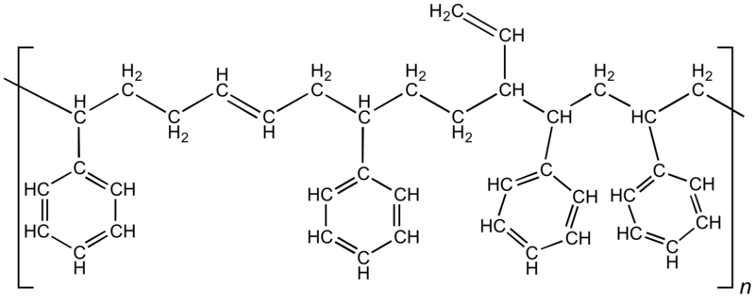
Butadiene – styrene Rubber
Trans!

Slide 39
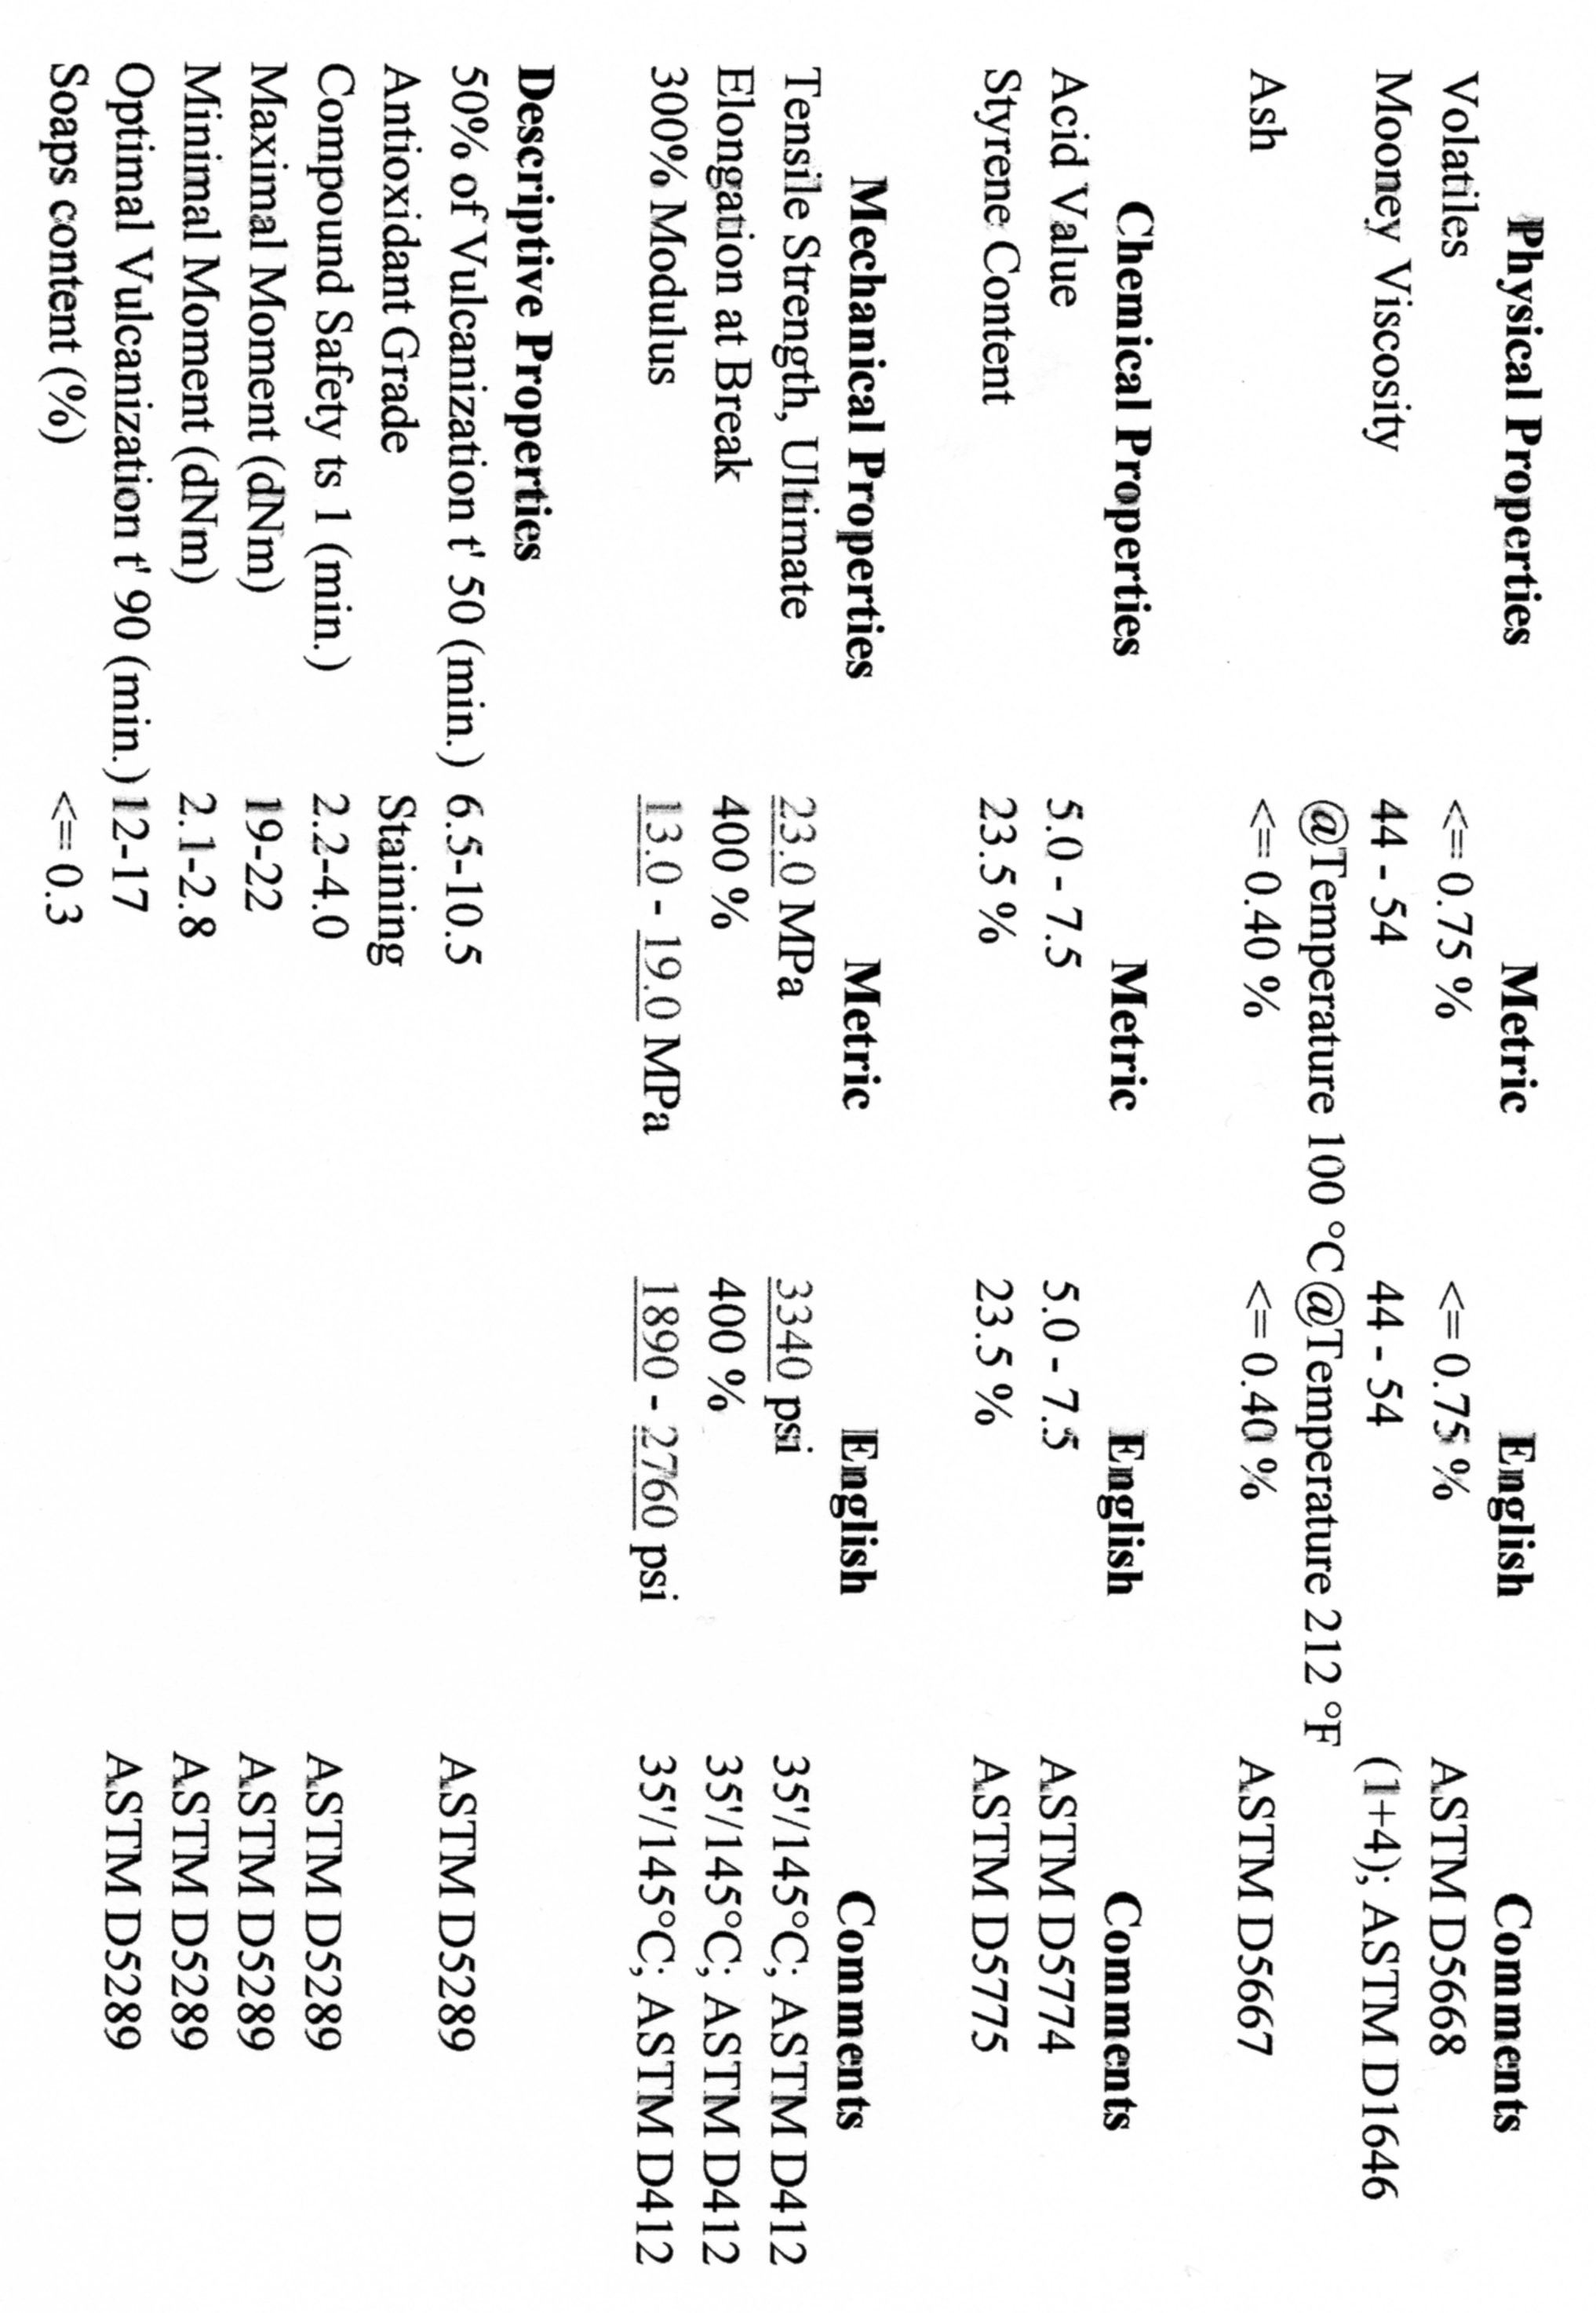
KRALEX® 1500
is a standard grade of styrene butadiene rubber. It is produced by a technology of cold emulsion polymerization based on soaps of rosin acids and contains 23.5% of chemically bonded styrene. It is coagulated by a system of acid and organic coagulant, does not contain extender oil and is stabilized by staining antioxidant. KRALEX® 1500 is appropriate for rubber compounds used in the production of car tires and inner tubes, conveyor belts, footwear, cables, hosepipes and various technical rubber articles.
It is not approved for production of rubber articles coming into contact with foods or drinking water.

Slide 40
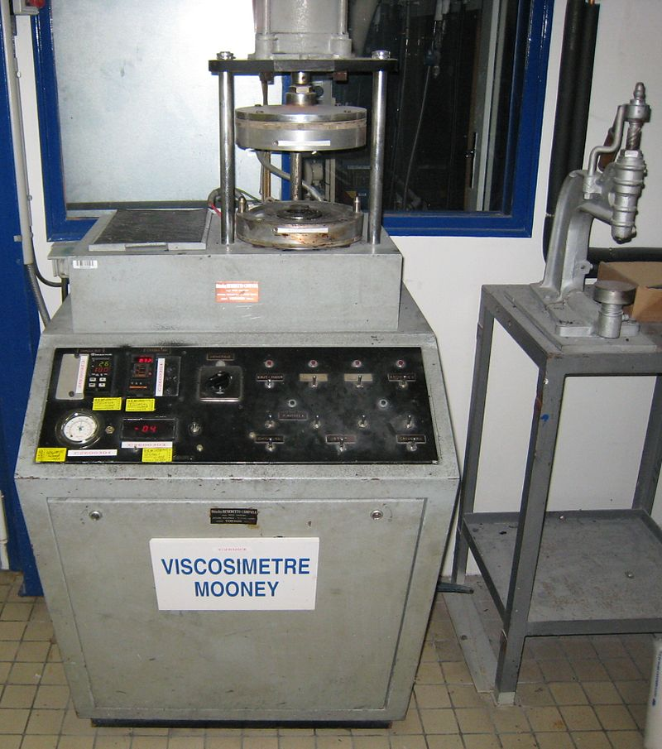
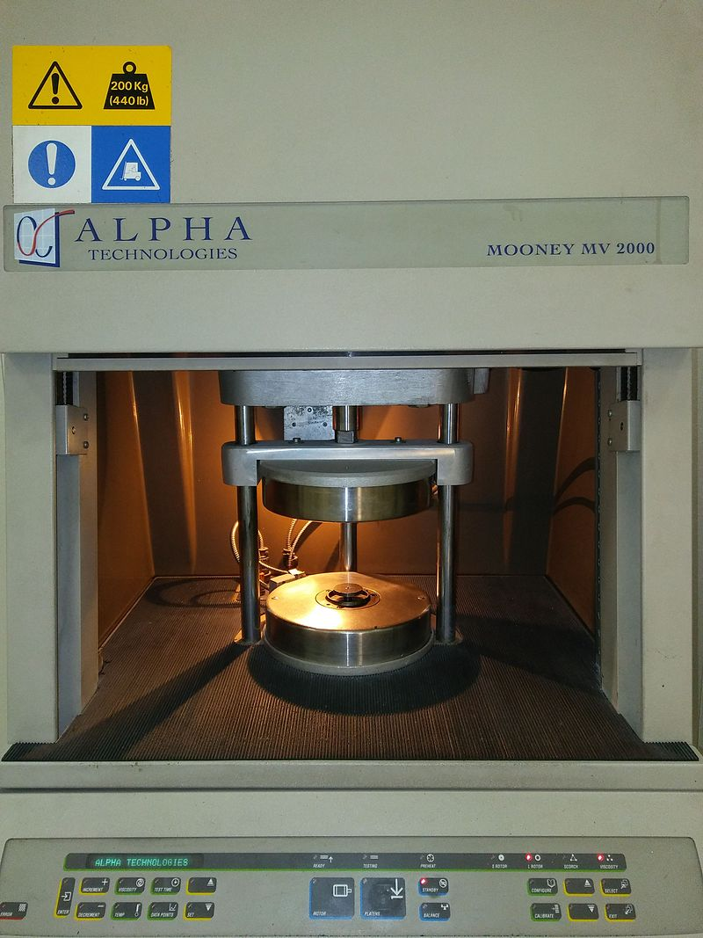
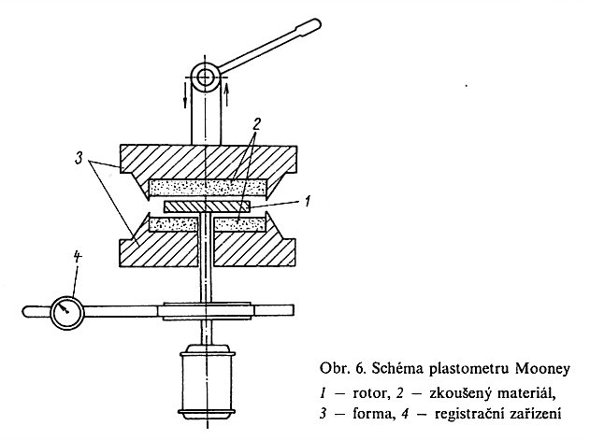
Viscosity Mooney – Explanation and Measurement
Rotor
Tested Material
Mould
Registration Device

Slide 41
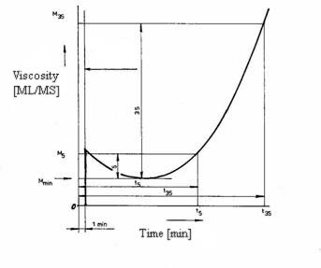
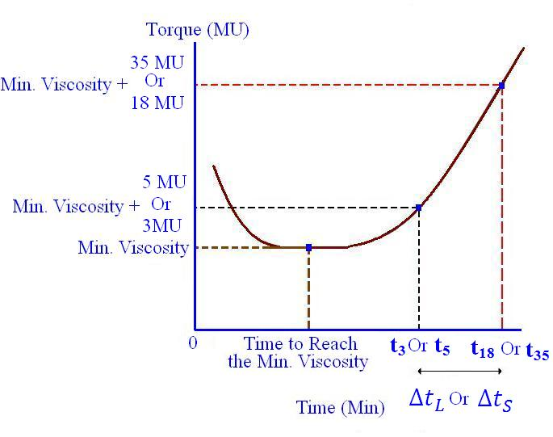

Slide 42
The rubber compound, including the vulcanizing system, is shaped on the mill as 6–8 mm thick sheets. Round-shaped samples with 45 mm diameter are cut from the sheets. The samples are pierced in the middle in order to allow the rotor shaft to pass. Before the beginning of the measurement, the instrument is heated up to 118 degree C. After the sample is introduced, it takes a minute for the sample to reach the thermal equilibrium, and then the rotor is started.
The value of Mooney viscosity decreases at the beginning, due to the decrease of the compound viscosity as temperature rises. After about 4 min, a minimum value is reached, which stays constant for a while. This value is indicated as MV. After a certain period of time, vulcanization starts and the Mooney viscosity increases.
The following values are indicated on the obtained curve:
minimum viscosity MV; scorch time (t5) - the time interval (measured from rotor start) corresponding to a viscosity increase of 5 Mooney units over MV, measured at rotor start. The t5 value indicates the prevulcanization tendency of the compound. The larger t5 is, the lower the prevulcanization tendency, and, therefore, the rubber compound can be more reliably processed on mill, calender or extruder. ^{[3]} vulcanization time (t35) - the time interval (measured from rotor start) corresponding to a viscosity increase of 35 units over the MV value. vulcanization index - Dt30 = t35 - t5 - provides indications about the vulcanizing ability of a rubber compound. A compound with a low vulcanization index, cures more rapidly than a compound with a higher vulcanization index. optimum vulcanization time at the experimental temperature employed (top).

Slide 43
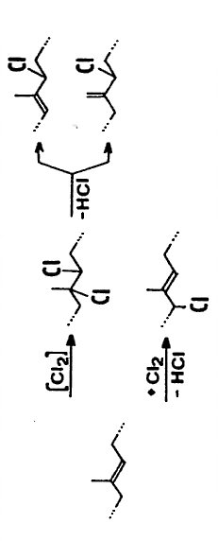
Modification of the NATURAL RUBBER 1
The MOST COMMON IS CHLORINATION by elementary Chlorine
Chlorinated Rubber
It is here Demonstrated at:
Trans isomer = Gutta-percha
The double Bonds are here maintained > Kept the Possibility of the Vulcanisation

Slide 44
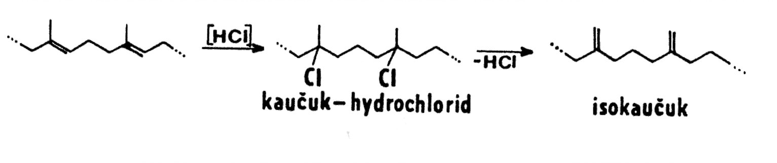
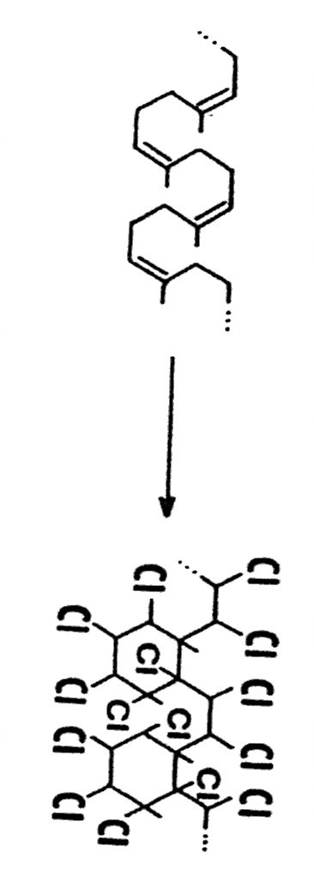
Modification of the NATURAL RUBBER 2 & 3
The LESS COMMON PPROCEDURES
2
Trans!
RUBBER
iso-RUBBER
3
Acid catalyzed addition of H⁺ on the DOUBLE BONDS, isomerisation and cyclization > CYCLORUBBER

Slide 45
Modification of the NATURAL RUBBER (NOT VULCANIZED RUBBER)
a její využití
Type | Properties | Use
Chlorinated Rubber (chlorine content up to 60 % w/w) | Film forming, better chemical stability than NATURAL RUBBER , decreased flammability, SOLUBILITY IN ORGANIC SOLVENTS | Coating compositions (chemical works, e.g. Starch factory, Sugar factory etc.), Glues
Rubber hydrochloride (modification by gaseous HCl) (chlorine content up to 35 % w/w) | Film forming, better chemical stability than NATURAL RUBBER, bur worse than Chlorinated Rubber, decreased flammability, SOLUBILITY IN ORGANIC SOLVENTS | Films, Sizing for Textile industry
Chlorinated Rubber is probably the most important
MODIFIED NATURAL RUBBER

Slide 46
Modification of the NATURAL RUBBER (NOT VULCANIZED RUBBER)
Type | Properties | Use
CYCLORUBBER | Film forming, SOLUBILITY IN ORGANIC SOLVENTS | Films, Sizing for Textile industry, paper, lacquers, glues, printing inks

Slide 47
Modification of the NATURAL RUBBER (NOT VULCANIZED RUBBER)
What interesting did I personally
Coating compositions (Starch factory in Brno town)
I have worked in the Maintenance department, getting ready for the Starch season (Beginning of the Potato processing to Starch). I have painted the processing devices inside.
EXPERIENCE: Hygiene problems, Vapours of Solvent, Shortage of fresh Air

Slide 48
Vulcanized Rubber and Antiques conservator - restorer
The response need also the Subjects made of Rubber already!
My former Student turned to me for Help in his Task in the Technical Museum in Brno
PROBLEM:
Gas mask restoration dated in the 1. World war
Gas mask restoration dated in the last 30rd years

Slide 49
POLYTERPENES and
Antiques conservator - restorer
Gutta-percha > isolation of the electric conductor > The first submarine TELEPHONE CABLE EUROPE - AMERICA
BALATA > another interesting Plant, a similar and cheaper natural material called balatá is often used in gutta-percha's place. The two materials are almost identical, and balatá is often called gutta-balatá.

