Slide 1
NATURAL POLYMERS Polysaccharide I STARCH 1
Dr. Ladislav Pospíšil

Slide 2
Time schedule
LECTURE | SUBJECT
1 | Introduction to the subject – Structure & Terminology of nature polymers, literature
2 | Derivatives of acids – natural resins, drying oils, shellac
3 | Waxes
4 | Plant (vegetable) gums, Polyterpene – natural rubber (extracting, processing and modification), Taraxacum_kok-saghyz
5 | Polyphenol – lignin, humic acids
6 | Polysaccharides I – starch
7 | Polysaccharides II – cellulose
8 | Protein fibres I
9 | Protein fibres II
10 | Casein, whey, protein of eggs
11 | Identification of natural polymers
 | Laboratory methods of natural polymers’ evaluation

Slide 3
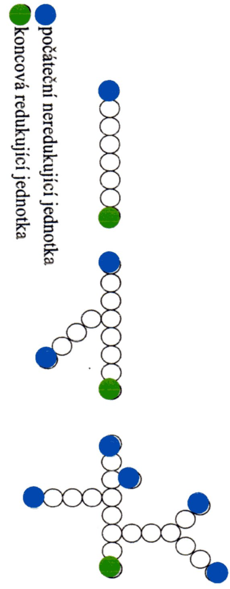
POLYSACCHARIDES - DEFINITION
Polysaccharides are polymeric carbohydrate molecules composed of long chains of monosaccharide units bound together by glycosidic linkages, and on hydrolysis give the constituent monosaccharides or oligosaccharides. They range in structure from linear to highly branched. Polysaccharides are often quite heterogeneous, containing slight modifications of the repeating unit.
When all the monosaccharides in a polysaccharide are the same type, the polysaccharide is called a homopolysaccharide or homoglycan, but when more than one type of monosaccharide is present they are called heteropolysaccharides or heteroglycans.
When the repeating units in the polymer backbone are six-carbon monosaccharides, as is often the case, the general formula simplifies to (C₆H₁₀O₅)_{n}, where typically 40≤n≤3000.
Points of Branching
Initial NONreducing unit
End reducing unit

Slide 4
LITERATURE BOOKS
Thermoplastic Starch
ISBN: 978-3-527-32528-3
Starches
ISBN: 978-1-4200-8023-0
Starch – Chemisty and Technology
ISBN: 978-0-12-746275-2

Slide 5
LITERATURE – JOURNALS
Starch ‐ Stärke
Journal of Carbohydrate Chemistry
Carbohydrate Polymers (Impact Factor: 5,1 !!!)

Slide 6
Sorts of Starch
Production of Starch
Starch Chemistry
Starch utilisation
Starch Modification
Production of Dextrin
Dextrin use

Slide 7
Sorts of the Industry important Starches
Two Sorts of Grains!
Grain (Particles) shapes
The Characteristic shape of the STARCH GRAINS a) Potato, b) Wheat, c) Rice, d) Corn

Slide 8
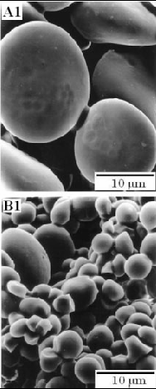
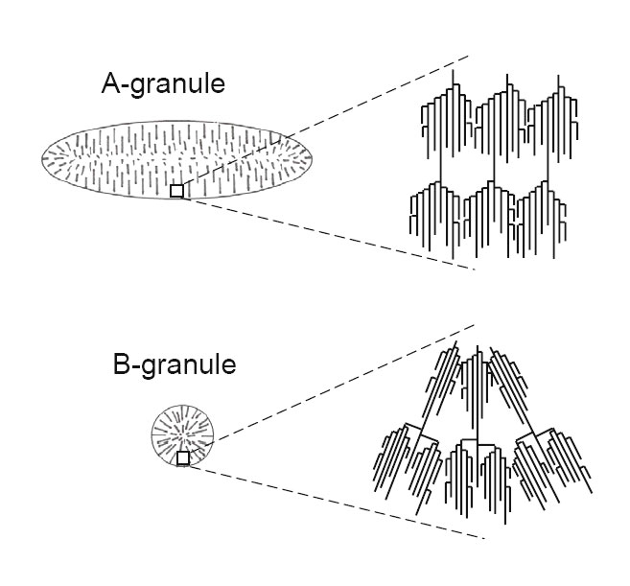
WHEAT STARCH
Two Sorts of Grains!
Two Grain shapes
The Different Branching

Slide 9
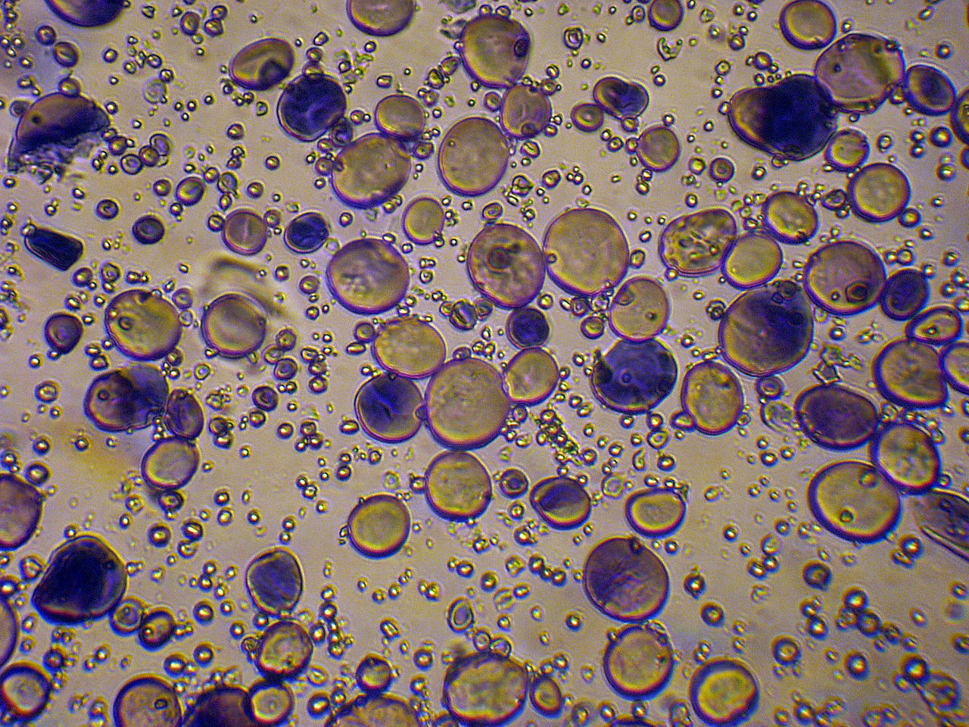
WHEAT STARCH – Two Sorts of Grains & Two Sizes of Grains

Slide 10
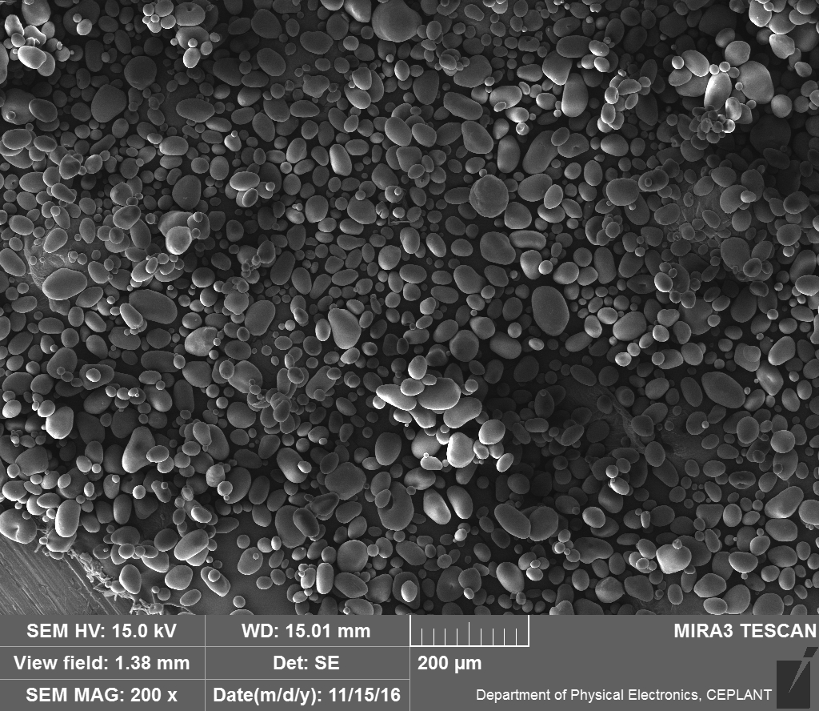
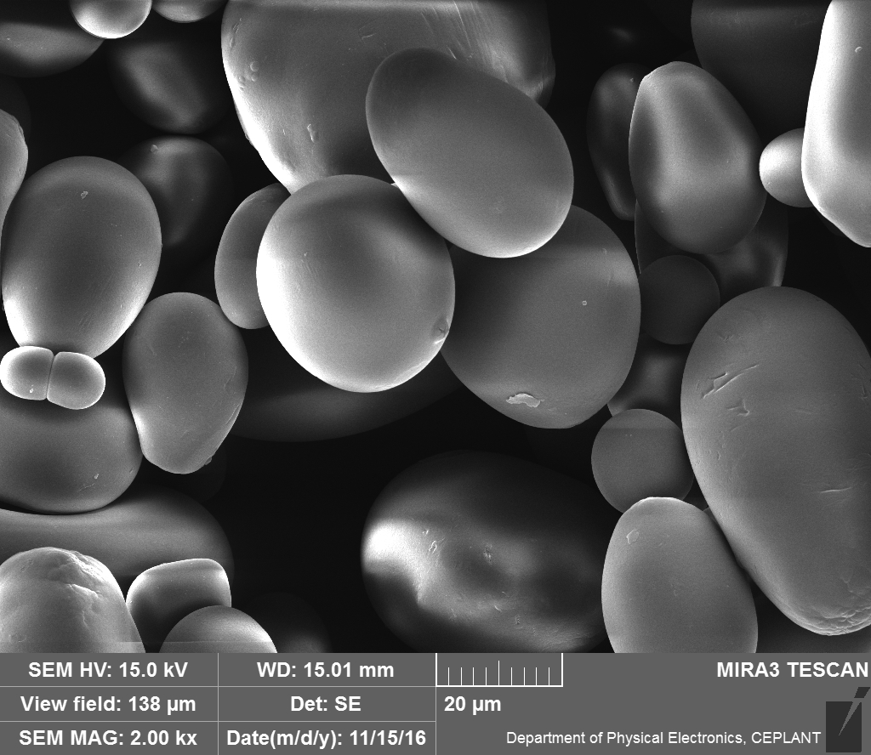
Starch SEM – my own Work at MU 1
You didn't see any Surface Wrinkling, as you can see on the Pictures drawn and taken from a Literature.
The Reason IS PROBABLY IN THAT, because the Starch grains were not dried before taking the SEM Pictures.
Potato Starch

Slide 11
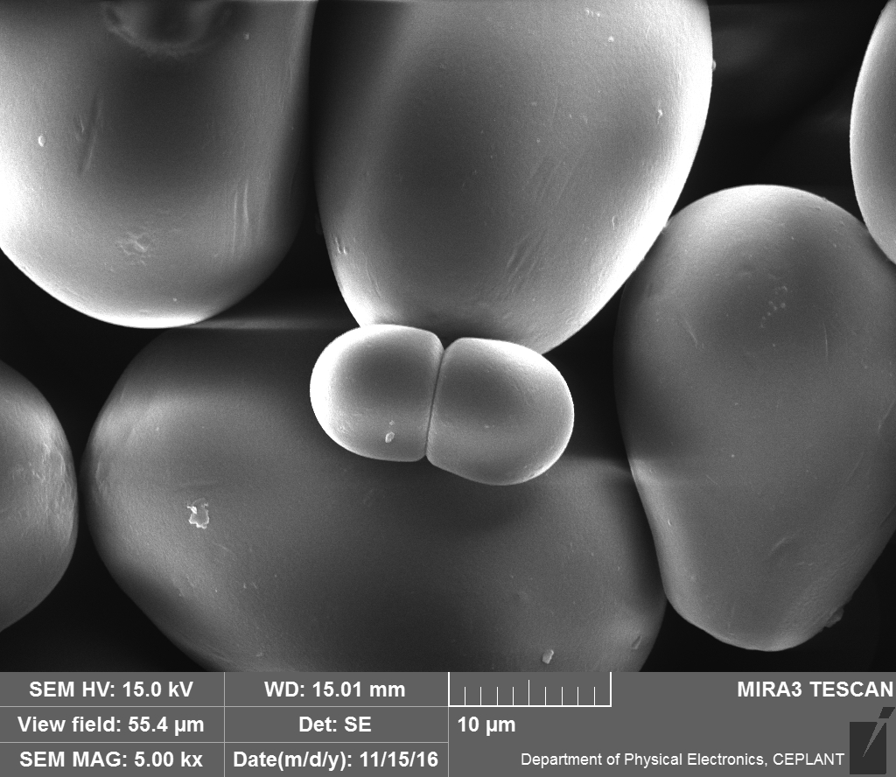
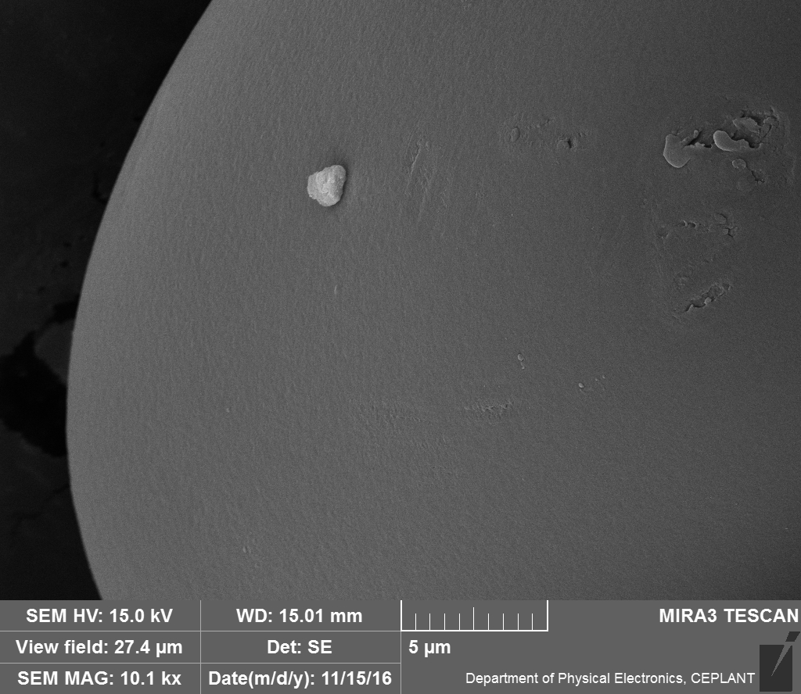
Starch SEM – my own Work at MU 2
Potato Starch

Slide 12
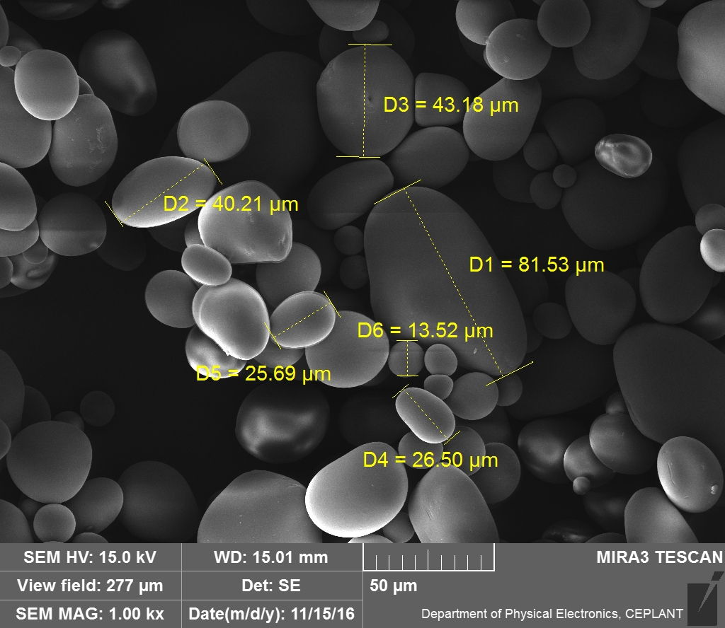
Starch SEM – my own Work at MU 3
Potato Starch

Slide 13
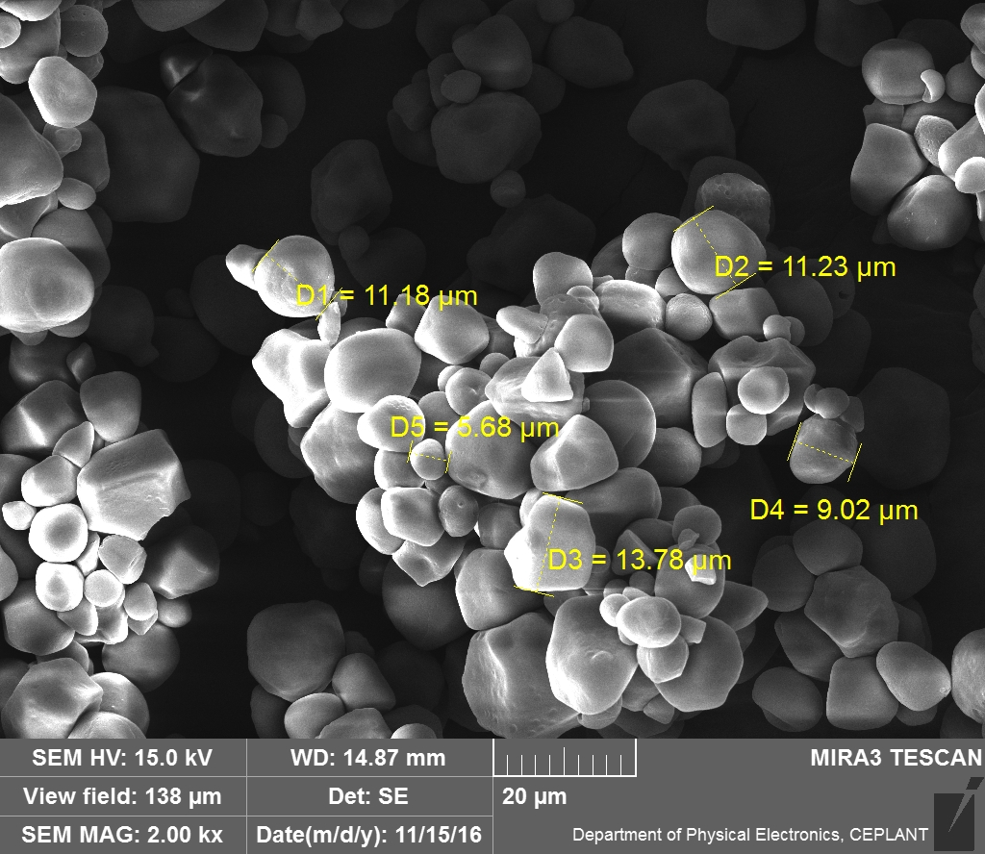
Starch SEM – my own Work at MU 4
Corn (Maize) Starch

Slide 14
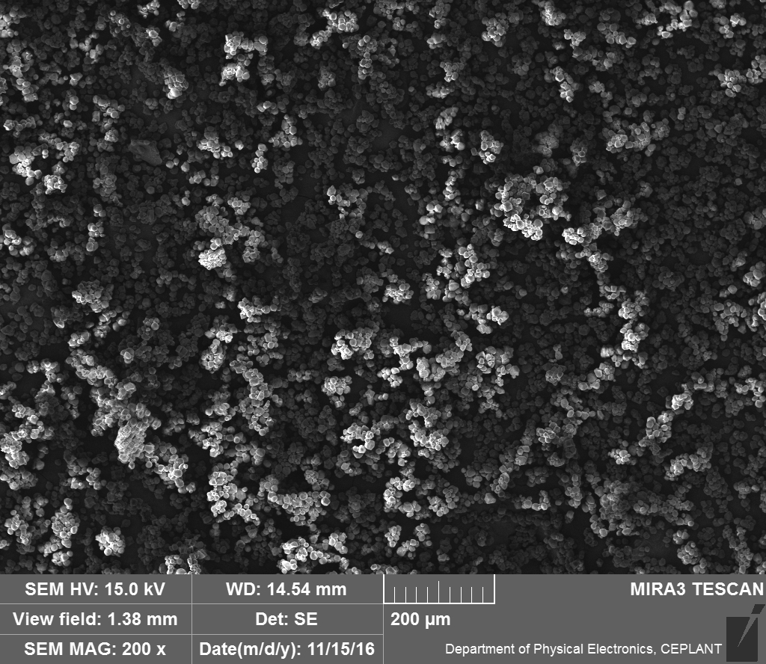
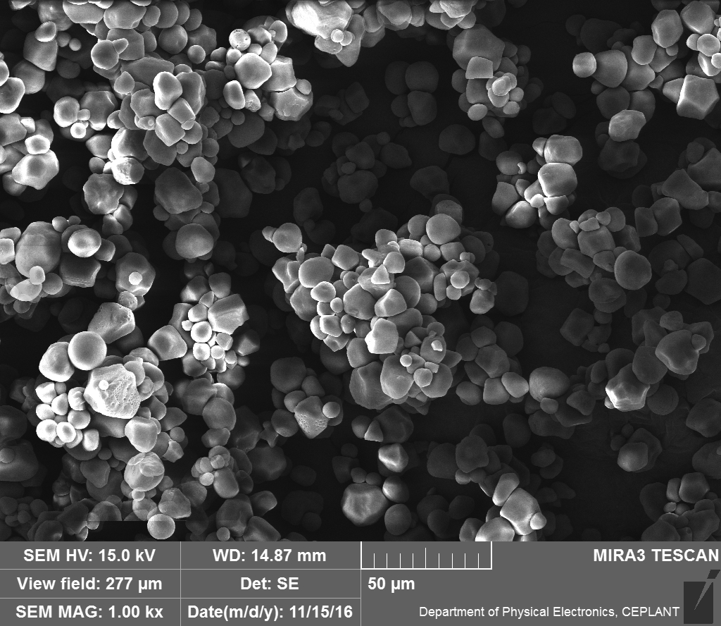
Starch SEM – my own Work at MU 5
You didn't see any Surface Wrinkling, as you can see on the Pictures drawn and taken from a Literature.
The Reason IS PROBABLY IN THAT, because the Starch grains were not dried before taking the SEM Pictures.
Corn (Maize) Starch

Slide 15
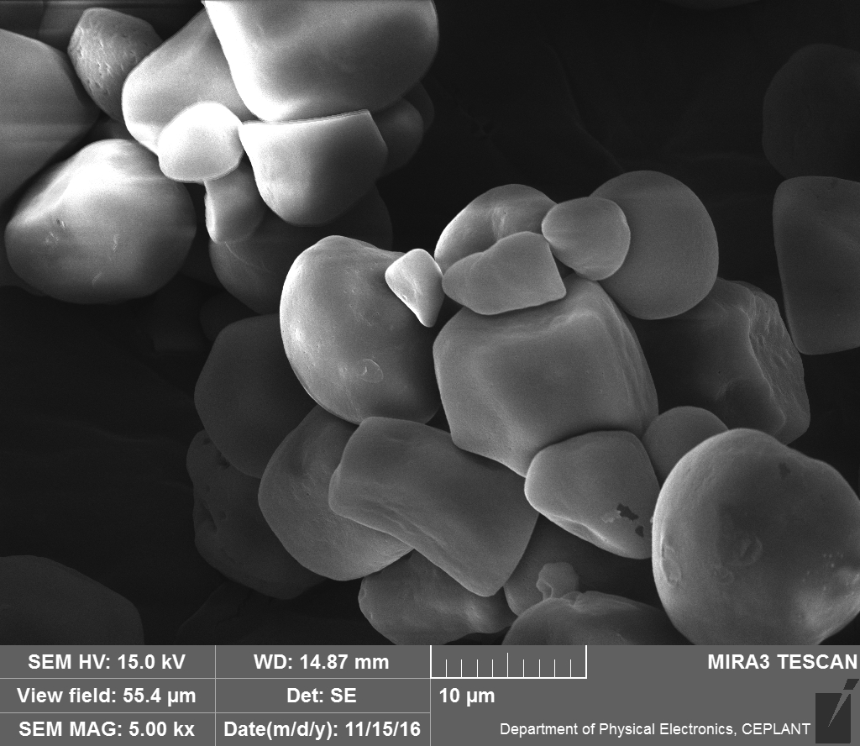
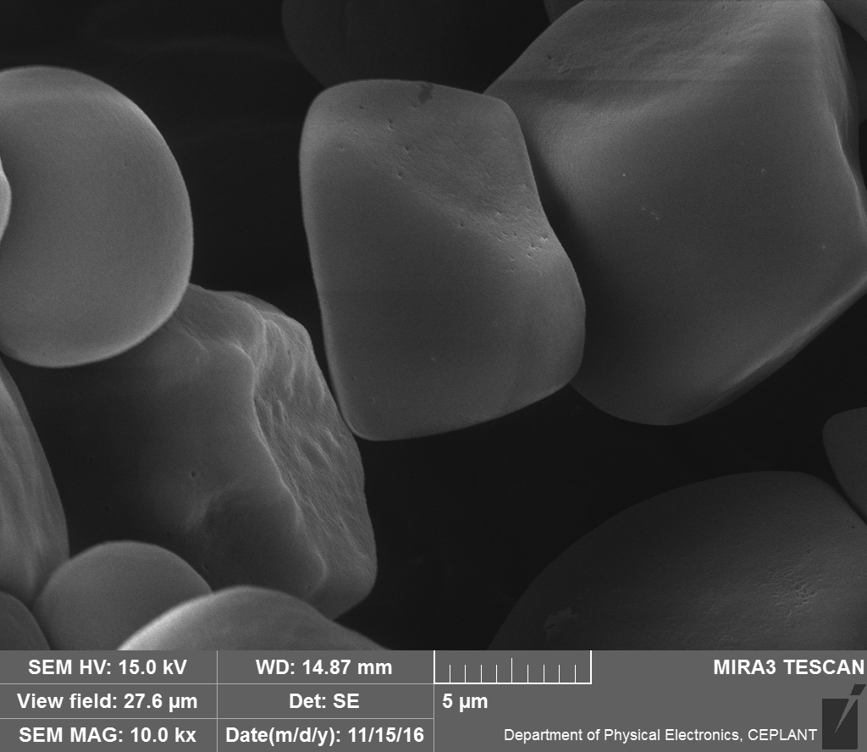
Starch SEM – my own Work at MU 6
Corn (Maize) Starch

Slide 16
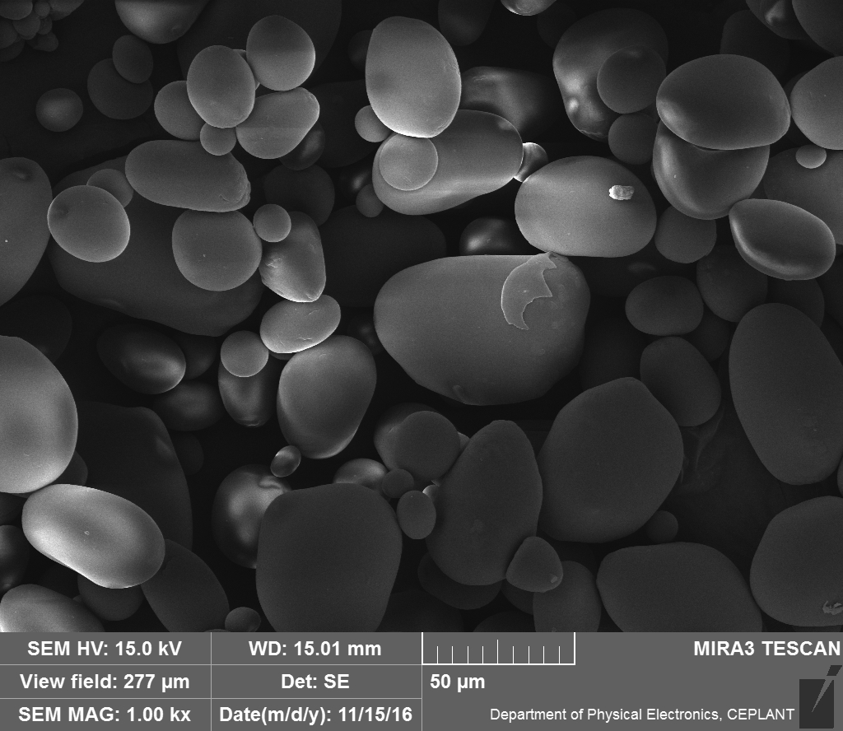
Starch SEM –my own Work at MU 7
Corn (Maize) Starch X Potato Starch

Slide 17
Starch SEM –my own Work at MU 8
Corn (Maize) Starch X Potato Starch

Slide 18
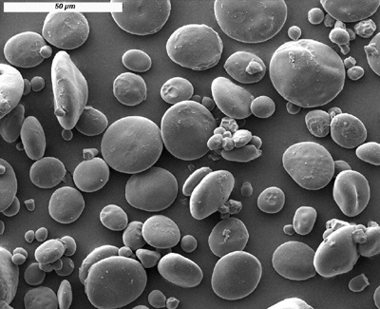
Starch SEM – WHEAT (taken form Literature)
A-Grain
B Grain

Slide 19
Sizes of Starch Grains (Particles)
Potato : predominantly 10 – 70 μm (BROAD Grains’ sizes distribution)
Corn: predominantly 20 μm (NARROW Grains’ sizes distribution)
Wheat: Two Sorts of Grains
Size 1 – 10 μm > Starch B (Waste product, contains Proteins)
Size 10 – 25 μm > Starch B (PRODUCT)
Rice: predominantly approx. 5 μm (NARROW Grains’ sizes distribution)

Slide 20
STARCH - Production and Use (Data from the Years 1991 & 2011)
World Production (1991): 22 000 000 tons
World Production (2011): 70 000 000 tons
Corn STARCH : 15 000 000 tons
The most important plants utilized to STARCH production: CORN, Potato, Rise, Cassava
The principal STARCH Producers: USA (CORN), former USSR republics, Netherland, Germany, Poland (Potato)
Nutrition use: approx. 70 %
Modified STARCH :approx. 5 000 000 tons
World Production of the SYNTHETIC PLASTICS
is approx 300 000 000 t/annual

Slide 21
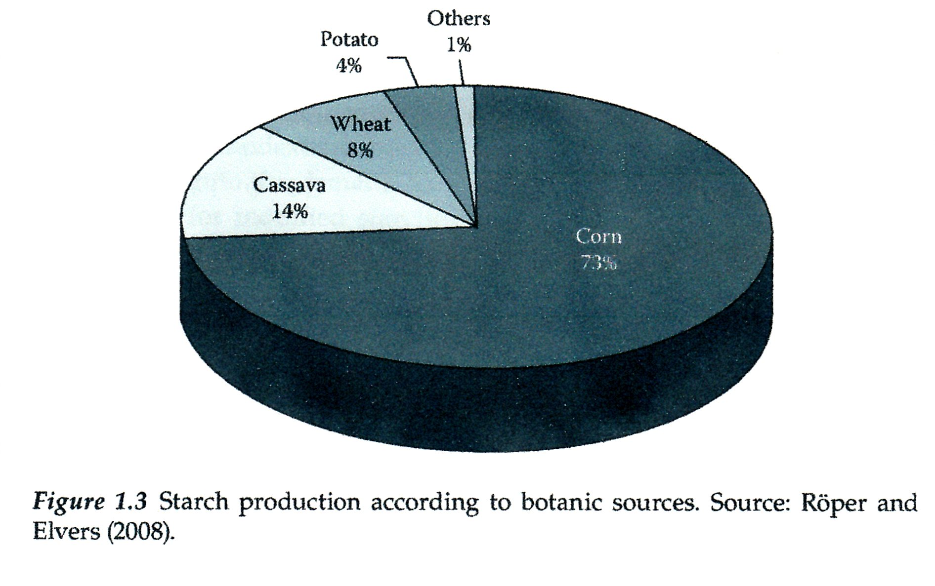
Cassava

Slide 22
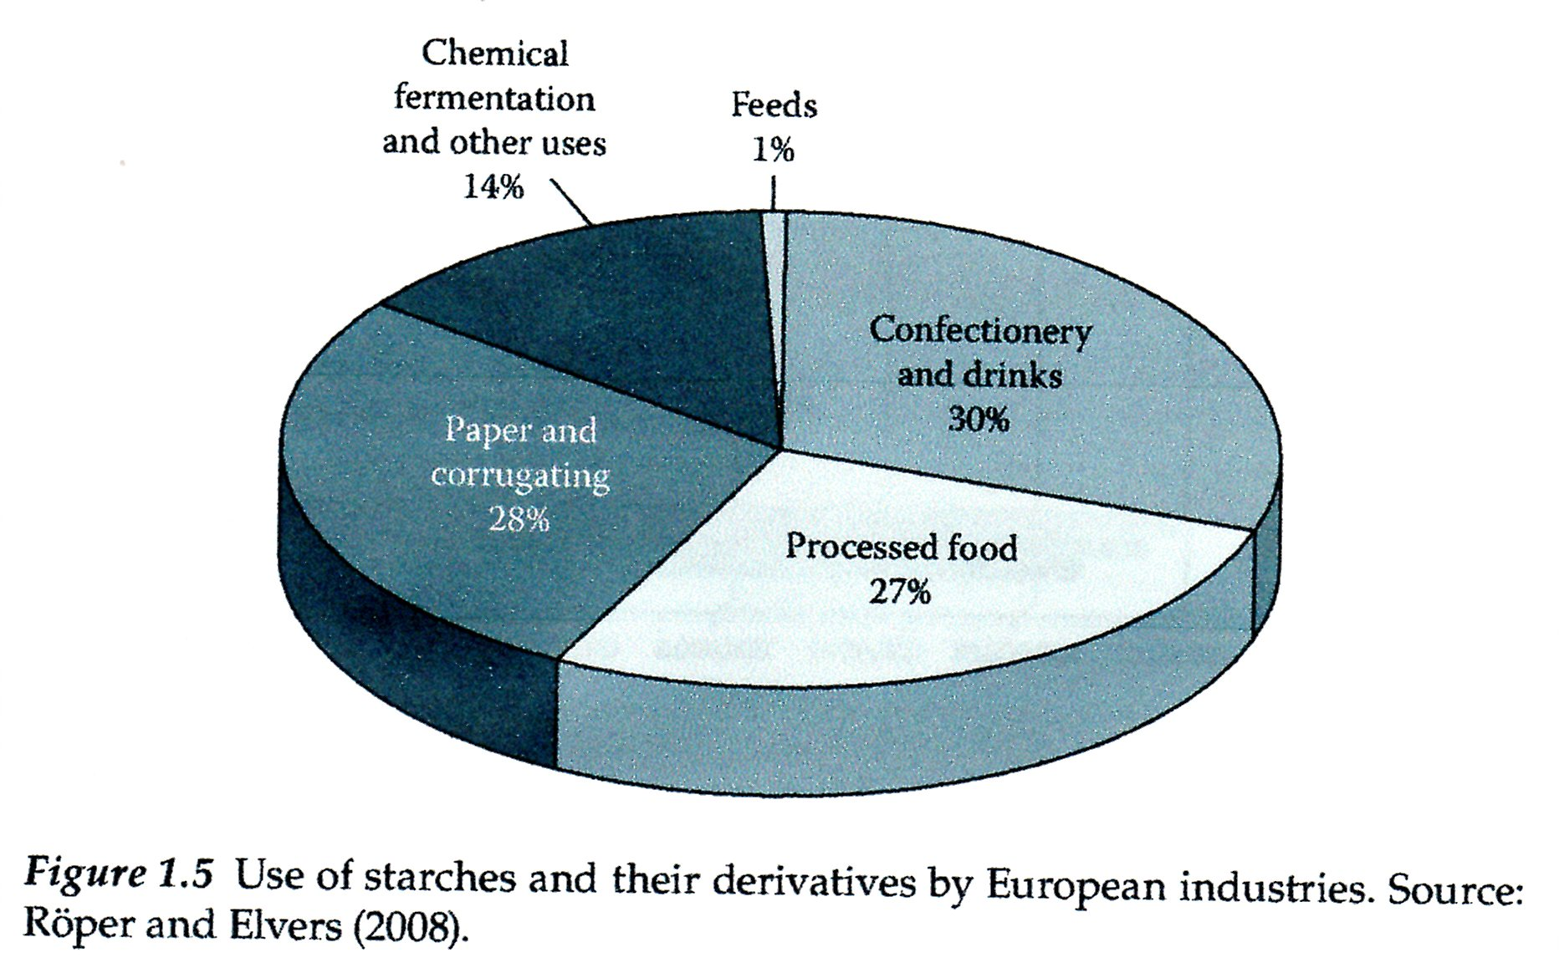

Slide 23
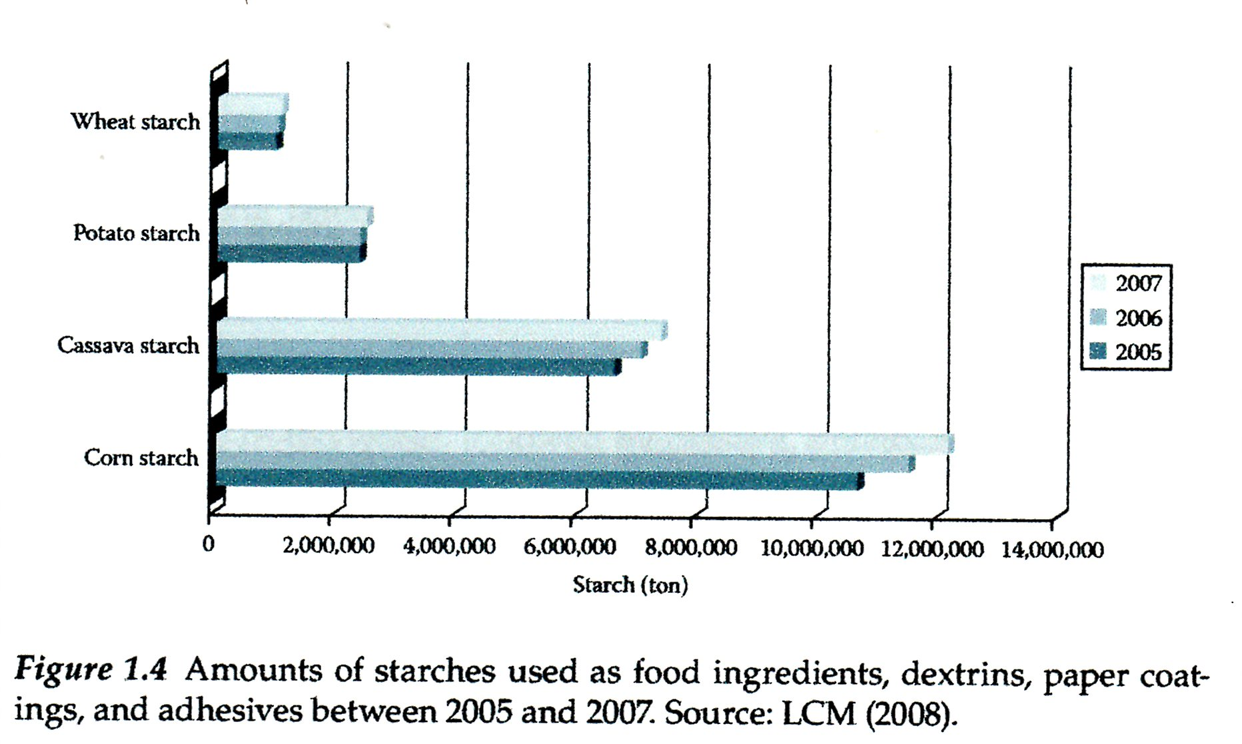
World Production of the SYNTHETIC PLASTICS
is approx 300 000 000 t/annual

Slide 24
STARCH - Production from Potato 1
Potato contain 14 – 21 % w/w of Starch, which is not so much
It is possible to take approx. 4 tons of Starch from 1 ha of the Cultivated field
The Water Need is for the production, up to 3,5 – 8 m³/ton of Potato, but more modern Technologies can lower this Volume
Sušina škrobu je cca. 84 % hmot.
Ostatní složky jsou:
Nitrogen compounds
Lipids

Slide 25
„Classical“ starch factory
Potato are transported by Water stream, so the Water Recycling must be done using Sedimentation Vessel to remove the Sand and Soil
Potato Slicer (Pulper)
WASTE Water with Proteins
Second Pulping
COAGULATION
Of Proteins
Potato Pulp
Small Grain Starch
Potato Depot, 2. Washing machine, 3. Sedimentation Vessel, 4. Belt scales, 5. Potato hopper, 6. Potato slicer, 7. Centrifuge, 8. Wash out (Starch) machine, 9. Second Pulping, 10. Potato pulp Press, 11. Centrifuge, 12. Mesh, 13. Starch size sorting (Starch refining), 14. Filter, 15. Preheating, 16. Centrifuge, 17. Roller dryer
A – Starch, B - Potato pulp, C – Clean Water, D – Waste Water, E – Dry protein, F – Liquid animal feed

Slide 26
From the STARCH to ethanol
STARCH
ENZYME from the Grain malt
Monosaccharide
ENZYME from the Yeast
ethanol

Slide 27
STARCH - Production from Potato 2
Starch factory is usually combined with Agricultural alcohol Distillery
Raw Materials for this Distillery:
Fine Fraction of Starch gained during so called Starch size sorting (Starch refining),
WASTE Water with Proteins gained during Centrifuging of the Starch Pulp
Potato pulp after Washing out the Starch by Water (It can be used as the Animal feed also)

Slide 28
STARCH - Production from Wheat
Wheat flour contains approx. 68 % w/w of Starch, what is really much,
It is possible to take approx. 4 tons of Starch from 1 ha of the Cultivated field, so it is the same Quantity as for Potato,
The Water Need is for the production, approx. 3,5 m³/ton of Wheat flour,
It is possible to utilize the Fraction B also and the Waste protein (Gluten)
Dry matter of this Starch is approx. 84 % w/w

Slide 29
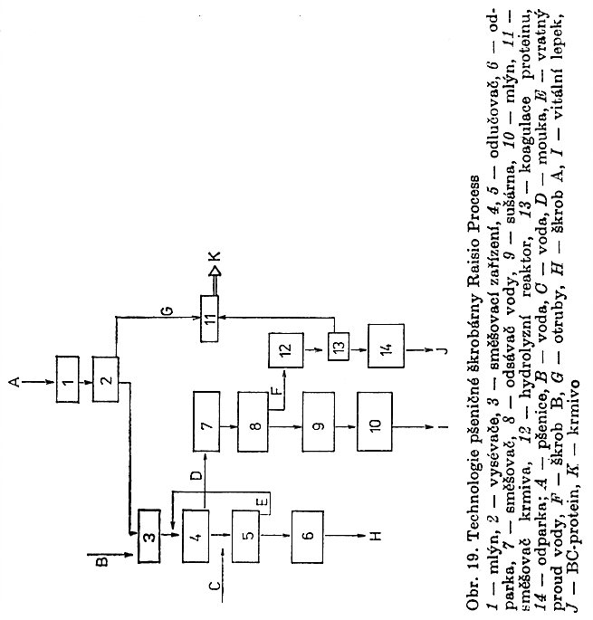
Wheat starch factory
Nothing goes to Waste here!
Small Grains B Starch are separated and are processed in the Separate Branches I and J
Mill, 2. Washing machine, 3. Flour sifting machine, 4. Separator, 5. Separator, 6. Evaporator, 7. Mixer, 8. Water suction device, 9. Dryer, 10. Mill, 11. Animal feed Mixer, 12. Reactor for Hydrolysis, 13. Proteins Coagulation, 14. Evaporator
A – Wheat, B - Water, C – Water, D – Flour, E – Water returning Stream, F – Starch, G - Wheat middlings, H – Starch, I – Gluten, J – Protein, K - Animal feed

Slide 30
STARCH - Production from Corn
Corn Grain for the Starch production has the following Composition:
Water
Starch
Proteins
Oil
Fibre
Ash
Pentosans
Other
The Varieties has been cultivated, containing either mostly AMYLOSE or mostly AMYLOPECTIN
The Top Varieties having in the Grain up to 90 % w/w of Starch
The Water Need is for the production ( m³/ton of Corn) – I do not know
Dry matter of this Starch is approx. 84 % w/w

Slide 31
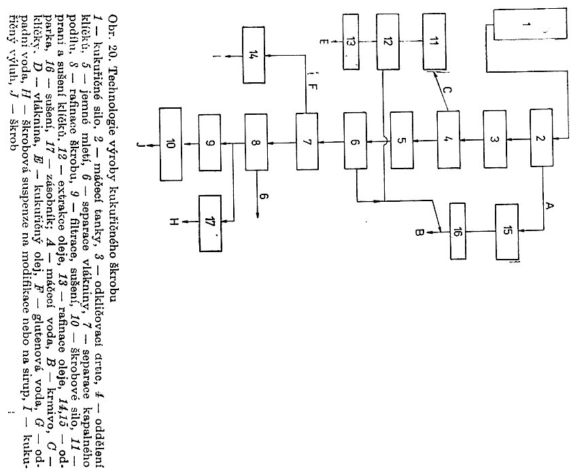
Corn starch factory
Very similar to Wheat starch factory, up to SOAKING
Nothing goes to Waste here!
Corn grain silo, 2. Soaking tank, 3. Sprout removing & Milling machine, 4. Sprout processing block, 5. Fine milling, 6. Fibre separation, 7. Liquid part separation, 8. Starch size sorting (Starch refining), 9. Filtration & Dryer, 10. Starch silo, 11. Sprout washing & Dryer, 12. Oil extraction, 13. Oil refining, 14.&15. Evaporator, 16. Drying, 17. Hopper
A – Soaking Water, B - Animal feed, C – Sprout, D – Fibre, E – Corn oil, F –Gluten Water, G - Waste Water, H – Starch Suspension for Modification or Syrup, I – Corn eluate (infusion), J – Starch

Slide 32
Starch Products for Food Industry
Sweets, Jam and Marmalade, Drinks, Bakery products, Pastry etc.
Milk Products, Meat Products, Soup (especially dehydrated), Sauce, Salad dressing etc.
Ice cream, Children's nutrition …

Slide 33
Starch Products for NONFood Industry
Paper Industry
SIZING in the MaSS (MATTER),
SURFACE SIZING,
pasting & painting
TEXTILE Industry
Slashing, Printing, Final treatment, …..
Gluing
Paperboard, Corrugated paperboard, Multilayer bags, Lamination, ………….

Slide 34
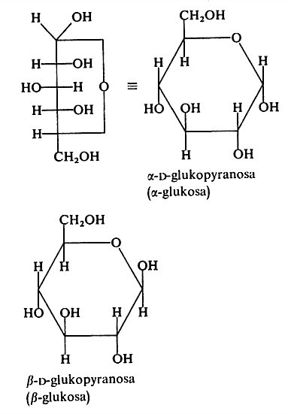
STARCH versus CELULLOSE 1
They differ in the Position of –ch₂oh toward to
-oh
STARCH is the α-D-glukopyranose polymer
Dextrose
CELULLOSE is the β-D-glukopyranose polymer

Slide 35
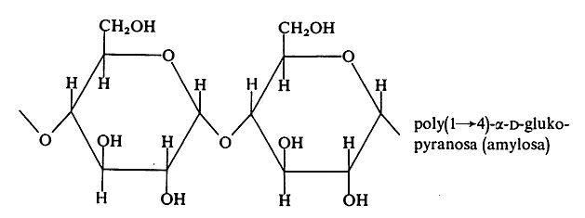
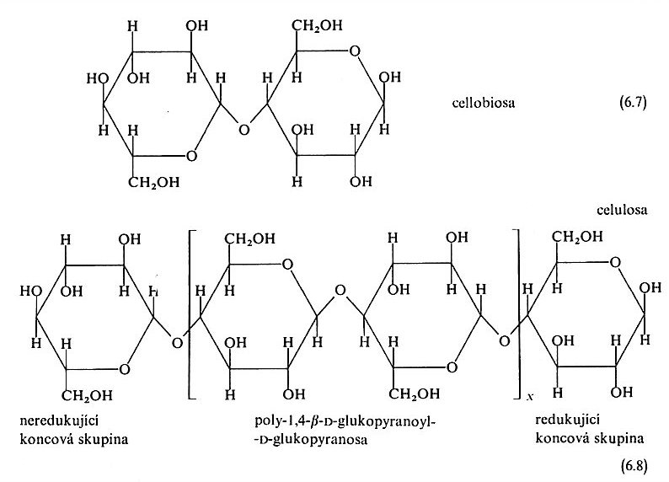
STARCH versus CELULLOSE 2
Notice the Position of the Bond via Oxygen between the Glucose Units
C4
STARCH
C1
CELULLOSE
C4
Initial NONreducing unit
End reducing unit
C1

Slide 36
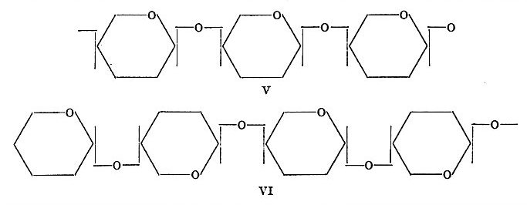
STARCH (amylose - linear) versus CELULLOSE 3

Slide 37
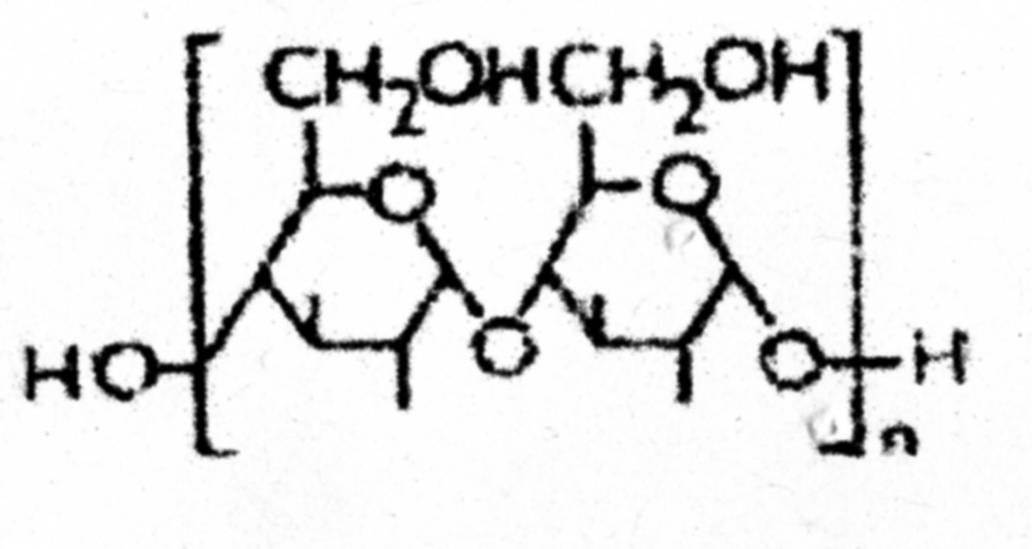
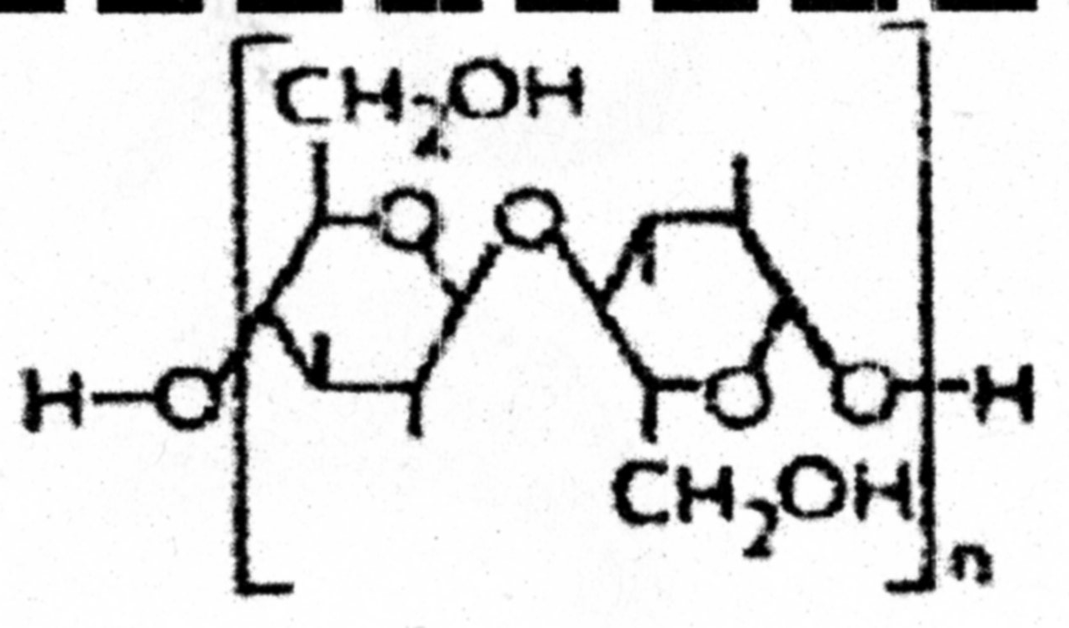
STARCH versus CELULLOSE 4
STARCH
n = 1 > (1→4)−α−D-glukopyranosyl 1-α−D-glukopyranose Ţ MALTOSE
n = 150 ….. 500 AMYLOSE
n = 550 ….. 7500 AMYlopeCtin, Branching (1→6) on the approx. Each 8 to 10 GLUCOSE unit
n = 1 > (1→4)−β−D-glukopyranosyl 1−β−D-glukopyranose ŢCELOBIOSE
n = 1000 ….. 7000 CELULLOSE
CELULLOSE

Slide 38
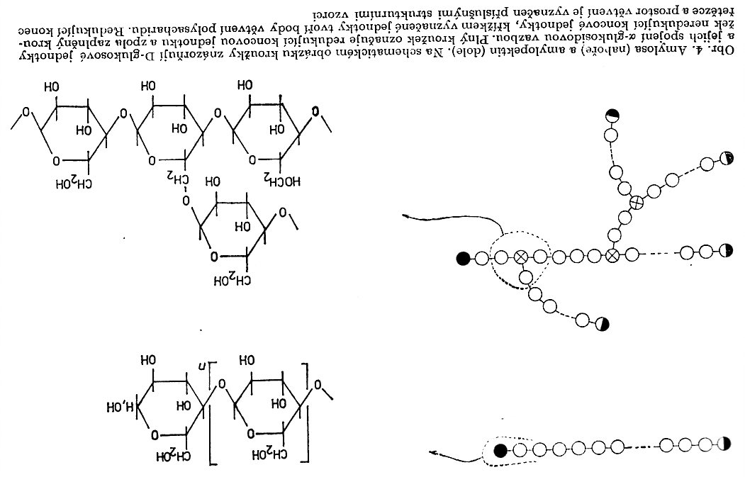
AMYLOSE & AMYLOPECTIN 1
AMYLOSE
AMYLOPECTIN
AMYLOSE (Picture up)
AMYLOPECTIN (Picture down)
Initial NONreducing unit
End reducing unit
Point of Branching

Slide 39
Separation AMYLOSE - AMYLOPECTIN 2
Selective enzymatic break down AMYLOPECTIN to Saccharide
Different Solubility of the AMYLOPECTIN and AMYLOSE
Mixture of DMSO + Water > Different Solubilities
Water + NaOH > salt out by NaCl > AMYLOSE in the Solution and AMYLOPECTIN forms the Gel (Separation takes a longer time)

Slide 40
Isolation (Separation) of AMYLOSE and AMYLOPECTIN
Laboratory instructions
Principle
Starch is a universal storage Polysaccharide of Plants. It is present in the Form of Starch grains there. There is high Concentration of the Starch in some parts of Plants (Potato tuber, Corn Grain etc.). The Grains are formed from two Structures. AMYLOSE - linear polymer and AMYLOPECTINE - branched polymer. These Polymers is possible to separate on the basis of their different Solubility
Isolation (Separation) of AMYLOSE from AMYLOPECTIN
Pour to the Beaker of Volume 1000 cm³ 360 cm³ 0,2 mol.dm⁻³ of the NaOH solution in Water, 75 cm³. Add 5,3 g of the dry Starch mixed in 35 cm³ in Water and at Temperature 25 °C mix (stir) by glass Stick up clarifying the Solution. Add 125 cm³ of the NaCl Solution (5 % w/w) and neutralize by HCl Solution up to pH 6 – 7. Check the pH Value by test paper. Leave the system stay at laboratory Temperature 20 hours, avoid Sun light. AMYLOPECTIN is separated on the Bottom as the Gel, AMYLOSE remains in the Solution.
It is possible to call this as the „salt out “. It is visible influence of ions on the polymer solubility.
REMARK: The separated AMYLOPECTIN is possible filter out and AMYLOSE precipitate as the Complex with Butanol. Add 12,5 ml of Butanol to 100 cm³ of the AMYLOSE Solution and leave it stay for 2 hours.

Slide 41
AMYLOSE & AMYLOPECTIN 3 SIMILARITY TO Polyethylenes
LDPE
HDPE
Branched
Higher Melt elasticity
Linear
LOWER Melt elasticity
AMYLOPECTIN
AMYLOSE
Branched
Higher Melt elasticity in the Mixture of Starch - Glycerol
Linear
LOWER Melt elasticity in the Mixture of Starch - Glycerol

Slide 42
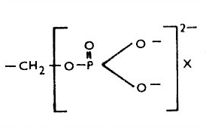
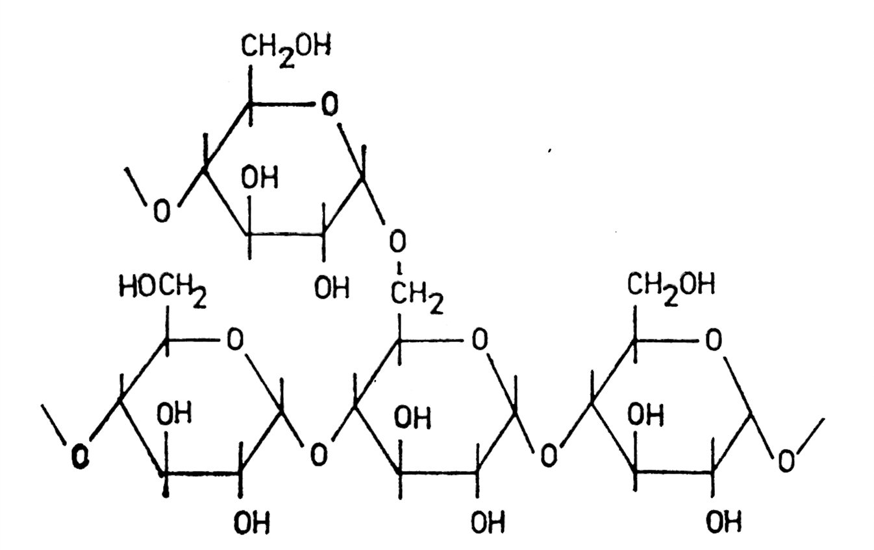
AMYLOSE - AMYLOPECTIN 4
The Orthophosphoric acid could be bound on AMYLOPEKTIN, especially in the Potato starch.
The Cations (K⁺, Ca⁺², Mg⁺² etc.) have then influence on the Viscosity of the Water solutions and/or Gels.

Slide 43
AMYLOSE - AMYLOPECTIN 5
Properties Comparision of AMYLOSE - AMYLOPECTIN
Property | AMYLOSE | AMYLOPECTIN
Complex with I⁻¹ Colour | Blue | Red-vilolet
Relative MW | 10³ – 10⁶ | 10⁷ - 10⁸
Crystallinity by RTG Diffration | High crystallinity | Amorphous
Solubility in Water | Different | Soluble
According to Literature: Radley, J.A. (Editor): Starch and its Derivatives, Chapman and Hall, London 1968

Slide 44
AMYLOSE - AMYLOPECTIN 6
Relativ Average molar mass (MW) | AMYLOSE | AMYLOPECTIN | Source, Remark
M _{n} | 10⁵ - 10⁶ | 10⁷ | Czech Texbook
M _{w} |  |  | It was not found
M _{??? n or w} | 10⁵ - 10⁶ | 10⁷ - 10⁸ | Czech Book
Any case, these Figures are HIGH, at Level (Rank equally ) Synthetic polyolefis (PE, PP)

Slide 45
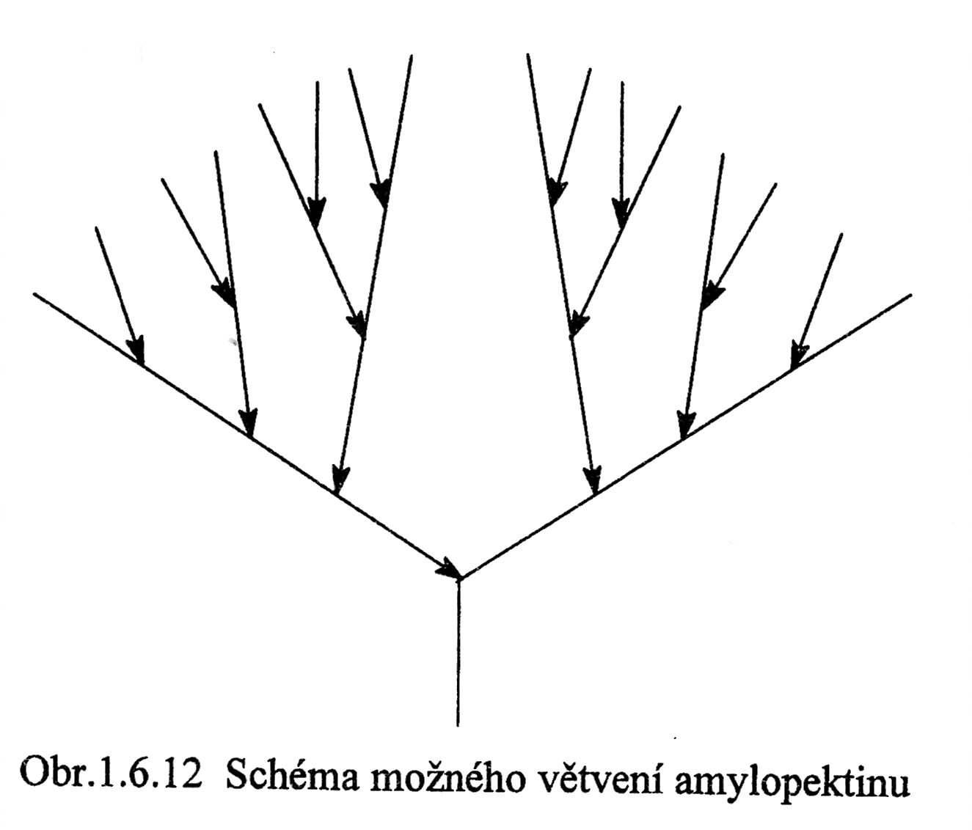
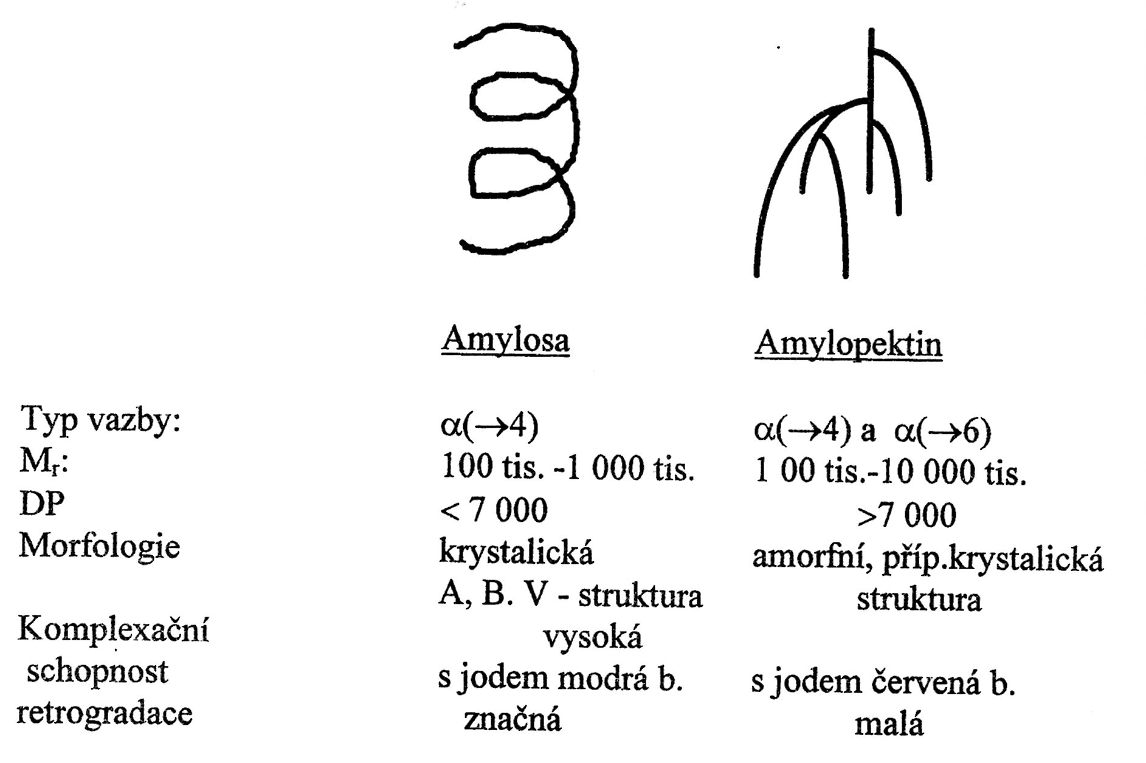
AMYLOSE & AMYLOPECTIN 7
This Picture concerns
WATER SOLUTIONS!
A possible structure of the AMYLOPEKTIN branching
AMYLOSE
AMYLOPECTIN
Bond type | α(1→4) | α(1→4) and α(1→6)
Morphology | Crystalline | Amorphous, alternatively partly
RETROGRADATION | Considerable | Low
RETROGRADATION = from a Gel and/or Solution is precipitated POLYMER

Slide 46
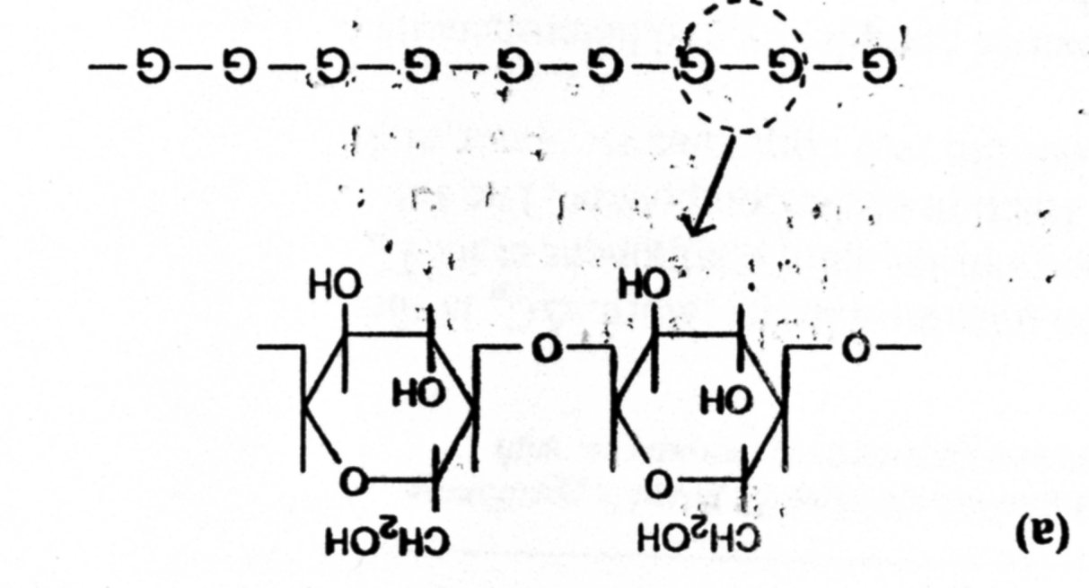
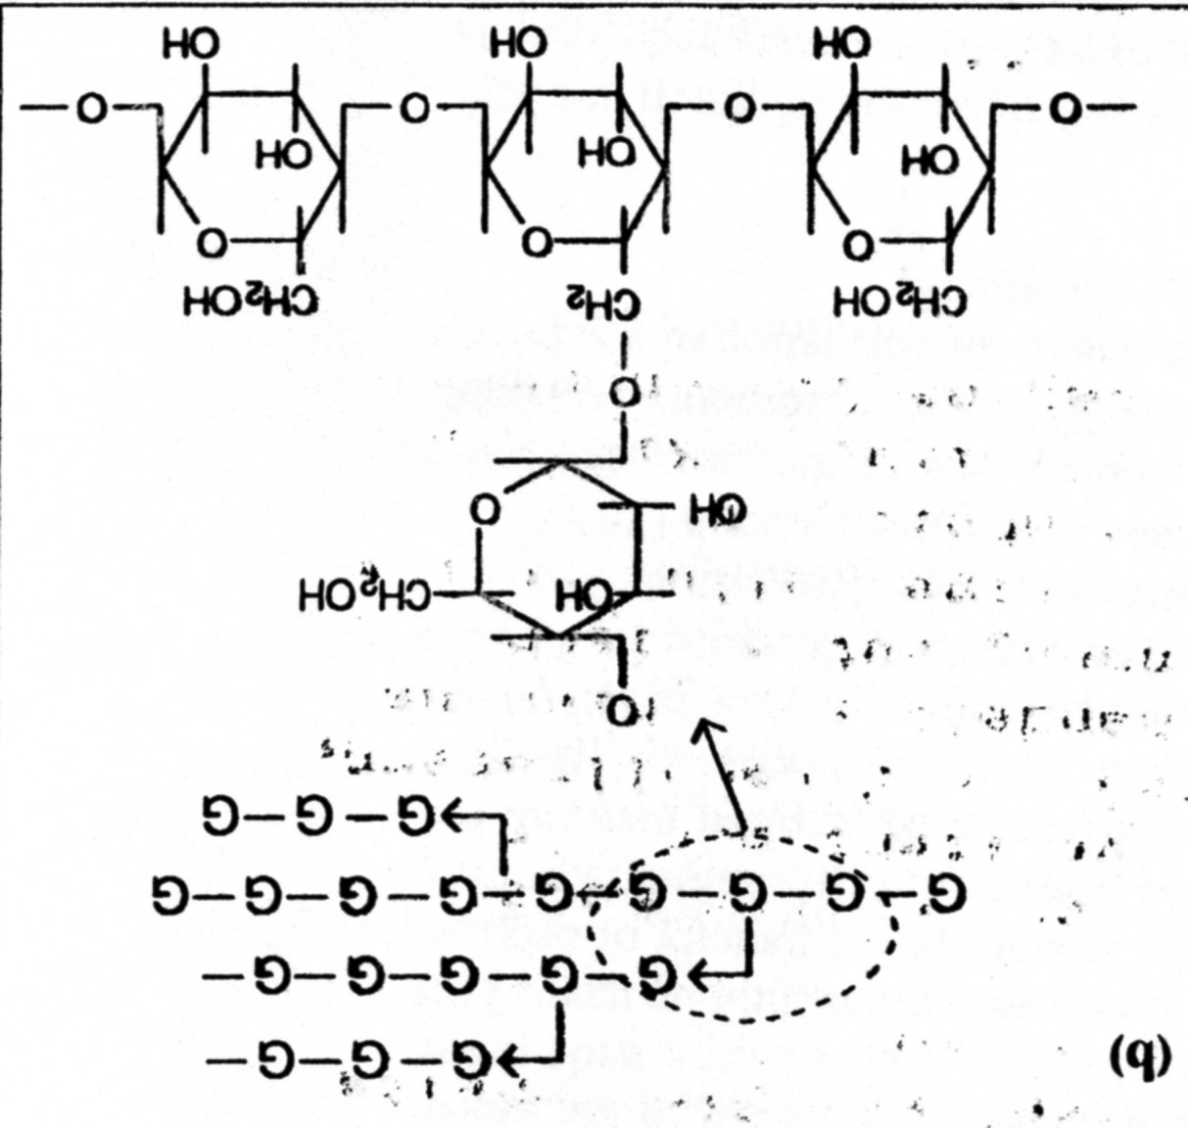
AMYLOSE & AMYLOPECTIN 8
G – glucose unit

Slide 47
AMYLOSE & AMYLOPECTIN 9
AMYLOPECTIN usually prevails in Ratio 4/1
AMYLOPECTIN does not give BLUE Colour with Iodine
Some Starches, e.g. Pea Starch, contain AMYLOSE only
The other Starches, e.g. Corn cultivar called Waxy Corn (Maize), have MYLOPECTIN only
AMYLOPECTIN has higher MW
……………….

Slide 48
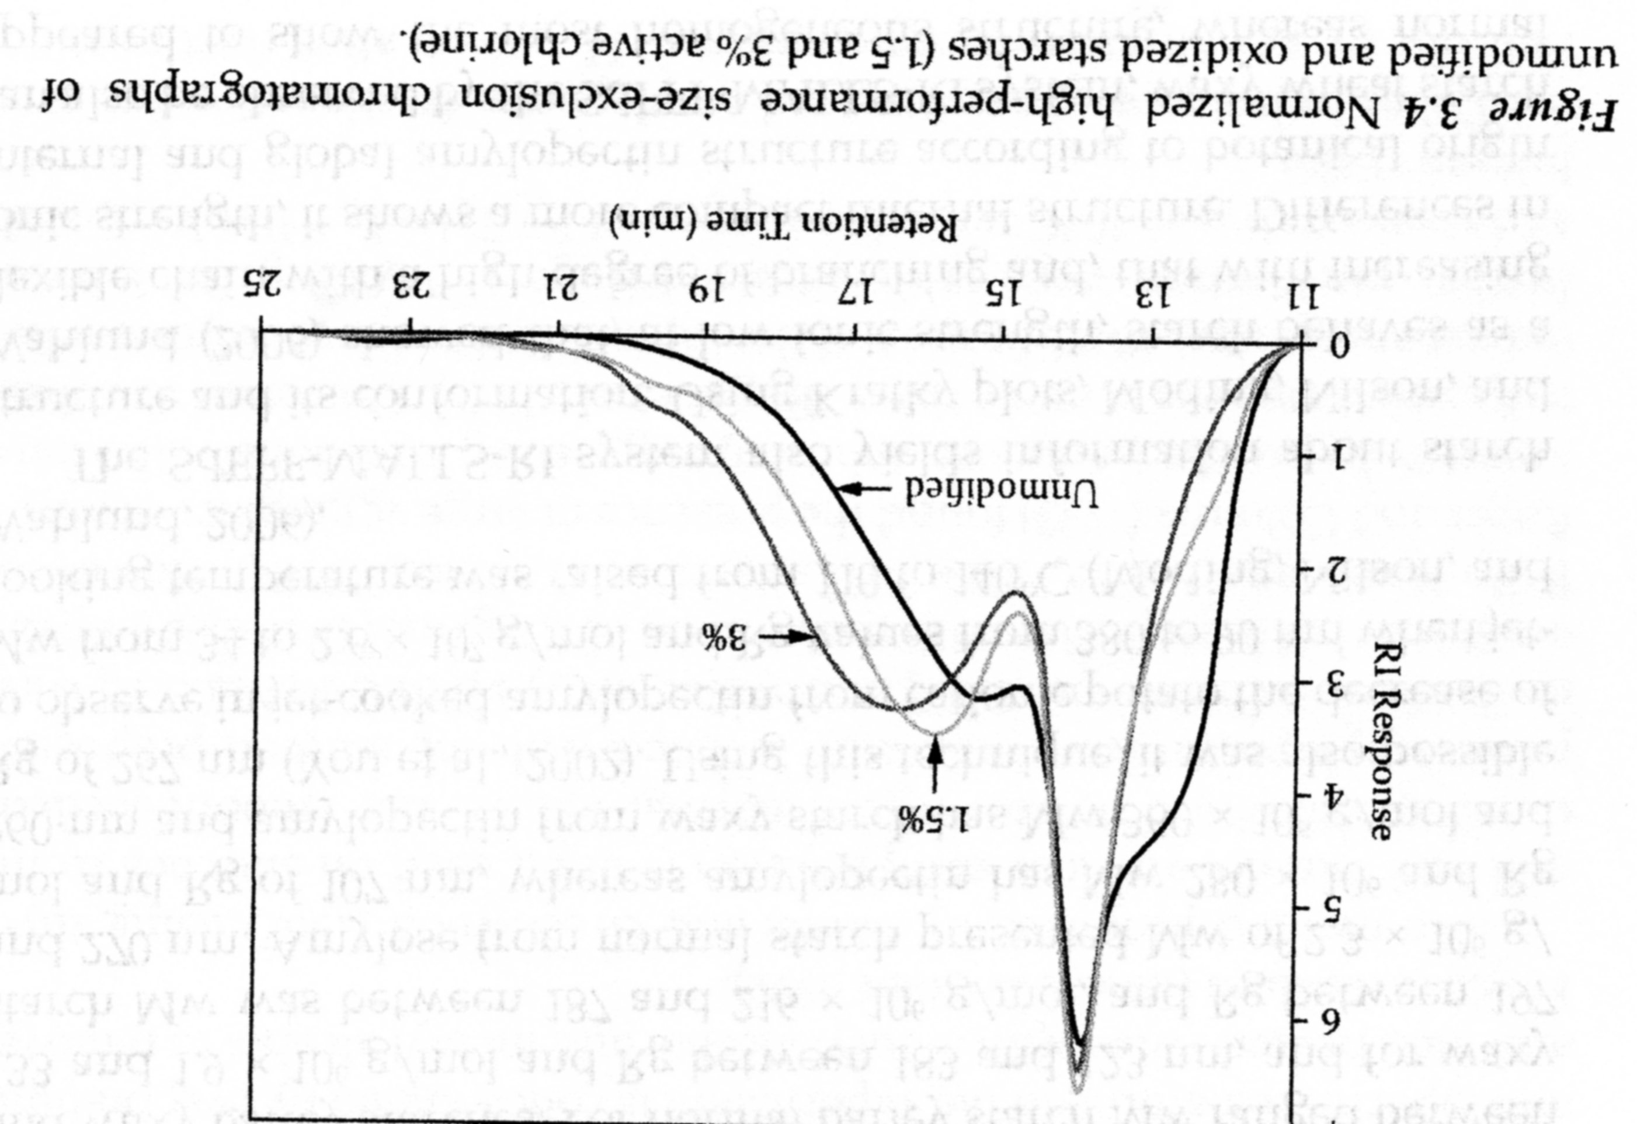
Starch MWD 1 (method GPC)
OXIDATION CRAKS THE MAIN CHAIN > MW LOWERING

Slide 49
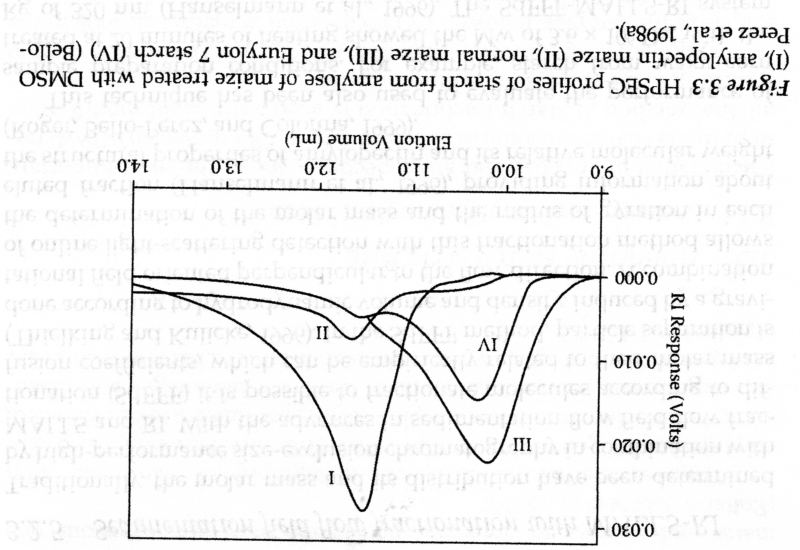
Starch MWD 2 (method GPC)
What can be done by DMSO, I do not know!
VARIOUS Starches > VARIOUS MWD

Slide 50
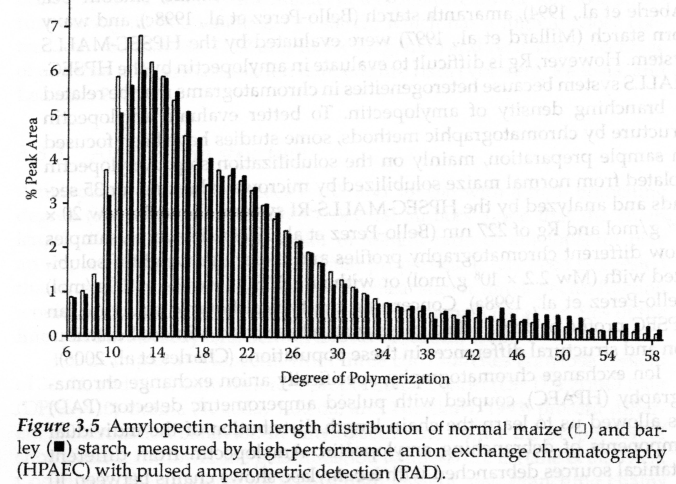
Starch MWD 3
VARIOUS Starches > almost the Same MWD
Starch is the je NATURAL POLYMER And so MWD is different for the same Plants’ Sources

Slide 51
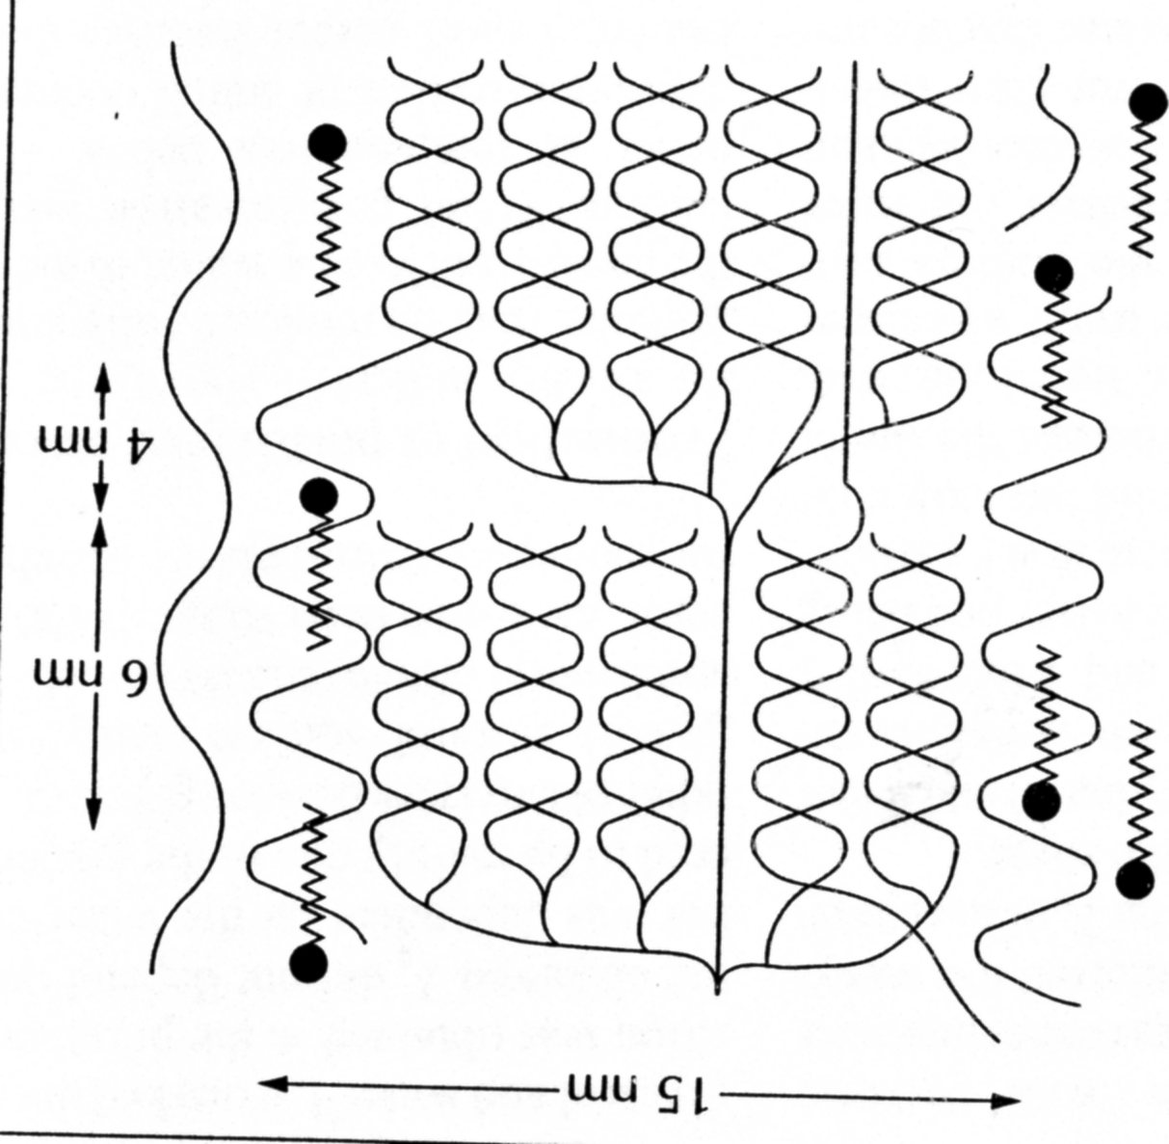
Possible deposition of the Fats molecules in the Cereal Starch
Molecule of Fat in the Amylose helix
I do not like this Scheme, because Fats are TRIGLYCERIDES and here is only one Helix!
There is not enough Space in the Helix of Amylose!

Slide 52
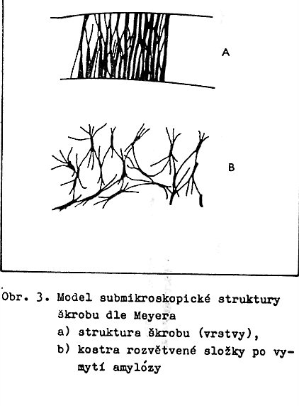
supramolecular STRUCTURE of STARCH
Crystalline parts are permeated by and connected by Amorphous parts (NONCrystalline ), as it is in synthetic SEMIKRYSTALLINE polymers
Spherollitic Structure of the Starch Particle
Linear AMYLOSE – Crystallize via Hydrogen bond
Branched AMYLOPECTIN – the only enough long Branches can Crystallize. The Basic chain can go trough many such Crystalline parts.
supramolecular Structure of the Starch Particle according to Meyer:
Structure of the Starch layer
Framework of the branched part after Washing out the Amylose

