Slide 1
Optogalvanic spectrometry
Vítězslav Otruba

Slide 2
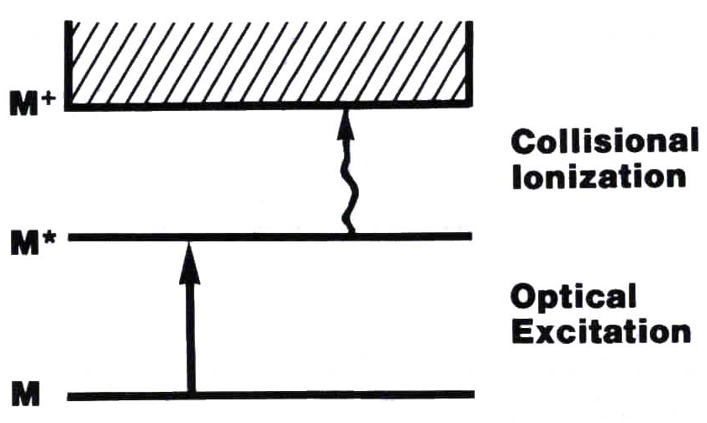
Fundamentals of the method
The optogalvanic effect utilizes a combination of atom excitation by resonance radiation and collision ionization by plasma (flame) particles to selectively ionize the determined elements. Ionization is measured using the generated ions and thus indirectly the absorption of radiation.
The first experimental observation was made by Penning (r.1928) during irradiation of the neon discharge with another neon lamp.

Slide 3
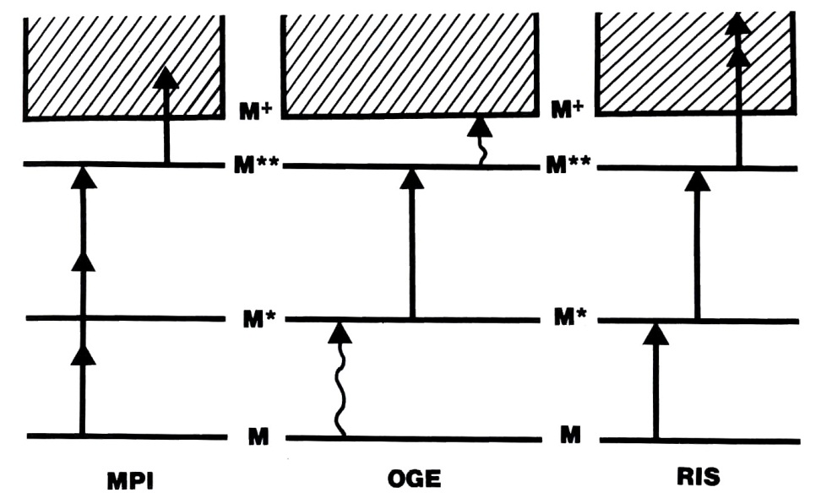
Multiphoton Ionization
Ionization in MPI is achieved by intense non-selective radiation of very high intensity. Absorption of a series of photons that excite an atom (molecule) into virtual energy states leads to ionization.

Slide 4
Resonance Ionization Spectroscopy
RIS uses stepped excitation by resonant radiation followed by ionization. Usually requires two to three tunable lasers.
The method is highly selective (the resulting selectivity is the product of the selectivity of excitation to individual stages).
Achieved selectivity of 10²² (Cs in Ar), isotopic ratios up to10¹³ – 10¹⁸ (1 pg in 1t, 1 ag ¹⁴C)

Slide 5
Optogalvanic Effect
It uses a combination of resonant laser radiation with collision excitation with particles with high kinetic energy:
  Kinetic energy of particles at high temperature (thermal movement in flame, plasma)
  Kinetic energy of charged particles accelerated by electric field (discharges, especially under reduced pressure)
  It is a certain variant of atomic fluorescence, where there is a high probability of deexcitation by collisions
  Does not require optical detection equipment
  It detects all ions as opposed to the tiny number of photons detected during fluorescence.

Slide 6
Applications
Laser keying measurement
Calibration of wavelengths (e.g. tunable lasers)
Spectroscopy of states with long life
Doppler-free spectroscopy
Spectroscopy of radicals
Trace analysis
  in flame
  in electrotermal atomizer
  in hollow cathode

Slide 7
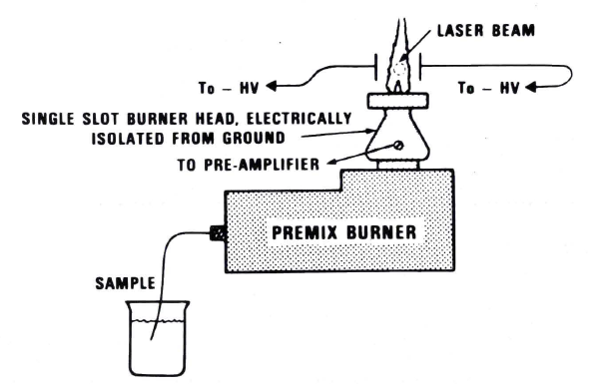
Laser-Enhanced Ionization Spectrometry
In Flames
High voltage on electrodes - 1000 V, burner isolated from apparatus,
connected to the preamplifier input. An analytical signal is taken from the torch (anode).

Slide 8
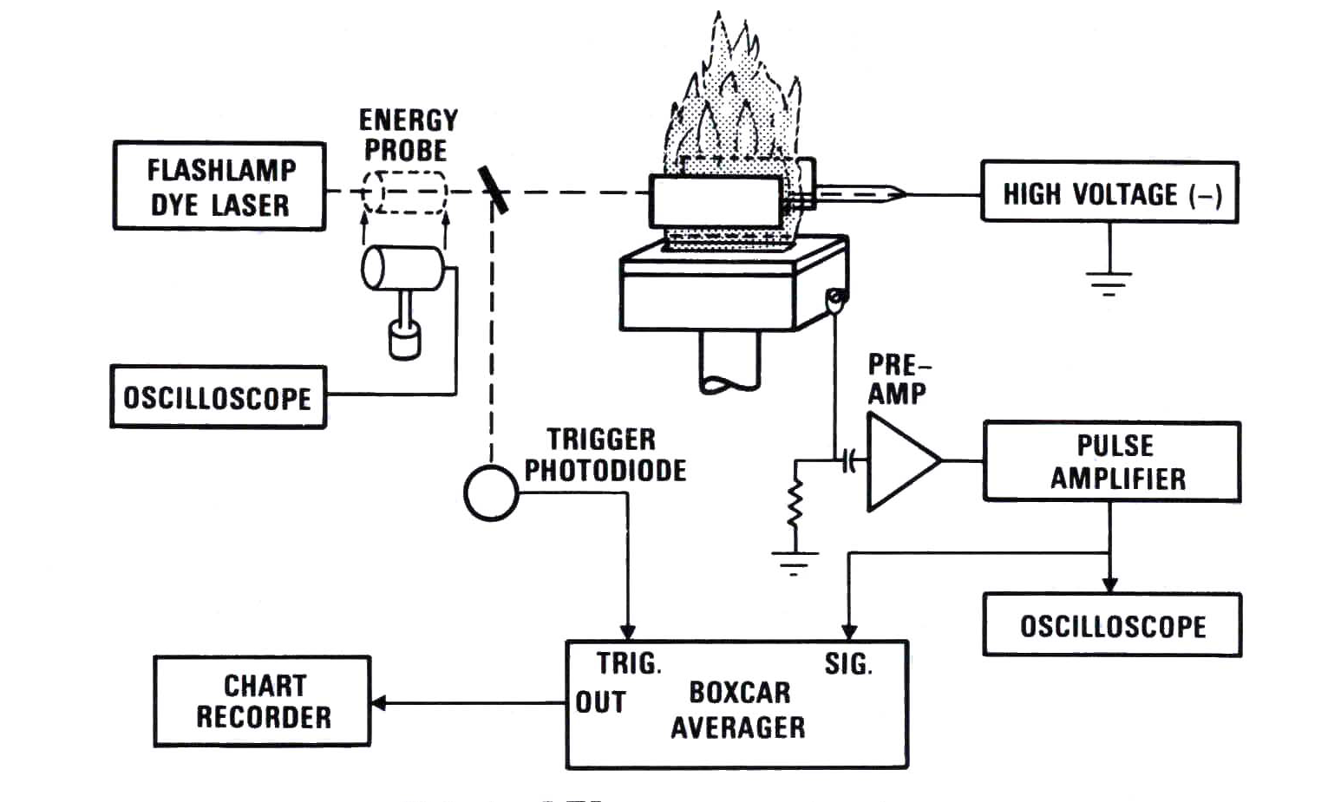
LEI measurement system

Slide 9
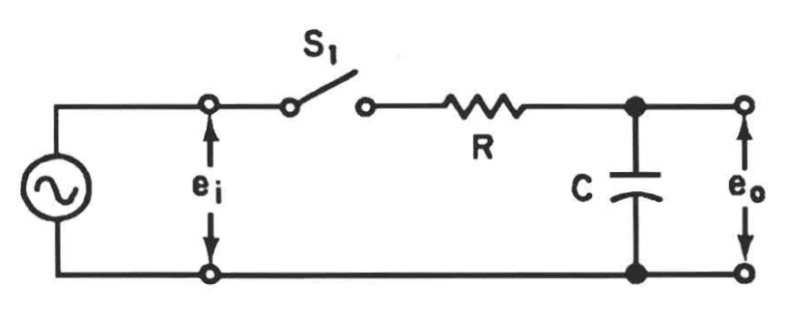
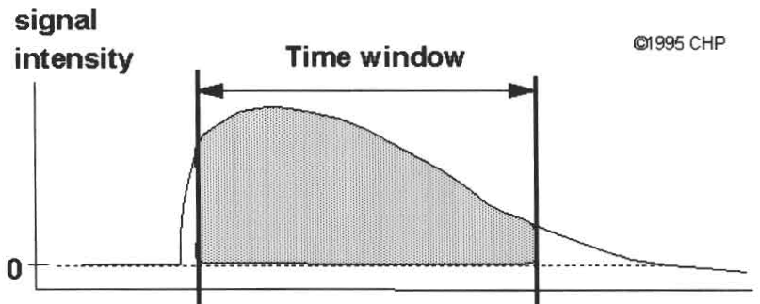
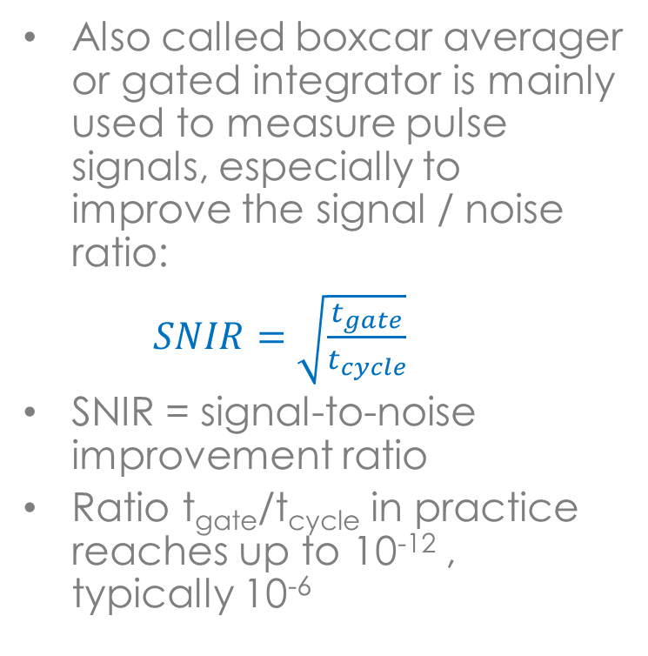
Boxcar integrator
Also called boxcar averager or gated integrator is mainly used to measure pulse signals, especially to improve the signal / noise ratio:
$SNIR=\sqrt{\frac{t_{gate}}{t_{cycle}}}$
SNIR = signal-to-noise improvement ratio
Ratio t_{gate}/t_{cycle} in practice reaches up to 10⁻¹² , typically 10⁻⁶
tcycle
tgate
time

Slide 10
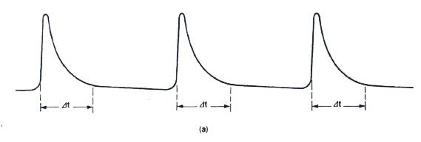
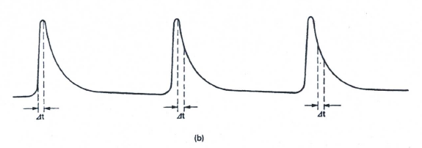
Basic integrator modes
The integrator can be used as a gateway that transmits periodic signals comparable to pulse duration Δt. The gate opening length can be freely set, including the determination of the sample pulse offset against the measured pulse.
In the second case, in the time of the pulse waveform scanning is performed. It is also possible to set an arbitrarily wide time window for the selected time resolution of the pulse waveform.

Slide 11
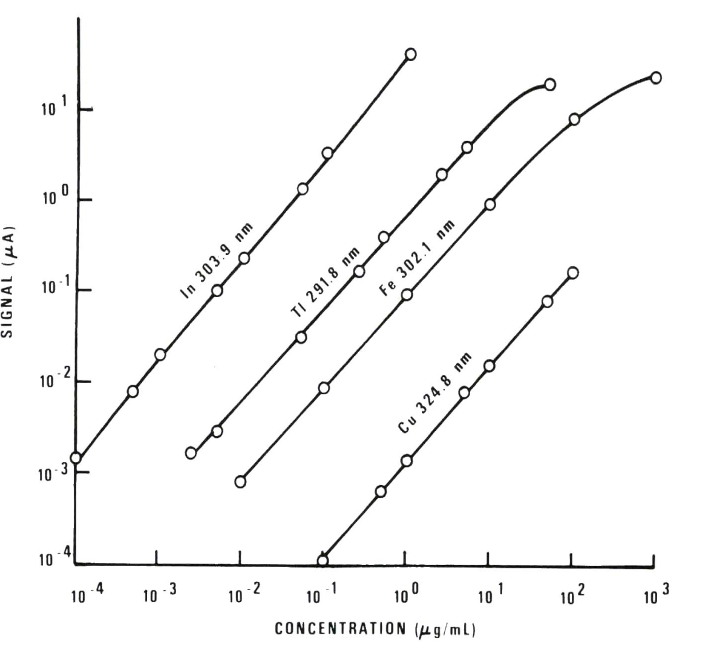
LEI - flame
Dynamic range of concentrations
The linear concentration range is 4 - 5 orders of magnitude
Application in practice to about 20 elements

Slide 12
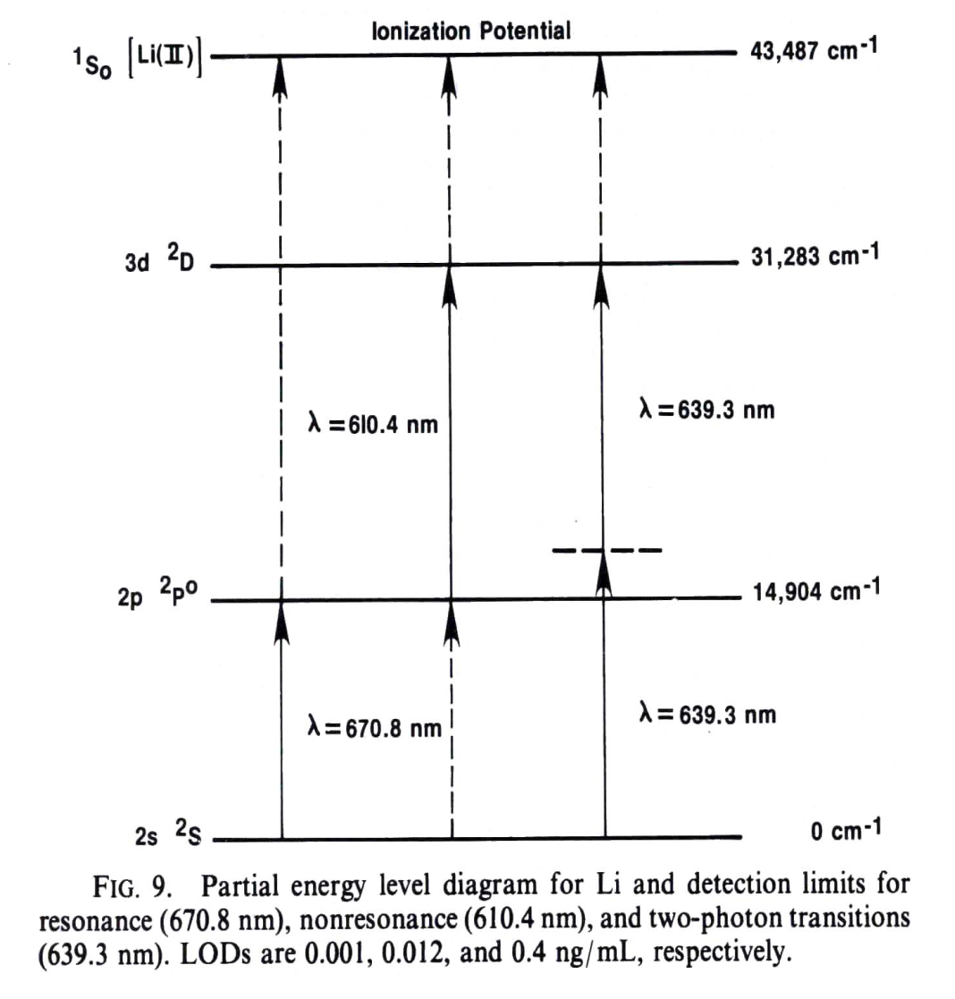
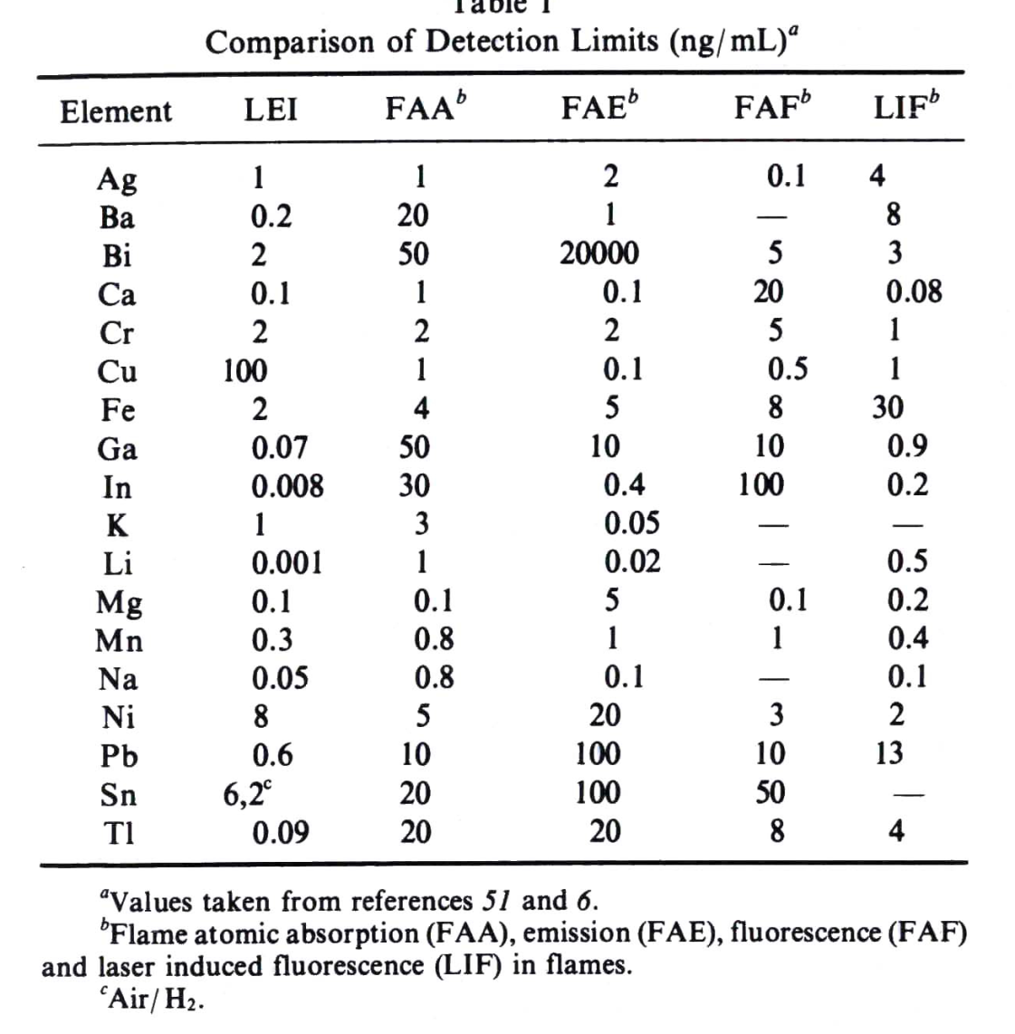
LEI – flame - LOD

Slide 13
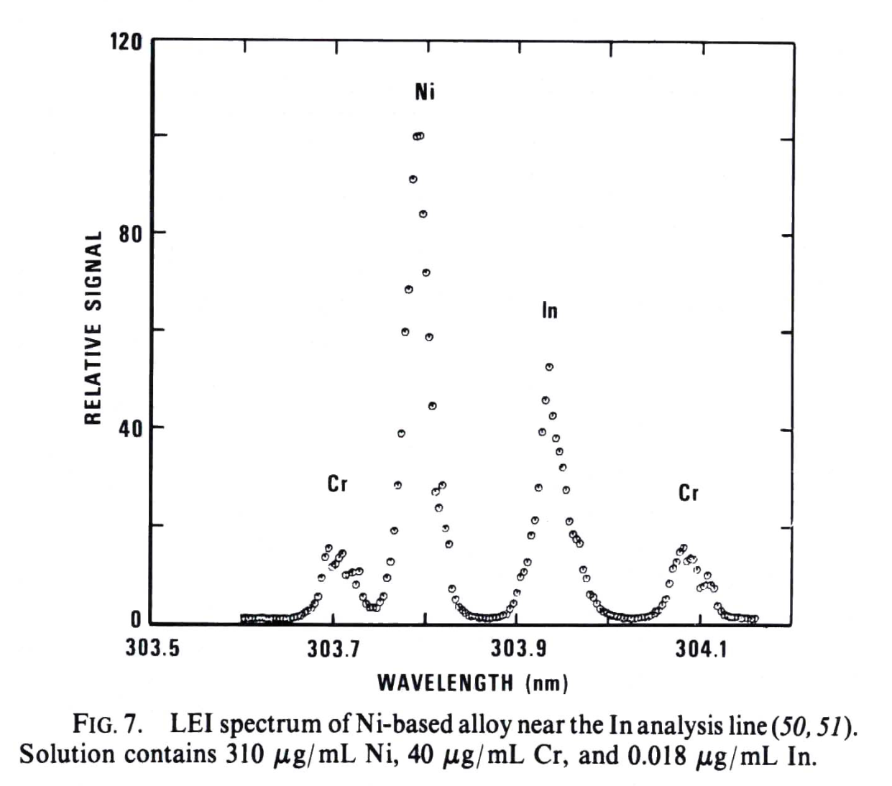
LEI – flame - selectivity
The spectral resolution is determined by the absorption profile of the spectral line and the properties of the measuring radiation.
Using a sodium dye laser, 589.0 nm was R≅60 000
When using a commercial broadband laser it was R≅8700 – see fig.

Slide 14
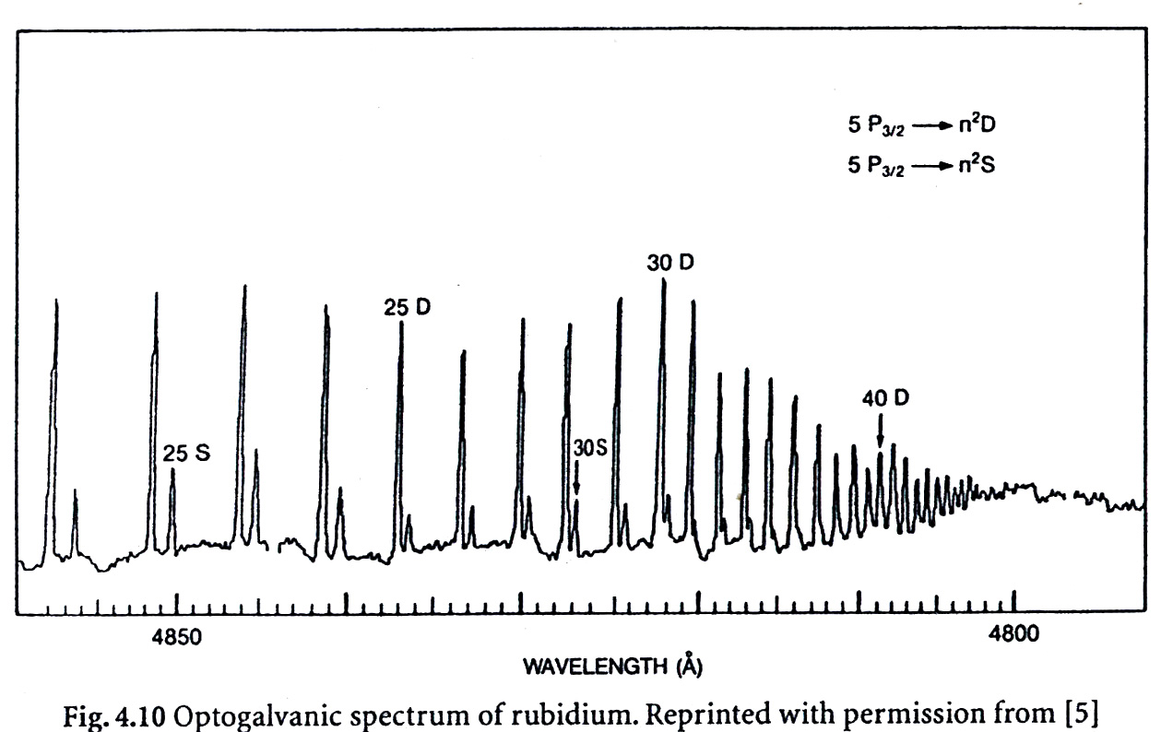
LEI – absorption of non-resonance transitions

Slide 15
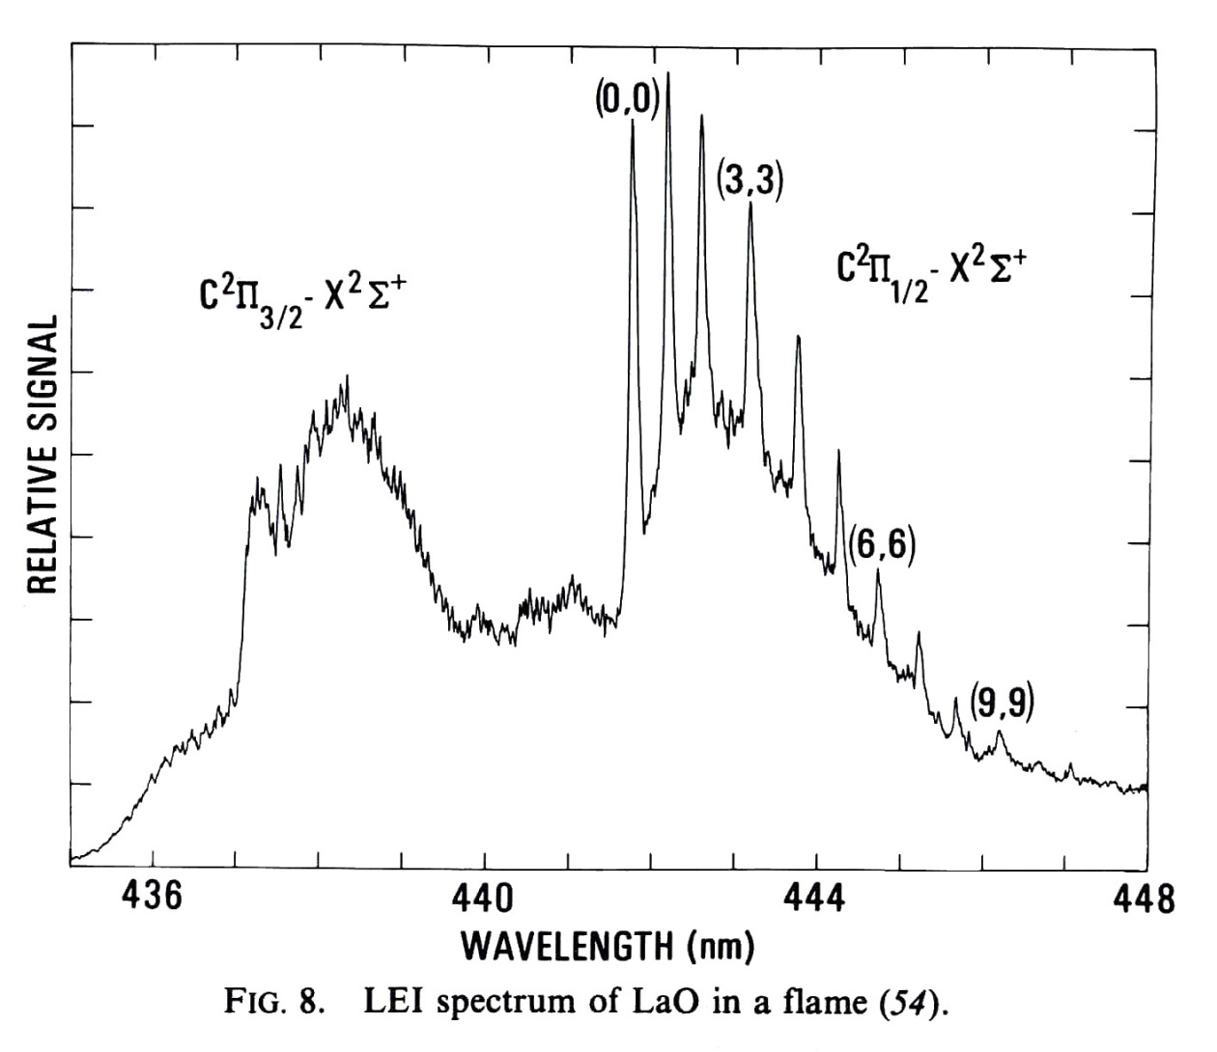
LEI-flame-molecular spectra

Slide 16
LEI - flame
LEI differences from other flame methods:
It is possible to use non-resonant lines with good sensitivity. E.g. for Li, the 2p level occupation in the flame (Boltzmann) is only 2.10⁻⁴ of baseline, but the LOD is only 12 times worse.
Possibility to use two-photon transitions with good sensitivity
Low sensitivity for elements with high ionization potential. For elements with IP> 9 - 10 eV it would be necessary to work in the vacuum UV region of the spectrum.
Interference of determination (reduced sensitivity) by easily ionizable matrix elements

Slide 17
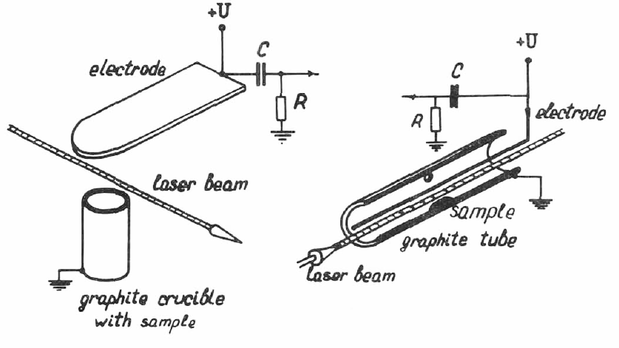
OGE electrothermal atomization

Slide 18
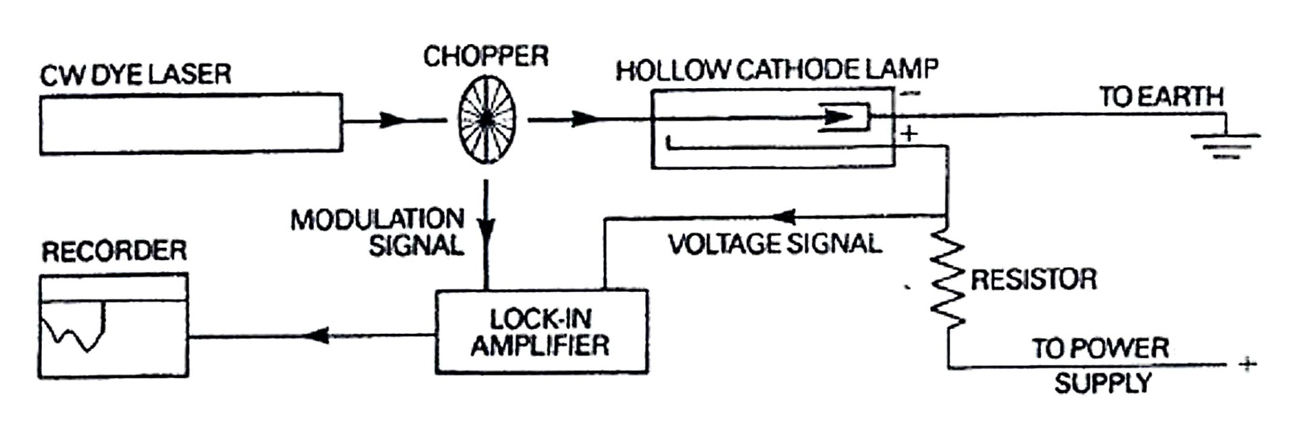
OGE in gas discharges
Applications:
Calibration of lasers wavelength using discharge tubes, a hollow cathode without using a complicated optical apparatus (line cathode material and filler gas).
High energy levels can also be excited in discharges, which can be measured by OGE.
Sufficient concentration of atoms even low volatile materials.
Possibilities of Doppler-free spectrometry of atoms and molecules with resolution up to 100 MHz.
Isotope analysis.

Slide 19
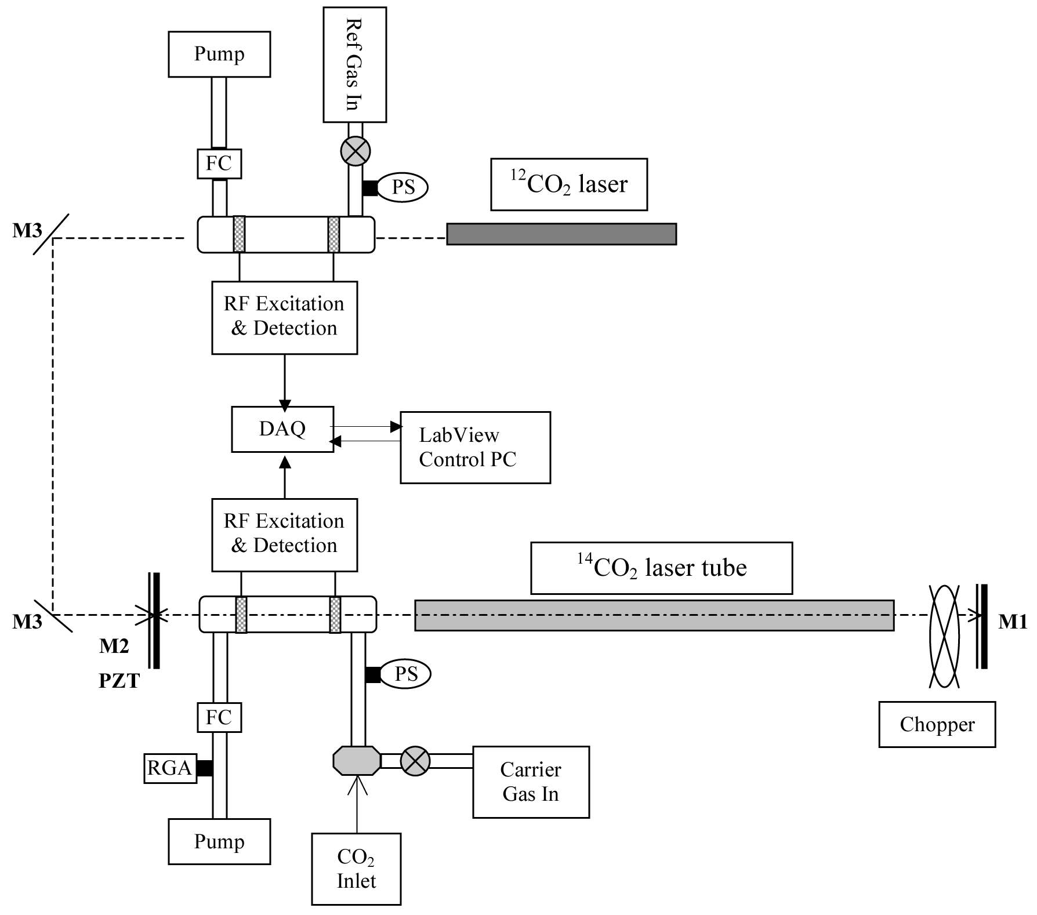
Intracavity Optogalvanic Spectroscopy, Ultra-sensitiveAnalytical Technique for ¹⁴C Analysis Murnick et al.Anal Chem. 2008 July 1; 80(13): 4820–4824
Experimental configuration: The OGE cell inside the cavity has Brewster windows to reduce losses. The C12 laser incident on the OGE cell provides a “C12 signal” that is used for normalization of the C14 signal. The shutter inside the laser cavity is for modulating the 14CO2 laser. M1: High reflective mirror & grating, M2: 85% reflective output coupler, M3: Gold plate mirror, PS: Pressure Sensor, FC: Flow Controller, RGA: Residual Gas Analyzer, DAQ: Data Acquisition Board

Slide 20
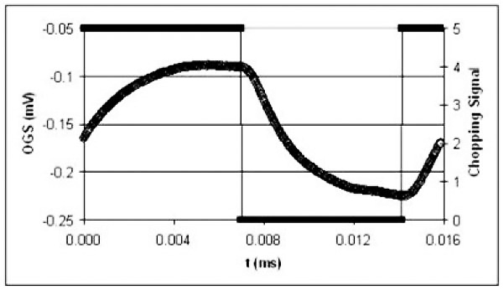
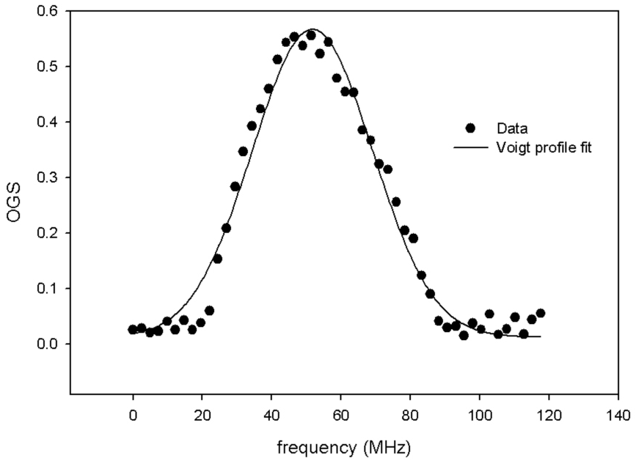
Experimental results
The OGE signal in response to a laser modulated at 63 Hz. The sample is 5% CO₂ in N₂ at
10⁻¹¹ ¹⁴C enrichment
Resonance curve for intracavity optogalvanic effect. The solid line is a best fit Voigt Profile,
The width, 48 MHz is expected for ¹⁴CO₂ in the 5 mbar discharge at 385°C

Slide 21
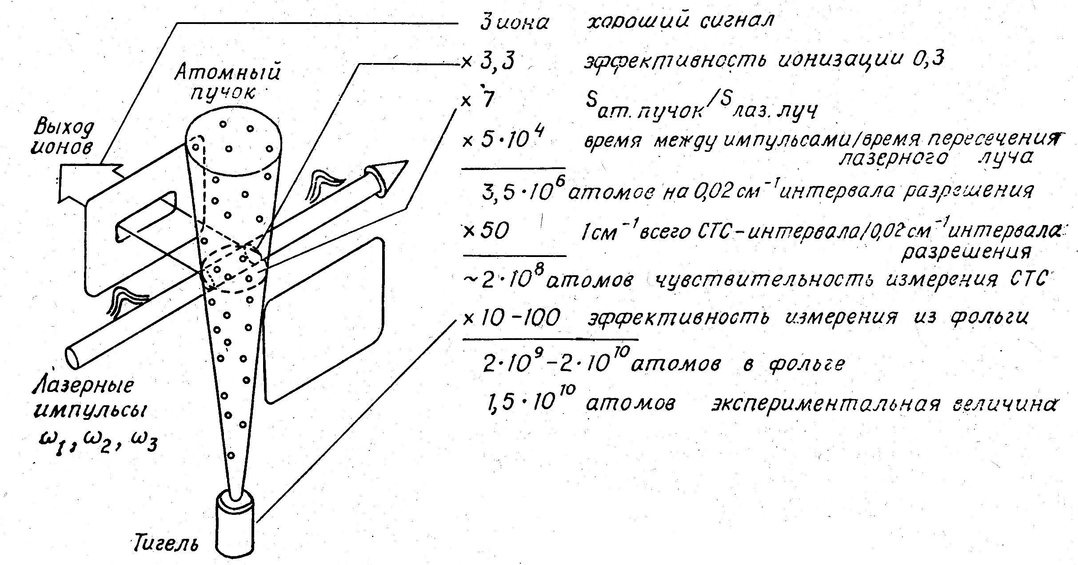
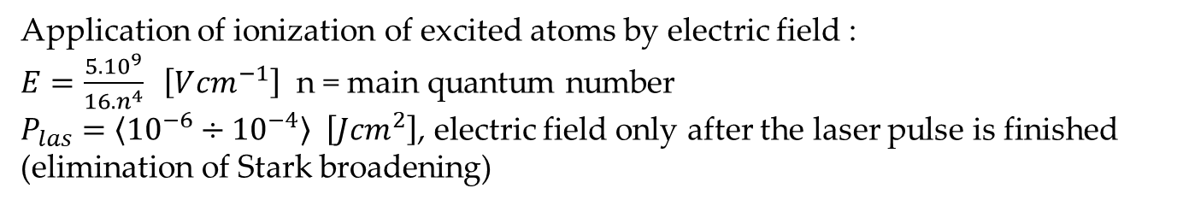
Photoionization - atom detection
Application of ionization of excited atoms by electric field :
$E=\frac{5.{10}^{9}}{16.n^{4}} \left[V{cm}^{−1}\right]$ n = main quantum number
$P_{las}=\left\langle {10}^{−6}÷{10}^{−4}\right\rangle \left[J{cm}^{2}\right]$, electric field only after the laser pulse is finished
(elimination of Stark broadening)

