Slide 1
Laser-Induced Breakdown Spectroscopy
(LIBS)

Slide 2
Content
Introduction to fundamentals of LIBS
Basic instrumentation and configurations
Double pulse LIBS (instrumentation)
Depth profiling (zinc coated steel, ceramic tiles)
Elemental mapping (teeth, plants, urinary stones ...)

Slide 3
Content
LIBS techniques for powder materials (pressed pellets)
LIBS techniques for liquid samples (algae suspension)
LIBS technique for nanoparticles (QDs)
Remote analysis by LIBS (identification of biominerals)
Conclusion

Slide 4
Laser beam - solid sample interaction
ICP-OES
laser beam
aerosol
ICP-MS
microplasma
atoms, ions,
particles, aerosol
absorption of radiance
in plasma
vaporization
atomization
excitation
ionization
hν
LIBS
deposit
solid sample
crater
crumbling
heating, melting,
vaporization, explosion
shock
wave

Slide 5
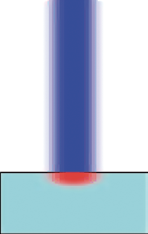
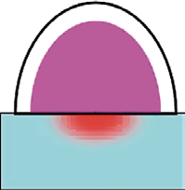
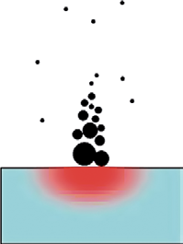
Laser beam - solid sample interaction
Plasma ignition: ns laser (10⁷ – 10¹¹ W/cm² )
fs laser (10¹² – 10¹⁷ W/cm² )
Thermal vaporization (10⁻⁹ – 10⁻⁸ s)
Non-thermal ablation (10⁻⁹ – 10⁻⁸ s)
Plasma shielding (10⁻⁹ – 10⁻⁸ s)
Plasma expansion and cooling:
Shockwave propagation
Plasma expansion (10⁻¹¹ – 10⁻⁶ s)
Plasma radiation cooling (10⁻⁶ – 10⁻⁴ s)
Particle ejection and condensation:
Ejection of liquid droplet (10⁻⁸ – 10⁻⁶ s)
Solid exfoliation (10⁻⁸ – 10⁻⁶ s)
Nano particles formation (10⁻⁴ – 10⁻³ s)
Laser-Induced Breakdown Spectroscopy Jagdish P. Singh & Surya N. Thakur
© 2007 Elsevier

Slide 6
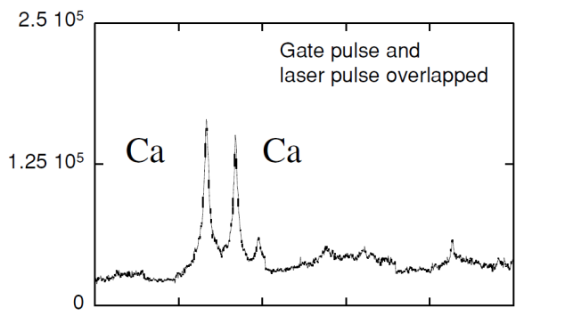
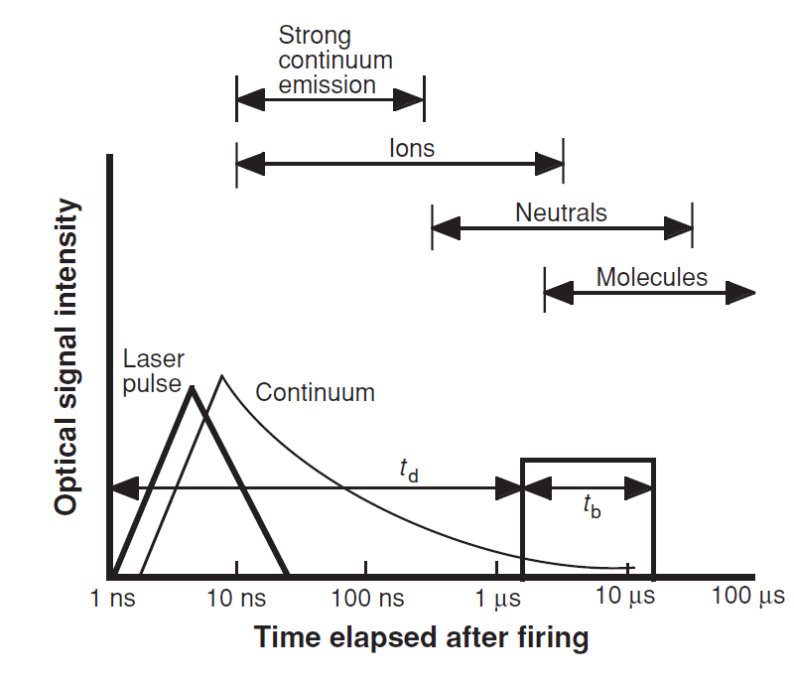
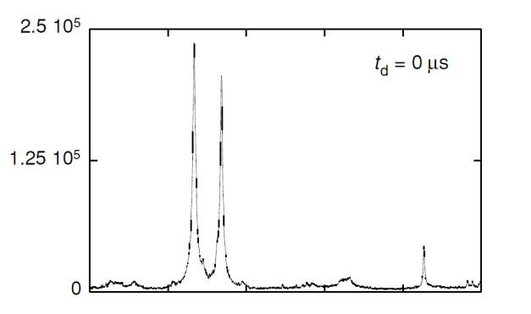
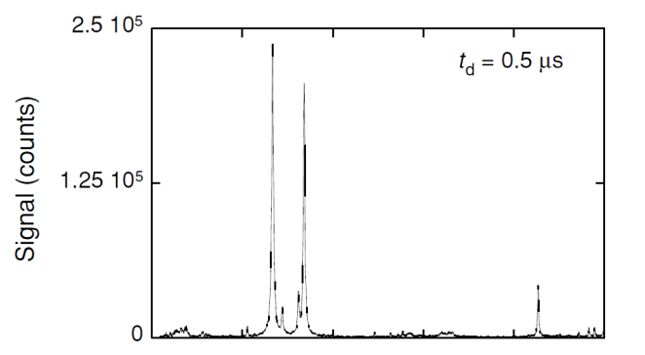
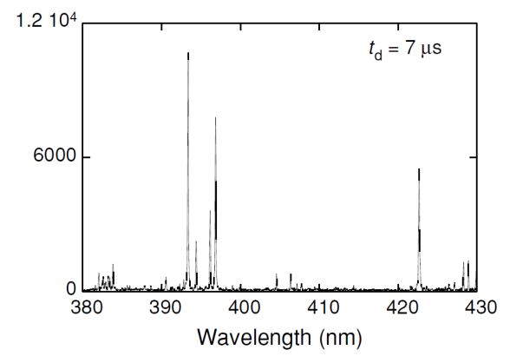
Important time periods after plasma formation
t_{d} - delay time, t_{b} – gate pulse width
Laser-Induced Breakdown Spectroscopy (LIBS), Fundamentals and Applications Andrzej W. Miziolek, Vincenzo Palleschi, Israel Schechter © 2006 Cambridge

Slide 7
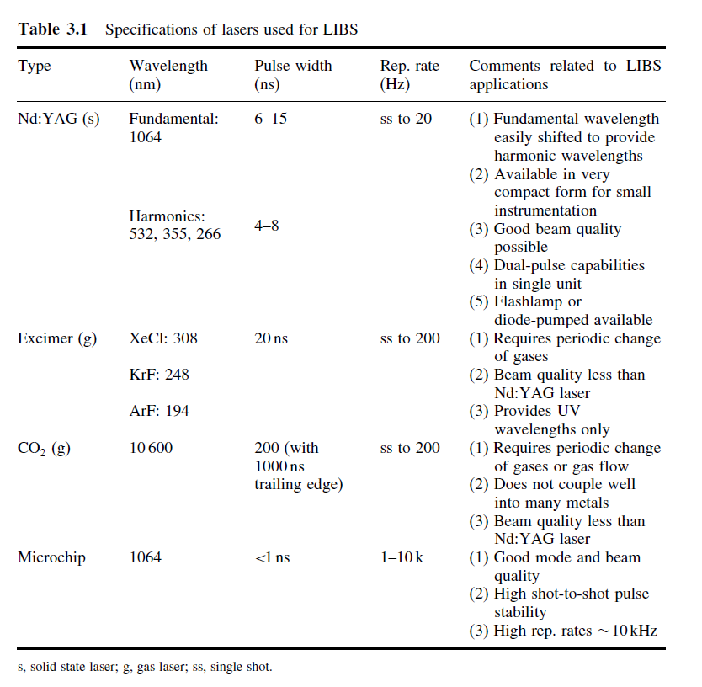
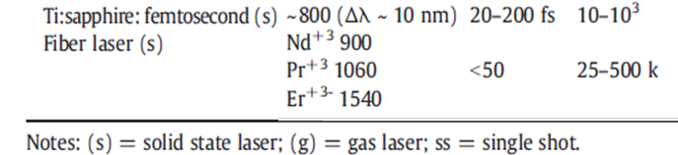
LIBS - lasers
Handbook of Laser-Induced Breakdown Spectroscopy D. Cremers and L. Radziemski
© 2006 John Wiley & Sons, Ltd

Slide 8
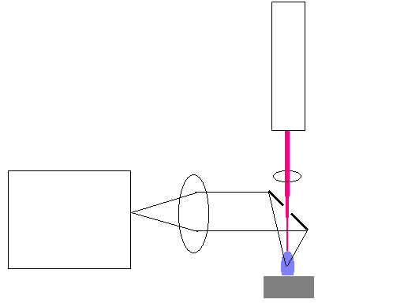
Basic configurations
1. Experimental setup with pierced mirror
Laser
Triggering
Spectrometer
ICCD
z
y
PC
Sample (x,y,z stage)
x

Slide 9
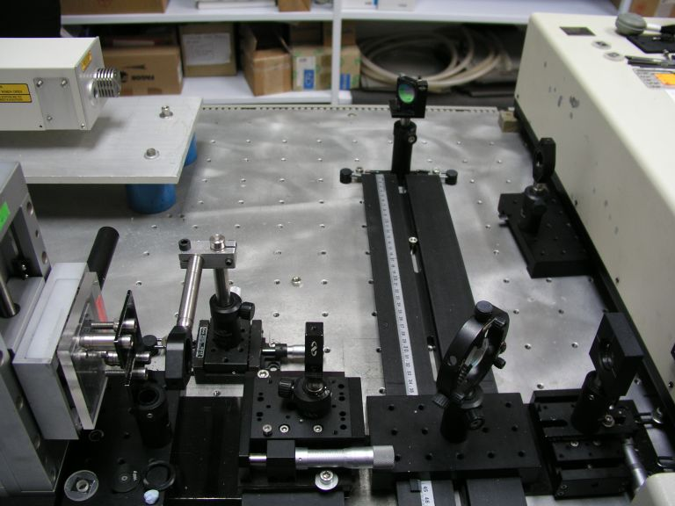
Basic configurations
Laser
Spectrometer
Dichroic mirror
Sample
University of Malaga 2006

Slide 10
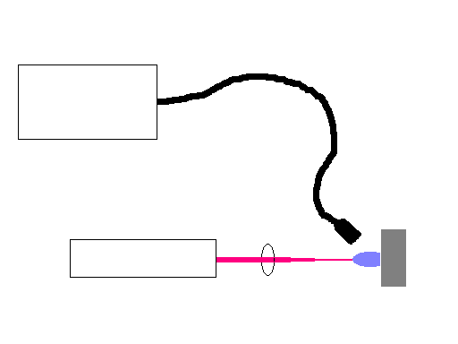
Basic configurations
2. Experimental setup with optical fiber
PC
Optical fiber
Spectrometer
ICCD
Collecting optics
Sample
Laser
Triggering

Slide 11
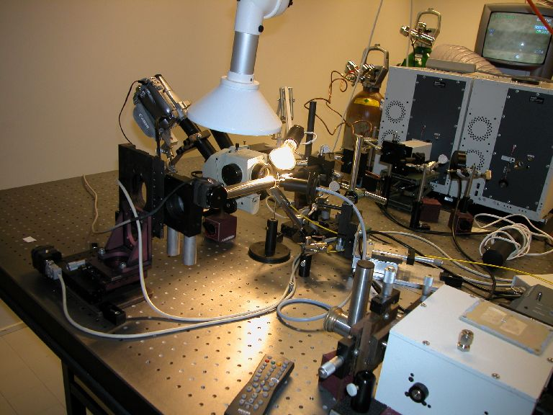
Basic configurations
University of Jyvaskyla 2007

Slide 12
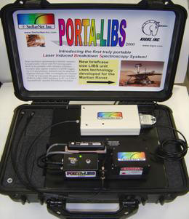
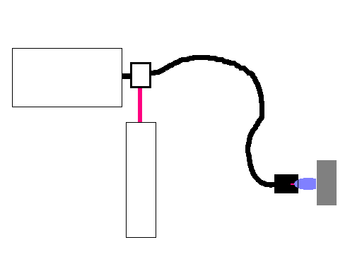
Basic configurations
3. Experimental setup with optical fiber
(portable LIBS, underwater measurements)
Adapter
PC
Optical fiber
Spectrometer
ICCD
Sample
Triggering
Laser
Probe

Slide 13
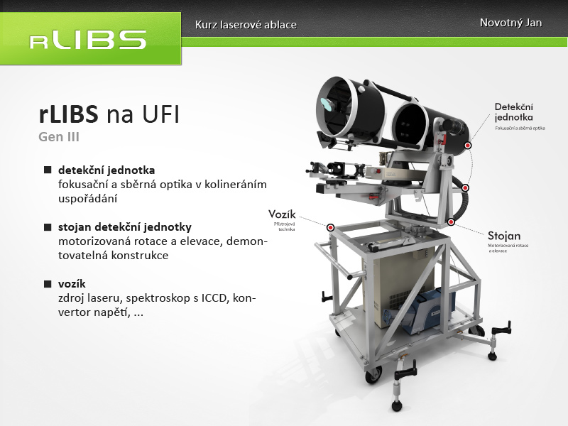
Basic configurations
PC
3. Experimental setup with telescope
(Stand-off measurements)
ICCD
Triggering
Spectrometer
Telescope
Sample
Laser

Slide 14
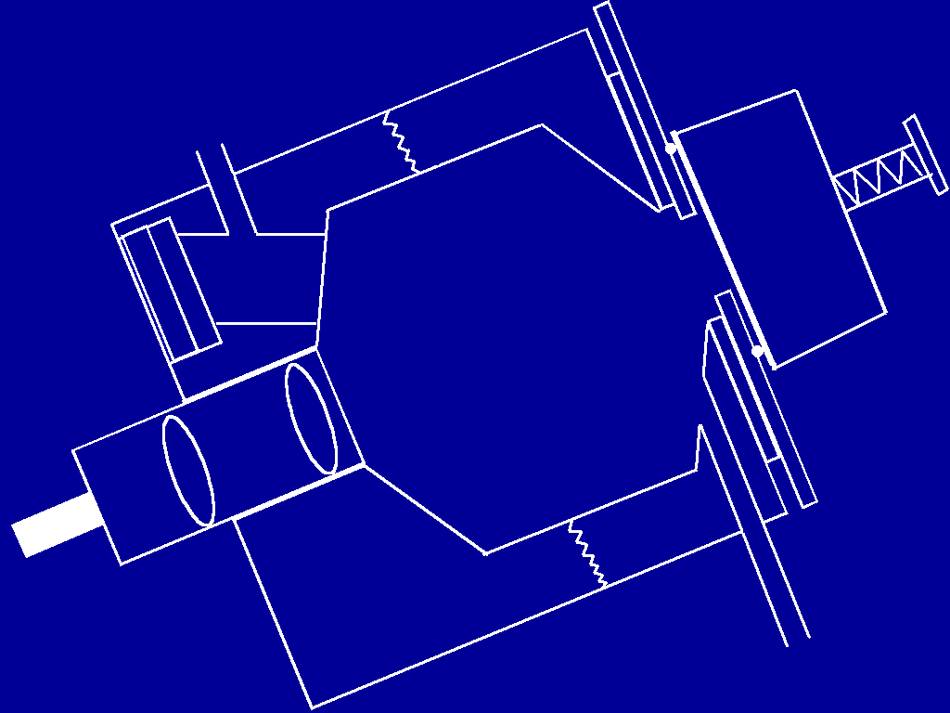
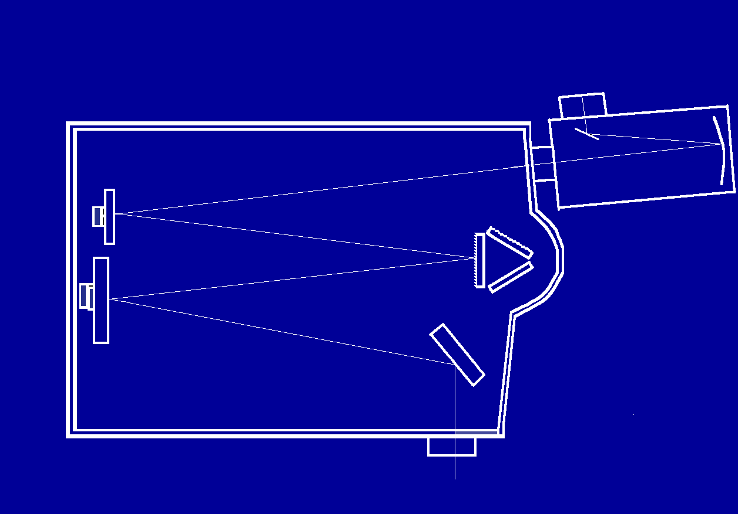
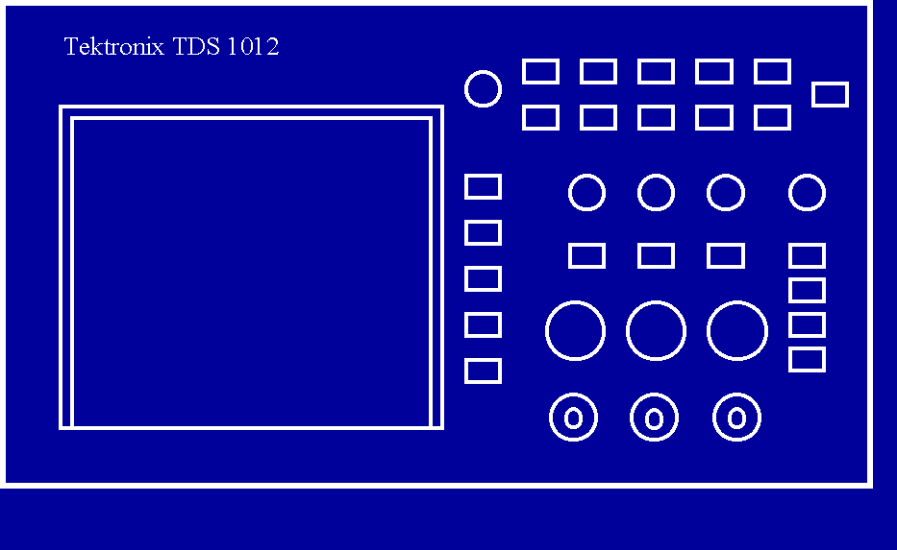
MU setup - 1st generation
Nd:YAG Brilliant
sample
10 Hz 5 ns
Jobin Yvon – Triax 320
OSCILLOSCOPE
Tektronix TDS 1012
PMT Hamamatsu R928
Gated Socket Assembly
Hamamatsu C1392
Control unit
(laboratory made)
Triggering – Q switch
Triggering oscilloscope
DELAY TIME

Slide 15
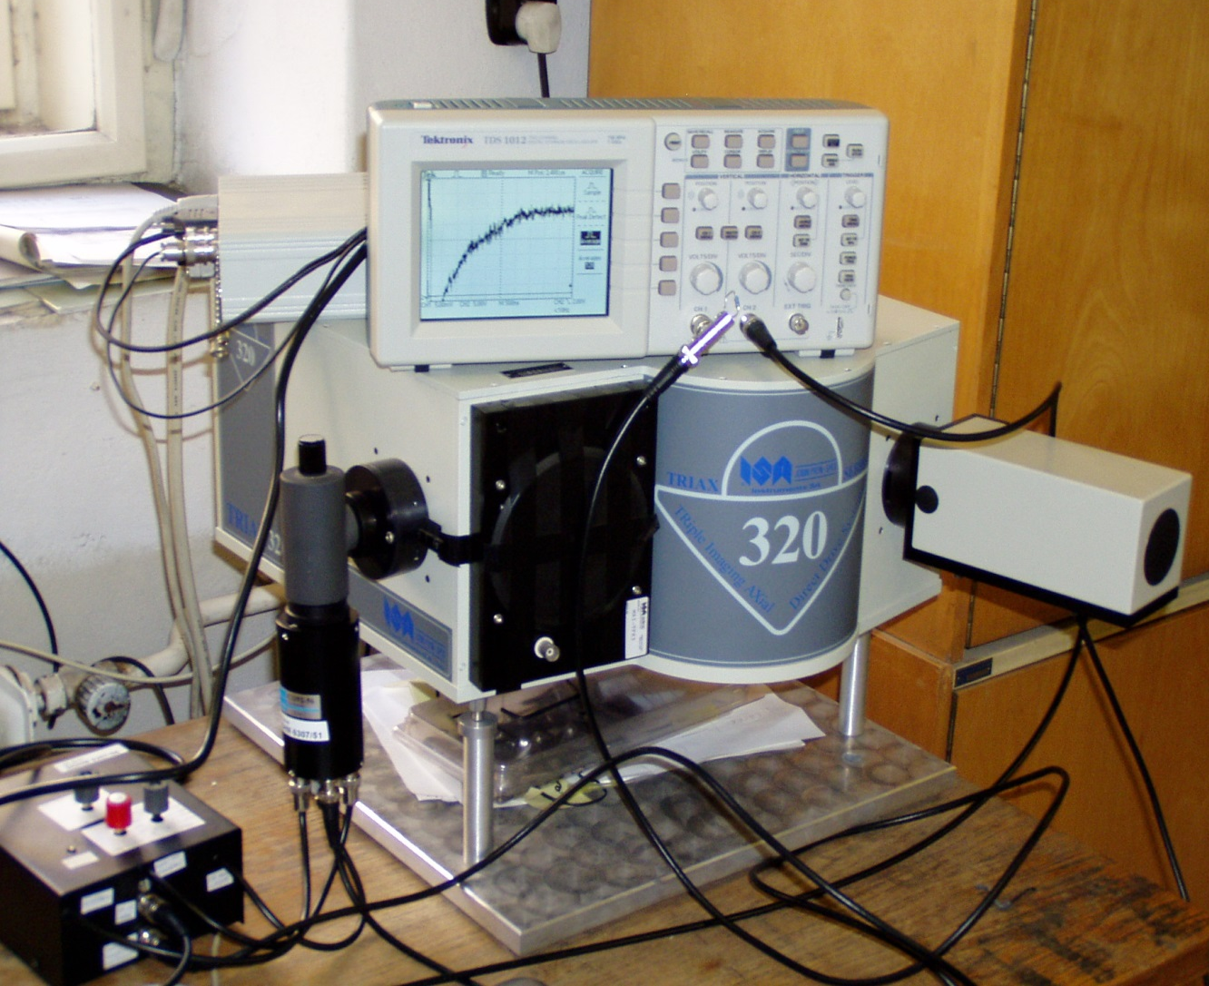
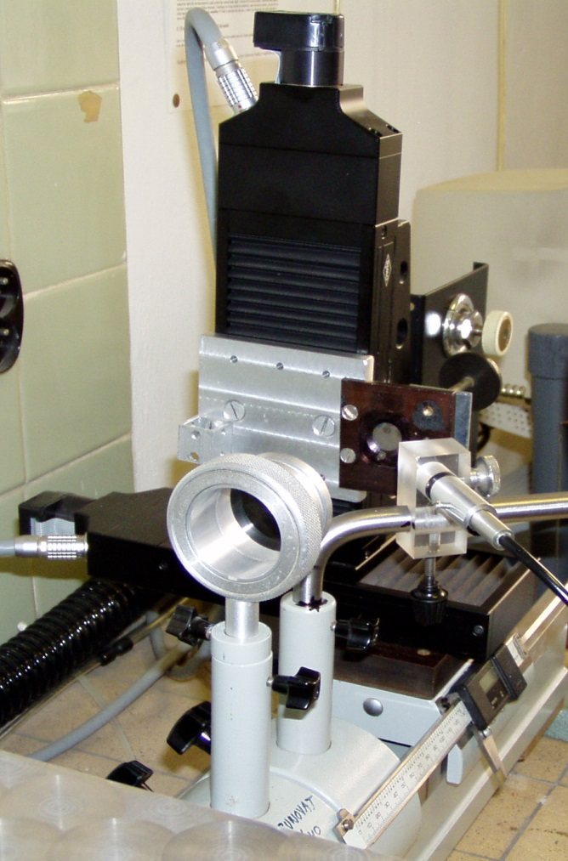
MU setup - 1st generation
x,y stage OWIS
Nd:YAG Brilliant (Quantel)
glass lens
optical fiber
Monochromator TRIAX 320 (Czerny – Turner 320 mm)
PMT Hamamatsu R928
Control of the PMT by Q – switch pulse
Oscilloscope TDS 1012

Slide 16
MU setup - 2nd generation
Nd:YAG Brilliant
sample
10 Hz 5 ns
Jobin Yvon – Triax 320
ICCD Jobin Yvon Horiba
Flashlamp control
Q – switch control

Slide 17
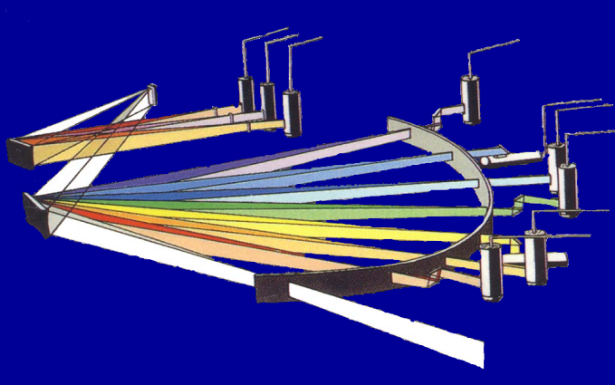

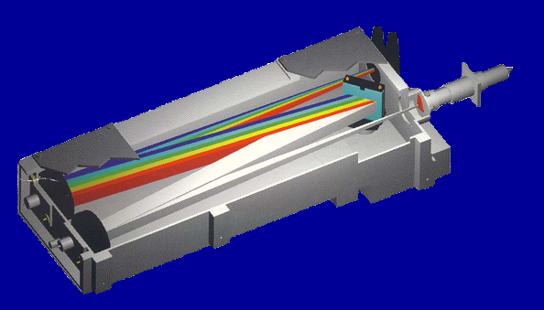
LA-ICP-OES
Ar, He
Nd:YAG Brilliant
sample
10 Hz 5 ns
ICP-OES Jobin Yvon – 170 Ultrace
POLYCHROMATOR
MONOCHROMATOR

Slide 18
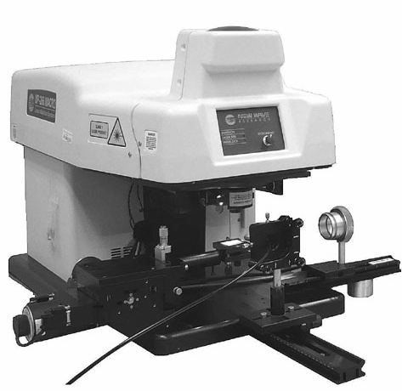
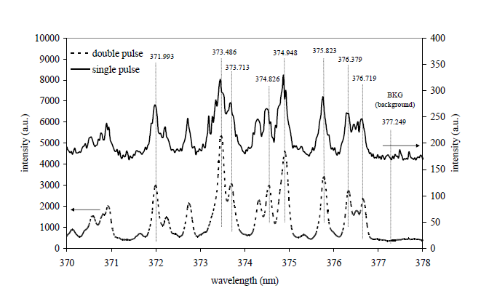
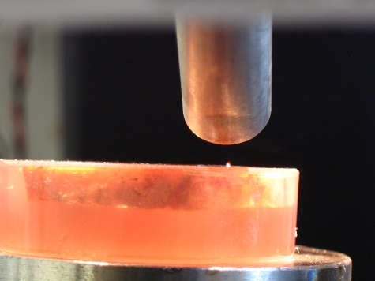
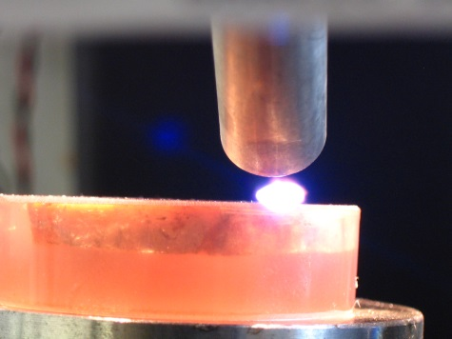
MU setup - 3rd generation
Double pulse technique (DP-LIBS)
Emission enhancement
plasma volume increasing
higher temperature
longer decay time
S/N enhancement
Decreasing of LOD up to two orders of magnitude
New Wave, UP 266 MACRO
Nd:YAG laser @ 266 nm (4^{-th} harmonic frequency)
Second laser pulse Nd:YAG (Quantel Brilliant) @1064 nm
Comparison of the single and double-pulse signals in spectral
region of selected iron lines
Double Pulse
Single Pulse
Novotny, K.; Lutzky, F.; Galiova, M.; Kaiser, J.; Malina, R.; Kanicky, V.; Otruba, V., Double pulse laser ablation and plasma: time resolved spectral measurements.
Chemicke Listy 2008, 102, S1399-S1402.

Slide 19
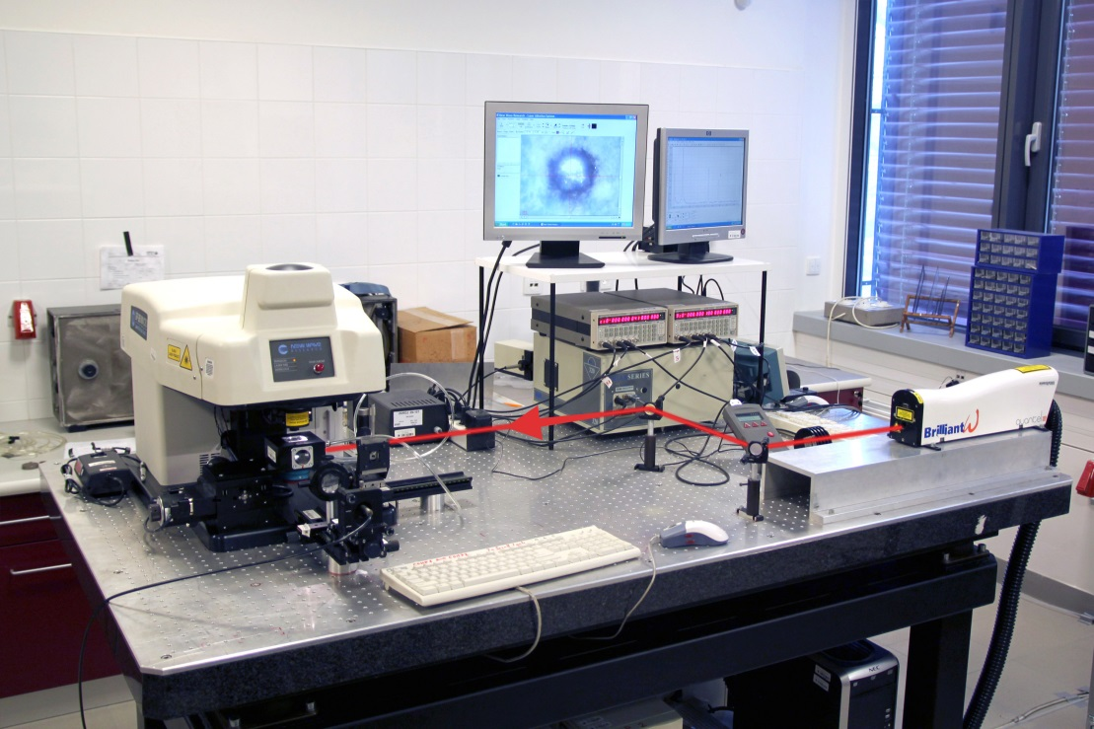
MU setup - 3rd generation
SIMULTANEOUS DP-LIBS AND LASER ABLATION ICP-OES SYSTEM
designed by utilizing a modified commercially available laser ablation system (New Wave, UP 266 MACRO)
no modification of the original optics - possible to use all advantages of the original arrangement
spot ablation for depth profiling, line scanning for lateral analysis and raster scanning for bulk or surface analysis.
second re-heating laser pulse (Quantel Brilliant) is delivered orthogonally
(periscope arrangement allowing precise laser beam positioning)
two digital delay generators DG 645
collection optics for emission transport to the monochromator Triax 320 (Jobin-Yvon)
ICCD Princeton Instruments PI MAX-3
sample holders
(different size and shape)
For LA-ICP-OES experiments the original ablation chamber was replaced with a special laboratory made chamber
window for entering the second orthogonal laser pulse
window for collection of LIP emission
stage for sample height alignment

Slide 20
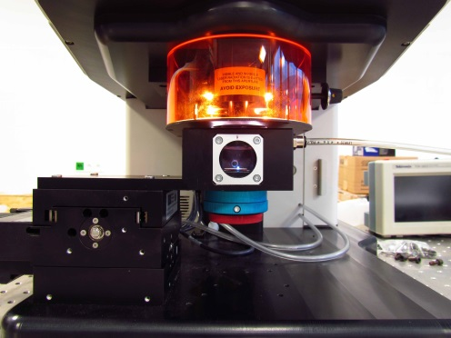
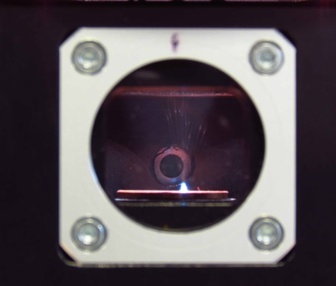
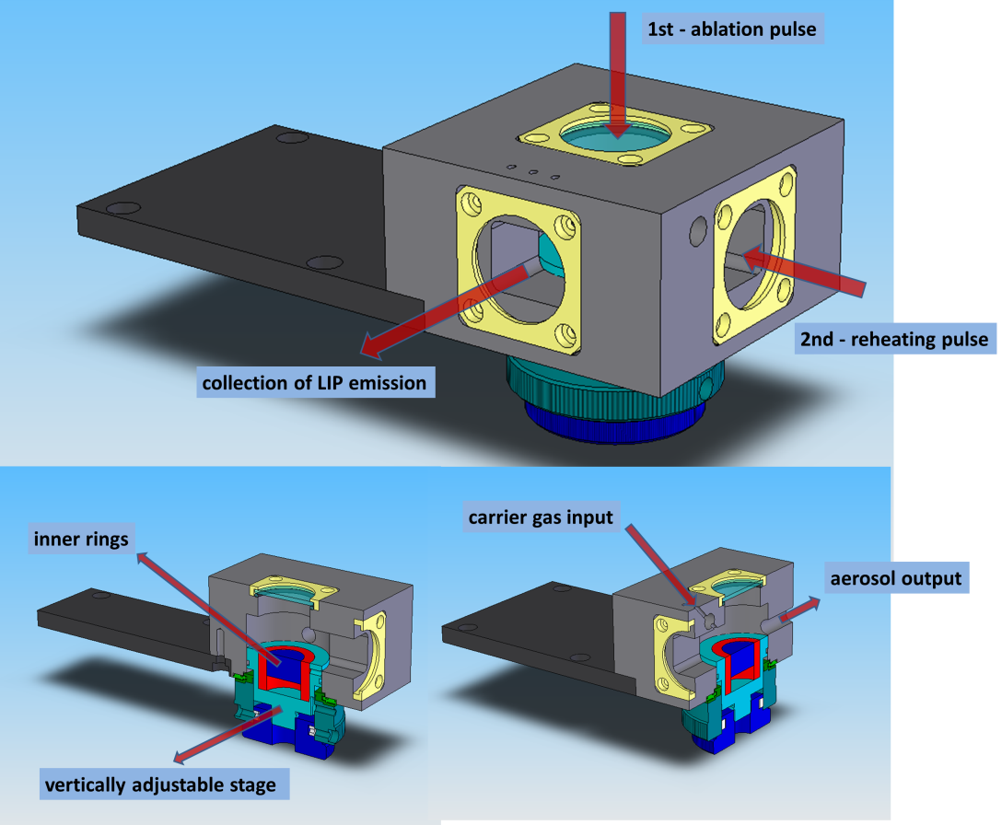
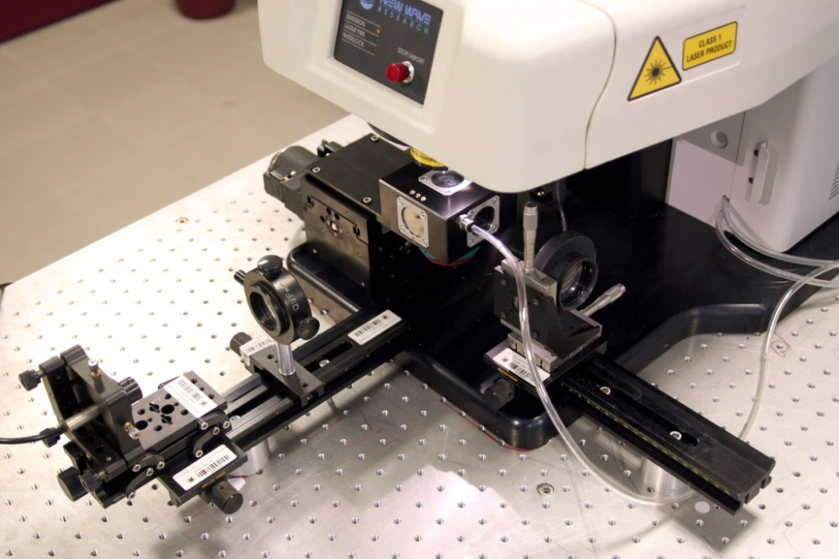
ALATION CHAMBER FOR SIMULTANEOUS
DP-LIBS AND LA- ICP-OES/MS
Construction in cooperation with Institute of Physical Engineering
BUT Brno (prof. J. Kaiser)
compatible with the UP 266 Macro and UP-213 laser ablation systems
ablation pulse led through the window from above
re-heating pulse focused through the second window from the right side
collection of LIP emission through third window at the front side
oblique jets for carrier gas input
aerosol output near the ablated sample surface
vertically adjustable sample stage
exchangeable inner rings to minimize the inner chamber volume

Slide 21
Instrumentation - Summary
1st generation
Nd: YAG laser Brilliant (1064, 532 or 266 nm)
monochromator Jobin Yvon TRIAX 320 (f=320 mm, three gratings – 1200, 2400 and 3600 g/mm)
photomultiplier Hamamatsu gated by a laboratory-built control unit
time resolved emission signal at given wavelength
laboratory-made aluminum ablation chamber - different ablation atmosphere
                - connection to ICP OES
2nd generation
ICCD camera Jobin Yvon Horiba (iStar Andor)
3rd generation
orthogonal double pulse configuration
laser ablation system New Wave UP 266 MACRO
ablation chamber for simultaneous DP-LIBS and double pulse LA-ICP-OES
sample surface monitoring by the internal CCD camera
easy settings of all laser and detection parameters
programmable sample moving - depth profiling, line scanning or raster scanning for bulk or surface analysis
single or double pulse experiments
detection by PMT or ICCD

Slide 22
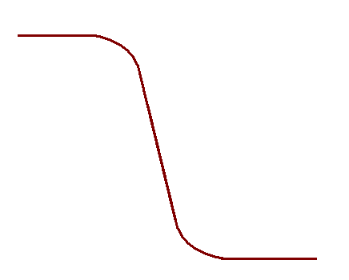
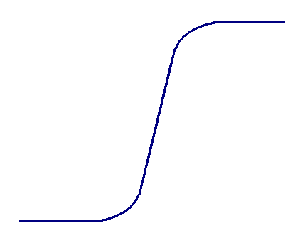
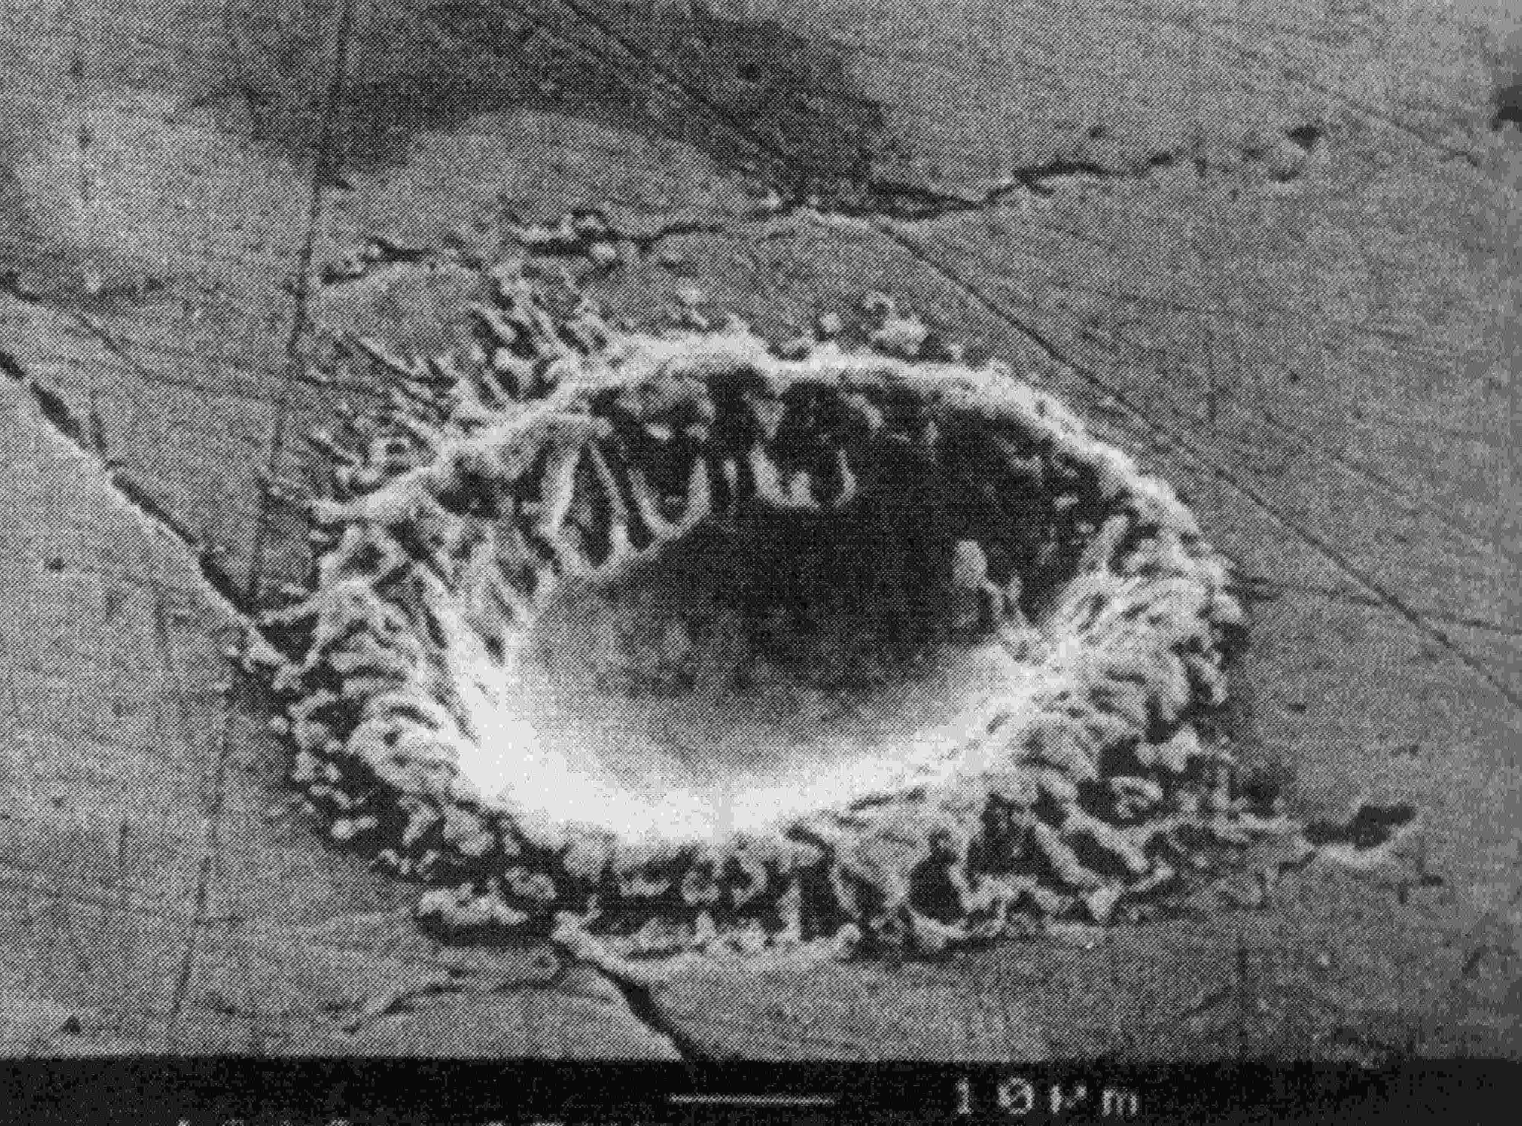
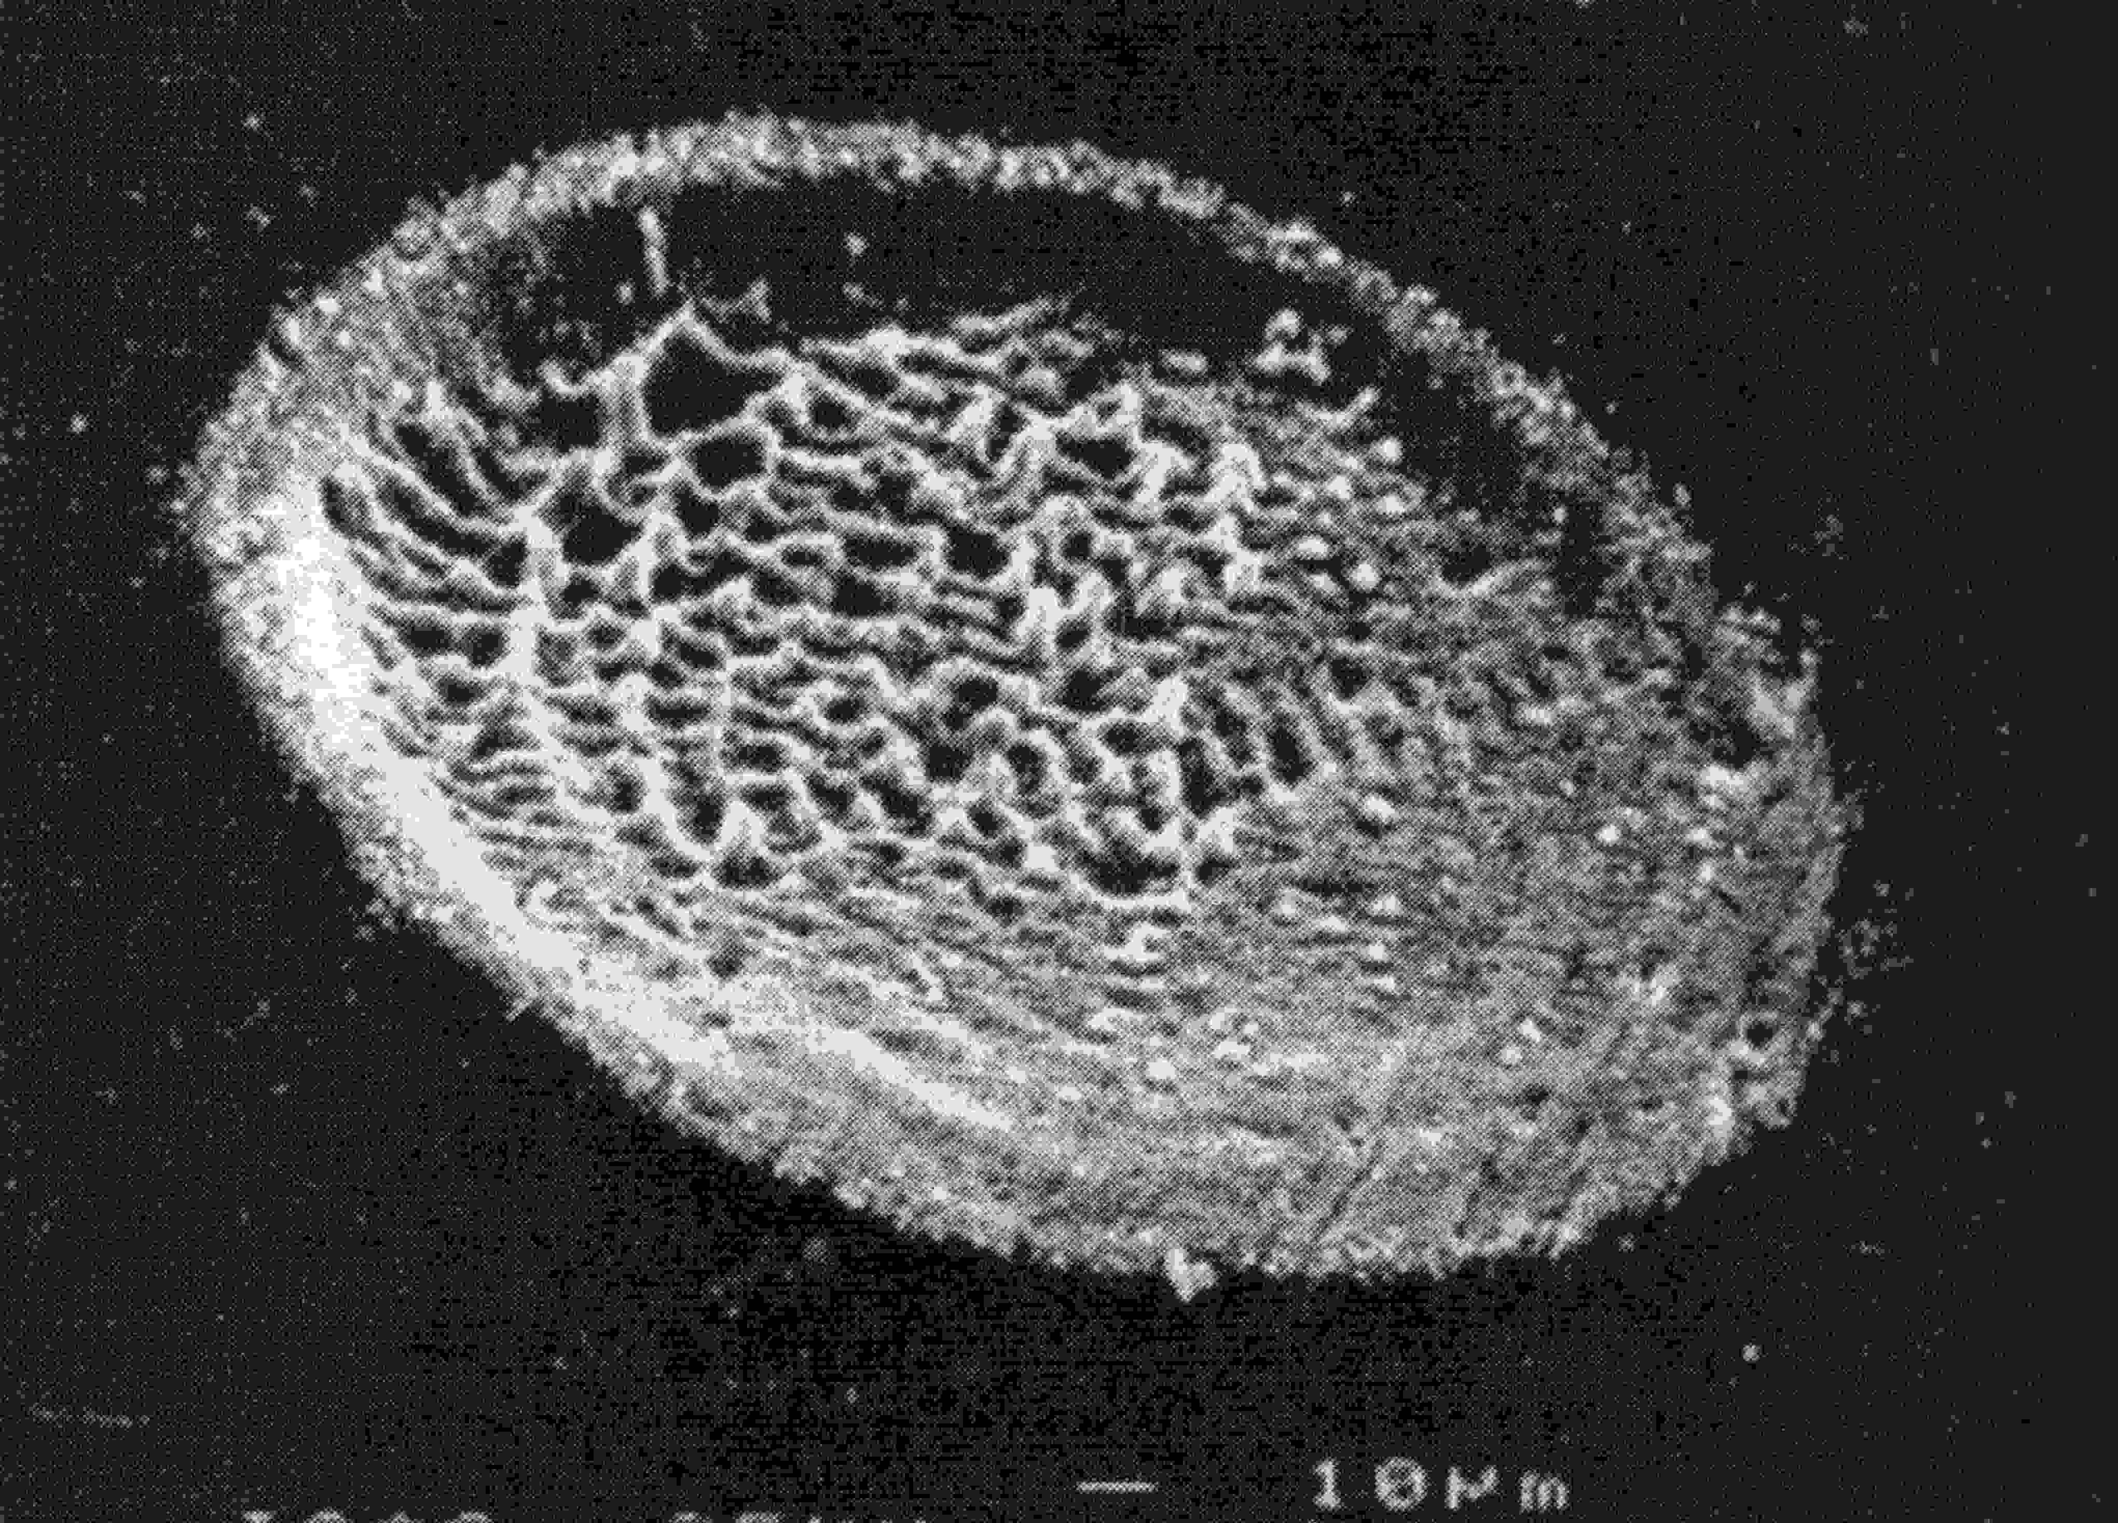
Depth profiling
Depth profiling by LIBS
from nanometer to millimeter scale
no or minimal sample preparation
without restrictions on the shape, size or conductivity
under atmospheric conditions
on-line and in situ measurement
Δz
A
B
Signal
84 %
Δz – depth resolution
defined by convention: depth range over which the signal changes from 84 to 16% of its full value
Δz = Δp AAR
Δp – number of laser shots needed to reach 84 and 16% of signal
AAR – averaged ablation rate
16 %
x
depth
ns - laser
fs - laser
layer A
layer B
K. Niemax, Laser ablation – reflection on a very complex technique for solid sampling, Fresenius J. Anal. Chem. (2001) 370:332-340)

Slide 23
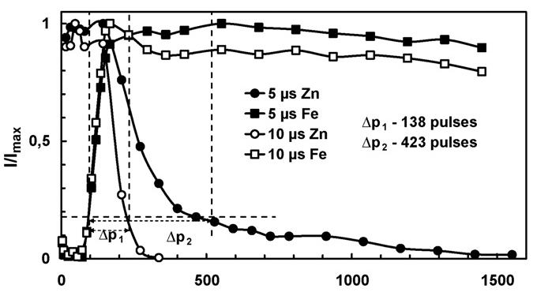
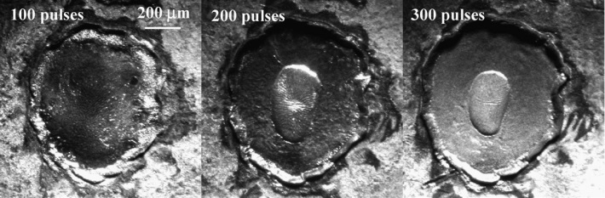
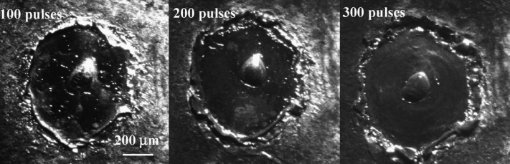
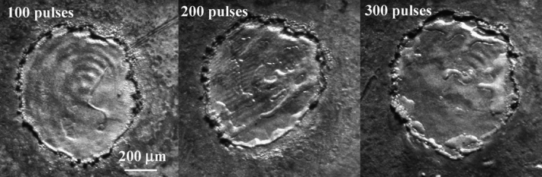
Depth profiling
(zinc-coated iron sheets)
Different manufactures and different zinc-coating thicknesses:
previously analyzed by glow discharge optical emission spectrometry
Hoesch Stahl (20 µm)
electroplated Zn coating, Sollac (10 µm)
Aluzink, SSAB (24 µm)
Galfan, Voest Alpine (6 µm)
Galvanneal, British Steel (9 µm)
Optimized parameters
laser pulse energy
focusing condition
different surrounding gases
delay time
air
Ar
He
Depth profile of electroplated Zn in helium focusing at -20 mm. Comparison of LIBS signals of Zn(I) 280.08 nm and Fe(I) 344.06 nm at 5 and 10 ms delay times. Ablation was performed with an energy of 100 mJ/pulse.
Novotny, K.; Vaculovic, T.; Galiova, M.; Otruba, V.; Kanicky, V.; Kaiser, J.; Liska, M.; Samek, O.; Malina, R.; Palenikova, K., The use of zinc and iron emission lines in the depth profile analysis of zinc-coated steel. Applied Surface Science 2007, 253, 3834-3842.

Slide 24
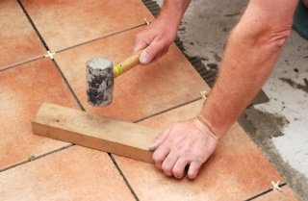
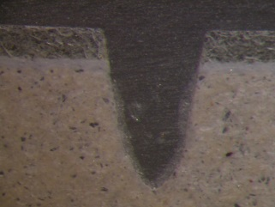
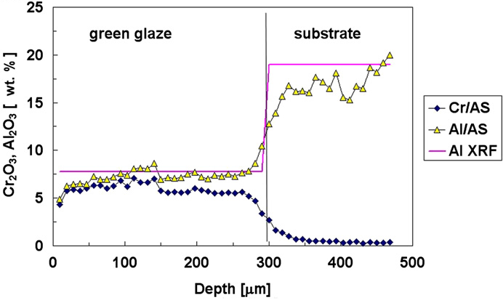
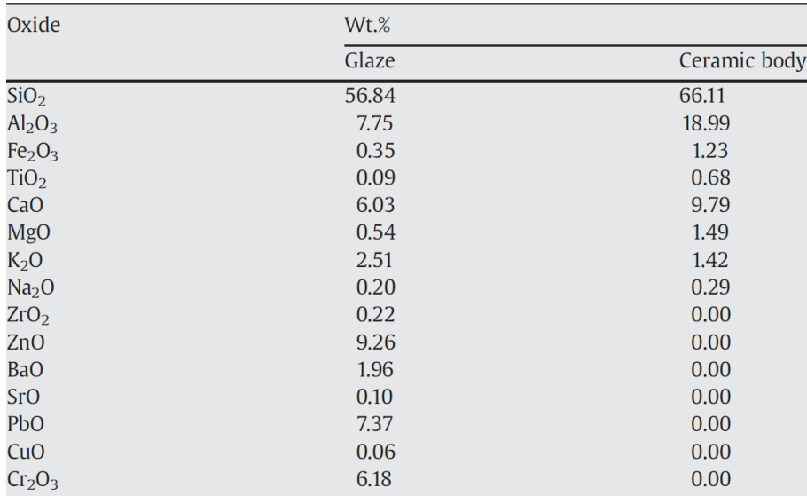
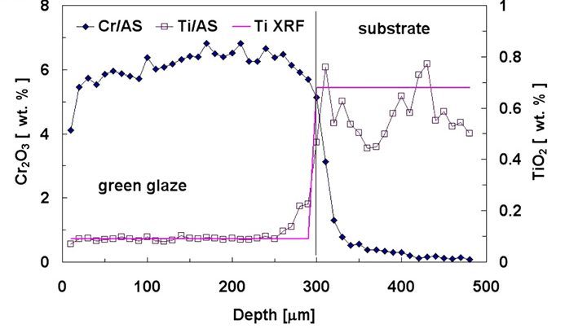
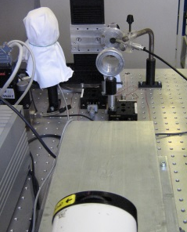
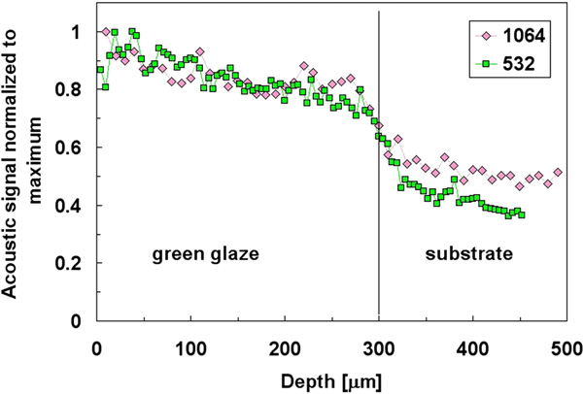
Depth profiling
(ceramic tiles)
1 mm
Model sample of glazed silicate ceramics
well-defined average contents of constituents
reproducible production series
decrease in the optical emission
during ablation was successfully compensated by normalization to the acoustic signal
Depth profile of the green tile acquired for Al(I) 309.271 nm, Cr(I) 295.368 nm and Ti(II( 334.904 nm.
Hrdlicka, A.; Zaoralkova, L.; Galiova, M.; Ctvrtnickova, T.; Kanicky, V.; Otruba, V.; Novotny, K.; Krasensky, P.; Kaiser, J.; Malina, R.; Palenikova, K., Correlation of acoustic and optical emission signals produced at 1064 and 532 nm laser-induced breakdown spectroscopy (LIBS) of glazed wall tiles. Spectrochimica Acta Part B-Atomic Spectroscopy 2009, 64, 74-78.

Slide 25
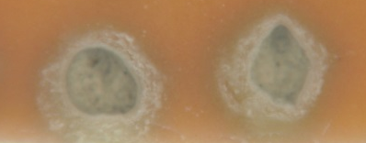
Mapping and depth profiling
(ceramic tiles)
Zn
Cr
Ti
Ti(II) 334.9 nm
Cr(II) 336.8 nm
Zn(I) 330.29nm
ablation craters
Zn
Ti
Number of pulses
Ti
Zn
Cr
Normalized intensity
Position on the sample
Position on the sample

Slide 26
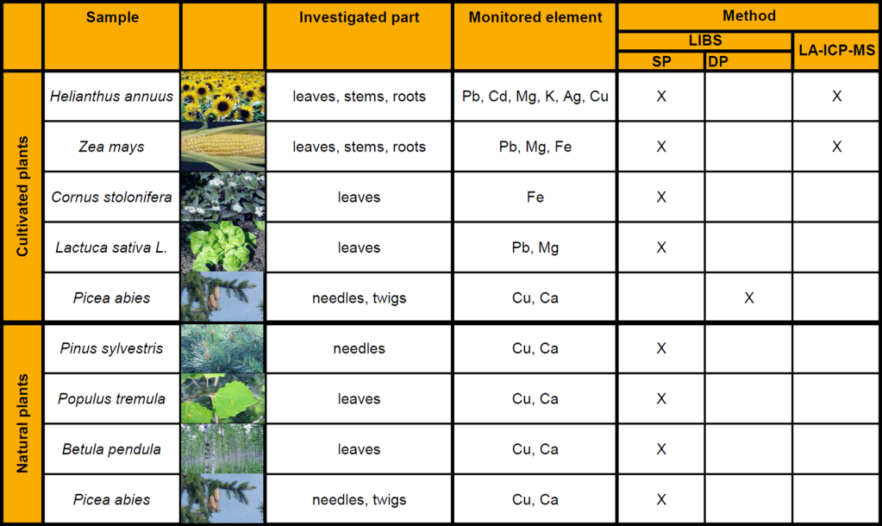


Mapping of elemental distribution
(plant samples)
Cleaning of metal contaminated soil - PHYTOREMEDIATION
resistant, strong tolerance, effective plant-transport mechanisms, high accumulation,
high biomass, fast growth
herbs: Zea mays, Helianthus annuus ...
trees: Betula pendula, Populus tremula ...
Samples from naturally growing trees
recultivated sludge bed in locality Smolník (Slovakia)
Laboratory cultivated plants
Department of Chemistry and Biochemistry, Mendel University in Brno

Slide 27




Mapping of elemental distribution
(plant samples)
Smolník
Copper distribution in the needle of pine tree (Pinus sylvestris) obtained by LIBS single pulse.
Copper distribution in central vein of the aspen leaf (Populus tremula) obtained by LIBS single pulse; two laser pulses on each point.

Slide 28


Mapping of elemental distribution
(plant samples)
Example of copper and calcium distribution maps on cross sections of spruce twigs (Picea abies) cultivated in 50 mmol.l⁻¹ CuCl₂ obtained by LIBS double pulse.
Point distance = 150 µm
Krajcarova, L.; Novotny, K.; Babula, P.; Provaznik, I.; Kucerova, P.; Adam, V.; Martin, M.Z.; Kizek, R.; Kaiser, J., Copper Transport and Accumulation in Spruce Stems (Picea abies (L.) Karsten) Revealed by Laser-Induced Breakdown Spectroscopy. International Journal of Electrochemical Science,2013, 8, 4485-4504.

Slide 29




Mapping of elemental distribution
(plant samples)
Mapping of accumulation and distribution of heavy metal (lead)
and nutrition elements (potassium) in leaves of
Capsicum annuum L. samples.
(a) Set of C. annuum L. samples used for monitoring of effects of lead(II) ions. (b) Example of the investigated C. annuum L. leaves.
The maps of K obtained from the studied area of the 2 days 10 mmol L⁻¹ Pb(NO₃)₂ treated C. annuum L. leaf. The K distribution in fresh (frozen) and dried samples measured by (a) LIBS and (b) LA-ICP-MS.
The maps of Pb obtained from the studied area of the 2 days 10 mmol L⁻¹ Pb(NO₃)₂ treated C. annuum L. leaf. The K distribution in fresh (frozen) and dried leaf measured by (a) LIBS and (b) LA-ICP-MS.
Galiova, M.; Kaiser, J.; Novotny, K.; Hartl, M.; Kizek, R.; Babula, P., Utilization of Laser-Assisted Analytical Methods for Monitoring of Lead and Nutrition Elements Distribution in Fresh and Dried Capsicum annuum L. Leaves. Microscopy Research and Technique 2011, 74, 845-852.

Slide 30





Elemental mapping
(geological sample)
Comparison study:
multi-element (Ca, Al, Fe, Mn) mappings of a granite sample surface
performed by LIBS and subsequently by LA-ICP-MS analysis
The 2 x 2 cm² area of the granite was sampled with a spatial resolution of 200 μm (the distance of the LIBS and LA-ICP-MS craters).
Set of normalised spectrums obtained by six subsequent pulses from the different places of the sample.
Typical LA-ICP-MS signal for Fe monitoring obtained for ~40 ablation craters.
Novotny, K.; Kaiser, J.; Galiova, M.; Konecna, V.; Novotny, J.; Malina, R.; Liska, M.; Kanicky, V.; Otruba, V., Mapping of different structures on large area of granite sample using laser-ablation based analytical techniques, an exploratory study. Spectrochimica Acta Part B-Atomic Spectroscopy 2008, 63, 1139-1144.

Slide 31

Elemental mapping
(geological sample)
100×100 individual sample points to map an area of 20×20 mm²
LIBS
LA-ICP-MS
LIBS
LA-ICP-MS
Novotny, K.; Kaiser, J.; Galiova, M.; Konecna, V.; Novotny, J.; Malina, R.; Liska, M.; Kanicky, V.; Otruba, V., Mapping of different structures on large area of granite sample using laser-ablation based analytical techniques, an exploratory study. Spectrochimica Acta Part B-Atomic Spectroscopy 2008, 63, 1139-1144.

Slide 32






Elemental mapping
(teeth)
Upper palaeolithic reindeer tooth
locality at Moravany-Lopata, Western Slovakia
Fossil brown bear (Ursus arctos) was excavated at Dolní Věstonice II-Western Slope, South Moravia, Czech Republic.
Protemnodon - an extinct species of a kangaroo that lived about 50 000 years ago, found in Australian swamps

Slide 33

Elemental mapping
(teeth)
The estimation of the sample hardness via magnesium ionic to atomic line intensity. The estimated hardness characteristic was proved by microhardness measurements.
ETHOLOGY OF THE STUDIED FOSSIL BROWN BEAR
The seasonal fluctuations of the Sr/Ca and Sr/Ba detected by DP LIBS evidenced the migration of this bear between his hibernaculum’s location and the place where the fossils were found.
Sr/Ca and Sr/Ba ratios derived from LIBS line scan and LA-ICP-MS mapping; dotted lines represent the different regions (white, summer bands; brown, winter bands) of the tooth cross section. The bar has a length of 500 μm.
Galiova, M.; Kaiser, J.; Fortes, F. J.; Novotny, K.; Malina, R.; Prokes, L.; Hrdlicka, A.; Vaculovic, T.; Fisakova, M. N.; Svoboda, J.; Kanicky, V.; Laserna, J. J., Multielemental analysis of prehistoric animal teeth by laser-induced breakdown spectroscopy and laser ablation inductively coupled plasma mass spectrometry. Applied Optics 2010, 49, C191-C199.

Slide 34





Elemental mapping
(fossil snake vertebrae)
Elemental mapping of pathological bony tissue (osteitis deformans phases in fossil vertebrae)
The fossil material:
Natrix natrix
Mladeč Caves excavation II
(Czech Republic),
Early Pleistocene
The photographs of the studied a fossil (N. natrix) snake vertebrae.
The investigated healthy (the left images) and pathological (the right images) bones are shown.
Lower Ca/P ratio indicating the later stage of the osteitis deformans.
Na content can be caused by metabolic derangement (“acidosis”).
SR-μCT slices of a healthy and b pathological fossil snake vertebra together with c the 3D rendering of the investigated fossil snake vertebra segment
Galiova, M.; Kaiser, J.; Novotny, K.; Ivanov, M.; Fisakova, M. N.; Mancini, L.; Tromba, G.; Vaculovic, T.; Liska, M.; Kanicky, V., Investigation of the osteitis deformans phases in snake vertebrae by double-pulse laser-induced breakdown spectroscopy. Analytical and Bioanalytical Chemistry 2010, 398, 1095-1107.

Slide 35


Elemental mapping
(urinary stones)
Mineralized tissues and bio-mineral structures are “archives” related to living habits, nutrition and exposure
to changing environmental conditions.
Line scans of the urinary concrement cross-sections may provide information about the accumulation history of the elements of interest.
Four categories of urinary stones: a) oxalates b) phosphates c) uric acid and d) cystine.
5 mm
Ca distribution
5 mm
Sample no. 10806: oval, ellipsoidal, pale yellow-brown zone.
The main components:
uric acid (90%)
weddellite CaC₂O₄·2 H₂O (10%)
Correlation between calcium and phosphorus indicates the presence of apatite.
Distribution of iron is connected with accumulation of blood clot during the growth of urinary stones in the urinary bladder.

Slide 36




Powder samples
powdered tungsten carbide hard-metal precursors (WC/Co)
Samples: Pramet Tools, Šumperk, Czech Republic
The elemental composition of powders samples:
element | content % (m/m)
W | 57–88
C | 4.8–7.5
Co | 3–10
Ti | 0.04–9.6
Ta | 0.1–8.2
Nb | 0.05–3.4
preparation of pressed pellets with or without binder (binder powdered silver)
Novotny, K.; Stankova, A.; Haekkaenen, H.; Korppi-Tommola, J.; Otruba, V.; Kanicky, V., Analysis of powdered tungsten carbide hard-metal precursors and cemented compact tungsten carbides using laser-induced breakdown spectroscopy. Spectrochimica Acta Part B-Atomic Spectroscopy 2007, 62, 1567-1574.

Slide 37




Powder samples
calibration pellets (urinary stones)
Mineralogical composition of calibration pellets
Laser ablation LIBS (LA-LIBS)
(analytical LIBS plasma is completely separated from LA)
Comparison of
LIBS and LA LIBS
Problems with elements present in high content are related mainly to the LIBS technique and most probably they are connected to the processes in the LIP and self-absorption.
Comparison of LIBS and LA-LIBS calibration curves for Sr in phosphate matrix pellets.
Comparison of LIBS and LA-LIBS calibration curves for Mg in phosphate matrix pellets.
Stepankova, K.; Novotny, K.; Vasinova Galiova, M.; Kanicky, V.; Kaiser, J.; Hahn, D.W., Laser ablation methods for analysis of urinary calculi: Comparison study based on calibration pellets. Spectrochimica Acta Part B-Atomic Spectroscopy, 2013, 81, 43-49.

Slide 38





Liquid samples
Investigation of liquid samples or bio-fluids (algae suspension)
Instrumentation at Institute of Physical Engineering BUT Brno (prof. J. Kaiser)
LIBS system employing laminar water jet setup
Segments of LIBS spectra of algae suspensions recorded using water jet liquid arrangements
Porizka, P.; Prochazka, D.; Pilat, Z.; Krajcarova, L.; Kaiser, J.; Malina, R.; Novotny, J.; Zemanek, P.; Jezek, J.; Sery, M.; Bernatova, S.; Krzyzanek, V.; Dobranska, K.; Novotny, K.; Trtilek, M.; Samek, O., Application of laser-induced breakdown spectroscopy to the analysis of algal biomass for industrial biotechnology. Spectrochimica Acta Part B-Atomic Spectroscopy, 2012, 74-75, 169-176.

Slide 39



Nanoparticles (QDs)
Spatial distribution of quantum dots (QDs)
cadmium containing QDs – CdS, CdTe
injection onto the carrier material (chromatographic paper, polystyrene ...)
Calibration graphs for injection of 5 µl CdS GSH and CdS MPA solution injected on the chromatographic paper .
Cd signal was obtained by LIBS on emission line Cd(I) 508.58 nm and signal intensity was summarized by counting pixels and all points of raster.
CdS QDs spatial distribution after injection of different volumes and different concentrations on chromatographic paper, 6 x 6 points with spacing 600 µm, emission line Cd (I) 508.58 nm and fluorescence (excitation wavelength 460 nm, emission wavelength 700 nm).

Slide 40





Remote analysis
Stand-off identification of biominerals
Instrumentation developed at Institute of Physical Engineering
BUT Brno (prof. J. Kaiser)
Comparison of linear discriminant analysis (LDA) and artificial neural networks (ANN)
input data - PCA scores
Vitkova, G.; Novotny, K.; Prokes, L.; Hrdlicka, A.; Kaiser, J.; Novotny, J.; Malina, R.; Prochazka, D., Fast identification of biominerals by means of stand-off laser-induced breakdown spectroscopy using linear discriminant analysis and artificial neural networks. Spectrochimica Acta Part B-Atomic Spectroscopy 2012, 73, 1-6.

Slide 41


Conclusion
rapid progress during the last two decades
significant improving of LIBS measurement
(advanced lasers, detection systems and data processing)
improving precision and accuracy
(process monitoring, on-line/on-situ screening)
further improving to be accepted as an analytical technique for quality control
commercialization
rapidly expanding field of LIBS applications
Perspectives at the Department of chemistry PřF MU:
further development of instrumentation and methodology
applications on real samples to solve the real scientific problems
cooperation with the Institute of Physical Engineering BUT Brno, Department of Chemistry and Biochemistry Mendel University in Brno, etc.
involvement in the project CEITEC
continuation of international cooperation with many universities and research teams around the world
Self-portrait of Curiosity in Gale Crater on the surface of Mars
(October 31, 2012)
Radziemski, L. ; Cremers D., A brief history of laser-induced breakdown spectroscopy: From the concept of atoms to LIBS 2012 , Spectrochimica Acta Part B-Atomic Spectroscopy 2013, 87, 3-10

